Slide 1
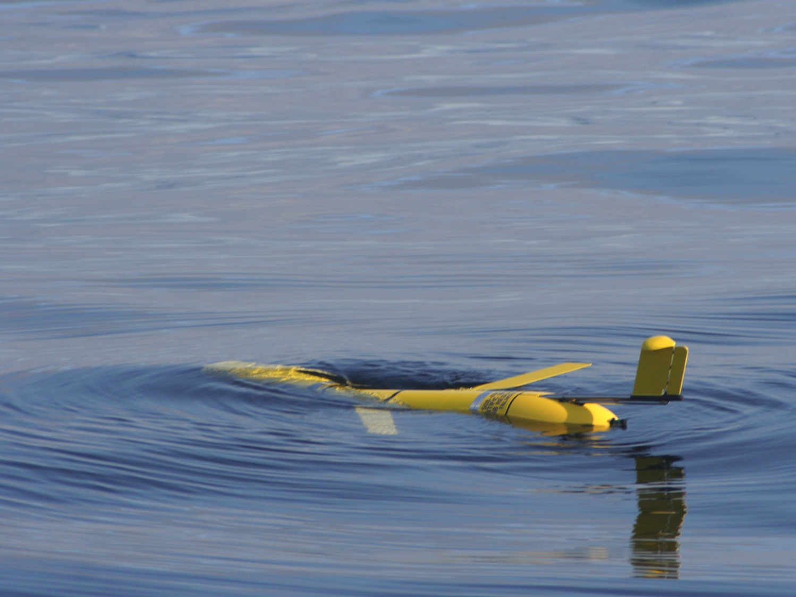
How to Use Autonomous Underwater Vehicle Gliders to Make Your Oceanography Better
Kipp Shearman
College of Oceanic & Atmospheric Sciences
Oregon State University
Autonomous Underwater Gliders
Describe some useful glider operations
Endurance
Footprint
Weather
OSU Glider Group:
Jack Barth
Anatoli Erofeev
Zen Kurokawa
Kate Adams
Piero Mazzini
Chris Ordoñez
Gonzalo Saldias
Alejandra Sanchez
Thanks to: RV Elakha Captain and Crew (OSU), J. Brodersen (OSU), Laura Rubiano-Gomez (OSU), C. Jones (WRC), F. Stahr (UW), Miss Linda Captain and Crew, T. Peery (OSU), F. Chan, K. Page-Albins (PISCO), Oscar Pizarro (UdeC), Gadiel Alarcon and Nadin Ramirez (UdeC)

Slide 2
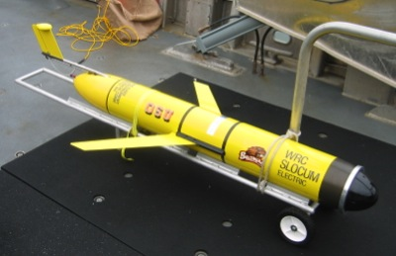
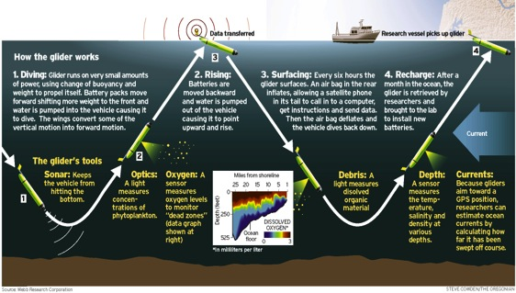
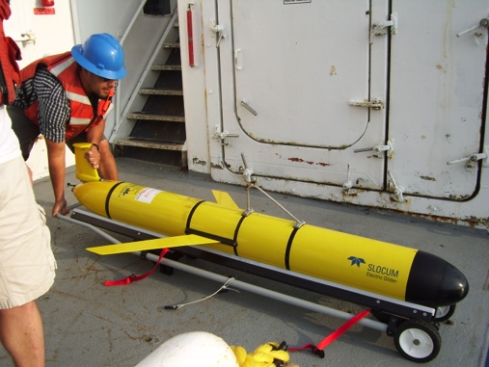
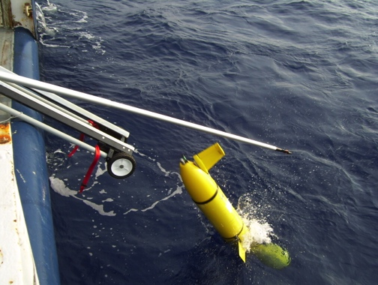
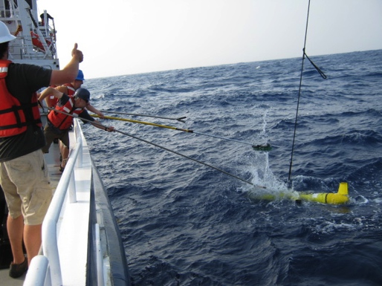
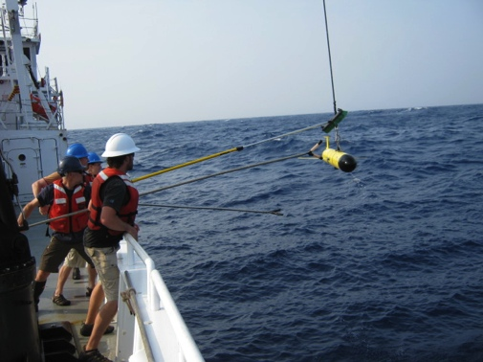
What’s a glider?
Autonomous underwater vehicle – a robot!
Flies by changing its buoyancy
takes on water, becomes heavy and sinks
wings turn vertical motion into forward motion
expels water, becomes light and rises
flies saw tooth pattern through the ocean
Slow, but can stay out a long time
½ knot
3-4 week endurance
Collects same data you would on a research vessel at a fraction of the cost
Research vessel: approx. $20K/day (fuel + crew)
Glider: $150K to buy + $200-1000/day (batteries + communications + techs)
3500 days of glider operation:
3500 days x $20K/day – 4 x ($150K+3500 days x $1000/day) = $55 million saved!

Slide 3
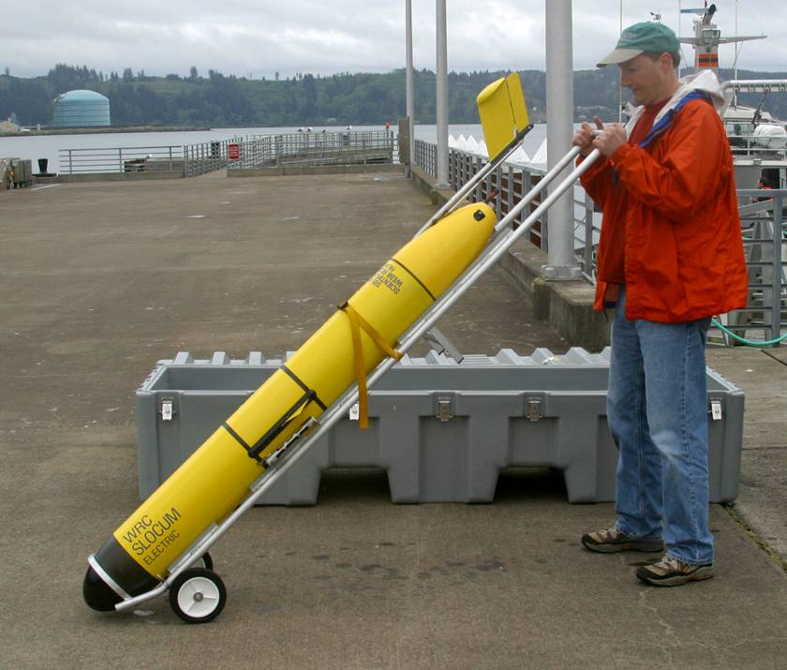
7 ft long
100 lbs in air
GPS, Iridium and Freewave Antennae in tail fin
Aanderaa Optical Dissolved Oxygen sensor
Glider Control and more batteries
Science Bay
Air bladder
Pitch Batteries
Optical Sensors (Chl, CDOM and Backscatter)
CTD
Webb Slocum Electric Glider
Displacement Pump

Slide 4
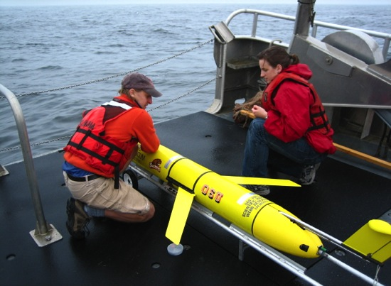
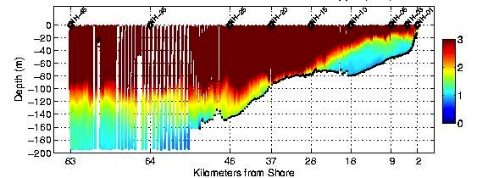
Shelf Glider Sections
~20 km day (21+ day endurance)
Very high spatial resolution
Surface to Bottom coverage (200 m max)
Surface every 1-6 hr to get GPS fix, download data and receive new instructions (via Iridium)
Keep track via web:
gliderfs2.coas.oregonstate.edu/gliderweb
T (°C)
May 05 – 10, 2006
Salinity
Chlorophyll (μg/L)
Backscatter (1/m)
Dissolved Oxygen (mL/L)

Slide 5
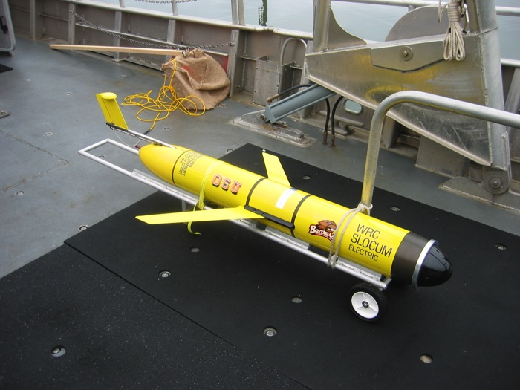
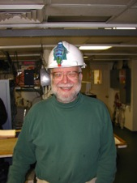
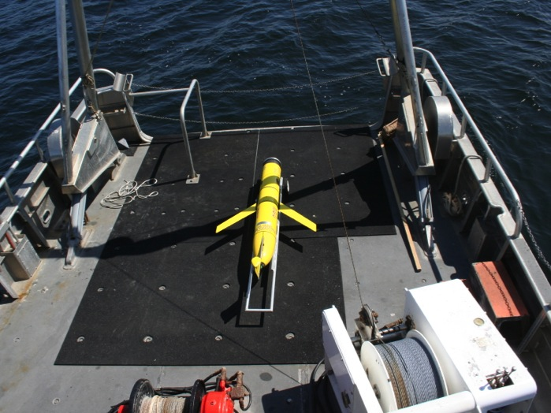
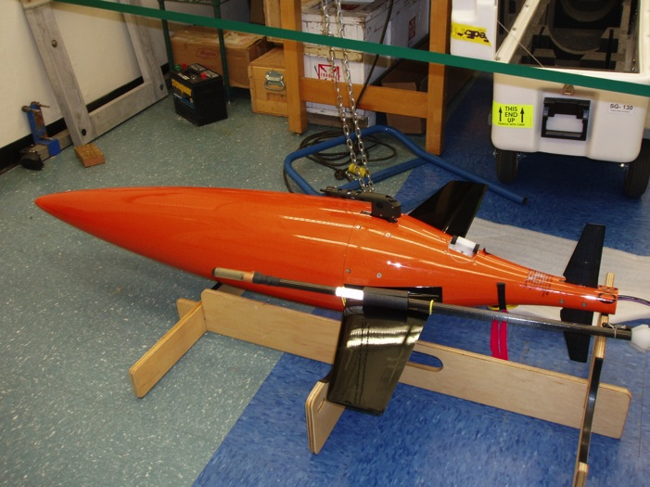
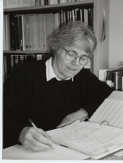
The OSU Glider Fleet
3 TWR Slocum 200 m
CTD, chl, bs, cdom, DO
CTD, microstructure
1 TWR Slocum 1000 m
CTD, chl, dye, bs, ADCP
5 UW/iRobot/Kongsberg Seagliders 1000 m
CTD, chl, bs, cdom, DO, PAR
Bob Smith
Glider Bob
Glider Jane
Jane Huyer
Five Seagliders: sg130, sg157, sg158, sg205 & sg206

Slide 6
Not true!
Just because it says autonomous, doesn’t mean you get to sit around and do nothing …

Slide 7
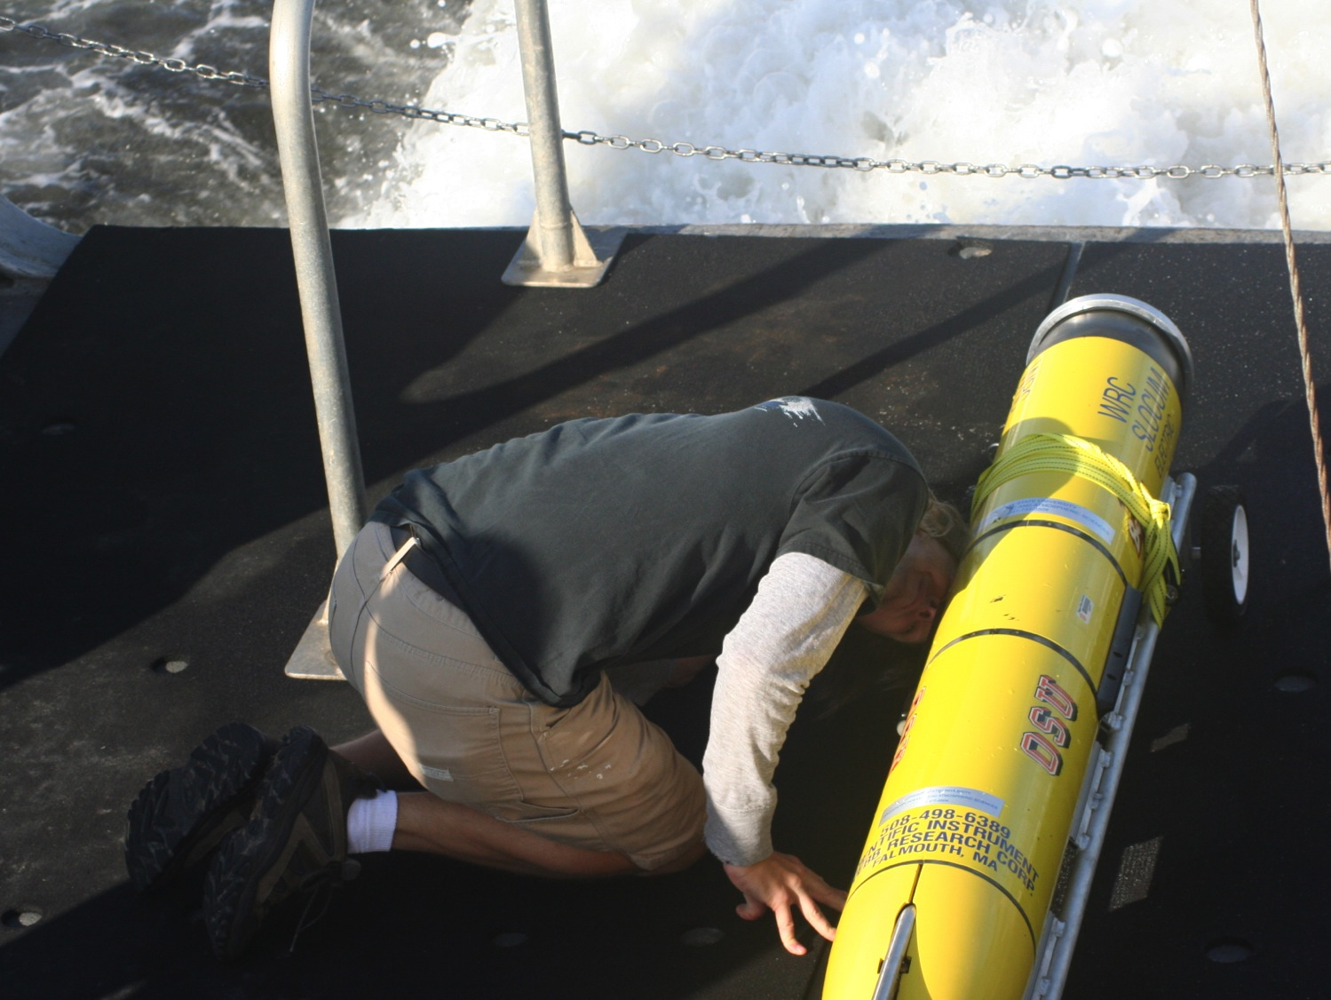
Useful Glider Ops Versus Less-Useful Glider Ops
$$$$
$$$
$$
$$$
$
$$$$
All platforms have strengths and weaknesses
Glider strengths are low cost, high resolution and long endurance
Glider weaknesses are slow speeds, coarse navigation, and limited payloads
What we must avoid at all costs is the op where you deploy a glider and then follow it around with a research vessel …

Slide 8
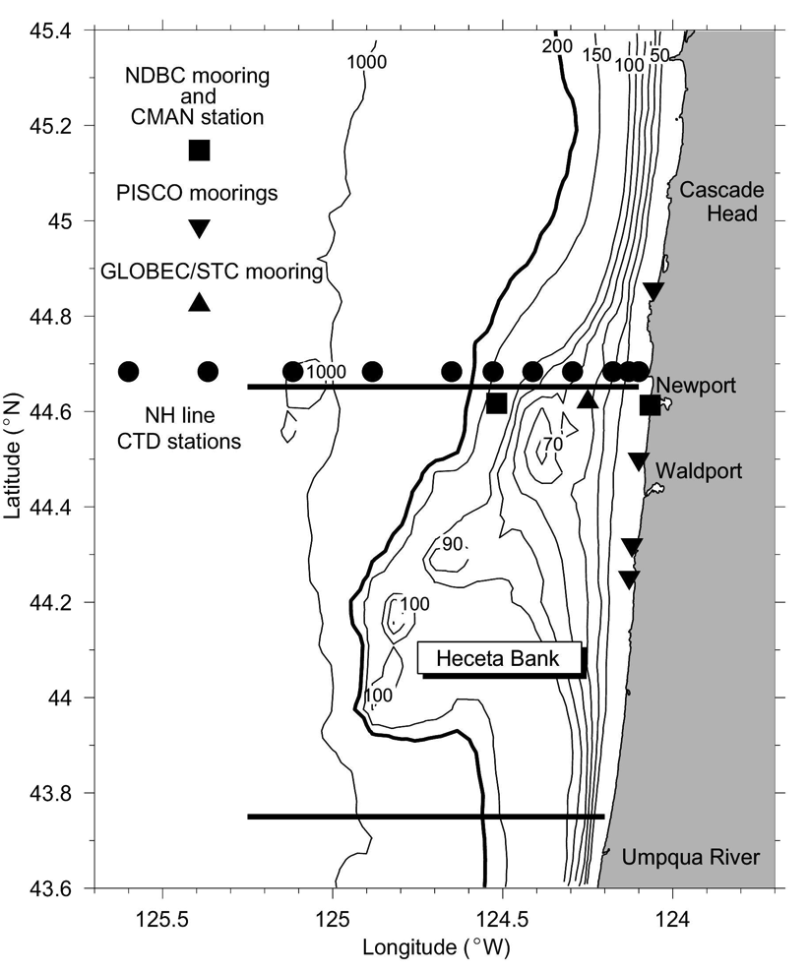
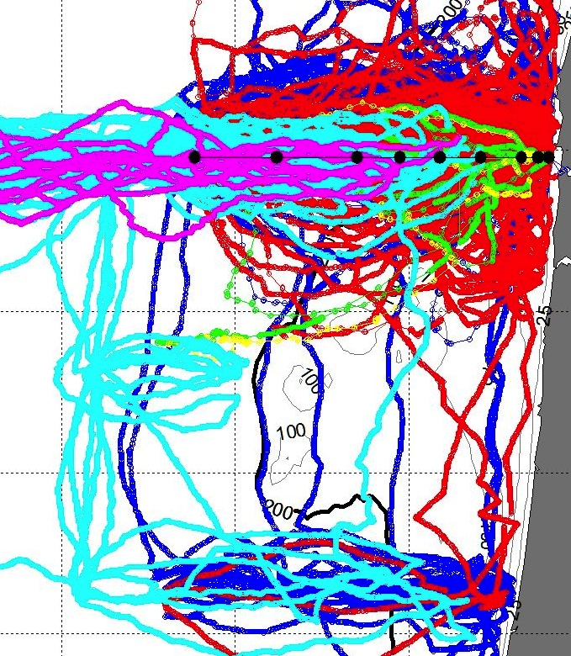
Endurance
46050
NWPO3
Bob
Jane
Seaglider
Newport Line
80 km cross-shelf
Strong currents (50+ cm/s)
Complex Bathymetry
Historical Observations (1950s)
NH-10
April 2006 – Nov 2014
3486 glider-days at sea
187 deployments
82,120 km
260,190 vertical profiles
Use a variety of ships to get the gliders in/out of the water
Be prepared for emergency recoveries
Don’t assume piloting will be trivial

Slide 9
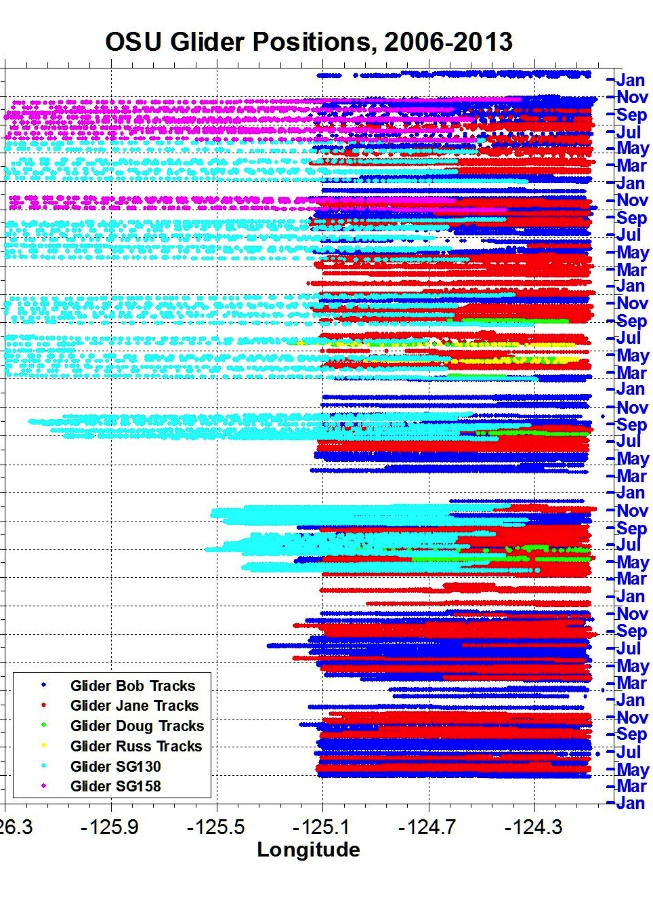
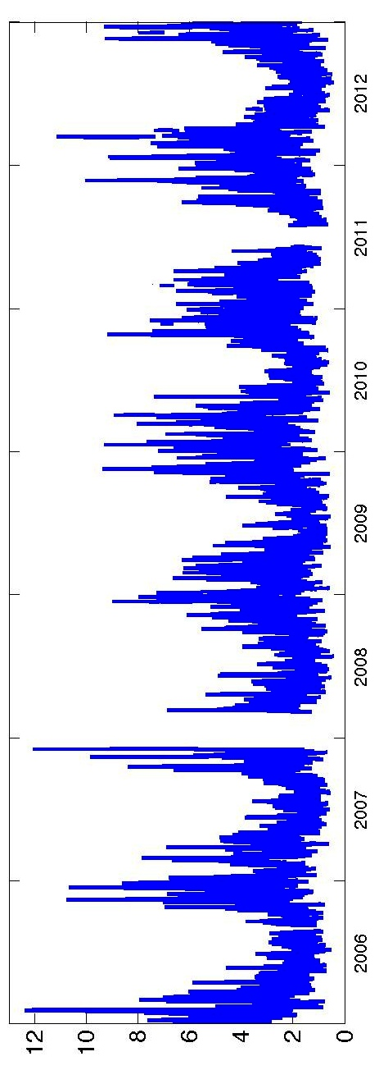
N-S Wind Speed
Significant Wave Height
2012
2011
2010
2009
2008
December 2007 Storm
35+ ft seas
80 mph winds
2007
2006
(m/s)
(m)

Slide 10
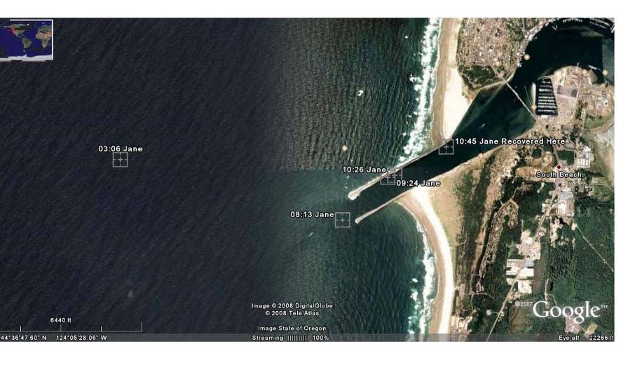
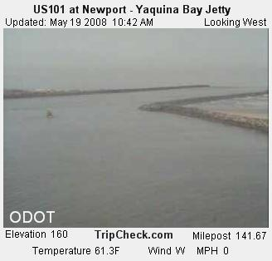
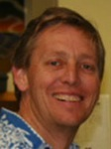
Glider Stories: Jane is in a bit of a pickle …
Wow!!! You are the best glider pilots in the world!!! I bow to your precision!!! osc
Oscar Schofield, Rutgers U.

Slide 11
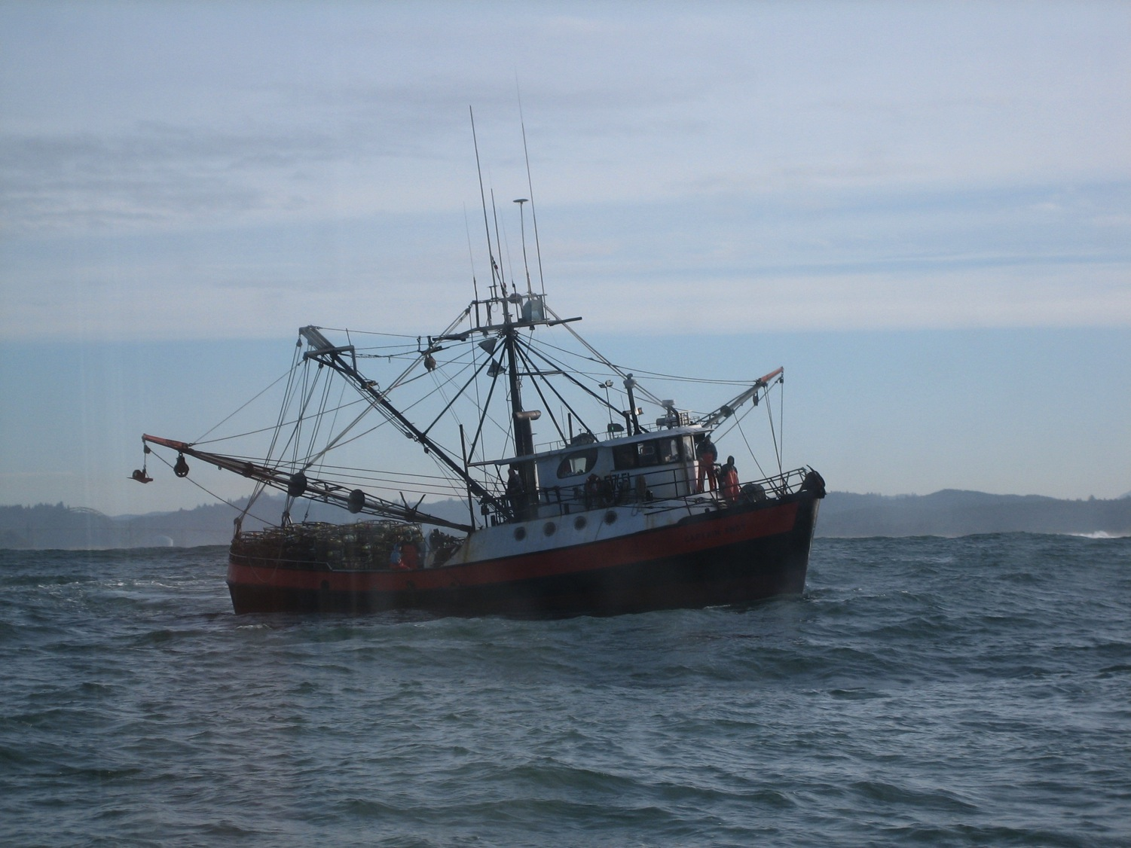
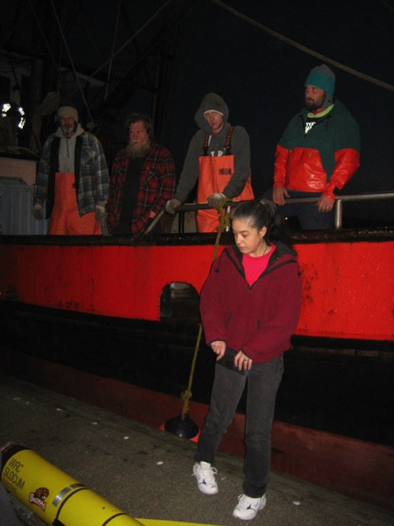
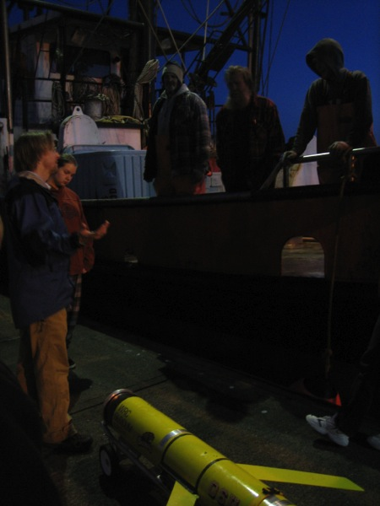
We’re collaborating with local fishermen …

Slide 12
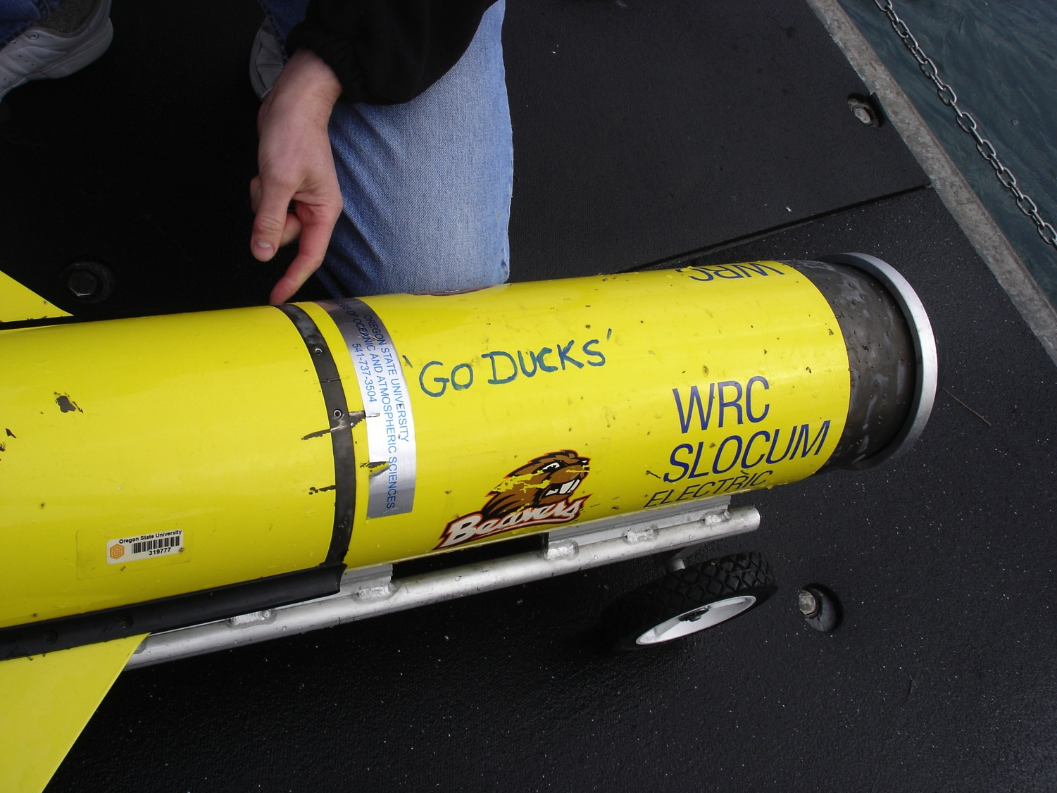

Slide 13
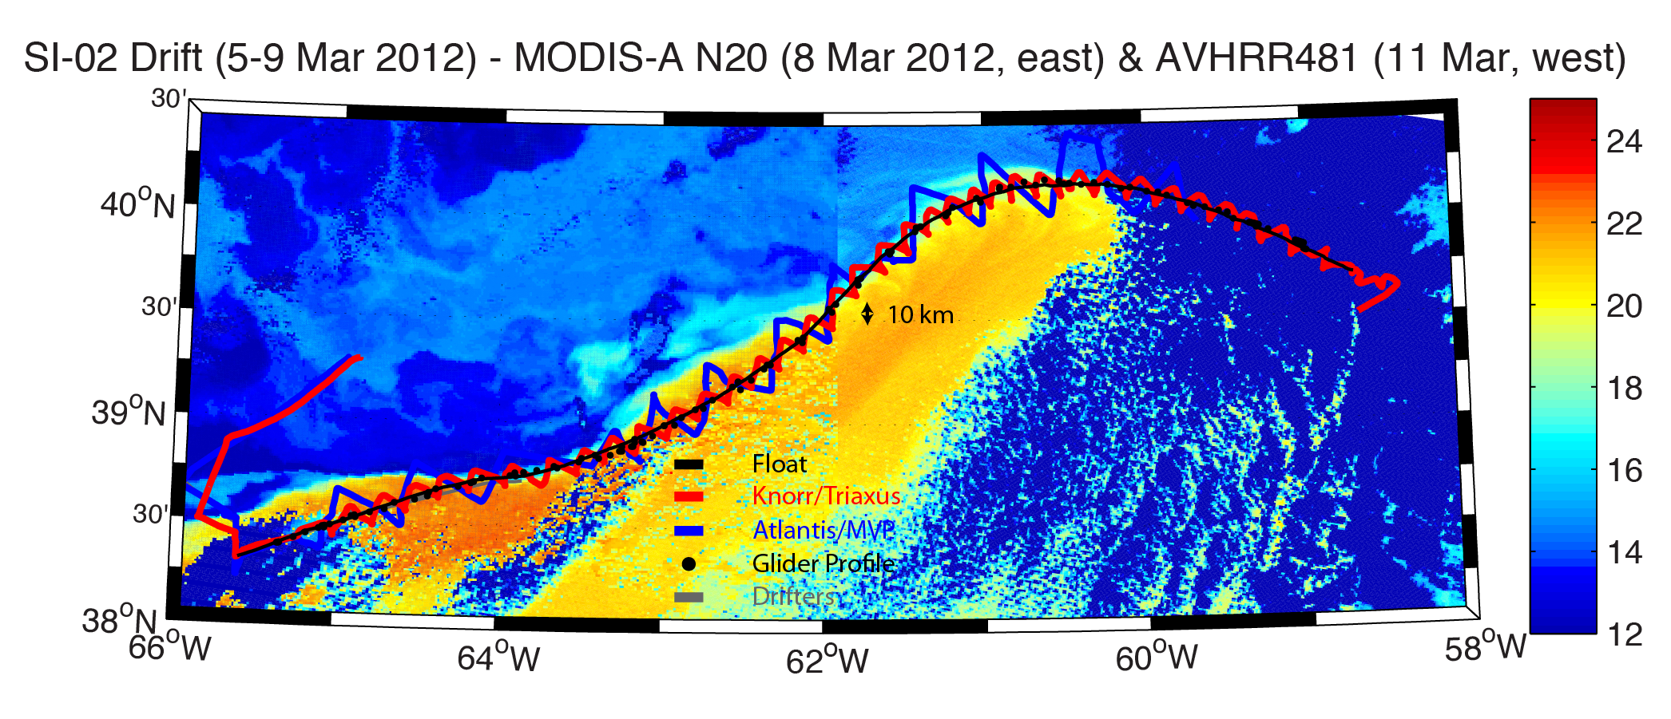
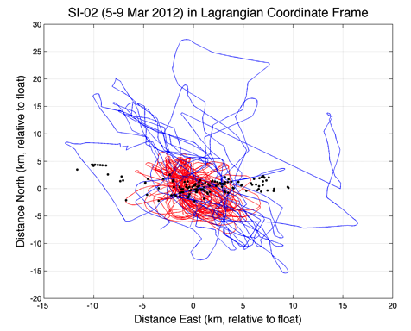
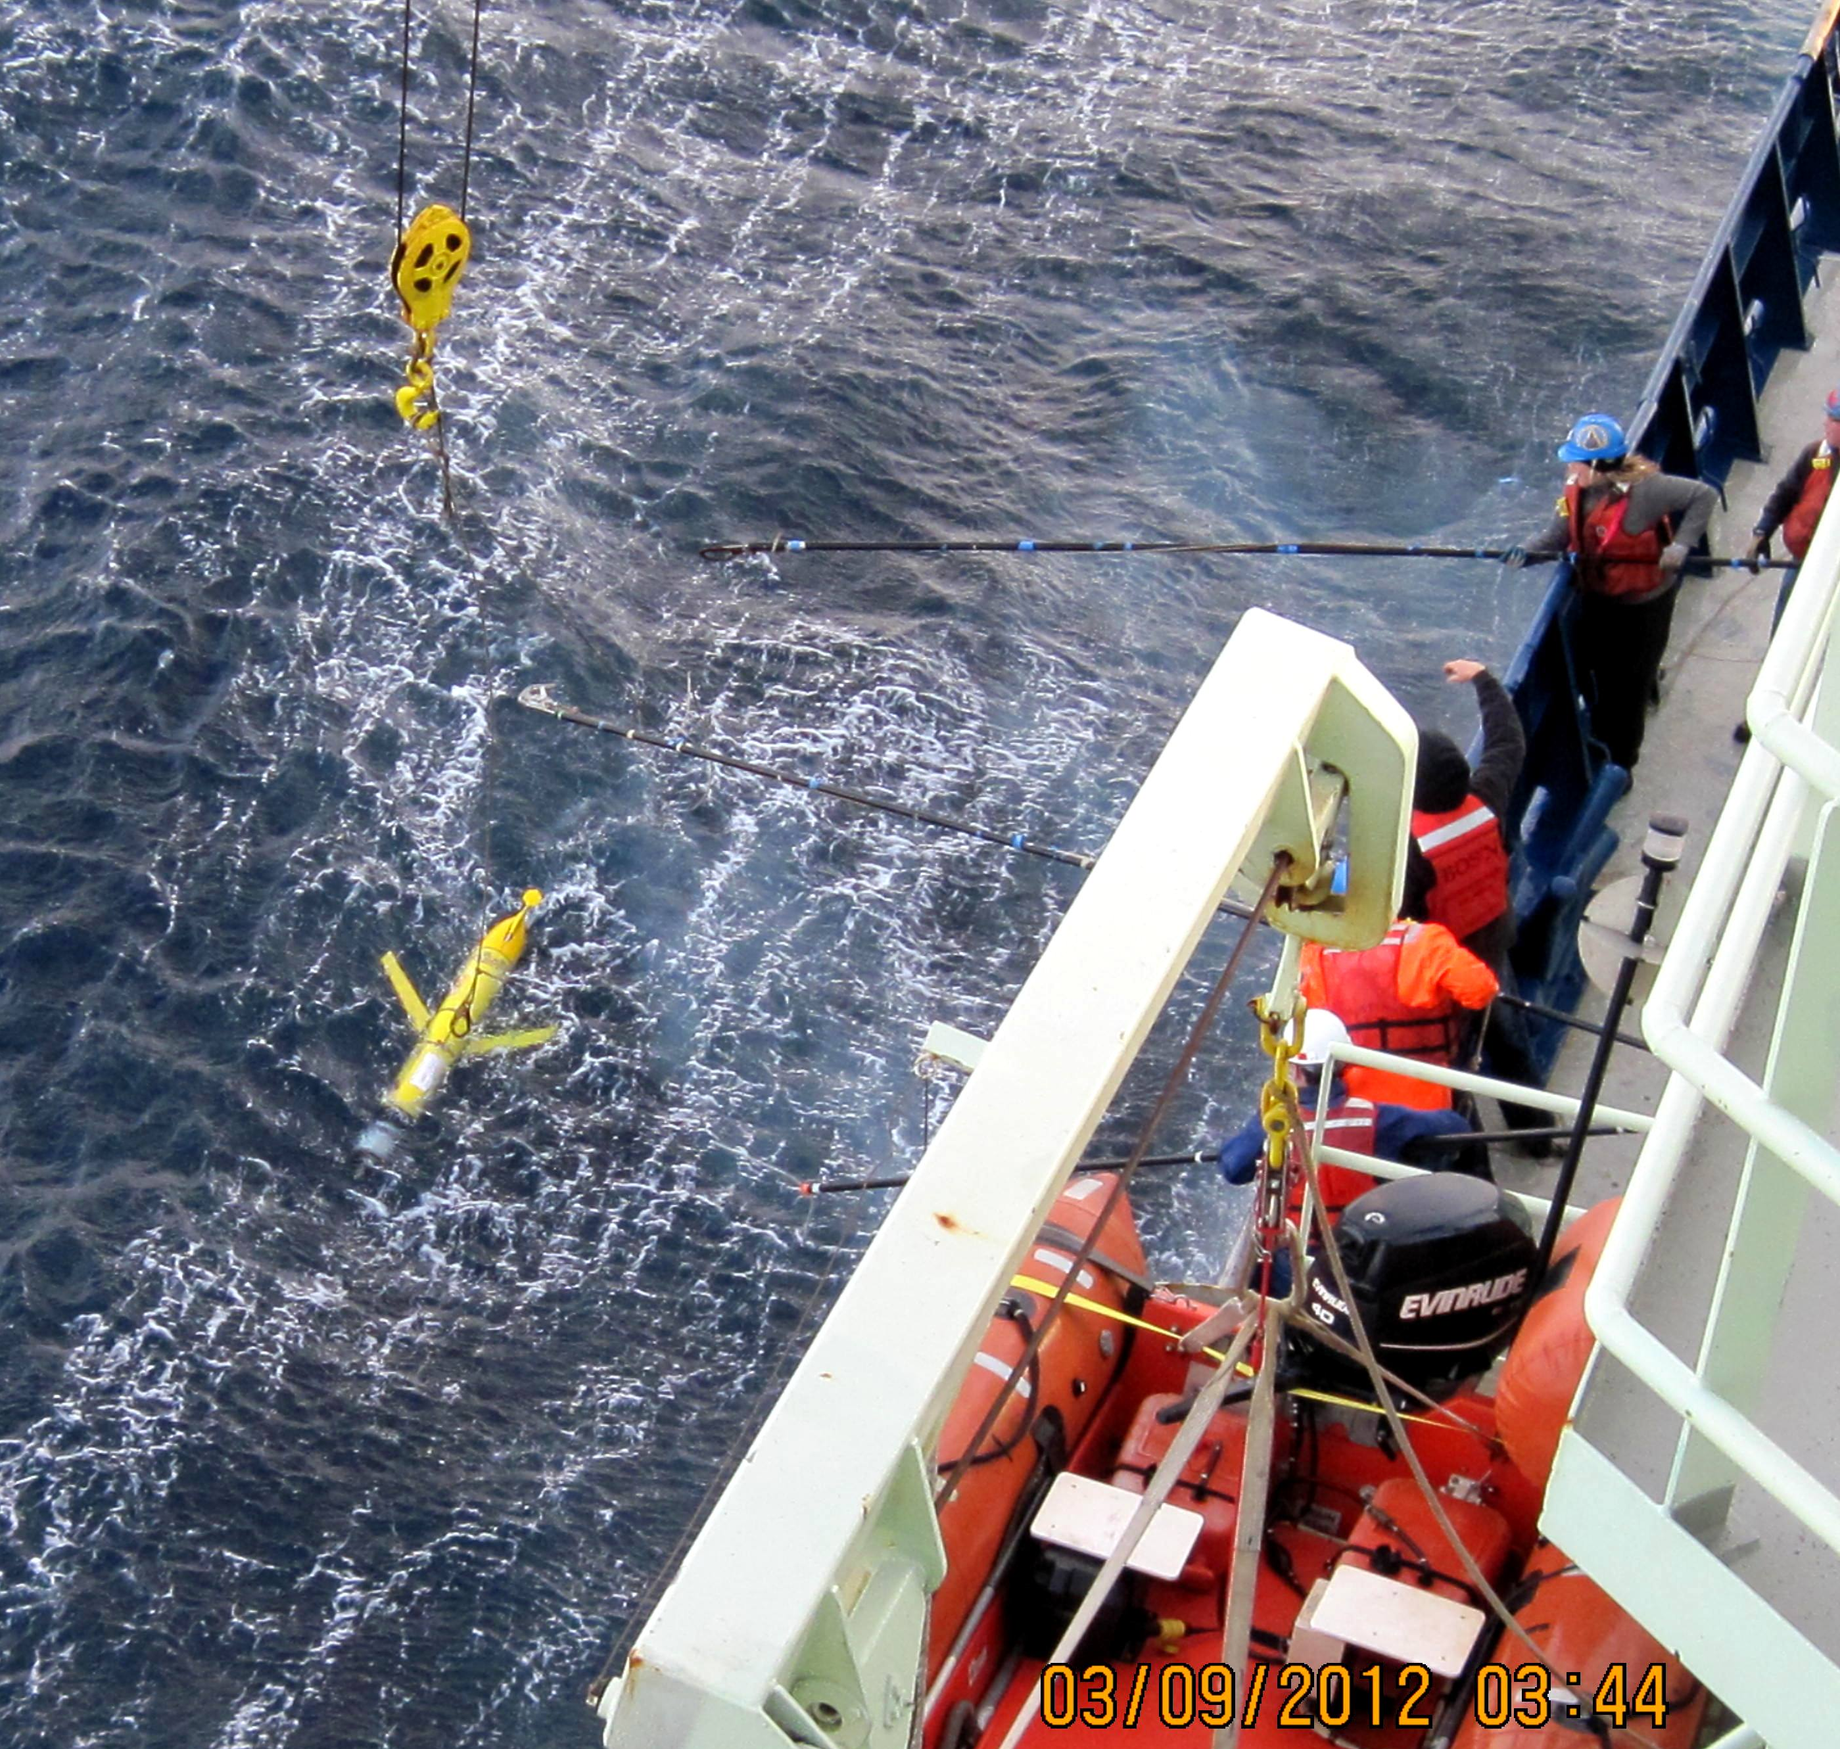
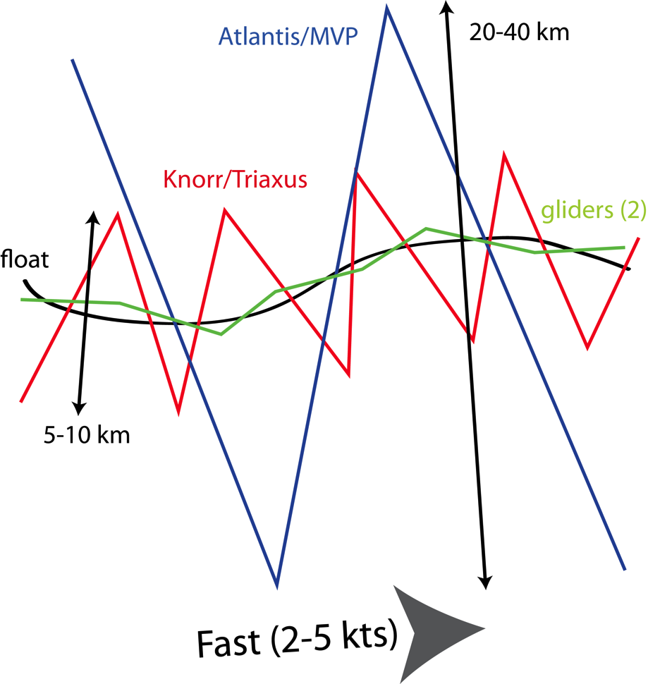
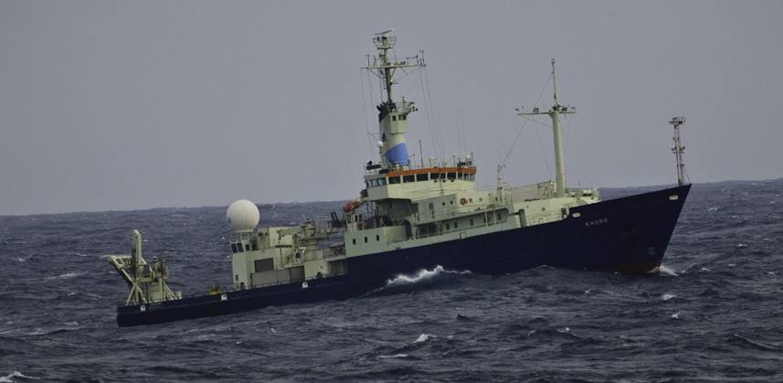
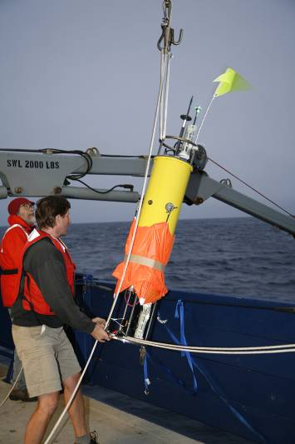
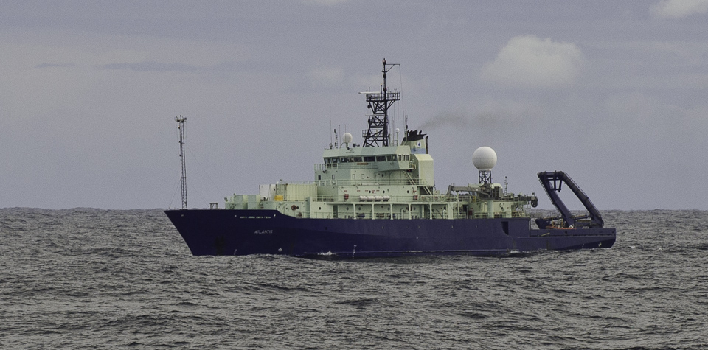
Enhancing Ship-based Survey Footprint
Notes:
Additional realizations of SI. Winds begin down-front (SI favorable) but later switch to have a larger cross-front component.

Slide 14
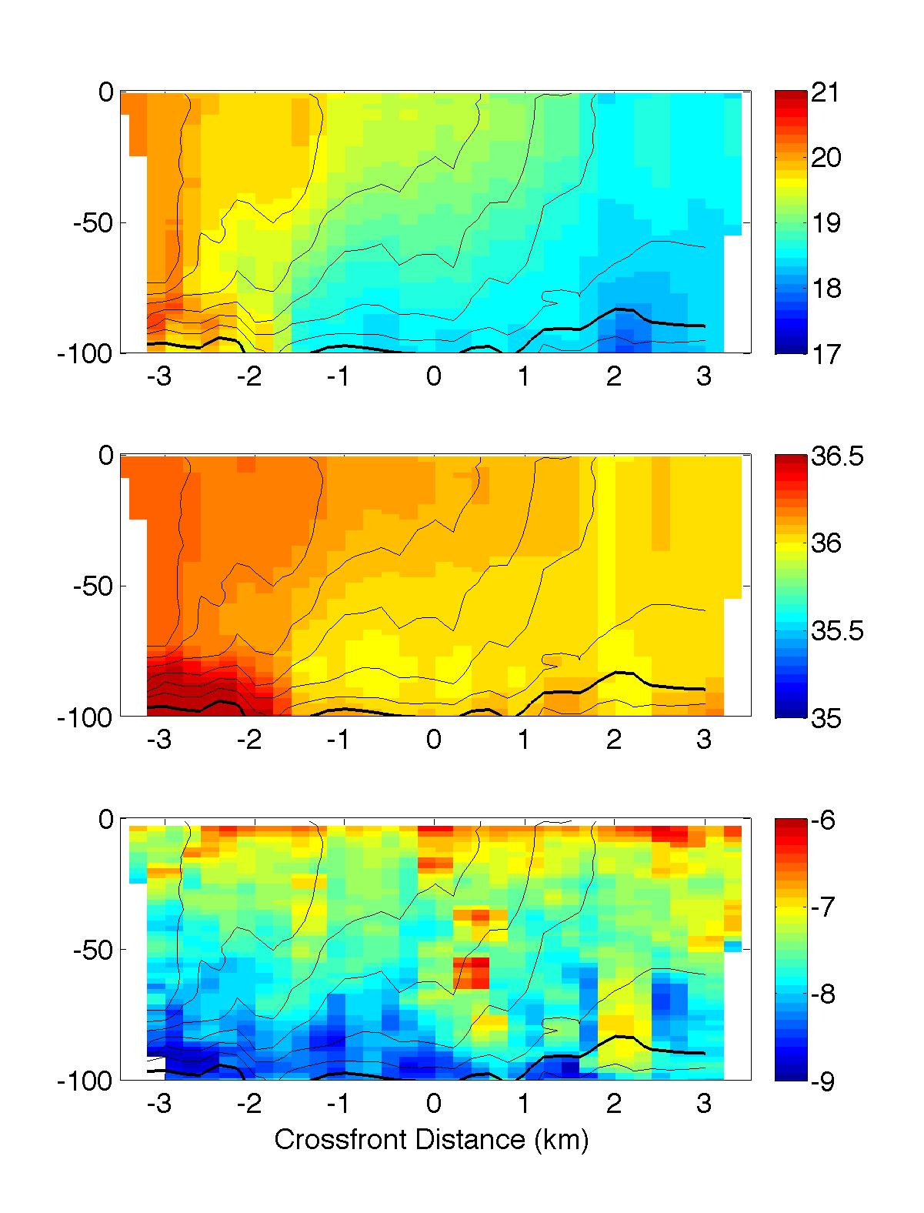
Average section
Temperature (°C)
25.8
26.0
Vastly increased data and resolution at the front
Better characterization of the structure on small scales
Salinity
25.8
26.0
Log₁₀ ε (W/kg)
25.8
26.0
Notes:
Glider observations bin averaged in the cross front direction, using observations from all four gliders

Slide 15
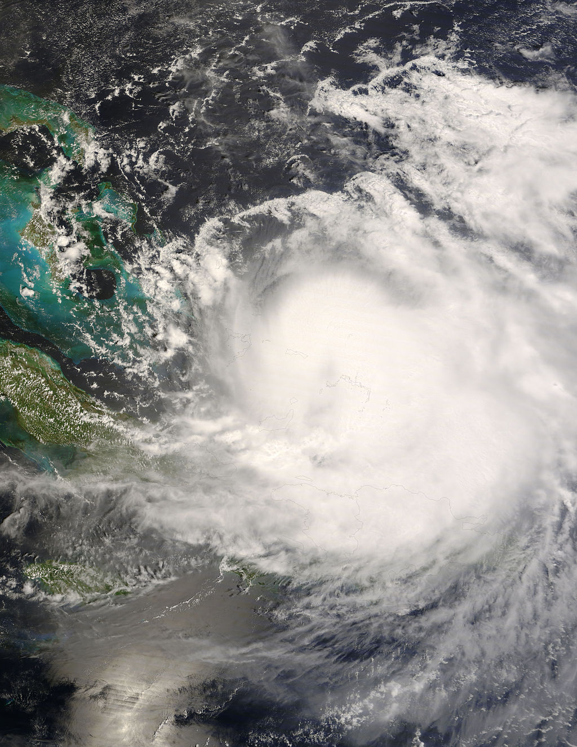
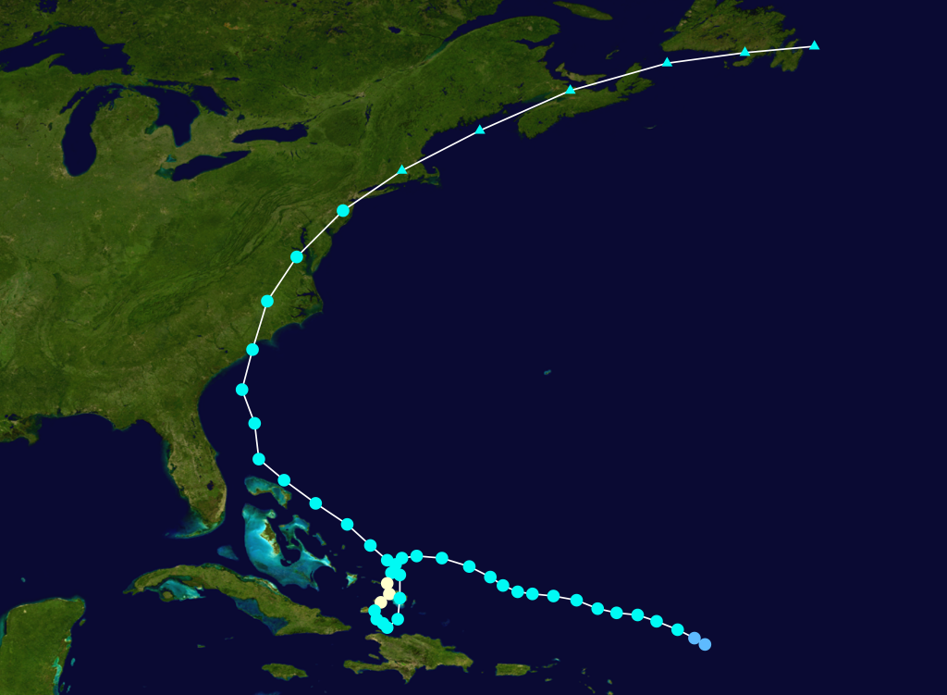
Continuous Sampling in Bad Weather
Tropical Storm Hanna Sep 2008

Slide 16
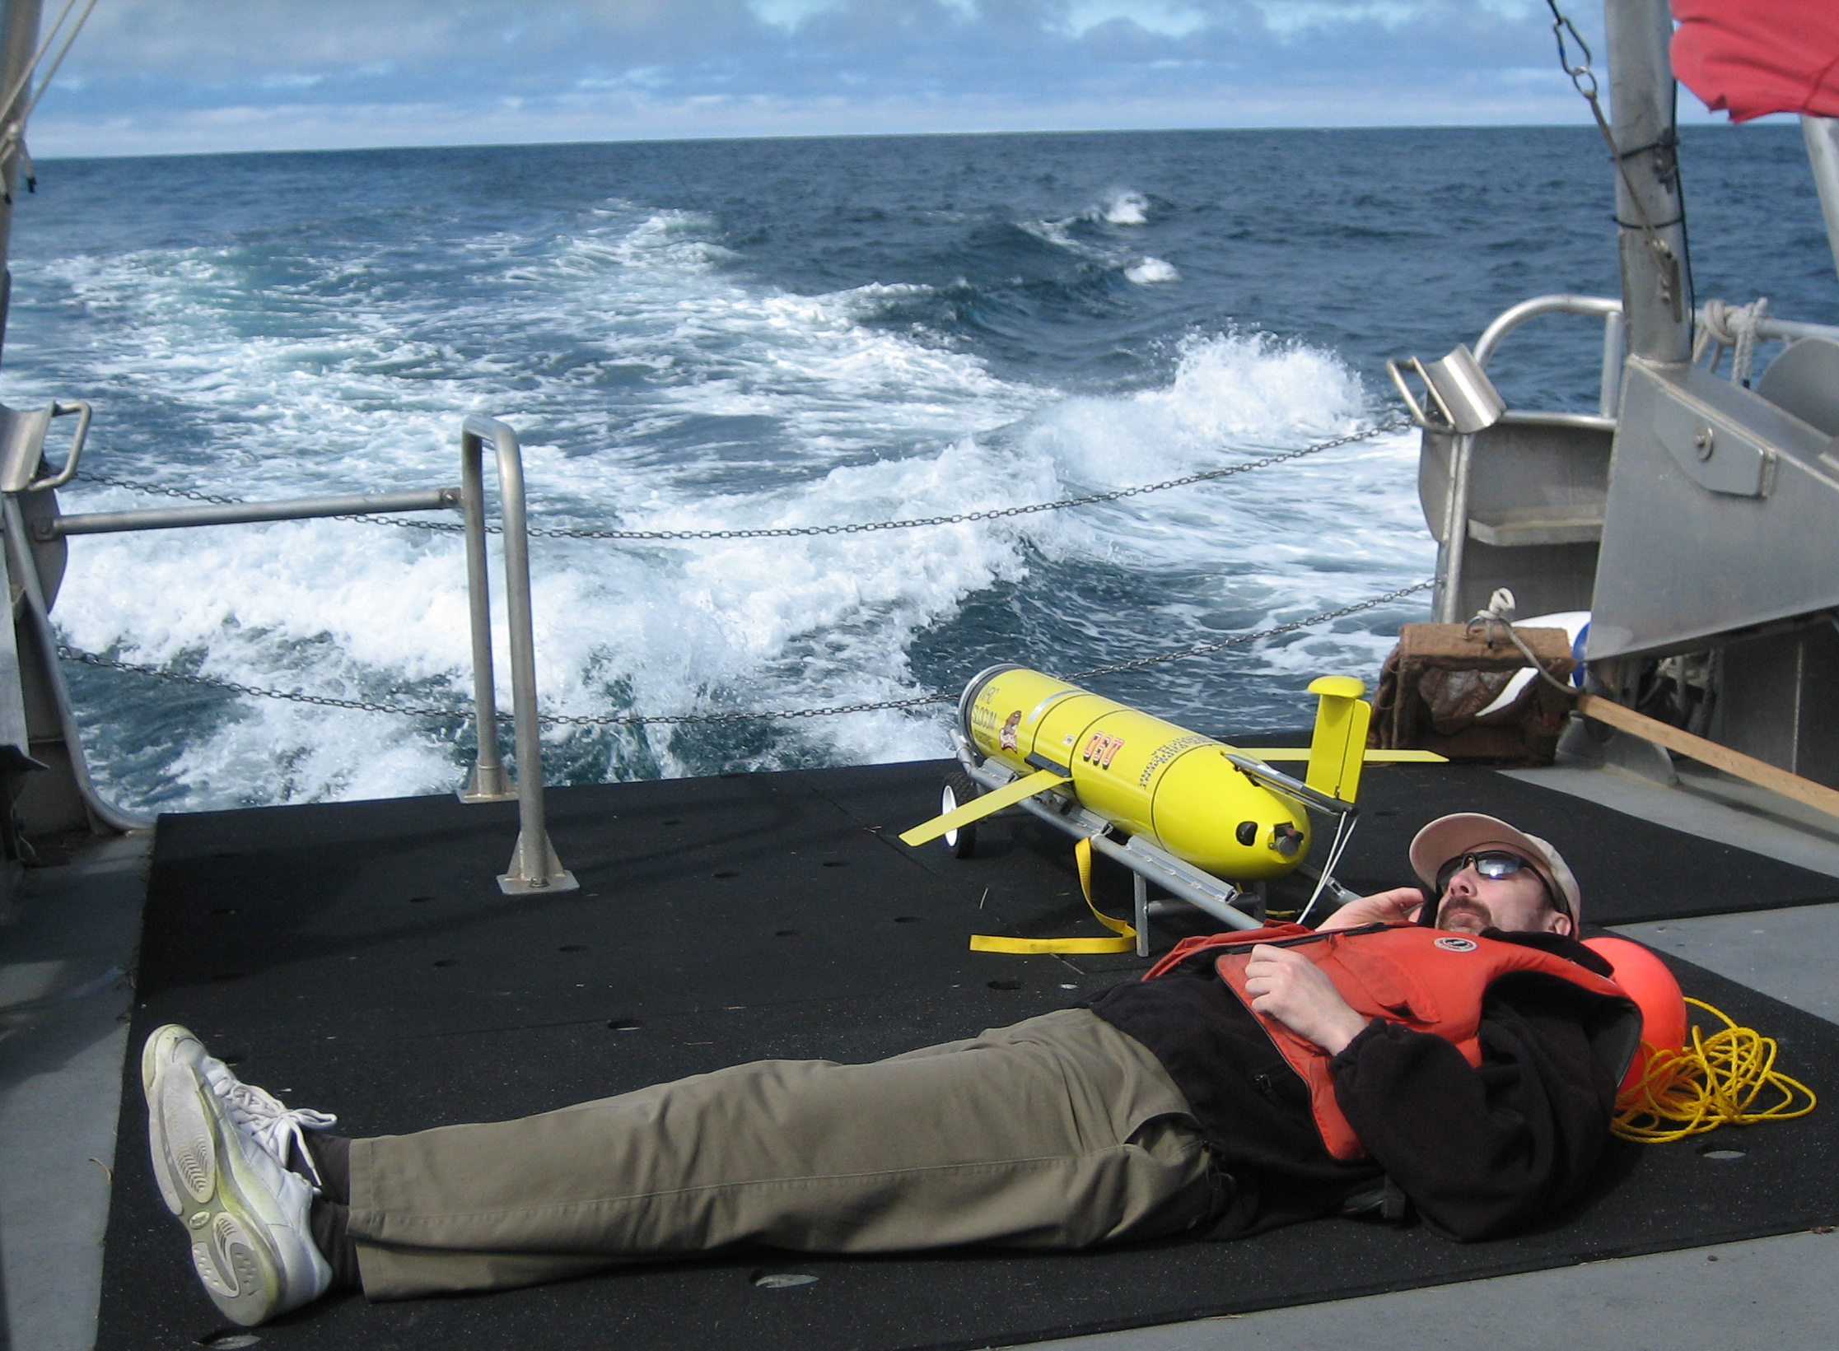
Autono-my-ass
Autonomous Underwater Gliders
Slow, rough navigation & limited sensor payload
Cheap, high spatial resolution & long endurance
Useful glider operations
Endurance, Footprint & Weather

