Slide 1
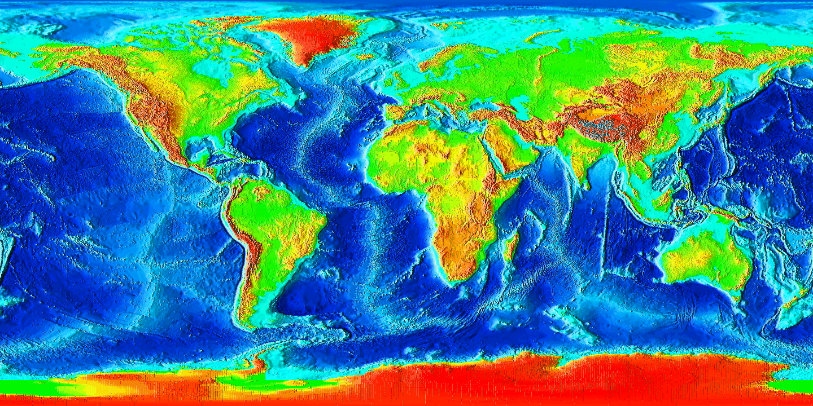
Recent Advances in Underwater Robots at the Deep Submergence Laboratory James C. Kinsey¹, Andrew D. Bowen¹, Christopher R. German¹, Michael V. Jakuba¹, Carl L. Kaiser¹, Larry Mayer^{,1,2}, Adam S. Soule¹, Louis L. Whitcomb^{1,3} and Dana R. Yoerger¹ ¹Woods Hole Oceanographic Institution, ²University of New Hampshire, Center for Coastal and Ocean Mapping, ³The Johns Hopkins University

Slide 2
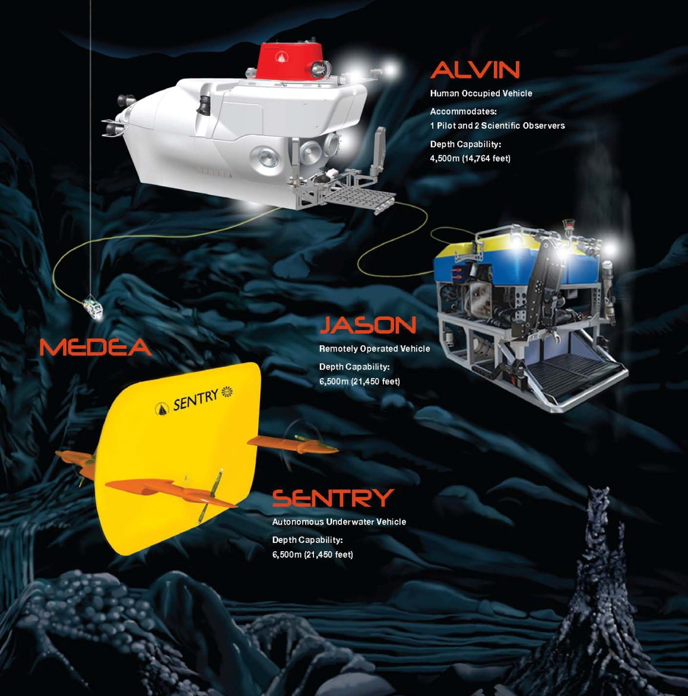
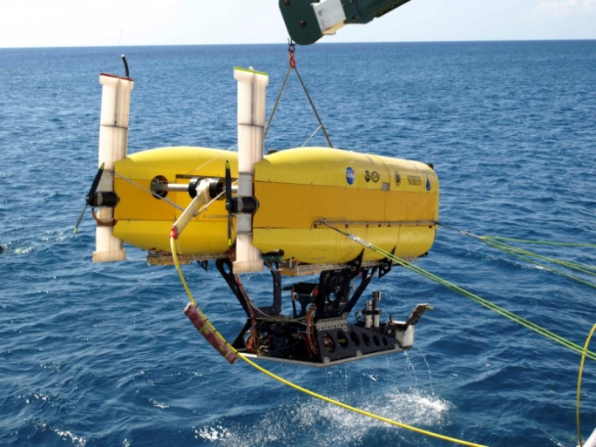
Deep Submergence Lab
Design, build and operate a variety of ocean robots
Home to the National Deep Submergence Facility (NDSF)
Field Operations:
10+ ROV cruises/year
~10 AUV cruises/year
Core areas include:
Robotics
Control and navigation
Sensing
Autonomy

Slide 3
Deep Submergence Lab
Design, build and operate a variety of ocean robots
Home to the National Deep Submergence Facility (NDSF)
Field Operations:
10+ ROV cruises/year
~10 AUV cruises/year
Core areas include:
Robotics
Control and navigation
Sensing
Autonomy
Today’s talk focuses on 2 recent projects:
Coordinated AUV-ASV operations
Nereid Under-Ice robot

Slide 4
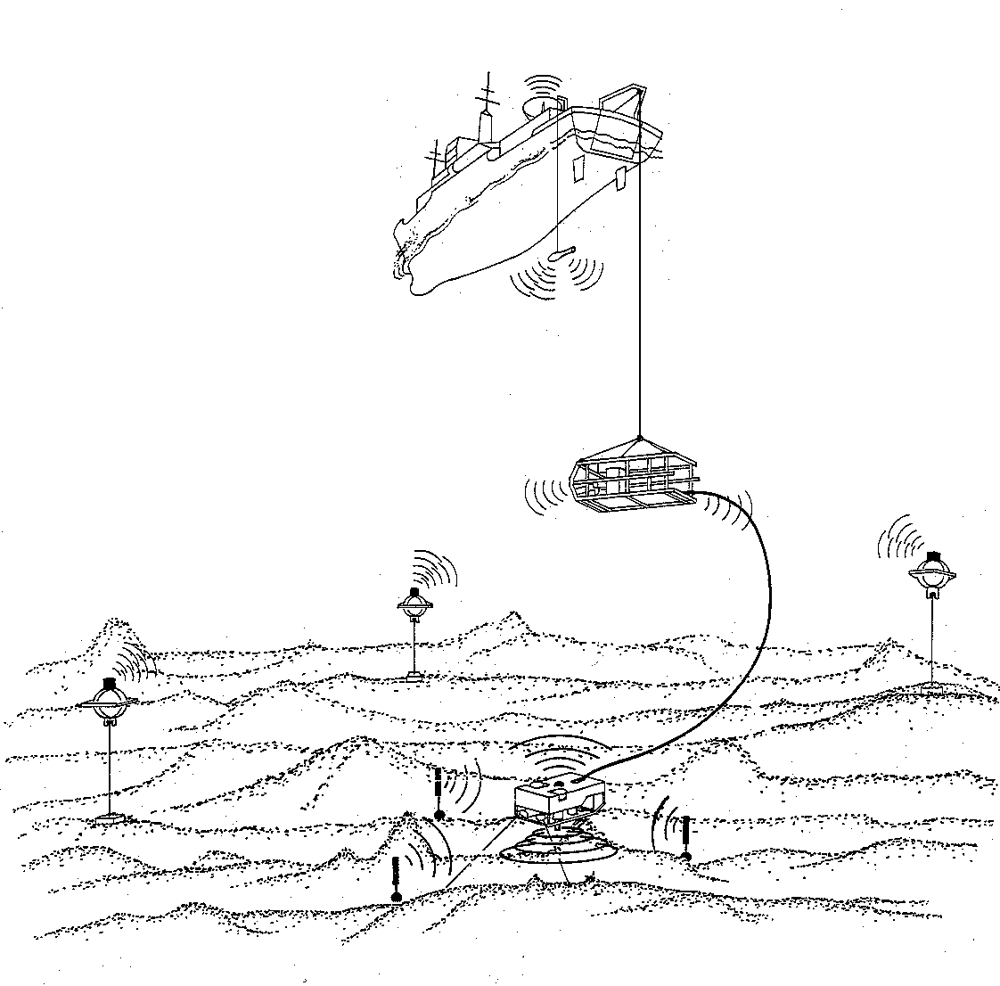
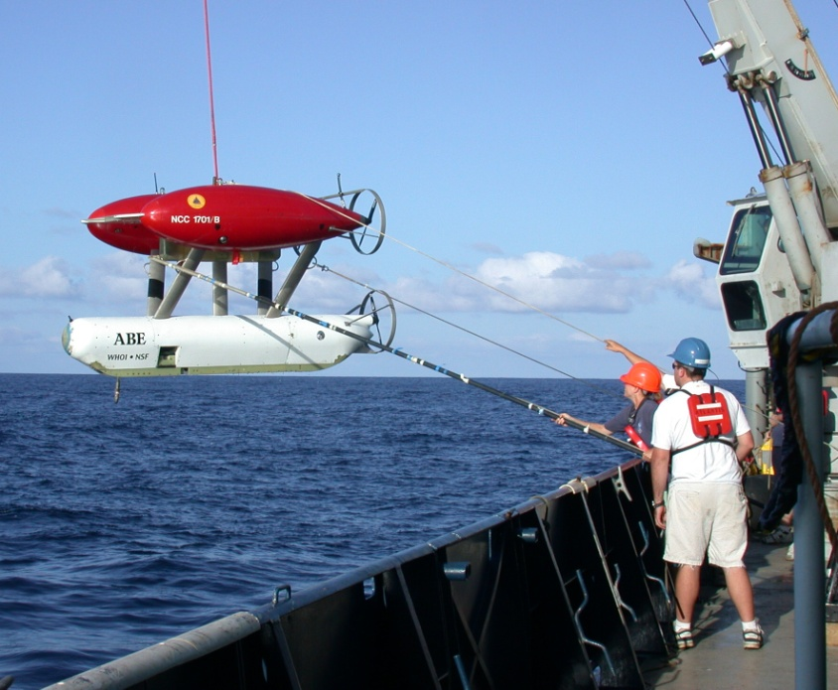
Coordinated AUV-ASV Operations
AUV Operations: Then
Credit: D. Yoerger WHOI
Use to deploy a deep AUV and leave it for 20+ hours to go do other work
LBL provided external nav aiding
Very minimal telemetry

Slide 5
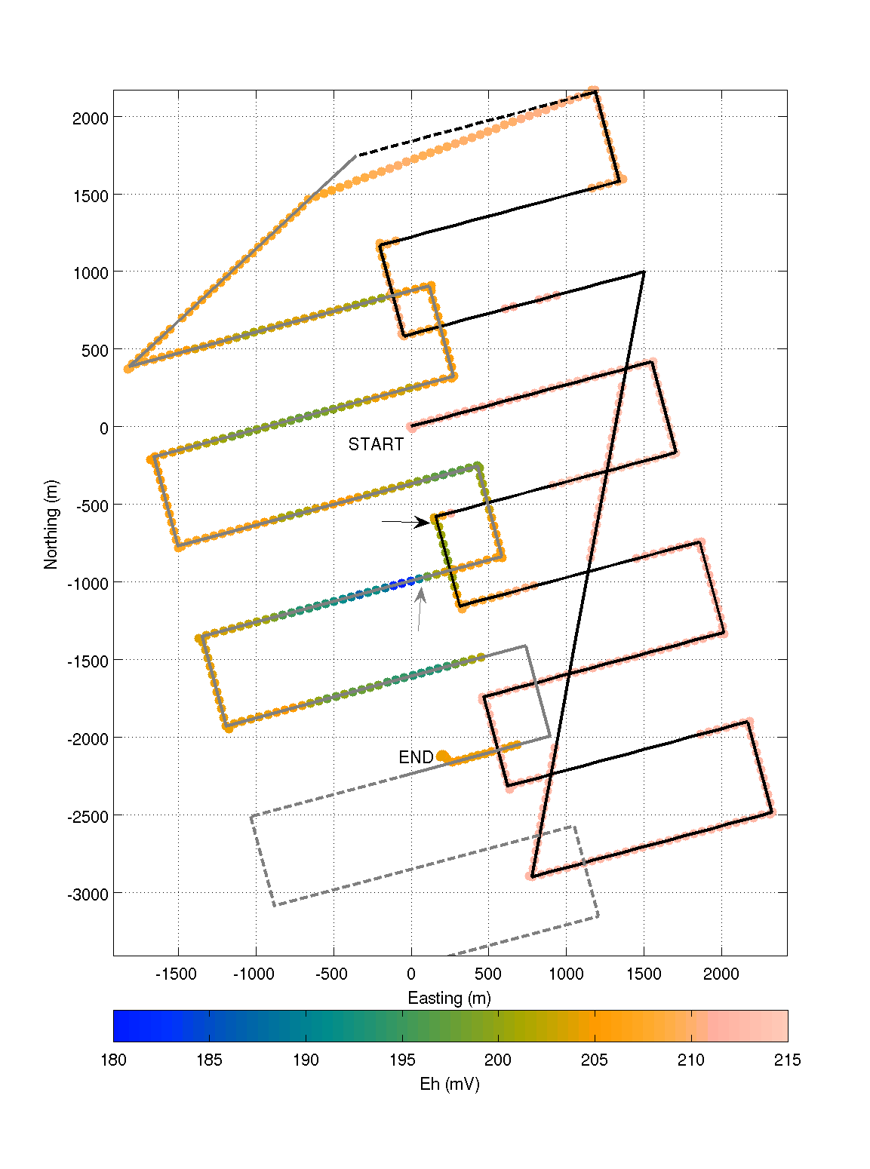
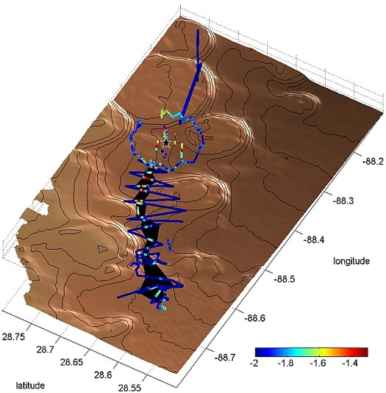
Coordinated AUV-ASV Operations
AUV Operations Now:
Limited Acoustic Telemetry
Transmitted science data enabled interrogation of mission progress
Facilitated in-situ re-tasking of vehicle
Acoustic telemetry has transformed AUV operations however it has created an “acoustic leash” for many AUVs!
Strongest Plume Signal
[German et al. PNAS 2010]
[Camilli et al. Science 2010]

Slide 6
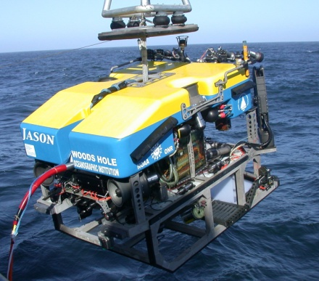
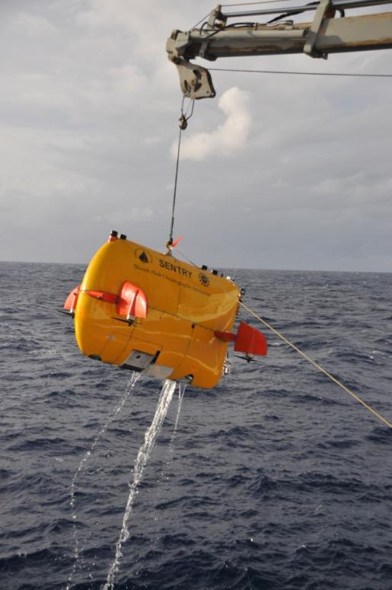
Joint Vehicle Operations
Joint operations with AUVs and ROVs or manned submersibles are increasingly common
For example, in the last year the Sentry AUV did 6 cruises with either the Jason ROV or the Alvin manned submersible
With Alvin, Sentry dives at night for a 10-12 hour dive. Is recovered with a 50% battery charge.
With Jason, Sentry operates within ~5km of the ship.
Launch and recover with Jason in the water.
Efficiency could be improved if Sentry could operate far away from the ship without having to sacrifice:
External navigation aiding
In-situ monitoring and intervention
Image Credits: WHOI.

Slide 7
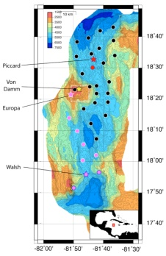
Autonomous AUV Tending
CONOPS
Actuated AUV and Waveglider
AUV/ASV deployed and recovered from ship
AUV performs mission as usual
ASV, with knowledge of AUV mission plan, “tends” AUV
ASV as navigation aid
Eliminates ship-required USBL systems or pre-deployed transponders
ASV as force-multiplier:
Provides operators with real-time data and re-tasking capability
Frees ship to perform other over-the-side operations

Slide 8
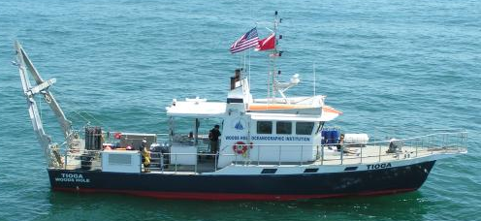
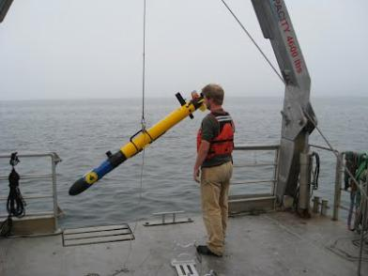
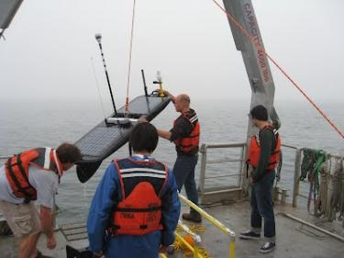
Pilot Project Overview
PROJECT GOALS
Demonstrate basic feasibility in shallow water
Wave-Glider ASV
Iver2 AUV
Develop software that coordinates ASV trajectory with the AUV
Investigate performance of different WaveGlider ASV trajectories
Comms and Nav constraints
Field tests
.

Slide 9
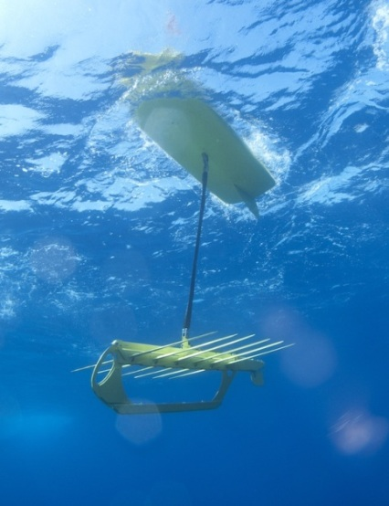
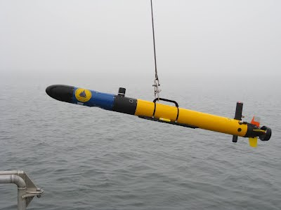
Acoustic Cycle (WHOI Micro-modems)
OWTT
Coordinator software on Wave-Glider manages acoustic communications cycle and determines ASV trajectory.
GPS & Range
Iver State
Ping
WG GPS
& Range
Ping
Reply
Iver
State
WG GPS & Range for single-range nav
Navigation code uses DVL, compass, and range data to estimate AUV position.
State Estimate & Science Data
Notes:
WHOI ,icro-modems (Lee Freitag)

Slide 10
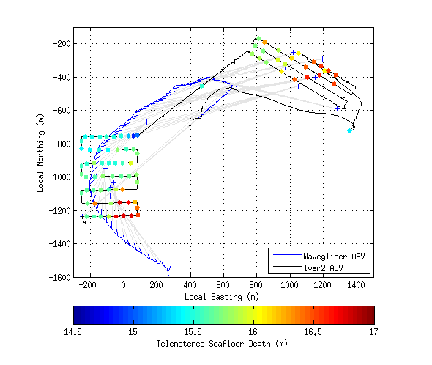
Oct 2012 Buzzards Bay Experiments - Results
AUV mission planned a-priori; ASV has knowledge of the mission.
ASV plans its trajectory based on the AUV trajectory and the current AUV position
External aiding provided by single acoustic modem ranges
Experiment demonstrated the following capabilities:
Active control of the WG-ASV
External navigation aiding using WG
Using WG as a telemetry relay for data uplink and retasking

Slide 11
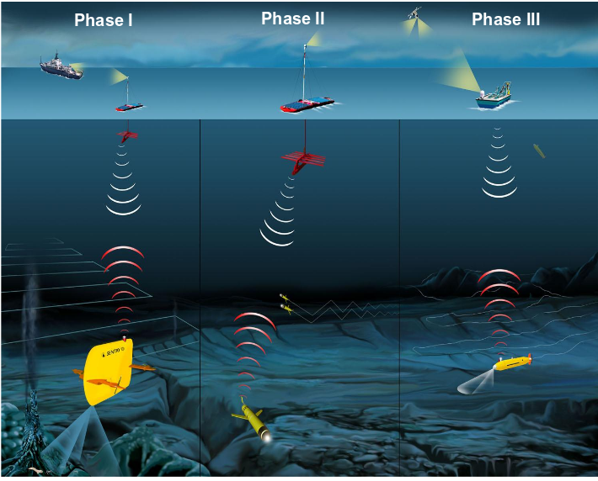
Our long term vision for ASV-AUV deep ocean operations
AUV Tending
(10s of km)
Ridge-Segment
(100s of km)
Basin-Scale
(1000s of km)

Slide 12
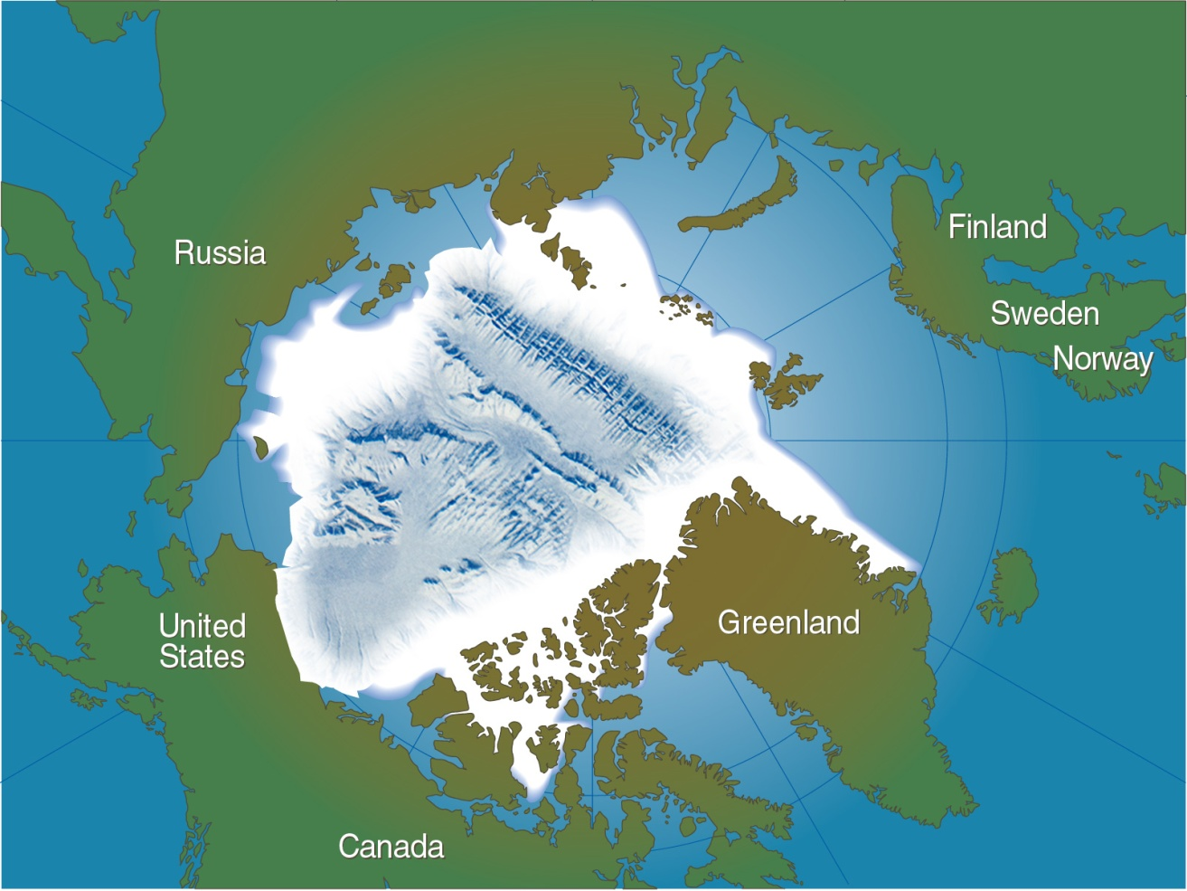
Nereid Under-Ice (NUI)
Nereid Under-Ice (NUI) focuses on exploring biological and physical environments in the polar regions including:
Operations under fixed ice shelves
Operations moving sea ice
Tasks include:
Near-ice inspection and mapping
Instrument emplacement
Sediment sampling
Grounding line inspection
Notes:
PO and geo questions driven by climate change and sea-level rise questions.
Still don’t know much about biology. No known climate change importance.

Slide 13
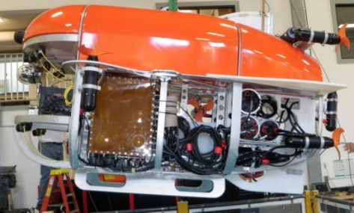
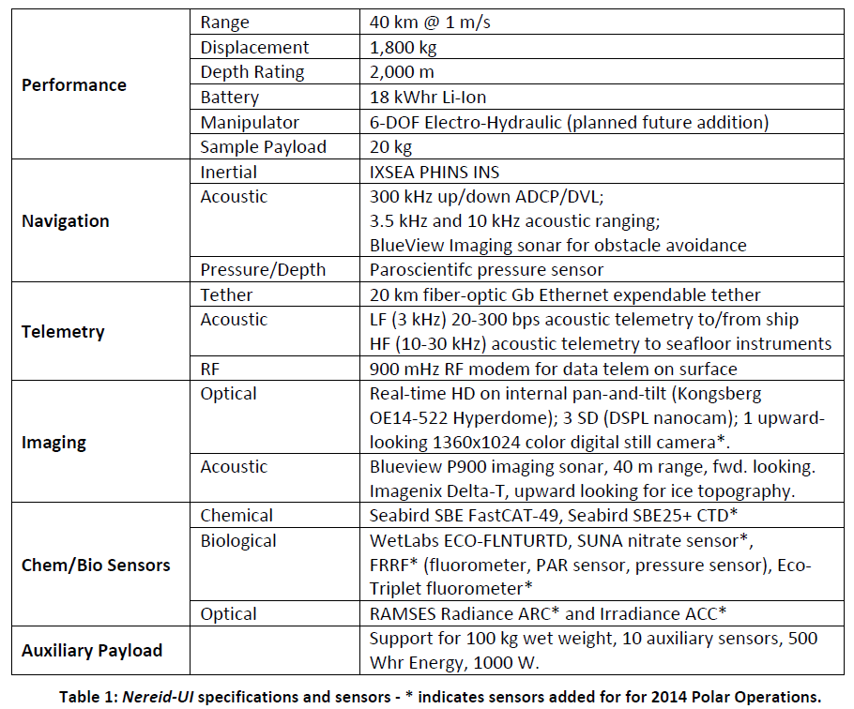
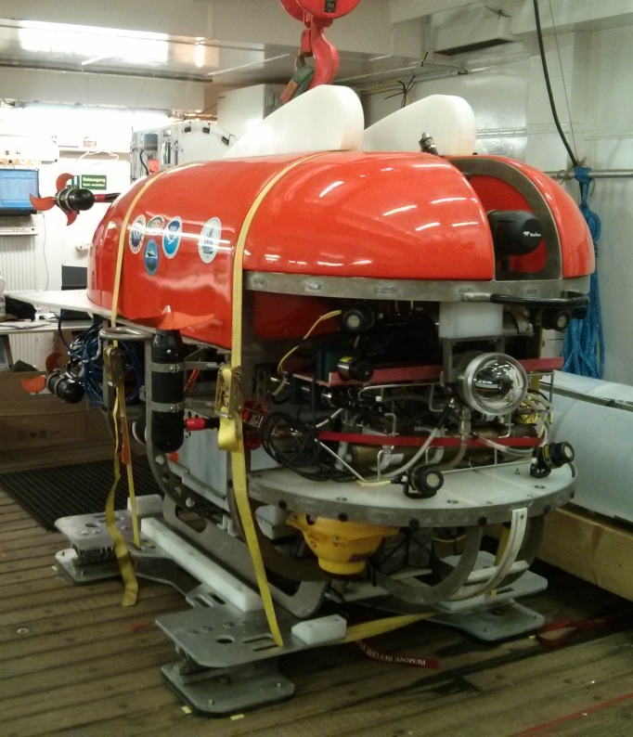
NUI Specifications

Slide 14
NUI Concept of Operations: Light Fiber-Optic Tether Operations
Light-weight Armored Cable (10 m - 100 m)
Acoustics package
nUI
Depressor (~50 kg)
Umbilical (5 m)
Light Fiber-Optic Tether (20 km)
Tow-body (~35 kg)
Operating Envelope
Two-body launch :
No descent/ascent weights---Pilot has control.
Short descent (10-20 m)
Light-weight depressor/tow-body system, ~85kg, 2 m tall

Slide 15
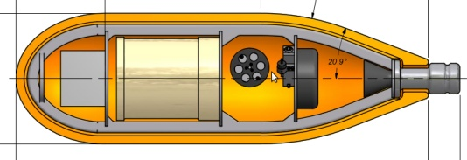
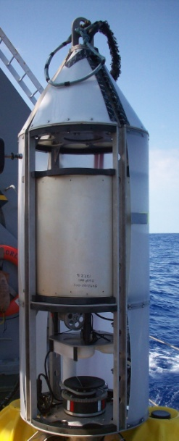
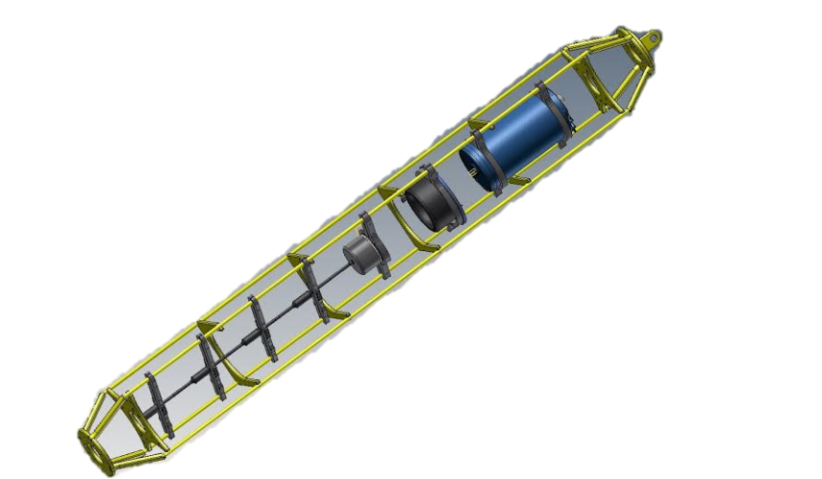
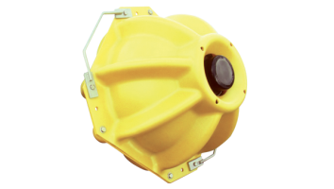
Equipment Overview: Over-the-side
nUI
Tow-Body
Depressor
(prototype)
35 kg
1 m long
Mated to depressor for launch
≥ 5 m umbilical to nUI
1800 kg
1.8 m x 1.8 m x 3 m
Soft-line recovery
Transponders (2)
Benthos XT 6001
Acoustics
Package
~100 kg
2 m tall
1000 m max depth
2 m tall
~40 kg
Deployed fore and aft
Battery powered

Slide 16
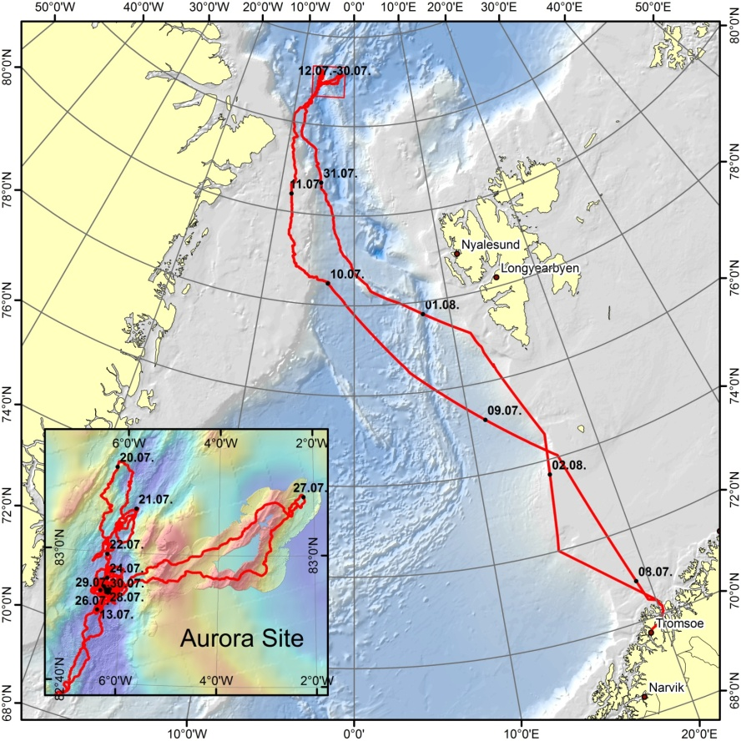
NUI Summer 2014 Deployments at 83° N 6° W F/V Polarstern PS86

Slide 17
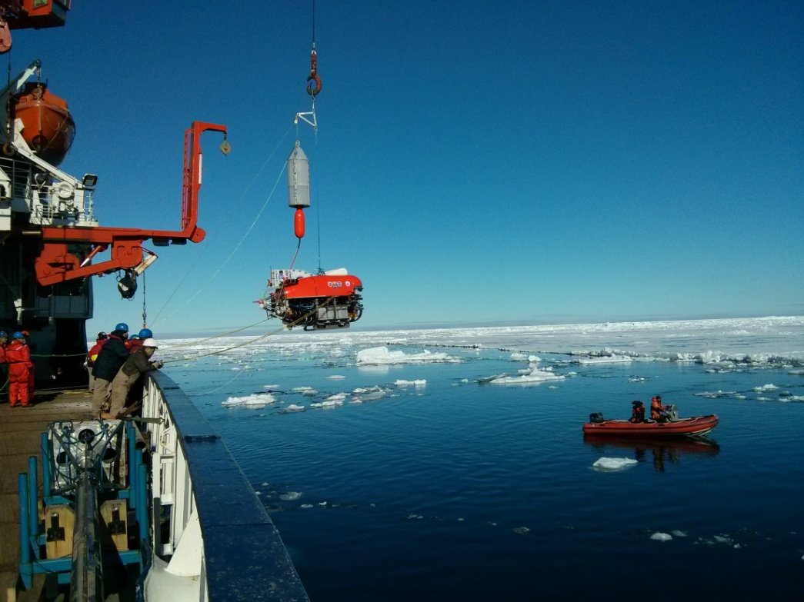
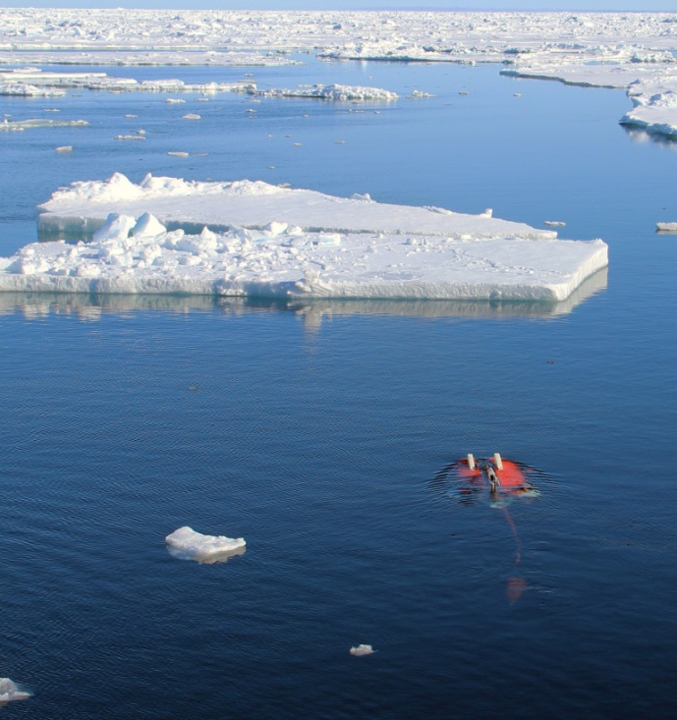
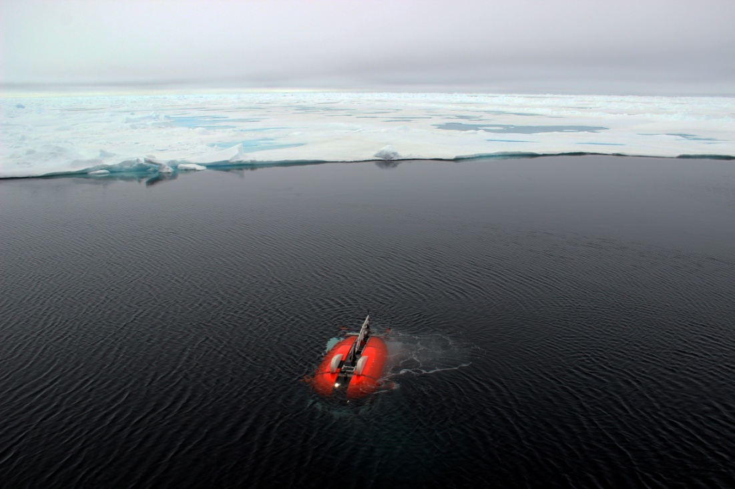
Launch and Recovery

Slide 18
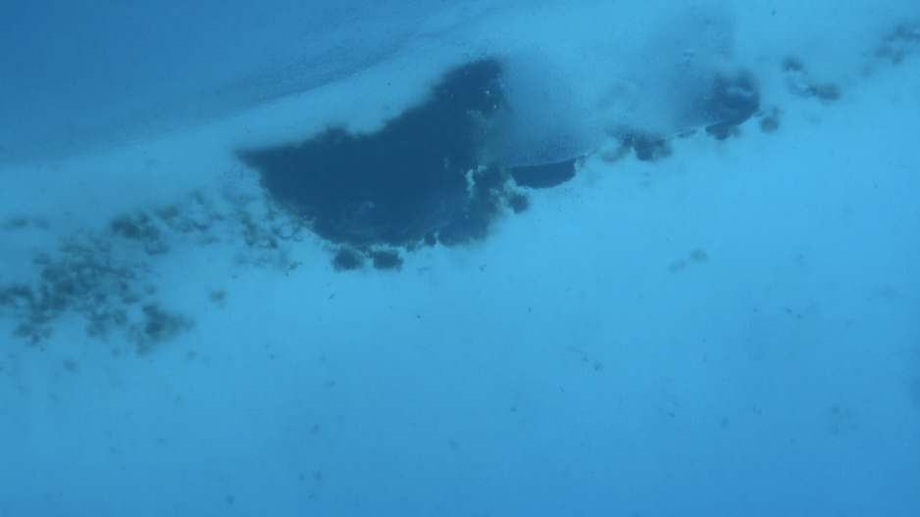
Under-Ice

Slide 19
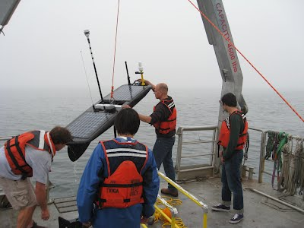
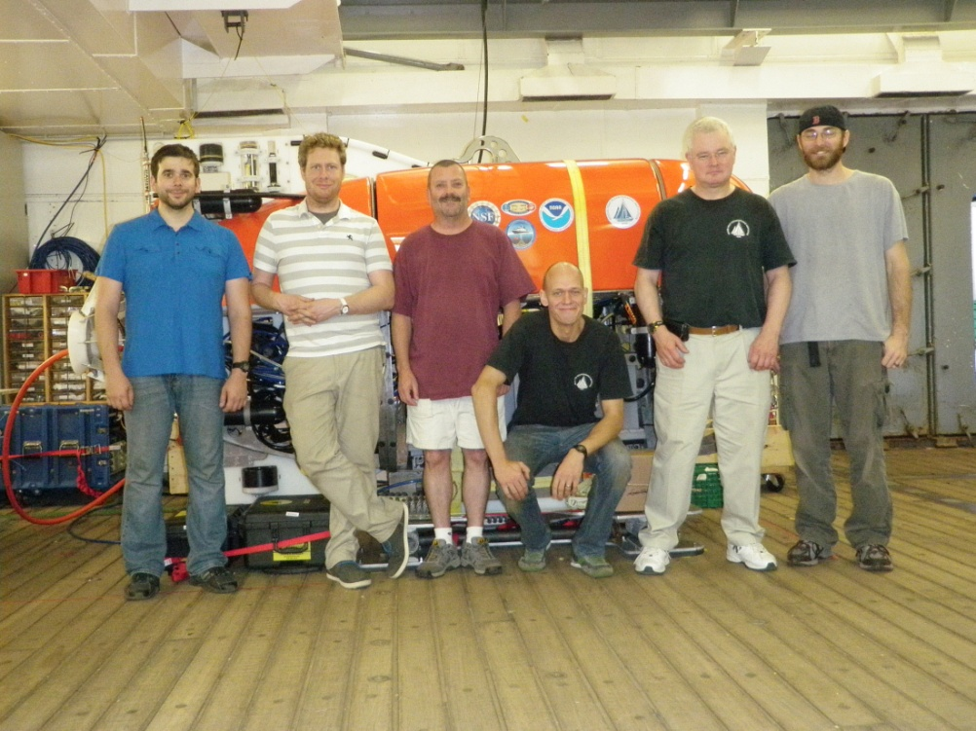
Questions
jkinsey@whoi.edu

