Slide 1

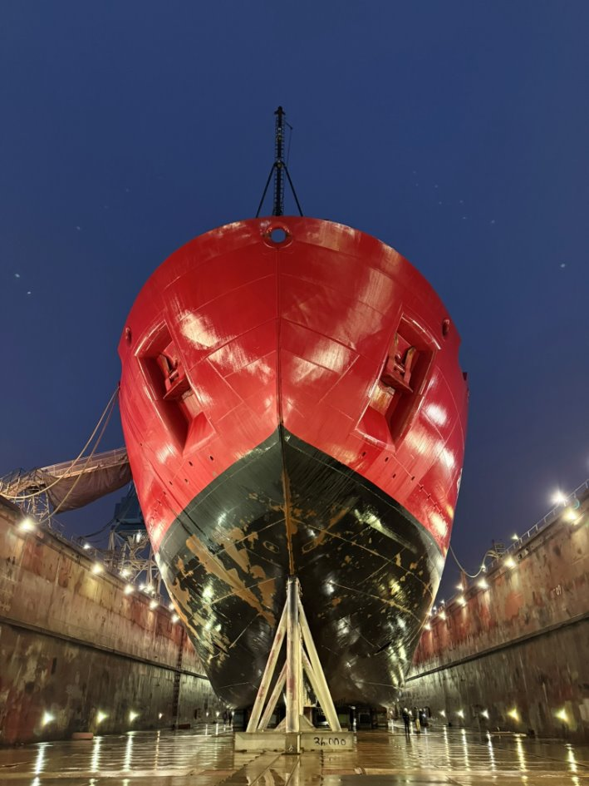


STARC Report AICC Winter 202
2026 Drydock Update

Slide 2
Acknowledgements
National Science Foundation (NSF)
United States Coast Guard (USCG)
UNOLS Office and Arctic Icebreaker Coordinating Committee (AICC)
STARC Partner Institutions (SIO. OSU, UW)
Multibeam Advisory Committee (MAC)
WHOI Potential Fields Pool Equipment (PFPE)
National Oceanic and Atmospheric Administration (NOAA)

Slide 3
2026 Drydock Goals
  Multibeam upgrade EM124 to EM304 MKII
  Installation SBP29 Sub-Bottom Profiler
  Sonar system UPS installation
  Preservation of transducers wells

Slide 4
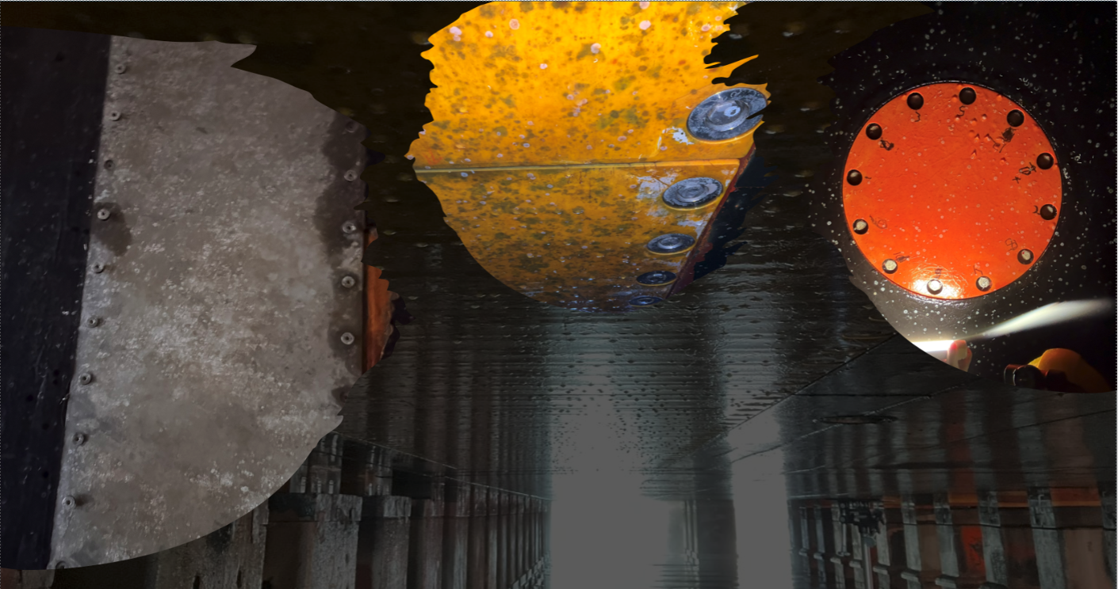
Transducers Windows Entering Drydock
September 2020 Arctic Sea Ice Extent
Arctic Sea Ice Extent

Slide 5
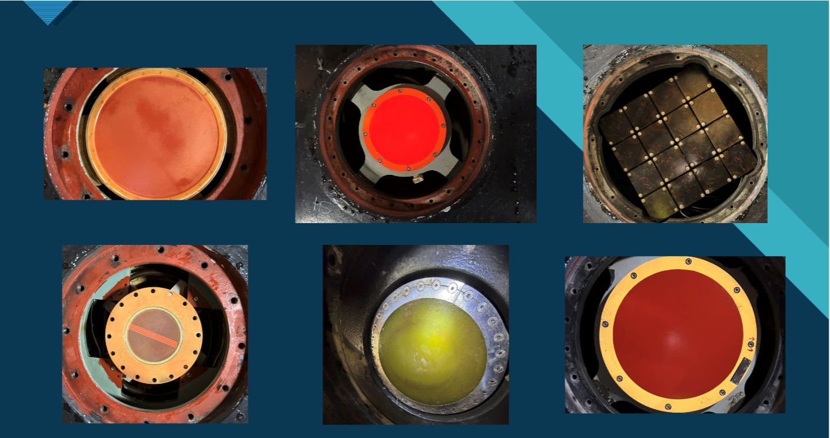
Transducer Well Inspection and Preservation

Slide 6
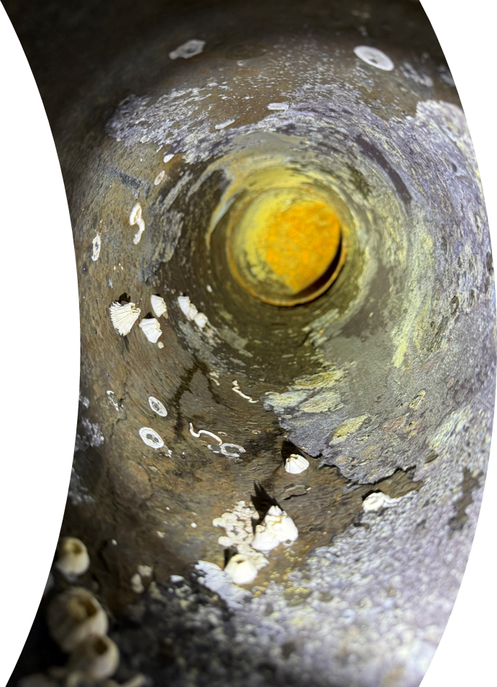
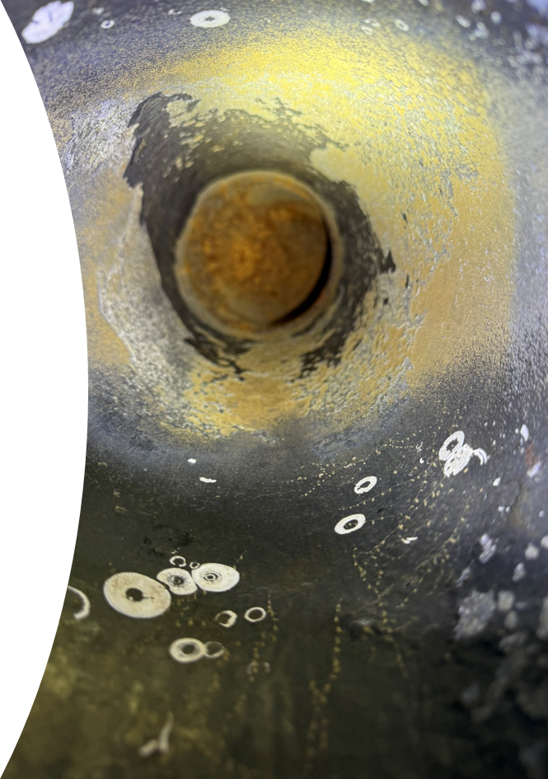
Cable Conduits Replaced and Renewed
Multibeam transducer conduits were replaced and renewed as needed for transducer installations images of cleaning before preservation

Slide 7
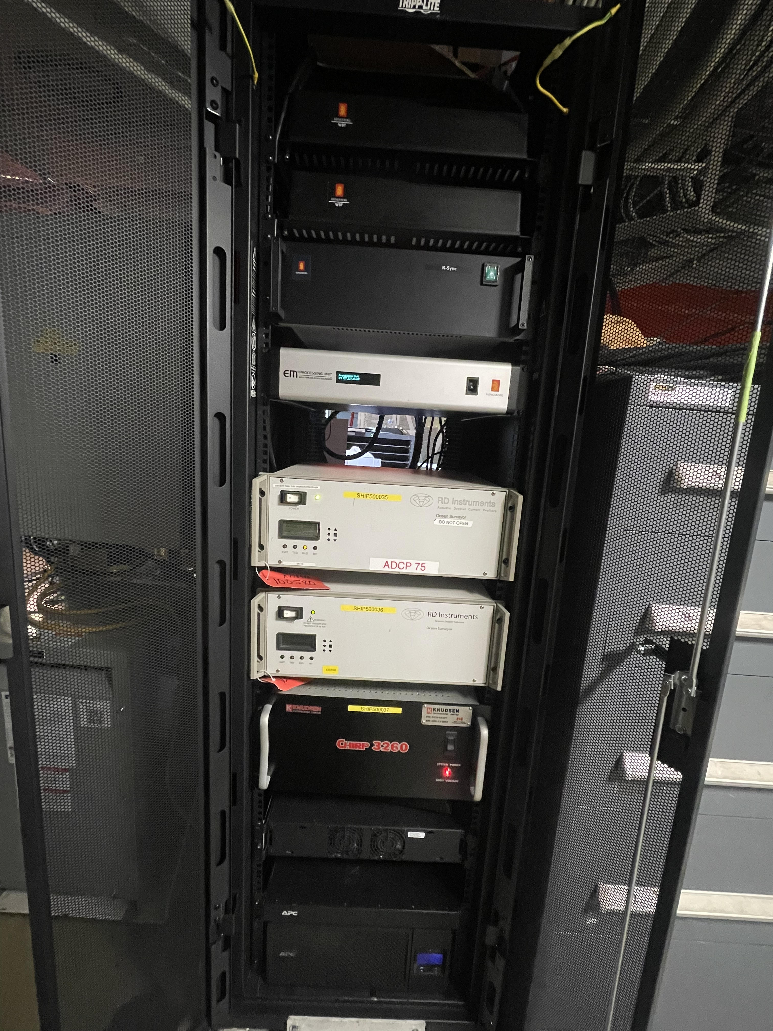
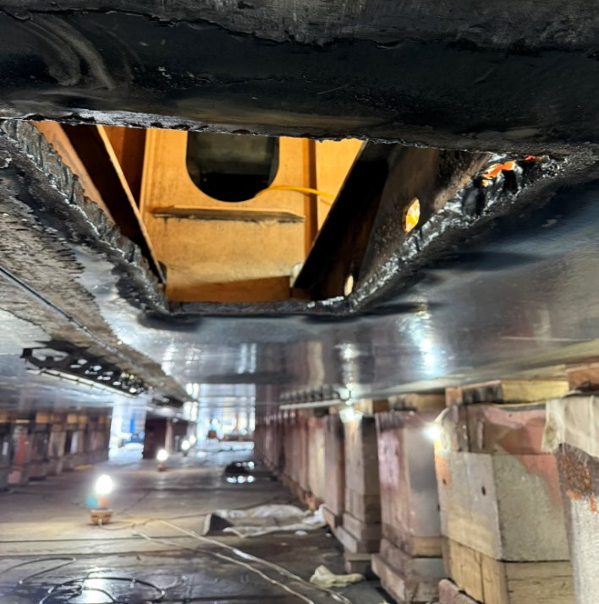
Removals
Equipment
Starboard Hull for SBP29
Sent out and repaired:​
Teledyne deck units​
Knudsen Unit​
​
New:
​
2 EK80 WBT's ​
Kongsberg K-Sync

Slide 8
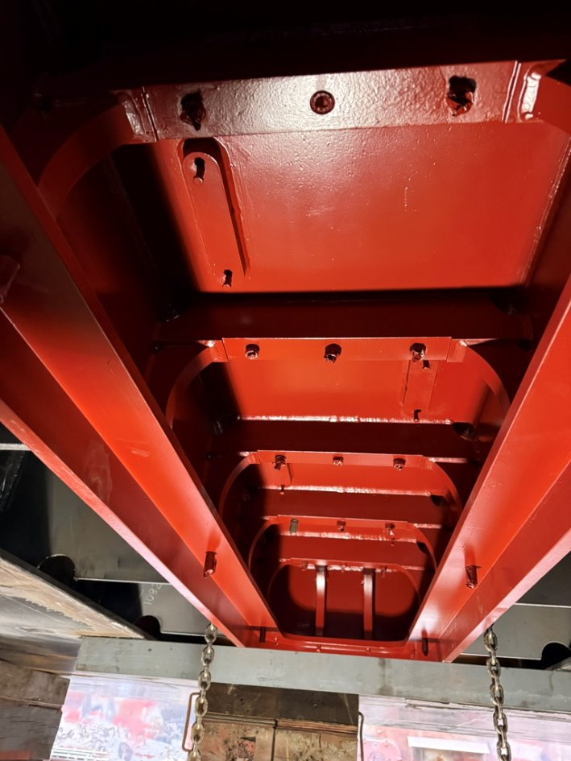
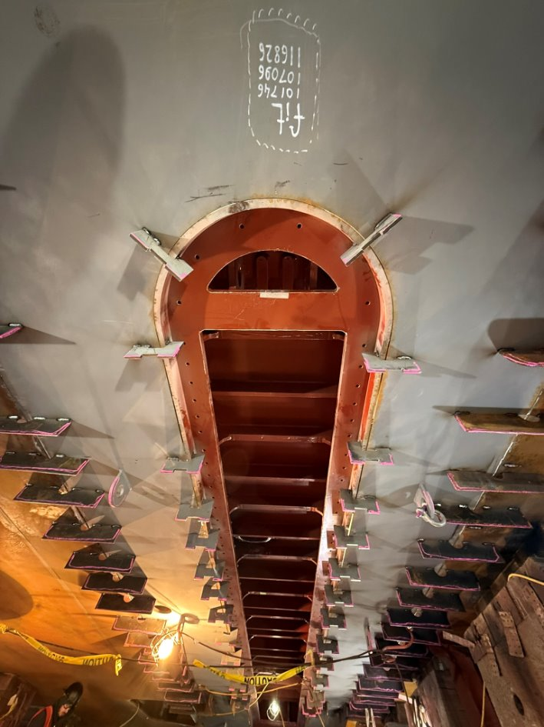
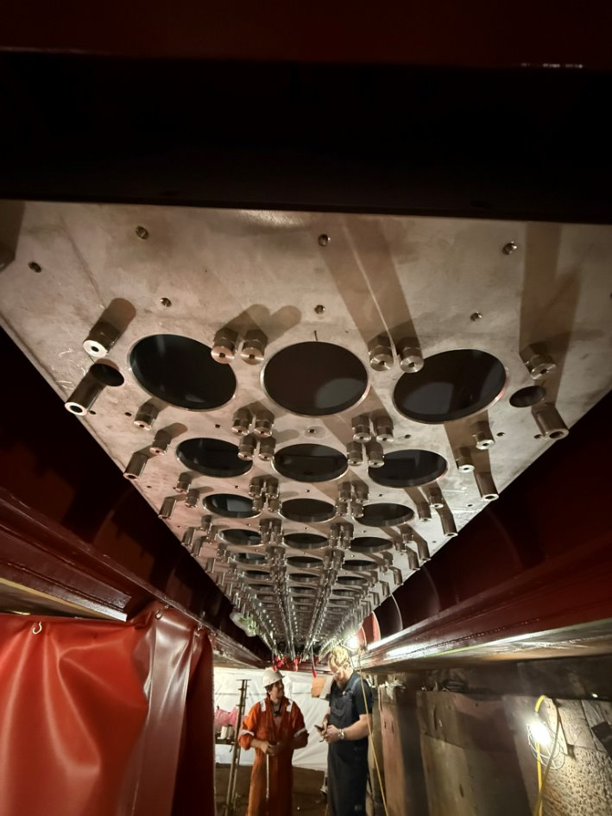
EM304 and SBP29 Frame Installations

Slide 9
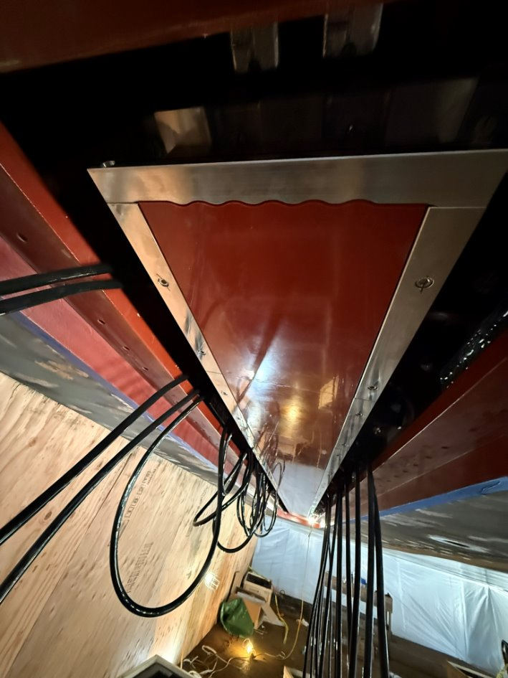
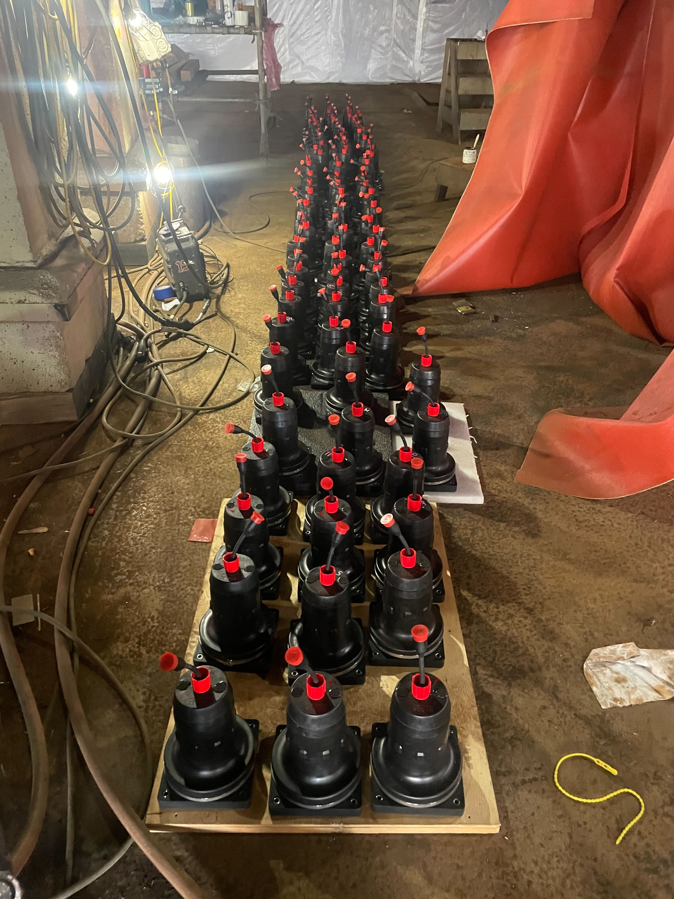
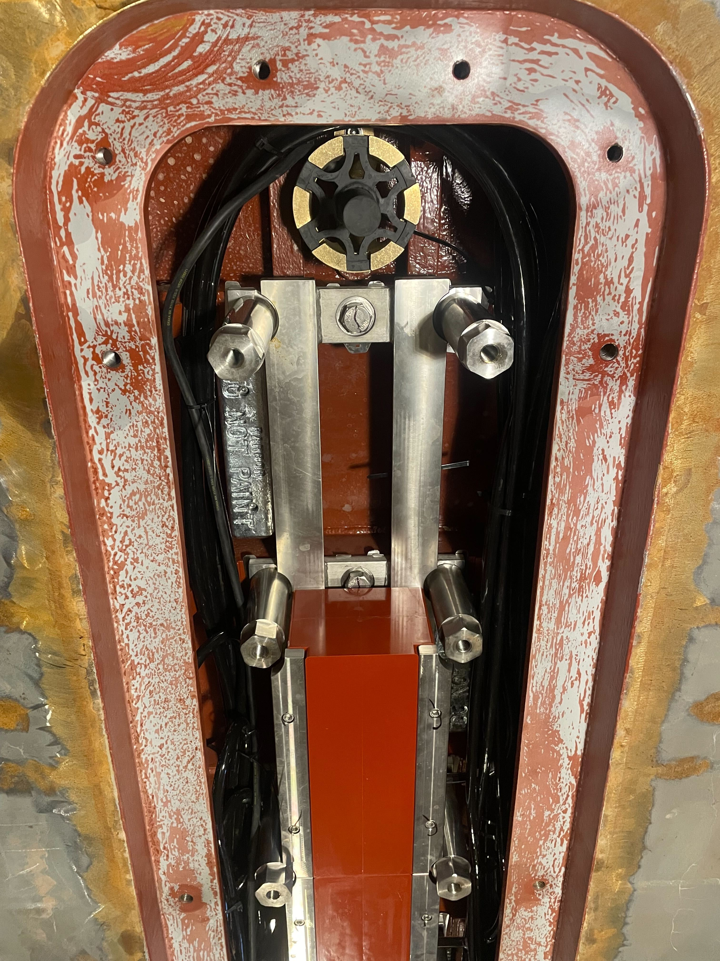
Transducer and Cabling Installations
IMG_9535

Slide 10
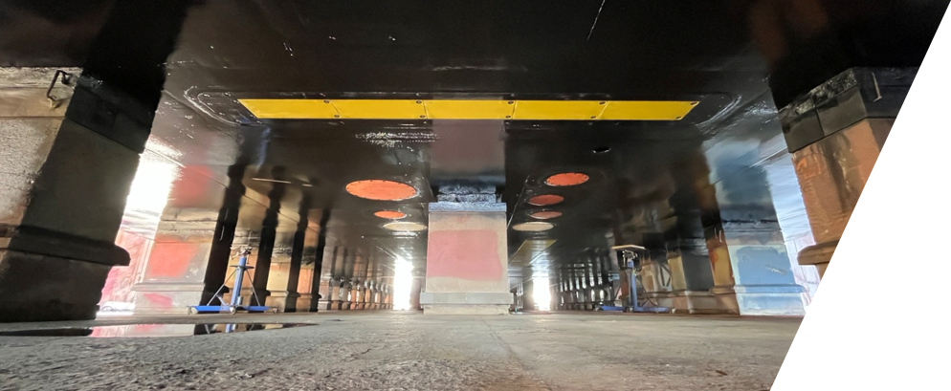
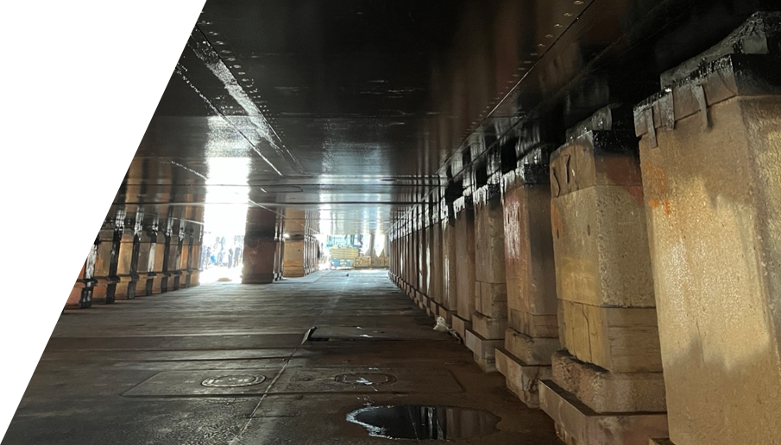
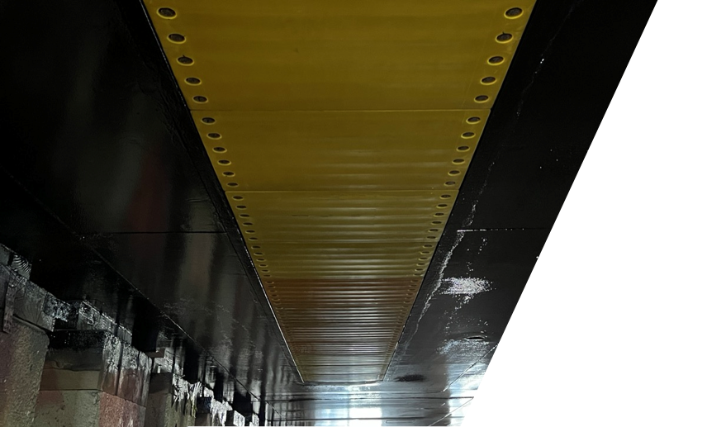
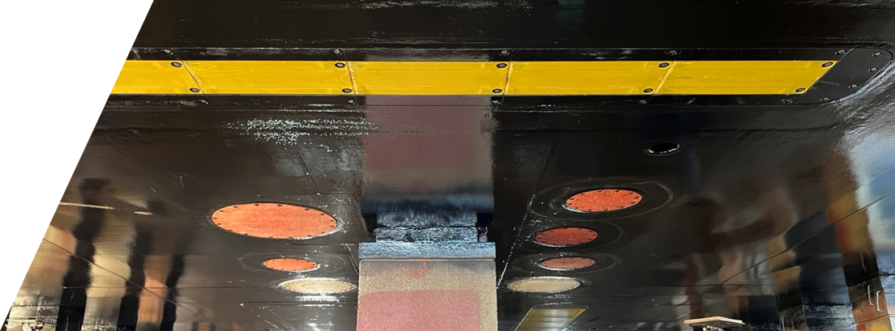
Finished with Ice windows installed

Slide 11
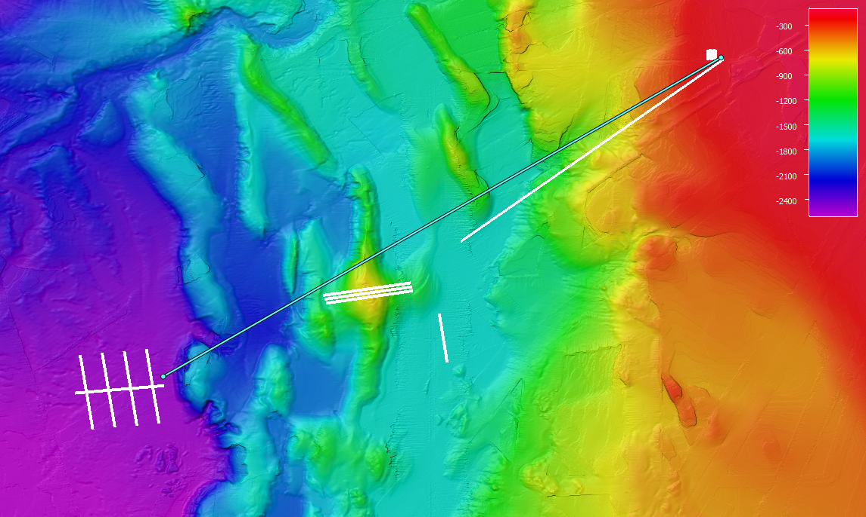
Sea Acceptance and Shakedown
Dockside Configuration Verification
Patch Test
Noise Testing
Swath Coverage
Accuracy Survey
SBP29 SAT
Winch Testing
Instrumentation Verification
UCSC Collaboration SBP29 Assessment
Credit UNOLS MAC – Kevin Jerram

Slide 12
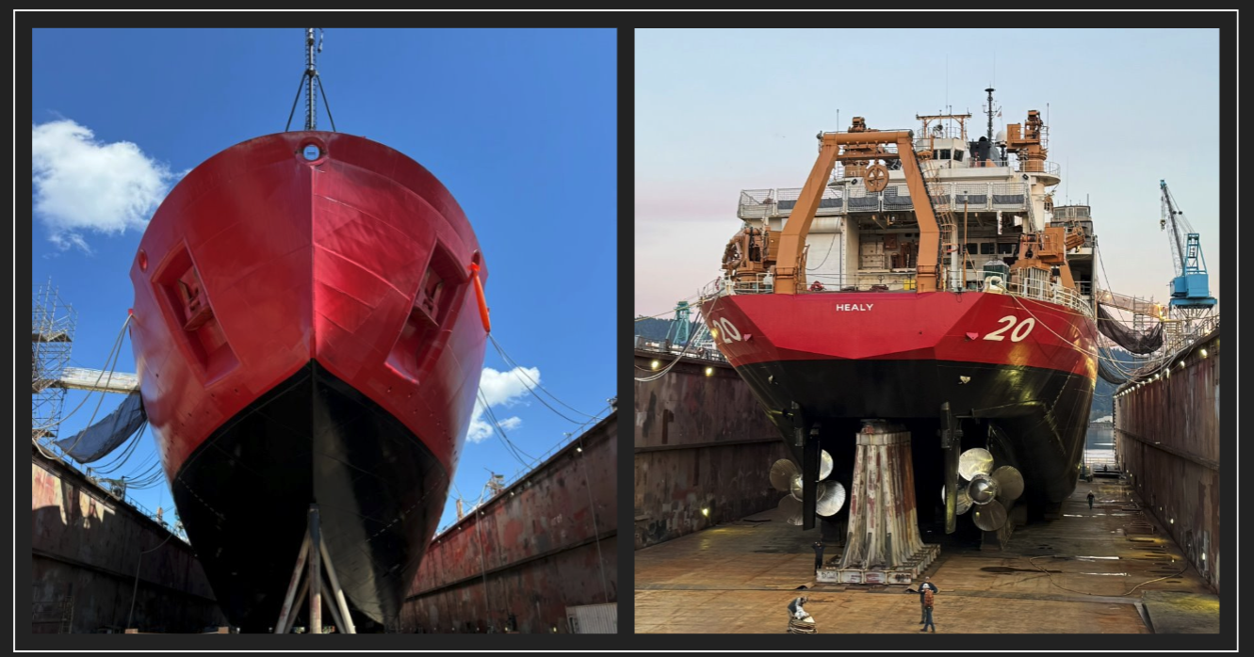
Questions

