Slide 1
R/V Sikuliaq Oceanographic Technical Services Update
AICC 2026 Summer Meeting
June 25, 2026
Gabriel Matthias
Science Operations Manager
College of Fisheries and Ocean Sciences, UAF
Email: grmatthias@alaska.edu
Website: https//www.sikuliaq.alaska.edu/ops/

Slide 2
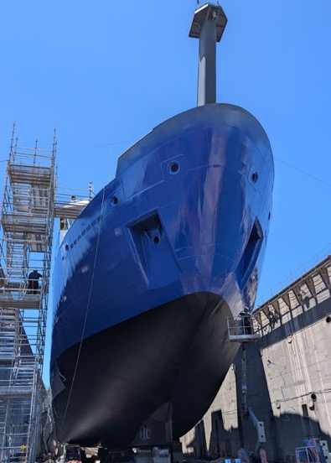

Projects of Interest to the AICC
Finishing up Shipyard
Centerboard Shoe replaced
Transducer flat shuffle
Diaphragm Pump in Centerboard
Starshield x2, OneWebb x2, LTE modems x2

Slide 3
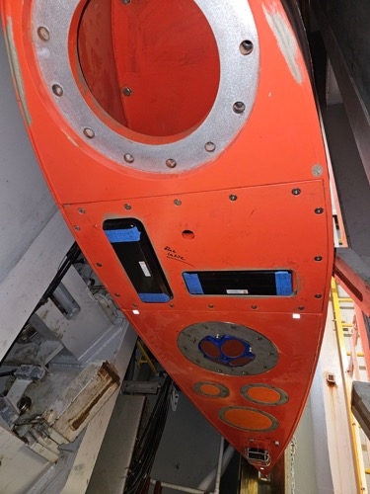
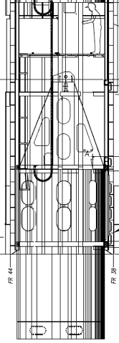
Centerboard Shoe
Available Blank
EM2042 Multibeam
WH300 ADCP
70, 120, and 200 khz
EK80 transducers
Tonpilz (Acomms)

Slide 4
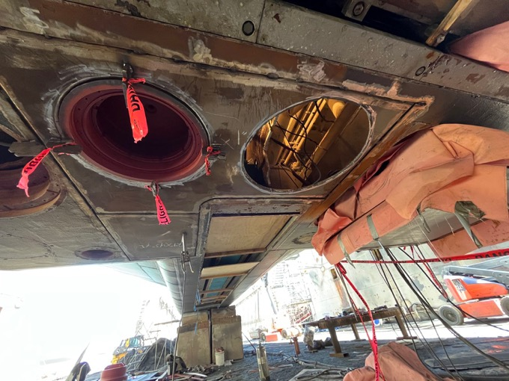
Other changes to Acoustics

Slide 5
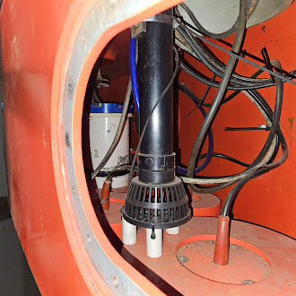
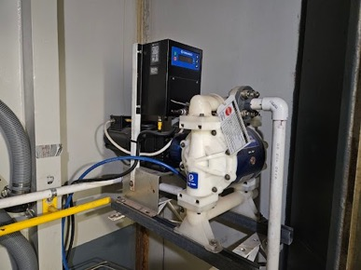
Centerboard Seawater Intake
Husky Graco 1050e Diaphragm pump with intake in centerboard shoe for visiting underway sensors.
1” outlet line.

Slide 6
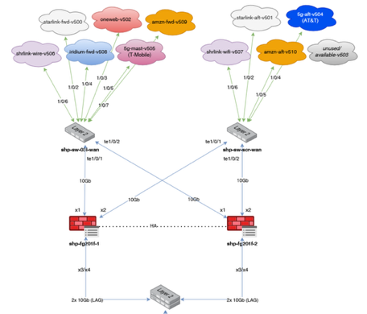
Satellite Communications Systems
HiSeasNet is now providing commercial lease options — Marlink is the service provider
Starshield (aka Starlink) is the primary communications platform for the ship. Dual terminals provide excellent bandwidth for operations and science.
OneWebb antennas installed. Near-coastal coverage, but not tested yet.
C/Ku-Band antennas removed. Port dome now houses a OneWebb antenna. These require testing in Arctic conditions.
Cellular modems x2. TMobile and AT&T

Slide 7
Thank you!
Gabriel Matthias
Science Operations Manager
College of Fisheries and Ocean Sciences
University of Alaska Fairbanks
Email: grmatthias@alaska.edu
Website: https//www.sikuliaq.alaska.edu/ops/

