Slide 1
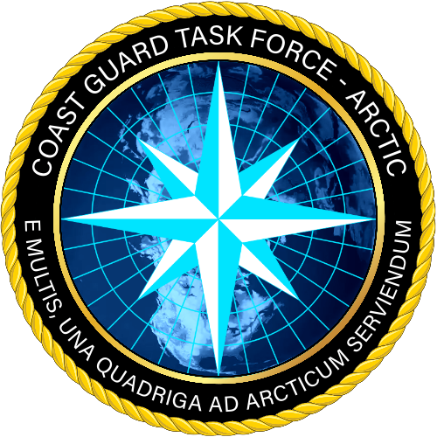


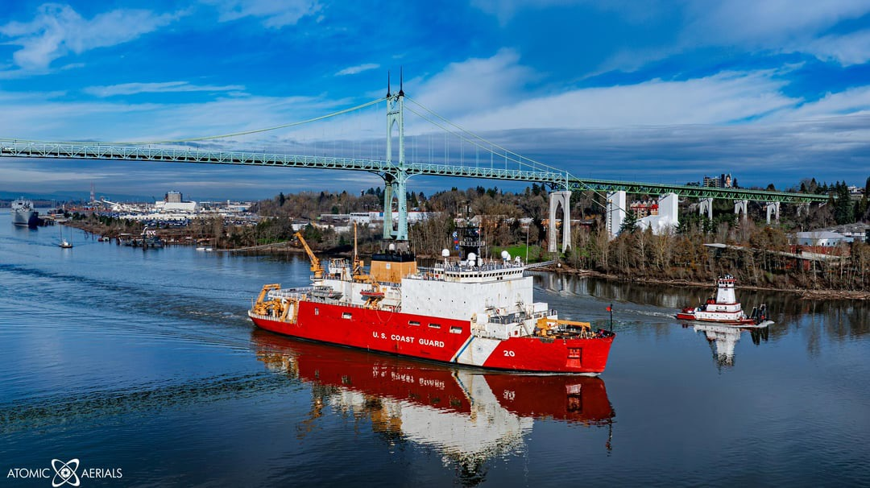
USCGC Healy
UNCLASSIFIED//FOUO
AICC Summer 2026

Slide 2
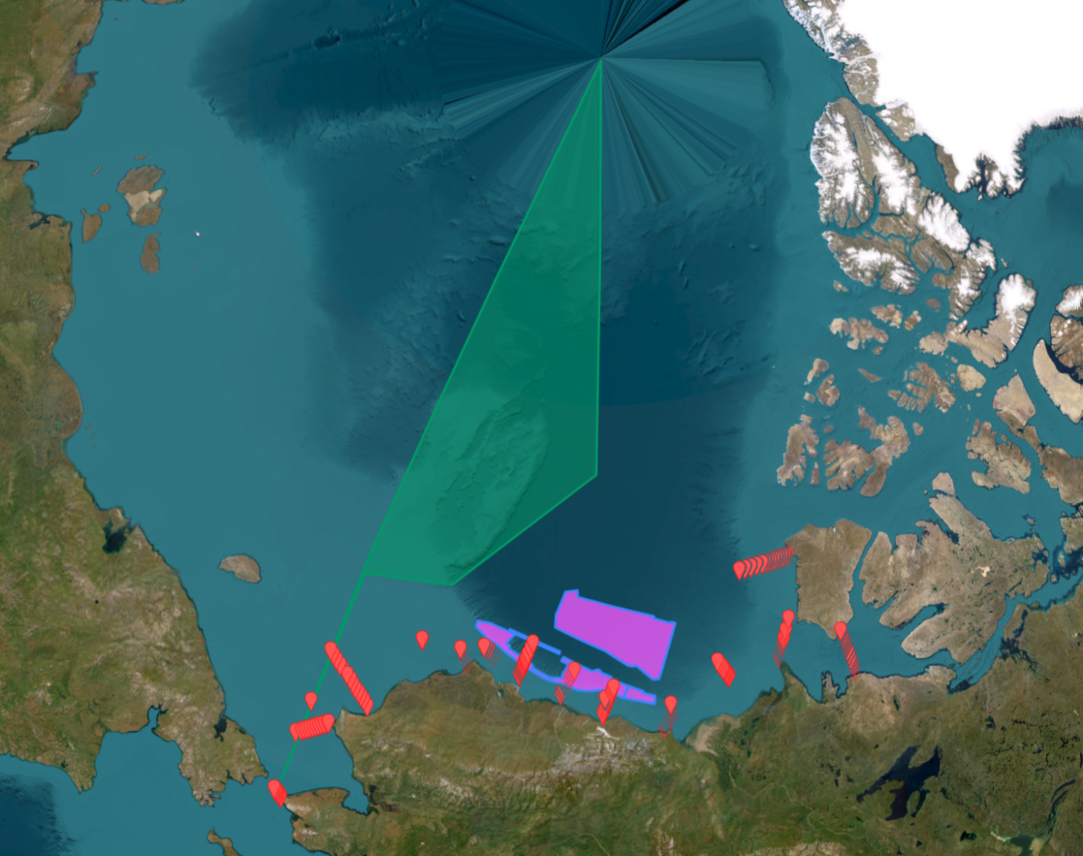
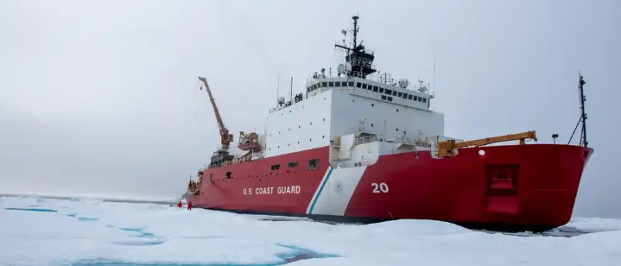
UNCLASSIFIED//FOUO
CGC HEALY (WAGB 20)
Arctic Deployment 2026
Phase 1 – Sea Acceptance Trials and Shakedown
Timeframe: July
Port Calls: Portland- Seattle
Operations: Crew training and ship’s system testing
    Multibeam calibration
    Power trials
    Drills and training
    Phase 2 – Crew Training
Timeframe: August
Port Calls: Seattle – Dutch Harbor
Operations: CG required inspections and crew training
    AVSTAN (Port Angeles)
    Limited Training Team (LTT)
Phase 3 – Coast Guard Ice Operations
Timeframe: August/September
Port Calls: Dutch Harbor –Dutch Harbor – Seward
Operations: Operation Frontier Sentinel, Ice Pilot Training, and Science of Opportunity
    Mid-patrol break in Seward
Phase 4 – Arctic Observation Network (AON)
Timeframe: October/November/December
Port Calls: Seward – Kodiak – Seattle
Operations: AON with WHOI, funded by NSF, Arctic Observing Network
    Science team disembark in Kodiak
    Joint operations with R/V Sikuliaq possible
    NOAA mapping
Phase 3
Phase 4
Note: Depicted track lines are notional and not navigational waypoints

Slide 3
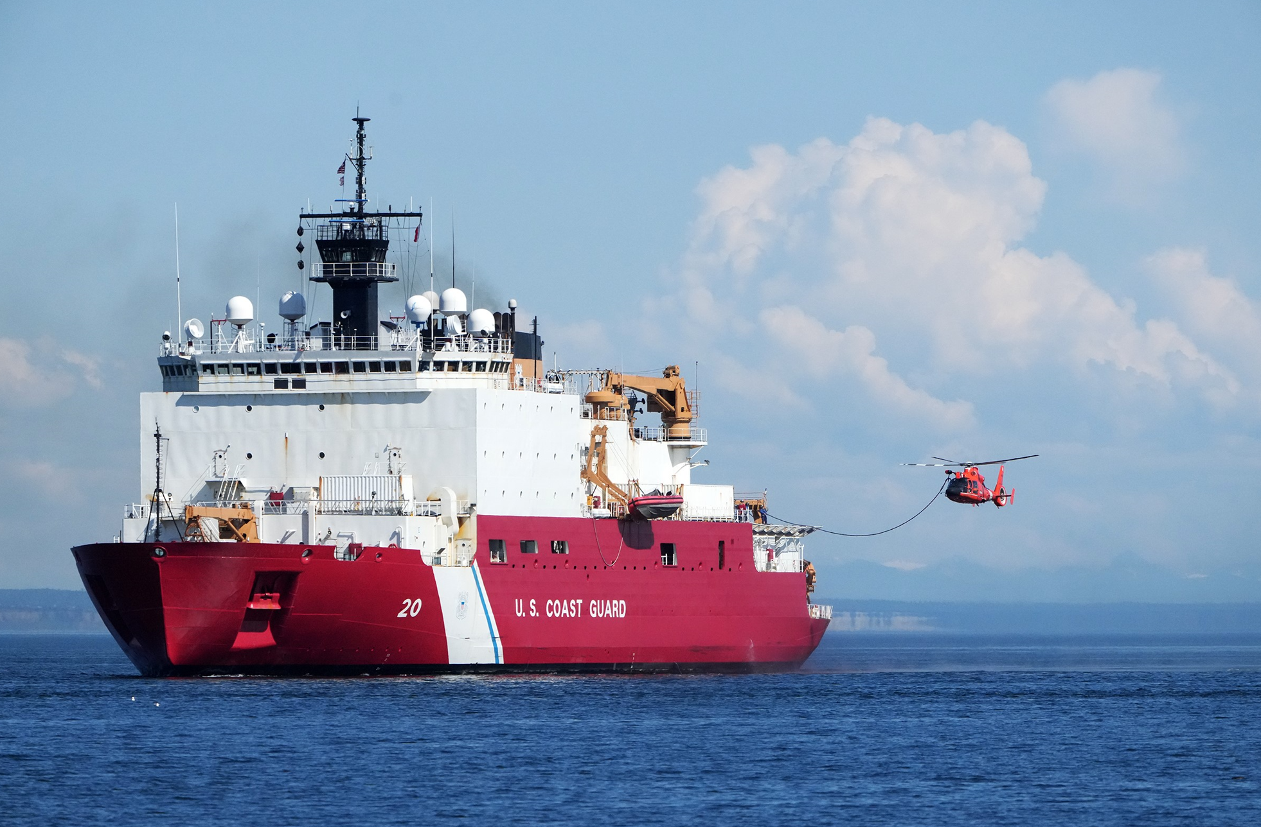
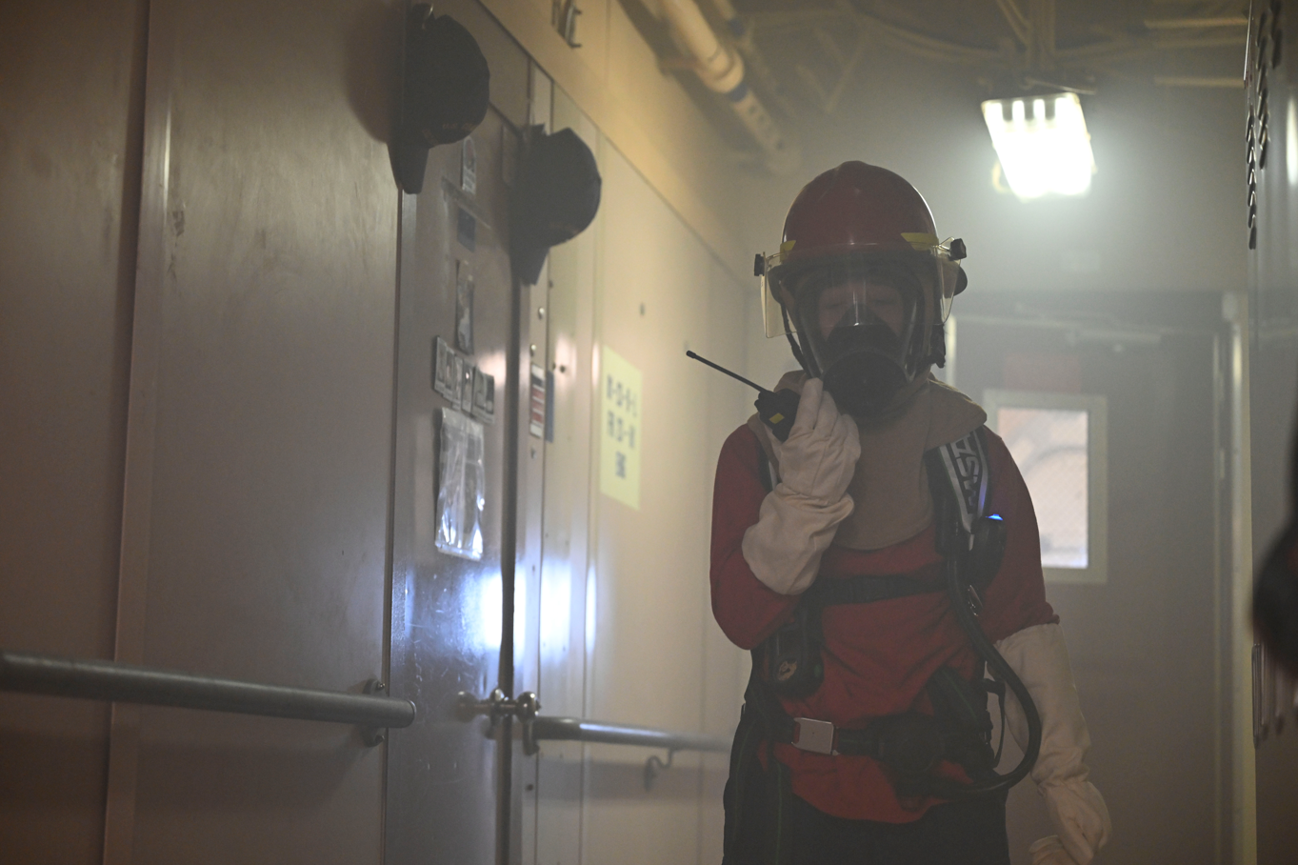
UNCLASSIFIED//FOUO
CGC HEALY (WAGB 20)
Arctic Deployment 2026
Phase 2 – Crew Training
Aviation Standardization Visit
Review of flight program
Training and evaluation of aviation personnel
Limited Training Team
Focus on damage control, navigation, and medical training while en route to Dutch Harbor

Slide 4
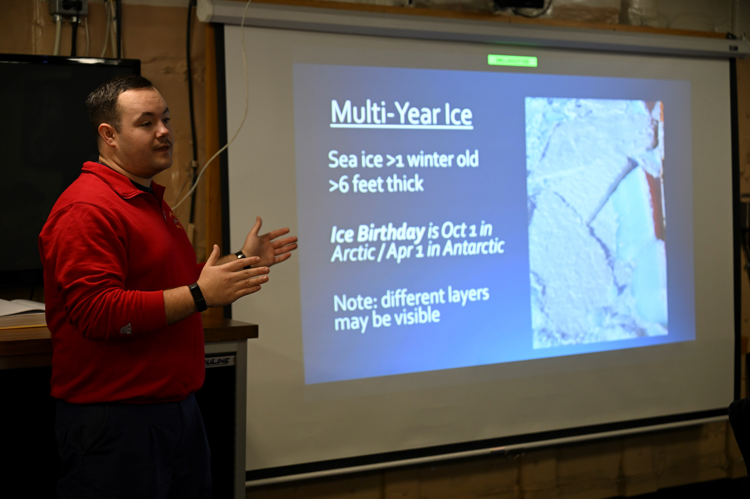
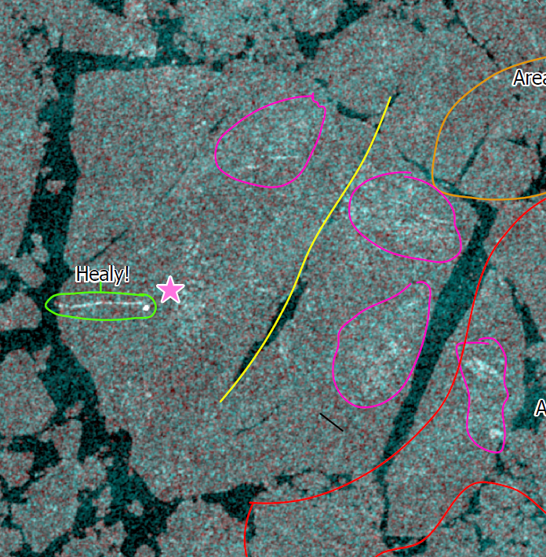
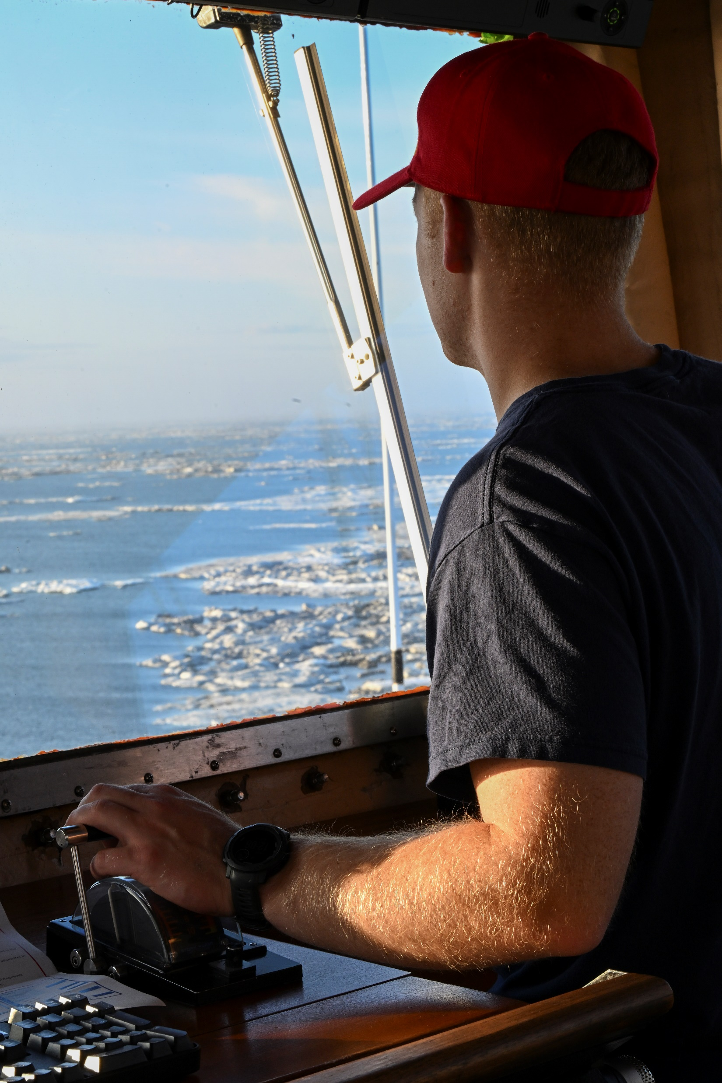
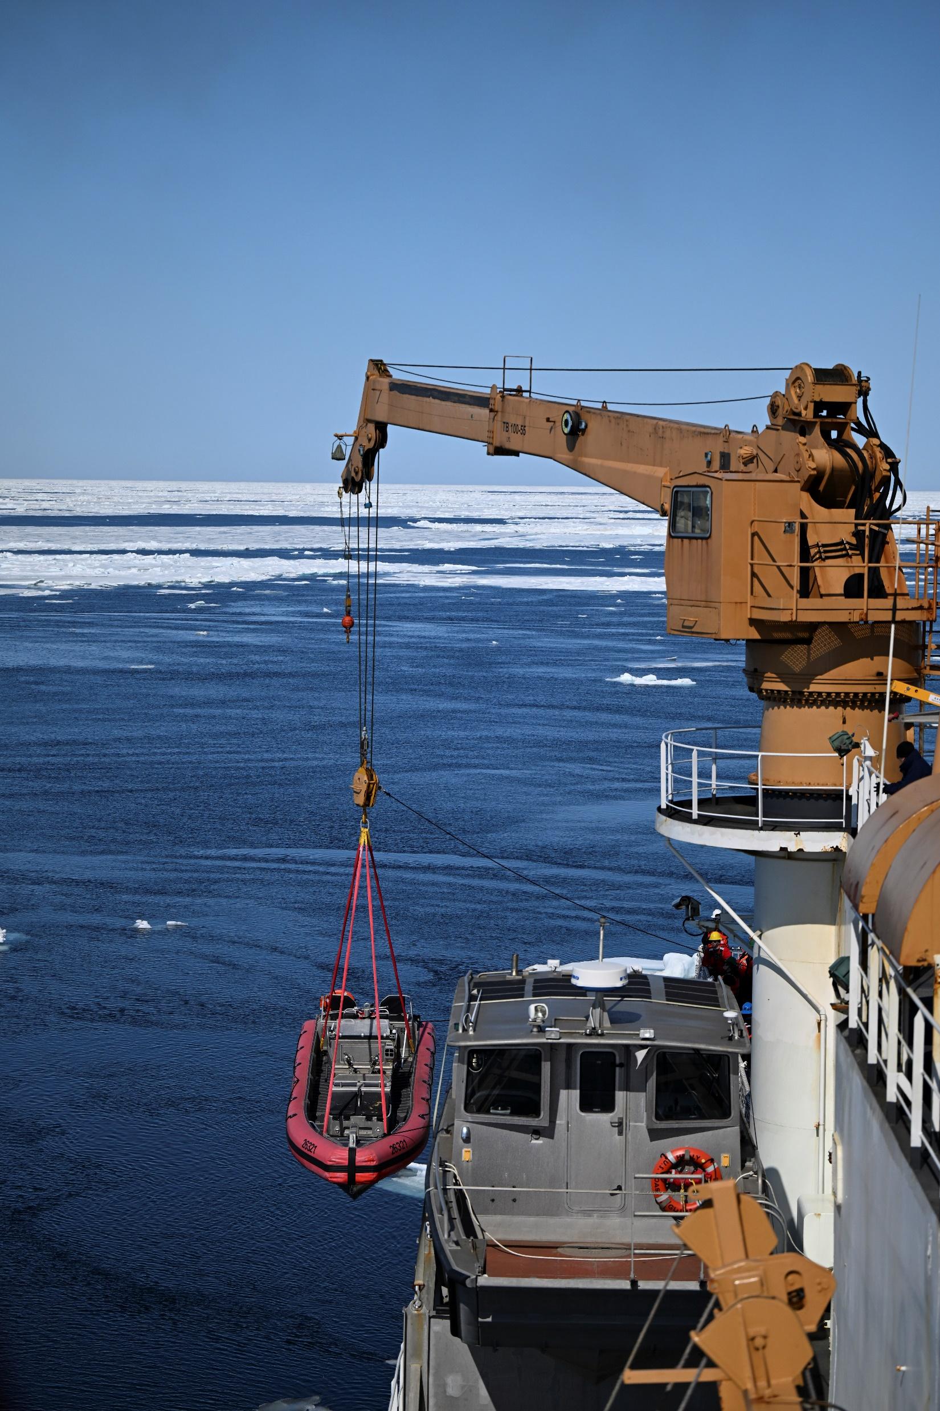
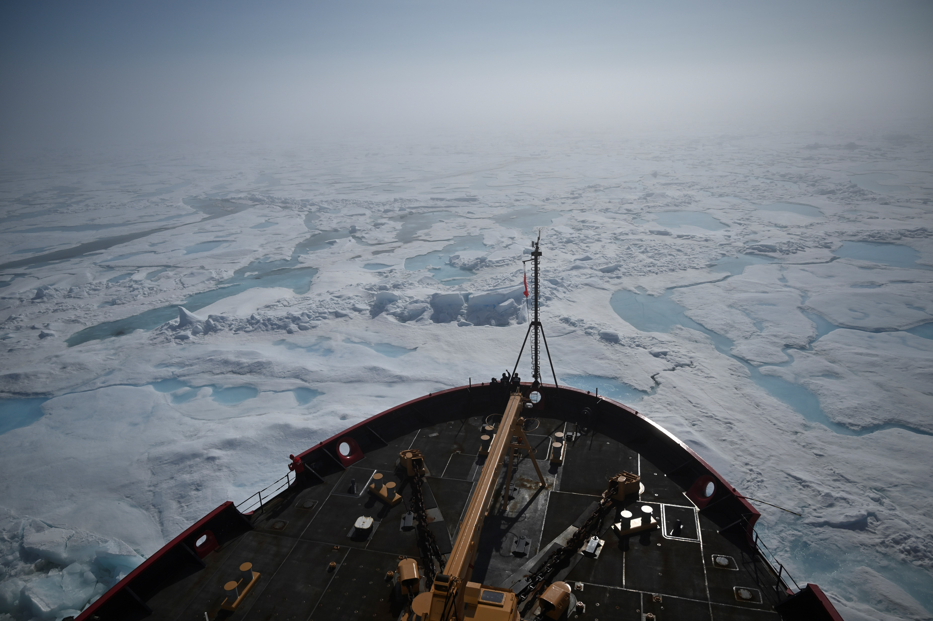
UNCLASSIFIED//FOUO
CGC HEALY (WAGB 20)
Arctic Deployment 2026
Phase 3 – Coast Guard Ice Operations
Operation Frontier Sentinel
  – Control, secure, and defend the border and maritime approaches.
Ice Pilot Training
  – Focused on training Deck Watch Officers (DWOs) in ice piloting; including safe navigation, efficient transiting, emergency response, and science operations.
– Potential North Pole transit.
Science of Opportunity Projects:
  – 8 proposals received, accepted proposals TBD
Notes:
Preparing ice pilots for new icebreakers

Slide 5
UNCLASSIFIED//FOUO
CGC HEALY (WAGB 20)
Arctic Deployment 2025
Phase 3 – Coast Guard Ice Operations
Focused on training Deck Watch Officers (DWOs) in ice piloting; including safe navigation, efficient transiting, emergency response, and science operations.
Bringing 5 additional DWOs onboard for ice piloting training program to better prepare USCG’s future icebreaker operators
Science of Opportunity Projects: 8 proposals received, accepted proposals TBD
Transit to North Pole planned
Notes:
Preparing ice pilots for new icebreakers

Slide 6
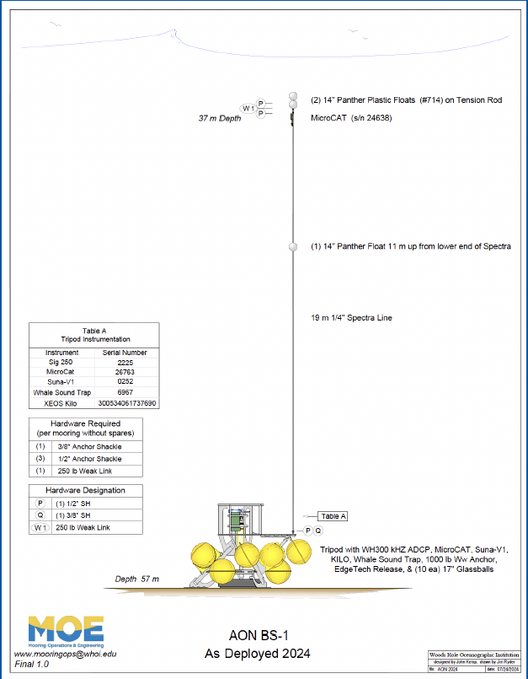
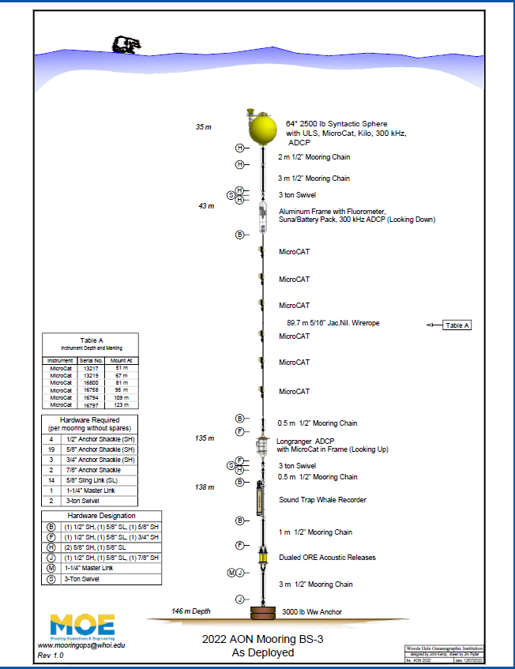
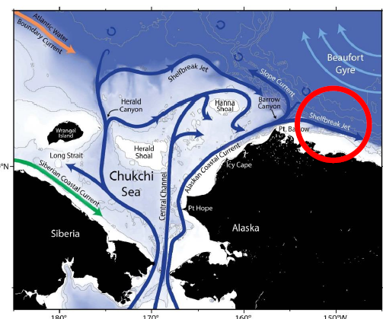
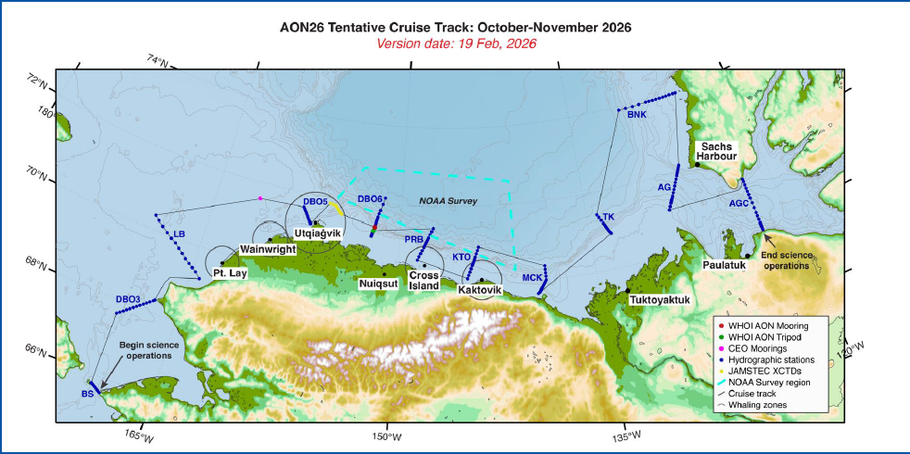
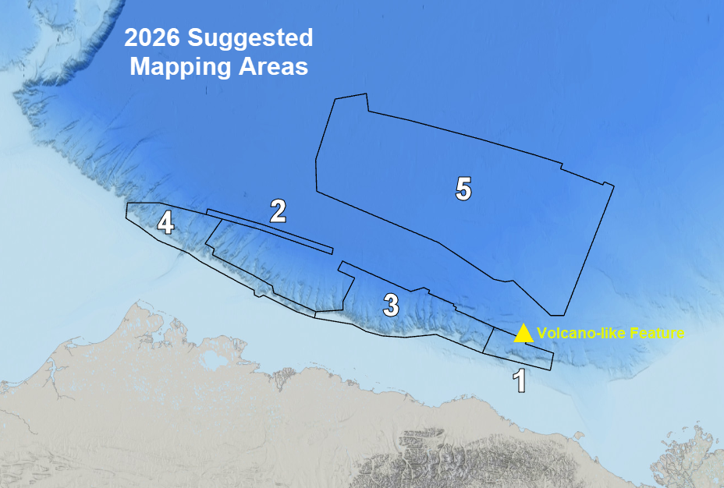
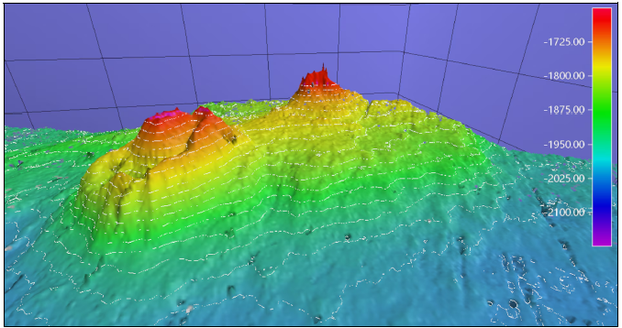
UNCLASSIFIED//FOUO
CGC HEALY (WAGB 20)
Arctic Deployment 2026
Phase 4 – Arctic Observation Network (AON)
AON studies the Western Arctic Boundary Current and Beaufort Shelfbreak Jet. The Beaufort jet impacts the regional ecosystem, supplying nutrients, zooplankton, and heat, and influencing whale habitat.
The goals for the 2026 AON cruise are
Recover/deploy 2 WHOI and 3 UAF moorings
CTD/shipboard ADCP surveys
Benthic Operations
Underway water measurements
NOAA survey (volcano like feature!)
10 ancillary projects from UAW, UAF, WHOI, USFWS, JAMSTEC, and Lamont-Doherty Earth Observatory
Healy will be coordinating operations with the fall R/V Sikuliaq cruise led by A. Tessin, Kent State University
Potential for joint operations
Notes:
Volcano like feature found in 2024, could be the largest mud volcano ever discovered but need more data to confirm

Slide 7
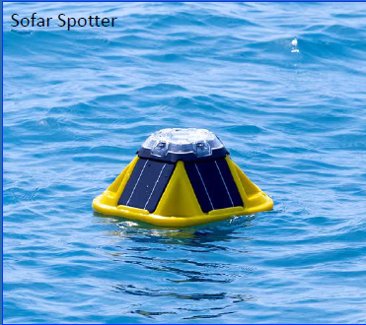
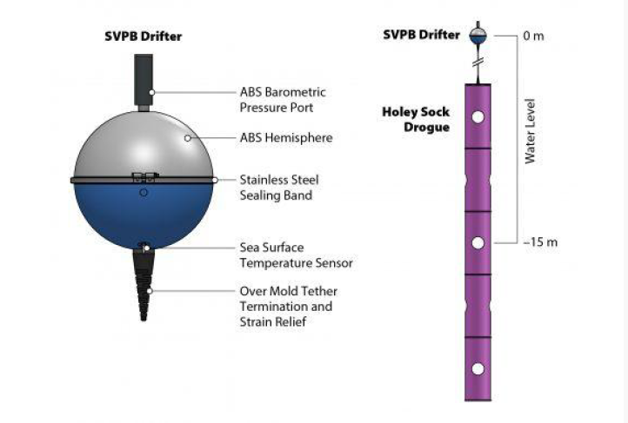
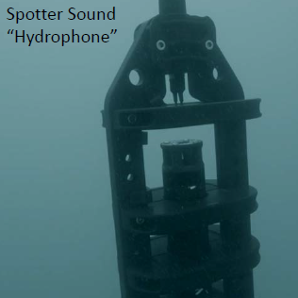
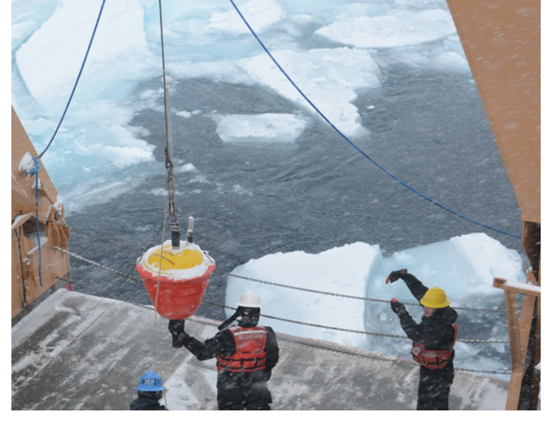
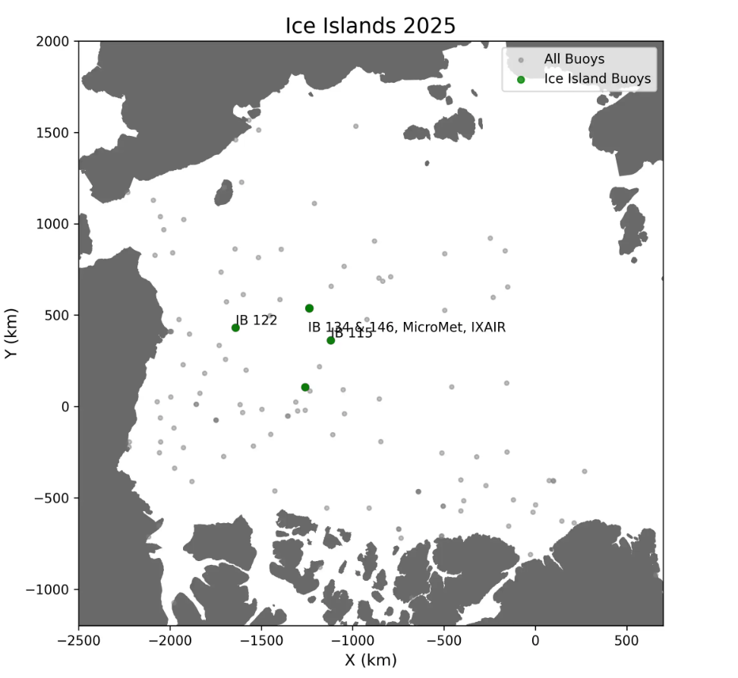
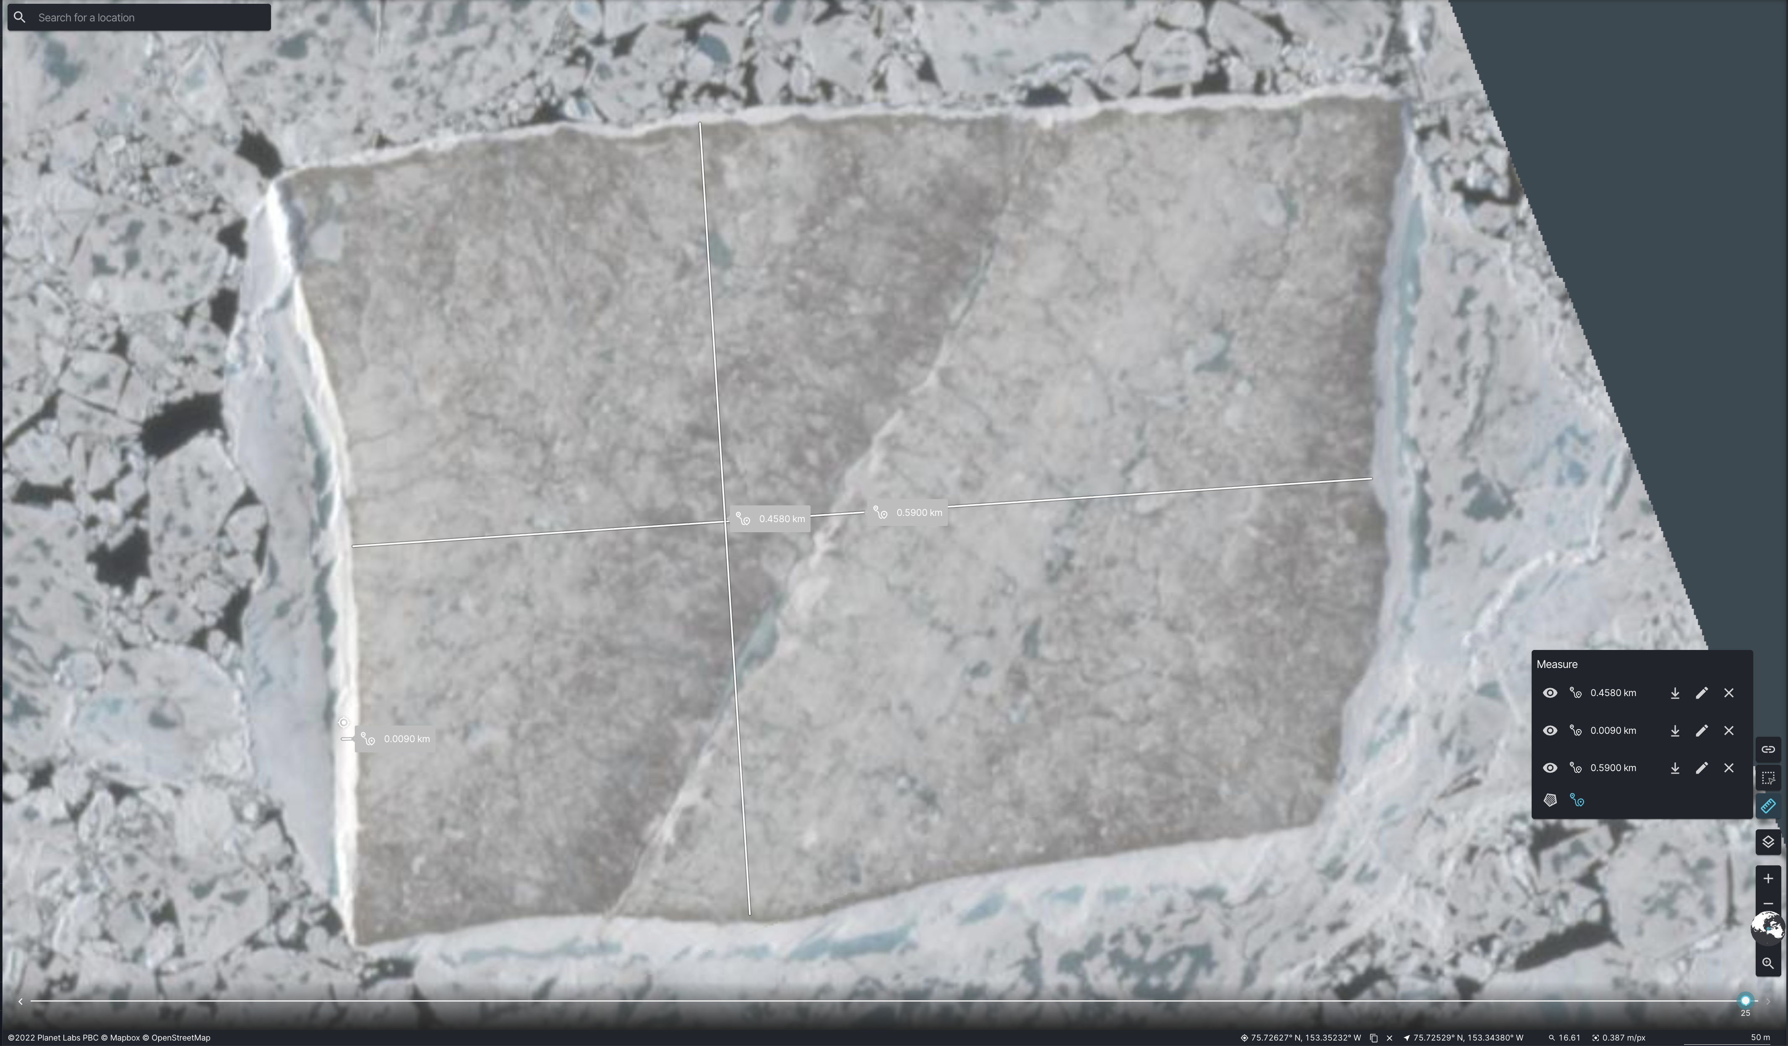
UNCLASSIFIED//FOUO
CGC HEALY (WAGB 20)
Arctic Deployment 2026
Additional Projects Supported
International Arctic Buoy Program
  The IABP provides meteorological and oceanographic data for real-time operational purposes including forecasts, satellite verification, and model validation.
  Healy will be deploying AXIBs, SVP drifters, Sofar Spotter buoys, and potentially other on-ice buoys over the course of the deployment.
  Possible hunt for Ice Ball 122 if Healy is in the vicinity

Slide 8
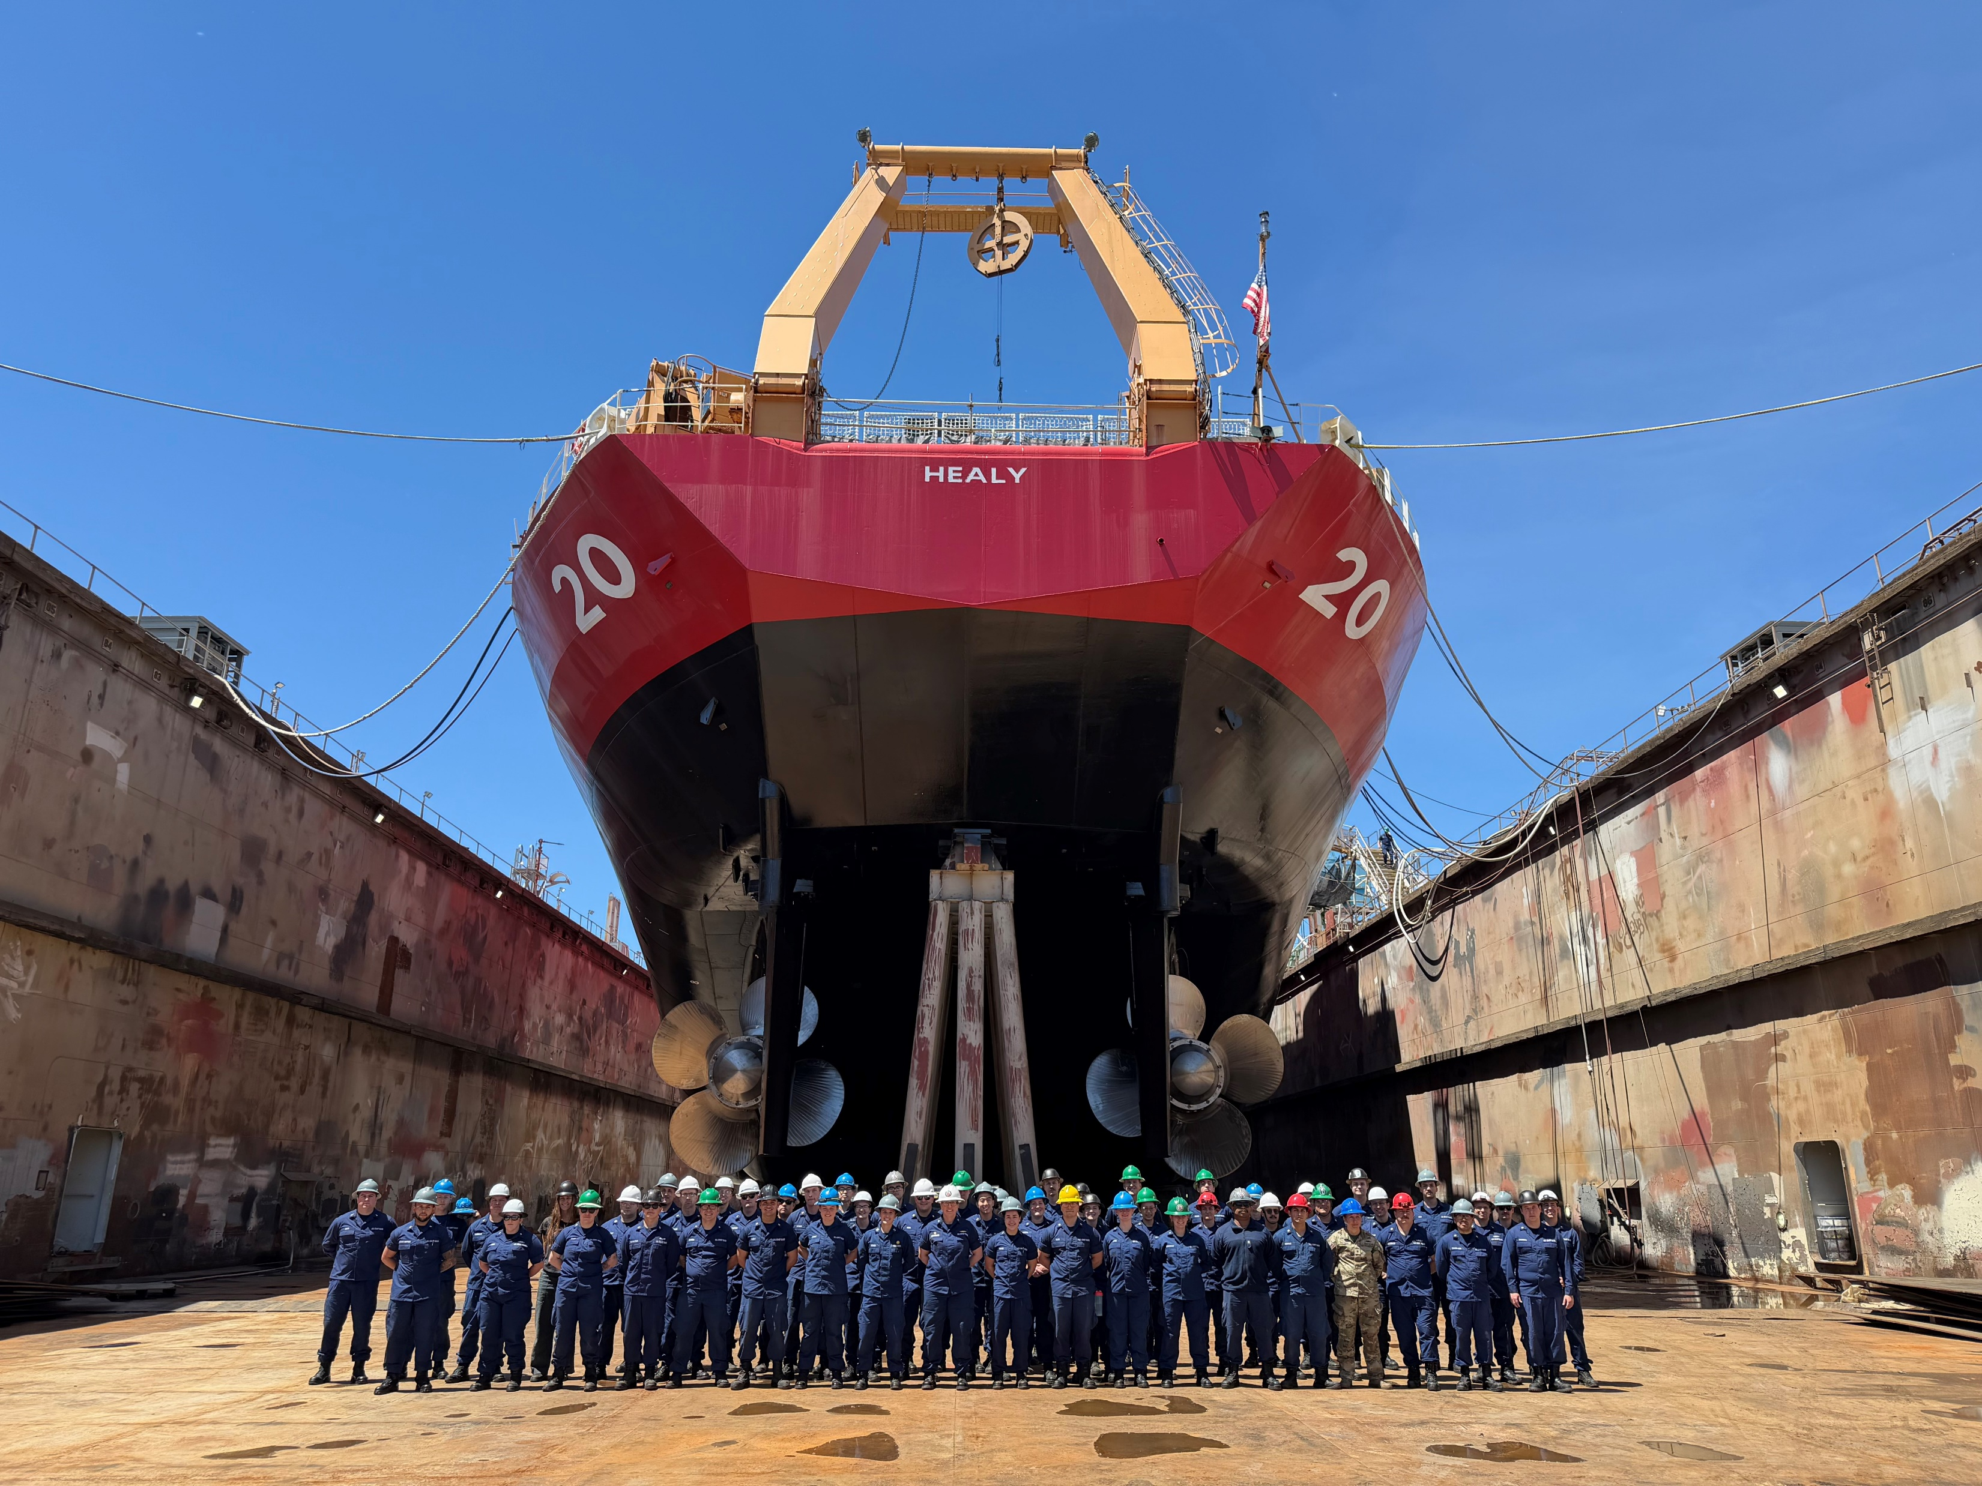
UNCLASSIFIED//FOUO
CGC HEALY (WAGB 20)
2026 Drydock
2026 Maintenance Drydock Availability Review
  Drydocking portion complete
    Installation of new Multi-Beam sonar complete – Verification testing
    Removal and renewal of Propulsion Shafts
    Bow Thruster repairs
    Crane/A-Frame/Winch inspect and repairs
    Science control system groom
    Renewed Stbd UNLOS cleats IVO A-Frame
Concurrent non-DD work
  General Electric
    Switchboard and cyclo groom and upgrades
    Encoder upgrades
    MPCMS communication reliability groom
  Ship Led items
    Crane Smart installed
    Refrigeration unit grooms
    Science seawater reliability upgrades

Slide 9
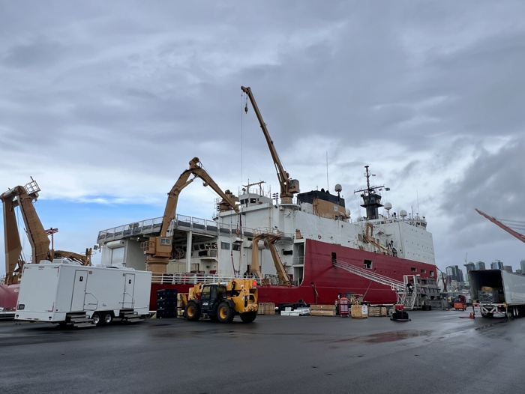
UNCLASSIFIED//FOUO
CGC HEALY (WAGB 20)
2027 Dockside
2027 Maintenance
  Dockside availability ~Jan-May in Seattle
  50 Item worklist (7 SLEP items)
  Science Sea Water Strainer
  Recap Ice Radar
  Recap Science Data Network Infrastructure
POC:
  Engineer Officer, LCDR Trey Thunborg
  Trey.A.Thunborg@uscg.mil

Slide 10
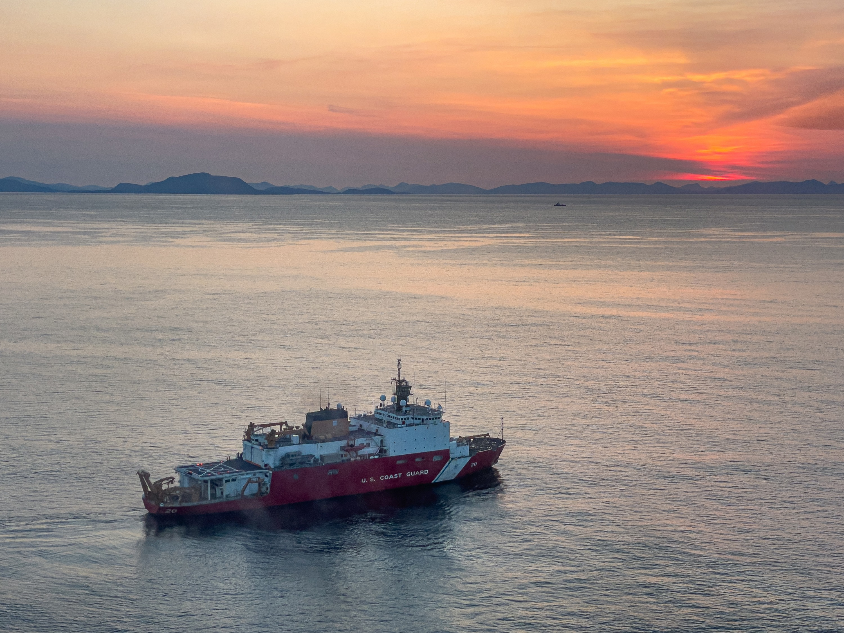
UNCLASSIFIED//FOUO
CGC HEALY (WAGB 20)
Future work
  Service Life Extension Project (SLEP) - next 5+ years
    Dockside 2027, 2028, 2030, 2031
    Drydock 2029
    110 additional SLEP work items
    Projects to restore outdated systems
    Extend lifespan ~25 years
Predicted Outstanding items for 2026 Deployment
  WIFCOM/Pager System upgrades
  Helo Hangar Door
  Oily Water Separator
  Incinerator efficiency
  UNLOS Cleat repair on fantail

