Slide 1
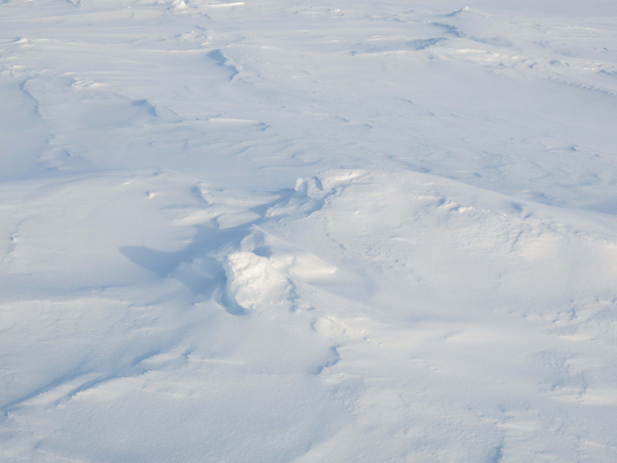
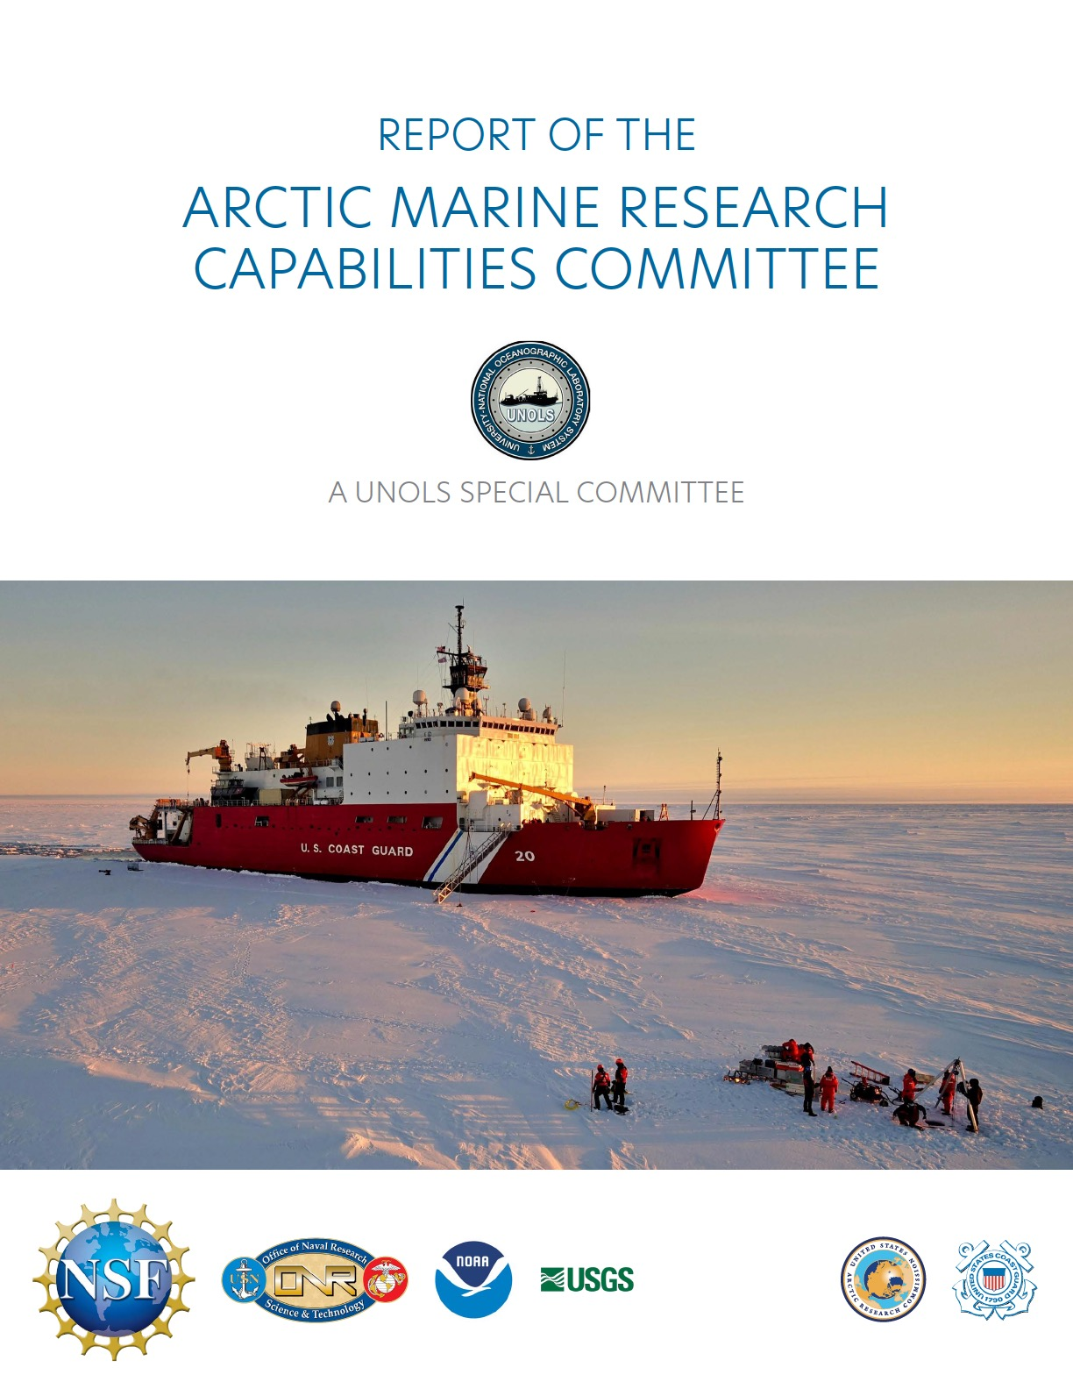
Arctic Marine Research Capabilities Committee
Report
Carin Ashjian, AMRCC Chair
June 25, 2026

Slide 2
Report Completed January 28, 2026
  Report edited and laid out by Ellen Kappel
  Report sent to UNOLS Council for Concurrence on February 22, 2026.
  Unanimous concurrence on February 28, 2206
  Final report sent to USCG, USARC, NSF, and ONR on March 5, 2026
  Available on UNOLS Web Site

Slide 3
The AMRCC and Liaisons are all co-authors and valuable contributors to the report
Committee
Dr. Carin Ashjian, WHOI, Chair
Dr. Lee Cooper, UMCES
Dr. Laurie Juranek, OSU
Dr. Jim Swift, SIO
Dr. Jeff Welker, UAA
Dr. Emily Eidam, OSU
Dr. Laura Whitmore, UAF
Dr. Christopher Cox, NOAA
Dr. Bernard Coakley, UAF
CAPT William Woityra, USCG
Ethan Roth, OSU
Brendon Mendenhall, SIO
Liaisons
Dr. Jamie Austin, Dr. John Farrell (for USARC)
LT Christine McCulla (USCG)

Slide 4
Primary Task
  Identify SMRs required to ensure that Federal icebreakers will meet the needs of the Arctic marine research community for the next 30 years
  “Federal icebreakers” include (a) any commercially available polar icebreaker that may be acquired or procured and refit for operation by the Federal government; and (b) the conceptual design of future “medium” or “heavy” federal-flagged and owned icebreakers.

Slide 5
What the Report IS and What it is NOT
  What it does:
  In the absence of any other planned ships, assumes that the options for federal Arctic icebreakers are limited to the existing and to be built USCG ships
  Identifies potential science missions from which SMRs are derived
  Describes the basic science infrastructure for ships that will enable a broad suite of scientific measurements using both installed equipment (acoustics) and modular equipment brought on to support the mission
  Describes the science measurements that will need to be taken and science capabilities
  It does NOT:
  Describe the ideal Arctic research icebreaker
  Make specific recommendations about instrument type/model. Wire types/strengths, sizes of spaces, etc.
  Describe how to conduct science operations

Slide 6
Critical Findings/Observations
Ship-based research will continue to be a core requirement for Arctic marine science over the next 30 years, as a platform for both more “traditional” sampling technology and for more recently developed, and to be developed, assets such as autonomous equipment
Modular equipment can expand the capabilities of a ship with only minimal permanent science equipment
All the science missions can be supported by at least one category of ships
The US’ prominence in Arctic marine research is threatened, in part because of limitations of our Arctic research fleet
The international community (Canada, China, Japan, Korea, Sweden, Germany) has dedicated significant resources to supporting Arctic marine research and to build icebreakers to conduct marine research. To maintain prominence in Arctic marine research, the US needs to similarly dedicate resources. When the Healy retires, the US’s science capability will be severely diminished without new assets.
US Arctic scientific research contributes critically to US maritime capabilities in the Arctic, including economic benefits, safe navigation, national security and defense, national sovereignty, and long-term strategies
Many of science’s needed capabilities contribute to the USCG’s Statutory Missions

Slide 7
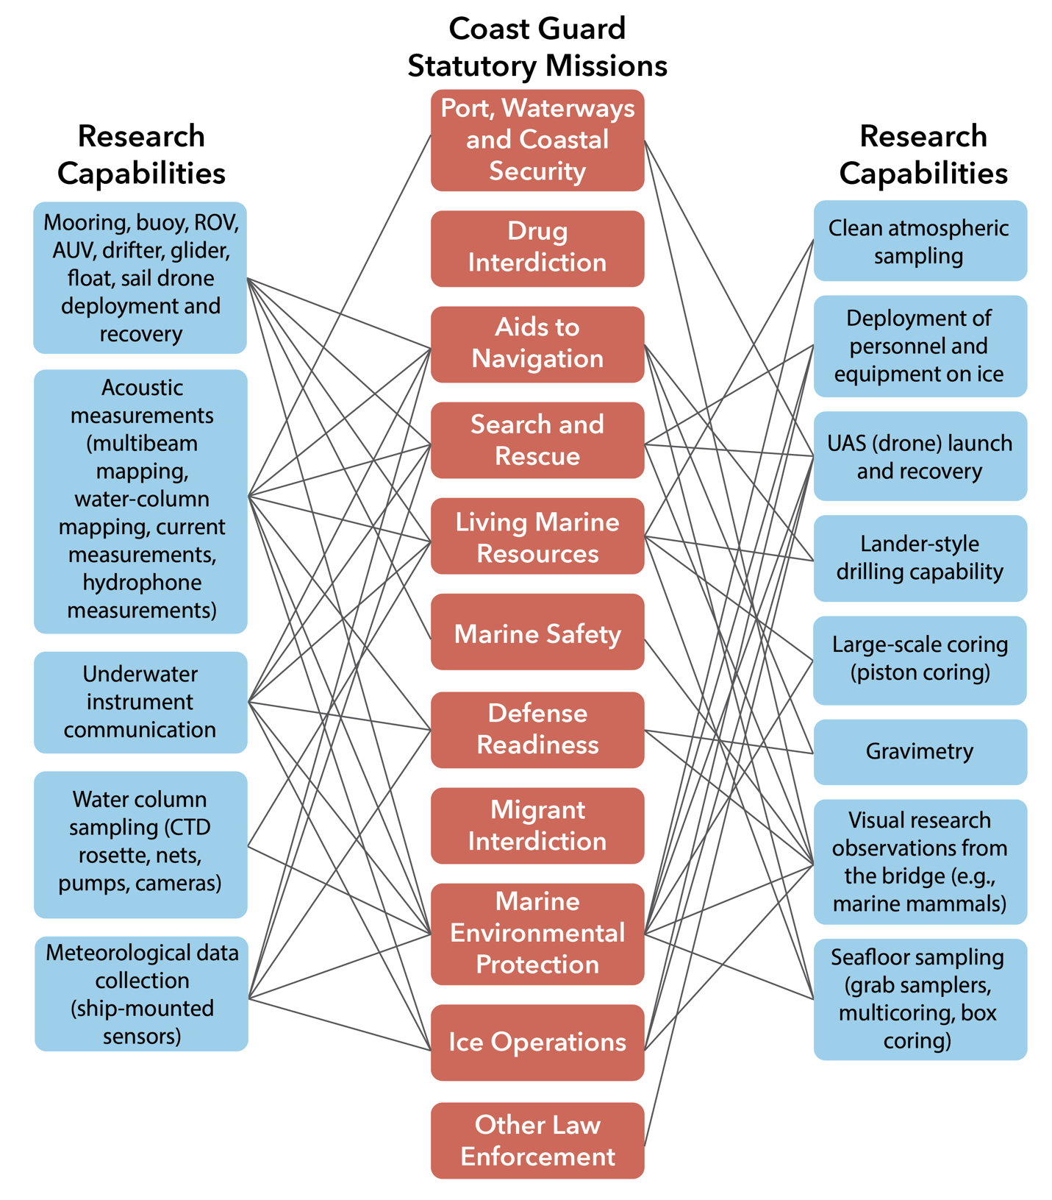
Critical Findings/Observations
Many of science’s needed capabilities contribute to fulfilling the USCG’s Statutory Missions

Slide 8
Recent Activities
Carin Ashjian, John Farrell (USARC Exec.Director), Larry Mayer, RDML Dick West, and Tom Dans (USARC Chair) presented highlights of report March 16 and 17 to:
  Congressional staffers for Lisa Murkowski (Sen-AK), Dan Sullivan (Sen-AK), and Nick Begich (Rep.-AK)
  John Reyfield, Republican Staff Director, House Subcommittee USCG and Maritime Transportation
  OMB Special Assistant C. Humphrey
  NSC Staffer, R. Andrews
Carin Ashjian and Doug Russell offered assistance to USCG as they continue to assess potential science capabilities on Arctic icebreakers
Tom Dans (Chair, USARC) and John Farrell continue to champion the findings and distribute the report in DC
  Example: Meeting with OMB Budget Reps tomorrow

Slide 9
Questions?

Slide 10
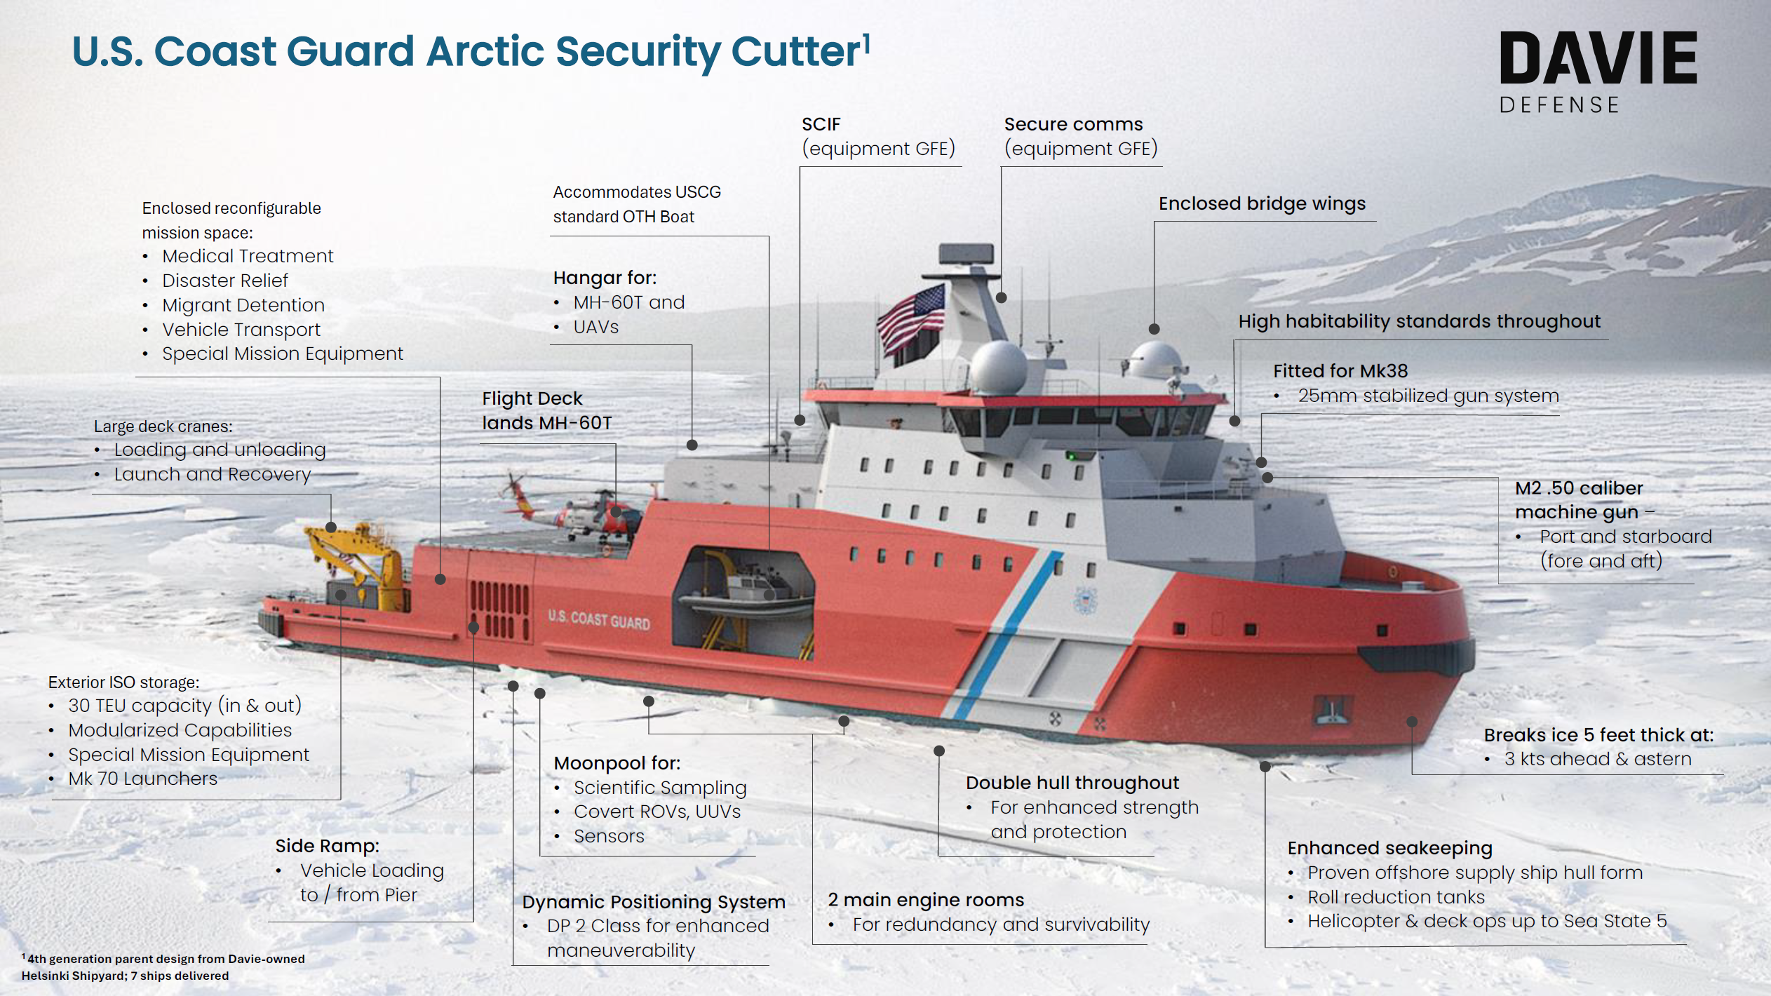
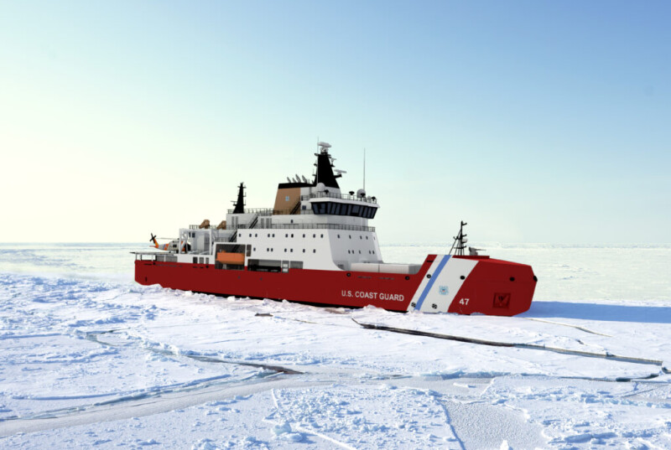
Arctic Survey Cutter (ASC) Designs and Shipyards
MPPS-100
MPI
Davie Image
Aker Image
Multi-Purpose Polar Support Ship (MPPS-100) to be built by Davie/Helsinki Shipyard Texas. Two ships to be built in Finland, 3 ships to be built in Texas (5 total)
Multi-Purpose Icebreaker (MPI), originally designed for the Canadian Coast Guard, to be built by Bollinger/Rouma/Aker/Seaspan consortium. Two ships to be built in Finland, 4 ships to be built in Louisiana (6 total)
Note different locations of the working decks on the two designs
First 4 ships nominally to be completed by 2028

Slide 11
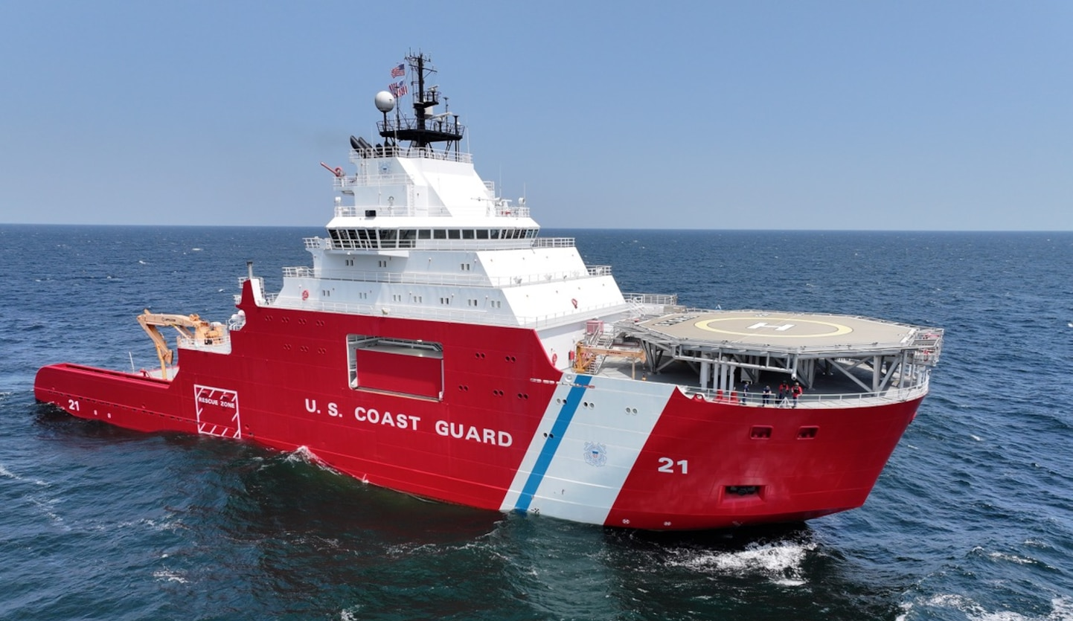
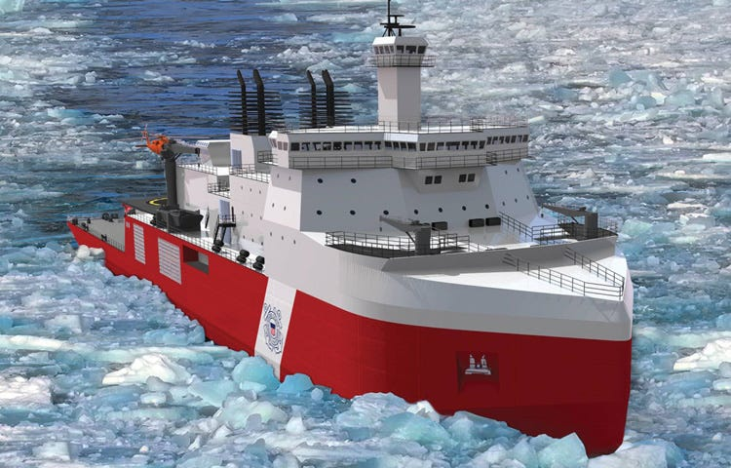
Storis and PSC
USCGC Storis
PSC
USCGC STORIS, WAGB21 (formerly the Aiviq that was owned by Edison Chouest). Needs modifications to be a “cutter”. Has good potential to support science. Commissioned and did her first deployment this summer. Procurement specified that ship must have Healy science capabilities.
Polar Security Cutters (3?) – Heavy Icebreakers, minimal science infrastructure, being built in US by Bollinger. Nominal date of first delivery in 2030. Based on modified design for future Polarstern II. Contracted for 2 so far. Primary mission is to support Antarctic icebreaking. Likely to have some science capability (CTD, MB, met data collection)

Slide 12
Some Elements of the Report
Case for US preeminence in Arctic research
Status of the US Icebreaker Fleet and of International Icebreakers
Present limitations to science using our current Arctic icebreaker assets
Synopsis of community survey and future science
Thirteen science missions
Science mission requirements (SMRs)
Categorize potential US vessels by their capability to support the science missions
Intersection of science needs with USCG Statutory Missions

Slide 13
Comparison of Past, Present, Future (?) Ships

Slide 14
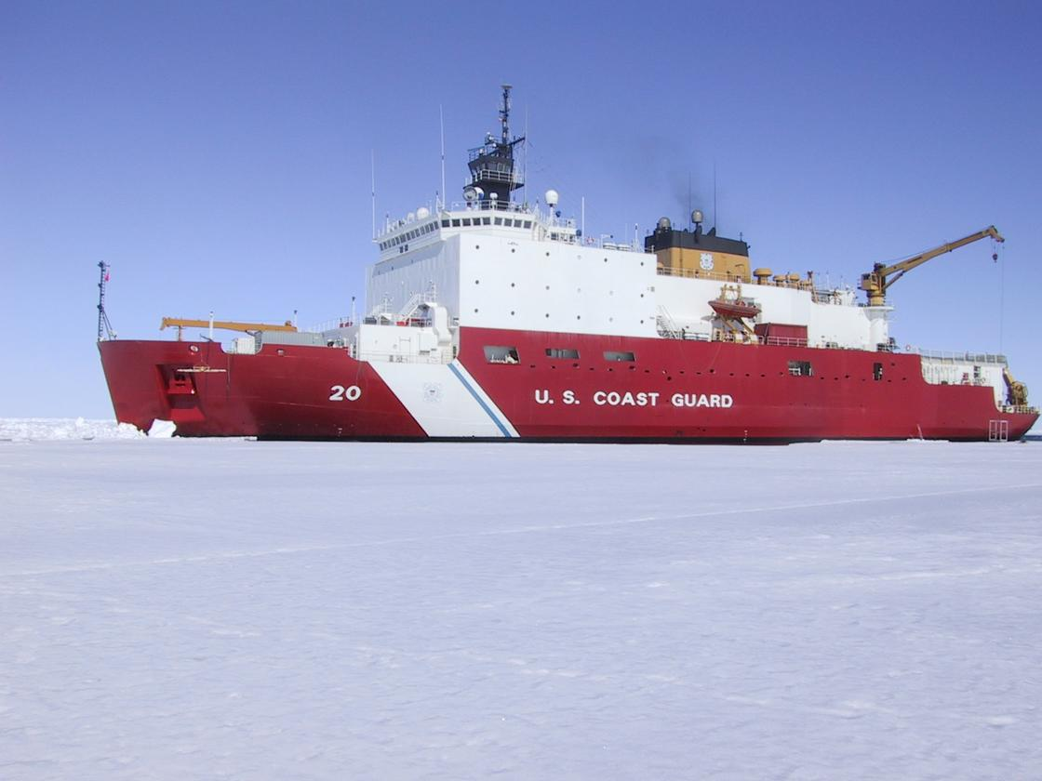
Present and Future US Federal Arctic Icebreakers
USCGC Storis
USCGC Healy
USCGC Storis
Arctic Security Cutters – Medium icebreakers
  Two designs: MPPS-100 and MPI
Polar Security Cutters – Heavy icebreakers
PSC
ASC: MPPS-100 Design
ASC: MPI Design
USCGC Healy
Davie Image
Aker Image

Slide 15
The Core of the Recommendations are in Three Tables
Science Enabling Capabilities (Table 5) – Basic infrastructure that will enable scientific work on the ship
Research Capabilities (Table 6) – What we want to measure and/or collect and equipment we need to deploy
Research Capable Small Boat (Table 7)– A well-equipped small boat

Slide 16
Table 5: Science Enabling Capabilities
  Enable scientific work on a ship, even if the ship is not a dedicated research vessel
  Most partly permanent characteristics of equipment on the ship although some can be brought aboard for a specific science mission
  May not be used for all the ship’s missions but generally are necessary to conduct science missions or missions that include a scientific work component
  Identified for each:
    If it can modular
    Needed supporting systems (e.g., cables, network, gear handling)
    Potential contributions to national security
  Examples: Hull mounted transducers, berthing, lab space, moon pool, overboarding, flow through science seawater, science data network and internet, modular capability

Slide 17
Table 6: Research Capabilities – what we want to measure/collect
  Types of data or samples to be collected and associated equipment to be deployed from or installed on a ship
  Many can be accomplished using modular equipment brought on board for the science mission
  Identified for each:
    If it can modular
    Needed supporting systems (e.g., cables, network, gear handling)
    Contributions to national security
    USCG statutory missions supported by this research
  Example: Sea-floor sampling
    Can be modular,
    Requires winch/A-frame, dynamic positioning, and ambient seawater,
    Contributes to validation of multibeam/backscatter measurements, detection of pollutants in seabed, support of fisheries, detection of harmful algal blooms
    Supports USCG Statutory Missions “Aids to Navigation”, “Living Marine Resources”, and “Marine Environmental Protection”

Slide 18
Table 7: Research Capable Small Boat
  Need: Sampling in shallow water or away from the ship where the upper water column is undisturbed
  Permanent equipment and capability to support researcher supplied equipment
  Identified for each type of equipment and instrumentation:
    If it can modular
    Related research goals
  Example: Hull-mounted multibeam
    Cannot be modular
    Mapping

Slide 19
Science Mission Scenarios

Slide 20
Not all future icebreakers will have all the recommended enabling capabilities or ability to conduct needed measurements but all Science Missions can be supported by at least one type of ship
Modular equipment can greatly expand the science capabilities of a ship

Slide 21
Key Suggestions for the USCGC Storis
Provided recommendations for 1) high priority infrastructure, 2) overboard handling, 3) meteorological and other underway sensors, 4) laboratory and staging spaces, and 5) science network and data handling
Included general estimates of the phasing and scope of each modification and whether the capability could be modular/portable (i.e., brought on board for a science mission)
Described needed supporting infrastructure for each capability (e.g., wiring for sensors, deck strength for heavy modular equipment)
Identified how each science capability contributes to US National Security needs and the type of science it would support

Slide 22
Key Suggestions for the USGC STORIS
High Priority Infrastructure
  Hull Mounted Transducers
  Capacity for up to 35 science
Overboard/Handling
  DP
  Stern A-Frame
  Support for modular equipment
  LARS
  Oceanographic winches
Met. and underway sensors
  Flow through SW
  Met mast or equivalent
Laboratory/Staging
  Permanent lab space
  Capability for modular lab and science equipment
  Heated/weather protected staging space(s)
  Science cargo hold
Science Data/Network
  Independent science network and data storage
  High bandwidth satellite coms (internet, telepresence)
  Situational awareness (e.g., navigation and bathymetry data)
  Access to ice radar
  On-board CCTV system to monitor deck activities, winches, etc

