Slide 1
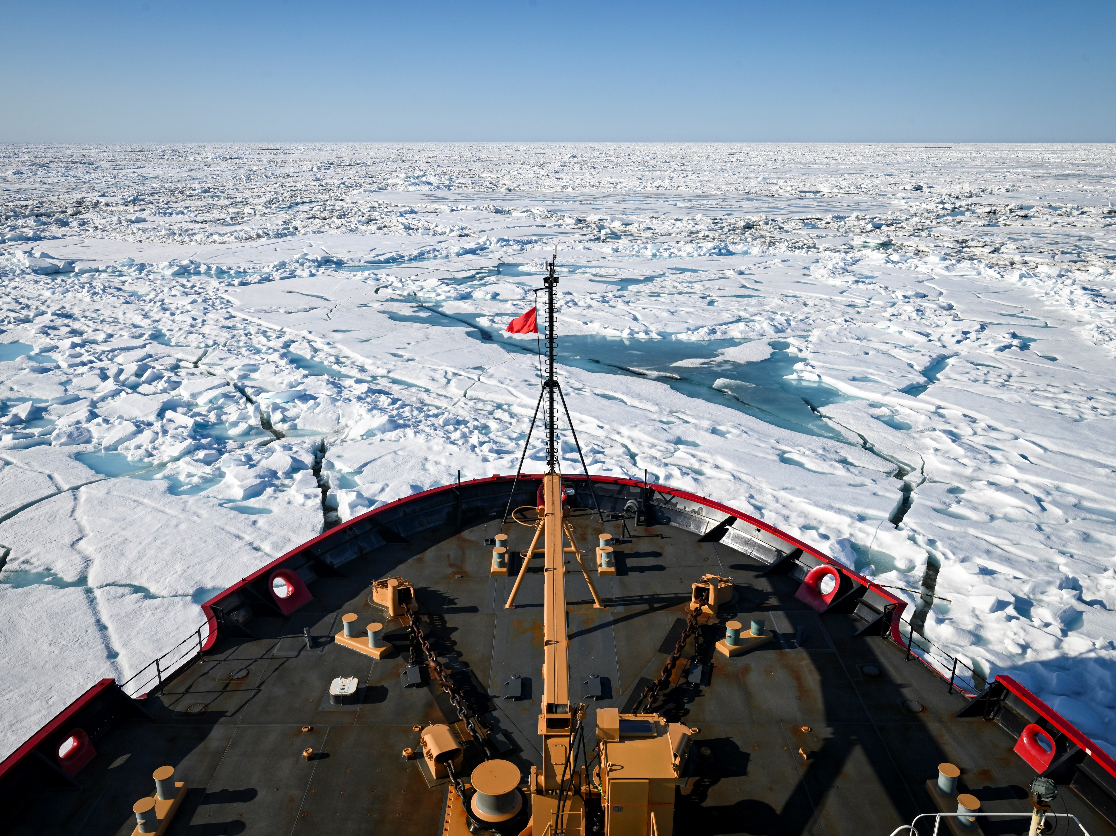
Name | Title/Portfolio
CAPT J. Sky Holm Jeffrey.S.Holm@uscg.mil | Office Chief
 | Deputy Chief
CDR Lisa Hatland Lisa.M.Hatland@uscg.mil | Aids to Navigation & Icebreaking Division Chief
LT Christine McCulla Christine.C.McCulla@uscg.mil | Arctic Security Cutter & CGC Healy
 | Polar Security Cutter, CGC Polar Star, CGC Storis
CG-751
Office of Cutter Forces
0
Notes:
Refer to Sharepoint site for all POCs

Slide 2
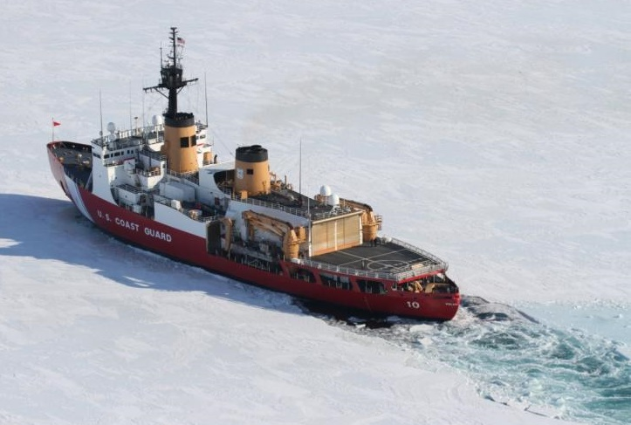
Overview of Polar Acquisitions
The Coast Guard’s Office of Cutter Forces (CG-751) serves as the Sponsor’s Representative for the Polar Security Cutter (PSC) & Arctic Security Cutter (ASC) acquisitions.
Arctic Security Cutter
Three contracts were signed in December 2025 and February 2026 to build 11 ships in two design variants
  MPI: Multi-Purpose Icebreaker (6)
  MPPS: Multipurpose Polar Support Ship (5)
First two hulls of each design are being built in Finland
Delivery of at least the first three ASCs is projected for CY2028
Hull Designation: WASC
Will not have polar classification but PC 3 or 4 equivalent
Will operate at an initial baseline out of shipyard for several months or years before extended engineering availability for missionization
Key Performance Parameters:
  Draft of 23ft or less
  Icebreaking Capability (3ft at 3kts)
  35 day endurance (minimum of days between resupply)
Polar Security Cutter
Contract signed to build 3 ships at Bollinger Shipyard
Delivery of the first PSC is projected for CY2030
Hull Designation: WPSC
Will not have polar classification but PC2 equiv
Key Performance Parameters:
  Icebreaking Capability (6ft at 3kts/21 ft Ridge)
  80 day endurance
  Comms interoperability with DHS/USCG/DOW stakeholders
Unclassified
Notes:
ASCs will also have a deferred Comms interoperability requirement that will be installed during the Post-Shipyard Availability (PSA).

