Slide 1
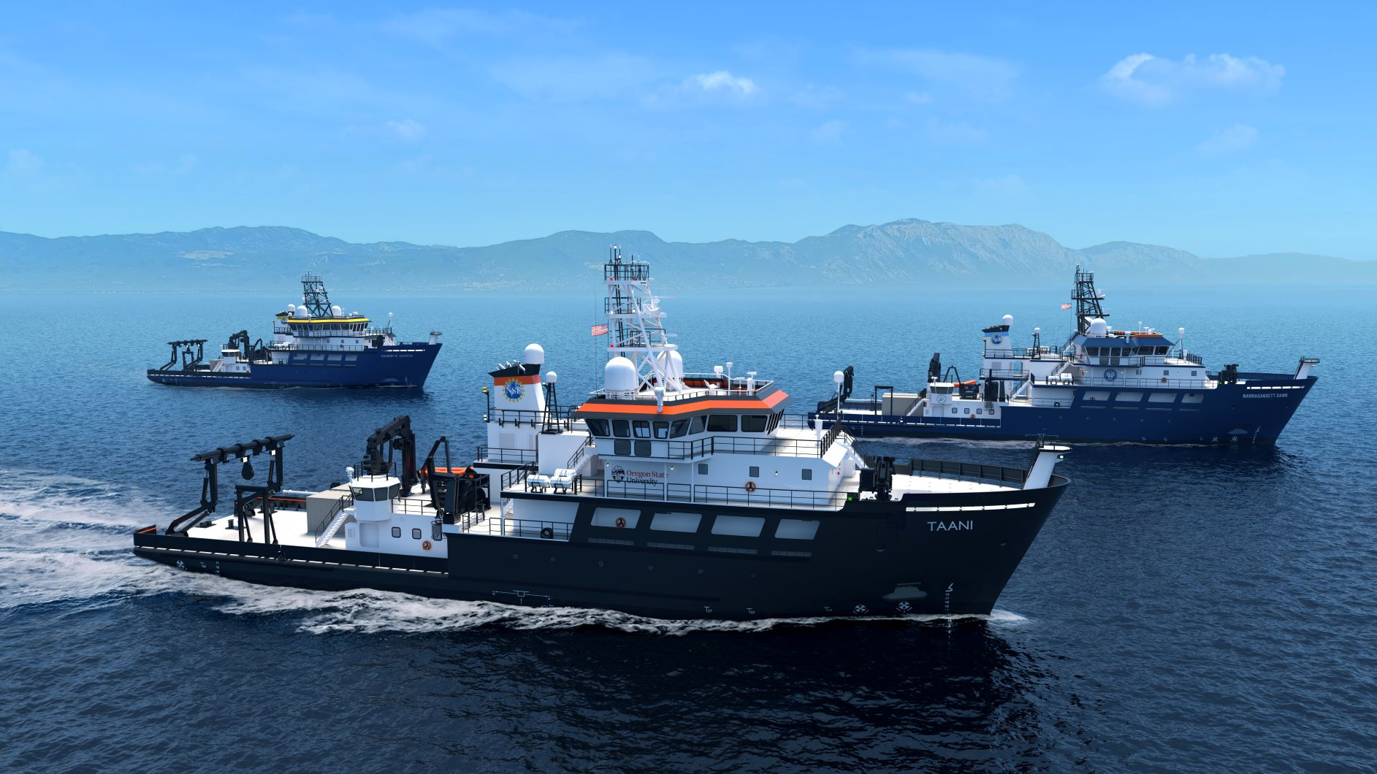
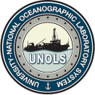

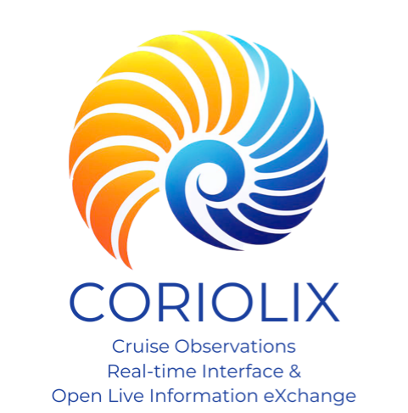
UNOLS AAIC 2026 Summer Meeting

Slide 2

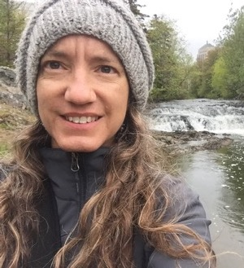

CORIOLIX Team
Chris Romsos Datapresence Systems Engineer
2015 →
Lead for Datapresence and RCRV Cyberinfrastructure
Background – Marine Geology, Fisheries, Geographic Info Systems
2015 →
CORIOLIX developer and support technician
Background – Ocean Optics, Data Processing & Management, UI design
2024 →
CORIOLIX developer and support technician
Background – 3D Visualization and Web Development
Jasmine Nahorniak
Assistant Datapresence Systems Engineer
Tristan King
Data Systems Specialist

Slide 3
What is CORIOLIX?
CORIOLIX, In one line -
A distributed software system, connecting shipboard and shoreside nodes, for live situational awareness.
Expanding on above, CORIOLIX -
Is designed around real-time/near-real-time mission support: not just data logging but live visualization, alerts, data services, and remote monitoring.
Bridges ship‐to‐shore in a unified way: same interface for both, which helps coordination. Moves real-time observational data to shore and near real-time products to ship (bi-directional)
Built with operations in mind (sensor health monitoring, event logs, remote alerts) — adds operational value beyond just science data capture.

Slide 4

How does it work?
CORIOLIX integrates operation and management of:
Data Acquisition
    Manages configuration and state
Data Processing
    Performs real-time and delayed/batch processing
Data Storage & Management
    Annotates data, logs system configuration, performs replication
Data Access
    Offers multiple modes (File Download, Real-Time Streaming, API Polling)
    And multiple standards (ASCII, JSON, OpenDAP, netCDF, OGC, MQTT)
    Supports role-based access

Slide 5
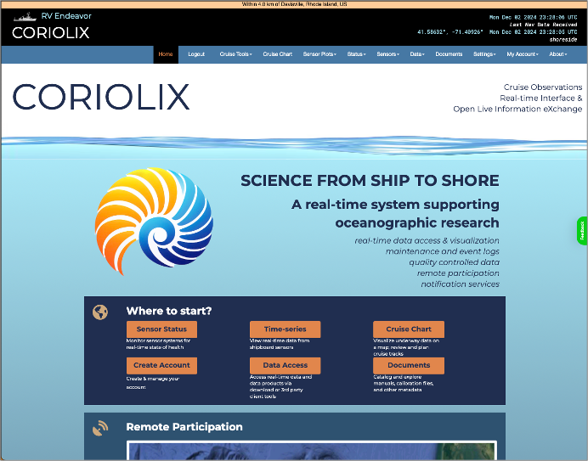
User Interface – Designed to serve multiple user groups
Public access:
Visualize and Download Data
View Sensor Metadata
View Event and Sensor Logs
Scientist account access:
Visualize and Download Data
View Sensor Metadata
View Sensor Logs
Create Event Logs
Set Personal Notifications
Technician account access:
Visualize and Download Data
Create/Edit Sensor Metadata
Create/Edit Event and Sensor Logs
Change System Configuration
Set Personal Notifications

Slide 6
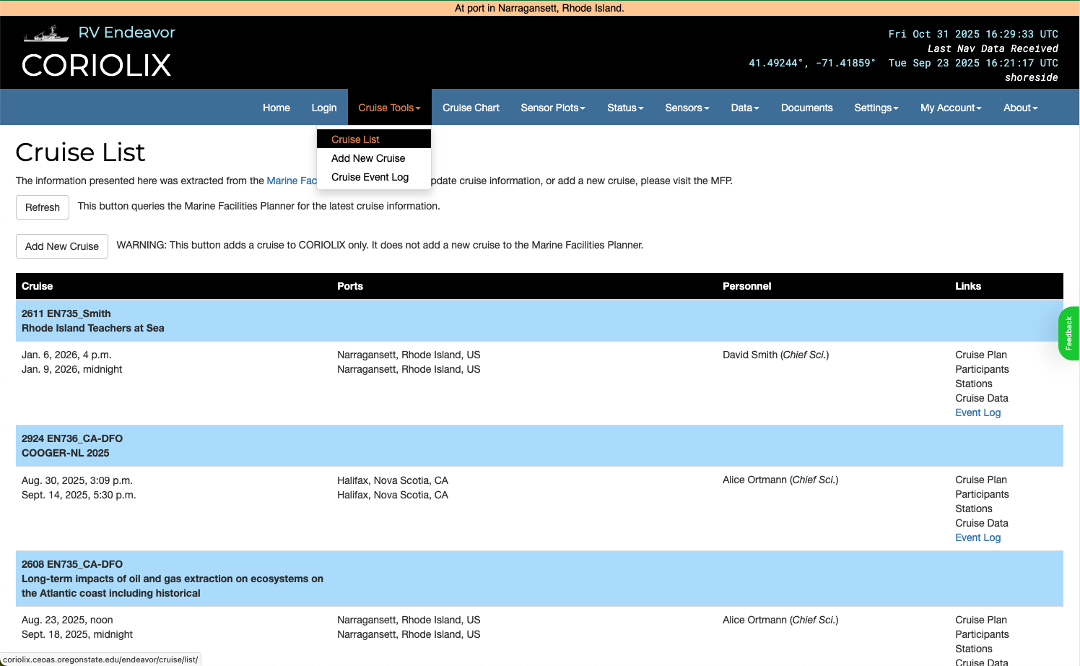
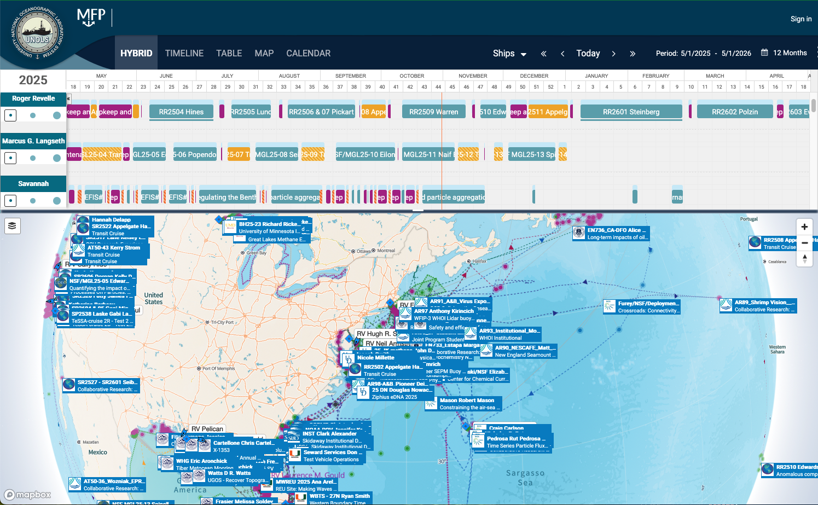
User Interface – Inherits cruise metadata from MFP or MOMs
planning
metadata

Slide 7
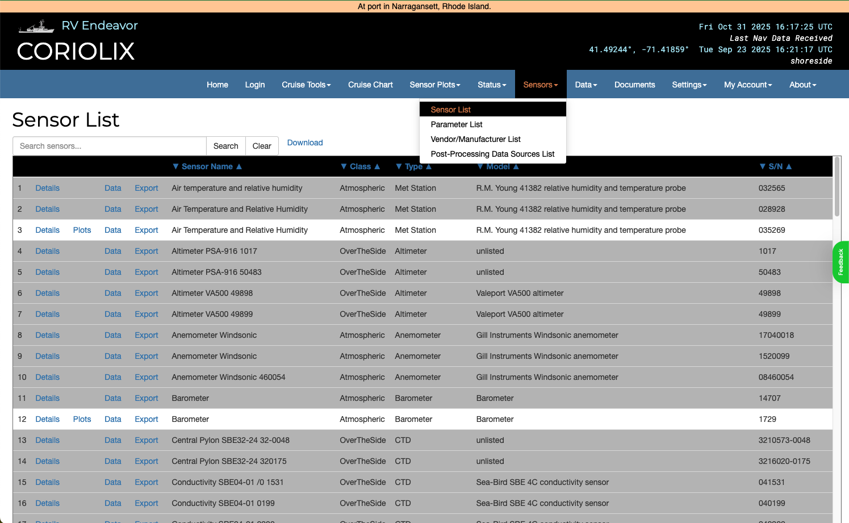
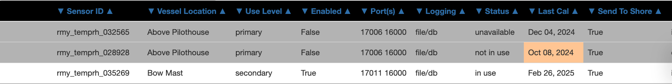
User Interface – Catalogs/Inventories all underway instruments

Slide 8
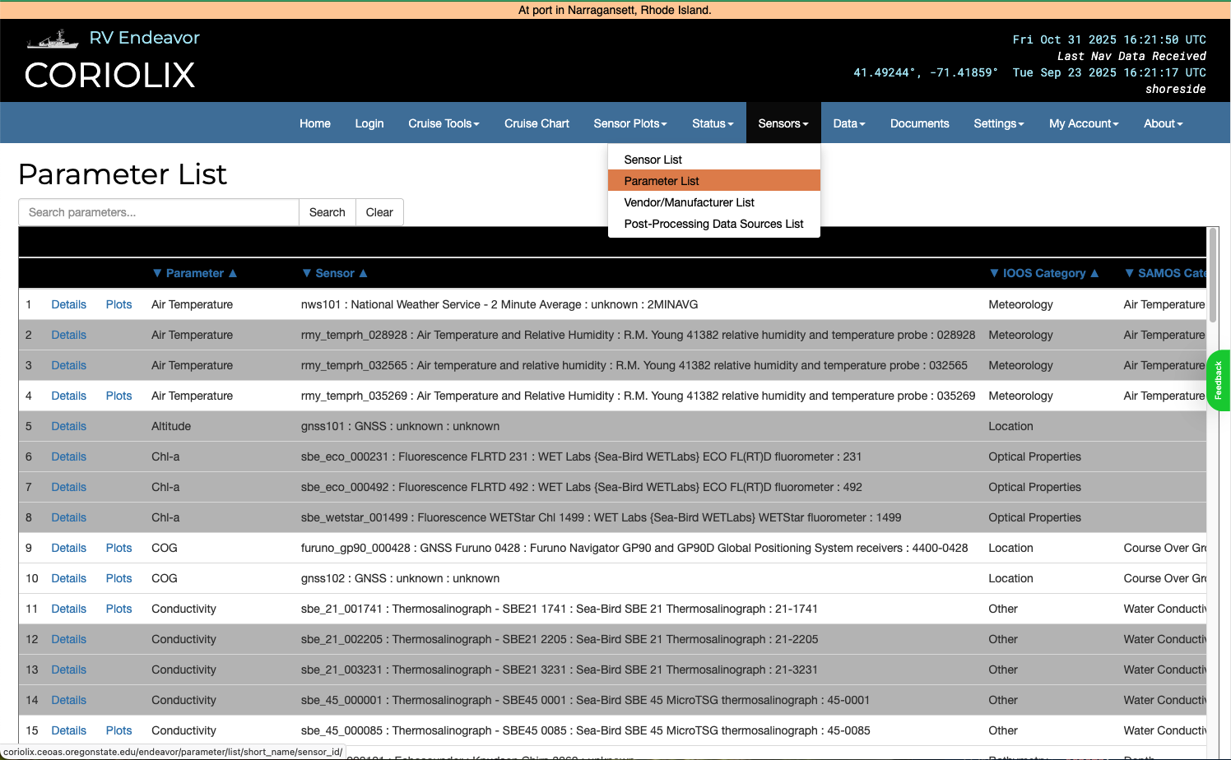
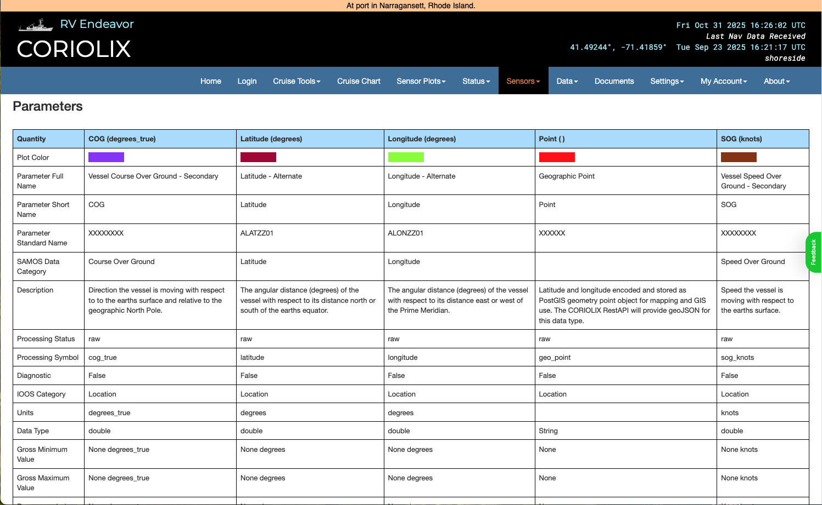
User Interface – Maintains standardized parameter metadata

Slide 9
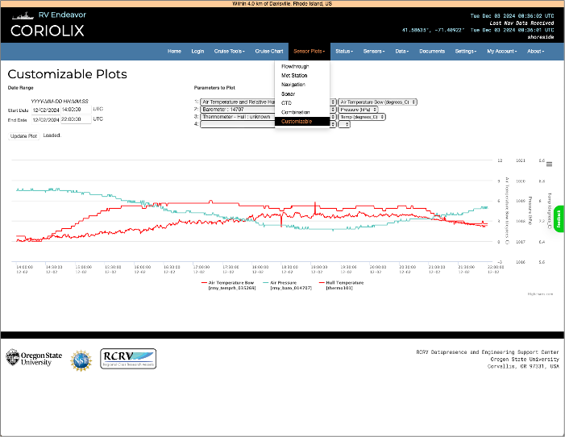
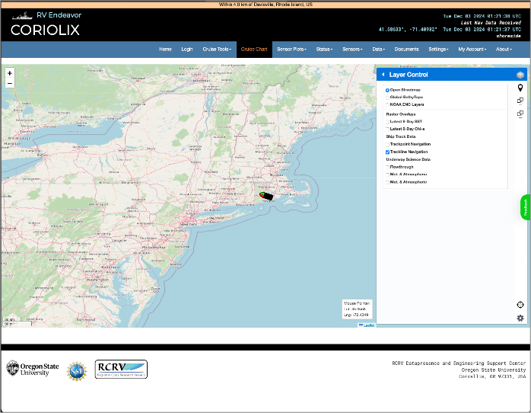
User Interface – Map and timeseries data visualization

Slide 10
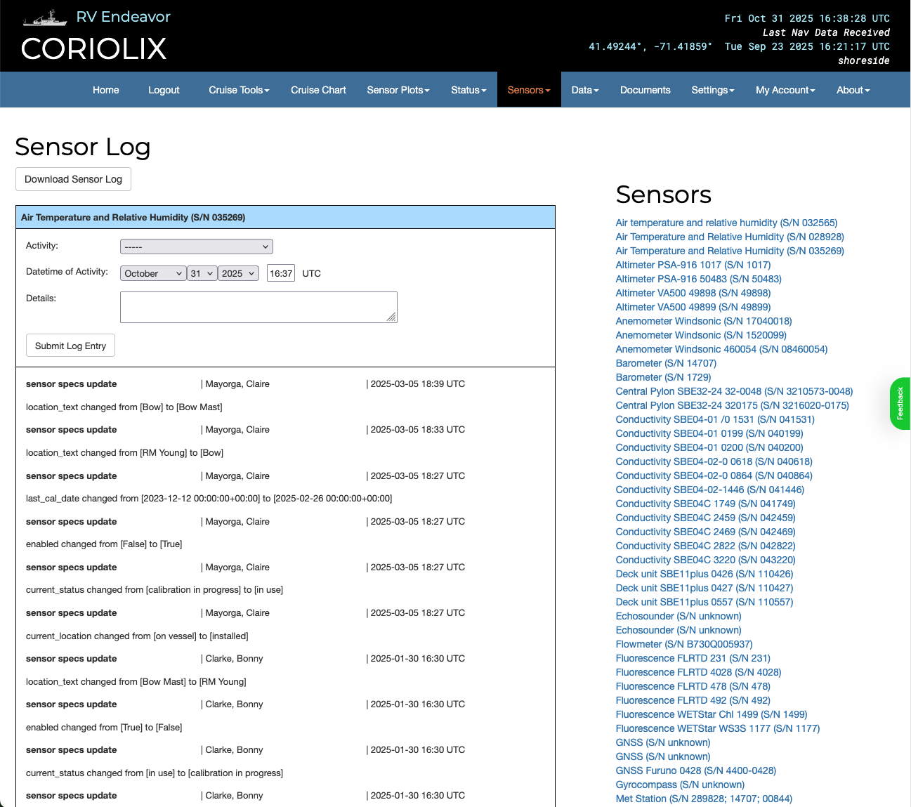
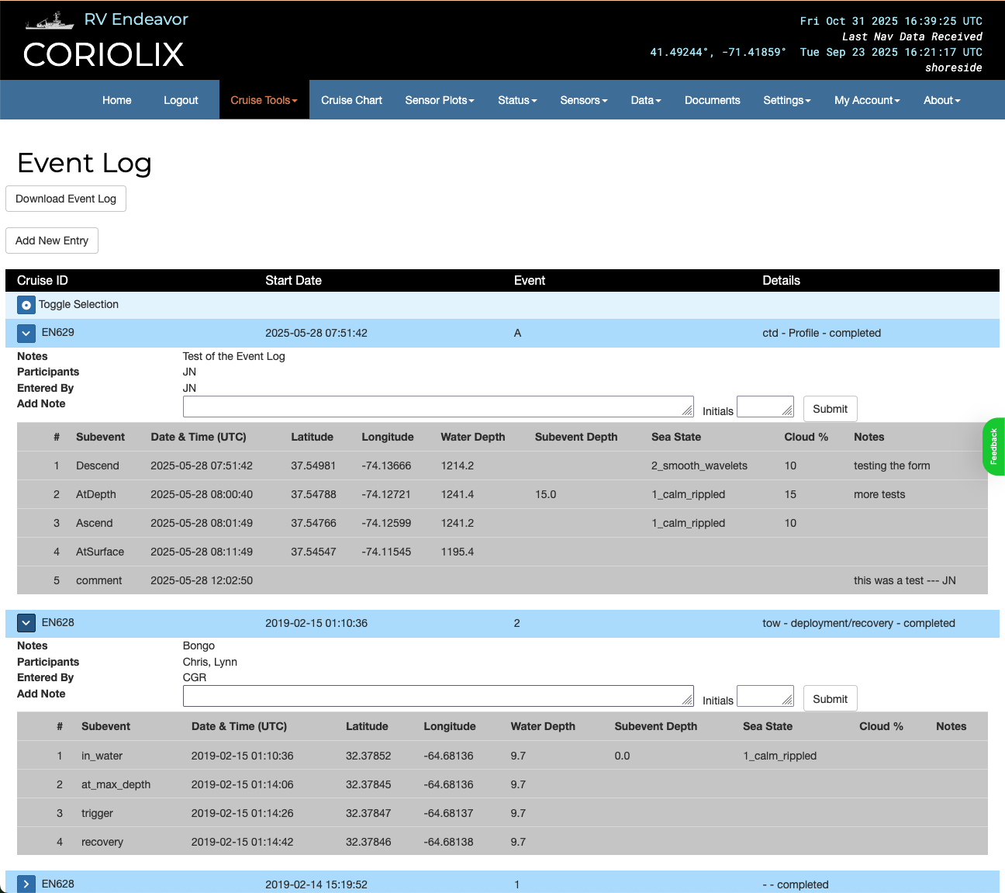
User Interface – Logs all configuration changes automatically

Slide 11
CORIOLIX Specialized Service
Codebase Maintenance & Management
  Security Compliance & General Code Improvement
Deployment Maintenance & Management
  Deploy security and code patches through regularly scheduled maintenance
  Monitor and maintain system health of deployed systems
Client Support
  Tech Side - Onboarding help, on-call remote support, focused training
  Science Side – Data access support, training, code examples

Slide 12
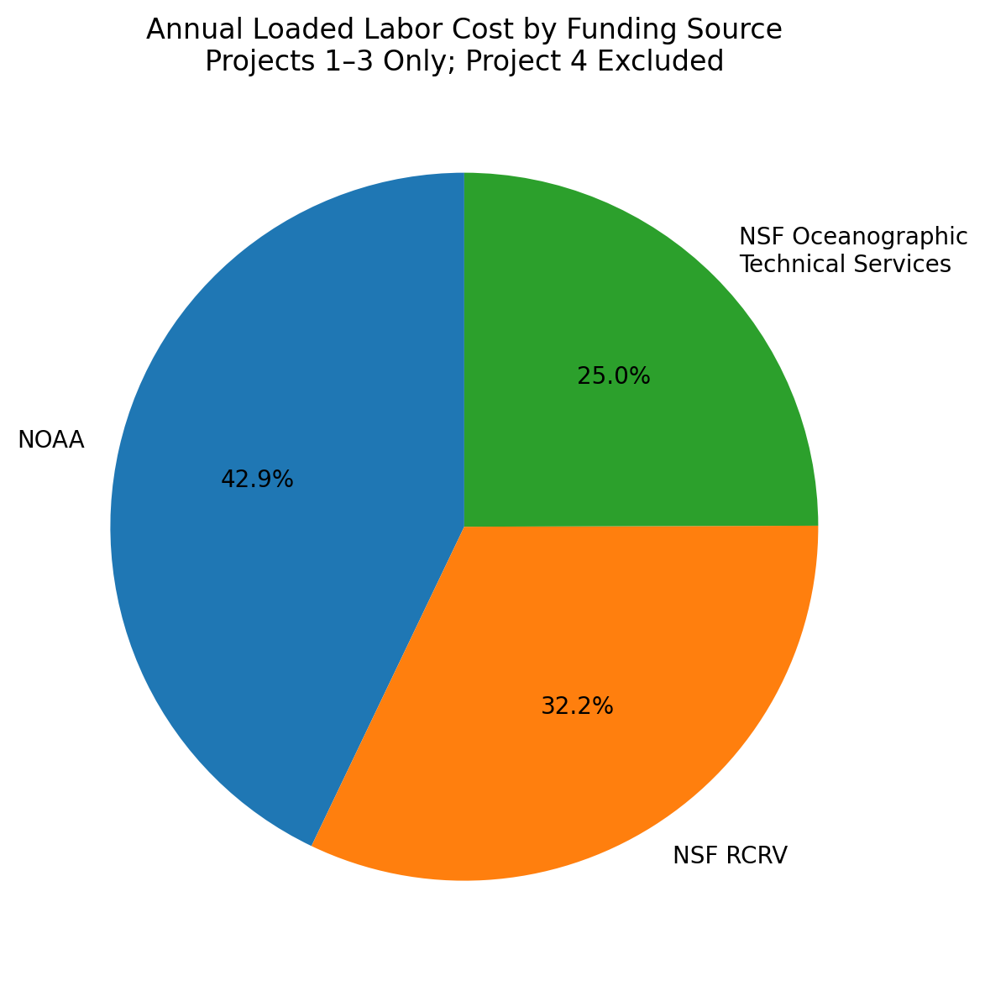
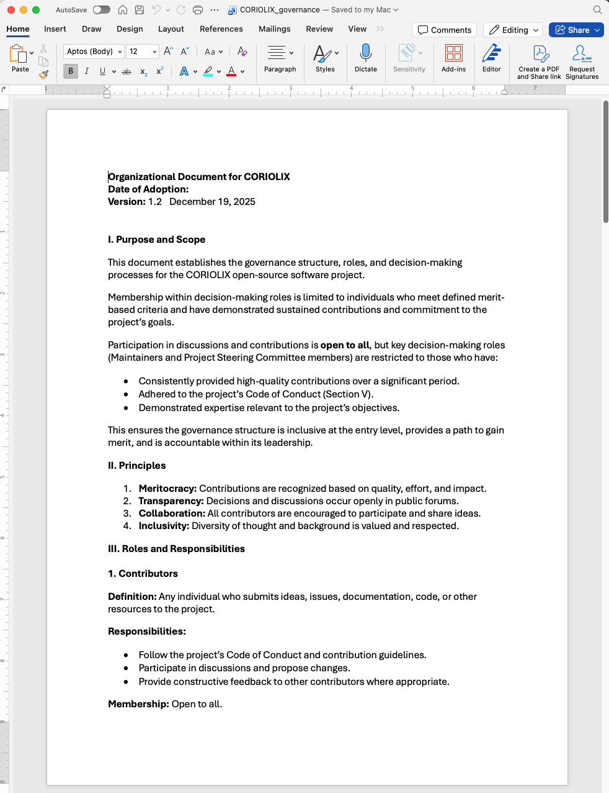
How is CORIOLIX supported & managed?
Quarter 1 2026

Slide 13
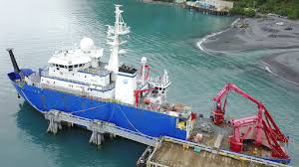
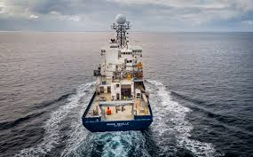
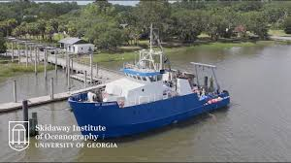
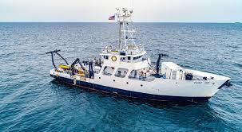
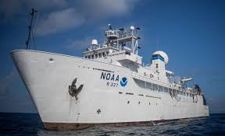
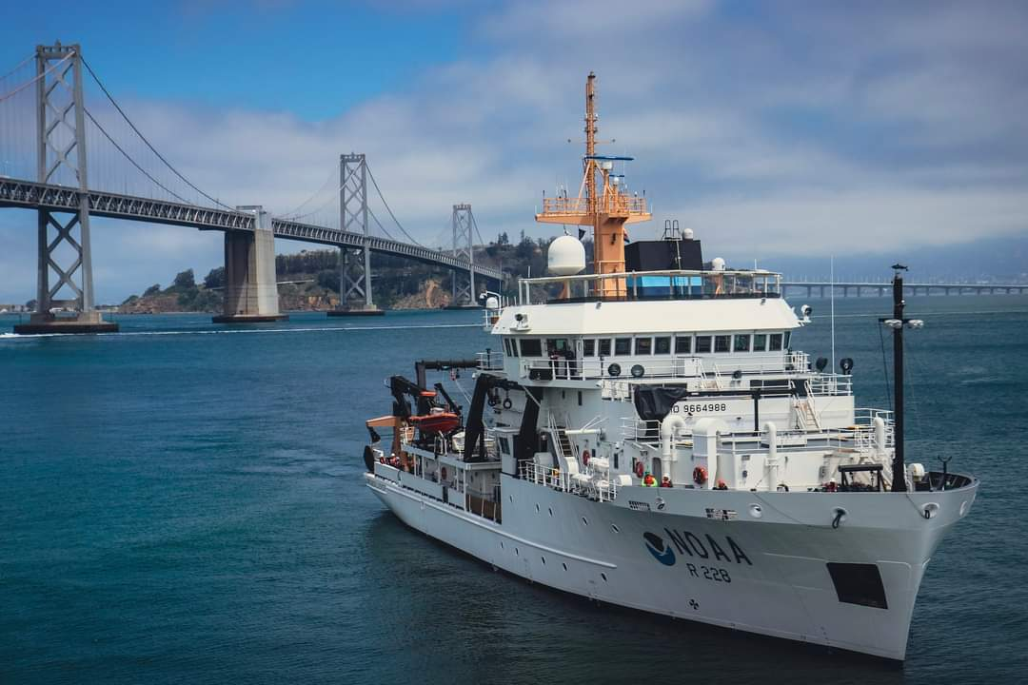
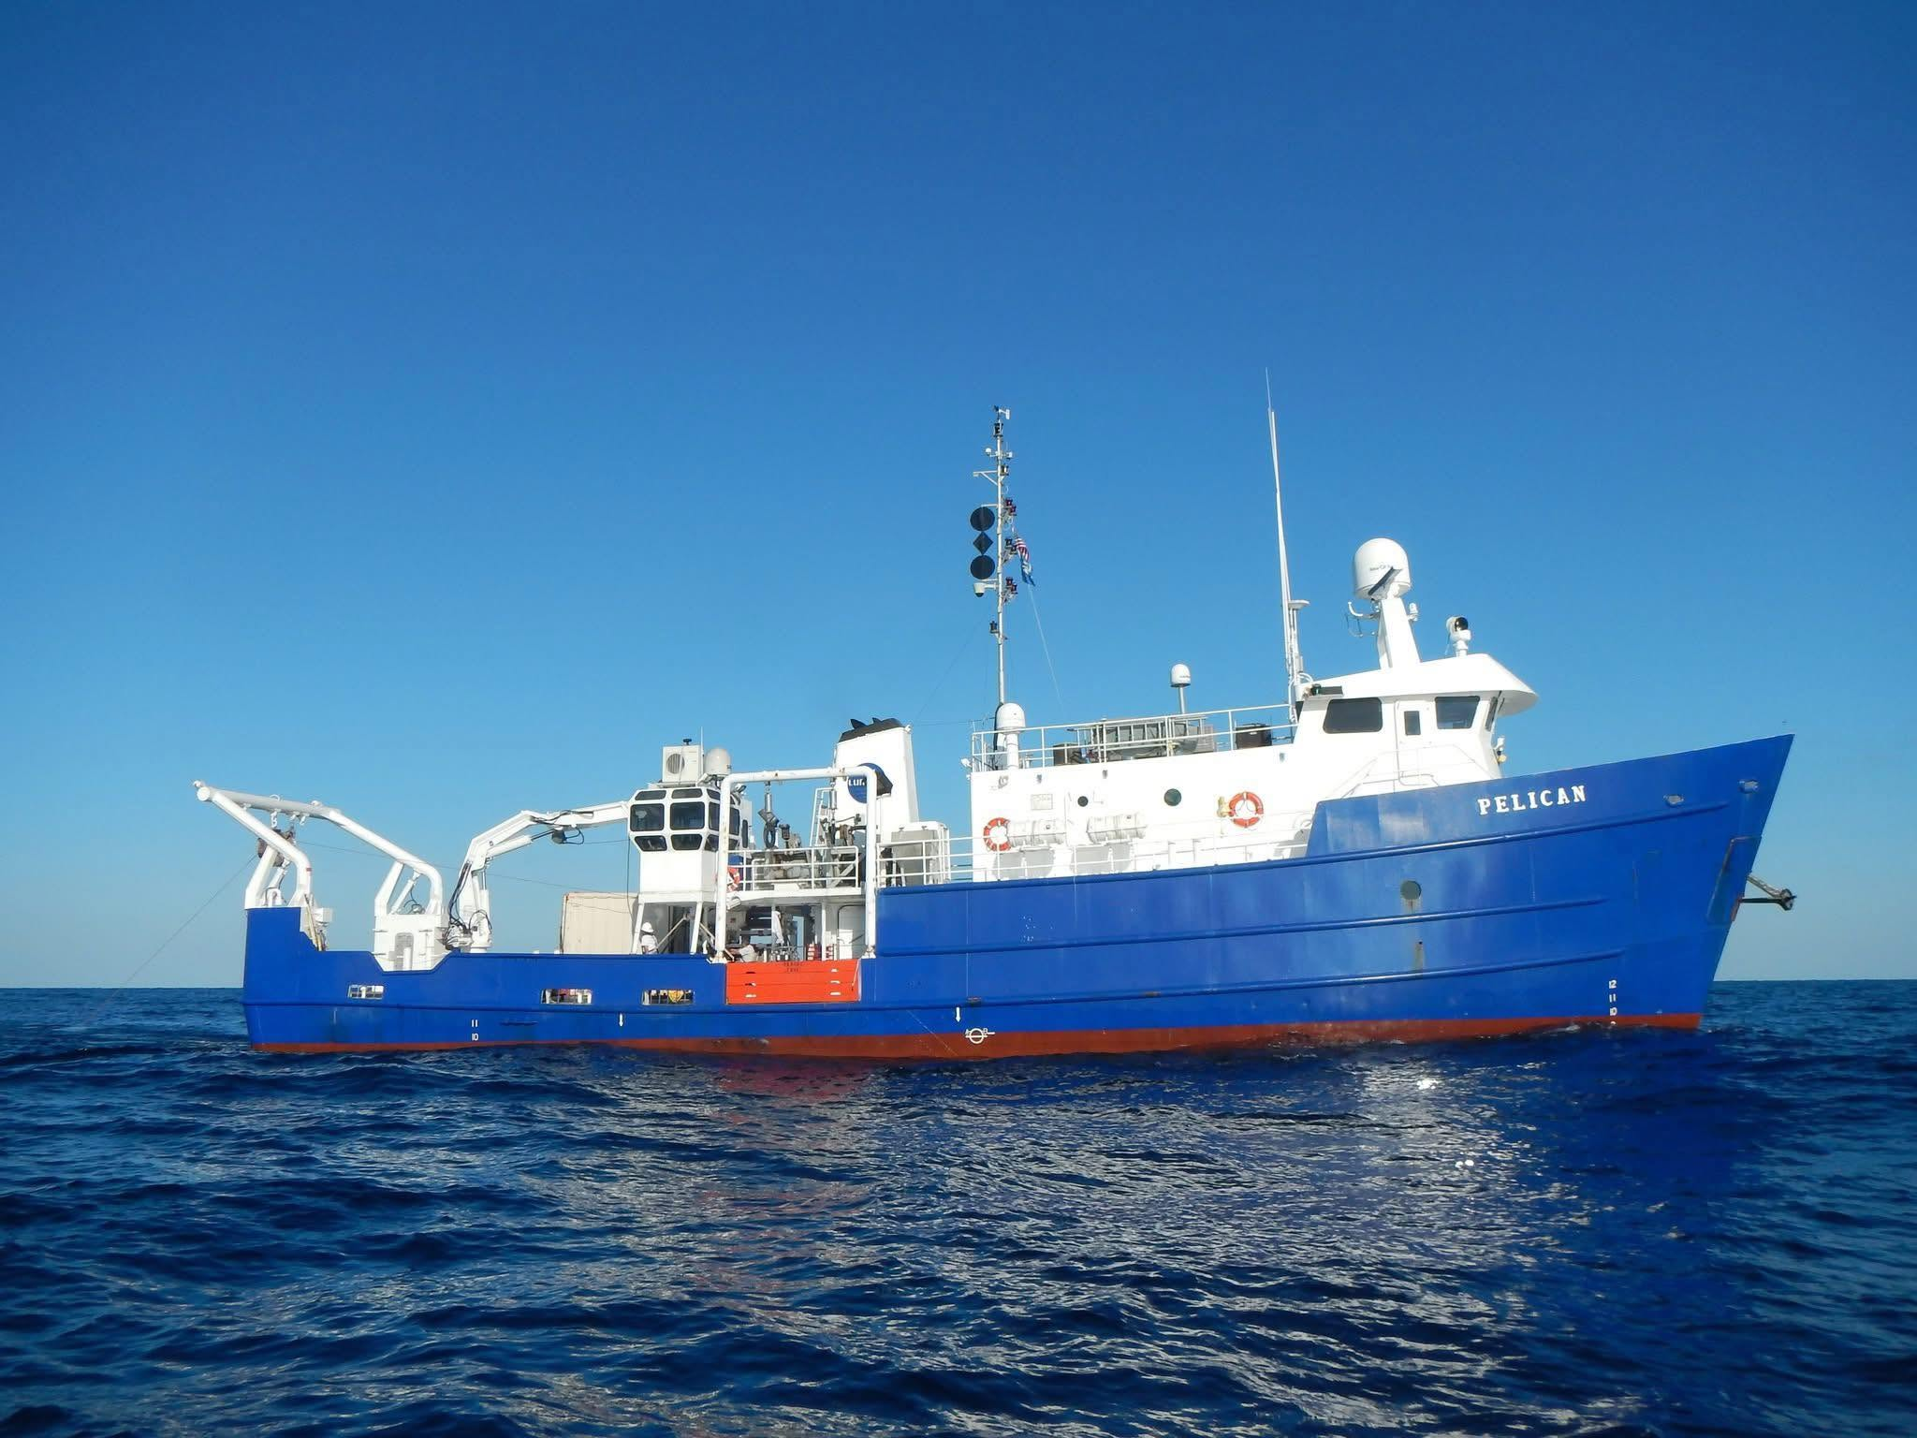
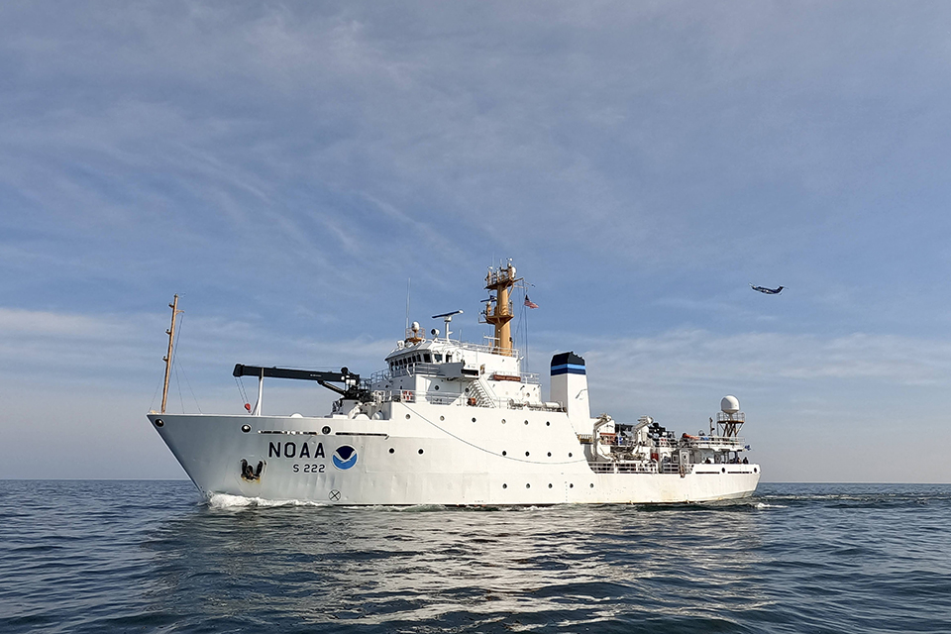
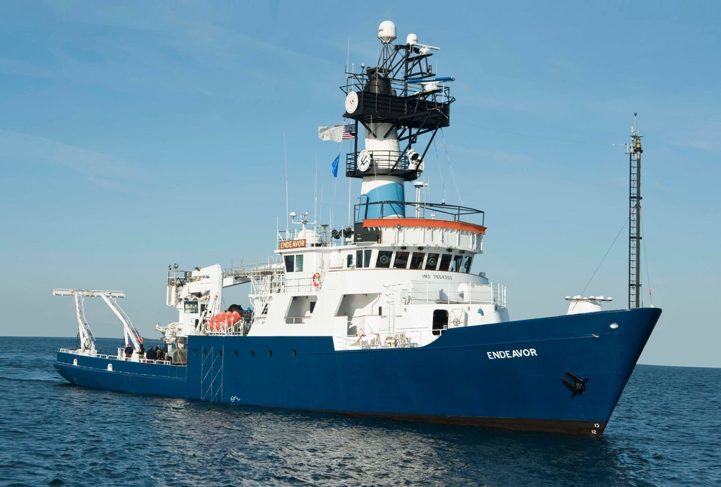
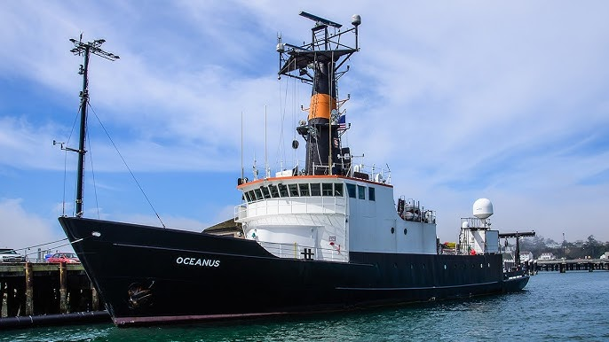
Who are we working with?
US Academic Research Fleet:
Sikuliaq
Roger Revelle
Savannah
Point Sur
NOAA
Okeanos Explorer
Reuben Lasker
Next Up (Fall/Winter 25/26):
ARF - Pelican
NOAA - TBD
Retired
Oceanus
Endeavor
?

Slide 14
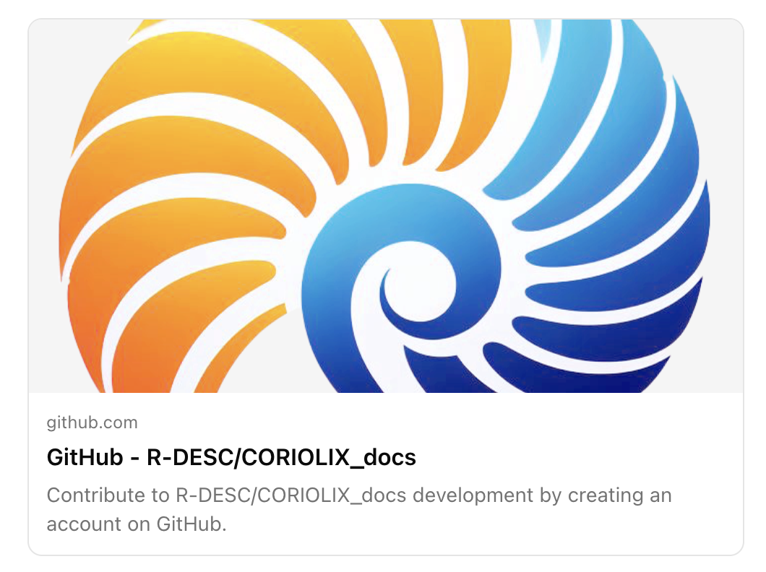
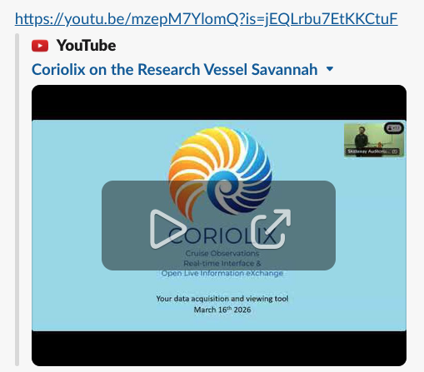
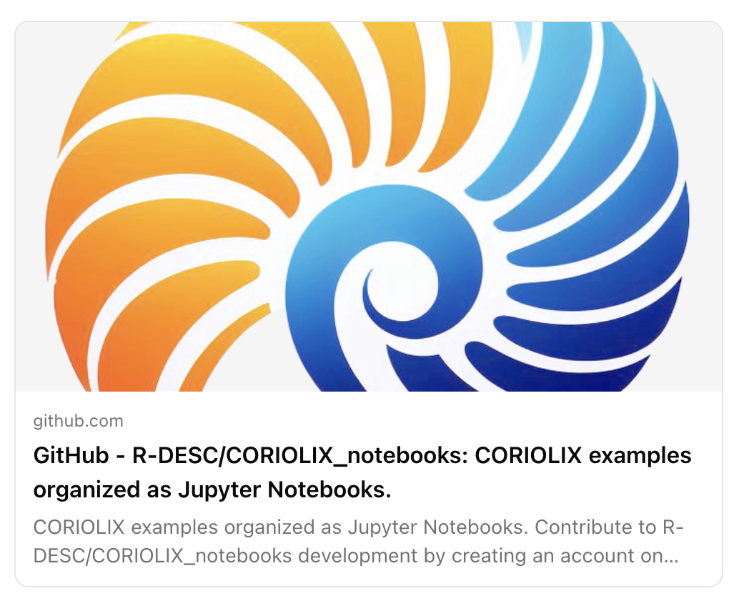
Online CORIOLIX Resources!
Rivero-Calle Lab at SKIO Pre-Cruise Training Video: https://youtu.be/mzepM7YlomQ?is=jEQLrbu7EtKKCtuF
Software Documentation: https://github.com/R-DESC/CORIOLIX_docs
Jupyter Notebooks:
https://github.com/R-DESC/CORIOLIX_notebooks

