Slide 1
Code of Conduct
Everyone is treated respectfully and collegially.
Good practices for intercultural collaborations are utilized to ensure all participants are afforded respect.
Participants are mindful of their surroundings and of their fellow participants.
Everyone is accountable: When we as organizers or participants fail to meet these guidelines, we work together to identify problems and adjust policy and practice together.
Ground rules
I will model the behavior I expect to see from others.
I will speak from my own experience and no one else's.
We will give credit appropriately.
We will practice respectful communication.
We will respect and include all voices.
We will not interrupt.
We will focus on listening as well as speaking.

Slide 2
Quarterly Report
UNOLS has now developed
a Quarterly Report to
summarize UNOLS activities

Slide 3
- Meetings
May
  Council – USM Gulfport, MS
  Safety / RVOC - WHOI
  DeSSC May – WHOI
June
  OBSIC-OS UTIG Austin, TX
AICC – today
Scheduling biweekly - ongoing
Development of Harassment Reporting Guidance
Supporting public outreach, government relations efforts
MATE Internships – 7 this year so far (limited budget), but Schmidt just gave a gift that should enable 5-6 more interns
TECH Pool – 5 techs for 7 cruises during last quarter
AMRCC completed its report on recommendations for science mission capabilities on new icebreakers
MFP – operator/science user support, continued development of new/improved capabilities & functionality
In process of submitting new MATE Internship proposal to NSF
Working on proposal for new telemedicine devices for fleet
UNOLS Activities

Slide 4
Funding for ARF / UNOLS
Strategies for fleet recapitalization – FIC
Addressing the ARF in federal statute
Pilotage issue
MATE Internship Program – obtain new grant
Telemedicine unit replacement due to obsolescence
MFP – Project Support Review & Project Support Agreement
MFP – Inventory Management
UNOLS Issues

Slide 5
Scheduling Update
2026 Ship Scheduling was very dynamic
Initial funding concerns
schedules revised as funding became available and projects were added back in (i.e. OOI)
other adjustments – i.e. Ron Brown E/R fire & need to complete GO-SHIP A16S
2027 Ship Scheduling
Virtual kick off meetings in April
Global/Ocean class schedulers meeting bi-weekly
NOAA active participant
NOMEC joining process (seabed mapping)

Slide 6
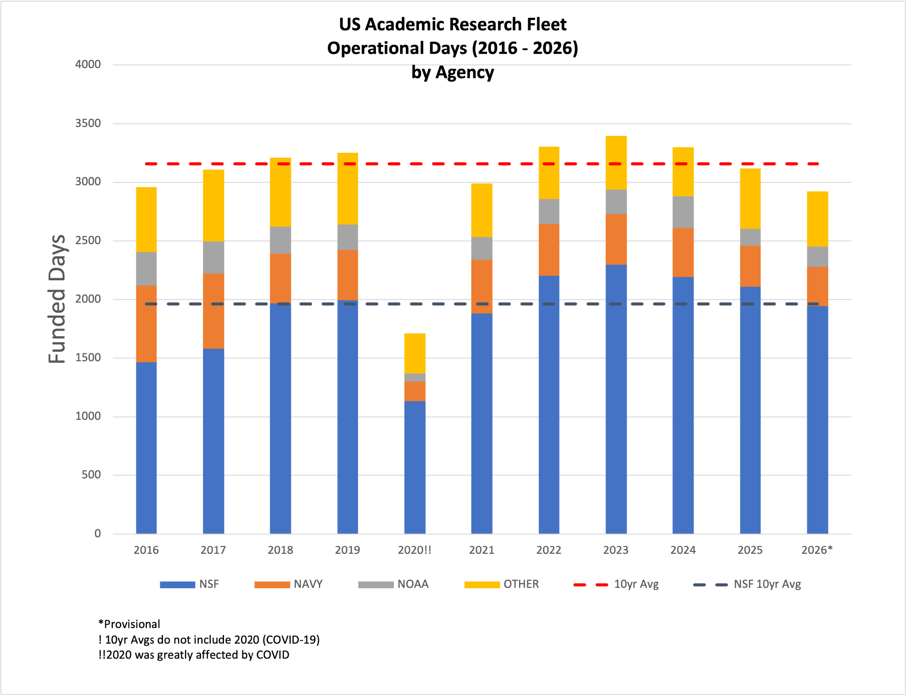
[Topic Title]
Speaker 1
Speaker 2
Speaker 3
Section Header - EXAMPLE
2026 ARF Schedule Data
- by Agency

Slide 7
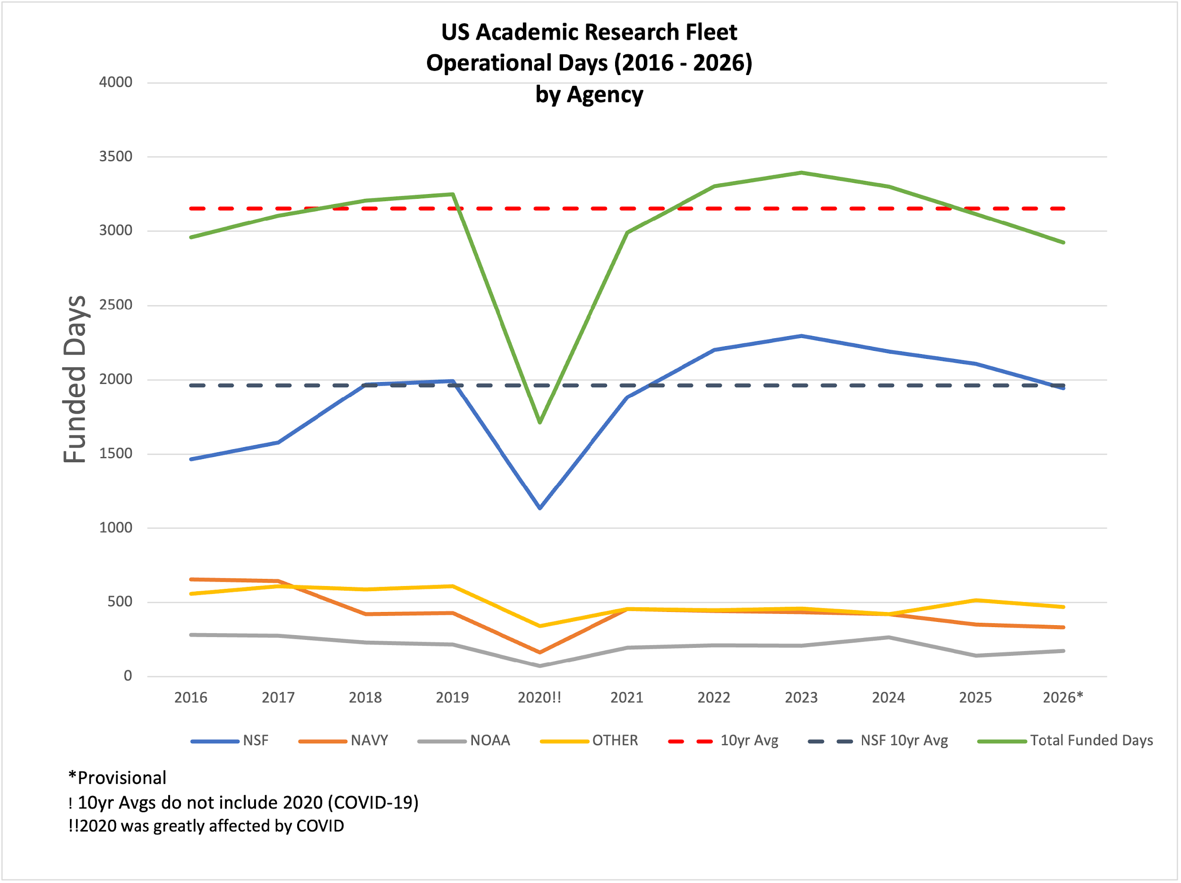
[Topic Title]
Speaker 1
Speaker 2
Speaker 3
Section Header - EXAMPLE
2026 ARF Schedule Data
- by Agency

Slide 8
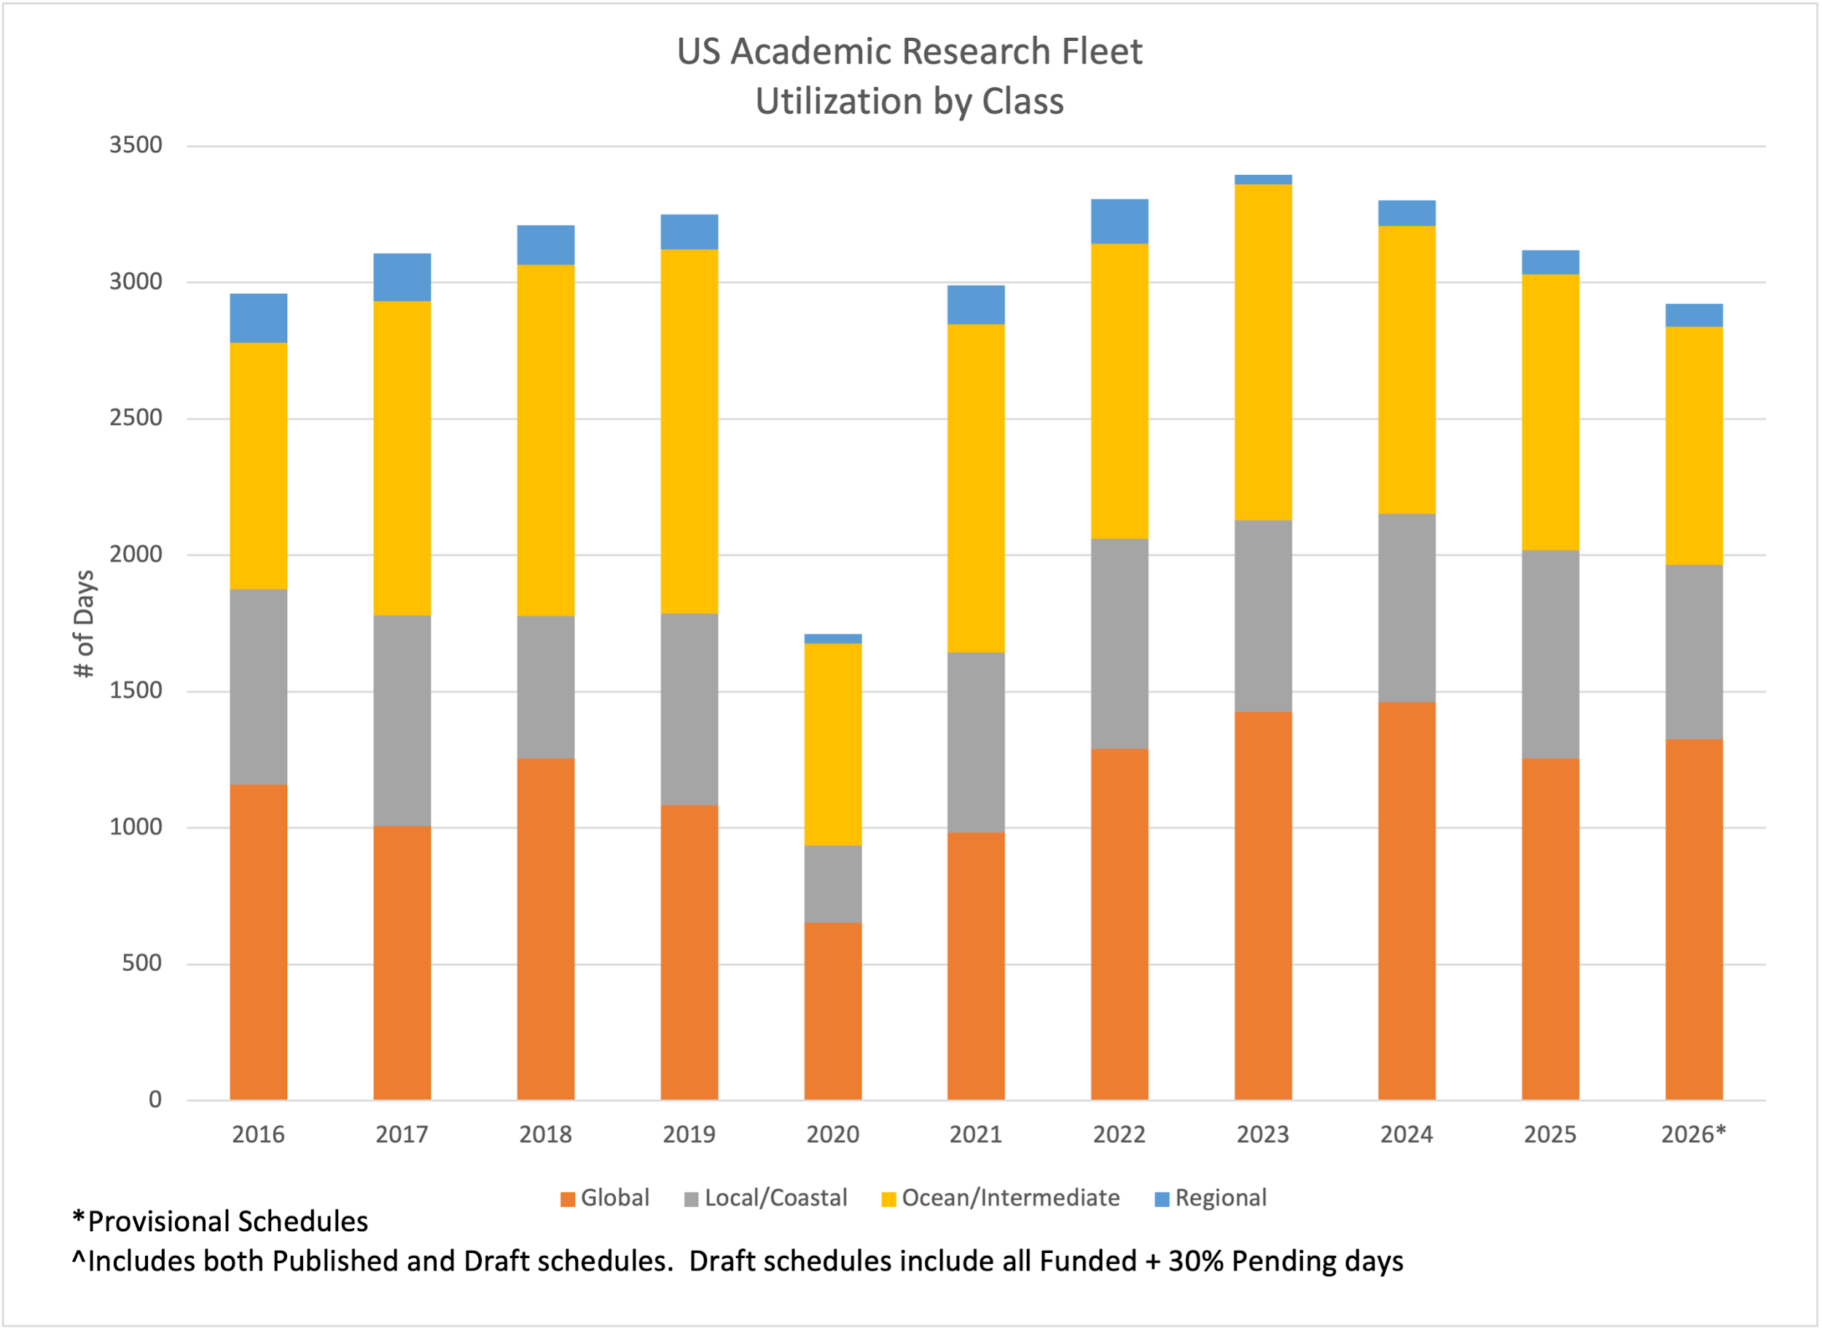
[Topic Title]
Speaker 1
Speaker 2
Speaker 3
Section Header - EXAMPLE
2026 ARF Schedule Data
- by Vessel Class

Slide 9
2027 Scheduling Update insights
2027
Planning for similar funding as 2026
Initial outlook
  Revelle & Thompson working Pacific
  Atlantis in Pacific / ALVIN
  Sikuliaq
    - light schedule early in year, Arctic,
    plan for Antarctica again late 2027 / early 2028
  Langseth – Caribbean & Pacific
  Kilo Moana – mapping & HOT
  Armstrong – North Atlantic
  Ride – Eastern Pacific
As usual, aiming to firm up late spring / early summer, work details in summer, publish in September.
All pends 2027 Federal funding process
Science funding as compared to Ship Time funding – new NSF organizational arrangement

Slide 10
Latest Estimated RCRV Delivery Schedule
- Taani 15 Mar 2027
- Narragansett Dawn 28 July 2027
- Gilbert R Mason 3 Jan 2028
RCRV Schedule Update

Slide 11
- NSF / NOAA / UNOLS working together to coordinate opportunities to accomplish needed bottom mapping / seabed characterization
- dedicated days in concert with transits
- ancillary mapping in conjunction with scheduled ocean science projects
- NOAA participation in ship scheduling process
- NOAA working to obtain funding to cover ship time used for opportunistic bottom mapping (i.e. in conjunction with planned transits)
- Working with NOAA Integrated Ocean & Coastal Mapping (IOCM) / NOMEC (National Ocean Mapping, Exploration, and Characterization)
- integrating ARF schedules into NOAA U.S.
Mapping Coordination web tool
Using ARF Vessels for Seabed Characterization / Mapping

Slide 12
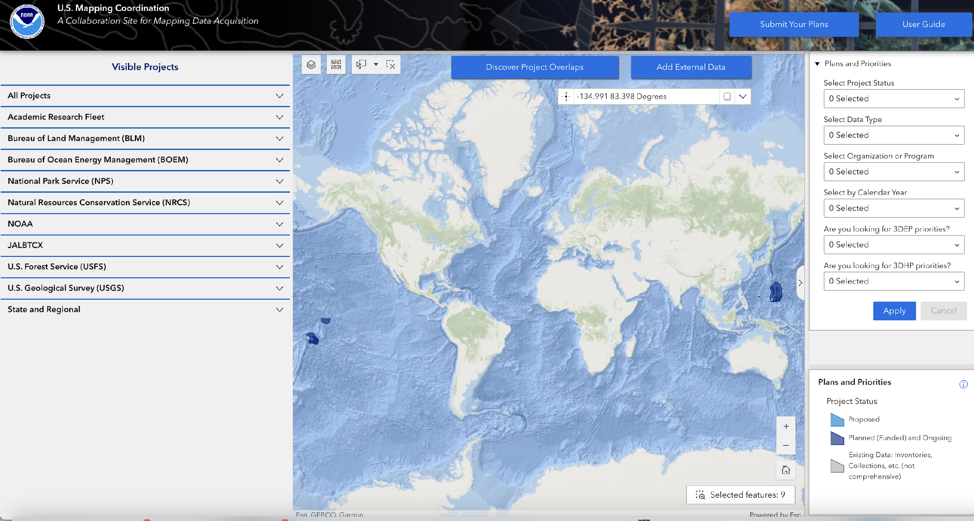
U.S. Mapping Coordination Web Tool
Website can be found here

Slide 13
Issue: what additional methods should we pursue for educating the public & government officials about the importance & value of the ARF?
Methods we currently use:
- UNOLS News listserv
- UNOLS Website
- Social Media – UNOLS, some institutions
- RECOS Efforts
- Institutional Government Relations Representatives
What else should we do?
- write / propose / submit articles to periodicals /
online forums? which ones?
- who should do this? UNOLS, community members
- how should we collect ideas? Track to completion
- host public Webinars?
Other ideas?
Strategies for Telling the ARF Story

Slide 14
Proposed amendments to title 46 of the U.S. Code would add a new subsection (1) to section 2021 — General Definitions:
Academic Research Fleet means the oceanographic research vessels owned by or whose operation is funded by the United States and operated by institutions of higher education or research laboratories.
New legislative language to classify ARF ships

Slide 15



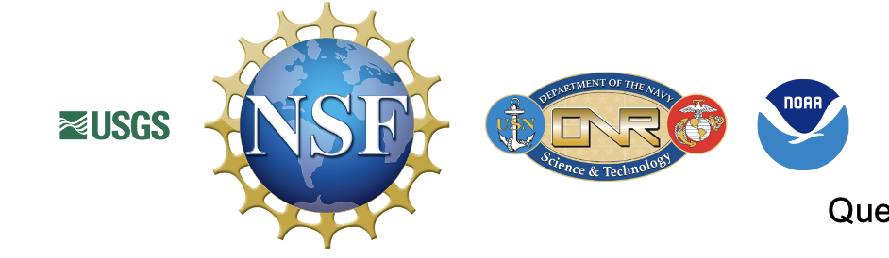


Thank you!
@UNOLS
Contact media@unols.org for comments & questions or to share your news stories, accounts, pictures and hashtags.
We want to hear what’s new with you!
@UNOLS
@UNOLS_org

