Slide 1





Slide 2

East Coast Winch Pool Team
Jamie Haley
System Maintenance
Josh Eaton
Engineering
Sean Whelan
Oversight & Coordination

Slide 3
East Coast Winch Pool Mission
The East Coast Winch Pool (ECWP) provides overboard handling systems, wire spooling, wire lubrication assistance, consulting, and engineering solutions as part of the NSF UNOLS Equipment Pool Program.
By pooling large value assets with subject matter experts, efficiencies are achieved to provide safe and reliable equipment to the whole UNOLS fleet.

Slide 4
Equipment Requests
ECWP has met over 35 requests for equipment and services in the past year. These included:
- Mooring work
- Hydrography
- Trace metal sampling
- Towed systems
- Sheaves
- Wire spooling

Slide 5
ECWP Website Upgrade
Rajesh Mishra – Director of IS, Science and Engineering Information Services | WHOI
Mike Chagnon President & CTO | Kaimika Technology LLC
Many changes are under the hood- removing bugs and enhancing security, but there are significant enhancements to help tracking and NSF reporting, while easing the process for prospective users to view documentation and request equipment.

Slide 6
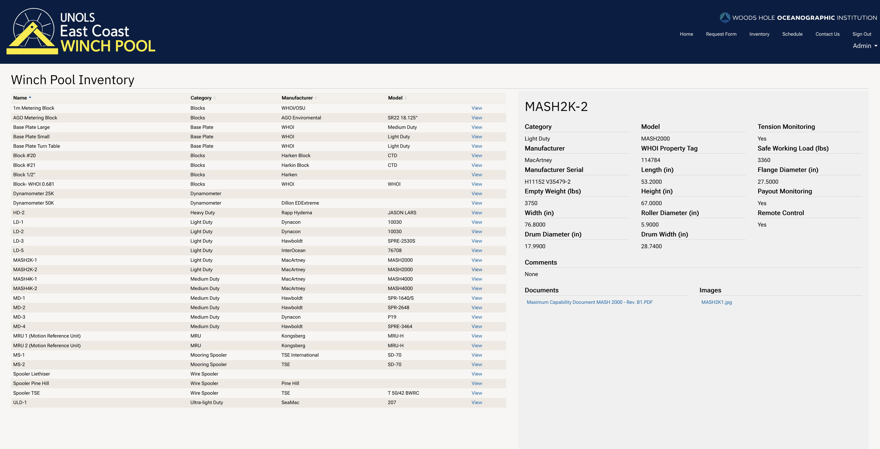
ECWP Equipment
winchpool.whoi.edu

Slide 7
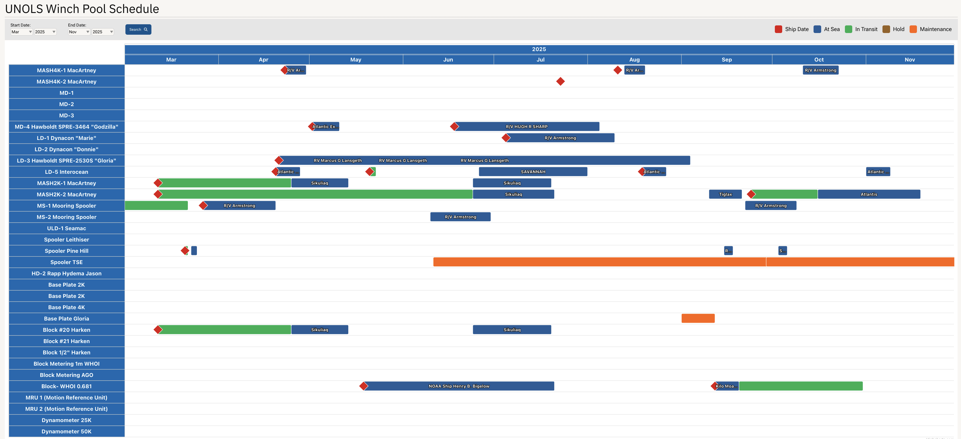
ECWP Schedule
winchpool.whoi.edu

Slide 8
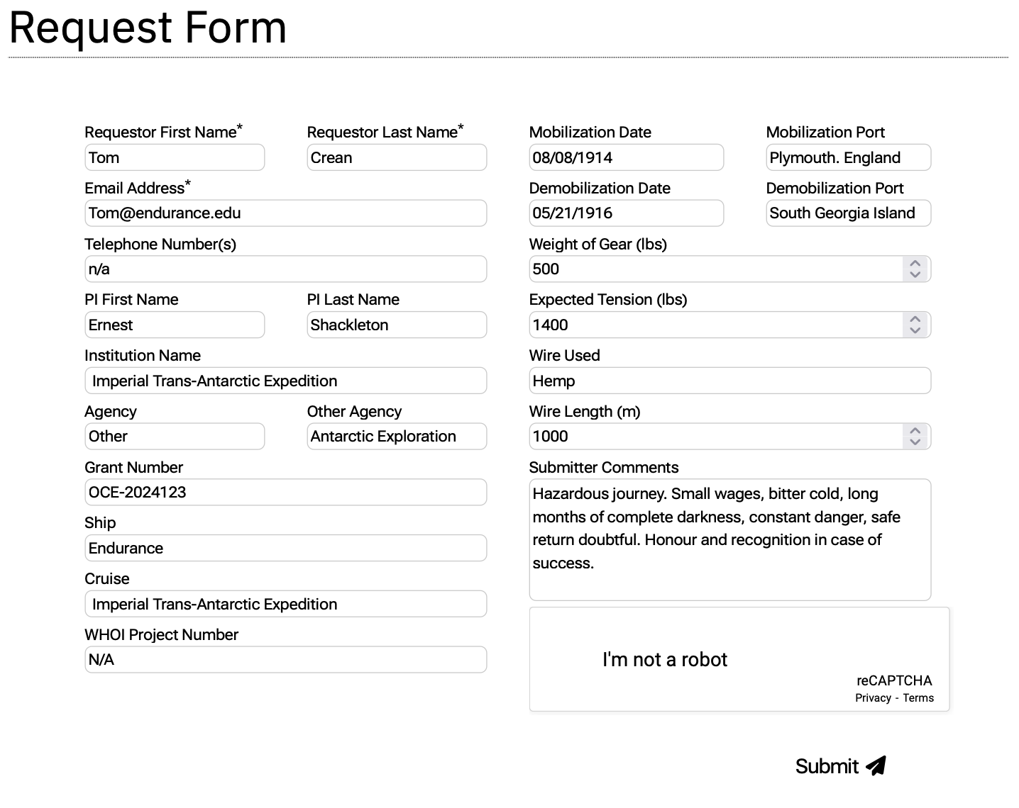
ECWP Request Form
winchpool.whoi.edu
winchpool.whoi.edu

Slide 9
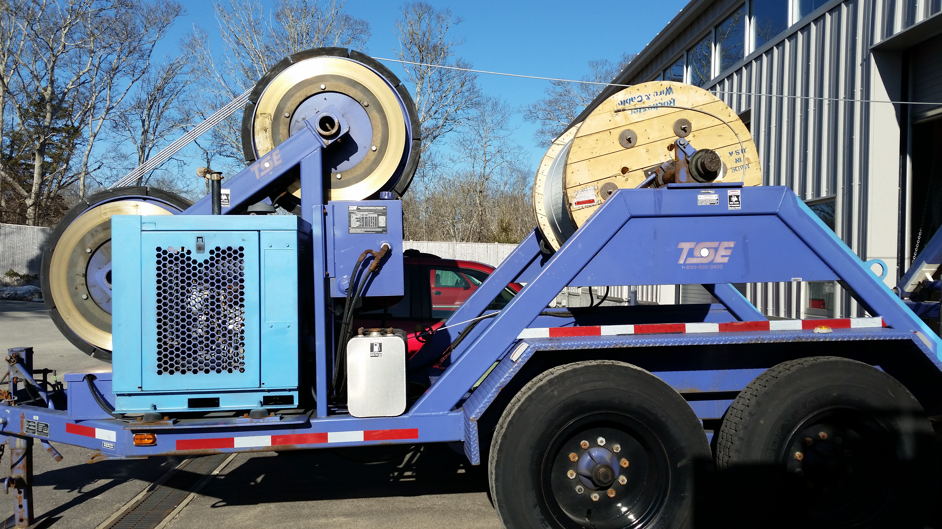
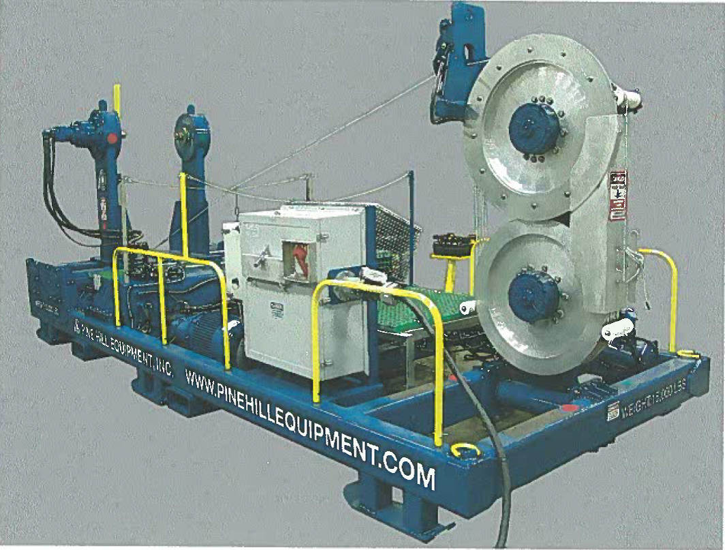
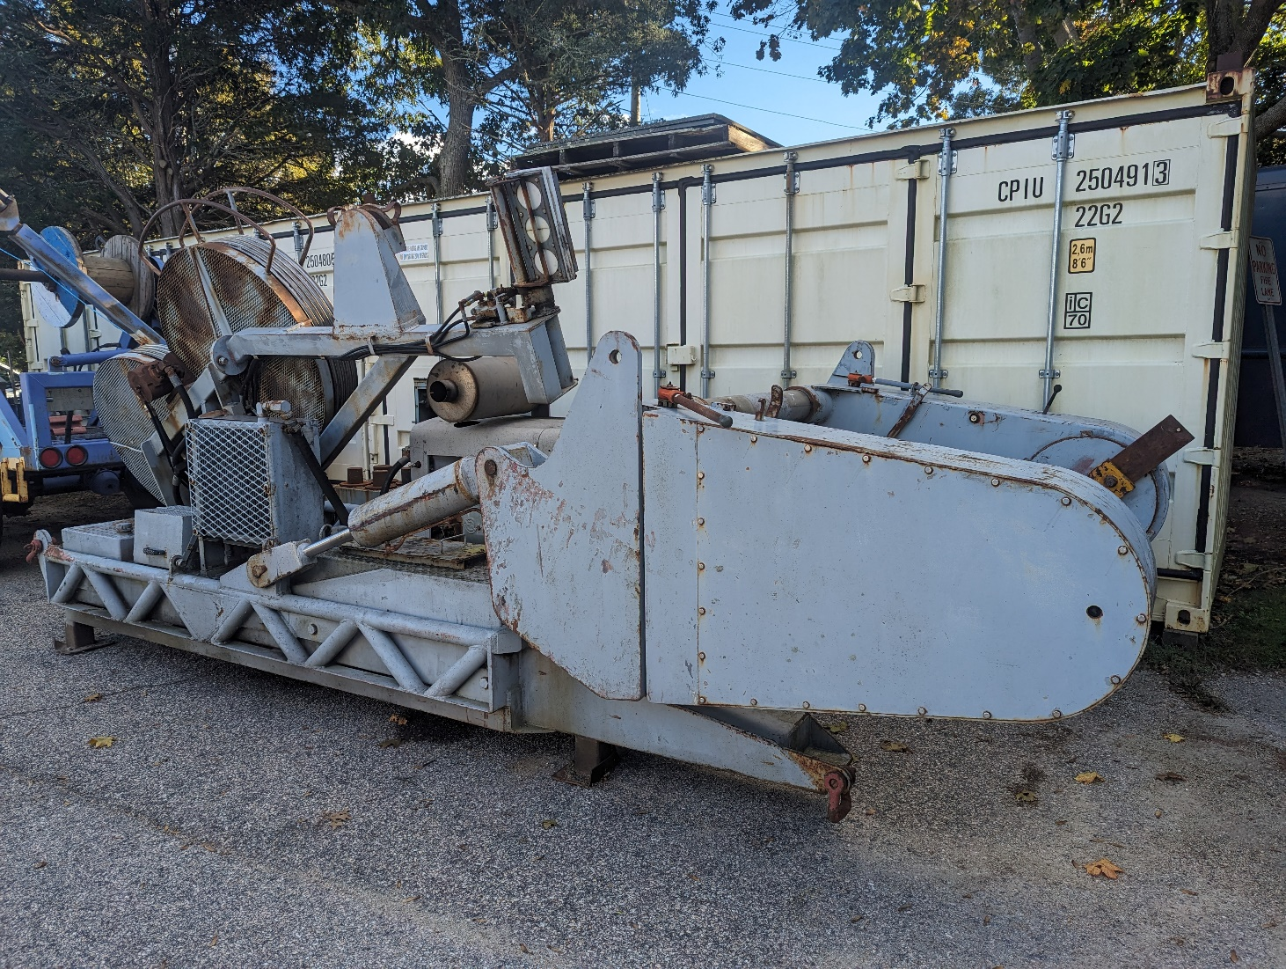
ECWP- Tension & Spooling
TSE
Pine Hill
Leitheiser

Slide 10
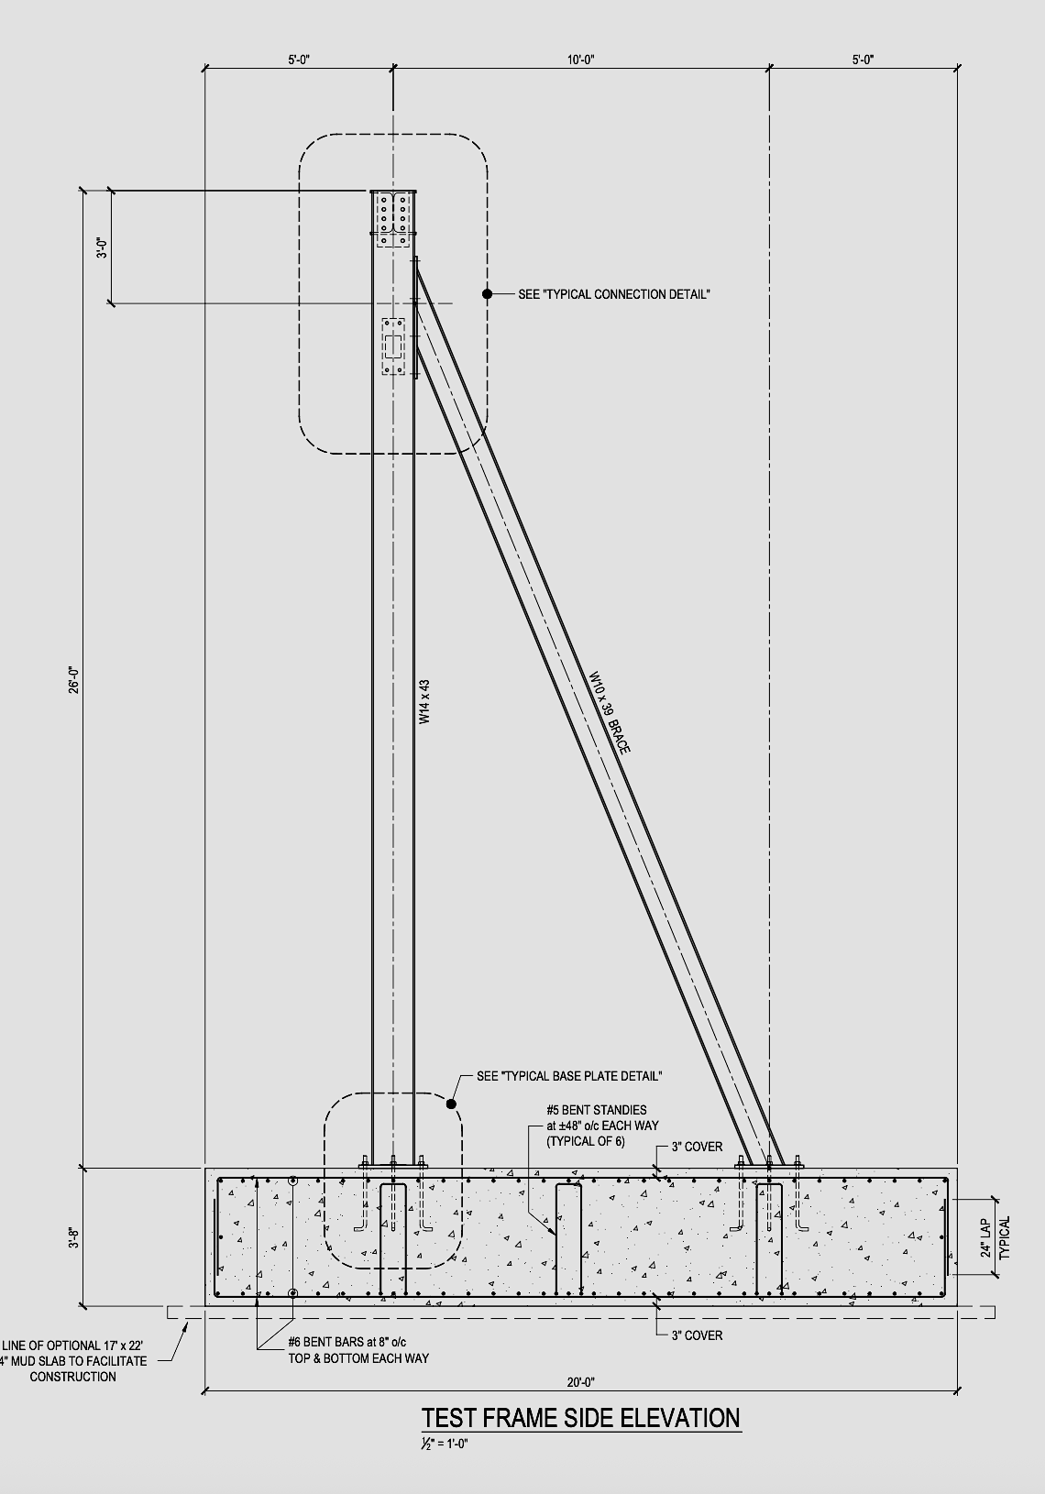
ECWP Test Frame
On site dynamic testing for generating Maximum Capability Documents
Online Nov 2025

Slide 11
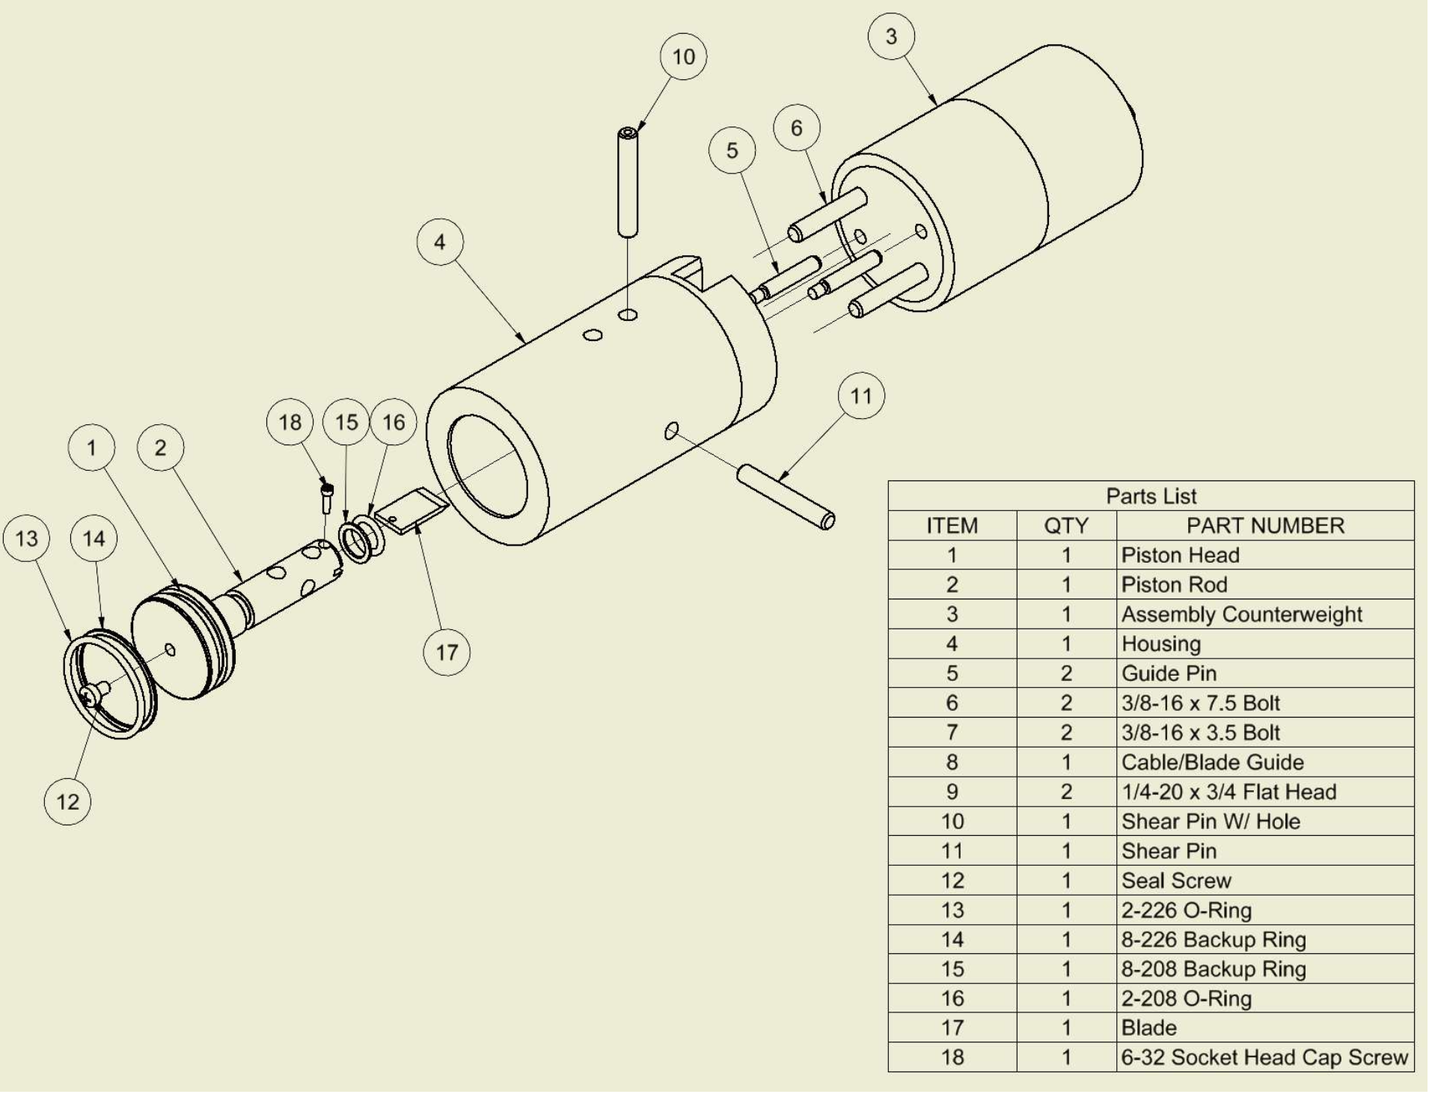
ECWP Hydrostatic Cutter
The Hydrostatic Cutter is a device developed to cut a tension member at depth.
When a tension member
becomes fouled or anchored at the bottom, instead of cutting it at the surface, the device is deployed to cut and release it near bottom.
A portion of the expensive tension member is saved reducing economic loss.
(26) wire cutters fabricated and delivered by Josh Eaton to ECWP OCT 2025

Slide 12
East Coast Winch Pool
Leveraging resources at WHOI, the ECWP subject matter expert provides the fleet with reliable overboard handling systems, wire winding, engineering support, training, and the logistics for delivery anywhere in the world.
winchpool.whoi.edu

Slide 13
Thank You
Sarah Fuller, David Fisichella, Rob Munier- Shipboard Scientific Services and Marine Operations
Isaura Weddige Welch and Isabella Costa Marcondes- WHOI Finance/Administrative Services
Brian Guest- WHOI Oceanographer Emeritus
John Brinckerhoff- WHOI International & Domestic Shipper
Eric Trotto, Barbara Callahan, Andrea Harvey- NSF Wire Pool
Tim McGovern- NSF Program Director

