Slide 1
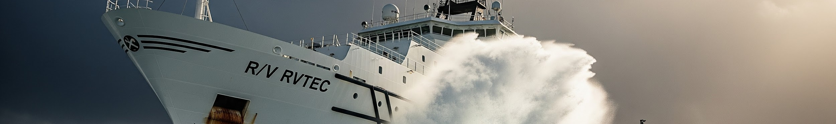
IT TAKES A VILLAGE TO DEFEND IN DEPTH
6 NOV 2025
RVTEC
Ezra Van Everbroeck
Scripps IT

Slide 2
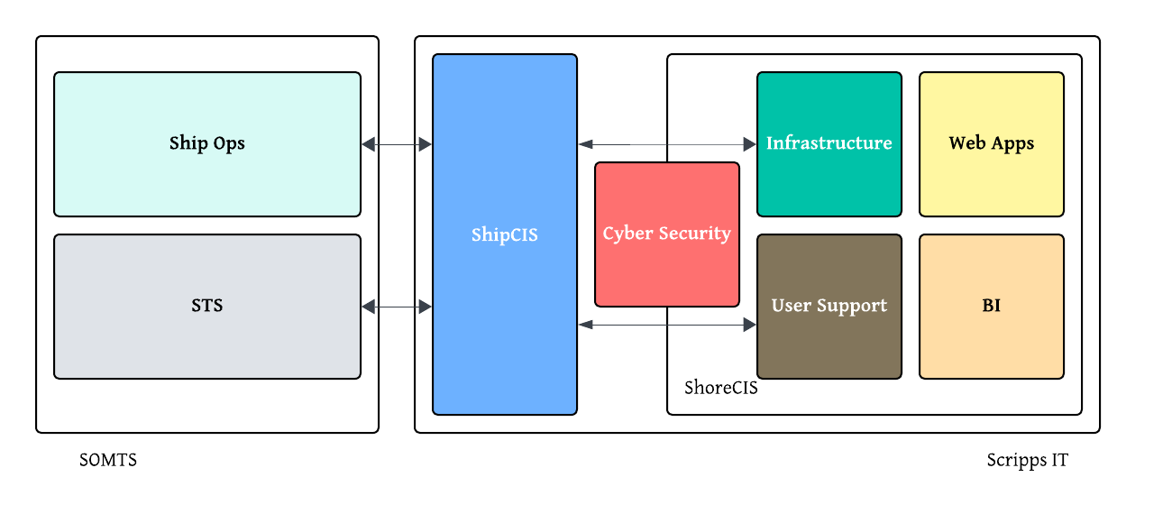
ShipCIS in Context

Slide 3
Driving Factors (Technology)
Increasing technology (IT & OT) on the ships
  Raw number of devices
  Dependencies on the services

Slide 4
Driving Factors (Technology)
Increasing technology (IT & OT) on the ships
  Raw number of devices
  Dependencies on the services
+
Increased bandwidth for the ships
  Inbound attacks more likely
  Outbound activity more problematic

Slide 5
Driving Factors (Technology)
Increasing technology (IT & OT) on the ships
  Raw number of devices
  Dependencies on the services
+
Increased bandwidth for the ships
  Inbound attacks more likely
  Outbound activity more problematic
=
Increased attack surface

Slide 6
Driving Factors (Compliance)
Formal requirements are coming from multiple sources:
USCG ABS
Operator institution
Sponsors
Science party

Slide 7
Driving Factors (Compliance)
Formal requirements are coming from multiple sources:
USCG ABS
Operator institution
Sponsors
Science party
Cyber Risk Management Plans cover a lot of ground
Device inventory
Logging and monitoring
Account management
Protection agents
System management tools
Data protection and backups
Patching schemes
Firewalls
Incident response and recovery

Slide 8
Driving Factors (Compliance)
Formal requirements are coming from multiple sources:
USCG ABS
Operator institution
Sponsors
Science party
Cyber Risk Management Plans cover a lot of ground
Device inventory
Logging and monitoring
Account management
Protection agents
System management tools
Data protection and backups
Patching schemes
Firewalls
Incident response and recovery
For IT, OT and/or networking devices

Slide 9
Driving Factors (Compliance)
Formal requirements are coming from multiple sources:
USCG ABS
Operator institution
Sponsors
Science party
Cyber Risk Management Plans cover a lot of ground
Device inventory
Logging and monitoring
Account management
Protection agents
System management tools
Data protection and backups
Patching schemes
Firewalls
Incident response and recovery
For IT, OT and/or networking devices
“Maturity” demands policies, procedures and lots of documentation

Slide 10
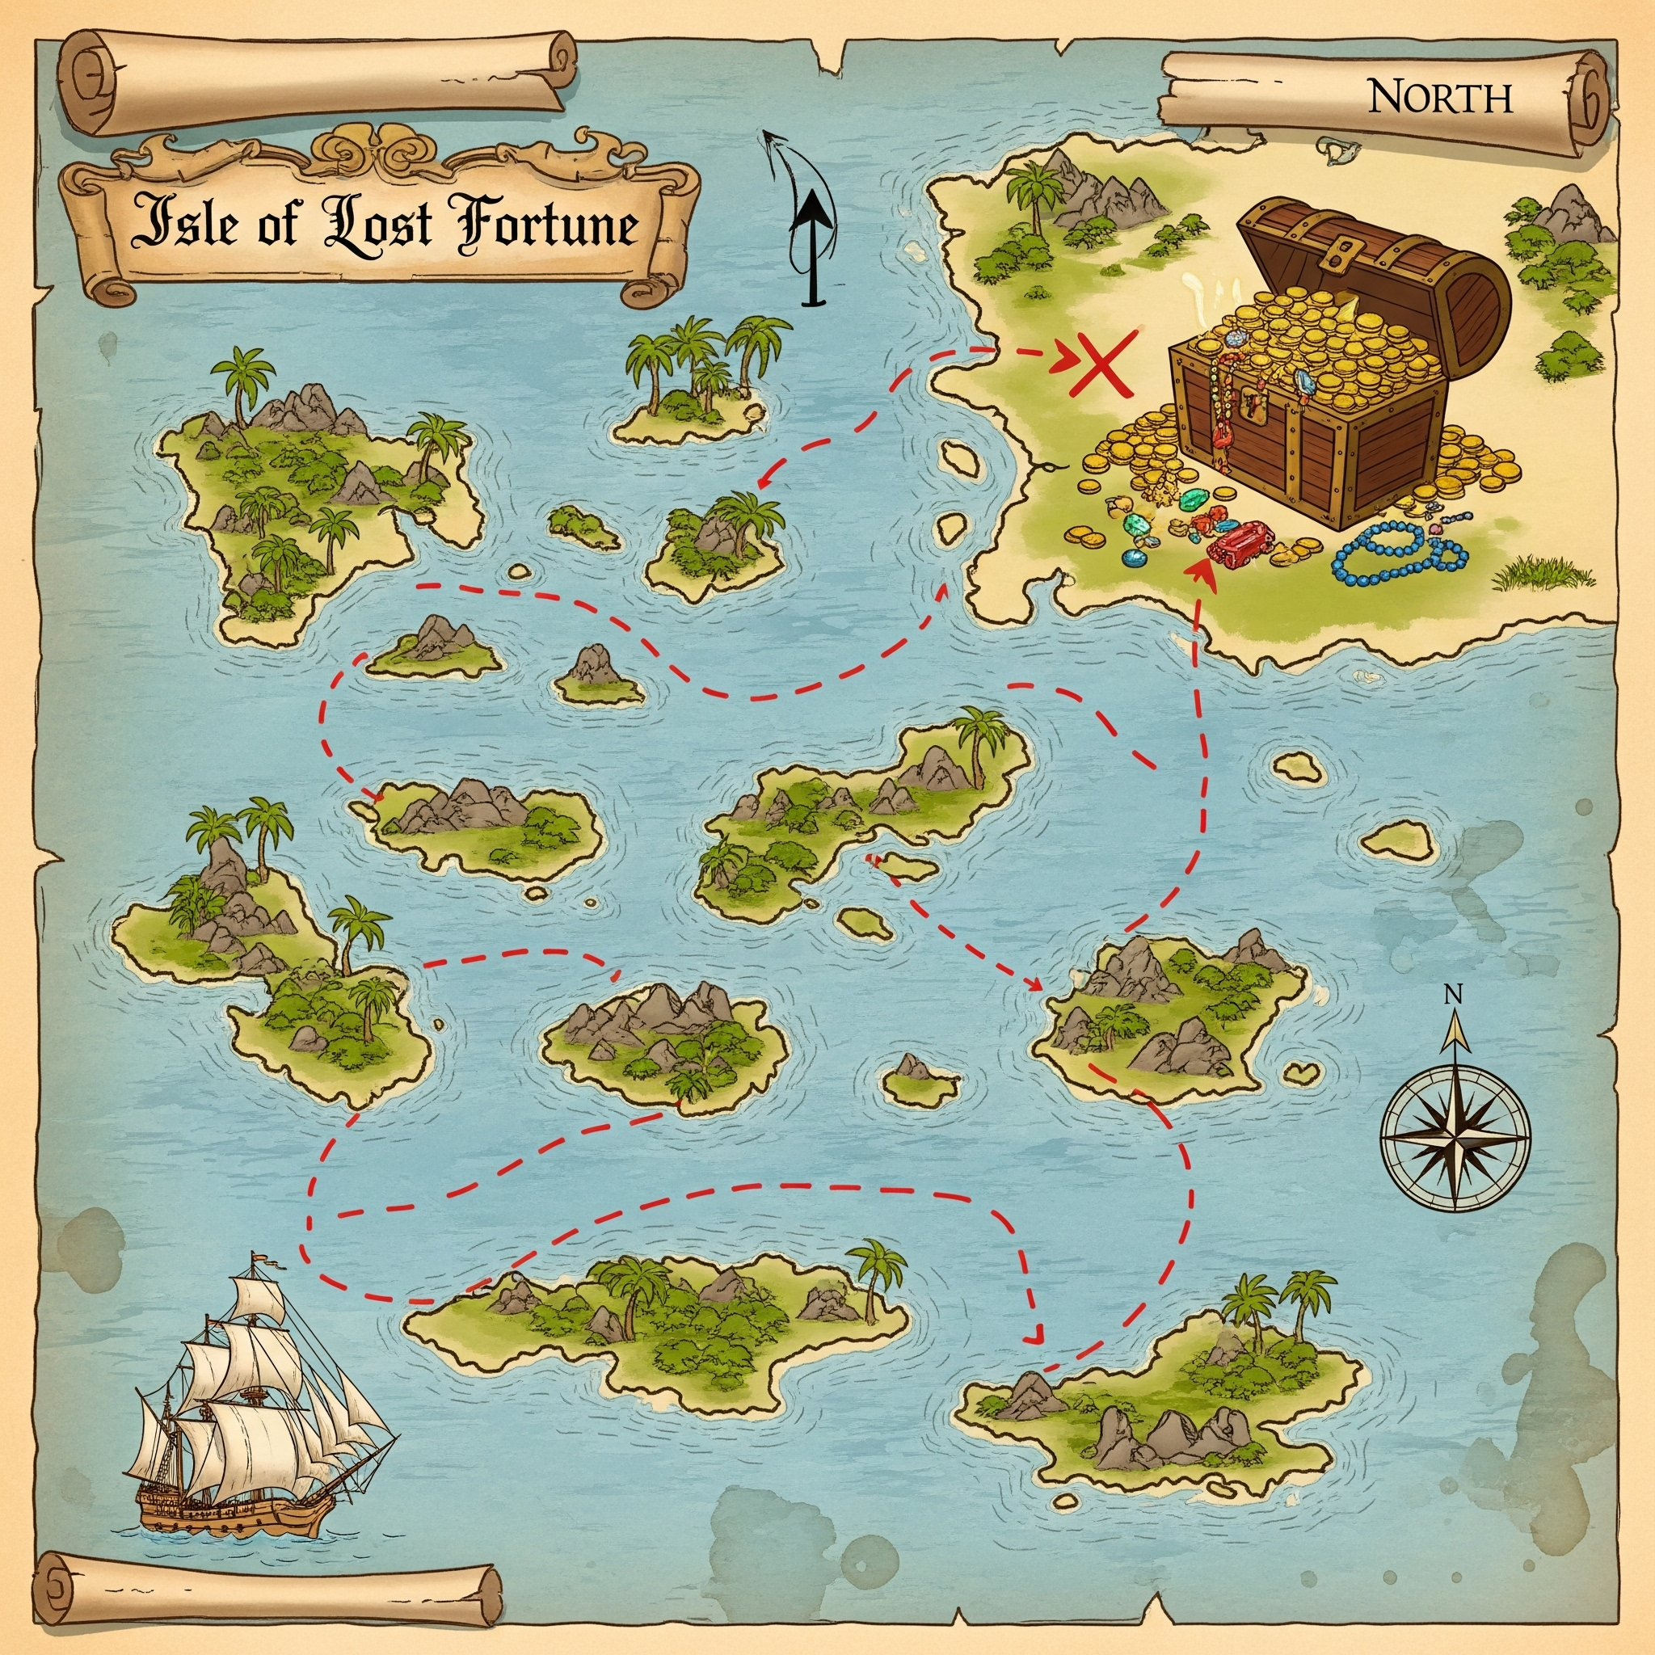

Slide 11
Other Considerations
This is a lot of work with limited benefit for science

Slide 12
Other Considerations
This is a lot of work with limited benefit for science
All operators need to solve these problems

Slide 13
Other Considerations
This is a lot of work with limited benefit for science
All operators need to solve these problems
Cybersecurity is not unique to ships

Slide 14
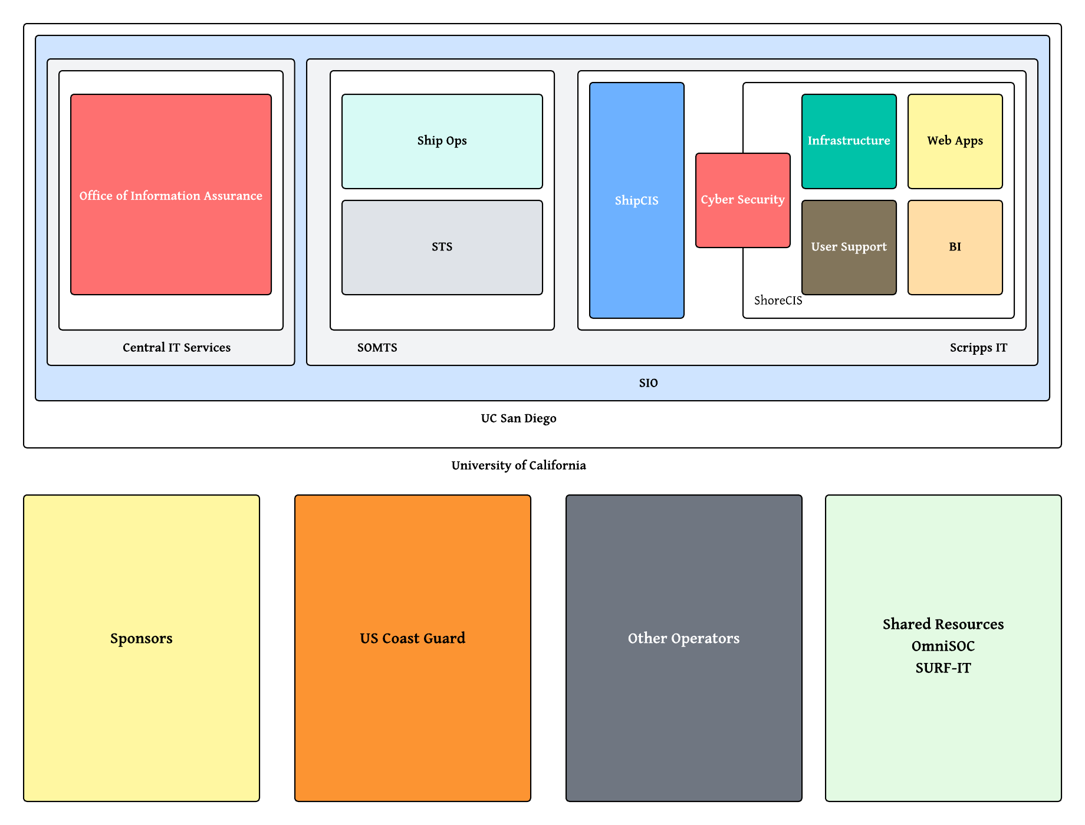
ShipCIS in More Context

Slide 15
Enough with the PSA

Slide 16
Why I Really Care (And You Should Too)
We are here to support the science

Slide 17
Why I Really Care (And You Should Too)
We are here to support the science
Cyber security problems interfere with science

Slide 18
Why I Really Care (And You Should Too)
We are here to support the science
Cyber security problems interfere with science
Which impacts our researchers

Slide 19
Why I Really Care (And You Should Too)
I am here to support the science
Cyber security problems interfere with science
Which impacts my researchers
And affects my unit’s funding

Slide 20
Why I Really Care (And You Should Too)
I am here to support the science
Cyber security problems interfere with science
Which impacts my researchers
Which I need to report per regulations
And affects my unit’s funding

Slide 21
Why I Really Care (And You Should Too)
I am here to support the science
Cyber security problems interfere with science
Which impacts my researchers
Which I need to report per regulations
And affects my unit’s funding
Or risk my unit’s funding

Slide 22
Why I Really Care (And You Should Too)
I am here to support the science
Cyber security problems interfere with science
Which impacts my researchers
Which I need to report per regulations
And affects my unit’s funding
Or risk my unit’s funding
… but my researchers are on your ships (and vice versa)

Slide 23
Please protect my researchers on your ships
I promise to protect yours

Slide 24
THANK YOU
Please protect my researchers on your ships
I promise to protect yours
Ezra Van Everbroeck
ezra@ucsd.edu

