Slide 1


NSF Wire Pool
Eric Trotto

Slide 2
What is the Wire Pool
The Wire Pool supports the tension members needs of the U.S. Academic Research Fleet
Maintaining an inventory
Coordinating requests
Conducting break tests
Maintaining a wire database

Slide 3
Maintain An Inventory of Wire Rope, Cable, and Synthetic
One Wire Pool, two storage facilities
East Coast - Woods Hole Oceanographic Institution (WHOI)
West Coast - Scripps Institution of Oceanography (SIO)
Inventory of commonly used tension members
3x19 Wire Ropes: ¼”, ½”, 9/16”
Cables: .322” EM, .680” Coax, .681” power optic
Other tension members
Synthetics: 9/16” Plasma HiCo

Slide 4
Requesting New Wire
Wire Pool fields all requests for new and used tension members
Determine availability of requested item (inventory)
Wire Pool prepares package for NSF consideration
If approved, arrange for shipping to nearest domestic port
Long Lead Times
.681”: 8 Month lead time
3x19: 4 Month lead time

Slide 5
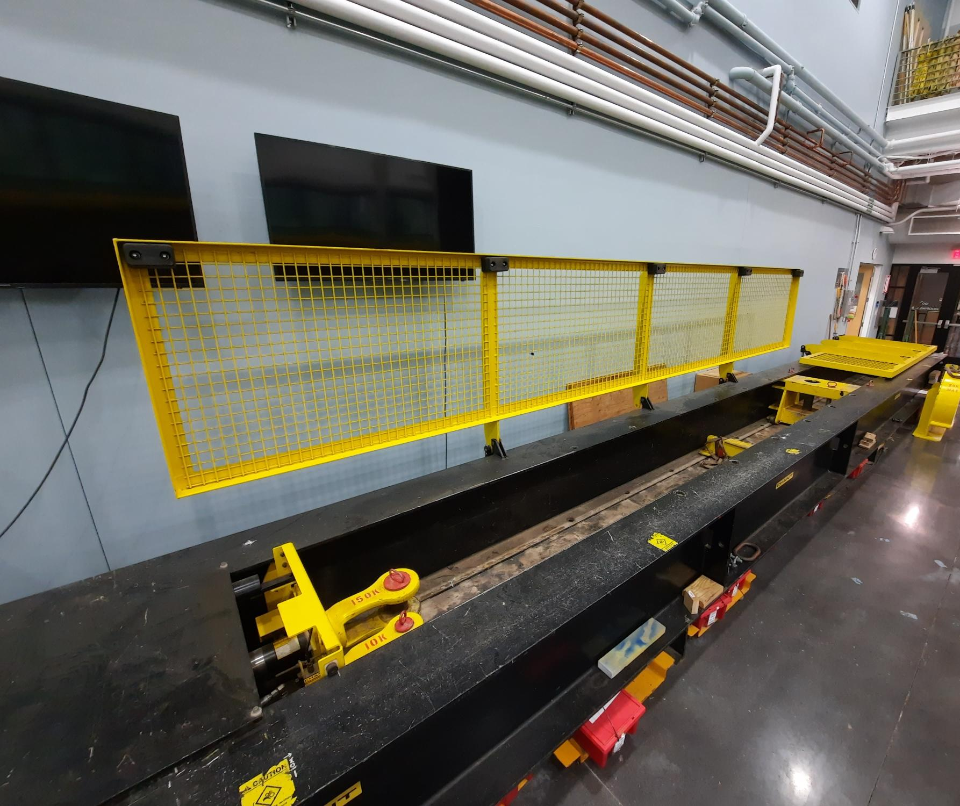
Break Testing
Barbara Callahan, Wire Testing Coordinator
Submit break test request via the Wire Pool database
Testing mandated by Appendix A of RVSS and funded by NSF (no cost to vessel)
Evaluate
Recommendations

Slide 6
Wire Pool Database
Andrea Harvey, Wire Pool Database Administrator
Manage wire and cable assigned to your Institution’s vessel(s)
Update wire status (e.g. ‘In use’ or ‘Stored’)
Manage Safe Working Load (SWL) information for cable and wire in use or onboard a vessel
Report events (lubrication, cutback/re-termination, splits, end-for-end, document uploads)
Submit break test requests and view results/recommendations
Other Features
Request wire or cable from the Wire Pool
Add a tension member to a vessel (report a reel)
Break test request
Disposal request
Add new users (full access or read-only)
User-centric

Slide 7
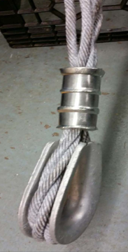
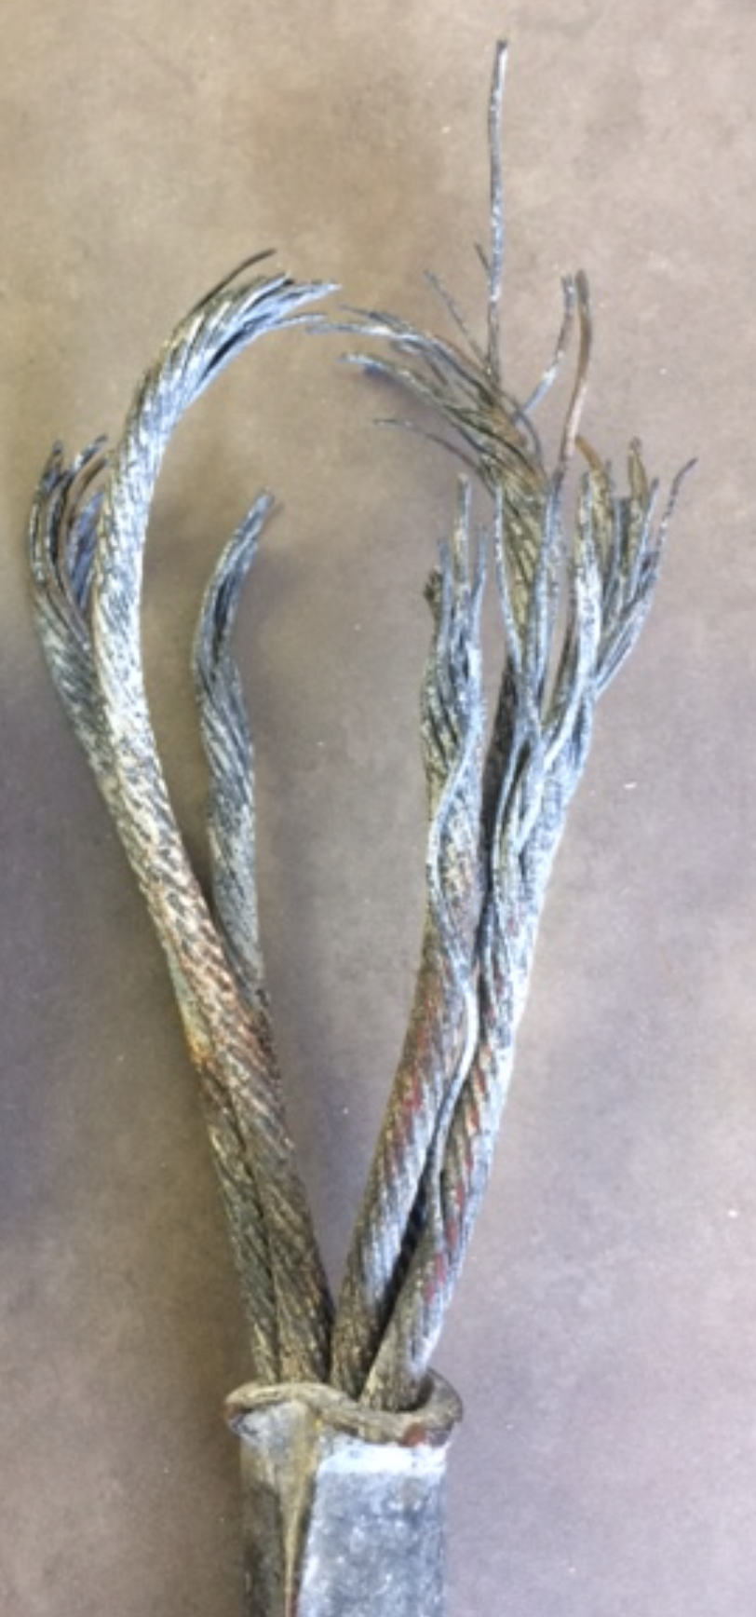

How are your terminations holding up?
3x19 Wire rope
Most comely used termination is NICO press
What we see wrong?
Improper dies and spacing
Pressing in incorrect order
Wrong thimble

Slide 8
3x19 Nico Pressed wire

Slide 9
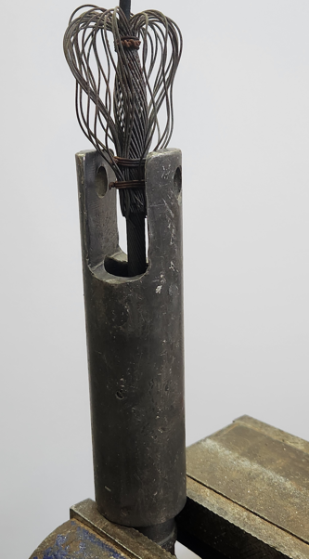
.322 Poured Socket

Slide 10
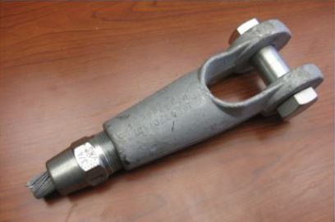
Mechanical

Slide 11
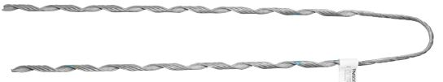
Helical Termination

Slide 12
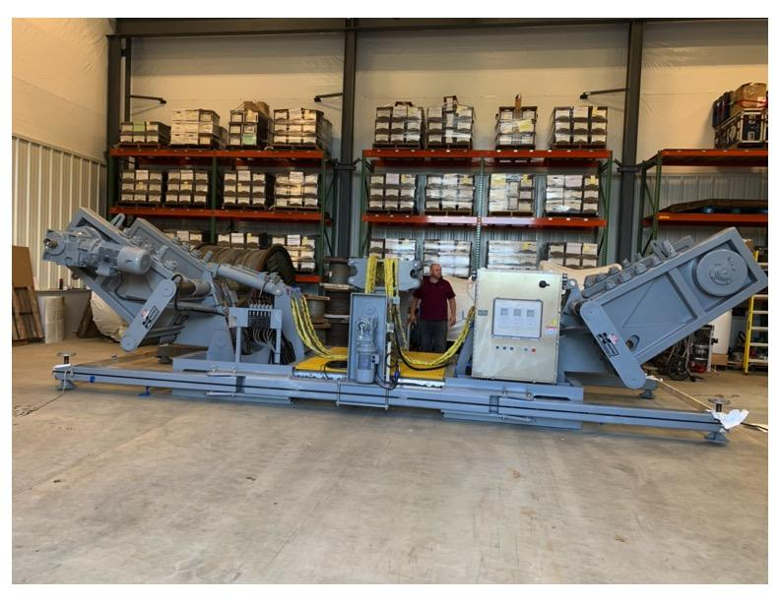
Spooler
Hawboldt Industries spooler capable of spooling 10,000 M reels of .681
Allows the Wire Pool to inspect and lubricate factory reels
Cut from factory reels to distribute to vessels, saving on shipping costs

Slide 13
Questions?

