Slide 1
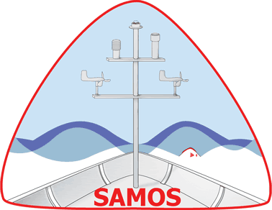
Celebrating 20 Years of SAMOS!
Shawn R. Smith, Kristen Briggs, Julia O’Neill, and Amanda Lovett
srsmith@fsu.edu, kbriggs@fsu.edu, jpo21a@fsu.edu, alovett@fsu.edu
Center for Ocean-Atmospheric Prediction Studies
The Florida State University, Tallahassee, Florida USA
RVTEC, 6 November 2025

Slide 2
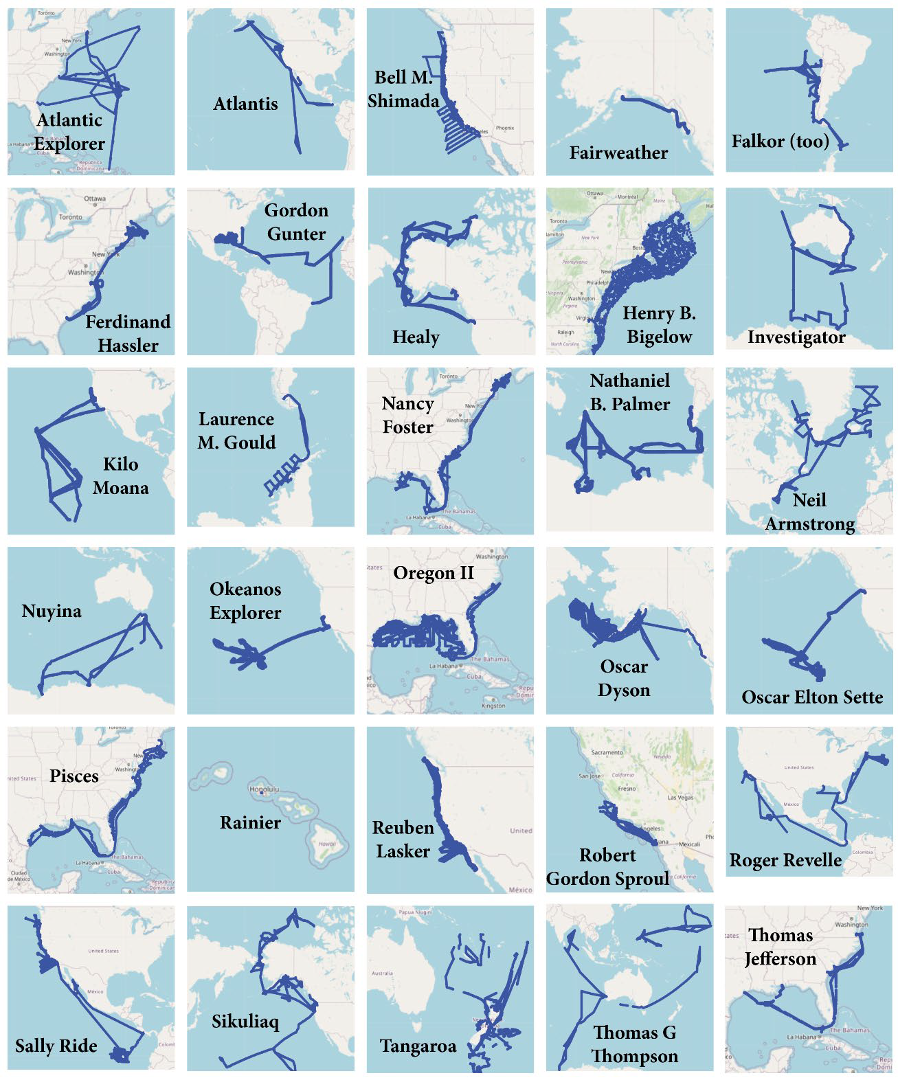
SAMOS Today
Receiving, quality controlling (QC), distributing, and archiving underway meteorological and surface oceanographic data
30 recruited vessels in 2025
9 Academic Research Fleet
15 NOAA
USCG Healy
Nathaniel B. Palmer
3 International RVs (Investigator, Tangaroa, Nuyina)
RV Falkor (too)
Cruise maps for 2024

Slide 3
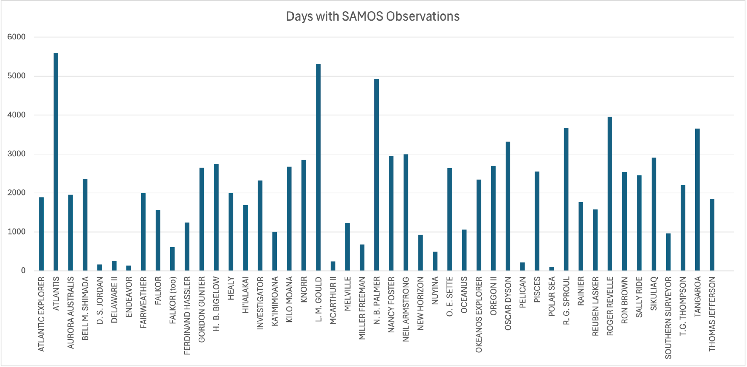
SAMOS Through the Years
47 research vessels
98,500 daily SAMOS files
Over 2.9 billion 1-minute observations
Only 4.5% of data failed QC
Over 40 Publications
25+ Technical Reports
Days with SAMOS Observations
Notes:
Publications range from data/qc practices, observation practices, physical oceanography/meteorology, climatology, modeling, satellite products, informatics,
Reports include annual QC report published annually since 2010

Slide 4
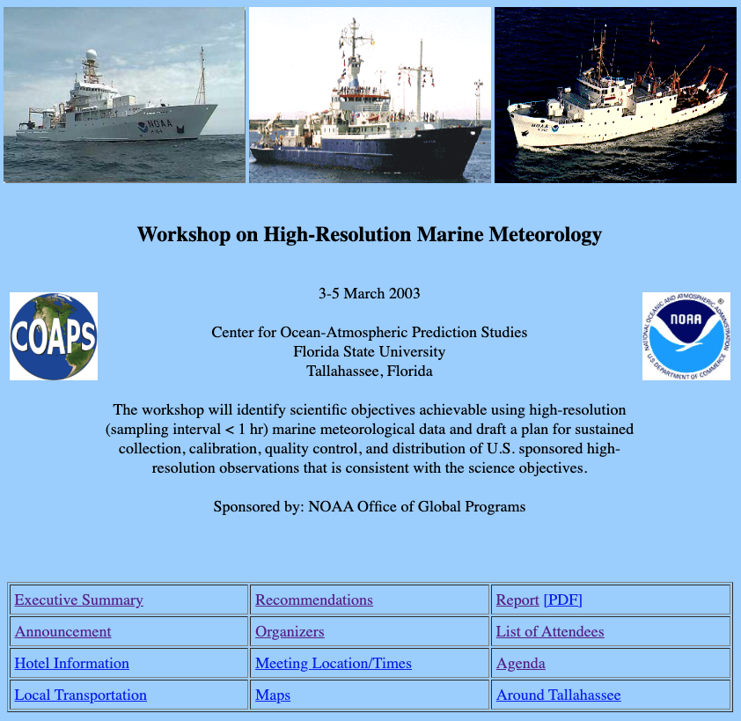
How This All Started
March 2003 – Workshop on High-Resolution Marine Meteorology
https://www.coaps.fsu.edu/RVSMDC/marine_workshop/Workshop.html
SAMOS addresses most of the 13 recommendations from this workshop
SAMOS data center established in 2004
RV Knorr first routine contributor (May 2005).
Notes:
Workshop brought together scientists, marine technicians, and data specialists to forge a partnership to ensure access to high-quality automated weather and oceanographic measurements from research ships (and other platforms).

Slide 5
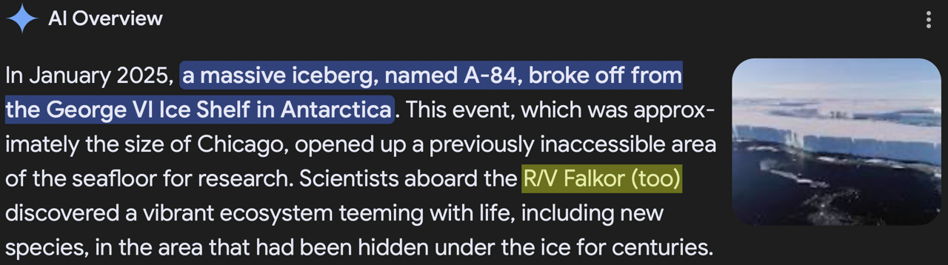
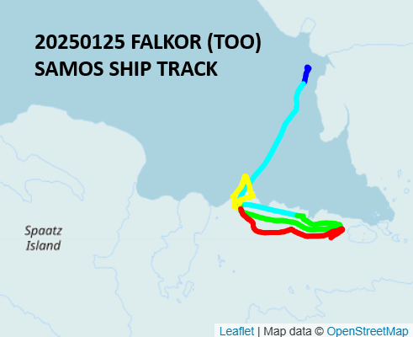
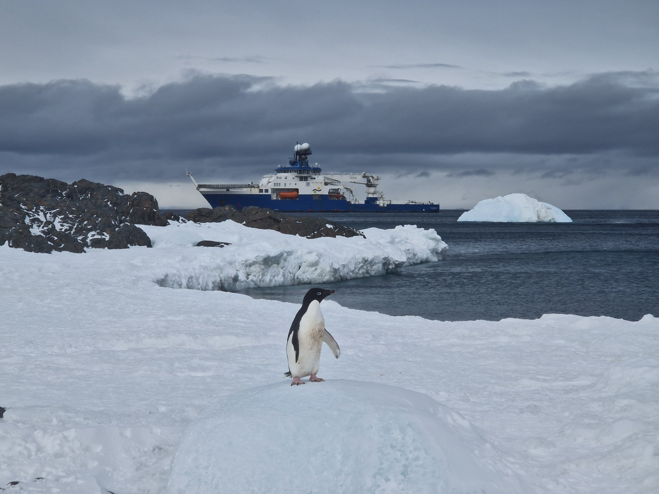
Cool Events
!
!
Image credit: J Garwood, C/O Falkor(too)
Notes:
This was just days after the shelf break – note ship track map still shows the ship “on” the shelf. (Note, Falkor(too) was already in the area and took advantage of the opportunity.)

Slide 6
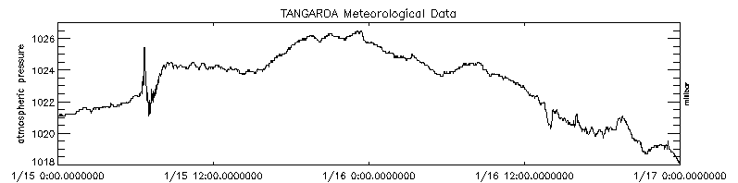
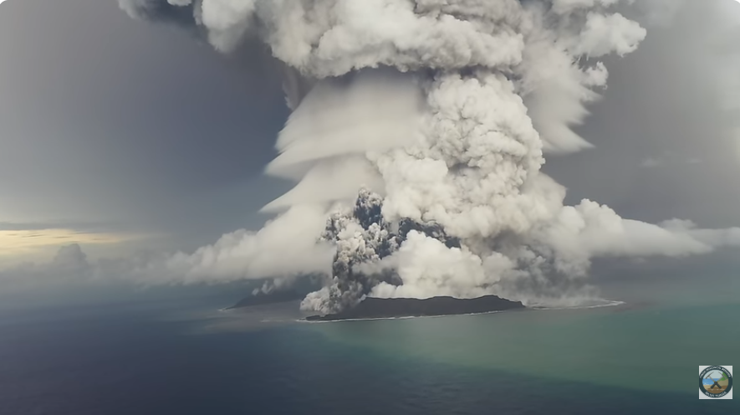
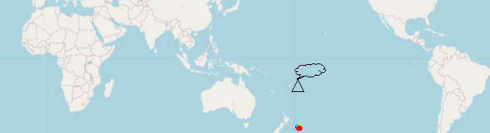
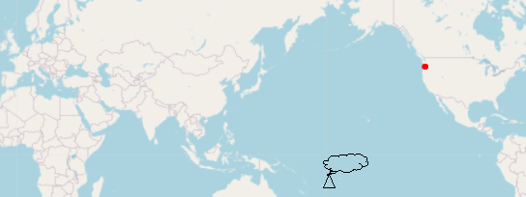
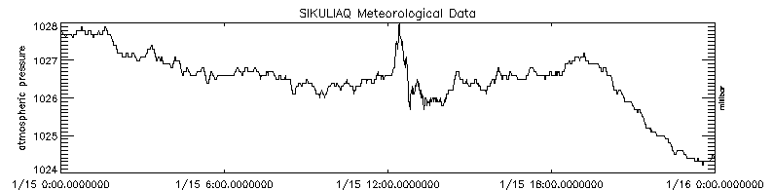
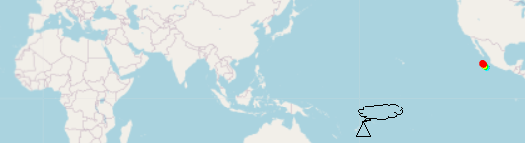
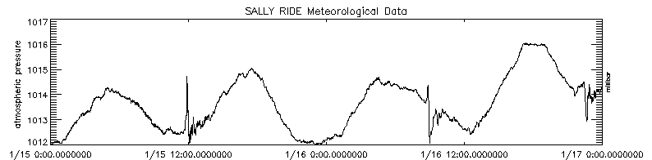
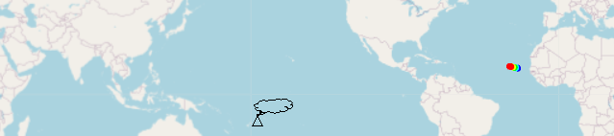
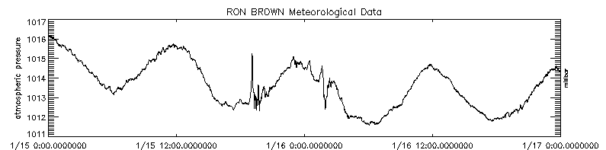
When the Volcano Blew…
P WAVE HEIGHT ~5 MB
TANGAROA: APPROX. 0600 20220115
P WAVE HEIGHT ~2.5 MB
SIKULIAQ: APPROX. 1300 20220115
P WAVE HEIGHTS ~3 MB, ~2.5 MB, ~1.5 MB
Image credit: Tonga Geological Services
SALLY RIDE: MULTIPLE HITS, APPROX. 1200 20220115, AND 0900 AND 2300 20220116
RON BROWN: SUSPECTED HITS FROM EAST AND WEST OVER A FEW HOURS!! APPROX. 1900 20220115 AND 0200 20220116
P WAVE HEIGHTS ~3 MB, ~2 MB
Hunga Tonga-Hunga H’apai 2022 volcanic eruption released a pressure wave that rocked the world!!
Notes:
13 SHIPS TOTAL, INCLUDING:
INVESTIGATOR @TASMANIA ~4 MB (8Z 20220115)
REVELLE @GUAM ~3 MB (9Z 20220115)
PALMER @AMUNDSEN SEA ~2 MB (11Z 20220115)
SPROUL @SAN DIEGO ~1.5 MB (12Z 20220115)
GOULD @PUNTA ARENAS ~1 MB (12Z 20220115)
ARMSTRONG, ATLANTIS @WHOI ~2.5 MB (5Z 20220116)
ATLANTIC EXPLORER @BERMUDA ~2 MB (6Z 20220116)
KILO MOANA @HAWAII ~2 MB (12Z 20220116)
DYSON @SAN FRANCISCO ~1 MB (22Z 20220116)

Slide 7
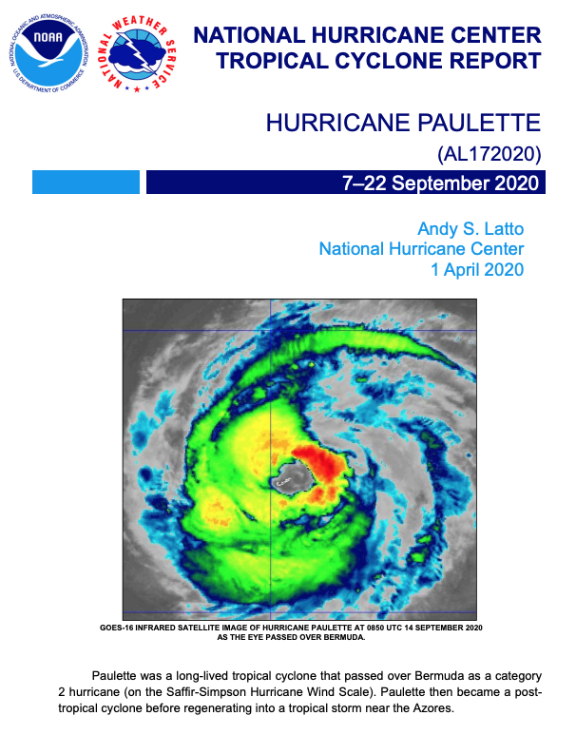
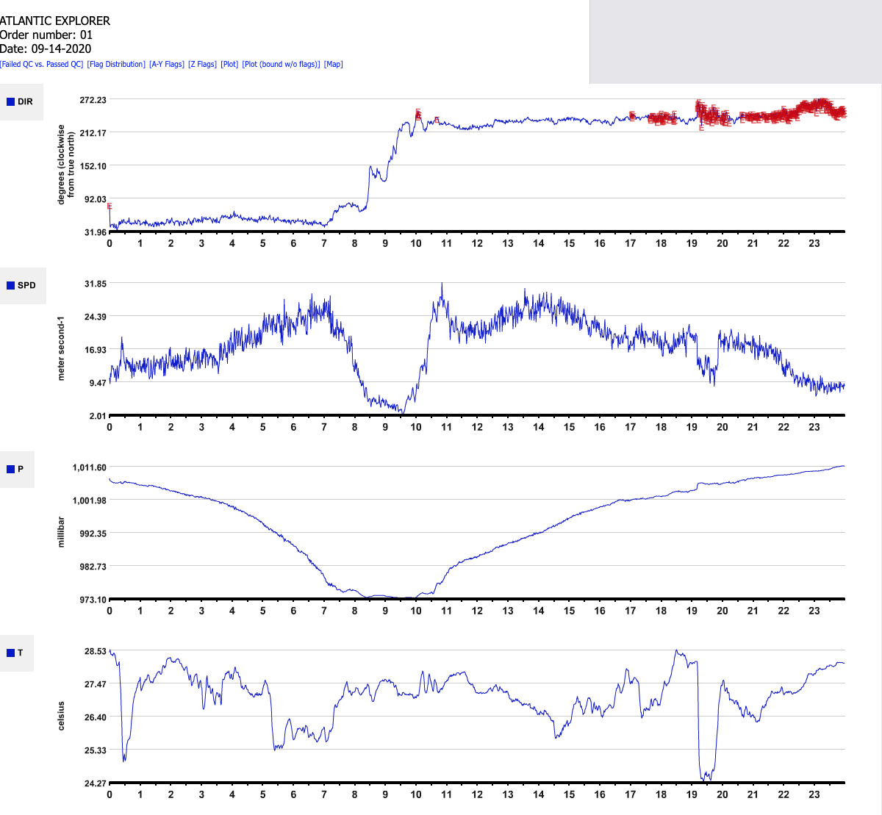
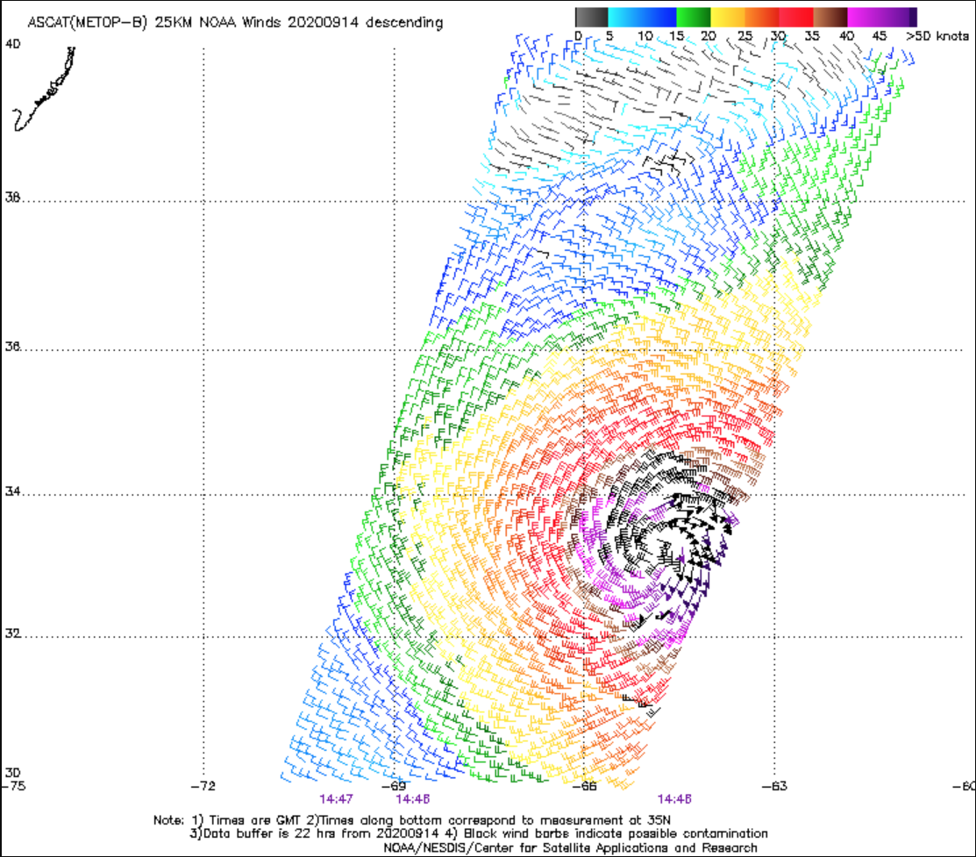
Sometimes It’s Good to be in Port
Notes:
Paulette visits the Atlantic Explorer.

Slide 8
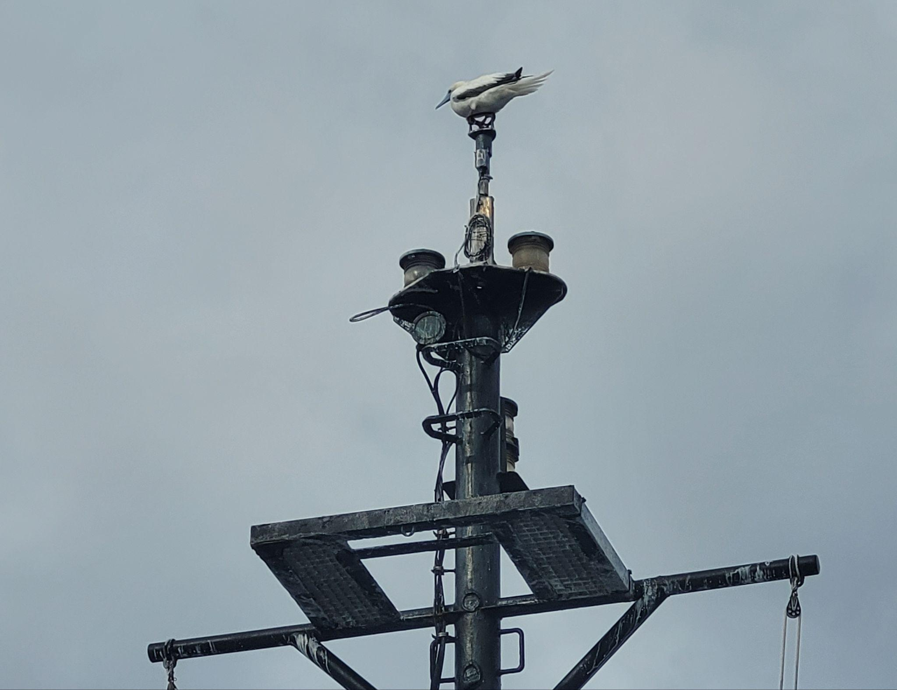
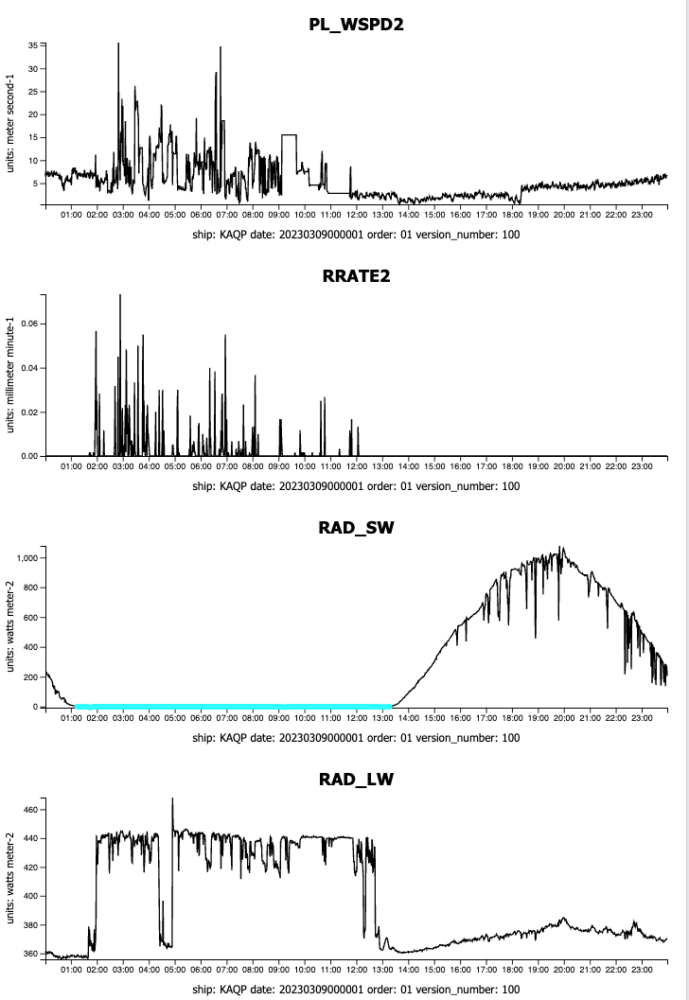
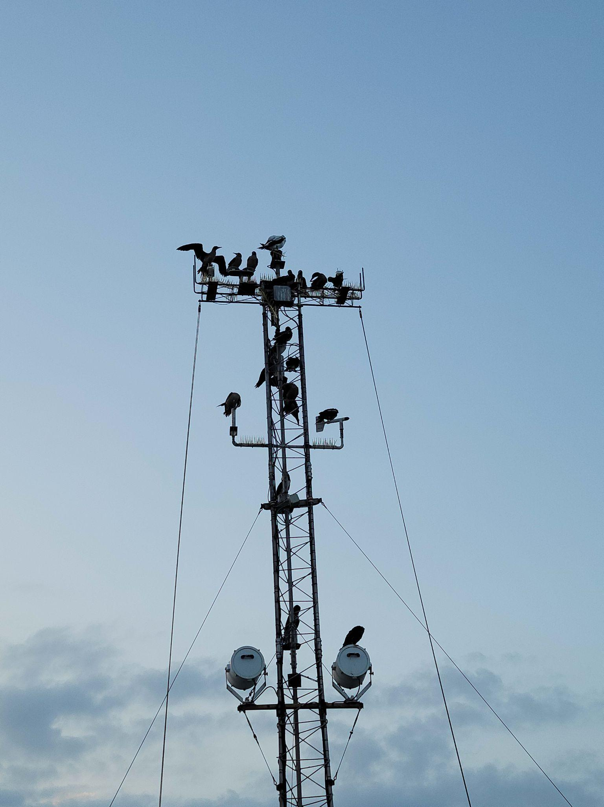
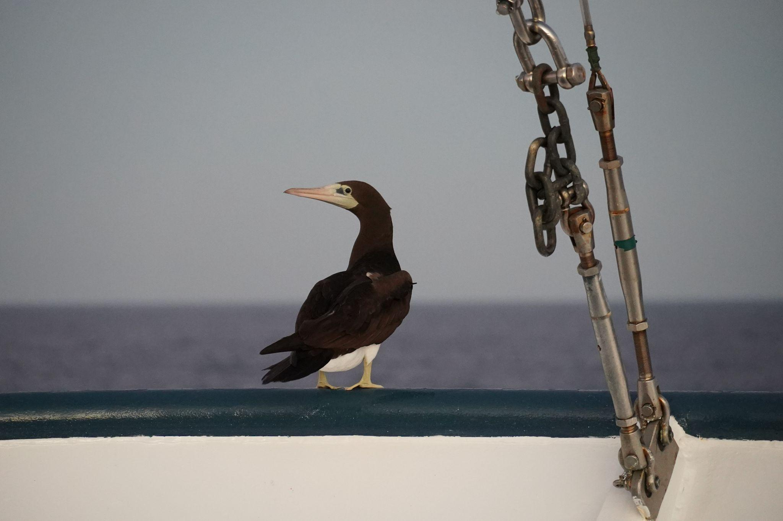
Birds! Those Pesky Birds!
Courtesy UW
Wind Speed
Courtesy WHOI
Rain Rate
Shortwave
Longwave
Courtesy Ella @ WHOI
Notes:
We’ve seen everything from bird butts warming radiometers, to artificial rain from their tap dancing, 80 m/s sonic winds from wing flaps, to sensors picked apart by eagles.

Slide 9


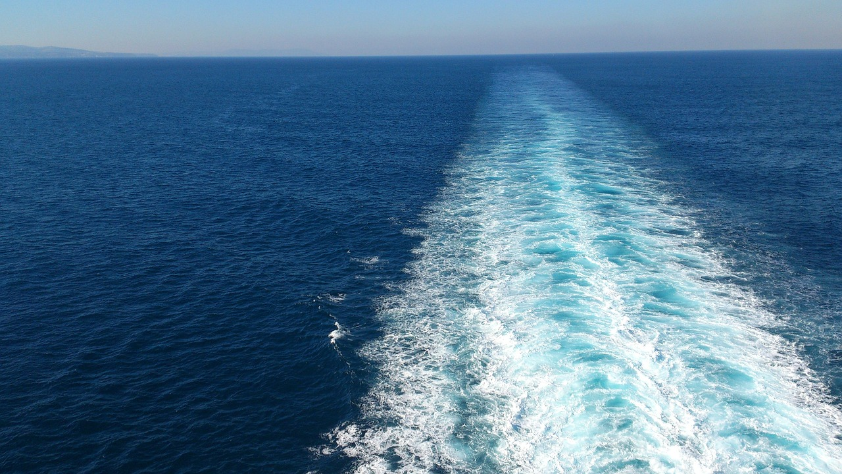
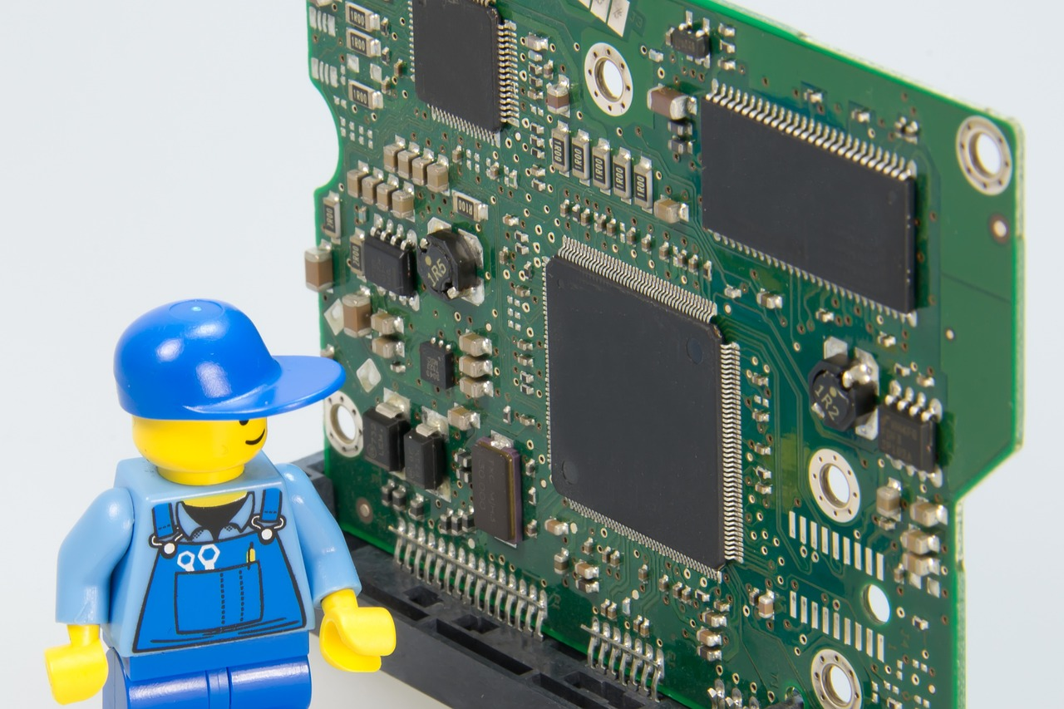
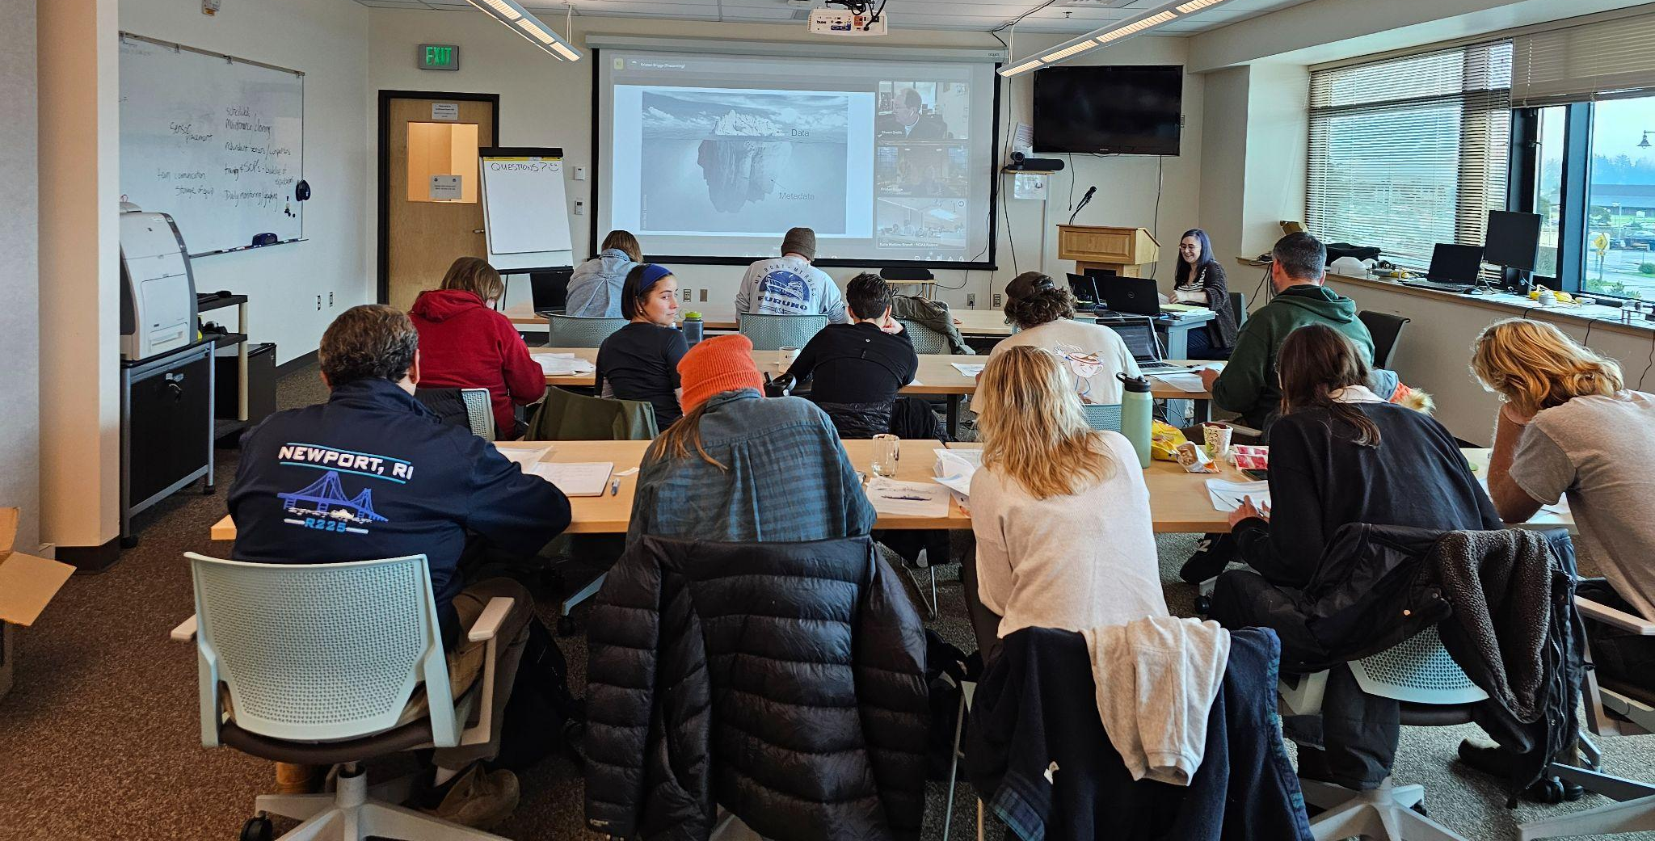
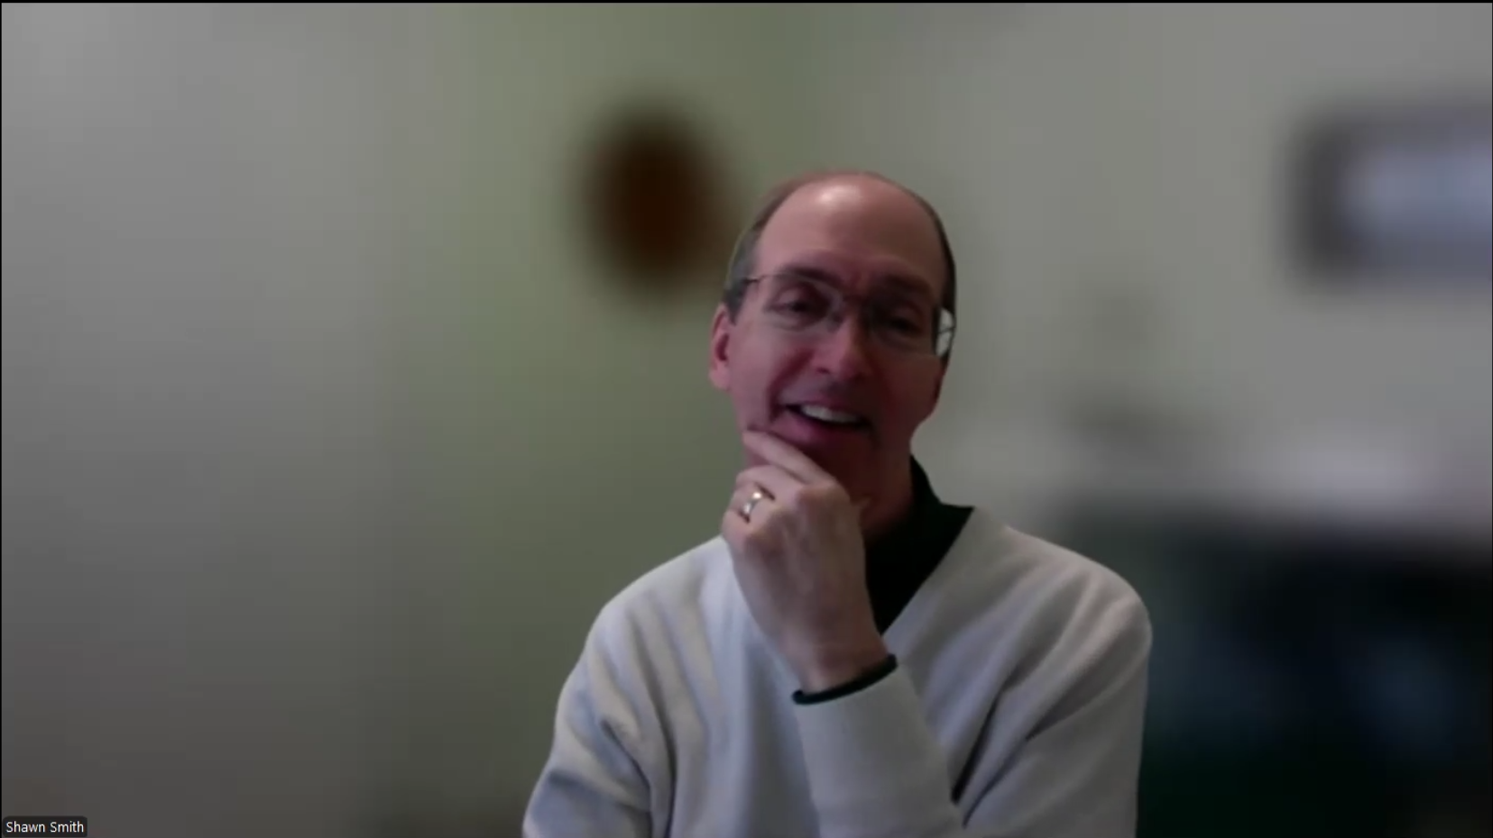
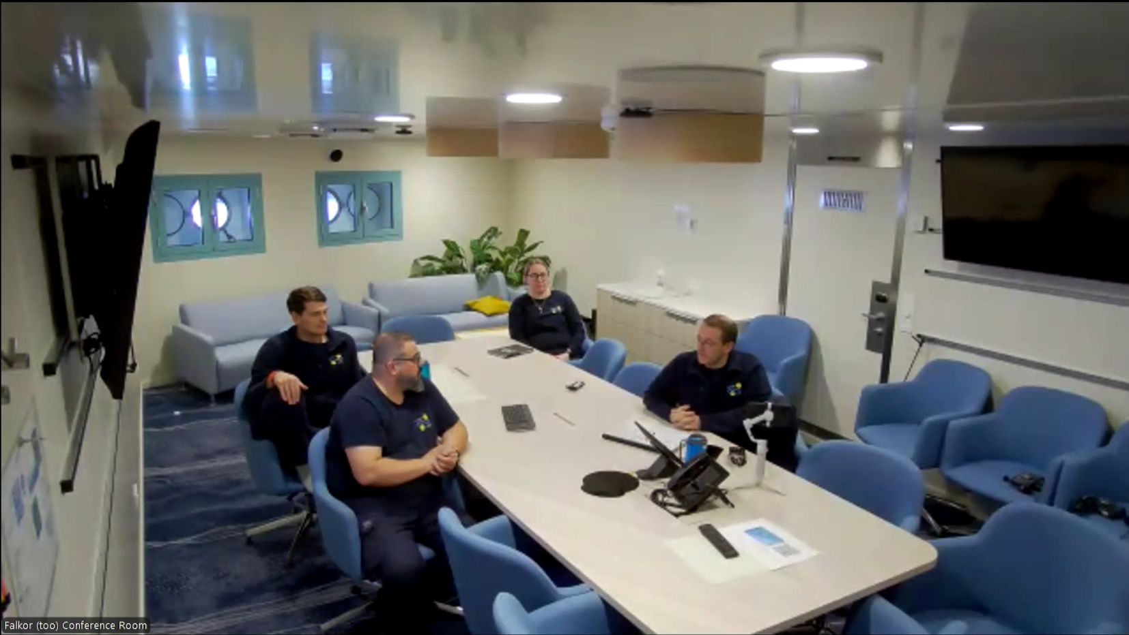
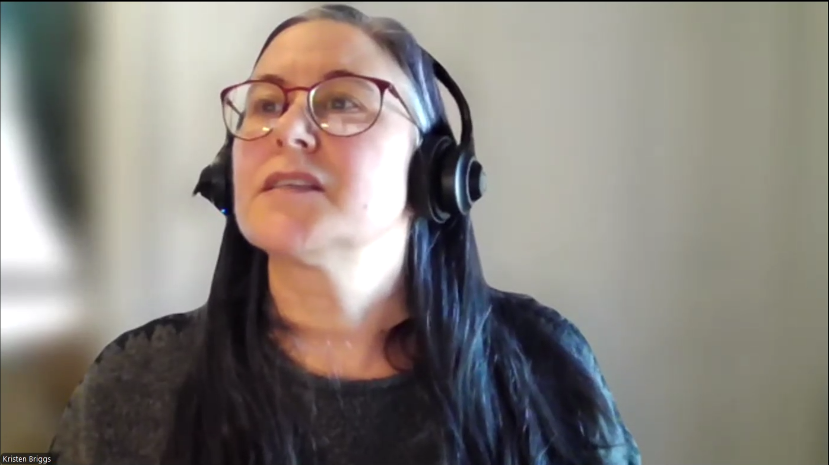
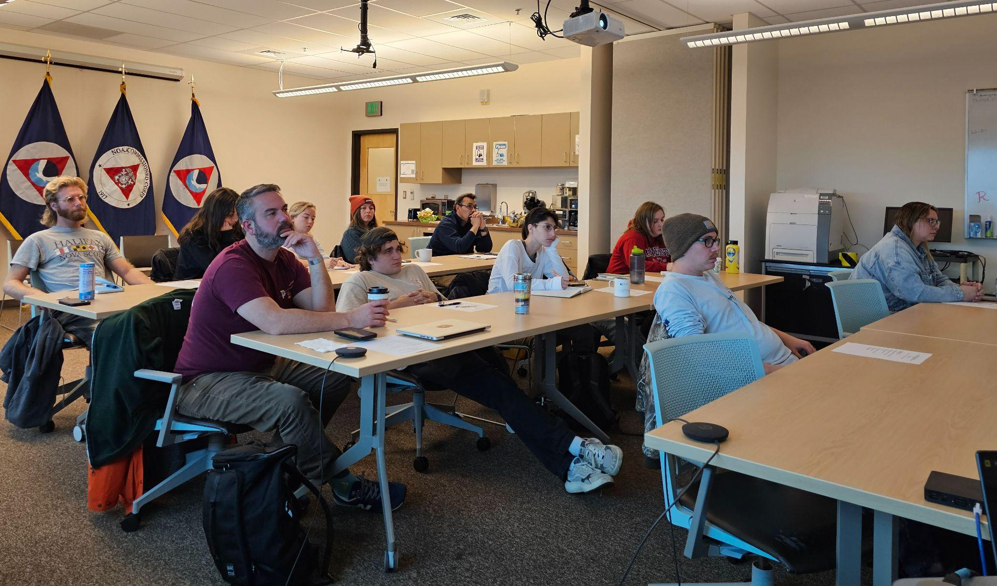

Can’t Do It Without You!
Technicians and Operators make SAMOS a success!
Falkor(too)/SAMOS 2025 Virtual Visit and Device Review
NOAA MO-DATA 2023 –
–SAMOS MET TECH SHORT COURSE
Oof!
Soooo many "ometers!"
Joke: courtesy Charlie Wilkins,Science Svcs NOAA Marine Ops - Engineering
"Pleasure in the job puts perfection in the work." - Aristotle*
Images: courtesy Katie Watkins-Brandt, Section Chief, Science Services NOAA Marine Operations - Engineering
Notes:
Tech/Operator Contributions:
hundreds of email communications a year! (SAMOS-wide)
techs also communicate with instrument manufacturers to resolve issues
techs also communicate with each other!! (RVTEC subscription mailing list)
yearly device reviews
vessel visits (virtual and in-person)
training opportunities (RVTEC, MO-DATA, virtual seminars e.g., Falkor(too), etc., SAMOS MET short course)
always a willingness to understand and learn (Two way street!)
* not actually Aristotle. (from Google AI: “While the exact phrasing "pleasure in the job puts perfection in the work" is widely attributed to Aristotle, the sentiment aligns with his philosophical ideas on activity and flourishing but doesn't appear in his surviving works with that specific wording. The quote is a modern interpretation of the Greek philosopher's views, suggesting that joy in an activity leads to greater skill and excellence.”)

Slide 10
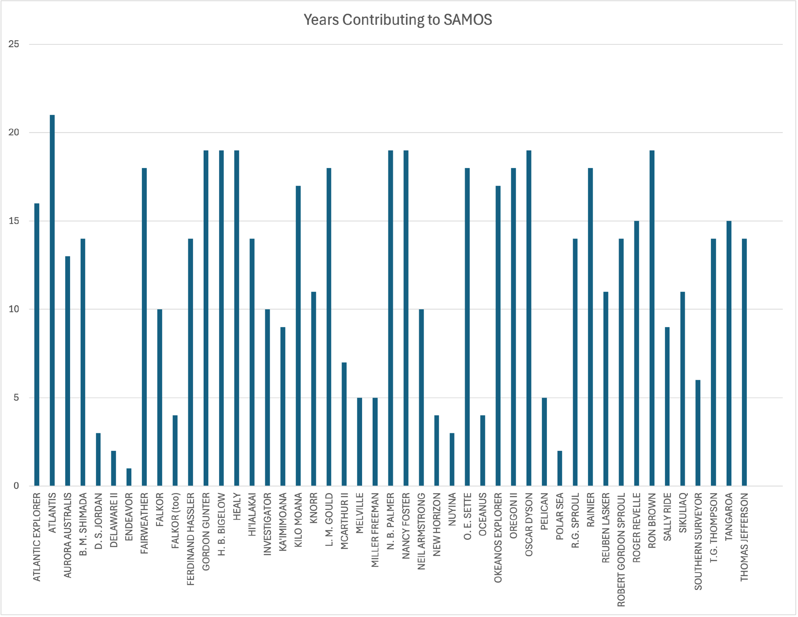
Many Long Time Contributors
Years Contributing to SAMOS

Slide 11
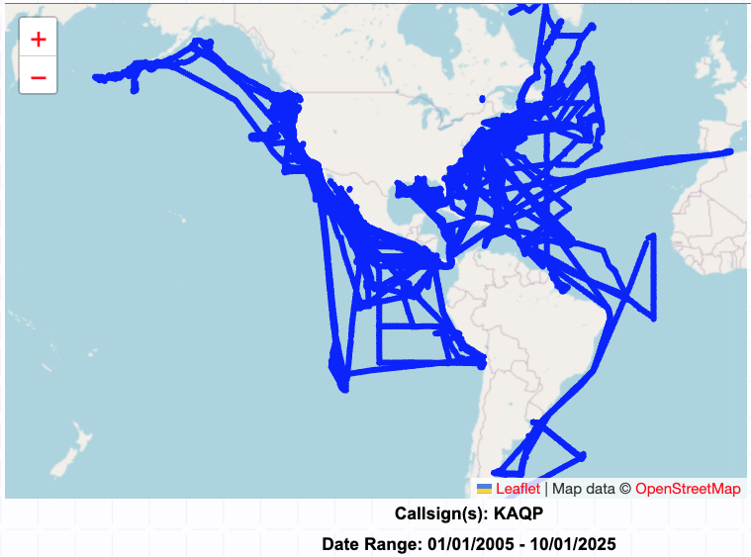
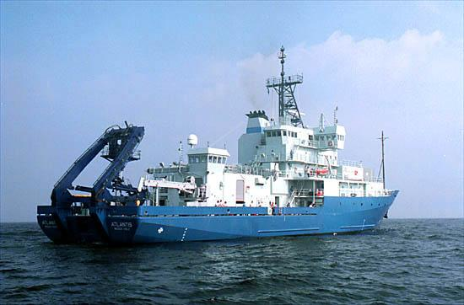
Congrats to ATLANTIS: 20+ Year Contributor!

Slide 12
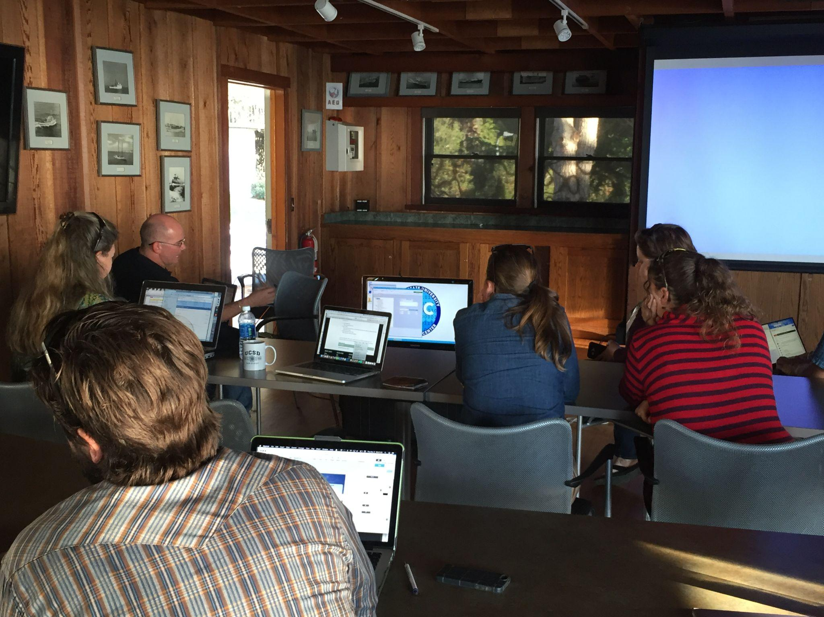
Thank You!
NSF Oceanographic Instrumentation and Technical Services Program
NOAA Global Ocean Monitoring and Observing Program
NOAA Office of Marine and Aviation Operations
Schmidt Ocean Institute
RVTEC Community!
Met training, RVTEC 2016 @ Scripps
Notes:
And several NOAA programs before GOMO: Global Programs, Climate Observations, etc.
Too many techs, others to thank.

Slide 13
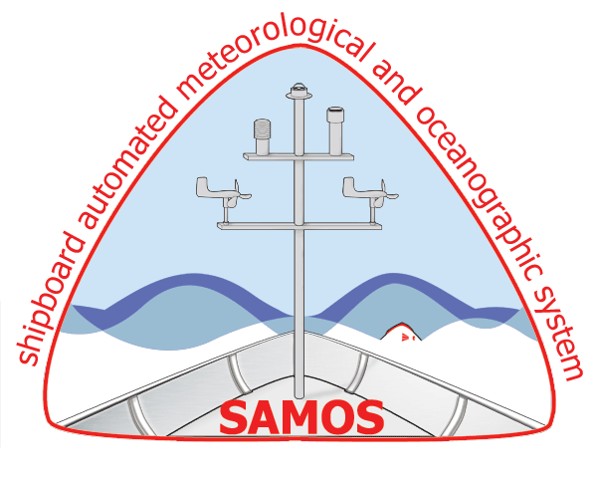
Questions?
The SAMOS data center is funded by the National Oceanic and Atmospheric Administration’s (NOAA) Global Ocean Monitoring and Observing Program (FundRef number 100000192) and the Office of Marine and Aviation Operations via subawards (191001.361472.01B, 191001.361472.01F) administered by the Northern Gulf of Mexico Cooperative Institute (grant NA21OAR4320190) at the Mississippi State University. Support for Academic Research Fleet vessels’ participation within SAMOS is provided by the National Science Foundation (NSF), Oceanographic Instrumentation and Technical Services Program via a subcontract from the University of California San Diego grant OCE-2439640. The Schmidt Ocean Institute (SOI) provides contract funding to include the RV Falkor and Falkor (too) in the SAMOS initiative.
Any opinions, findings, and conclusions or recommendations expressed in this presentation are those of the author and do not necessarily reflect the views of NOAA, NSF, or SOI.

