Slide 1




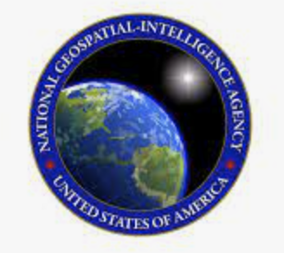

PFPE 2025
PFPE
Marissa Small, Masako Tominaga, Maurice Tivey, Jyun-nai Wu, Steve Faluotico AND Tom Lanagan
Nigel Brady (DGS), Alicia Metzger (NGA)

Slide 2
PFPE
Potential
Field
Pool
Equipment
= Marine gravimetry and magnetometry for science and national security relevance.
Notes:
Science and national security relevance
Summarize how pfpe works, liaison among operator and R2R, and occasional science user support
We are a resource for science and ship support

Slide 3
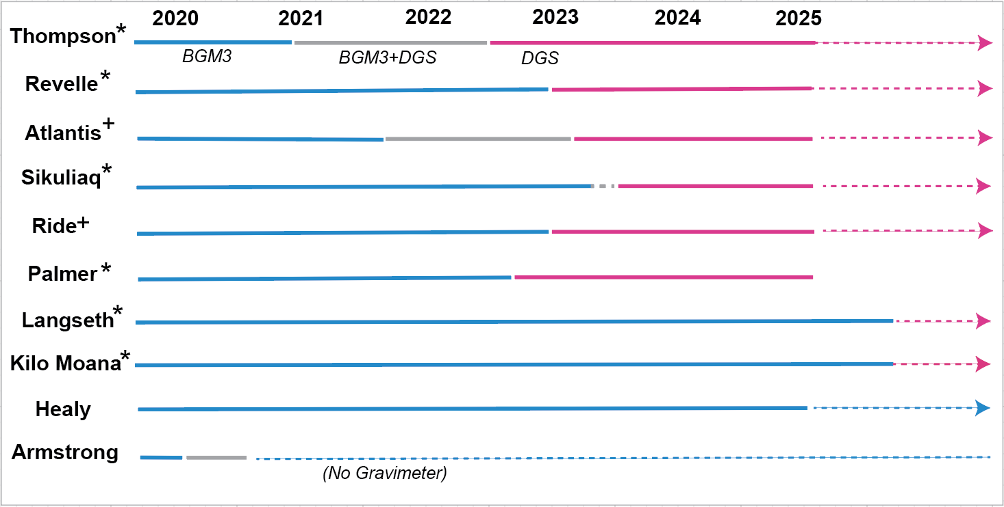
2025-PFPE Activities and Updates
Notes:
This year’s highlight – Thank to Tim McGovern’s continued support, PFPE could retire the Langseth’s BGM3 system and installed DgS.
The first Academic Research vessel that experienced the BGM3 to DGS was Thompson; her 5-yr maintenance is currently undertaken. The DgS meter is being checked out, and then sent back to Singapore toward the end of the dry dock to support upcopming science missions.
The saddest news was the demob of science instrument from Palmer. I was there for their newly installed DGS meter (December 2023) in the 3rd week of September in Punta Arenus Chile. This meter will be on the way to the manufacture to check up in next February, and the PFPE is hoping to then replace the BGM3 system with this meter on Kilo Moana.
If I can find in the room Andrew, matt and hila – thank them for USAPs effort to have them there, and thank them for being there at RVTEC as well

Slide 4
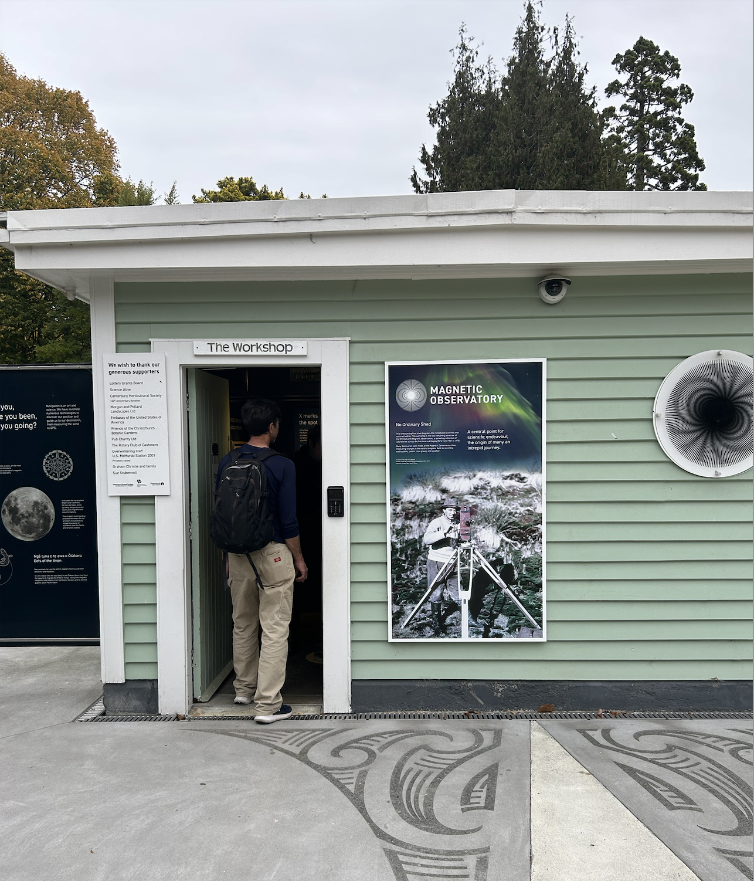
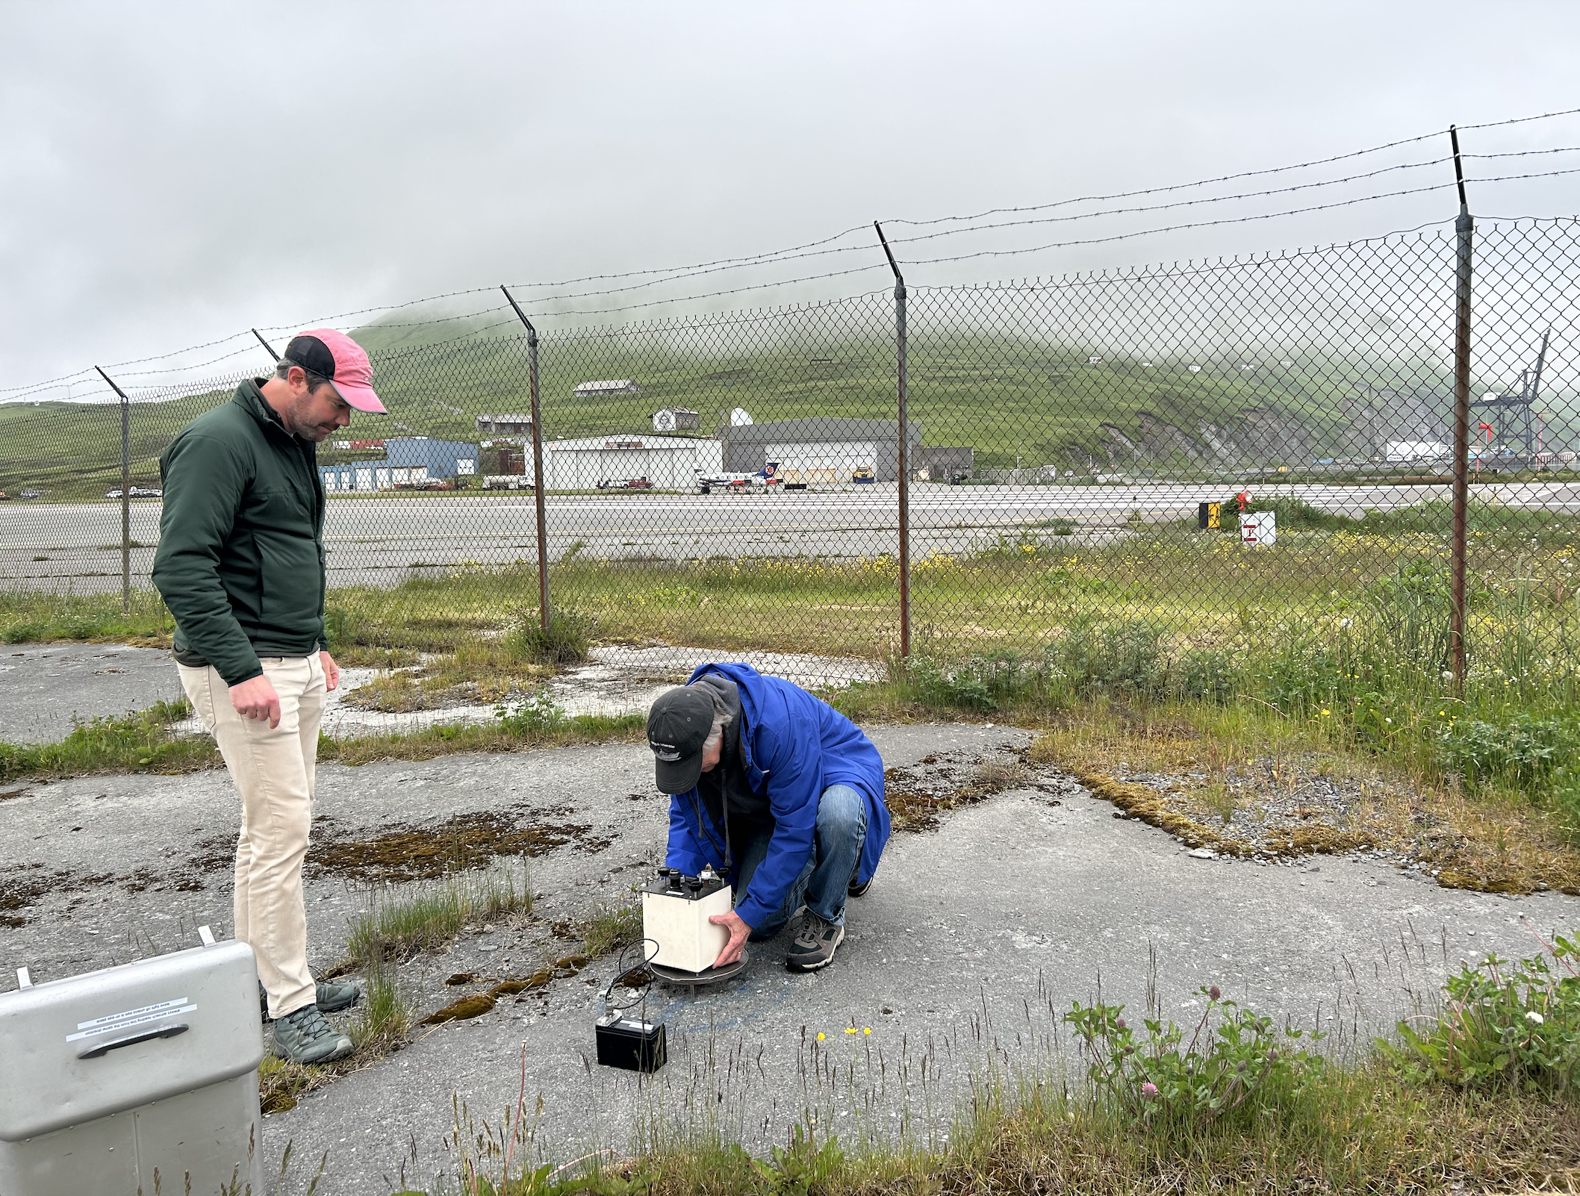
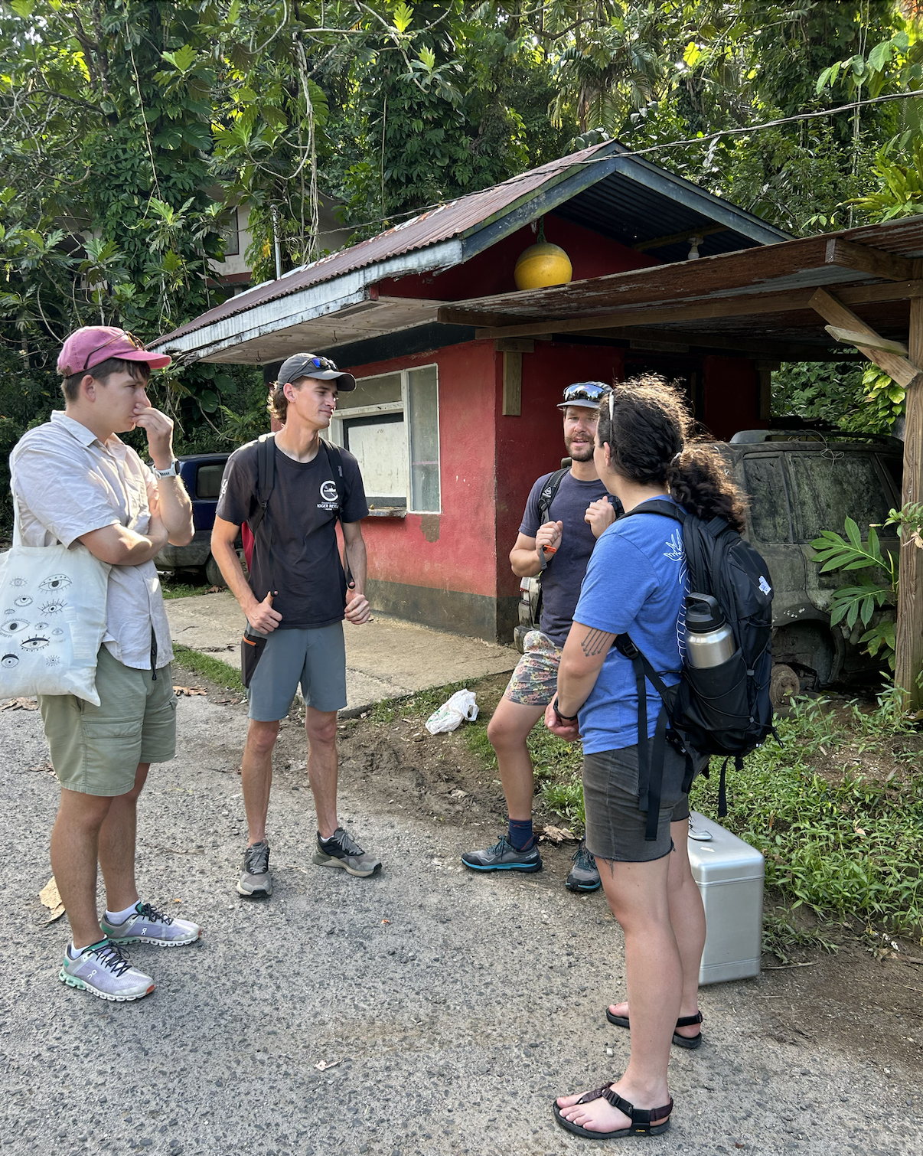
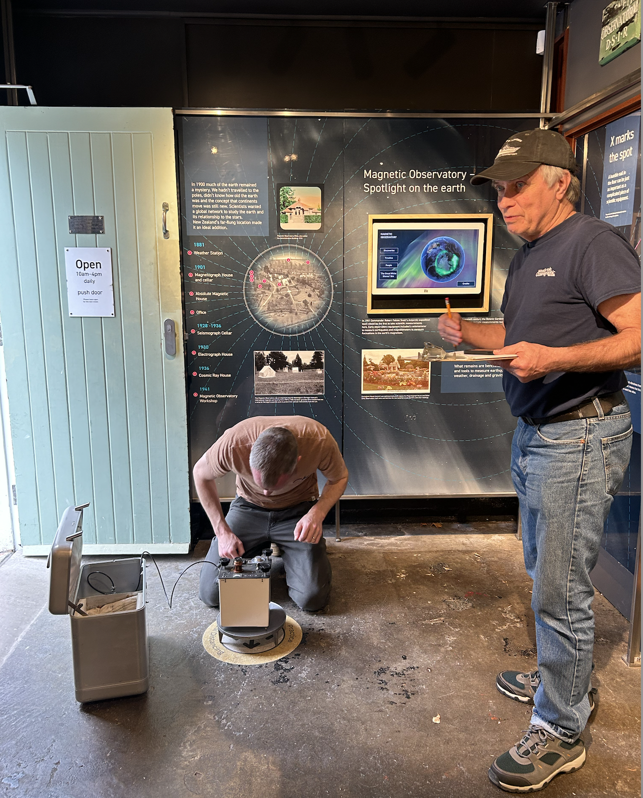
WHY “TIES” NECESSARY?
Because without them, the data (that goes to R2R) will not be use-able!!
Both the gravity tie bias number and the gravity data should go to R2R
Notes:
We often get questions: “should we do land tie/gravity tie?” – the question should be “we will be in this port, do you have any information where would be the land tie station?” because the answer to the first question is always YES. Even with this new, 21-st century gravimeter, the mechanical components will drift over time, and correcting them as frequent as possible is the only way to make the data collected use-able.
Many of you went through this – if you are lucky, the absolute station has it’s own little museum like the one in botanical garden in Christchurch, New Zealand. Or, you may never find one in the jungle in Pohnpei – even two marked back in 1970s….. Or, you find a very faint paint mark on the station mark right next to the Dutch Harbor airport….. so after your successful measurements, you might want to retouch the paint for future fellow grav-tie-rs.
IF you have questions about (1) whether or not your port call situation would be gravity tie or land tie – ask PFPE! (2) sometimes you have to be on anchorage – ask PFPE what to do!
We are here to help.

Slide 5
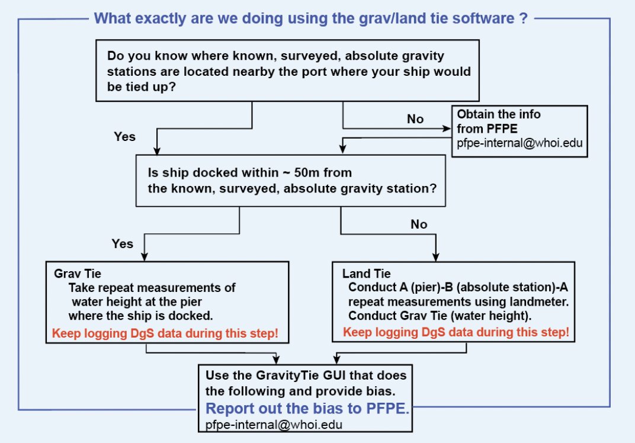
GRAVITY/LAND TIEs

Slide 6
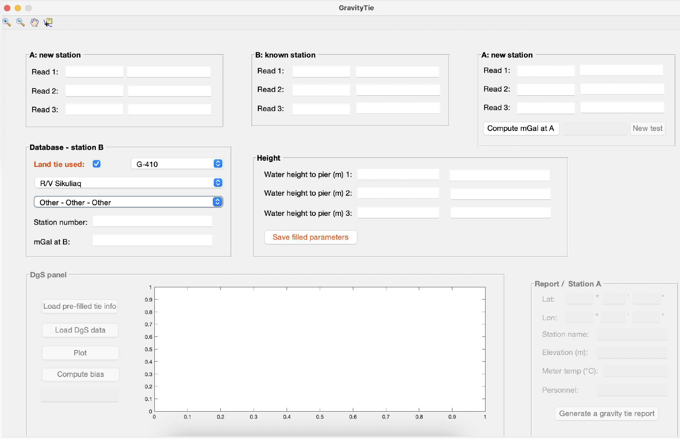
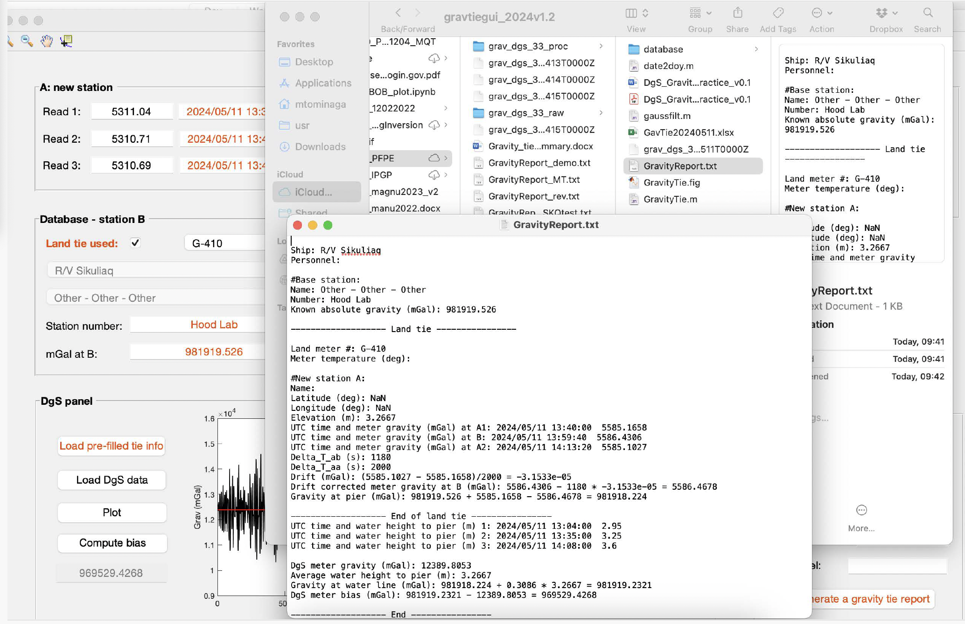
Have you used the new GravGUI yet?

Slide 7
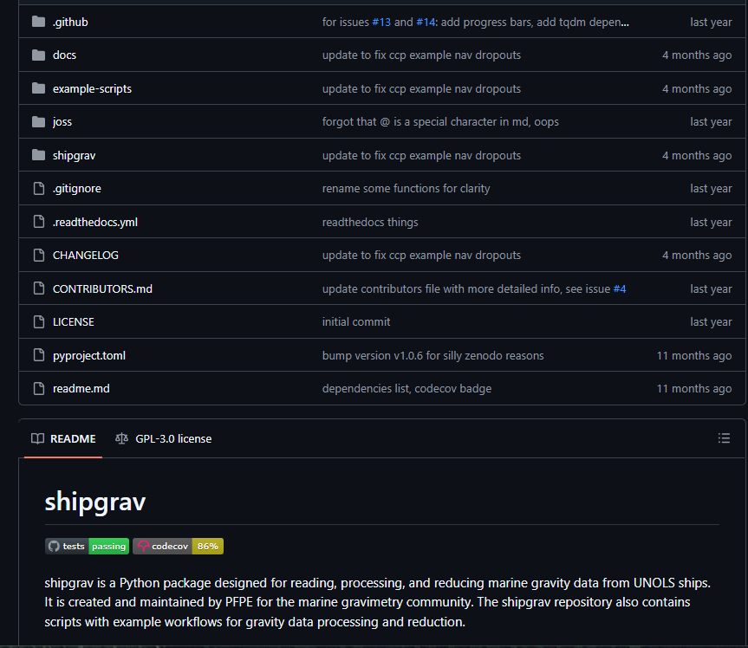
Gravity Data Processing and Quality Checking
PFPE has developed a python package called ‘shipgrav’ with various functions for processing gravity data. This is available through the PFPE github.
PFPE can (often will ask to!) perform data quality checks, especially from newly installed Gravimeters using example scripts from this package, which are also available to anyone who wants to process gravity data.
To accurately check the data, the bias number from the gravity tie is needed to calculate the drift.
Notes:
We are providing the operators to be able to guide the science users, software and documentation repository, extra thanks to Hannah Mark at Columbia and Jyun-Nai Wu at WHOI

Slide 8
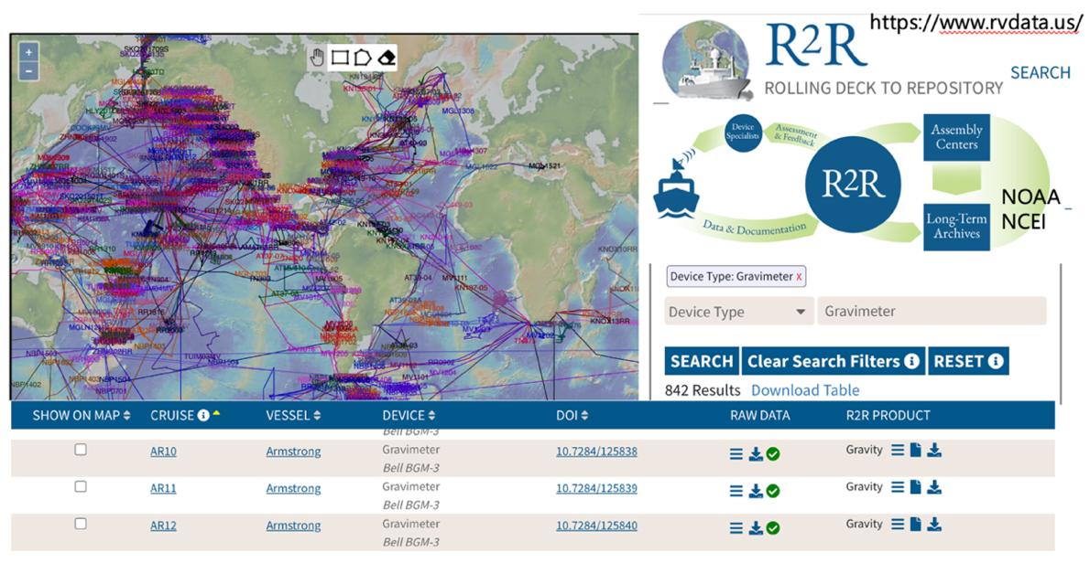
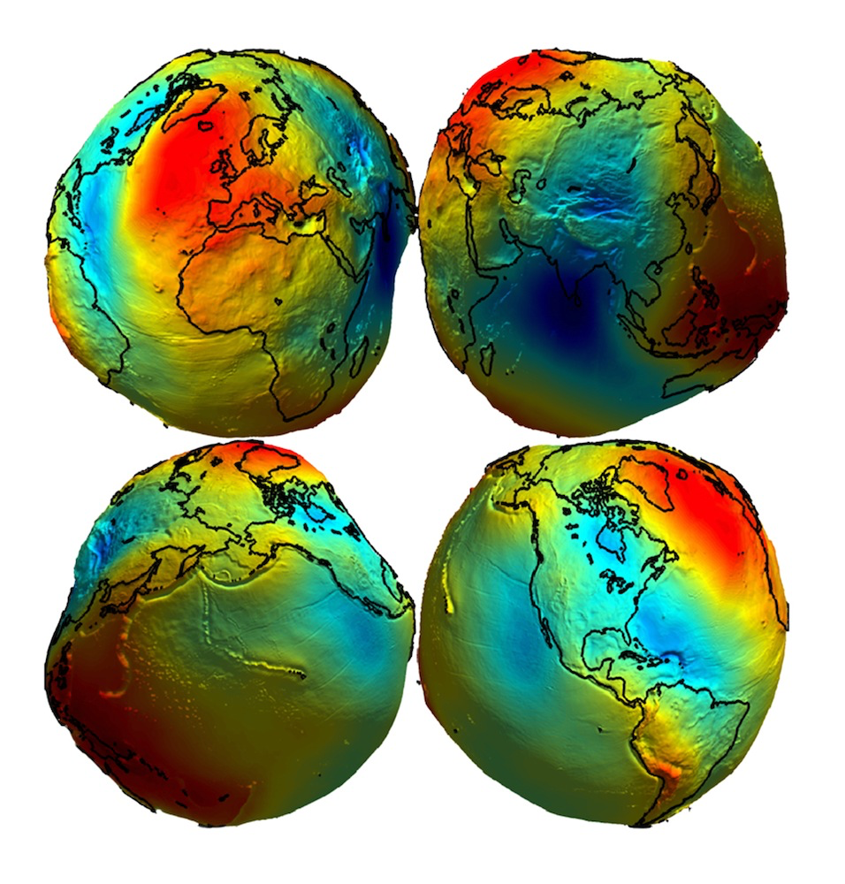
GRAVITY DATA from UNOLS ARF Multi-agencies Multi-Institutions collaboration
Why is Gravity Data Important?
(National Geospatial Agency)
Notes:
To refine our understanding on the ACTUAL shape of Earth (GEOID),
we need gravity data from your vessels!!
Another example – so that you could hold a visual image.
This is why it matters.
EVERY SINGLE nautical mile you sail DOES matter for addressing this question.
It is, in essence, what academic research fleet delineates their missions from any industry or defense platforms.
“Earth Gravitational Model (EGM)
This division in the Office of Geomatics at NGA is responsible for
collecting, processing, and evaluating gravity data (free-air and
Bouguer gravity anomalies). These data are then used to compute
gravimetric quantities such as mean gravity anomalies, geoid heights,
deflections of the vertical, and gravity disturbances. All of these
quantities are used in World Geodetic System 1984 support, navigation
systems, mapping projects, and different types of surveys.
An Earth Gravitational Model (EGM) is set of geopotential coefficients
used in a spherical harmonic expansion to create a global potential
surface to coincide with Mean Sea Level (MSL).
This surface is called a geoid and it fluctuates above
and below the reference ellipsoid surface established by WGS 84.”

Slide 9
PFPE within UNOLS/NSF-supported Facilities
[From MISO point of view. Scale and location of boxes are arbitrary.]
MARSSAM
Wire pool/EC- & WC-Winch pool
WHOI Mar. Ops.
[SSSG]
PFPE
SCIENCE: UNOLS ARF cruises
& extra-UNOLS clientele
WHOI Mar. Ops.
[NDSF]
R2R, MGDS
Core Repositories
MISO
WHOI deep submergence
science/technology expertise
US Oceanography

