Slide 1

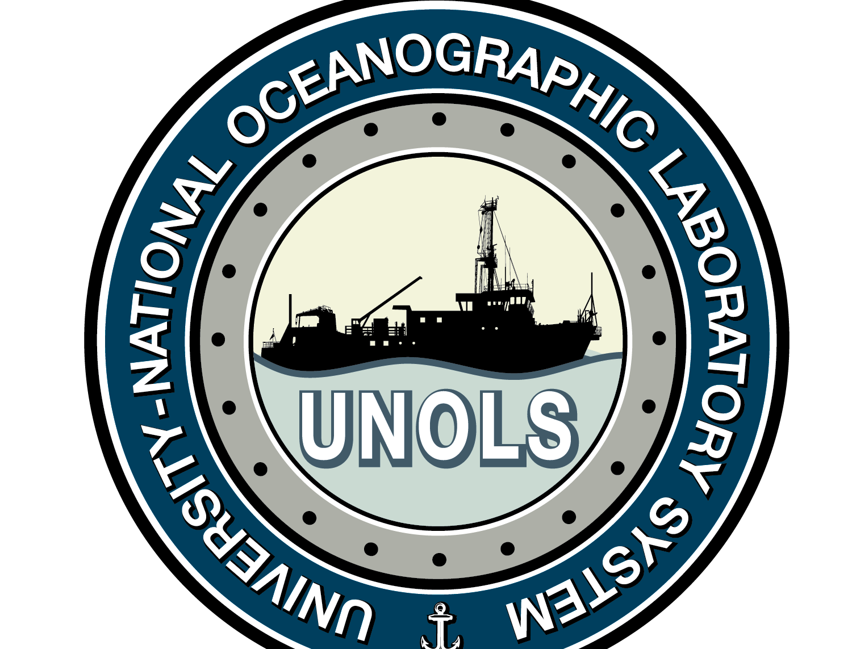
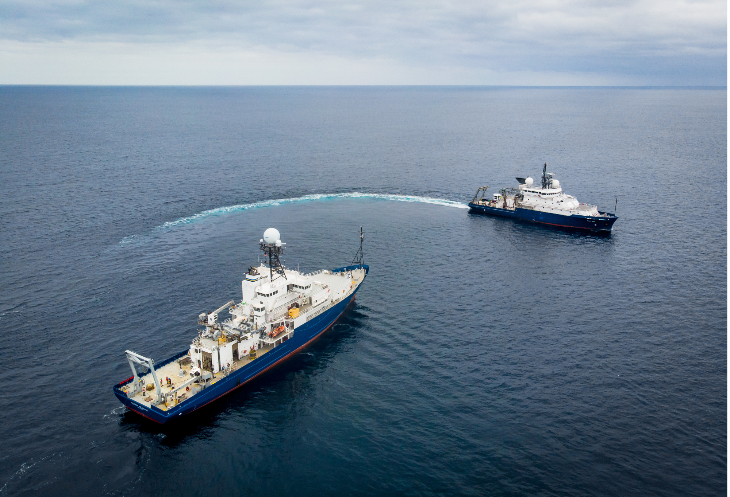


The UNOLS Technician Pool – 2025 Update Supporting Oceanographic Research through Technical Expertise
Kyndra Reed & Tara M. Clemente

Slide 2
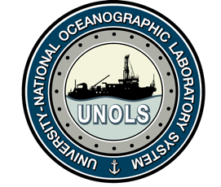

History
2012 Small-scale start of pool (2 techs)
Jan 2015 NSF issues RFP for 5-year Cooperative Agreement
Jan 2016 Final agreement between NSF and TAMU;
pool to run through February 2021.
March 2016 Pool begins operations with 2 members; 7 by year end
February 2021 No-cost extension
June 2022 New 5-year contract with TAMU;
October 2025 In year 9, 12 techs deployed this year, 50 have participated to date

Slide 3
Goals of Program
To retain a pool of experienced technicians and ensure that the necessary technical support is available for oceanographic research cruises when the ship’s operator does not have the necessary support in house;
To provide opportunities for new/younger marine technicians to sail on multiple ships and learn the latest techniques from senior operatives they would likely not meet otherwise;
To ensure that experience built up over many years of marine operations is retained within the marine technician community even as older operatives retire; and
To work with UNOLS Technical Support Manager and handle all necessary support functions for technicians, including being a voice.

Slide 4
How it Works
Technicians employed as independent contractors
Initial agreement plus individual service supplements for each deployment
Group insurance covers Maritime Employers’ Liability and Marine General Liability insurance (2 claims to date); technicians responsible for own medical coverage
Paid at standard day rates (depending on experience/abilities) based on 8 hr/day ashore, 12 hr/day at sea; includes travel and mob/demob days. Pay rise of 5% at all levels began Jan 2022. Another 7% increase for all levels began Jan 2025
Eligible for attending training workshops if complete 100 days at sea/yr
Work NOT guaranteed and techs may opt in and out of assignments and/or pool

Slide 5
Tech Pool Participation
Since 2016, 50 Techs have participated in 337 Cruises.
24 Ships have used the Tech Pool
2025: 12 Techs have participated in 15 cruises, so far.

Slide 6
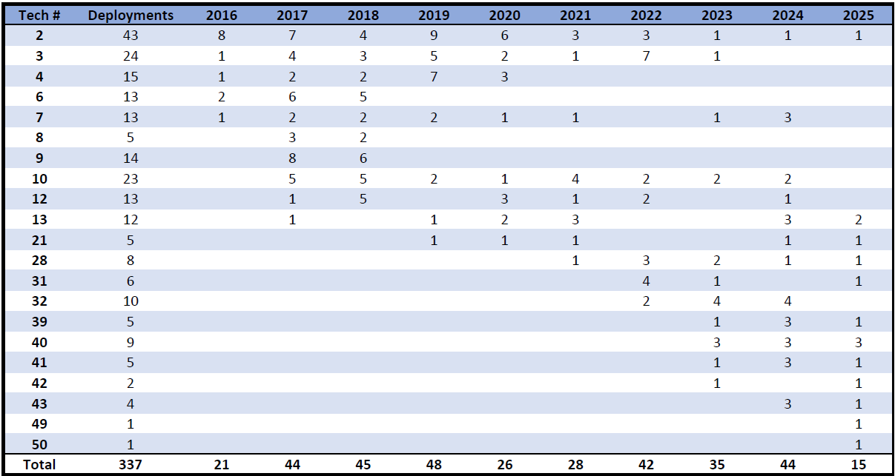
Deployment Variety
Work With:
Different Ships
Different Technicians
Gain & Share
Knowledge & Experience

Slide 7
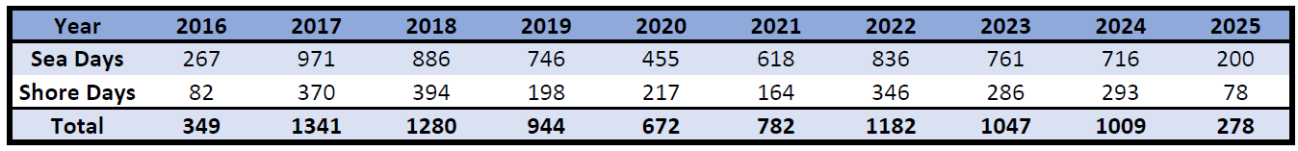
Days Worked

Slide 8
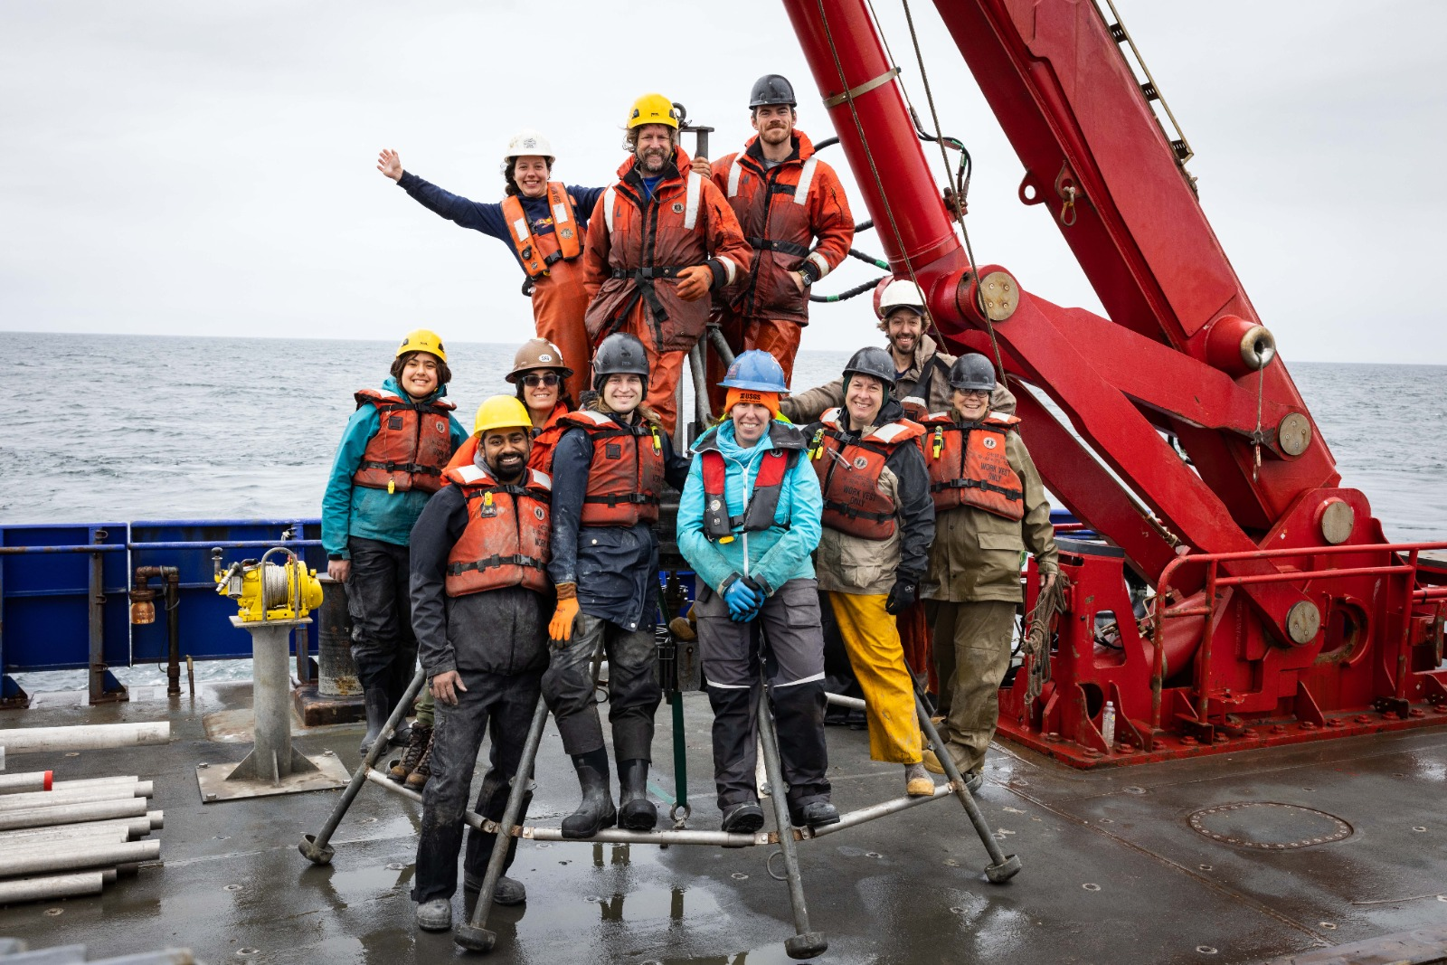
Getting Involved with the UNOLS Tech Pool
Who’s heard of the UNOLS Tech Pool?
Who’s been in the Tech Pool — or is in it right now?
And who’s curious to learn more about how to join the Tech Pool?

Slide 9
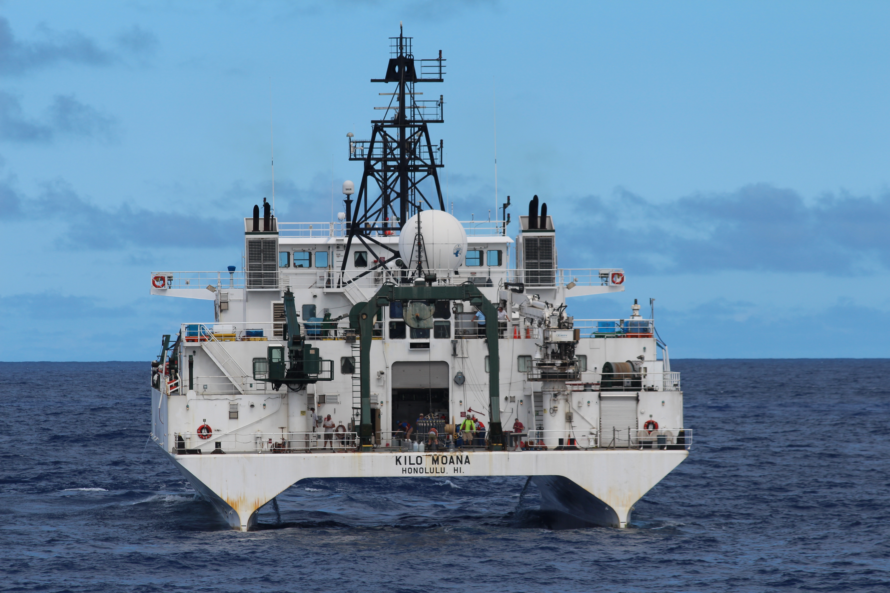
Why Join the Tech Pool?
Always looking for experienced and aspiring Marine Technicians
Benefits include:
Hands-on experience – Work aboard state-of-the-art research vessels supporting cutting-edge science.
Career Flexibility – Take on projects as available with no long-term commitment
Networking Opportunities – connect with marine professionals and researchers.
Travel & Adventure – Participate in Research cruises worldwide.
UNOLS Tech Pool Operations

Slide 10
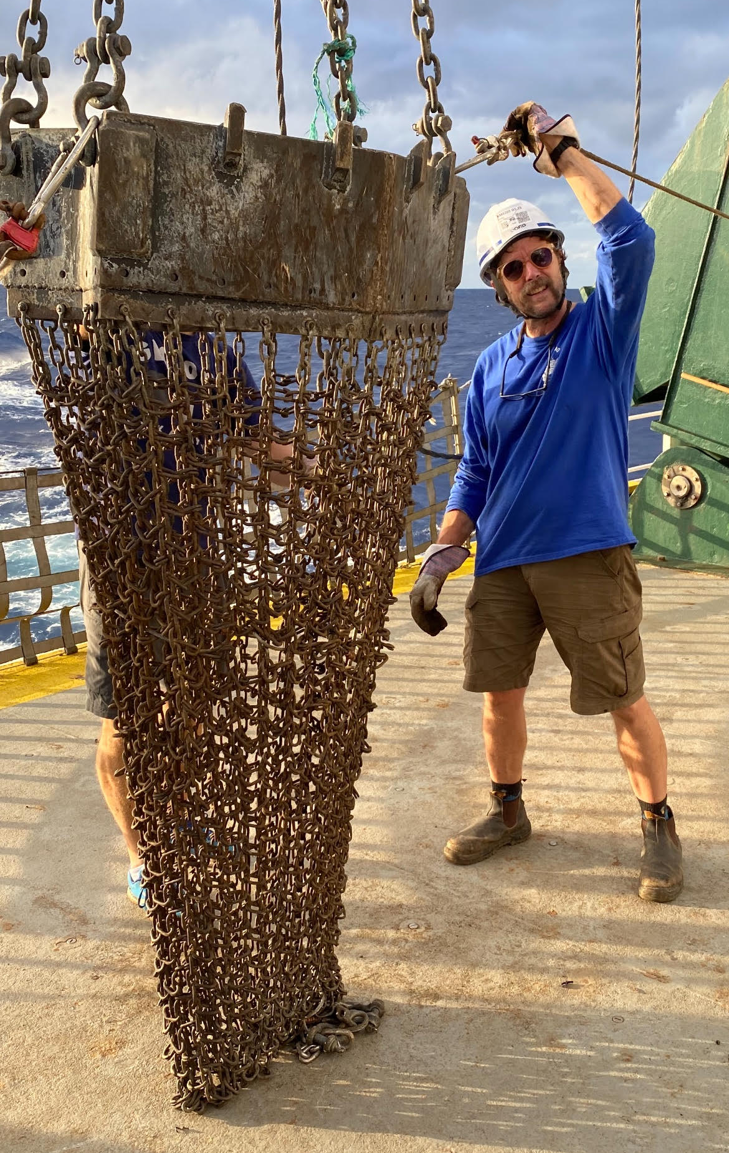
Areas of Technical Specialization
Who can Apply?
We welcome applications from individuals with backgrounds in:
Marine Science, Oceanography or Engineering
Shipboard technical support (electronics, IT, instrumentation, ROV’s etc.)
Data collection and field research operations
Electronics: Maintenance of electrical systems and sensors
Networking: Shipboard network infrastructure
Data Acquisition: Integration, calibration and validation of multi-sensor measurements systems
Instrumentation: Operation of CTDs, ADCPs, multibeam, etc.
Rigging & Deployments: Safe handling of gear under sea conditions (moorings, coring, etc.)

Slide 11
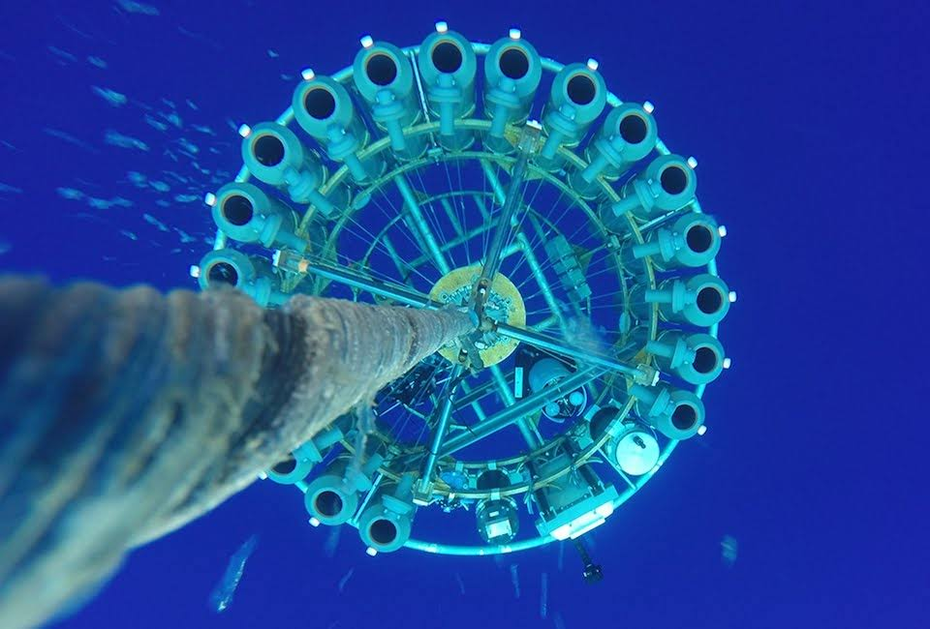
Interested in joining?
How to Apply:
Contact the UNOLS Technical Services Manager, Tara Clemente – Tara@unols.org
To apply, Send:
A copy of your resume or CV
2-3 references who can speak to your sea-going and technical experience
A short cover letter summarizing your experience and expertise
A completed Marine Technician Skills Questionnaire
Available projects are advertised via the UNOLS Tech Pool Listserv.
UNOLS Tech Pool Operations

Slide 12
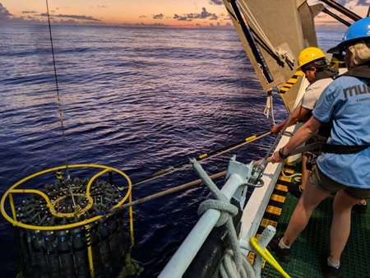
How it works?
Available projects are announced via the UNOLS Tech Pool Listserv.
Projects often arise as urgent, last-minute requests, so technicians should be ready to prepared to respond quickly.
Once selected, you will be contracted through TAMU and will receive a Services Supplement outlining the project details.
Technicians coordinate their own travel directly with the project manager.
Participate in the cruise and complete assigned duties.
After the cruise, submit invoices to Kyndra Reed (TAMU) and Tara Clemente (UNOLS) for payment and processing.
UNOLS Tech Pool Operations

Slide 13
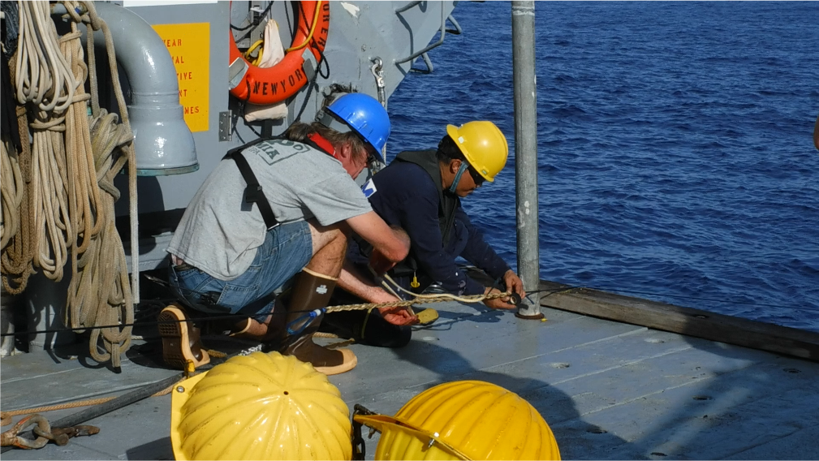
Technician Assignment
Assignments are made based on technician skillset and availability.
Institutions may request specific technicians, pending coordination and approval.
Technicians may arrangements directly with institutions but must keep the UNOLS Tech Services Manager informed.
Pay Structure
Technician rates are determined by experience and technical proficiency.
Experienced technicians with specialized skill receive higher compensation.
New technician rates are set by the UNOLS Tech Manager upon joining the program.
UNOLS Tech Pool Operations

Slide 14
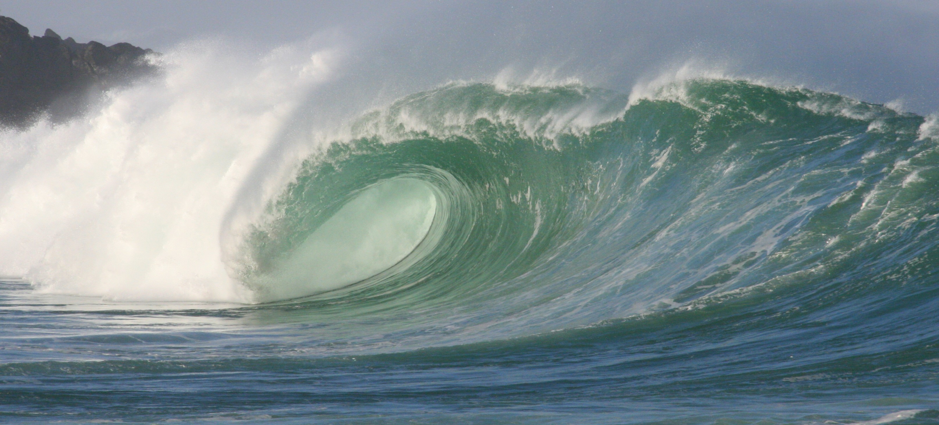
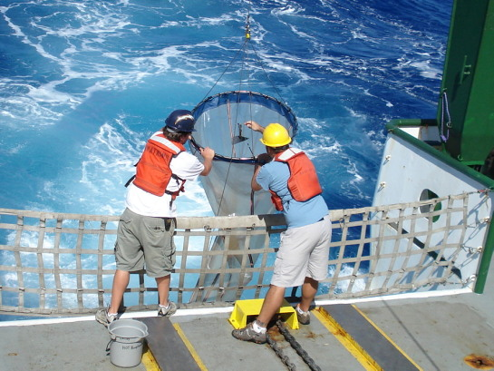
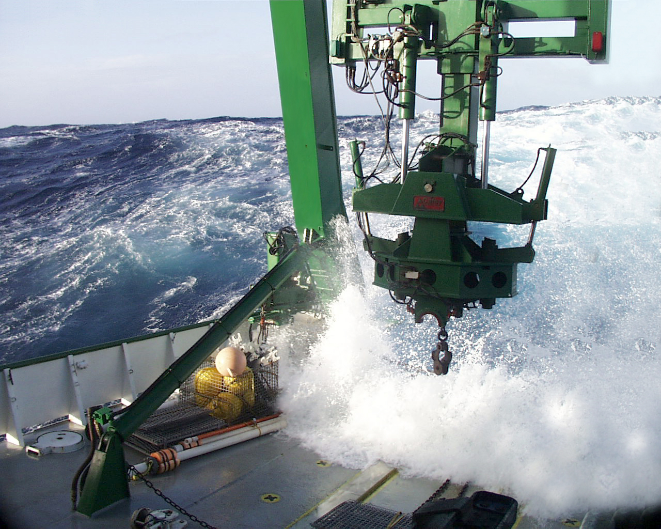
Requesting a Technician
Plan Ahead for Success
While last- minute requests can be accommodated, early planning is strongly encouraged.
Submitting your technician request well in advance ensures:
Availability of qualified technicians
Better project preparation and support
More efficient coordination with TAMU and UNOLS staff
Notes:
While last-minute requests can sometimes be accommodated, early planning is strongly encouraged.
Submitting your technician request well in advance ensures:
• Availability of qualified technicians
• Better project preparation and support
• More efficient coordination with TAMU and UNOLS staff

Slide 15
Requesting a Technician
The UNOLS Technician Pool is coordinated by the UNOLS Office and Texas A&M University’s (TAMU) Geochemical and Environmental Research Group (GERG).
1. Identify your project needs
2. Contact the Tech Pool (tara@unols.org)
3.Receive technician recommendations
4. Review and confirm – Complete Service Supplement Form
5. Finalize request – TAMU issues Contract; Travel arranged
6. Deployment and support checks
7. Post-project invoice submission and debrief
Note: The UNOLS Technician Pool provides skilled technical support for research cruises, shore-based projects, and other oceanographic operations.
Notes:
Step 1: Identify Your Project’s Needs
Determine the type of technical support required for your project, such as:
• Electronics or networking
• Data acquisition systems
• Instrumentation and sensors
• Rigging or deck operations
Be clear about the project timeline, duration, and any specialized expertise needed.
Step 2: Contact the Technician Pool
Reach out to Tara Clemente at tara@unols.org to discuss your project.
Provide the following details:
• Project description and objectives
• Type of support needed
• Project dates and duration
• Preferred technician (if any)
If you already have a technician in mind, you may proceed directly to Step 4.
Step 3: Receive Technician Recommendations
The UNOLS Technician Pool will review your project requirements and recommend available technicians who best match your needs.
We work to ensure the right technician is paired with your project for a successful outcome.
Step 4: Review and Confirm
Once a technician has been identified, the hiring manager completes a Services Supplement Form.
Upon submission, TAMU will process the form and begin the contracting process.
Step 5: Finalize the Request
All logistics, including travel and coordination, will be handled in collaboration with the project manager.
Step 6: Deployment and Support Checks
Step 7: Post Project invoice submission and Debrief
The UNOLS Technician Pool provides skilled technical support for research cruises, shore-based projects, and other oceanographic operations.

Slide 16
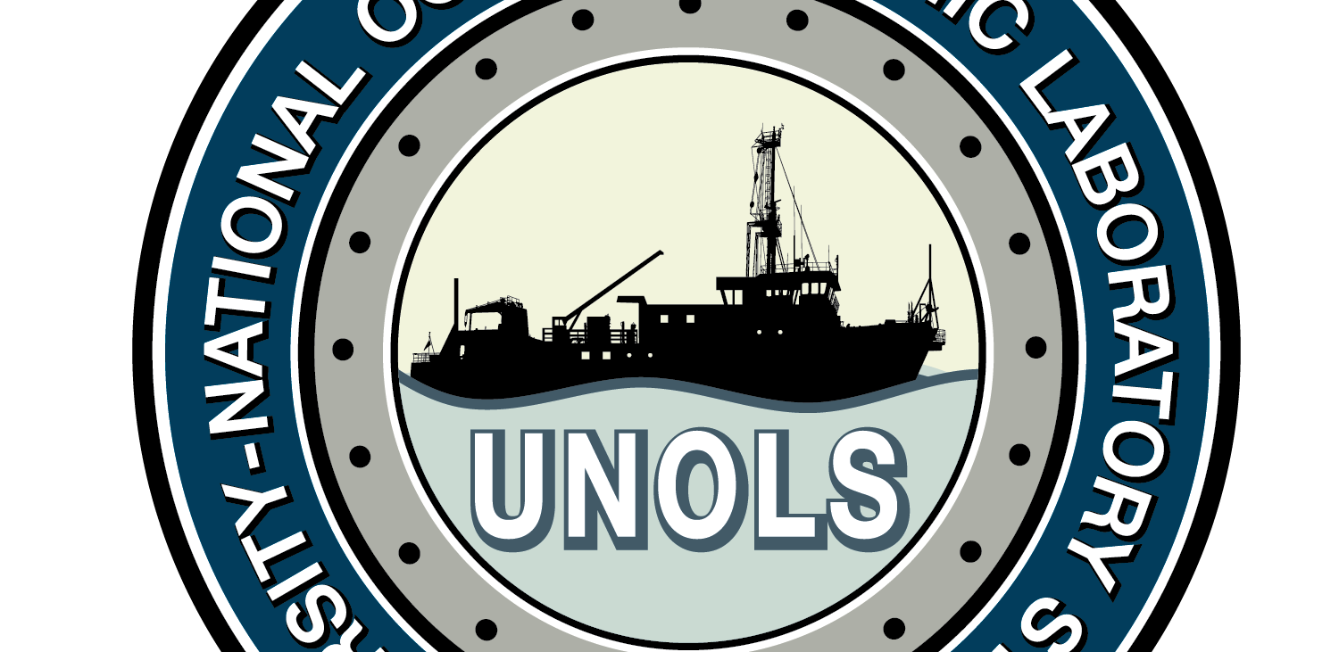
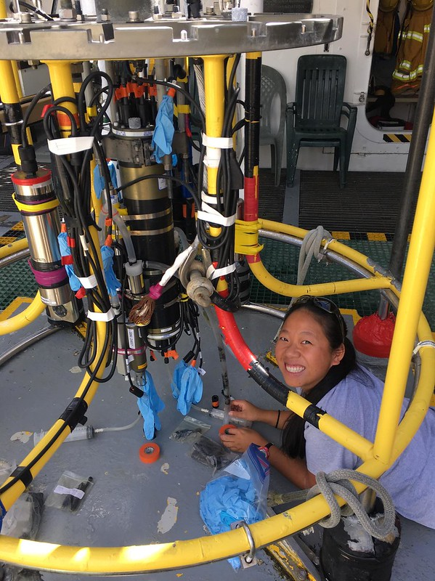
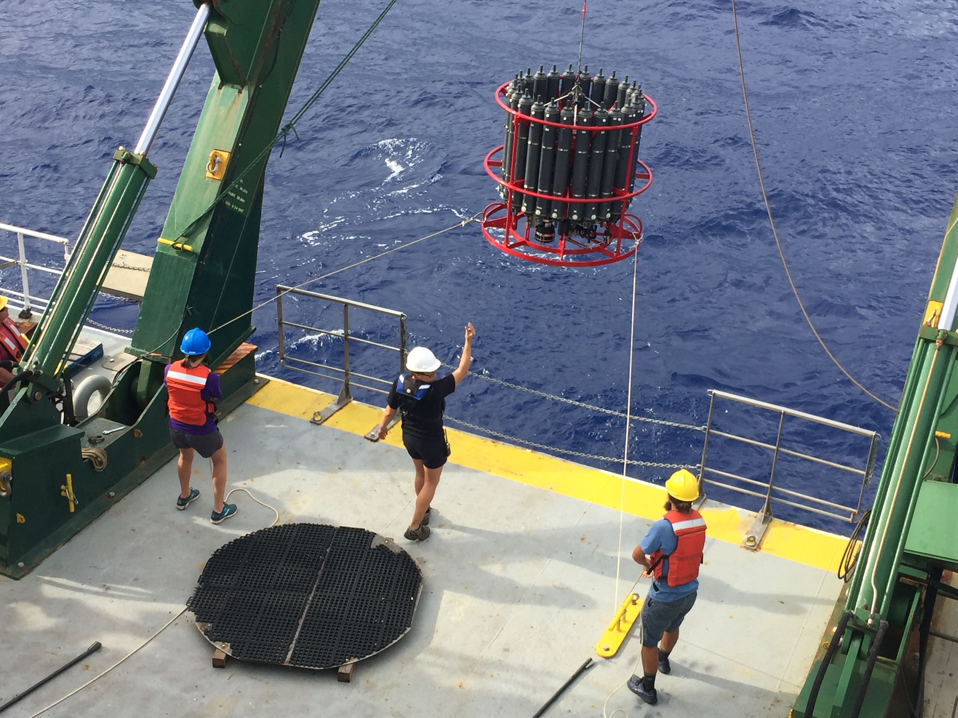
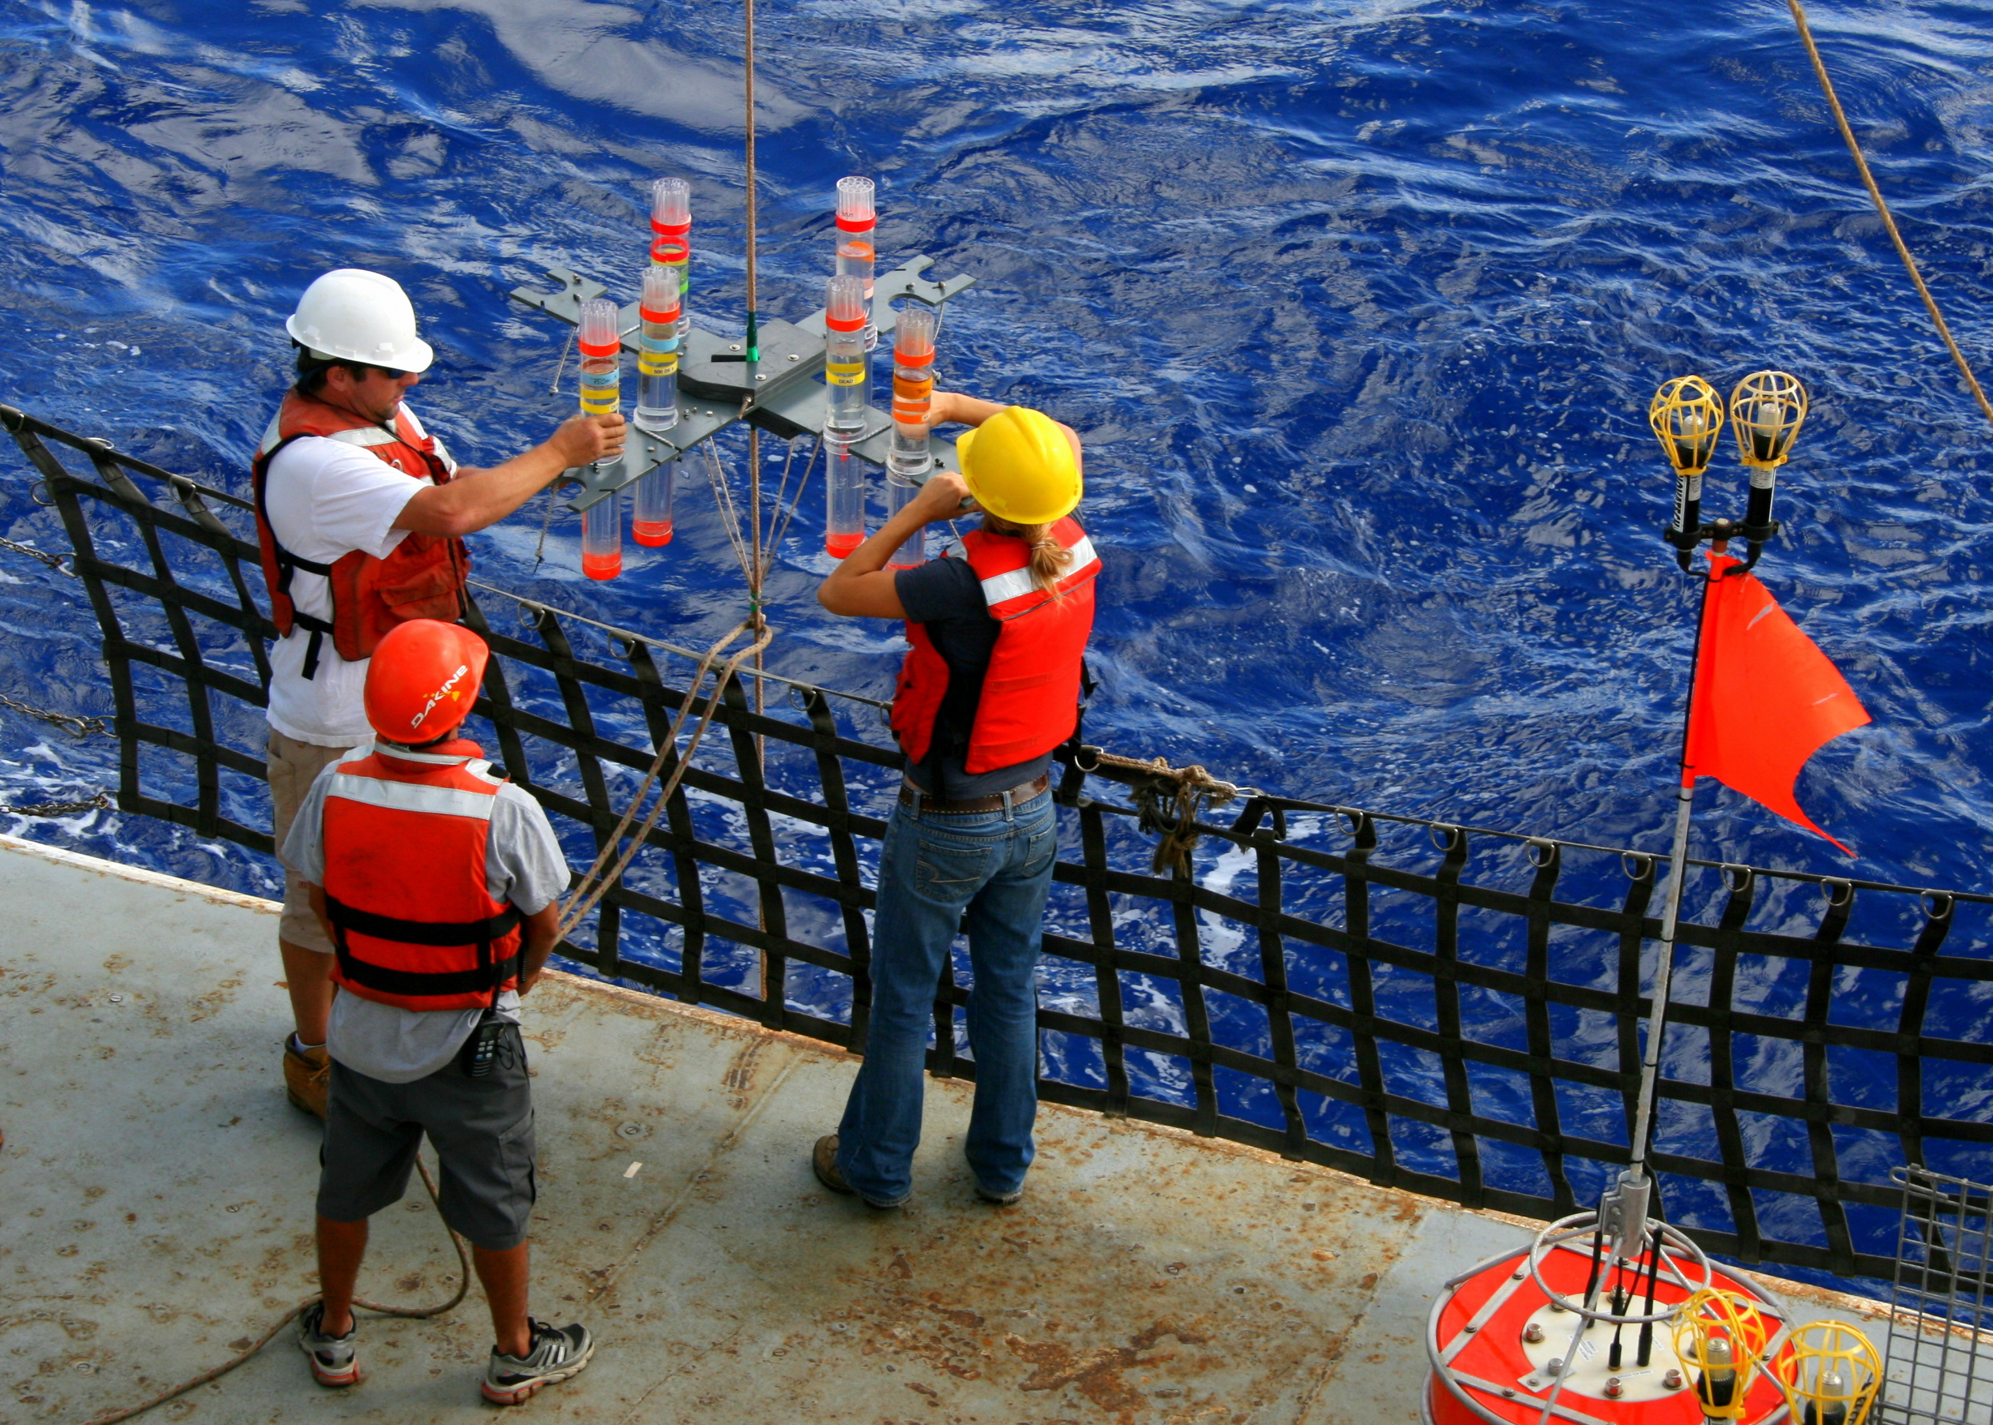
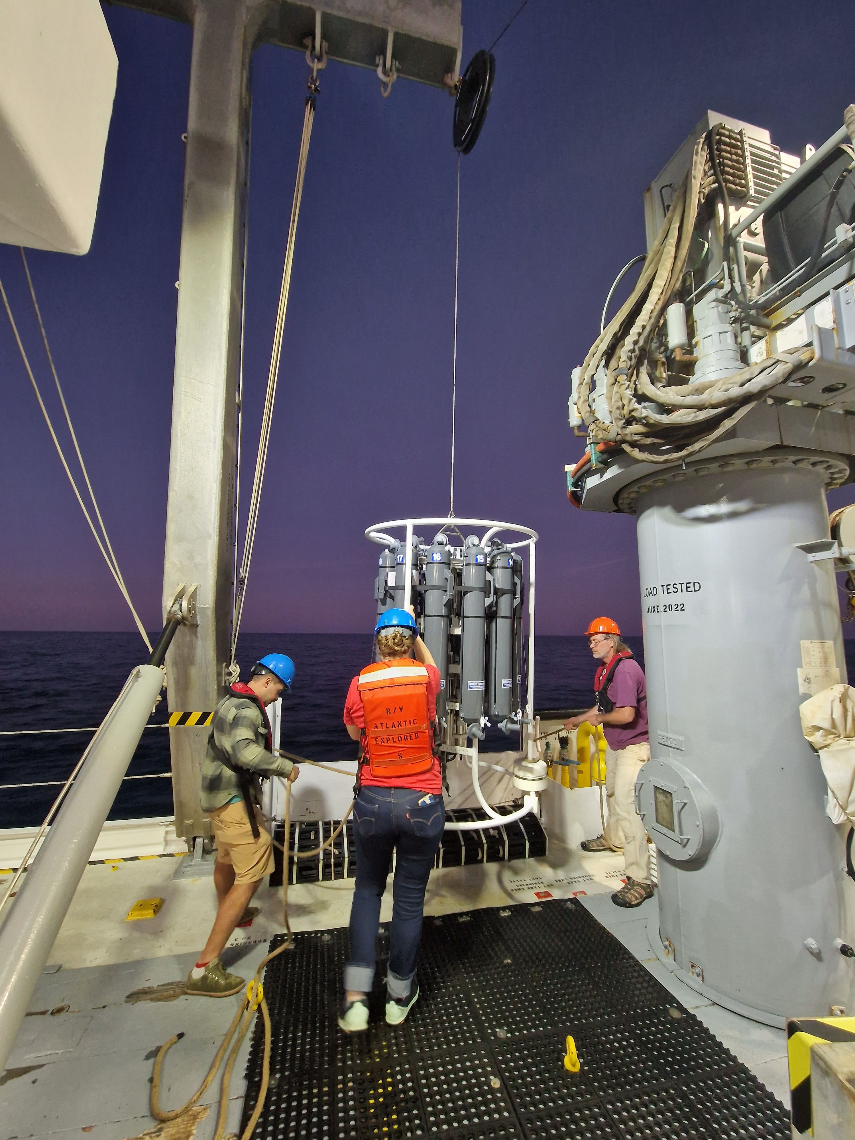
Benefits of the Tech Pool
Provides institutions with a flexible, efficient solution for technical support.
Reduces the administrative burden of direct hiring.
Enables rapid onboarding of qualified technicians for time-sensitive needs.
Provides access to experienced techs for mission-critical operations.

Slide 17
Conclusion
Pool has relieved ship operators from having to keep additional techs in house
Pool has provided operators with ability to see techs in action before hiring them permanently
Techs have more freedom to work when they want to although pay not guaranteed
Pool provides techs with additional opportunities to sail on multiple vessels and meet other techs, as well as get training in new techniques and with new equipment

Slide 18
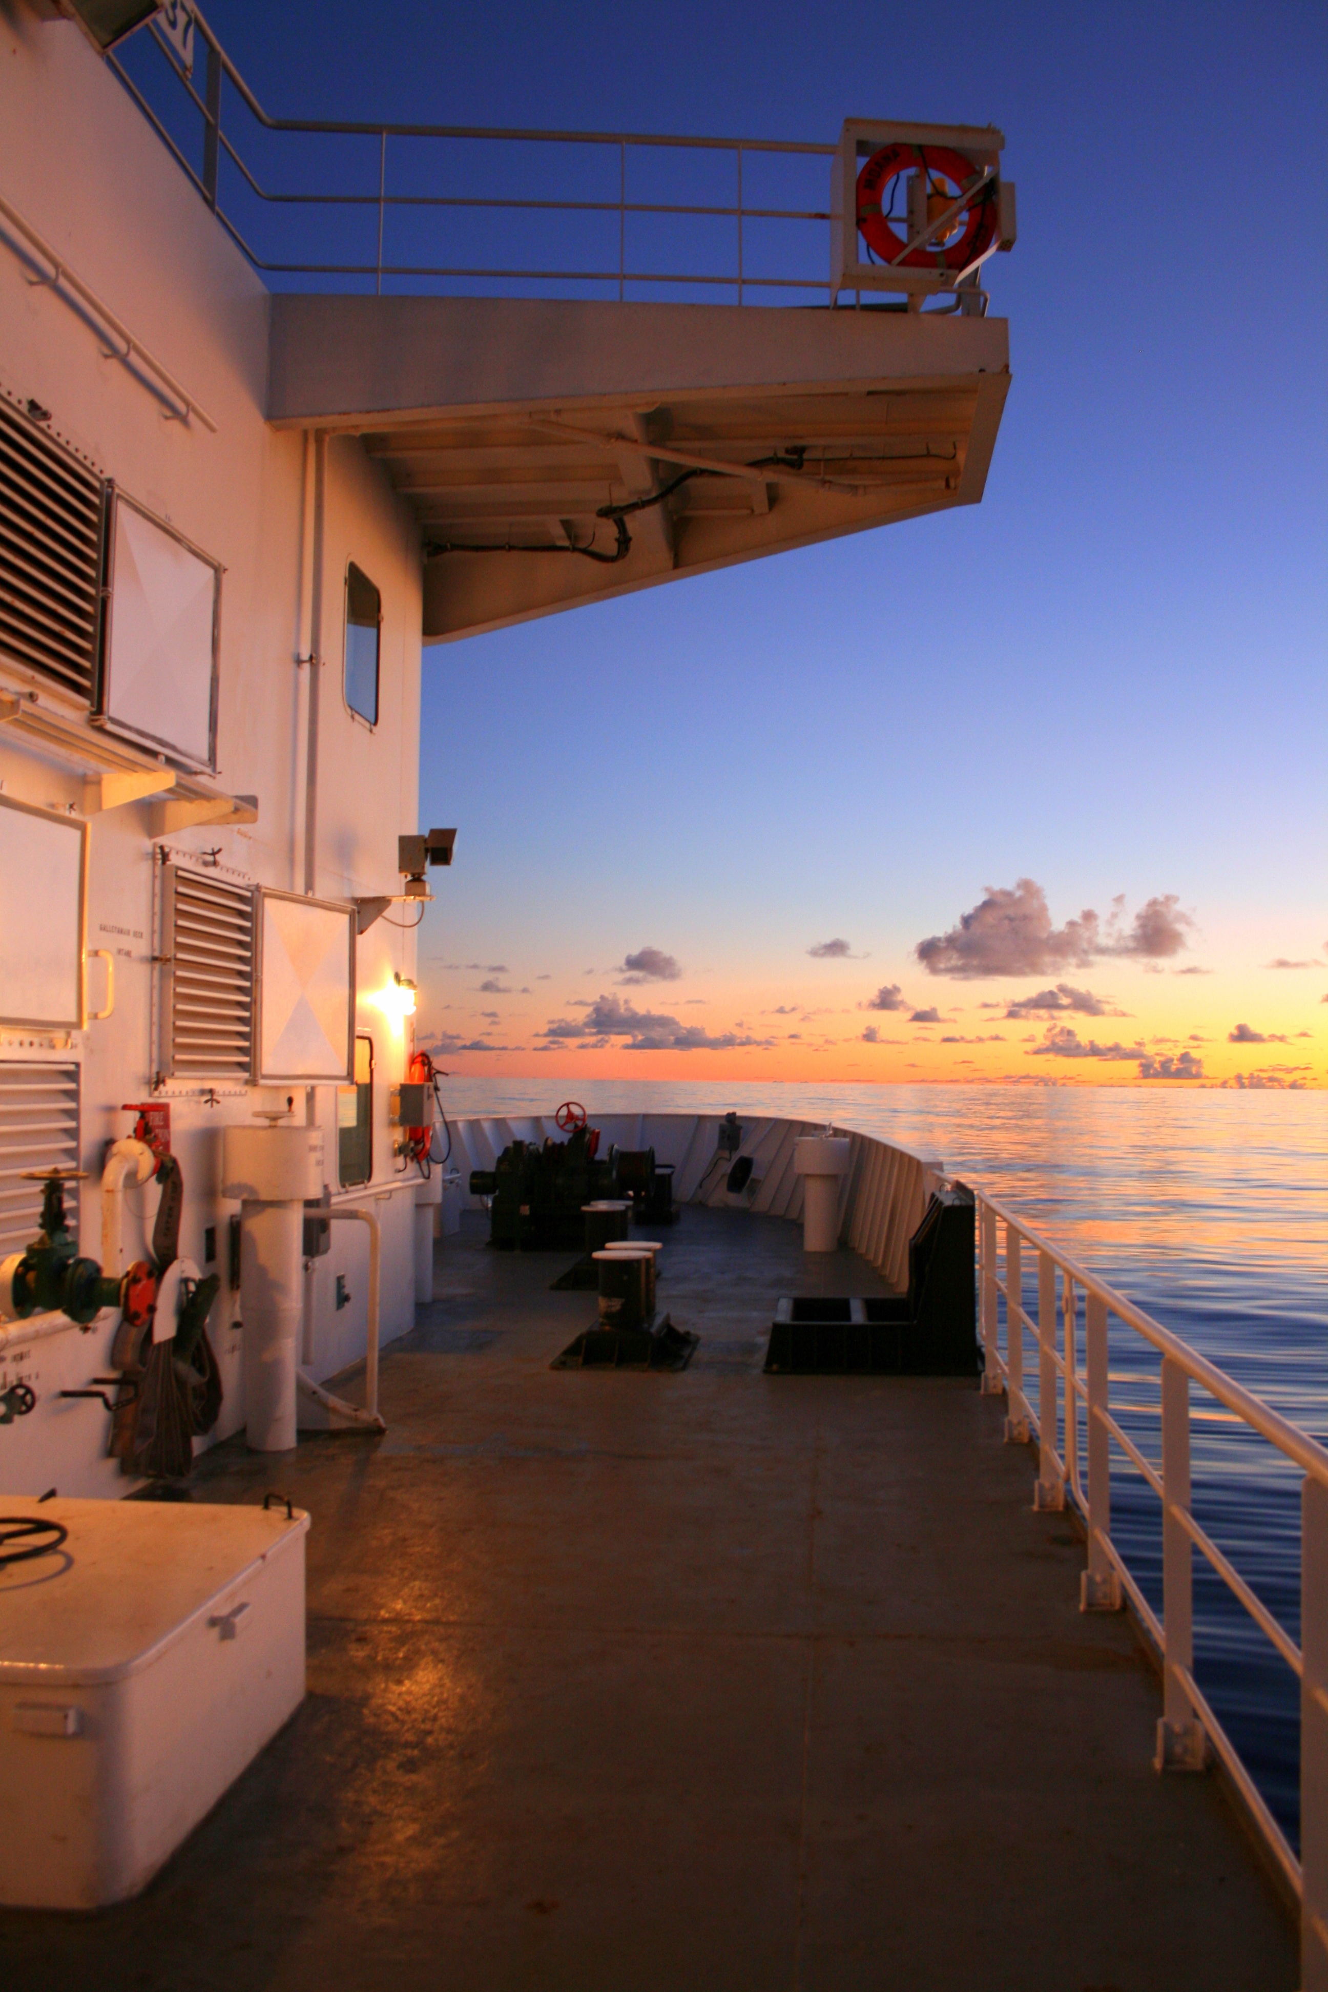
Thank YOU! QUESTIONS?
Kyndra Reed Geochemical and Environmental Research Group Texas A&M University kreed@tamu.edu
Tara M. Clemente University-National Oceanographic Laboratory System tara@unols.org
https://www.unols.org/unols-technician-pool

