Slide 1
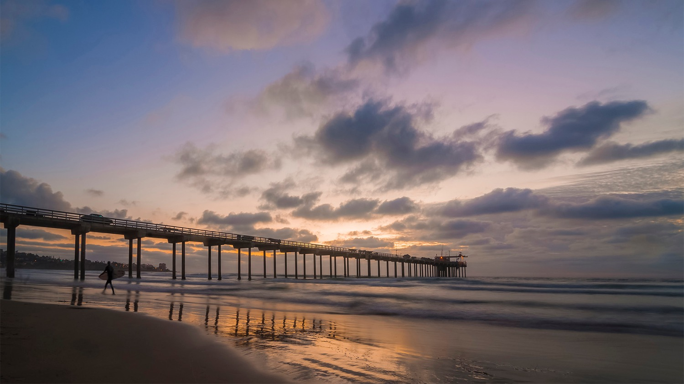

THE IAPSO WORKGROUP - CTDO₂ DATA PROCESSING
Aaron Mau, Allen Smith
Scripps Institution of Oceanography
Oceanographic Data Facility (ODF)
RVTEC, November 2025

Slide 2
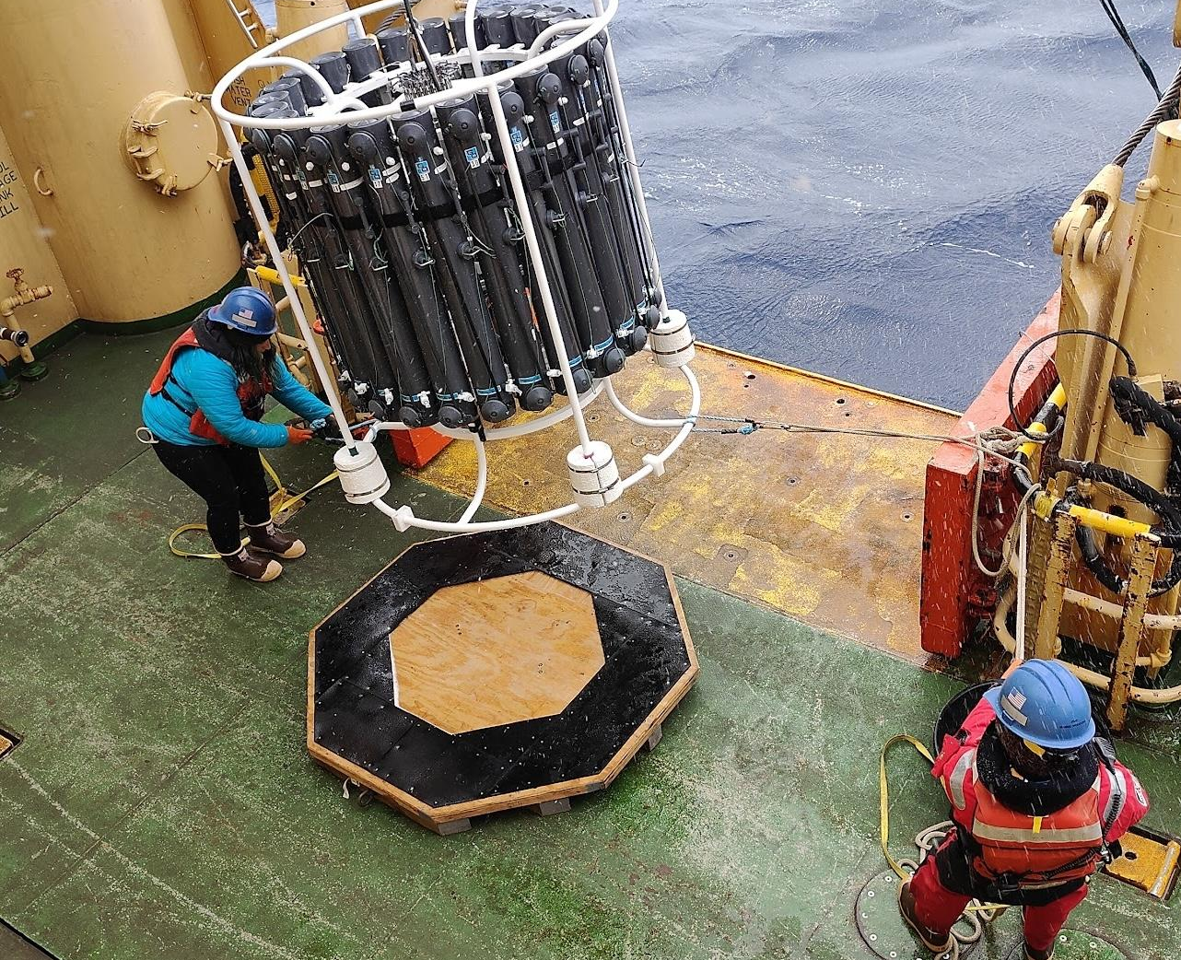

THE IAPSO CTDO₂ WORKGROUP
Acronyms
IAPSO - International Association for the Physical Sciences of the Oceans
CTDO₂ – Instrument package that continuously measures conductivity, temperature, depth, and oxygen
What this project is
International workgroup of GO-SHIP level scientists and technicians
Led by Bernadette Sloyan at CSIRO
2-year goal of assembling a forum capable of assessing global CTDO₂ data processing status and routines
Intercomparing CTDO₂ data processing between labs/institutions/countries

Slide 3
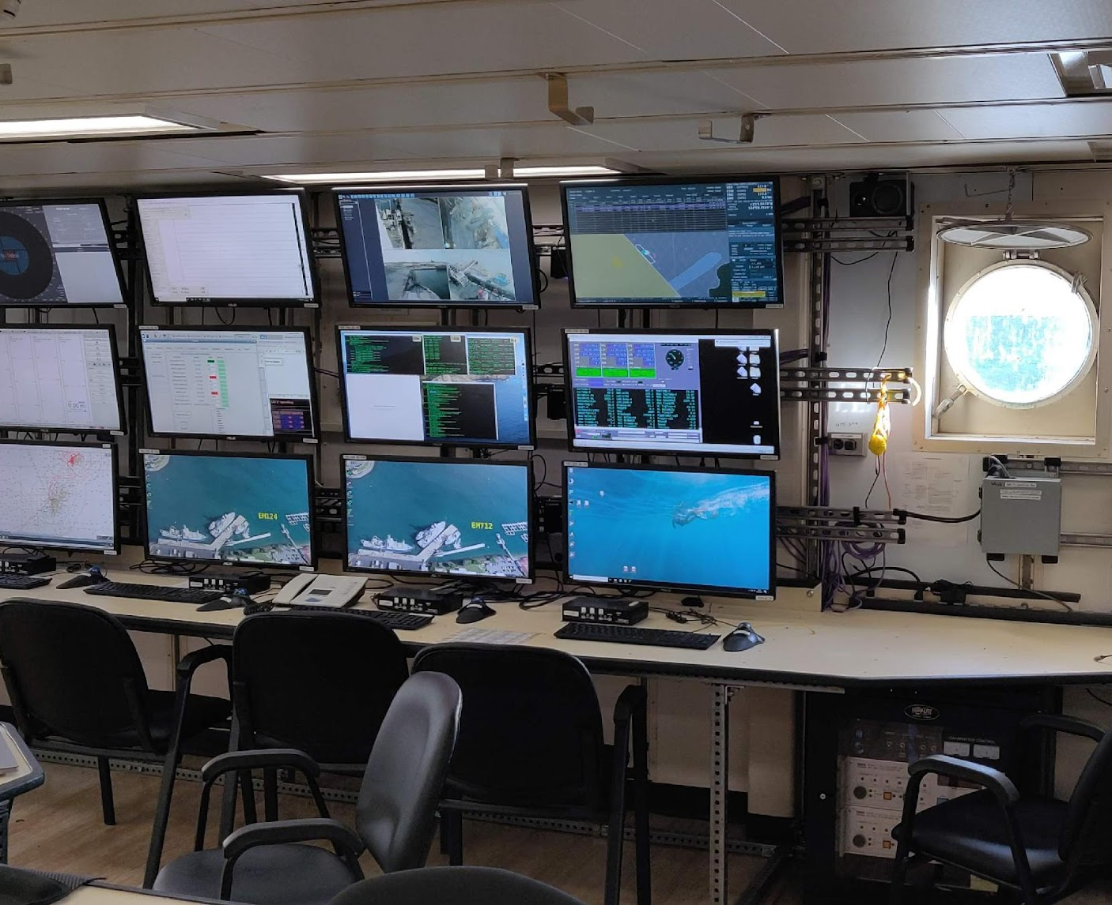
MOTIVATION
CTDO₂ data is important
GO-SHIP Hydro Manual turns 14
How has technology changed?
Exploring algorithms
Group divergence
Unknown differences in how data is processed around the world
Numerous “wrangler” international programs
Is there a “best” or “better” procedure for data processing for producing high-quality (GO-SHIP) data?
Notes:
ICES
US GO-SHIP
Euro GO-SHIP
WGOH
German DAM project

Slide 4
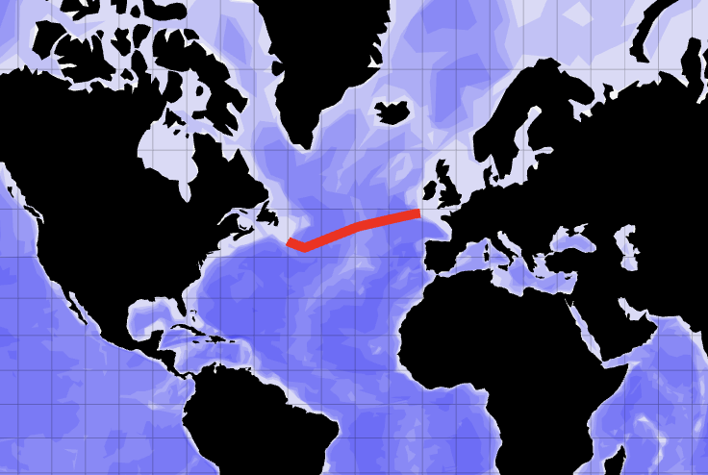
Results so far
Survey of 33 participants
Antarctica only continent w/o representation
CTD intercomparison project
18 international participants
Process GO-SHIP line A02
Statistical analyses
Reported methods
Other experiments
CTDO₂ relative to bottle oxygen
Changing step order

Slide 5
Results so far
CTD intercomparison project
Each group processes it differently
Most participants inherited their routine and have not derived it themselves
No one follows SeaBird or GO-SHIP recommended series of steps (“typologies”)
Statistically, the most “average” groups run two processing typologies
A, B, C
H, J
Unprocessed typology is “P”
Typology | A | B | C | H | J
# Part. | 2 | 1 | 2 | 1 | 1
Steps order | # datcnv | # datcnv | # datcnv | # datcnv | # datcnv
 | # wildedit | # wildedit | # wildedit | # filter | # alignctd
 | # filter | # filter | # filter | # alignctd | # filter
 | # alignctd | # celltm | # alignctd | # celltm | # loopedit
 | # celltm | # loopedit | # celltm | # loopedit | # celltm
 | # loopedit | # wfilter | # loopedit | # wfilter | # binavg
 | # binavg | # binavg | # binavg | # binavg | # file
 | # file | # file | # wfilter | # file
 |  |  | # file

Slide 6
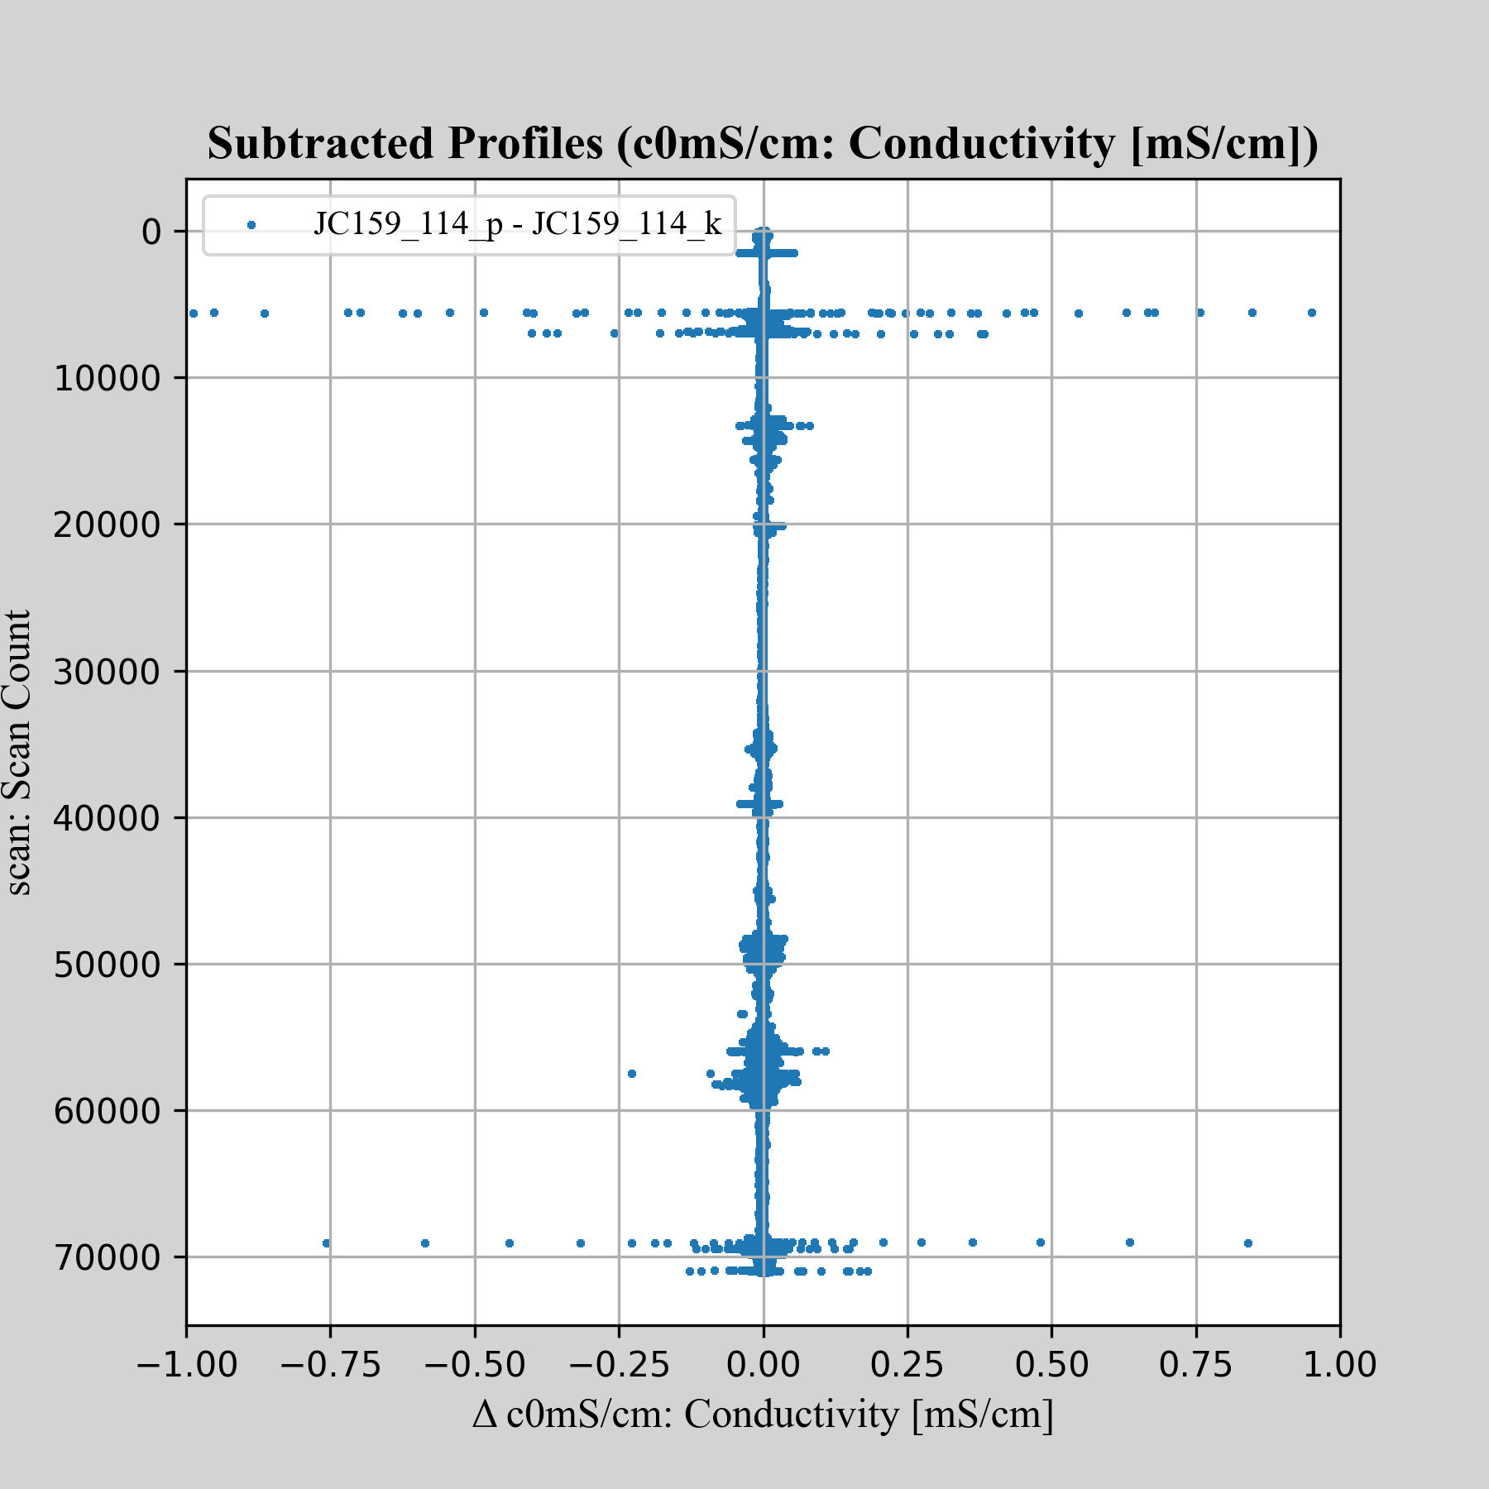
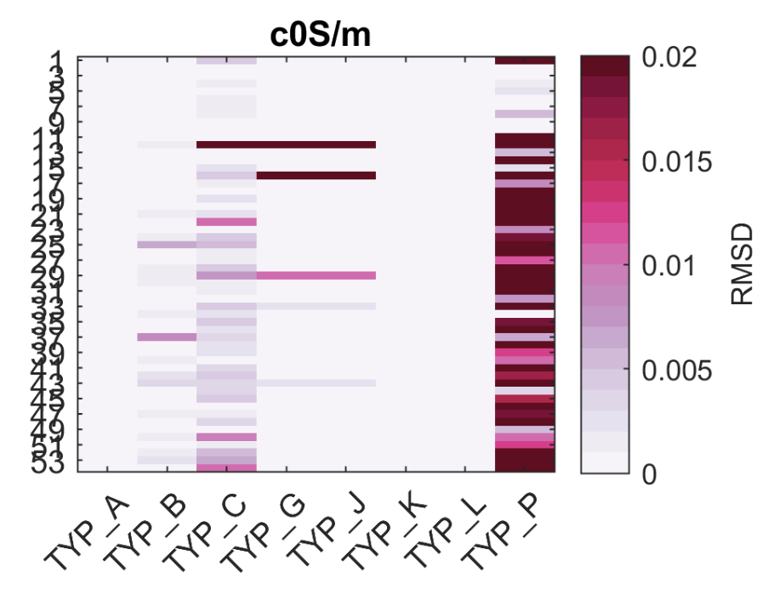
Results so far
Conductivity changes for unprocessed data vs typology “K” (GO-SHIP)
Visualizing root mean square deviation for different typologies against type A. Type P is unprocessed (Figure credit Dr. Berx, Scottish Marine Directorate)

Slide 7
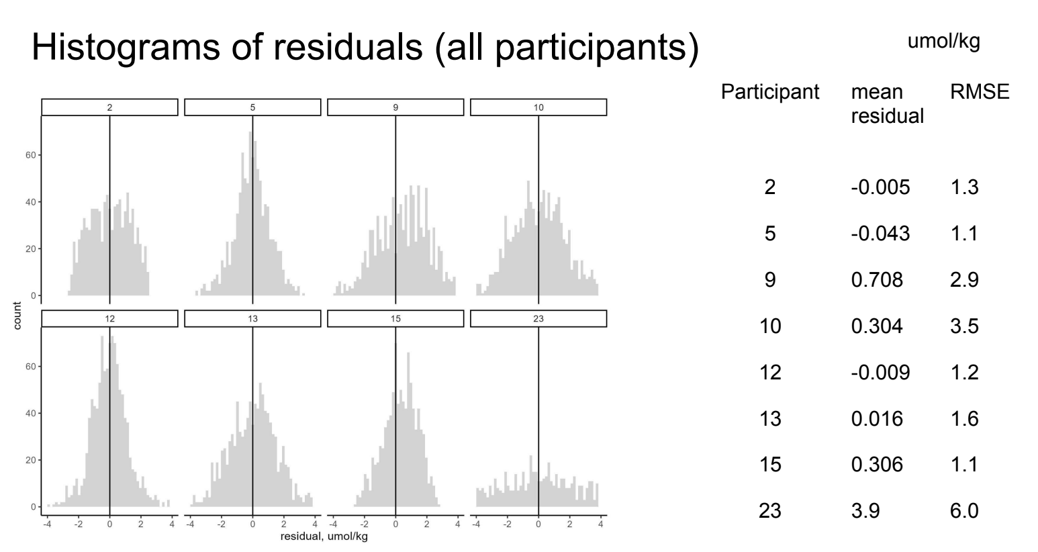
Results so far
Oxygen comparisons
8 participants used Niskin bottles for oxygen analysis
3 different methods for calculating oxygen from voltage
Some groups did not QC Niskin bottles
Hysteresis correction is important
Finding “significant” steps
Few groups did pressure adjustments external to SBEDataProcessing
# celltm is a very minor improvement
# wfilter placement matters
Groups use # alignctd with different settings
Oxygen comparison histogram (Figure credit Dr. Langdon, RSMAS)

Slide 8
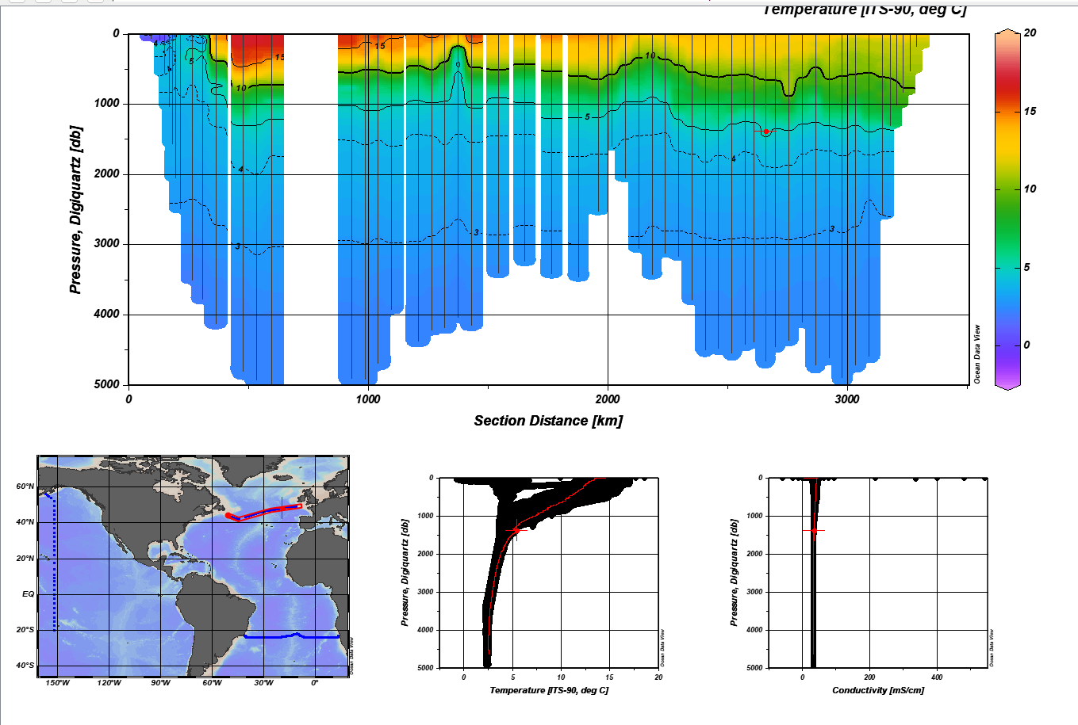
What’s next
Future tests
Looking into step settings, rather than just typologies
Disentangle statistical bias
Expanding to a meridional section
Oxygen optimizations
Town hall at 2026 Ocean Sciences Meeting in Glasgow
Build up the public Github to facilitate more collaboration and transparency
At least two publications
Intercomparison findings
Oxygen processing

Slide 9
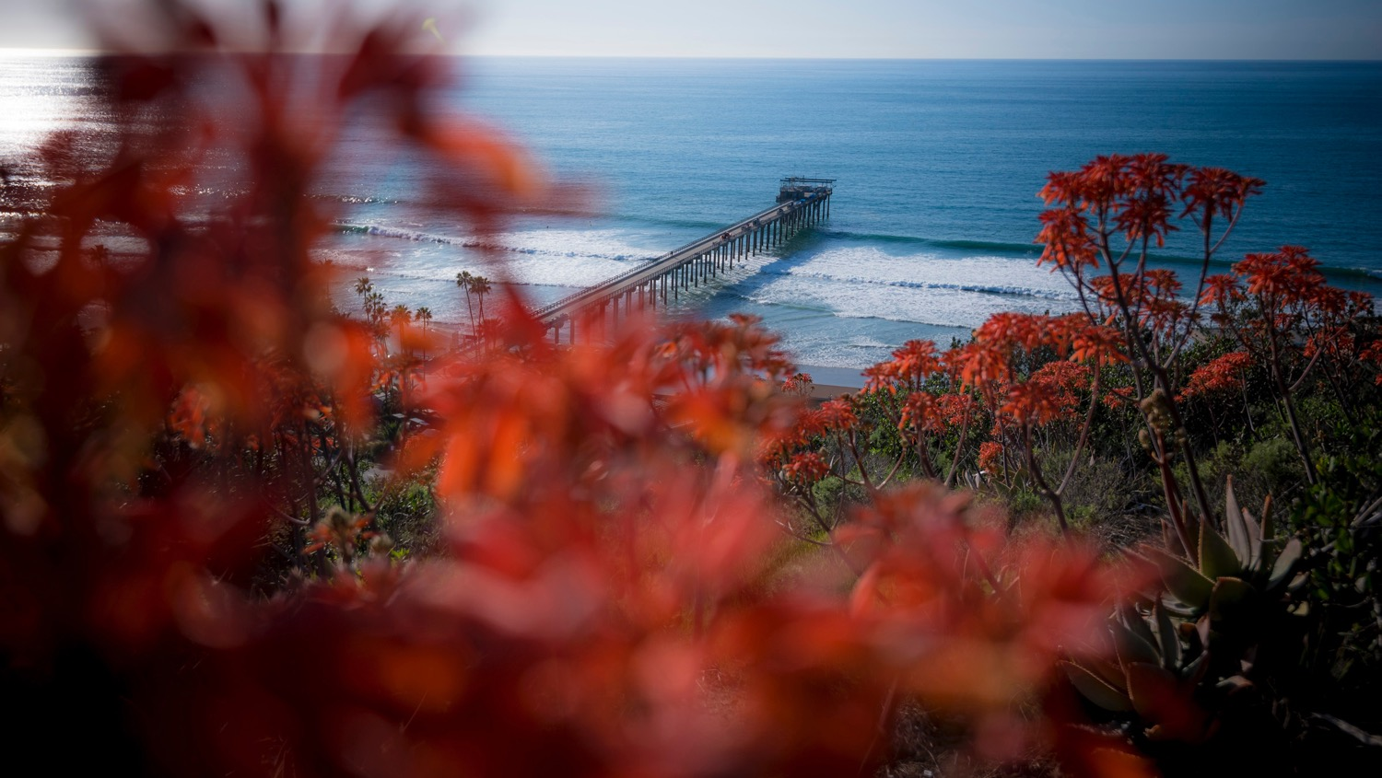


THANK YOU
AARON MAU – AJMAU@UCSD.EDU
SENSORS-L@UCSD.EDU

