Slide 1
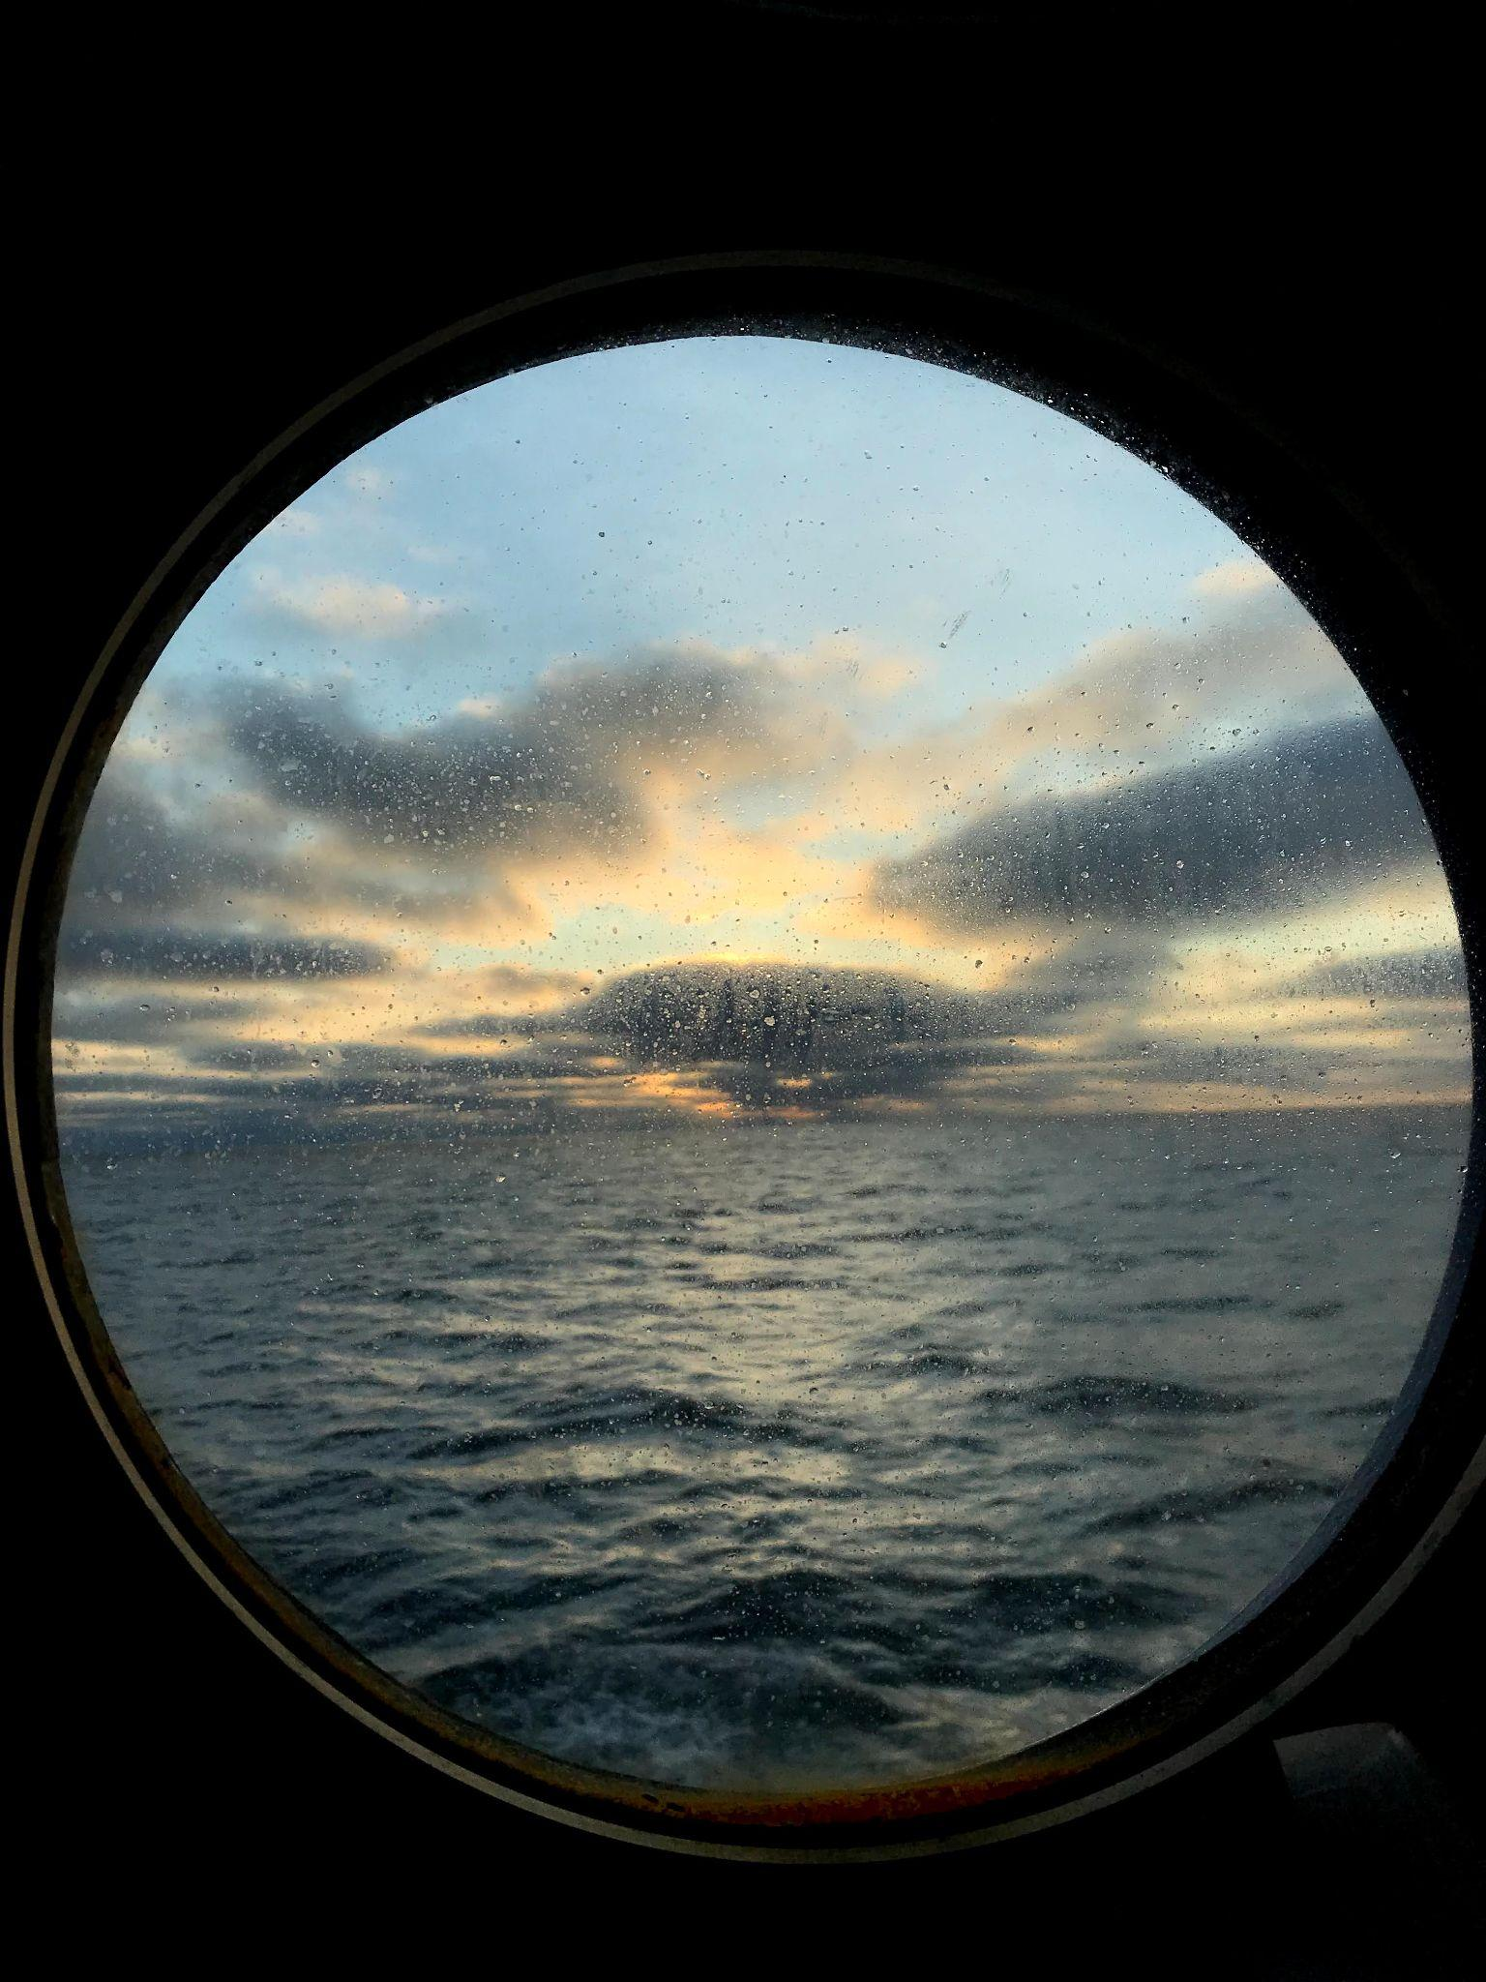
RVTEC Work Life Balance
Brought to you by:
Kristin Beem
Bonny Clarke and
Rebecca Hudak

Slide 2
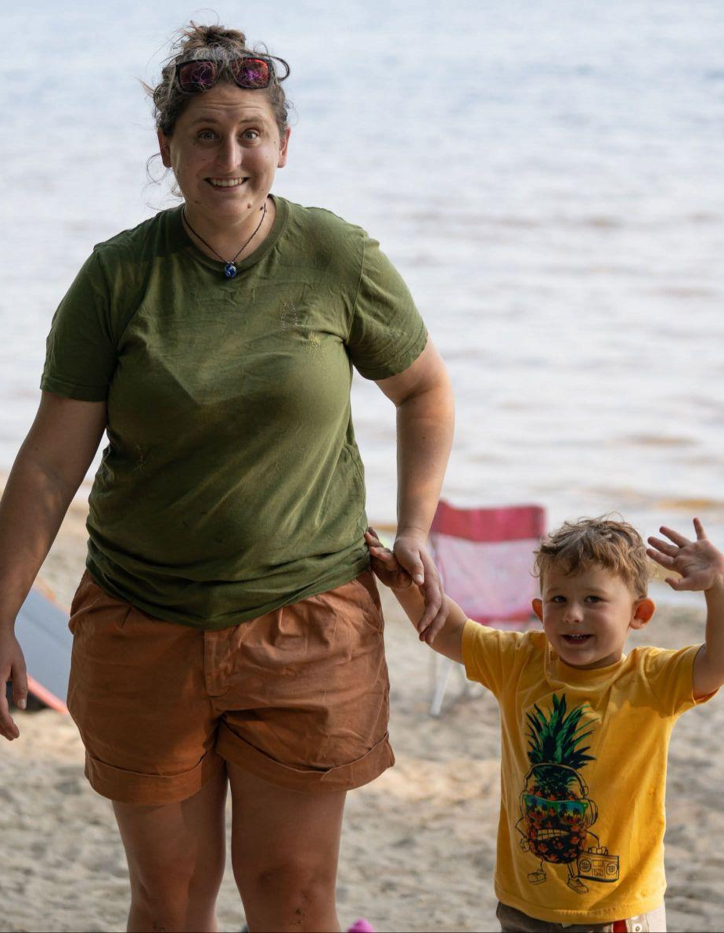
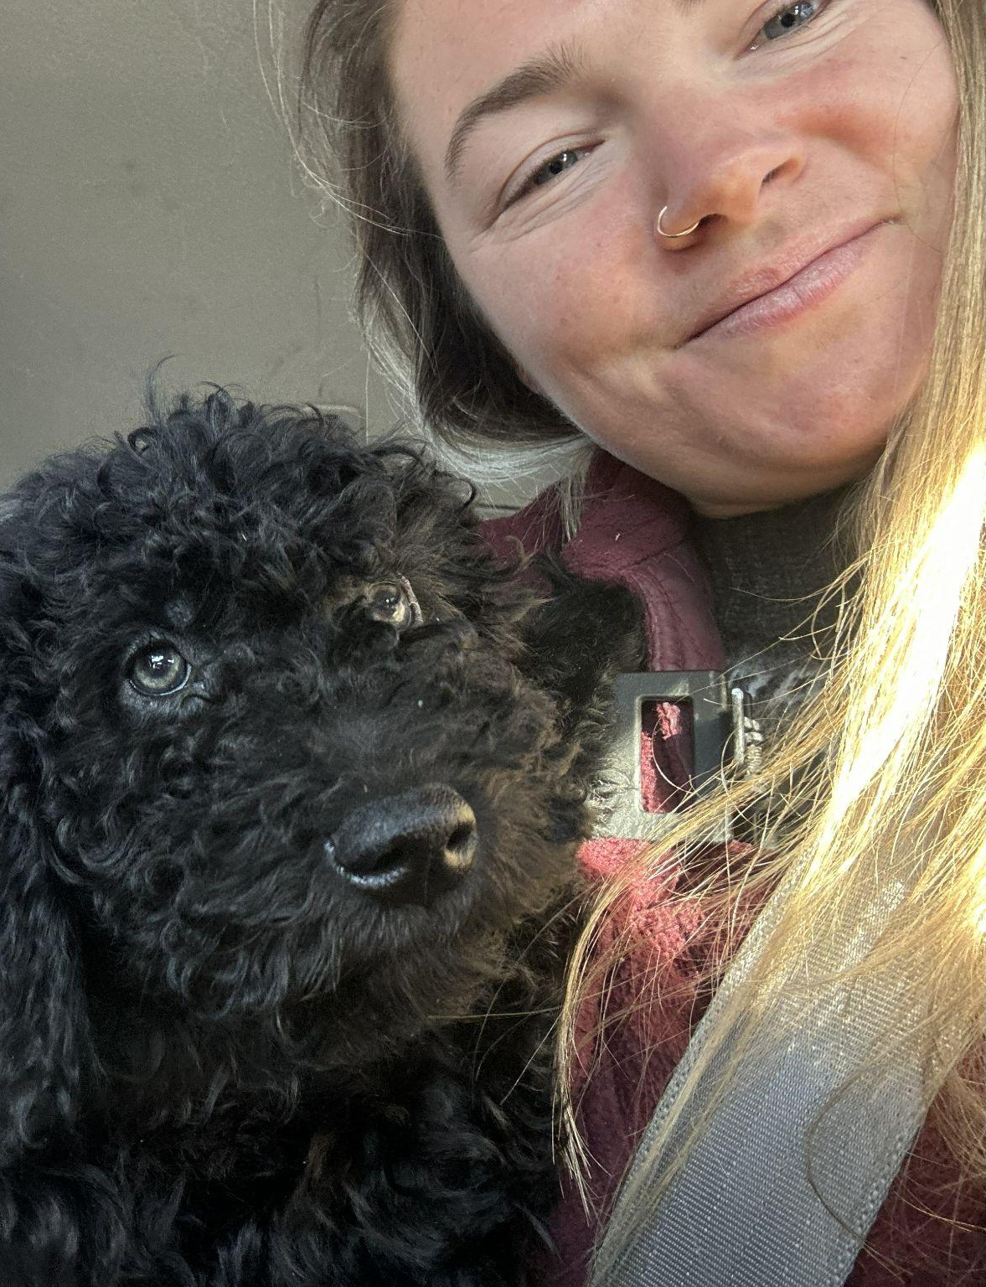
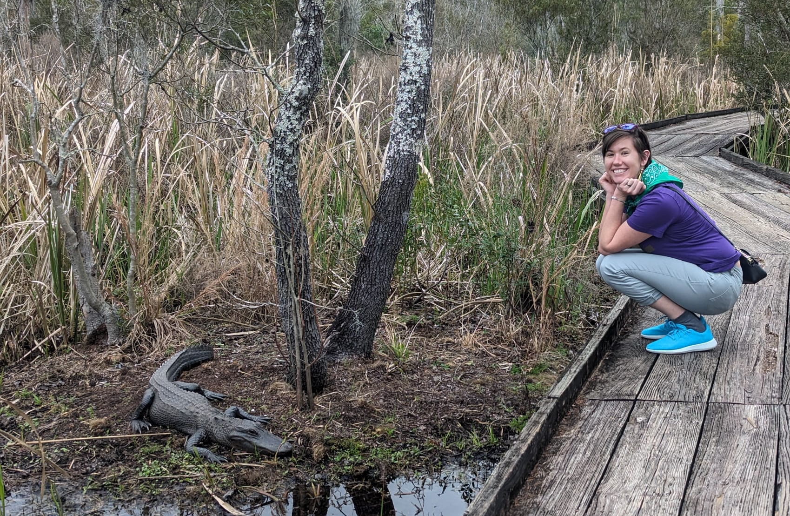
Who Are We?
Rebecca Hudak
Single parent to a 3 year old
Transitioned from part time tech to fully remote
Bonny Clarke
Marine tech at URI
Planning to start a family but want to stay in the industry/ community!
Kristin Beem
Moved to SE Louisiana a few years ago with spouse- interested talking about balancing dual careers
Transitioned from sailing marine technician to shoreside management position in a shipyard

Slide 3
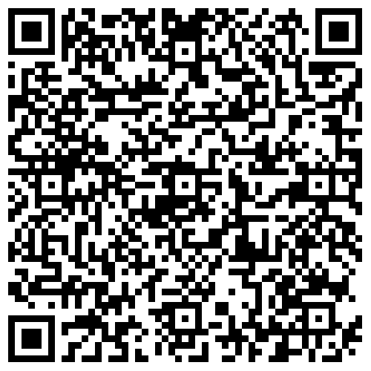
Why Now?
We are all on different stages of life/career paths
Traditionally a male dominated career path
Not openly talked about in our community
We want an open discussion about the challenges of being a Shipboard Technician
Sent a poll link to the community!

Slide 4
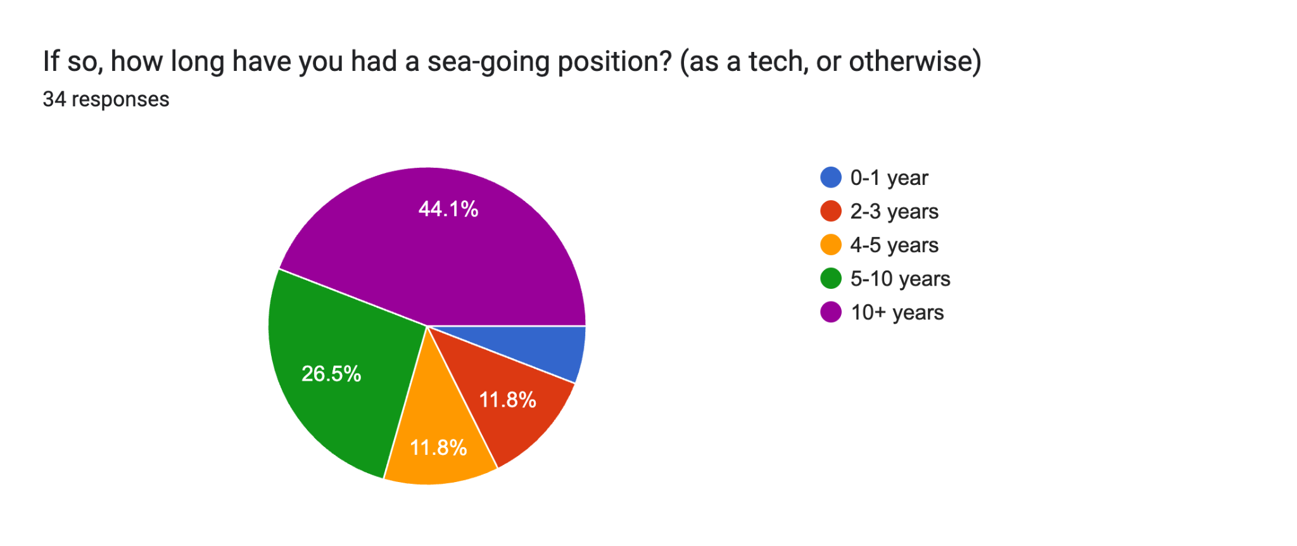
Poll Results - 34 Responses!

Slide 5
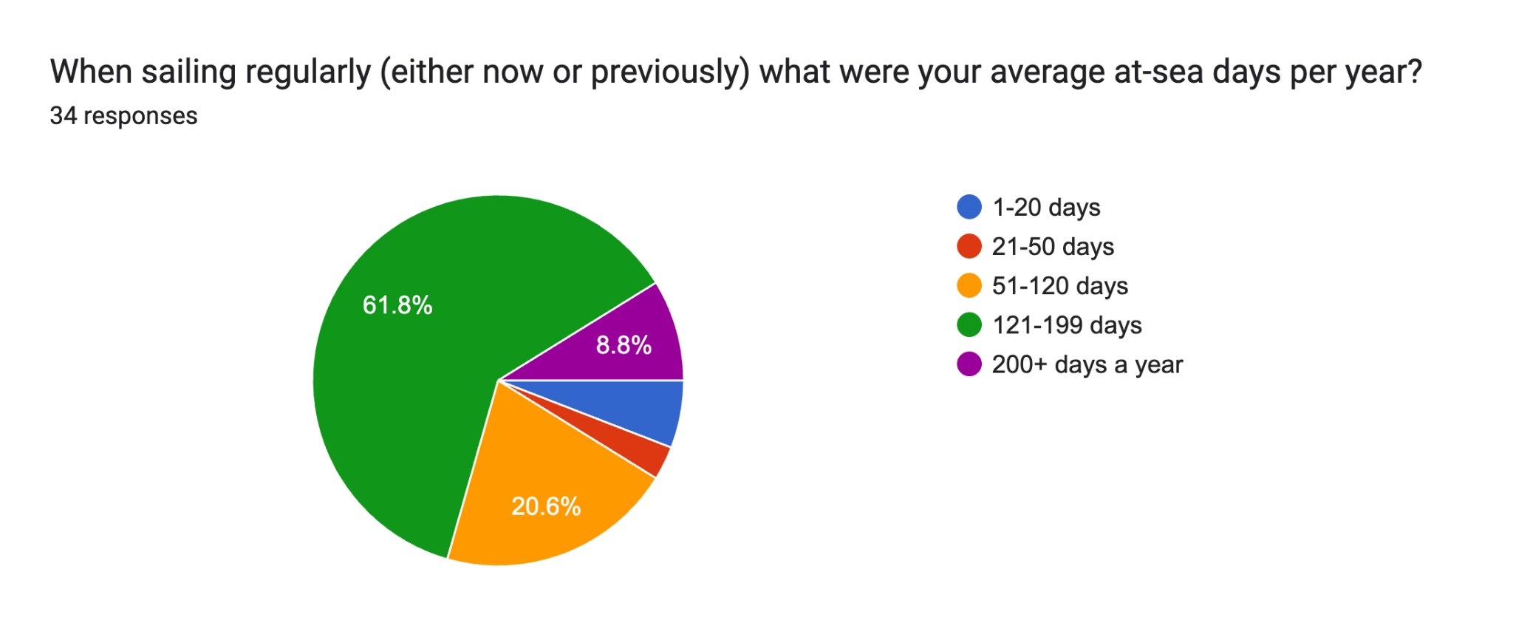
Poll Results

Slide 6
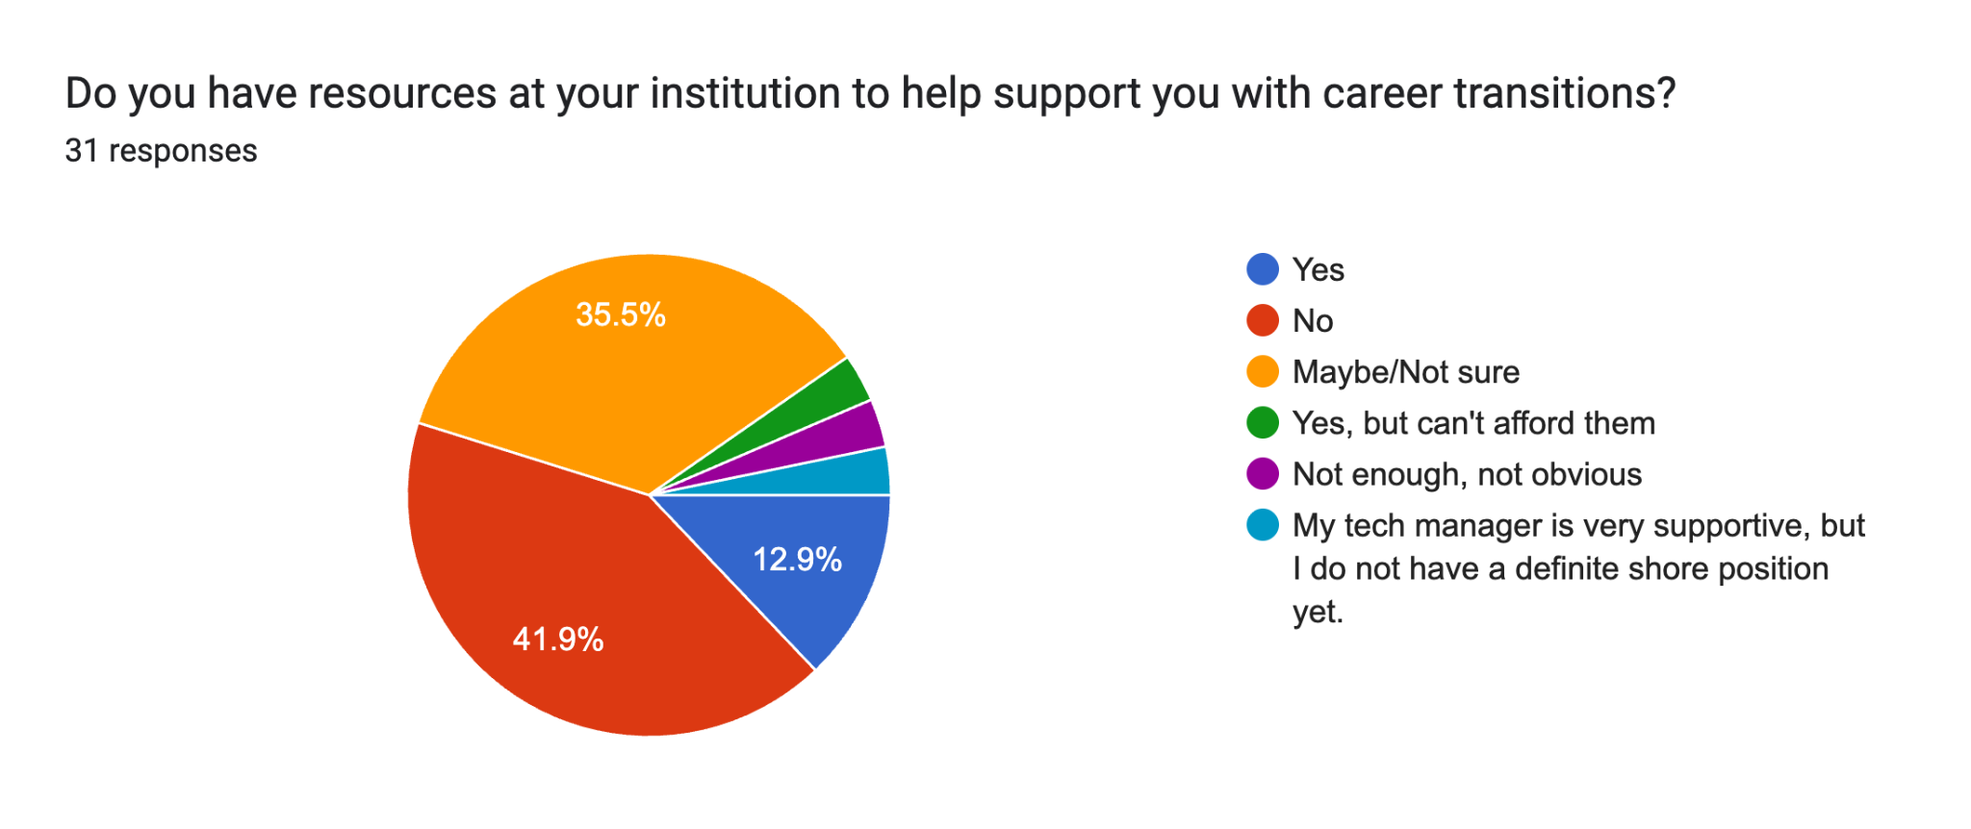
Poll Results

Slide 7
Breakout Groups
Group 1: Career Transitions and Growth
  What pathways or support systems could help sea-going technicians grow into new roles (shore-based, hybrid, or leadership) while staying connected to science and operations?
  What are some resources available that may be helpful in building skill sets to help you qualify for a non-sailing position?
Group 2: Supporting Caregivers & Families
  How can organizations better support caregivers so they can thrive in seagoing careers while balancing family responsibilities?
  Is there something your organization does that helps you manage these challenges?

Slide 8
Breakout Groups
Group 3: Health, Well-being, and True Time Off
  What practices or policies could improve physical and mental health for technicians, both at sea and during shore rotations, and ensure they can truly disconnect during off periods?
  Are there practices in place that have helped you maintain physical and mental health at sea and ashore?
Group 4: Future Flexibility and Innovation
  How might we reimagine technician roles to allow more flexible, modern work arrangements (remote work, hybrid sea/shore models, rotational pools) while still meeting mission needs?
  Scheduling differs per organization and may work for some and not others. Is there something about the scheduling arrangements at your organization that works well for your schedule?

Slide 9
Breakout Groups
1 - Career Transitions and Growth
What pathways or support systems could help sea-going technicians grow into new roles (shore-based, hybrid, or leadership) while staying connected to science and operations?
What are some resources available that may be helpful in building skill sets to help you qualify for a non-sailing position?
2 - Supporting Caregivers & Families
How can organizations better support caregivers so they can thrive in seagoing careers while balancing family responsibilities?
Is there something your organization does that helps you manage these challenges?
3- Health, Well-Being, and True Time Off
What practices or policies could improve physical and mental health for technicians, both at sea and during shore rotations, and ensure they can truly disconnect during off periods?
Are there practices in place that have helped you maintain physical and mental health at sea and ashore?
4 - Future Flexibility & Innovation
How might we re-imagine technician roles to allow more flexible, modern work arrangements (remote work, hybrid sea/shore models, rotational pools) while still meeting mission needs?
Scheduling differs per organization and may work for some and not others. Is there something about the scheduling arrangements at your organization that works well for your schedule?

Slide 10
Next Steps:
Beginning of the Conversation of Work Life Balance within RVTEC
Sharing Resources
  What has worked well for folks at different institutions in terms of policies, practices, or expectations?
Letter to the Community
THANK YOU!!

