Slide 1
RVOC Safety Committee Update
RVTEC 2025
Matt Durham - SIO
Erich Gruebel - URI

Slide 2
Safety Committee Charge
Maintain the Research Vessel Safety Standards (RVSS)
Consider waiver requests to the RVSS
Evaluate mishaps, near-misses, and ongoing safety issues relevant to the research fleet
Provide advice to Federal Funding Agencies on safety issues

Slide 3

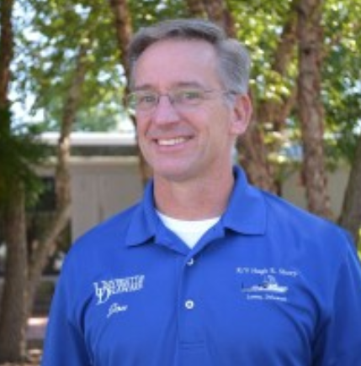
2025 Safety Committee Meeting
April 30th - Beautiful Lewes, Delaware
New Committee Chair!
Jeff Garrett 2015-2025
Jon Swallow 2025 -

Slide 4
Resolved Issues
Tension Monitoring System Accuracy Change Request Accepted into RVSS
3%-4% of Applied Load
Constant error window = 3%-4% of the Safe Working Tension

Slide 5
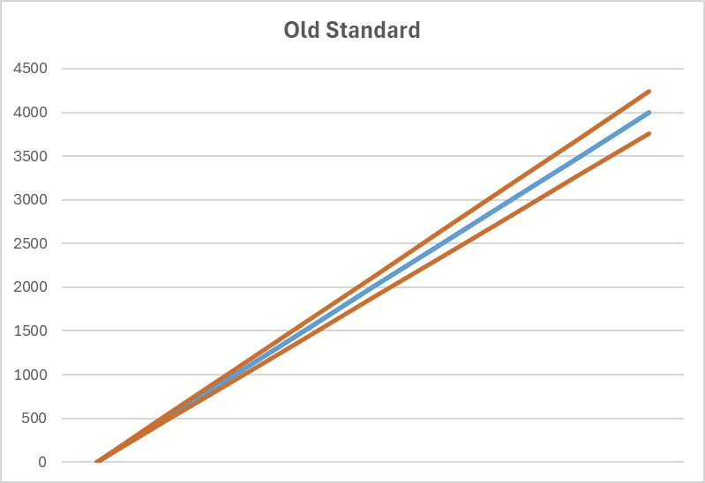
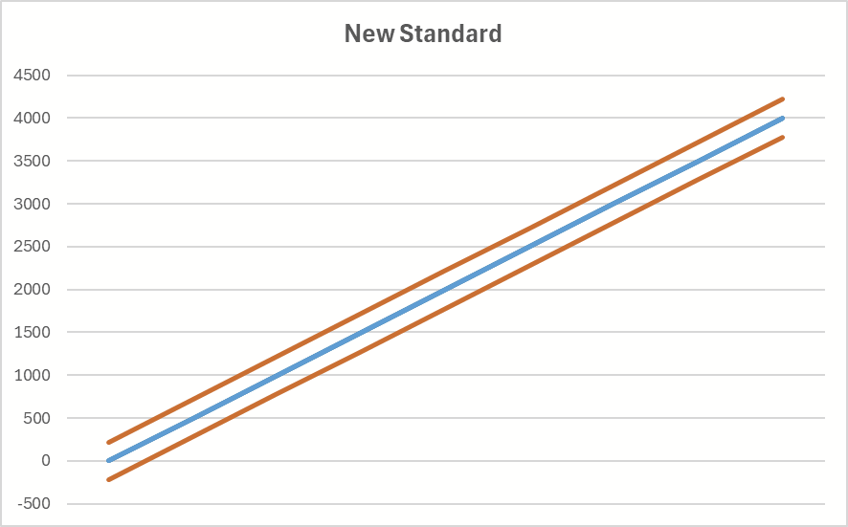
Resolved Issues
Tension Monitoring System Accuracy Change Request Accepted into RVSS

Slide 6
Resolved Issues
Clarification of the RVSS Alcohol Policy
All UNOLS vessel operators shall ban the consumption of alcoholic beverages on board vessels of the Academic Research Fleet by crewmembers or embarked members of the scientific party. Possession of alcoholic beverages onboard ARF vessels is also prohibited.
Certain exceptions can be approved in writing by institutional management for the purpose of allowing the possession and consumption of alcohol on board ARF vessels while in port for receptions, special occasions and entertainment of visiting dignitaries.
-RVSS 6.1.2
Notes:
RVSS policy supersedes institutional policy

Slide 7
Open Issues
Break Testing of Field-Terminated Samples
The Vessel Operator shall send samples to a UNOLS-accepted test facility (UNOLS Wire Pool at WHOI) for consistency of testing purposes and maintaining statistics.
For steel cables and wire rope, the Operation shall send a five-meter (16 ft.) test sample terminated on both ends with the fittings normally used in the field.
-RVSS A.5.2

Slide 8
Open Issues
Labeling of Overboard Handling Apparatus
OHS components must be labelled with SWT, most recent test date, and whenever possible, a SWT diagram providing a clear illustration of the tension member’s allowable range of angles when loaded to SWT.
-RVSS B.3.3

Slide 9
Ongoing Discussions
RVSS exclusions for light-duty overboarding systems
RVSS guidance for high-voltage considerations
Comprehensive update for harassment and respectful behavior
Wire lubrication protocols
Consistent testing of ship’s cranes
Lithium battery safety

Slide 10
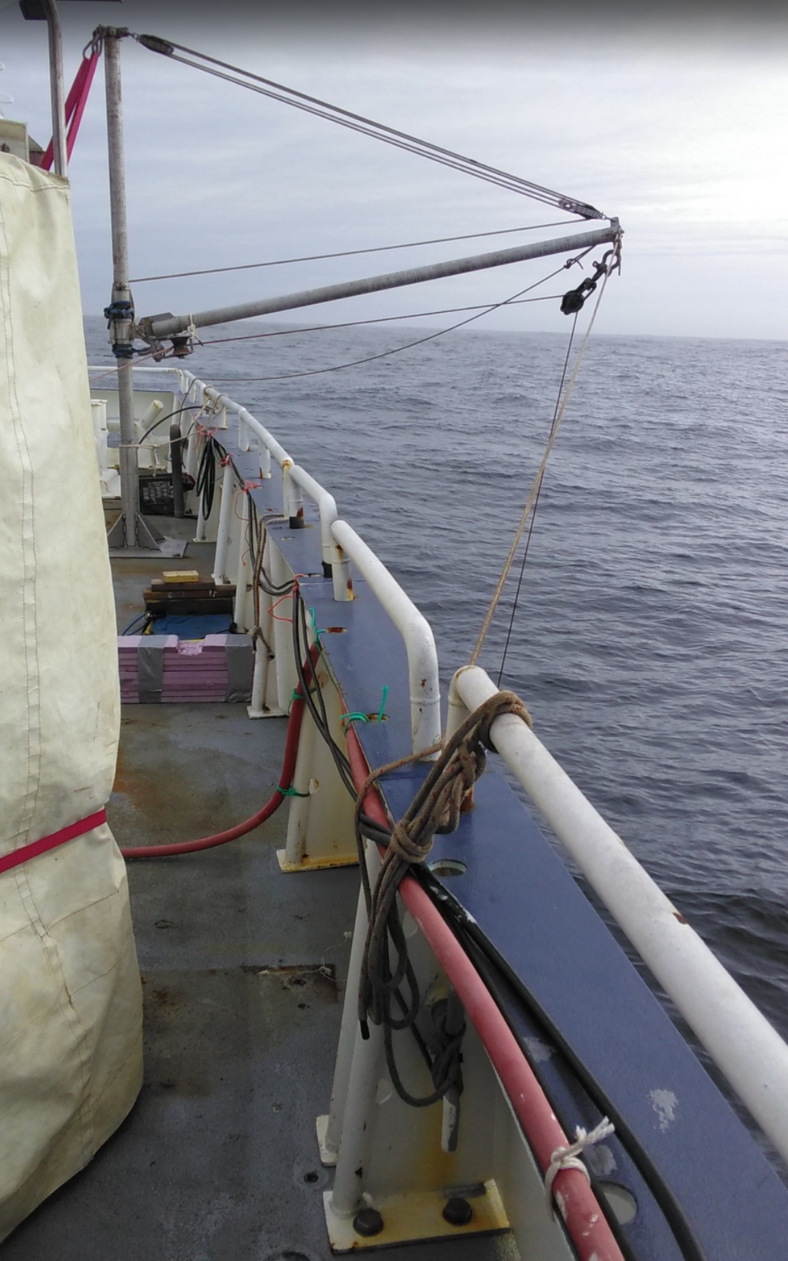
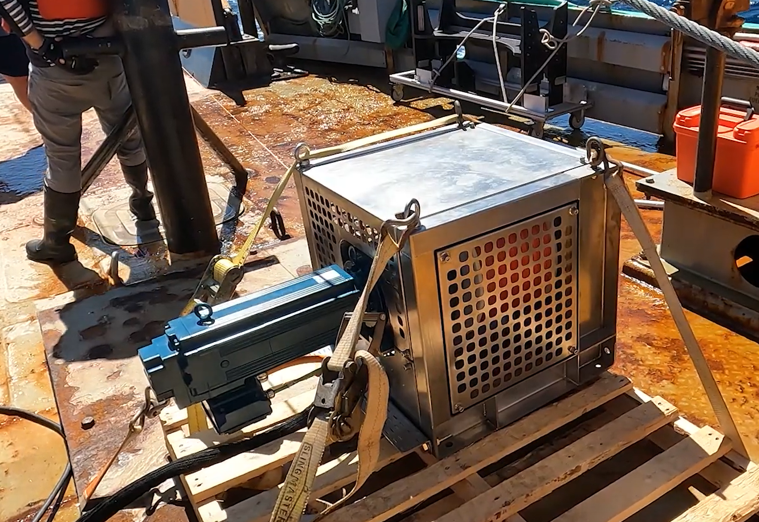
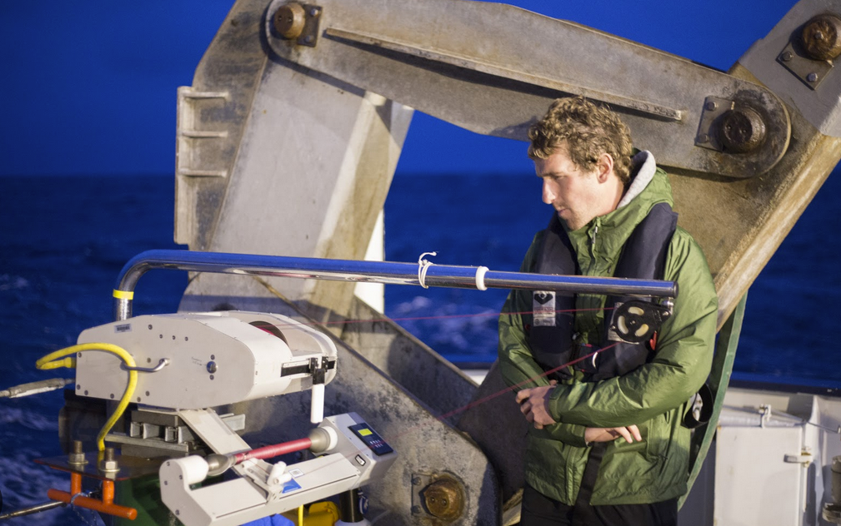

Slide 11
UNOLS Fleet Improvement Committee Update
RVTEC 2025
Erich Gruebel - URI

Slide 12
Fleet Improvement Committee Charge
The Fleet Improvement Committee (FIC) works to assure the continuing excellence of the Academic Research Fleet (ARF), to improve the capability and effectiveness of individual ships and to assure that the number, mix and overall capability of ships in the ARF match the science requirements of academic oceanography in the U.S.

Slide 13
Science Mission Requirements (SMRs)
Specifications which define minimum requirements and capabilities needed for research vessels, separated by classification
SMRs are the first step in ~10 year ship acquisition process
Updated periodically by panels of scientists, engineers, maritime professionals, and vessel operators. Driven by community input.
The FIC has begun the newest update to the Ocean Class SMR, last updated in 2003

Slide 14
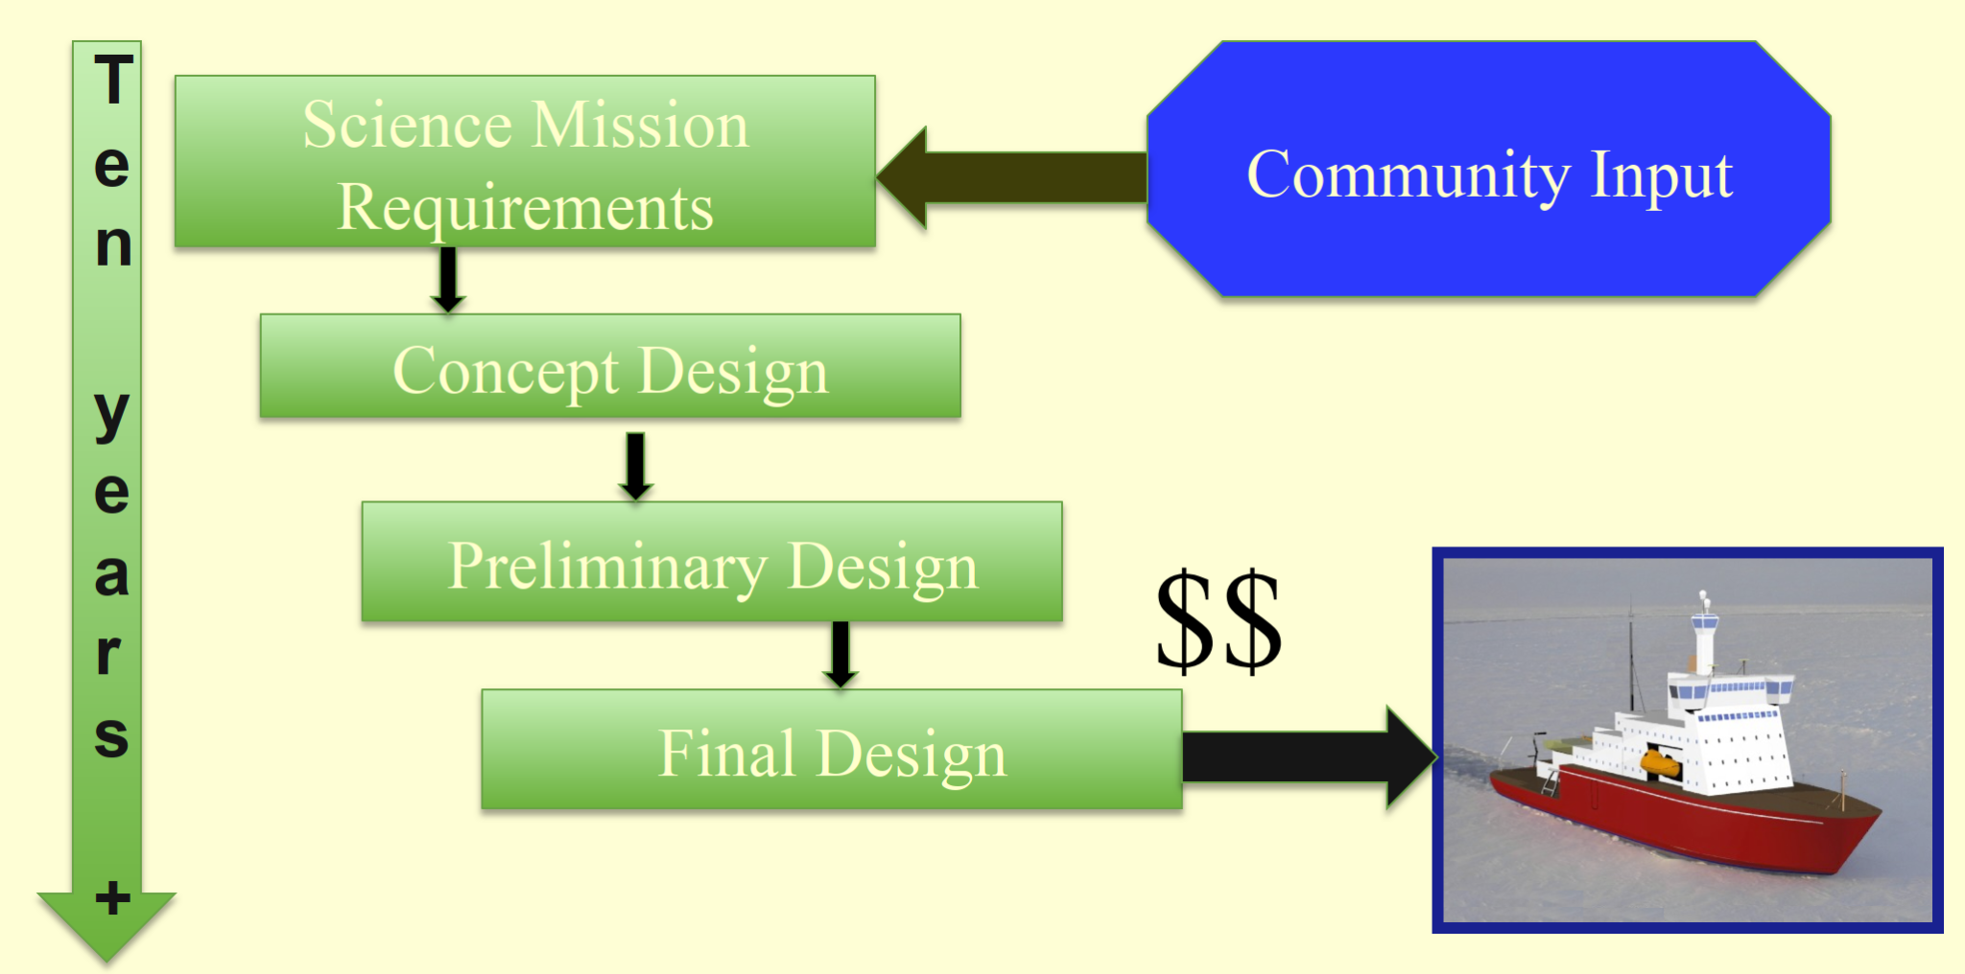
Science Mission Requirements (SMRs)
Notes:
RCRV SMRs were published in 2003, 22 years ago.

Slide 15
Replacing the Kilo Moana and Thomas G. Thompson
RV Kilo Moana’s service life ends 2032
RV Thomas G. Thompson service life ends 2036
No formal replacement program is in place for either vessel at this time
Notes:
28 vessels in 2001, 17 in 2025, 3 vessels by 2050. USAP has no ship.

Slide 16
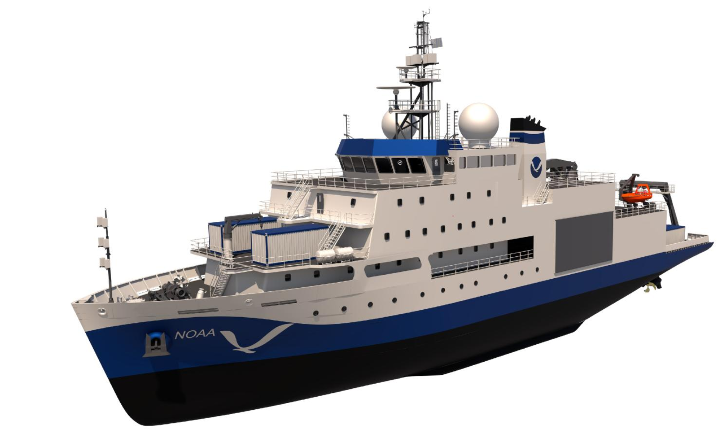
Evaluation of NOAA “Class B” Vessel

Slide 17
Evaluation of NOAA “Class B” Vessel
Design review to determine the suitability of the new NOAA Class B (Surveyor & Navigator) as a potential replacement for Kilo Moana and Thomas G Thompson
The Class B design is inadequate for several reasons
Deck and Lab Space (-1400 sq. ft.)
Overboard Handling Capability
Seakeeping (up to SS4)
Endurance (-40 days)
Built as survey vessels, not general purpose RVs

Slide 18
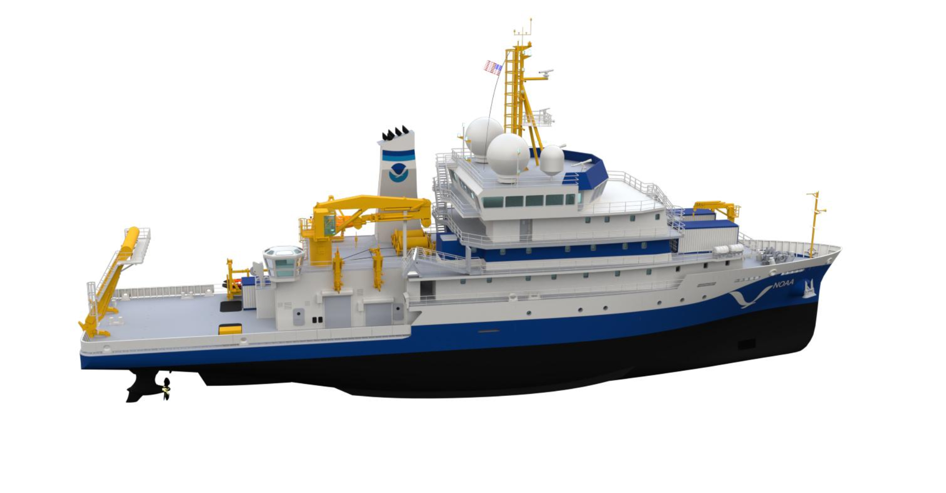
Evaluation of NOAA “Class A” Vessel

Slide 19
Evaluation of NOAA “Class A” Vessel
Design review against the to determine the suitability of the new NOAA Class A (Discoverer & Oceanographer) as a potential replacement for Kilo Moana and Thomas G Thompson
The Class A is a suitable replacement for Kilo Moana
The Class A does NOT meet the GCSMR
Recommendation sent to UNOLS Council in July of 2025

Slide 20
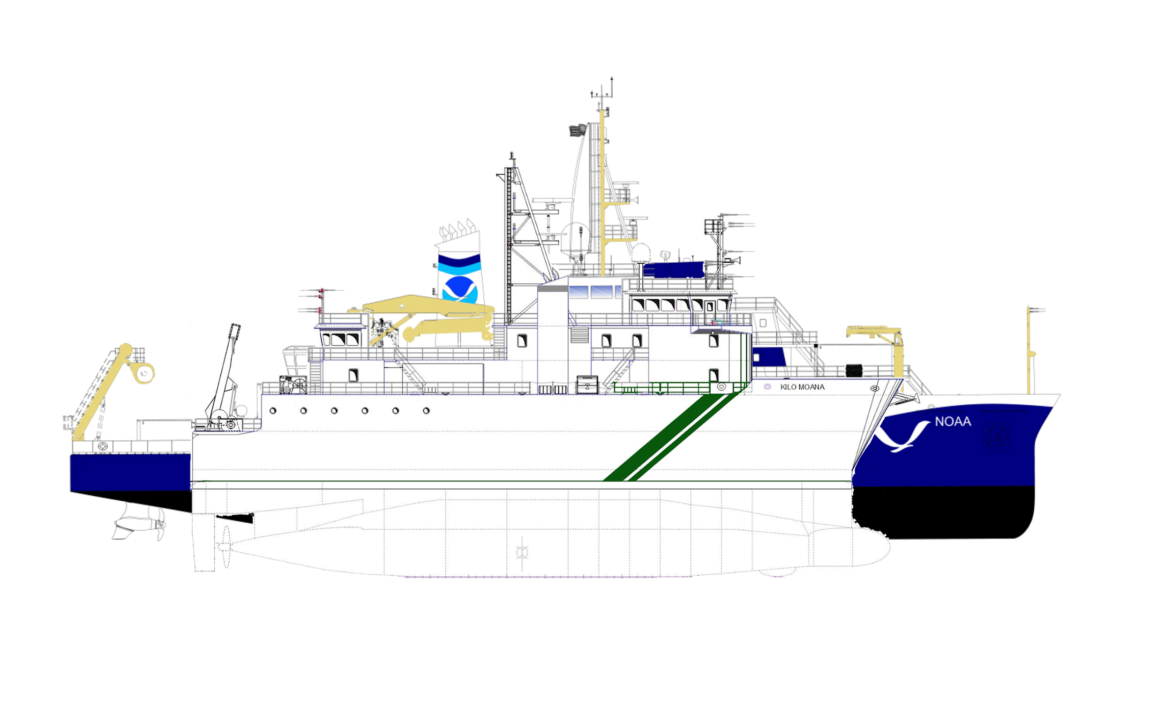
Evaluation of NOAA “Class A” Vessel
Meets or exceeds OCSMRs *with reasonable modifications
Overboard handling system needs a refresh
Lab layout modifications from the NOAA design

Slide 21
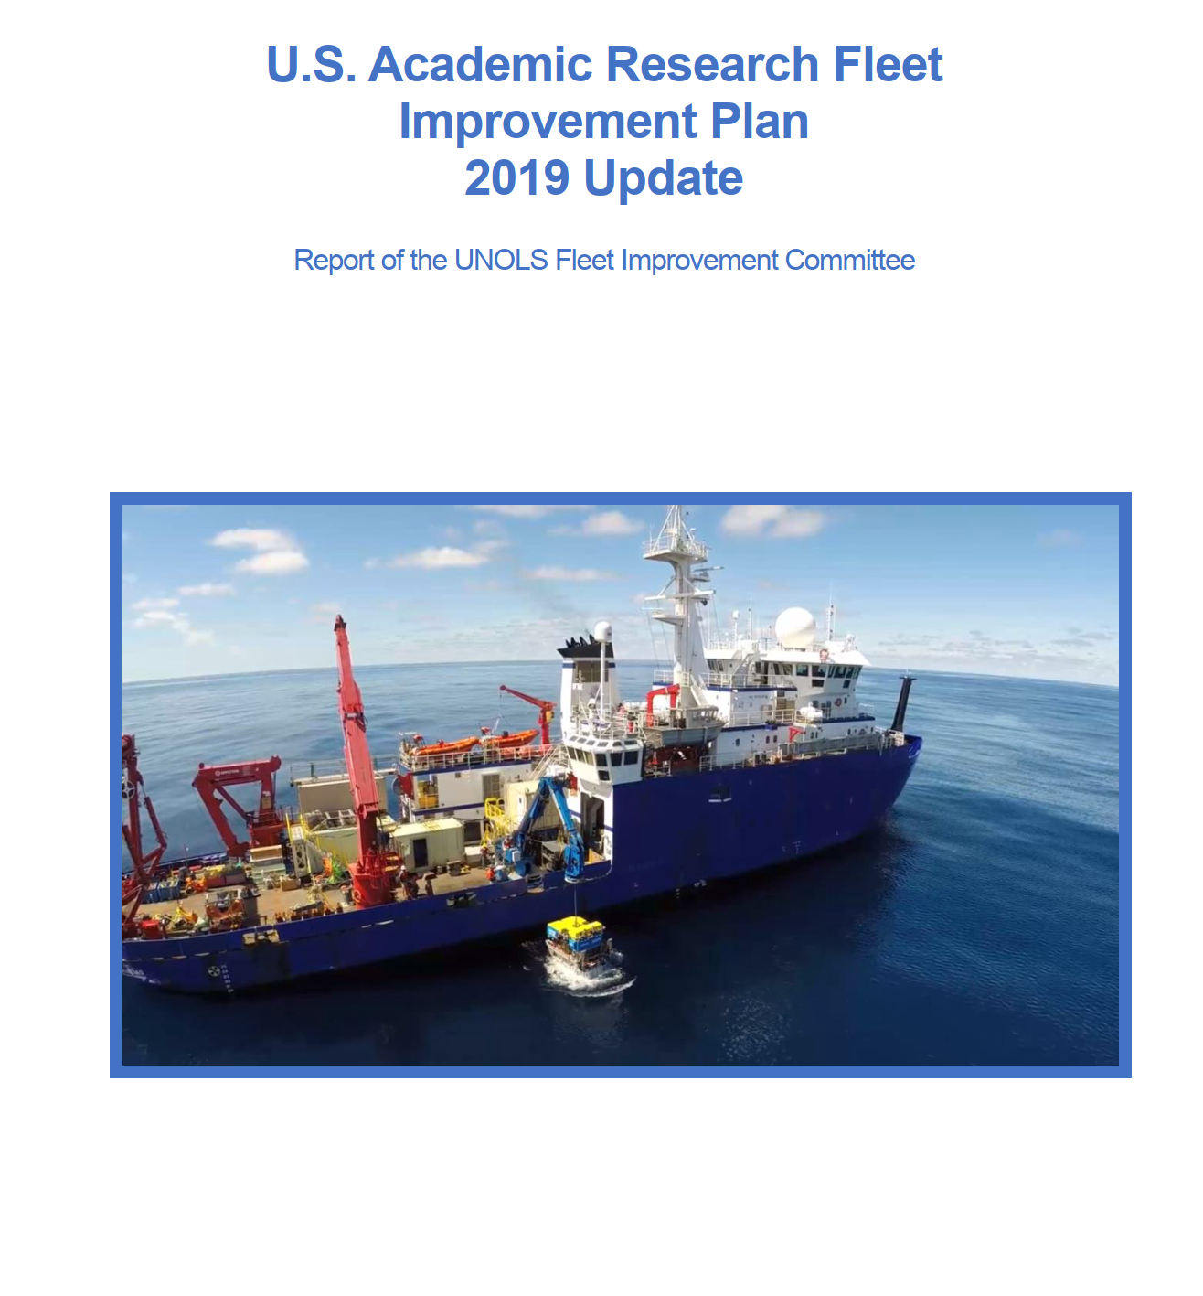
2025 (or ‘26) Fleet Improvement Plan
FIP last updated in 2019
Assessment of the past, present, and future of the ARF
Recommendations to funding agencies and the UNOLS Council on funding priorities
Fleet Recapitalization!

