Slide 1


NSF West Coast Winch Pool operated by Scripps Institution of Oceanography
RVTEC 2025

Slide 2
Our Mission
To provide an inventory of oceanographic winches (etc.) for shared use.
To keep our inventory in good repair and in compliance with applicable standards (CFR, RVSS).
To modify our inventory to better serve our community.
To provide technical support: cable/wire rope spooling, training, maintenance, repairs, engineering, fabrication, advice…
Notes:
Our primary purpose is to have winches that can be borrowed so science parties don’t have to purchase and maintain their own.
We keep them in great shape.
We get rid of machinery that’s no longer relevant or reliable. We buy new things our community needs. We add bells and whistles to our existing equipment as the need for them arises.
We also provide technical support of all sorts. We maintain and repair winches for others. We can lubricate the cables and wire ropes on your ships. We engineer and fabricate things. We give advice, and so on.

Slide 3
How the Winch Pool Works
Funded by NSF
Customers (science parties, vessel operators, technicians…) communicate their needs to us (email, phone, text…).
We provide the machinery/personnel required to meet their needs.
We send the machinery/personnel where they’re needed.
Those conducting NSF-funded research generally incur no costs to use our machinery and personnel.
Others generally pay a “day rate” and the cost of freight.
Notes:
We’re primarily funded by NSF.
Customers generally contact us via email to describe their projects—the missions they’re trying to support.
If we have a piece of equipment that meets their needs, we send it to the vessel or job site at the appropriate time and send it back to us when the project is done.
If the project is funded by NSF, this is all done at no cost to the customer.
Others have to chip in by paying a day rate (rent) and the cost of freight.

Slide 4
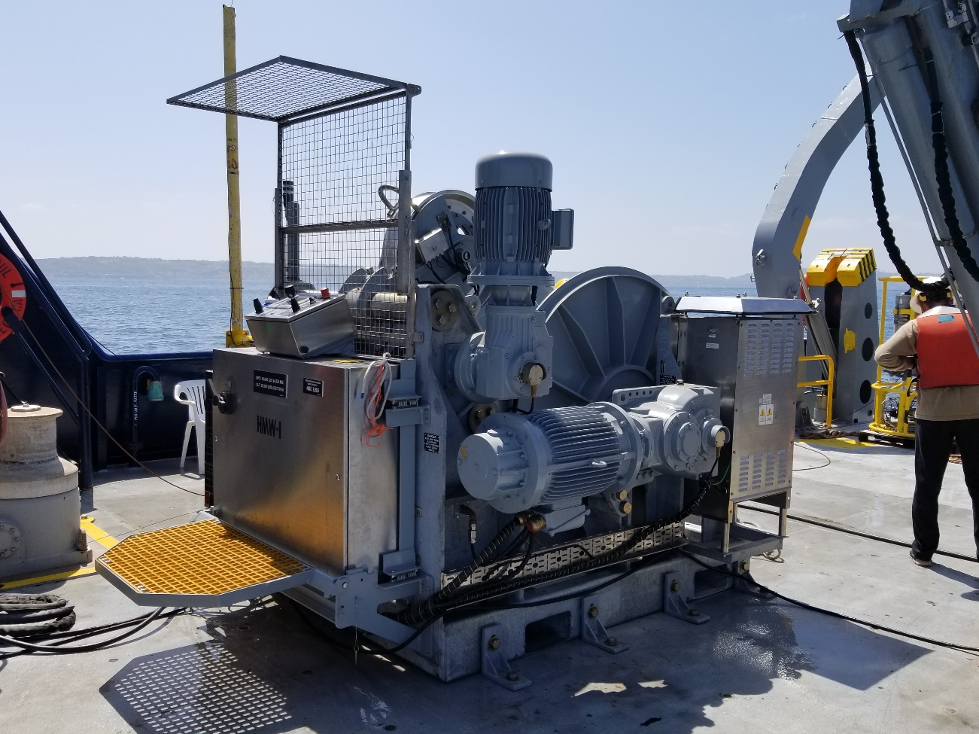
Equipment
Winches, capstans, spooler for handling moorings
Small and medium-sized multipurpose winches
A large traction winch
Blocks
Sliprings
Fiber-optic rotary joints
Notes:
If you need overboard handling equipment to carry out a project, give us a call, or send us an email so we can discuss what you aim to do and when. We’ll let you know what equipment we have available for your project.

Slide 5
Projects 2024-2025
Report: WCWP.
Negotiated a new 5-year contract for WCWP.
New winch delivered/installed on Atlantic Explorer.
Sally Ride CAST-6 modifications.
Robert Gordon Sproul NSF inspection.
Delivered/integrated portable cranes for Roger Revelle.
Put together OHS operator's manuals for Sikuliaq.
Started OHS operator’s manuals for Thomas G. Thompson and Atlantic Explorer.
Integrated with wife 3.0.
Notes:
Report: NSF wished for a detailed report about the state of the west coast winch pool—what equipment we had, what it was used for, if it was needed, what its state of repair was, what its
remaining usable lifespan was, and so forth.
Manuals: I’m not currently taking on any engineering projects outside of making OHS operator's manuals for UNOLS vessels. We are still offering every other form of support though (spooling,
repairs, advice, and so on).
Wife: In 2018 was surprised to learn wife 2.0 was no longer compatible with my hardware.
I put out an RFP on Match.com. In April, negotiated a new contract with wife 3.0. Bugs were discovered in the integration phase, but we managed to fix them.
Marriage 3.1 is stable. (It was actually way more romantic than it sounds. I’m just trying to communicate in terms you’d understand.)
On a side note: Wife 2.0 integrated with a wife of her own.

Slide 6
Contact Us
Capt. Heather Galiher
(858) 534-5568
hegaliher@ucsd.edu
Aaron E. Davis, PE, Engineer
(619) 251-6368
aed001@ucsd.edu
https://scripps.ucsd.edu/ships/west-coast-winch-pool
Notes:
Give us a call if you need equipment or technical support. For those of you that don’t know, I am a licensed engineer available to any of you. If I can help you I will.
Are there any questions?
Thank you.

