Slide 1
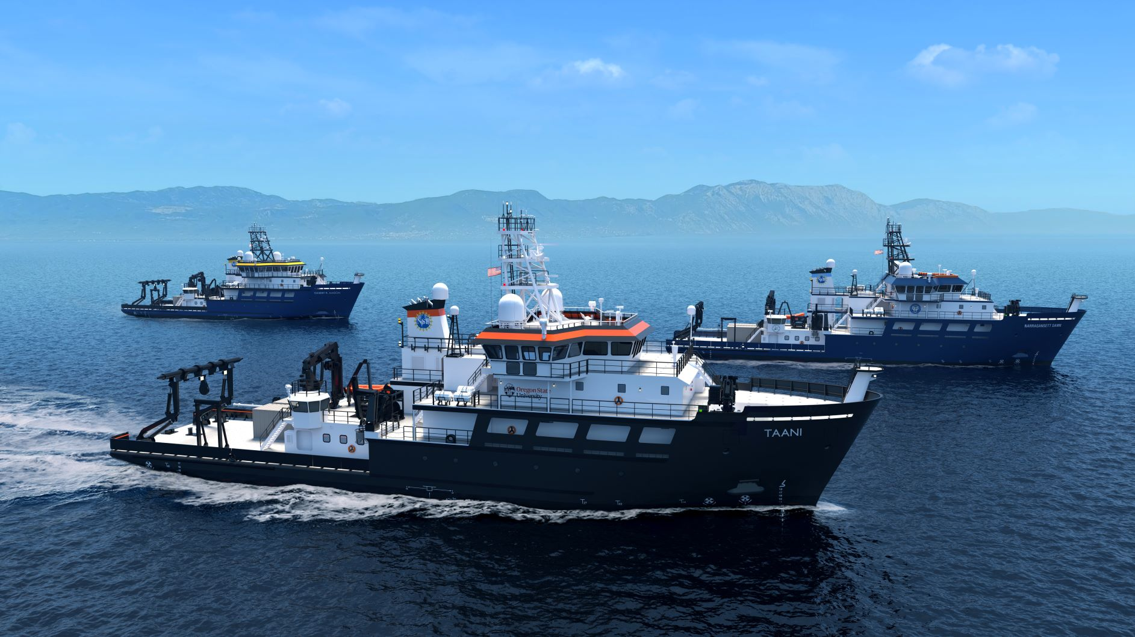


RCRV Update RVTEC 2025
Regional Class Research Vessel Program- Oregon State University
November 06, 2025

Slide 2
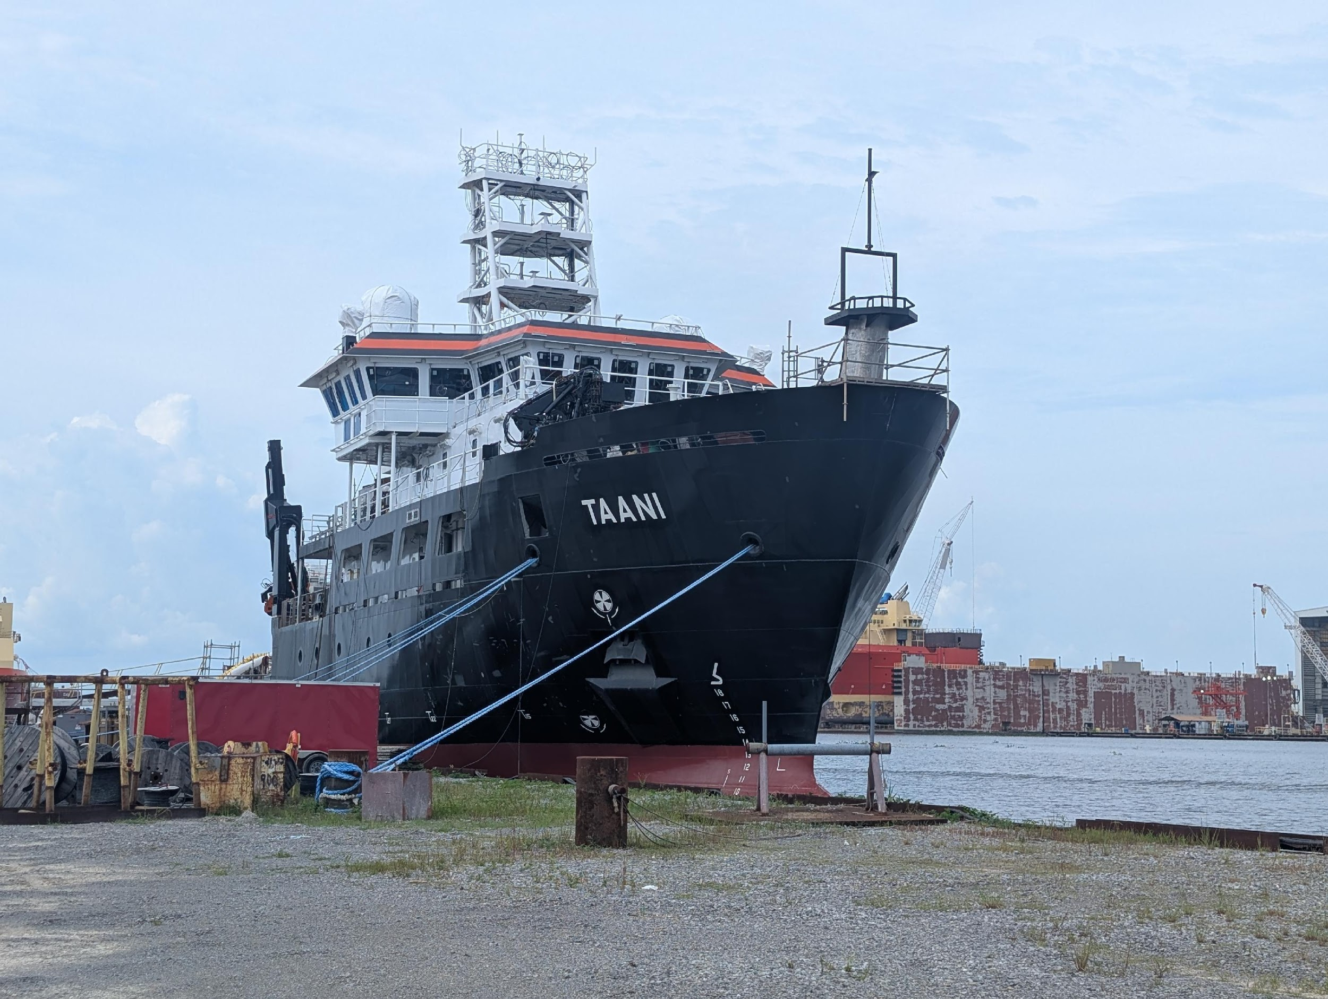
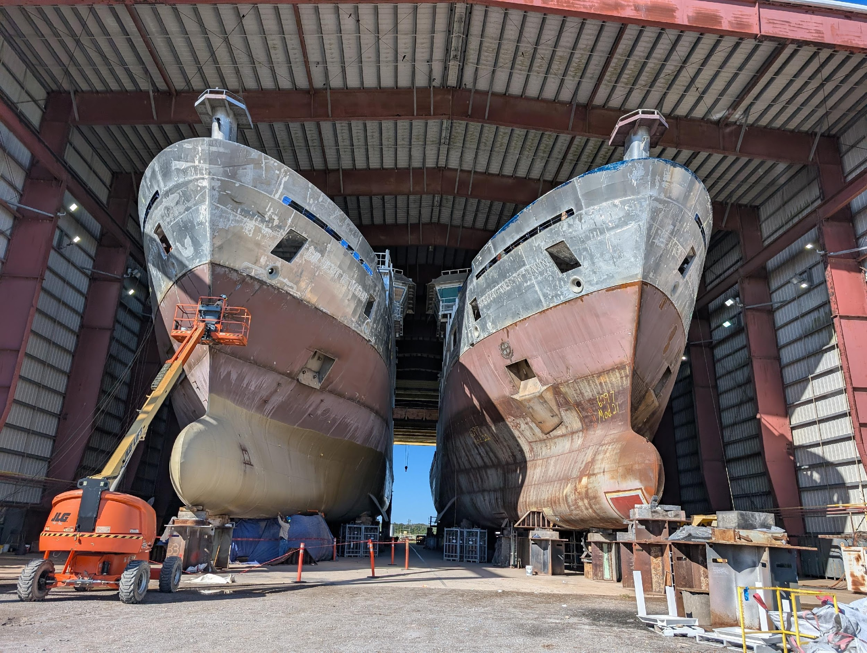
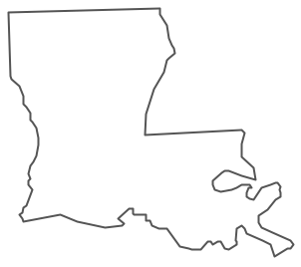
Regional Class Research Vessel Program- Summary
Design and build three new research vessels- Project is managed by Oregon State University & funded by the National Science Foundation (NSF)
Operating Institutions
Oregon State University- R/V Taani
East Coast Consortium- University of Rhode Island- R/V Narragansett Dawn
Gulf Caribbean Oceanographic Consortium- USM and LUMCON- R/V Gilbert R. Mason
Currently being built in Houma, Louisiana at Bollinger Shipyards.
New Orleans
Houma

Slide 3
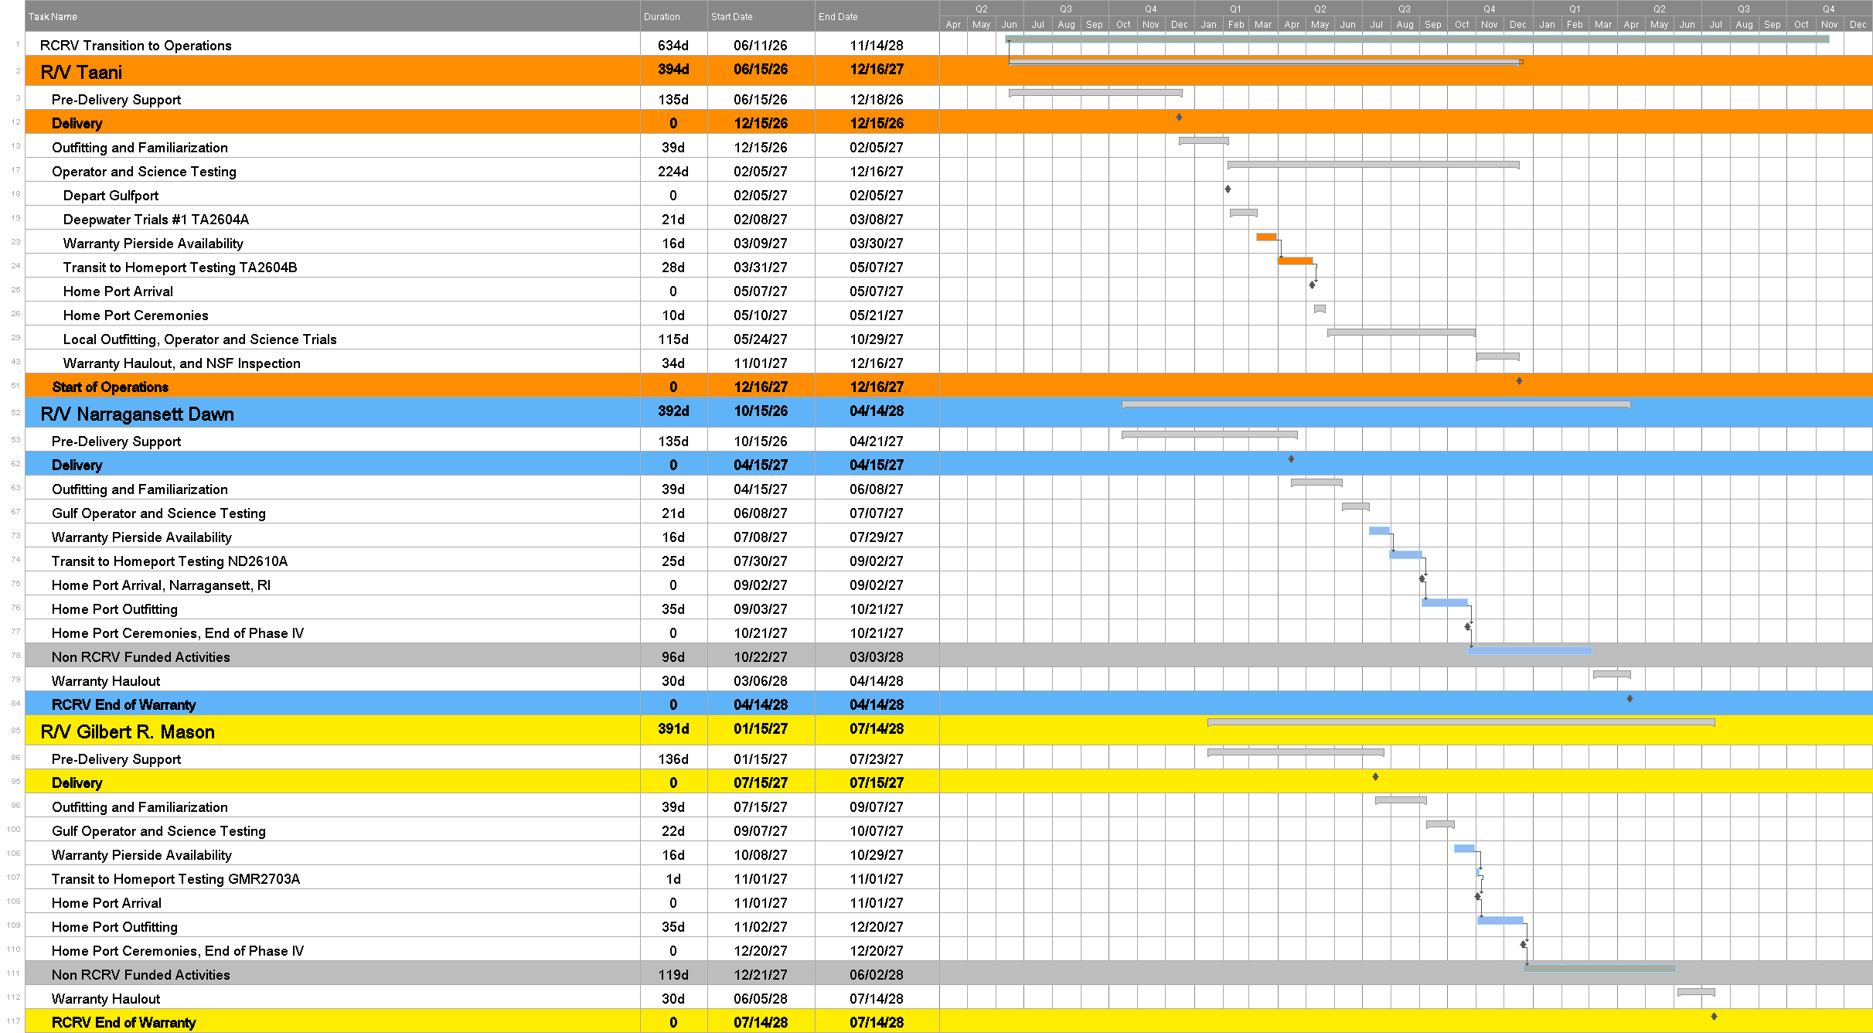
RCRV Estimated Schedule
R/V Taani
Start of Transition to Operations
06/15/2026
Vessel Delivery
12/15/2026
Start of Operations
12/16/2027
R/V Narragansett Dawn
Start of Transition to Operations
10/15/2026
Vessel Delivery
04/15/2027
End of T-to-O
10/21/2027
R/V Gilbert R. Mason
Start of Transition to Operations
01/15/2027
Vessel Delivery
07/15/2027
End of T-to-O
12/20/2027

Slide 4
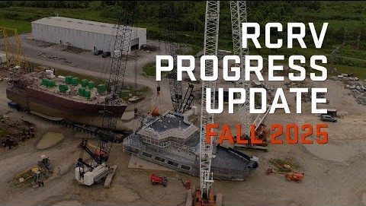
RCRV Progress Update
Fall 2025 Video
https://www.youtube.com/watch?v=UV2KN5O-z8I

Slide 5
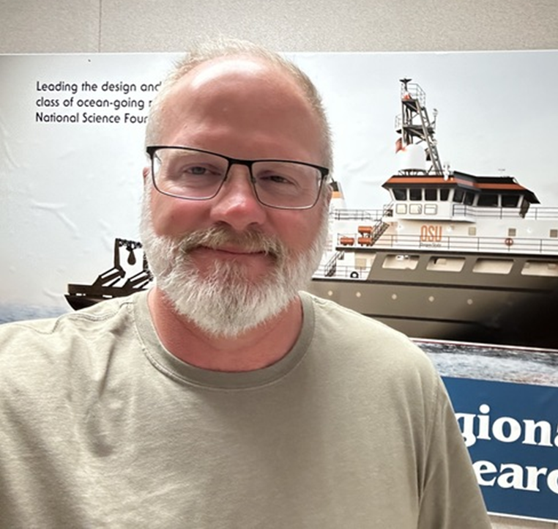

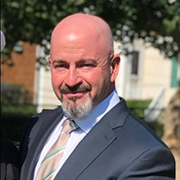
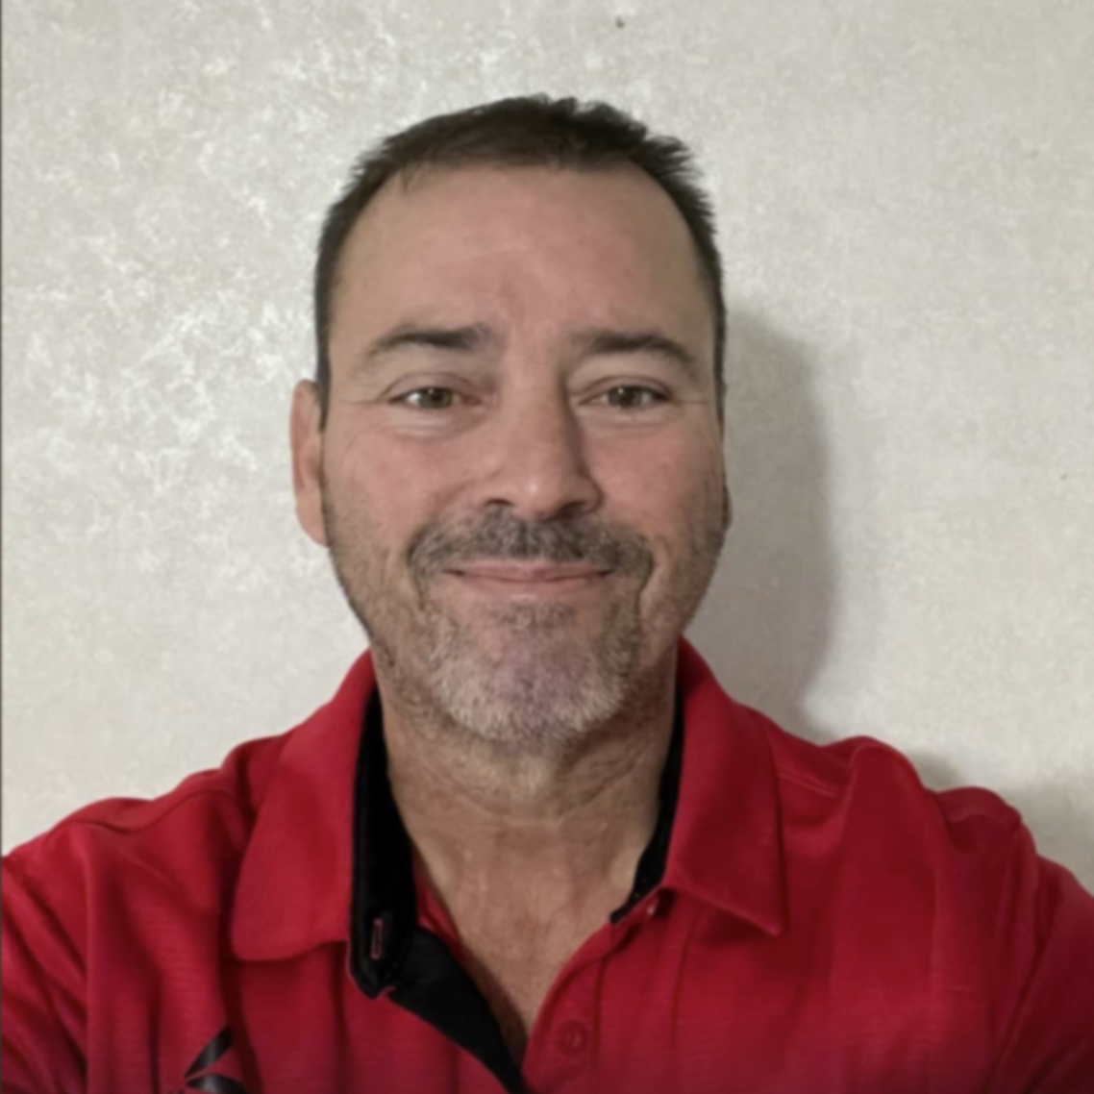
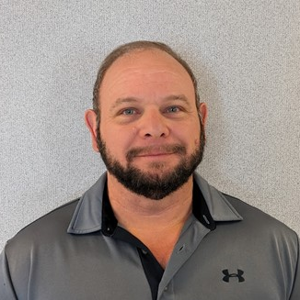
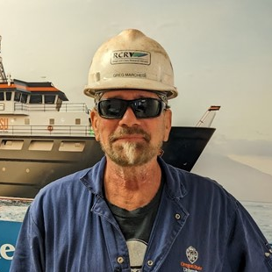
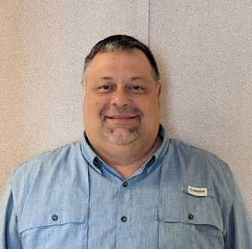
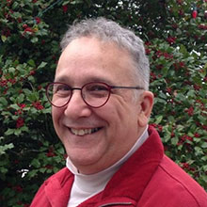

Regional Class Research Vessel -
Project Field Office- Bollinger Shipyard- Houma, LA
*Indicates Subcontractors to OSU
John Comar
Shipyard Representative
Hannah Rivera
Program Administration Coordinator
Russ Morton
Deputy Shipyard Representative / Lead Inspector
Olan Cobb
Electrical Inspector*
Mike Portier
Electrical and Electronics Inspector*
Greg Marchese
Weld and Structure Inspector*
Jason Duplechin
Hull and Machinery Inspector*
Dan Slobodzian
Lead Technical Reviewer
Kristin Beem
Marine Science Technical Director

Slide 6
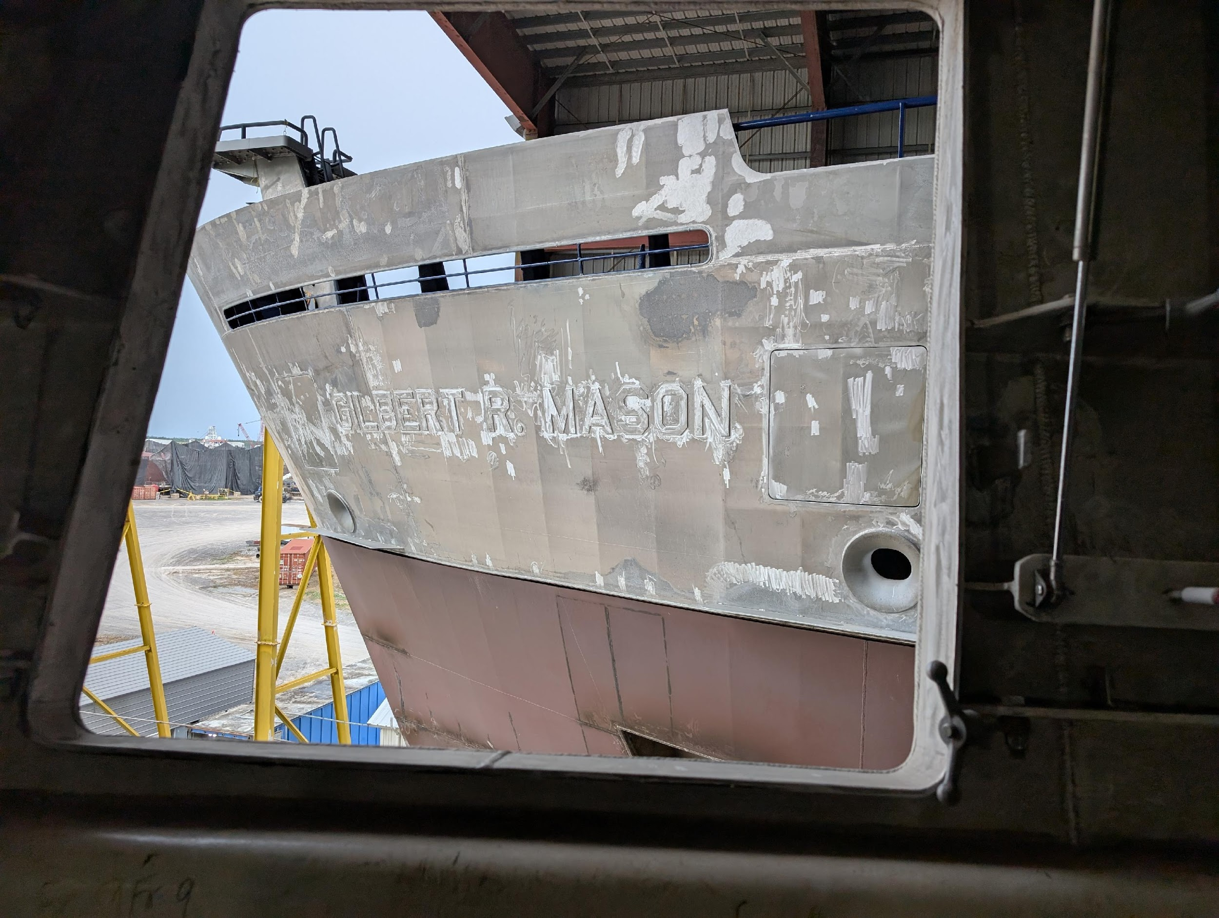
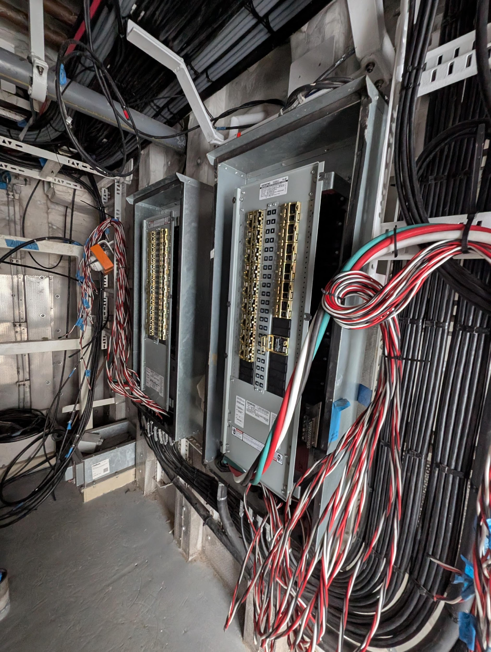
Delays – 10 Years to Build a 200’ Ship?
Subcontractor default
Detail Design/Production Drawings subcontractor
Electrical subcontractor (see also next slide)
Covid-19 Impacts
Skilled Labor availability issues (ongoing industry-wide for complex vessels USN, USCG)
Disruption to Detail Design Effort (7-9 month effort took 18 months)
Hurricane Ida (major impacts at shipyard and surrounding area)
Skilled Labor availability issues (ongoing) (lack of lower-income housing)
Threat of future storms has impacted desirability of area
6-month immediate pause in construction
National shipbuilding industry at all time low, struggling to recover. (USCG now buying icebreakers from Finland)

Slide 7
Electrical Subcontractor Challenges
Original subcontractor defaulted on V2 and V3 in May of 2024. Shipyard attempted to rebid, then unsuccessfully tried to do in-house with sub-contractor labor.
May 2025 shipyard defaulted V1 subcontractor due to very poor performance. Subsequently hired new vendor to correct installation issues (misrouting, cable damage) and finish work
September 2025 Shipyard hired V1 subcontractor to do V2 and V3 with some schedule relief and financial assistance from OSU. New contract delivery dates for V2 and V3 similar to OSU’s ”estimated” dates. No real change in actual delivery.
Very complex electrical design:
Vessel | CABLE COUNT | CABLE (FT) | Useable Internal Volume (Cubic Feet) | Cable Weight (Lbs.)
RCRV (199’-6”) | 7,156 | ~544,000 | 170,149 | 108,400
RV SIKULIAQ (261’) | 6,758 | ~684,000 | 344,609 | -
RV DAVID PACKARD (164’) | - | - | 156,294 | 54,000

Slide 8
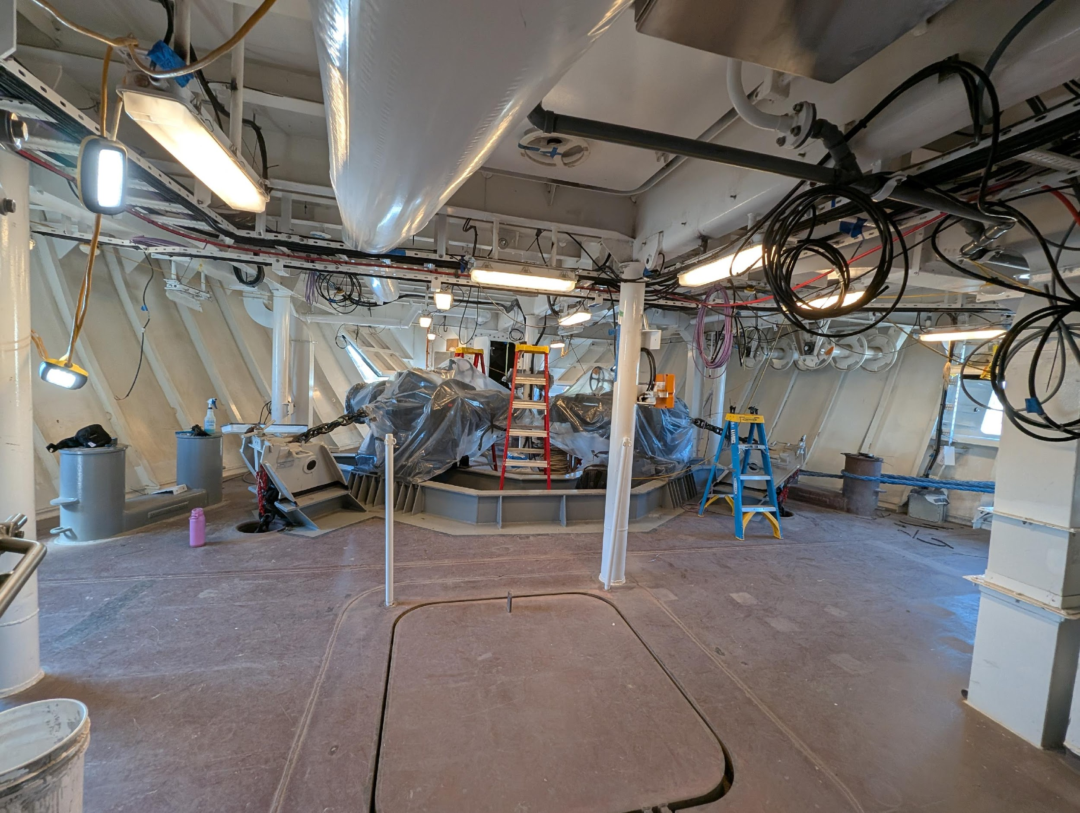
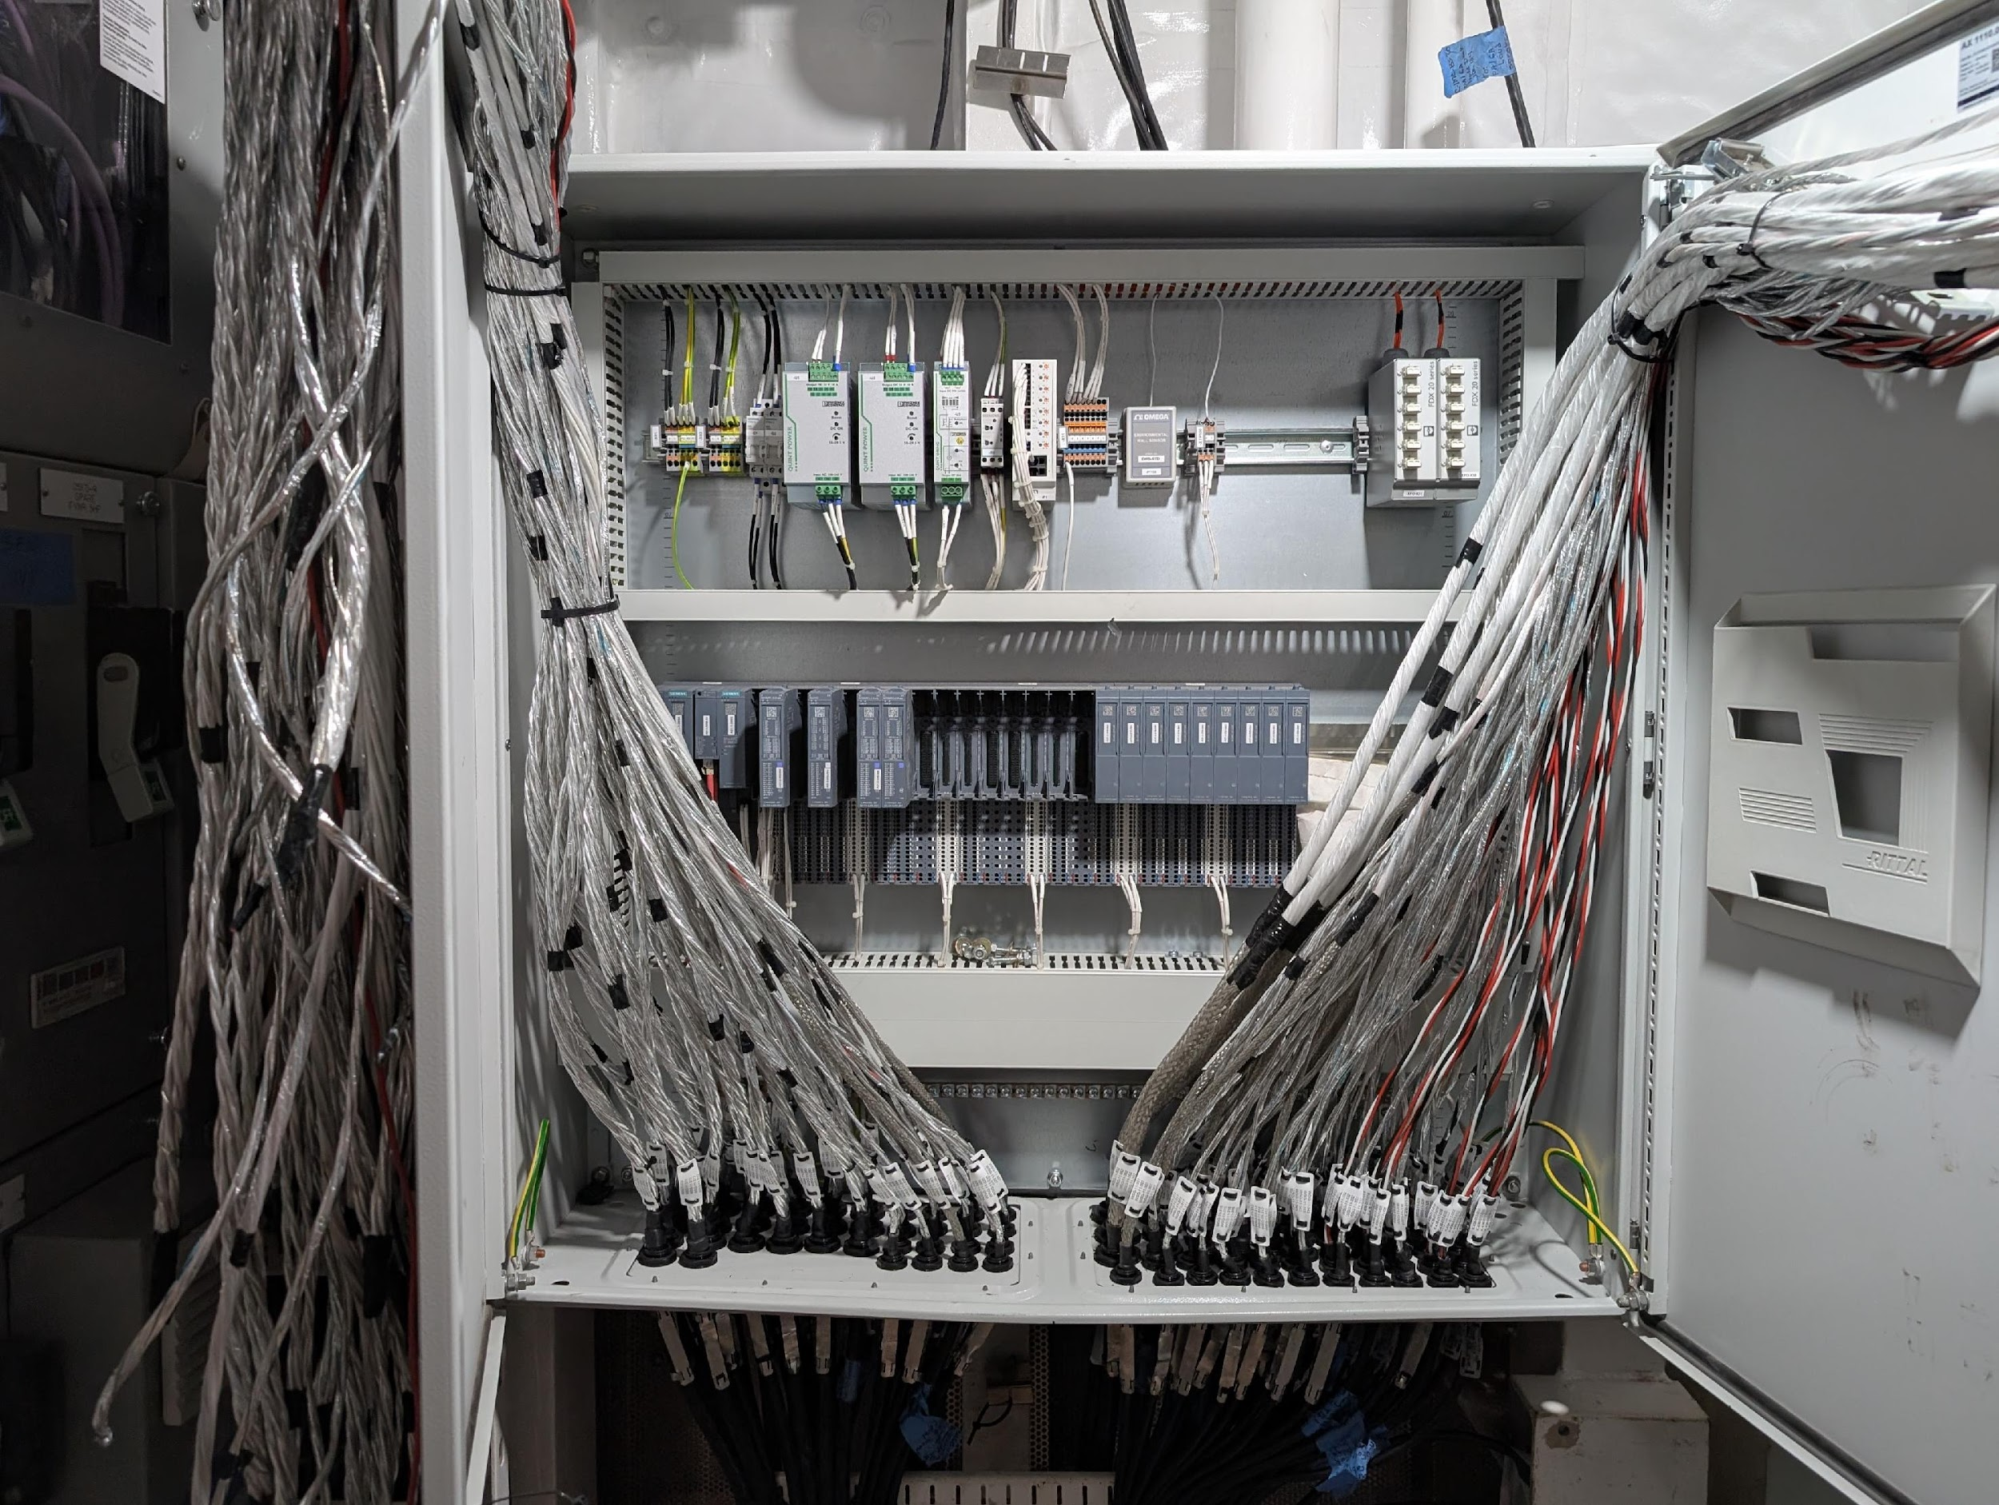
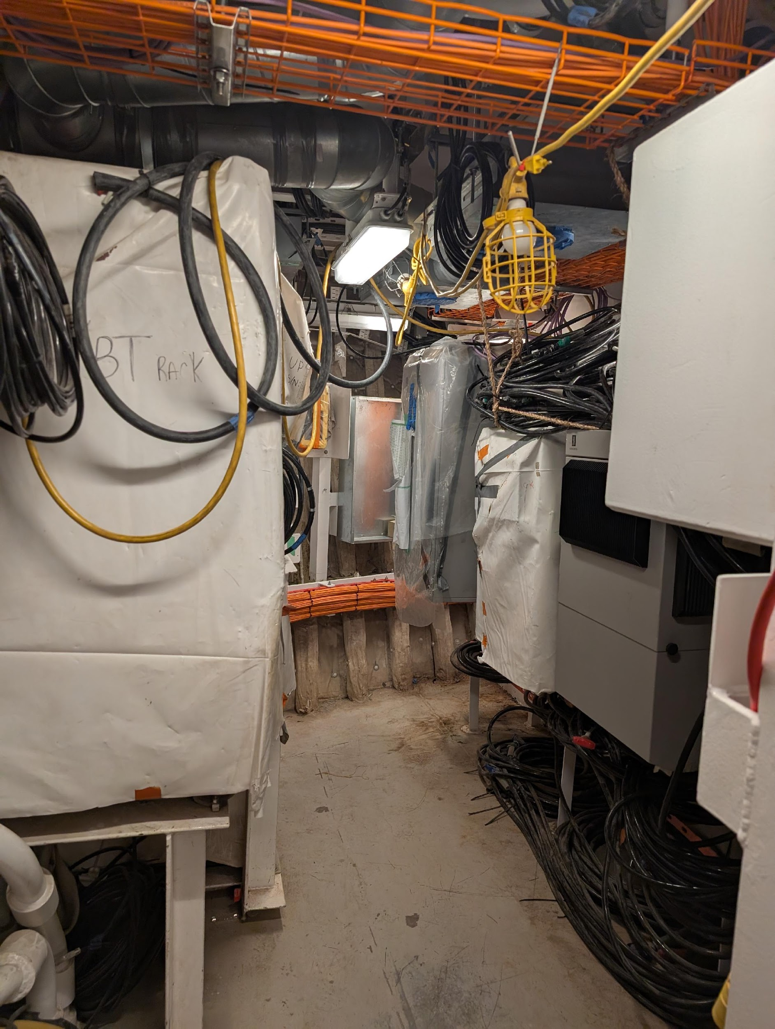
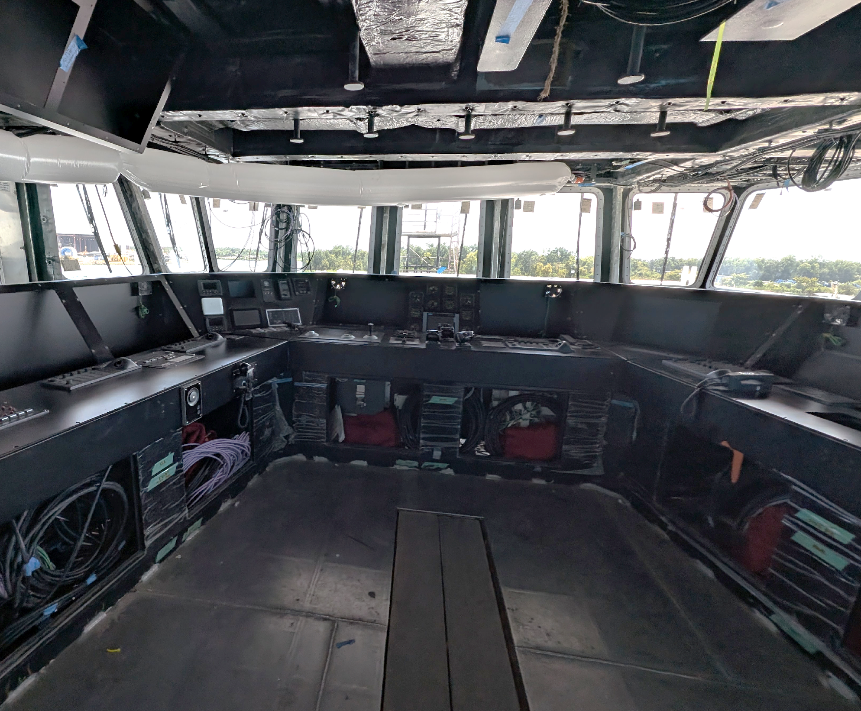
R/V TAANI
Build Update
Cable pulling & cut in/terminations to boxes & meggering cables. New electrical sub-contractor that is very dedicated to craftsmanship and meeting deadlines
To date 91.96% cable pulled & 368 cables ran into a cabinet 16 cables terminated 135 cables meggered (1.91%)
Starting to power systems on (working through the lighting systems now and will progress to commissioning the mechanical systems as the power is distributed through the ship
All the OHS equipment is installed. Working on alignment of the A-Frame, Hydro Winch/LARS alignment, and completion of piping systems.

Slide 9
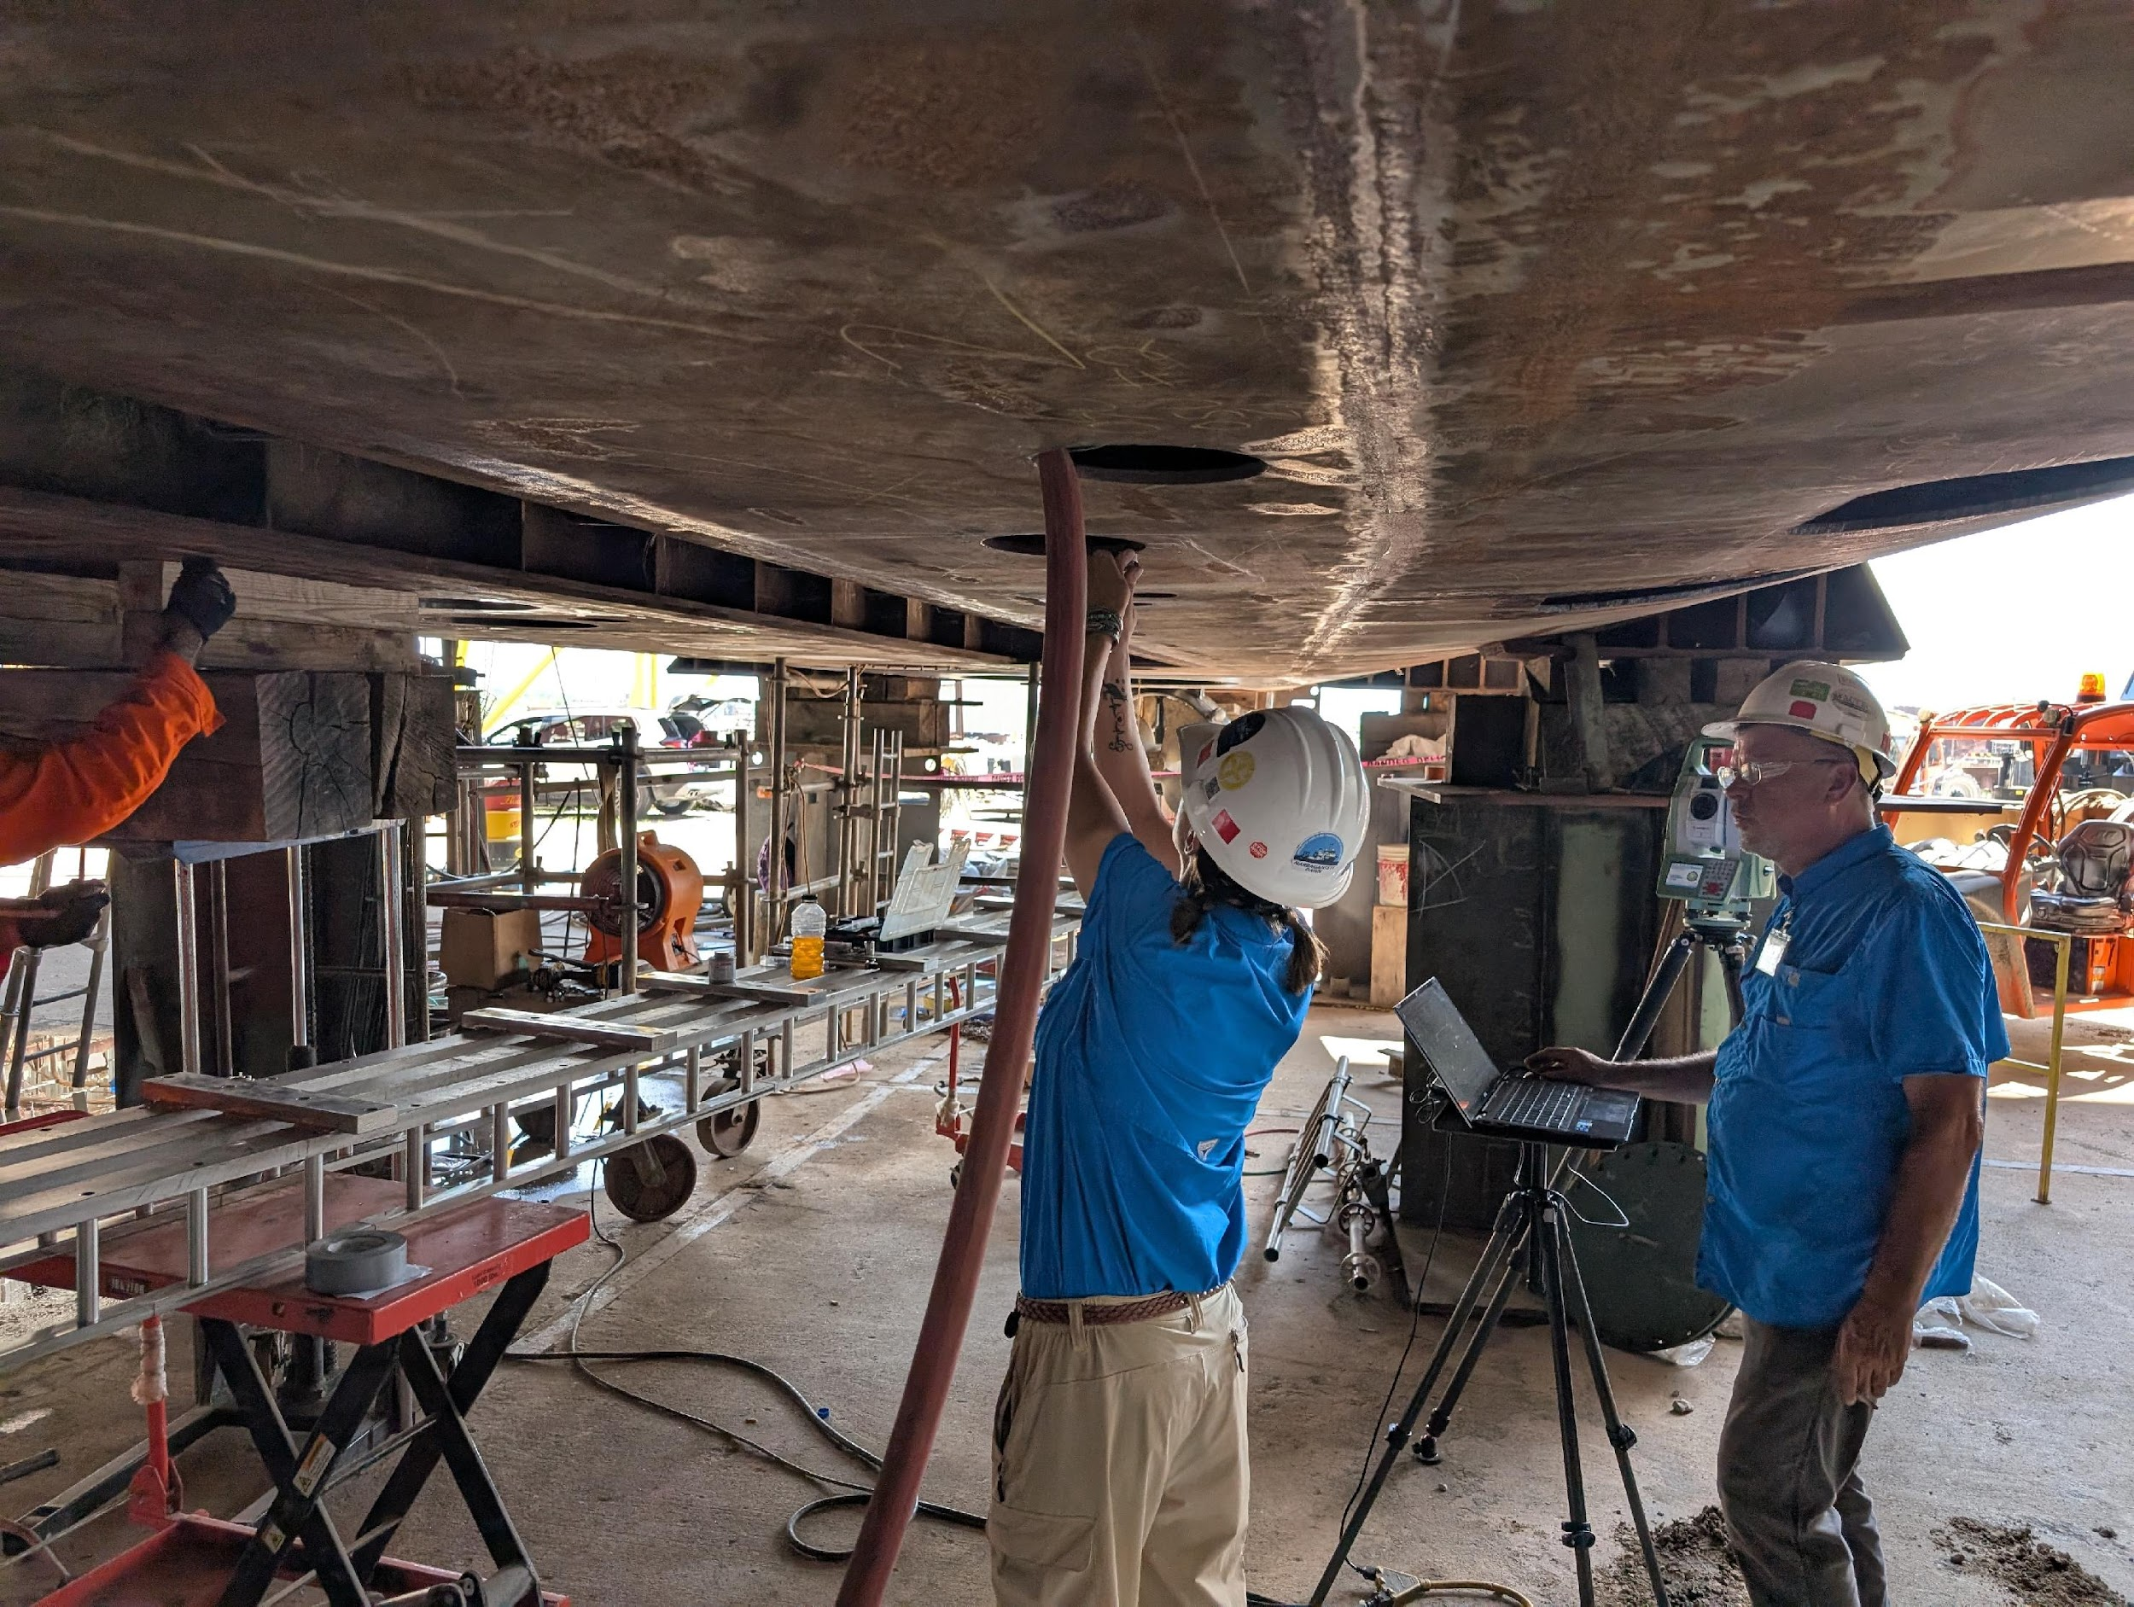
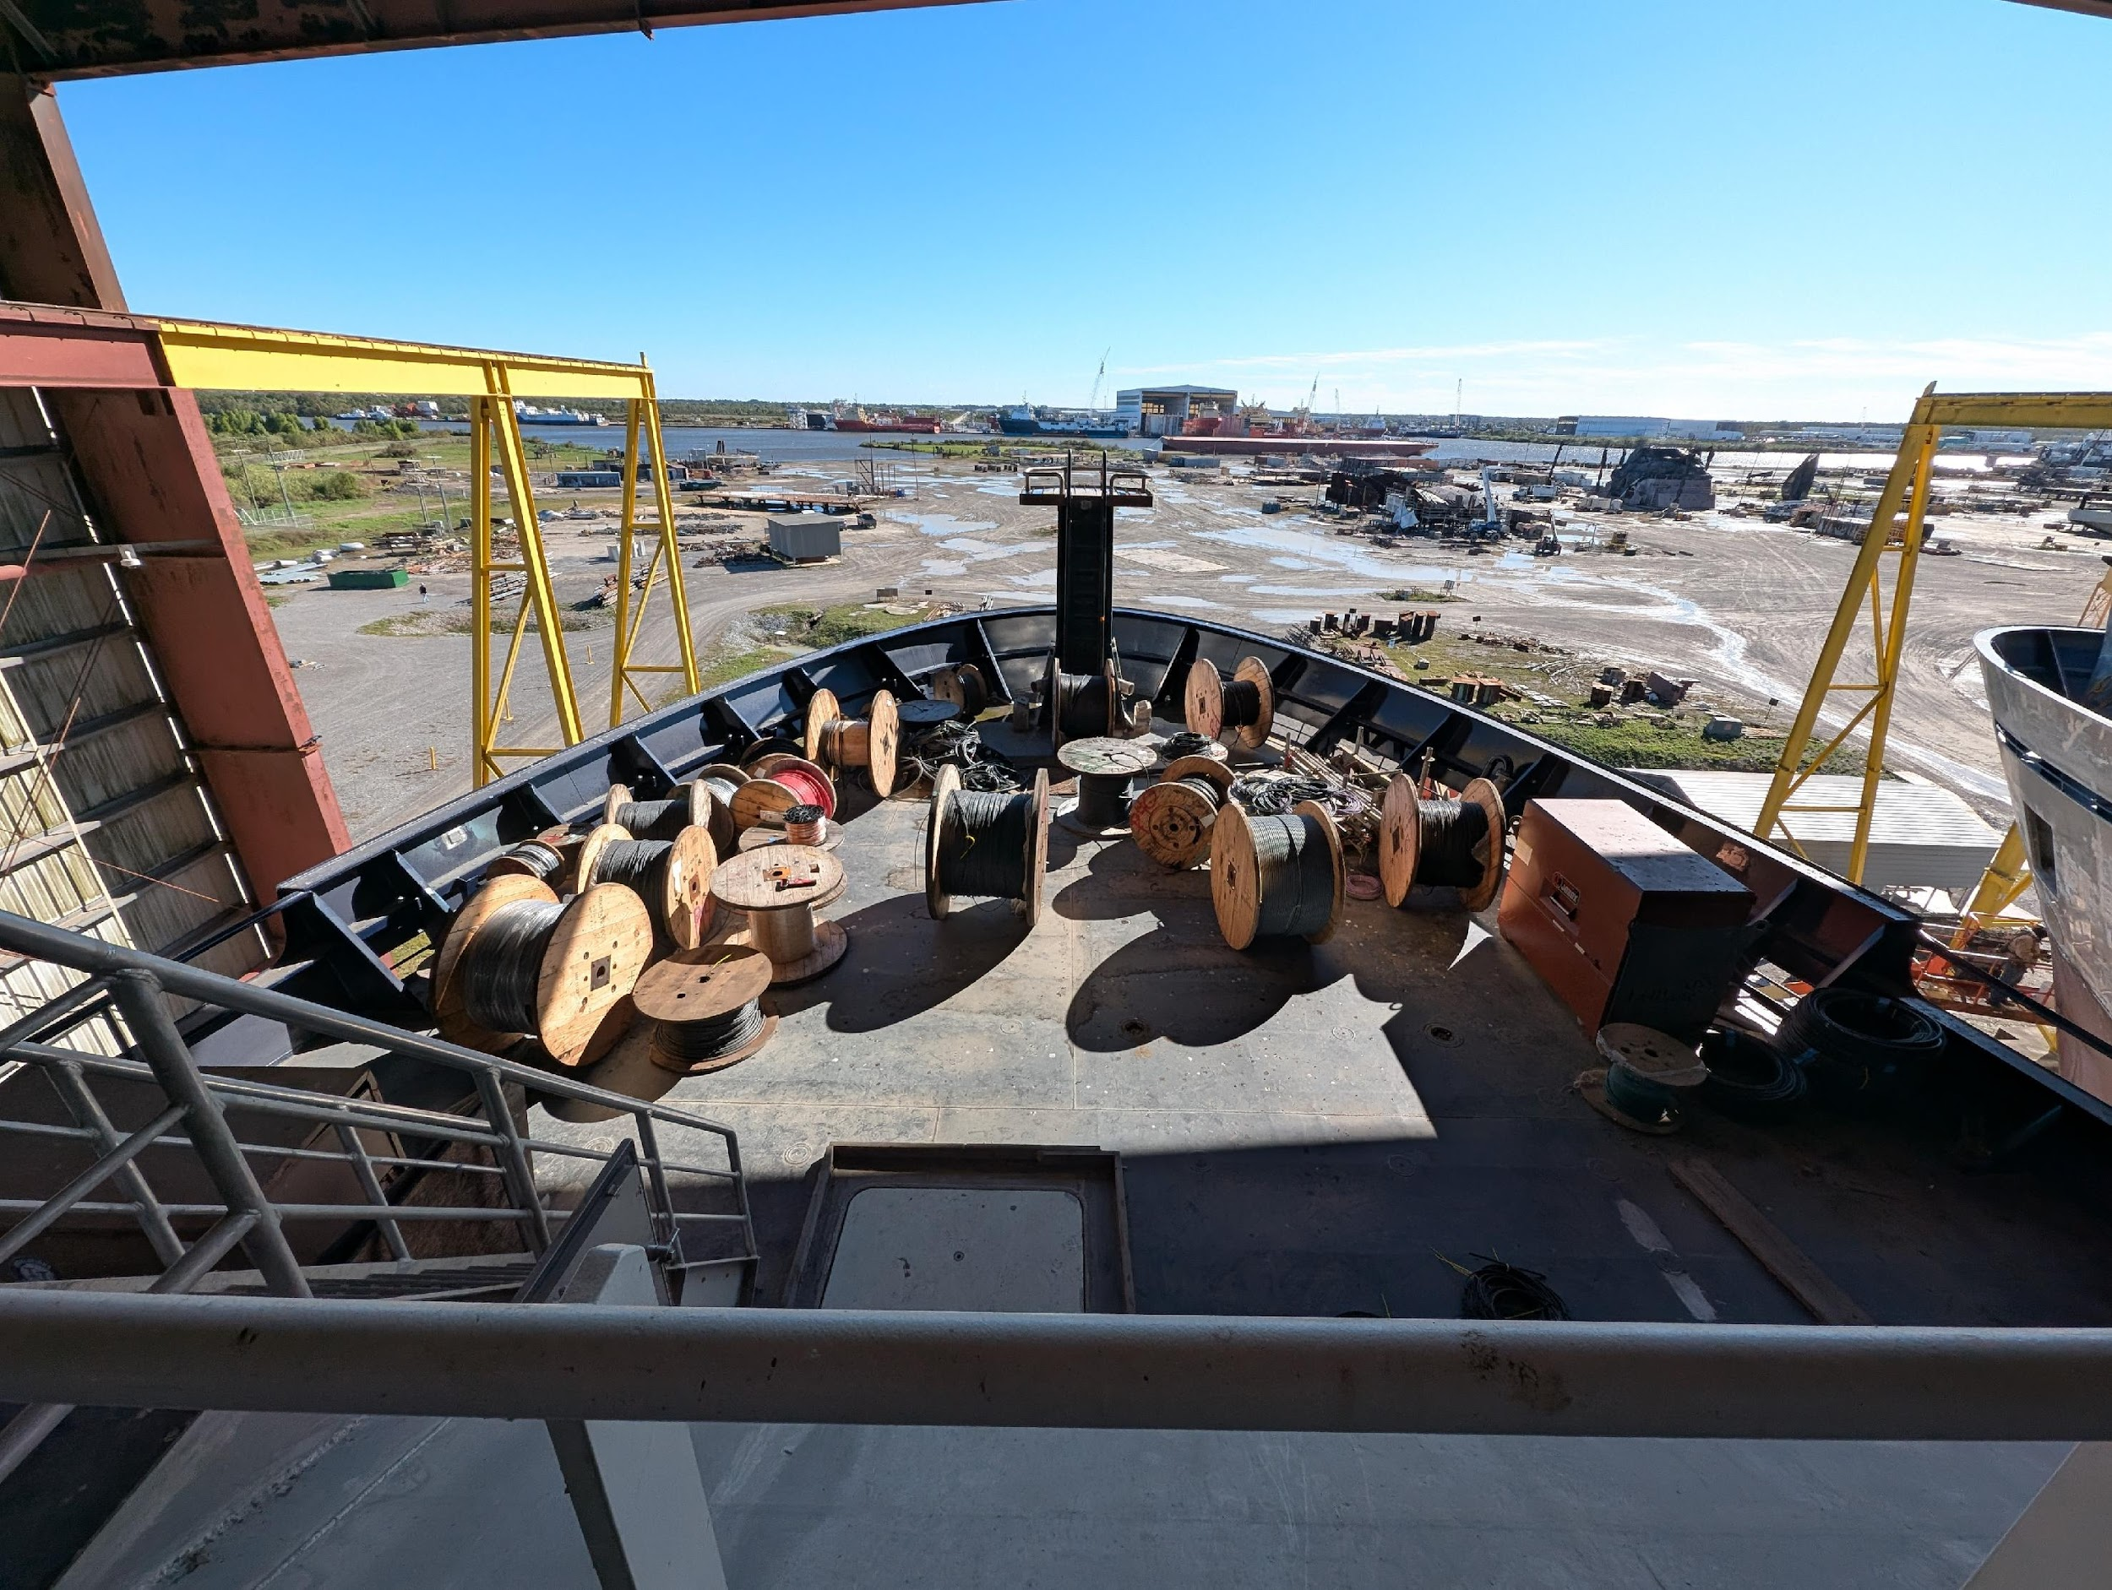
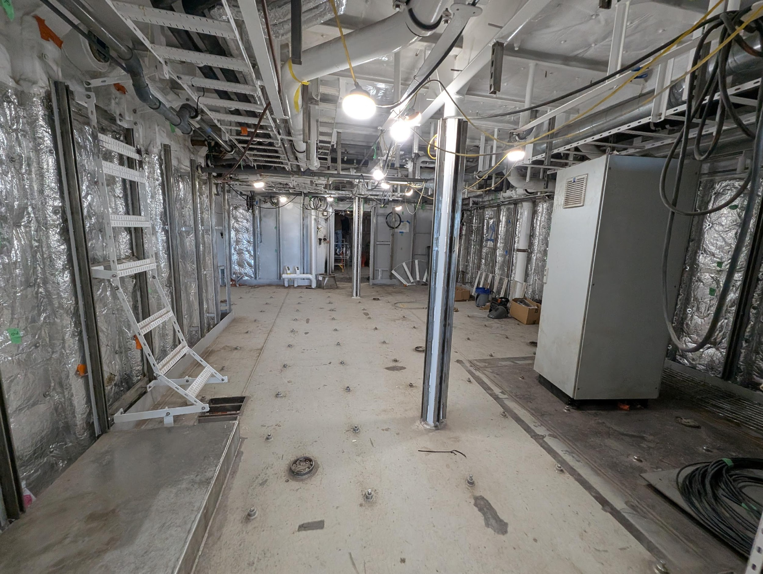
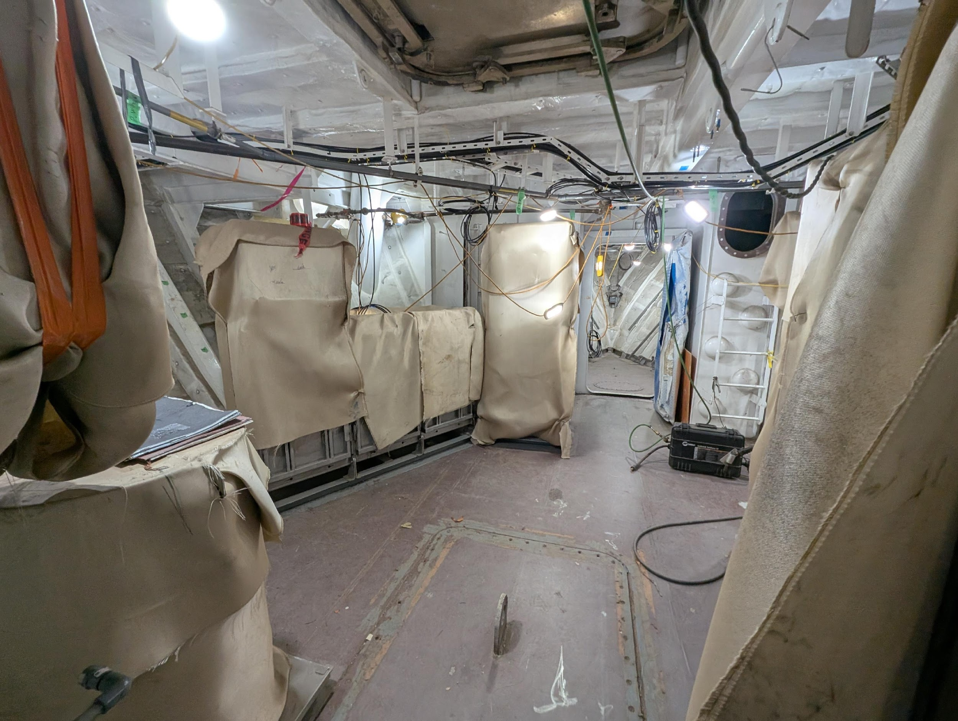
R/V Narragansett Dawn Build Update
Installed Main Crane & conducted the bulk of the work for the Vessel Survey (benchmarks and offsets for MGCs/MRUs) in August this year.
Pulling cable (efforts started under former contractor and is now restarting under the new sub-contractor)
Started flushing piping and blasting/painting tanks while the ship is still inside the building saving time
As missing foundations brackets, wireways, or various items are identified on R/V Taani, those lessons are applied almost immediately to Vessels 2 & 3
Launch scheduled for Spring 2026

Slide 10
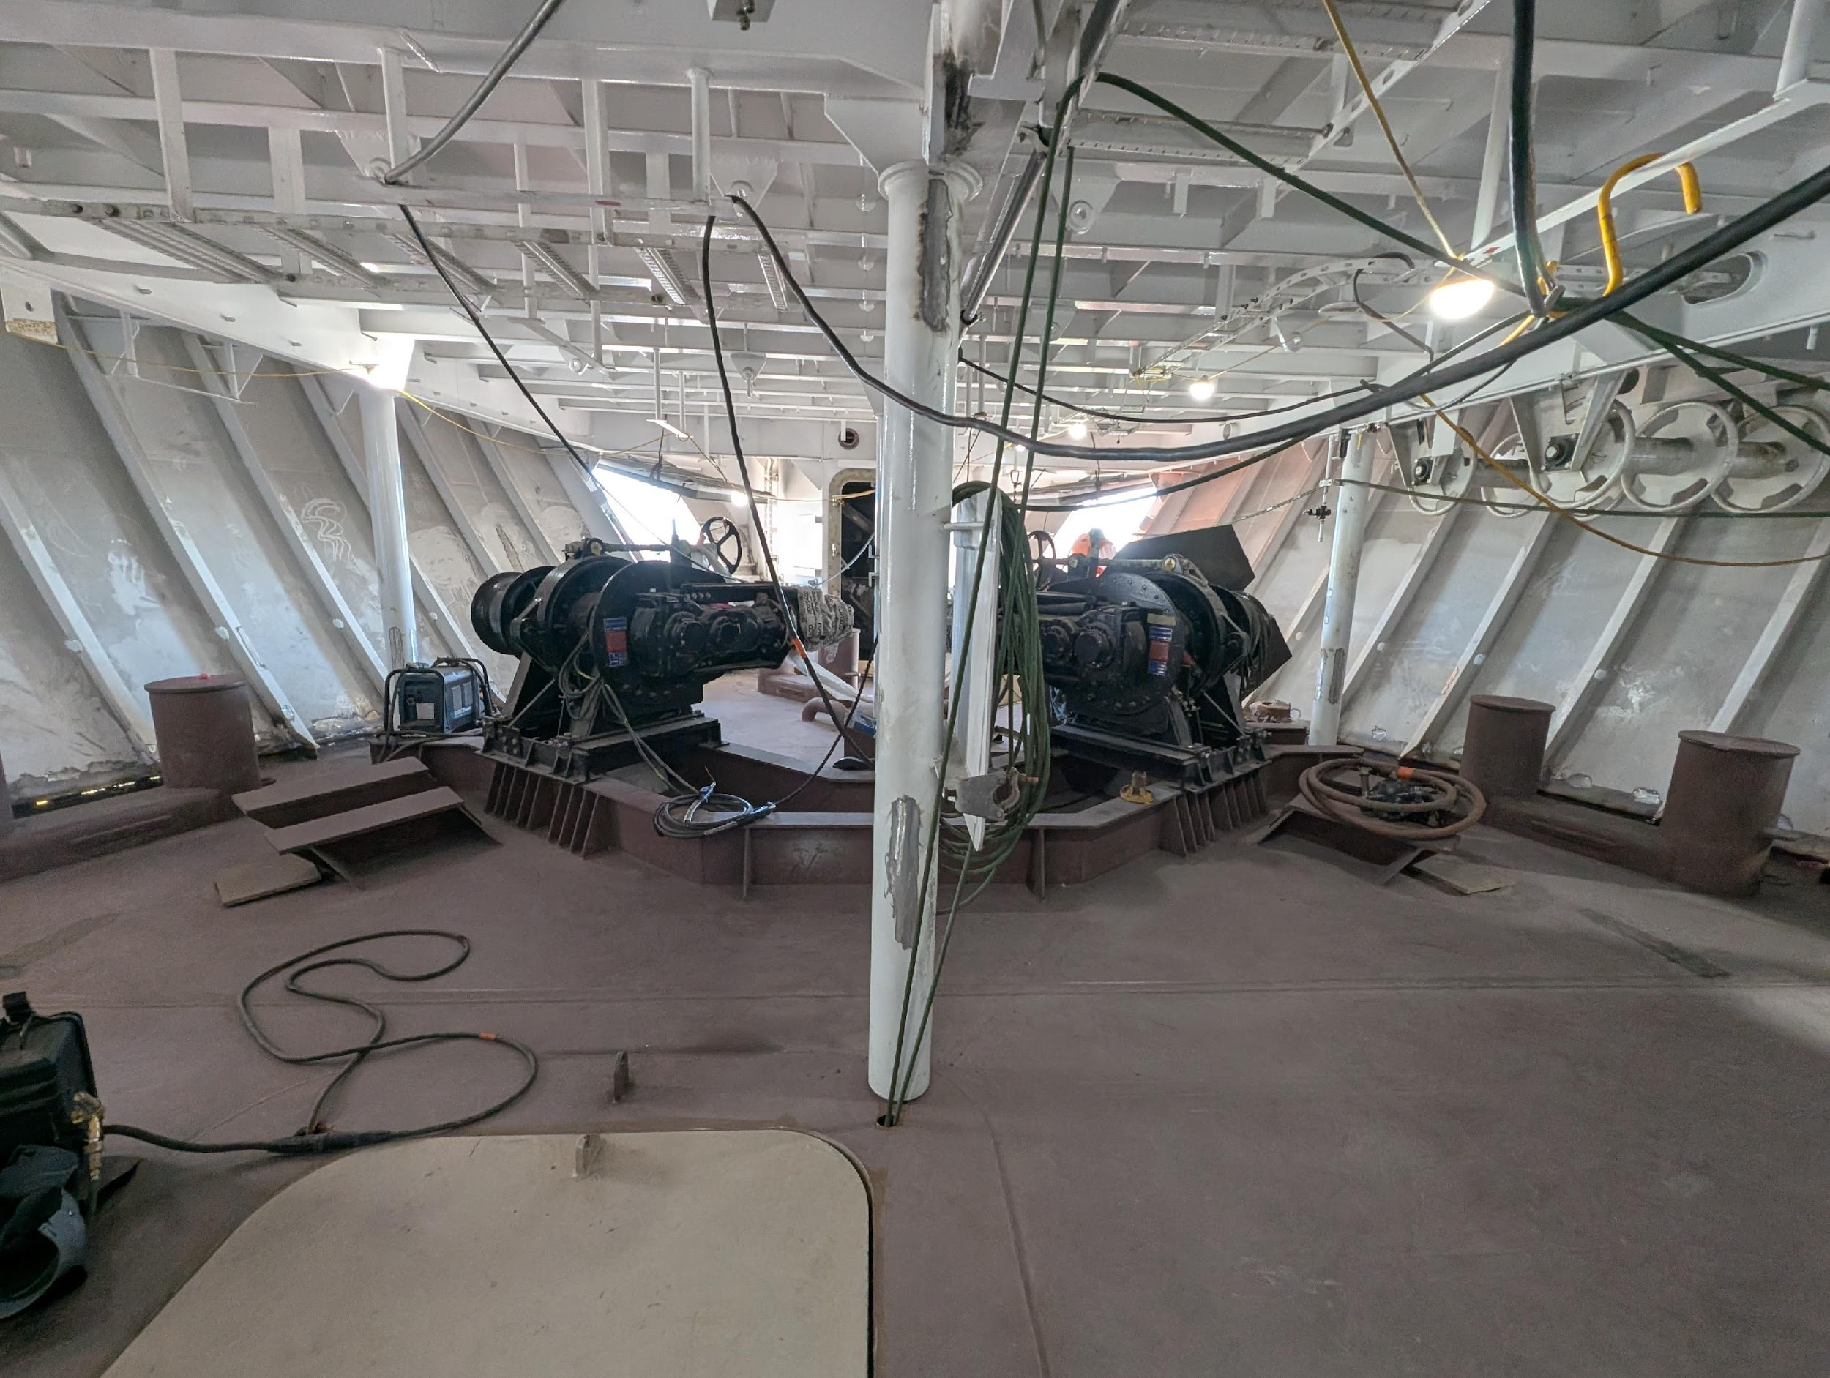
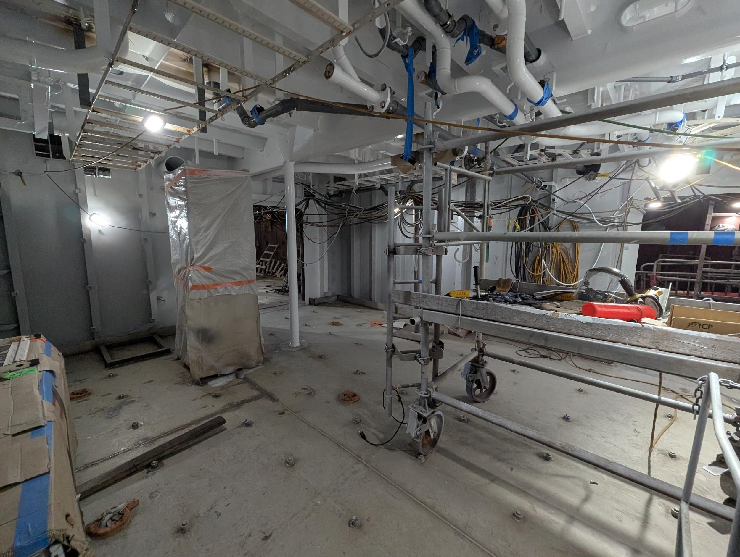
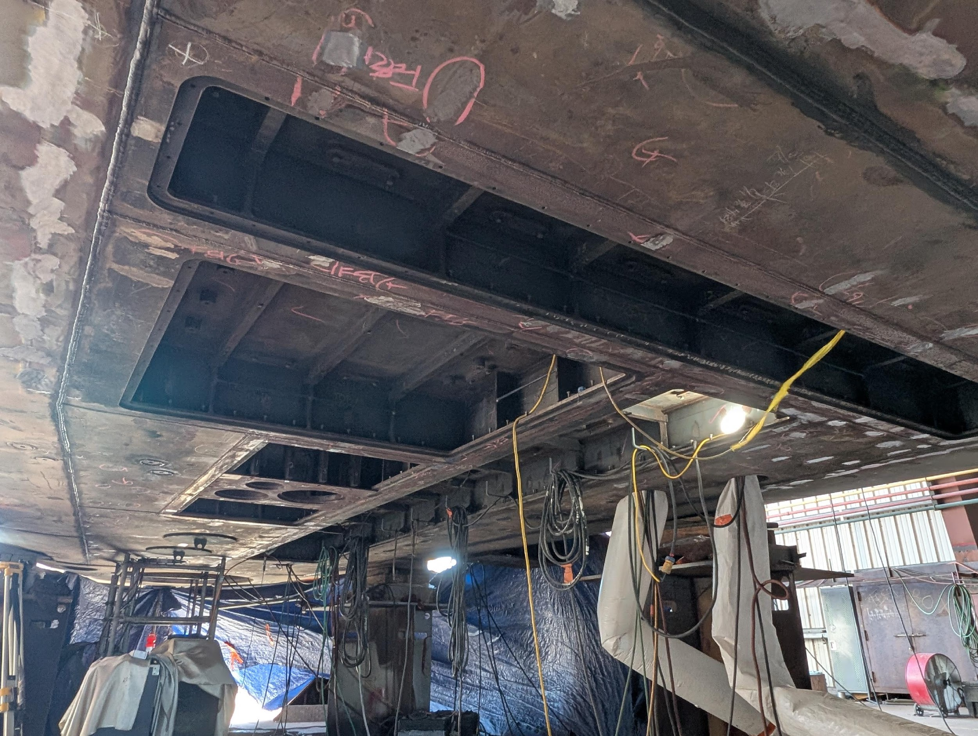
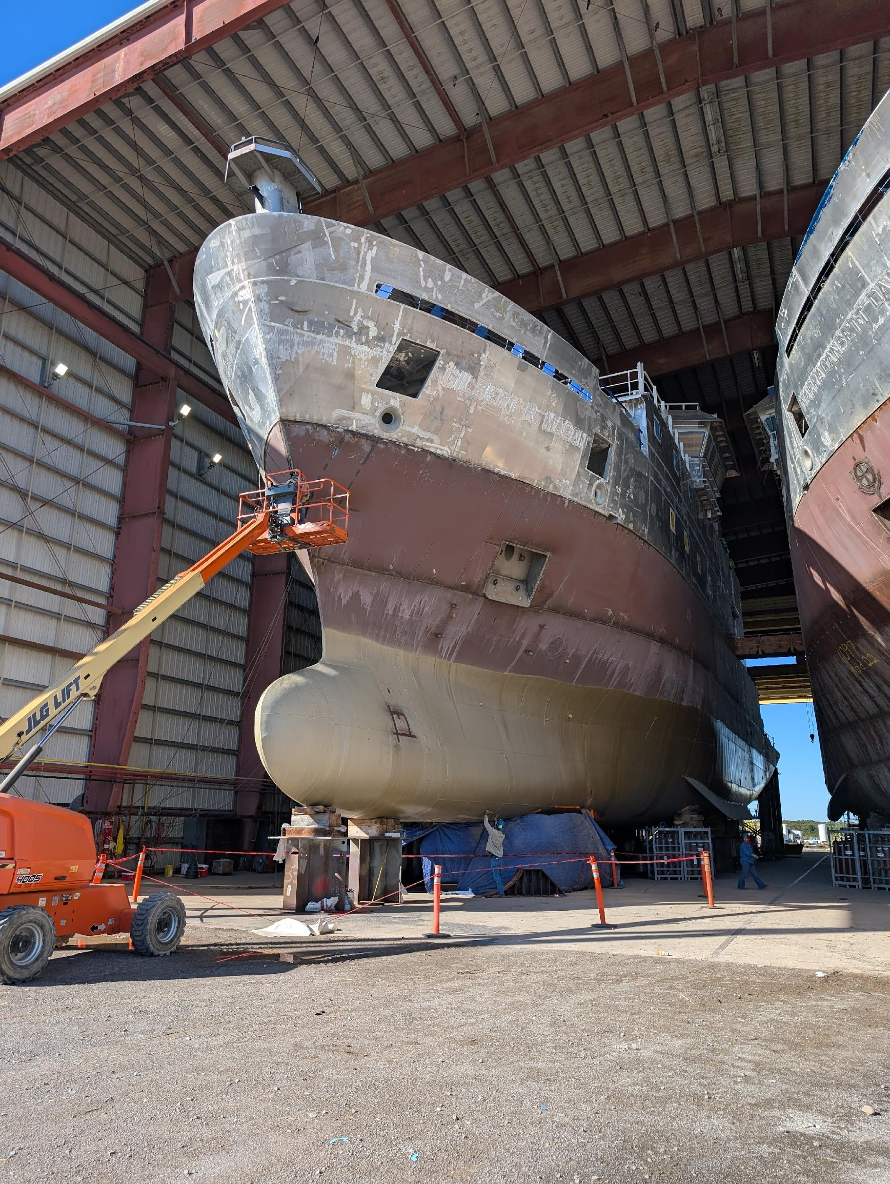
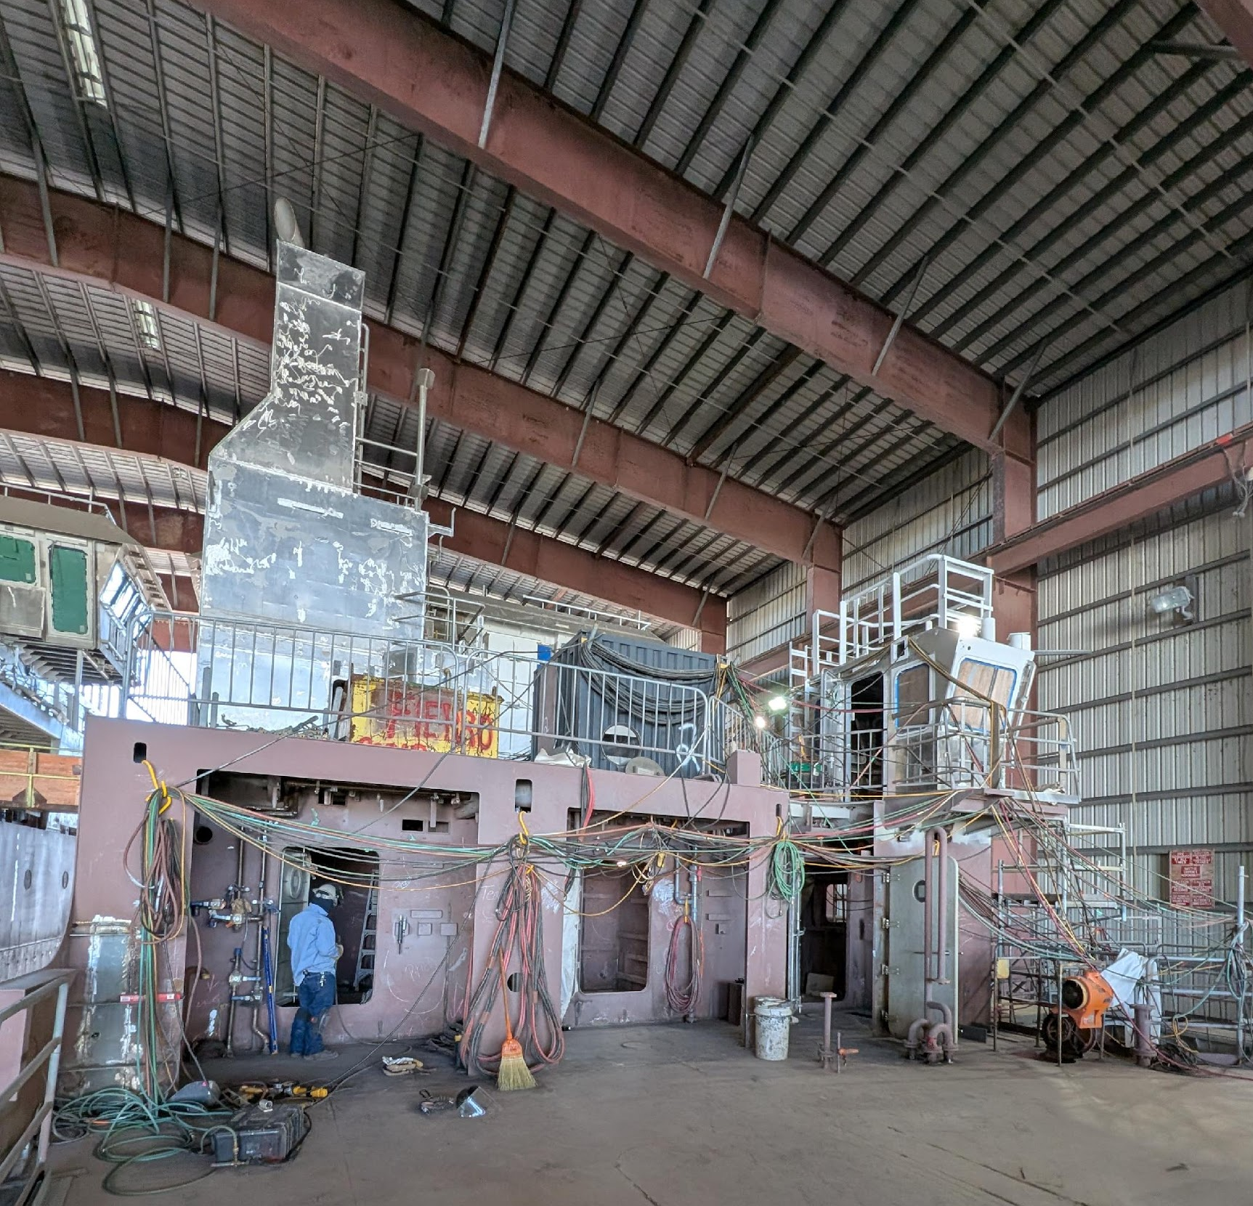
R/V Gilbert R. Mason
All the modules have been erected. Finishing aluminum superstructure and stern module erection joints, working piping systems across the erection joints, and installing wireways.
Applying lessons learned from the first two vessels & going very quickly
Installing the Z-drives in the next few weeks and just completed welding out the sonar flat.
Expect to start pulling cable in 1st quarter of 2026

Slide 11
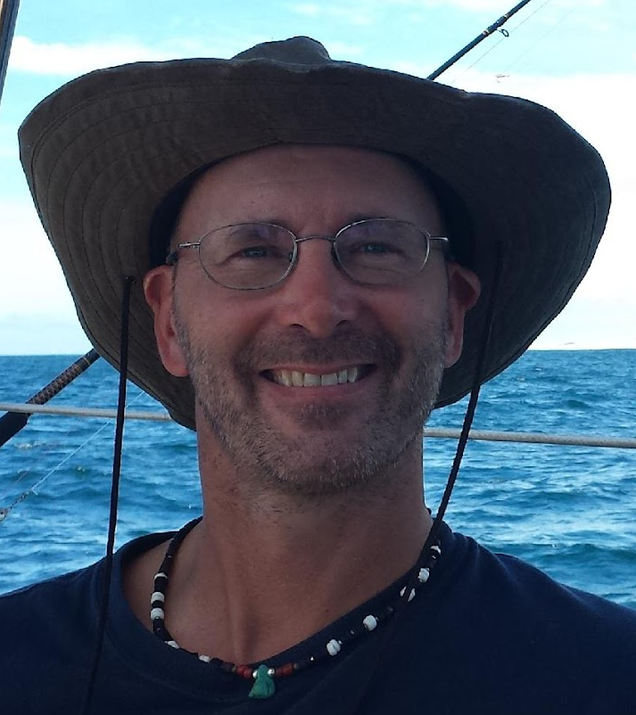
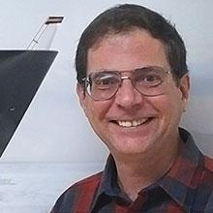
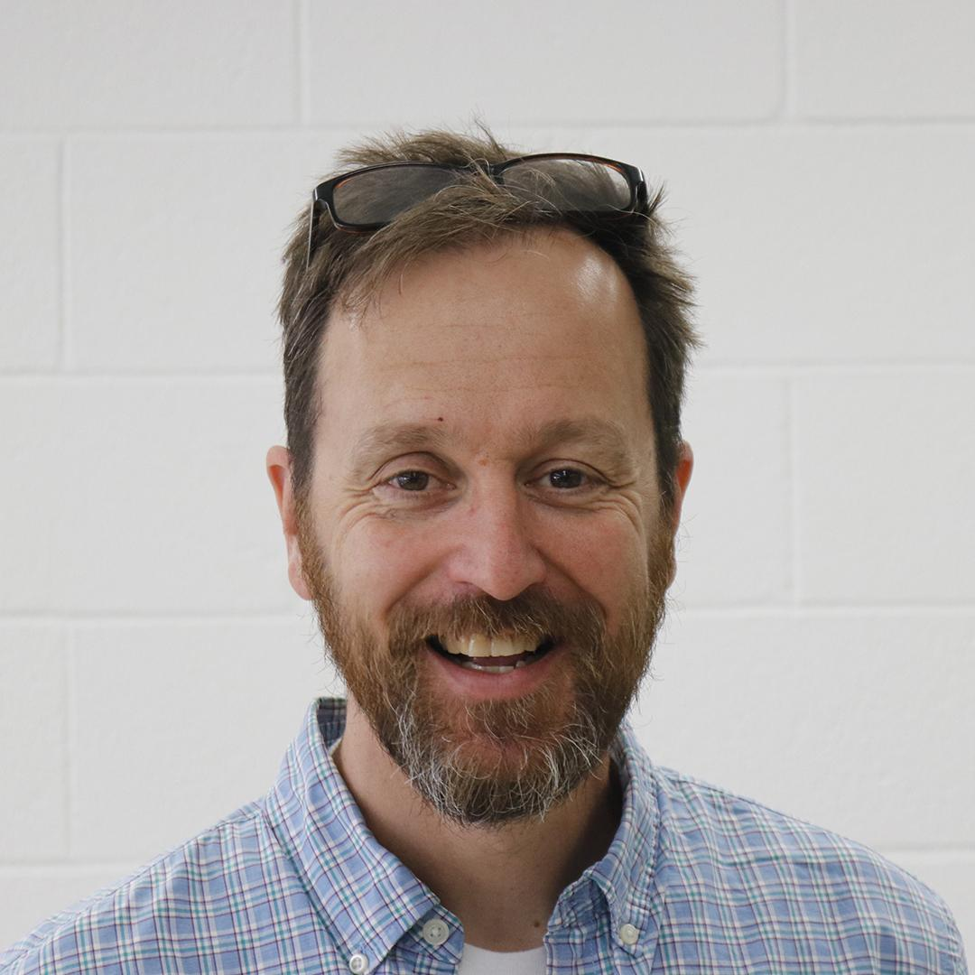
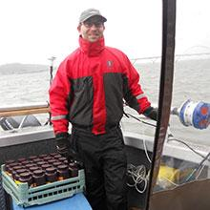

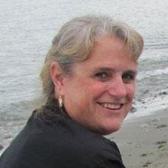
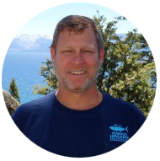
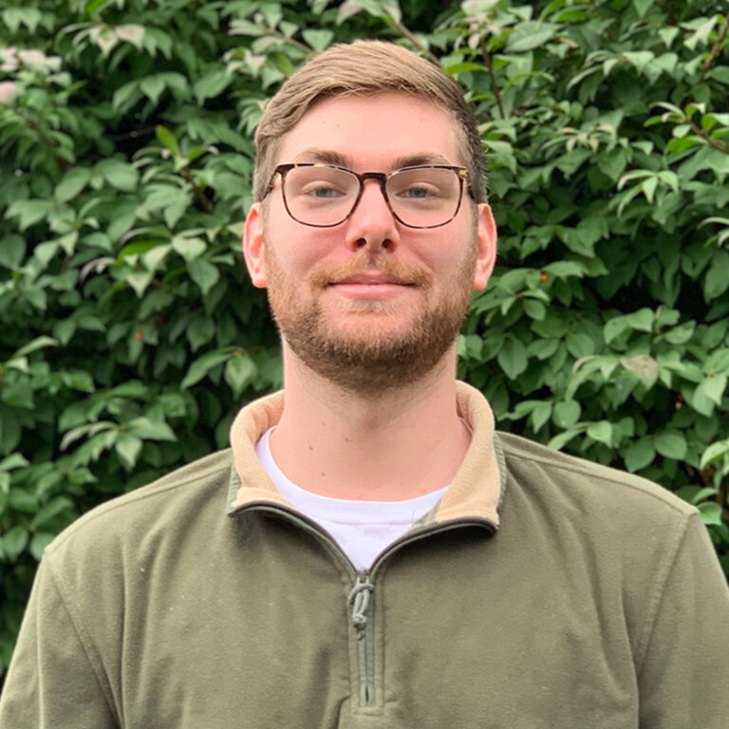
Regional Class Research Vessel
Transition to Operations Phase IV
Daryl Swensen
Transition to Ops. Coordinator
Don Hilliard
Fleet Engineer
Chris Romsos Datapresence Systems Engineer
75% RCRV
30% RCRV
Yvan Alleau
Logistics Specialist
Jasmine Nahorniak
Assistant Datapresence Systems Engineer
Kris Saathoff
Buyer
80% RCRV
10% RCRV
James Caison
Design Specialist
Tristan King
Data Systems Specialist

Slide 12
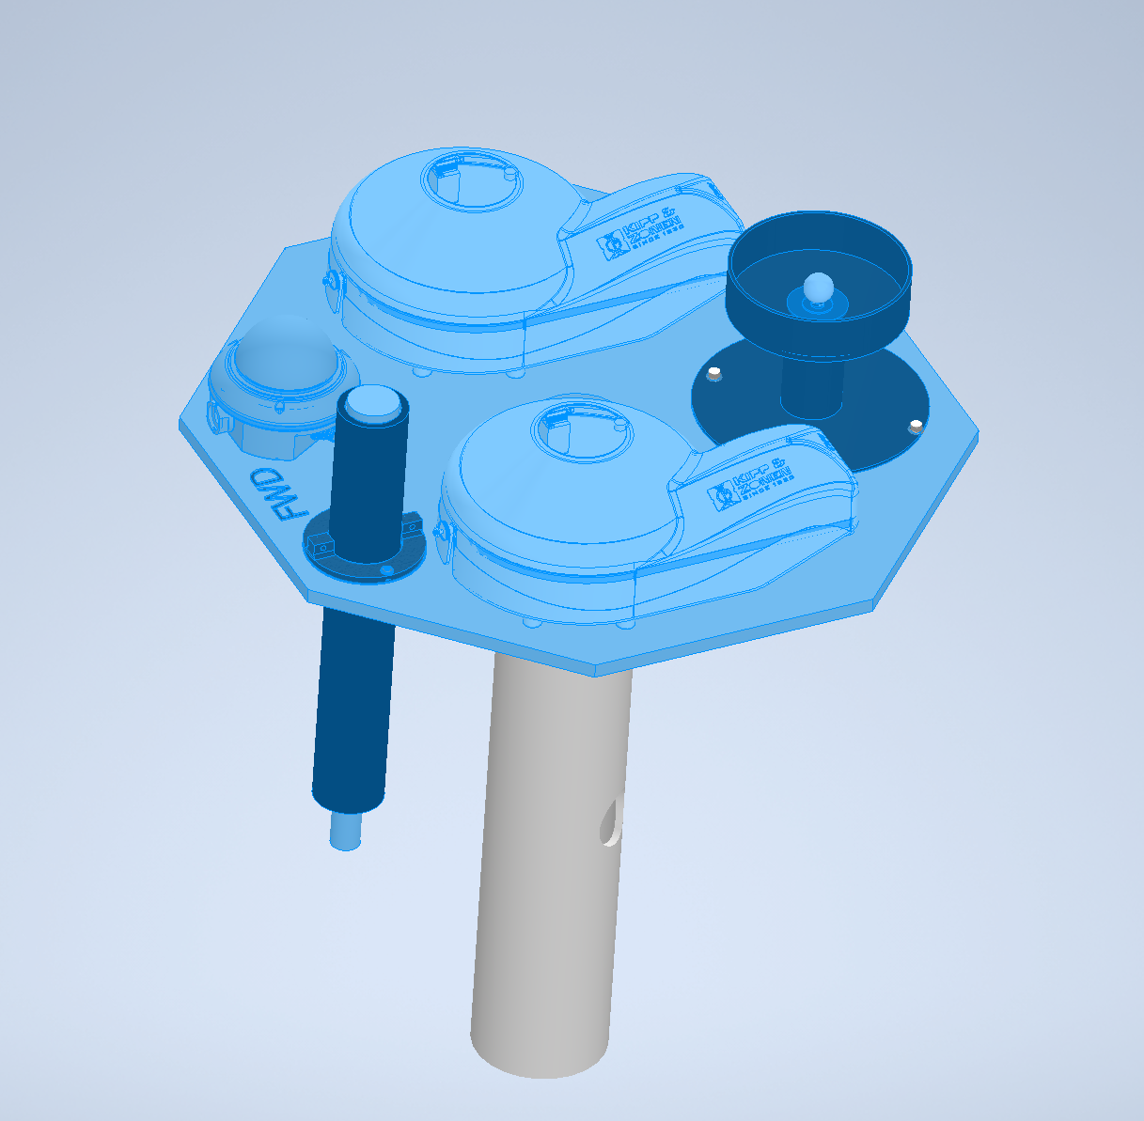
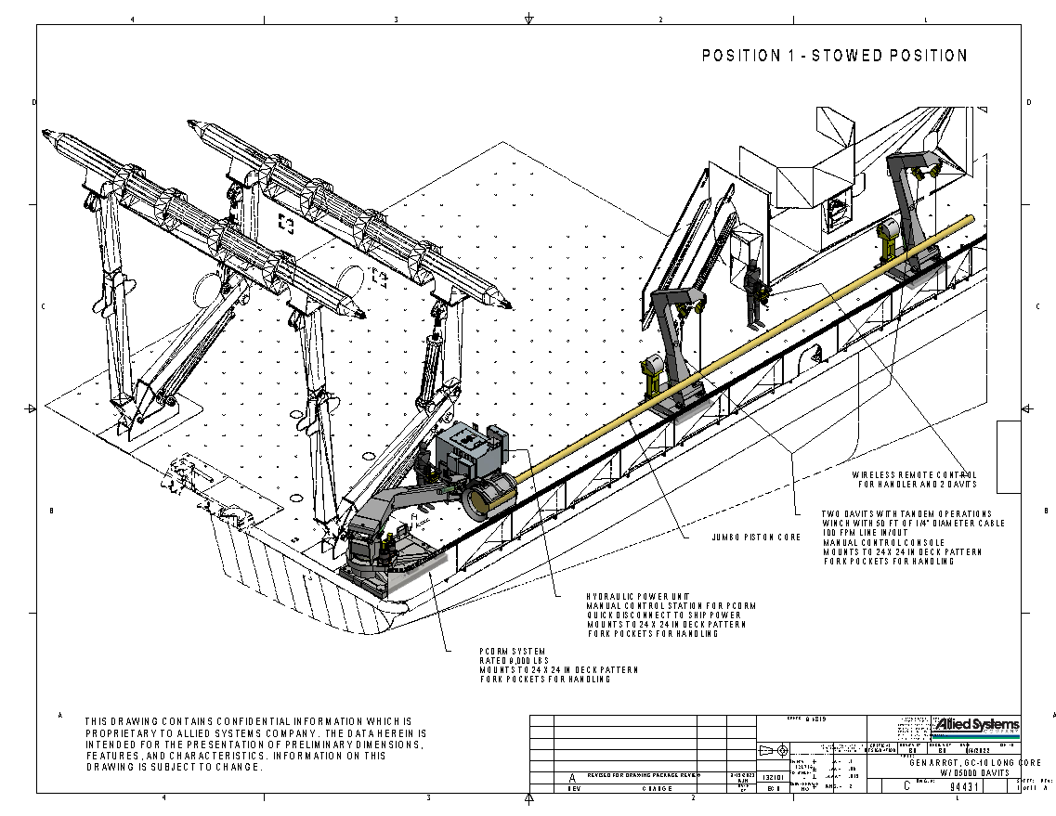
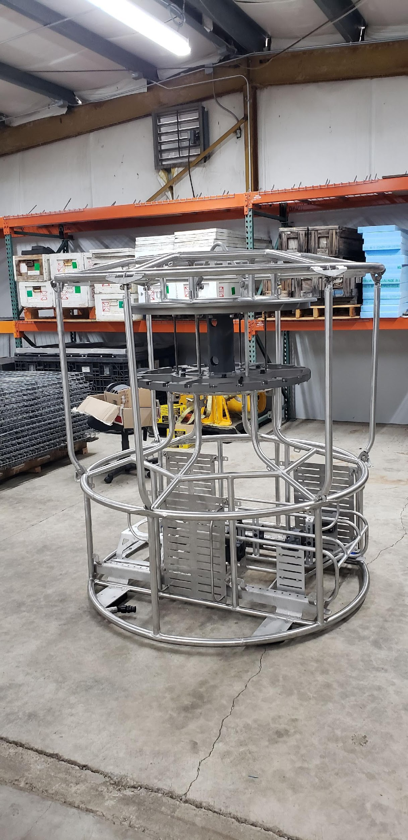
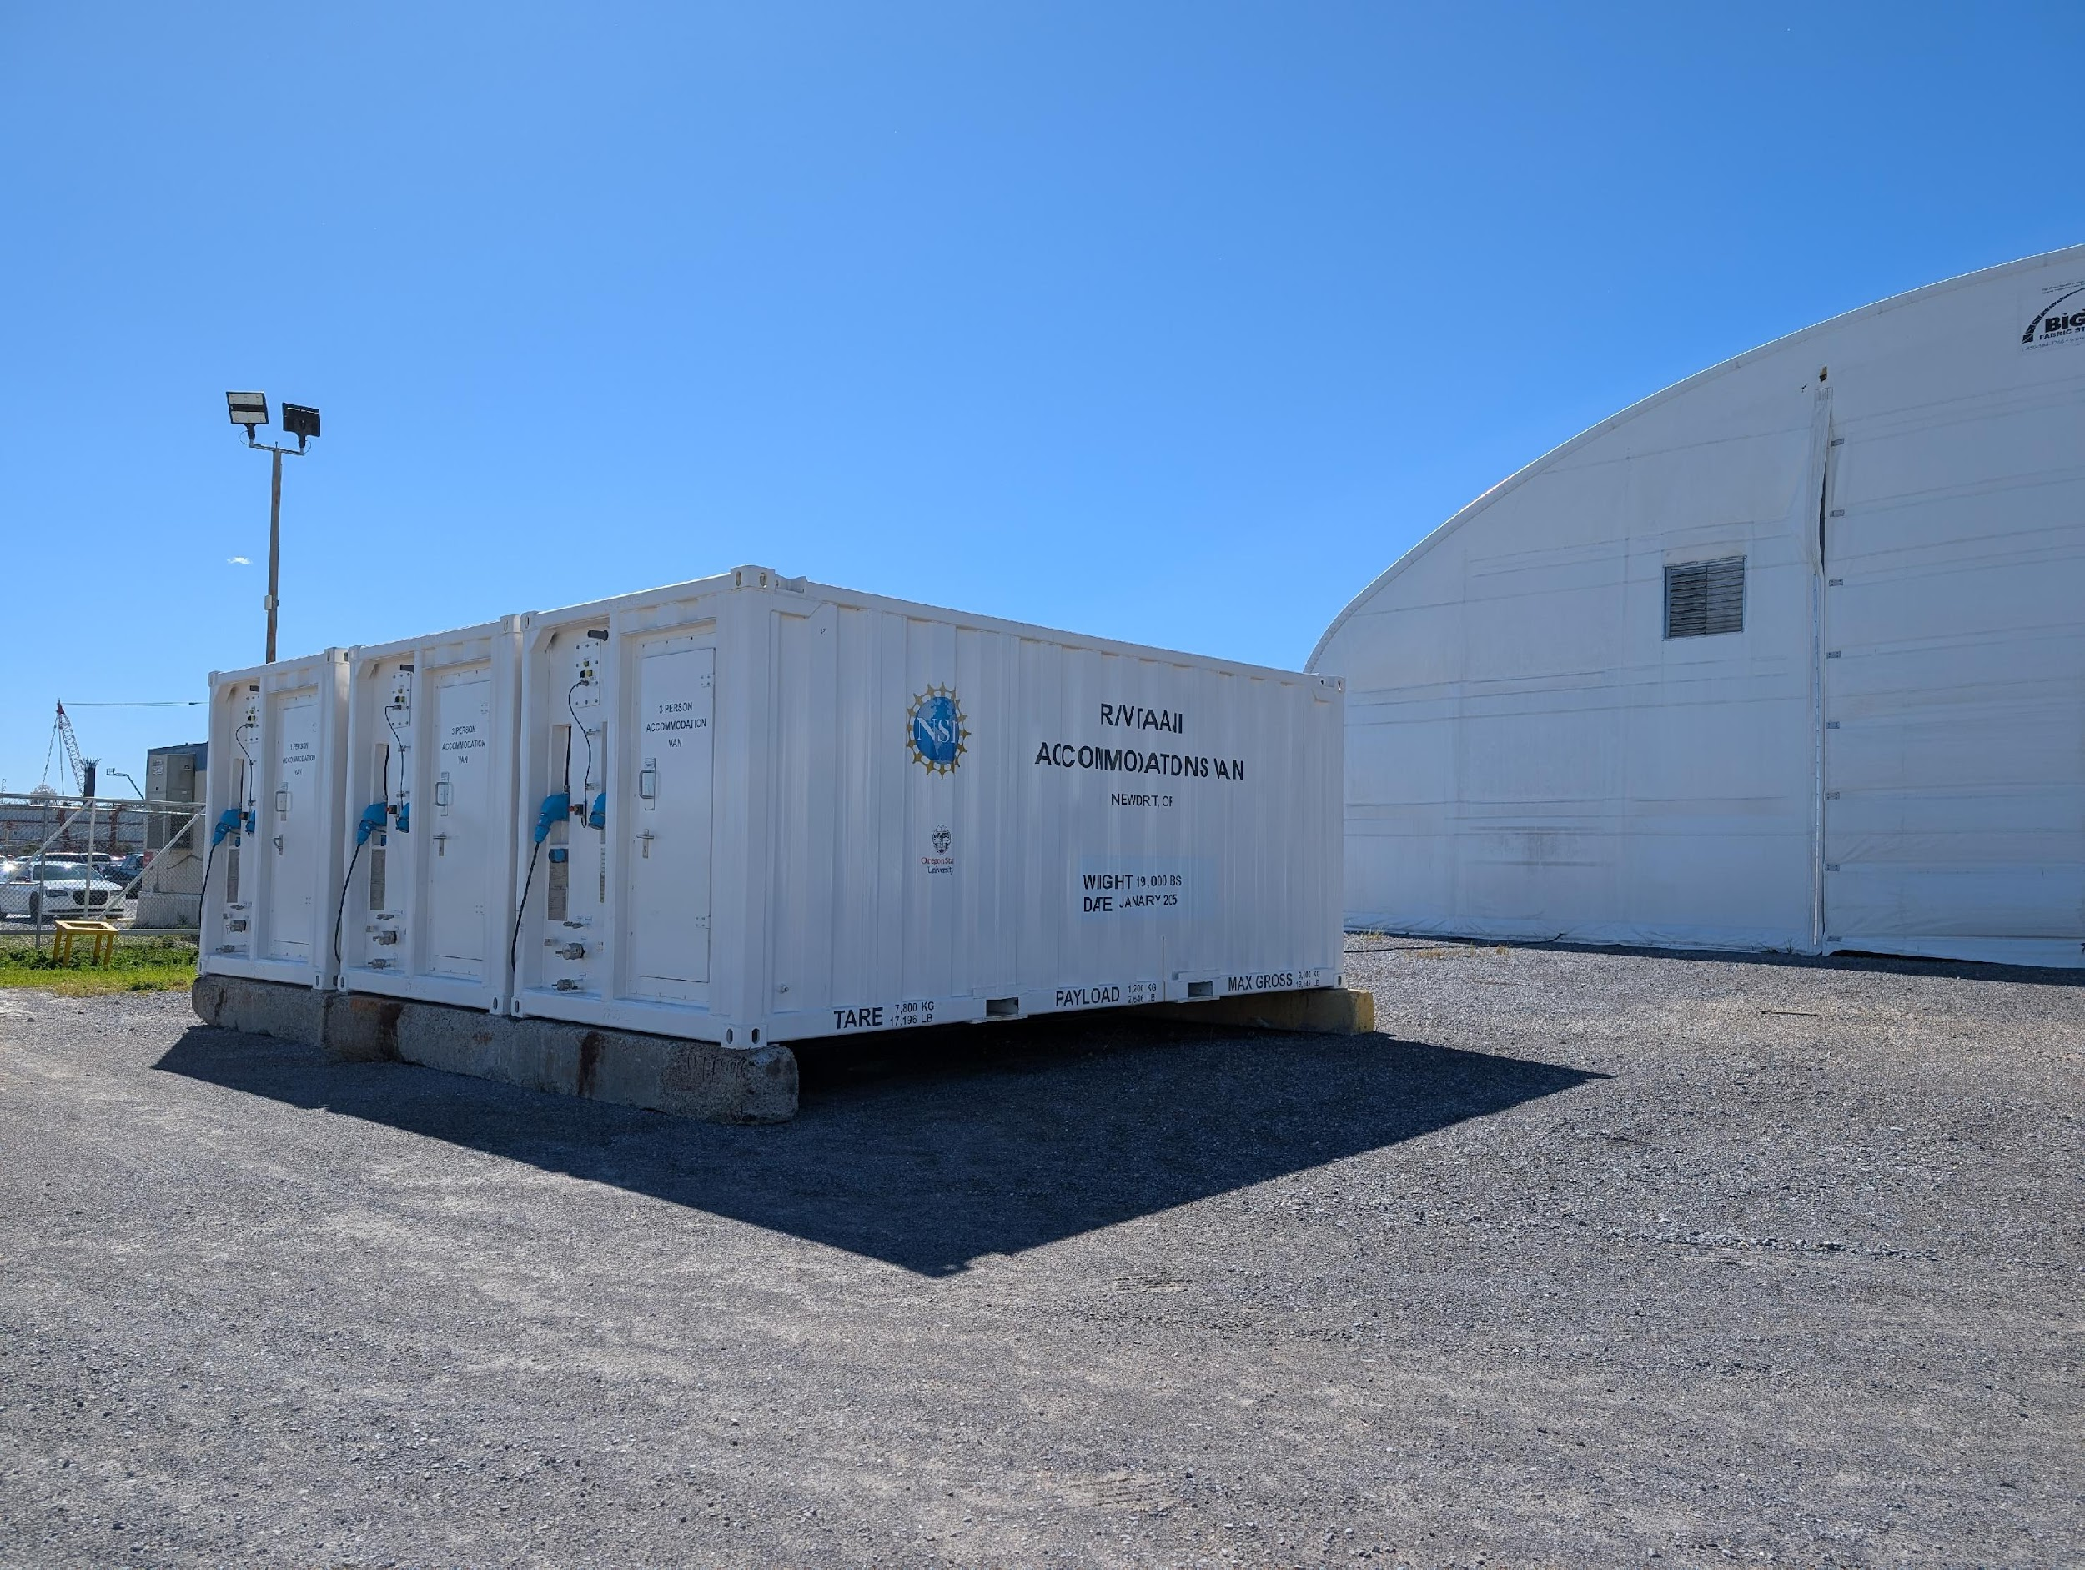
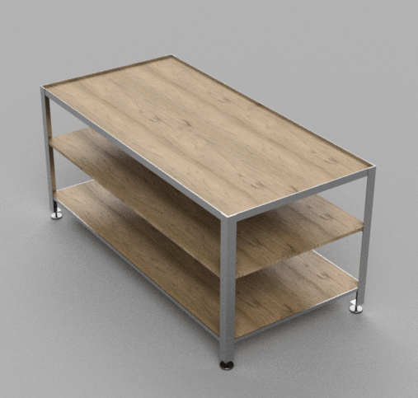
Transition to Operations
Operations and Science Trials Update
Design Build Progress
Accommodation Modules
CTD Frame
Piston Coring Deployment and Recovery System
Lab Benches
Sensor Mounting
Hazardous Material Lockers
Operations and Science Trials
Communication with support stakeholders
Refinement of Test Matrix
Field testing
Apollo ASP3 pCO2 System
R/V Sikuliaq
CORIOLIX Integration

Slide 13
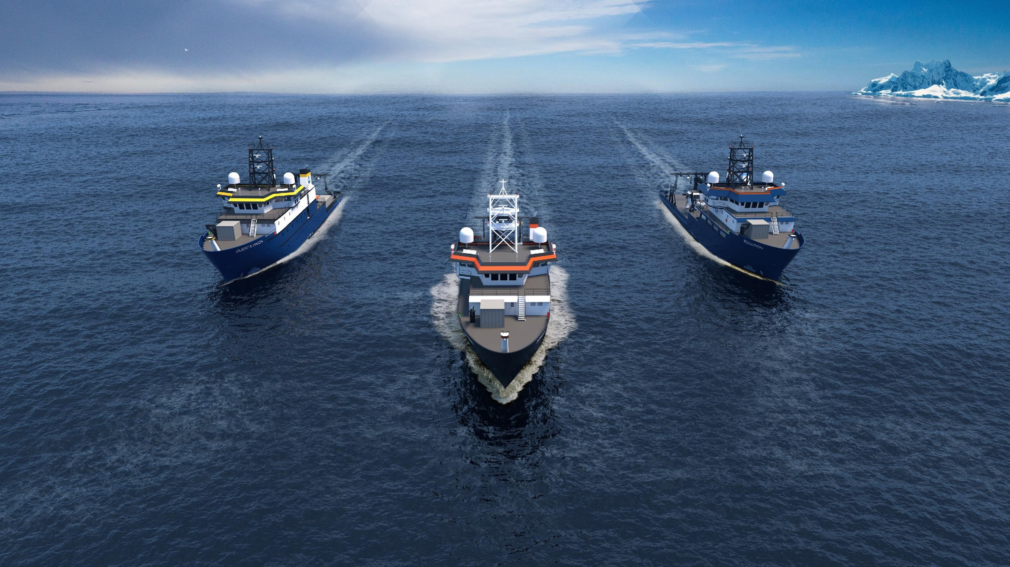


Webcam 01
Webcam 02
Webcam 03
Webcam 04
Webcam 06
Webcam 08
RCRV Update
@Regional Class Research Vessel Program
Regional Class Research Vessel Program- Oregon State University
@rcrv_program
November 06, 2025
‹#›

