Slide 1
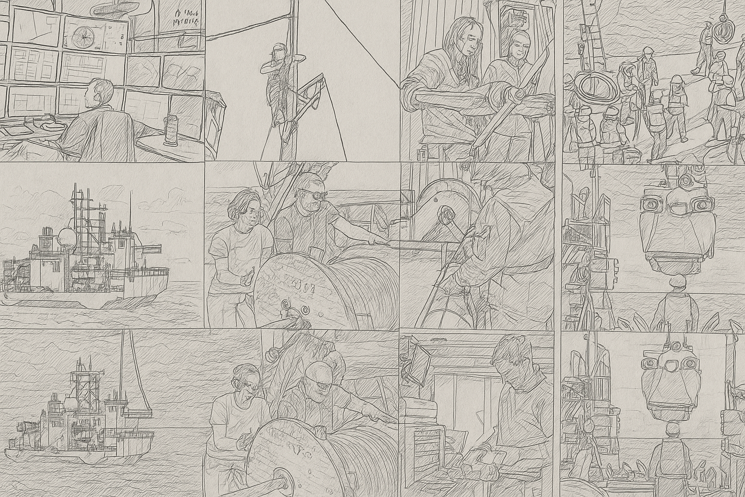

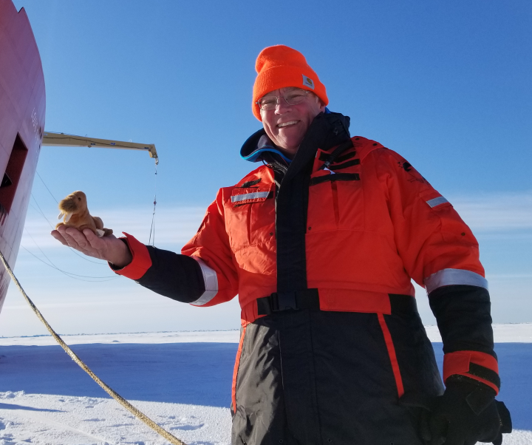
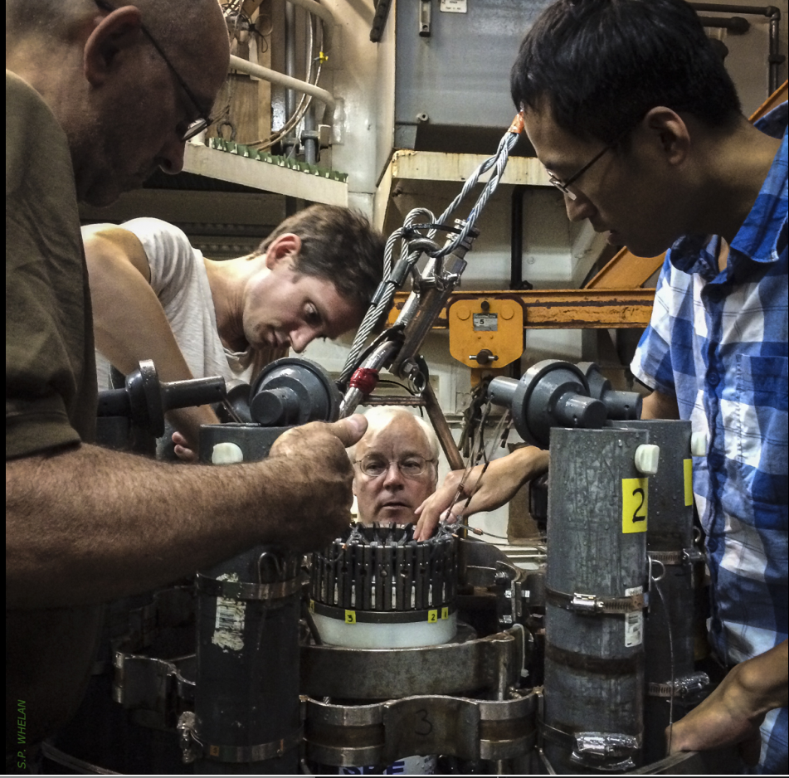
2025 RVTEC Meeting
Name:
Marshall Swartz
mswartz@whoi.edu
Email:
University-National Oceanographic Laboratory System
Institution:
WHOI
Greatest challenge of 2025:
Get to know me:
Maintaining our positive attitude and energy to assure we don’t lose competent people, outstanding capabilities and desire to push ahead.
Started at WHOI in ’76 helping develop the first CTDs Neil Brown built. Six weeks later boarded a Russian Navy ship for 16 days and knew I really liked this! Two years and 6 cruises, left to get my MBA and GE. Ten years and 6 promotions later, I was making lots of money but not happy. WHOI enticed me to return in ’92 to lead the CTD group, and I never looked back. Retired last year and still hands-on involved. I enjoy the amazing people, the mentoring opportunities and the technical challenges.
Insert a Portrait
Insert a Work Shot
WHat are you looking forward to at RVTEC 2025?:
Meeting the attendees and hearing their stories, discussing how they have identified and solved resource, equipment and procedural issues, and how they help others.

