Slide 1
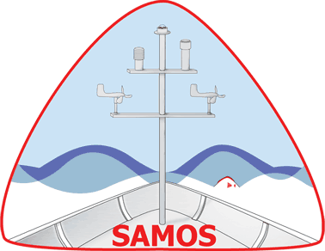
Advancing SAMOS into the Next Decade
Shawn R. Smith, Kristen Briggs, Julia O’Neill, and Amanda Lovett
samos@coaps.fsu.edu
Center for Ocean-Atmospheric Prediction Studies
The Florida State University, Tallahassee, Florida USA
RVTEC Breakout, 5 November 2025
Notes:
As we enter our 21st year, SAMOS is looking to advance our data/metadata handling and quality control system. We are seeking to automate more of the processes, which requires a better understanding of the future directions of the fleet with regards to data acquisition systems, sensors, and shipboard data processing.

Slide 2

Data Acquisition
To start, we want to gather some information regarding data acquisition and metadata management on your vessels.
https://bit.ly/SAMOS_slido
Notes:
In the next five years, which data acquisition/management software are you planning to use on your vessel (e.g., SCS, OpenRVDAS, CORIOLIX)?
How do you plan to manage sensor metadata (e.g., hand edited spreadsheets, text files, database)?
What is your method for documenting sensor events (e.g., cleaning, maintenance, swap, failure)?After survey:
After survey:
In the coming years, SAMOS would like to automate both the collection of sensor metadata and sensor events.

Slide 3
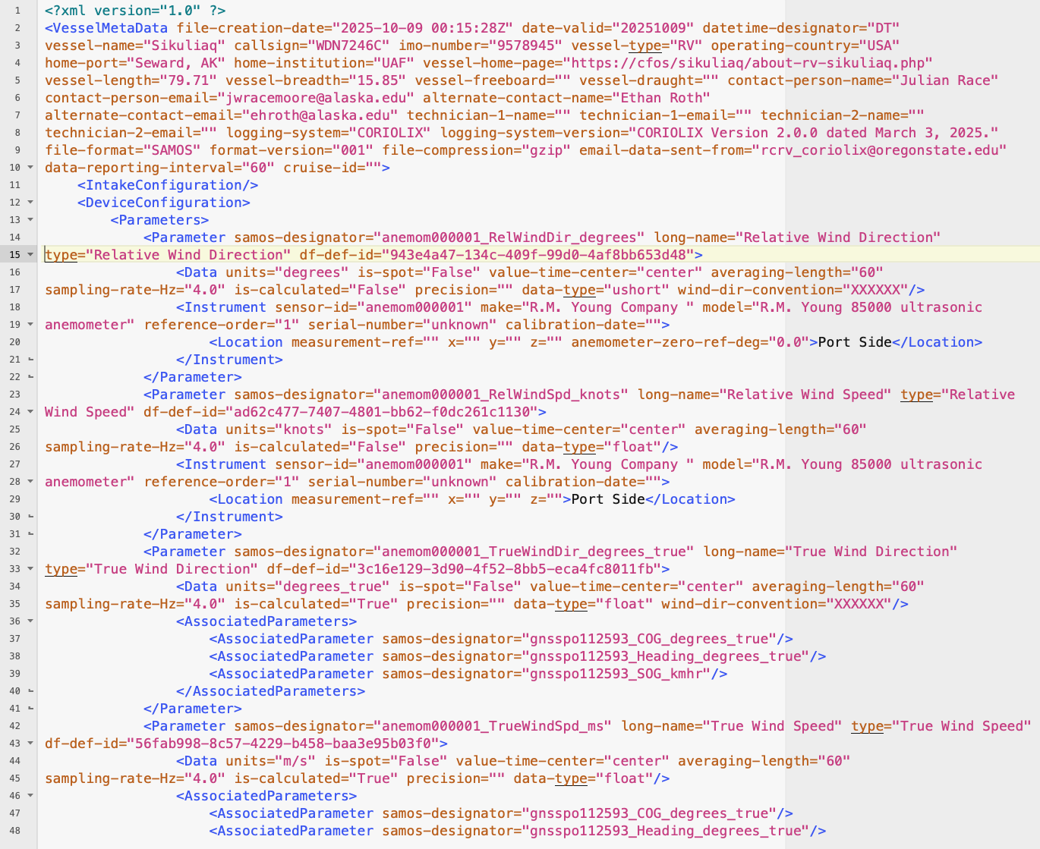
Automating Metadata Exchange
Why?
Up-to-date metadata benefits downstream data users
Also supports data QC and sensor evaluation
Trying to move away from email exchange of metadata
CORIOLIX and SCS5 support XML metadata exchange to SAMOS
Notes:
Automating metadata allows technicians to enter updates in one place - in a machine harvestable system on the ship.
Metadata exchange with SAMOS can then be automated via API calls or exchange of machine-parsable metadata files (SCS and CORIOLIX presently support the latter).

Slide 4
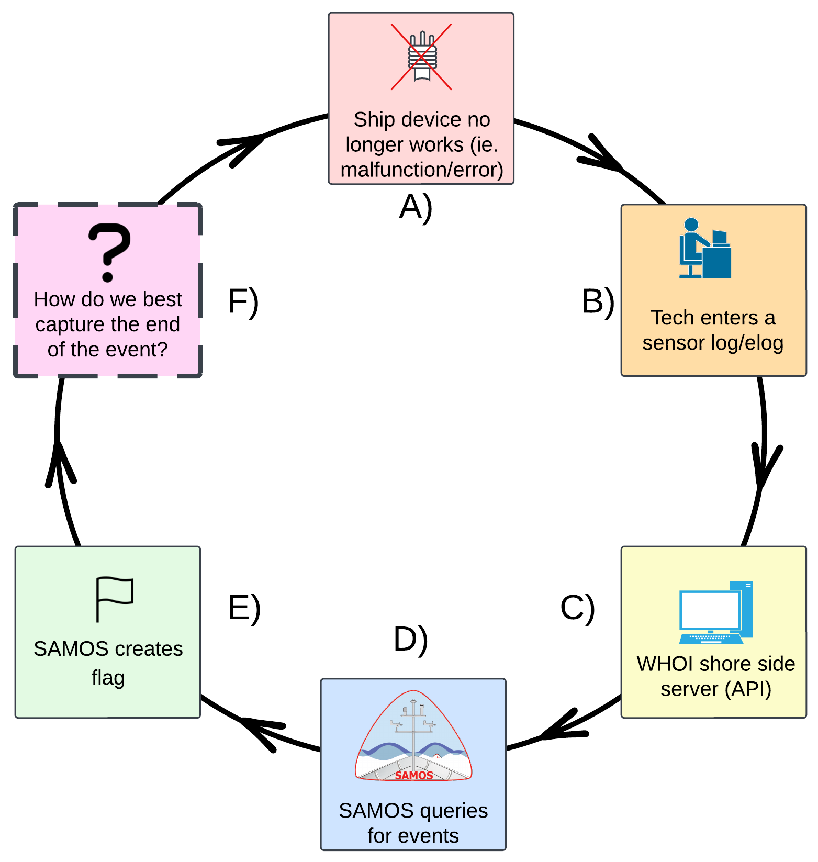
Sensor Logs to Support QC
More Info: See R2R EventLog; Sensor Log Poster
Notes:
Being able to harvest sensor events programmatically (e.g. via API call) will allow SAMOS to use events to automate quality flagging for some parameters (see Poster on this topic).

Slide 5
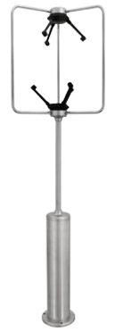
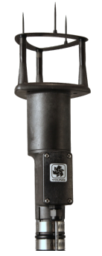
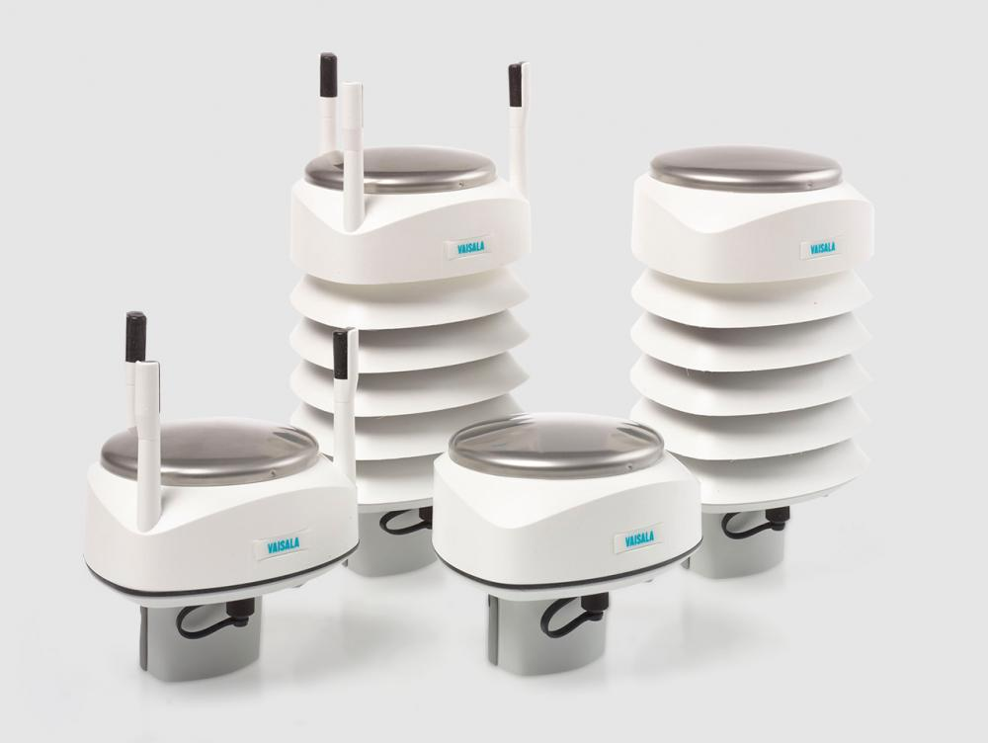
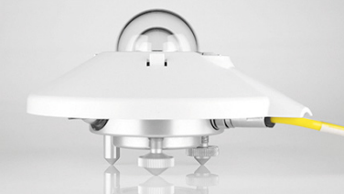
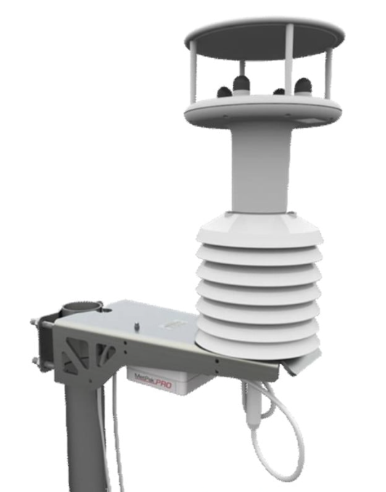
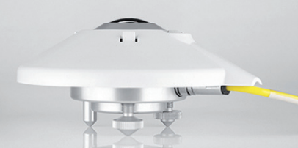
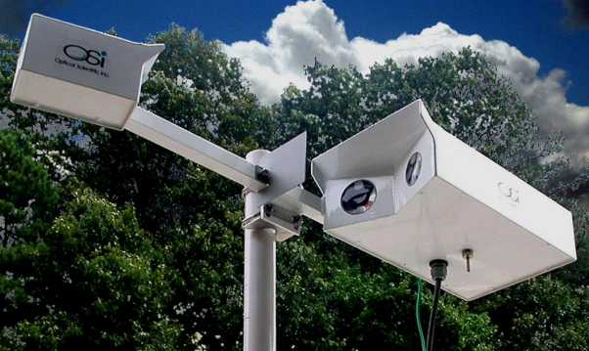
Changing Sensor Landscape
Images courtesy: Vaisala, Gill Instruments, RM Young, OSI, Kipp and Zonen
Notes:
Over the past few years, we have seen several changes in the available weather and ocean sensors.
We want to take this opportunity to discuss some of the trends in sensors measuring SAMOS parameters.
Images of all-in-one weather stations, sonic anemometers, OSI optical rain sensor, K&Z radiometers.

Slide 6

Current Sensor Usage
Please take a few moments to fill out this quick device survey for your vessel.
https://bit.ly/SAMOS_survey
Notes:
Are you deploying “all in one” meteorological sensors (e.g., Vaisala WXT, Gill MetPack…)?
Are deploying stand-alone sonic anemometers?
Do you still operate stand-alone mechanical (propellor/vane or cup) anemometers?
For shortwave/longwave atmospheric radiation, are you using Eppleys?
Do you have a plan to move away from Eppley sensors?
Do you currently have a rainfall/precipitation sensor deployed?

Slide 7
Orienting Sonic Anemometers
Goal: To orient the North mark in a direction parallel to the center line of the vessel and facing towards the bow.
Why: This results in a wind blowing directly from the bow having a ship-relative wind direction equal to zero degrees.
Notes:
All in ones and sonic anemometers pose an installation challenge.
Note the Goal and Why.
How do you orient the north mark (zero line) on the sensor to ensure correct platform (ship) relative wind direction?
This is one of the most common problems SAMOS identifies with ship-relative winds (and subsequently the calculated true winds).

Slide 8
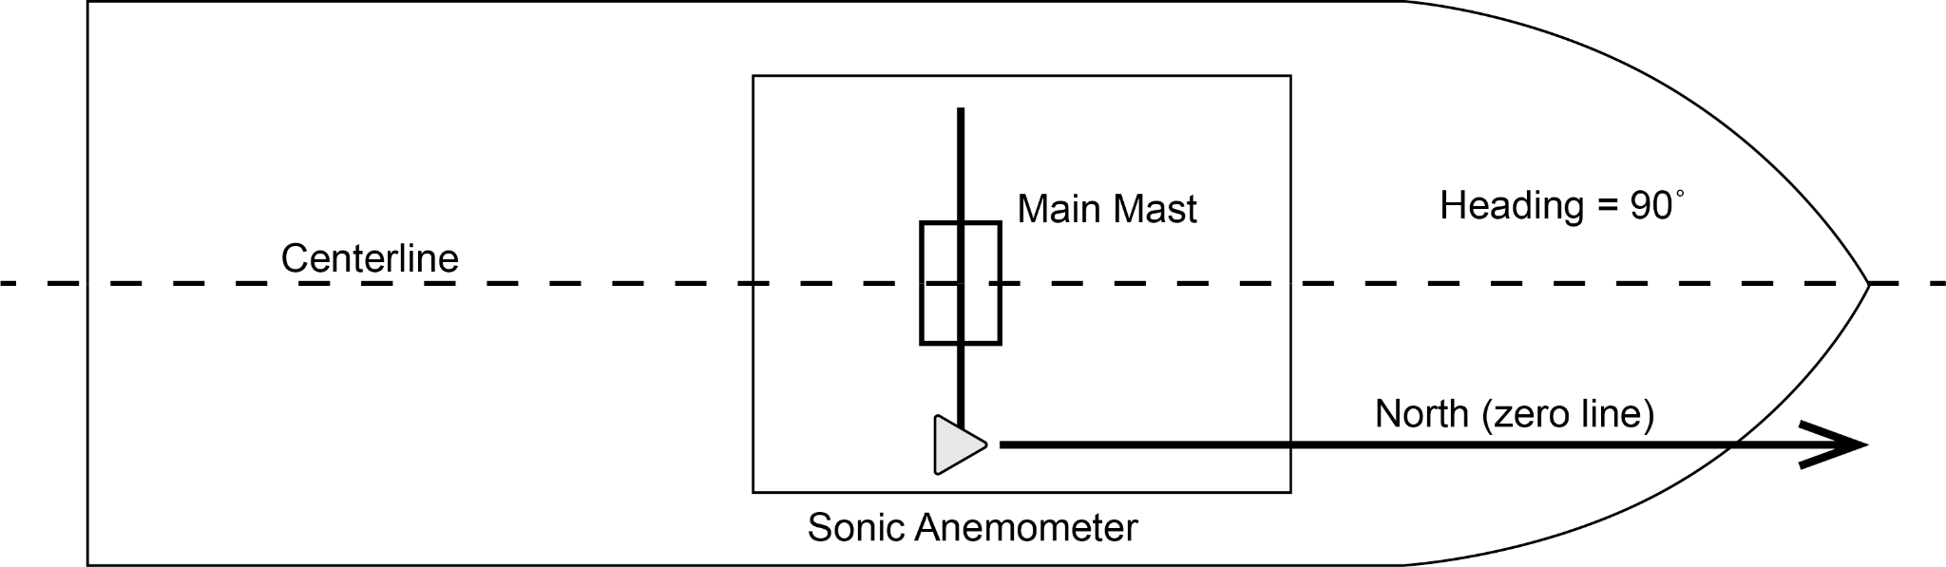
Orienting Sonic Anemometers
Notes:
Open discussion (possible prompts to stimulate discussion):
Prompt: Who has done this and what are your methods?
Prompt: When in port, can you use a portable compass and the ship’s heading (from gyrocompas) to help?
Prompt: Can you orient the north mark to another easier reference point and adjust the wind direction following acquisition?
Facilitator note: Here you can raise the idea of orienting along a cross spar with a known angle between the spar and the centerline. Must ensure this zero line angle correction is applied to the ship-relative wind, so may need to do in acquisition software or in sensor, but not in both. Will depend on your vessel setup.
What do you do when anemometer position does not have good “line of sight” to front of ship?

Slide 9
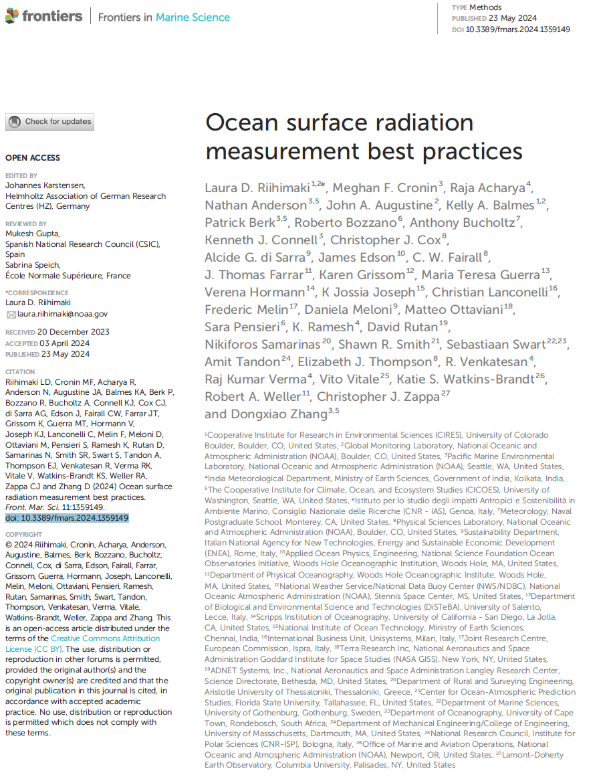
SW and LW Atmospheric Radiation
Eppley radiometers getting hard to maintain.
Replacement options
Based on current best practice document
Riihimaki et al. 2024
https://doi.org/10.3389/fmars.2024.1359149
Ideally looking for Class A pyranometer (SW)
Pyrgeometers (LW) have no present standard
Kipp and Zonen are being deployed on some vessels.
Notes:
There has been a move in the fleet towards Kipp and Zonen for SW and LW radiation.
Also community interest in diffuse SW measurement - SPN1 is a low cost option.
We have seen operators struggle with integrating Kipp and Zonen sensors into their existing systems.
Prompt - do you have suggestions for how to interface these sensors with your data system? Are you using MODBus vs RS485?
James Caison (OSU) and Carmen Greto (UAF) both note they developed custom scripts to interpret and process these sensors’ unique protocols.
Prompt: K&Zs have data loggers/software that can be purchased for independent operation, but will these integrate into your shipboard systems?
Prompt: Can some sharing of code/procedures be done?

Slide 10
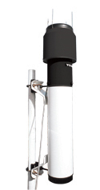
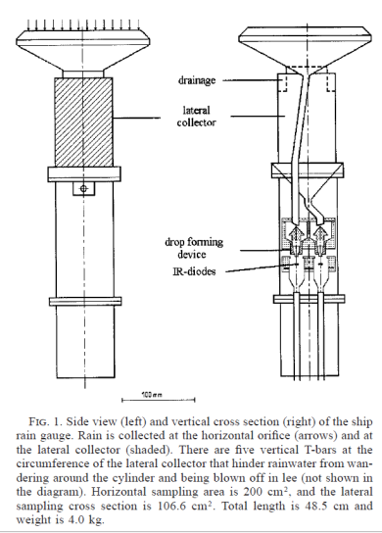
Measuring Precipitation
Volumetric
Acoustic
Siphon
Hasse et al., 1998
Notes:
Generally three options for ships - volumetric gauge (RM Young being most common), acoustic (Vaisala WXT), optical (OSI APG).

Slide 11
Optical All Precipitation Gauge
Note: OWI-430 is newer version of ORG 815
Measurements:
Rain and snow-water equivalent rate and accumulation
Present/Past weather codes
NWS – Alphabetic with intensity (+/-)
WMO - Likely code table 4680, but not specified
Visibility
Technology
Falling precipitation varies intensity of infrared light beam along measurement path
Variations, known as scintillation, have patterns that can be detected and converted to a precipitation rate
Off-axis Lens
Notes:
Recommended orientation:
Off-axis lens facing outboard (port or starboard)
Mounting pipe inboard of sensor
Experience on other vessels that this sensor sensitive to EMI, so can be challenge to find EMI free install location.

Slide 12
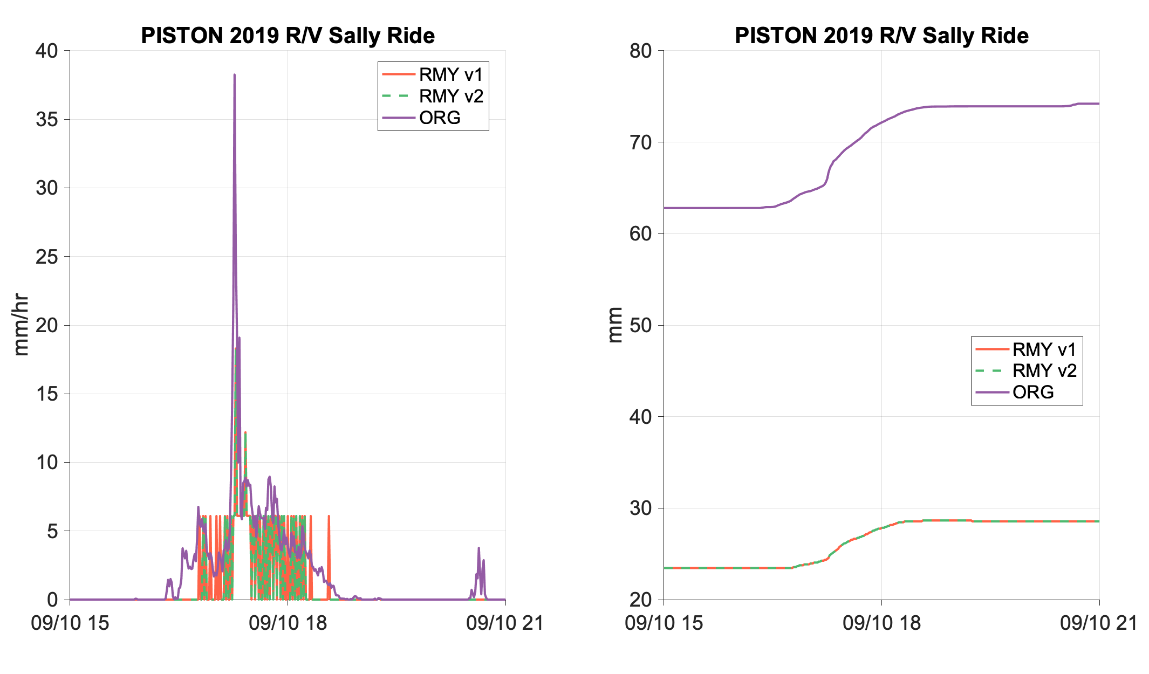
Why the OWI sensor?
Recent comparisons by Dr. Elizabeth J. Thompson (NOAA/PSL) showed significant difference between RM Young 50202 and ORG 815
RMY can only resolve 0 vs 5 mm/hr changes
RMY can not resolve very high rain rates
ORG resolves higher rates
6-hour accumulation is 11 mm for ORG, only 5 mm for RMY
Notes:
Figure: Courtesy E. Thompson - At shorter time scales of a few hours, the deficiencies of the RMY 50202 are even more obvious. See here how the rain rate measured by ORG is accurately depicted (compared to radar, disdrometer, and other accounts of natural rainfall patterns) as varying quickly between low and high rain rates. The RMY can only depict 0 vs. 5 mm/hr changes and so it neglects/misses the high resolution rain rate time variability. The highest rain rate that the RMY can achieve is also only 18.3 mm/hr, whereas the ORG measures just over double that at 38.26 mm/hr, an error of 109%. Note also how the small increase in rain briefly just before 21 Z was also missed entirely by the RMY because it lacks sensitivity between 0 – 5 mm/hr. The minimum non-zero rain rate it can even detect is 5 mm/hr per minute due to it’s coarse resolution in rain depth per raw time step. The resulting rain accumulation estimates over this 6-hr time period differ between the two sensors. The ORG measures an increase from 62 to 74 mmm, 11 mm accumulation, whereas the RMY only increases 5 mm total, a vast underestimation by over a factor of 2. This is unacceptable for weather and climate records or for studying rain’s impact on the ocean.

Slide 13
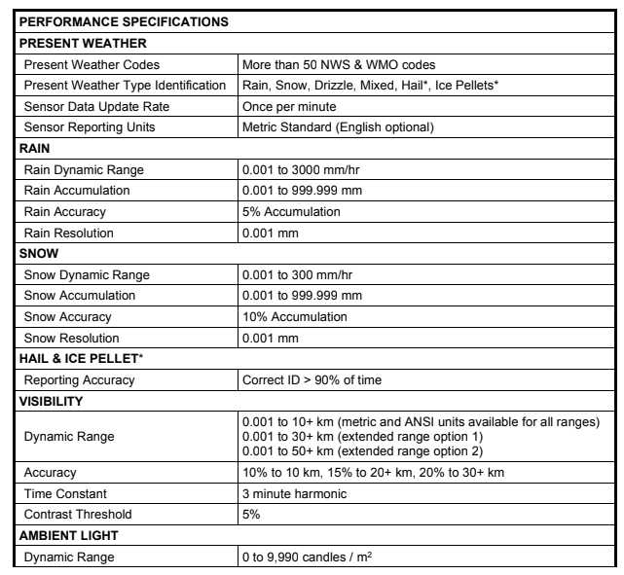
Why the OWI sensor?
OWI-430 Specifications
RM Young 50202
prone to evaporation, sloshing, data resets that make data analysis hard
Flow distortion and undercatch are a problem
Coarse data resolution (+/- 5 mm/hr)
Soot/grit inside sensor can impact capacitance readings
ORG 815
Measures precipitation rate regardless of wind angle
Sensitive to very low and high rain rates
Suitable update rates
Notes:
Note: comparisons between APG 815 and WXT are needed (along with comparisons to Vaisala Present Weather sensor).
Soot problem discovered recently on the Tangaroa.
Note: Recent concerns with S-band radar interference – looks to depend on bandwidth of radar
Possible community activity: can we get a WXT on a vessel with an optical rain sensor? Would be great to get some comparison data? Or maybe the OSU/RCRV roof lab? You get the data, FSU can find a student to analyze.

Slide 14
Future SAMOS Processing
Modernizing data format
NetCDF CF/ACDD standards
Use of controlled vocabularies
Additional parameters (flow rate, weather codes, cloud height)
QC software rewrite
Single open-source code base
Promote data pull from operator (vs email push)
New QC procedures
Updated climatology
Comparisons to models, satellites
Web-based visual QC tools
Possibly applying AI/ML approaches
Visual QC data for training
Modernize data services
ERDDAP
Data visualization

Slide 15
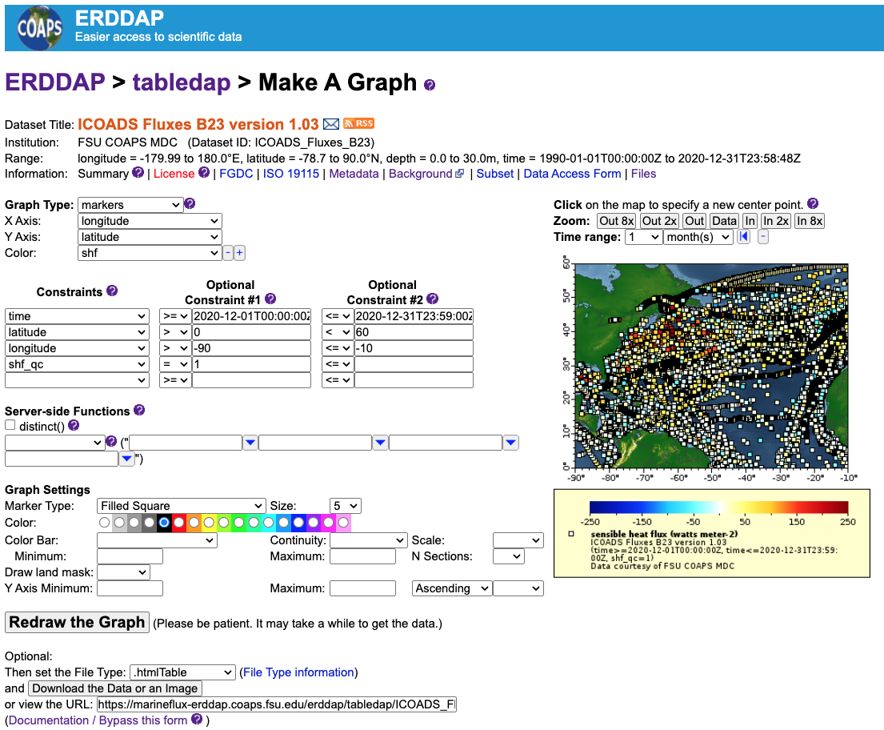
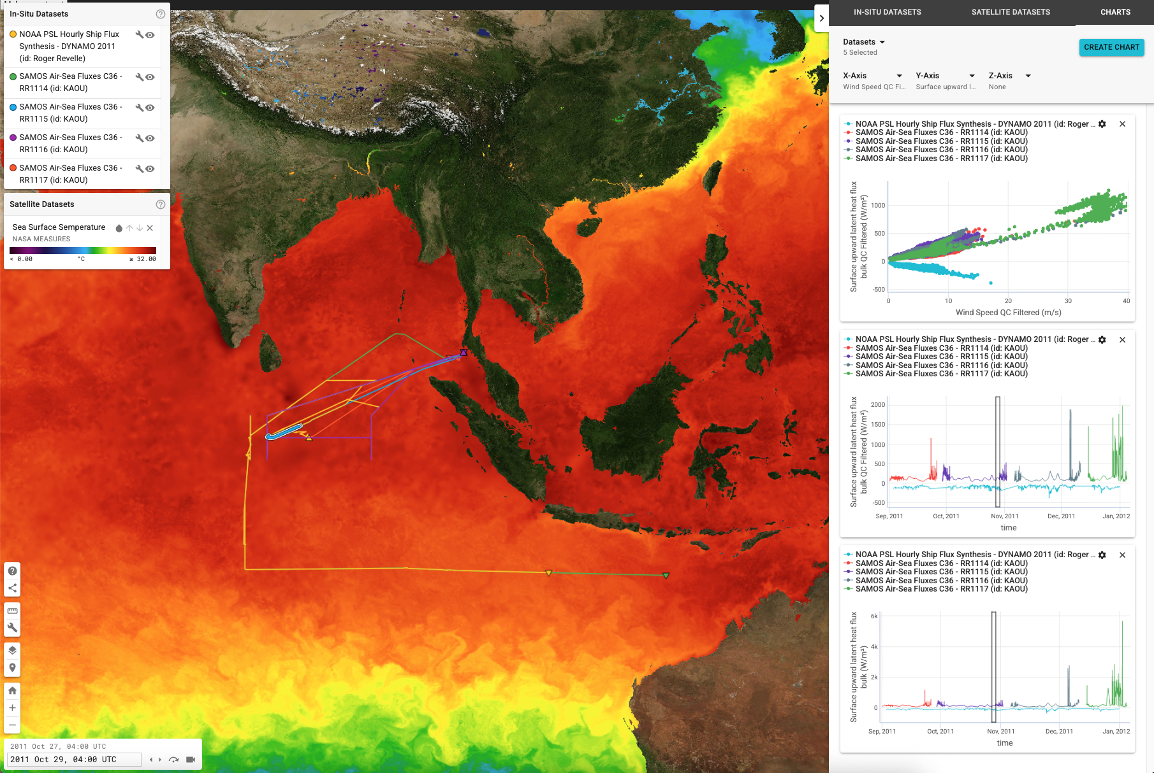
SAMOS Air-Sea Flux Service
https://mdc.coaps.fsu.edu/marineflux/data
Notes:
Future expansion to include all SAMOS data.

Slide 16
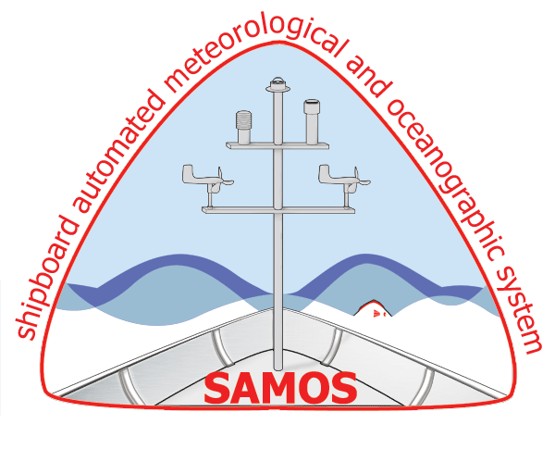
Questions?
The SAMOS data center is funded by the National Oceanic and Atmospheric Administration’s (NOAA) Global Ocean Monitoring and Observing Program (FundRef number 100000192) and the Office of Marine and Aviation Operations via subawards (191001.361472.01B, 191001.361472.01F) administered by the Northern Gulf of Mexico Cooperative Institute (grant NA21OAR4320190) at the Mississippi State University. Support for Academic Research Fleet vessels’ participation within SAMOS is provided by the National Science Foundation (NSF), Oceanographic Instrumentation and Technical Services Program via a subcontract from the University of California San Diego grant OCE-2439640. The Schmidt Ocean Institute (SOI) provides contract funding to include the RV Falkor and Falkor (too) in the SAMOS initiative.
Any opinions, findings, and conclusions or recommendations expressed in this presentation are those of the author and do not necessarily reflect the views of NOAA, NSF, or SOI.

