Slide 1
RVTEC Wiki
Breakout
Kristin Beem, Bonny Clarke, Rebecca Hudak,
November 3 - 6 San Diego, CA

Slide 2
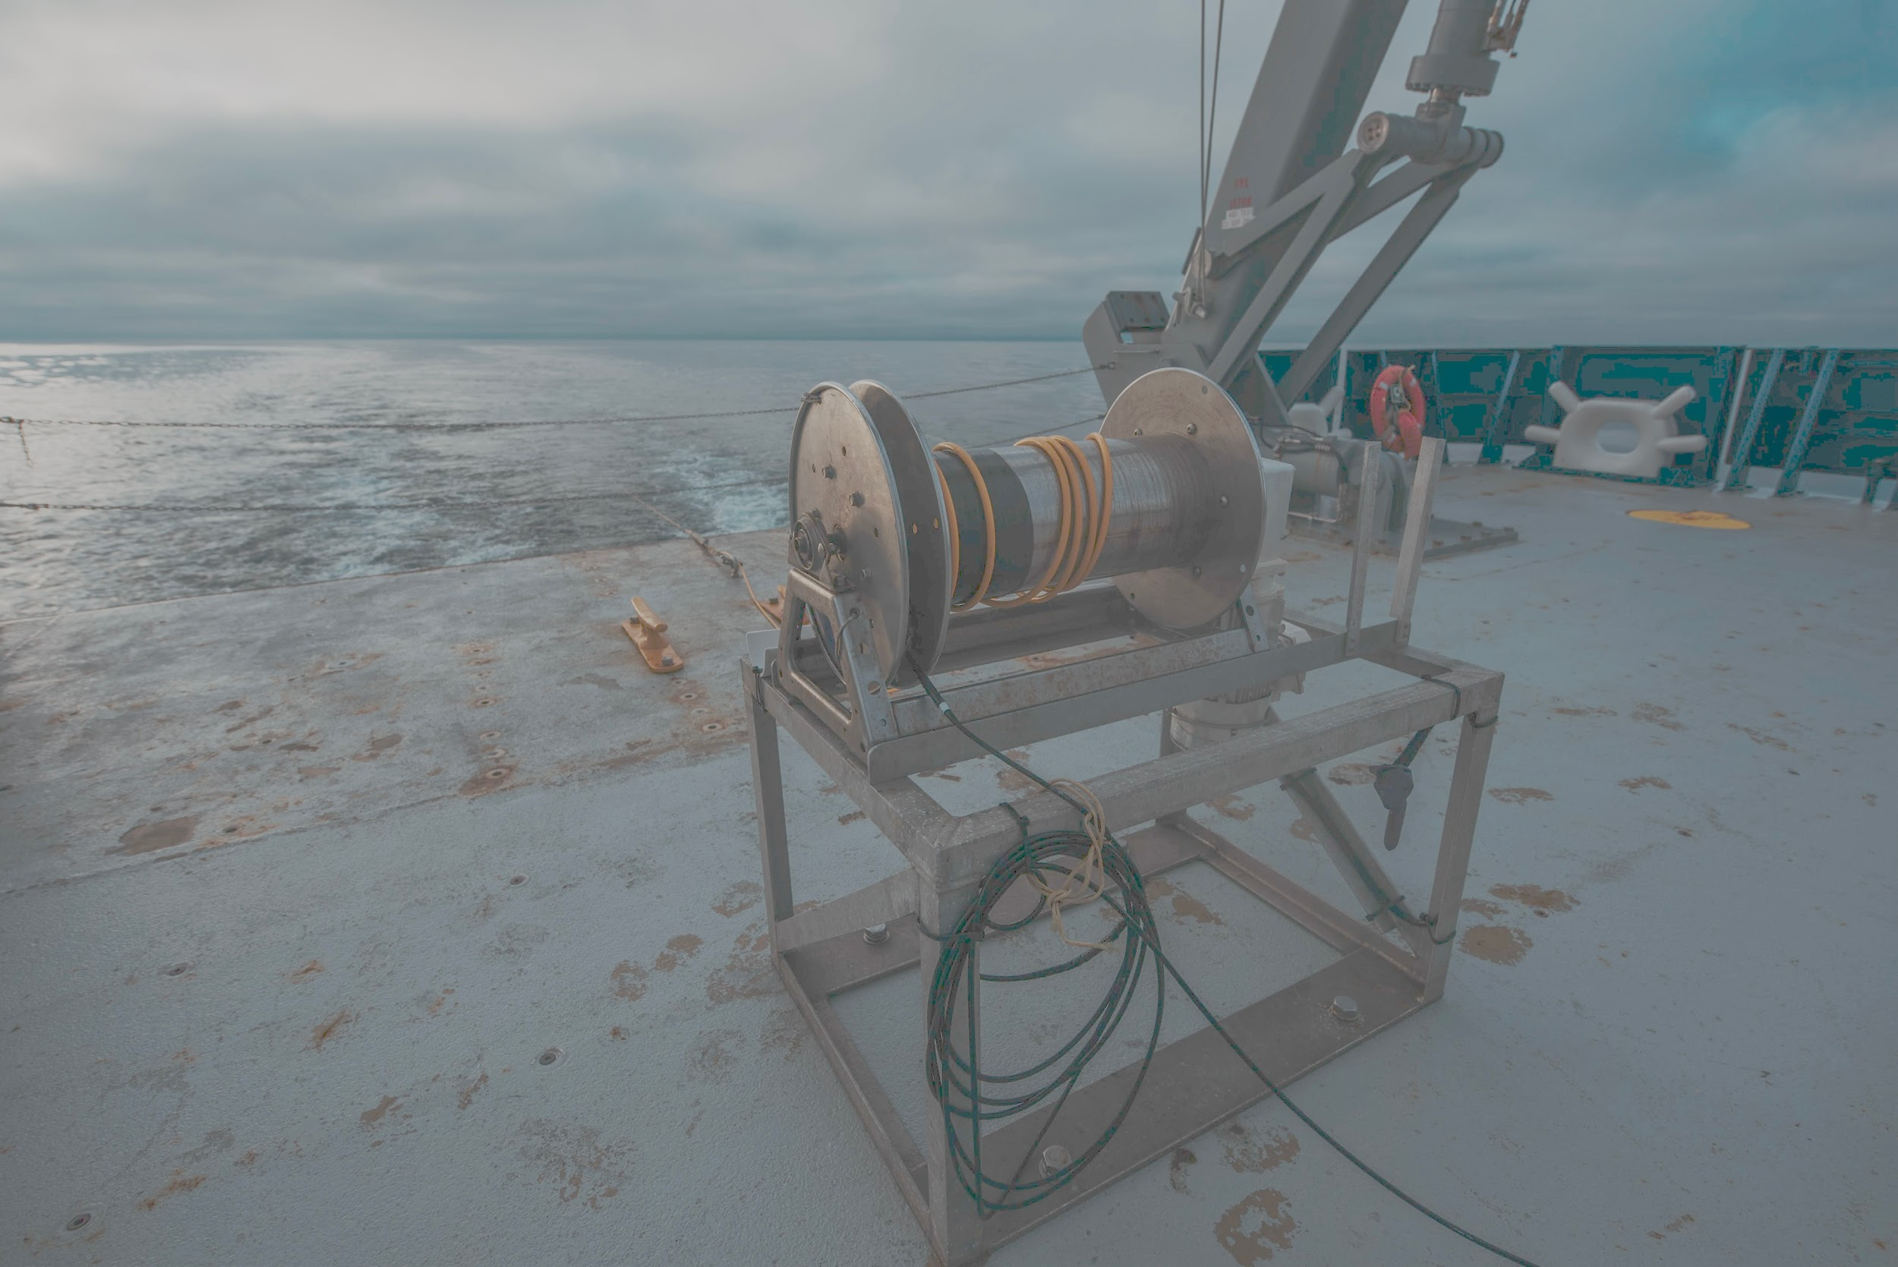
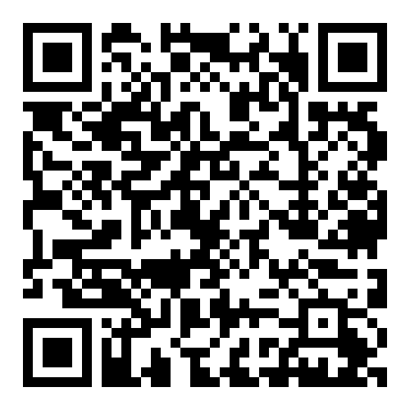
Introduction
Came about last RVTEC when interest in providing access to resources collected during Best Practice documentation for the Tech Community
Sent out Google Form for feedback and volunteers
We now have a official wiki!
https://rvtecwiki.unols.org/doku.php?id=welcome

Slide 3
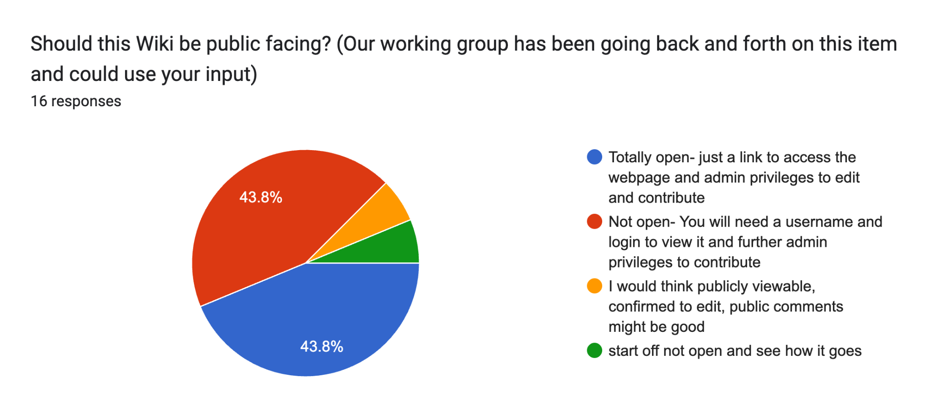
Poll results- 16 responses

Slide 4
Wiki ‘Code of Conduct’:
Disclaimer: The information provided here is intended as general guidance and may not reflect ship-specific configurations or procedures. Please use caution and always refer to vessel-specific documentation and protocols when applicable.
We want to work with the community to develop community guidelines for the RVTEC wiki to encourage positive recommendations and respect the structure and formatting (page health) of our shared website.

Slide 5

Wiki Roles:
* If any changes are requested please email: rvtecwiki@unols.org

Slide 6
Infrastructure
Hosted on UNOLS Azure account
Use of plugins for file management, indexing of namespaces, moving pages and documents, etc.
WYSIWYG editor for more familiar editing
User management for editing and approval process

Slide 7
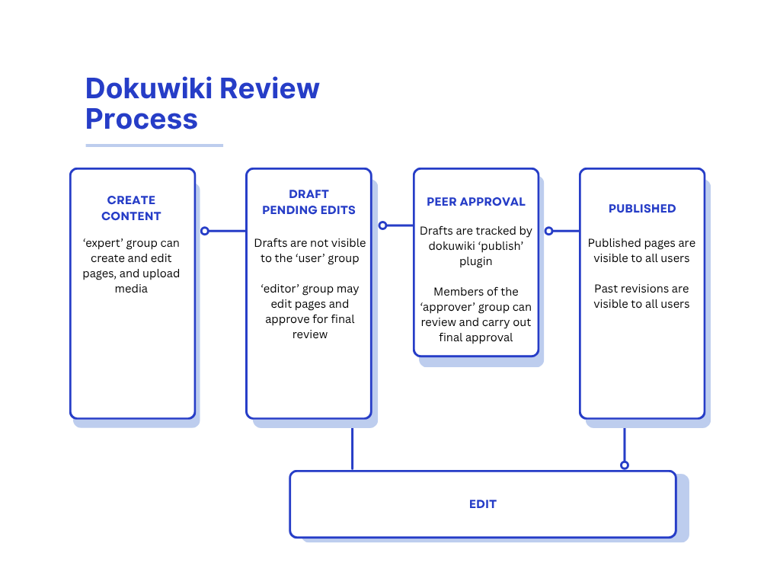
Approval Process

Slide 8
Wiki Guidelines:
PDF and JPG preferred (no videos and editable documents)
We can embed youtube links (WWWW recordings, and tech training videos will be made available)
Scrub sensitive information (e.g., IP addresses, user account info) for cybersecurity compliance before submitting to the wiki

Slide 9
Wiki Guidelines (continued):
Avoid ship specific documentation - Fleet Specific; NOT ship specific
Avoid opinionated statements, as unbiased as possible
Not operational systems (ie engines, bridge, satellite systems)
We will link to other UNOLS groups (SatNAG, Hiseasnet, Tech training group, MAC group)

Slide 10
Walkthrough of the Wiki

Slide 11
Rest of the breakout:
Working session!
Check out the playground/sandbox if you are unfamiliar with wiki formats
If you have wiki experience, start adding content!
Sign up to stay involved and part of this project (email us- rvtecwiki@unols.org)

Slide 12

Potential Action Items:
Create an account
Create a page
Adding a document
Embedding a video
Edit a page
Plug-ins
Data Mine/ Look through documents /Pictures related to instruments (use QR code)

Slide 13
Plug-ins We’ve Added:
Authorlist - shows contributing authors per page
Auto-tooltip - hoverable summaries for key phrases
Copy, delete, move pages
Filelisting - list files in namespace
Indexmenu - show sortable index or a namespace
Prosemirror - WYSIWYG editor for dokuwiki
Publish - integrate publishing process

