Slide 1
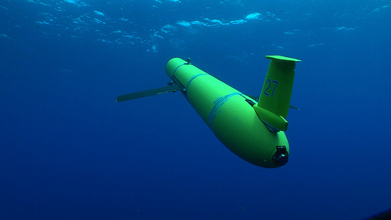
Biofouling Considerations and Solutions for
Undersea Instruments and Platforms
UNOLS RVTEC Meeting

Slide 2

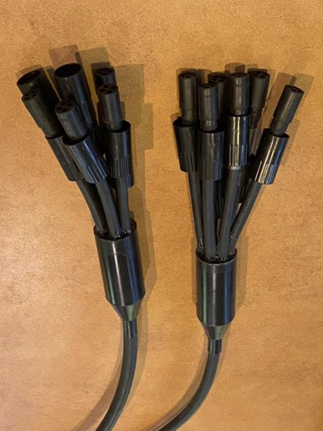
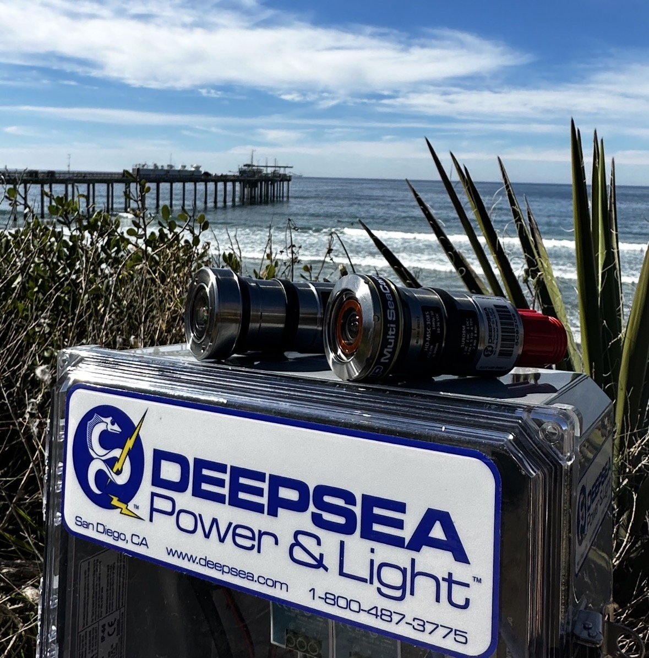
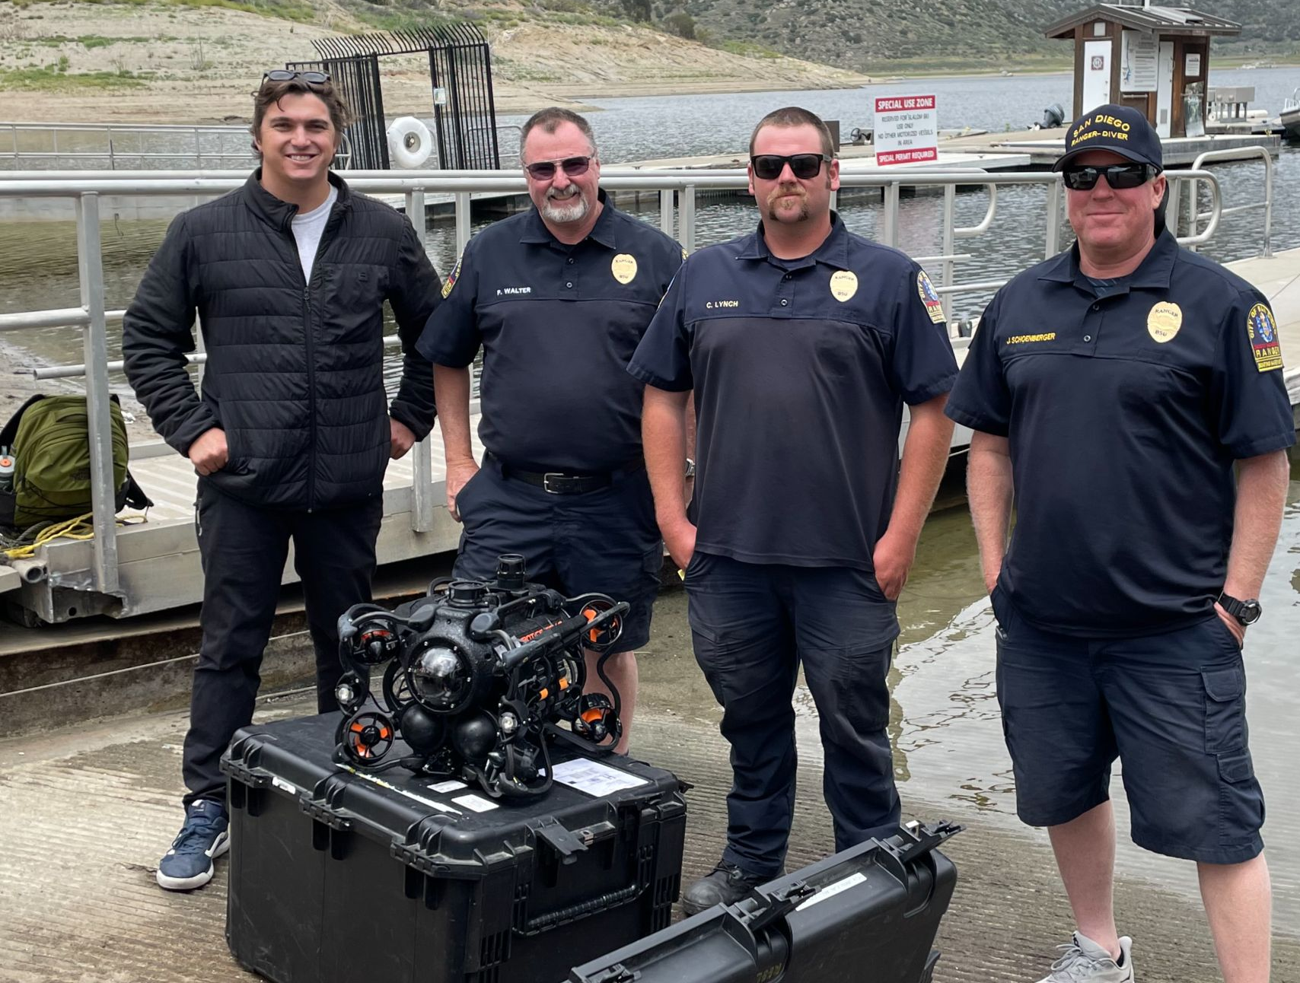
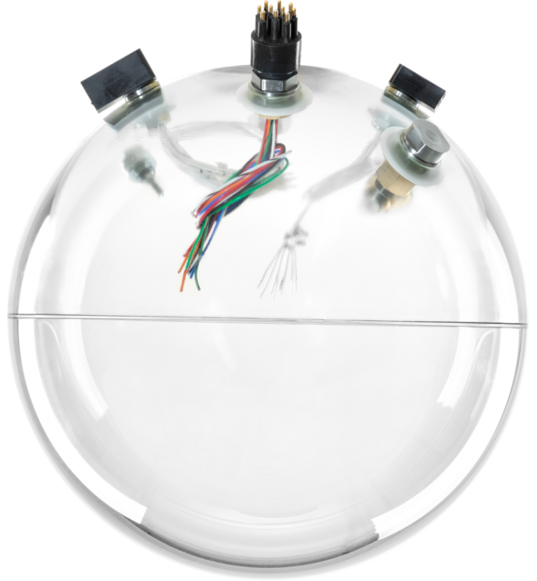
Ocean Innovations
Company Overview
Manage the west coast division of ClearSignal biofouling control coating.
Supply specialized oceanographic equipment for research, commercial, and defense applications.
Quick turnaround custom cable assemblies, junction boxes, and mechanical support.
Subsea cameras, lighting, and pressure relief.
Glass instrumentation and floatation spheres.
Represent leading manufacturers such as SubConn, DeepSea, Nautilus Marine, Novatech, SRS Fusion, Oceanbotix, and many more

Slide 3
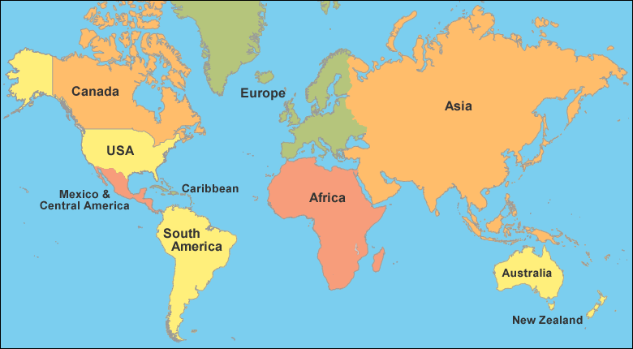
Severn Marine Technologies
Company Overview
Supported By Ocean Innovations in San Diego and other Worldwide Representatives
Research, Development and Marketing non-toxic biofouling resistant materials since 1997
Focus on: Seismic, Oil/Gas Energy, Marine instruments
Coating Locations: Houston, San Diego, Norway, Denmark, Australia, UK

Slide 4
Topics to Discuss
1. Biofouling Protection – General Case
2. Biofouling Protection – Instrument Case
3. Optical Devices
4. Biofouling Protection – Best Practices

Slide 5
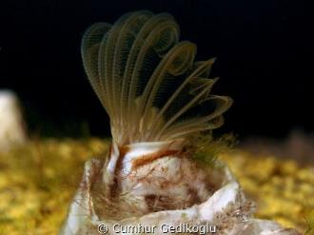
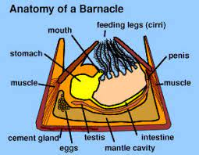
In the Beginning
and can we Outsmart a Barnacle?

Slide 6
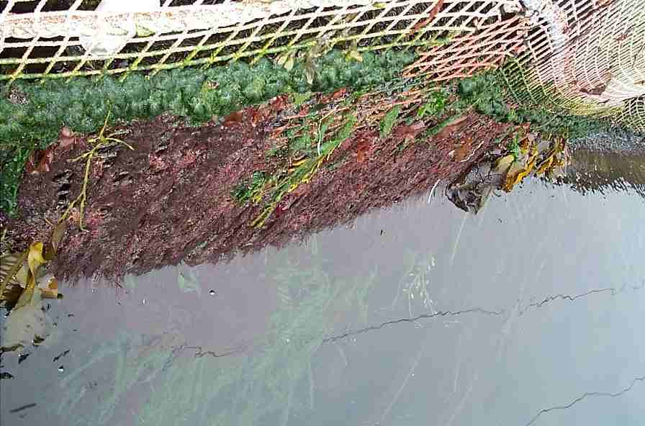
The Problem

Slide 7
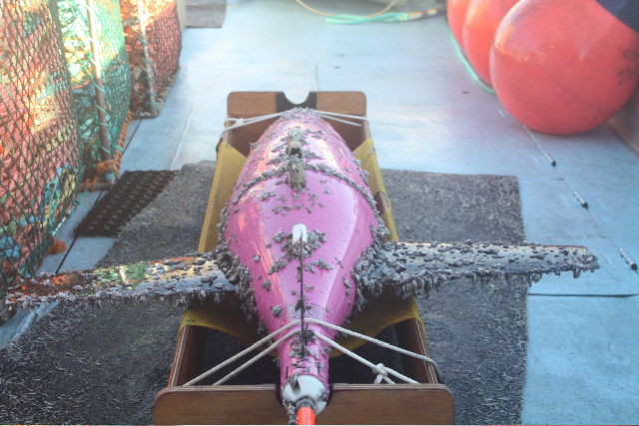
The Problem

Slide 8
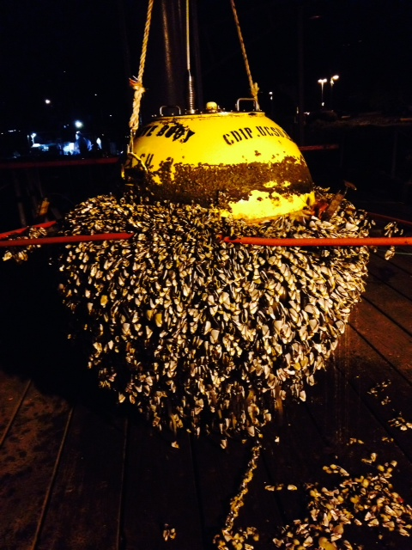
The Problem

Slide 9
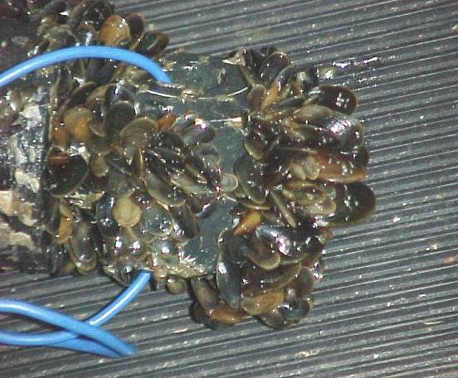
The Problem

Slide 10
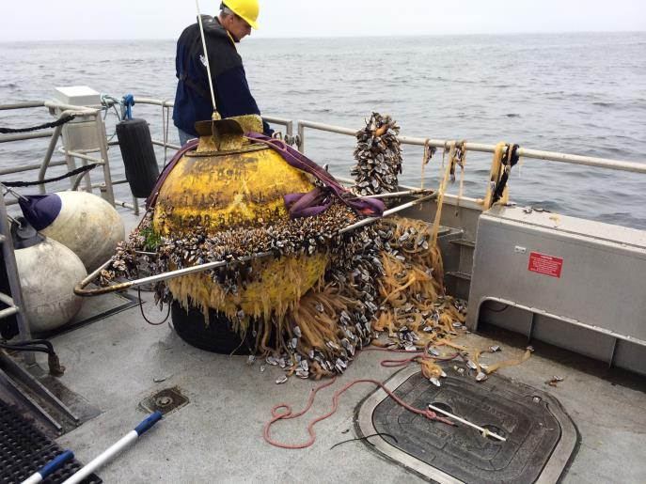
The Problem

Slide 11
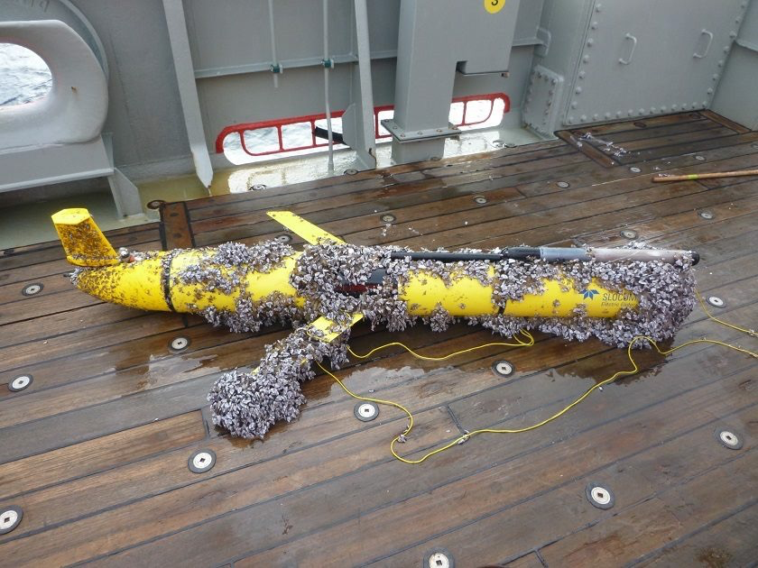
The Problem

Slide 12
Instrument Considerations for 2022 and Beyond
With Improved Batteries - Instruments
With Improved Memory – Instruments
Long Term Considerations for Deployments – all Devices
Toxicity/HSE Considerations – all Devices
Biofouling is Becoming a Dominating Limitation.

Slide 13
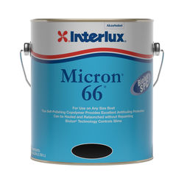
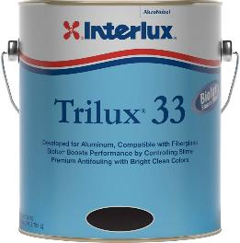
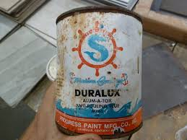
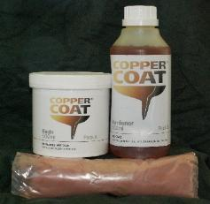
Traditional Solution- Biocide Paint

Slide 14
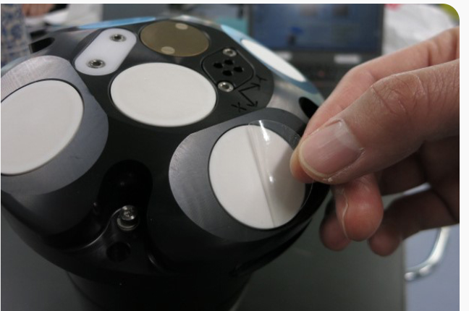
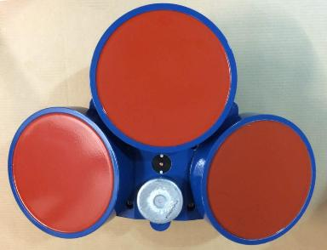
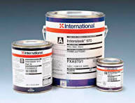
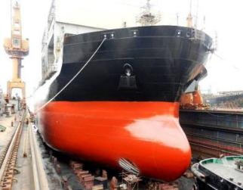
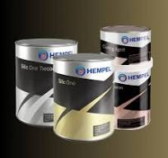
Advanced Solution – Foul Release

Slide 15
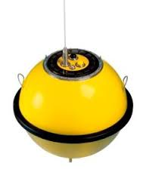
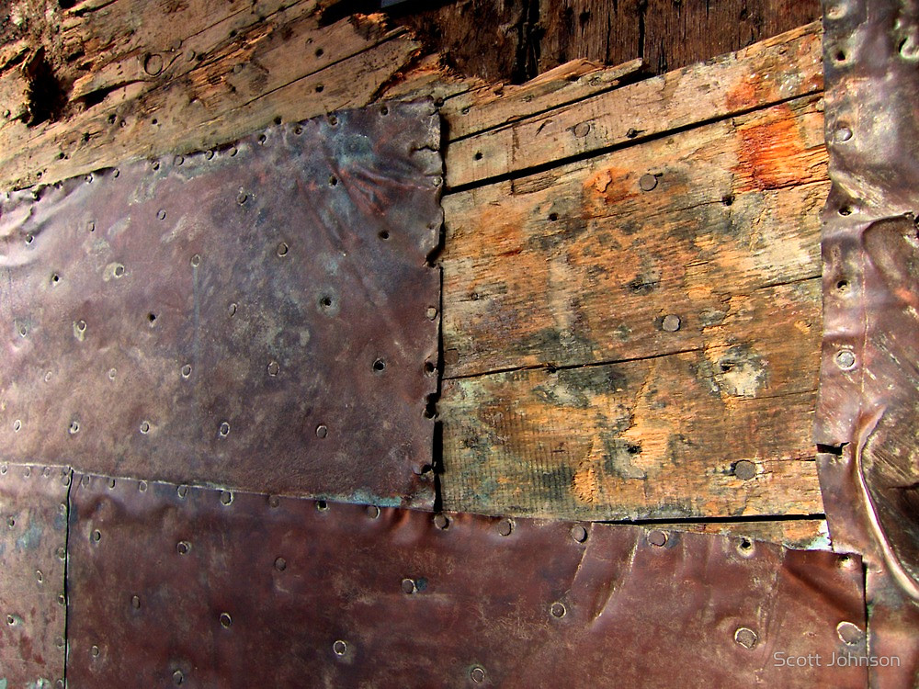
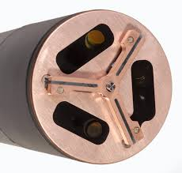
Copper Cladding

Slide 16
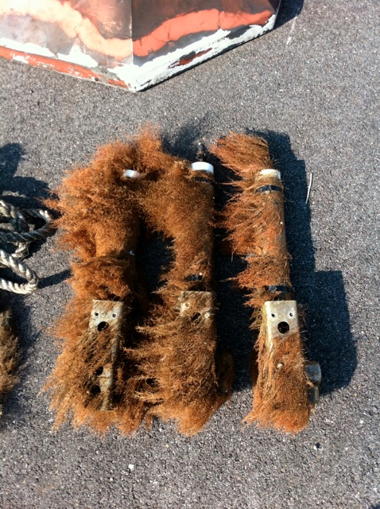
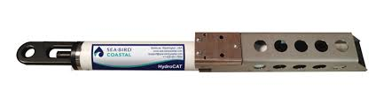
Case History – TBT Biocide

Slide 17
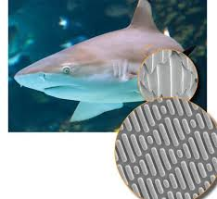
Topography (Sharklet)

Slide 18
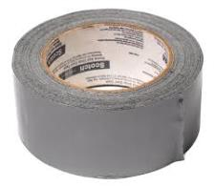
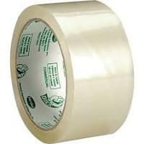
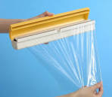
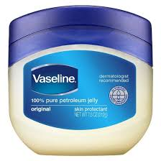
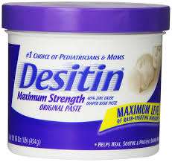
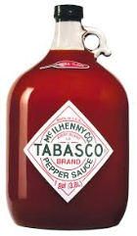
Home Remedies
Tape Wraps
Grease Grease Additives

Slide 19

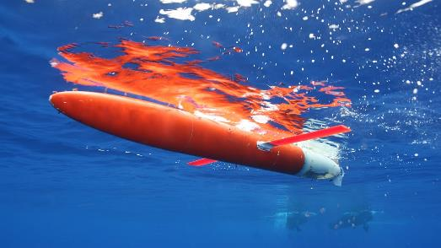

General Biofouling Control Choices
= Foul Release or Biocide
Operational and Performance Considerations Often Favor Foul Release:
Long Duration Missions and Long Term Efficacy
Possible Optical Transparency Requirements
Field Turnaround
HSE – No Toxicity

Slide 20
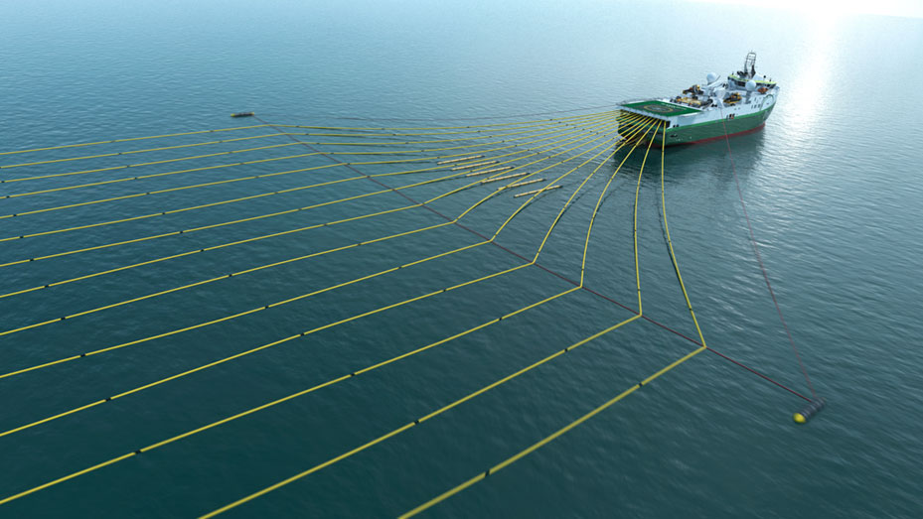
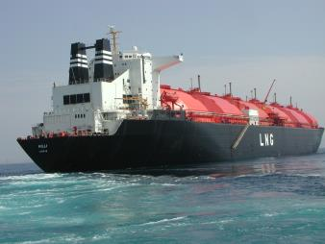
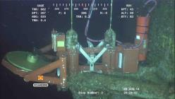
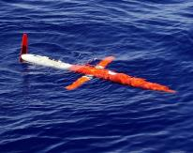
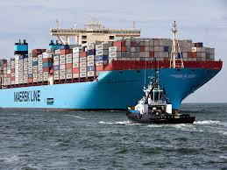
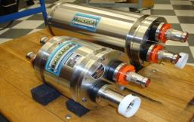
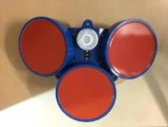
Foul Release Use Today
ClearSignal (Severn Marine Technologies)
Intersleek (International Paint Co.)

Slide 21
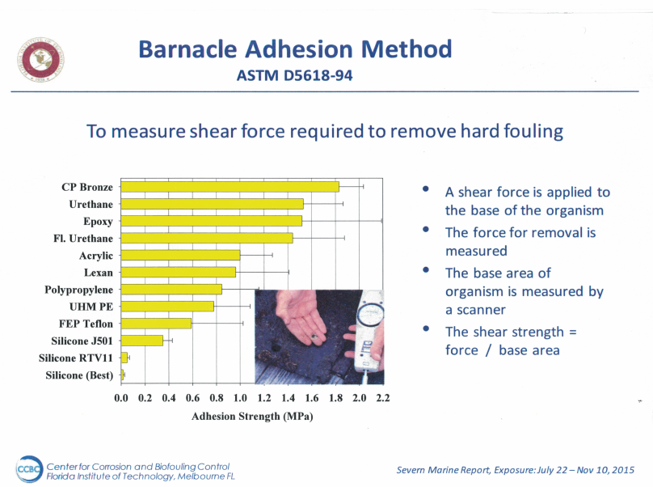

Slide 22
Barnacle Adhesion Method ASTM D-5618-94

Slide 23
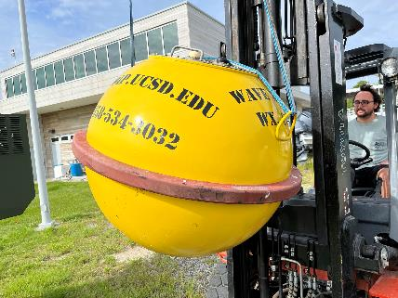
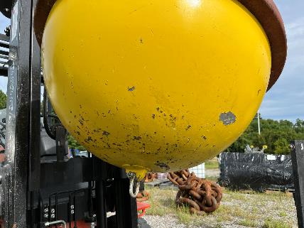
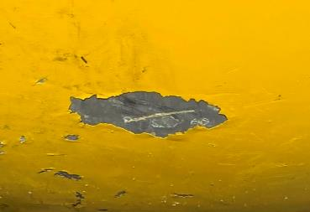
Coating Robustness
Failure Containment from Anchor Chain

Slide 24
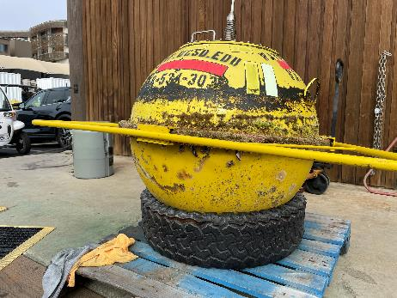
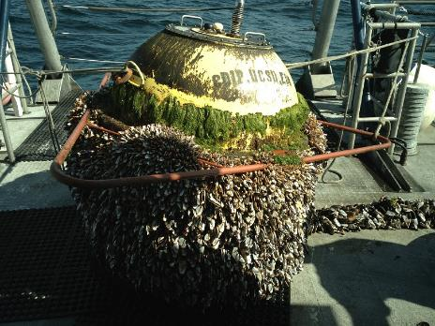
Enhanced Wave Measuring Buoy Performance through
the use of ClearSignal 2 years Pacific
ClearSignal Coated
Copper Coated

Slide 25
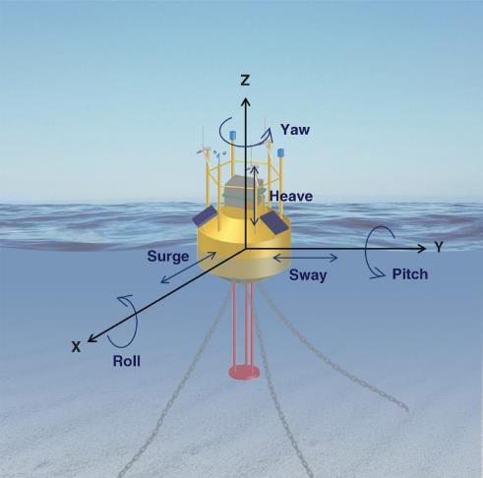
Heave Provides Self Cleaning to Foul Release Coatings

Slide 26

Case History – ClearSignal and Control

Slide 27

Case History (Foul Release - ClearSignal)
DSC01535.JPG

Slide 28

Case History-(Foul Release - ClearSignal)

Slide 29

Case History - (Foul Release - ClearSignal)

Slide 30
Summary Review
Foul Release Coatings offer Long Term Protection
Biofouling and its Prevention is an Adhesion Issue
Coating Robustness and Adhesion to the Substrate are Critical Factors
Flow Separation Contributes to Biofouling Settlement
Buoys in Heave Provide Self Cleaning for Foul Release Coatings

Slide 31



Streamlining

Slide 32

Streamlining

Slide 33
Streamlining

Slide 34

Streamlining

Slide 35

Streamlining

Slide 36

Streamlining

Slide 37





Protection of Optical Devices

Slide 38


UV(AML System)

Slide 39

Wiper System

Slide 40

Case History - Wiper

Slide 41

Liquid Immersion (Probe Guard)

Slide 42


SMT Solution

Slide 43
Conclusions
Foul Release for Long Term Deployments (adhesion and durability are key)
Integrated Solutions – (especially for specialized sensor areas)
Implement Streamlining for Low Flow Separation
Best Practices Yield Large Results - Reductions of maintenance by
3X to 10X
Best Practice Guideline Development for Science is Recommended

Slide 44
Contact Info
Hank Lobe
President
Severn Marine Technologies
1303 Redwood Ave
Annapolis, MD 21403
Phone - (410) 263-1143
Fax - (410) 263-0904
Cell – (443) 995-6644
Email – hank@severnmarinetech.com www.severnmarinetech.com
Nico Woods
Sales Engineer
Ocean Innovations
7416 Cabrillo Ave
La Jolla, CA 92037
Phone (858) 454-4044
Email – nico@o-vations.com
www.ocean-innovations.net

Slide 45



ClearSignal Coating for CDIP Program

Slide 46





ClearSignal Coating for Various ADCP

Slide 47

Biofouling Solutions in Action
-Shot from a Deepsea HD MultiSeacam mounted to Scripps Pier
-housing coated with ClearSignal
-pulsed UV light for added biofoul control
Scripps Pier Live Cam | Coastal Ocean Observing Lab

