Slide 1
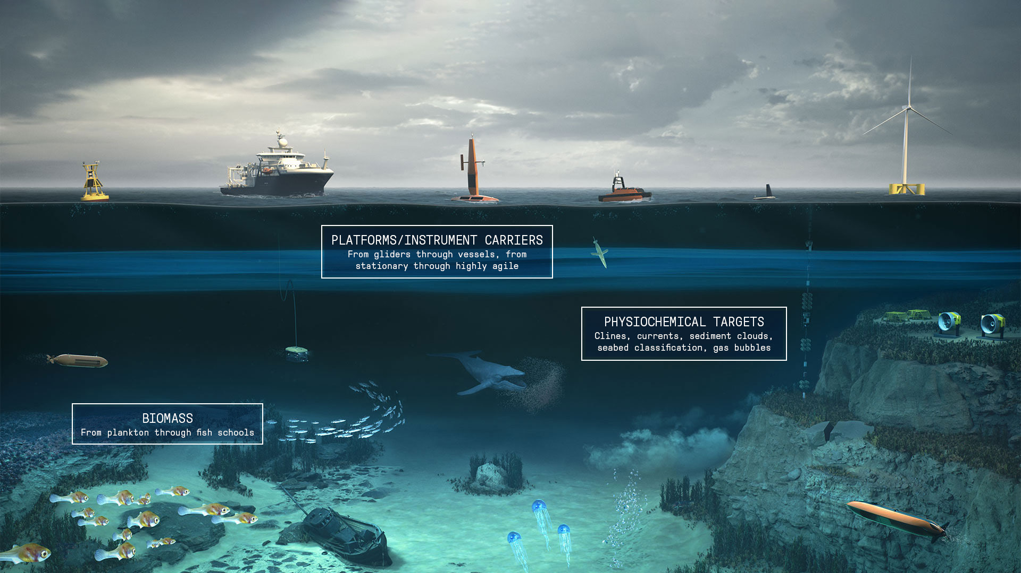
K-SYNC
OPTIMIZING THE CONDUCTOR OF HYDRO-ACOUSTICS

Slide 2

System Overview
1

Slide 3



Course Objectives
Understand K-Sync Capabilities
Identify and describe K-Sync components and integration on vessel
Perform startup, shutdown, and basic operation of K-Sync

Slide 4
System Overview
K-Sync controls pinging of each echosounder with real-time trigger display.
Avoids interference from echosounders with similar frequencies or harmonics that will cause bad data collection.
K-Sync receives ready signals from echosounders
Supports up to 16 groups in real time or manual depth input
Trigger from external input, calculated or fixed time
Notes:
Idea*** - your conductor for the myriad of systems so that interference is limited. Symphony of sound!
From our amazing website:
The KONGSBERG synchronizing unit, K-SYNC is designed to solve these problems by proper timing of the instruments and by controlling the triggering of each instrument's transmission.

Slide 5
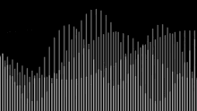
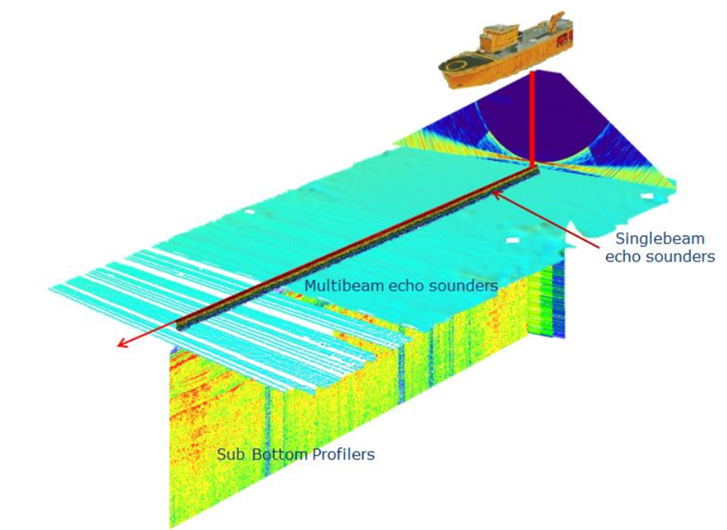
Frequencies and Interference
The Problem
EQUIPMENT | FREQUENCY
Sub Bottom Profiler | 0.5-30 kHz
HiPAP | 20-30 kHz
EM124 | 10.5-13.5 kHz
EM304/MKII | 26-34/20-32 kHz
EM712 | 40-100 kHz
EM2040 | 200-400 kHz
EK80 | 18-333 kHz
ADCPs | 38 – 300 kHz
ME 70 | 70 kHz
Notes:
Some sonars have overlapping ranges or harmonics resulting in interference between systems.

Slide 6
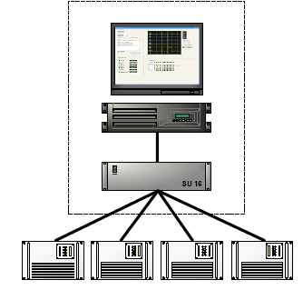
Synchronization
The Solution
Synchronize your systems together!
Note: Using a K-SYNC unit with several active acoustic systems will slow down ping rate and reduce the data density on the sensors involved.
Workstation
PU
Acoustic system
Notes:
The K-sync works to ping the systems in a way that prevents interference.
This is achieved through a combination of user settings and K-sync software intelligence

Slide 7
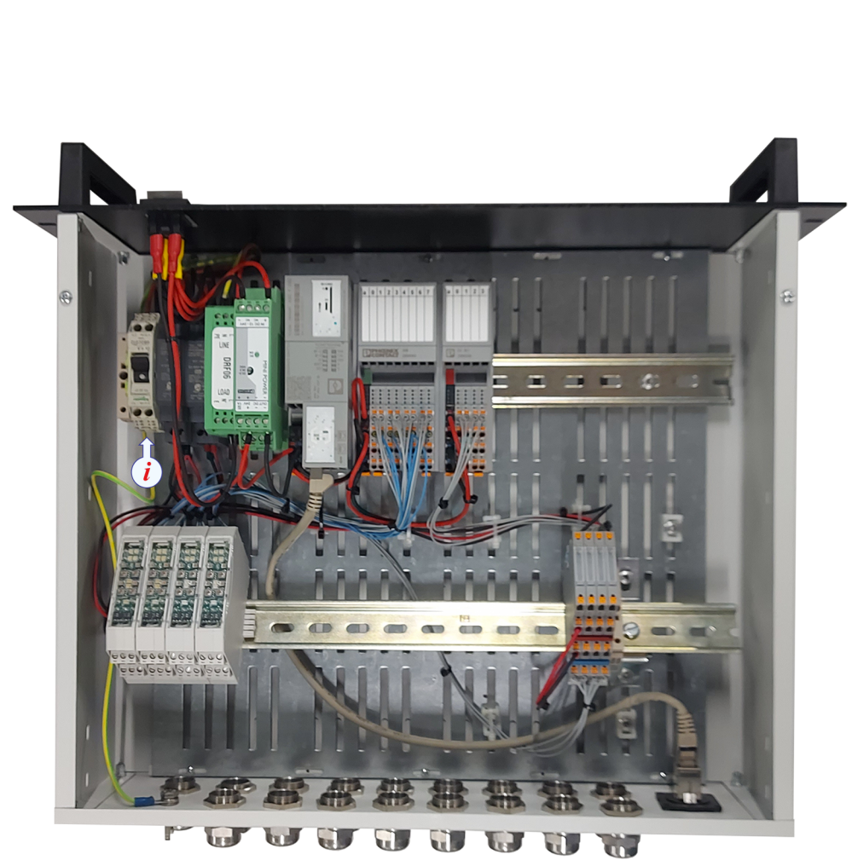
Hardware and Connections
2

Slide 8
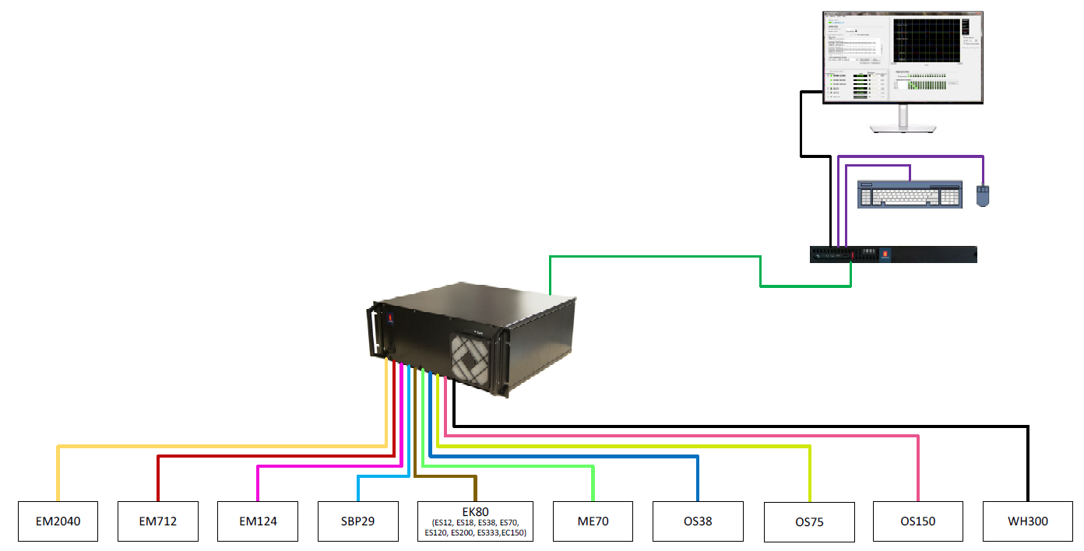
System Integration
Hardware and Connections

Slide 9
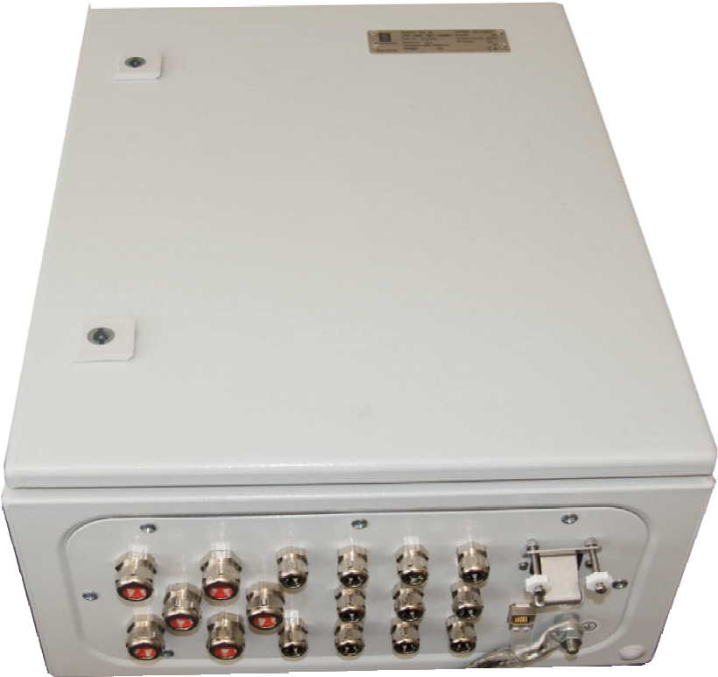
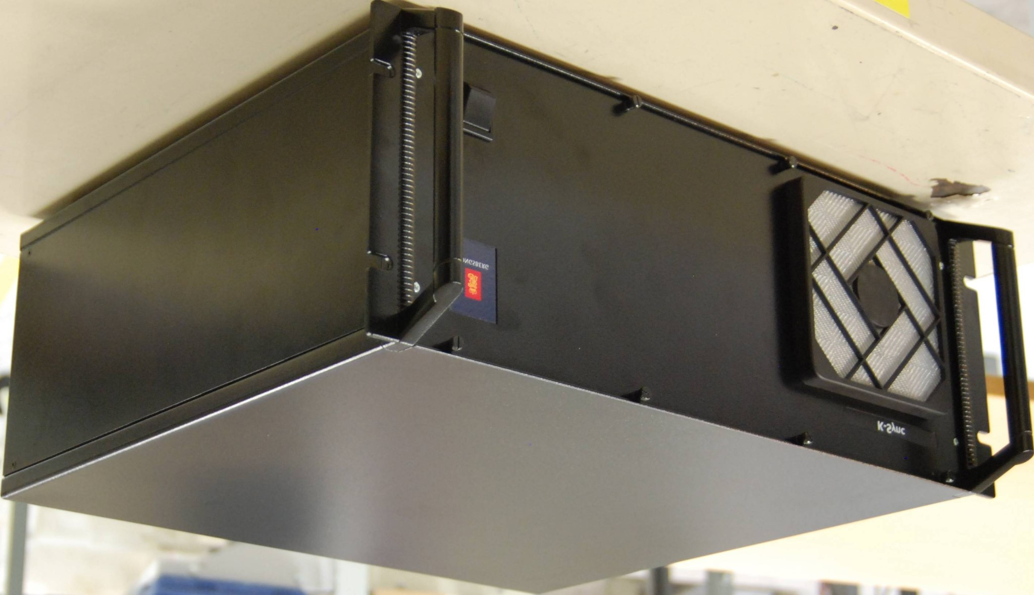
Processing Units (PU)
Hardware and Connections
19-Inch rack-mounted K-SYNC PU
1K-SYNC PU for wall-mount
Notes:
Your system is Rack Mounted

Slide 10
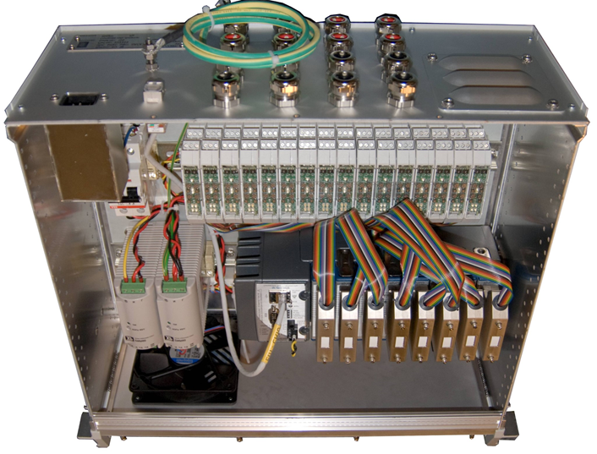
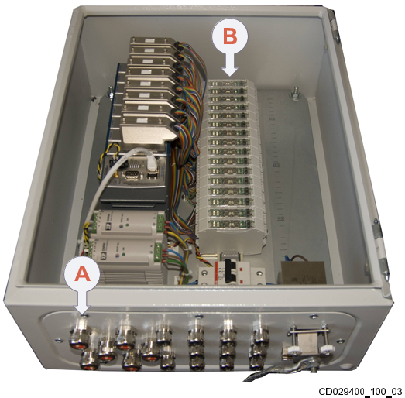
PU Internal Components
Hardware and Connections
A Power
B 16 modules for interfacing with different acoustic systems
19-Inch rack-mounted K-SYNC PU
1K-SYNC PU for wall-mount
Notes:
Up to 16 module for acoustic connections

Slide 11
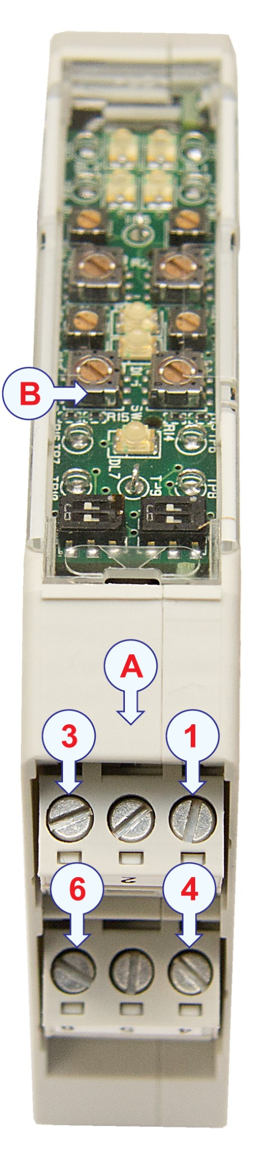
Modules
Hardware and Connections
There are 16 Modules to connect
A – Wire terminal connections
1 through 6 as indicated by the arrows
B – Configuration board

Slide 12
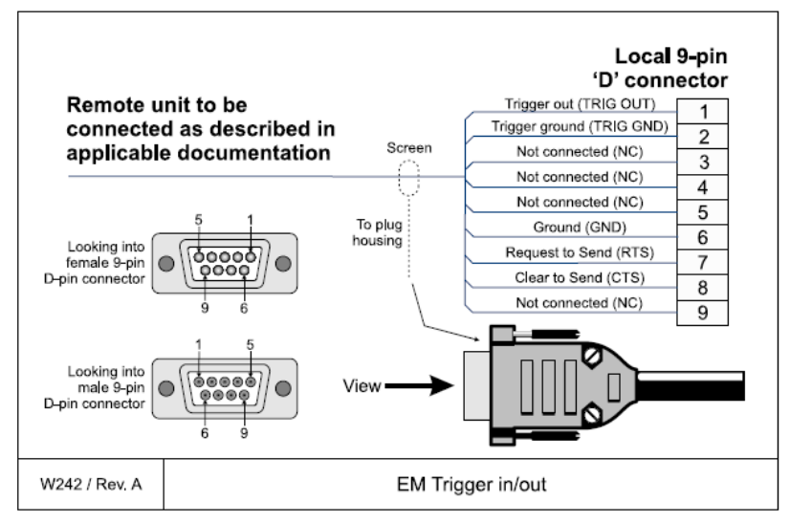
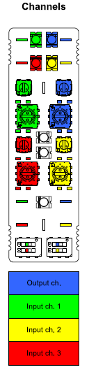
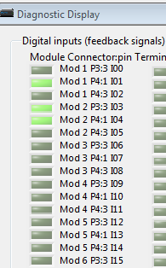
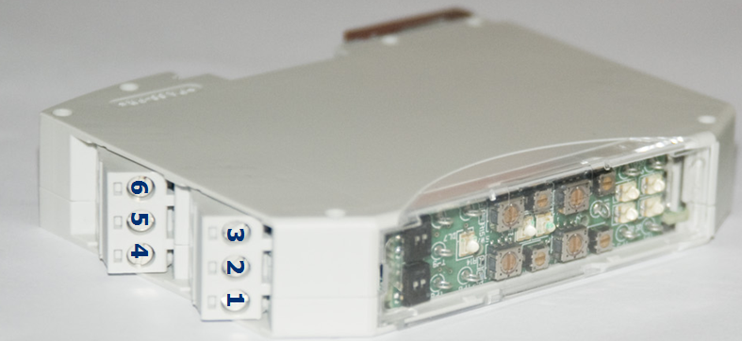
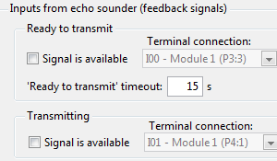
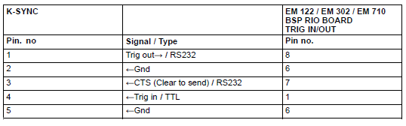
Module Connections
Hardware and Connections

Slide 13
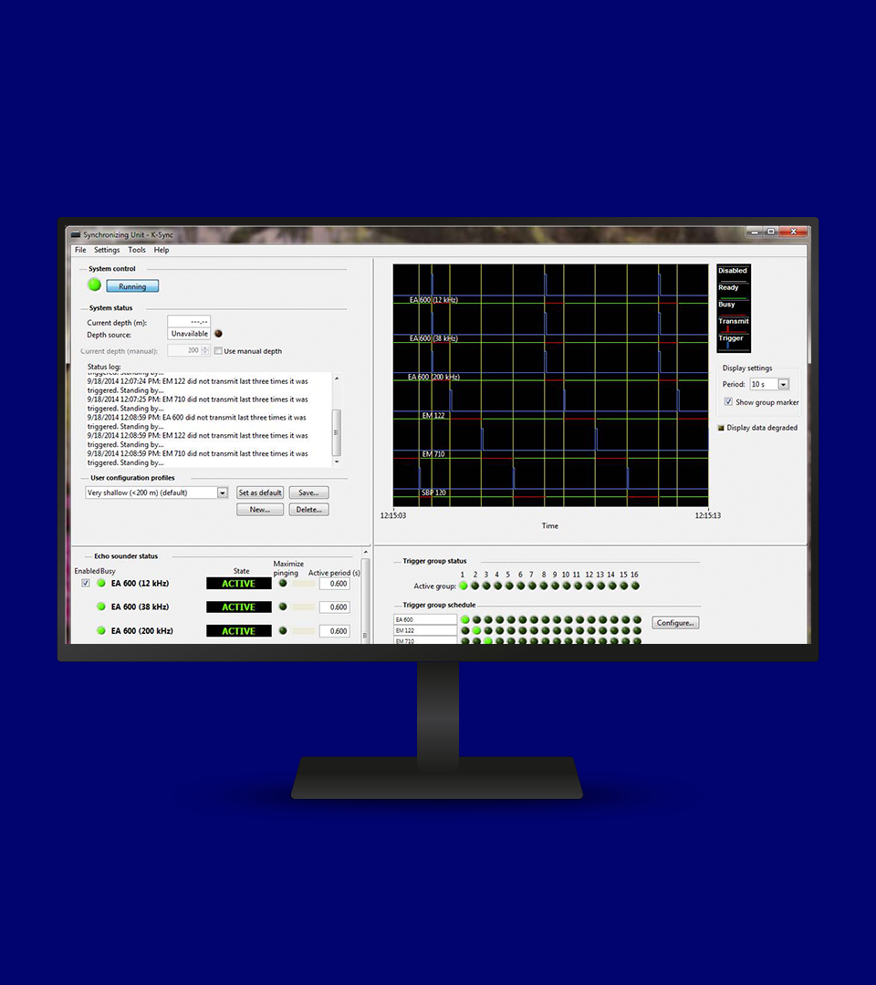
Software Overview
3

Slide 14
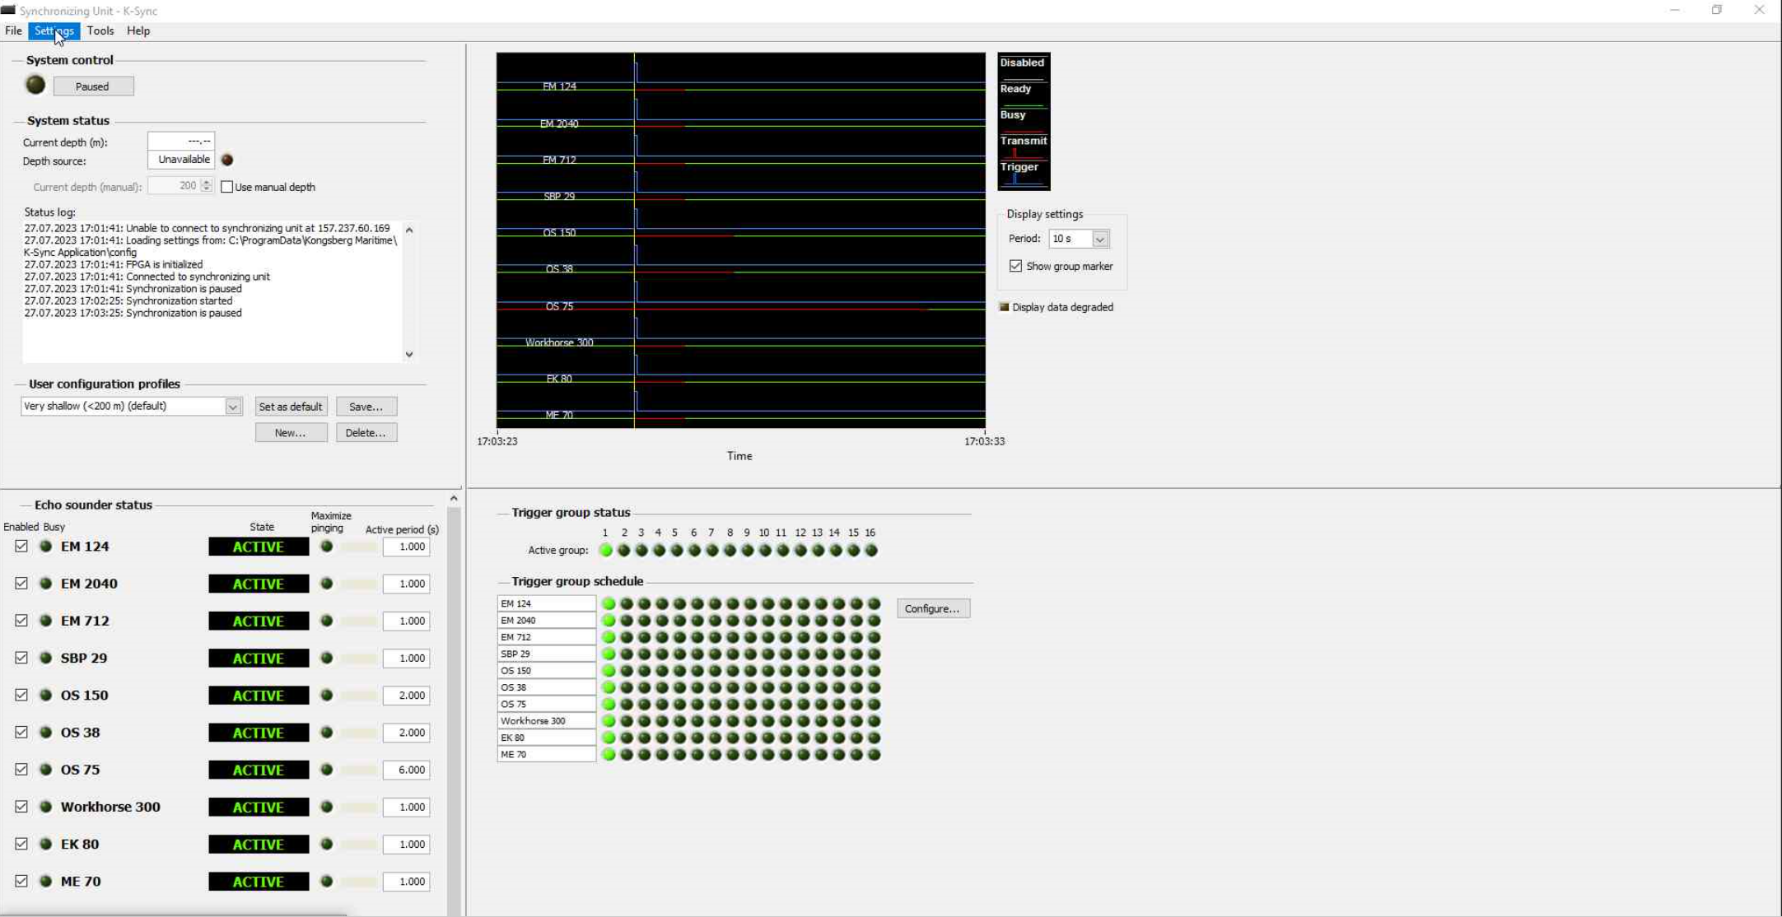
Software Overview
Notes:
Network based SU operator sw may be run on any PC
System setup
System monitoring
If setup the K-sync SU will continue to trigger the echosounders
- even if the operator sw is closed
CAUTION! Always power up the K-Sync before pinging echo sounders
Trigger outputs are undefined during power-up (first 20 seconds) and signal levels could potentially be interpreted as trigger pulse by the echo sounders until signal levels have settled
Systems that are currently connected to the K-sync in image
EM 124
EM 2040
EM 712
SBP 29
OS 150
OS 38
OS75
Workhorse 300
EK80
ME 70

Slide 15
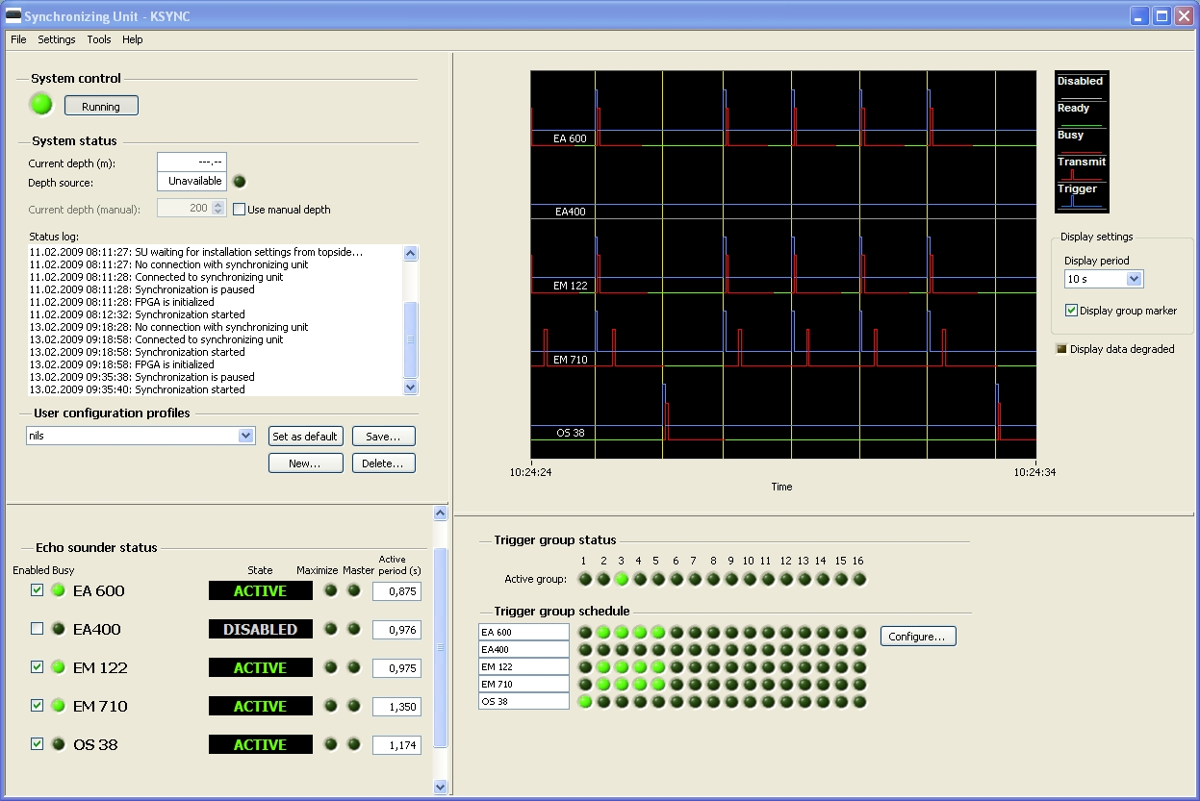
Synchronizing Unit Operation
Software Overview

Slide 16
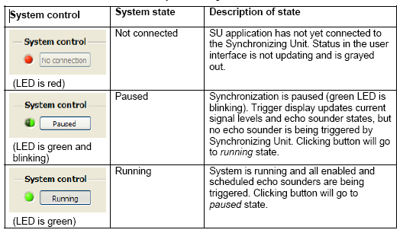
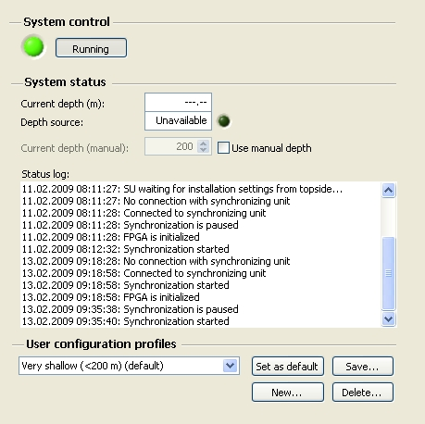
System Control
Software Overview
Notes:
On the left side of the window is the System control, status, and User Configuration profiles
You can create and save setup configurations based on priority and project goals
These are user selectable when the time arises

Slide 17

System Status
Software Overview
Incoming depth status
Override incoming depth
Depth is available

Slide 18
System Status
Software Overview
Incoming depth status
Override incoming depth
Note: Sometimes manual depth is best when doing pelagic sampling in deep water.

Slide 19
Activity Display
Software Overview
Notes:
Sonar Activity is shown in the red box (aka real time trigger display)

Slide 20

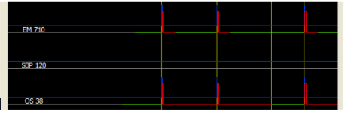
Realtime Trigger Display
Software Overview
Transmit and busy
Trigger
Ready
Yellow line separates the trigger groups
OS38 is busy much longer than EM710 and determines the ping rate
Note: The displayed pulses are indicators. They do NOT reflect active high/low settings
Notes:
Blue jump = Ksync triggered a transmit pulse
Red jump = system transmitted
Red line = system is waiting for the ready signal ( still listening for return)
Green line = system is done pinging/ listening and waiting for next trigger

Slide 21
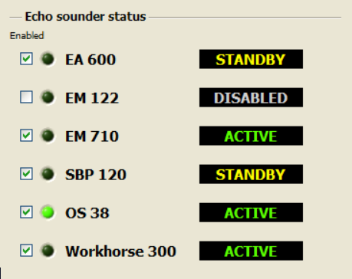
Echo Sounder Status
Software Overview
Echosounders may be disabled
Disabled echosounders will not be triggered - even if they are member of a group

Slide 22
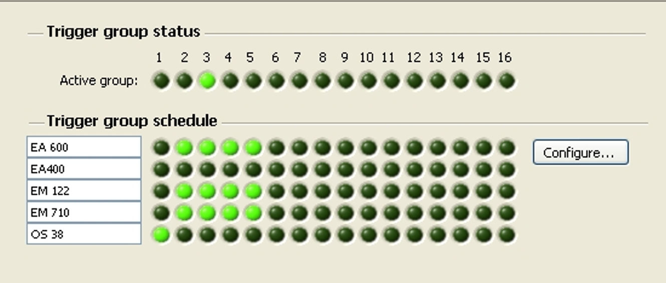
Trigger Group
Software Overview
Active Group
Set up groups
Notes:
Shows which group each echo sounder is assigned to
Trigger groups
Several (or one) echosounder in each group.
Specify the transmit sequence of each group.

Slide 23
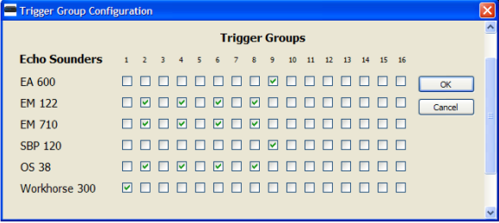
Trigger Group Configuration
Software Overview
If some echo sounders can ping several times before next instrument, make many equal groups

Slide 24
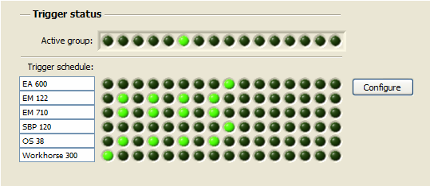
Trigger Group Example
Software Overview
Active Group
Empty groups are skipped
Shows which group each echosounder is assigned to
In this case: EM122, EM710 and SBP120 ping 4 times between each Workhorse 300

Slide 25
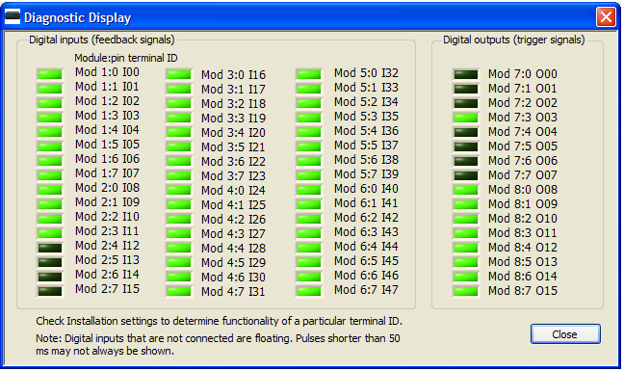
Diagnostic Tool
Software Overview
Shows signal level and pulses on each I/O
(Green = 5v(high)
Module & pin numbers refer to physical connections inside the K-Sync
Terminal ID refer to selections in the installation settings
Notes:
Shows signal level and pulses on each input and output signal. (Green = 5v(high))
Module and pin numbers refer to physical connections inside the SU.
Terminal ID refer to selections in the installation settings.

Slide 26
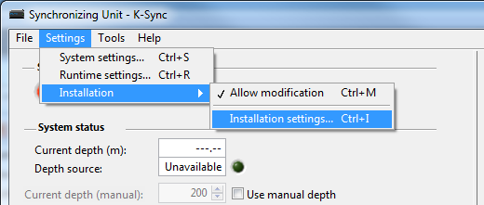
Installation Settings
Software Overview
To be able to change any installation settings:
Press “Allow modification” and input correct password
It is helpful to save a backup of all of these settings in a separate location
Notes:
Password simrad0
How to backup: Copy the folder to sperate location:
C:\ProgramData\Kongsberg Maritime\K-Sync Application\config
System settings are stored as an XML file
“Program folder”…\config\system settings.xml
Factory settings are stored under
“Program folder”…\system\
Installation settings are in separate files
make.model.installation.xml

Slide 27
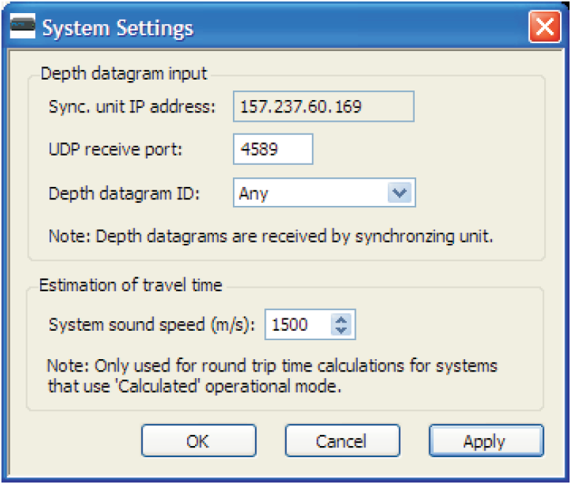
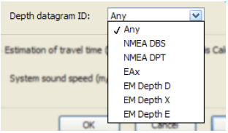
System Settings
Software Overview
Approximate sound speed:
Used for travel time calculations
Settings -> System settings
Sync unit’s IP address and port number.
Default Subnet mask: 255.255.240.0
Notes:
Define K-SYNC IP address and ports
Define type of depth data gram
Set approx. sound speed
Supported depth datagram formats:
NMEA depth (DBS, input datagram)
NMEA DPT (input datagram)
EAx: Single beam depth (EA 500 input datagram)
EM Depth ‘D’: Multibeam depth (e.g. EM 120/1002/3002)
EM Depth ‘X’: Multibeam depth (e.g. EM 122/302/710/2040)
EM Depth ‘E’: Single beam depth (e.g. EA 600)

Slide 28
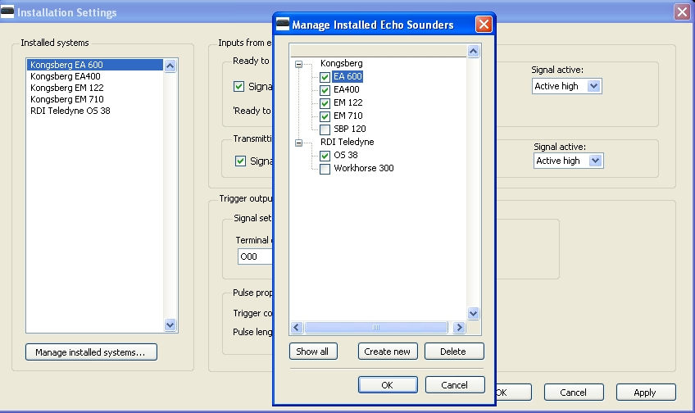
Manage Echosounders
Software Overview
Settings -> Installation -> Installation settings
Manage Installed Echosounders Mark the echosounders that are physically connected.
Add new echosounder if it is not already in the list.
To add or remove echo sounders from the Installed Systems
Password: simrad0
Notes:
Settings -> Installation -> Installation settings

Slide 29
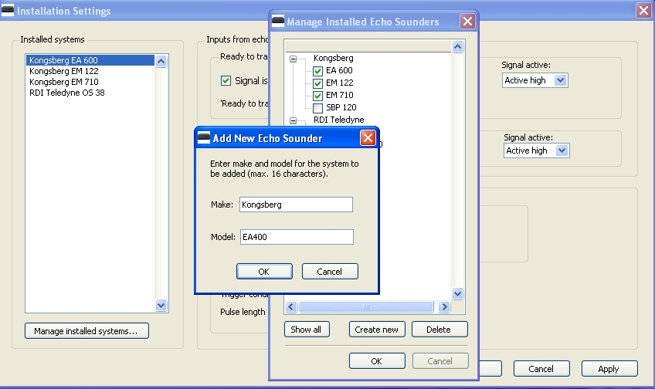
Add New Echosounder
Software Overview
Notes:
Make: Manufacturers Name
Model: Sounder type

Slide 30
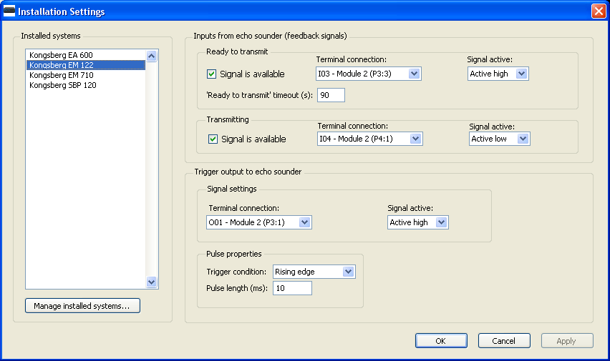
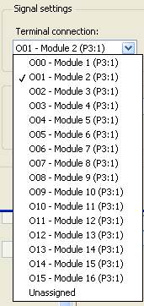
Installation Settings
Software Overview
Notes:
It is helpful to note which echosounder is connected to which module number
Connect each sounder to the appropriate module
For All signal types (Ready to transmit, Transmitting, and trigger output)
Mark Signal is available-- IF feedback signals from echosounders are available
Specify terminal connection and Module for Each signal available
Specify Signal Activity
Is signal active high or low?
Define pulse properties
Hit Apply then OK when complete

Slide 31
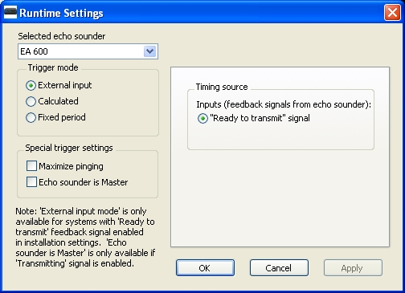
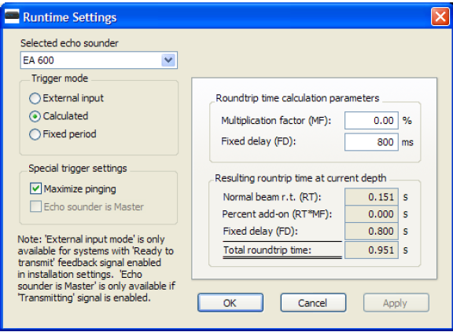
Runtime Settings
Software Overview
Settings -> Runtime settings
Calculated: Ping rate is based on depth and sound speed
External input: Automatic sequence calculations
Notes:
Calculate
Multiplication factor: increase ping rate echosounders due to longer range than depths.
Fixed Delay: Adds a fixed delay / min. ping period.
Fixed period:
Ping rate is depth independent
Maximize pinging allows that system to ping more while waiting for other systems

Slide 32
Optimizing Settings
4

Slide 33
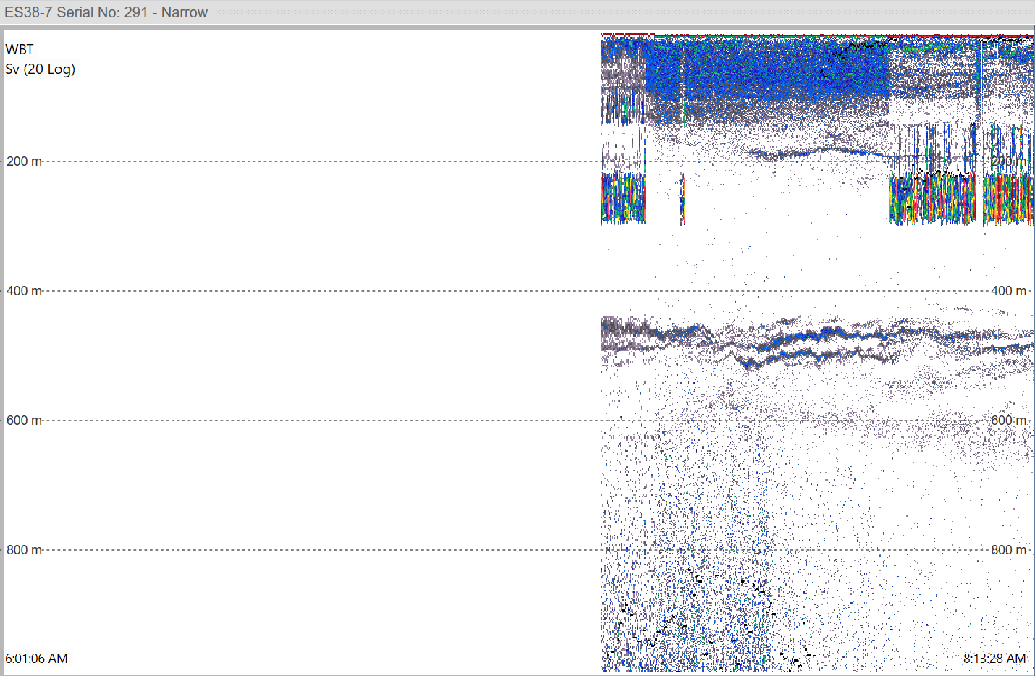
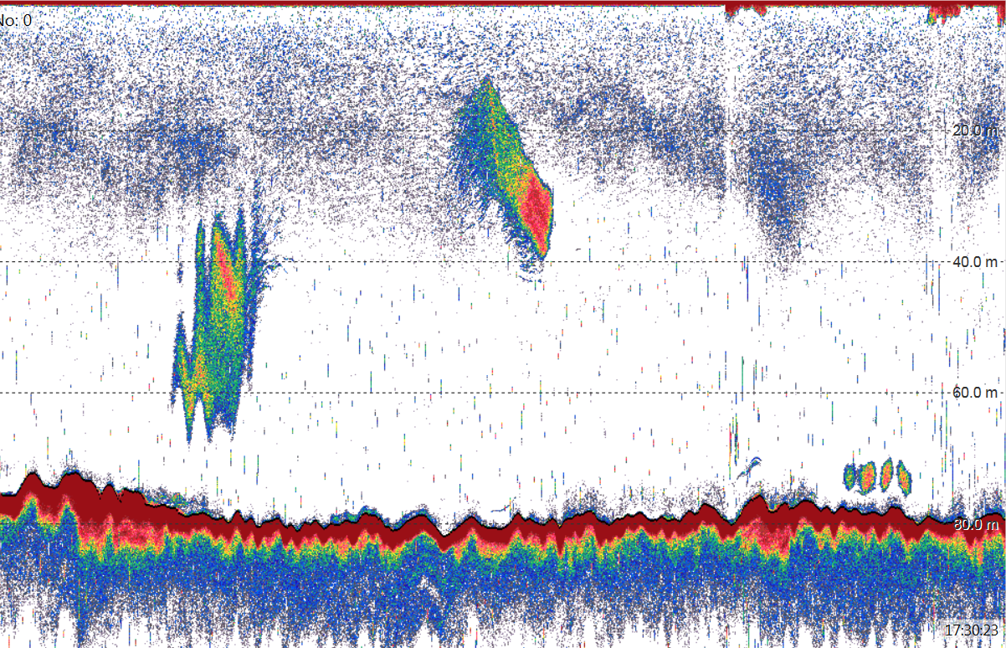
Knowing Crosstalk
Optimizing Settings
Noise at certain depth
“Rainy” Echogram
Notes:
Calculate
Multiplication factor: increase ping rate echosounders due to longer range than depths.
Fixed Delay: Adds a fixed delay / min. ping period.
Fixed period:
Ping rate is depth independent
Maximize pinging allows that system to ping more while waiting for other systems

