Slide 1




Multibeam Advisory Committee
RVTEC Update - 5 Nov 2025 - La Jolla, CA
Paul Johnson, Vicki Ferrini, Kevin Jerram
www.mac.unols.org mac-help@unols.org
Supported by NSF grants 1933720 (UNH) 1933776 (LDEO)

Slide 2
MAC Updates

Slide 3

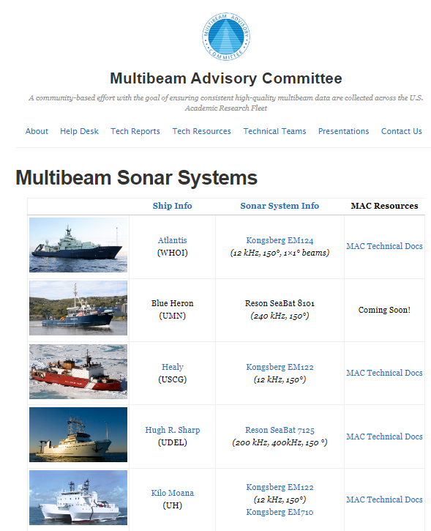
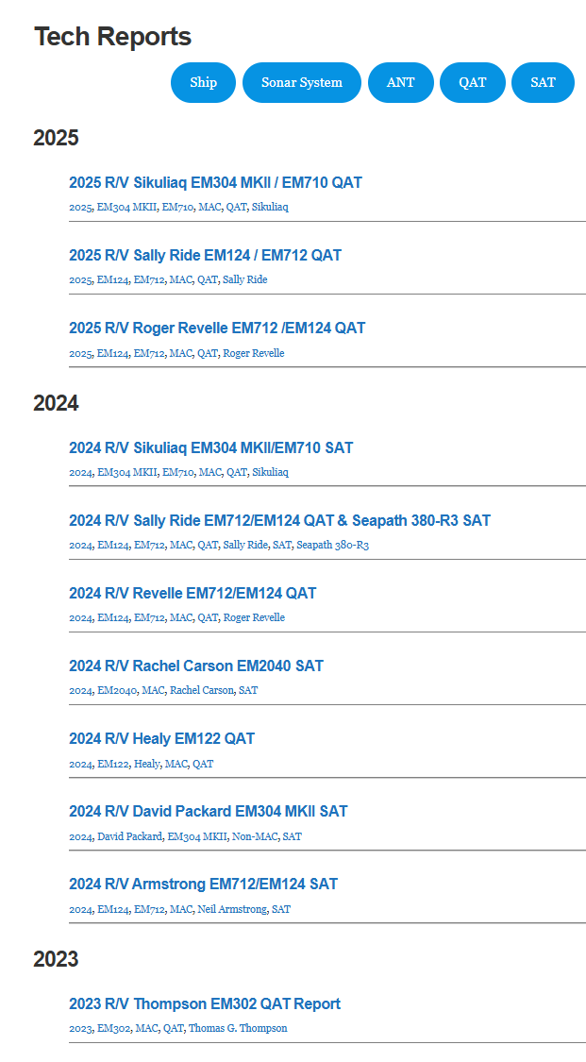
The Multibeam Advisory Committee (MAC)
Established in 2011 with NSF funding to support collection of high-quality multibeam data across the U.S. Academic Research Fleet (USARF)
Standardized system testing workflows
Sea Acceptance, Quality Assurance, Noise
On-board & remote support
Flexible scheduling by ship request
Public reporting
Technical reports and resources
Assessment tools, survey guidance
Non-USARF references
Website: mac.unols.org
Helpdesk: mac-help@unols.org
Wiki: oceanmapping.wiki
Notes:
Since 2011 MAC has worked to improve MB data quality
Standardize performance testing
Provide on-board and remote support
Report all major testing activities
Website, helpdesk, wiki

Slide 4
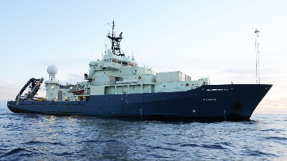
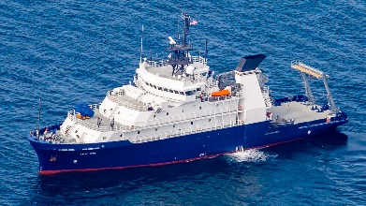
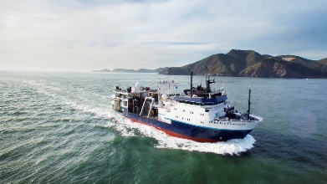
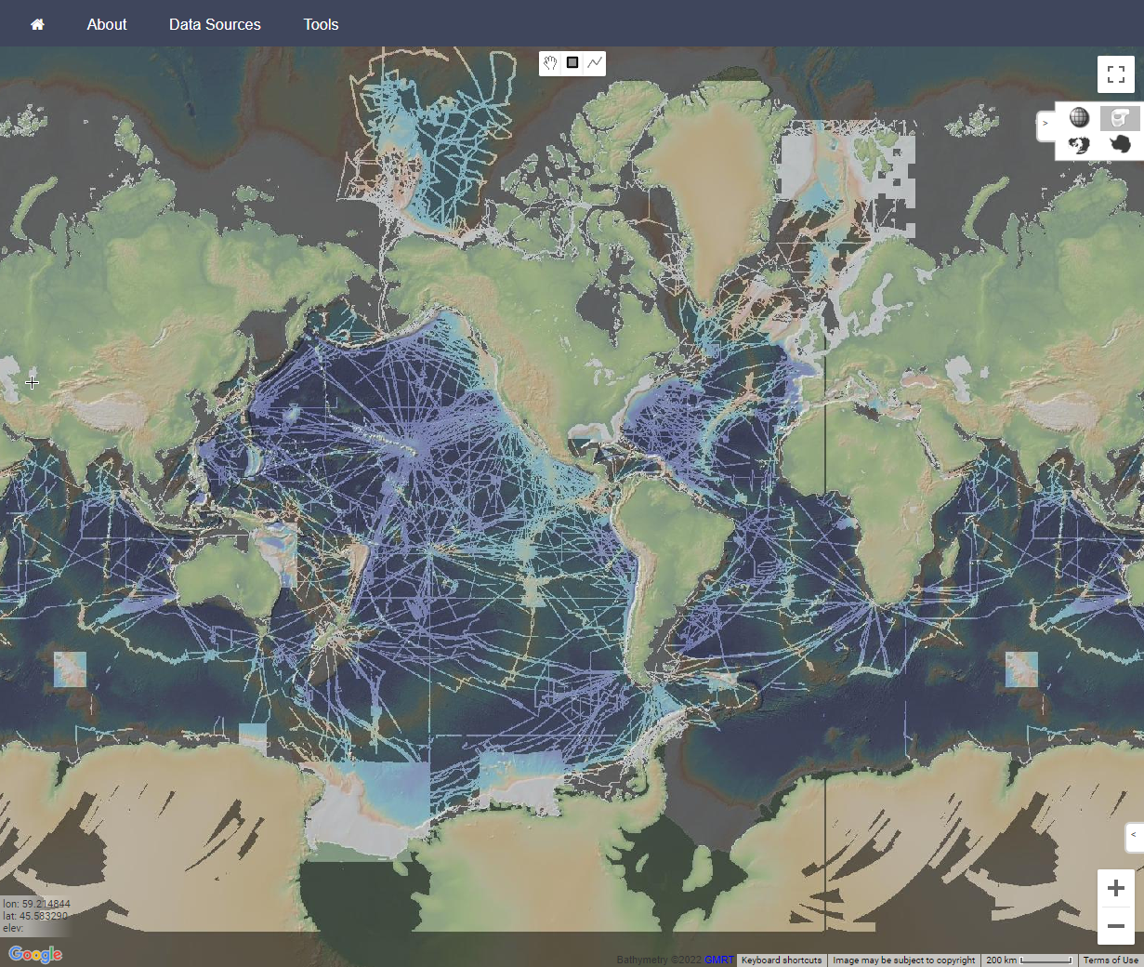
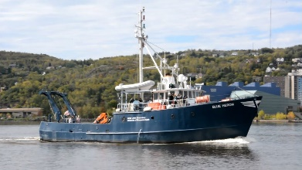
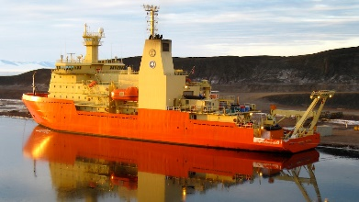
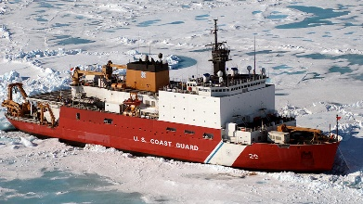
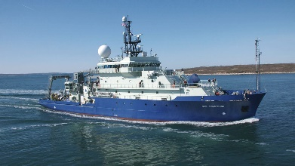
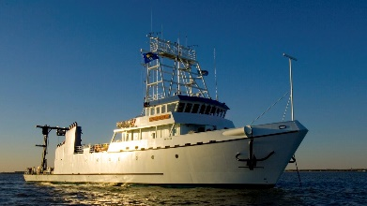
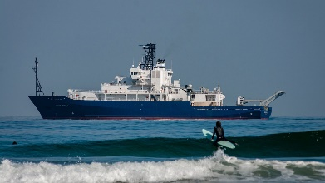
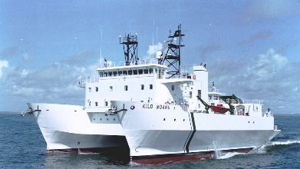
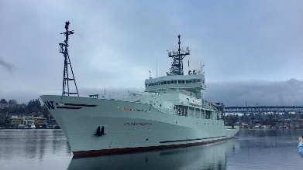
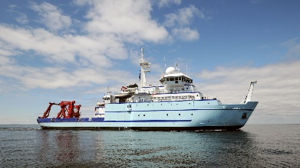
Multibeam Systems Supported by the MAC
12 Vessels with MBES
10 UNOLS Research Vessels
2 Icebreakers
15 Deep water systems
EM122 / EM124 (12 kHz)
EM304 MKII (26-34 kHz)
EM710 / EM712 (40-100 kHz)
2 Shallow water systems
EM2040 (200-400 kHz)
+7 Systems in 2026+
EM304s & EM2040s (RCRVs)
EM2042 (SKQ)

Slide 5
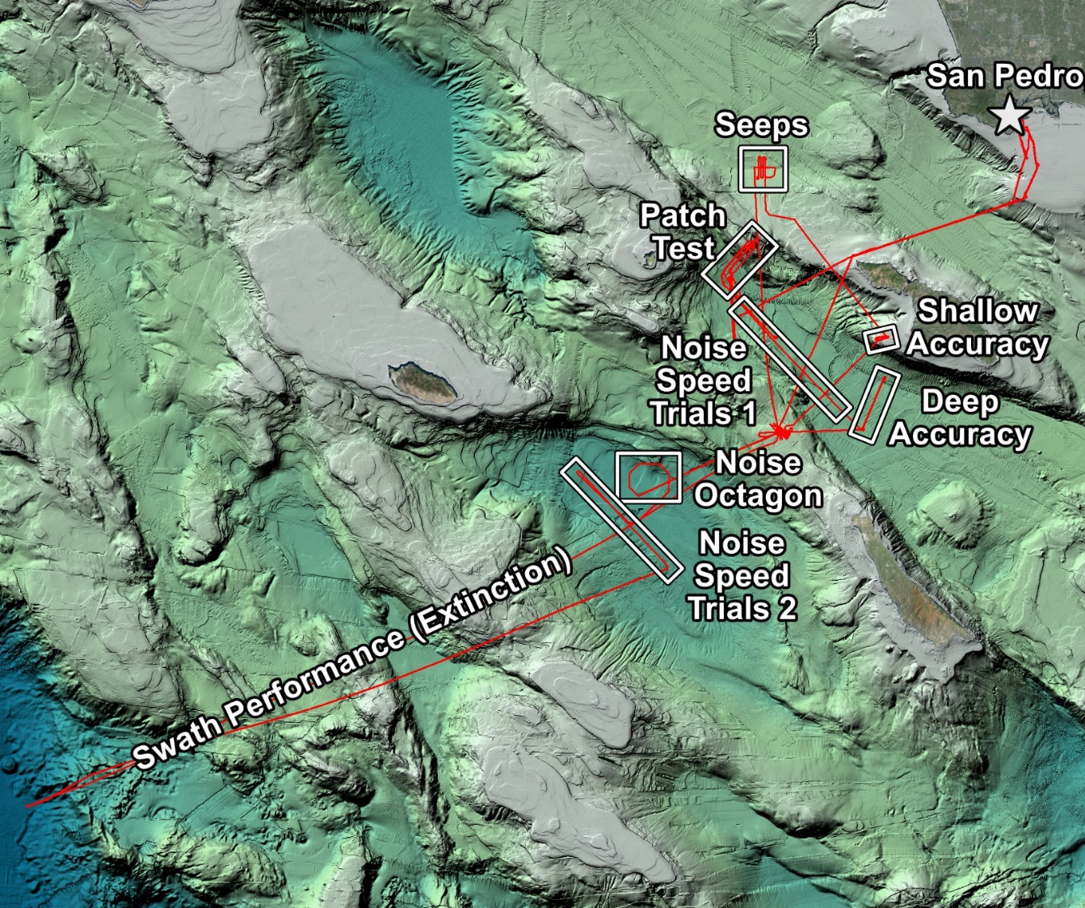
System Performance Testing
Early as possible
Planning
Review of recent data, issues, etc.
Vessel + sensor offset survey (as needed)
Site selection + scheduling
Software + firmware updates
1-2 days
Dockside
Configuration + offset review
Hardware health check
Test plan review with bridge (ongoing)
1-10 days
At Sea
GNSS antenna calibration
Multibeam calibration (‘patch test’)
RX noise vs. speed / seas
Swath coverage (extinction)
Swath accuracy
Water column evaluation
Backscatter normalization
1-2 mos.
Follow-Up
Data and configuration backup
Public reporting (MAC website)
Opportunistic testing
Notes:
Follow a standard order of operations
Applies for ON BOARD and REMOTE support
Takeaway: support is by request, early as possible

Slide 6
Kongsberg Installations and Life Cycles
Ship | System(s) | Arrays | Life Cycle | MAC Support (Most Recent) | 2025-26 Plans
Atlantis | EM124 (g) | 2021 | Early | SAT*, QAT (2024) | QAT
Healy | EM122 | 2010 / 2023 RX | Late | ANT, SAT*, QAT* (2025) | QAT
Hugh R. Sharp | EM2040 | 2024 | Early | QAT (2016), SAT (Kongsberg) | EM2040 SAT
Kilo Moana | EM122 / EM710 | 2012 | Late | ANT, QAT* (2023), spares planning | QAT
Marcus G. Langseth | EM122 (g) | 2007 TX / 2010 RX | Late | ANT, QAT (2023), spares planning | QAT
Nathaniel B. Palmer | EM122 | 2015 | Late | SAT, ANT, QAT (2015), spares planning | TBD
Neil Armstrong | EM124 / EM712 | 2024 (2016 710 RX) | Early | SAT* (2024) | QAT
Rachel Carson | EM2040 | 2024 | Early | SAT* (2024) | QAT
Roger Revelle | EM124 / EM712 (g) | 2020 | Mid | SAT*, QAT* (2025) | QAT
Sikuliaq | EM304 MKII / EM710 | 2024 | Early/Late | SAT, QAT (2025) | EM2042 SAT
Sally Ride | EM124 / EM712 | 2016 | Mid | SAT, QAT (2025) | QAT
Thomas G. Thompson | EM124 (g) | 2025 | Mid | SAT, QAT*, EM124 SAT planning | EM124 SAT
(g) indicates gondola installation
*Indicates remote support
Underline = recent install
Italic = pending replacement (2026+)
Green = testing in last year
ANT = Acoustic Noise Test (Gates)

Slide 7
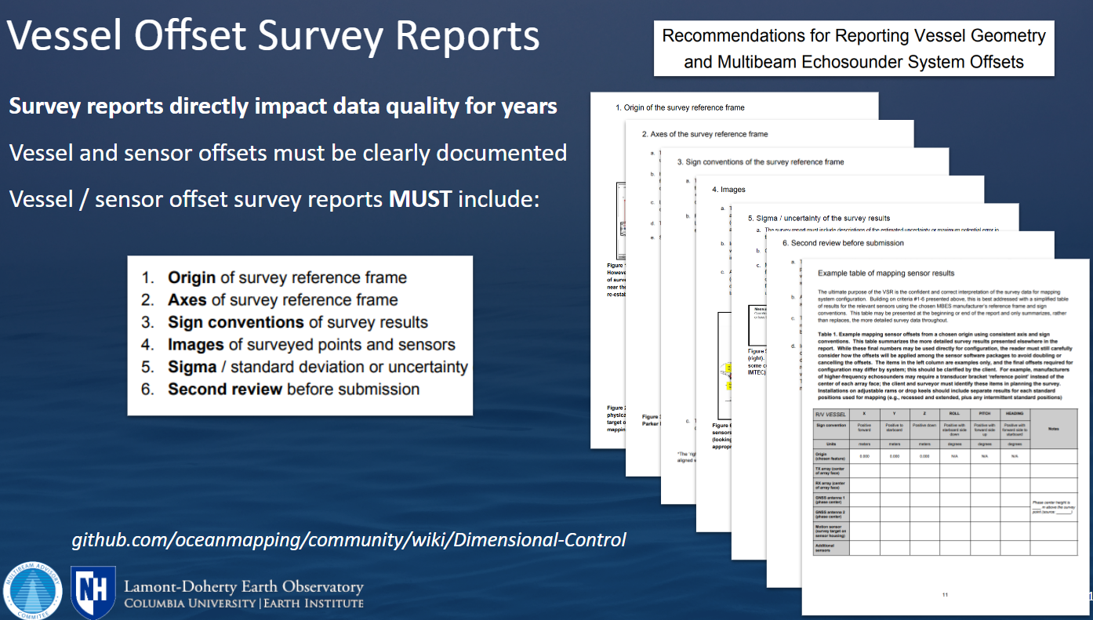
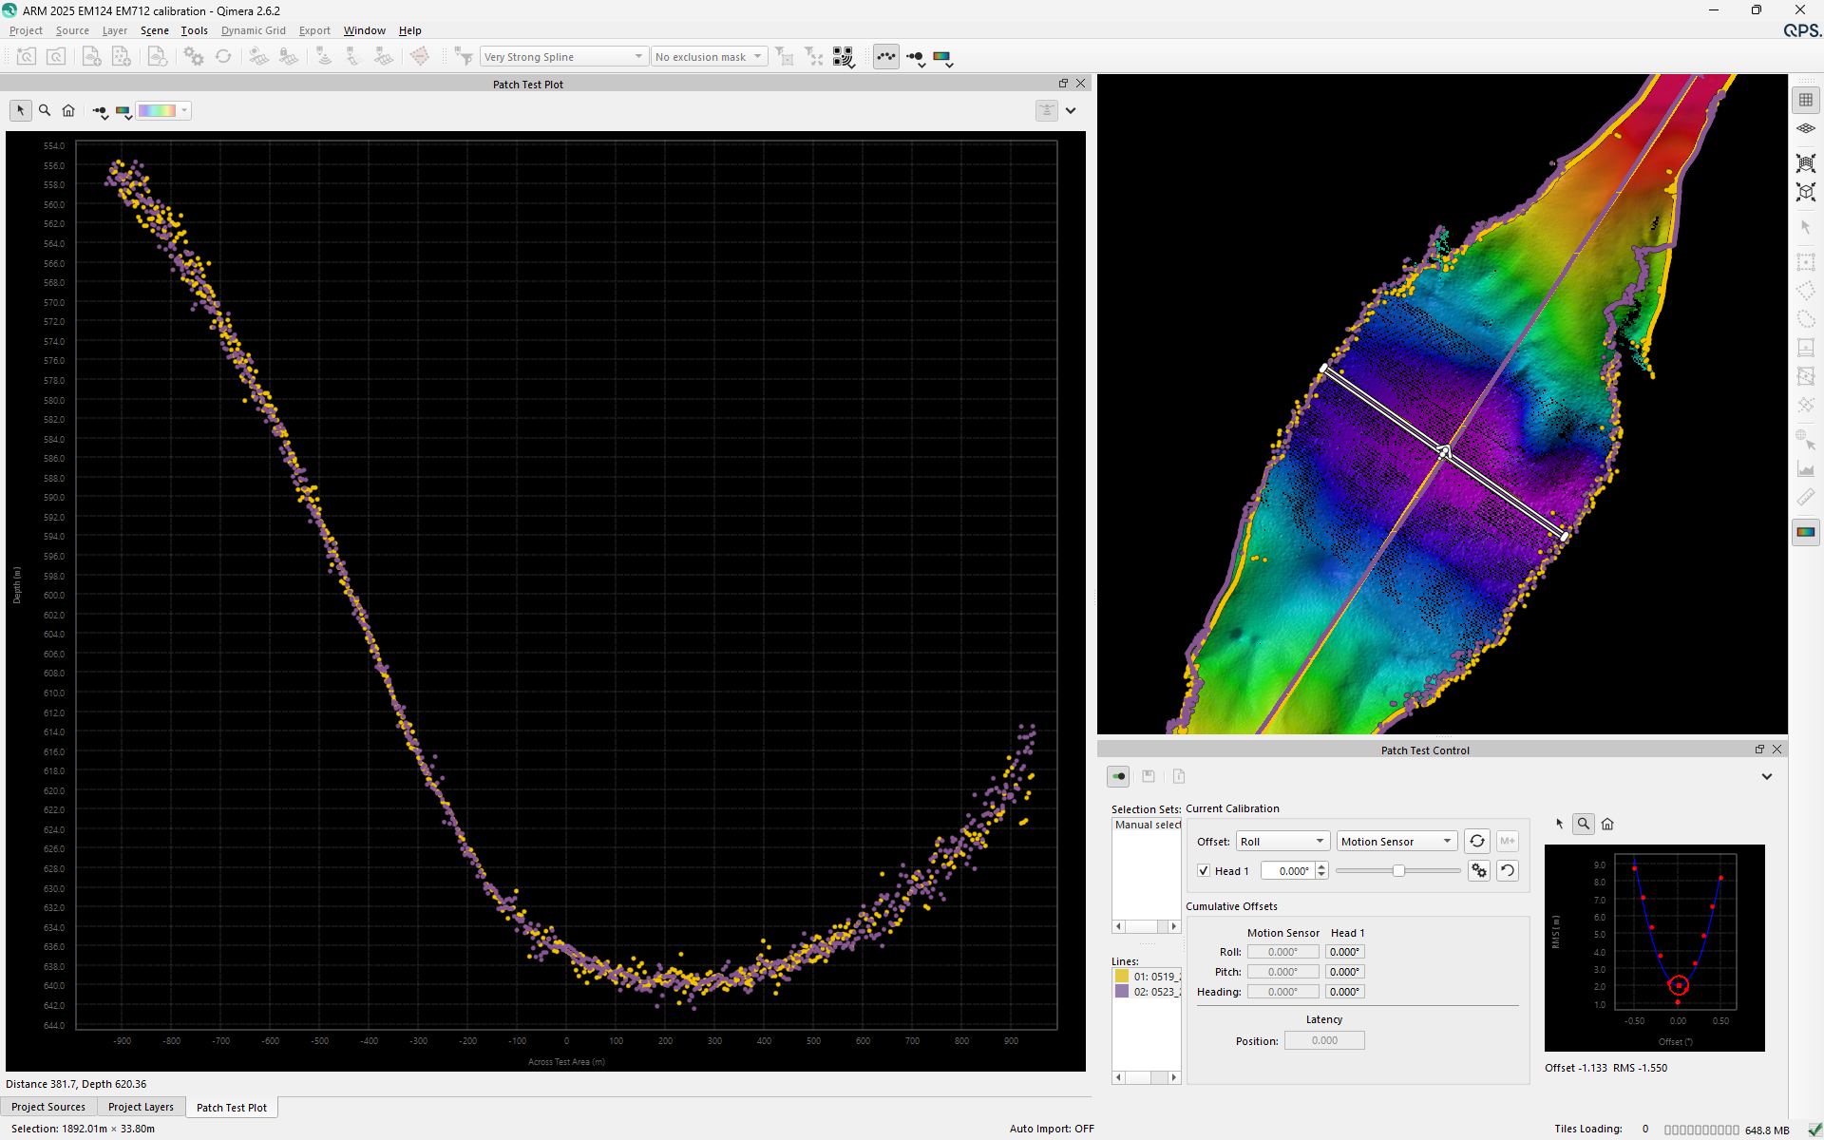
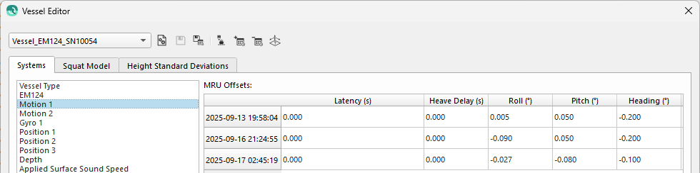
Recent Takeaways
MAC approaches reinforce manufacturer protocols
Offset survey requirements are critical
Linear offsets on order of 0.001 m
Angular offsets on order of 0.01°
Clear reporting for direct configuration
Standard calibration procedures are efficient
Standardized + quantitative ≈ repeatable
Specific seafloor types for each test
Configurations are managed by system owners
Users may apply different offsets in post-proc

Slide 8
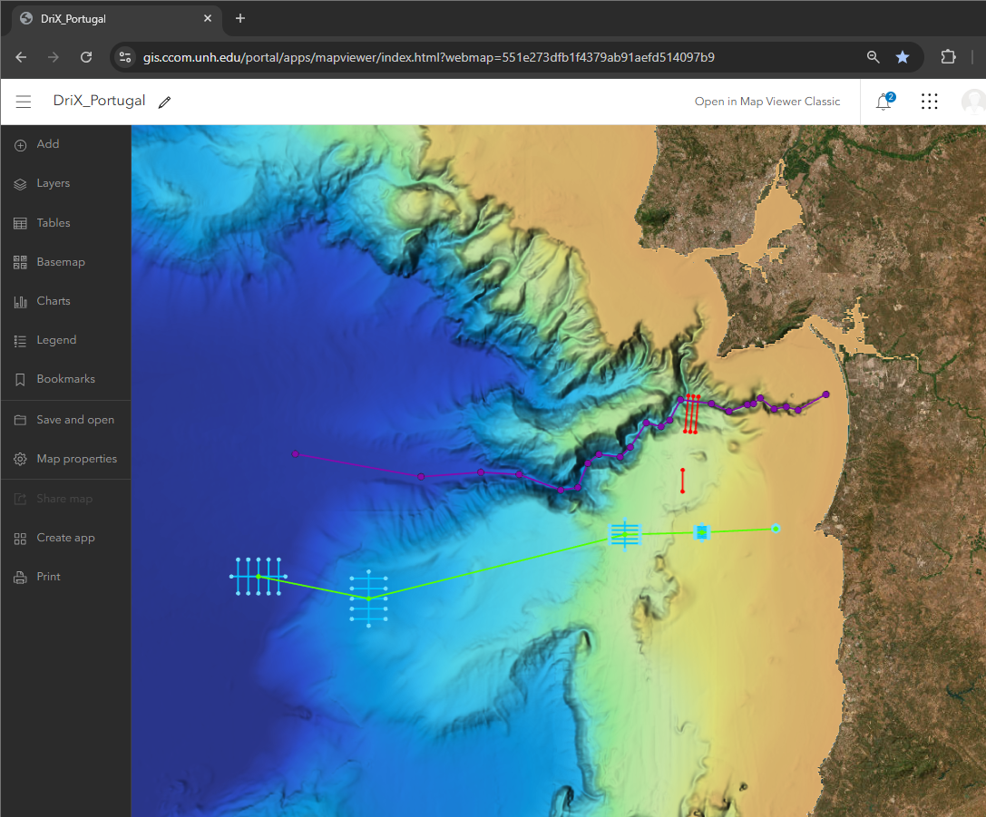
Related Activities Since RVTEC 2024
MAC-related projects:
Ocean Mapping Community Wiki
Echosounder Test Site Database
Sound Speed Manager
GMRT tiling package
Assessment tools
Spares planning
Survey support
Non-MAC field work:
David Packard (SAT)
Nautilus (QAT)
OceanXplorer (QAT)
Oden (SAT)
DriX O-16 (SAT)
Notes:
Quick highlights since 2024
MAC-related projects
Other field work that improves the process

Slide 9
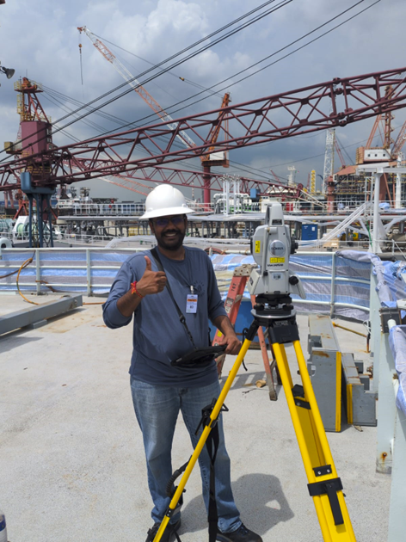
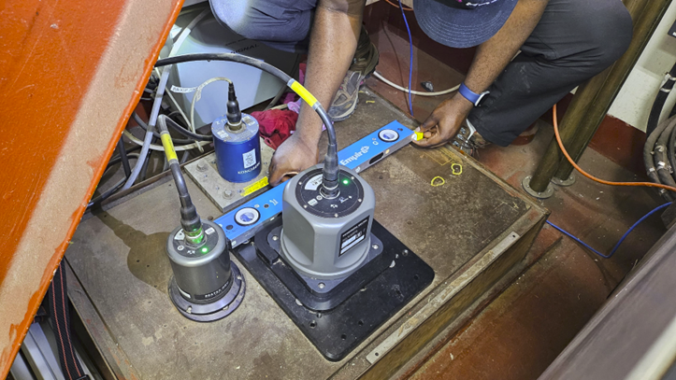
Vessel Offset Survey Support
Focus Area | Key Action
Verification | Verification surveys and cross-checks
Quality Assurance | On-site consultancy and survey supervision
Review | Evaluation / feedback for improving survey accuracies
Standards | Drafting of survey specifications and requirements
Coordination | Communication with survey contractors
R/V Roger Revelle
March 2025: Verification survey
R/V Thomas G Thompson
Sep 2025: On-site survey technical consultancy and verification survey

Slide 10
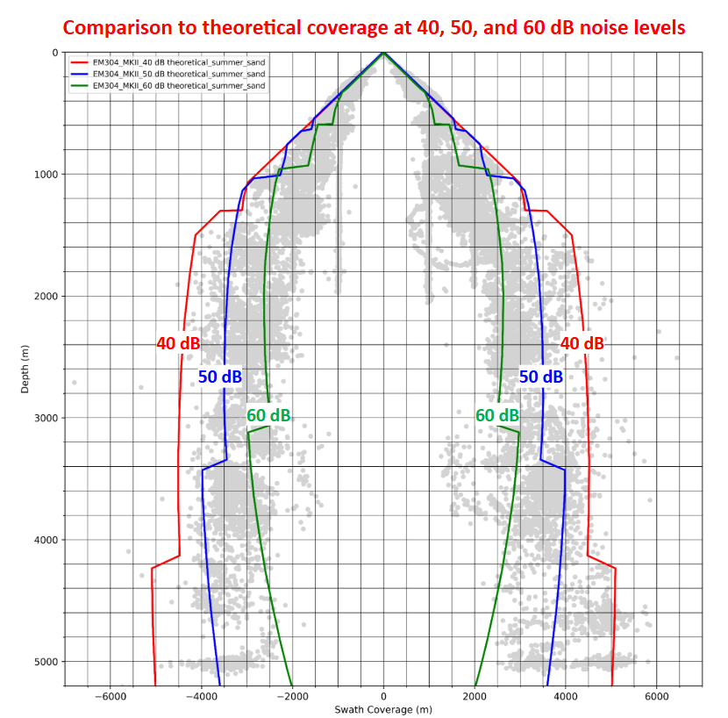
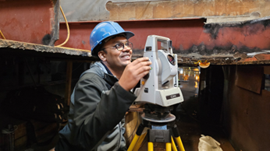
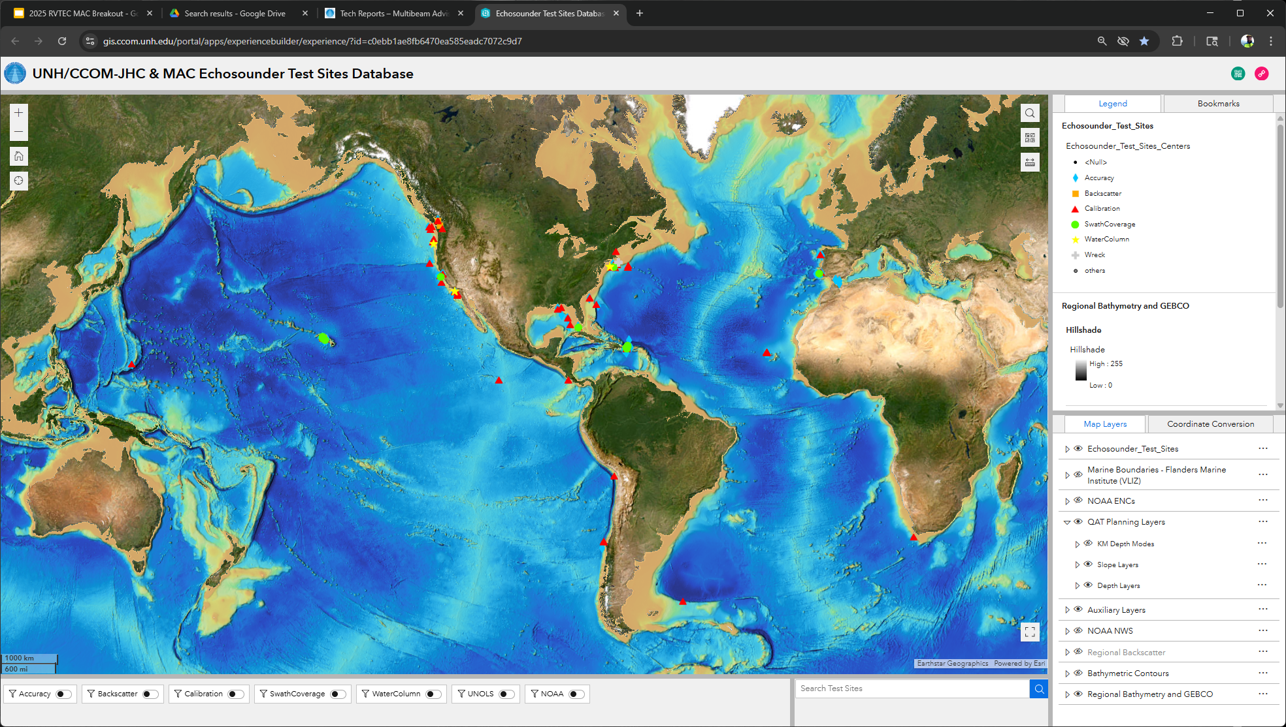
The (Next) Multibeam Advisory Committee (MAC)
Current grant is ending mid-2026
Next proposal will include:
Continuing on-board and remote support
Continuing helpdesk email support
Expansion of planning and assessment tools
Support for vessel / sensor offset surveys
Technical guidance and review
Not replacing commercial surveyors
Your feedback and suggestions
What do you need from the MAC?
Notes:
Since 2011 MAC has worked to improve MB data quality
Standardize performance testing
Provide on-board and remote support
Report all major testing activities
Website, helpdesk, wiki

Slide 11
Ocean Mapping
Community Wiki

Slide 12
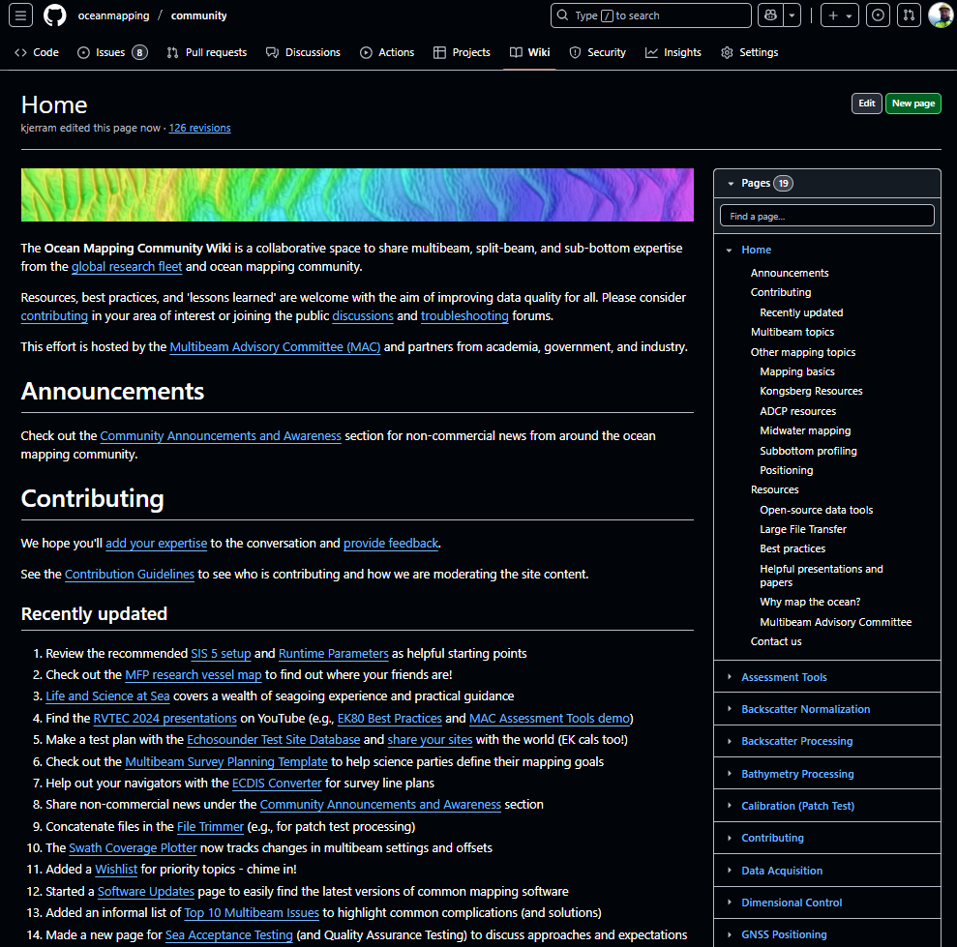
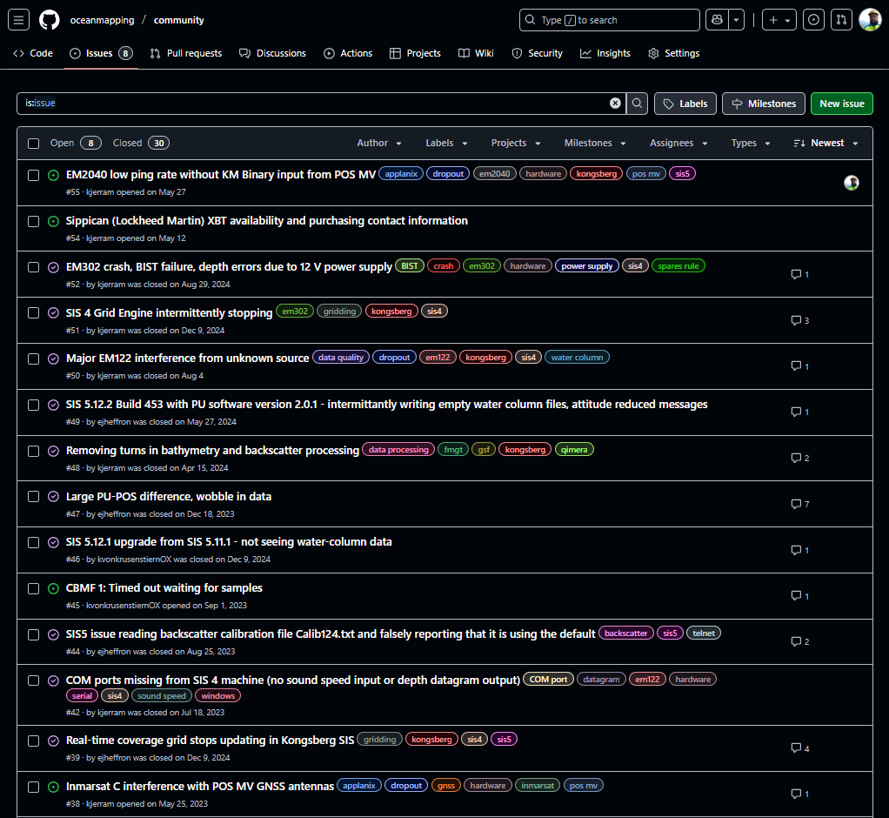
Ocean Mapping
Community Wiki
oceanmapping.wiki
omcadmin@ccom.unh.edu
Notes:
MAC continues to use the OMC Wiki
Co-admins with Shannon Hoy and Colleen Peters
Public platform to share resources and post issues
Sticking with Github for now

Slide 13
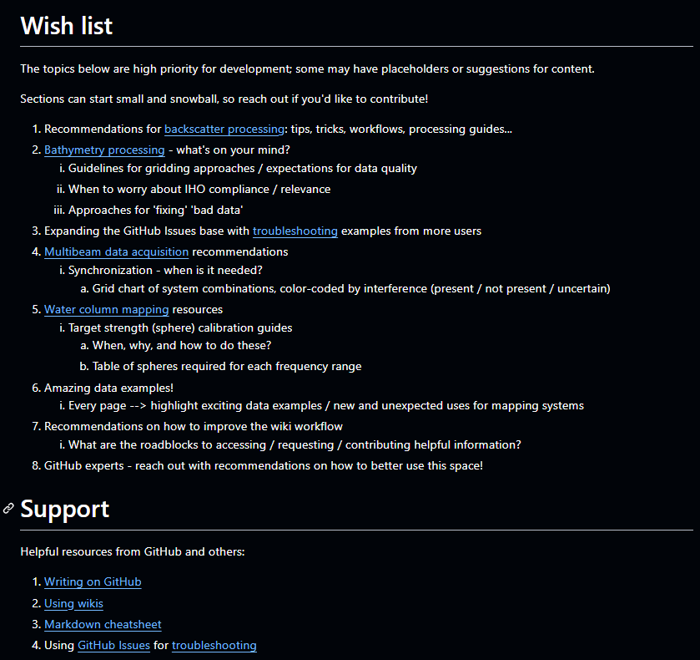
Ocean Mapping
Community Wiki
oceanmapping.wiki
omcadmin@ccom.unh.edu
Notes:
Like all wikis, this grows from the user base
All are welcome to contribute
Post ISSUES or add areas of interest
Lots of resources for new members
Email Wiki or MAC helpdesk for more

Slide 14
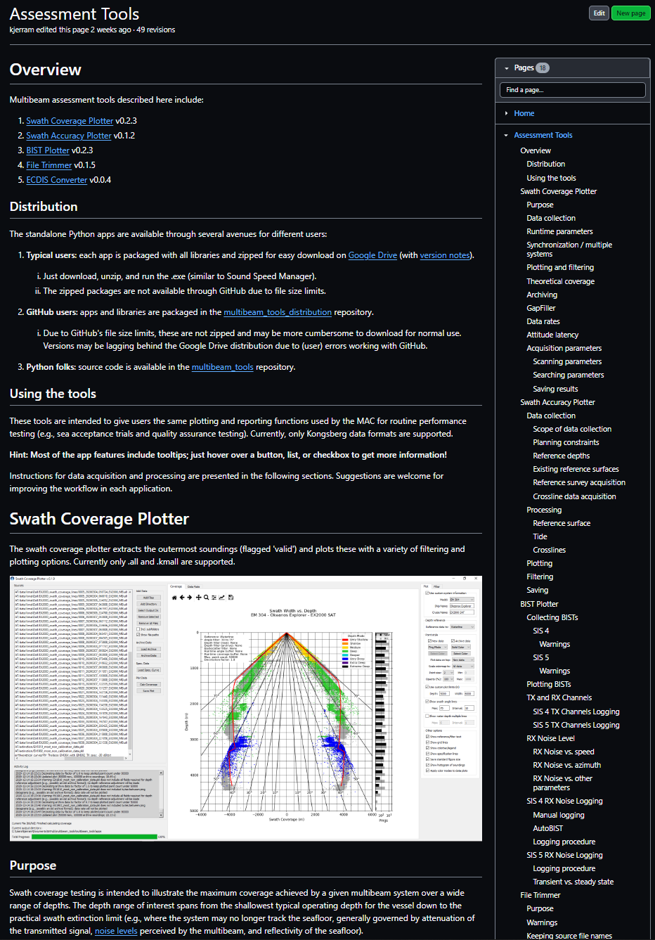
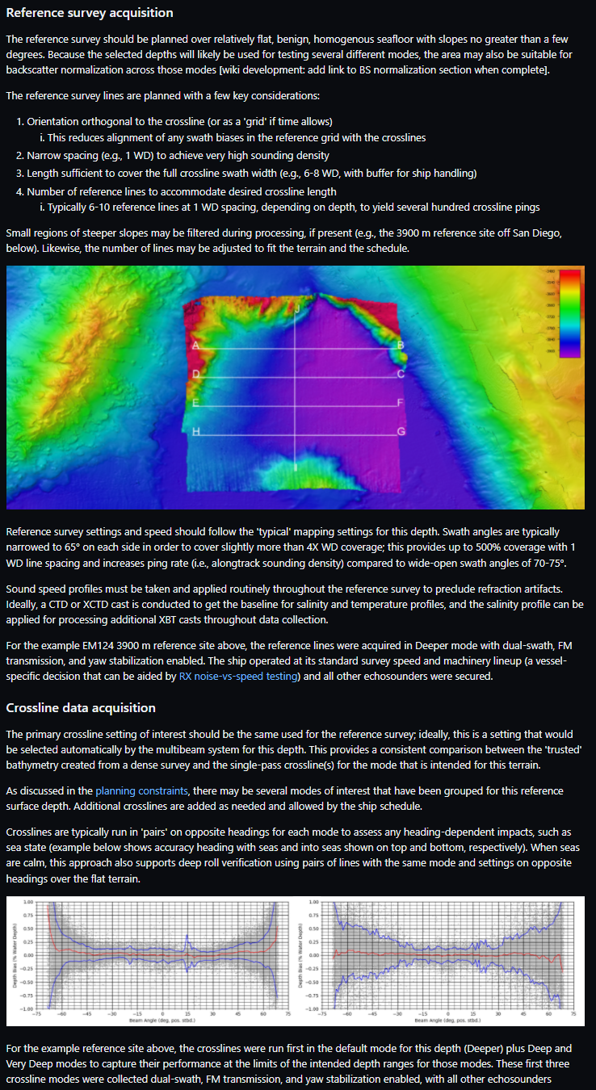
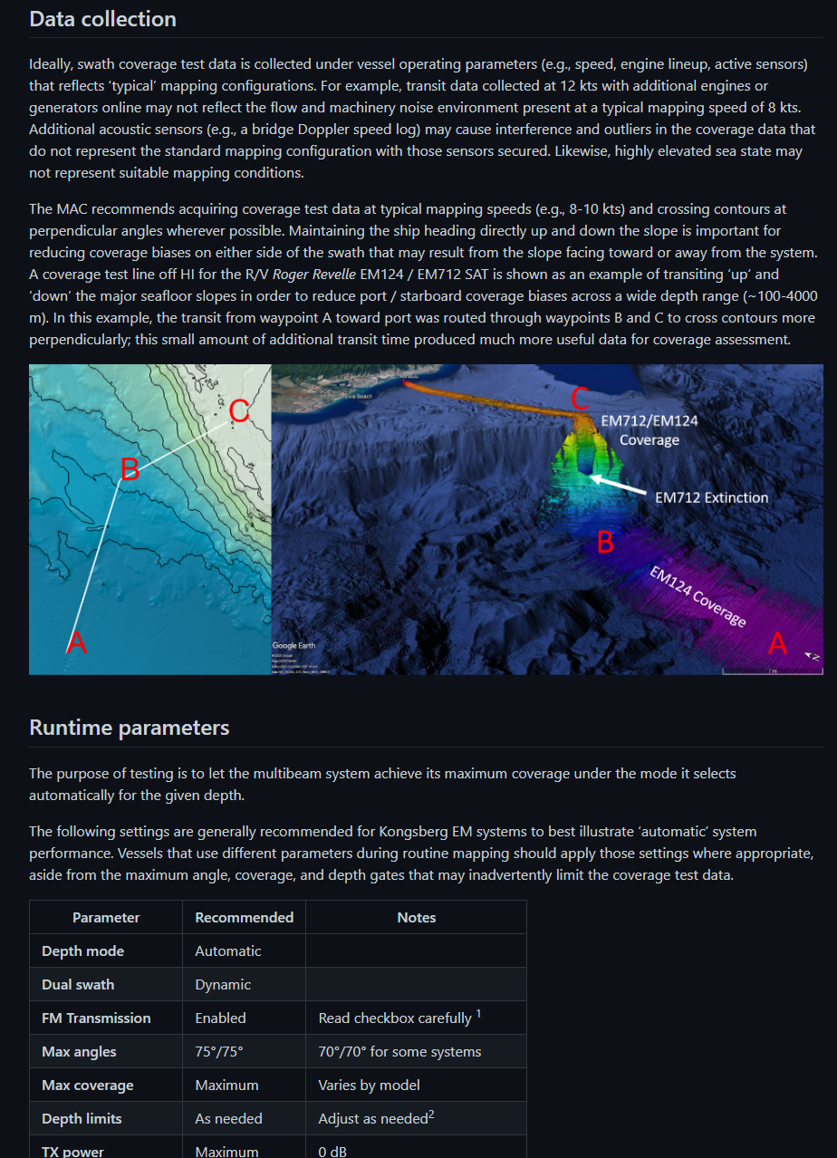
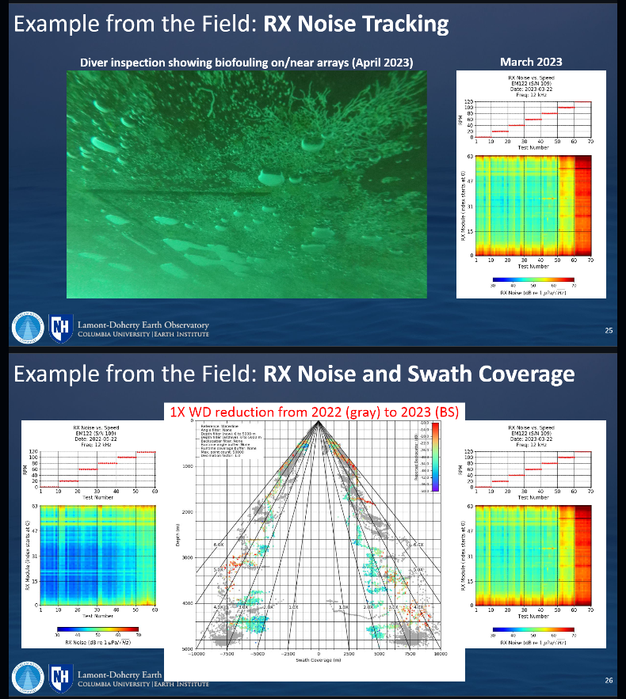
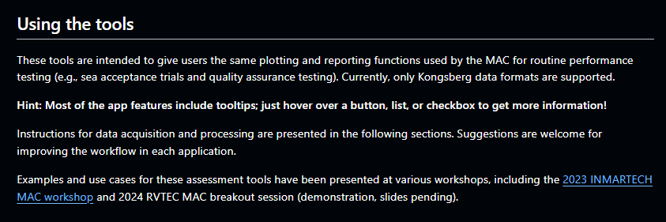
Ocean Mapping
Community Wiki
oceanmapping.wiki
omcadmin@ccom.unh.edu

Slide 15
Assessment Tools

Slide 16
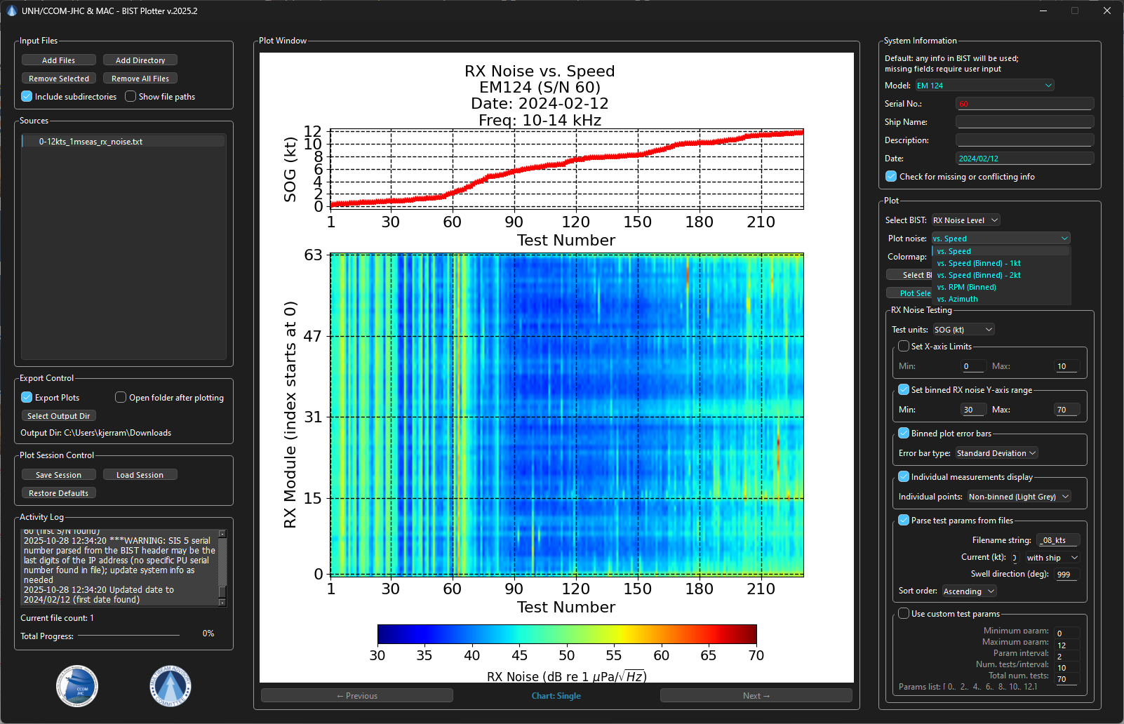
Assessment Tools: BIST Plotter

Slide 17
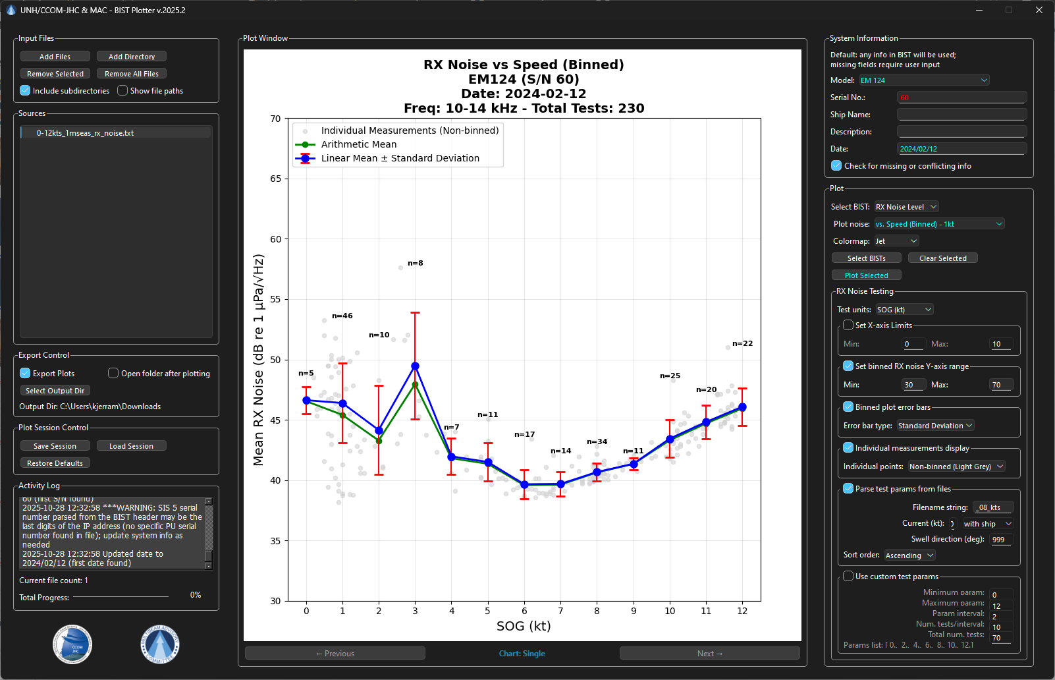
Assessment Tools: BIST Plotter

Slide 18
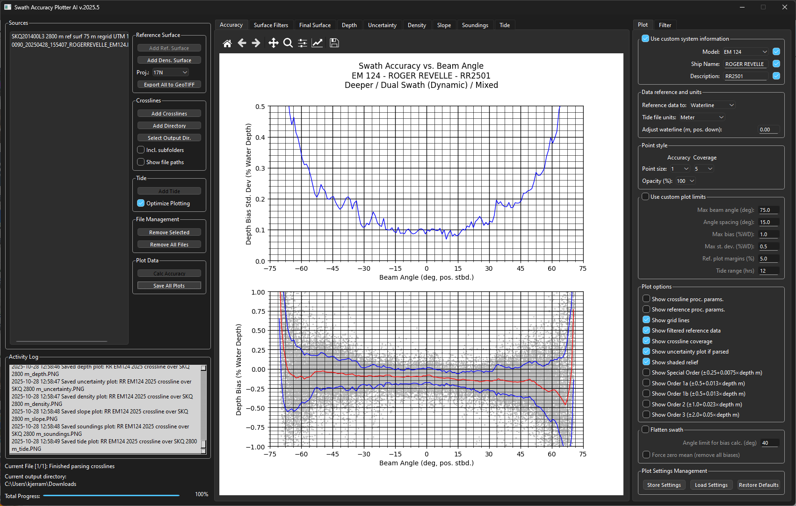
Assessment Tools: Swath Accuracy Plotter

Slide 19
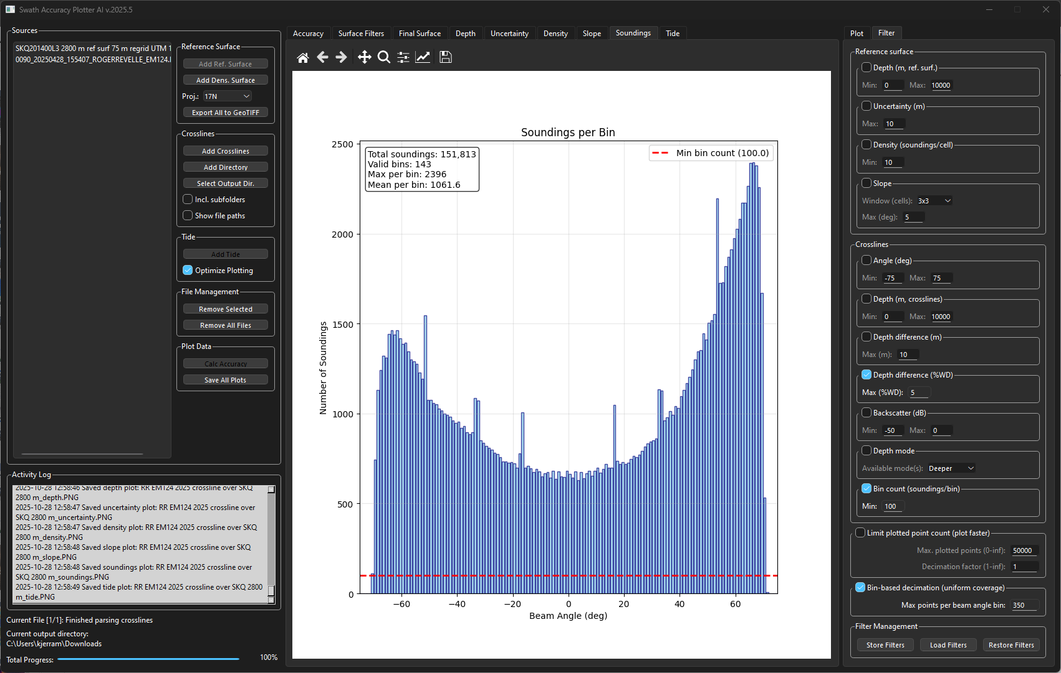
Assessment Tools: Swath Accuracy Plotter

Slide 20
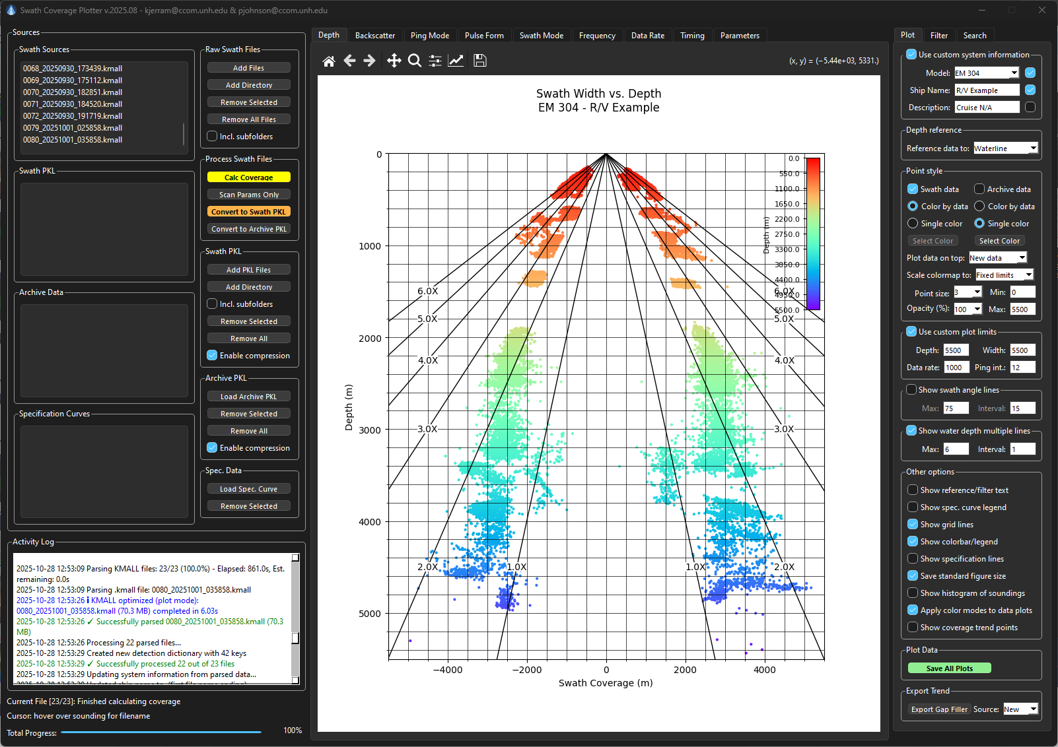
Assessment Tools: Swath Coverage Plotter

Slide 21
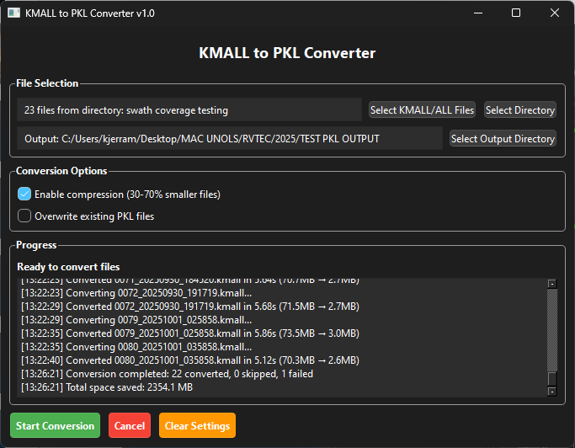
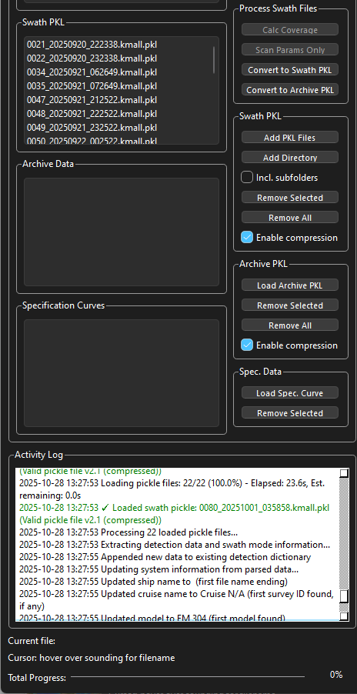
Assessment Tools: Swath Coverage Plotter

Slide 22
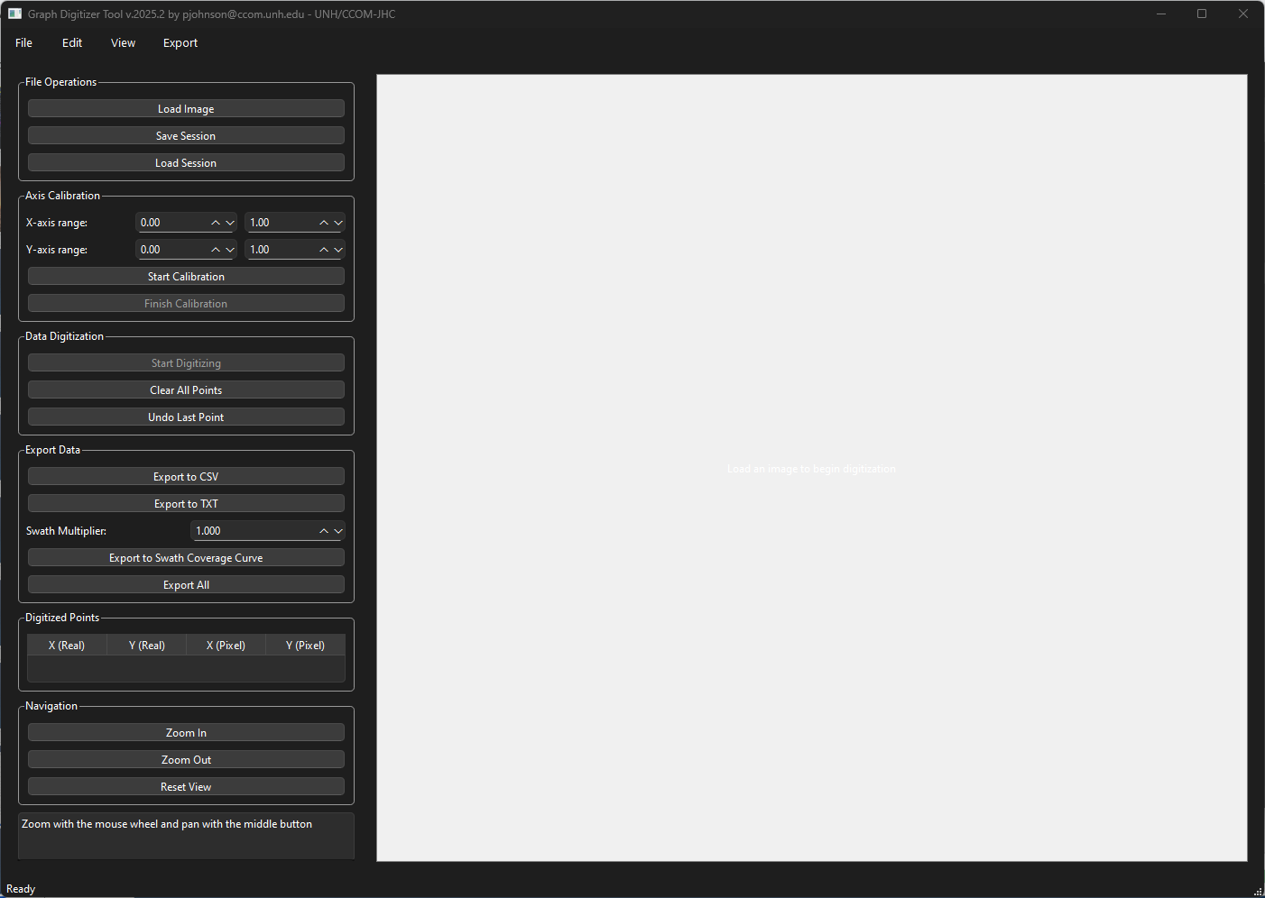
Assessment Tools: Swath Coverage Graph Digitizer
Digitize theoretical swath
coverage for comparison

Slide 23
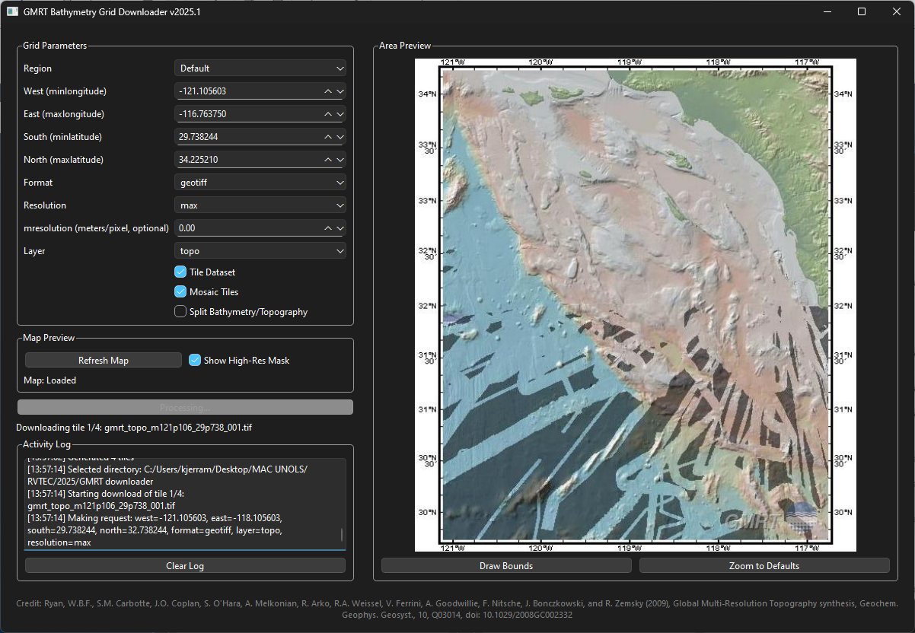
Planning Tools: GMRT Downloader

Slide 24
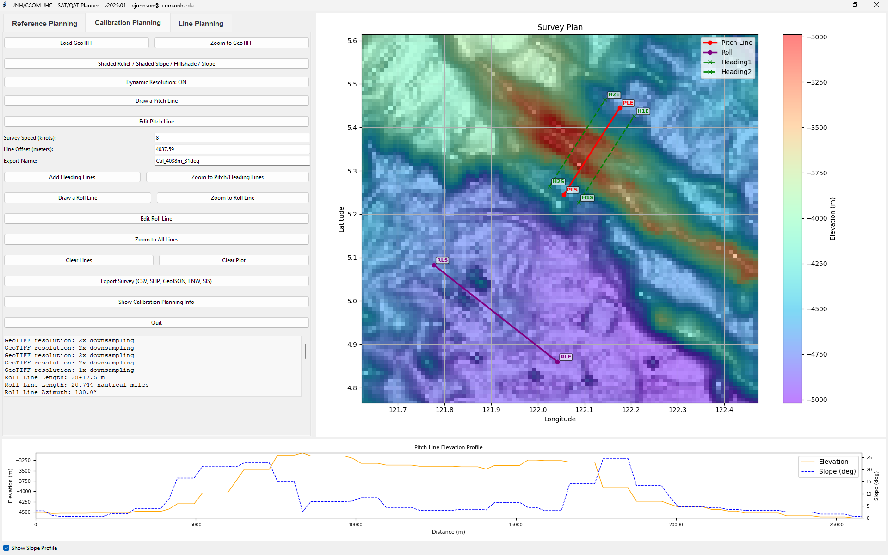
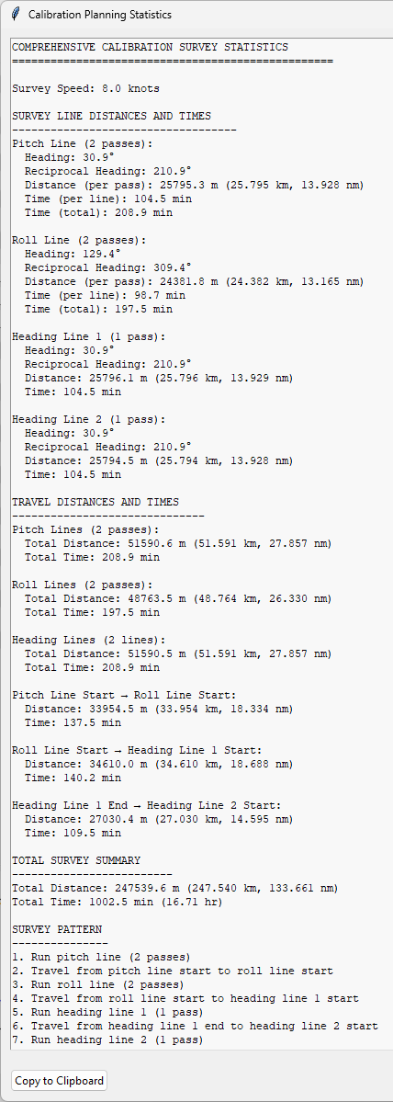
Planning Tools: SAT/QAT Planner

Slide 25
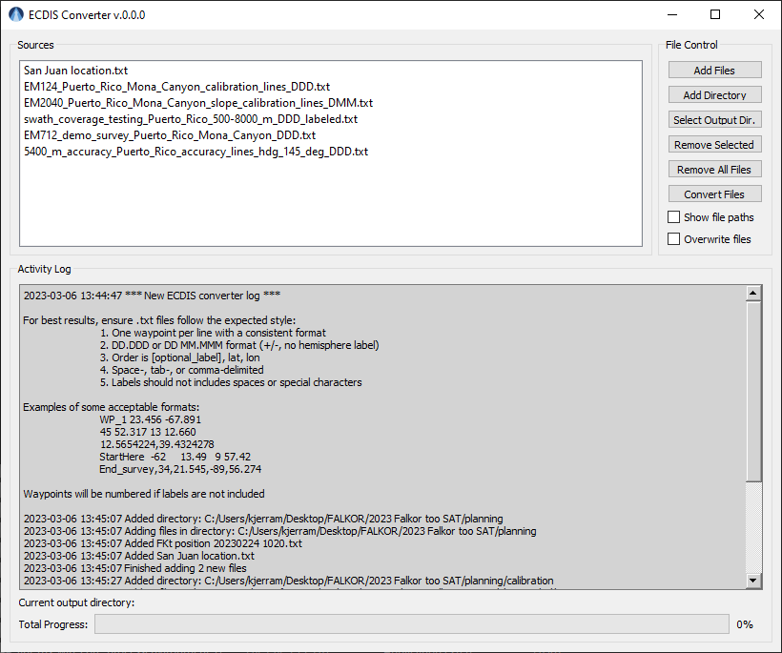
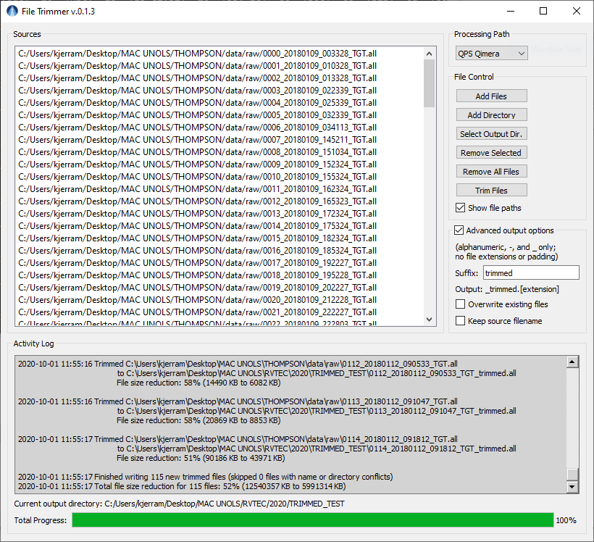
Other Tools: ECDIS Converter and File Trimmer

Slide 26
Test Site Database

Slide 27

Test Site Database
https://gis.ccom.unh.edu
Notes:
Reuse proven test sites whenever possible
Building a web interface to simplify this process
Interface includes several planning layers
Each site includes line plans, settings, reports
Backlog of MAC sites to be added

Slide 28
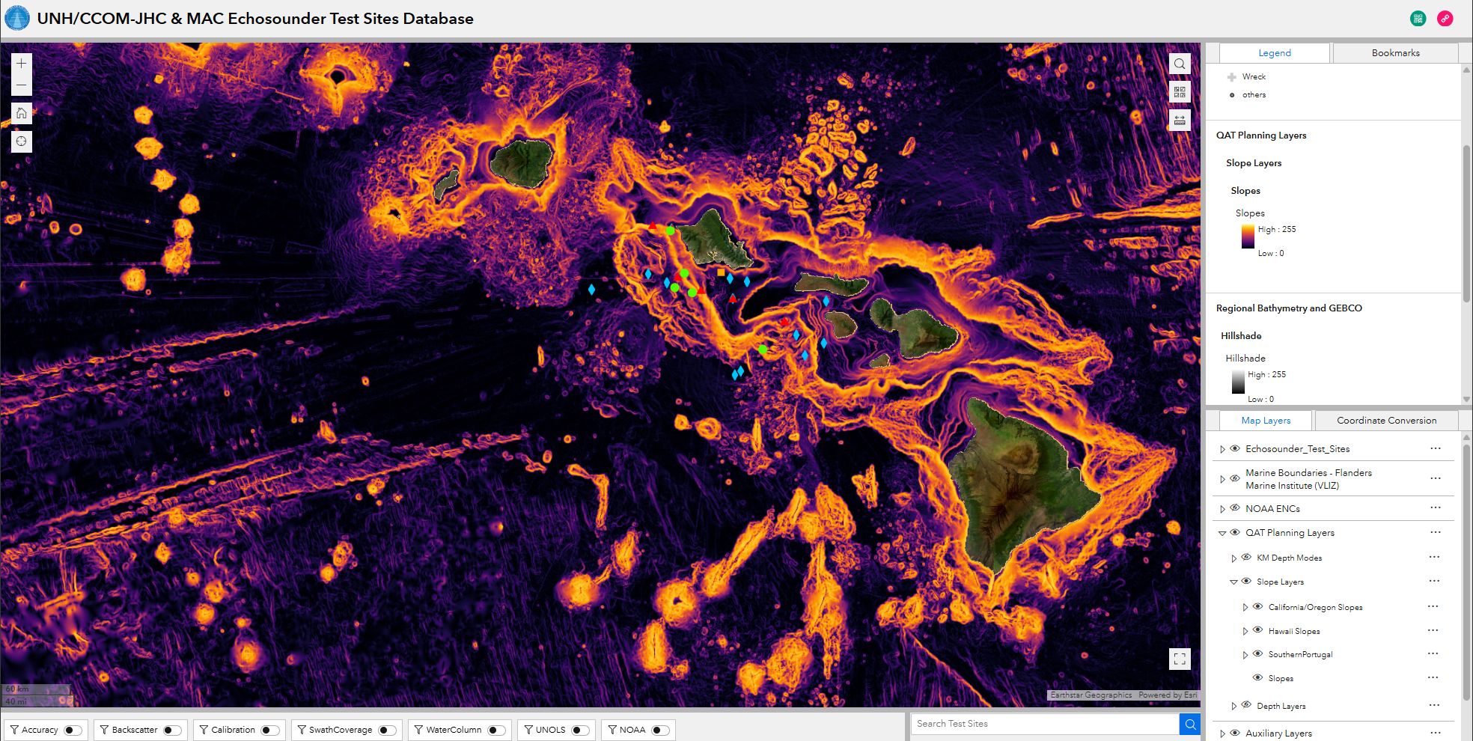
Test Site Database
https://gis.ccom.unh.edu

Slide 29
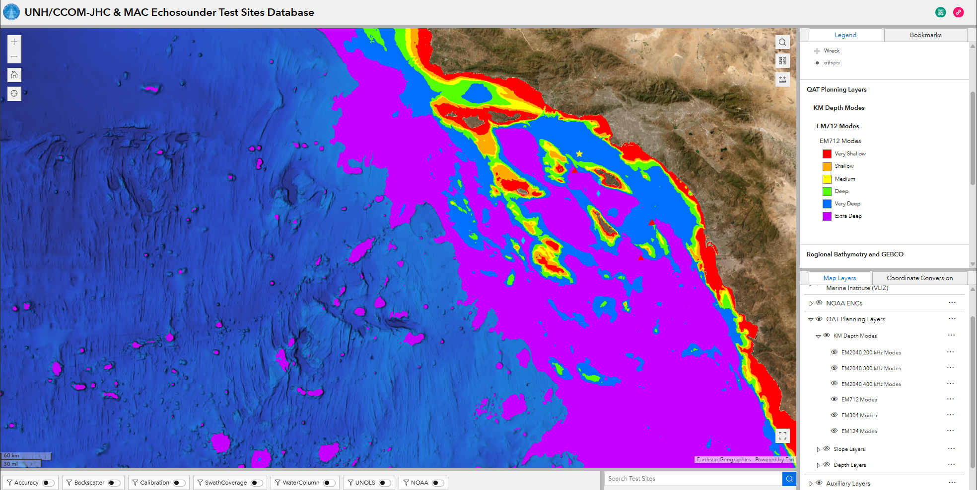
Test Site Database
https://gis.ccom.unh.edu

Slide 30
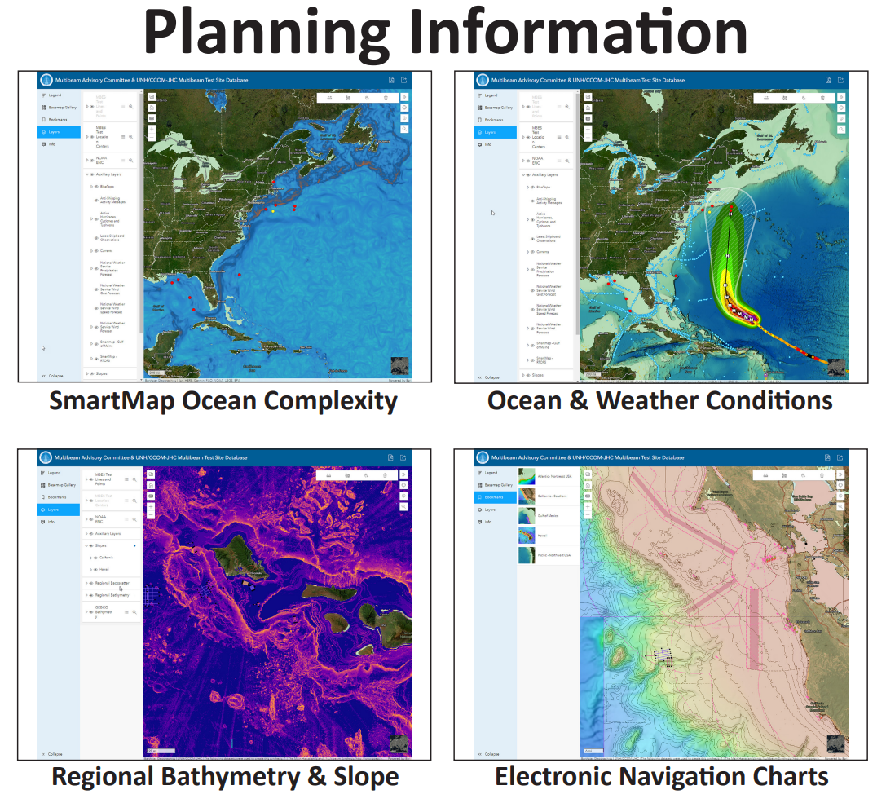
Test Site Database
https://gis.ccom.unh.edu

Slide 31
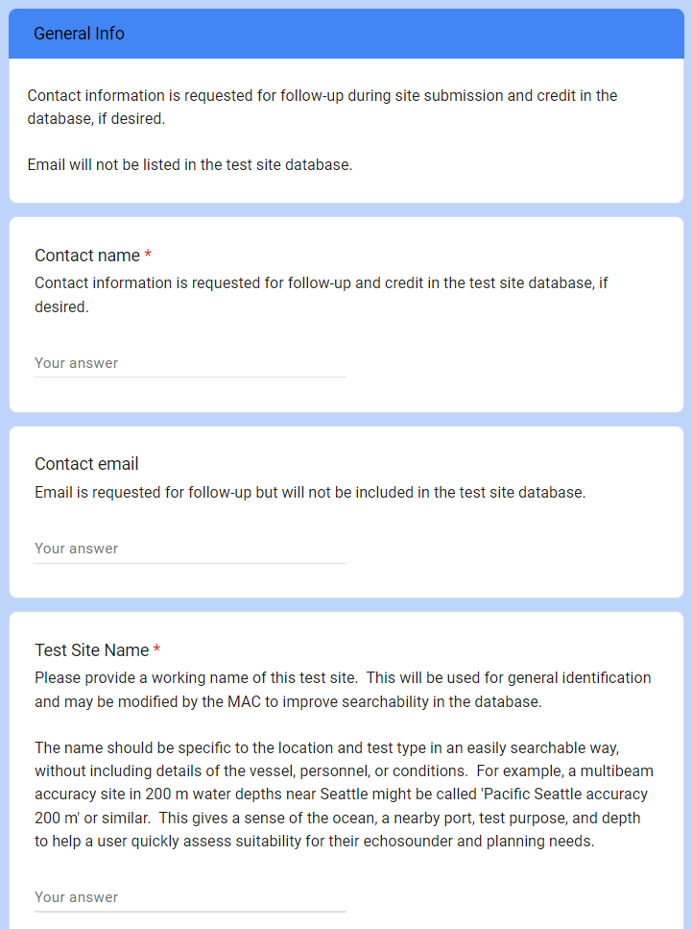







Test Site Submission Form
https://forms.gle/5EdGwomMF116DprFA

Slide 32

R2R, MGDS, GMRT

Slide 33



Slide 34



Transit Mapping

Slide 35
Sound Speed Manager

Slide 36




Sound Speed Manager
A ready-to-go and free
solution to ease
the management of
sound speed profiles
for ocean mapping
POCs: Giuseppe (gmasetti@ccom.unh.edu),
Barry (barry.gallagher@noaa.gov),
Chen (chen.zhang@noaa.gov)
https://www.hydroffice.org/soundspeed/
https://svn.pydro.noaa.gov/Docs/html/Pydro/downloads.html
Ref.: Masetti, G. et al., Sound Speed Manager: An open-source application to manage sound speed profiles, International Hydrographic Review, vol. 17, pp. 31-40, 2017.

Slide 37







Sound Speed Manager
Jointly developed by CCOM/JHC & NOAA OCS
2016 →
10k+
Notes:
We started the merge, and at the beginning of 2016 the first release of Sound Speed Manager was made publicly available.
Since then, we have been developing and improving Sound Speed Manager.
SSM has now reached a good level of maturity, with an important users base spanning from the scientific community to several commercial companies. It is widely used both within the US and world-wide with more than 10,000 downloads just from the HydrOffice website.

Slide 38



Recent Updates
New Features
NMEA-0183 network listener
Recent Ops Forecast Systems
Metadata and stats customization
Better SIS & HYPACK Integration
#SSM datagram & user guide
Interaction status on taskbar
Improved Supported Formats
AML, ASVP, CSV, NCEI, Valeport, etc.
Notes:
For example, the addition of a generic NMEA-0183 network listener is a great example of contributed code that improves and extends Sound Speed Manager.
In this specific case, most of the credits for the contribution go to Jean-Guy Nistad from the German Hydrographic Office.

Slide 39


Recent Updates
New Features
NMEA-0183 network listener
Recent Ops Forecast Systems
Metadata and stats customization
Better SIS & HYPACK Integration
#SSM datagram & user guide
Interaction status on taskbar
Improved Supported Formats
AML, ASVP, CSV, NCEI, Valeport, etc.
Notes:
Recent changes to the NCEI Operational Forecast System have required relevant changes to continue the support for synthetic profiles derived from OFS.
During such a work, the support has been extended to recently added OFS like, for instance, the West Coast OFS.

Slide 40



Recent Updates
New Features
NMEA-0183 network listener
Recent Ops Forecast Systems
Metadata and stats customization
Better SIS & HYPACK Integration
#SSM datagram & user guide
Interaction status on taskbar
DataDistrib bug in SIS 5.15.0!
Improved Supported Formats
AML, ASVP, CSV, NCEI, Valeport, etc.
Notes:
Relevant improvements have been applied to the integration with Hypack and Kongsberg Sis.
The ongoing collaboration with Kongsberg has triggered the creation of a dedicated SSM datagram starting with Sis 5.14 (released in November 2024). This improvement greatly reduces the network traffic and further simplifies the SSM initial setup on the Sis app to a single field.
Furthermore, a guide to integrating SSM with Sis is now included in the Sis installation documentation.
Given the current bug for DataDistrib in SIS 5.15.0, using the #SSM datagram is the ONLY working method.

Slide 41

Recent Updates
New Features
NMEA-0183 network listener
Recent Ops Forecast Systems
Metadata and stats customization
Better SIS & HYPACK Integration
#SSM datagram & user guide
Interaction status on taskbar
Improved Supported Formats
AML, ASVP, CSV, NCEI, Valeport, etc.
Notes:
Another relevant improvement has been that the SSM taskbar now shows different colors to capture user attention in case of issues (for example, ‘Not pinging for a while’ alert).

Slide 42
Recent Updates
New Features
NMEA-0183 network listener
Recent Ops Forecast Systems
Metadata and stats customization
Better SIS & HYPACK Integration
#SSM datagram & user guide
Interaction status on taskbar
Improved Supported Formats
AML, ASVP, CSV, NCEI, Valeport, etc.
Notes:
Finally, the set of currently supported profile formats has been extended and improved.
The "Kongsberg driver" has been extended to not only export ASVP format, but also export SSP format (that also contains temperature and salinity). As also recently clarified in Sis documentation, the use of the SSP file ensures that all absorption coefficients are updated in Sis.
Furthermore, a few changes have been required during the year to extend and improve supported formats (for example, MiniCTD probes in the Valeport driver).

Slide 43
Let’s keep building, together!
Visit: https://www.hydroffice.org/soundspeed/
Contact us at soundspeed@hydroffice.org
Notes:
Finally, the set of currently supported profile formats has been extended and improved.
The "Kongsberg driver" has been extended to not only export ASVP format, but also export SSP format (that also contains temperature and salinity). As also recently clarified in Sis documentation, the use of the SSP file ensures that all absorption coefficients are updated in Sis.
Furthermore, a few changes have been required during the year to extend and improve supported formats (for example, MiniCTD probes in the Valeport driver).

Slide 44

Questions? Answers? Reach out!
Multibeam Advisory Committee
https://mac.unols.org
mac-help@unols.org
Ocean Mapping Community Wiki
https://oceanmapping.wiki
omcadmin@ccom.unh.edu

