Slide 1




Marine
Technology Society MICROCREDENTIALS
Initiative

Slide 2
MicroCREDENTIALS
What are microcredentials?
Short, competency-based recognitions, with demonstration of mastery
Transferrable electronic badge is issued
Badges can be added to resumes, LinkedIn profiles or other social media
Microcredentials can be “stacked” in various ways to build toward competencies needed for learners to attain their specific certification, degree and/or employment goals.
Notes:
What are microcredentials?
Microcredentials are short, competency-based recognitions, with demonstration of mastery in a particular area. Once a learner demonstrates their competency, an electronic badge is issued. Badges are a transferrable symbol used to verify the attainment of specific competencies and can be added to resumes, LinkedIn profiles or other social media platforms as instant recognition of a personal skill set. Microcredentials can be “stacked” in various ways to build toward competencies needed for learners to attain their specific certification, degree and/or employment goals.

Slide 3
MicroCREDENTIALS
Microcredentials are:
Personalized: create own pathway based on interests and career goals and address gaps in skills
Flexible: addresses increasing need for flexible learning mechanisms
Performance-based: awarded based on demonstrated mastery of the subject matter
Notes:
What are microcredentials?

Slide 4
MicroCREDENTIALS
Stackable MTS microcredentials:
Will be endorsed by accredited institutions
Directly address the workforce preparation need
Improve the ability of educational institutions to transition some of their programs to skills based credentialling
The content offered within the microcredentials will not only address the technical content, but will be framed around the U.S. Department of Education’s Career and Technical Education (CTE) tenets.
Notes:
The stackable MTS microcredentials, which will be endorsed by accredited institutions, will directly address the workforce preparation need and improve the ability of educational institutions to transition some of their programs to skills based credentialling to better prepare the students for the workforce in a compressed time frame. The content offered within the microcredentials will not only address the technical content, but will be framed around the U.S. Department of Education’s Career and Technical Education (CTE) tenets

Slide 5
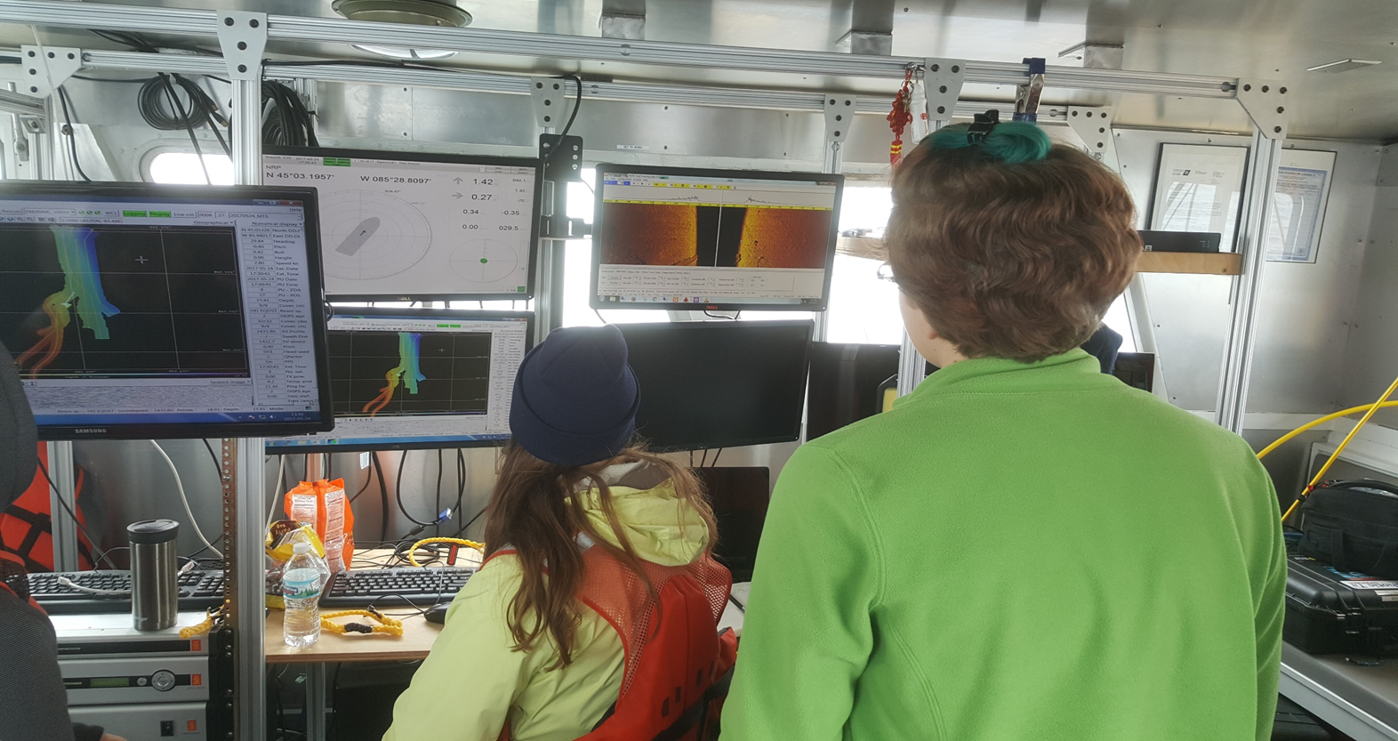
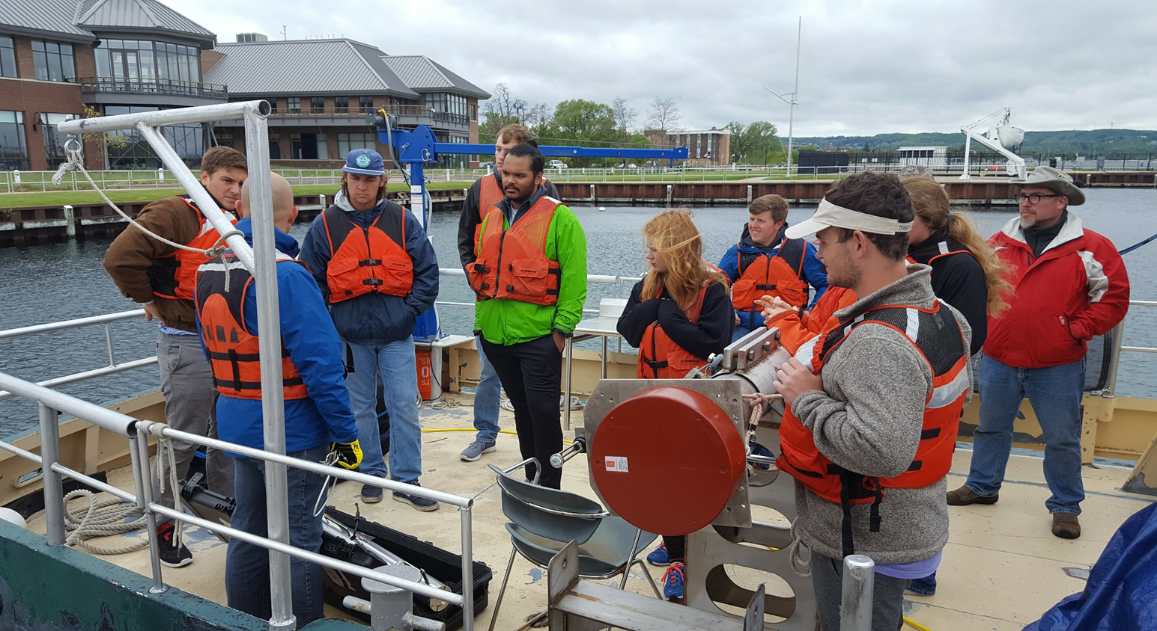
WORKFORCE
DEVELOPMENT
Innovative and flexible pathways
Recognition of skills - microcredentials
Partnerships
Notes:
MTS was awarded a grant by the National Science Foundation to create a program to foster critical marine technology focused abilities in a short time frame through a new set of flexible learning opportunities.
Microcredentials can be useful for a range of learners including undergraduate students, graduate students who want to round out some skills, people reskilling/upskilling (transitioning from oil and gas to offshore wind), people separating or retiring from military service
MTS is seeking community guidance to shape the competency framework to underpin the microcredentials, and seek partnerships with colleges and universities around the globe to implement the microcredentials locally.
We do not intend to generate curricula, but community created competencies.

Slide 6
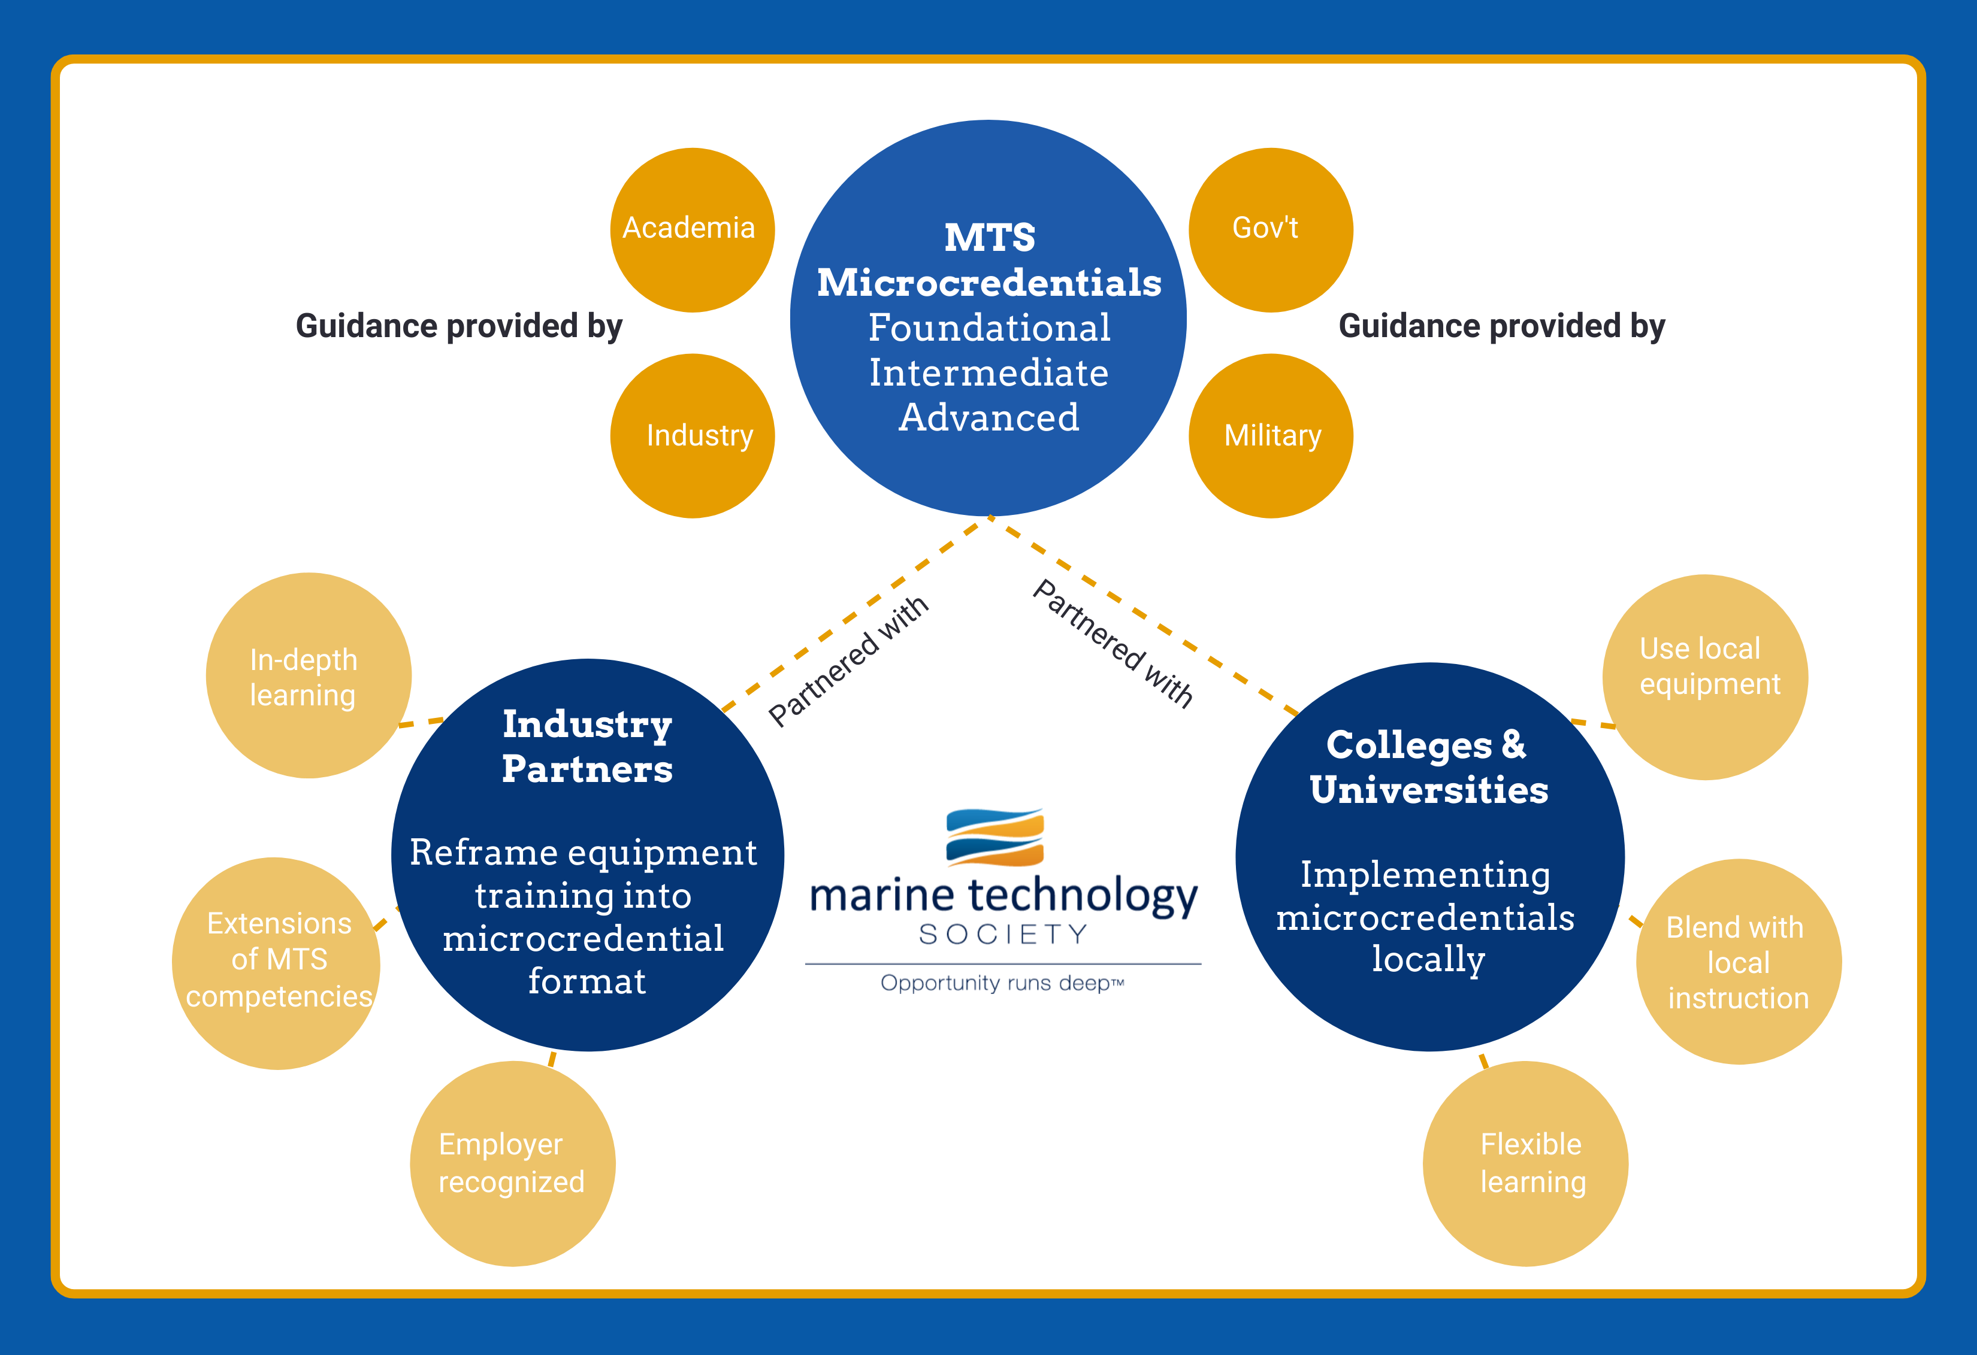
Notes:
We are pursing a new model of partnership for implementation, with MTS serving as a convener and organizer.
Bullet 1 – MTS Members and people from the community (academia, industry, government and military) will be recruited to the Microcredential Development Teams. These teams will define the competencies for each level required for employment.

Slide 7
Notes:
Bullet 2 – MTS will recruit colleges and universities to participate in the program and offer the microcredentials locally. The schools will apply to the program and demonstrate how they will implement the educational materials with the equipment available (vendor agnostic approach). The schools will award a digital badge and MTS will award a complementary badge. If the schools are not members of MTS, we will recruit them to join.

Slide 8
Notes:
MTS will also serve as an intermediary between schools and industry – raising awareness with companies as to what the heck the badges are, what they represent, and that MTS is behind the effort with our “stamp of approval” for the member educational institutions, and the benchmarks achieved by the students were designed by the community.

Slide 9
Notes:
Bullet 3 – Partnerships with organizations to adapt/adopt the microcredentials (Fugro/Seabird/Teledyne, etc) and to expand the program.

Slide 10
MicroCREDENTIALS
Ability Levels
Foundational (Learning focus) | Validated Experience: Fundamentals of the technology Beginning concepts Uses/application Basic knowledge demonstrated
Intermediate (Learning and competency demonstration/practicum) | Validated Experience: • Technology applications • Intermediate concepts • More complex uses • Intermediate level knowledge demonstrated • PD at work and application
Advanced (Competency mastery through demonstration) | Validated Experience: • Practical experience (months to years) • Capstone Experiences – demonstration of abilities O Platforms O Sensors O Data

Slide 11
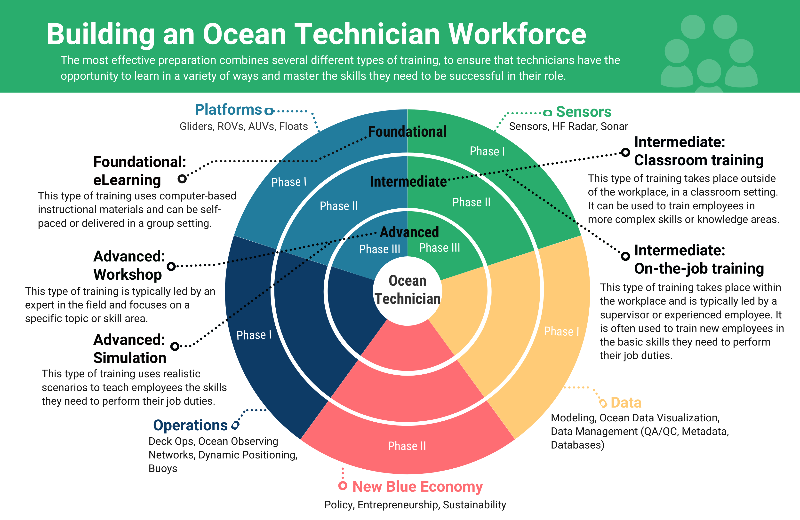

Slide 12
Mi
MicroCREDENTIALS
Microcredentials available for awarding:
Foundational Glider Hardware
Foundational Glider Software
Foundational Sonar
Foundational ROV
Foundational Deck Ops
Microcredentials online:
What is the blue economy
What is marine technology
Microcredentials In development:
Intermediate Glider software
advanced Glider
Advanced multibeam sonar
Foundational Prototyping
Foundational Floats

Slide 13
Mi
Cultivating Awarding partners
Rutgers University
Northwestern Michigan College
University of Alaska
Stockton University
University of Southern Mississippi
University of Washington
Oregon State University
University of Rhode Island
University of Massachusetts - Boston
University of New Hampshire
Mississippi Gulf Coast Community College
PLOCAN
University of Delaware
Mississippi State University
Pearl River Community College
University of South Florida
Florida Atlantic University
UCSD - Scripps
East Carolina University
University of Virgin Islands
National Oceanography Centre
Developing relationships with companies and
Independent Trainers to serve as awarding partners

Slide 14
awarding Microcredentials
Competencies equate to badges
Badges vary in length of time
Awarded by MTS to partner schools
Partner schools inform MTS
Can be alongside locally issued badges
Assessment rubrics will be developed

Slide 15
opportunities
Recruiting for Review Team Members
Recruiting for partners to implement Foundational ROV, Sonar and Glider
Recruiting students for summer experiences

Slide 16

Liesl.hotaling@mtsociety.org
mtsociety.org
Notes:
Thank you

Slide 17
Mi
Discussion
Structure of the microcredentials And program
Where are the pain points?
Training “Supply”
Training “Demand”
Potential for adoption and growth
Topics for Future Microcredentials

