Slide 1
What to Know Before you Code
A complete beginners guide to demystify and motivate
Erich Gruebel
university of rhode island
rvtec 2025

Slide 2
About Me
I don’t think of myself as a programmer
First delved in Javascript and XSLT ca. 2005
Office and Autocad automation
C++, C#, Python are my comfort zone
PowerPoint PowerUser

Slide 3
Motivation
Something unique and different for RVTEC
Kicking around the idea after careful observation
Incredibly useful skill for EVERYONE
Tara needed content
Notes:
inspired by observations of failed attempts at training

Slide 4

Motivation
Terms that keep you out of the room -Amy Poehler
Notes:
Terms that keep you out of the room

Slide 5
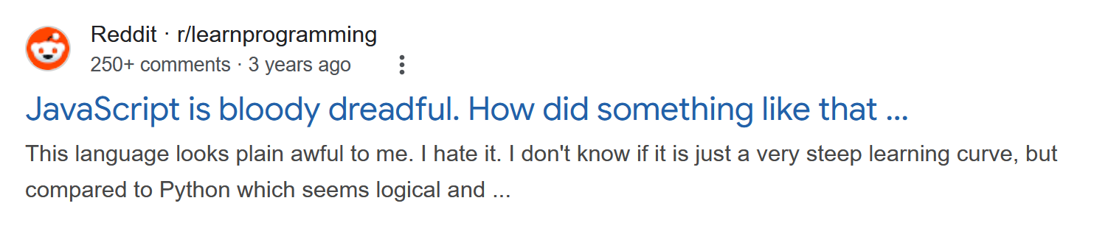
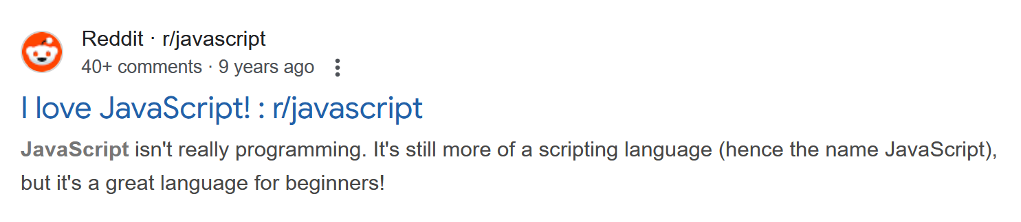
Motivation
Terms that keep you out of the room -Amy Poehler
Notes:
Terms that keep you out of the room

Slide 6
Agenda
What is Code
What is a Programming Language
Make Good Choices
Advice

Slide 7

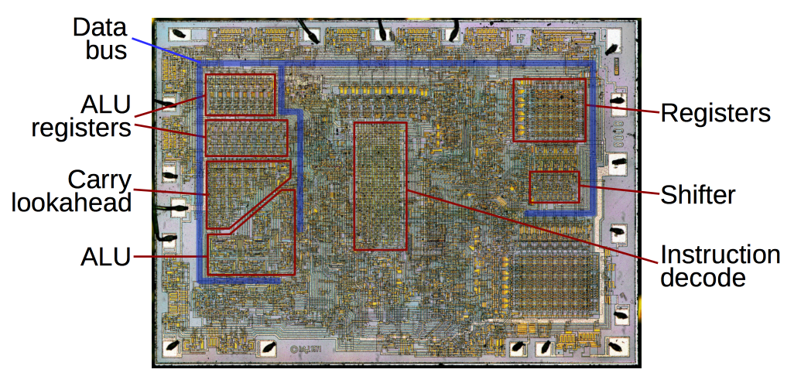
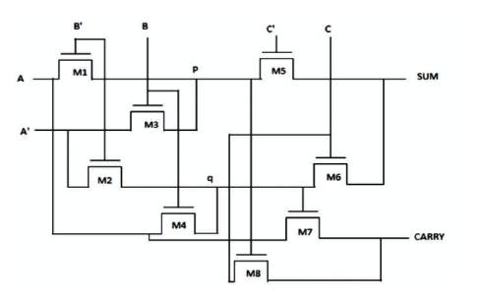
What is Code
Notes:
Mid 1800’s scientists began exploring the concepts of Boolean logic and binary mathematics (Charles Babbage, Ada Lovelace)
1930’s binary adder

Slide 8
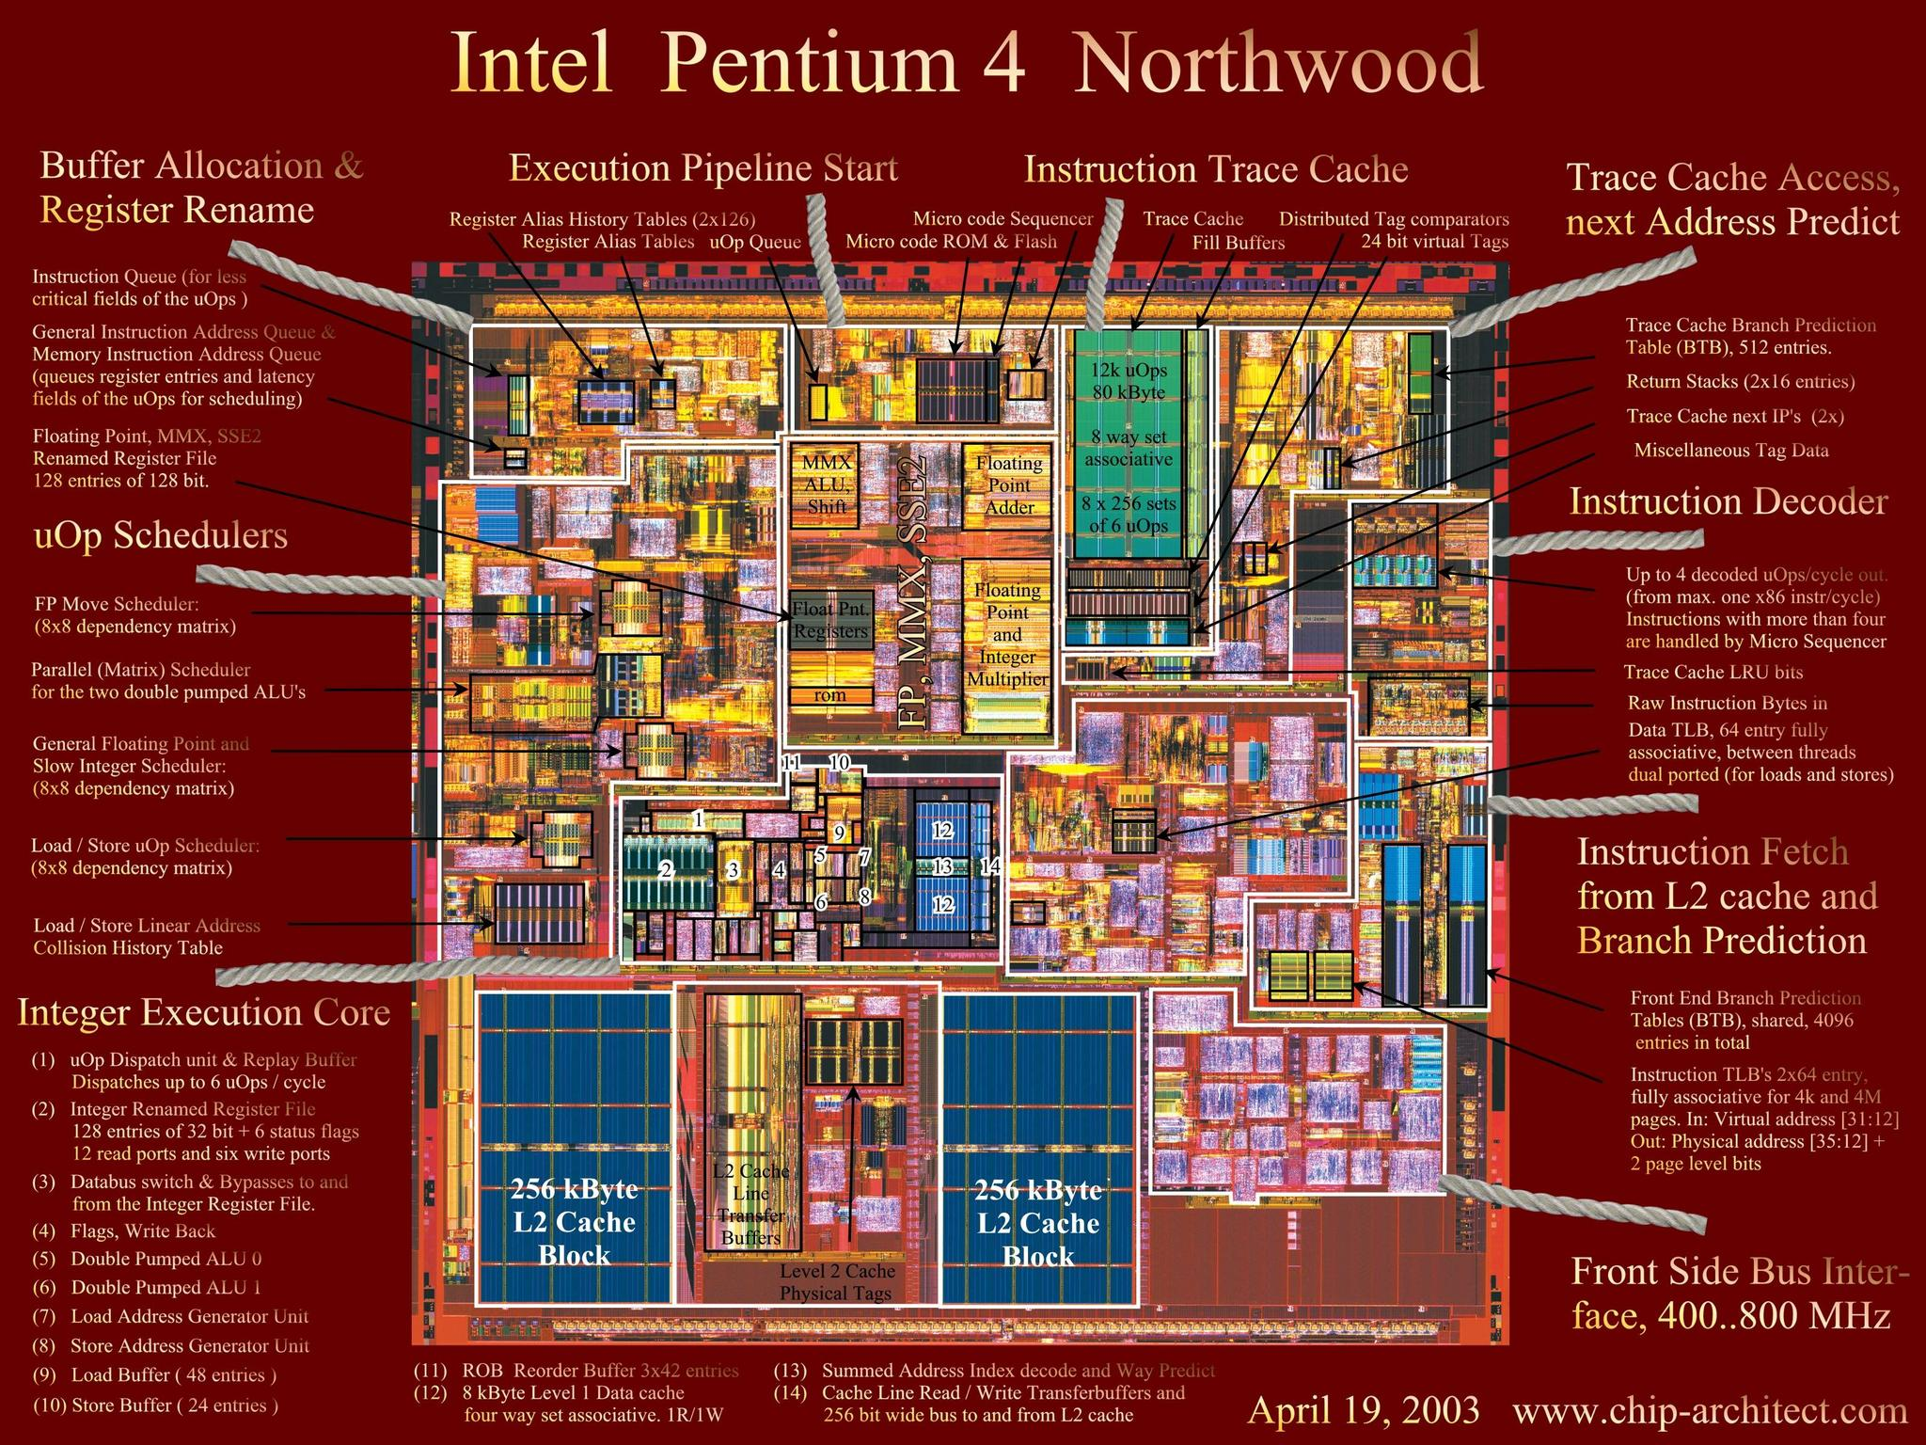
What is Code – The CPU
Registers: Temporarily store “in use” information
Control Unit: fetching, decoding, and executing instructions
Arithmetic Logic Unit: Performs addition, subtraction, and logical operations (AND OR NOT XOR)
Clock: The “heartbeat” which latches and unlatches circuits to execute instructions
Notes:
Extraordinarily complex, but there’s no magic. They are purpose built machines.

Slide 9
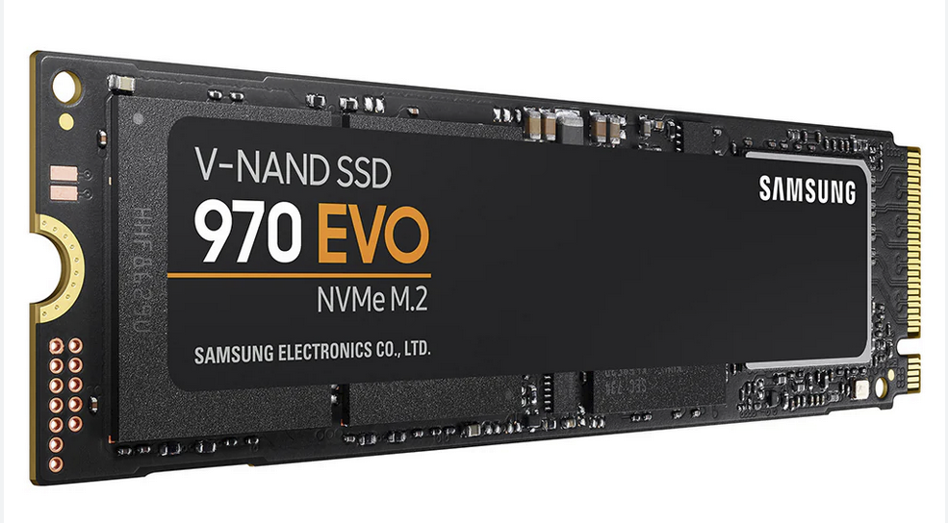
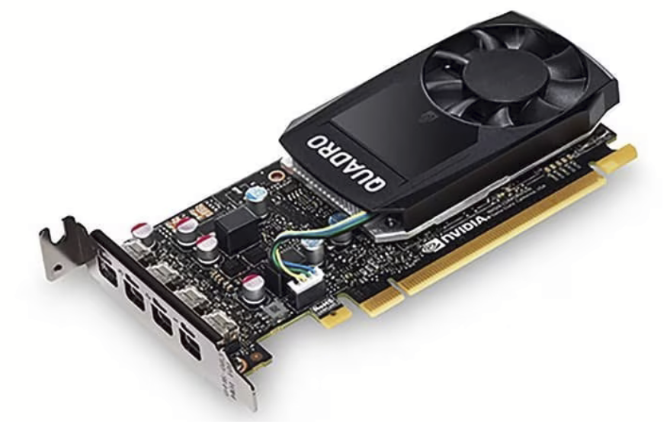



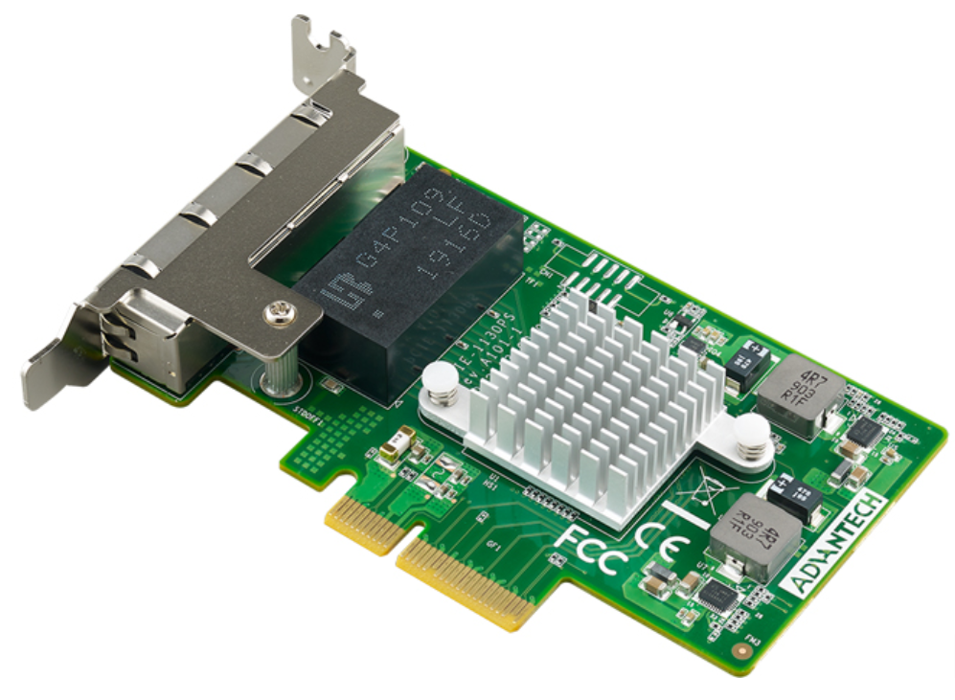
What is Code – The Memory - RAM
Notes:
RAM is volatile vs non volatile
Data bus and address bus
Memory mapped IO
Lookup! multistate memory – used for neural networks

Slide 10
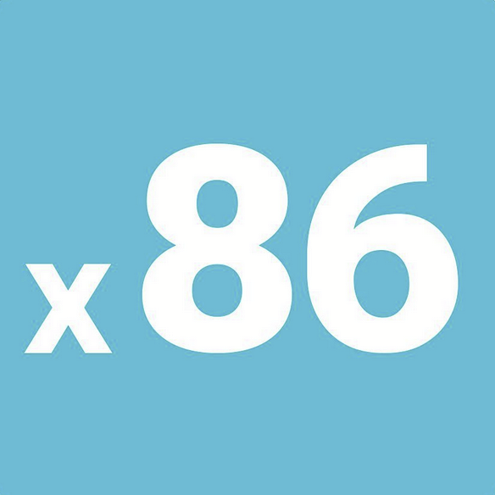

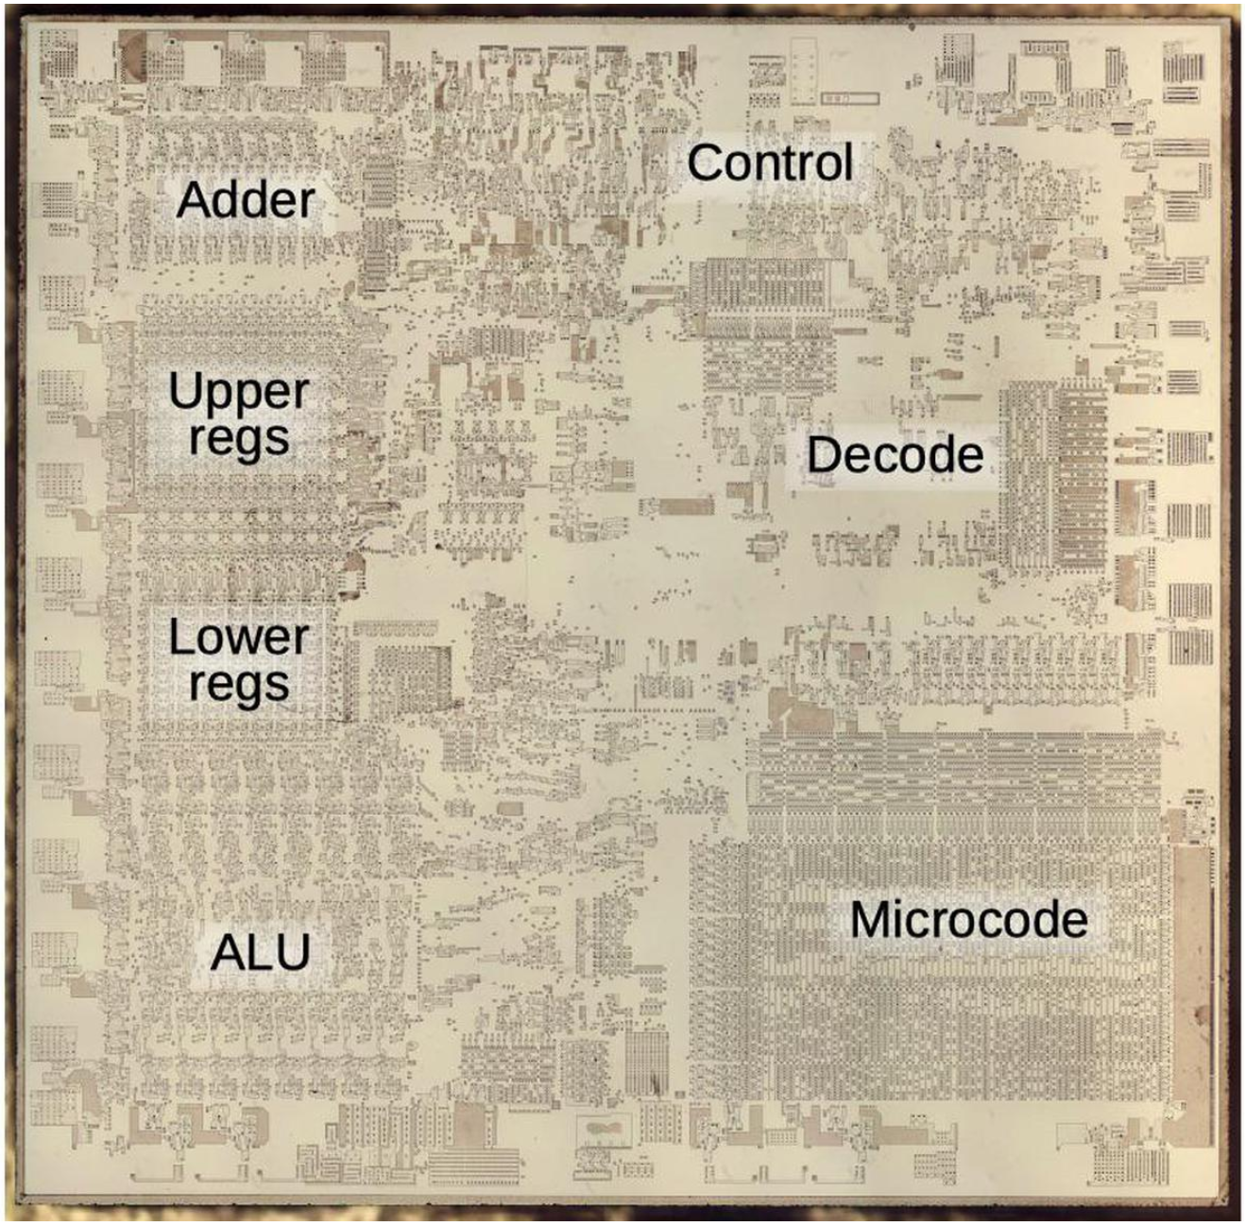
What is Code – Op Code & Machine Code
Instruction | Description | Opcode
ADD | Integer Add | 0x23
AND | Logical AND | 0x20
CALL | Call Procedure | 0x9A
CLC | Clear Carry Flag | 0xF8
DEC | Decrement by 1 | 0x48
OR | Logical OR | 0x0D
PUSH | Push to stack | 0x50
SUB | Integer Subtract | 0x81
Instruction | Description | Opcode
ADD | Integer Add | 0x02
AND | Logical AND | 0x02
CALL | Call Procedure | 0x25
CLC | - | -
DEC | - | -
OR | Logical OR | 0x06
PUSH | Push to stack | 0x50
SUB | Integer Subtract | 0x42
Notes:
A processor engineeer builds circuits that do those things, and then writes down the patterns of bits that cause those things to happen. Programmers read the book, and then write programs that do those things. The computer is just a thing built to do those things.
981 for x86

Slide 11
What is Code – Op Code & Machine Code
Machine Code – The “programming language” which can be processed by a CPU
Binary instructions (zeroes and ones) which perform a single fundamental task
Consists of an Opcode and Operands
0011010010110001
“Read the byte stored in memory location X and store it in CPU register Y”
1101001011000100
“Copy the byte stored in CPU register Y into CPU register Z”
Notes:
Machine code is non portable – can only be used on the CPU it was written for
Very tedious and time consuming
Very error prone to use in practice
Concept of Low Level Programming

Slide 12

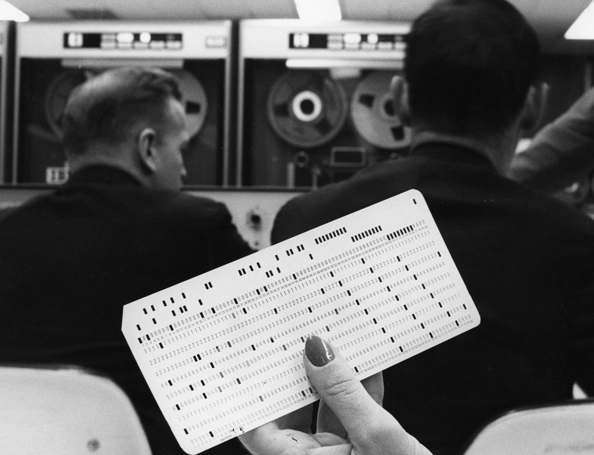
What is Code

Slide 13
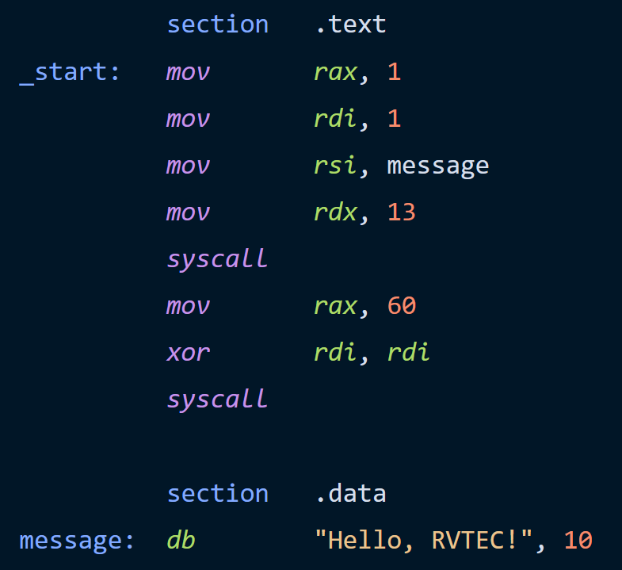
What is Code – Assembly
Human readable representation of machine code
Requires an Assembler to translate ASM -> Machine
Dump of assembler code HelloRvtec.asm:
0x00000000000005fa <+0>: push %rbp
0x00000000000005fb <+1>: mov %rsp,%rbp
0x00000000000005fe <+4>: movl $0x0,-0x4(%rbp)
0x0000000000000605 <+11>: addl $0x14,-0x4(%rbp)
0x0000000000000609 <+15>: syscall
0x000000000000060a <+16>: pop %rbp
0x00000000000008e2 <+17>: retq
0x0000000000000f12 <+0>: push %rbp
0x000000000000031a <+1>: mov %rsp,%rbp
0x00000000000005d4 <+4>: movb $0x0,-0x4(%rbp)
0x0000000000000601 <+4>: addl $0x14,-0x4(%rbp)
0x0000000000000309 <+6>: syscall
0x000000000000060a <+15>: pop %rbp
0x000000000000460b <+11>: retq
MASM Assembler
ml.exe HelloRvtec.obj HelloRvtec.asm
Notes:
Assembler is a program

Slide 14
What is Code - Assembly Example
11 | 5 | 22 | 7 | 1
6 | 14 | 8 | 23 | 3
31 | 9 | 11 | 28 | 29
60 | 5 | 51 | 70 | 41
3 | 18 | 9 | 88 | 2
MOV X, A:4
MOV Y, B:1
ADD Z, X, Y
MOV D:5, Z
65
X | Y | Z
60
5
65

Slide 15

The Operating System
Applications
Memory Management
Process Management
Device Management
File Management
Security!
Operating System
Hardware
Notes:
More specifically the Kernel
Conflict resolution

Slide 16
OS Appreciation
open(“my_awesome_file.txt")
Notes:
More specifically the Kernel
Conflict resolution

Slide 17
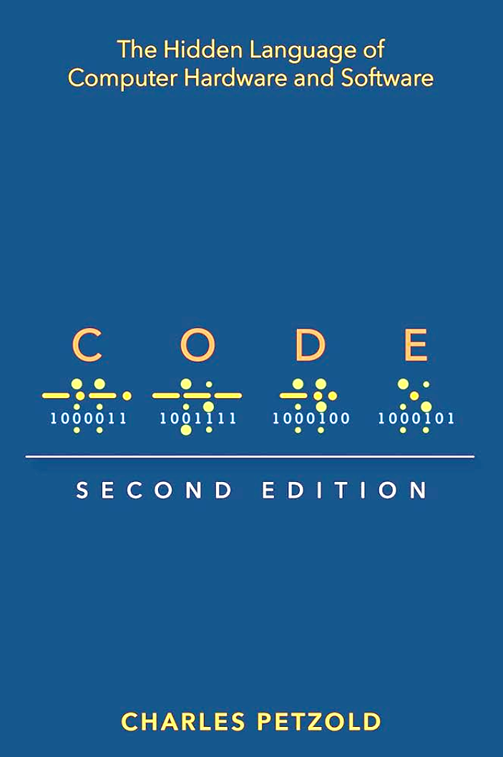
What is Code - Summary

Slide 18
High Level Programming
Java
MATLAB
C
Python
Javascript
Visual Basic
Bash
C#
Rust
FORTRAN
Cobol
R
C++
Go
Lisp
Powershell
Scala
Objective C
Pearl
Swift
Kotlin
Julia
Haskell
Batch
Ruby
Easily human readable
Hides away the complex details of the physical hardware
Execute practical tasks easily with fewer commands
Notes:
Imagine if you wanted to install a shelf in your closet but you had to make the material, color, fasteners, tools first.

Slide 19
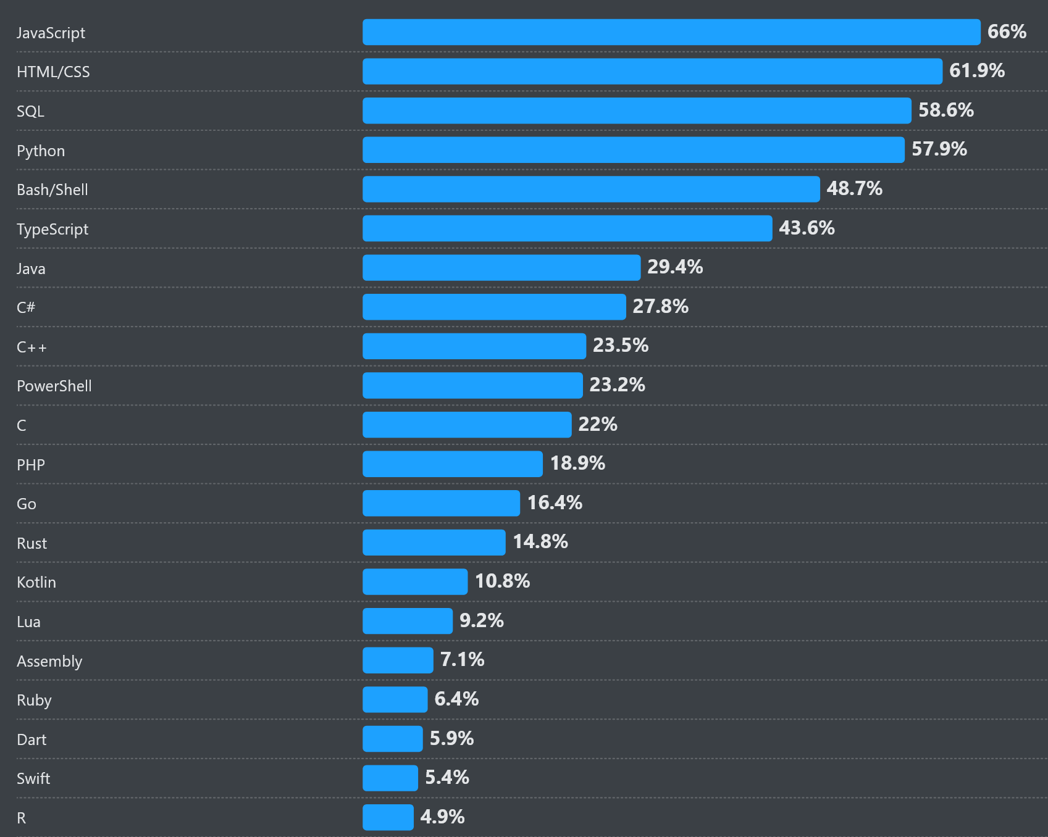
High Level Programming
Most Popular Programming Languages 2025*
*Source:
Stack Overflow Developer Survey
stackoverflow.com
Notes:
Imagine if you wanted to install a shelf in your closet but you had to make the material, color, fasteners, tools first.

Slide 20
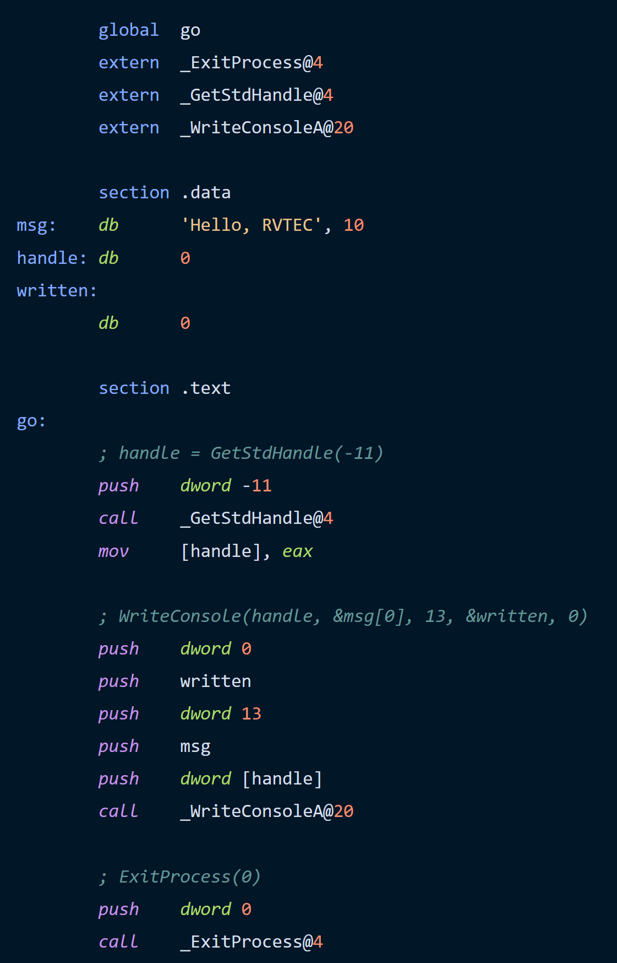
High Level Programming
print(“Hello, RVTEC”)
Python
cout << “Hello, RVTEC”;
C++
console.log(“Hello, RVTEC”);
Javascript
Notes:
Imagine if you wanted to install a shelf in your closet but you had to make the material, color, fasteners, tools first.

Slide 21

High Level Programming
Compiled (AOT)
Software Interpreted
cout << “Hello, RVTEC!”;
C++
print(“Hello, RVTEC!”)
Python
Compiler
Python Interpreter
Hello, RVTEC!
Hello, RVTEC!
Notes:
Compiled vs interpreted vs
But wait, how does that work if cpu can only execute machine code?

Slide 22
High Level Programming
Compiled (JIT)
System.out.println(“Hello, RVTEC!”)
Java
Compiler
bytecode
Java Virtual Machine
Hello, RVTEC!
Notes:
Compiled vs interpreted vs

Slide 23
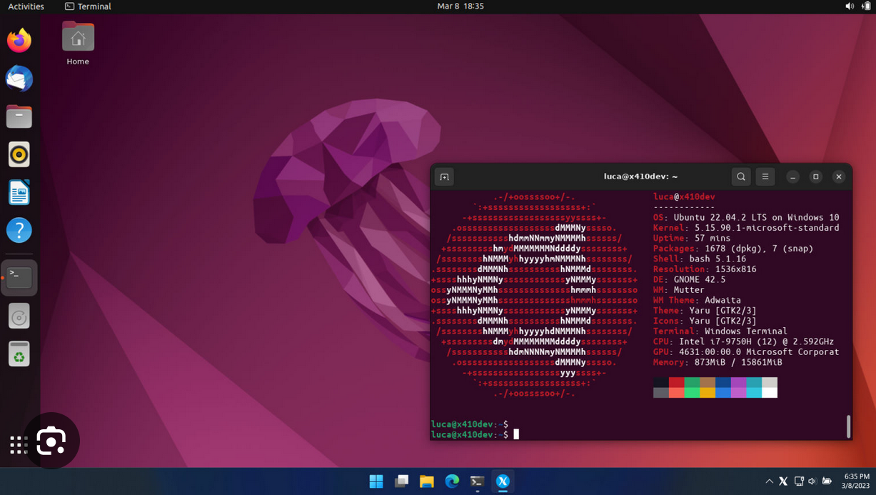
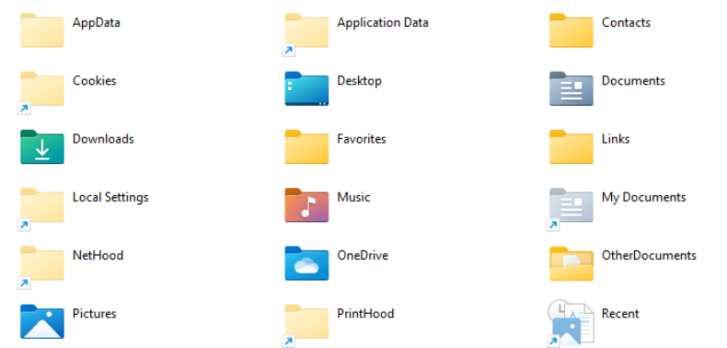
High Level Programming
High level languages run through an operating system
HelloRvtec.exe
Operating System
Hardware

Slide 24
High Level Programming – Language Features
Syntax
Static or dynamic
Strongly typed or weakly typed**
Object oriented
Memory management
(Save this page)

Slide 25
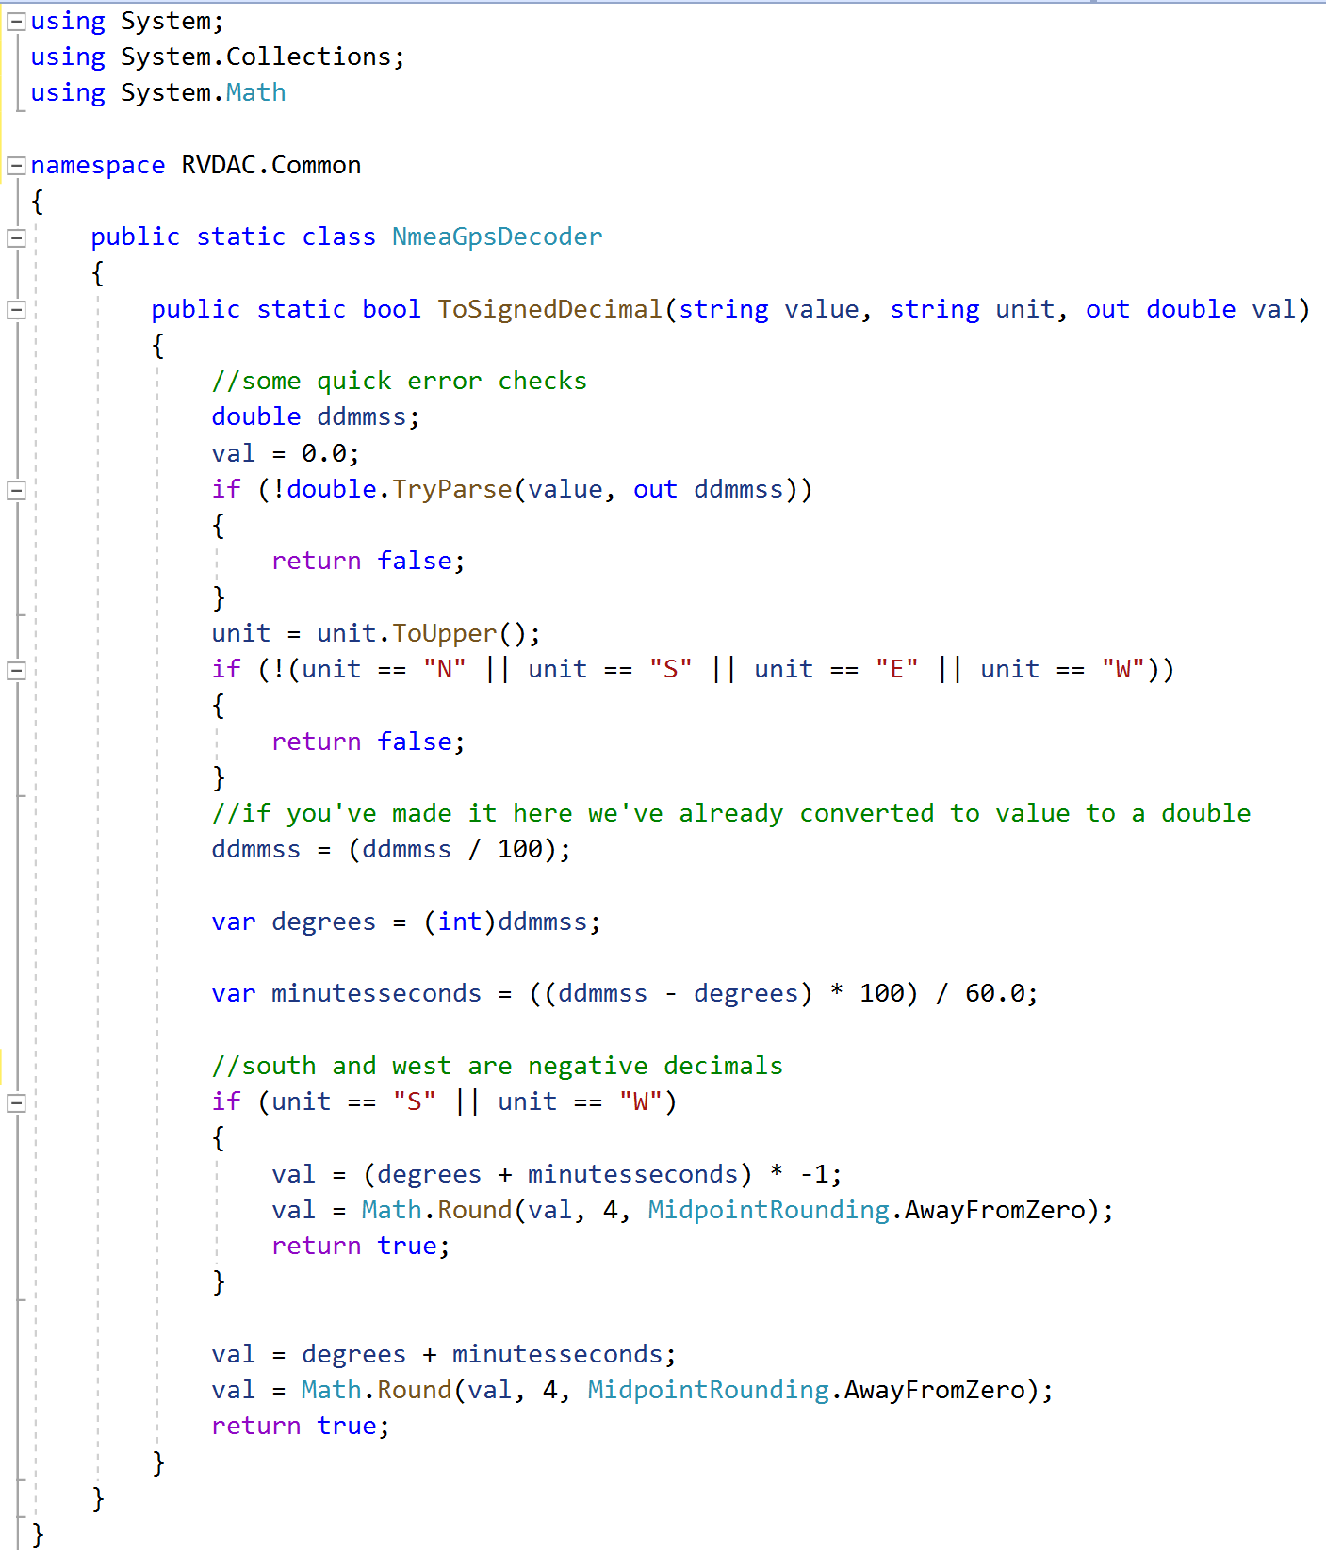
High Level Programming - Examples
Notes:
C-like syntax
using statements to import external code (libraries)

Slide 26
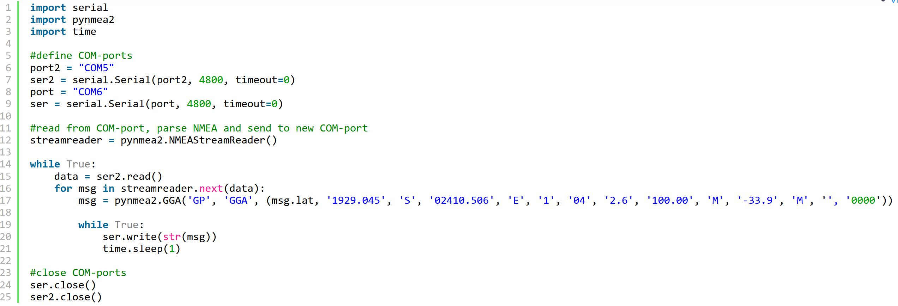
High Level Programming - Examples

Slide 27



High level programming - Libraries
AKA “Code other people have already written”
Sometimes included as part of the programming language
Sometimes as independent “products” both free and paid
Help you do burdensome things easily and SAFELY

Slide 28



High level programming - Frameworks
Fuzzy line between libraries and frameworks
Often confusing for newcomers between a programming language versus a framework
Framework is a combination of…
Large libraries
Defined patterns of organizing and/or writing code
Help you accomplish very complex tasks

Slide 29
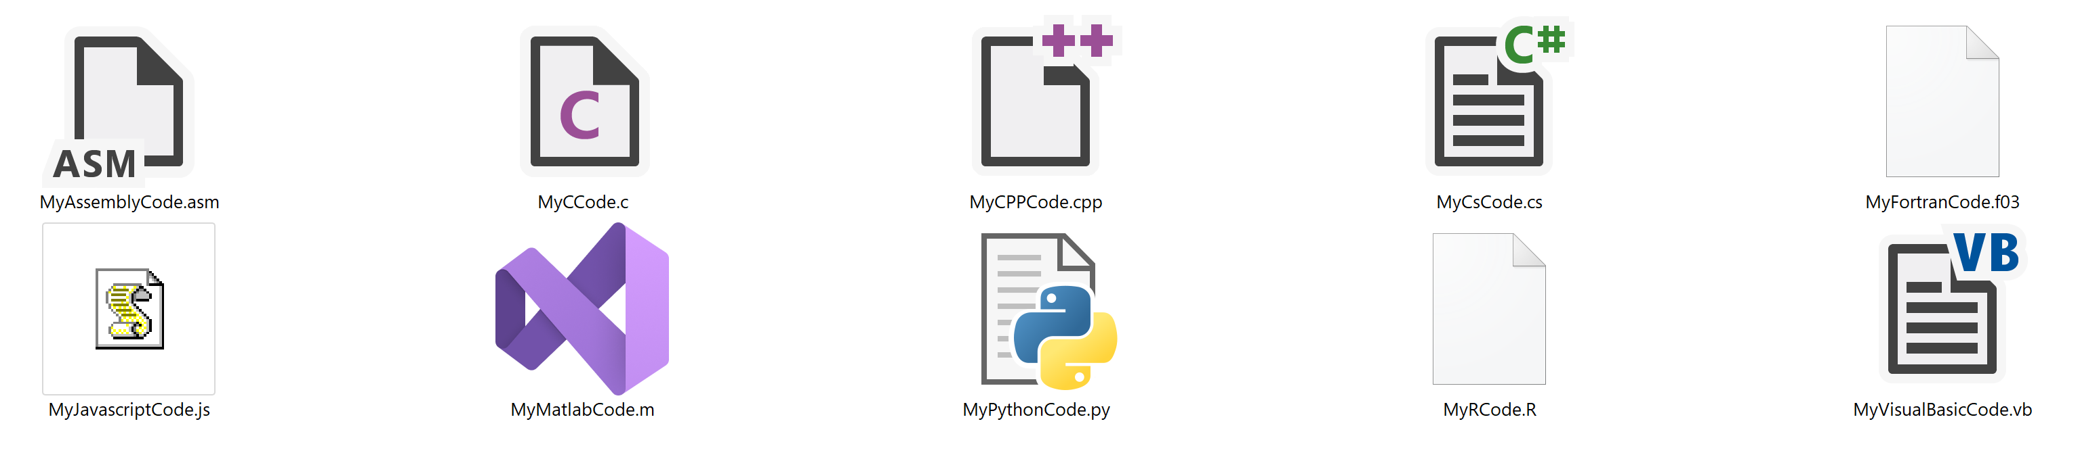
It’s All Simple Text Files
All you need is a text editor

Slide 30

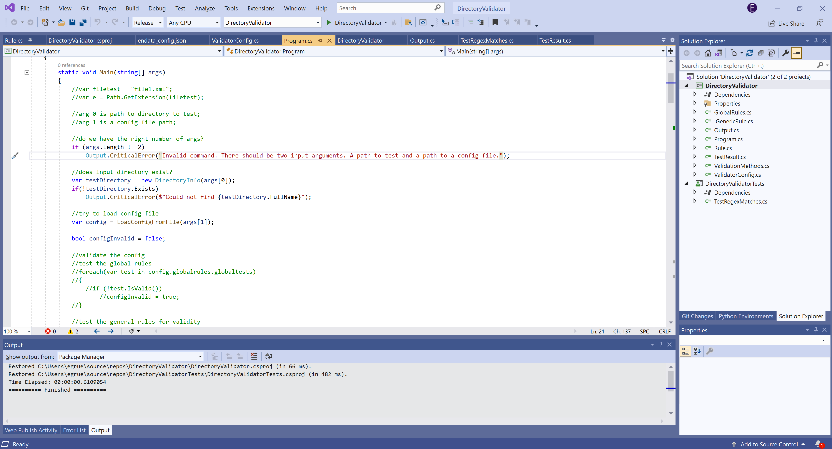
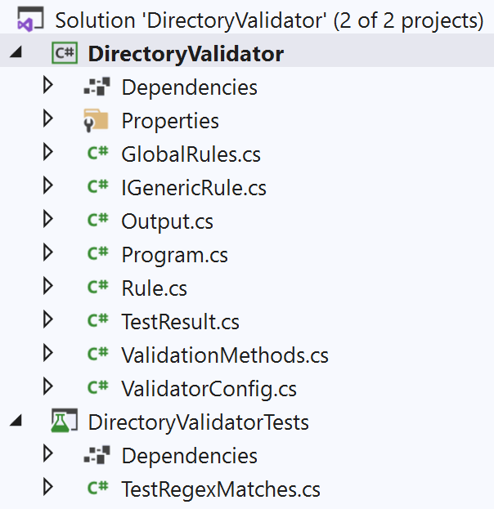

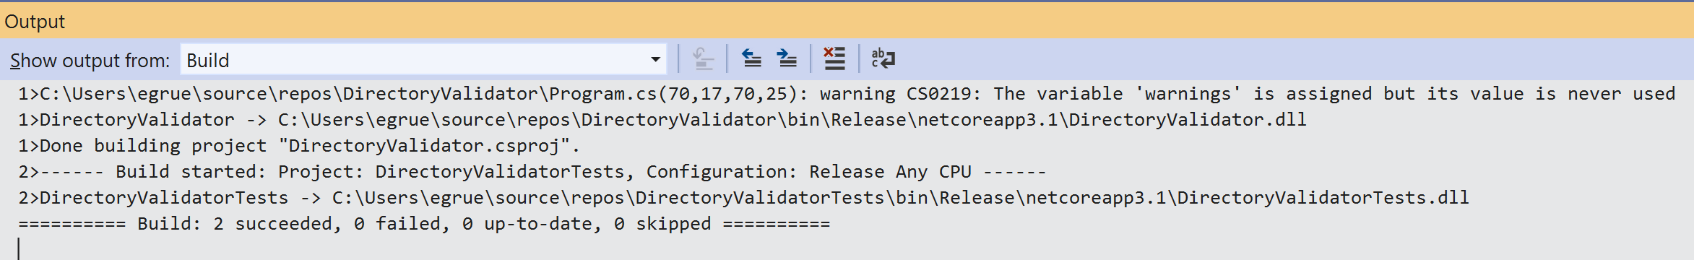
The Integrated Development Environment
Compile and run code
Interact with the Debugger Tool
Manage files and folders
Console and CLI
Notes:
Photoshop to edit photos, Excel to work with tabular data, an IDE to write applications

Slide 31





The Integrated Development Environment
Notes:
Jetbrains and Microsoft, pycharm and intellij

Slide 32
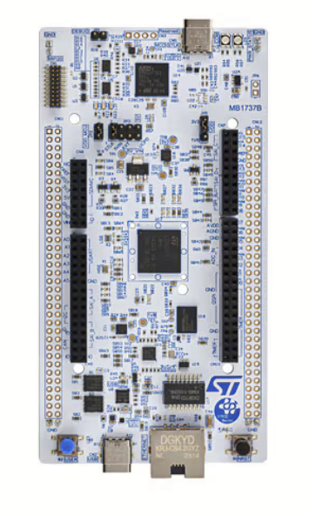
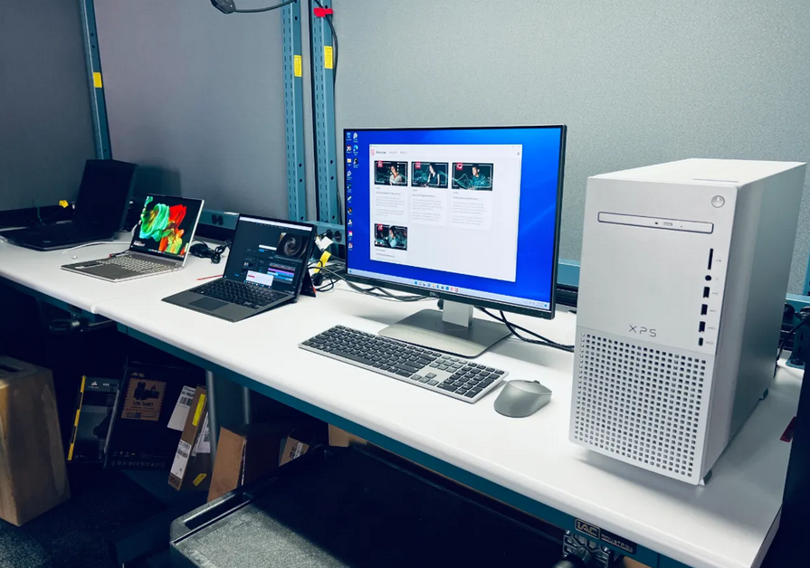
Choosing a programming language – Question 1
Embedded or PC?

Slide 33


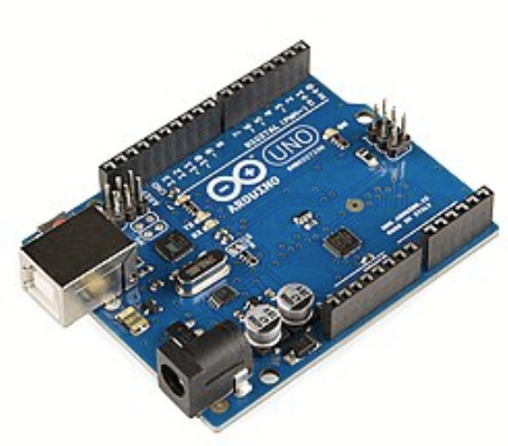
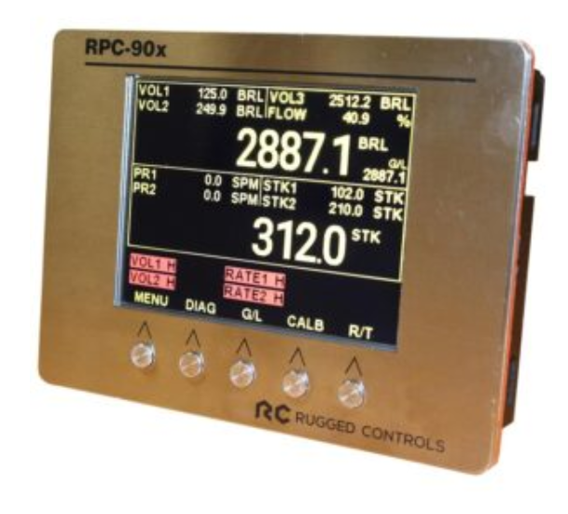
Embedded System
Single purpose computer for controlling hardware
Notes:
Do you want to tinker with devices, also related are PLCs

Slide 34
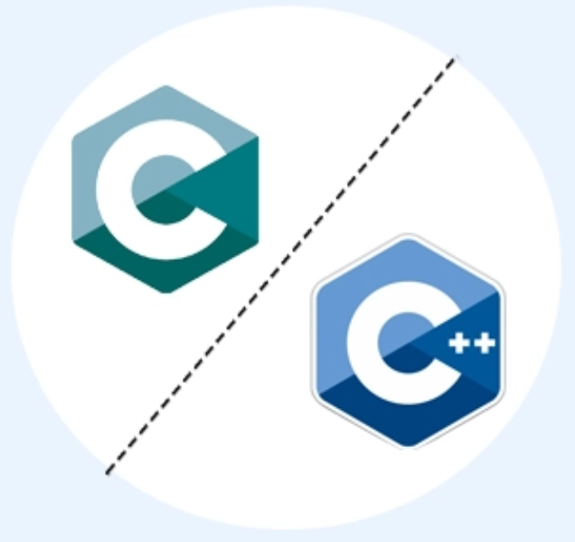
Embedded System
Your path ends here

Slide 35


Choosing a programming language – Question 2
Are you coming into an existing environment?
Powered By

Slide 36
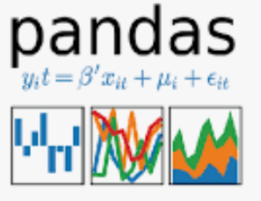
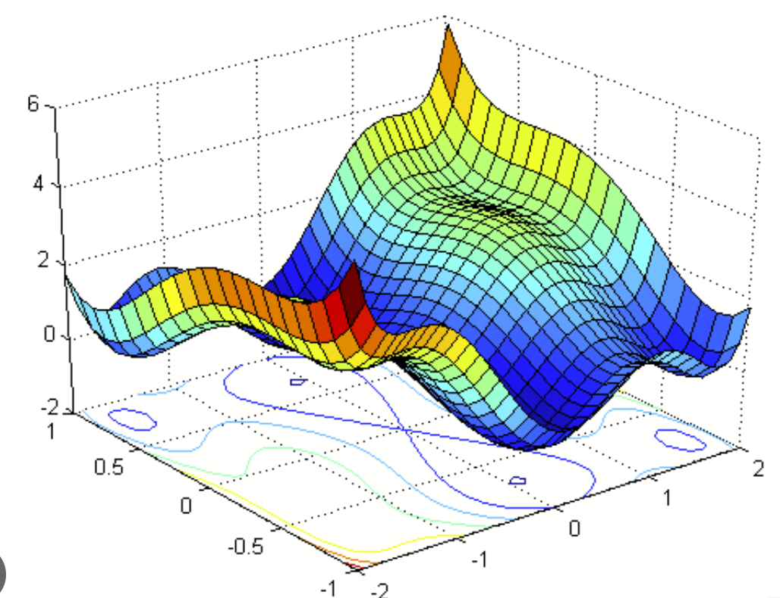



Choosing a programming language – Question 3
Is there a compelling library or framework?
Was the language purpose-designed for a particular task?
+
Scientific computing

Slide 37




Choosing a programming language – Question 3
Is there a compelling library or framework?
Was the language purpose-designed for a particular task?
+
Websites

Slide 38

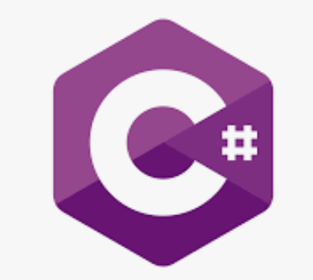

Choosing a programming language – Question 3
Is there a compelling library or framework?
Was the language purpose-designed for a particular task?
+
Games

Slide 39




Choosing a programming language – Question 3
Is there a compelling library or framework?
Was the language purpose-designed for a particular task?
Mobile Apps

Slide 40
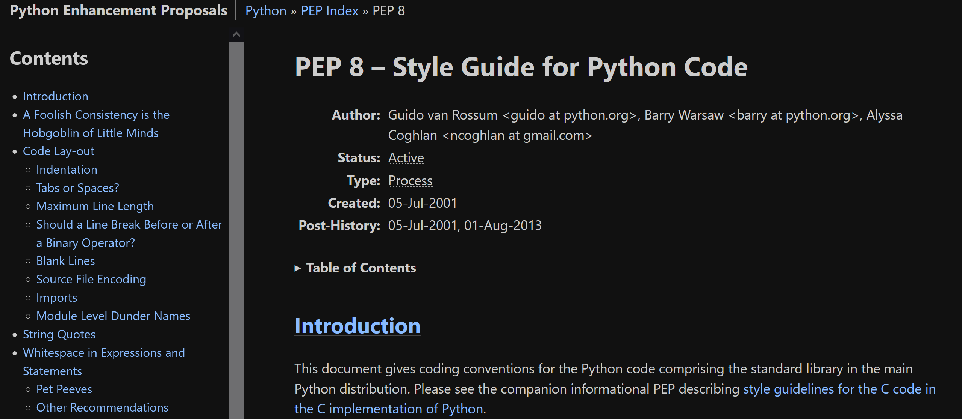
Advice
Find a mentor
RTFM (RTFD?)
Find a reputable style guide – sometimes included in the docs
Learn Git simultaneously

Slide 41
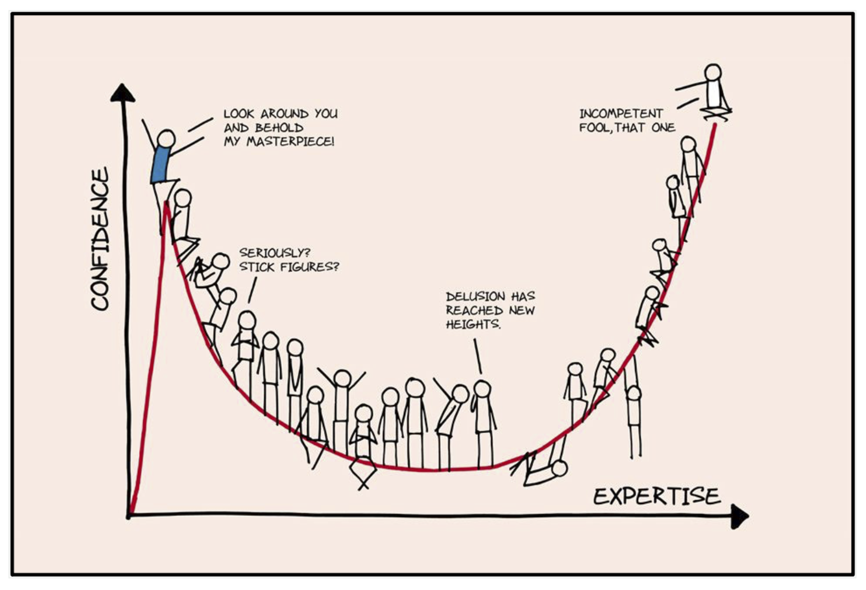
Relevant XKCD

