Slide 1


Research Vessel Technical Enhancement Committee
General Updates and Considerations
Subcommittee Updates:
  SatNag – Satellite Network Advisory Group
  CIWG – Cyber Infrastructure Working Group
  Tech Training – “What Went Wrong Wednesdays”
  MAC – Multibeam Advisory Committee
  Working Group
11 July 2025
Notes:
RVTEC promotes the scientific productivity of research programs that use research vessels and oceanographic facilities and fosters activities that enhance technical support for sea-going scientific programs.

Slide 2
RVTEC: General Updates
Budgets: Grants Cooperative Agreements
Tech Pool & Tech Exchanges
Vendor support
Shipping delays
Tariff impacts
RVTEC Conference, November 3 – 7 @ SIO
Increased comradery across operators
Cruise plan early and accurately
11 July 2025
Notes:
Many operators are switching tech budgets from grants to cooperative agreements. Many already issued, a few more are in progress.
Tech Pool and Exchanges are used across most operators to support relief for full-time technicians, supporting operators who are ‘between ships’ (OSU and soon-URI)
Some critical vendor support for repair, troubleshooting, and calibration is sub-par (paucity of informative responses, extremely long lead times, increased prices); these are niche industries without implementable alternatives
Shipping delays are disrupting cruises. Ship early whenever possible.
Tariffs impacting purchases made on awards issued pre-tariff
RVTEC Conference planning is well underway. To be held in-person November 3-7 at SIO. Focus will be on tech fundamentals and trainings with more breakout sessions and fewer plenaries. Topics include: Rigging, terminations, AI use, CI/CS, instrument troubleshooting, best practices, etc.
Tech teams and managers across the fleet have strong sense of comradery and have vested interest in helping each other with technical troubleshooting and problem solving of all flavors – it really speaks to the sense of community we share
Encourage science parties to provide cruise planning information early and accurately. Clear communication and organization is needed now more than ever and we need science to help us help them succeed.

Slide 3
Satellite Network Advisory Group (SatNAG)
Cyber Infrastructure Working Group (CIWG)
  Technical consulting and liaison role
Cyber Training Cruises
  RV Endeavor (December 2024)
  RV Sikuliaq (April 2025)
Next Generation Firewall - Fortigate
Help Organize RVTEC Cyber Monday
Advisory role for NSF Program Directors
  Anchor Act
  Safer Seas Act
11 July 2025
Notes:
Cyber Infrastructure Working Group (CIWG)
Technical consulting and liaison role
Cyber Training Cruises
RV Endeavor (December 2024)
Hands on experience with FortiGate for sailing techs from multiple ARF vessels
A lot of hands-on network troubleshooting skills development
RV Sikuliaq (April 2025)
Hosted first STEMSeas Computer Science Undergraduates
Facilitation of hands-on FortiGate training exercises
Diverse group of individuals from many walks of life fostered a rich exchange of ideas
Next Generation Firewall
Continued development and deployment of the Fortigate Next-Gen Firewall
Updated FortiGate information in SatNAG wiki
Help Organize RVTEC Cyber Monday
Advisory role for NSF Program Directors
Anchor Act
Safer Seas Act

Slide 4
Cyber Infrastructure Working Group (CIWG)
Updates on SASH (see other updates on Digigone)
Increased awareness of documentation requirements for regulatory requirements
Opportunities to form working groups on CI/CS topics
11 July 2025

Slide 5
Tech Training Committee
What Went Wrong Wednesday (WWWW) Webinars
  CORIORLIX: 16 April 2025 (https://www.youtube.com/watch?v=Ai2wVbWh4ic)
  UHDAS and ADCPs: 21 August 2024 *working on getting the upload now*
  pCO2 Systems: 24 April 2024 (https://www.youtube.com/watch?v=WDl0HMxgxhI)
  TBD Aug 2025: USGS sub-bottom expert to present on SBP-29, TOPAS, and Knudsen 3.5 kHz systems
RVTEC Wiki
Assisting with coordinating other training activities, as needed by the community.
11 July 2025
Notes:
Tech Training Sub-Committee Update
We are working on getting our page on the UNOLS website for the Tech Training Sub-Committee up and running.
In the meantime, we should get you on the mailing list and I am adding you to the shared Google Drive where we keep our meeting notes and other materials.
Accomplishments for 2024/2025-
What Went Wrong Wednesday (WWWW) Webinars
CORIORLIX - April 16th , 2025 (https://www.youtube.com/watch?v=Ai2wVbWh4ic)
UHDAS and ADCPs- August 21st, 2024 *working on getting the upload now*
pCO2 Systems- April 24th, 2024 (https://www.youtube.com/watch?v=WDl0HMxgxhI)
We now get the recordings posted to UNOLS YouTube account and send out a message to RVTEC, for visibility.
Our group also sends out polls to RVTEC listserv before the webinars, to get a pulse of how familiar folks are with the topic and what some of the burning questions are (these surveys are anonymous).
Remaining items for 2025-
Work on putting together a RVTEC Wiki (this isn't exclusively a Tech Training Sub-Committee item but we are heavily involved with it)
Upcoming WWWW - date still getting nailed down but likely August 2025- USGS sub-bottom expert to present on SBP-29, TOPAS, and Knudsen 3.5 kHz systems
Assisting with coordinating other training activities, as needed by the community.

Slide 6
Recent MACtivity: USARF Support 2024-25
Ship​ | System(s)​ | Arrays​ | Life Cycle​ | MAC Visits (Most Recent)​ | 2025 Plans​
Atlantis​ | EM124​ | 2021​ | Early​ | ANT, SAT* (2021), QAT* (2024) ​ | QAT*​
Healy​ | EM122​ | 2010 / 2023 RX​ | Late​ | ANT, SAT, QAT* (2025)​ | QAT*​
Hugh R. Sharp​ | EM2040P​ | 2024​ | Early​ | QAT (2016), SAT* (2025)​ | SAT*​
Kilo Moana​ | EM122 / EM710​ | 2012​ | Late​ | ANT, QAT* (2023, this week) ​ | QAT*​
M.G. Langseth​ | EM122​ | 2007 TX / 2010 RX​ | Late​ | ANT, QAT (2023)​ | QAT​
N.B. Palmer​ | EM122​ | 2015​ | Late​ | SAT, ANT, QAT (2015), Misc.​ | TBD​
Neil Armstrong​ | EM124 / EM712​ | 2024 (2016 710 RX)​ | Early​ | ANT, SAT* (2024)​ | QAT*​
Rachel Carson​ | EM2040​ | 2024​ | Early​ | SAT* (2024)​ | QAT*​
Roger Revelle​ | EM124 / EM712​ | 2020​ | Mid​ | SAT*, QAT* (2025)​ | QAT* ​
Sikuliaq​ | EM304 MKII / EM710​ | 2024 / 2014​ | Early/Late​ | SAT, QAT (2025)​ | QAT​
Sally Ride​ | EM124 / EM712​ | 2016​ | Mid​ | SAT (2021), QAT* (2025)​ | QAT​
T.G. Thompson​ | EM302​ | 2018​ | Mid​ | SAT, QAT* (2023)​ | SAT​
*Indicates remote support
Bold indicates recent install
Italic = pending replacement (2025+)
Green = testing in last year
ANT = Acoustic Noise Test (Gates)

Slide 7
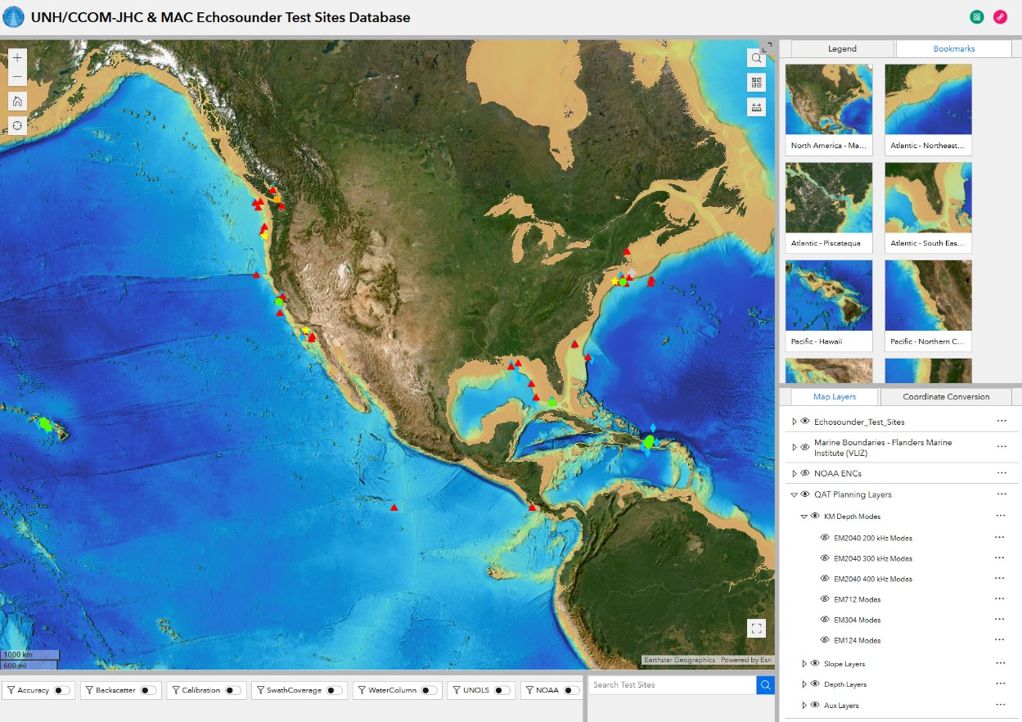
Recent MACtivity: Other Projects
Echosounder Test Site Database, Python tools, Ocean Mapping Community Wiki
RVTEC planning (+ training)
Sound Speed Manager updates
Kongsberg-CCOM annual visit
Kongsberg technical feedback
and documentation reviews
Non-routine support requests
Outreach / collaboration with
NOAA, CCOM, beyond USARF
Planning for MAC renewal ☺

Slide 8
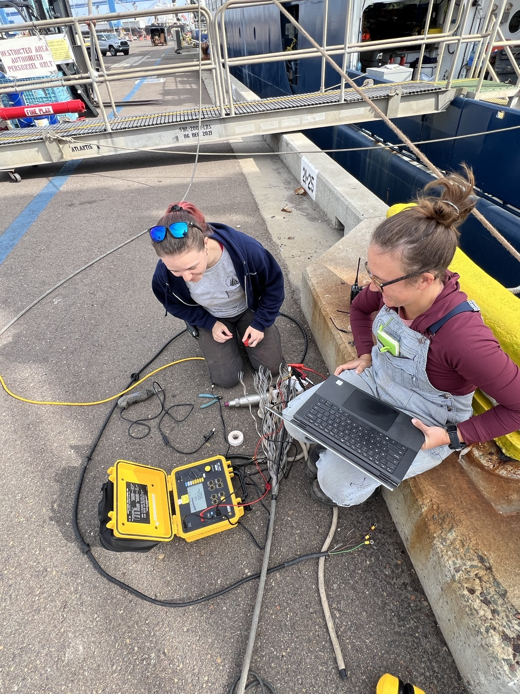
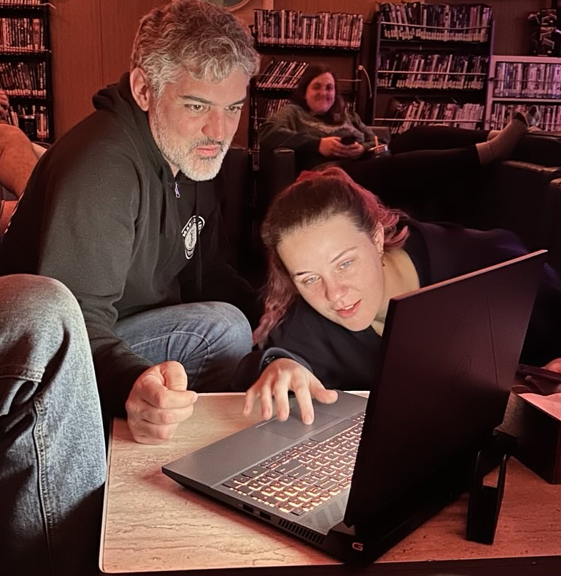
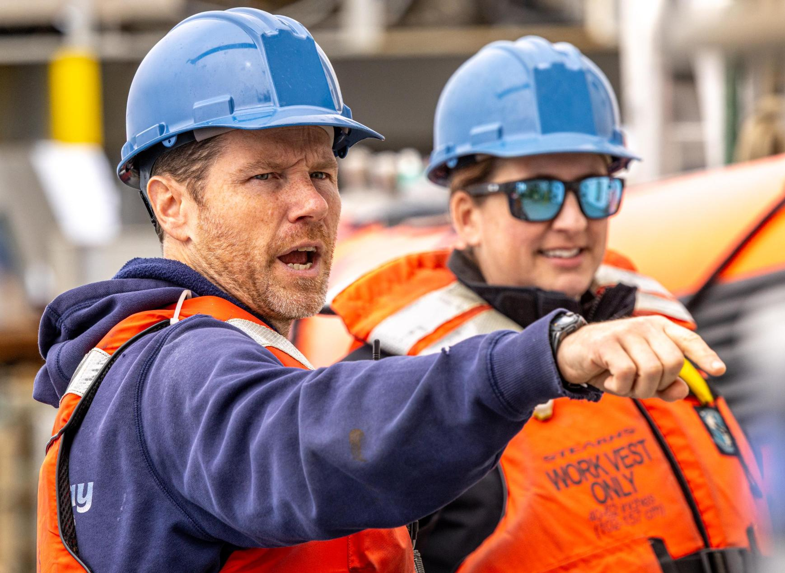
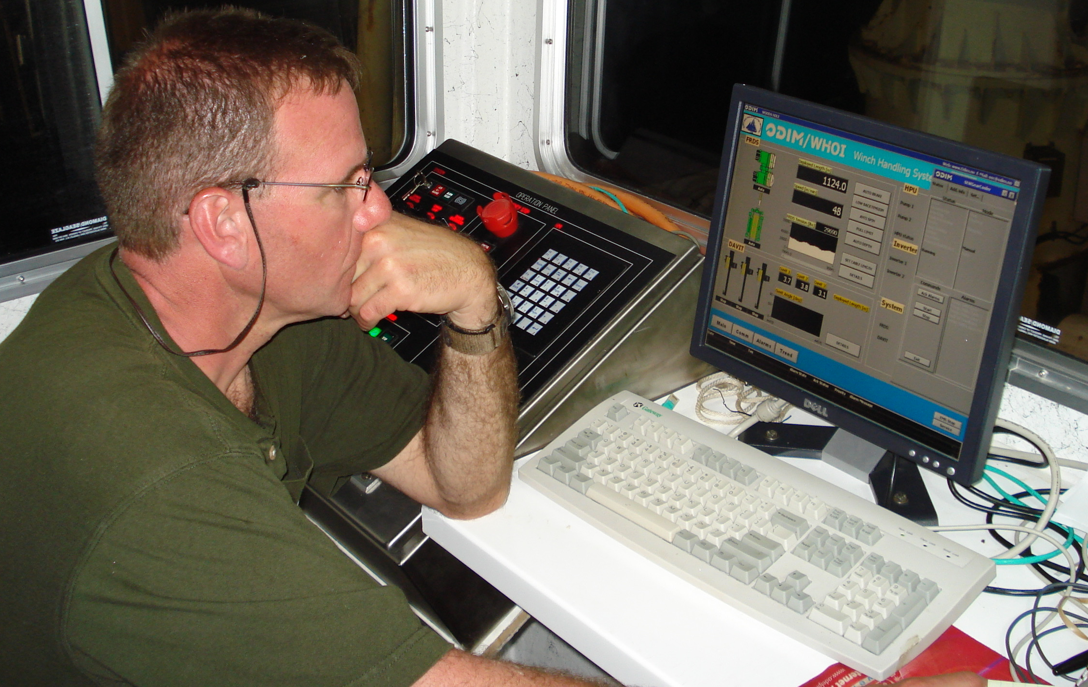
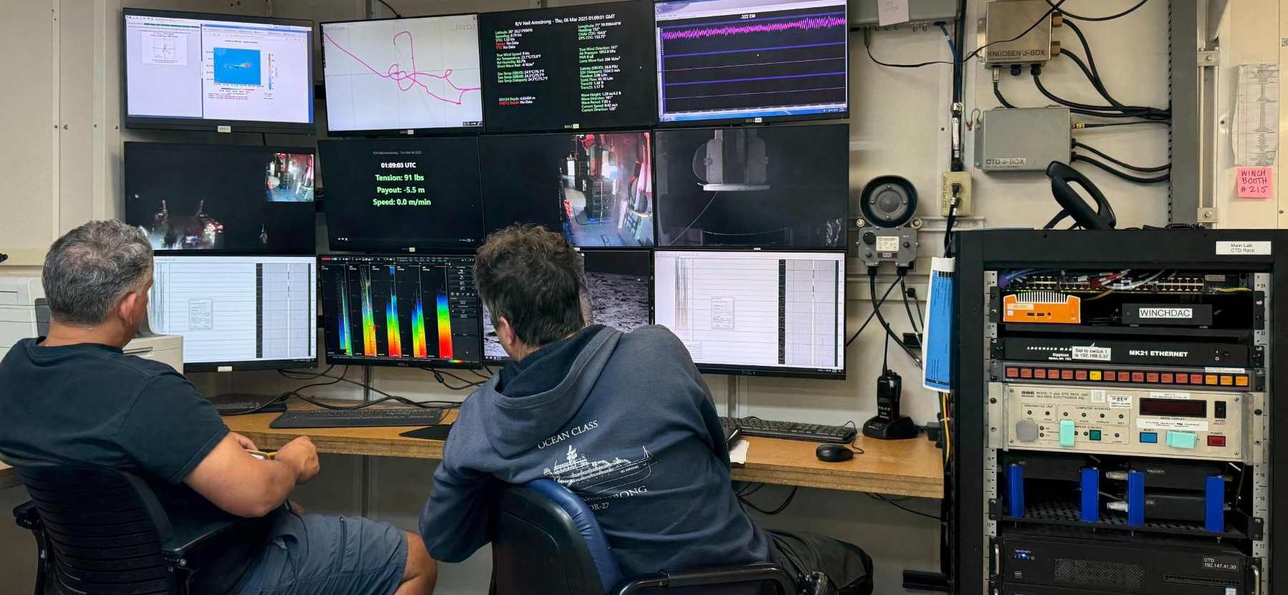
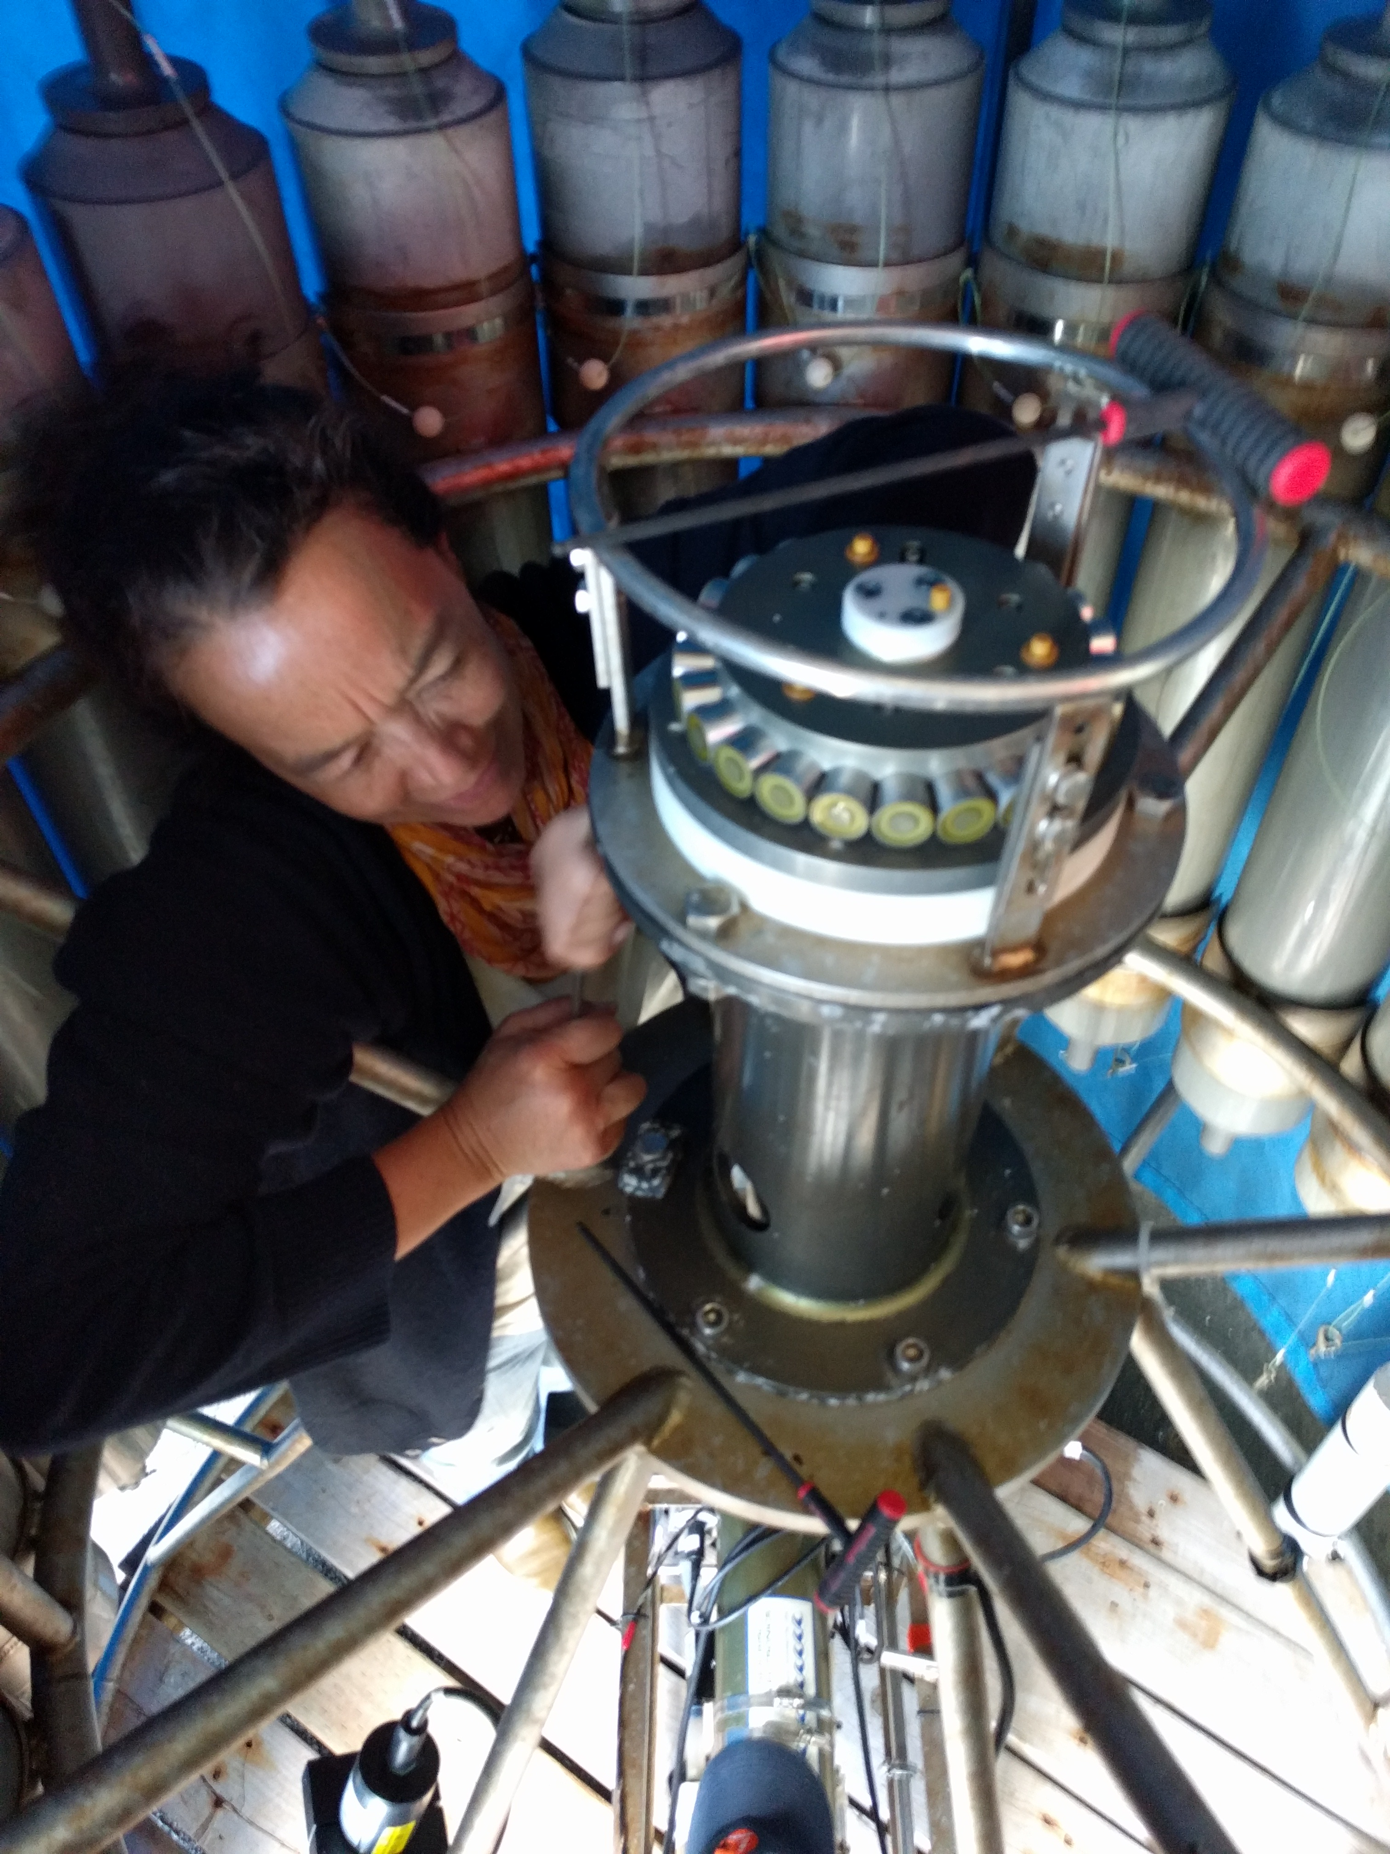
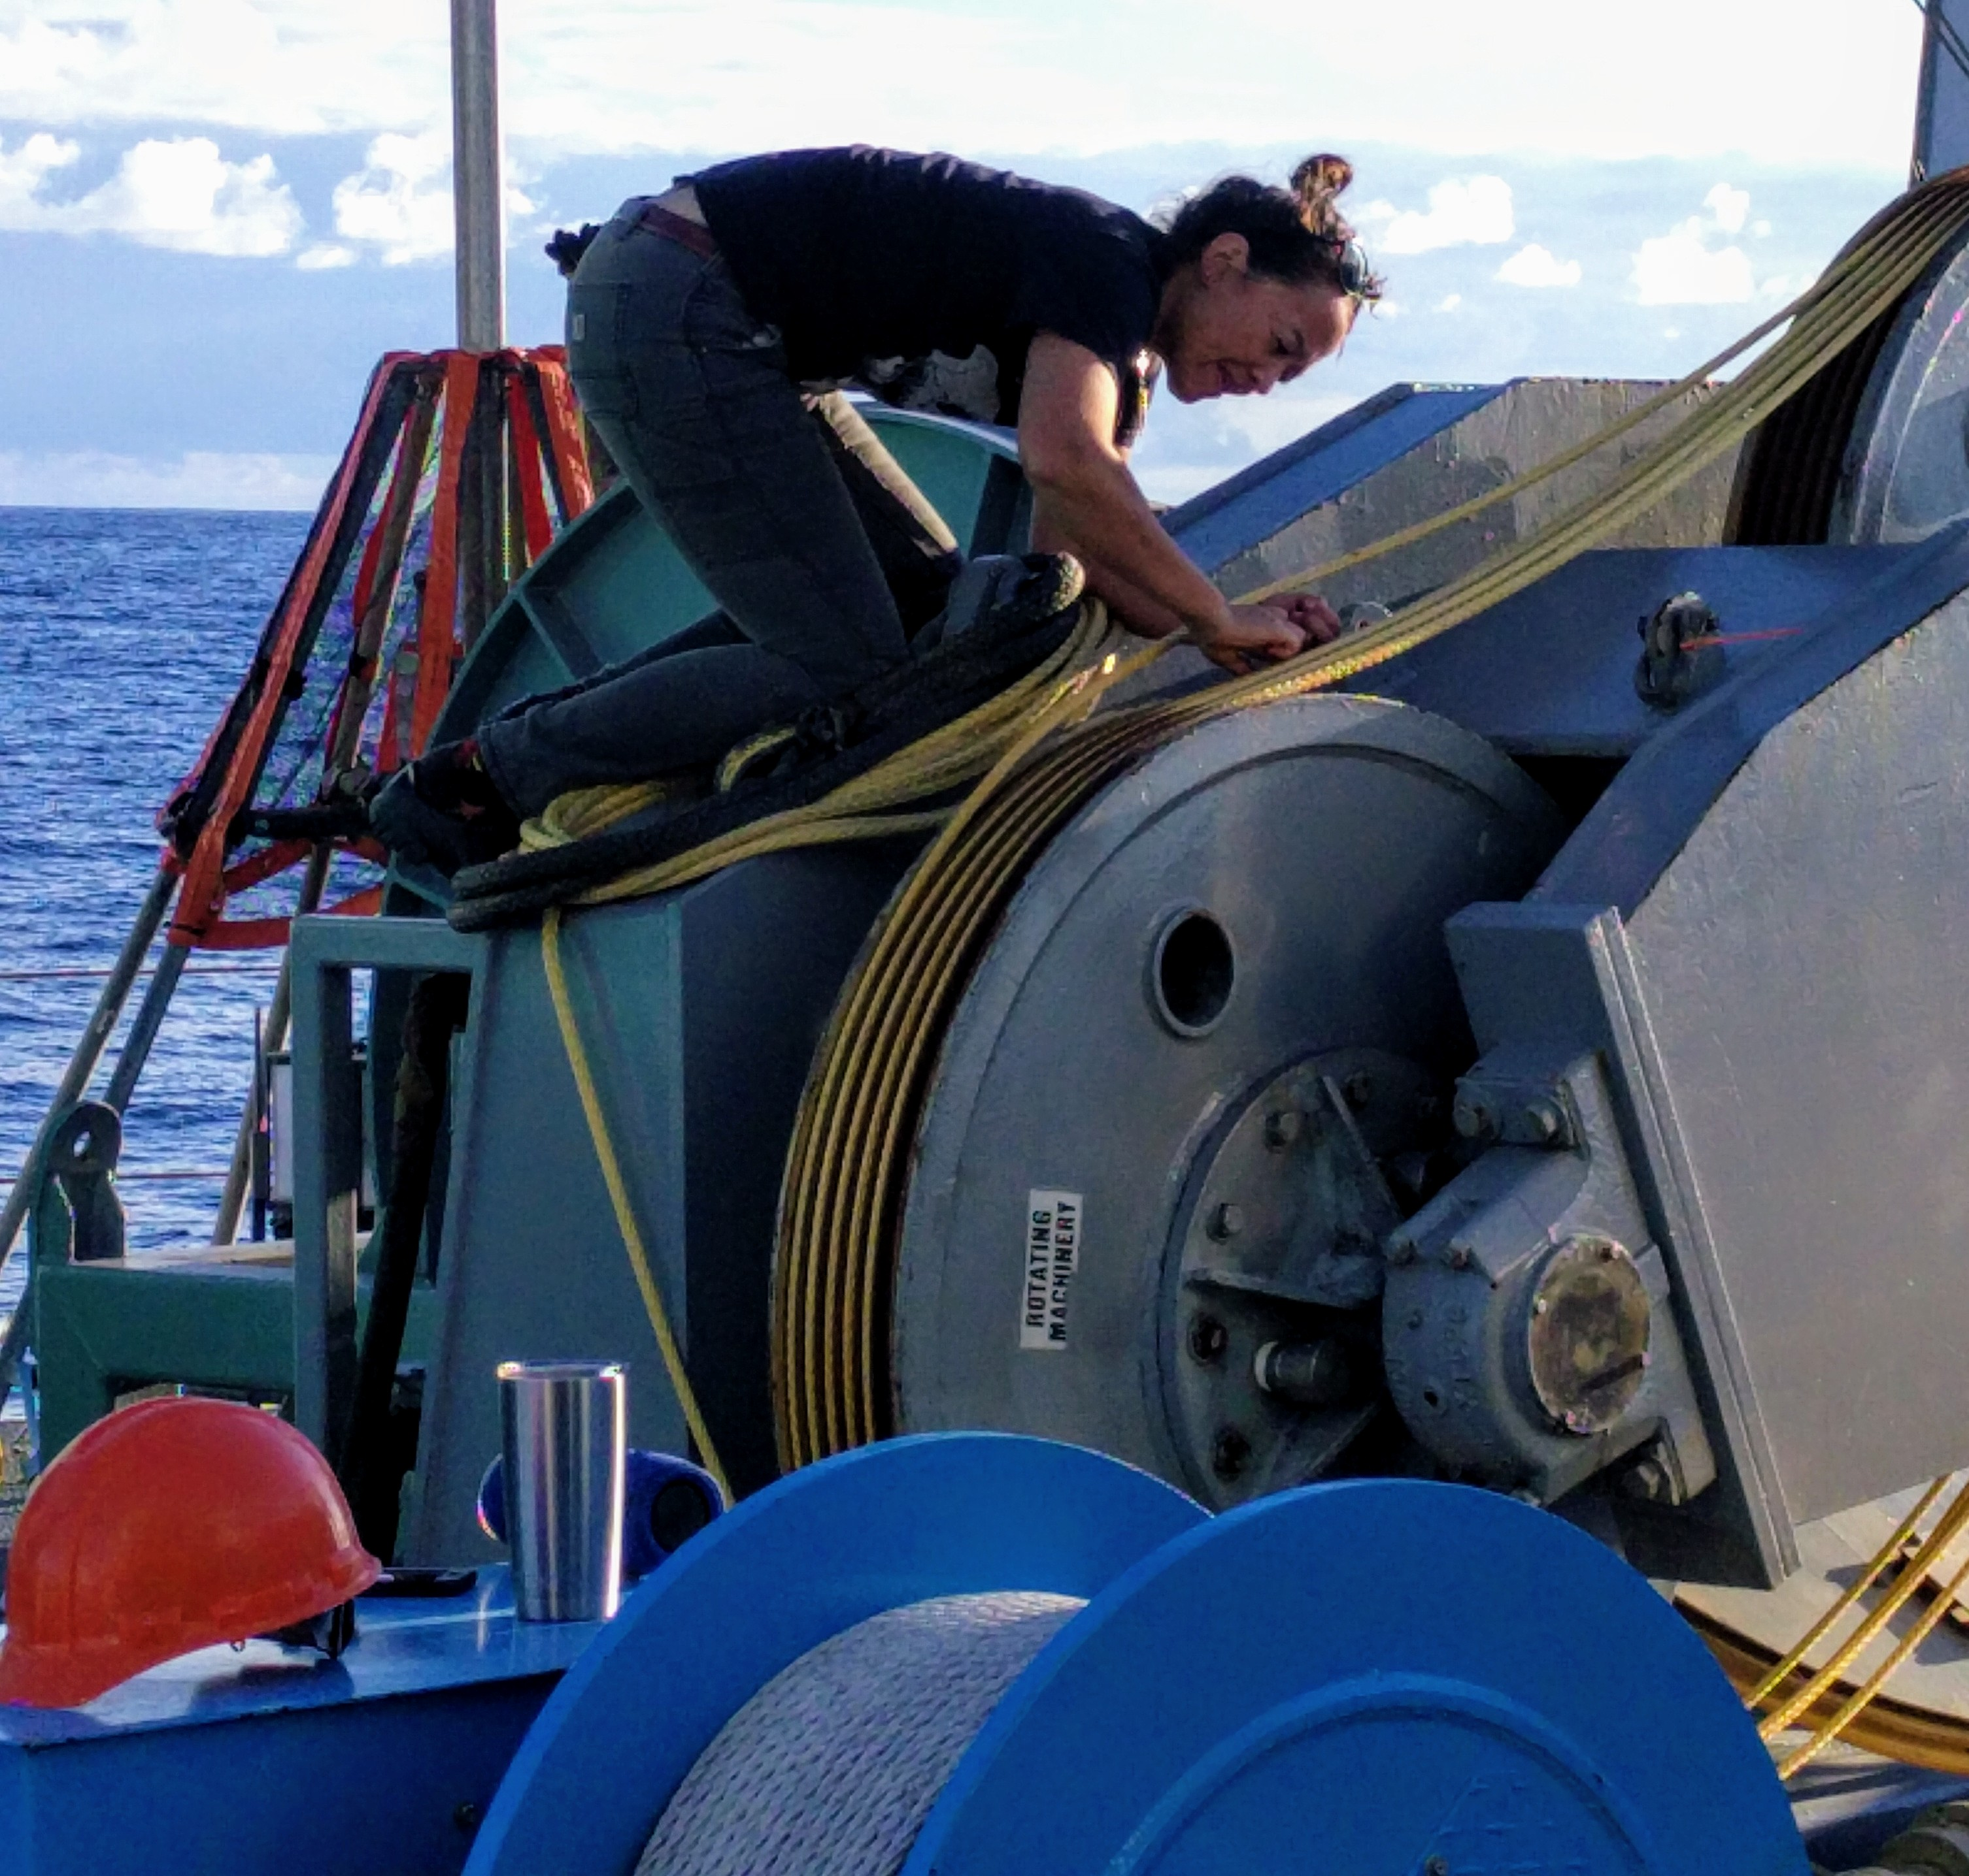
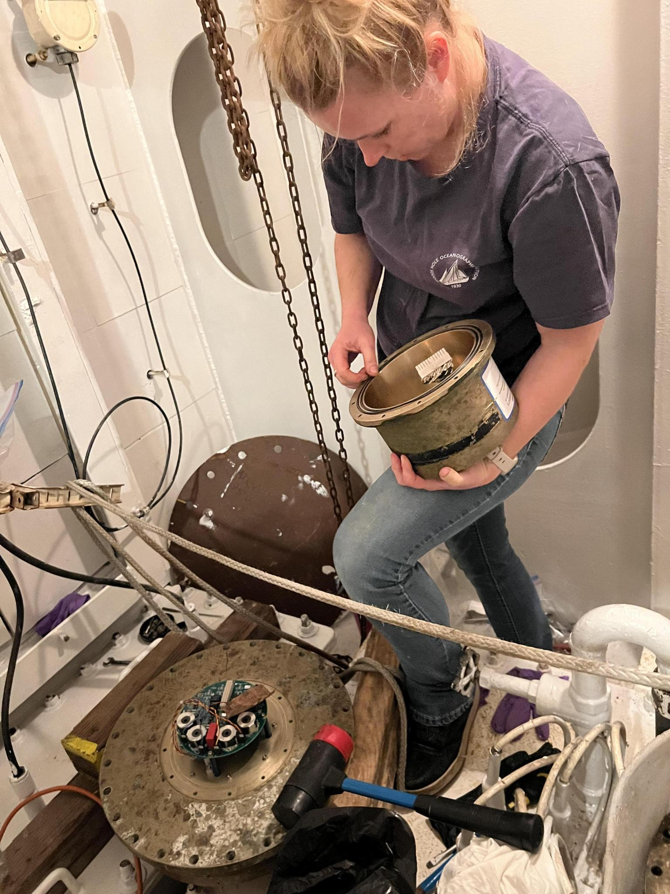
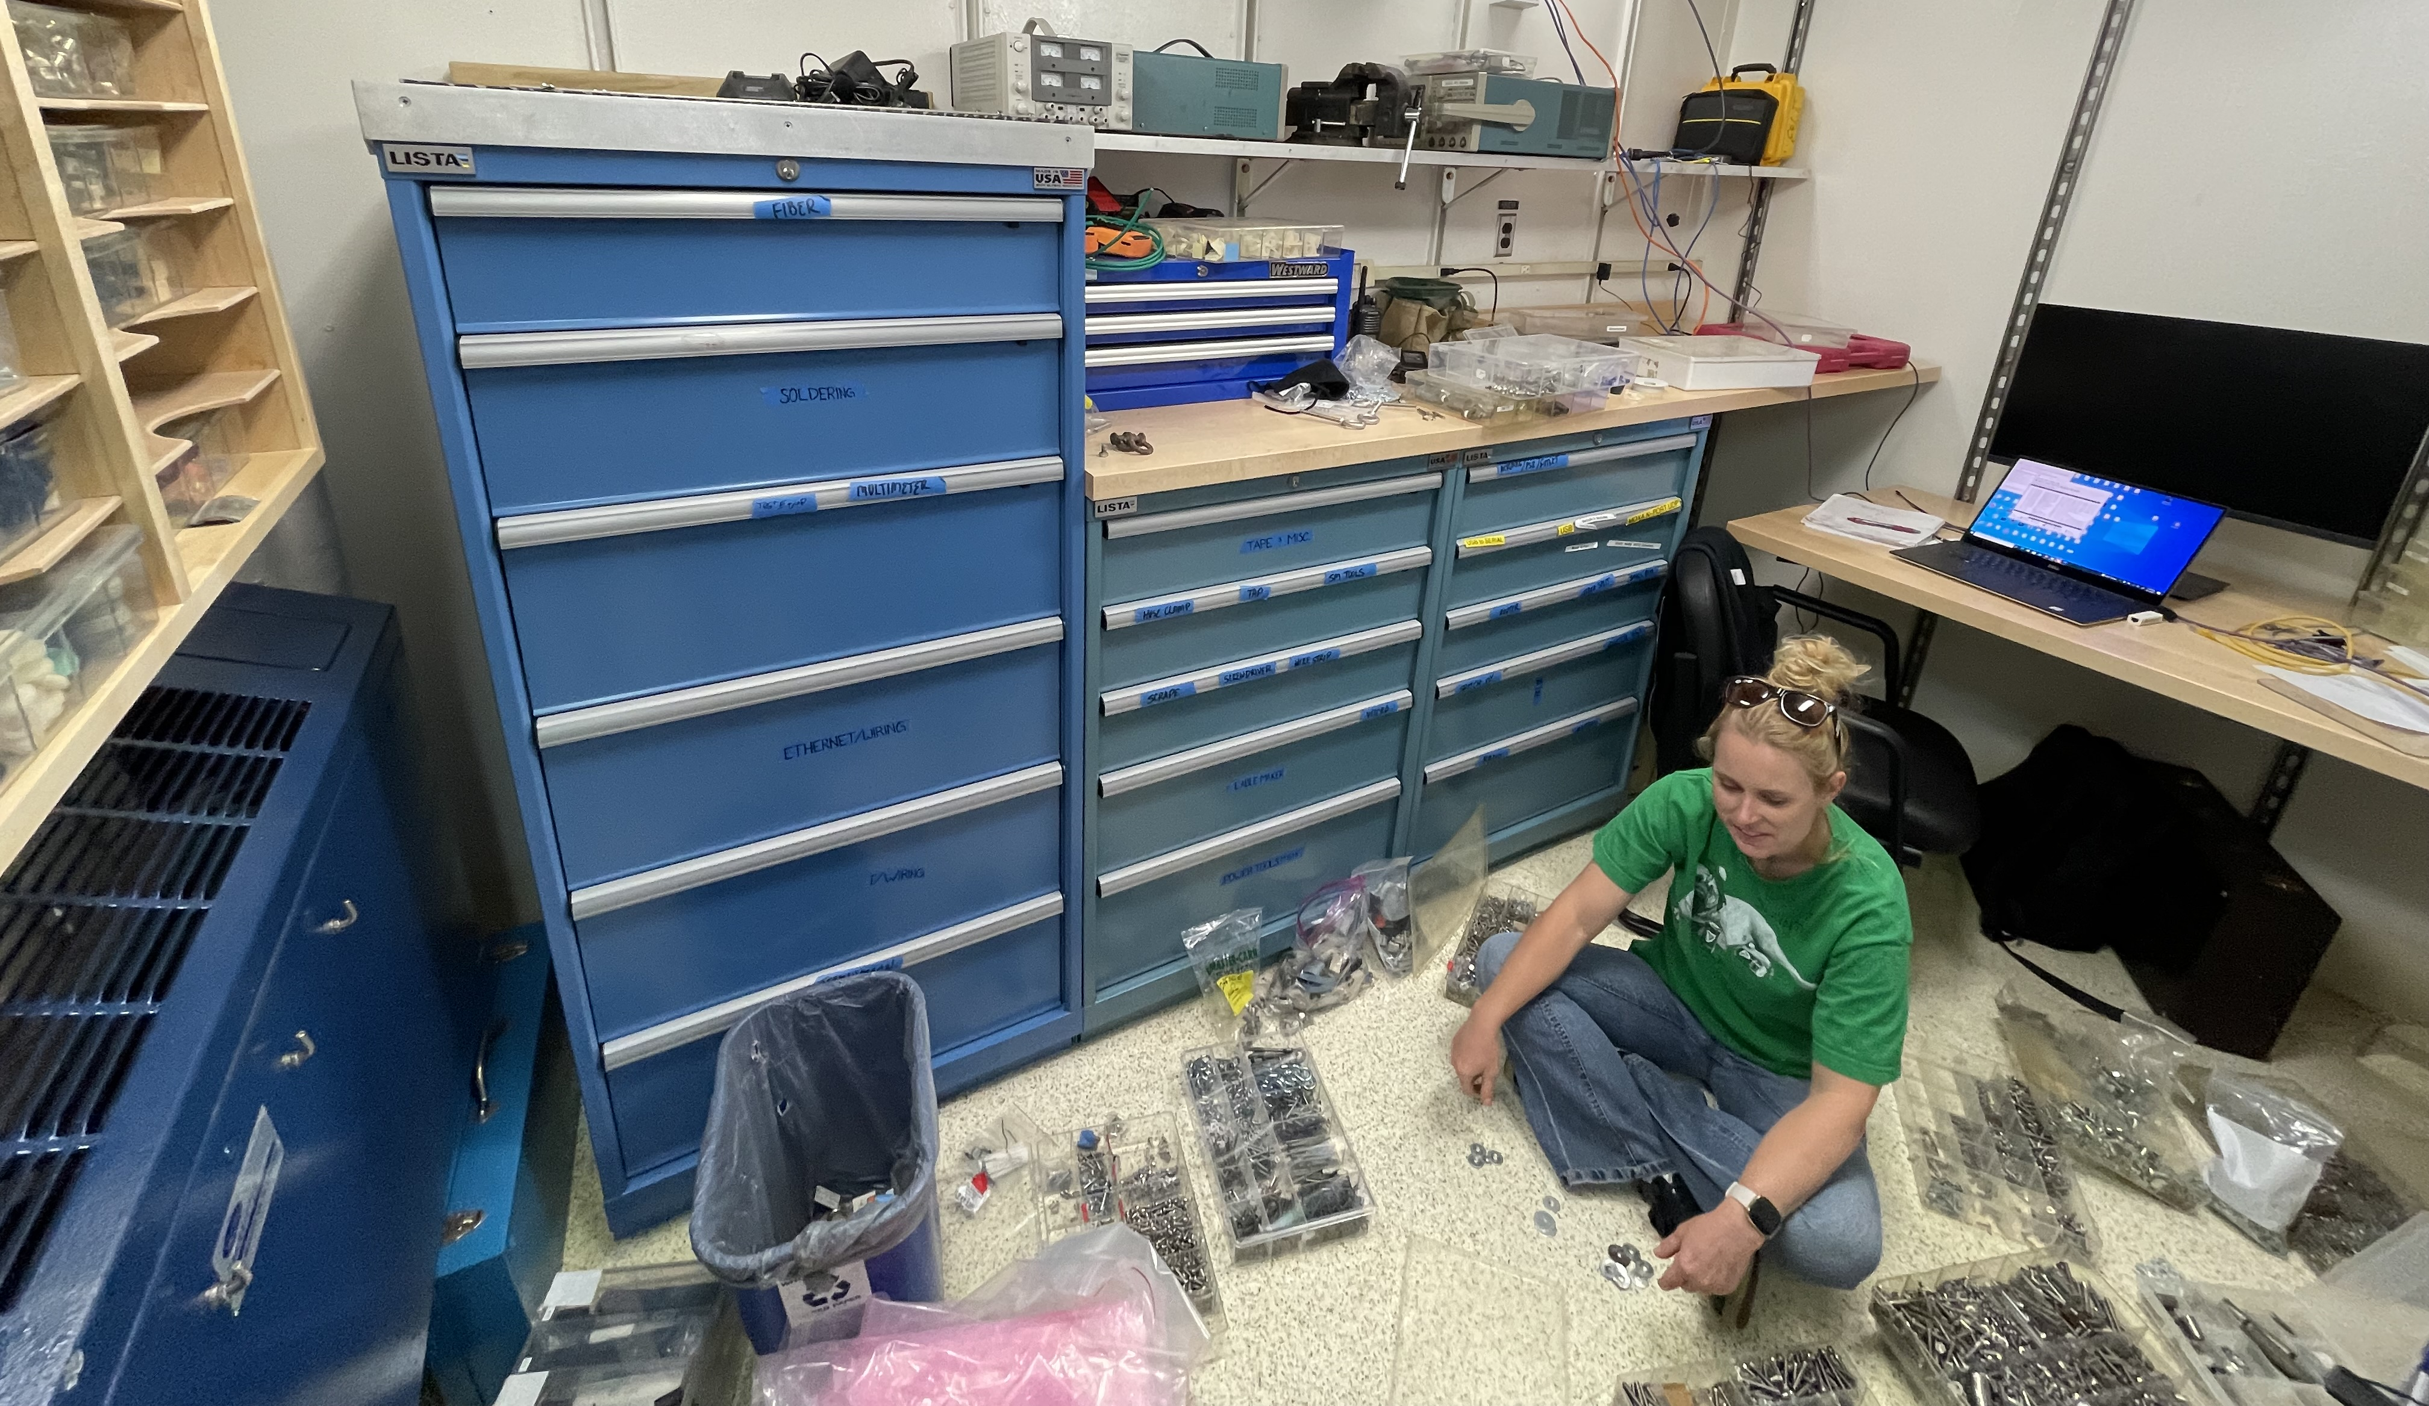
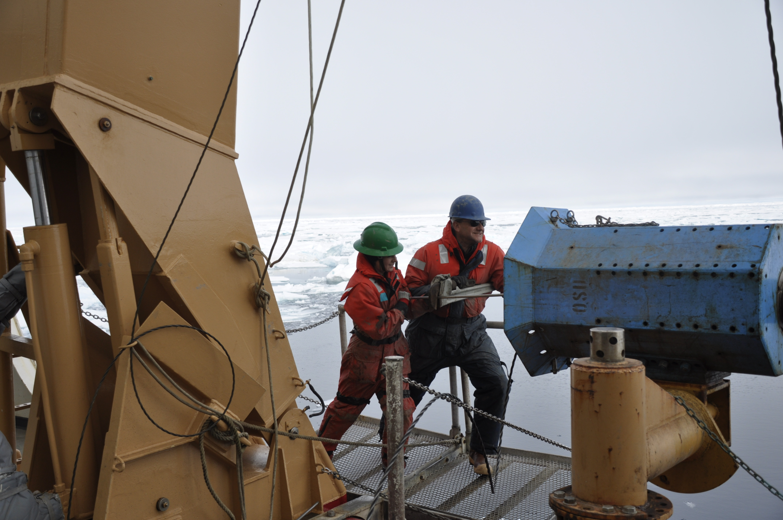
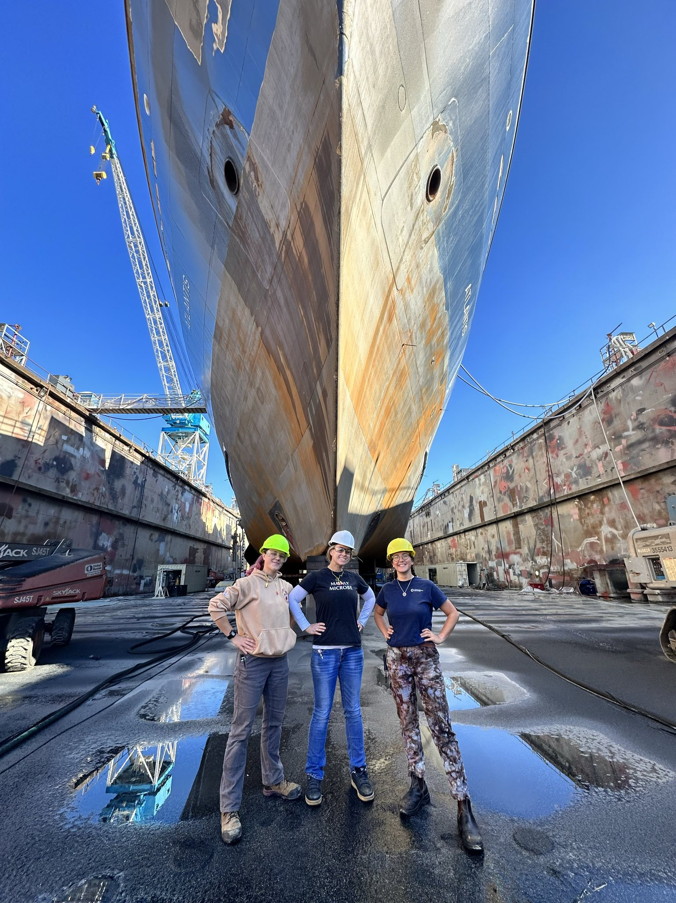
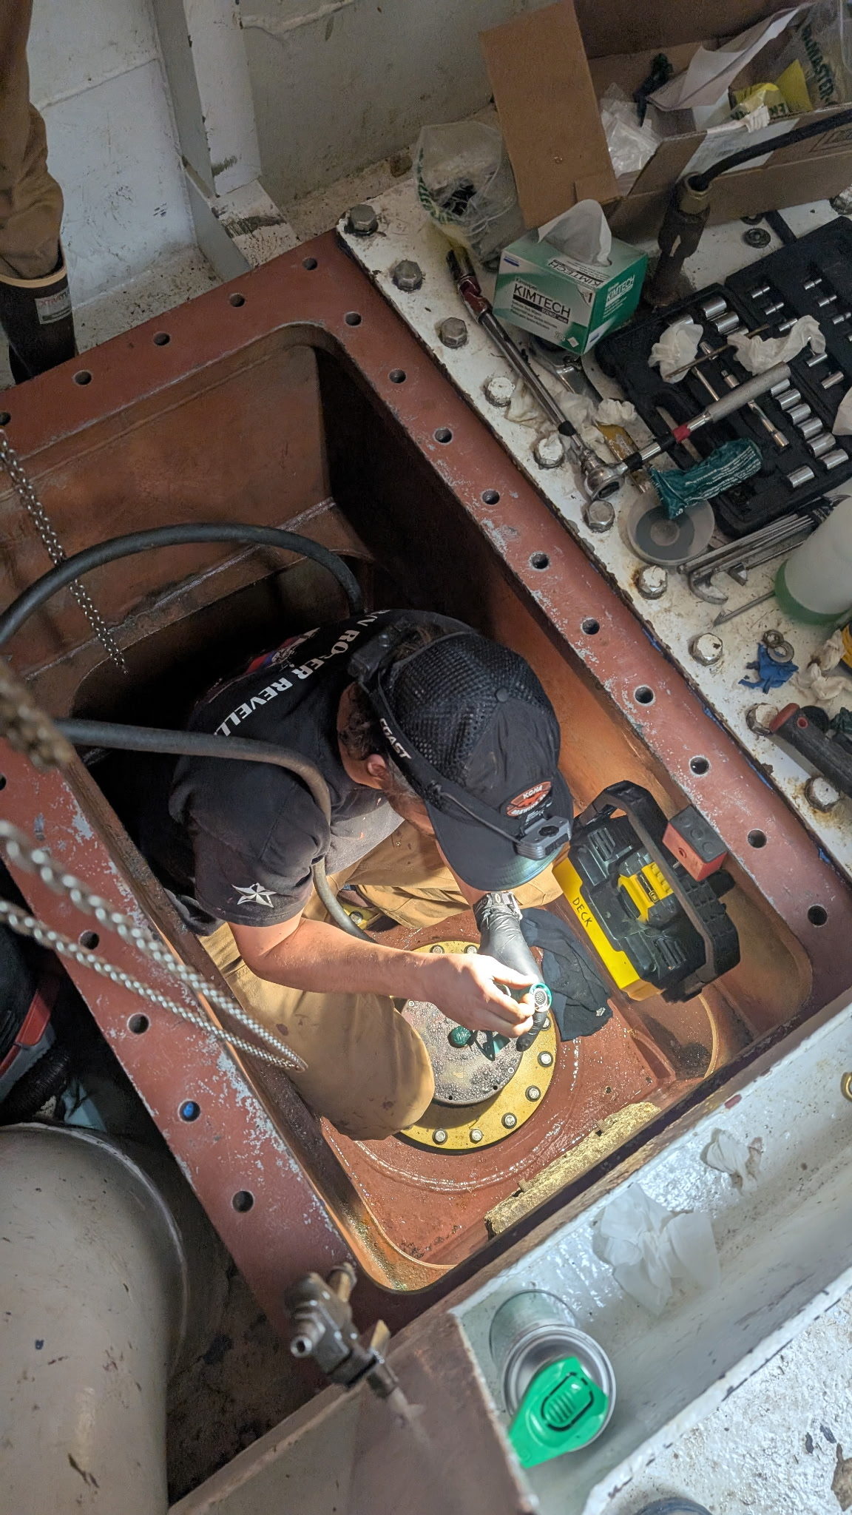
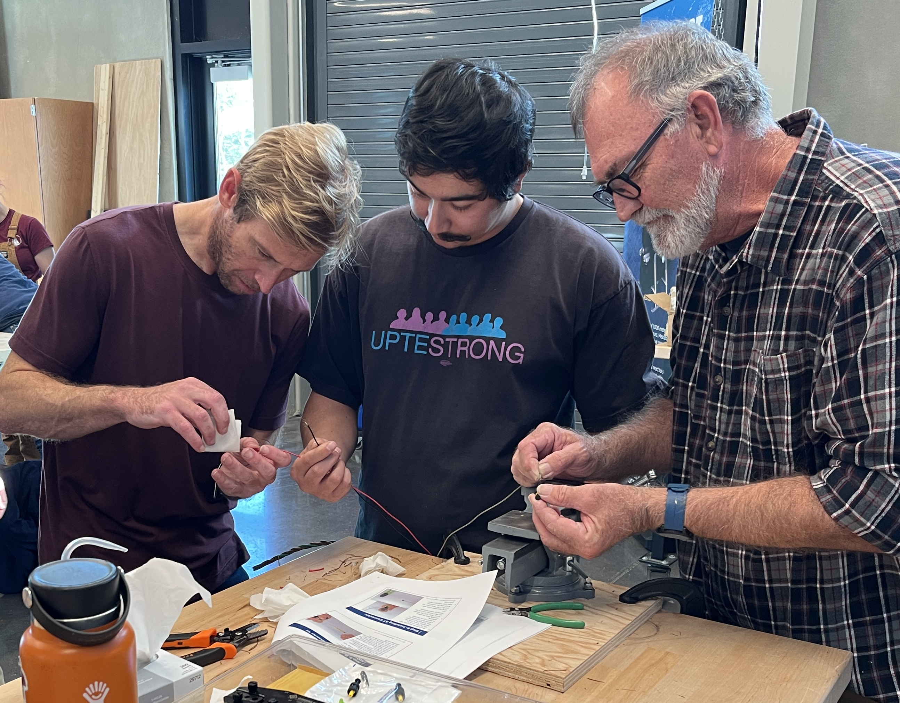
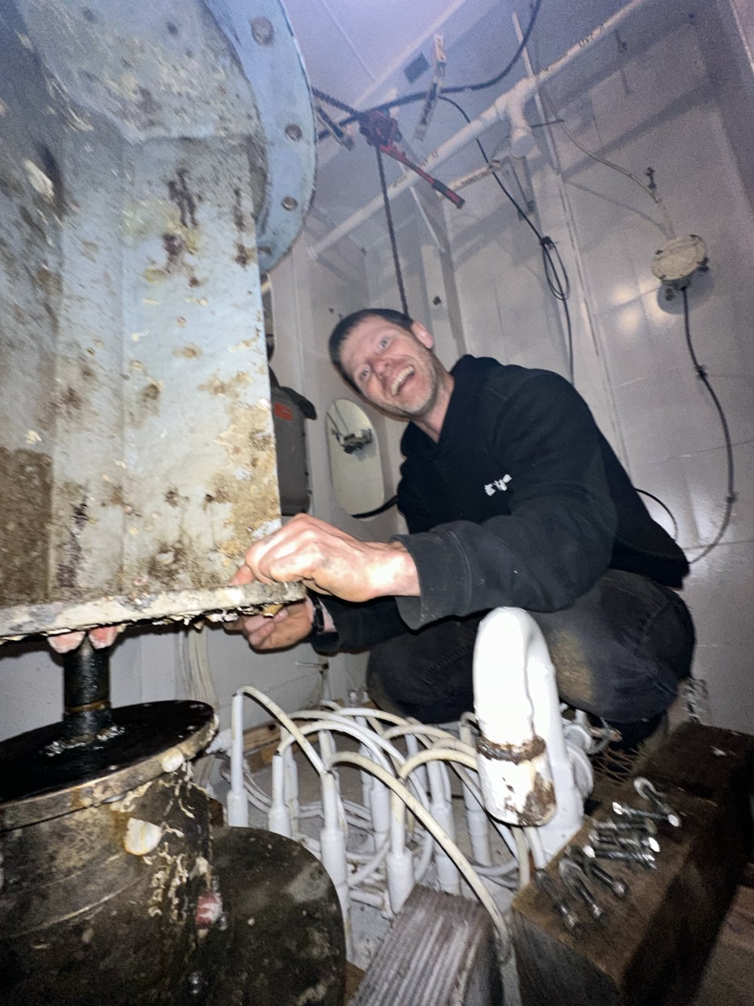
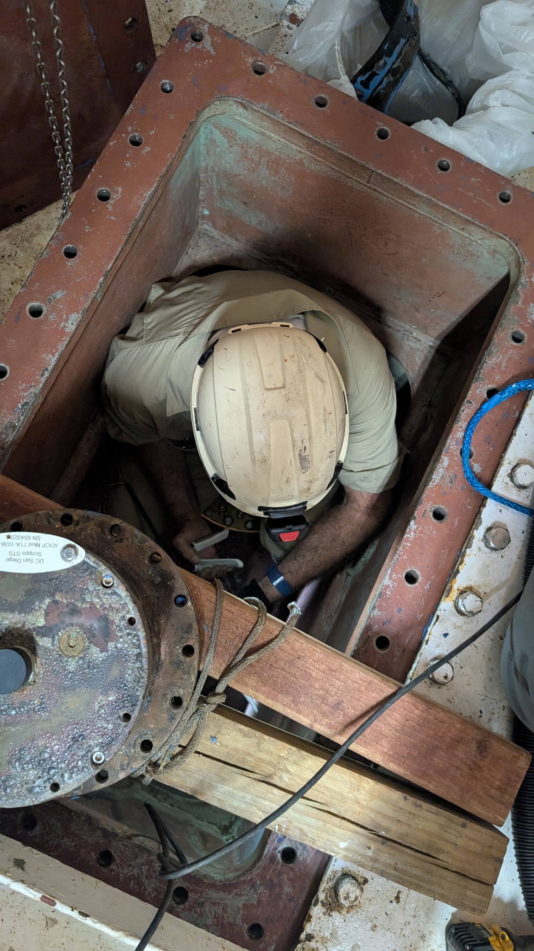
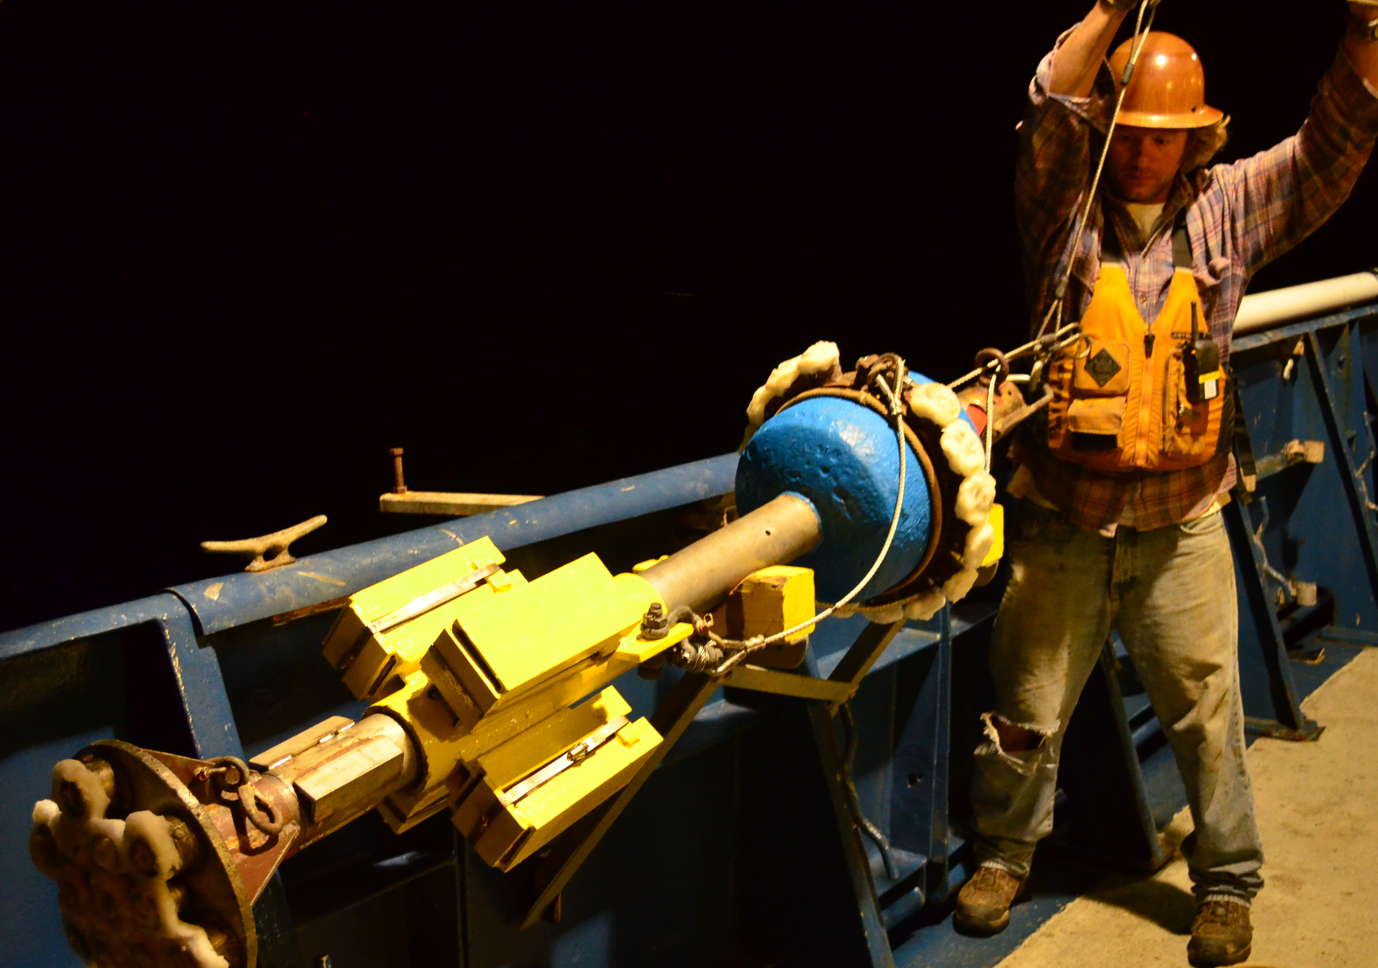
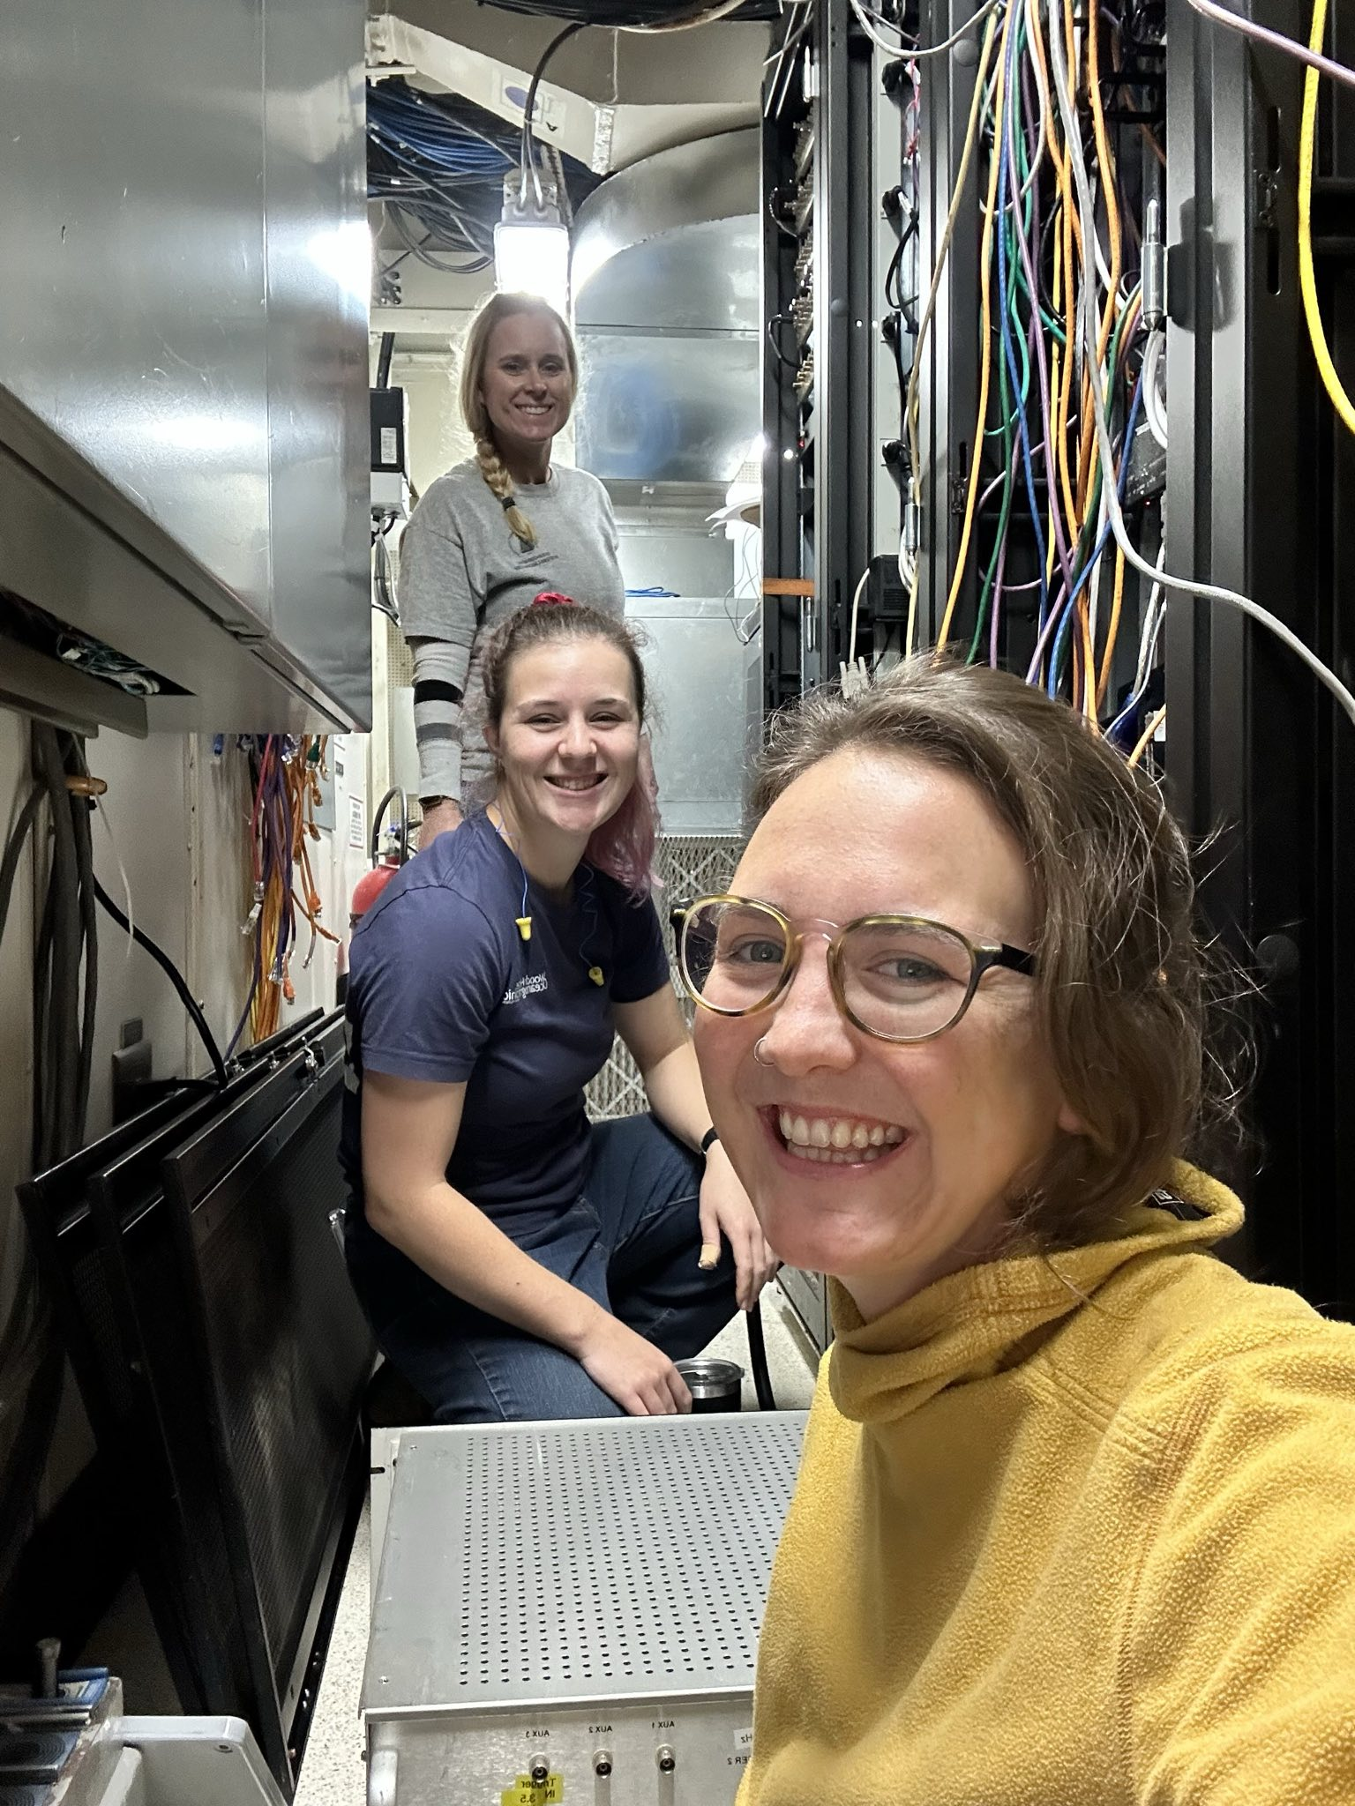
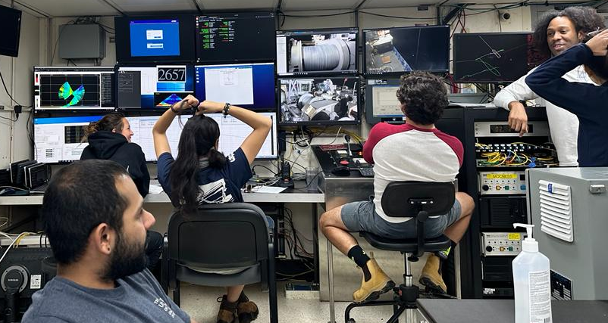
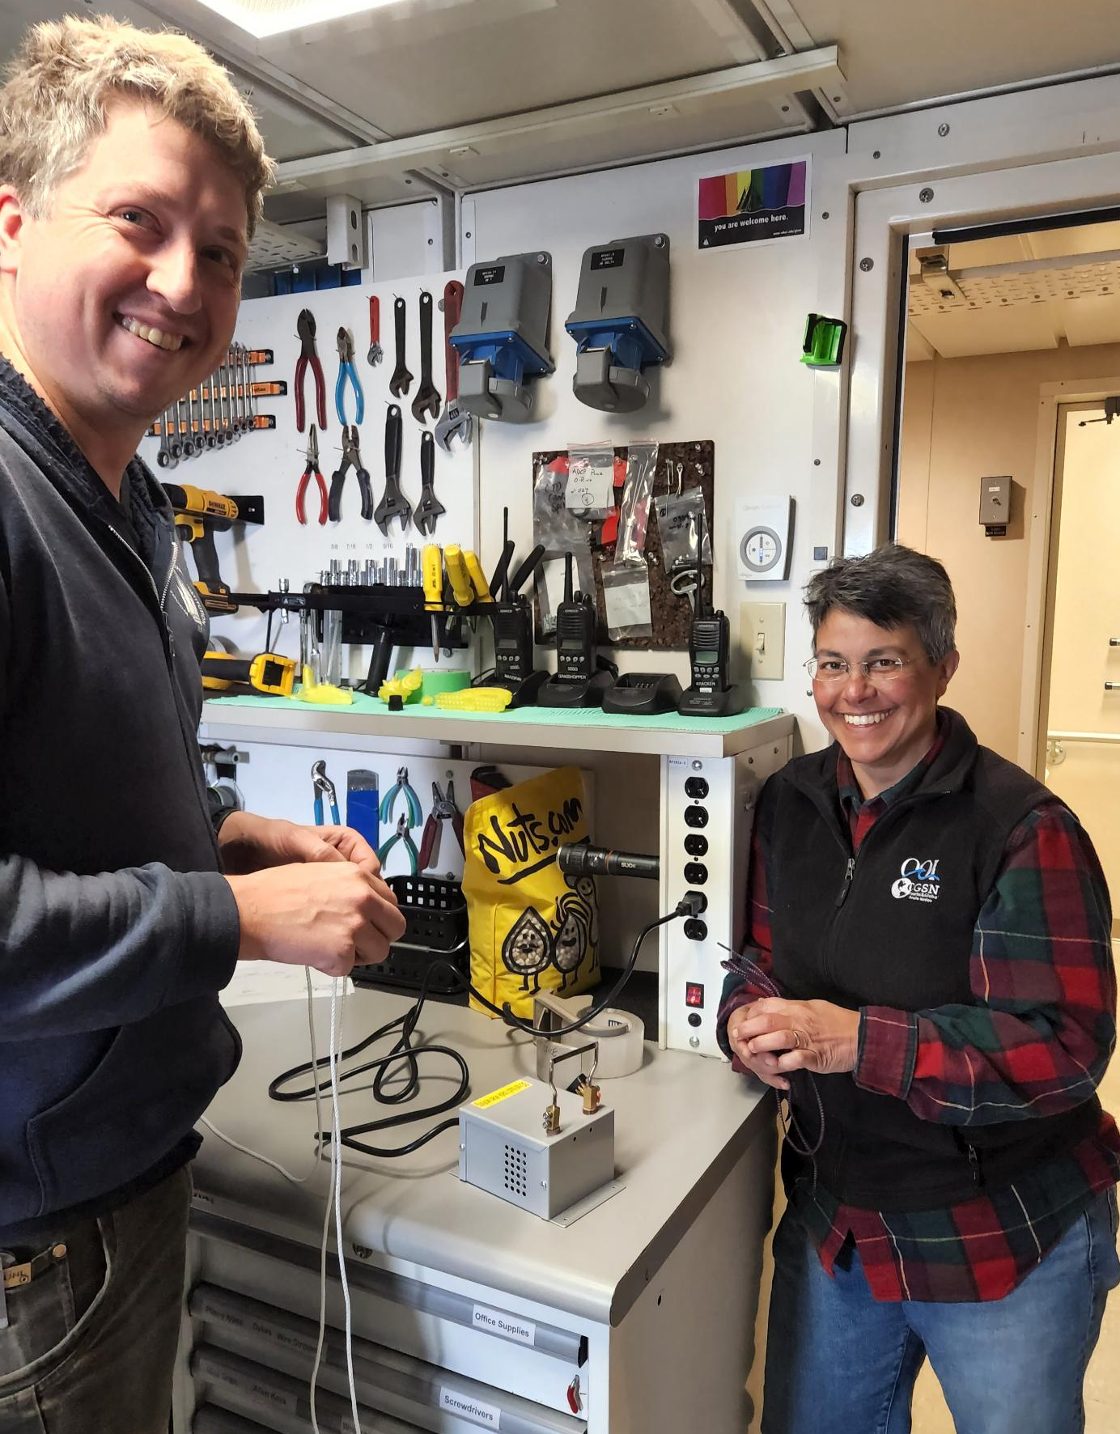
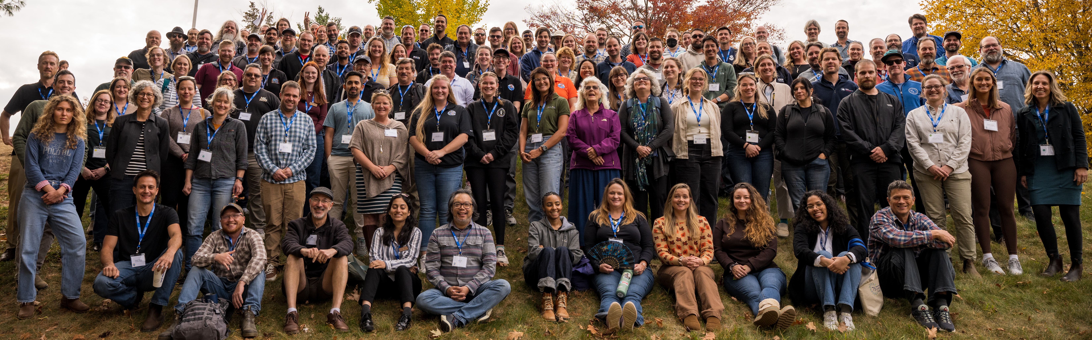
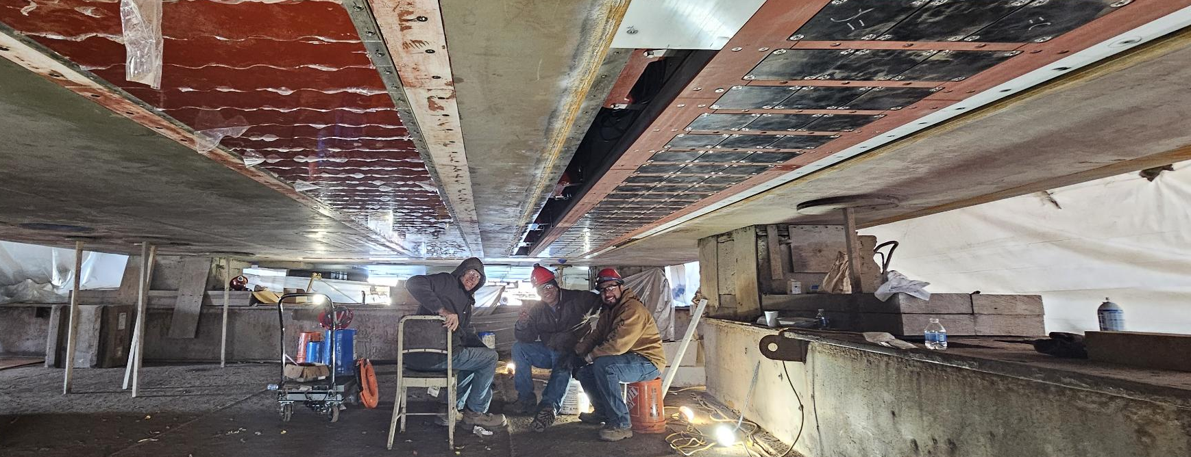
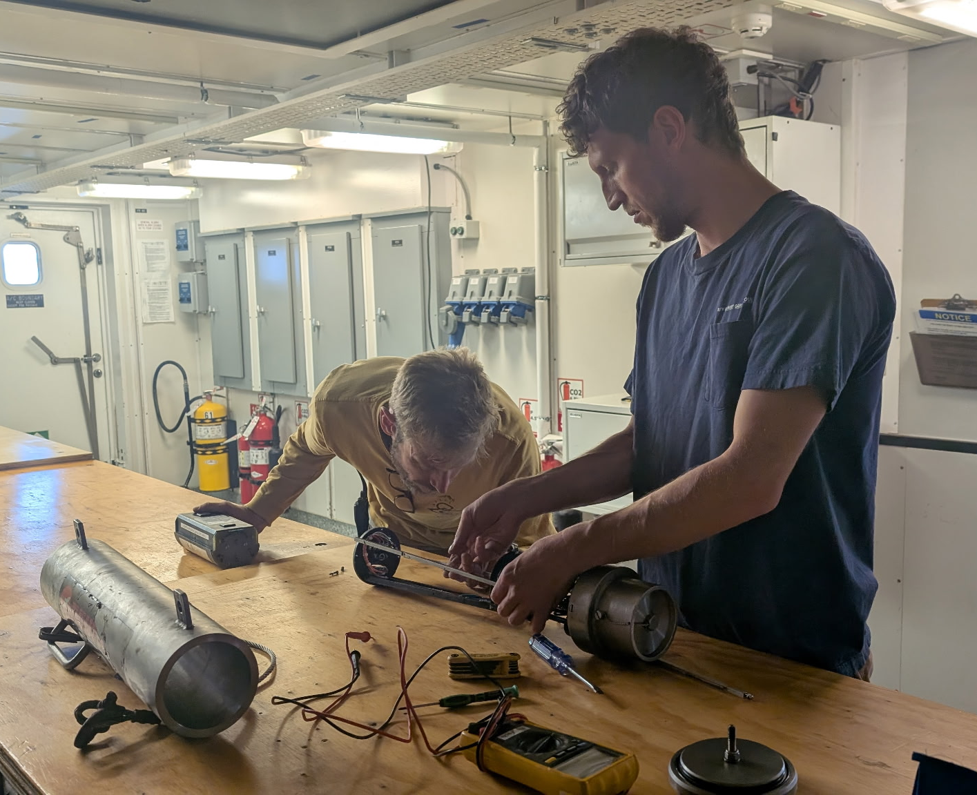
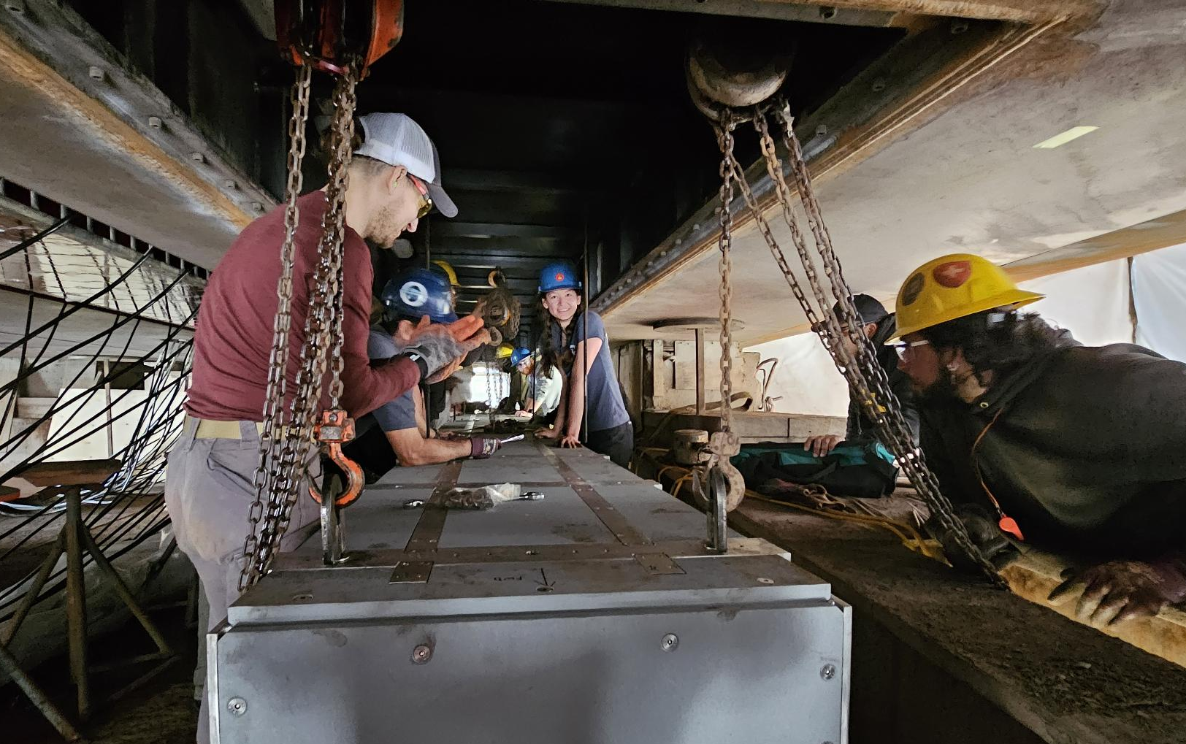
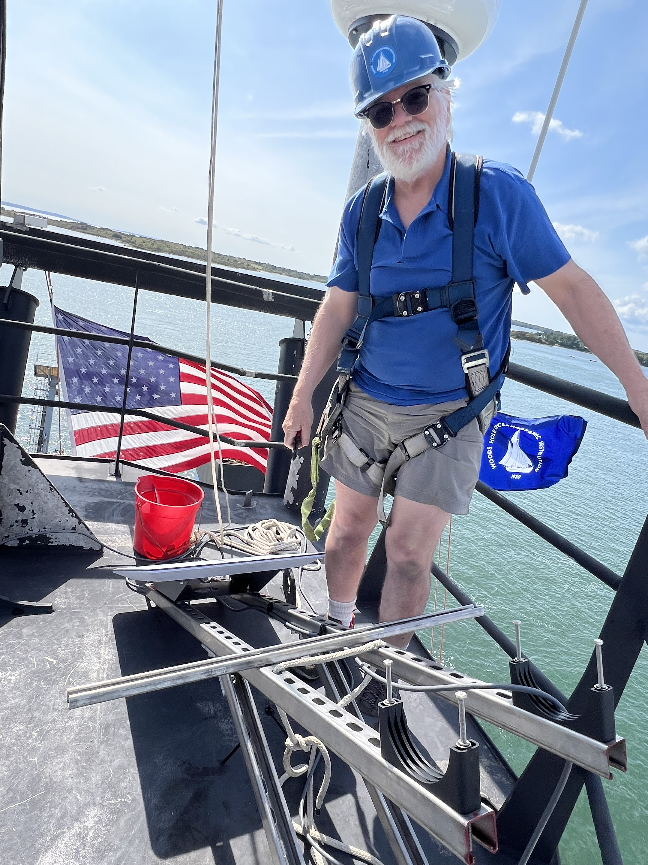
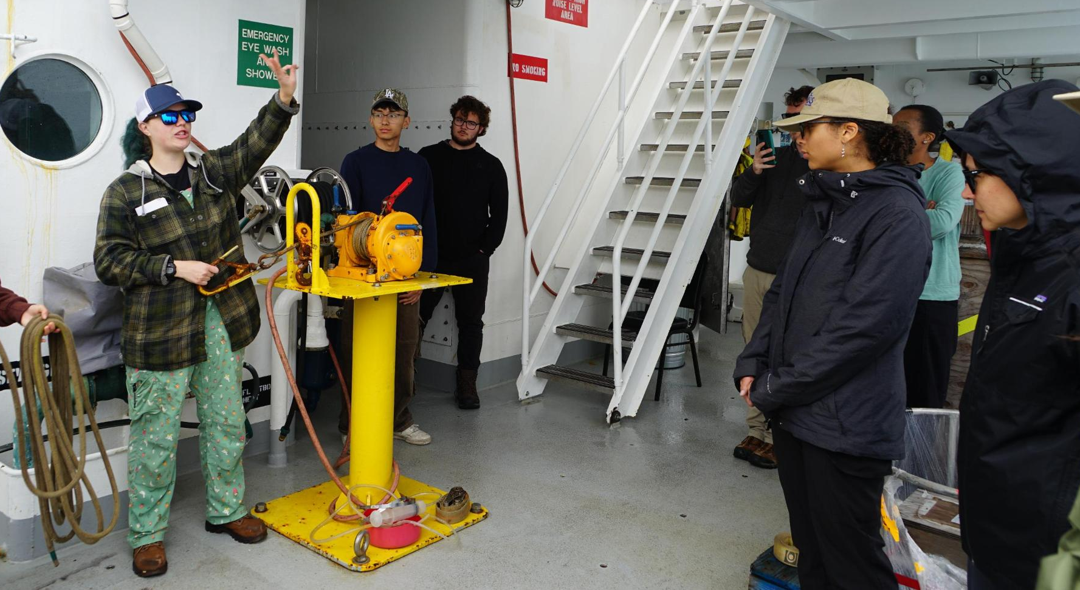
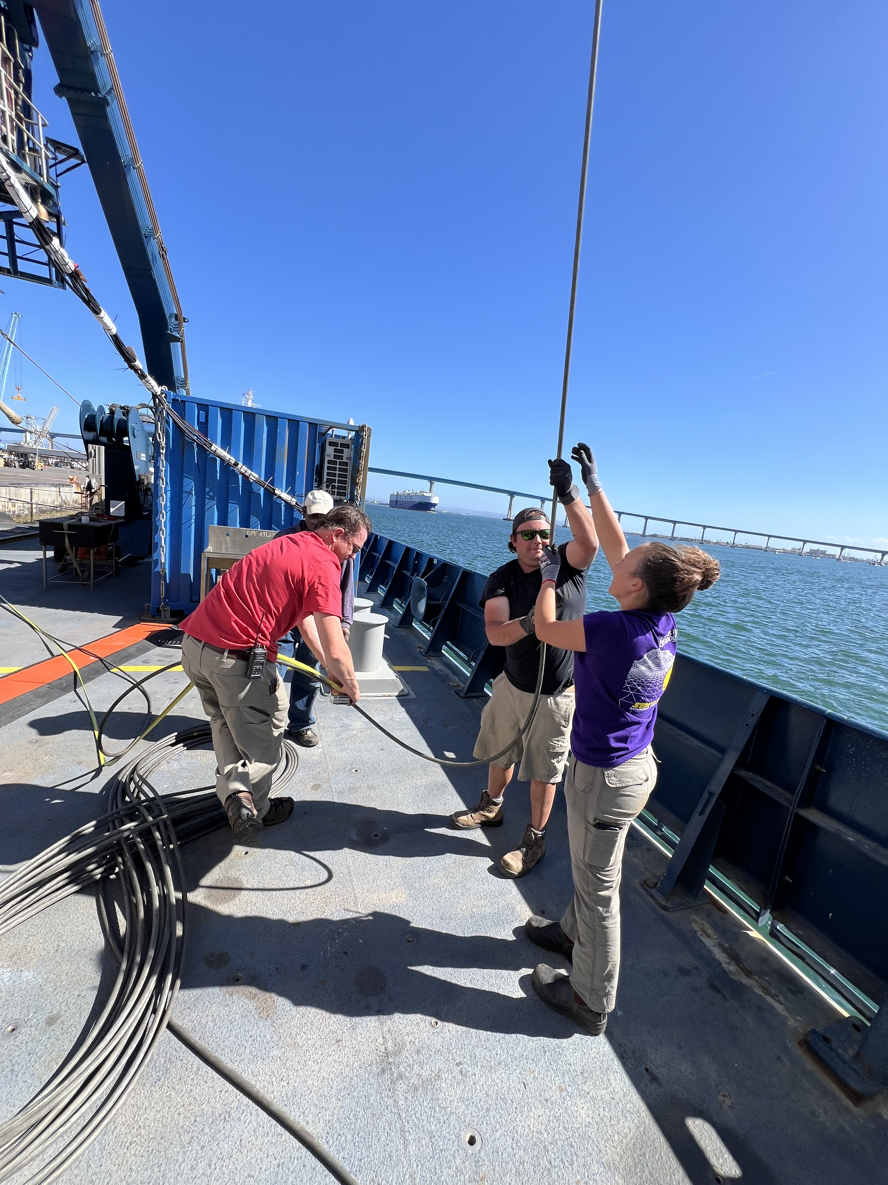
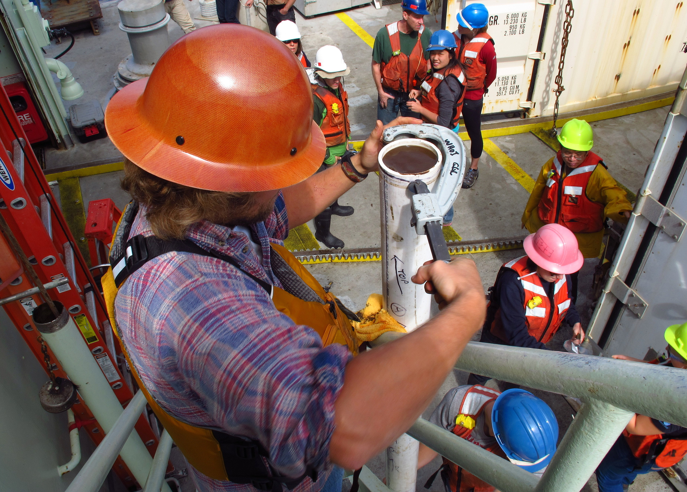
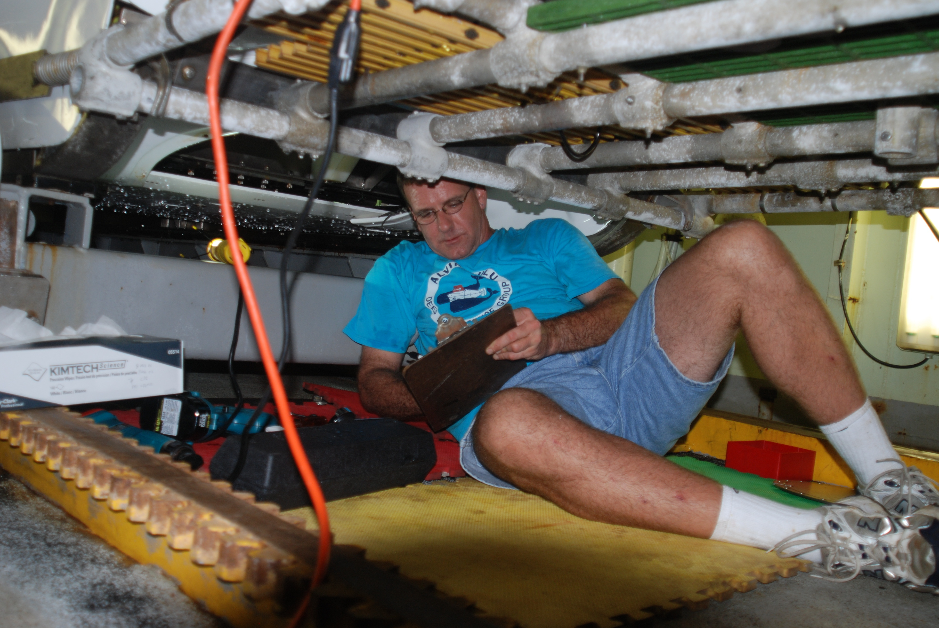
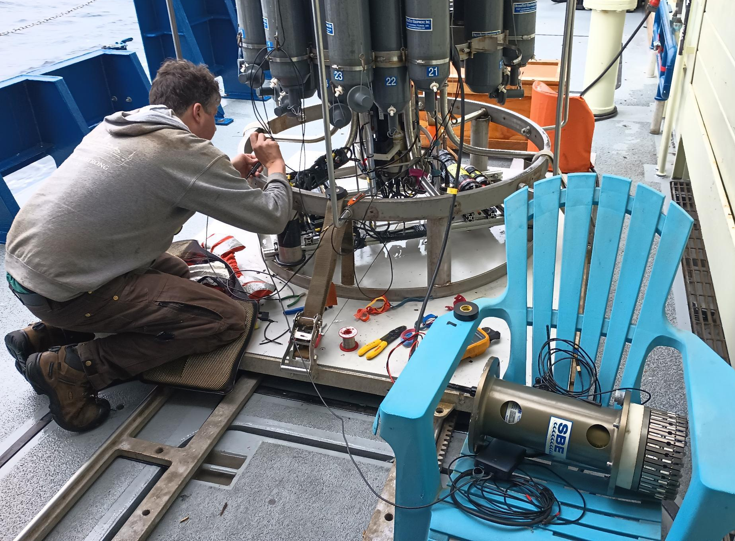
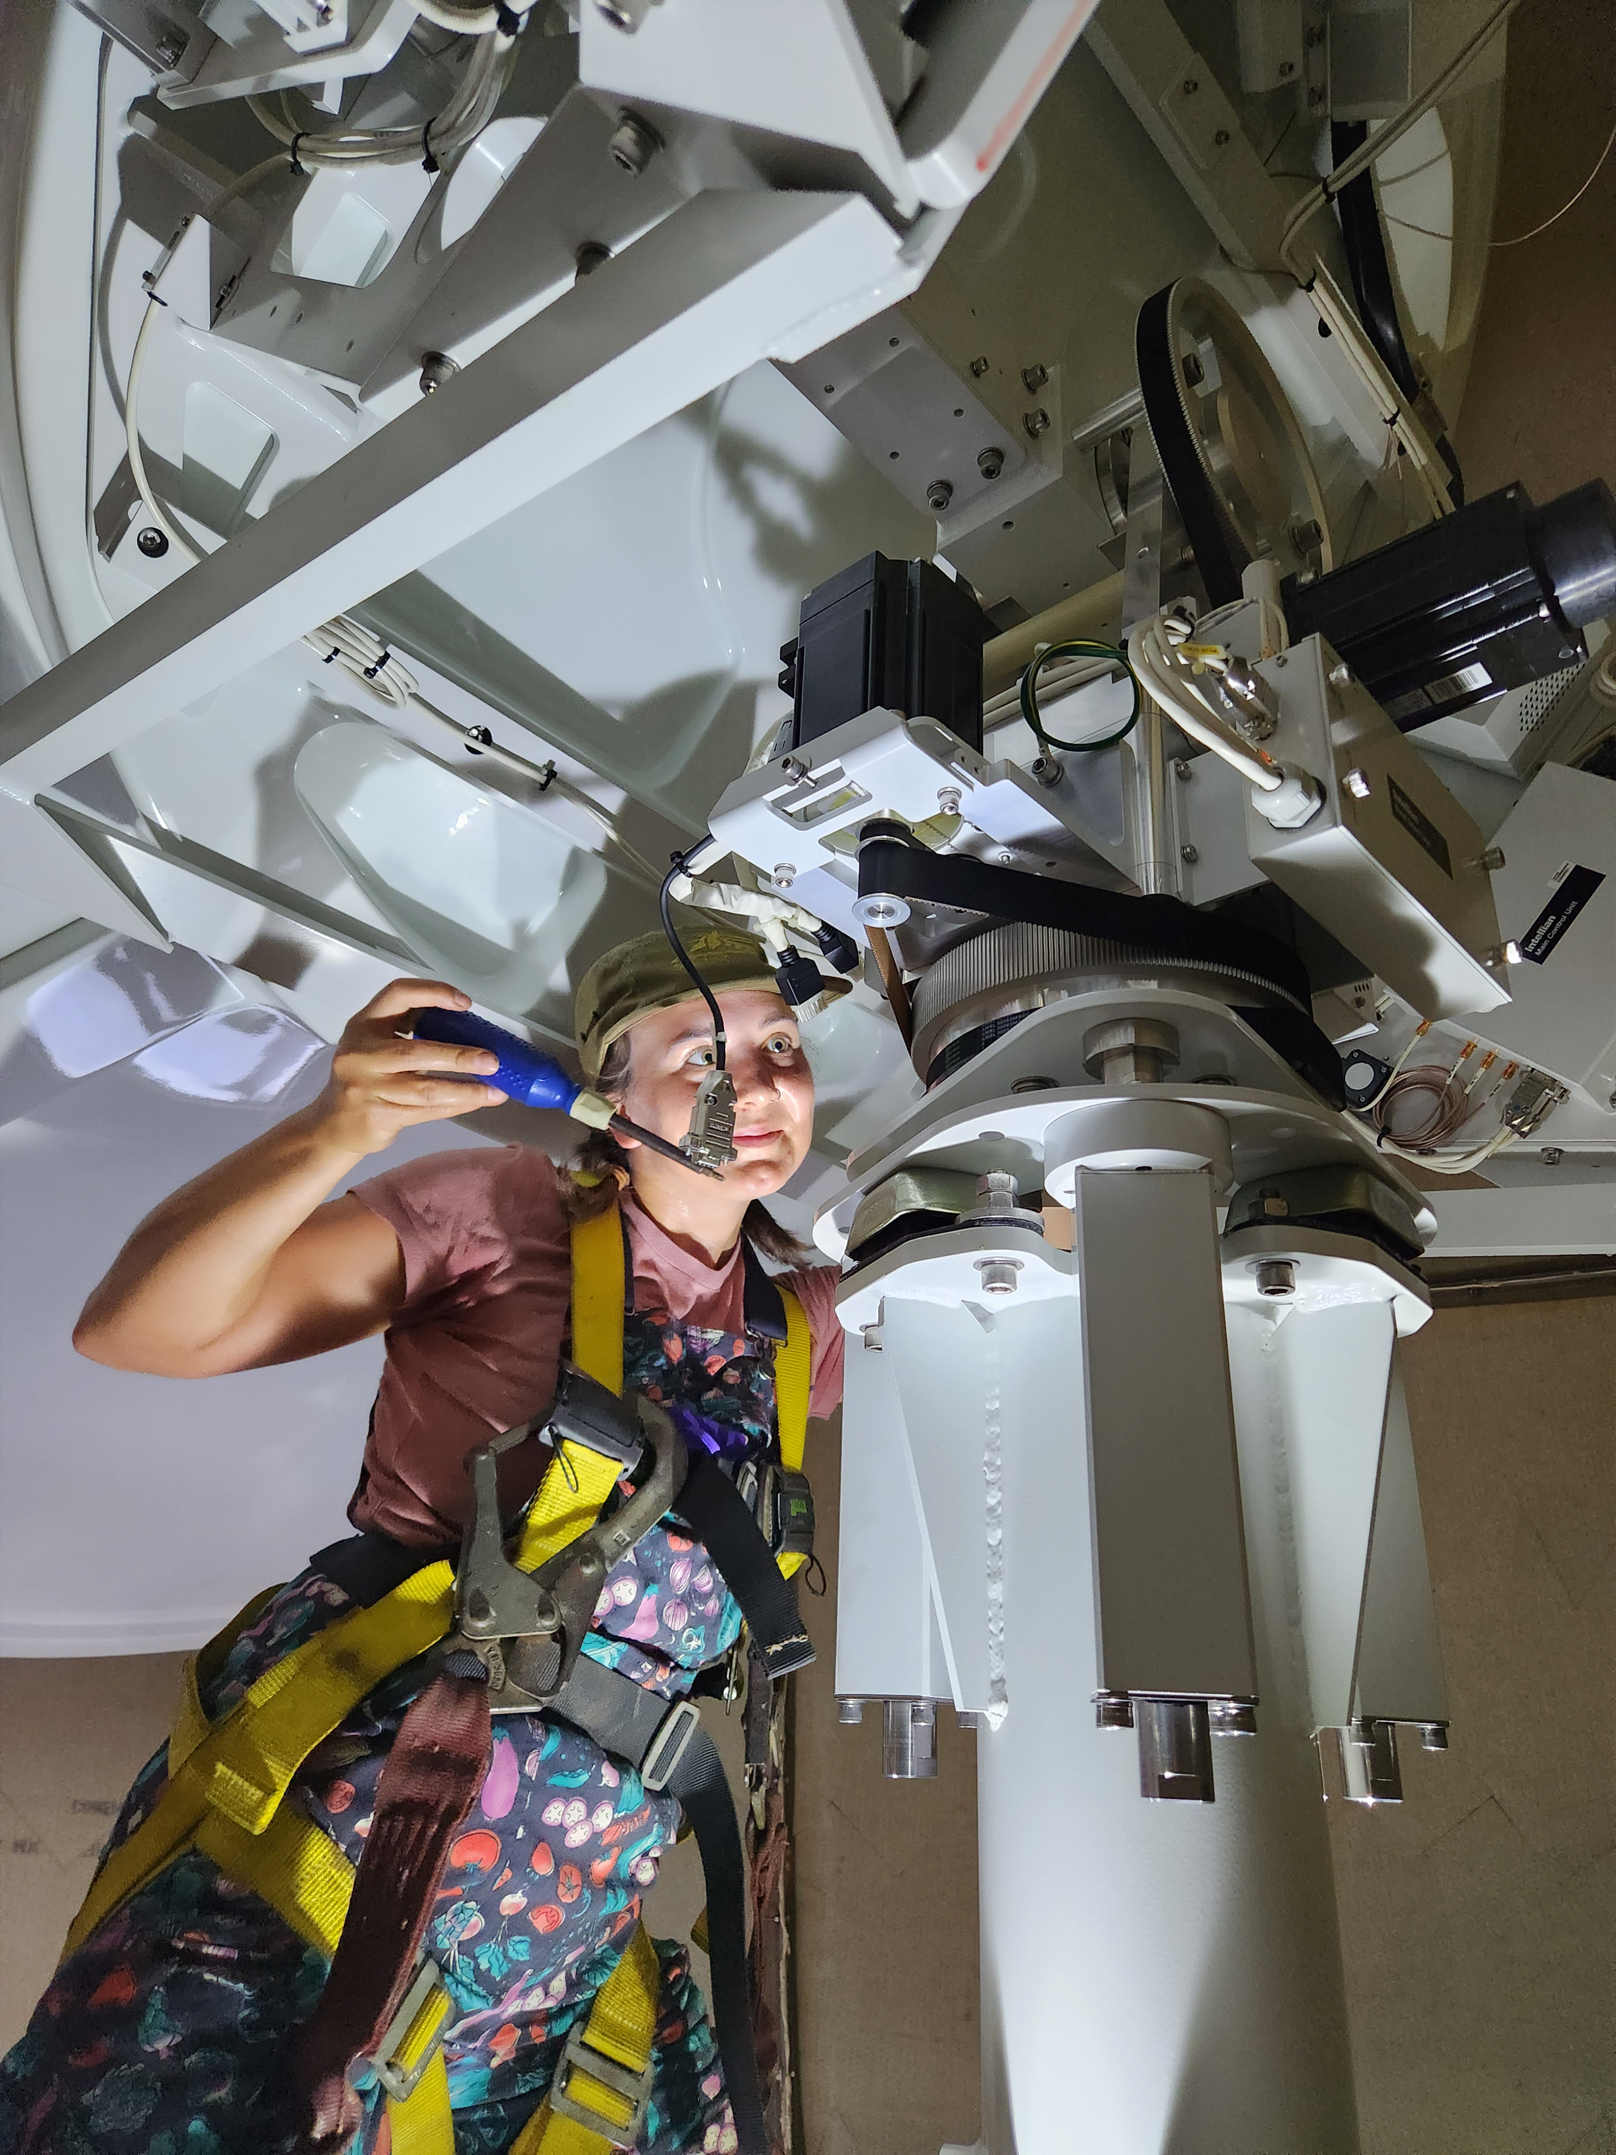
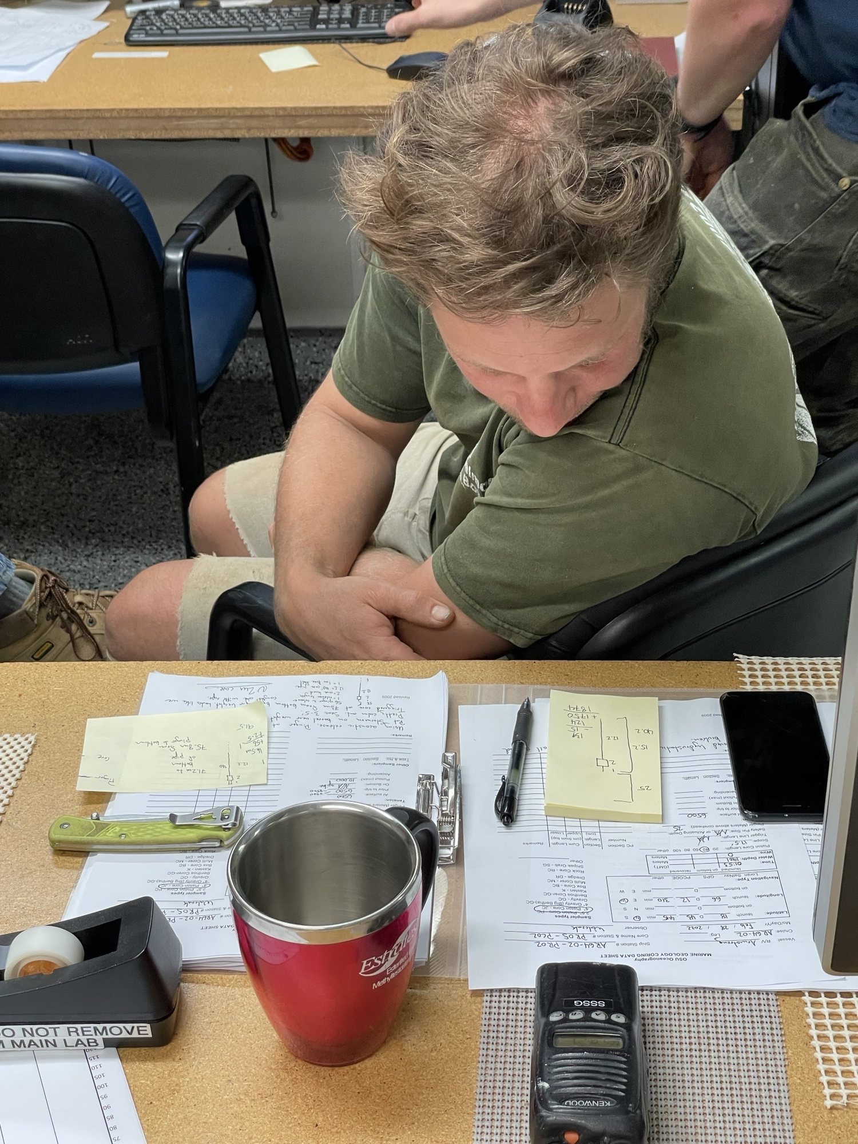
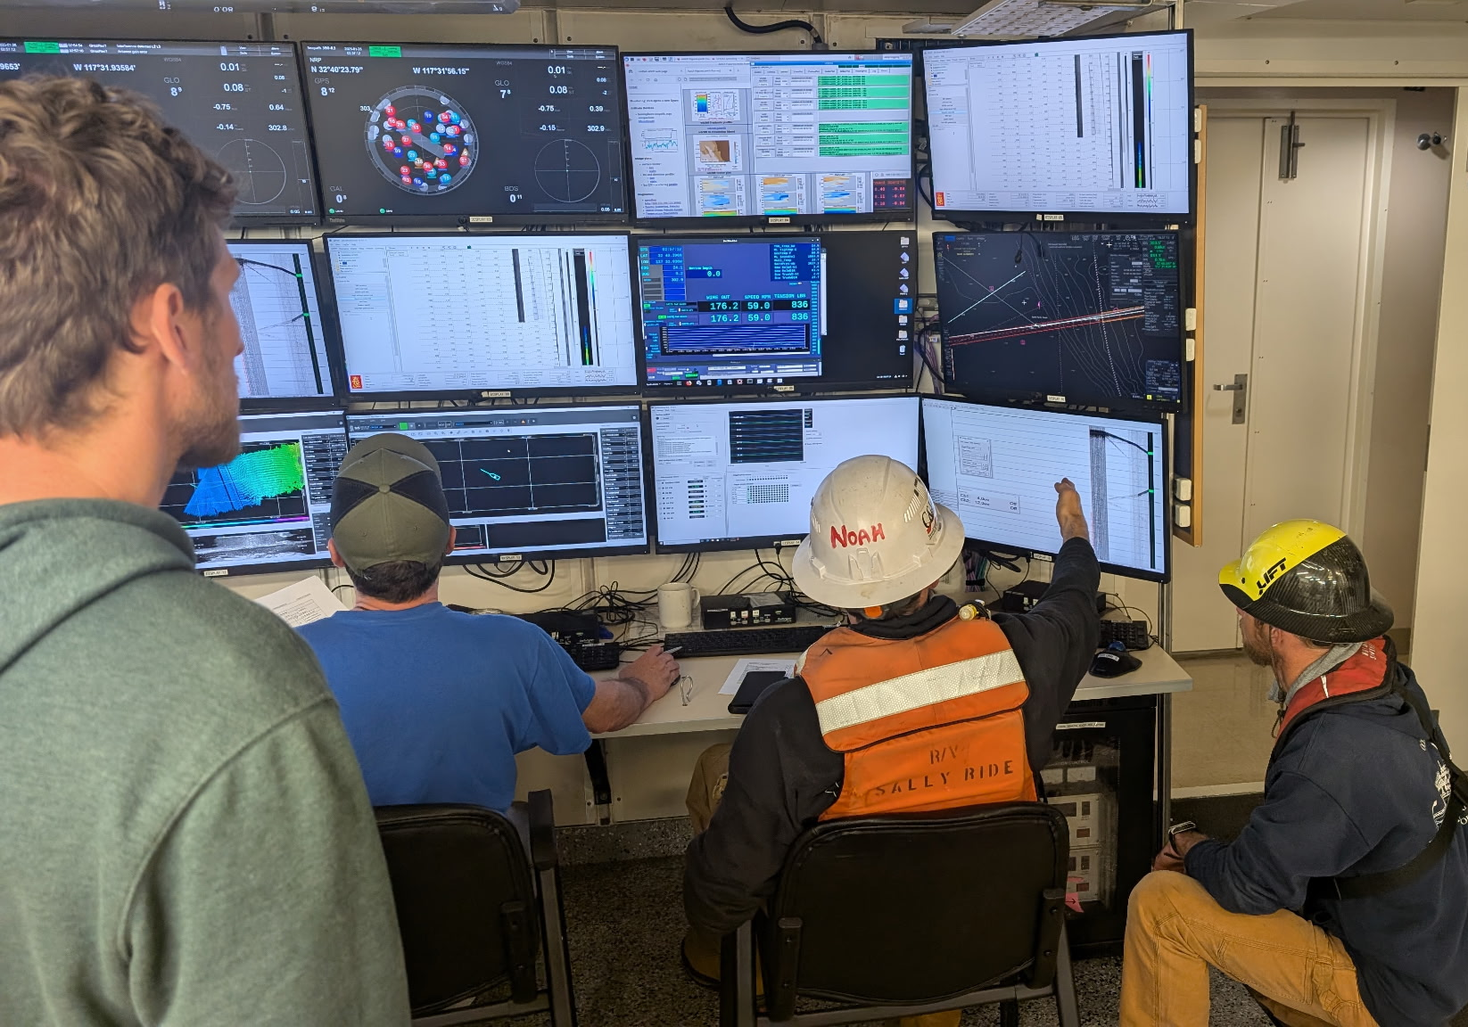
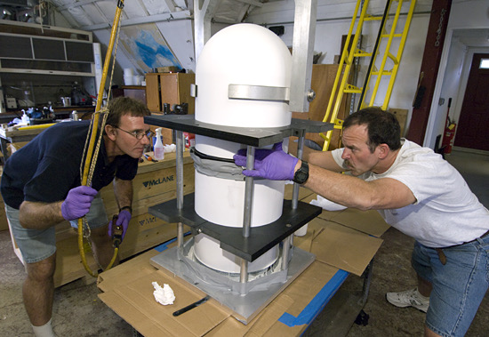
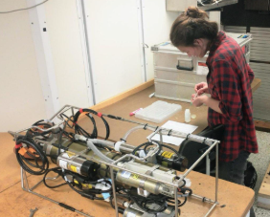
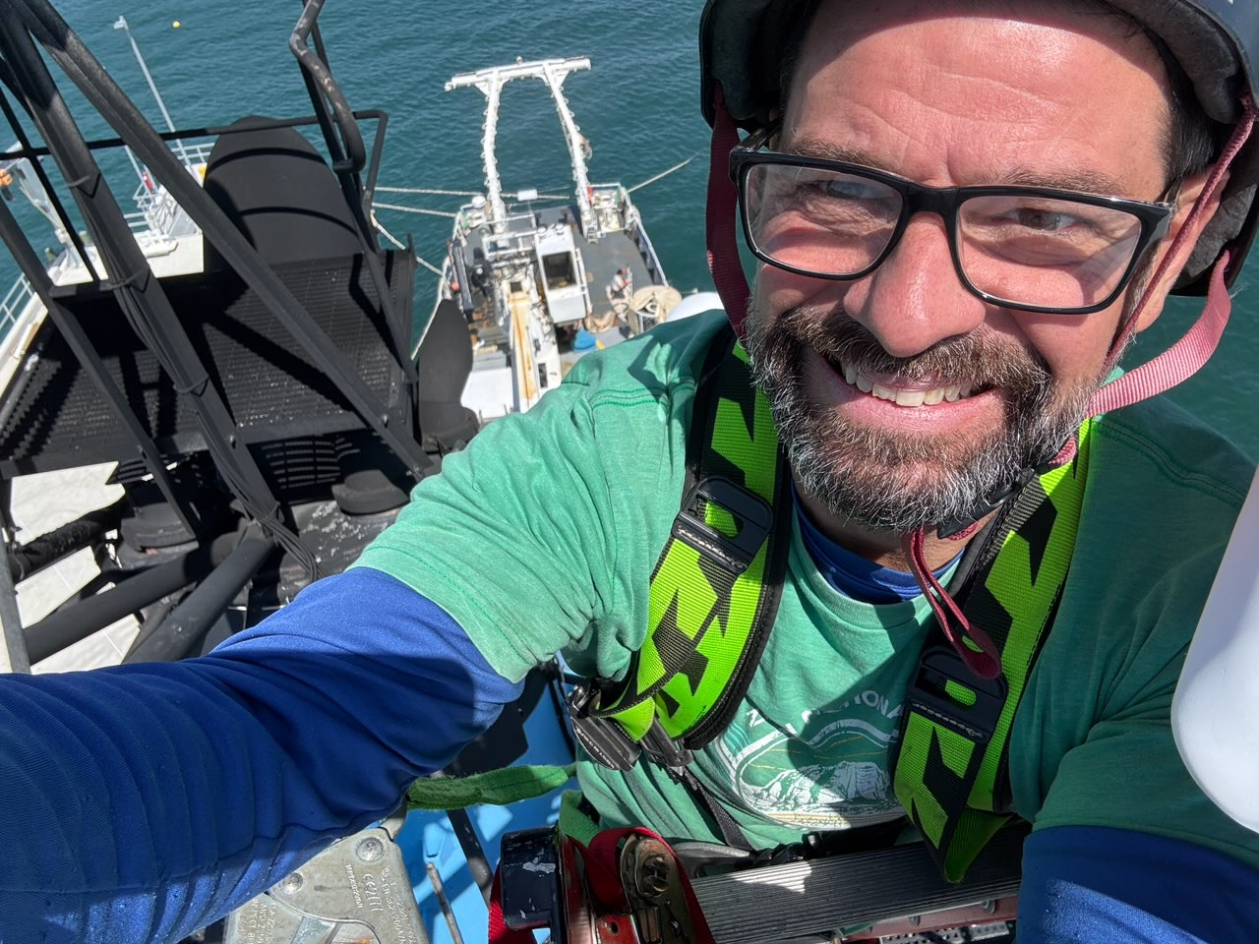
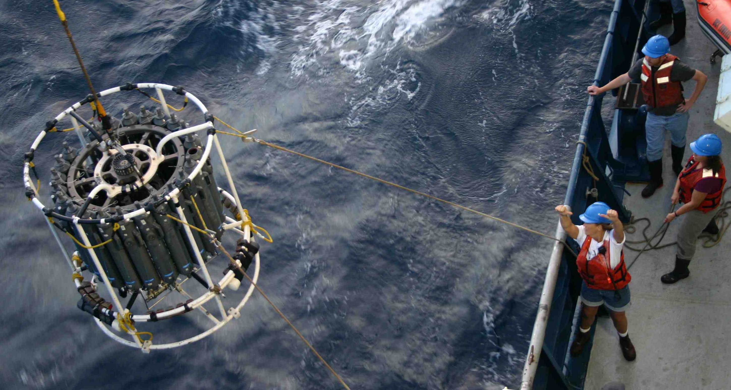
It’s all about the talent…
Notes:
techs use an incredible expanse of knowledge and skills, to make our missions possible at sea
The obvious
Internet access
data acquisition, quality control, and archiving
Overboarding
cruise planning
liaise between science and crew
Essential for a lot of the less obvious
electrical and mechanical engineering
Managing major installs at shipyards
cable terminations of all flavors
satellite comms
network administration
Coding for science provided instrument integration
Help with Manage cyber infrastructure and security needs
Even the morale officers
and much more!
Techs are so talented in the fleet that they are often the ones teaching vendors about the equipment so it can be improved upon. Rather than the other way around.
These extremely talented people may be forced out of this line of work, and a departure is likely permanent.
If a quorum is lost to build back will be painful for operators and all science at sea could suffer for a long time.

