Slide 1
Fleet Improvement Committee
Kipp Shearman
kipp.shearman@oregonstate.edu
New Membership
Carter Duval, NRL
Erich Gruebel, URI/GSO, RVTEC
Activities
Monthly Meetings
Virtual FIP Workshop, May 28-29
NOAA Class A Evaluation
OCRV SMRs
Focus Areas
Global/Overall Class Fleet Capacity
Coastal/Local Support
Fleet Improvement Plan Update

Slide 2
Fleet Improvement Committee
Membership
Kipp Shearman (Chair), OSU
Steven D’Hondt, URI
Carter Duval, NRL - New!
CAPT Zoltan Kelety USN/Ret, SIO
Joe Montoya, GA Tech
Masako Tominaga, WHOI
Qing Wang, NPS
Angelicque White, UH
Erich Gruebel, URI/GSO, RVTEC
Doug Ricketts, UM-Duluth, RVOC
Bruce Applegate, SIO, ExO Council
Katherine Schreiner, UM-Duluth, ExO Council

Slide 3
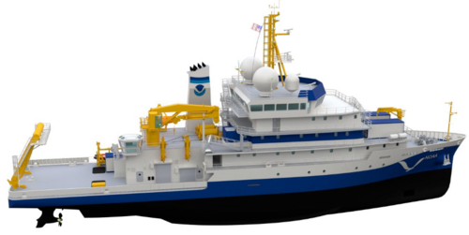
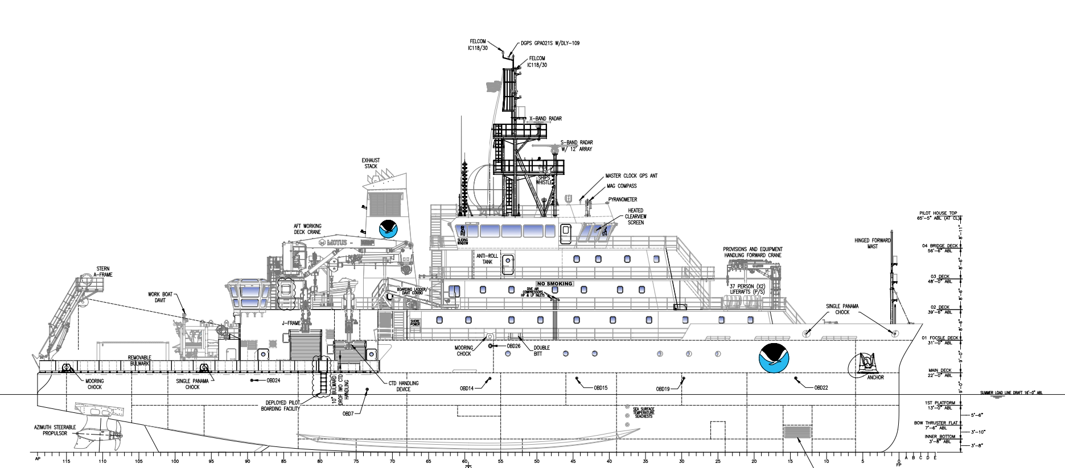
Length, BP: 244 ft
Beam, Max: ca. 50 ft
Draft: 15 ft
Displacement, Design: 3,100 LT
Sustained Speed: ~12 knots
Range: 10,000 nautical miles
Endurance: 40 days of continuous operations
Complement: 24 scientists, 44 total personnel
Science Staterooms: 8 single + 6 double
NOAA Class A Opportunity
Oceanographer and Discoverer completion 2026 Thoma-Sea Marine
NAVSEA (Navy) design related to AGORs 27/28
Feb 2025, FIC asked to evaluate Class A vessel as a replacement for Ocean Class RV Kilo Moana
Update to the ocean class SMRs required - formed subcom to address
Notes:
Primary Missions
– Physical, chemical, and biological oceanography
– Bathymetry, gravimetry, and magnetometry
– Marine Geology and Geophysics
– Ocean Engineering and Marine Acoustics
– Multi-discipline environmental investigations
Unknown what the actual opportunity is

Slide 4
NOAA Class A Comparison with OCRV and GCRV SMRs
Ship Characteristics | Ocean SMR (2003) | Global SMR (2022) | Class A | Modification Needed for Class A+ to meet OCSMR | Modification Needed for Class A+ to meet GCSMR
Range | 10,800 nm | 18,000 nm | 10,000 nm | Small increase in range | 80% increase in range
Endurance | 40 d operations | 70 d (incl 30 transit) | 40 days | None | None
Complement | 20-25 science | 45 Science + 2 MT | 24 science | None | Increase science party
Full ops Sea State | 4 | 5 | redacted | Improve seakeeping in SS4 | Improve seakeeping in SS5
Total lab space | 2,000 sf | 4,200 sf | redacted | Increase lab space (2500 sf feasible) | Increase lab space
Working deck | 1,500 sf | 3,500 sf | redacted | None | None
Hydrographic winches | 2 | 3 | redacted | None | Add hydro. winch
Trawl winch | 1 | 1 | redacted | Add trawl winch suitable for synthetics | Add trawl winch
Modified NOAA Class A vessel is a suitable replacement for RV Kilo Moana and is superior to the NOAA Class B vessel - letter to Council to follow
Notes:
Through tremendous effort of the FIC and especially Angelique White, Joe Montoya, and Erich Gruebel, and the rest of the FIC, we compared the Class A specifications with OCRV SMRs and GCRV SMRs.
We developed an evaluation of the NOAA Class A vessel.
A NOAA Class A variant meets most ocean class SMRs and with modification is a suitable replacement for RV Kilo Moana and is superior to a NOAA Class B variant.
It is based on the astronaut class designs providing some continuity in the class and connection to big Navy through NAVSEA
It is the ‘right’ size and displacement for an ocean class vessel – ie it will not be global sized (like class B) but only capable of holding an ocean class science compliment
It is a general purpose design as opposed to charting
??
I’ve had to redact some NOAA Class A information because it is subject to NDA.

Slide 5
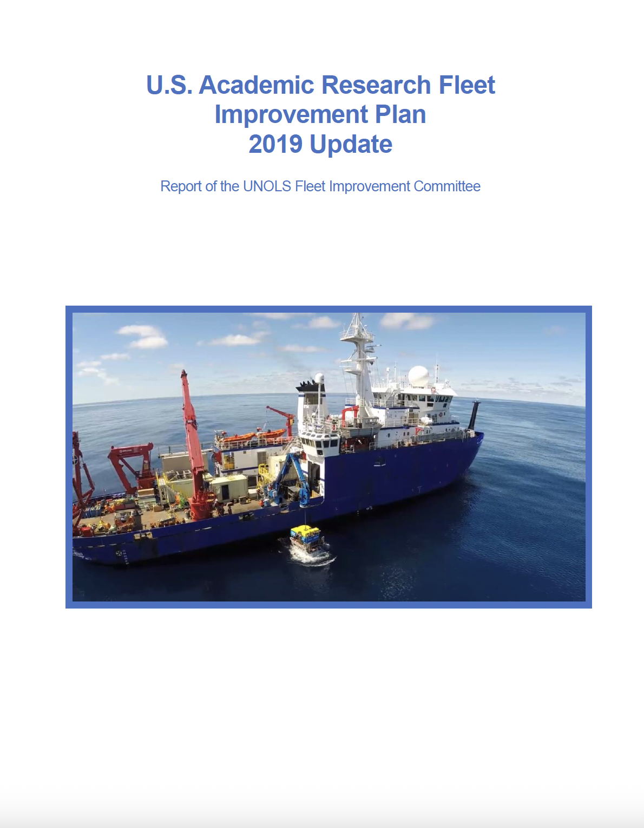
Fleet Improvement Plan Update
Last update 2019
Nov 2025 Deadline
May 2025 Workshop
Teaser Draft Recommendations
  Fleet Renewal/Implementation Plan
  3 global AGORs -> 4 global AGORs
  SLEPs for RVs Sikuliaq, Armstrong, and Ride
  RCRV entrance into ARF
2025
We have ignored budgetary realities in drafting the FIP …
Notes:
FIC is working on FIP 2025 update, hoping to finish by Fall Council 2025 Council Meeting
A teaser of some draft recommendations - none of which should come as a surprise
We have ignored budgetary instabilities - FIP is a long-term visionary document and not a reactionary document.

Slide 6
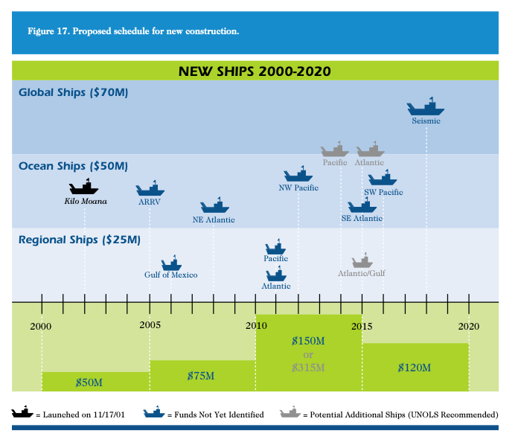
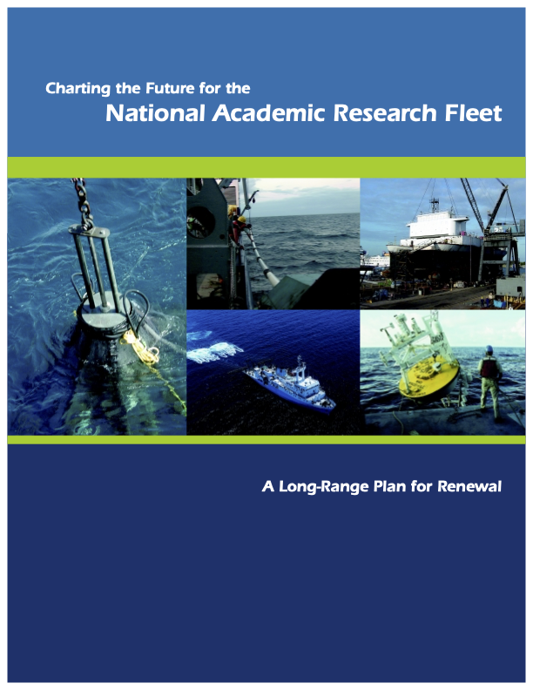
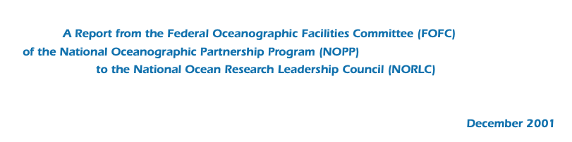
Fleet Renewal Plan
There is NO current guidance on what the future fleet should look like
We should do this
Federal Fleet Report
This document defined the ‘right’ size of the ARF
Hasn’t been updated since 2001
FY26 NDAA
Sustainment plans for the current oceanographic research vessel fleet
Operational requirements for the fleet
Strategy for future construction plans
Community
UNOLS call to action
National Reseach Council Report 2009
Notes:
We need a coordinated effort that includes the federal agencies, the Navy, and the community.
Maybe the FY26 NDAA is a platform for this coordination?
Should UNOLS charge an ad hoc committee to do this? Bigger than FIC - not only includes needs of the science community, but also other considerations …

Slide 7
Fleet Renewal Plan
NRC 2009 (paraphrased by me)
Federal agencies should implement one comprehensive, long-term research fleet renewal plan.
All future ship acquisitions should involve the scientific
user community from the preconstruction phase through postdelivery of the ship.
The future academic research fleet requires investment in larger, more capable, general purpose ships to support multidisciplinary, multi-investigator research and advances in ocean technology.
DSOS 2025 (paraphrased by me)
RECOMMENDATION 4.1: The National Science Foundation’s (NSF’s) Division of Ocean Sciences
and appropriate partners should conduct an evaluation that details the funding allocation
for the Academic Research Fleet in order to make informed distributions of the limited resources
available over the next decade and beyond.
days of use funded by NSF;
use of local vessels for NSF-funded research;
geographic distribution of assets;
and alternative mechanisms such as marine laboratories or new partnerships.
The long-term status of global-class research vessels is concerning; the committee urges interested
parties to initiate and/or continue significant and intentional planning for replacements.

