Slide 1
ONR Brief to UNOLS Summer AICC 2024 Rob Sparrock,

Slide 2
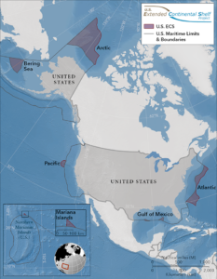
Strategic Trends
Dec 2023, expanded The U.S. ECS - United States Department of State
New OMB Grants Guidance: ⁠The Biden-Harris Administration Finalizes Guidance to Make Grants More Accessible and Transparent for Families, Communities, and Small Businesses | OMB | The White House
CFO.gov | Uniform Guidance: Title 2 of the Code of Federal Regulations
Key words: Data, Tribal Engagement, Program Evaluation

Slide 3
Strategic Trends
Deep Sea Bed – e.g. SBP-29 improvements
Foreign Ships in US EEZ – untapped opportunity
Foreign Ships – Barter (NSF agreement)
China Arctic Trends: Intersection of Geopolitics, arctic research and arctic infrastructure.
Polar Expertise in China's 14th Five-Year Plan | The Arctic Institute – Center for Circumpolar Security Studies

Slide 4
Select Quotes from Admiral Caudle USFFC
.. cannot sit idle as Russia creates a nine-dash line of territorial claims over the Arctic, like China aims to do in the Pacific”
.. not conceding the Arctic to Moscow or Beijing
“vast frontier” of the Arctic “has my utmost attention.”
“We need more partners to join us” in exercises like Ice Camp and Operation Nanook for surface ships … such as … Canadian, Japanese and British forces, as well as civilians from the Pentagon’s Defense Advanced Research Projects Agency and MIT’s Lincoln Laboratories, at this year’s camp.
“We have to put our money where our mouth is,”
U.S. Fleet Forces Commander Focused on Arctic, Increased Naval Presence in Region - USNI News

