Slide 1

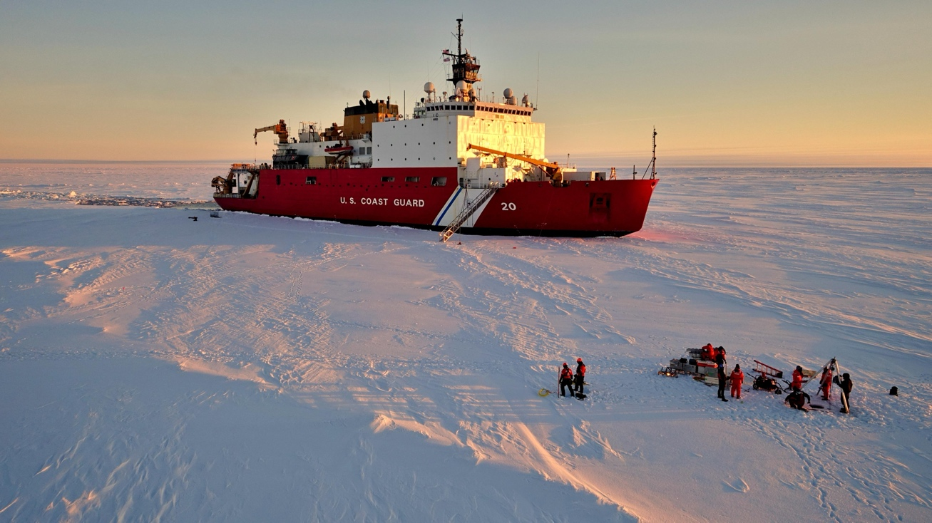



2024 Early Career Polar Chief Scientist Training Cruise
USCGC Healy, Northwest Passage
Update to AICC, 26 June 2024, Dr. Emily Eidam

Slide 2
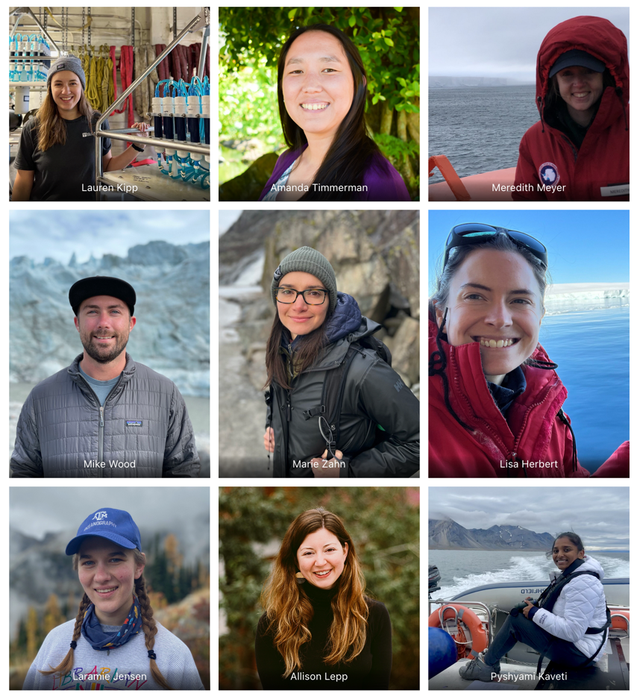
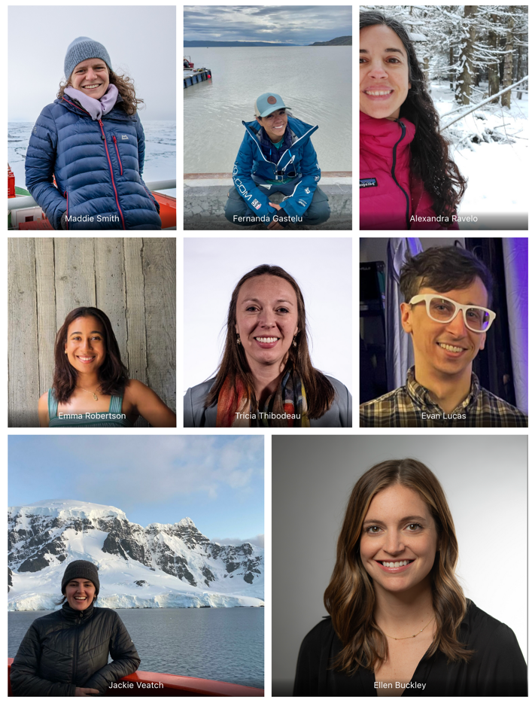
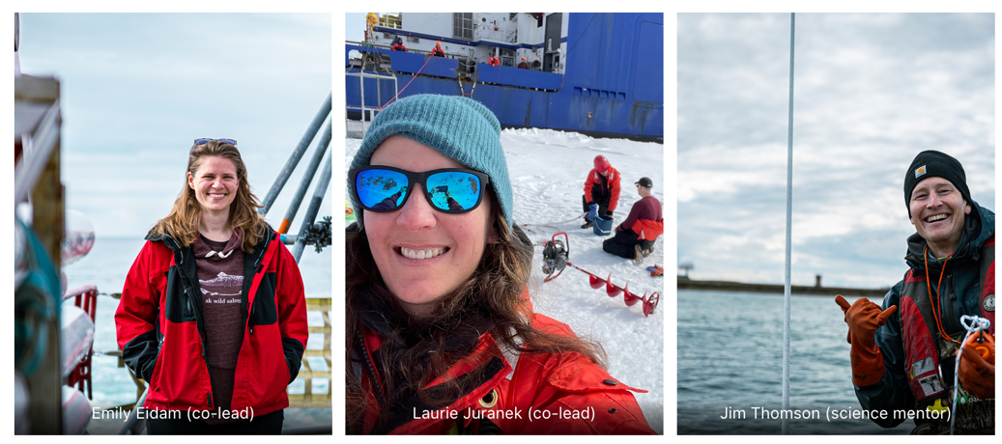
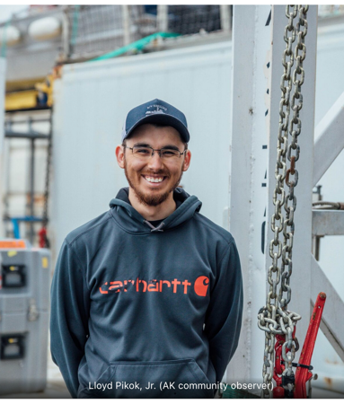
Cruise details
20 early career participants (X faculty, X students) representing 17 universities and NOAA
10 mentors
  Co-chiefs: Laurie Juranek, Emily Eidam
  NSF: Lisa Rom (program manager), Kayla Hubbard
  Community observers: Lloyd Pikok Jr. (UIC/Battelle), Bryan Vandenbrink (CHARS)
  UW: Jim Thomson
  UNH: Andrew Niedbala (also USCG), Kaan Cav (mapping team)
  NRL: Jeff Obelcz (mapping team)

Slide 3
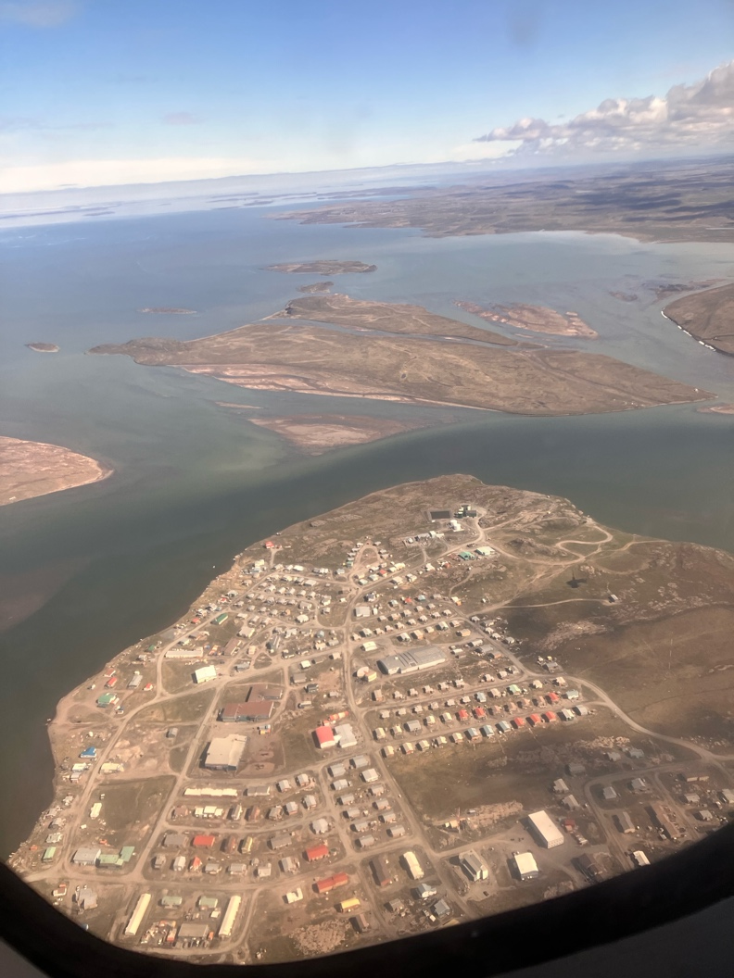
Disembark from Kugluktuk after personnel exchange with Bob Pickart’s group
Community BBQ for ~400 people
Charter flight
Lunch with community representatives on Healy (pending)

Slide 4
Sampling goals
Nearly continuous (24-hr) underway mapping (MBES, subbottom, EK80, ADCP)
Ice station north of Banks Island (?)
  Ice coring
  Small boat work
  SWIFT drifters
  Under-ice imaging
CTD and bottom grab/core stations
Met data acquisition, image acquisition (for sea state), sea surface elevation measurements

Slide 5
Professional development program will include many elements from last year’s program on Sikuliaq, with some changes – in no particular order:
MFP for UNOLS vessels, request process for Healy
Underway mapping, other data collection
MET systems
Managing multiple science parties
Creating a plan of the day
Ice station equipment and logistics
CESOP
MERAS
Fostering and maintaining an inclusive environment at sea
Coring equipment walkthrough
Utilizing MARSSAM
Overboarding considerations, CTD procedures, integrating your equipment
Education and outreach (NSF perspective - Lisa)
Permitting processes for this cruise
Flexibility in logistics, planning for your team (focus on international logistics)
Research collaboration discussion
Post-cruise assessment reports and cruise reports
Post-cruise follow-up activities
Evening presentations
Lloyd, Bryan – community considerations
Kayla – interning at NSF
Alex – coproduction of knowledge
Mapping team (3 science talks)
Participants (20 science talks)
Mentors (3 science talks if time)

