Slide 1
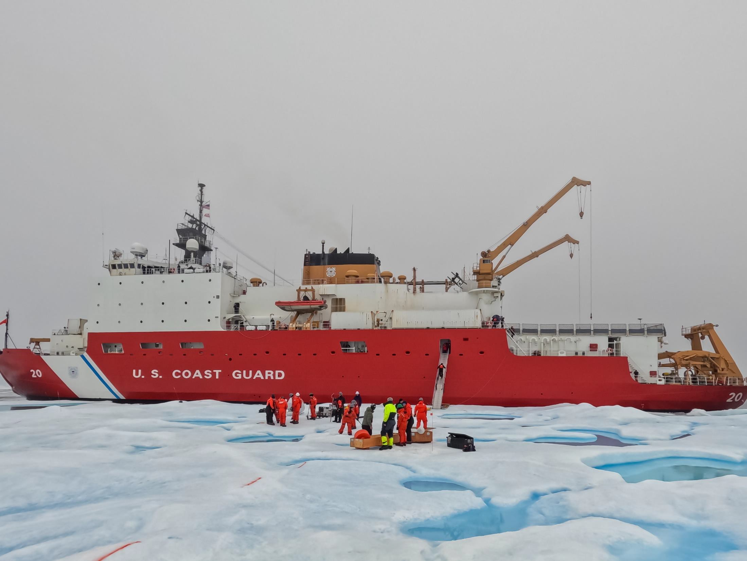

Slide 2
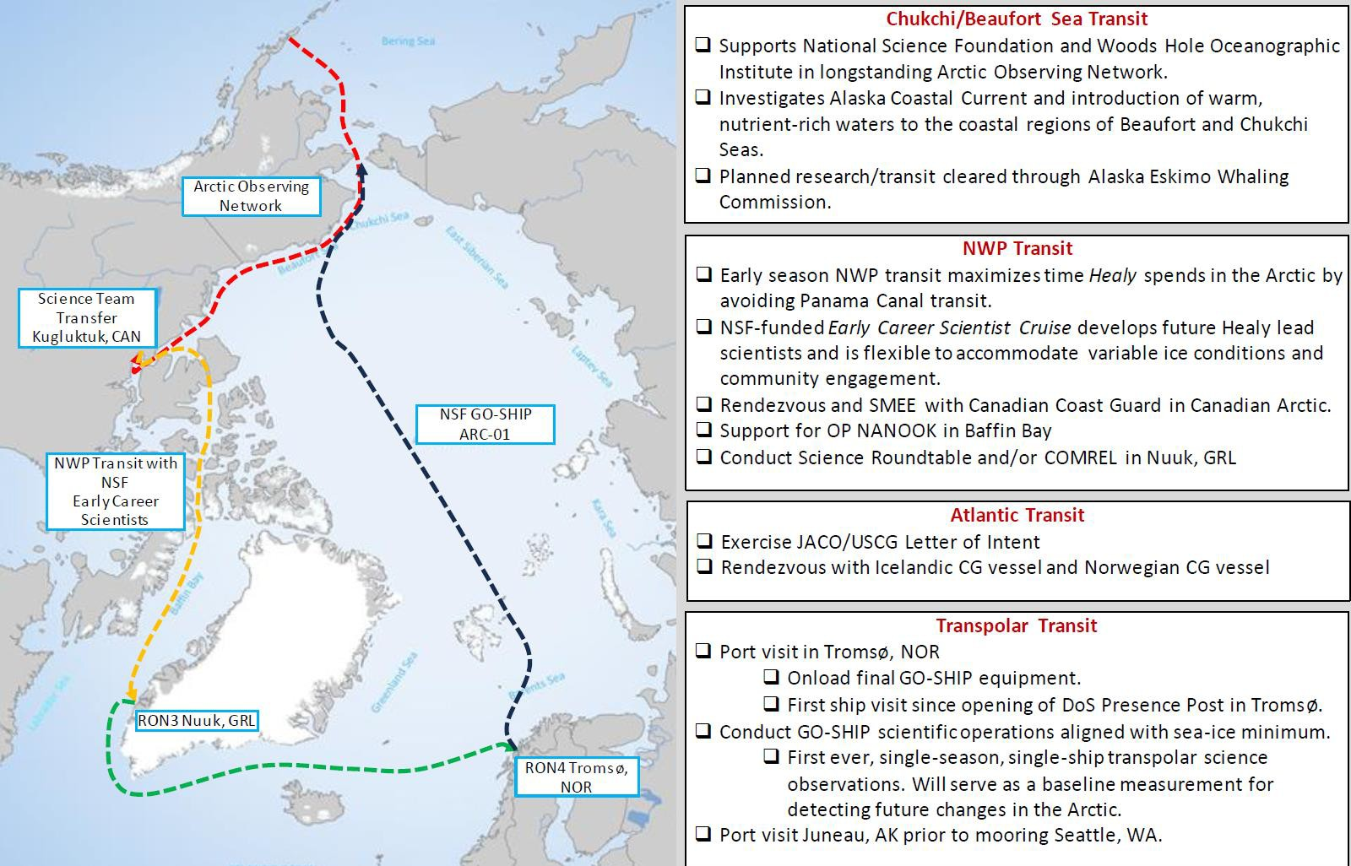
Arctic Deployment 2024
UNCLASIFIED//FOUO

Slide 3
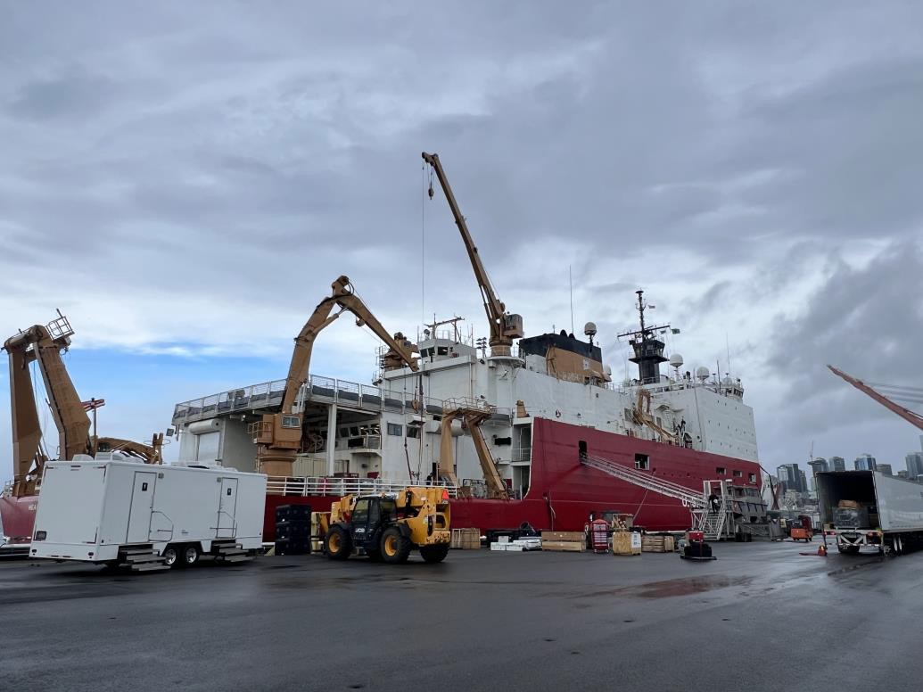
Dockside and Inport Period
UNCLASIFIED//FOUO
Completed 4-month dockside availability at Base Seattle
Trawl/core winch gearbox overhaul
Biennial overhaul on all
cranes and A-frames
Topside preservation work, including starboard staging & boat decks
Other major work items:
UHF satellite communications groom
Ship’s telephone upgrades
Polar Science Network
StarShield Install
POC: LCDR Ryun Konze, Engineer Officer: ryun.j.konze@uscg.mil

Slide 4
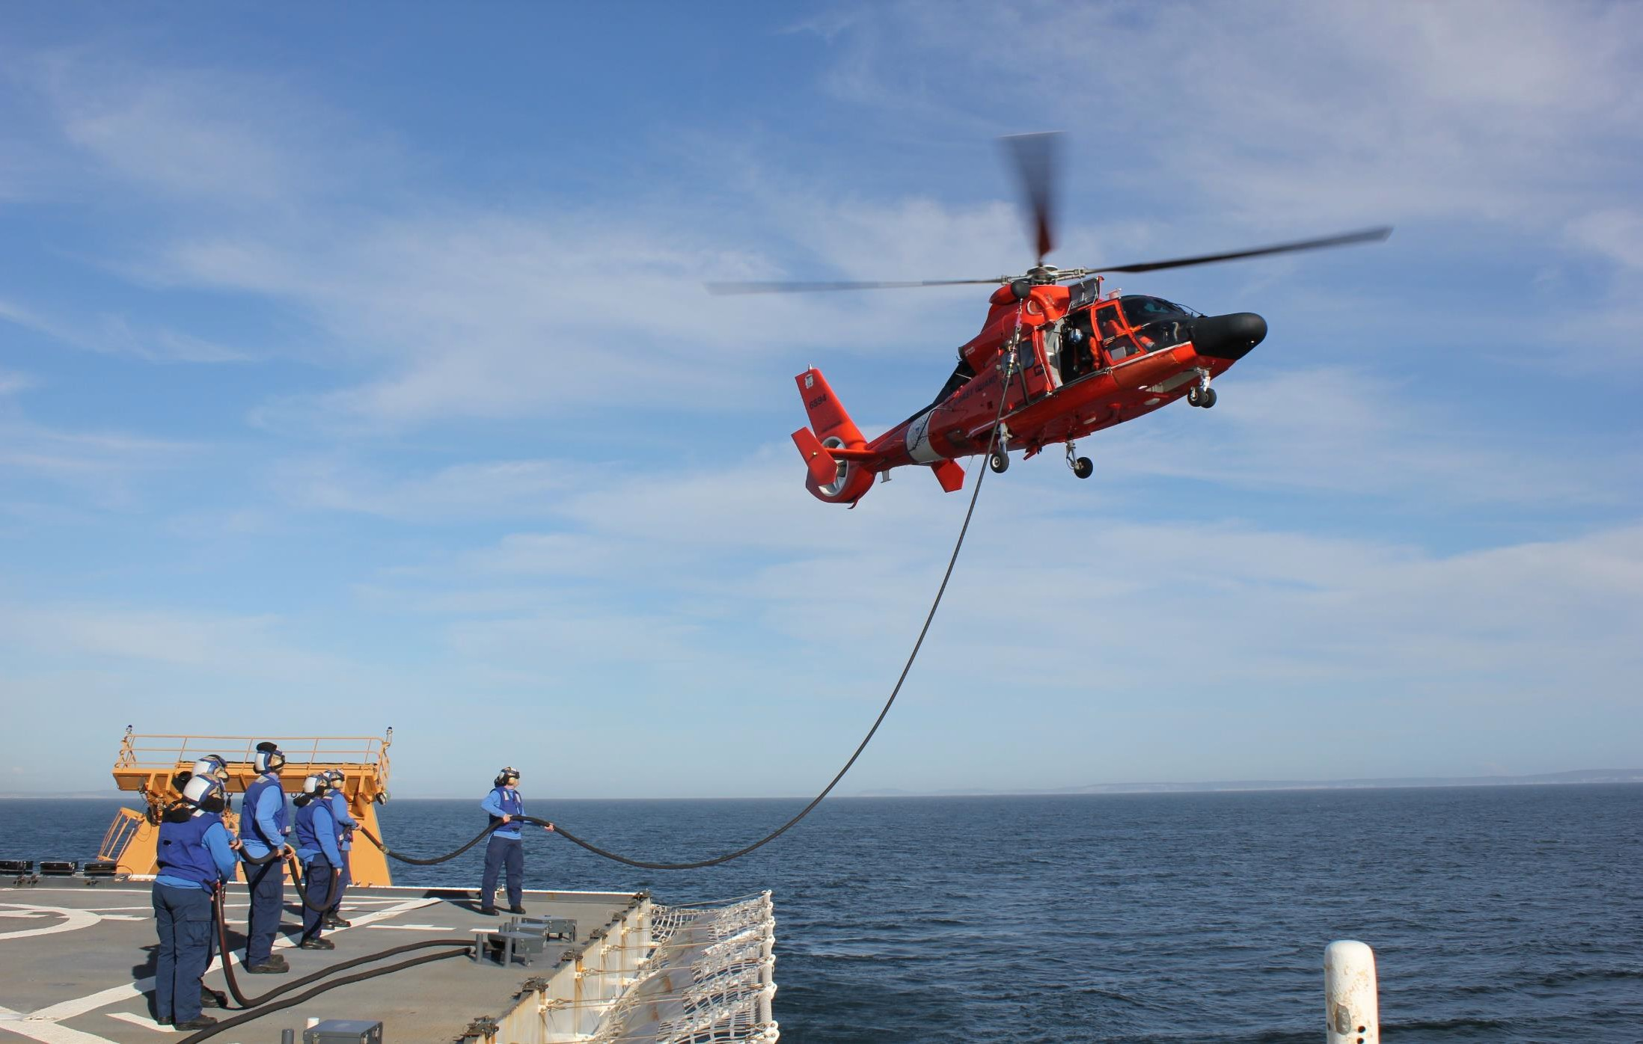
Pre-deployment Training
UNCLASIFIED//FOUO
Photo: Erin Asher

Slide 5
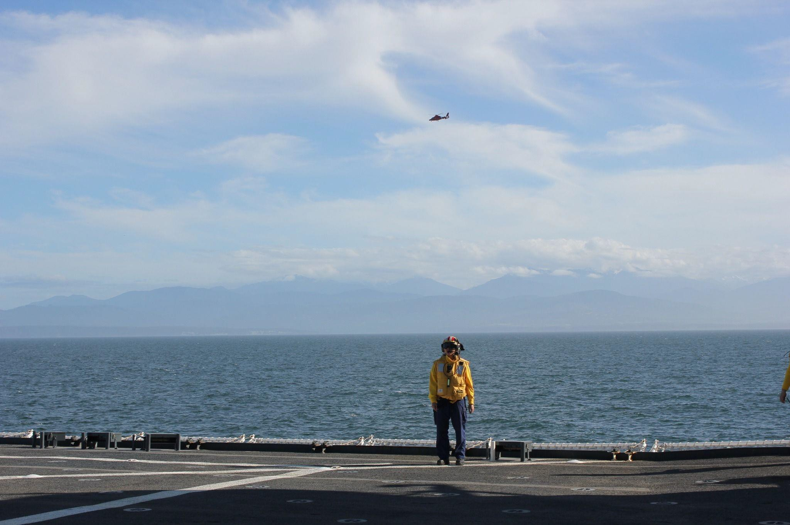
Pre-Deployment Training
Ensuring Healy is ready to operate and respond to casualties.
UNCLASIFIED//FOUO
Aviation certification and standardization visits (USN and USCG)
Tailored Ship Training Assessment
Towing Exercise
Arctic Survey Boat – fully operational
CTD deployment and recovery, exercise winches.
Photo: Erin Asher

Slide 6
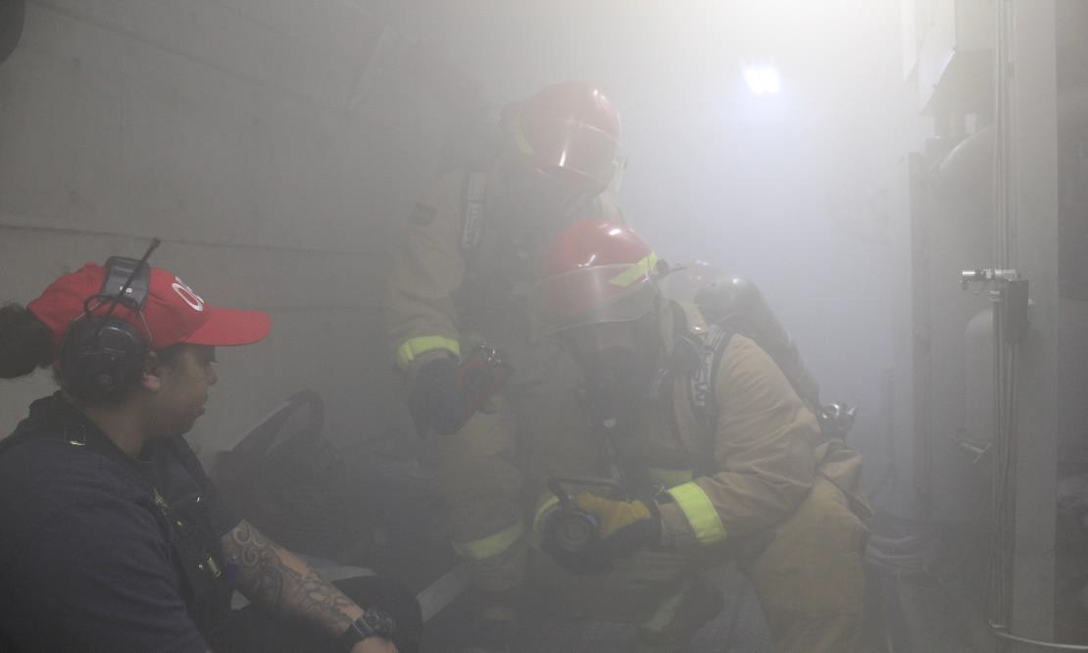
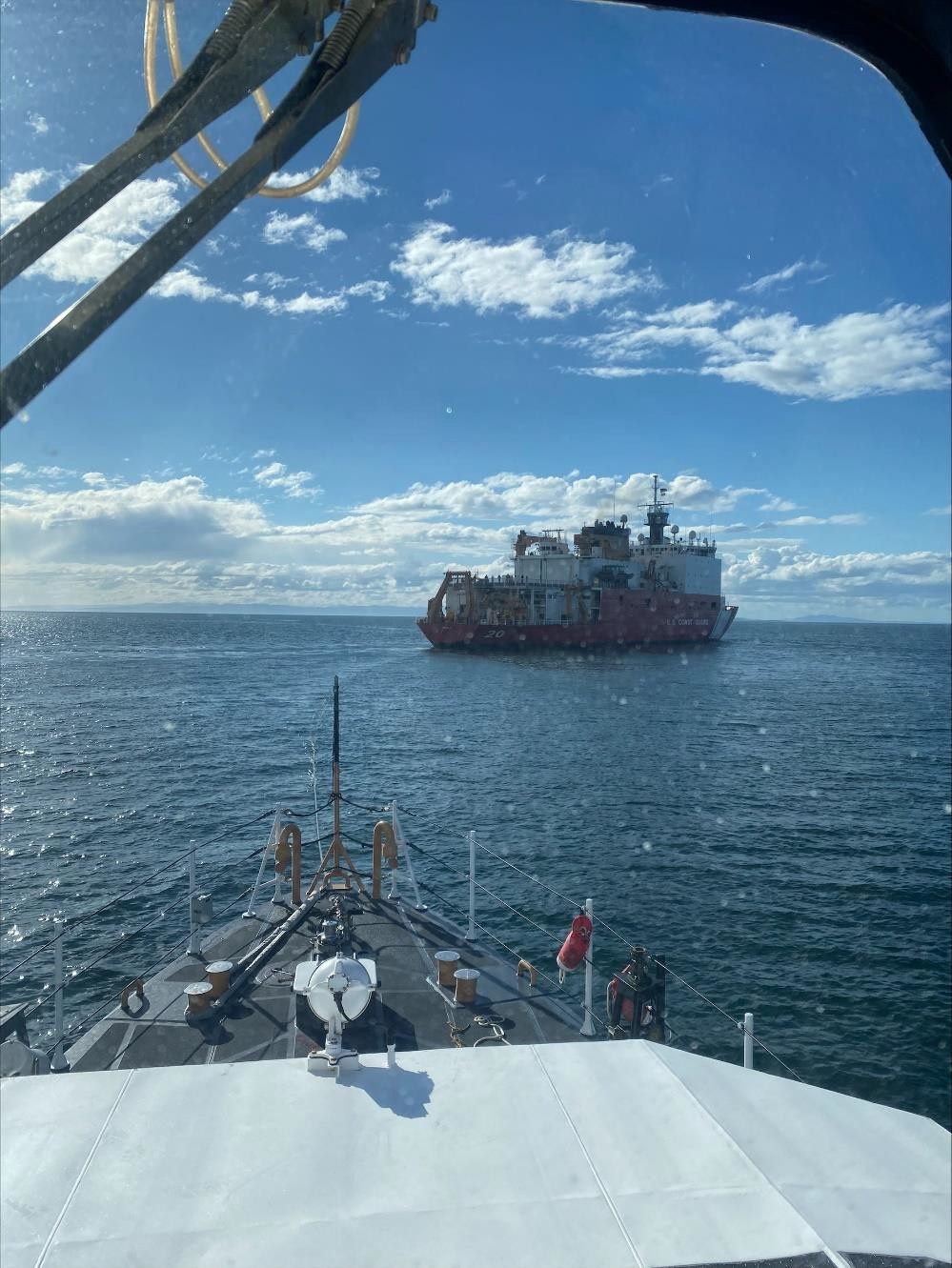
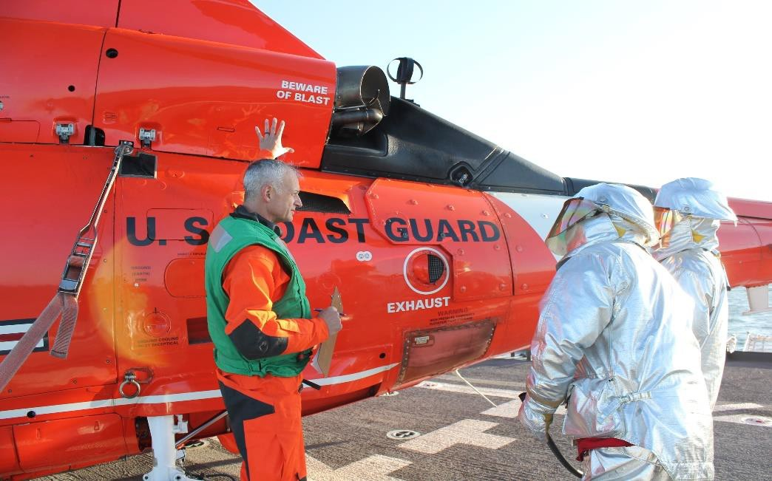
Training
UNCLASIFIED//FOUO
Photo:
Haley Howard
Photo: CGC Adelie
Photo: Erin Asher

Slide 7
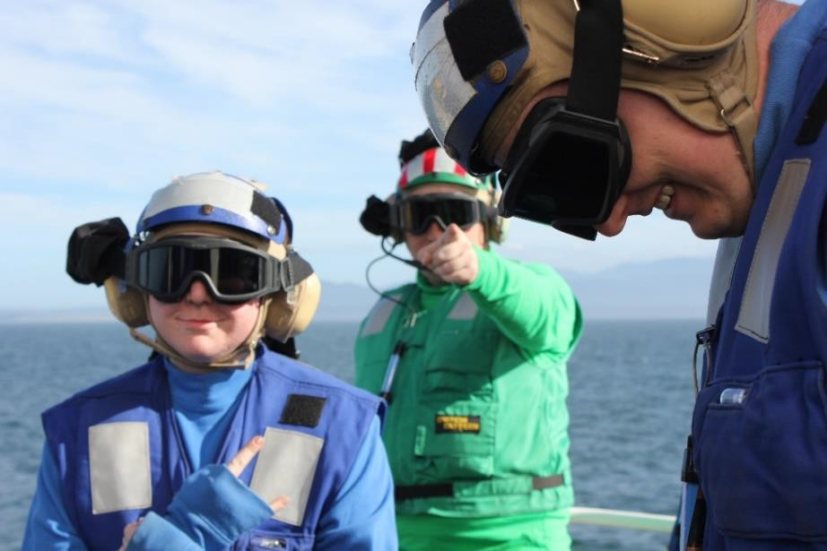
Personnel
UNCLASIFIED//FOUO
CO: CAPT Michele Schallip XO: CDR Ken Sauerbrunn* CSEL/FSO: CSCS David Hoover Ops: LCDR Alex Hamel* AOps: LTjg Mark Sporay* MSO: ENS Katherine Gower Navigator: BMC Kevin Tanski* CMAA: HSC Jason Rodriguez* Advanced Medical Officer:
AON/ECS: Dr. Richard Sumrall
GO-SHIP: LT Bryan Meek
BOSN: CWO Brian Williams
*New for 2024
TDY:
LT Nick Azzopardi, NOAA
LT Elena Calese , Afloat Icebreaker Training Program
International:
Royal Canadian Navy, 2 Officers
Invitations pend for several other countries.
No documentary crews planned for this deployment.

Slide 8
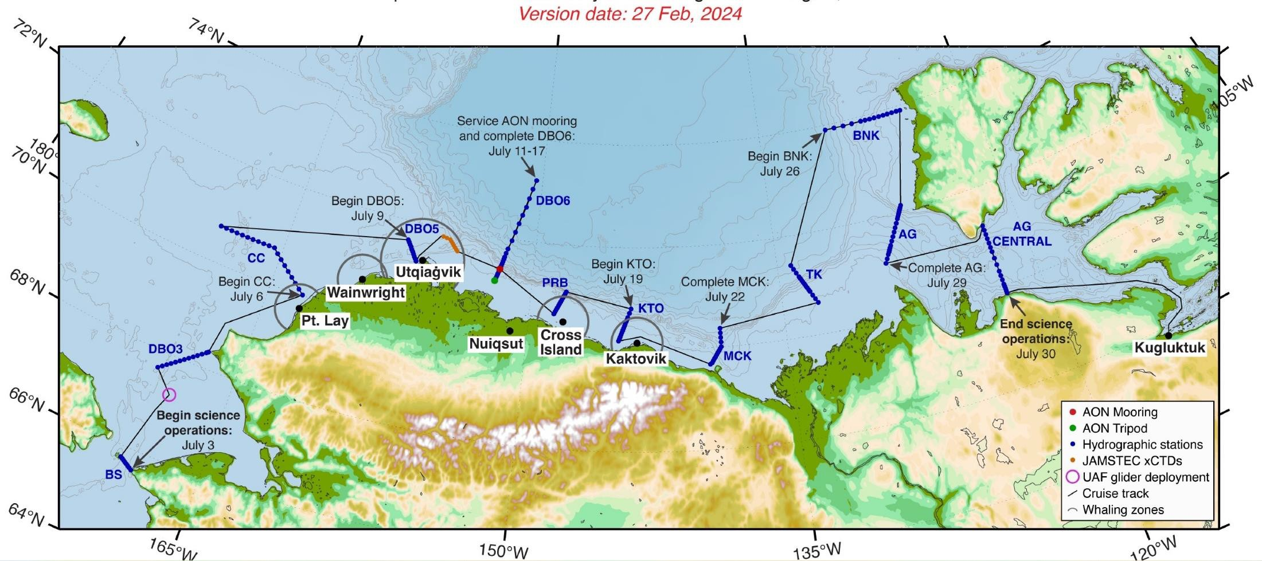
Phase 1 – Arctic Observing Network
UNCLASIFIED//FOUO
Figure: Robert Pickart
Principal Investigator: Robert Pickart, Woods Hole Oceanographic Institution
Funded by: Office of Polar Programs NSF – Arctic Observing Network

Slide 9
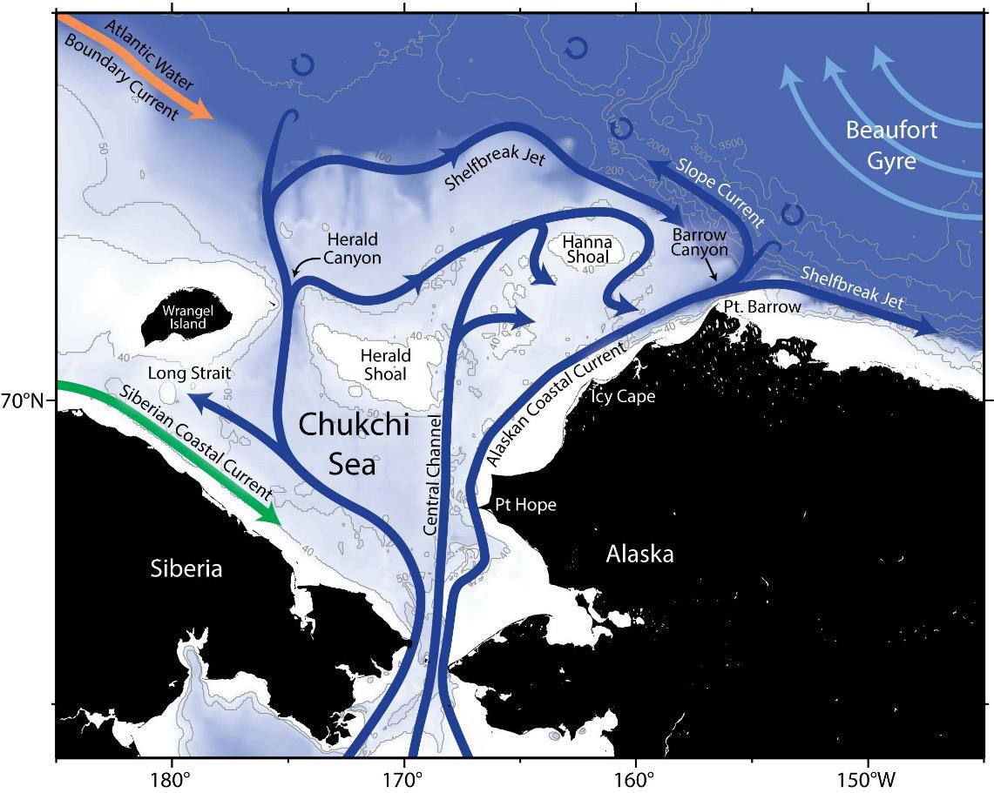
Phase 1 – Arctic Observing Network
UNCLASIFIED//FOUO
The Beaufort shelfbreak Jet:
Supplies the Beaufort Sea with heat and nutrients
Frequently undergoes wind-
driven exchange
Ventilates the interior of the Canada Basin
Brings Pacific-origin zooplankton into the region
Schematic circulation of the Chukchi Sea
Influences whale habitat
Figure: Robert Pickart

Slide 10
Phase 1 – Arctic Observing Network
UNCLASIFIED//FOUO
Other Operations:
Inorganic nutrient analysis – Scripps Institution of Oceanography
Carbon Export – Woods Hole Oceanographic Institution
Glider deployment – University of Alaska, Fairbanks
XCTDs - Japan Agency for Marine-Earth Science and Technology
Seabird Observations – U.S. Fish and Wildlife Service
Buoy Deployments – University of Washington
Harmful Algae Blooms - Alaska Ocean Observing System

Slide 11
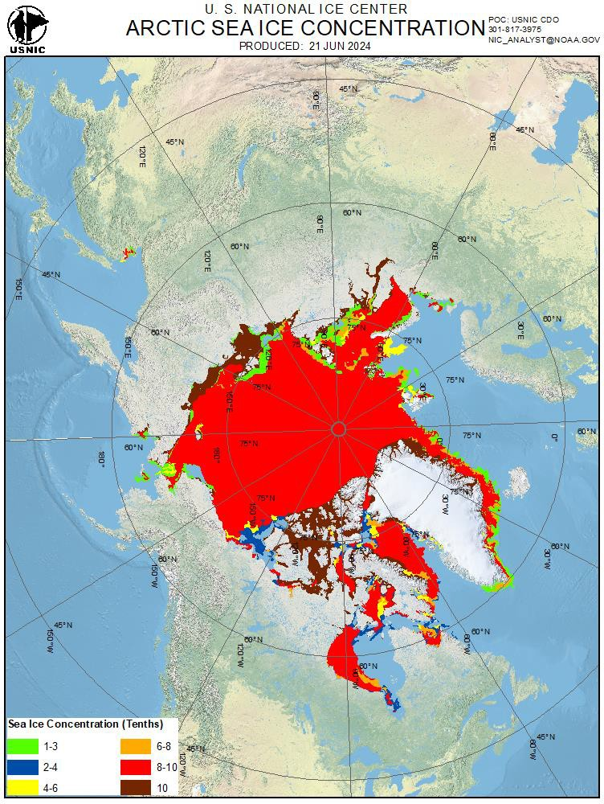
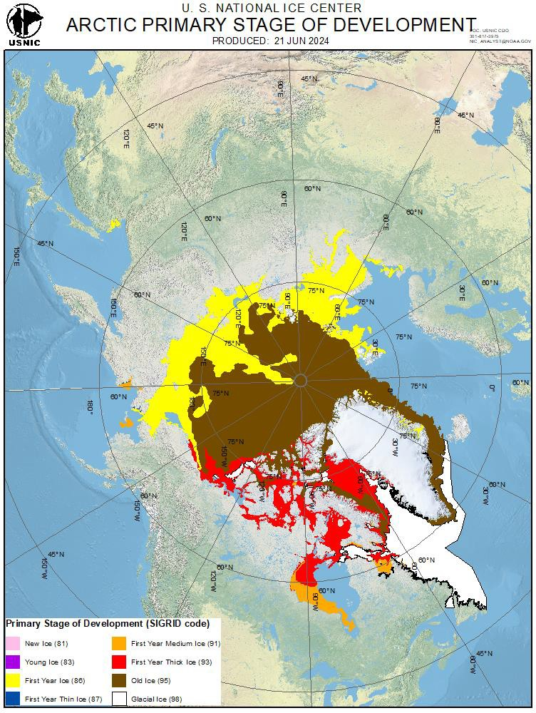
Phase 1 - Ice Conditions
UNCLASIFIED//FOUO

Slide 12
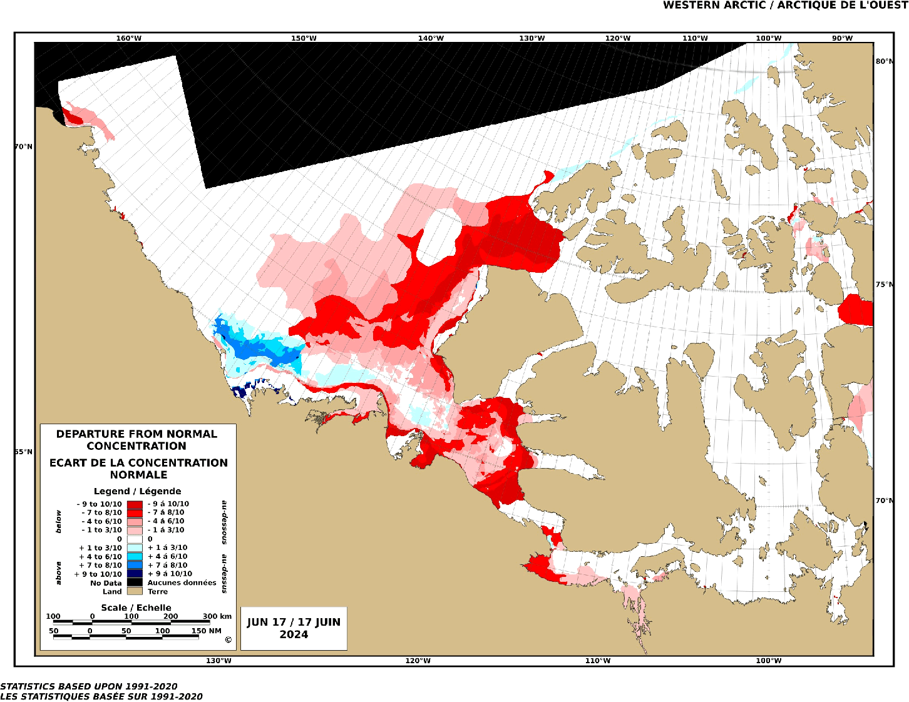
Phase 1 - Ice Conditions
UNCLASIFIED//FOUO

Slide 13
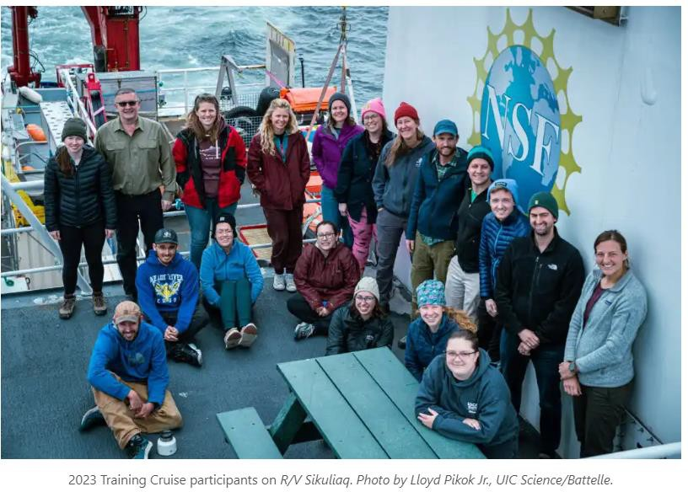
Phase 2 – Early Career Scientists
UNCLASIFIED//FOUO
Early career scientists will join Healy through the Northwest Passage to Greenland. This mission is intended
to train scientists in Arctic research practices and is modeled after a successful 2023 training program on board R/V Sikuliaq.

Slide 14
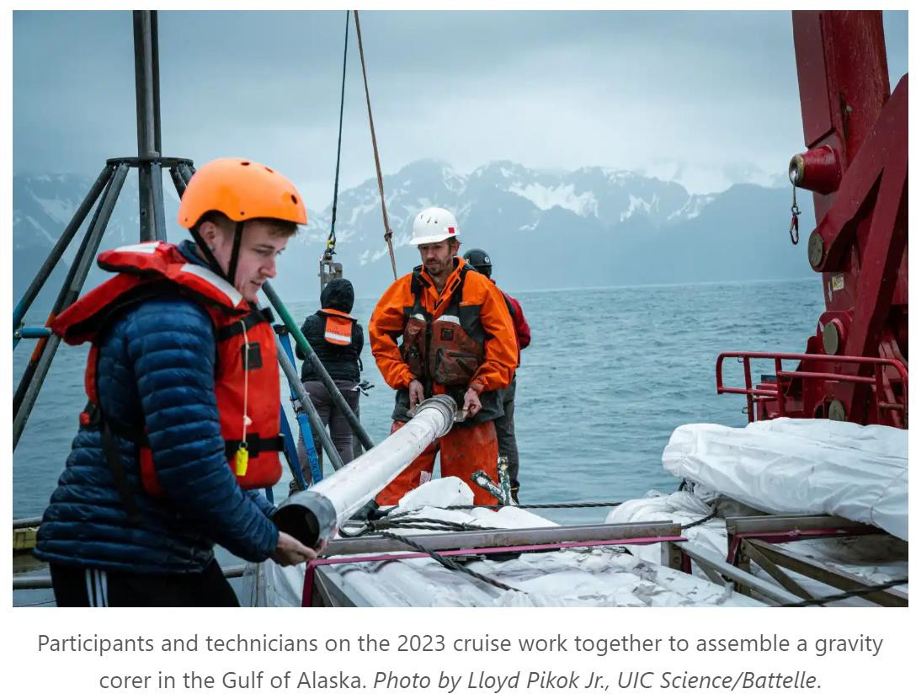
Phase 2 – Early Career Scientists
UNCLASIFIED//FOUO

Slide 15
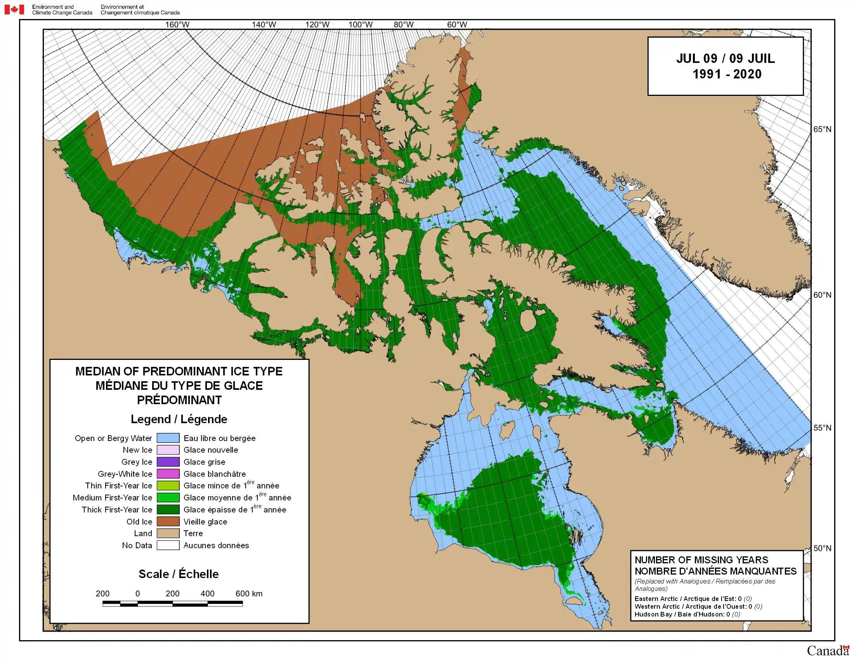
Phase 2 - Ice Conditions
UNCLASIFIED//FOUO

Slide 16
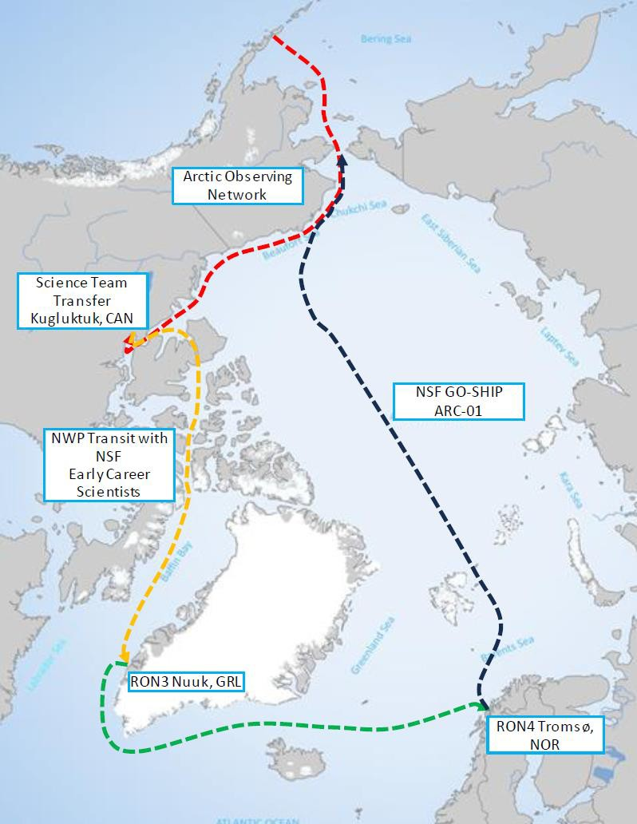
Phase 3 – GO-SHIP
UNCLASIFIED//FOUO
Global Ocean Ship-Based Hydrographic Investigations Program
First single-ship transpolar transect in GO-SHIP history.
Timed with annual sea ice minimum. 108 planned stations.
International exchange:
Canadian Royal Navy x2
Other invitations pend

Slide 17
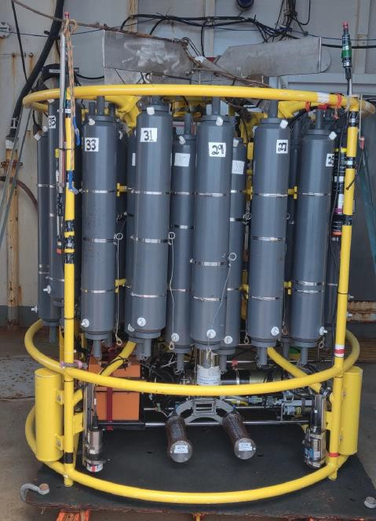
Phase 3 – GO-SHIP
UNCLASIFIED//FOUO
Global Ocean Ship-Based Hydrographic Investigations Program
Science Operations
ADCP
Dissolved Inorganic Carbon
Tracers
Nutrients/O2/salts
pH / Alkilinity
Dissolved Organic Carbon
Dissolved inorganic carbon
Radiocarbon

Slide 18
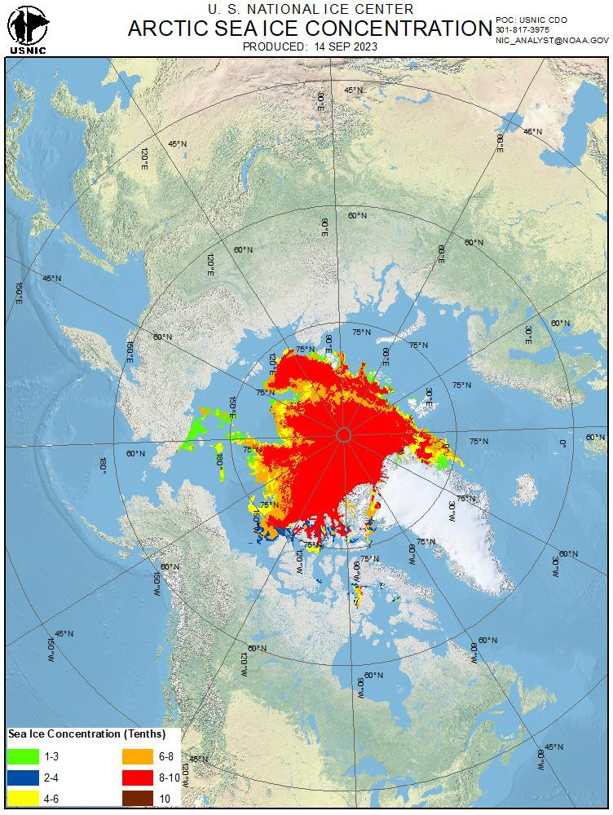
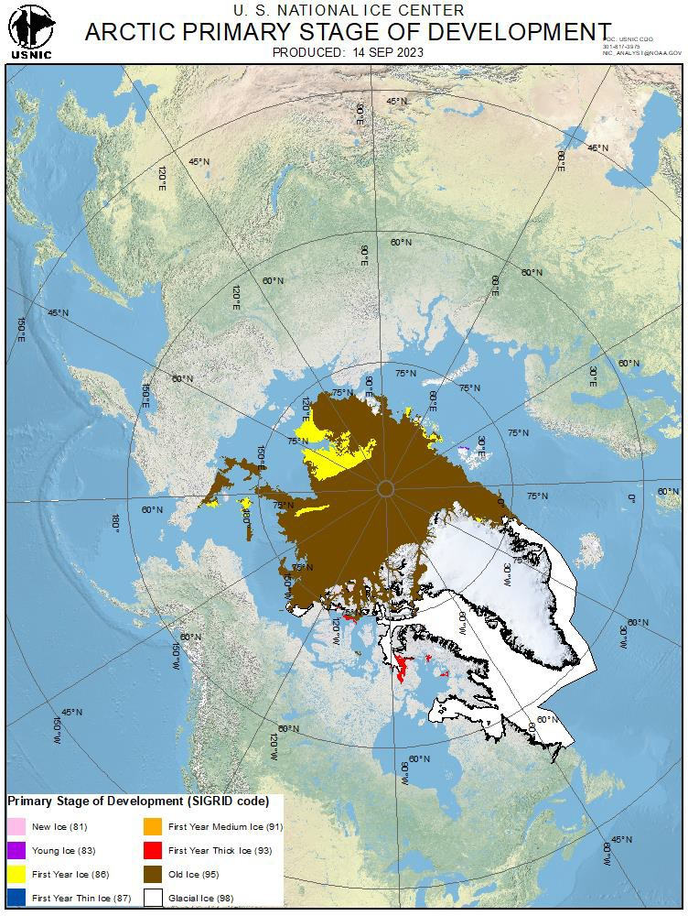
Phase 3 - Ice Conditions
UNCLASIFIED//FOUO

