Slide 1
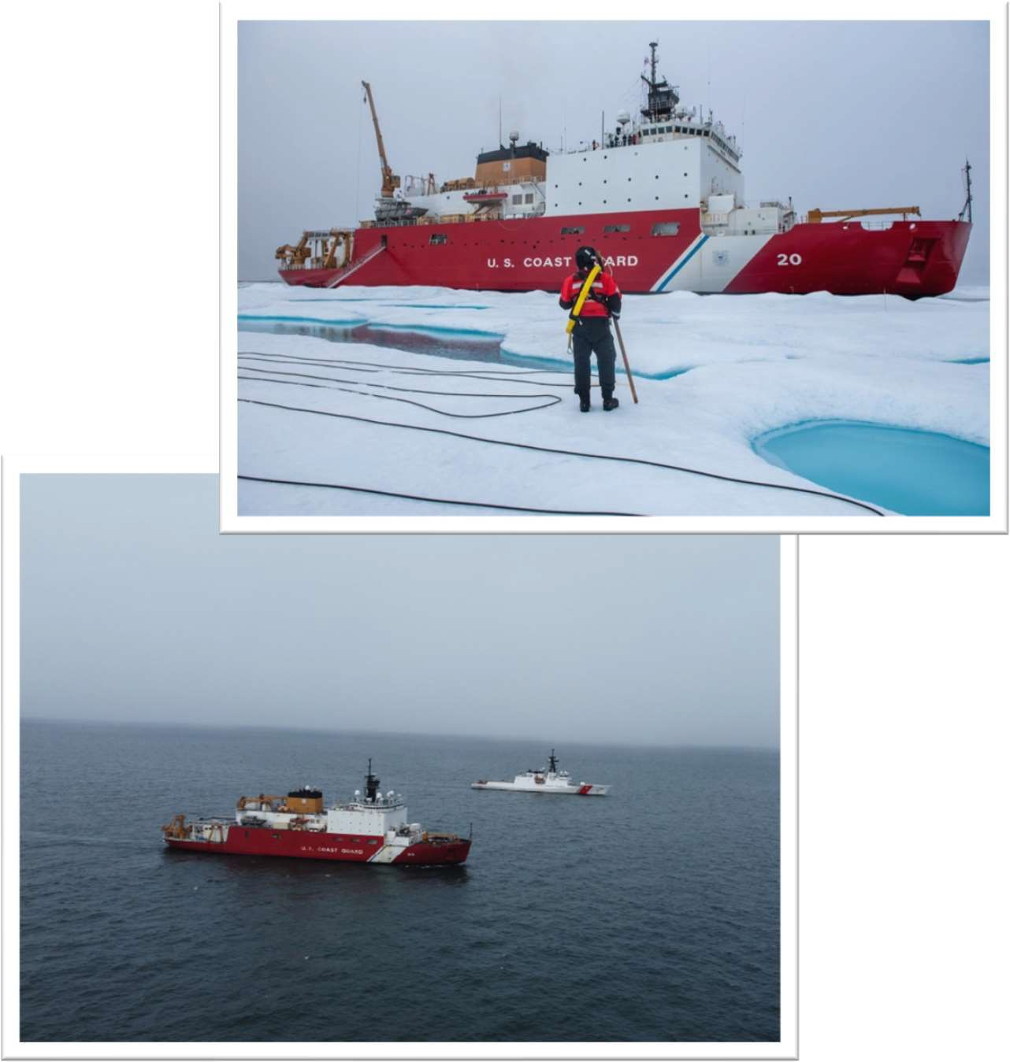
Arctic Icebreaker Coordinating Committee 26 June 2024
Arctic Surface Program Update
LT Christine McCulla Arctic Surface Capabilities Program Manager
Office of Cutter Forces (CG-751)

Slide 2
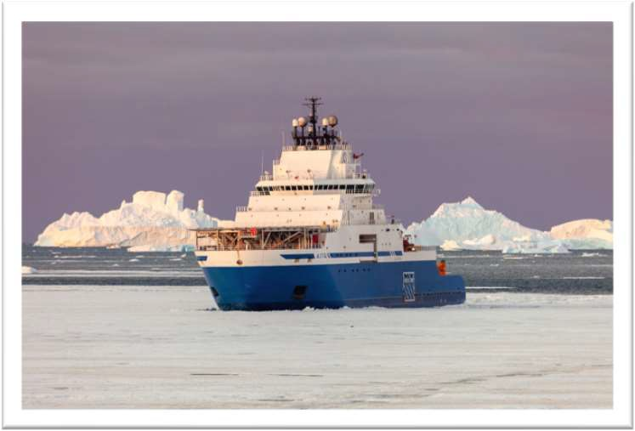
Commercially Available Polar Icebreaker (CAPI)
FY24 Appropriation
CG received funding to procure the CAPI
Received funding for initial crew
Initial Crew
12 military personnel reporting summer 2025
2 civilian positions to support the program
Acquisition Timeline
01 March 2024 – Notice of Intent to sole source CAI from Edison Chouest released
18 March 2024 – NOI closed
Summer 2024 – RFP Release
18-24 months – *Notional* timeline for the CG to purchase, take delivery of, outfit, and commence operations of CAPI

Slide 3
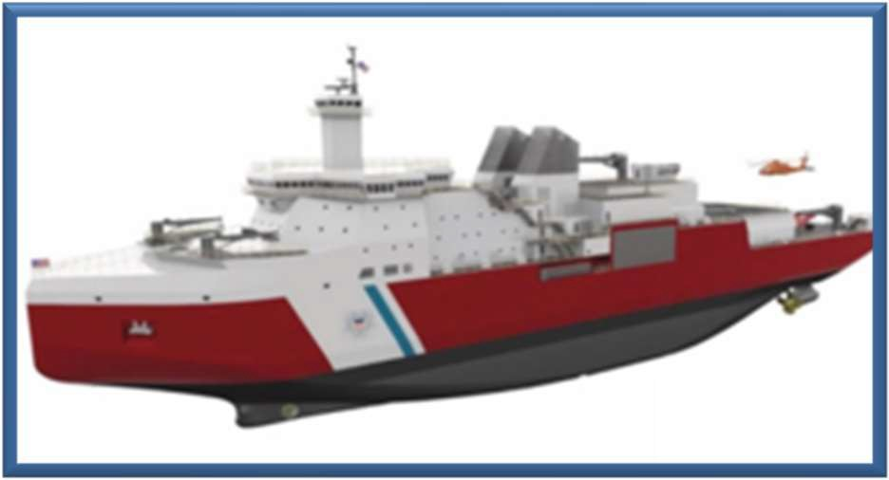
Polar Acquisitions
Arctic Surface Capability (ASC)
Notionally – Arctic Security Cutter
Requirements are in development with the CG in anticipation of a future acquisition
Polar Security Cutter (PSC)
Final Critical Design Review (FCDR) – scheduled for September 2024
Earliest delivery estimated 2029
Primary operational area following delivery – Antarctic

Slide 4
Questions?

