Slide 1
USCGC HEALY (WAGB 20)
Service Life Extension Program (SLEP)
Information Brief for
Arctic Icebreaker Coordinating Committee (AICC)
Winter Meeting
CG-9323 | PM: Mr. Kenneth King; APM: Thomas Hummer
26 June 2024

Slide 2
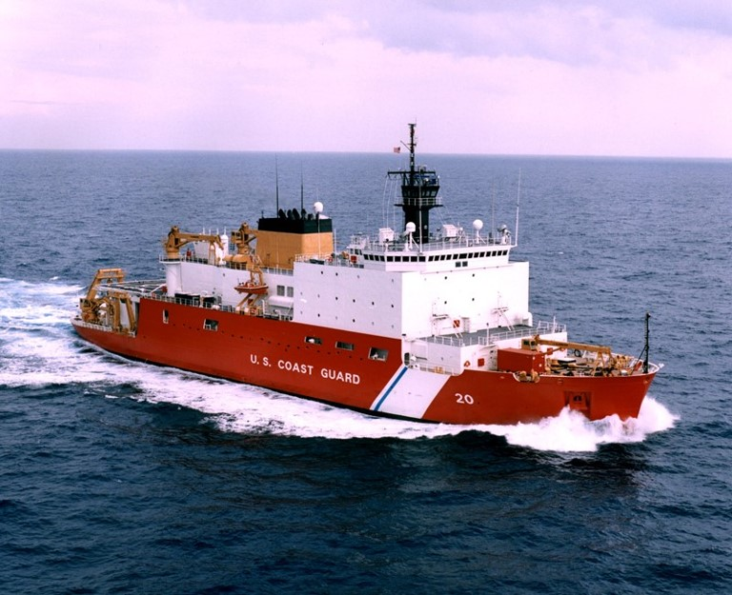
Agenda
Program Overview
Notional Milestone Schedule
Notional Worklist
Notes:
We are on slide 2 Agenda
This is the standard agenda for a level 3 non-major program

Slide 3
Program Overview
Maintain Capabilities
The Coast Guard’s current polar icebreaking capability consists of two polar icebreakers: POLAR STAR and HEALY
Polar icebreakers provide access and presence to national strategic objectives in the Arctic and Antarctic
HEALY provides unique support of the nation's strategic science efforts through partnerships with the Office of Naval Research (ONR) and National Science Foundation (NSF)
Notes:
Slide 3; overview
As we are all aware, the Coast Guard’s current polar icebreaking capability consists of two polar icebreakers: POLAR STAR and HEALY. Polar icebreakers provide access and presence to national strategic objectives in the Arctic and Antarctic.
Cutter HEALY is a unique coast guard asset in that she provides critical support of the nation's strategic science efforts through partnerships with the Office of Naval Research (ONR) and National Science Foundation (NSF).
HEALY provides science labs, support systems and space for 50 NSF personnel, as well as other mission support services.
Lastly, HEALY must maintain operational availability until the Polar Security Cutters (PSC) are delivered in order to meet statutory icebreaking requirements and support strategic Arctic objectives, particularly scientific support.

Slide 4
Program Overview
Progress Updates
02 April Program achieved ADE 2-A&B
Non-Requiring Engineering efforts are underway targeting the development for FY 27 and 28 availabilities.
Completed installation of new phone system.
Developing Engineering Change and procuring Coast Guard GFE for new multi-beam sonar installation, targeting FY26 DD
  NSF is procuring the new sonars
Notes:
Slide 4; Overview continued
A SSMEB was completed in 2019. This report shows that support expenditures are exceeding current funding and predicted to continue increasing. The report indicates this is due to obsolescence issues.
The SSMEB identified the systems that require non-standard maintenance or systems that require replacement that are driving the raising cost to operate and maintain the asset.
Some of these targeted mission degraders include Propulsion plant support systems, Piping, Structure, Auxiliary systems, & MPCMS integration system recap, various HM&E sub-systems, communications, and CGOne & NSF connectivity improvements.
A prioritized work list was developed using the SFLCs standard practices for all proposed items. Each item was evaluated for possible solutions with estimated cost. The prioritized proposed Work Item list is provided within this presentation.

Slide 5
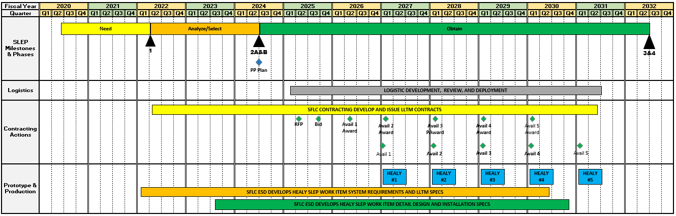
Notional Milestone Schedule
Key Assumptions & Applied Best Practices:
SLEP will comprise of 5 availability “phases” scheduled around recurring Arctic missions
Same shipyard/location for all 5 phases
To reduce vessel down time, maintenance periods will include O&D-level work items
Notes:
Slide 5
This is the notional program schedule. Please note that we have included some of the key assumptions and best practices from the ongoing POLAR STAR SLEP project based on feedback from our operational partners. These include:
The program assumes HEALY must be available to support the annual NSF artic mission. In support of this assumption the SLEP work will be completed using annual maintenance availabilities over a five year period.
Same shipyard/ location for all phases
Maintenance periods will include O&D-level work.

Slide 6
Notional Work Schedule
Notes:
Slide 6 Notional Work List.
This is Notional Work Item list.
The SFLC used a working group and the SSMEB report and input from the C5I community to determine the proposed work items. The first six items are currently being working on using CG-45 S&D funding. These items must be reviewed, updated and in a working format to insure their usefulness in evaluating the engineering changes as they are being developed

Slide 7
Notional Work Schedule(cont.)
Notes:
I am now on slide 7 Notional Work List (cont.).

Slide 8
Notional Work Schedule(cont.)
Notes:
Slide 8 Notional Work List (cont.).

Slide 9
Notional Work Schedule(cont.)
Notes:
Slide 10 Notional Work List (cont.).

Slide 10
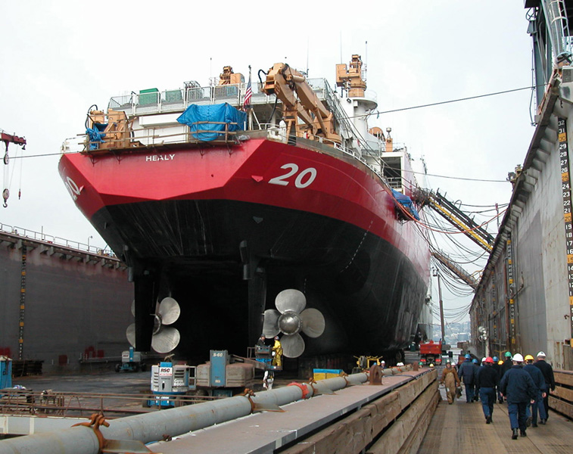
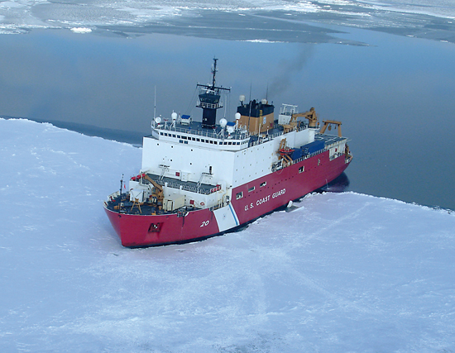
Questions/Discussion

