Slide 1
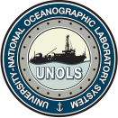
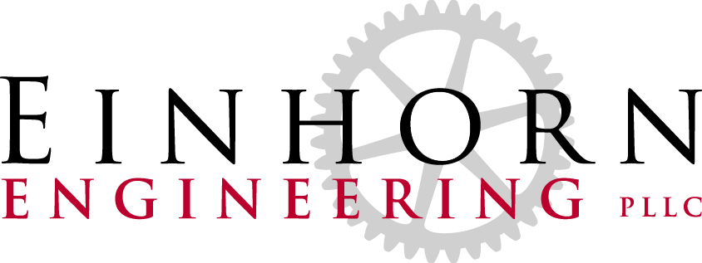
UNOLS Deck Sockets Compliance with RVSS, 11th ed.
Presented by:
Marcel Beaudin
Einhorn Engineering, PLLC

Slide 2
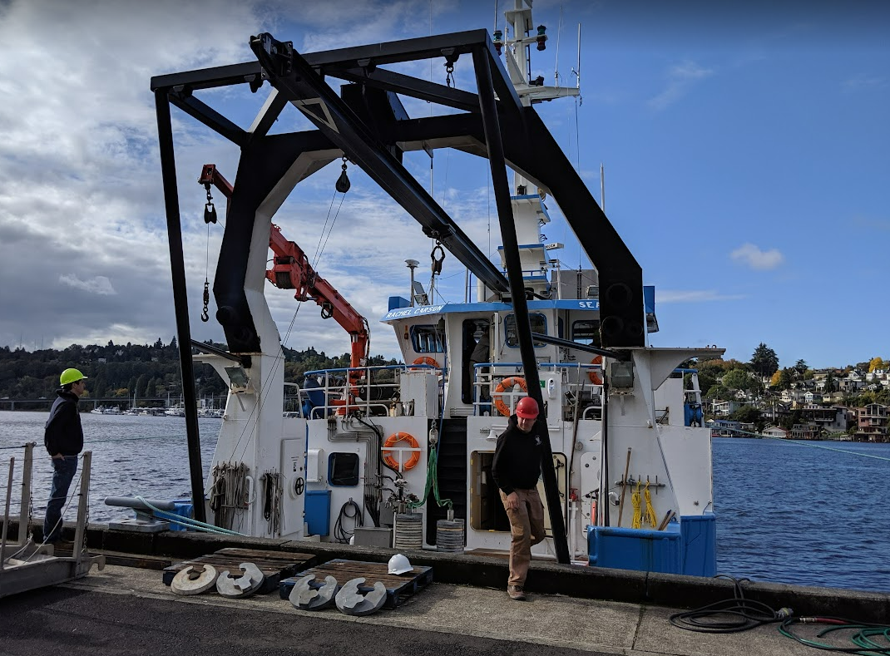
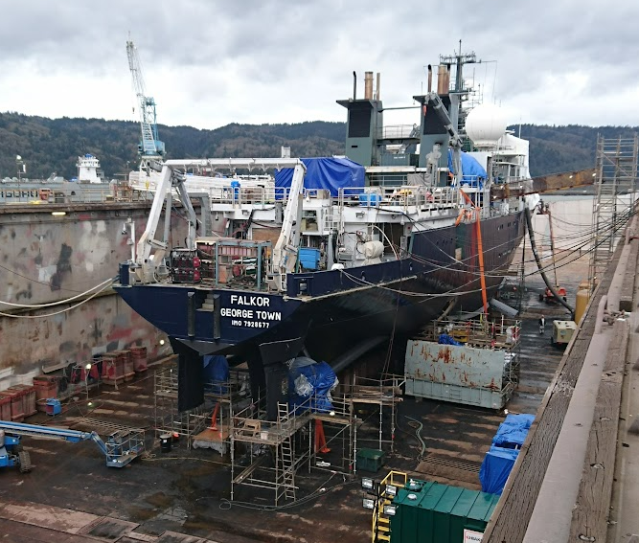
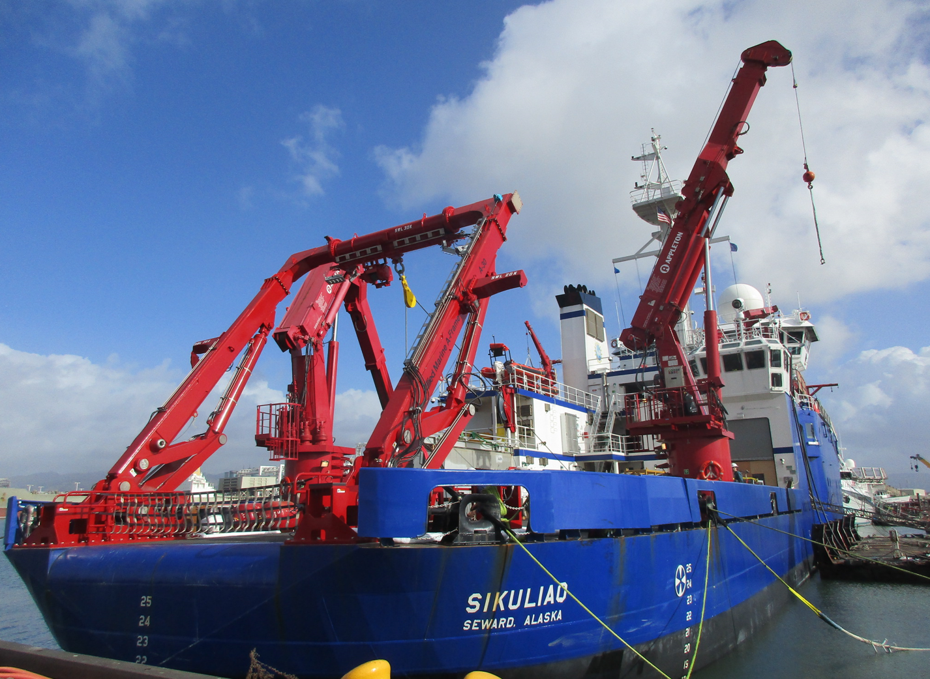
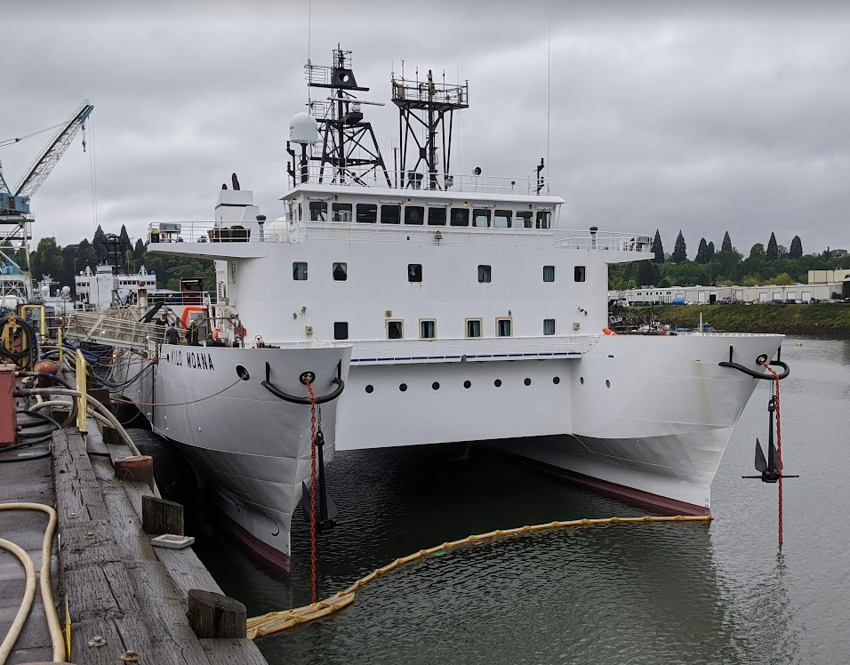
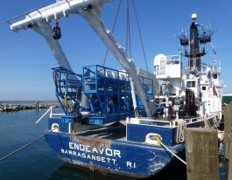
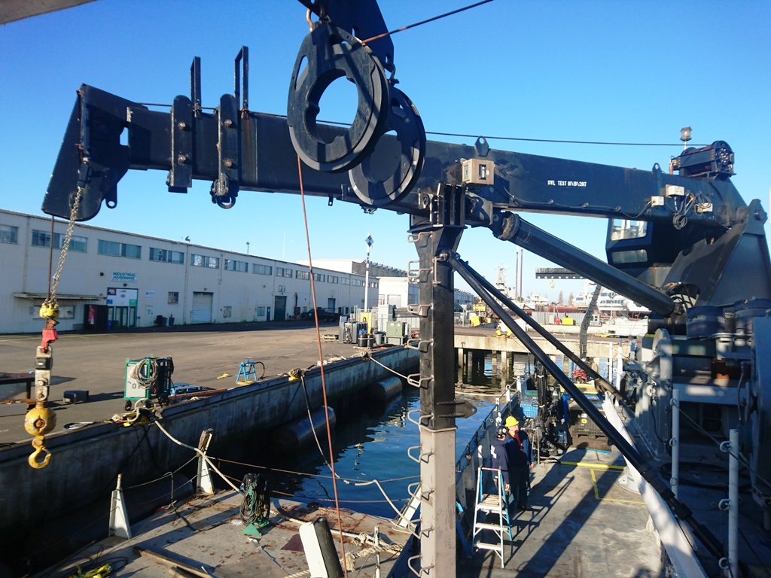
Past UNOLS Support
Beaudin Personal Experience
- Project Engineer with EE since 2020.
- Seward Marine Center Port Engineer
- R/V Sikuliaq 1st Engineer
- Mariner since 1996
Notes:
Endeavor-Just one example of a number of ship’s we have sailed on as a customer. Others include R/V Cape Hatteras, Point Sur, Melville, Knorr & Oceanus
U of H Kilo Moana-Design/build Aux HPU Power unit & switching station to integrate with existing unit.
UAF – Supported spec package for current A-frame system. Modification of HPU to integrate additional filtration for back deck supplies, replumbing of both cranes to eliminate hose failure issues, OHS Load Testing
UW- Design/Build of Overhead Handling System and A-frame Extension.
SIO – Design and installation of a system to make some sonar heads diver serviceable
OSU- Design/Build of a crane crutch system
Duke-Design/Build of a deployment system for a side scan sonar
UCONN-Troubleshooting and upgrades to hydraulic circuit for bow thruster control

Slide 3
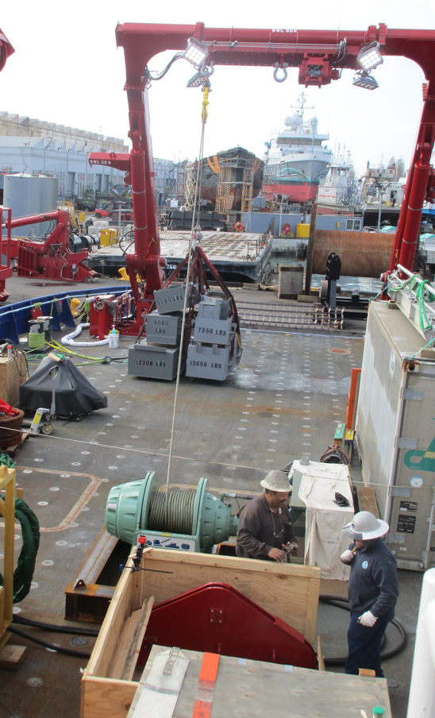
UNOLS Standard Deck Sockets
Deck Sockets Background
UNOLS vessels include 1”-8 UNC threaded bosses in a 24” x 24” grid for securing gear to the ship deck.
Used to transfer loads from deck mounted equipment to the ship structure.

Slide 4
Deck Socket Testing Requirements
Testing
RVSS, 11th edition:
Mandatory compliance for ARF unless “not practical or economical”
B.4.4.1: Requires routine testing of deck sockets used as part of OHS
Fixed and portable OHS systems must be tested every 5 years
B.4.1: Requires testing to 125% of Safe Working Tension using a calibrated instrument

Slide 5
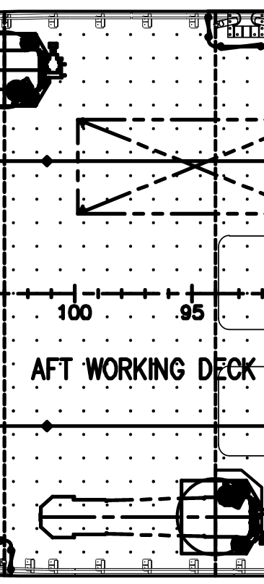
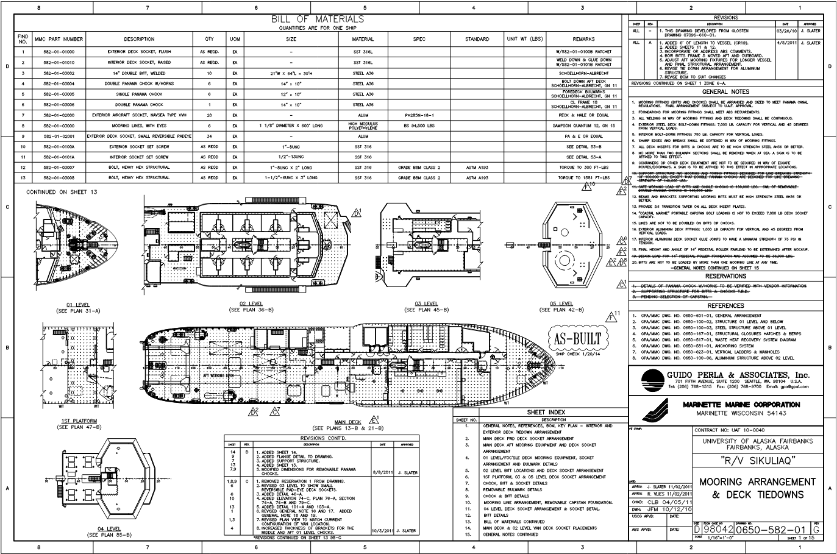
R/V Sikuliaq Case Study
Test load determined from delivery documentation
Quantity 1000+
QTY = 1019 (Main Deck)
+ 01 Level + 02 Level

Slide 6
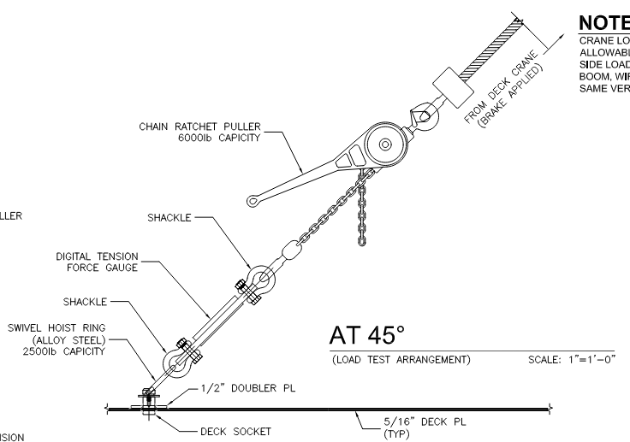
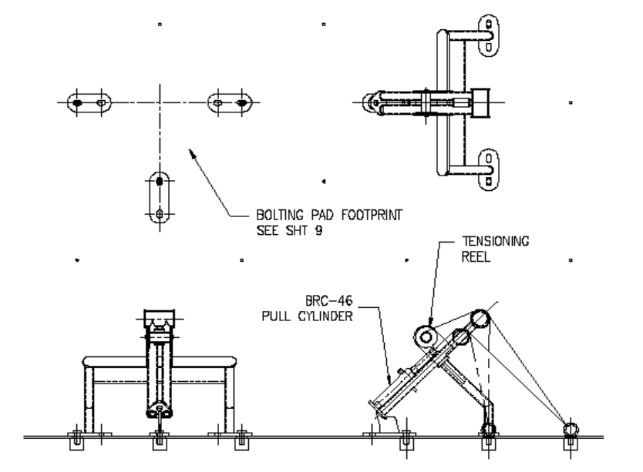
Previous Testing Methods
Previous testing methods:
Cumbersome and labor intensive
Require use of ship’s equipment
Require multiple personnel to perform each test
Time consuming
Possibility of damage by over-tensioning
“Can we just test a representative sample?”

Slide 7
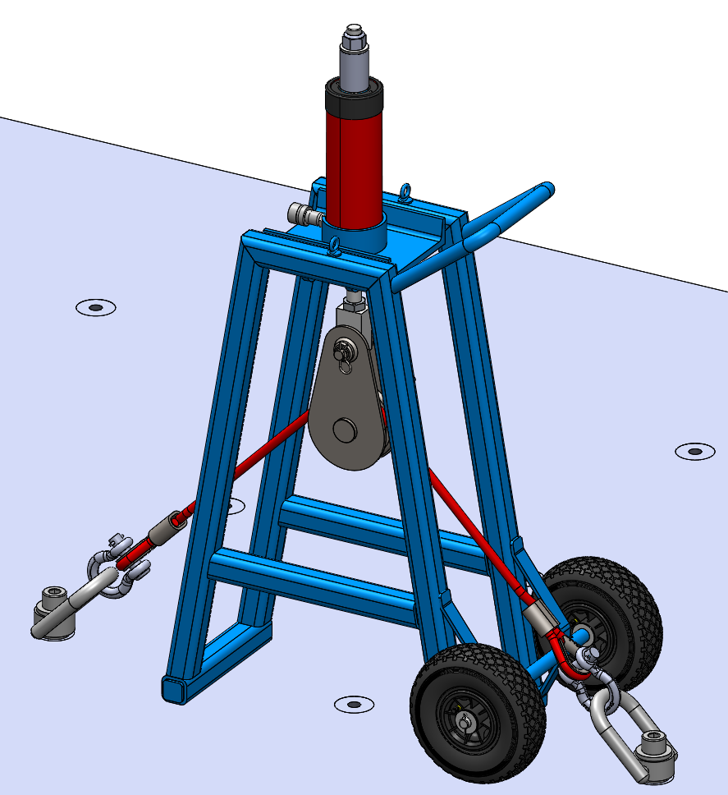
Einhorn Engineering Solution
Advantages
Easy to use
Kit is self-contained
(Don’t need to use ship’s cranes or equipment)
Saves time – needs one person only
Pulls to pre-calibrated tension
Portable and easily stowed
1”-8 UNC hoist ring
Tailboard block
45º test wire

Slide 8
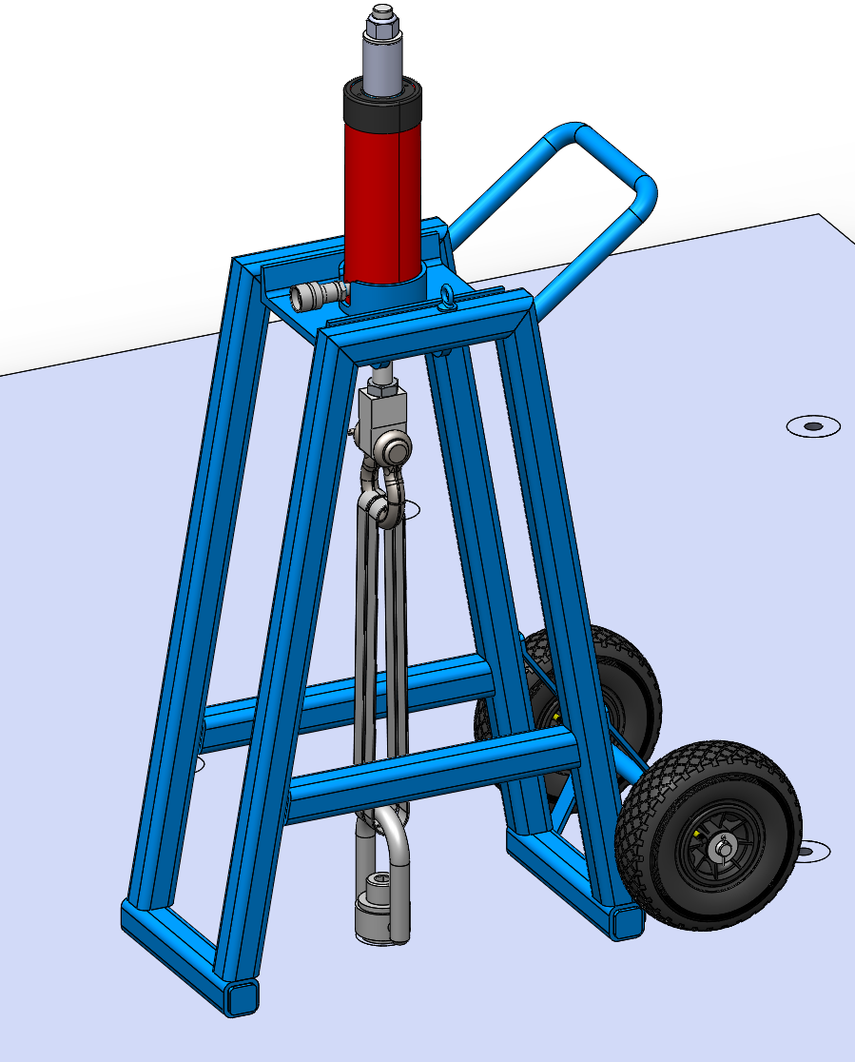
Assembly Overview
Threaded rod
Test frame
Carting handle
Polyester sling
Lifting eye for rigging
Pneumatic tires
1”-8 UNC hoist ring
Weight of test assembly: 190 lbs

Slide 9
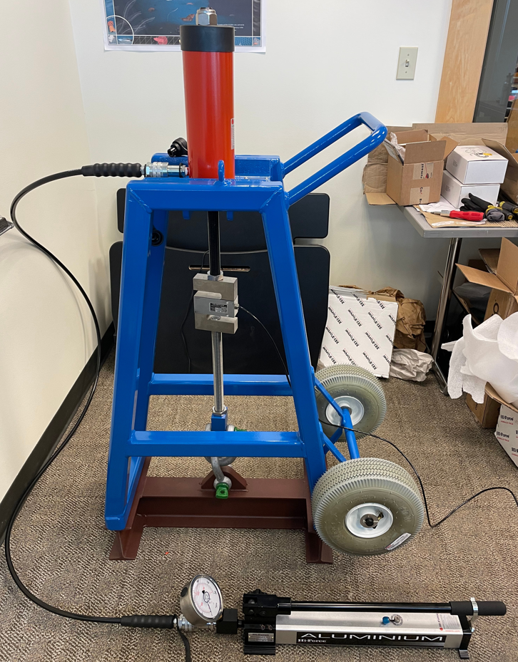
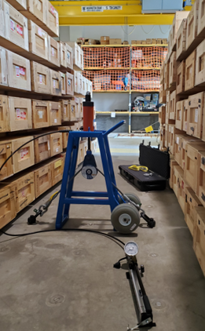
Calibration & Validation

Slide 10
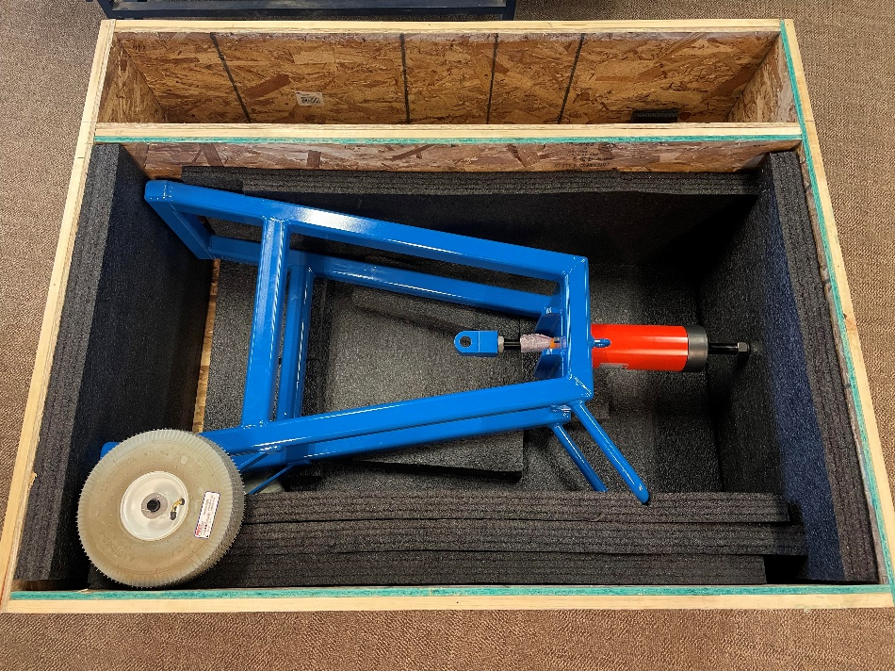
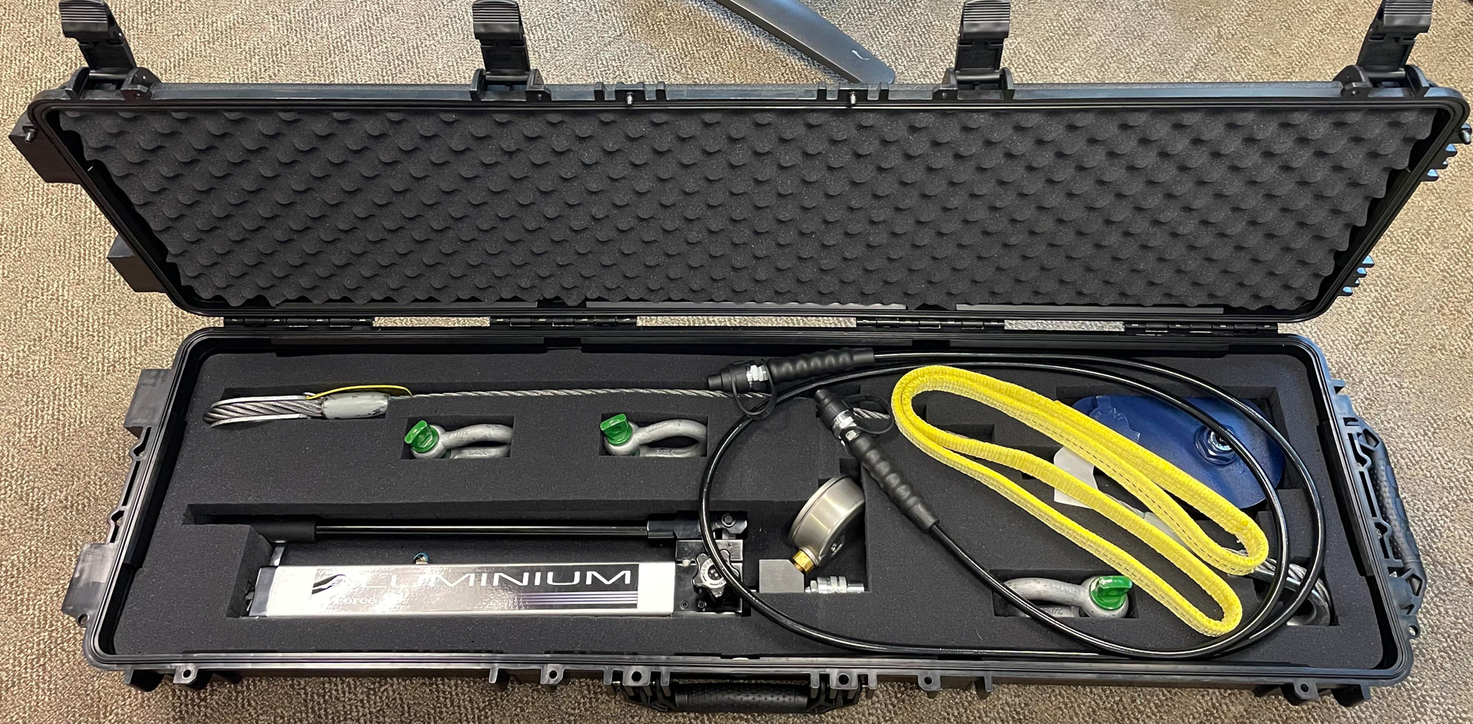
Ready for Shipment
Thank you!
Marcel Beaudin
Project Engineer
Einhorn Engineering, PLLC
marcel@einhornengineering.com

Slide 11
Deck Socket Testing Service
Einhorn Engineering, PLLC offers on-site testing services with the following advantages:
Lower upfront cost (no purchase of equipment necessary)
Consistent testing methodology used
Test Reports provided that satisfy requirements

