Slide 1
R/V Kilo Moana – Smoke Incident Brief
Overview of Mishap Report and Lessons Learned

Slide 2
Objectives
Summary of mishap
Conclusions
Lessons Learned

Slide 3
Summary of Mishap
On Friday January 13th, 2023, at 0231 local (UTC-10), smoke was detected in the Galley.
Crewmembers responded to the incident and found food smoldering on the serving line steam table causing smoke throughout the Galley and Mess Deck area.
One crewmember entered the space and deenergized the warmer and removed smoldering food trays.
This incident resulted in one injury that required treatment beyond first aid. There was no damage to the vessel, Galley or equipment.

Slide 4
Picture of Steam Table and Burned Food

Slide 5
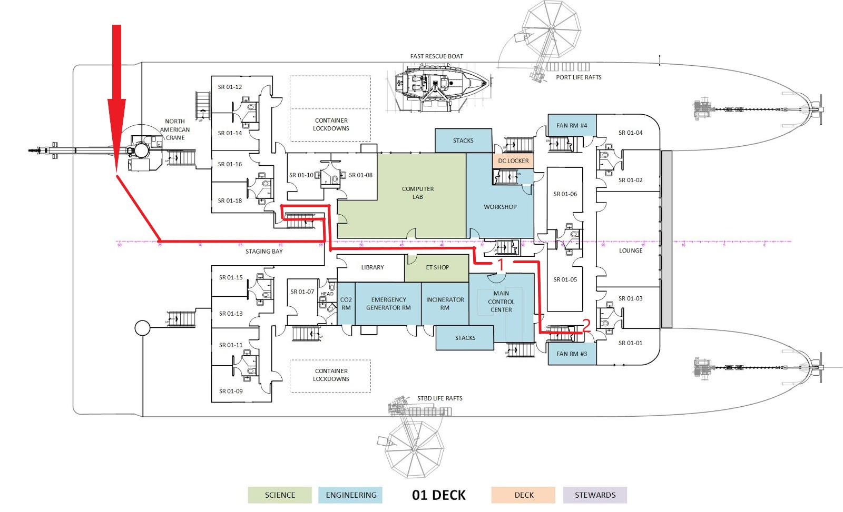

Slide 6
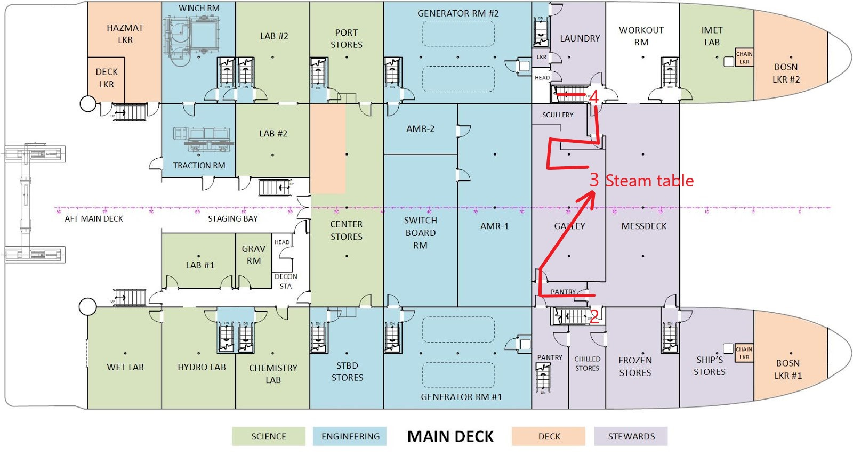

Slide 7
Conclusions
The source of the smoke and smoldering was determined to be from food that was left out overnight in the steam table.
It is unknown at what temperature the steam tables were set at as the Chief Mate secured them during the response.
It is neither UHMC or Kilo Moana policy to provide hot food outside of posted meal hours.

Slide 8
Lessons Learned
Lesson 1 – Galley Policy
Strict compliance to Galley policies, procedures and checklists are required to ensure food safety, sanitary dining areas and fire safety.
Due to the nature of the work as well as equipment and space arrangement, this area of the ship has a high potential for fire.

Slide 9
Lessons Learned
Lesson 2 – Watch Policy While In-Port
A proper watch is to be kept on the vessel at all times.
An alert watch stander making regular rounds provides the first line of defense against fire, flooding or security threats.
An overreliance on automated systems and new technology should never be allowed to replace proven maritime principles, best practices and requirements.

Slide 10
Lessons Learned
Lesson 3 – SMS Procedures
SMS Procedures are key to providing a ready source easily accessible information to all crewmembers and staff ashore.
SMS Procedures for Fire Fighting should be reviewed to ensure training doesn’t stop at the pier because fire and emergency services are nearby.

Slide 11
Lessons Learned
Lesson 4 – Crew / Science Member Training
Lifesaving and firefighting techniques and procedures must be continually reinforced through frequent and comprehensive training.
Science riders will be included into drill scenarios and be more active in training to ensure they feel a shared ownership to help protect the vessel whether at sea or in-port.

Slide 12
Lessons Learned
Lesson 5 – Fire Detection & Alarm Configuration
While R/V Kilo Moana is not required to have a 2-minute deadman alarm installed that will sound the General Alarm, it is agreeably a good idea given the vessel regularly carries up to 49 scientists and crew.
A deadman alarm is designed to provide an automatic vessel wide back-up incase the initial alarm goes answered.

Slide 13
Questions / Discussion

