Slide 1
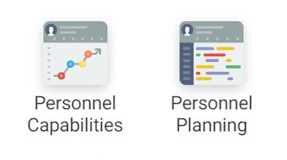
MFP personnel planning and capabilities
Erica Koning, NIOZ
RVOC Duluth

Slide 2
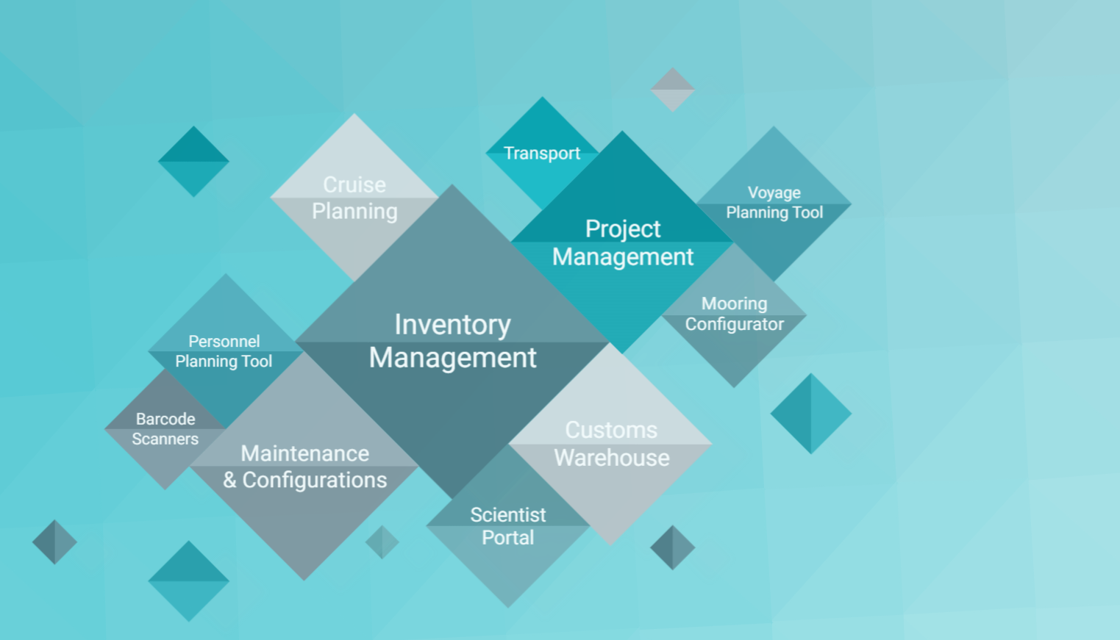
2011 Inventory management phase 1 (T&T) at NIOZ programmed by Jaco Möhlmann
2012 T&T phase 2 with Maas SE
2013 NERC buys into T&T
2013 OFEG discussions about a common system
2014 NIOZ – NERC commission MFP
2015 NIOZ – NERC start using MFP

Slide 3
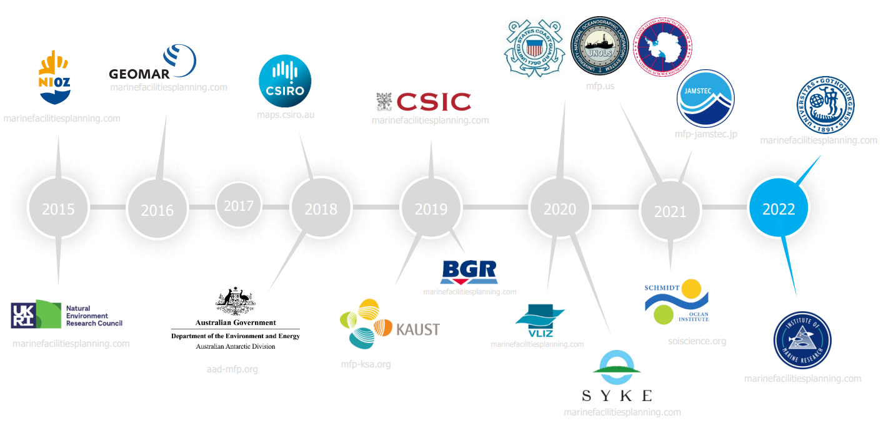

Slide 4
Personnel planning
Personnel planning is fully customized for each organization that wants to use it.
Depending on the setup, the planner can use automatic planning or manual planning.
Automatic planning requires to set crew change dates.
Custom events can be created.
MFP keeps count of the number of working days for each crew member, but can also be set up to calculate an amount of leave per day at sea.

Slide 5
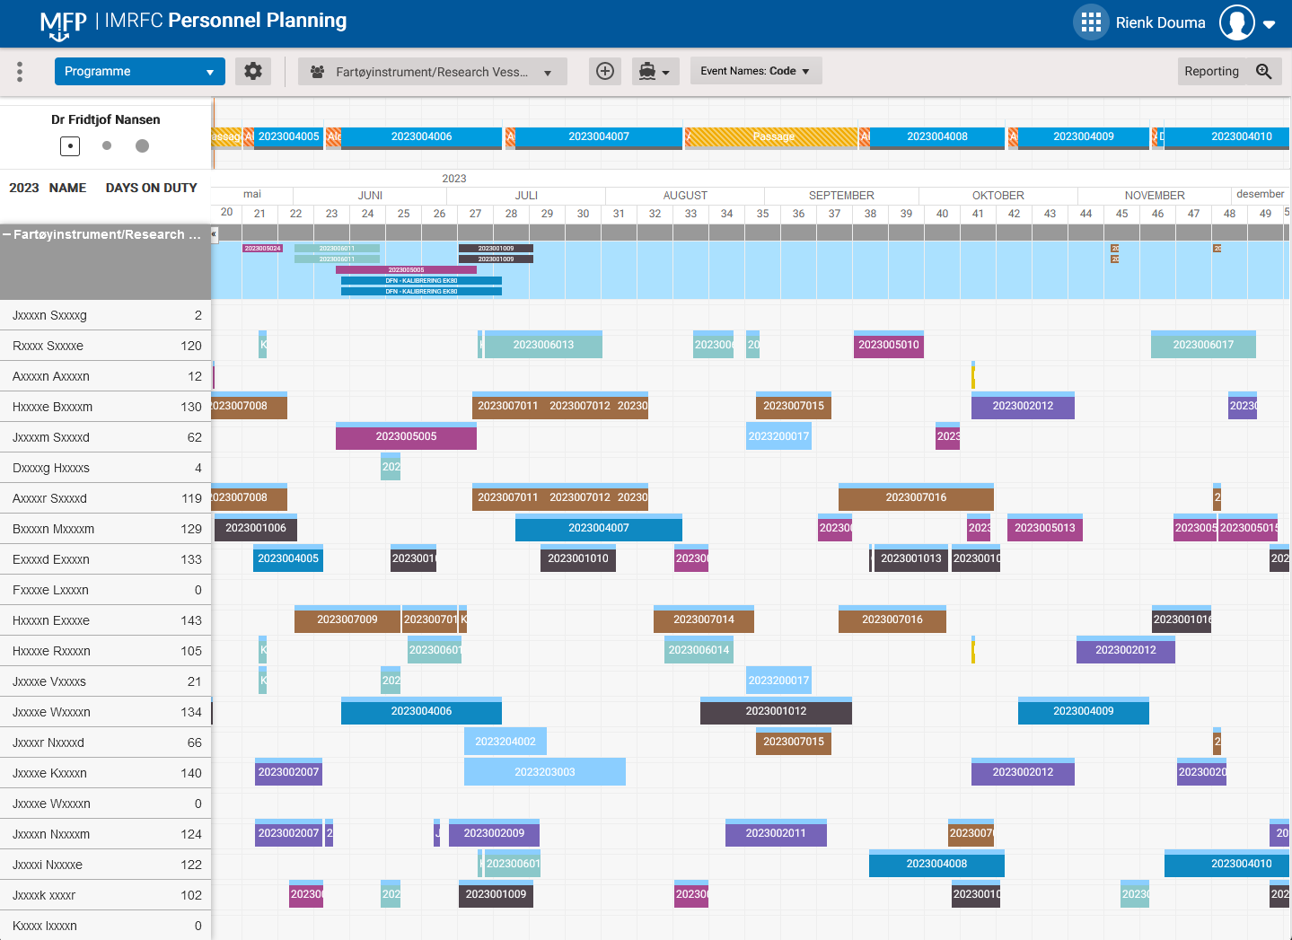
IMR technician planning
IMR:
Technicians only
9 ships
Approx. 300 technicians

Slide 6
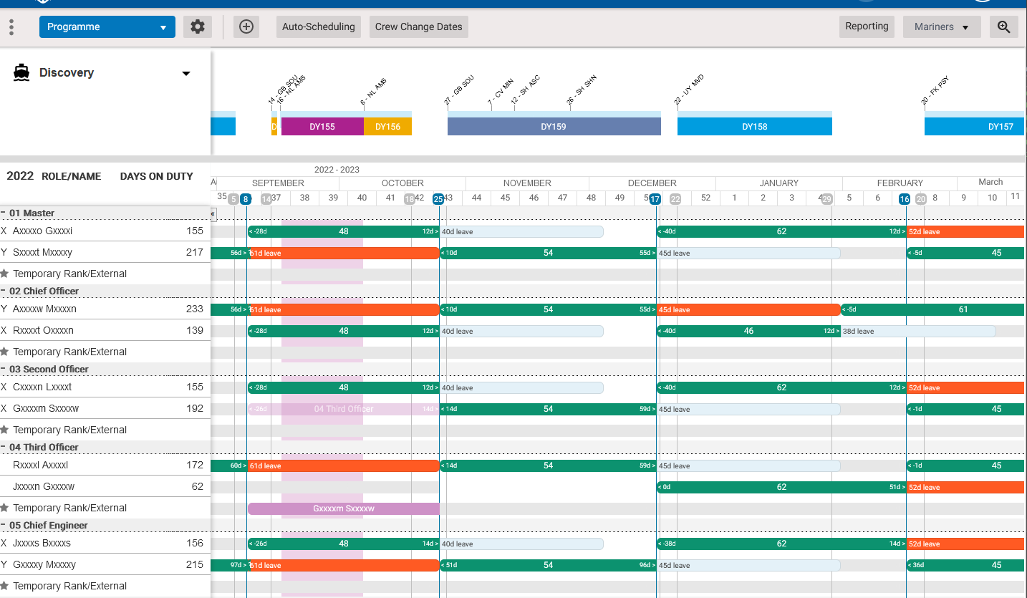
NERC Auto scheduling

Slide 7
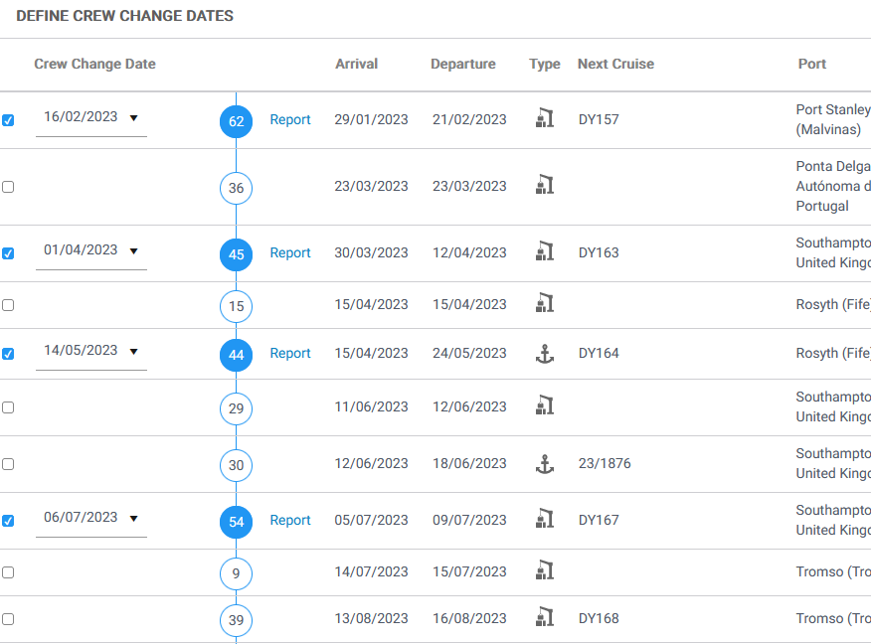
Auto scheduling – NERC crew change dates

Slide 8
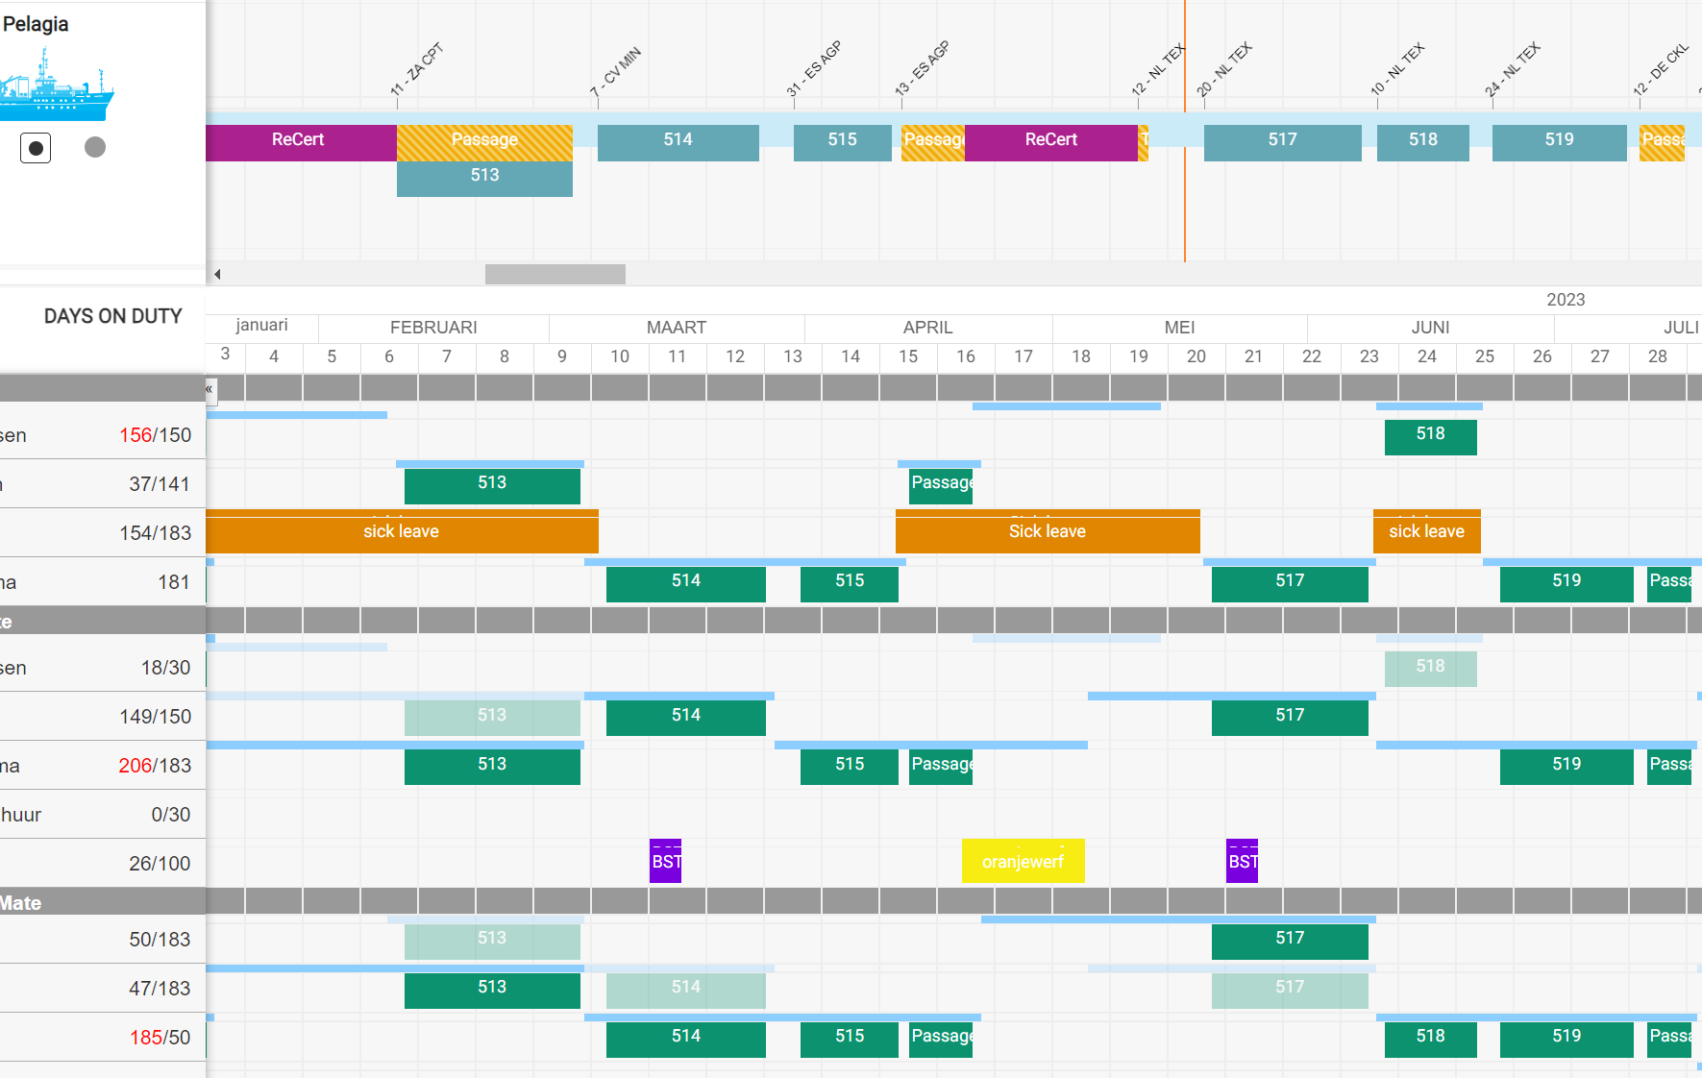
NIOZ: Manual planning

Slide 9
Manual planning - drafts

Slide 10
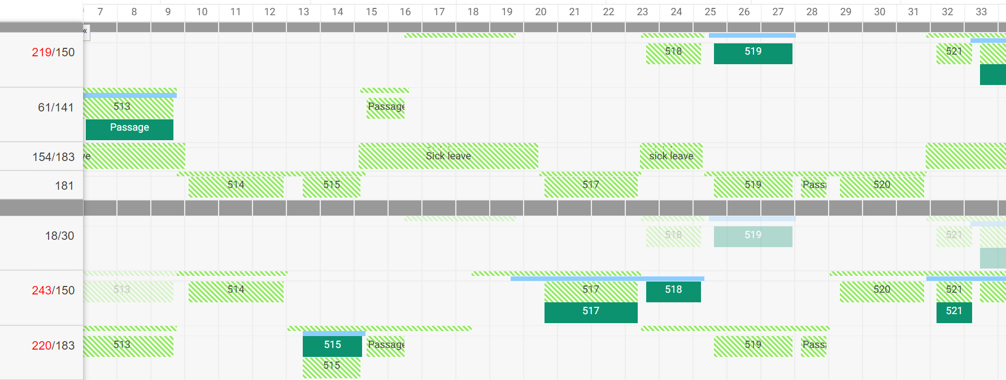
Manual planning - drafts

Slide 11
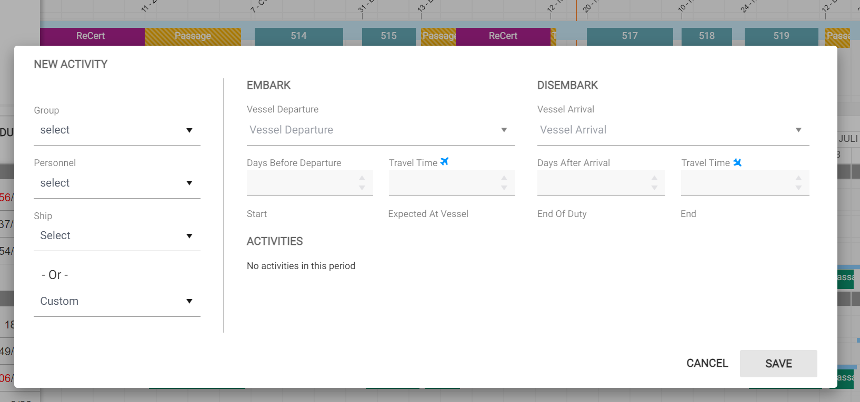
Manual planning

Slide 12
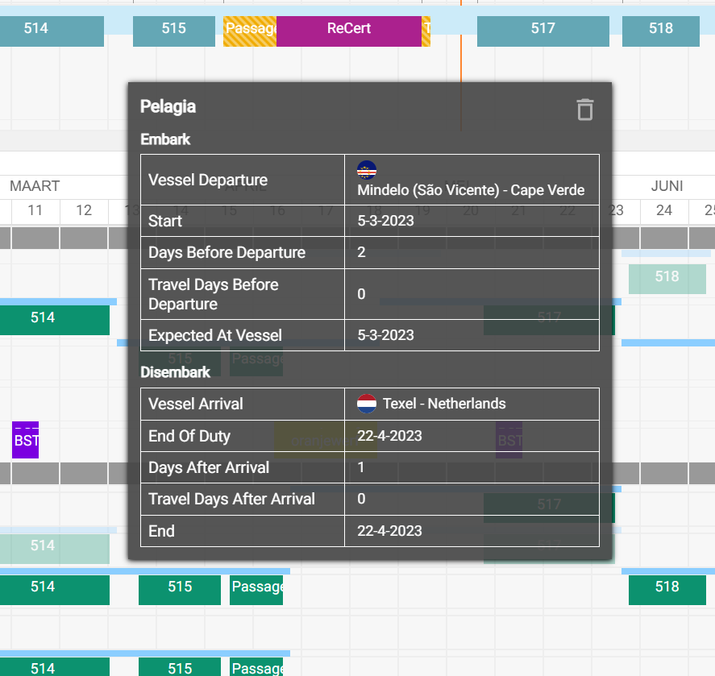
Manual planning

Slide 13
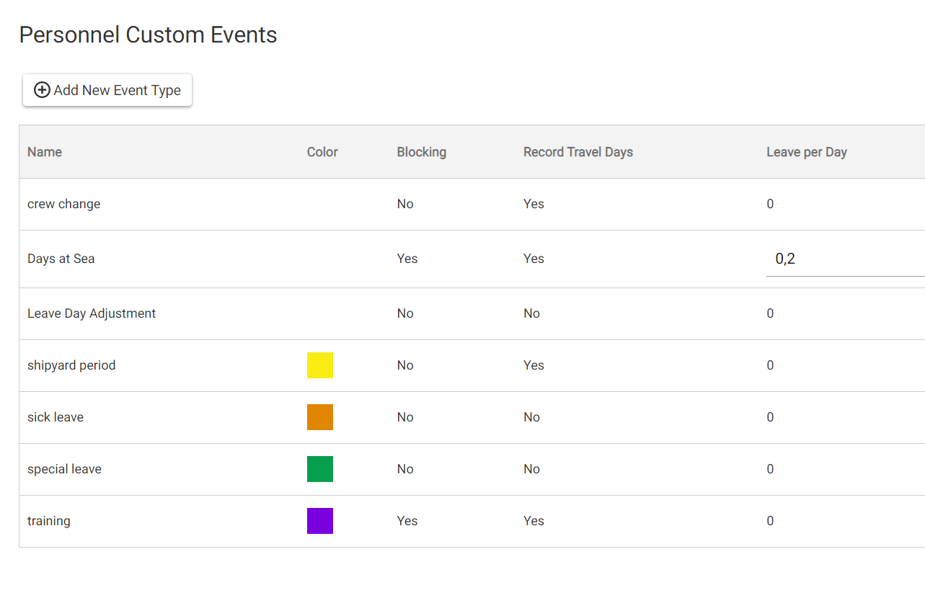
Manual planning

Slide 14
Personnel planning – crew calender view

Slide 15
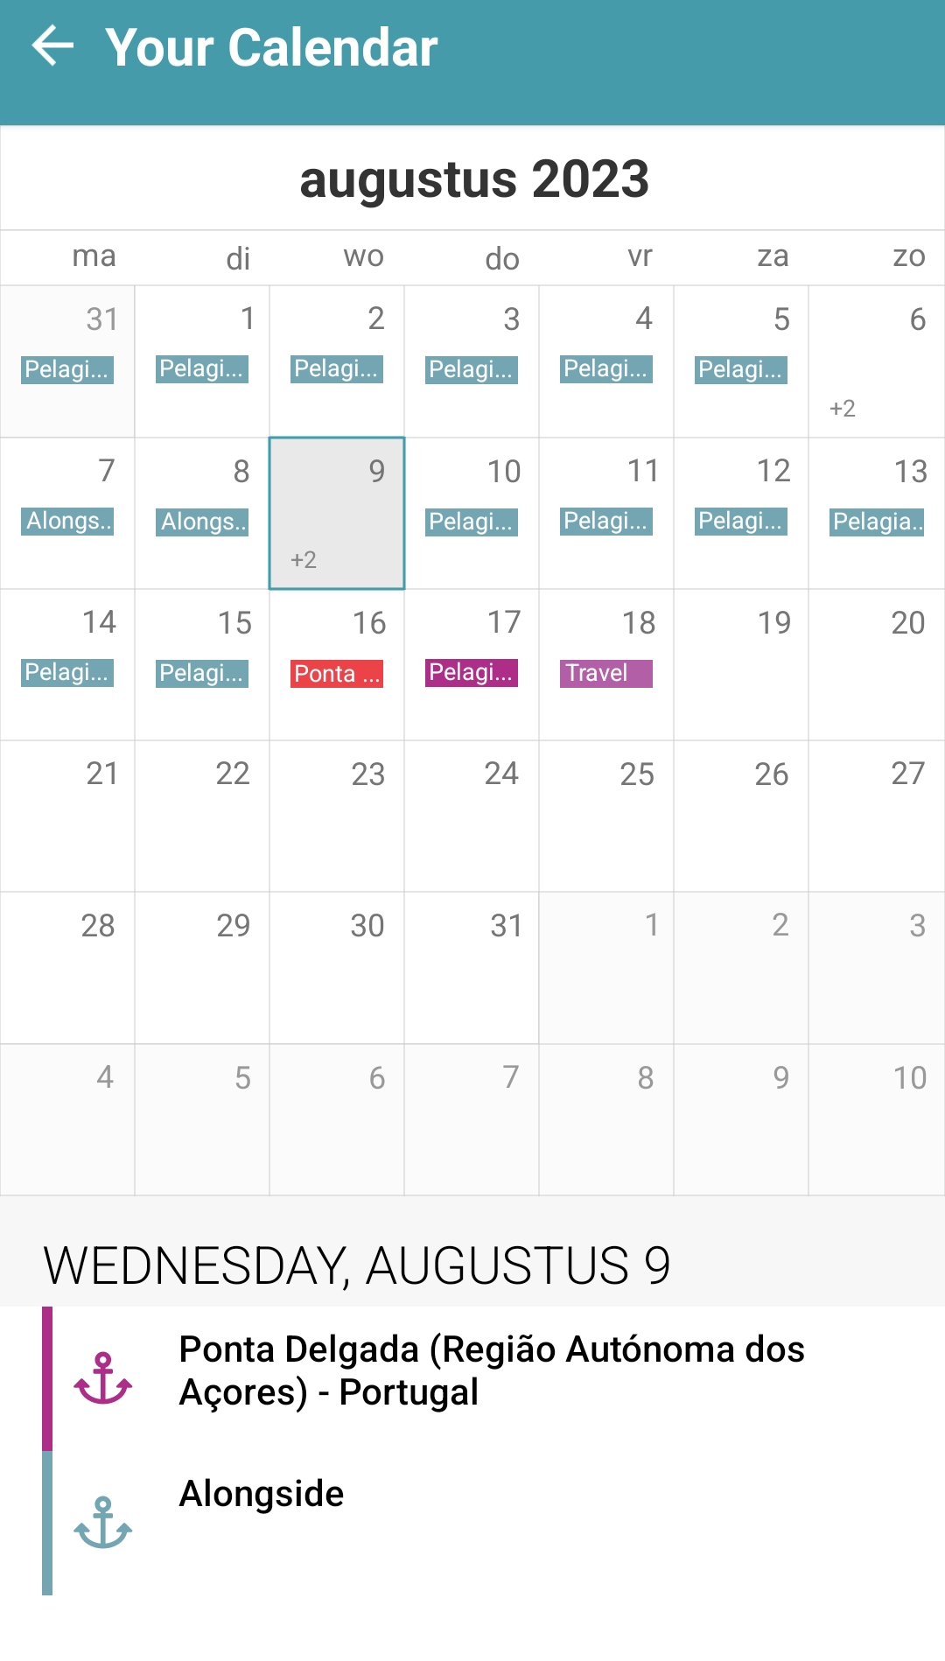

Slide 16
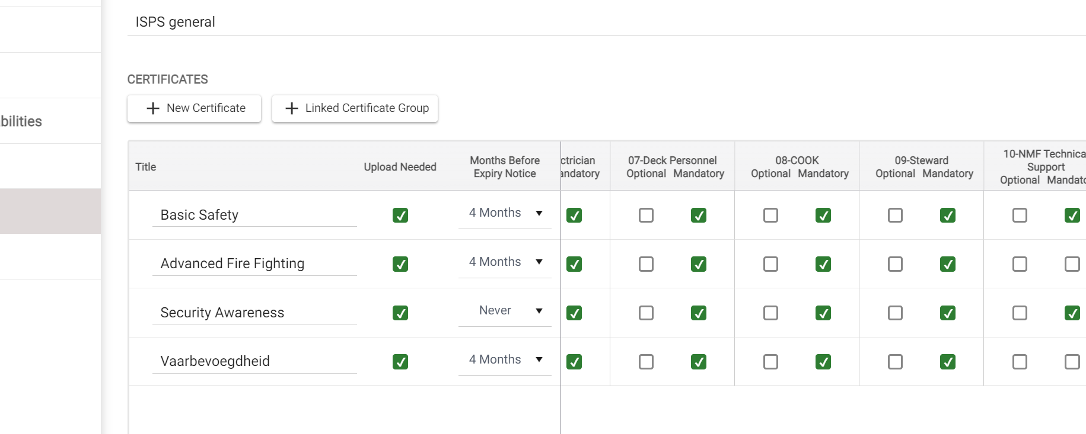
Personnel capabilities – expiring certificates

Slide 17
Personnel capabilities – expiring certificates
Personnel planning is customized for each organization that wants to use it
Auto planning or manual planning
Custom events
Automatic

Slide 18
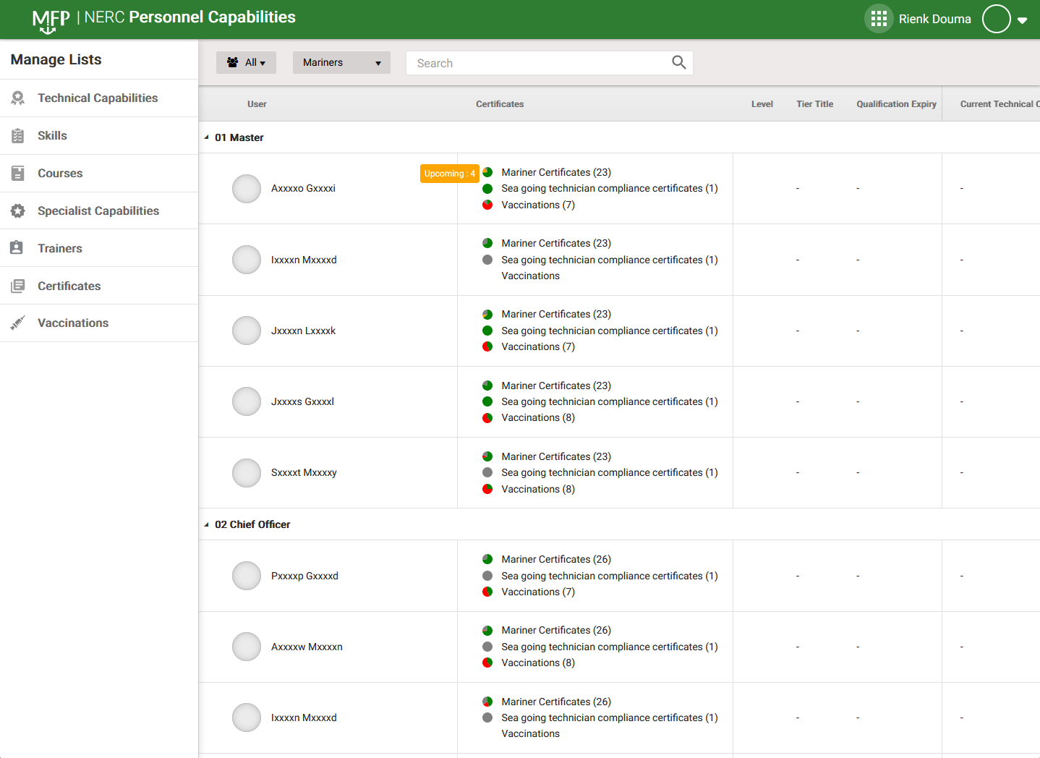
Personnel capabilities – expiring certificates

Slide 19
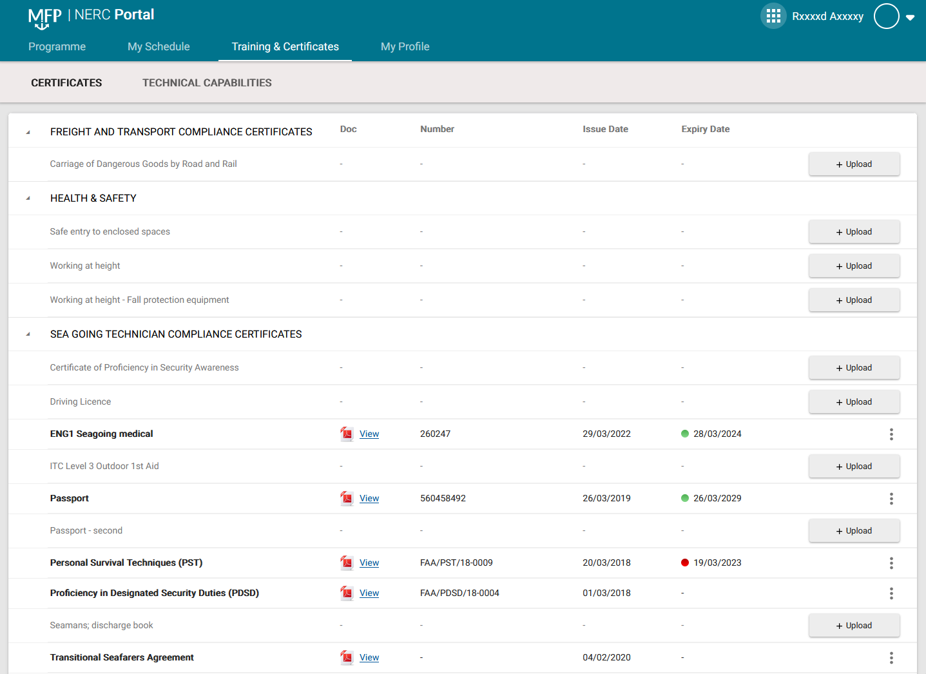
Personnel capabilities – uploading certificates

Slide 20
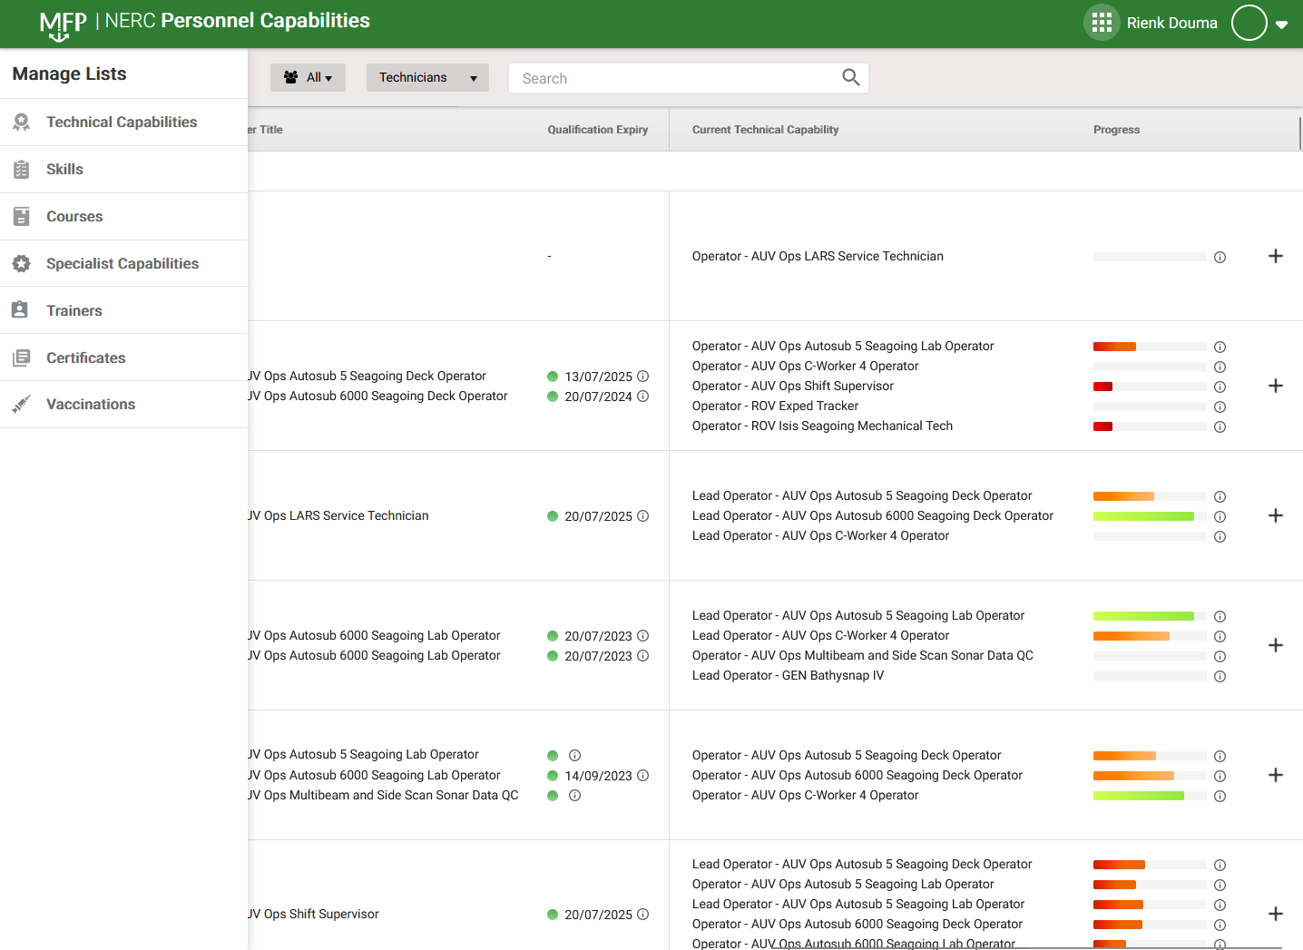
Personnel capabilities – expiring certificates

Slide 21
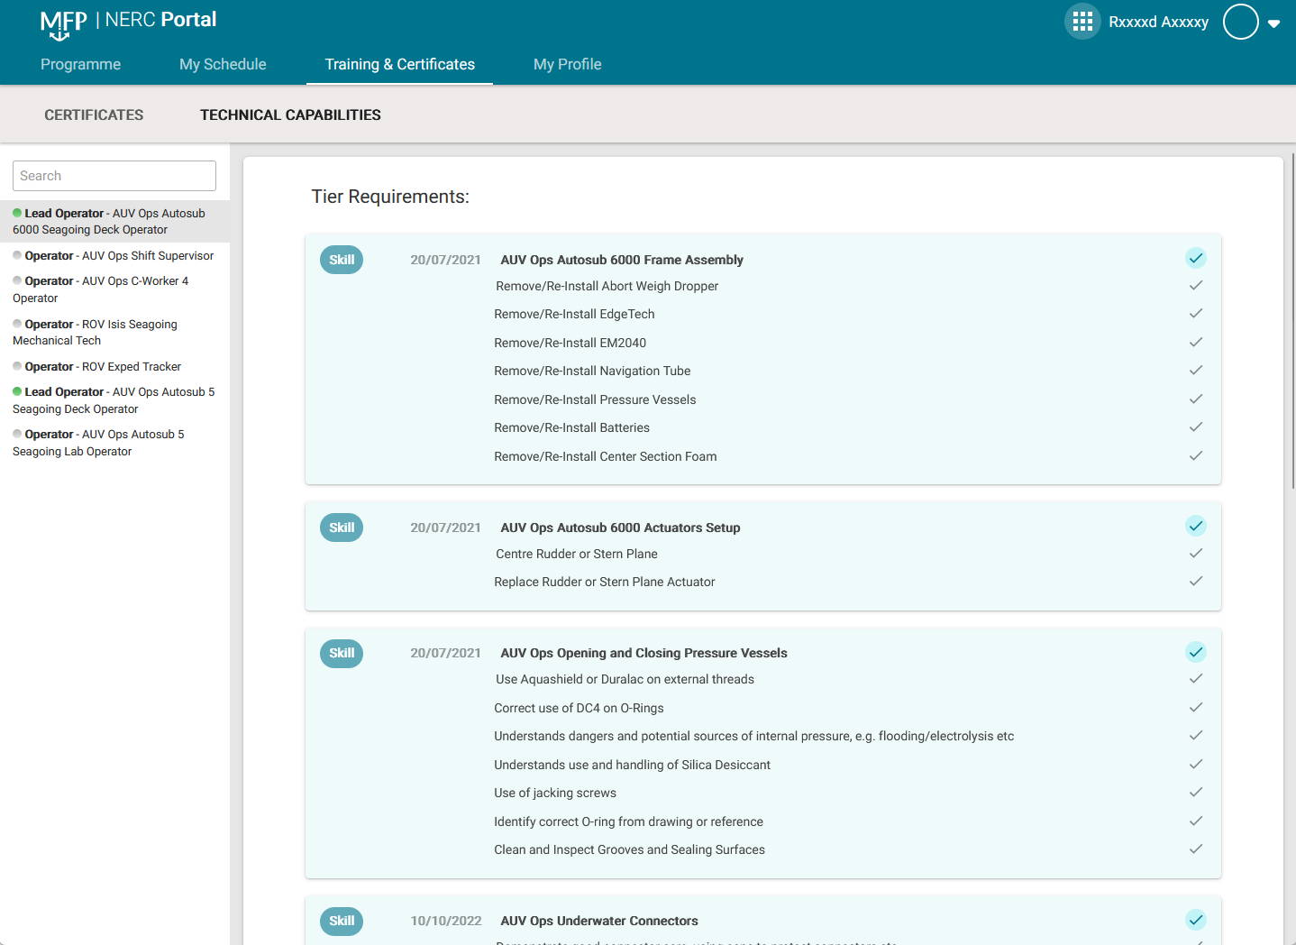
Personnel capabilities – expiring certificates

