Slide 1
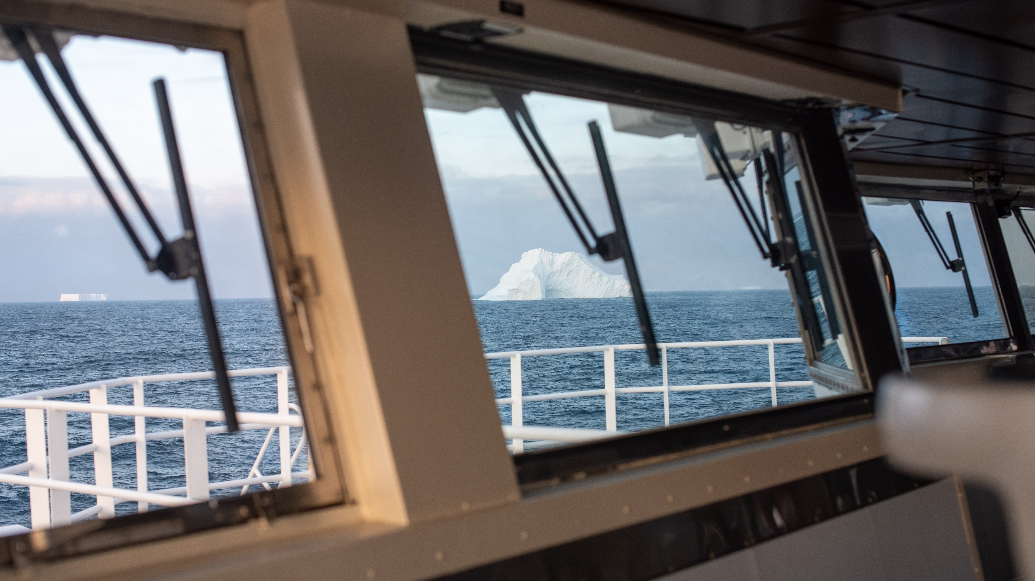

Polar Code on Roger Revelle
The what, why, where, and how

Slide 2
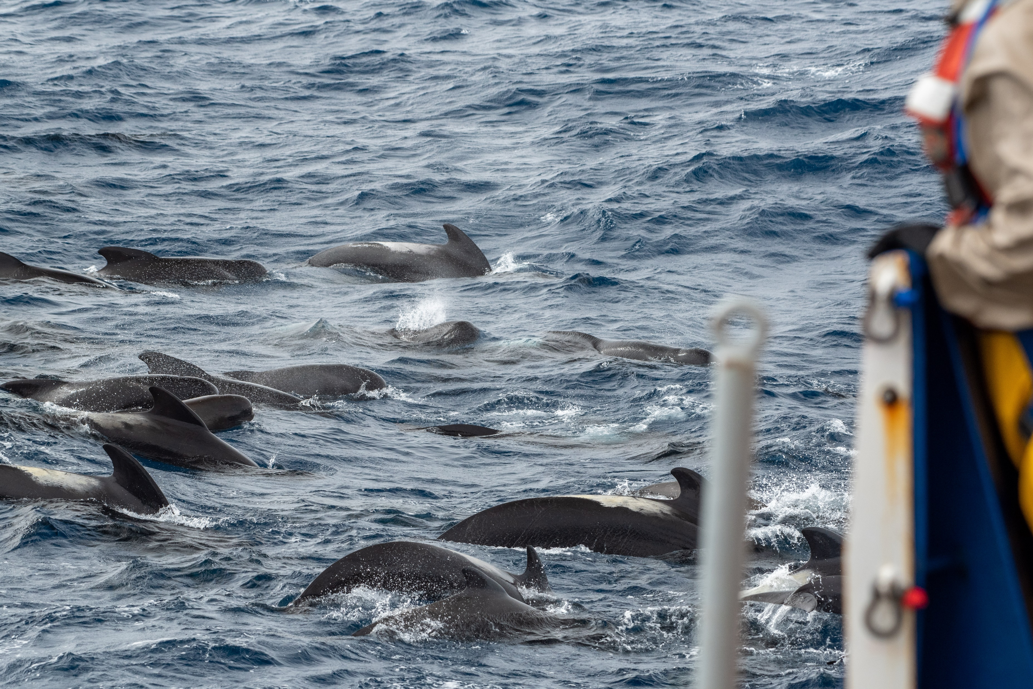

What is the Polar Code?
The polar code is Chapter XIV - Safety measures for ships operating in polar waters in the International Convention for the Safety of Life at Sea (SOLAS).
The U.S.A ratified the code on Oct 7 1977 and the code entered into force on May 25 1980. All SOLAS vessels are to comply with the code.
1 January 2017 – Compliance date for new ships
1 January 2018 – Compliance date for existing ships
1 July 2018 – Additional manning requirements for old and existing ships.

Slide 3
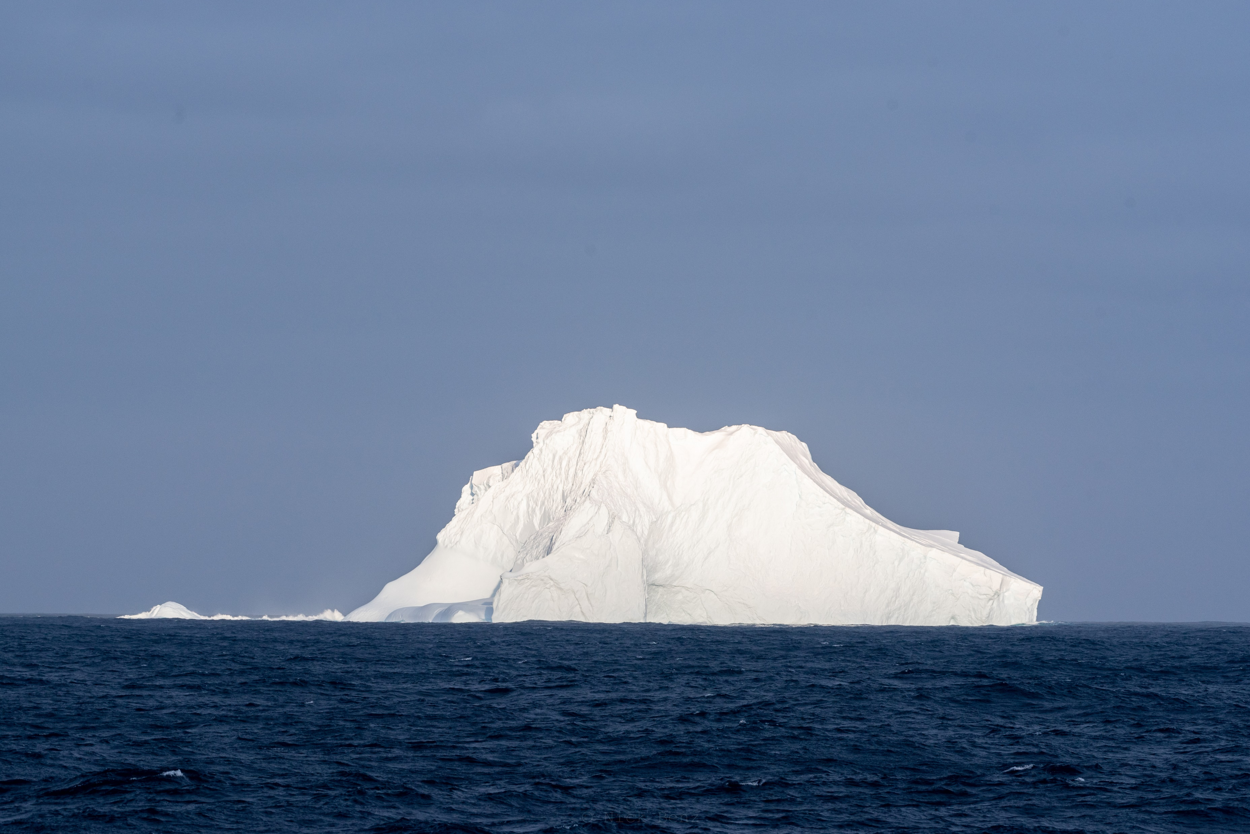
Why was the Polar Code developed?
The Polar Code has been developed to supplement existing IMO instruments in order to increase the safety of ships' operation and mitigate the impact on the people and environment in the remote, vulnerable and potentially harsh polar waters.
Equipment
Heated windows
Enclosed Lifeboats
Design & construction
Ship categories, A,B,C
Intact stability and ice accretion
Operations & Manning
Navigation
Environmental
Oil
Sewage
Garbage
Chemicals
Ice removal tools
Fire Safety
Ship Structure
Materials
Certificate & Manual
Training

Slide 4
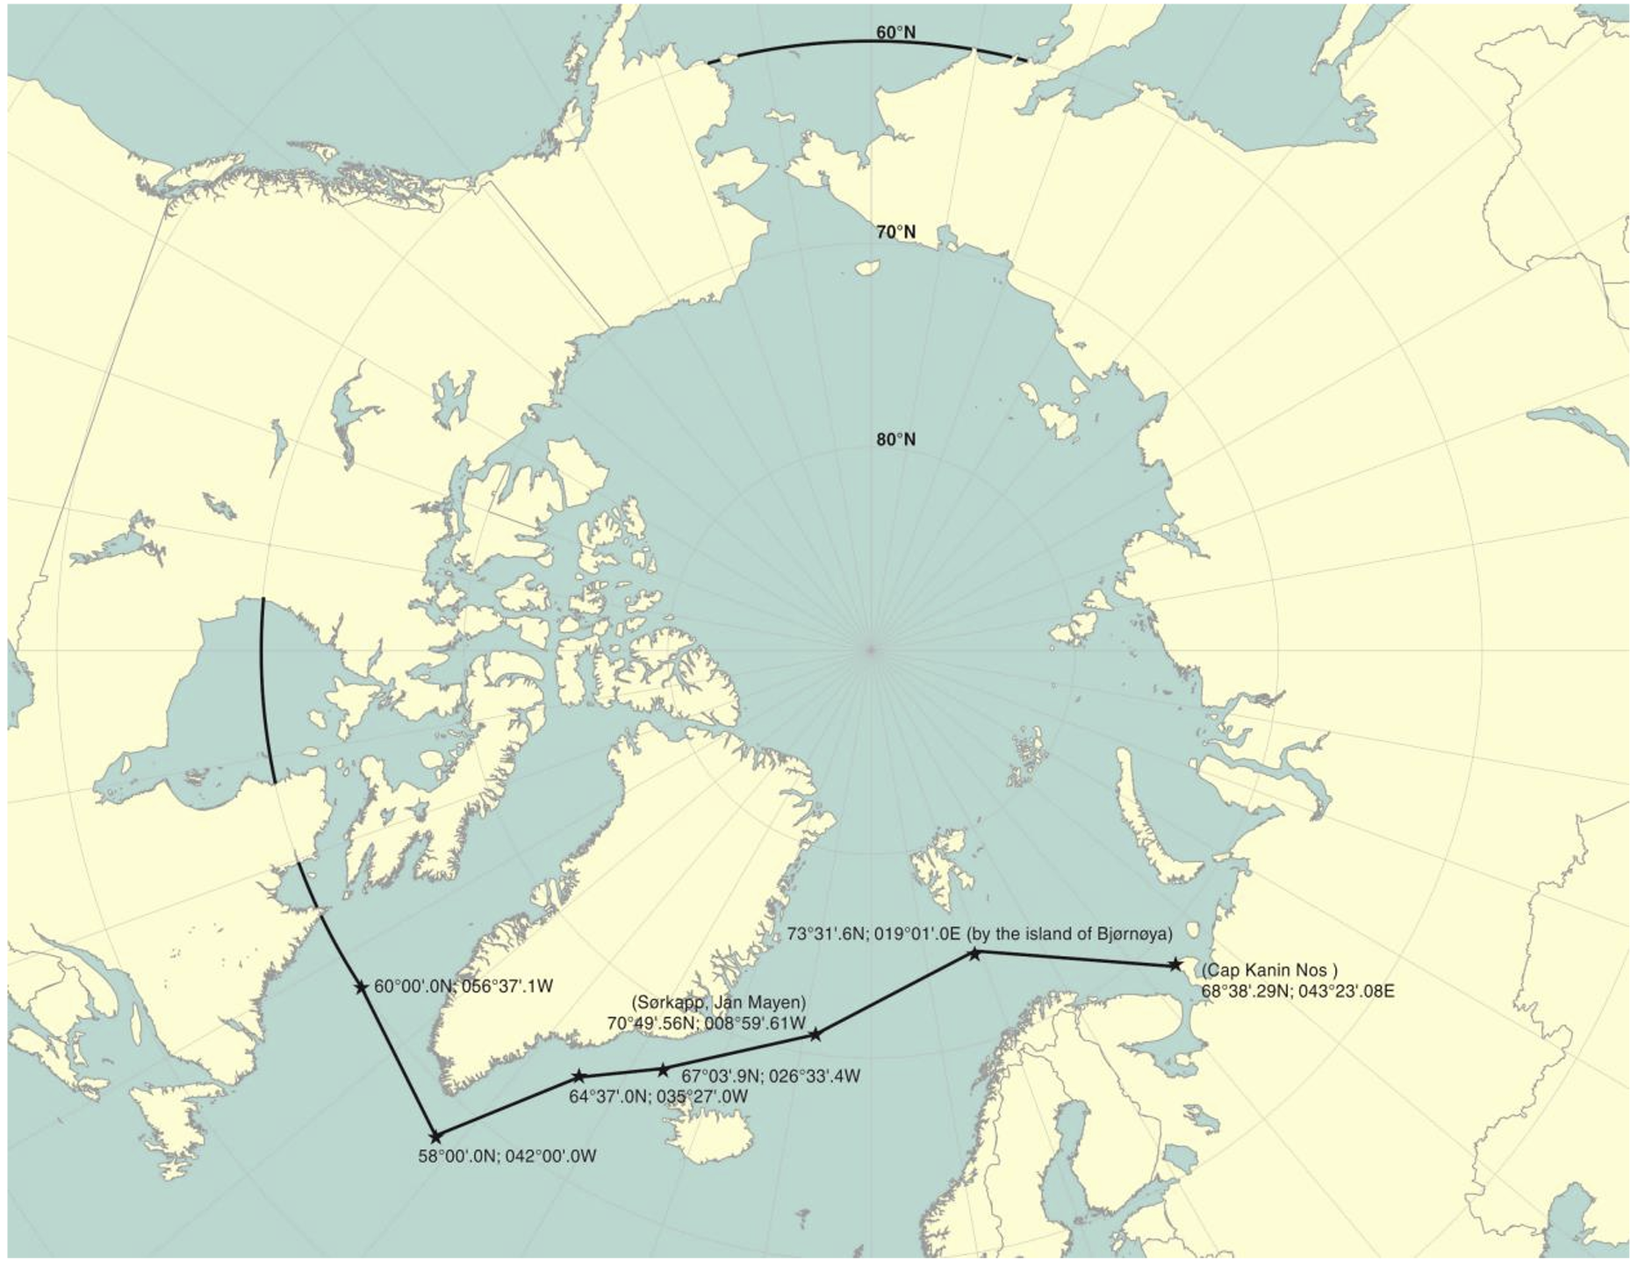
Where is it applicable in Arctic waters?

Slide 5
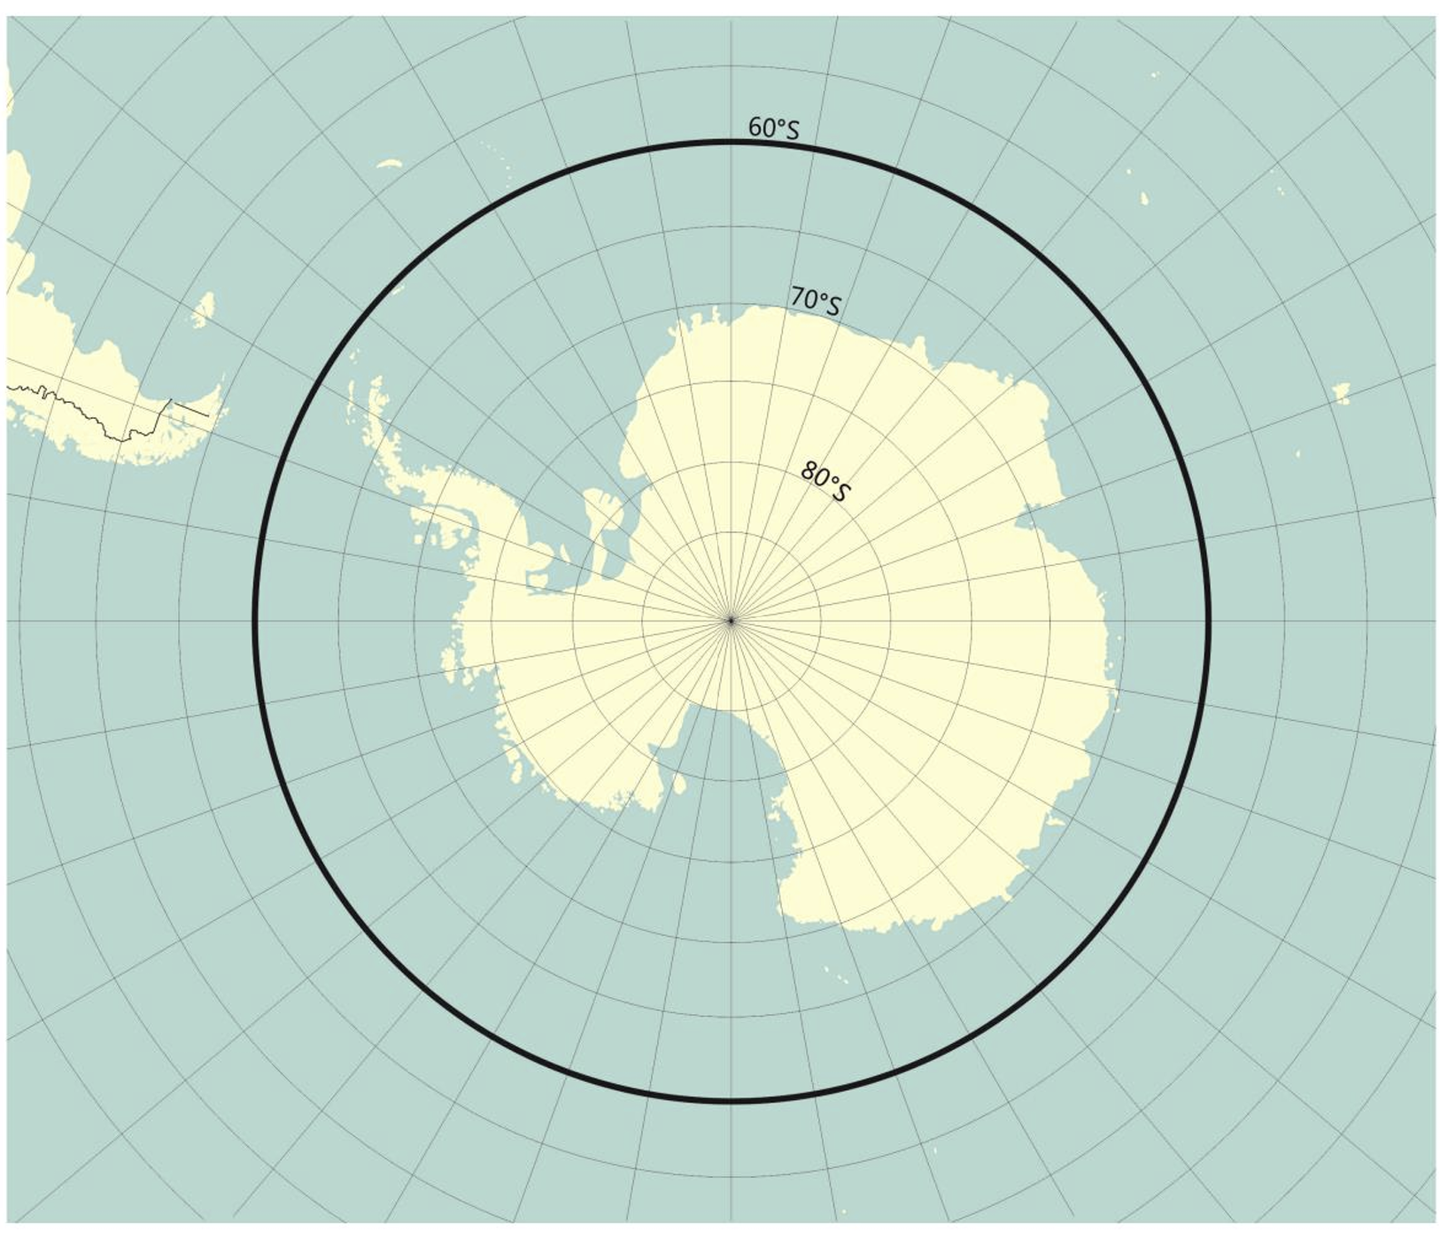
Where is it applicable in Antarctic waters?

Slide 6
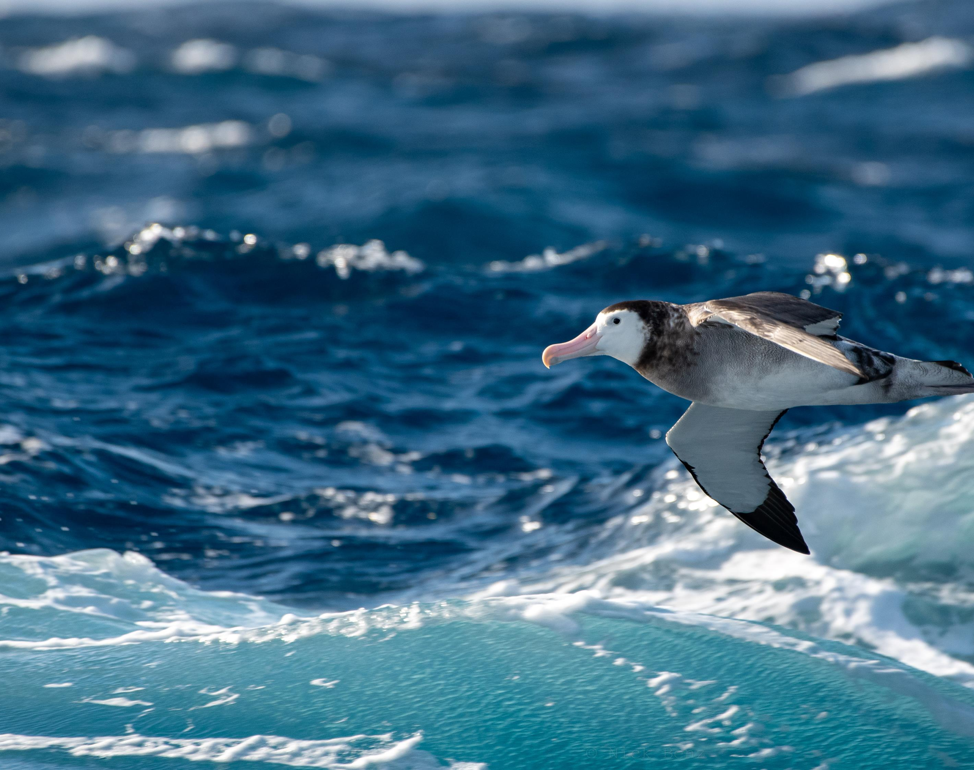
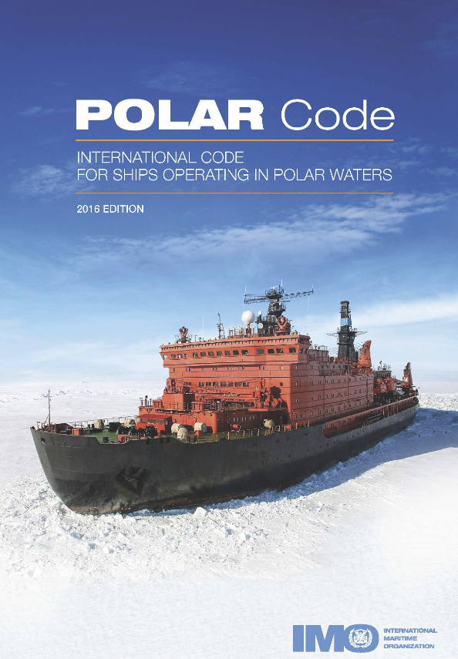
How is the Polar Code structured? (MEPC 68/21/Add.1 Annex 10

Slide 7
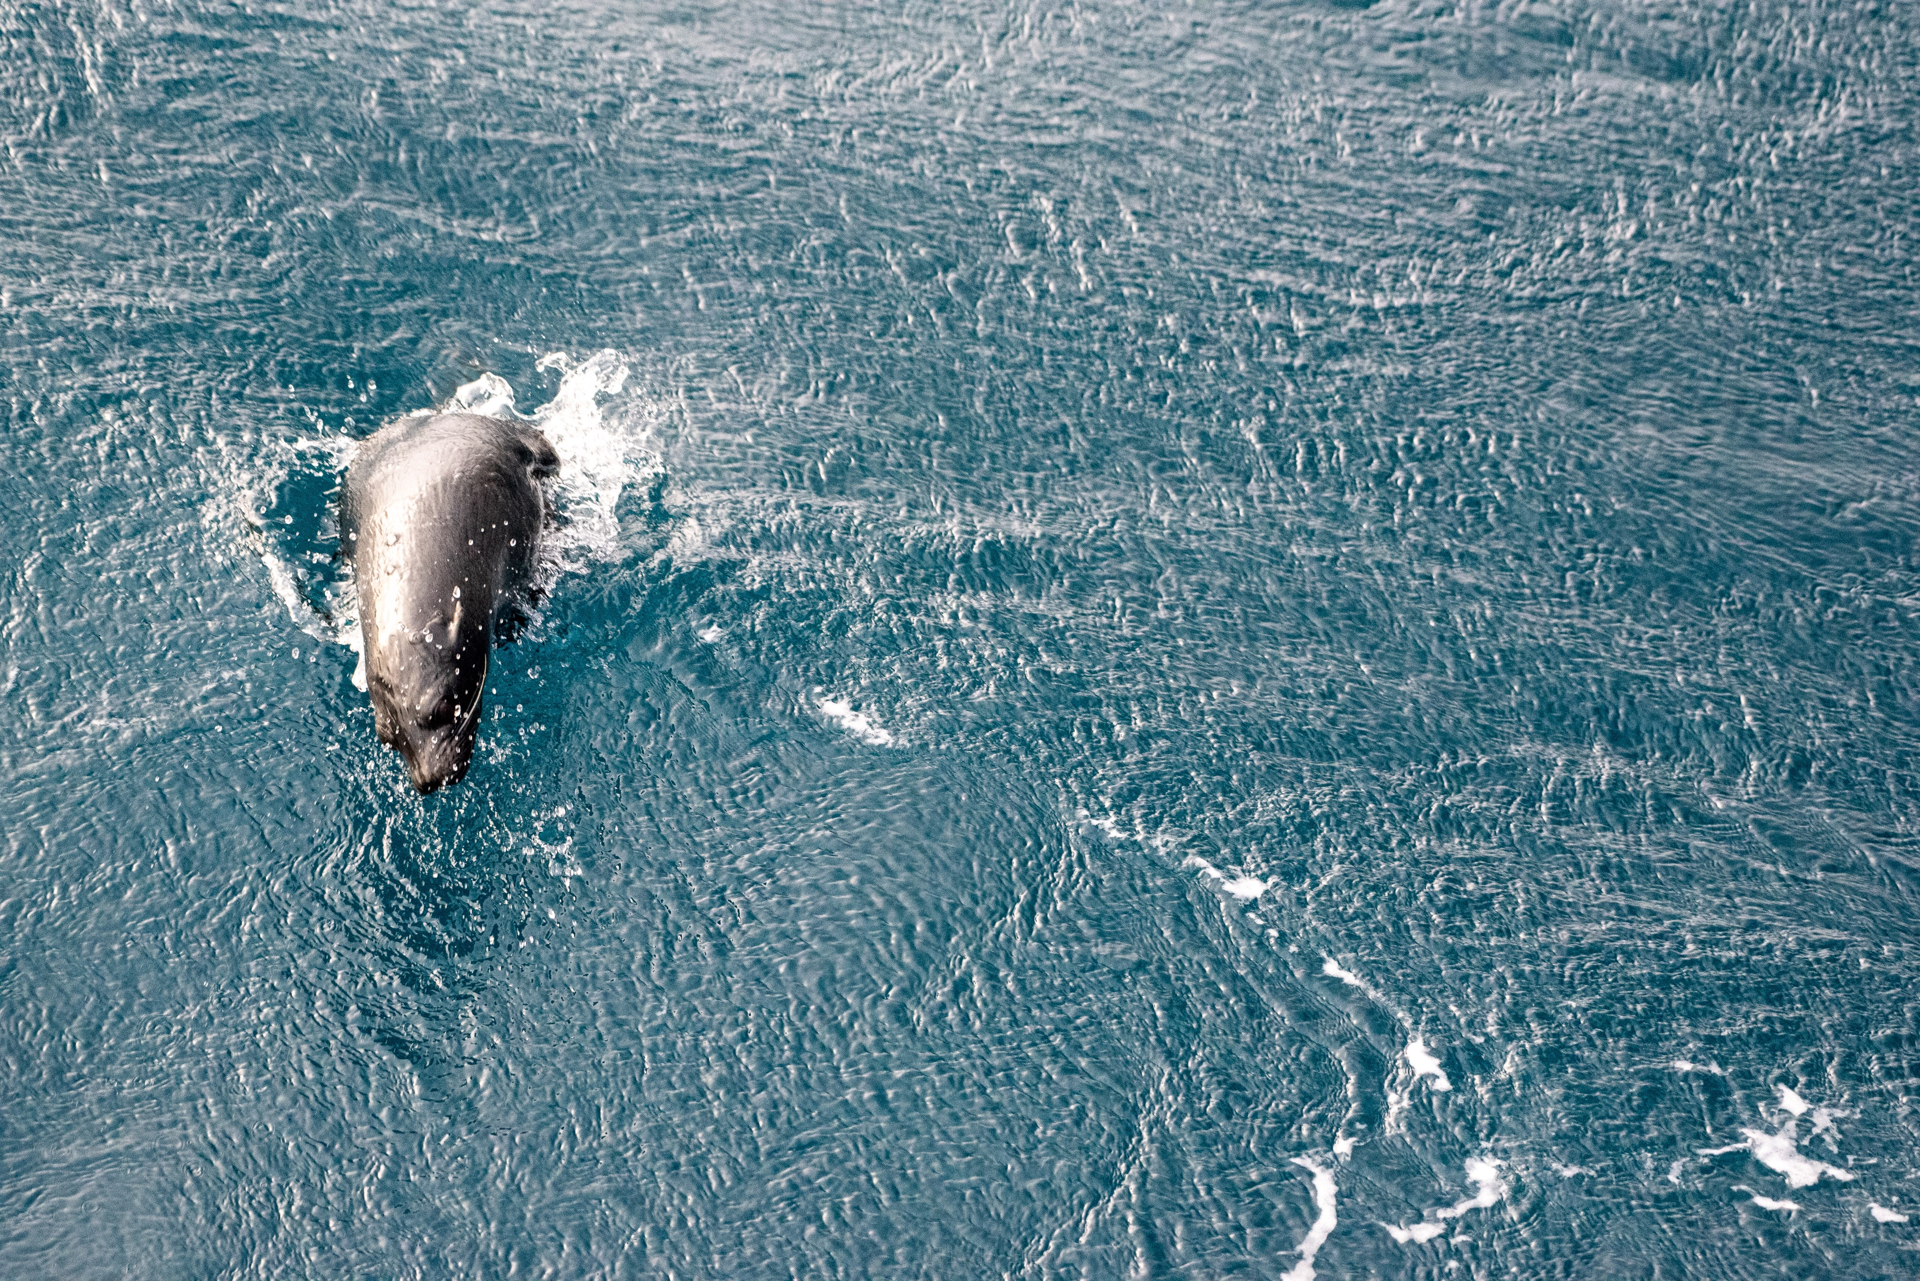
SHIP STRUCTURE
SUBDIVISION AND STABILITY
WATERTIGHT AND WEATHERTIGHT INTEGRITY
MACHINERY INSTALLATIONS
FIRE SAFETY/PROTECTION
POLAR WATER OPERATIONAL MANUAL (PWOM)
LIFE-SAVING APPLIANCES AND ARRANGEMENTS
SAFETY OF NAVIGATION
COMMUNICATION
VOYAGE PLANNING
MANNING AND TRAINING
ADDITIONAL GUIDANCES
POLLUTION PREVENTION MEASURES
Oil
information regarding the ship's operational capabilities and limitations in order to support their decision-making process.
Vessel to retain its structural integrity due to environmental loads and conditions.
ensure adequate subdivision and stability in both intact and damaged conditions.
provide measures to maintain watertight and weathertight integrity.
ensure that, machinery installations are capable of delivering the required functionality necessary for safe operation of ships.
fire safety systems and appliances are effective and operable, and that means of escape remain available so that persons on board can safely and swiftly escape to the lifeboat and liferaft embarkation deck under the expected environmental conditions.
safe escape, evacuation and survival.
to provide for safe navigation.
to provide for effective communication for ships and survival craft during normal operation and in emergency situations.
The goal of this chapter is to ensure that the Company, master and crew are provided with sufficient information to enable operations to be conducted with due consideration to safety of ship and persons on board and, as appropriate, environmental protection.
to ensure that ships operating in polar waters are appropriately manned by adequately qualified, trained and experienced personnel.
Additional instructions for all other chapters.
Sewage
Biofouling
Hazardous substances
Etc.
It basically is about everything that impacts anything on board the ship

Slide 8
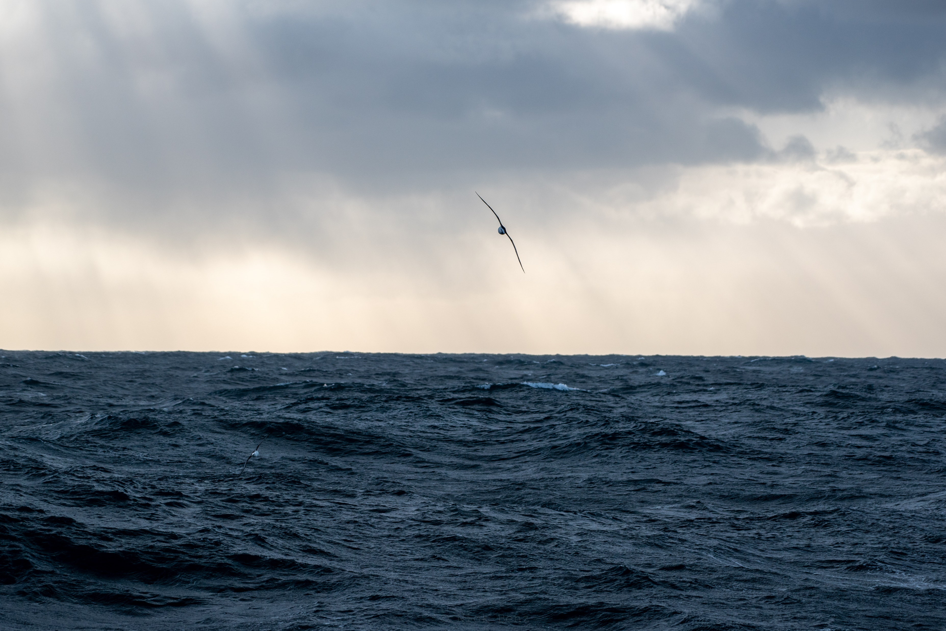
How does one comply with the polar code?
The Polar Water Operations Manual with as output the Polar Ship Certificate serves two purposes:
1. It is a risk mitigation tool. It identifies the equipment on board and its capabilities as it relates to the polar environment and location.
2. It is a document for future reference for the crew that have certain strategies to cope with low temperatures and ice.
Risk Assessment and mitigation actions
Polar Water operations manual
Polar Ship Certificate

Slide 9
The Sequence of work
Environmental Assessment
16 hours
Operational assessment
92 hours
Development of PWOM
20 hours
ABS Regulatory Review & issuance of Polar Certificate
108 hours
An ABS-POLARIS (Polar Operational Limit Assessment Risk Index System) analysis for ice operational limitations based on the vessels’
approximate correspondence ice class (Ice Class IC);
• a temperature analysis for temperature limitations2 and determine applicability of low
temperature and ice accretion requirements.
• Ice Accretion analysis
• Sea Water Temperature analysis
Precipitation analysis
• Hours of daylight/darkness analysis

Slide 10
The Sequence of work
ABS facilitated a workshop with the ship owner’s personnel and Glosten personnel. In
general, the specific scope of the workshop is highly dependent upon the extent of the operation
(risk of encountering ice and/or low air temperature and level of ice class) and has 2 day duration. (Brainstorming on operational risks)
Environmental Assessment
16 hours
Operational assessment
92 hours
Development of PWOM
20 hours
ABS Regulatory Review & issuance of Polar Certificate
108 hours

Slide 11
The Sequence of work
To write the PWOM. An ABS Polar
Code Subject Matter Expert (SME) will be available to offer guidance as needed to ensure the operational assessment report and PWOM are easily reviewed while also being useful for the ship’s crew for operations to polar waters. The SME will be available for phone calls, online meetings, emails, etc.
More than half of all the effort is for the creation of this manual. In practice this was a lot of joint editing with Glosten and SIO.
Environmental Assessment
16 hours
Operational assessment
92 hours
Development of PWOM
20 hours
ABS Regulatory Review & issuance of Polar Certificate
108 hours

Slide 12
The Sequence of work
Environmental Assessment
16 hours
Operational assessment
92 hours
Development of PWOM
20 hours
ABS Regulatory Review & issuance of Polar Certificate
108 hours
If a physical survey is required, the Engineering Review will identify items to be verified by the
attending surveyor.
If the survey is not required, the engineering documentation review may lead to
issuance of the Polar Ship Certificate (PSC).
(In Revelle’s case there was one final verification attendance)

Slide 13
How did the Roger Revelle satisfy the requirements?
The limitations depend on the complexity of risk mitigation: We tailored the polar ship certificate to our needs to avoid excessive work and cost:
Limited to open waters only (= ice concentrations of less than 1/10th)
Limitation to the lesser of 80° (Purposely no North or South hemisphere defined)
Air temperature limitation

Slide 14
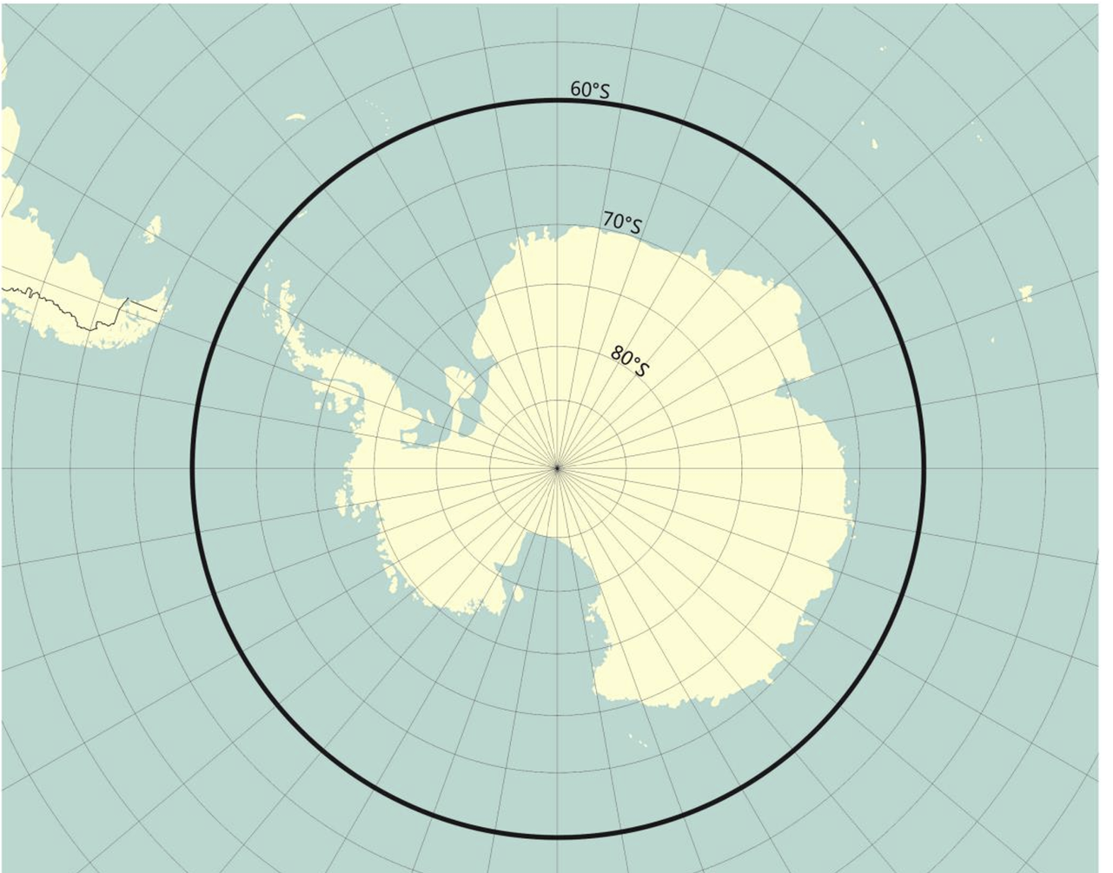
Issue | Limitation | Reason | Notes
5.1 Ice conditions | Limited to open waters [<10% Ice] and no ice accretion | Training requirements: we have not trained our crew as per the polar code requirements | The vessel was not close enough to warrant the expense.
5.2 Air temperature | Limited to -10°C | The Revelle has a design service temperature of 0°F (-17.8°C) and carries no winterization notations. | This temperature limitation, as well as the limitations of Ice Class C, were considered during the assessment of environmental hazards (ABS 2022b).
5.3 80 latitude limitation | 80 degrees. | No GNSS compass on board | For our purposes this was a perfect concession as 80 degrees south is 90% land, and far away from our stations.
What are our operational limitations based on?

Slide 15
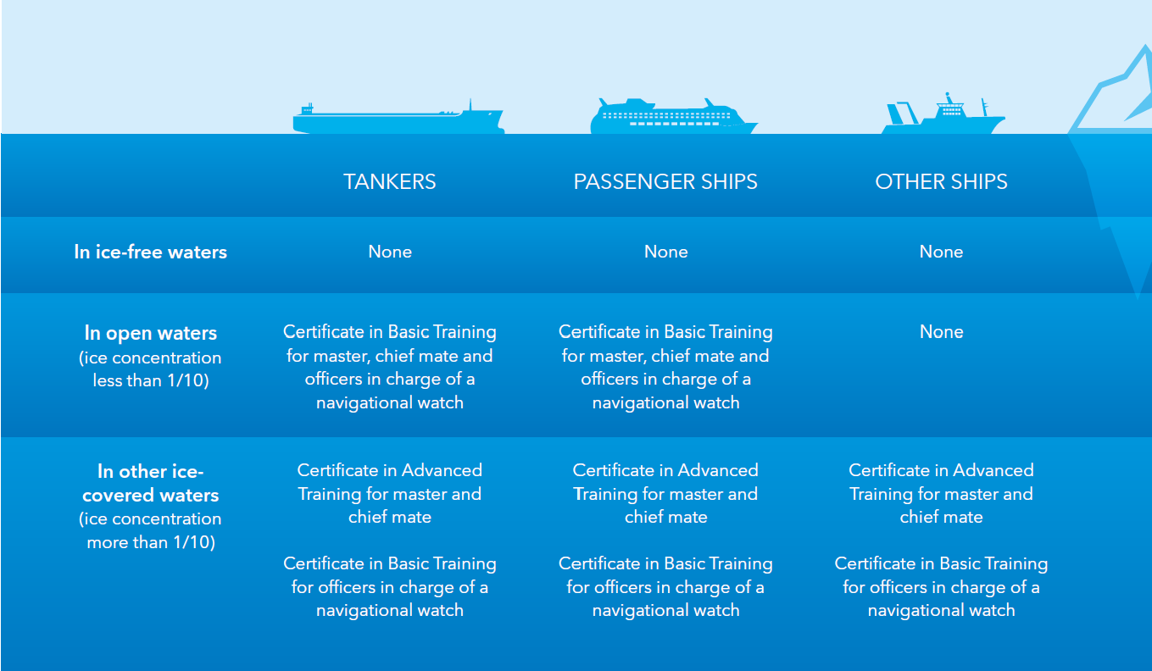
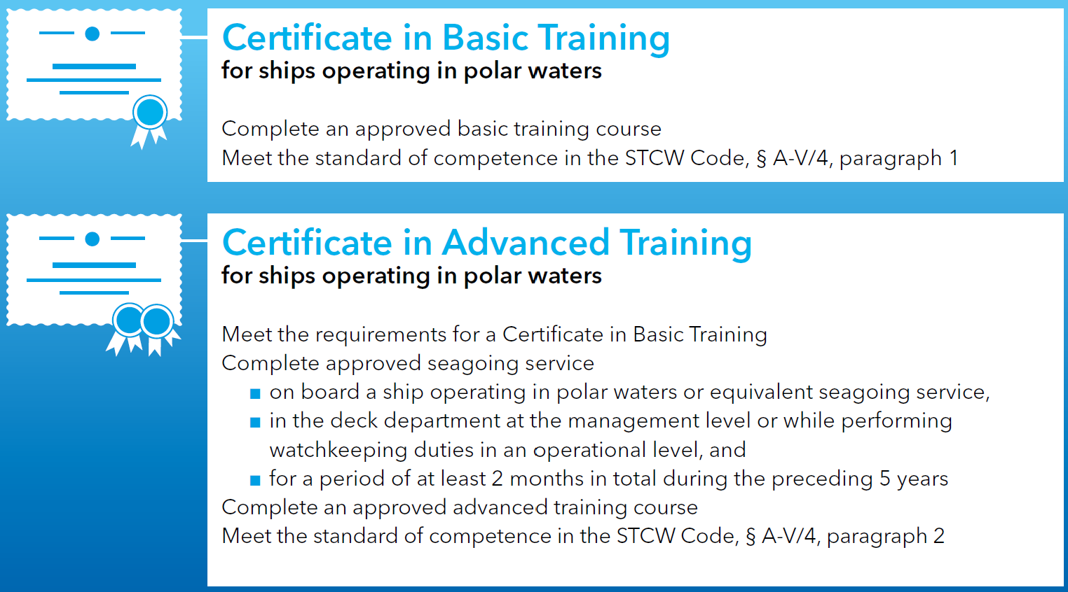
Training Requirements
Source: https://www.dnv.com/maritime/polar/index.html

Slide 16
Risk Mitigation
Identifying Hazards (Coming up during EA, OA, or any time)
Determining applicability
Determining impact and probability
Device Risk Mitigation Strategy
Put Physical, Procedural or training Requirement in place
Record in PWOM and other applicable documentation

Slide 17
Ice (sea ice, icebergs)
Ice ingestion (slush and sea ice)
Topside icing (ice accretion)
Snow Accumulation
Low seawater temperature: Adverse effects on machinery
Low seawater temperature: Survival.
Air temp. below freezing
Low air temperature (MDLT < -10C)
Extended darkness / daylight
High latitude
Poor hydrographic data
Limited available SAR facilities, Max Rescue Time, or Isolated / remote location
Lack of crew experience
Inadequate Safety Equipment
Inaccessible Survival Equipment
Lack of Commercially Available Equipment
Rapid weather changes
Environmental Sensitivity
Potential Immersion into polar water
Abandonment onto ice or land
Escort Operations
Hazards taken into consideration….. Just a small selection

Slide 18
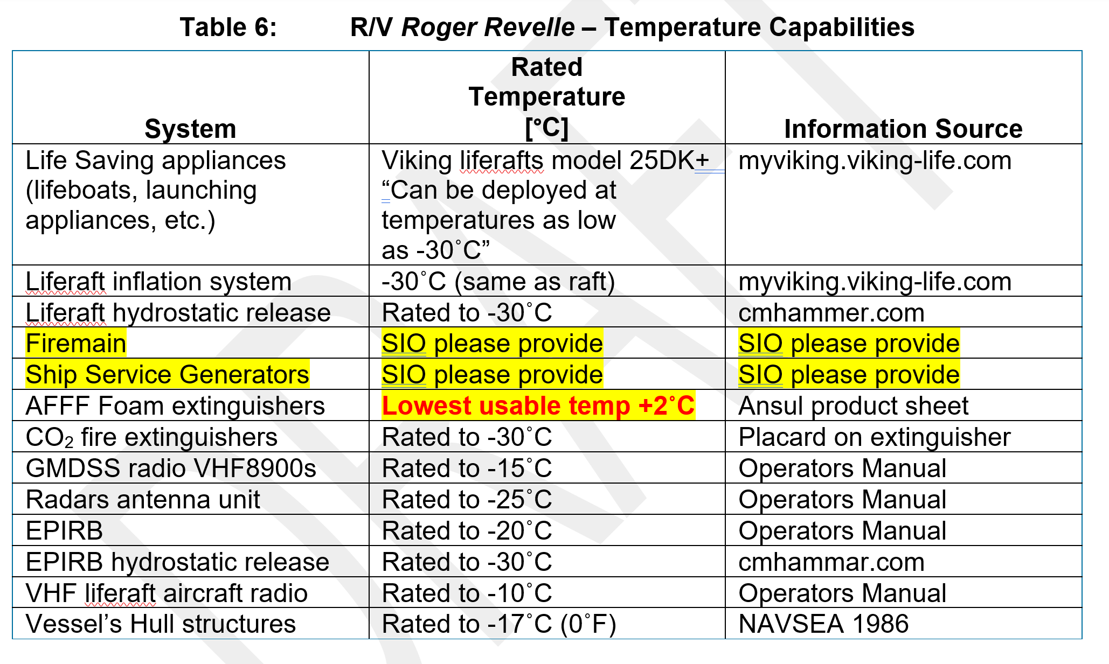
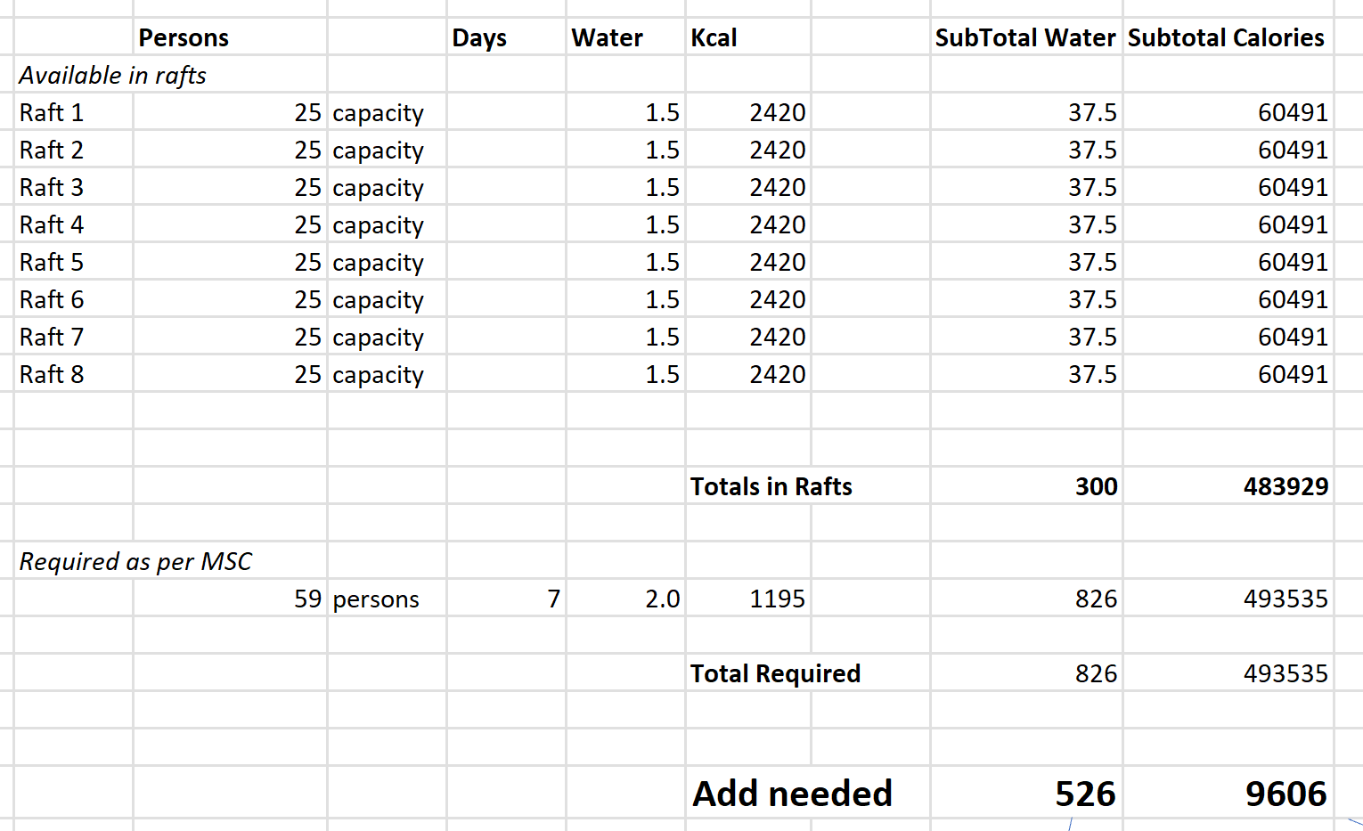
Risk Mitigation in action
While taking inventory of all ship’s equipment through the lens of seeking out compatibility with extreme temperatures and remoteness of the vessel, we found a couple of risks, such as our AFFF for example, and the quantity of calories and water available for abandoning ship situations.

Slide 19
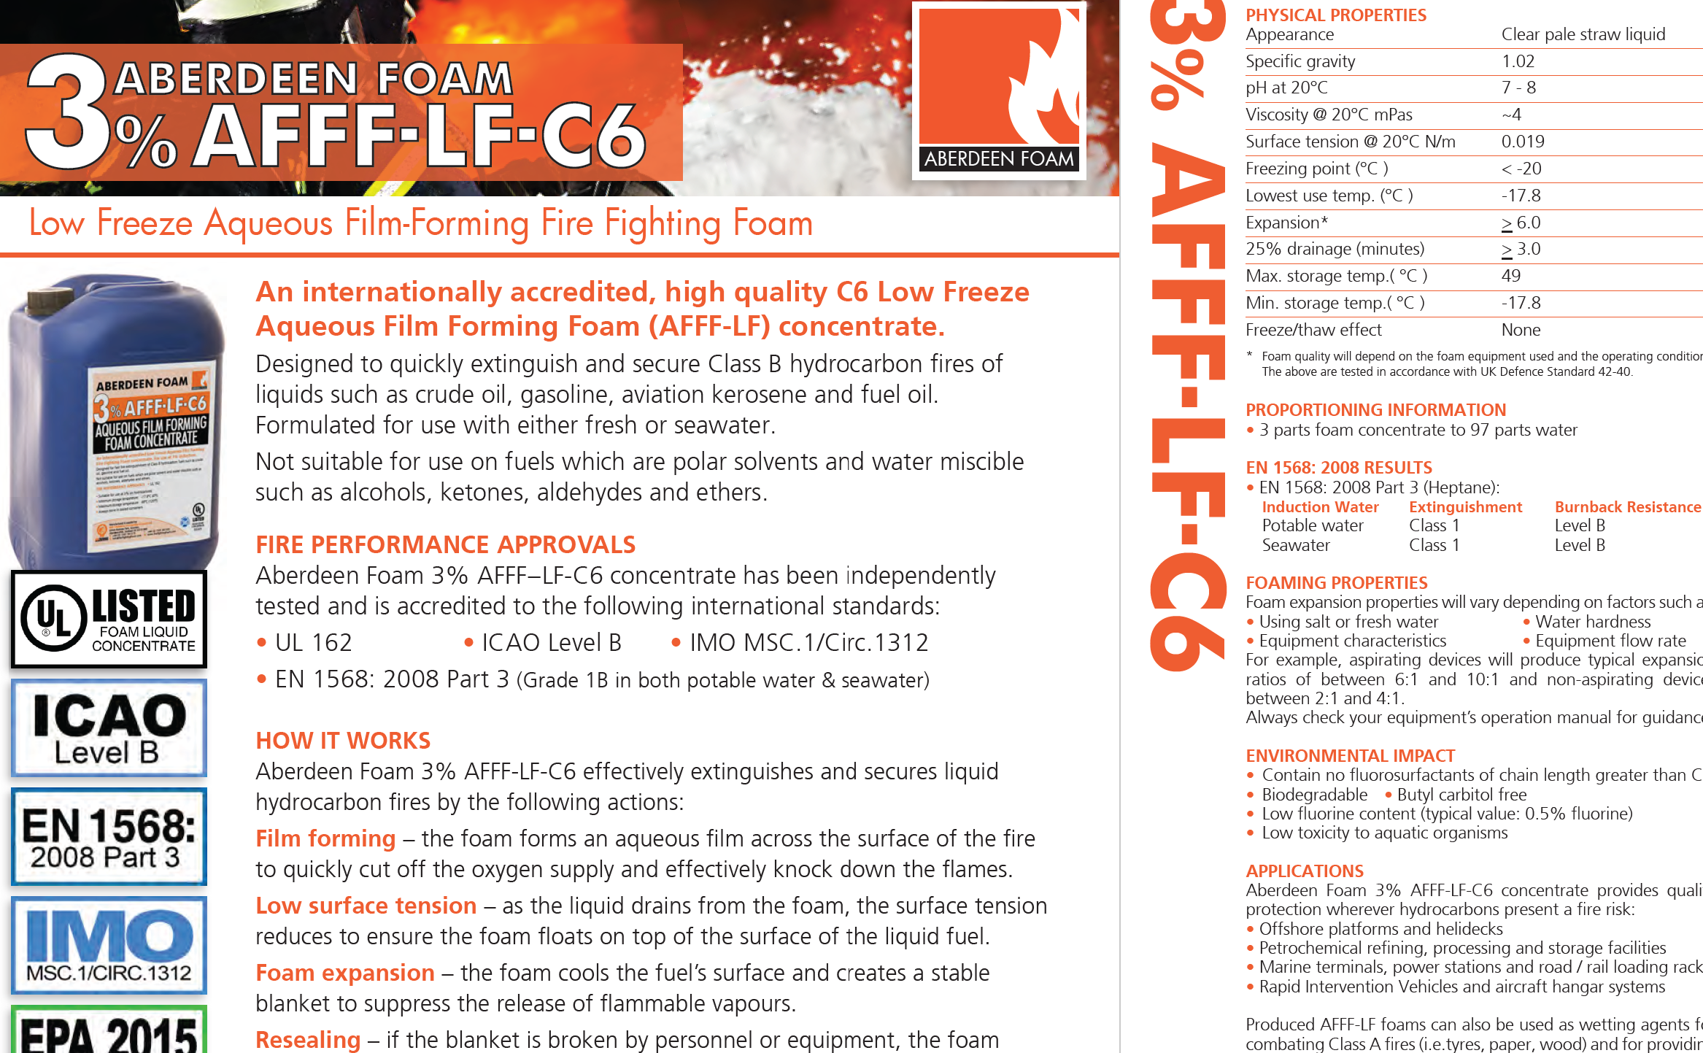
Physical corrections to be made
AFFF had to be replaced with a kind suitable for low temperature environments.
Water and food rations had to be sufficient for one week, due to being in a remote location. We ended up buying a pallet of water and boxes of high energy bars.
Tools had to be bought for removal of built-up ice
Abandon ship bags and additional cold weather gear was bought. (however not required )
Radio for aircraft frequencies.
Penray Winter Blend (bulk) Diesel Fuel Treatment 55 gal drum Prevents fuel gelling, prevents wax crystal formation. (800) 748-7788. A 55 gal drum treats 165,000 gallons. location)

Slide 20
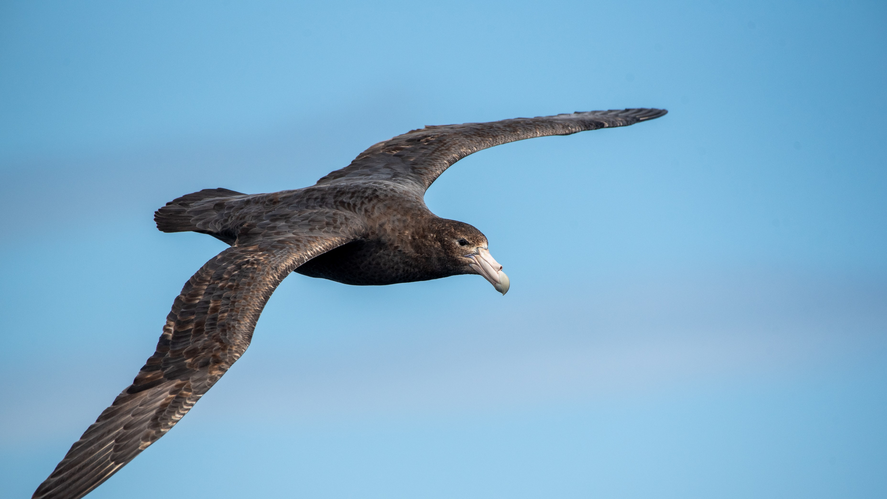
Procedural changes
Ice accretion rounds
Portable radio management
Keeping sludge tank empty
Avoiding critical operations
In short: Good Sea(wo)manship!

Slide 21
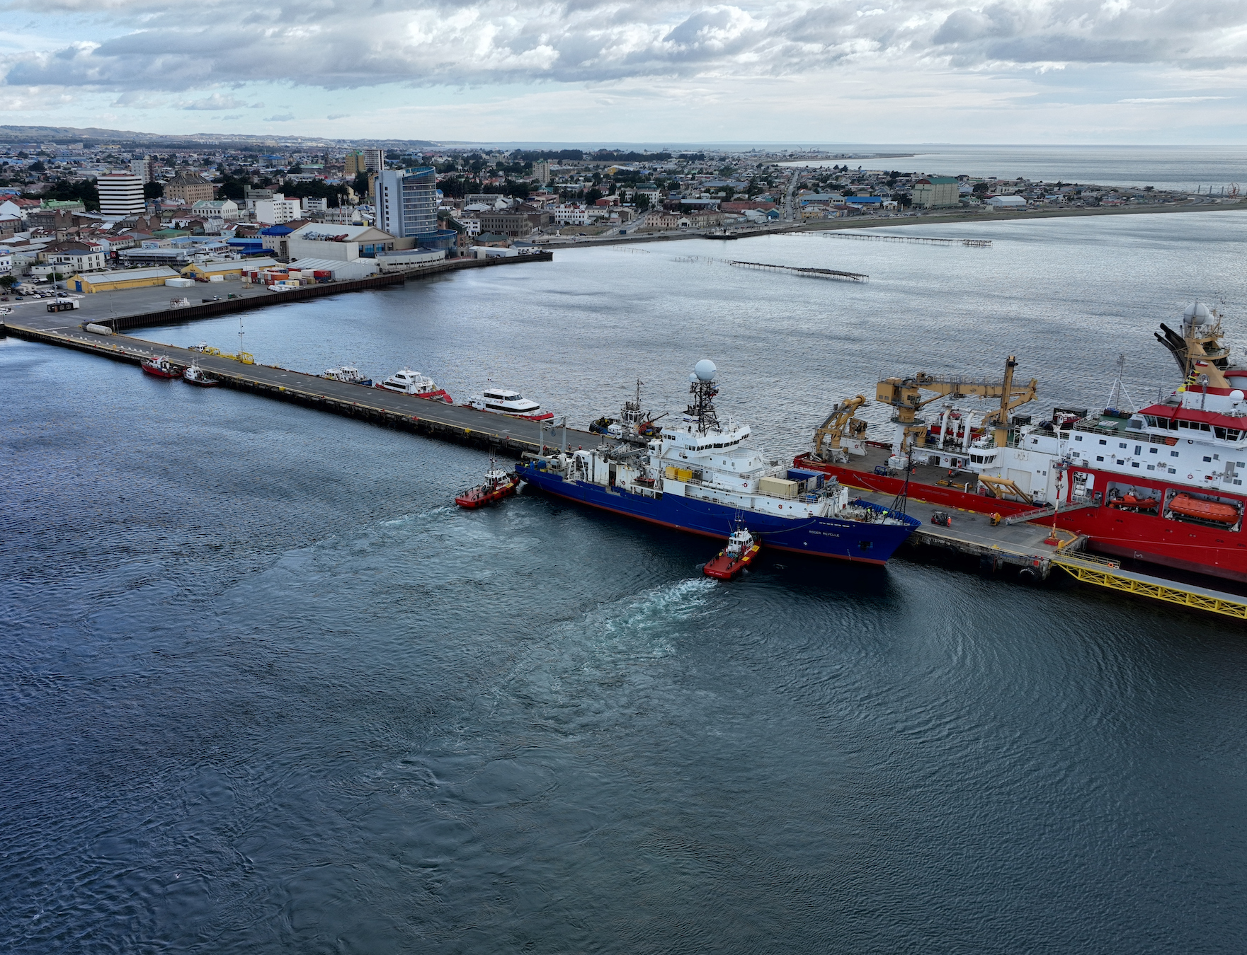
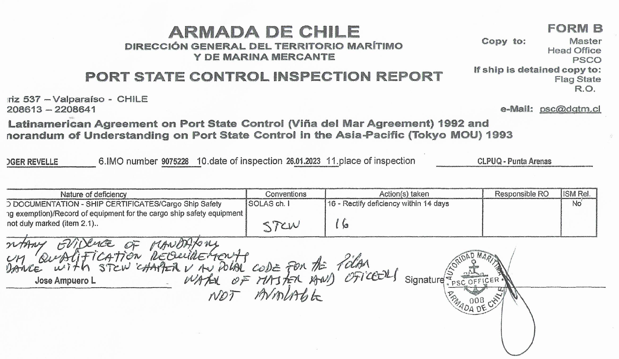
On Roger Revelle’s first port of call after the GEOTRACES cruise in Antarctic waters, port state control boarded the vessel in Punta Arenas, Chile.
Enforcement
Notes:
There seems greater likelihood enforcement in areas where authorities have a good awareness of the polar code due to the kind of visiting vessels. On the Roger Revelle’s first port of call after the GEOTRACES cruise in Antarctic waters, port state control boarded the vessel in Punta Arenas, Chile.

Slide 22
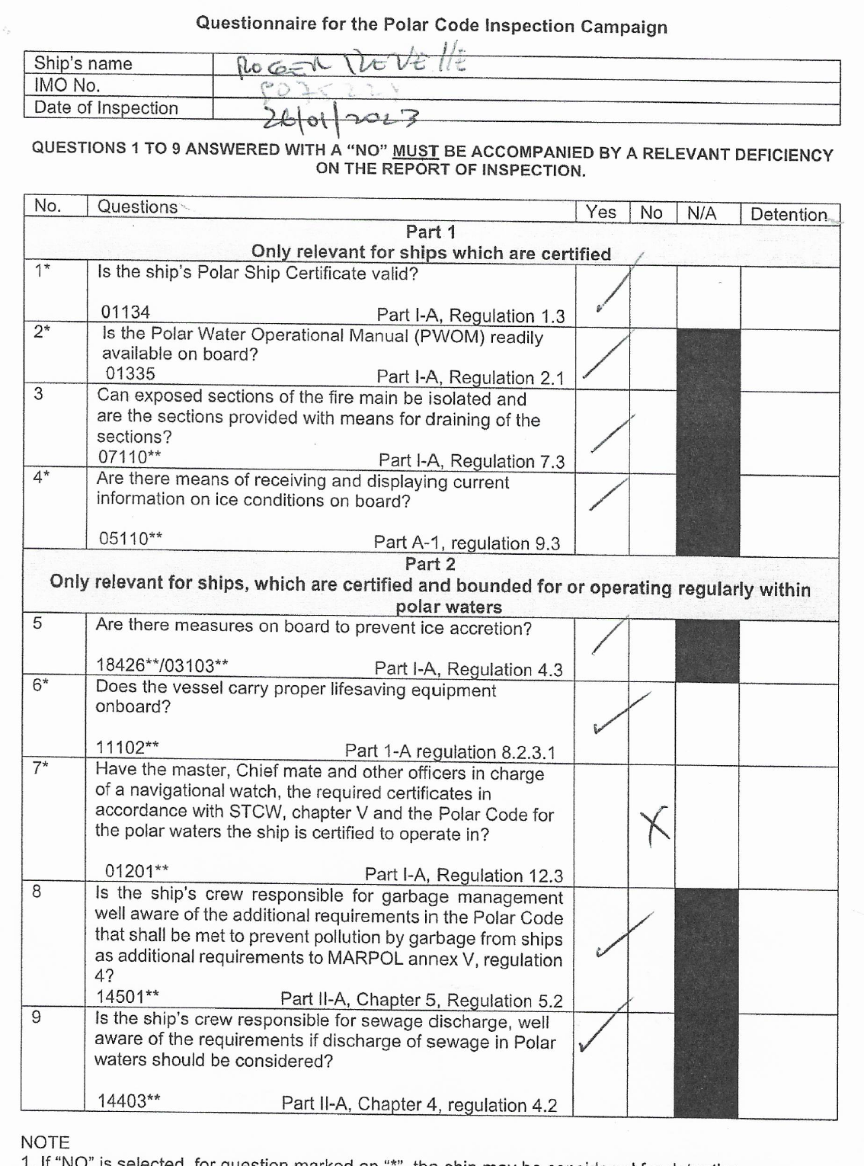
We were issued one deficiency for not having the master chief and other Officers in charge to be certified in accordance with STCW chapter V and the polar code.
It was a mistake by the port state control officer; he assumed we were navigating in ice concentrations exceeding 10%. We called our ABS representative, and a local surveyor discussed the matter with port state control. The finding was then cleared.
Notes:
It was a mistake by the port state control officer; he assumed we were navigating in ice concentrations exceeding 10%. We called our ABS representative, and a local surveyor discussed the matter with port state control. The finding was then cleared.

Slide 23
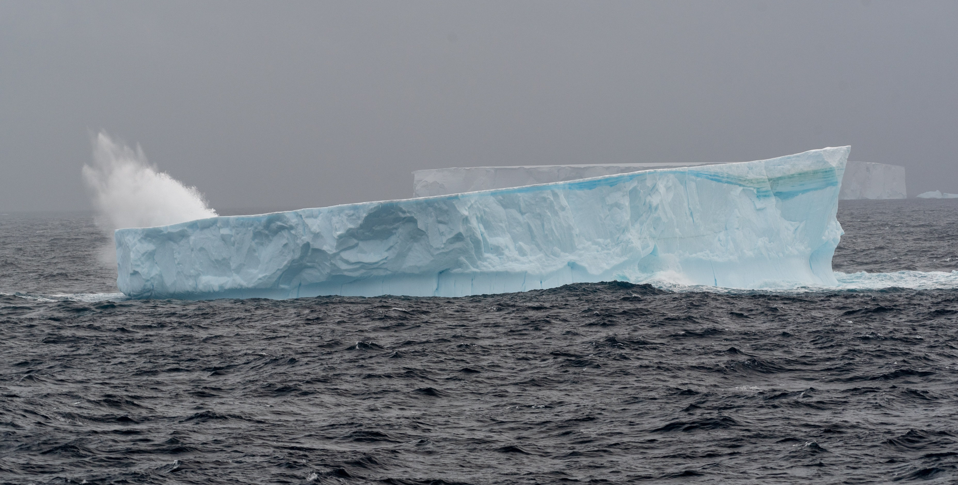
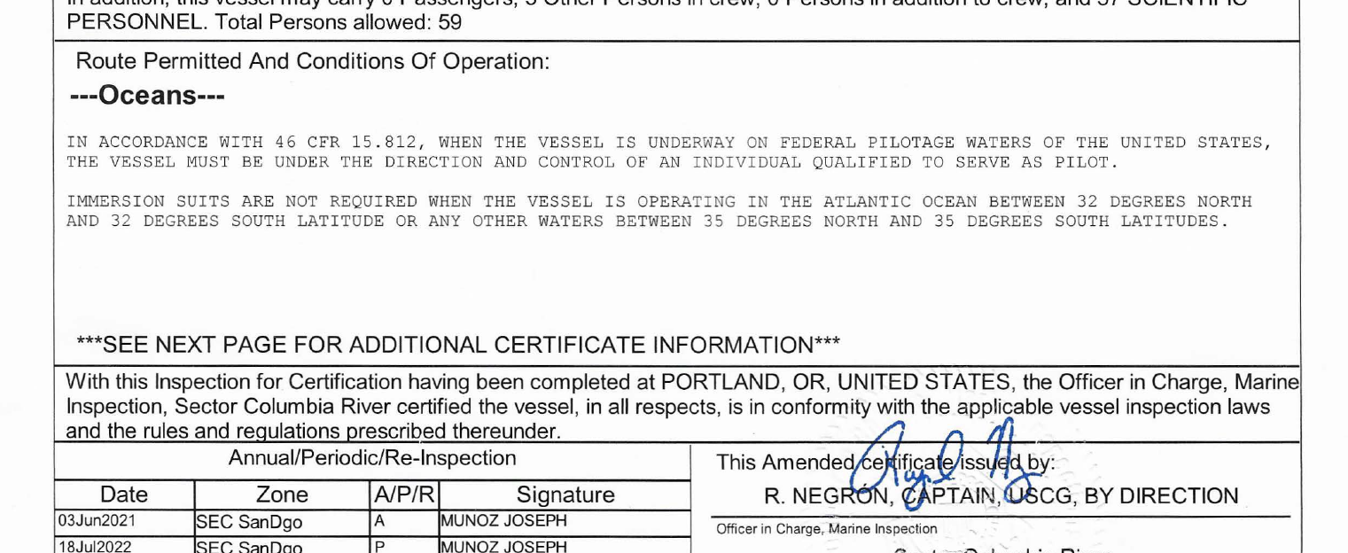
How was UCSG involved?
Minimal. The whole process was between ABS and us. (We did seek input)
Notes:
Also, an interesting fact is that no ship has any limitation noted on their COI under “ Route permitted and conditions of operation” – Whether you have the certificate or not. Just a curiosity on how determinations are made in regards to not including polar operations in route permissions of the COI. Also note the pilotage requirements which were later removed.

Slide 24
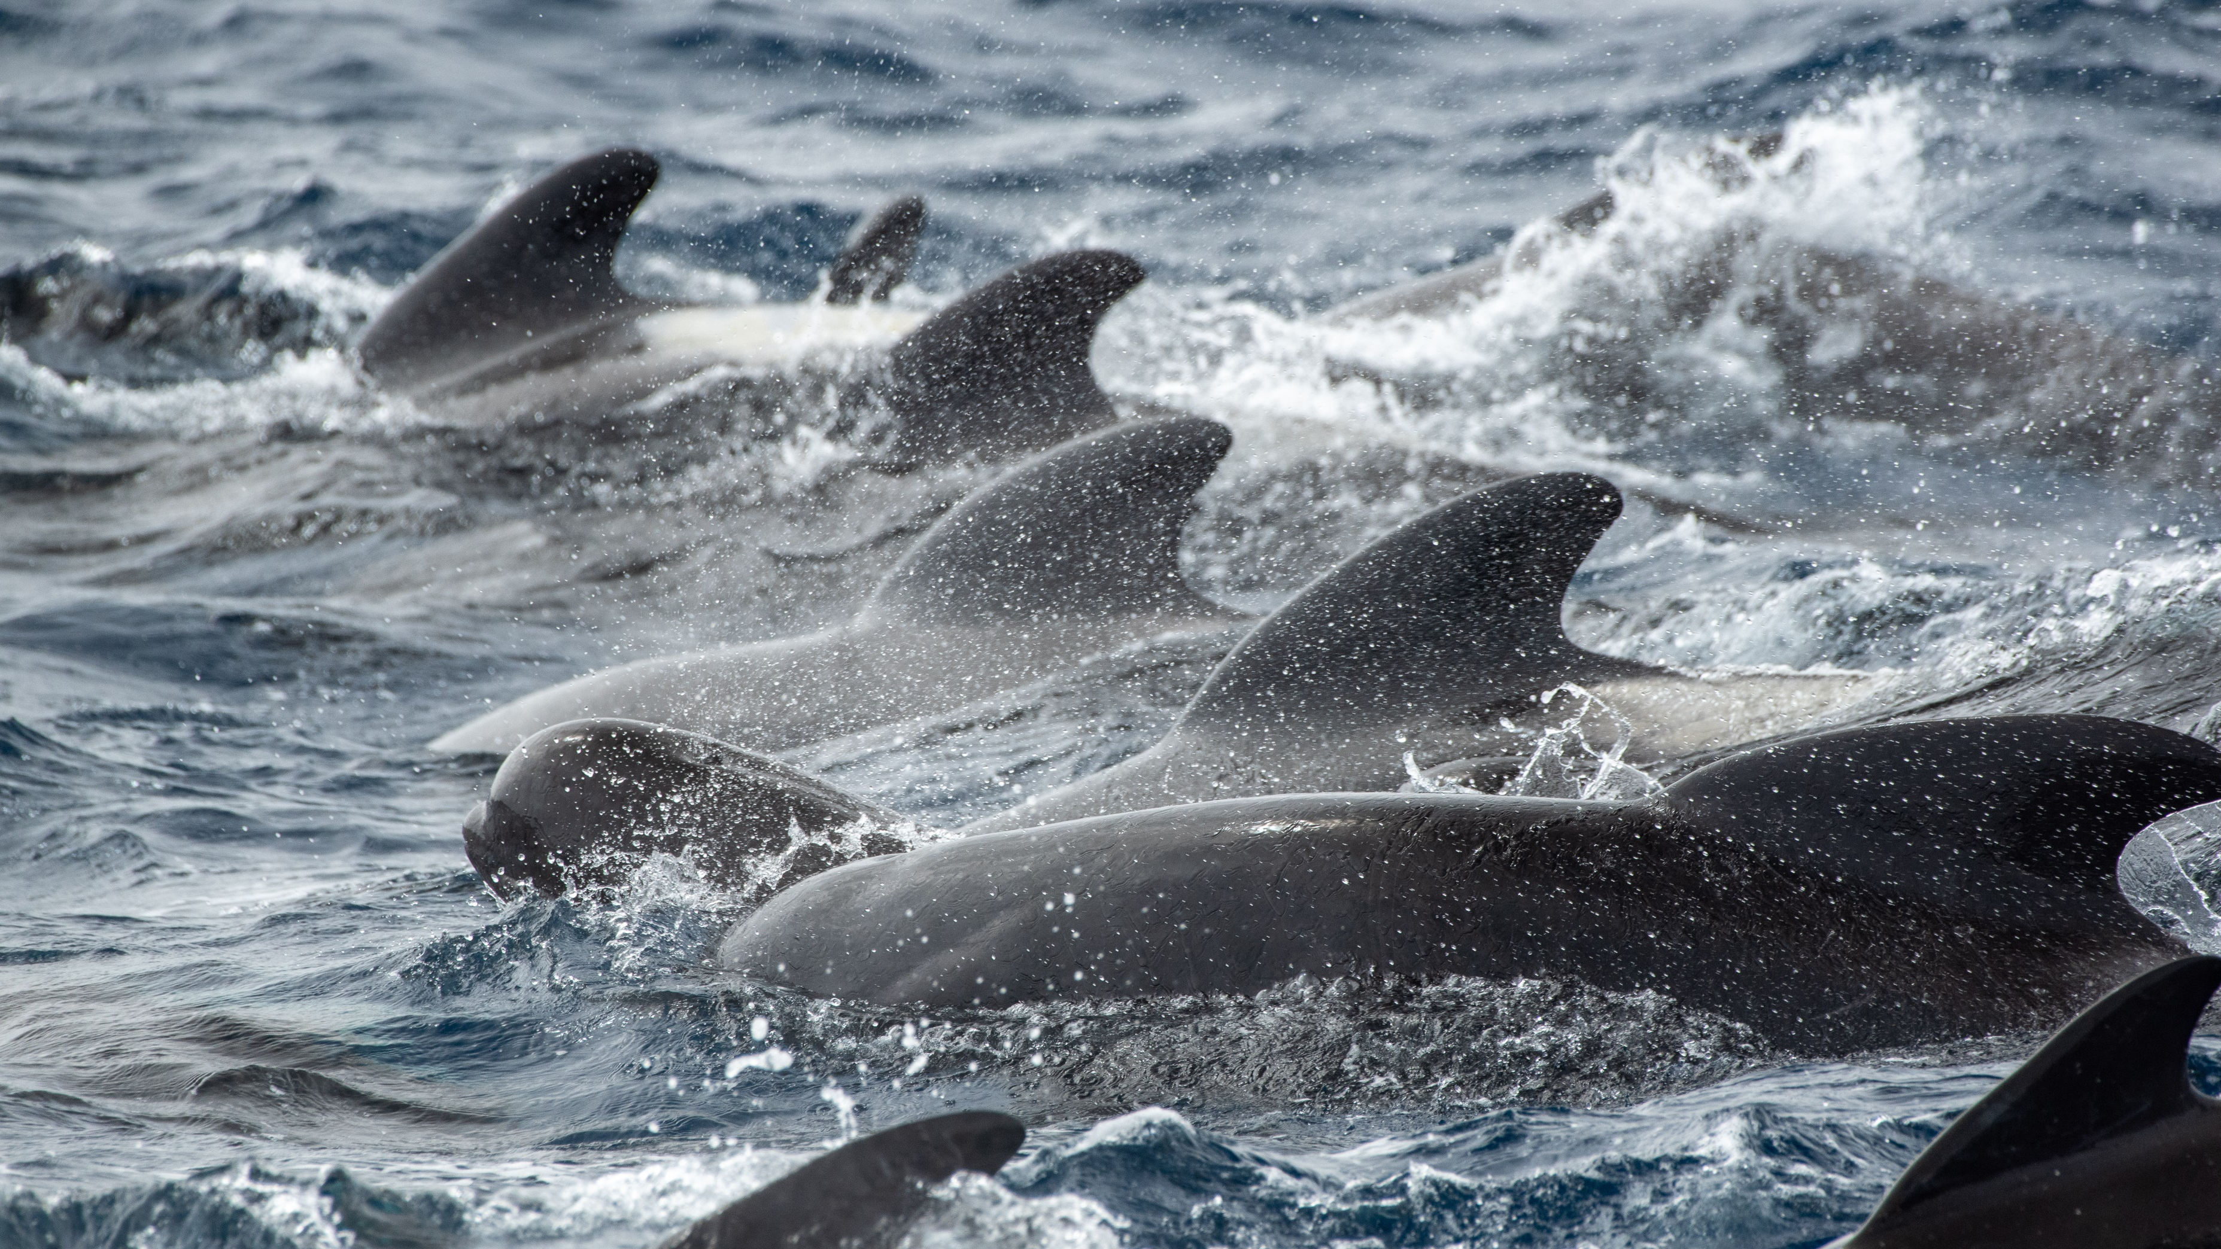
Costs
$90,297.83 - ~$100,000
Material costs: 20%
Manhours in Design : 80%

Slide 25
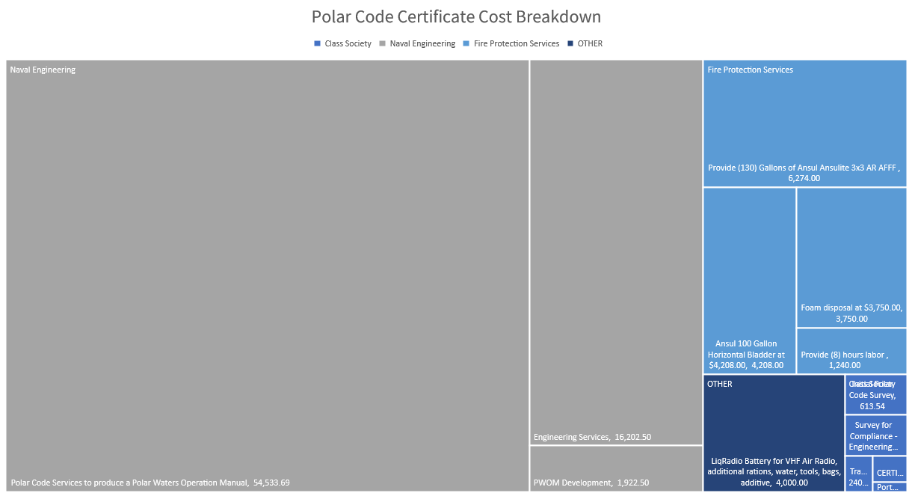
To facilitate a smoother transfer of information and utilizing the additional bandwidth through Glosten, a significant part of these Glosten costs are subcontracting costs with ABS.

Slide 26
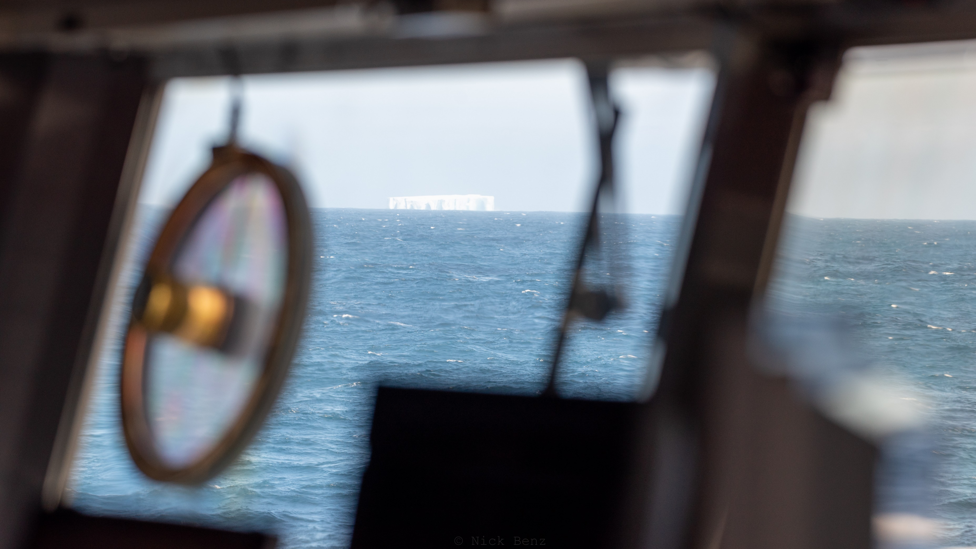
Key Stakeholders
Glosten
Timothy Leech
Dan Oldford
SIO
Captains
Chief engineers
Port Captain
Port Engineer
Marine Superintendent
ABS Harsh Environment Technical Committee (ABS HETC)
Chief Mates
Susan Fitzgerald
ABS
Joe McAndrews
Peter Soles
Notes:
Just a curiosity on how determinations are made in regards to not including polar operations in route permissions of the COI. Also note the pilotage requirements which were later removed.

Slide 27



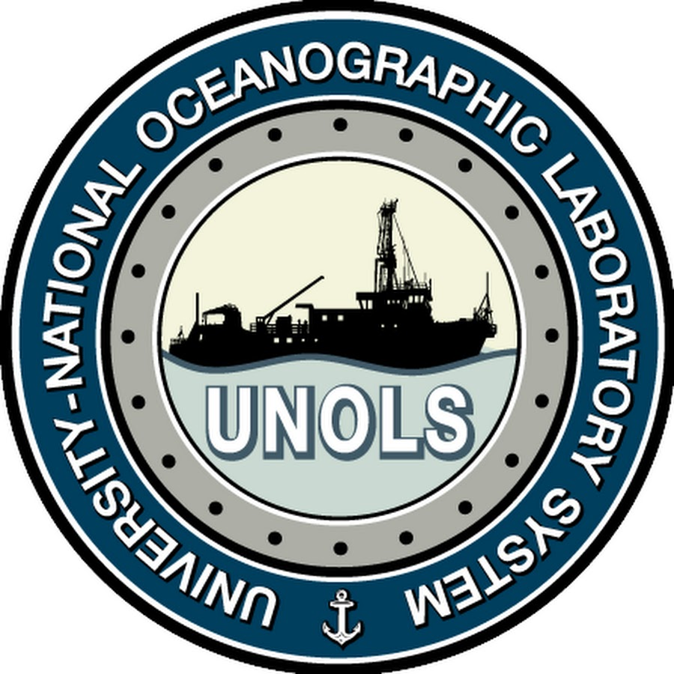


Thank you for your attention, and a thank you to our funding agencies!
Credits:
Pictures taken by ResTech Nicholas Benz nbenz@ucsd.edu
Slide 15 and 22 contain screenshots derived from DNV https://www.dnv.com/maritime/polar/index.html
Questions?

