Slide 2
The Safer Seas Act
Response to reports of sexual assault of USMMA cadets at sea and failure of USCG to undertake revocation and suspension proceedings based on sexual assault and harassment.
Safer Seas Act Proposed February 2022
Made part of the Don Young Coast Guard Authorization Act of 2022.
The Coast Guard Authorization Act made part of the James M. Inhofe National Defense Authorization Act for Fiscal Year 2023.
The Defense Authorization Act signed into law on Dec. 23, 2022

Slide 3
The Safer Seas Act: Overview
Various requirements intended to
  Reduce sexual assault and harassment aboard U.S. vessels
  Aid the criminal prosecution of and civil actions against those accused of sexual assault and harassment aboard U.S. vessels.
Horrible drafting – Like many maritime statutes.
USCG
  So far, no rulemaking – nothing in the CFR.
  Ability of federal agencies to give binding answers to silent/ambiguous statues in doubt – Chevron USA, Inc. v. Natural Resources Defense Council, Inc. to be reviewed in Loper Bright Enterprises v. Raimondo.
  Still very important.

Slide 4
Reporting sexual assault and harassment 46 U.S.C. § 10104: wh0?
“Responsible Party” for a vessel:
  Owner
  Master
  Managing Operator
  Employer of a Seafarer Aboard

Slide 5
Reporting sexual assault and harassment 46 U.S.C. § 10104: What?
The name, official position or role in relation to the vessel, and contact
information of the person making the report.
The name and official number of the documented vessel;
The time and date of the incident;
The geographic position or location of the vessel when the incident occurred; and
A brief description of the alleged sexual harassment or sexual assault being
reported.

Slide 6
Reporting sexual assault and harassment 46 U.S.C. § 10104: when?
“Immediately” upon learning of the sexual assault or
harassment by the “fastest telecommunication channel
available.”
Within 10 days of the initial report, describing any action
taken including the results of any investigation.

Slide 7

Reporting sexual assault and harassment 46 U.S.C. § 10104: to whom
“A single entity in the Coast Guard.”
  CGIS TIPS App (for Apple and Android).
  CGISTIPS@uscg.mil (recommended for record-keeping).
  National Command Center Hotline: (202) 372-2100.
The appropriate authority in a foreign country in whose waters the sexual assault or harassment occurred, if in a foreign country (initial report only).

Slide 8
Reporting sexual assault and harassment 46 U.S.C. § 10104: application to ARF Vessels?
Maybe no:
  Statute defines the responsible party as the owner, master, managing operator, or employer of a seafarer on “a documented vessel engaged in commercial service.”
  ARF vessels are oceanographic research vessels, and an oceanographic research vessel, by statute, “is deemed not to be engaged in trade or commerce.” 46. U.S.C. § 50503.
  For ARF vessels there is no responsible party party required to make the report.
Maybe yes.
  The statute does not limit the type of vessels to which it is applicable.
  The chapter (101) of Title 46 does not limit the type of vessels to which it applies exempting only scientific personnel
  The general reporting statute 46. U.S.C. § 10103, applies to seamen aboard Oceanographic Research Vessels

Slide 9
Reporting sexual assault and harassment 46 U.S.C. § 10104: Compliance
Reasons for:
  Avoid potential conflict with USCG
  Avoid penalties
    $25,000 for failure to report immediately.
    $500 for each day of non-compliance.
    Up to at total of $50,000.
  Avoid potential civil liability
Reasons against:
  Administrative burden.
    No requirement of investigation
    Only requirement is accurate reporting

Slide 10
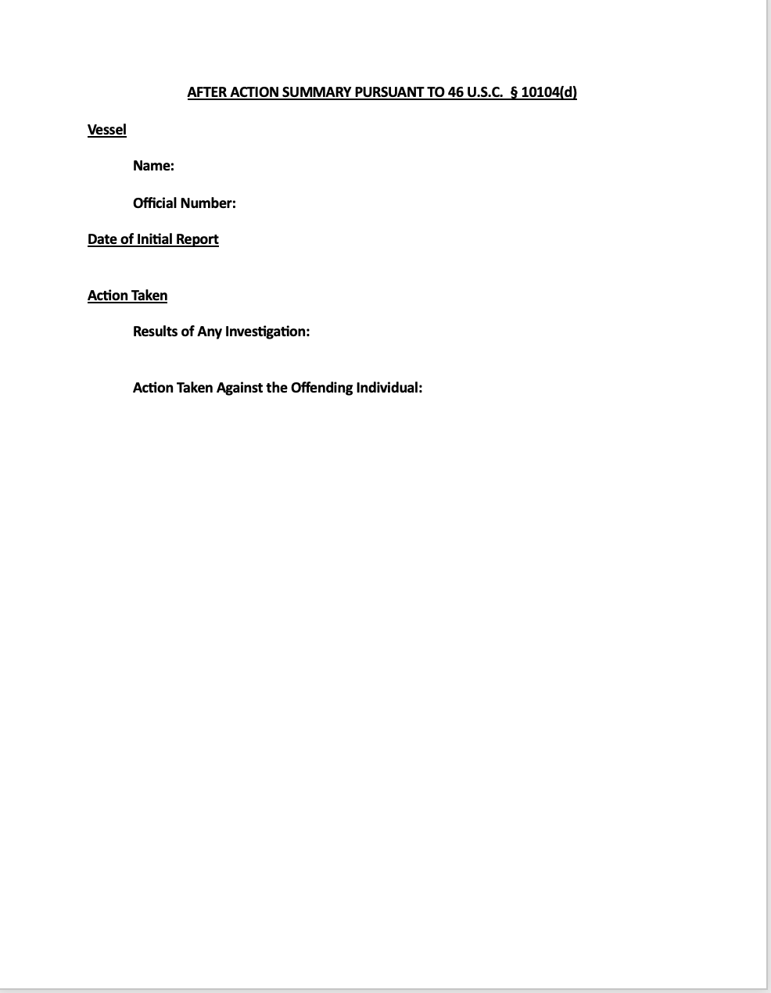
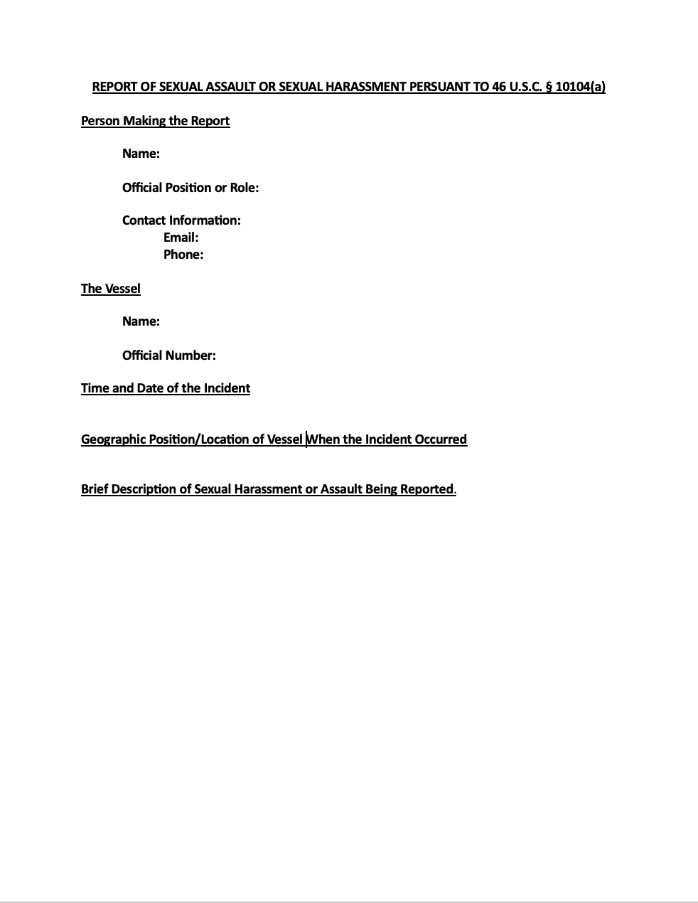

Slide 11
Surveillance requirements -- 46 U.S.C. § 4901 video surveillance: where?
Passageways on to which doors from staterooms open.
In a manner ensuring the visibility of every door in each such passageway

Slide 12
Surveillance requirements -- 46 U.S.C. § 4901 video surveillance: When?
Installation by the later of
  December 23, 2024 (two years after the enactment).
  The next scheduled drydock.
  New vessels?
Retention for
  At least one year.
  At least five years after “incident” to which the “footage” relates.

Slide 13
Surveillance requirements -- 46 U.S.C. § 4901 video surveillance: Training on Responding to and Reporting of Sexual Harassment
Provided by vessel owner (charterer, managing operator, master, or other individual in charge of a vessel) or employer of seafarer aboard a vessel.
Purpose
  Ensure employees “retain audio and visual records and other evidence objectively.”
  Ensure employees “act impartially without influence from the company or others.”
  Provide “training on applicable Federal, State, Tribal, and local laws and regulations regarding sexual assault and sexual harassment investigations and reporting requirements.”

Slide 14
Surveillance requirements -- 46 U.S.C. § 4901 video surveillance: What Vessels?
“(a) In general. --A vessel engaged in commercial service that does not carry passengers, shall maintain a video surveillance system.” (emphasis added).
“(b) Applicability.--The requirements in this section shall apply”
  Vessels with overnight accommodations for 10 or more
    On a voyage of 600 miles or more crossing seaward of the Boundary Line
    “At least 24 meters (79 feet) in overall length and required to have a load line”
  “ Operating for no less than 72 hours on waters superjacent to the outer Continental Shelf”
  Registered vessels of at least 500 gross tons

Slide 15
Surveillance requirements -- 46 U.S.C. § 4901 video surveillance: Applicable to ARF Vessels?
Most Likely No.
  46 U.S.C. § 4901(a) applies to “vessels in commercial service.”
  ARF vessels are oceanographic research vessels, and an oceanographic research vessel, by statute, “is deemed not to be engaged in trade or commerce.” 46. U.S.C. § 50503.
  ARF vessels are not in “commercial service.”
Unlikely Yes.
  “Commercial service,” the general term for covered vessels, is defined by the specific terms of 46 U.S.C. § 4901(b).
  But “commercial service is a defined term, “any type of trade or business involving the transportation of goods or individuals, except service performed by a combatant vessel.” 46 U.S.C. § 2101(4)

Slide 16
Surveillance requirements -- 46 U.S.C. § 4901 video surveillance : Compliance
Reasons for:
  Avoid potential conflict with USCG
  Make vessel safer.
  Make vessel more attractive to employees.
  Avoid potential civil liability – statue is not boundary of due care or seaworthiness.
Reasons against:
  Cost
  Practicality on an ARF Vessel
  Administrative burden.
    Training
    Retaining footage

Slide 17
Surveillance requirements -- 46 U.S.C. § 3106 Master Key Control System: The System
A system provides controlled access to all copies of the vessel's master key of which access shall only be available to the individuals on an established list of, identified by position, allowed to access and use the master key and maintain such list upon the vessel, within owner records and included in the vessel safety management system.
Crew not included on the list shall not have access to or use the master key unless in an emergency and shall immediately notify the master and owner of the vessel following use of such key.

Slide 18
Surveillance requirements -- 46 U.S.C. § 3106 Master Key Control System: The “Log Book.”
Electronic or written
In centralized location accessible to law enforcement authorities.
Containing information on all access and use of the vessel's master key, including--
  Dates and times of access;
  The room or location accessed; and
  The name and rank of the crew member that used the master key
Available to
  USCG
  FBI
  Other Law Enforcement

Slide 19
Surveillance requirements -- 46 U.S.C. § 3106 Master Key Control System: Penalties for Unauthorized Use by Crew
Up to $1000.
Suspension or revocation of credentials.

Slide 20
Surveillance requirements -- 46 U.S.C. § 3106 Master Key Control System: Applicability
Vessels subject to inspection.

