Slide 1
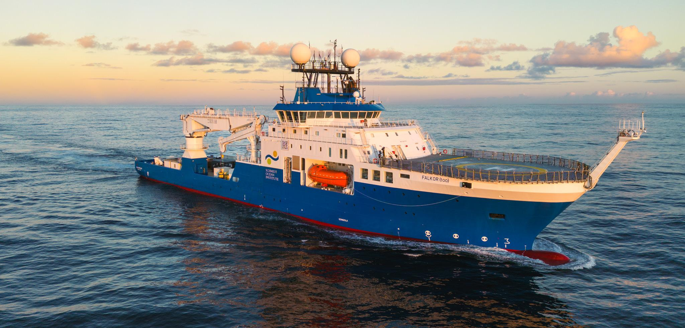
UNOLS RVOC May 2023

Slide 2
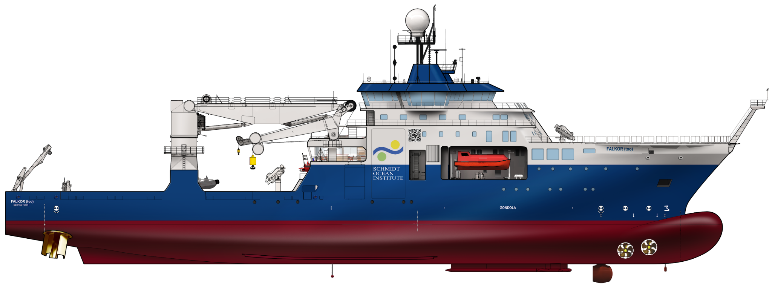
R/V FALKOR (too)
Formerly MV POLAR QUEEN

Slide 3
Specifications
LOA 363’
Beam 65’
Gross Tons 7,257
Labs 8 “rooms” for science
Cranes 9 up to 150 tons AHC
Moon Pools 2 (Hangar 17’ x 17’) (Aft Deck 23’ x 23’)
Open Deck 9,600 ft2
Fuel Capacity 453,000 gallons
Engines 10.8 mW (6 MAN 9 cylinder @ 1,800 kW each)
Thrusters 5 (Bow - 2 tunnel, 1 drop keel) (Stern - 2 cycloidal pitch props)
Science Sonars a lot
Class & Flag DNV - DP2, ICE-C Cayman Islands
Crew 28 + 8 ROV Technicians - 60 days on/off
Scientists 40 (2024+)
ROV 4,500 meters

Slide 4
SCIENCE ON
R/V FALKOR (too)
Eight Labs
Falkor | Square Meters | Falkor (too) | Square Meters
Dry Lab | 25 | Seawater Lab | 25
Wet Lab | 30 | Main Lab | 105
Lower Wet Lab | 5 | Wet Lab | 25
 |  | Hydro Lab | 30
 |  | Dirty Wet Lab | 10
 |  | Computer and Electronics Lab | 60
 |  | Cold Lab | 20
 |  | Robotics Lab | 30
Total | 60 | Total | 305
>5x Lab Space
75% increase in Met & Marine Underway Sensors
2x Sound Velocity Sensors
+2 MTs

Slide 5
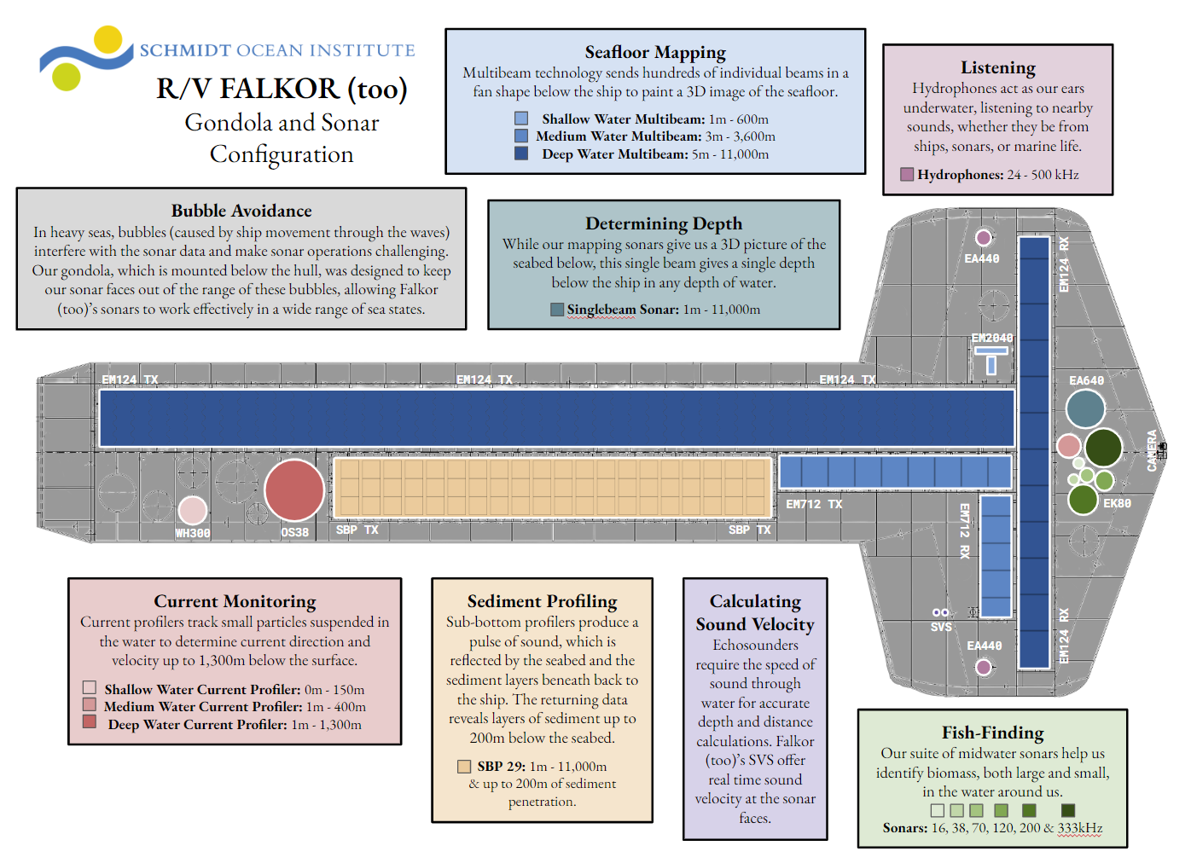

Slide 6
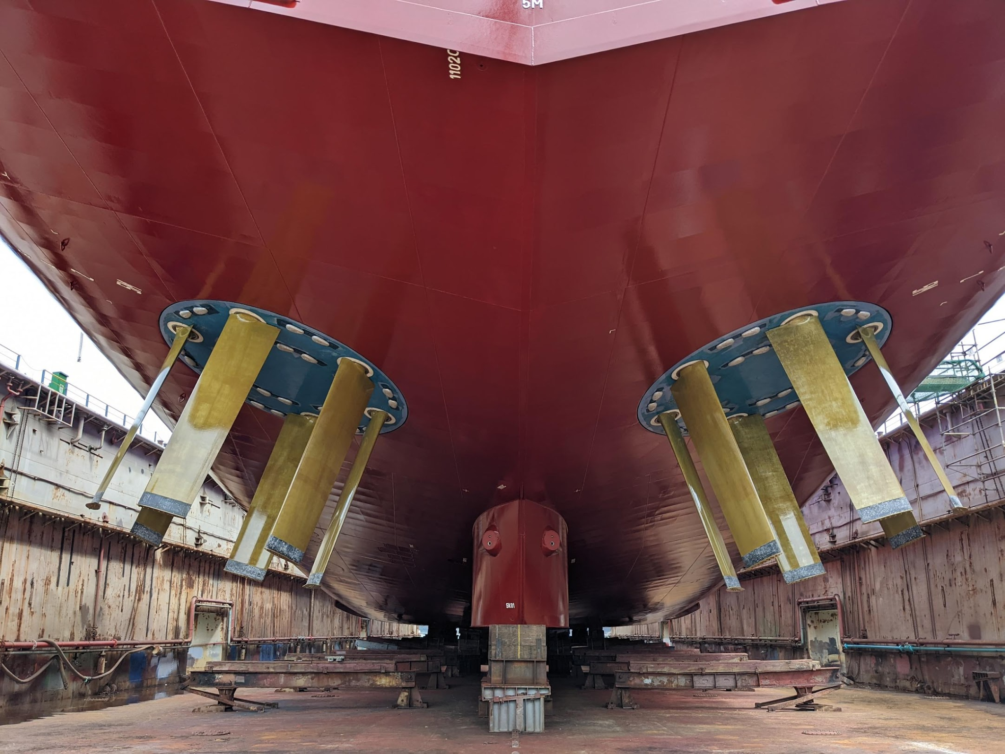

Slide 7
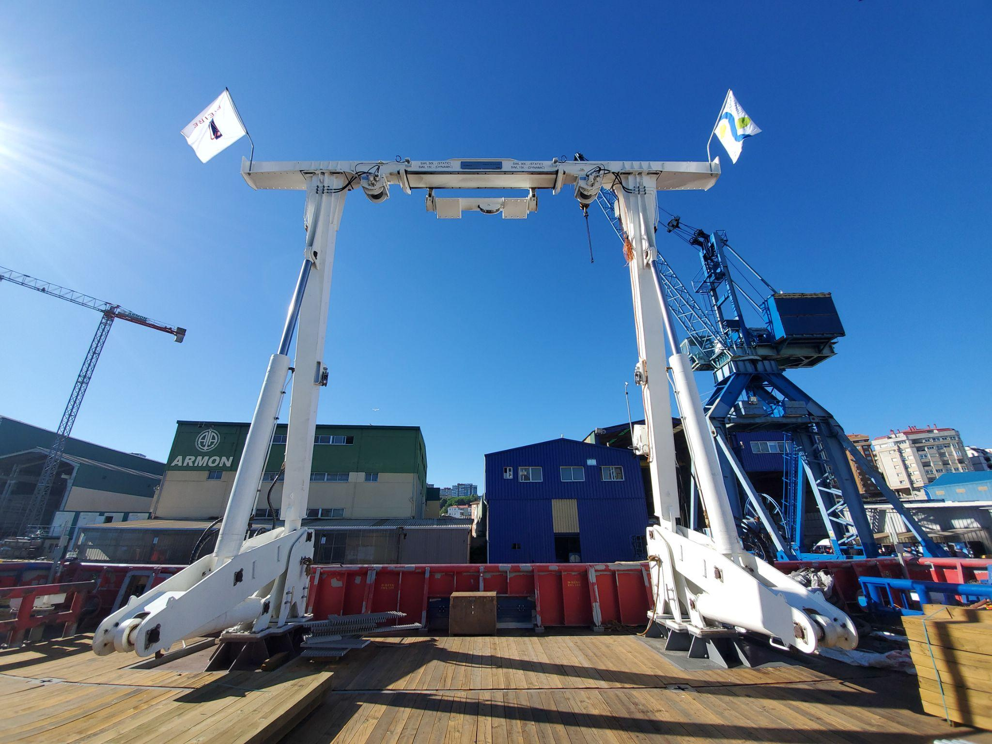

Slide 8
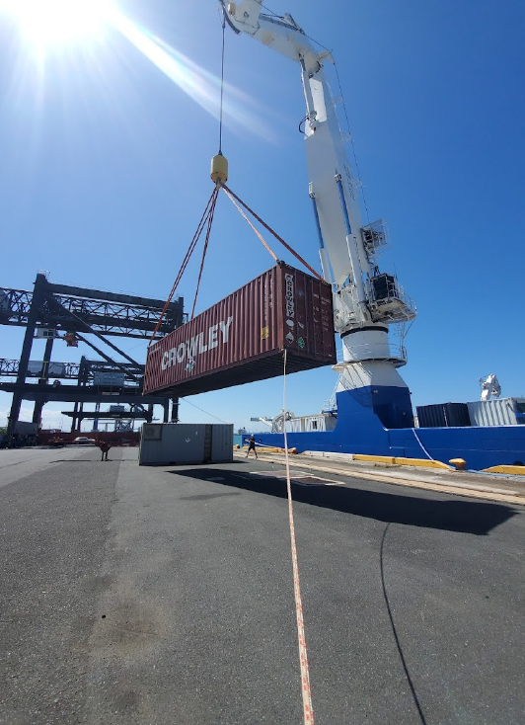
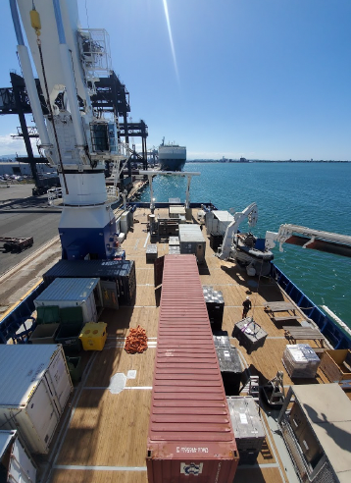

Slide 9
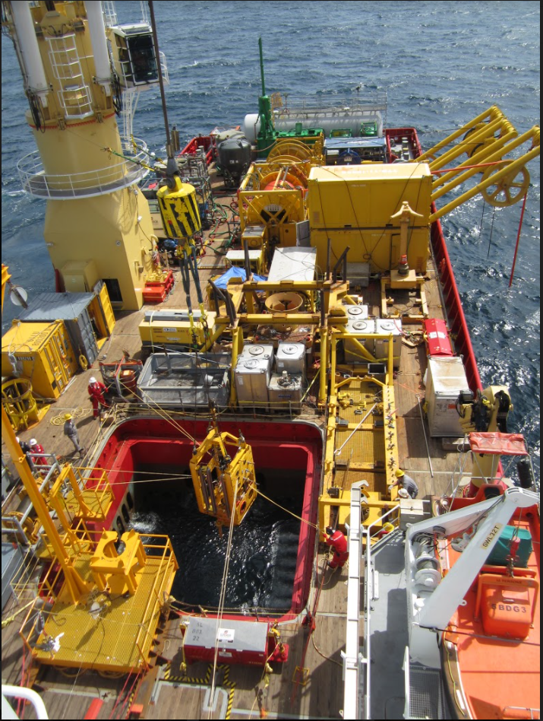

Slide 10
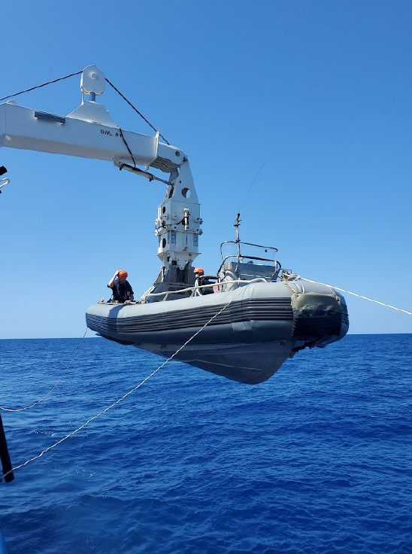
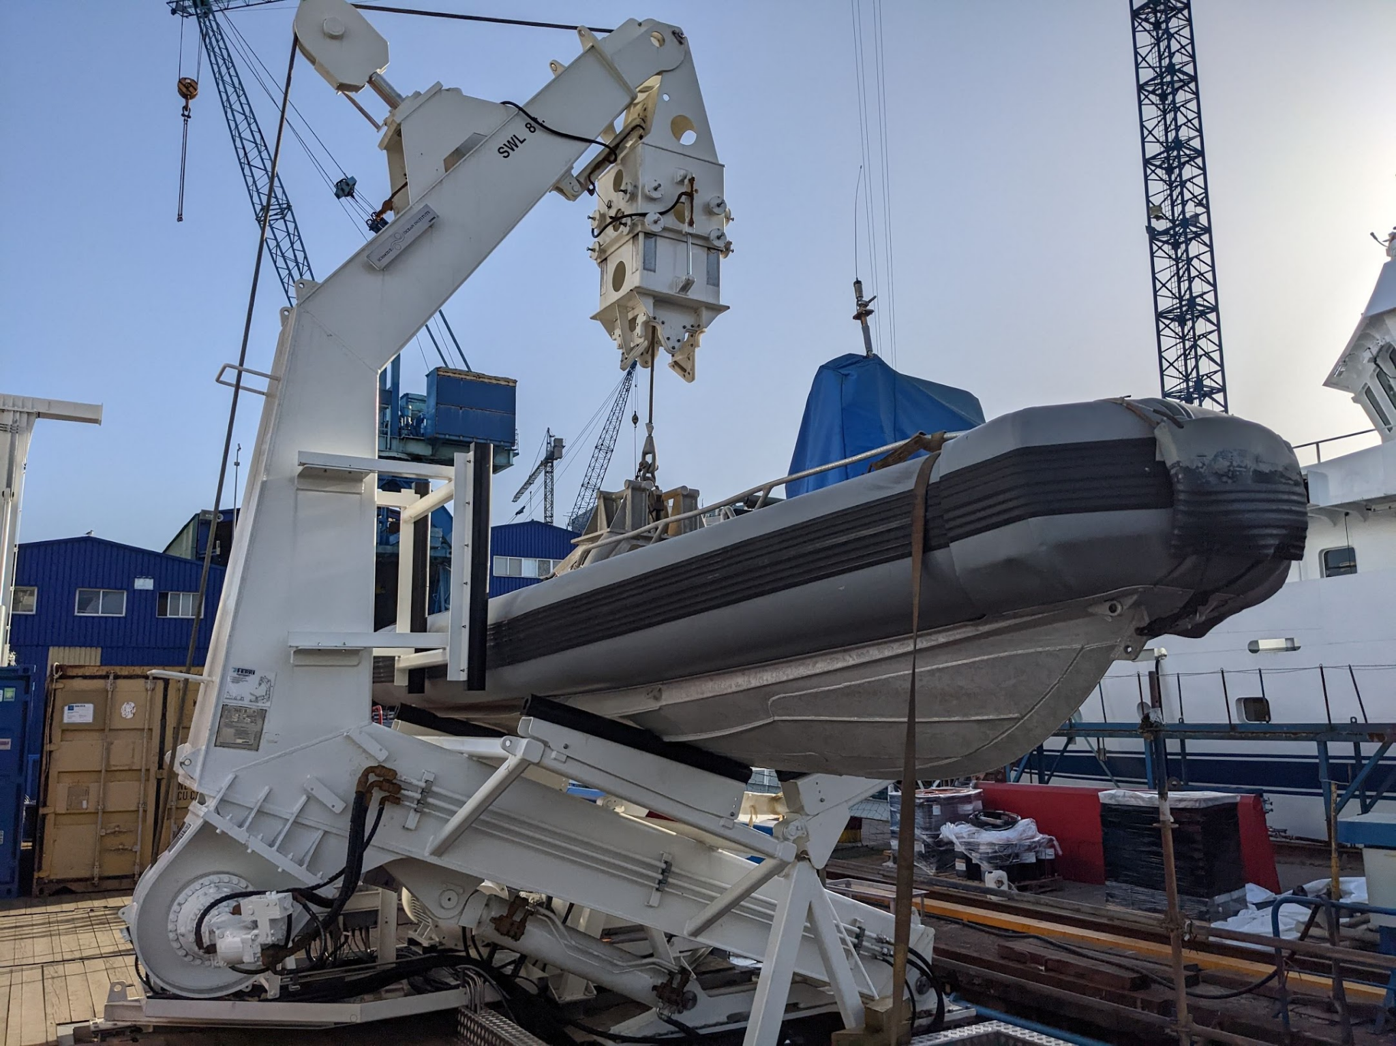

Slide 11
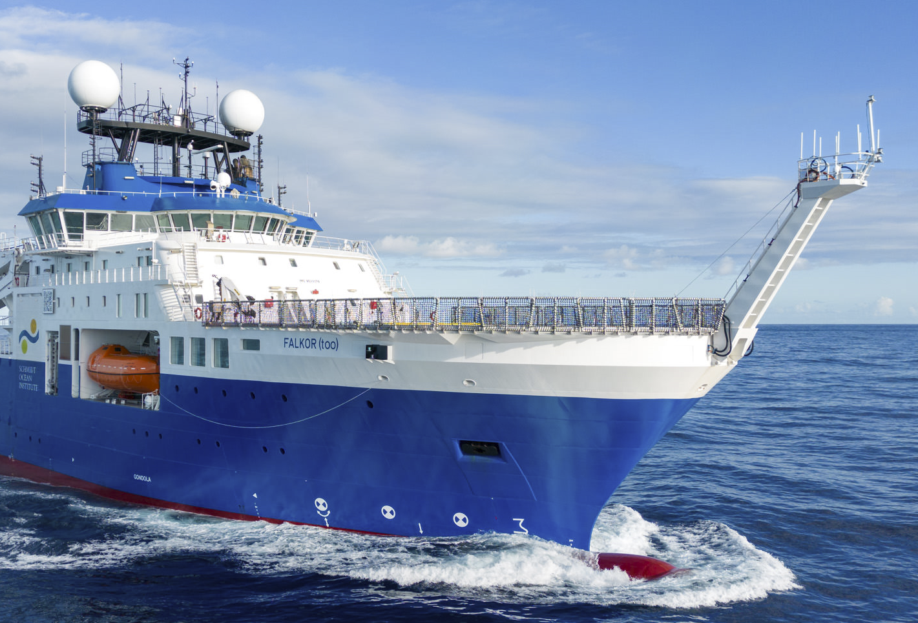
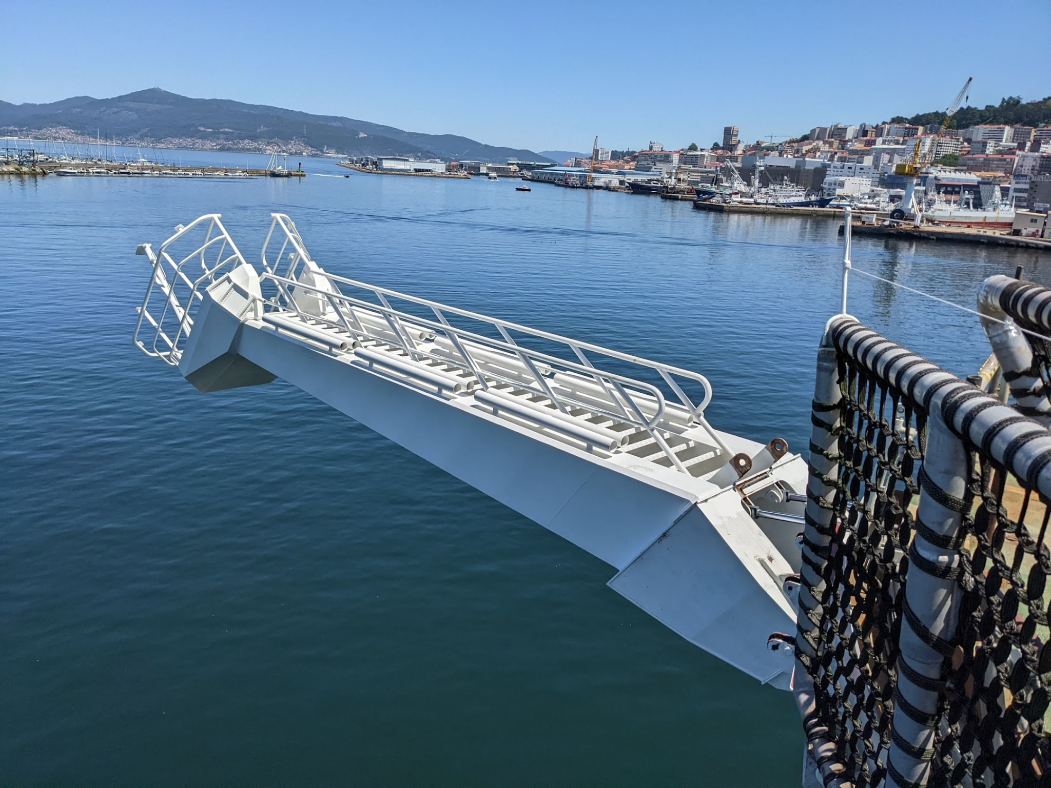

Slide 12
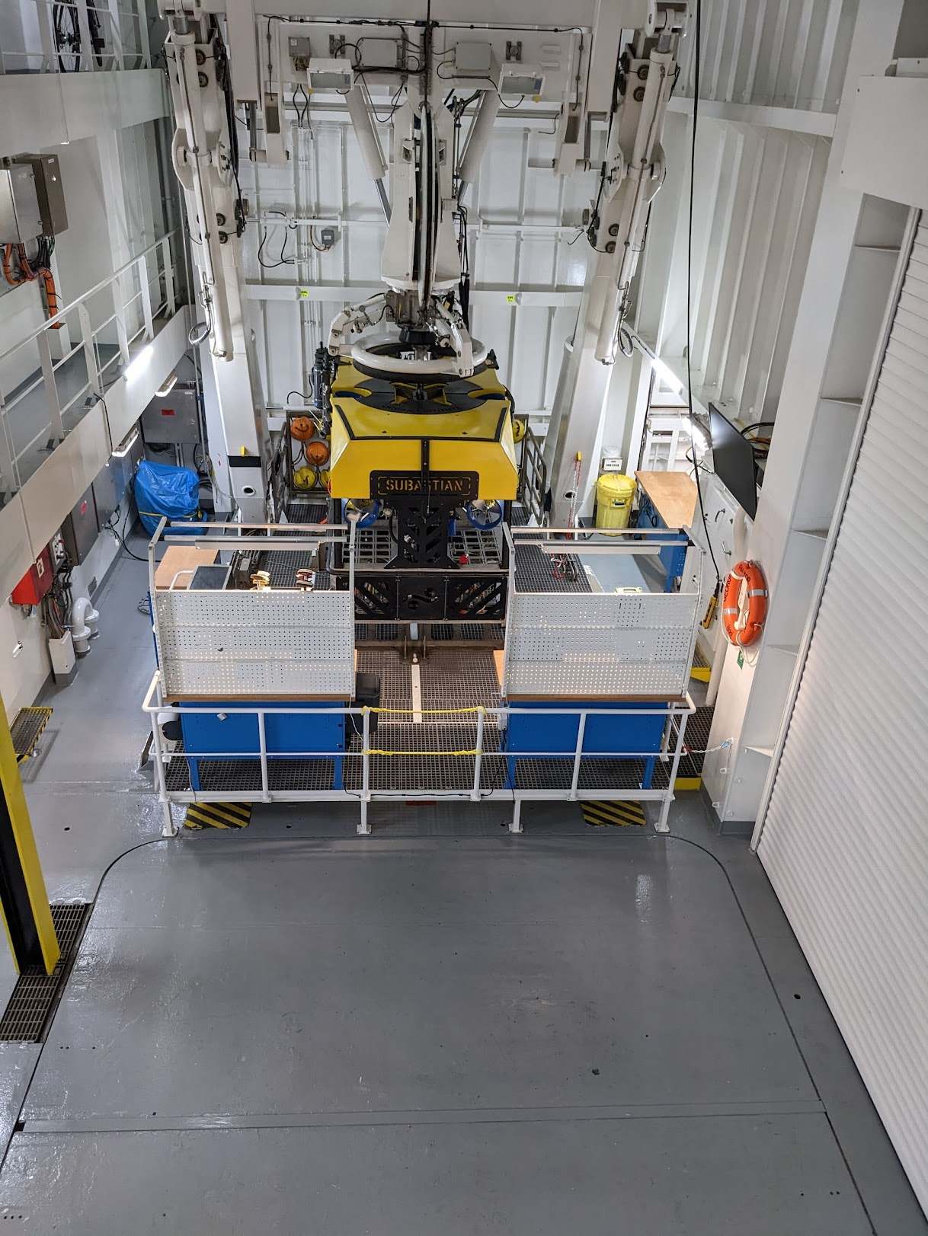
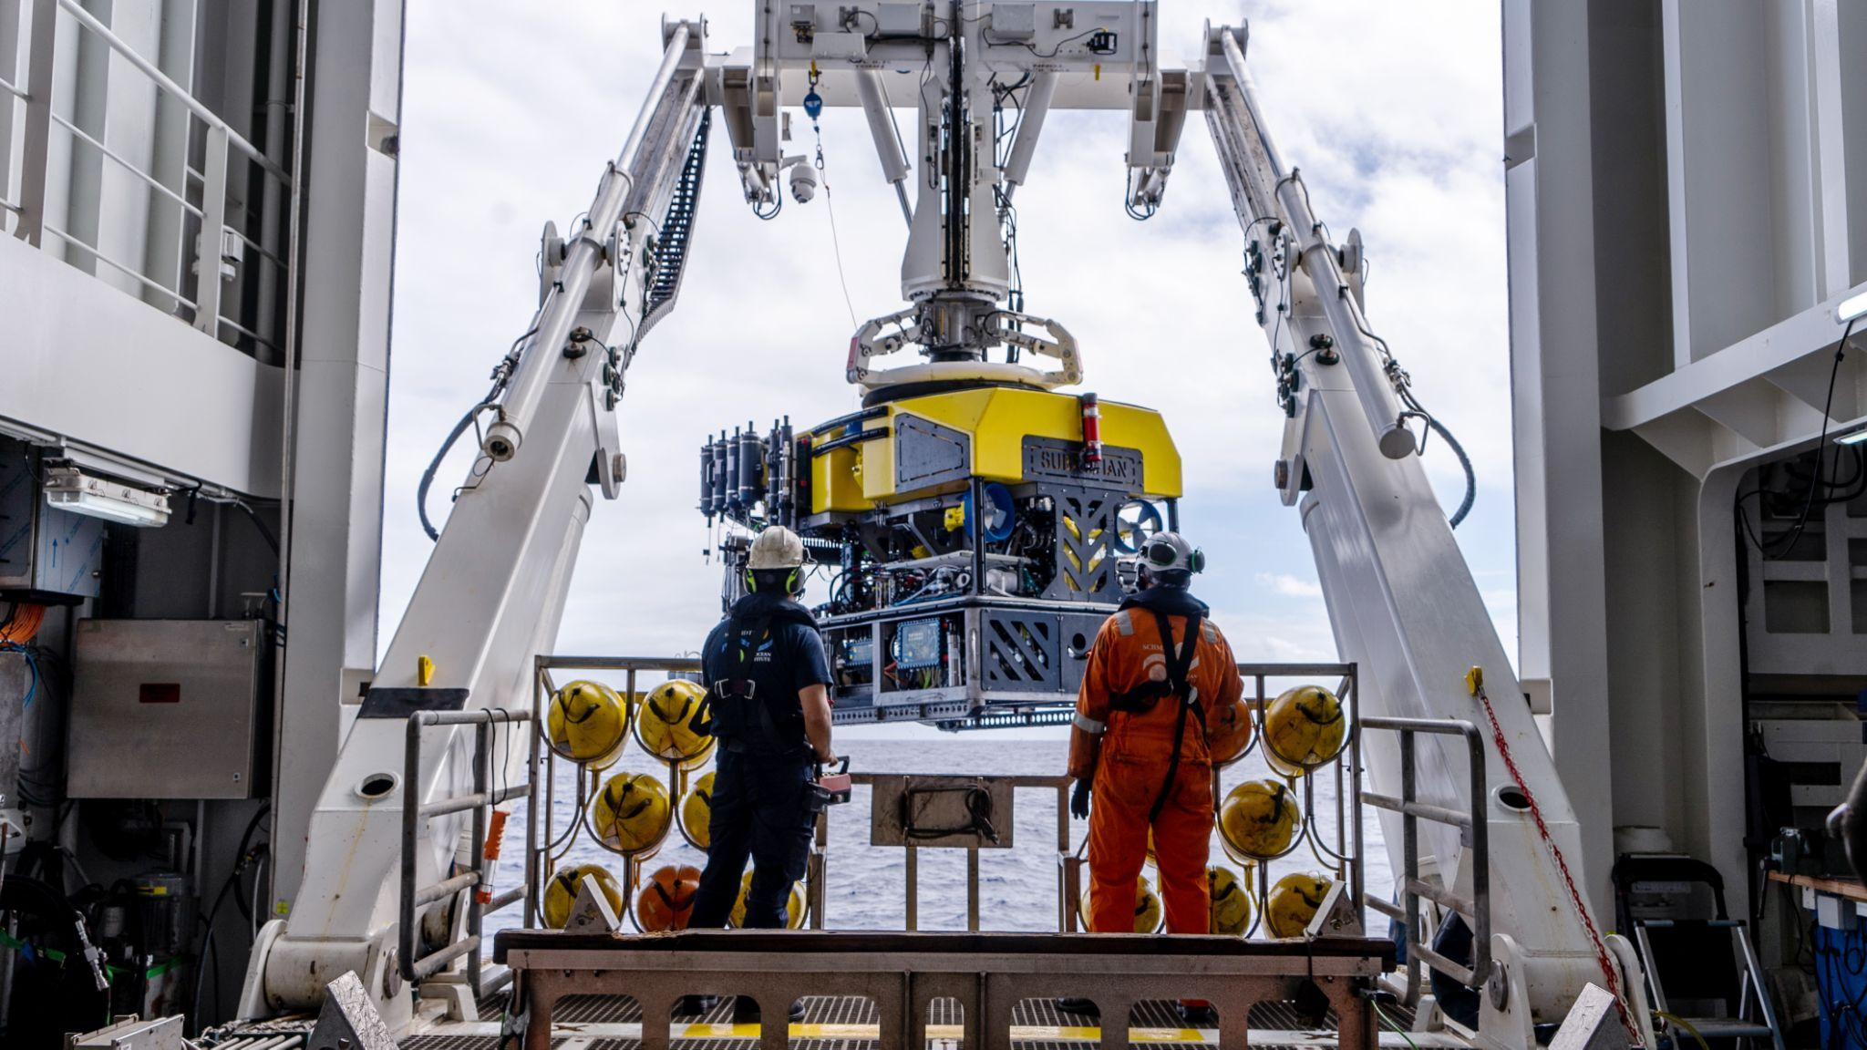
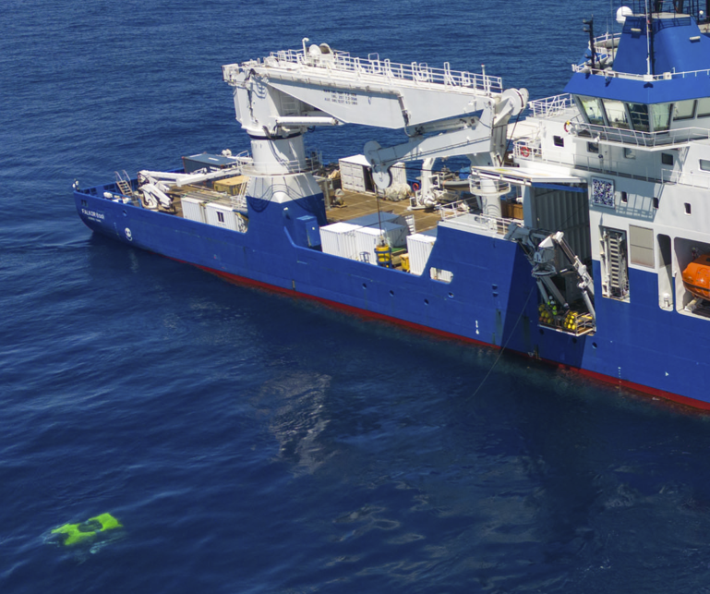

Slide 13
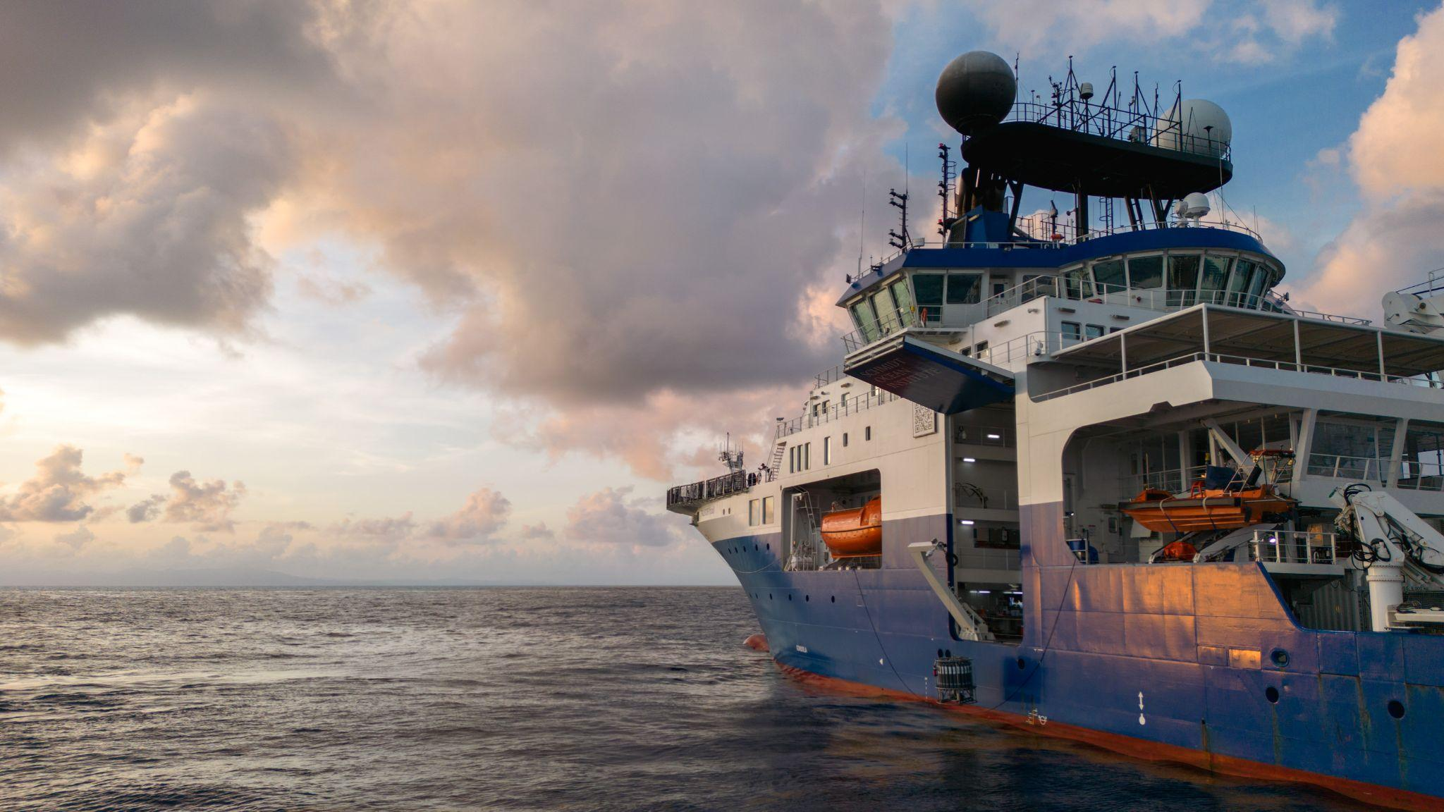
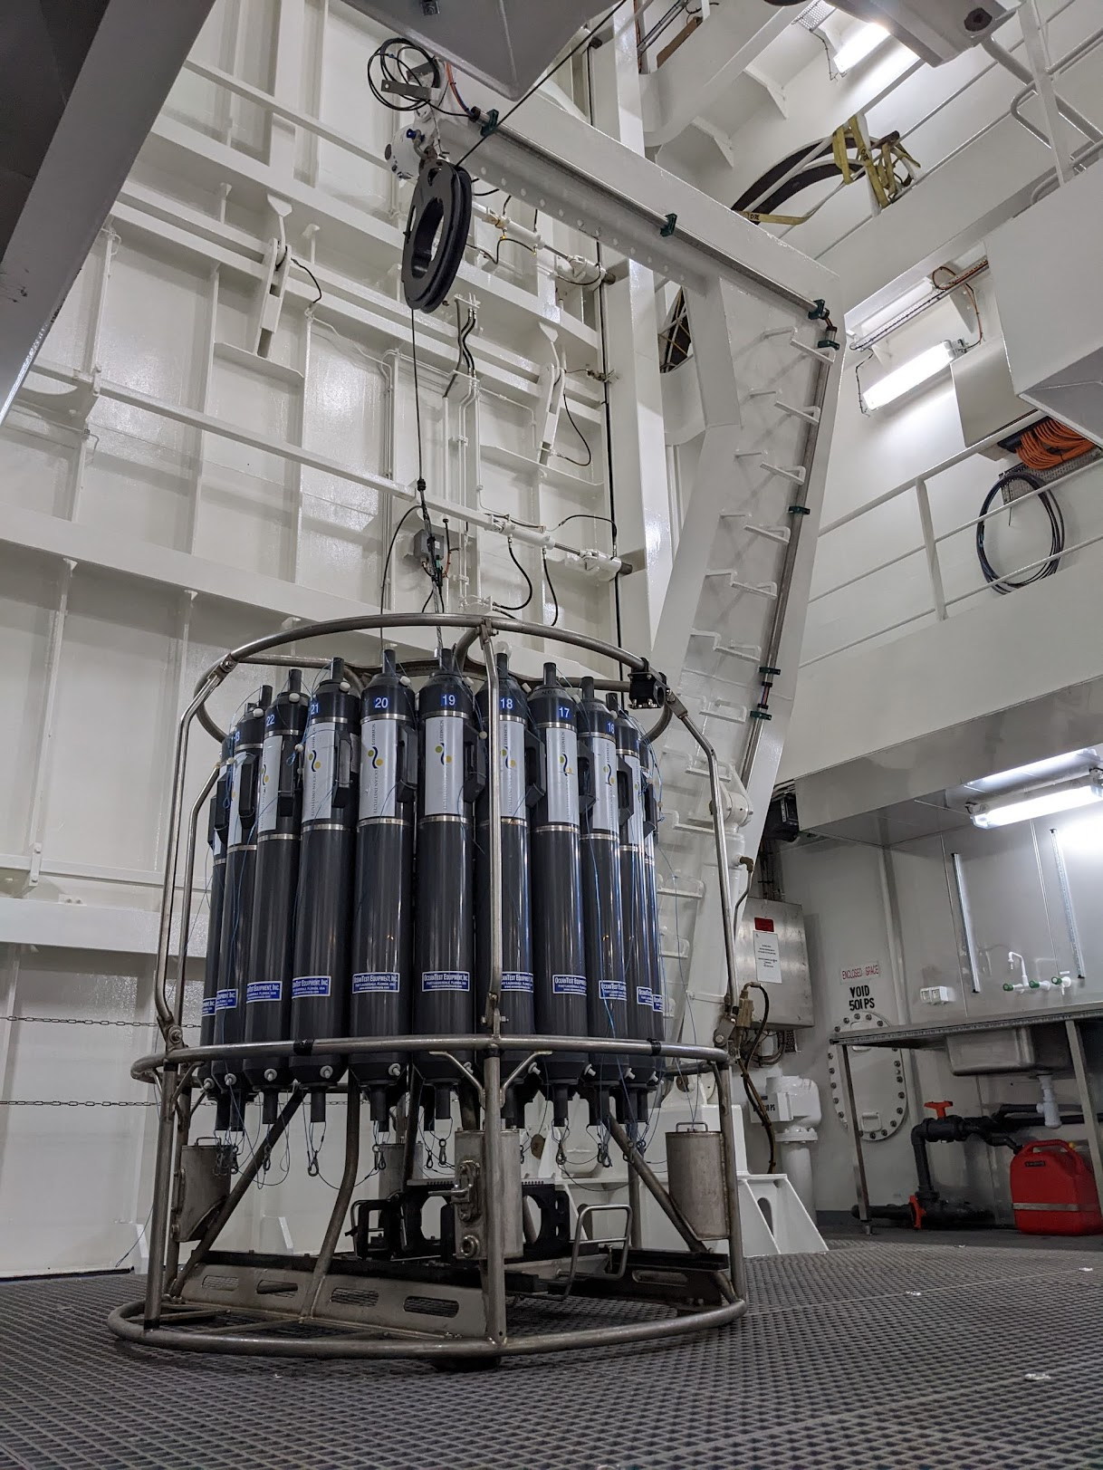

Slide 14
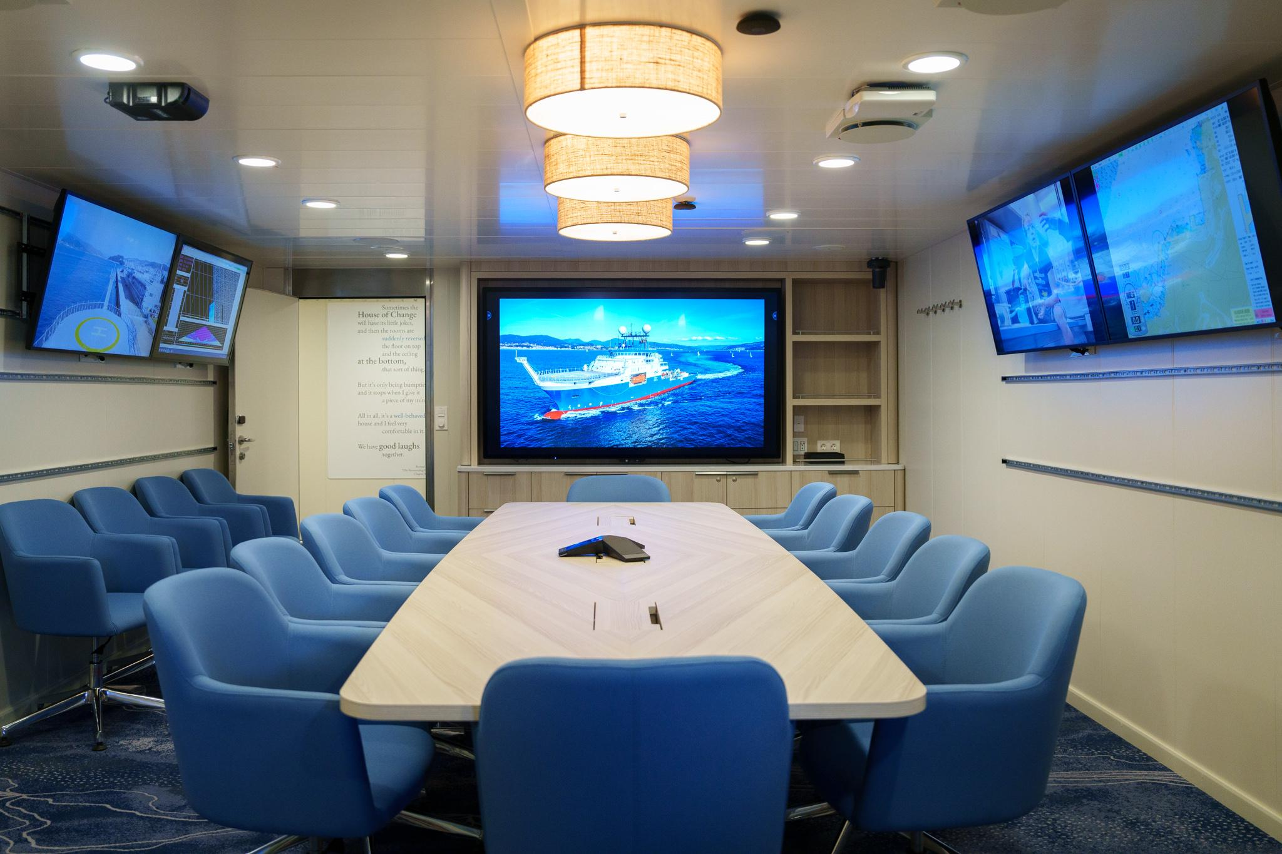

Slide 15
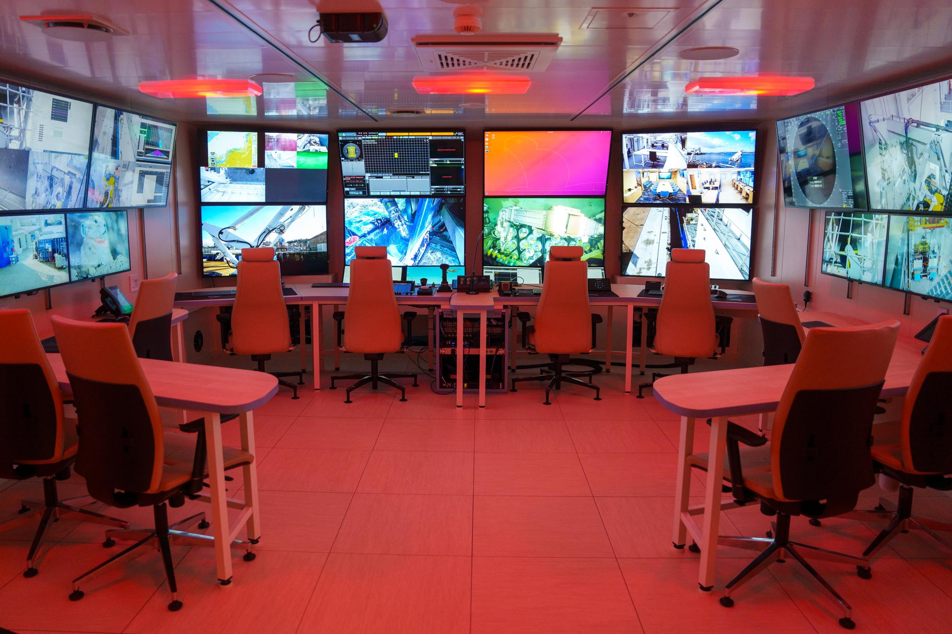

Slide 16
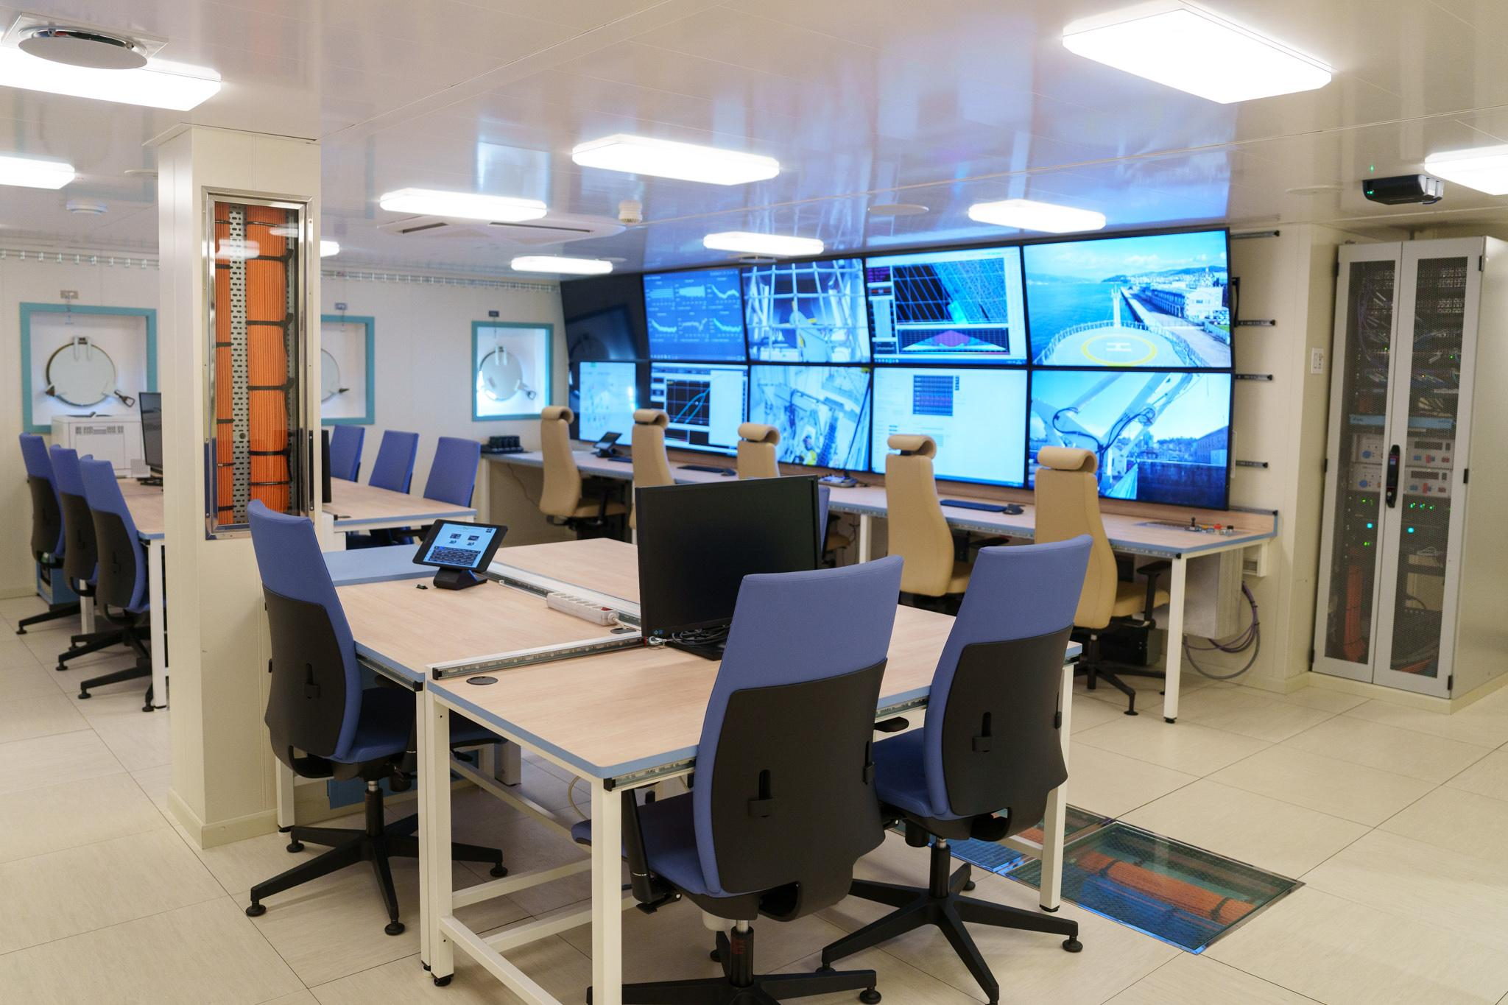

Slide 17
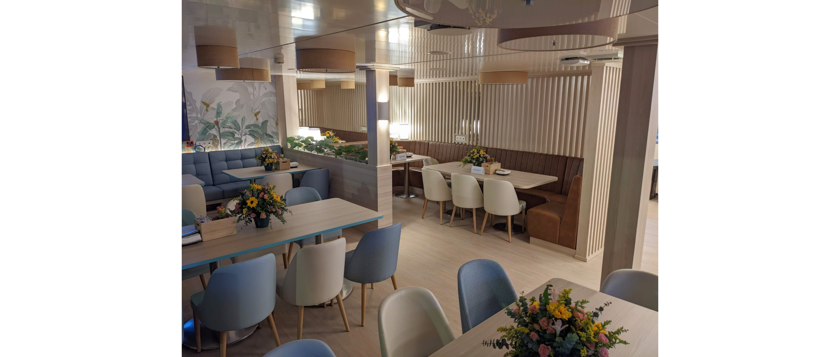

Slide 18
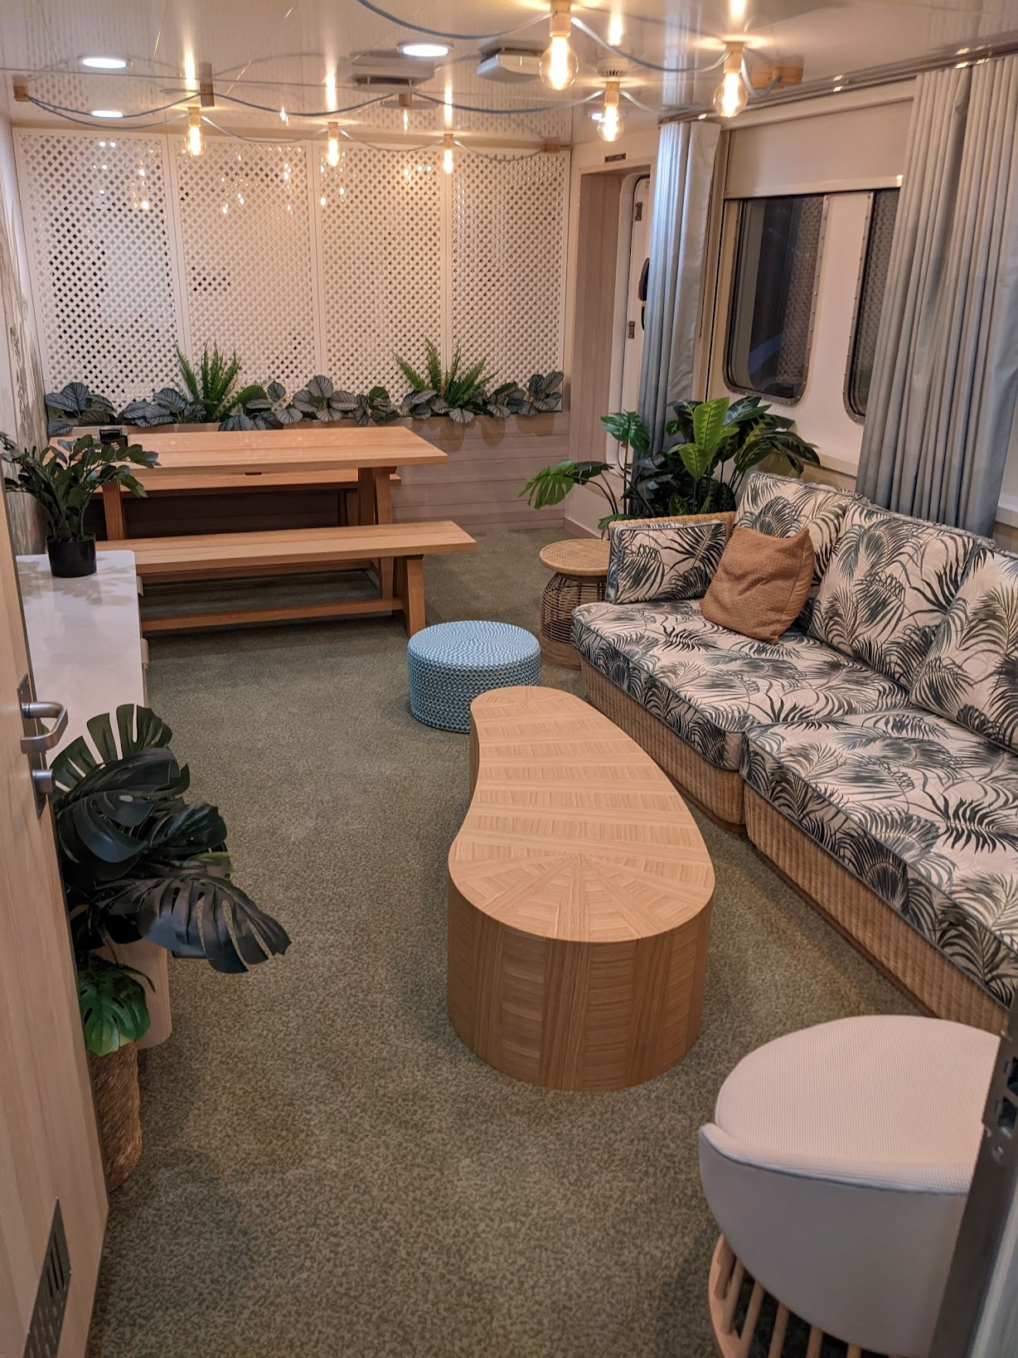
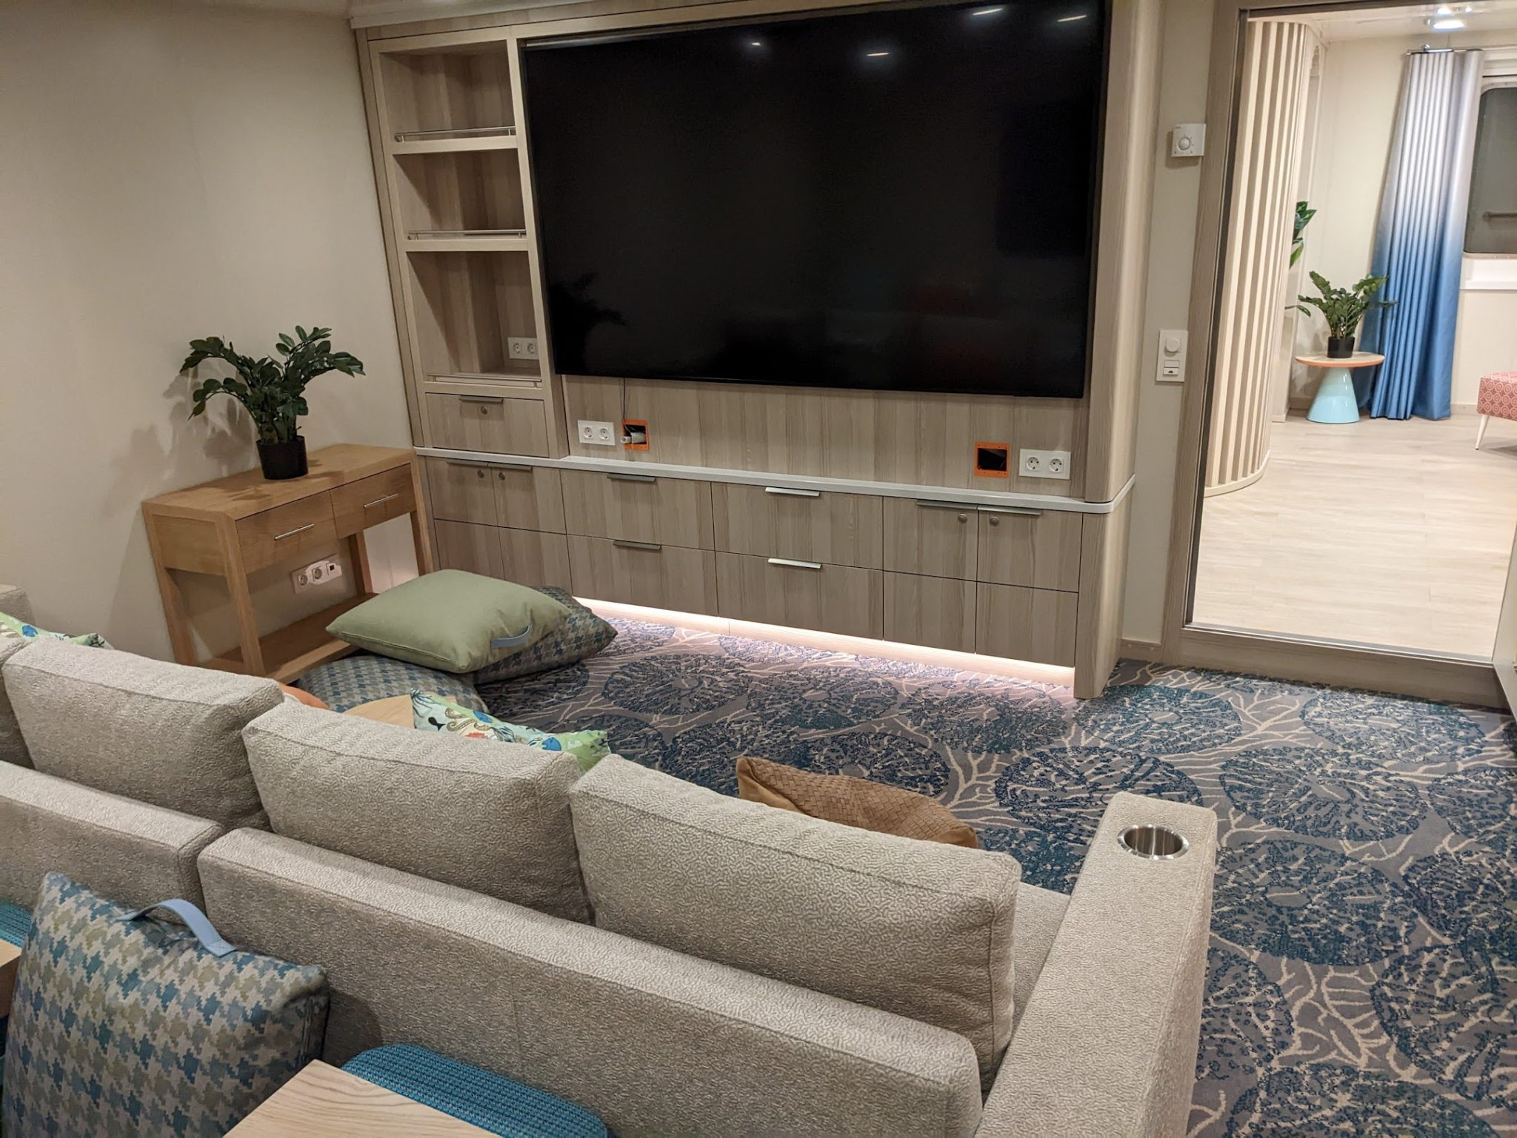

Slide 19
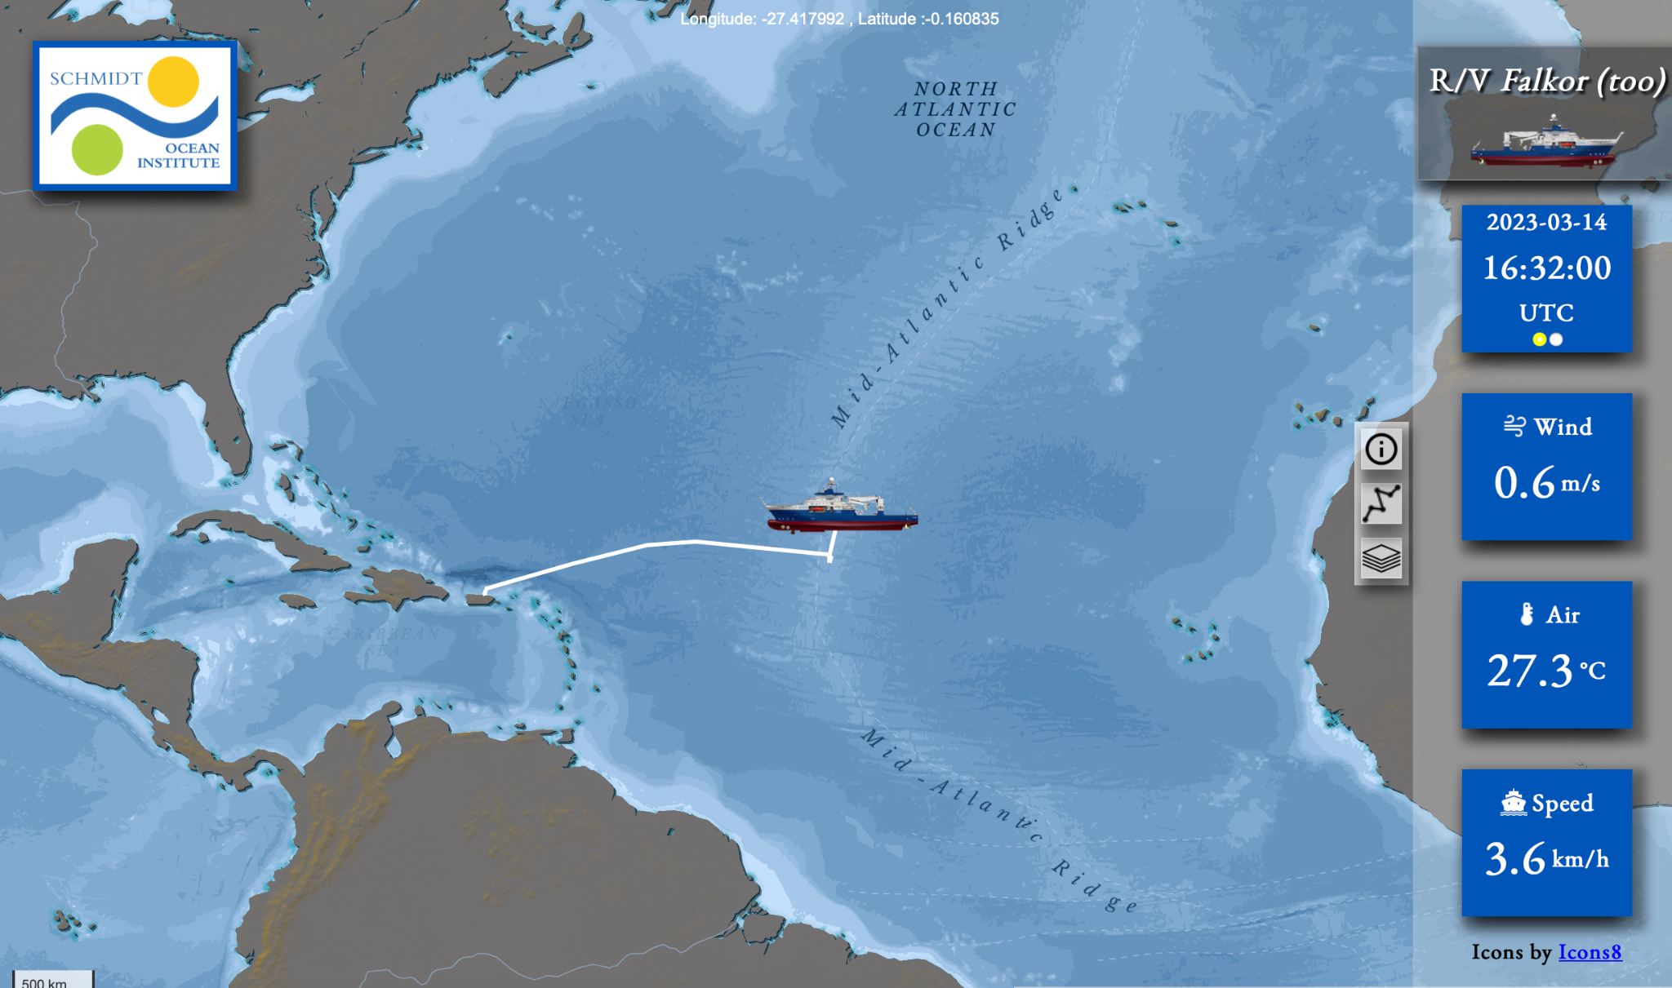
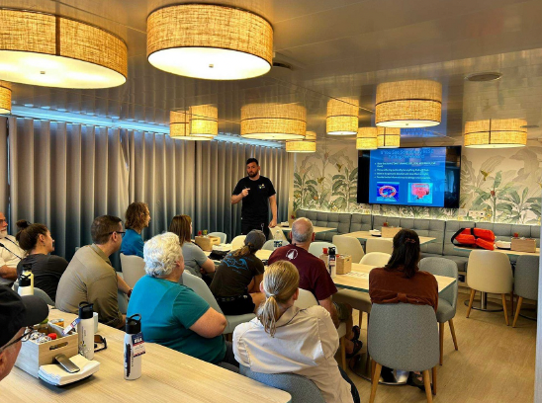
IN SEARCH OF HYDROTHERMAL LOST CITIES
1st Shakedown Cruise - 40 days with 24 scientists

Slide 20
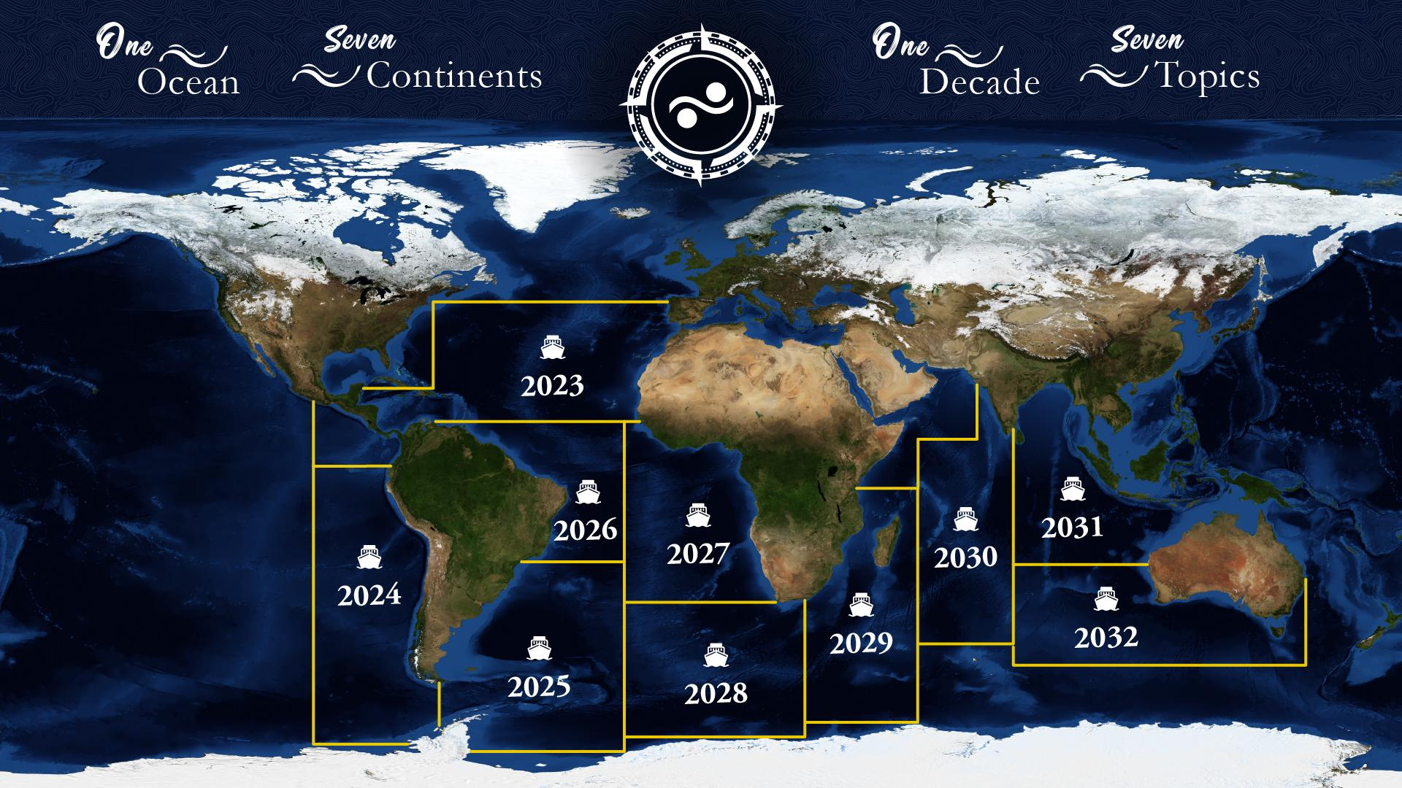

Slide 21
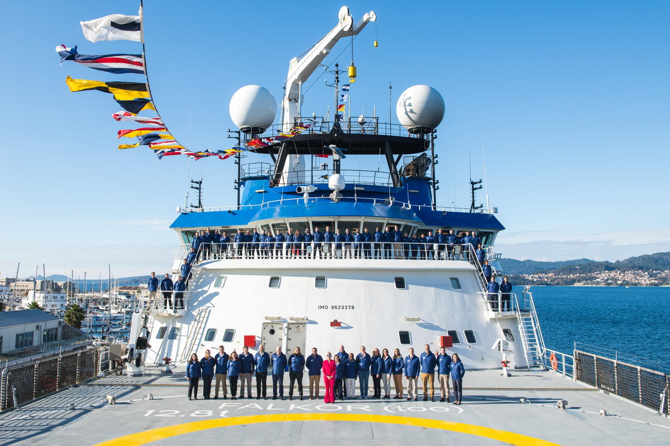
Thank you

