Slide 1

R/V Savannah Mid-life Refit
May 2023

Slide 2
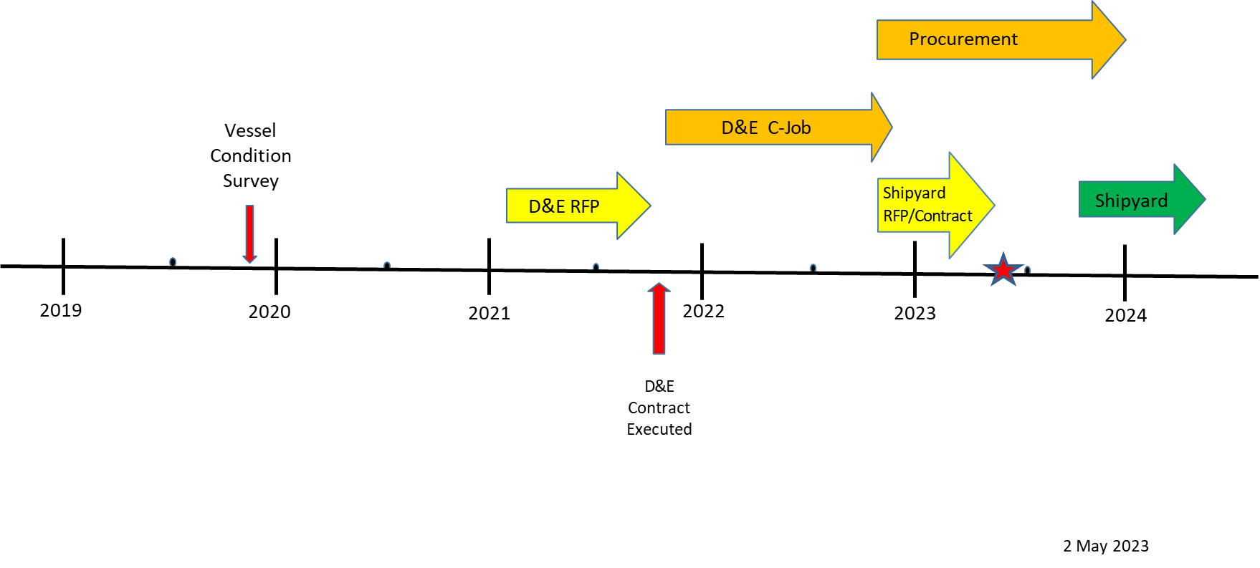
Timeline
Steering committees

Slide 3
Updates
Shipyard selected – total of 5 SY’s at site visit, 3 bids
Shipyard planned for October 2023 to April 2024
SOW “Finalized”
Long lead items ordered
  Main engines - delivery in August
  Generators – delivery in August
  Transmissions/controls – delivery in December
  Bow thruster – delivery by October

Slide 4
Service Life Extension - Refit
Resurface hull, decks, topsides, frames, bilges, tanks
Replace main engines, transmissions, and controls
Replace generators and switchboard
Replace bow thruster – increase tunnel dia from 16” to 20”
Sea chest modifications/repairs
Replace MSD
LED navigation lights
Wheelhouse window replacement
Door replacements

Slide 5
Science/Operation Enhancements
Main deck extension
Increase A-frame vertical clearance
Main deck ceiling and lighting upgrades
Laboratory upgrades
  New bench design
  Dedicated Tech space
Uniform deck socket pattern

Slide 6
Mid-life Cost Estimates
Description | Total
Condition Survey | $ 35,000
Architects - C-Job/Glosten | $ 456,404
Shipyard Purchase Order | $ 3,263,506
Owner Furnished Equipment | $ 683,446
Additional Costs (ABS, travel, gauging,etc..) | $ 701,400
Additional contingency | $ 408,500
Total | $ 5,548,256
Overall SY contingency of 30%

Slide 7


Acknowledgements
  NSF – Rose Dufour
  University of Georgia
  State of Georgia –B-budget
  University System of Georgia

