Slide 1
Major marine equipment suppliers are from all over the world.
Marine equipment is a specialty within the wider manufacturing industry due to the need to marinize products and systems to endure the harsh conditions found at sea.
Supplying the international maritime industry is a global enterprise due to international rules and regulations that set standards for everything from machinery to navigation equipment to lifesaving and firefighting equipment to seaworthiness and other issues to ensure the safety of life at sea and protection of the environment.
Decades ago, there was a robust US-based manufacturing sector to supply the US merchant marine. Over time however, and due to a variety of factors, the US merchant marine has contracted significantly with a corresponding reduction in the US-based manufacturers to supply it.
Most marine electronics (from Bridge radios and navigation receivers to engine control systems and sensors) now come from foreign manufacturers in Asia or Europe.

Slide 2
Heavy machinery such as engines, generators, motors, and propellers are produced globally.
There are a few US manufacturers still supplying the US market, notably engine manufacturers such as Caterpillar and Cummins.
While many of the heavy components such as engine blocks, heads, liners, and highly machined parts may still be produced in the USA, many of the sub-components and parts are produced as “OEM” parts in foreign locations and plants.
Some foreign factories producing OEM parts are owned by US companies, while others are third party factories manufacturing to the proprietary specifications of a US company.
Many foreign manufacturers have US subsidiaries to distribute their product in the USA.
A marine diesel that rolls off a production line in Indiana, South Carolina, or Texas is actually an assembly of parts from all over the world (the percentage of parts that are US-made is difficult to determine).
Foreign major systems providers (like Siemens, Wartsila, Kongsberg, Tees Whitegill, and Hundested – all in Europe) farm-out some portion of their manufacturing to other foreign countries.

Slide 3
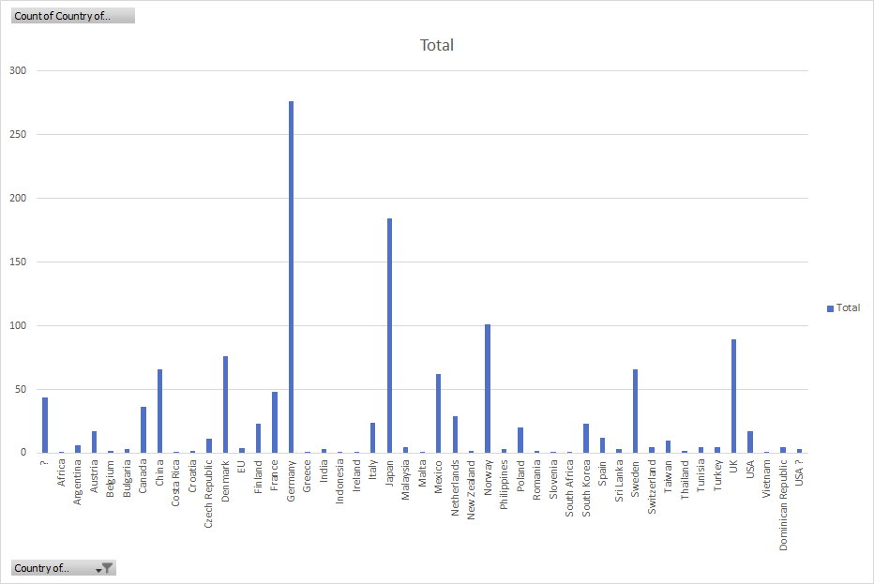
Plots show incidence of country names in BABAA inventory survey (includes manufacturing location and/or company headquarters).

