Slide 1
Update on Marine Scientific Research (MSR) Diplomatic Consent
Allison Reed, Amanda Williams, Elizabeth Buendia and Gabriella David
U.S. Department of State, Office of Ocean and Polar Affairs
May 2023
UNOLS RVOC 2023 Annual Meeting

Slide 2
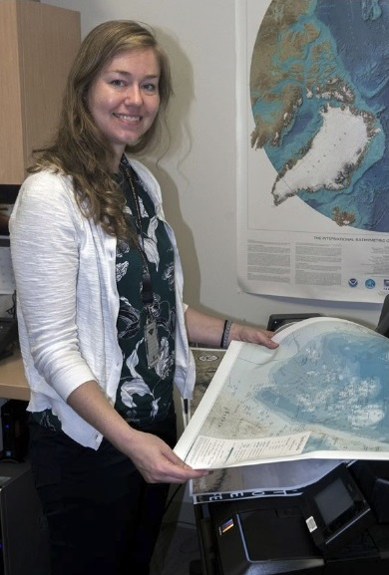
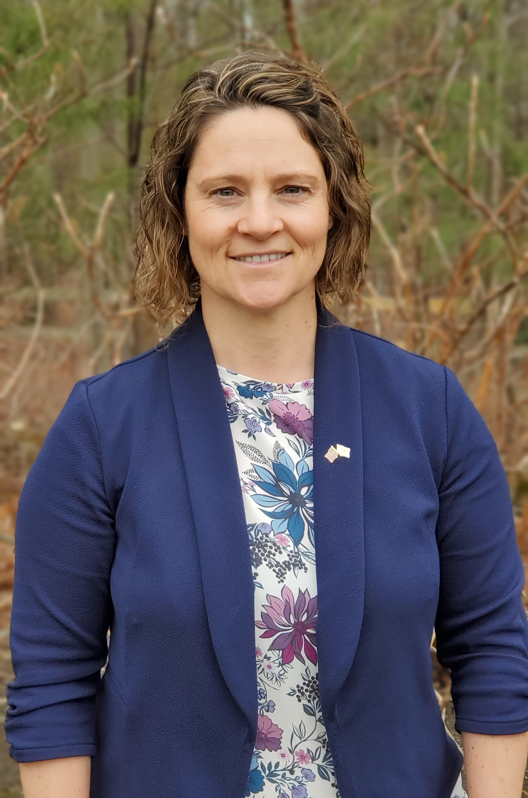
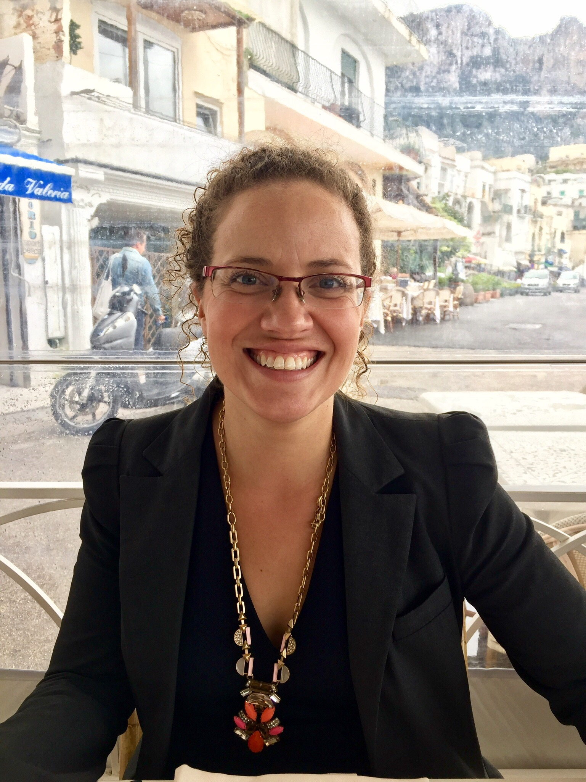
Your DoS MSR Team
Gabriella David
Elizabeth Buendia
Amanda Williams
Allison Reed
Suzanne Archuleta

Slide 3
Quick Refresher: MSR and LOSC
1982 Law of the Sea Convention
Article 238: right to conduct MSR
Article 245: coastal state jurisdiction over MSR conducted within territorial seas
Article 246: coastal state jurisdiction over MSR conducted within EEZ
Article 250: communications concerning MSR projects shall be made through appropriate official channels

Slide 4
Presidential Proclamation on MSR
Policy updated via Presidential Proclamation No. 10071 signed September 9, 2020:
Applies only to foreign scientists wishing to conduct MSR in the U.S.
Advance consent in all instances consistent with international law
In the U.S. EEZ and on the continental shelf (was always required in the territorial sea)

Slide 5
MSR Consent: It’s complicated…
Optics
Geopolitics (maritime boundaries)
Cannot rely solely on past practice- relationships and situations evolve
Diplomatic consent may be cumbersome, but it is necessary
Diplomatic consent is never guaranteed
We are involved for all of these reasons

Slide 6
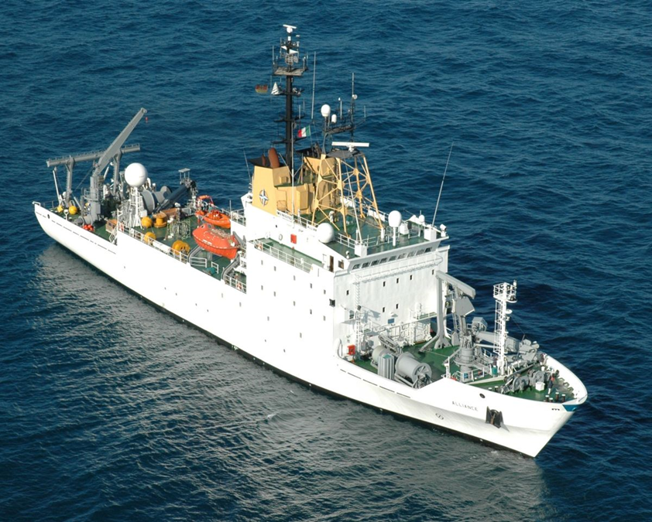
Who Requests MSR Consent?
Most Coastal States
Flag State of Vessel
United States
Nationality of Chief Scientist
Notes:
US = Chief Scientist Nationality

Slide 7
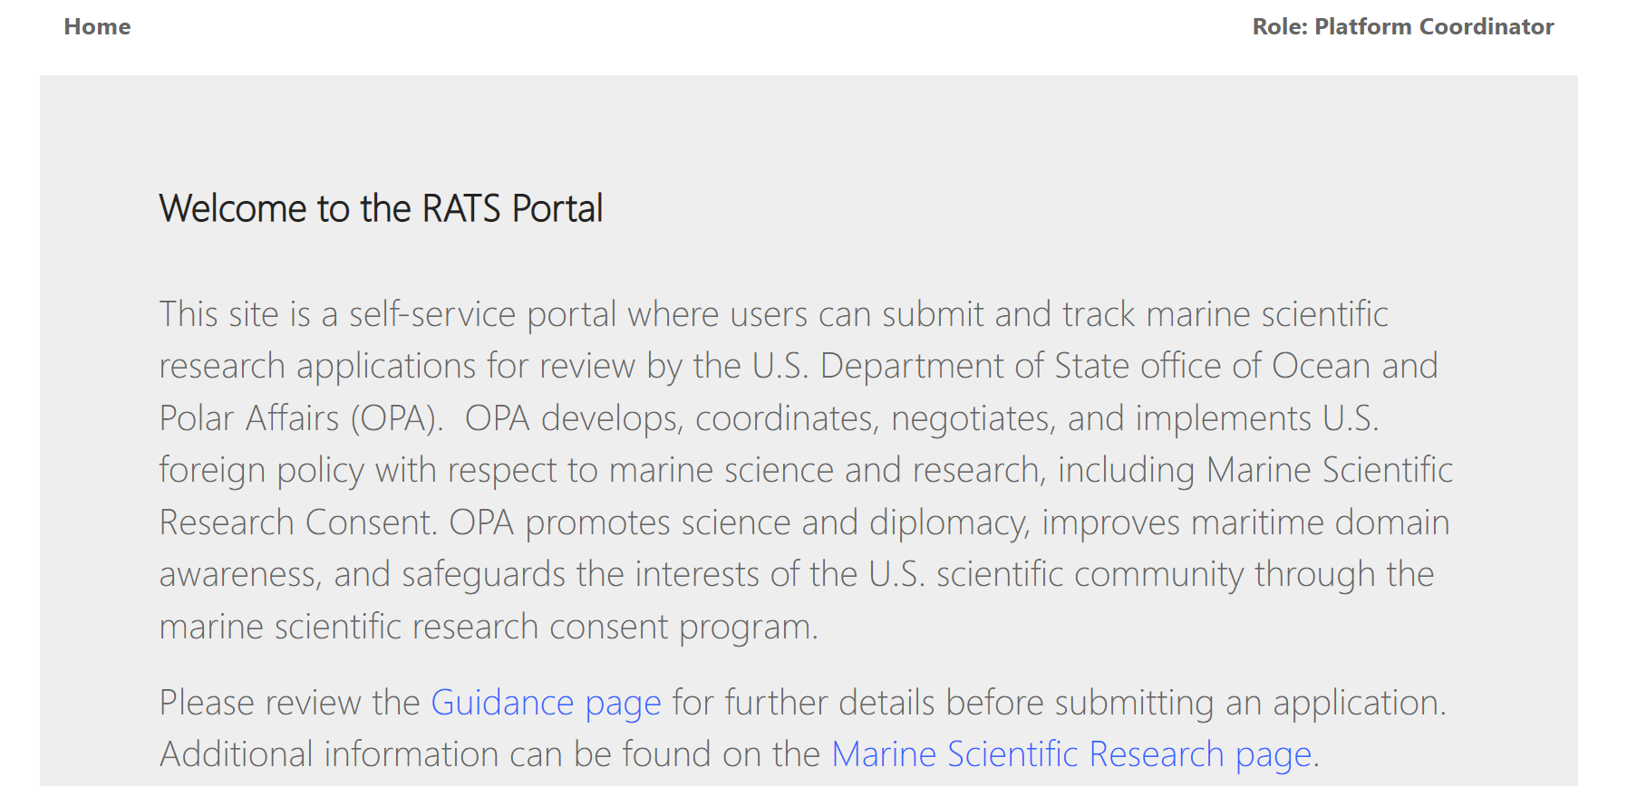
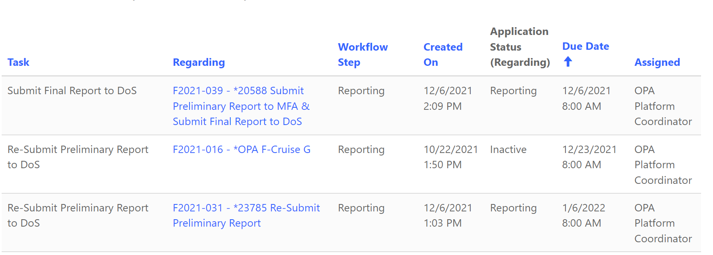
New RATS Portal
Designed on a Microsoft O365 cloud-based platform.
Several new features:
Online submission for new account requests,
Extra security (multi-factor authentication),
Automatic task reminders, and
Better search capabilities.
Please let us know if you would like to schedule a training!
RATS Portal: https://ratsportal.state.gov/

Slide 8
U.S. Scientists in Foreign Waters

Slide 9
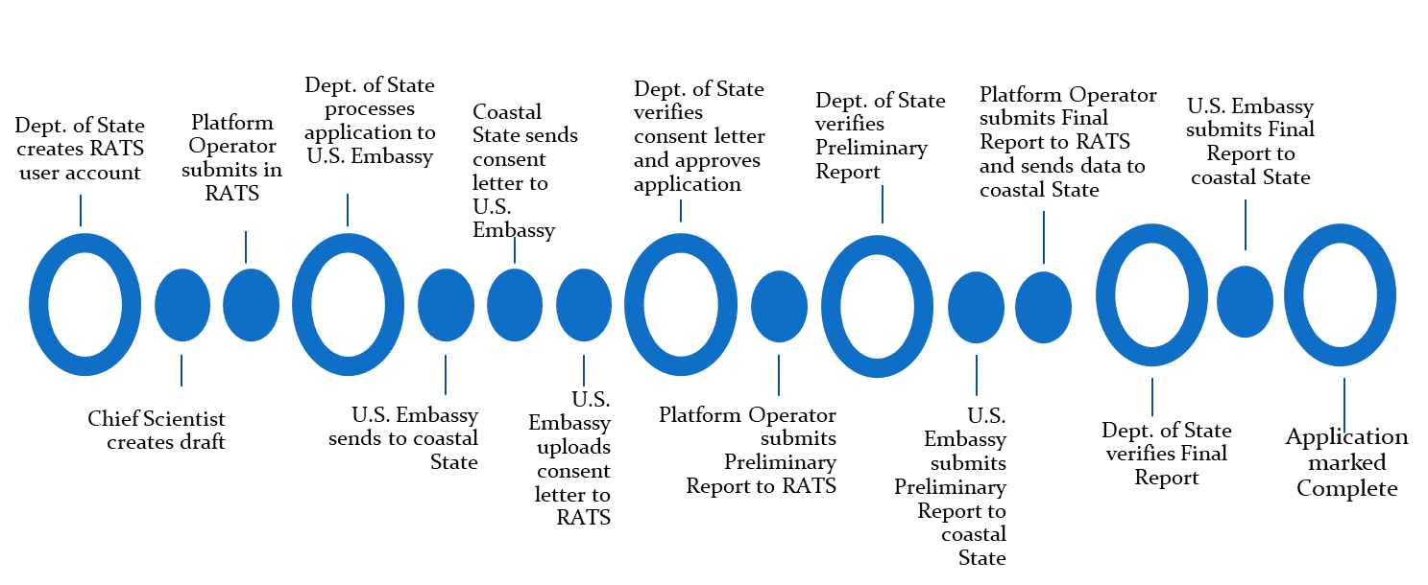
Process to Request MSR Consent for U.S. citizens in Foreign Waters

Slide 10
Trends/Challenges
Bureaucratic/Diplomatic Challenges
Applications due at least 6- 6.5 months advance, many coastal States firm
Increased scrutiny, evolving requirements, no uniform system
Late Reports/Data
Hundreds of late reports and data from U.S. scientists
Coastal States are asking – they can withhold consent from any U.S. scientist for another U.S. scientist’s late reports
NZ, Mexico, France, Costa Rica, United States, Canada, Bahamas, BVI, and Argentina may withhold/delay consent for outstanding reports.
Extreme Events
Hurricanes, COVID, etc.

Slide 11
More Trends…
The timing of requirement changes can be a challenge
Timing of quarantine, forms and documents for additional observers
Upward trend in requiring participants, which can present challenges
Clarifications from coastal states with more challenges with port call visits
Covid-19 safety protocols are still being requested along with additional insurance information.
Notes:
NZ, Mexico, France, Costa Rica, United States, Canada, Bahamas, BVI, Argentina

Slide 12
Coastal State Requirements
Please check the Marine Science Guidance Page for all new Coastal State updates and Covid-19 safety protocols.
Bahamas – has lifted the moratorium on sampling, but now has a new portal and fee structure for all marine science conducted in Bahamian waters. Contact marinescience@state.gov before applying.
Canada – January 2020 firm 6-month time requirement. Please see new guidance and requirements for any bathymetric data and overflight clearance.
Notes:
Barbados – review committee -> PM consent.

Slide 13
Coastal State Requirements
France
Preliminary cruise report must be sent between 1-3 months or 3-6 months after the end of the cruise, based on the Diplomatic Note.
The Final report must be sent within a year after the cruise has been completed.
If non-U.S. Flag vessel, provide proof of liability insurance.
Very strict on 6.5-month processing deadline.
Mexico – Over 30 additional forms and strict application and reporting deadlines.

Slide 14
Coastal State Requirements
St. Kitts and Nevis – Requires a separate application in addition to RATS application.
Kiribati – Fees due at time of application, additional application form required.
Japan – Increase in requirements. Now passports, crew lists, and detailed information and cruise tracks are required. Very strict 6-month processing deadline.
UK (all territories) – Now requiring applications to be submitted 6.5 months in advance and have outstanding reports submitted.

Slide 15
Helpful Tips
SUBMIT EARLY!!!!!
Talk to others for lessons learned
Build in time buffer (~1 week either end)
No maritime boundaries on cruise track
SUBMIT EARLY (7 months)
Sell your science-benefits (lay audience)
Outreach/engagement/public diplomacy
Engage local scientists
Follow up regularly on status of request
Timely submission of prelim report, final report, data
Did we say submit early?

Slide 16
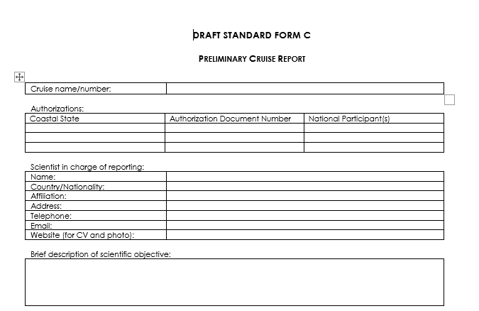
Outstanding Reports
State has ramped up efforts to improve reporting of foreign scientists who have conducted MSR in U.S. waters, and U.S. scientists who have conducted MSR in foreign waters.
In total, we estimate ~ 580+ prelim/final reports outstanding for all scientists in RATS.
Instructions for reports/data submission can be found in scientists’ consent letters/authorizations.
Coastal States have the right to withhold consent from any scientist on the basis of late reports. Please do your part and submit reports on time.
MISSING
MISSING
MISSING
Notes:
Hundreds of late reports and data from U.S. scientists
Coastal States are asking – they can withhold consent from any U.S. scientist for another U.S. scientists’ late reports

Slide 17
Resources
U.S. MSR Policy General:
https://www.state.gov/marine-scientific-research/
About the Research Application Tracking System (RATS):
https://www.state.gov/research-application-tracking-system/
**Documentation Required by Coastal State**:
https://www.state.gov/guidance-on-supporting-documentation/

Slide 18
Thank you!
MarineScience@state.gov
Notes:
Put the RAT.

