Slide 1
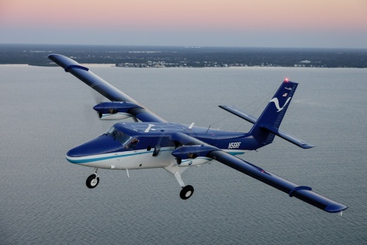
UNOLS Council Meeting
NOAA Update, May 2023
LCDR Cherisa Friedlander, NOAA
NOAA Office of Marine and Aviation Operations
Marine Advisor

Slide 2
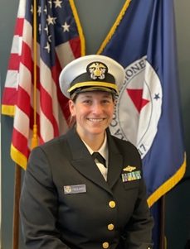
Hello! I’m New Here!
Just completed a 21 month tour in Washington D.C. serving as the flag aide to the Under Secretary of Commerce for Oceans and Atmosphere and NOAA Administrator, Dr. Richard Spinrad.
From 2019-2021, she was the Operations Officer aboard the NOAA Ship Henry B. Bigelow, a fisheries survey vessel out of Newport, RI.
Served as station chief of the Atmospheric Research Observatory at the South Pole, Antarctica from Nov 2017-Nov 2018. The 13 month assignment on the ice involved 6 months of darkness and 9 months of station isolation!
From 2014-2017 she served as the Operations Officer at the Southwest Fisheries Science Center, Fisheries Ecology Division in Santa Cruz, CA.
Master’s Degree in Applied Marine and Watershed Science from California State University Monterey Bay.

Slide 3
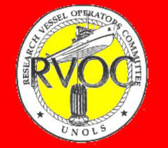
NOAA – UNOLS Partnership
Moving forward with year 5 of our Cooperative Agreement
COVID-19, Staffing Lessons Learned w/ Working Group
Fisheries Survey Vessels (FSVs) will be shifting into midlife/ service life extension periods starting in 2025
Likely increased interest in UNOLS ship time

Slide 4
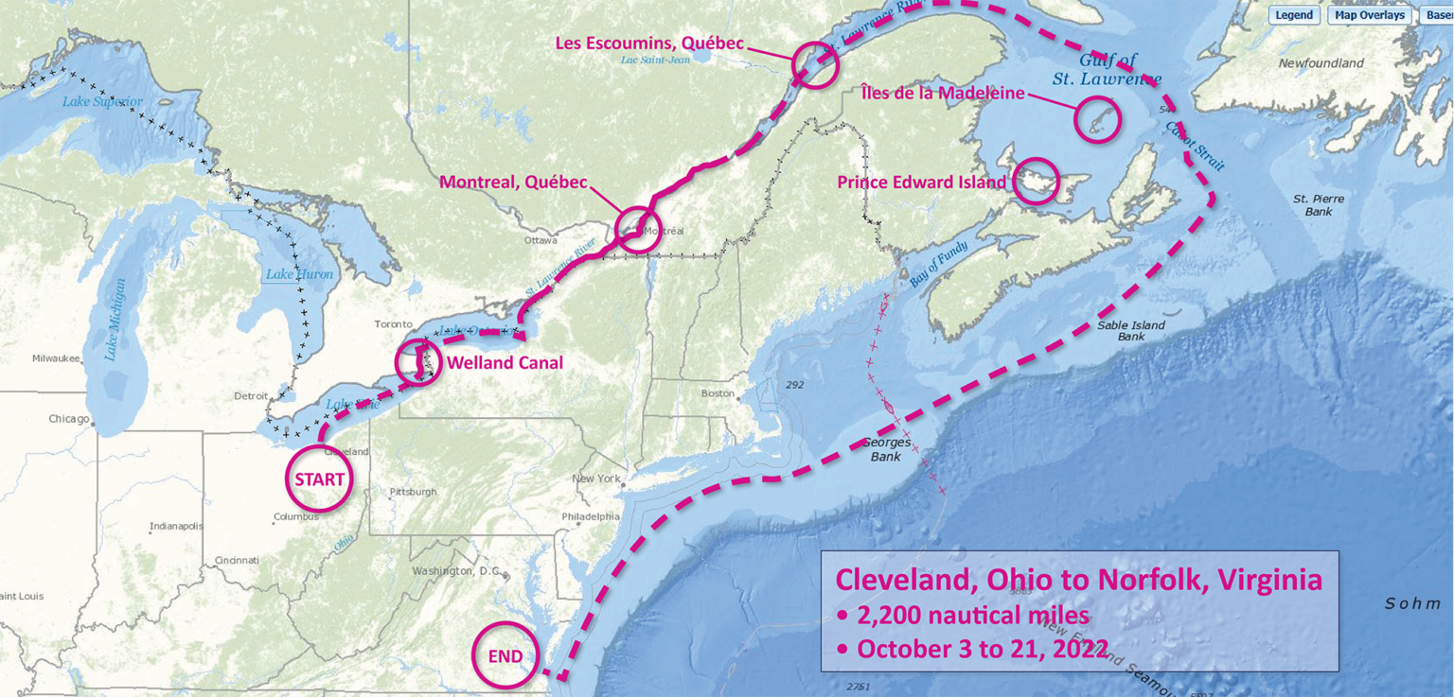
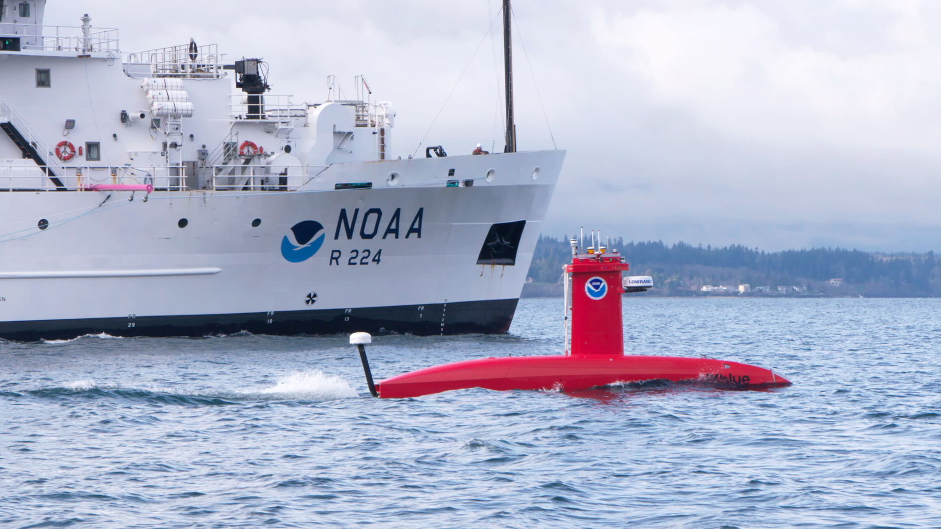
OMAO FY 2022 Accomplishments
NOAA Ship Thomas Jefferson completed productive field season
First deployment in Great Lakes region since early 1990s
Surveyed:
450 Square Nautical Miles of Lake Erie
274 Square Nautical Miles of Lake Ontario
Identified:
42 confirmed and new shipwrecks
22 additional features
Successfully deployed uncrewed system DriX
Established a Cadet Shipping Program with the U.S. Merchant Marine Academy
Notes:
The NOAA Fleet of 15 research vessels was very active in 2022 completing almost 2,000 DAS supporting 73 different projects for all parts of NOAA and our partners.
We collected fisheries data for pollock, hake, salmon, sardines, anchovies, shark, and over 20 groundfish species.
We resumed international operations on NOAA Ship Ronald H. Brown - which had been a huge challenge during COVID. Collecting international oceanographic data is vital to climate models.
Deep sea exploration resumed in the mid atlantic and caribbean with Okeanos Explorer positioning in the Pacific current and future year work.
The hydrography ships completed mapping missions around the tropical pacific, alaska, west coast, east and the Great Lakes for the first time in over thirty years.
NOAA Ship Thomas Jefferson (TJ) completed a productive field season in the Great Lakes, the first time a NOAA ship has been deployed there since the early 1990s, surveying 450 square nautical miles of Lake Erie, an economically important and ecologically sensitive region, and 274 square nautical miles in Lake Ontario.
More on UxS -
1,583 UAS flights across NOAA, all vetted and approved by UAS Division-- an all time record and representing an 18% (number of flights) increase over FY21
Couldn’t do it with out the industry and private sector partnerships
successfully completed the Ocean Aero demonstration with USM
UNH and DriX
Saildrone - wow what a patient company! Successes - collecting data in/around hurricanes and tropical pacific data
8 of UxS’ 9 high priority projects had successful field demonstrations of UAS and UMS platforms making significant progress towards routine operations
Personnel -
Staffing is hard
Throwing everything we have at this and in FY22 we issued recruitment bonuses for all positions, gained approval for a retention bonus, hired 109 professional mariners (thats one/third of the PM strength)...continuing to work on building partnerships such as through the Cadet Shipping Program at maritime academies.
It was a huge win working with this community to gain new shore leave authorities and we are working hard to implement that budget and policies permit.

Slide 5
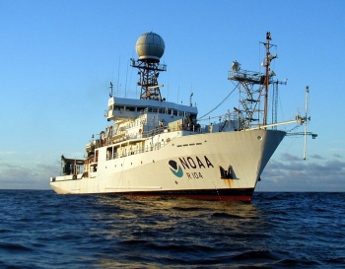
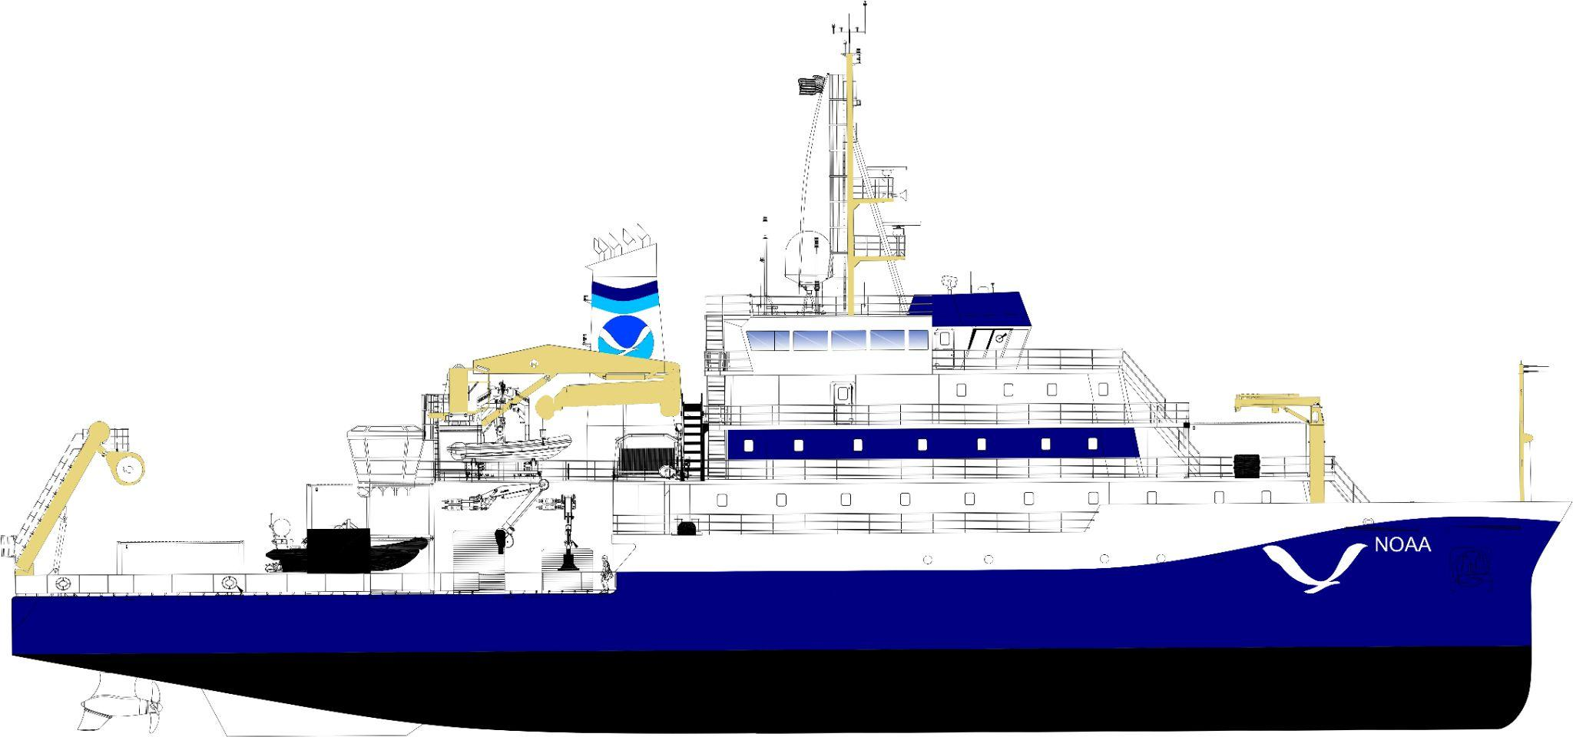
OMAO FY 2022 Accomplishments
Shipboard Energy Efficiency Management Policy Implemented
NOAA Ship Ronald H. Brown service life extension awarded
Fleet deferred maintenance reduced from $35M to less than $2M
Construction of two new oceanographic research vessels
Oceanographer and Discoverer
First planned vessel construction projects since the 2016 NOAA Fleet Plan was completed
Dive operations returned to pre-Covid levels in 2022.
Brought online new recompression chambers for remote diving, increased dive safety training and partnered with the U.S. Army on a pilot Hyperbaric Medical Tech course.
Notes:
NOAA and Thoma-Sea Marine Constructors, LLC held two keel-laying ceremonies in Houma, Louisiana for NOAA’s newest oceanographic research ships, Oceanographer and Discoverer, the first planned vessel construction projects since the 2016 NOAA Fleet Plan was completed. The Oceanographer will be homeported in Honolulu, HI, and the Discoverer will be homeported in New Port, RI.

Slide 6
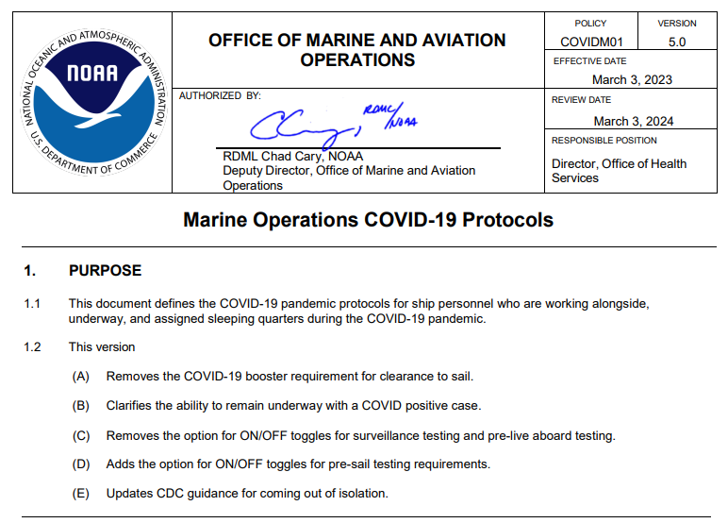
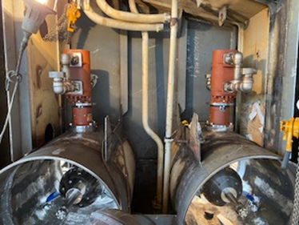
FY23 – In Progress
People
Initiatives to address staffing issues
Covid-19 protocol updated again
Stop surveillance testing
Recommended vs. Required booster
Metal
Class A – construction underway
Oceanographer has 86% steel cut overall with 67% structural assembly.
Discoverer has 40% steel cut overall and 19% structural assembly.
Class B (charting+mapping vessels)- Anticipated Q3 Award
Ronald H. Brown service life extension June 2023
2 Successful Machinery Control System installations on Pisces and Bell M. Shimada
New stern thruster installation on Okeanos Explorer
13 of 16 Ship Repair Packages Completed
Starlink rollout to fleet

Slide 7
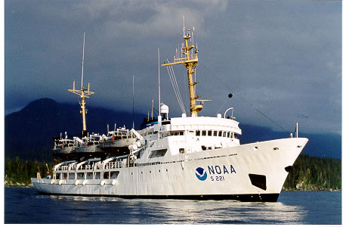
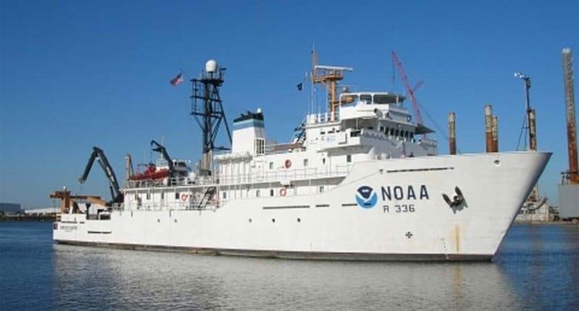
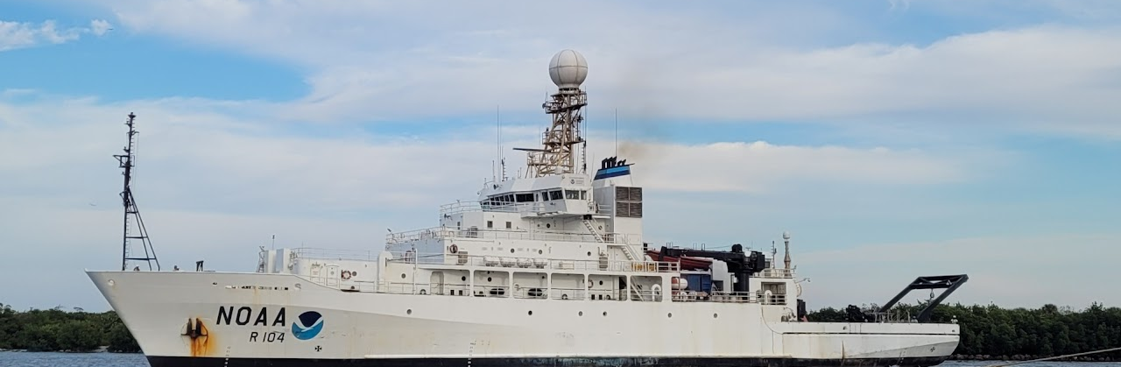
FY23 Continued: Mission
Rainier working in American Samoa
Oscar Dyson DriX operations out of Kodiak
Gordon Gunter working AMMAPS for the first time in 3 years
Ronald H. Brown GO-SHIP project (high profile worldwide initiative since 2018)
MOC-P support to UNOLS and Coast Guard vessels (CGC Elm support / CGC Halibut / R/V Sikuliaq). R/V Sally Ride / R/V Thomas G. Thompson on the schedule.
Notes:
Atlantic Marine Assessment Program for Protected Species
U.S. Global Ocean Ship-based Hydrographic Investigations Program

Slide 8
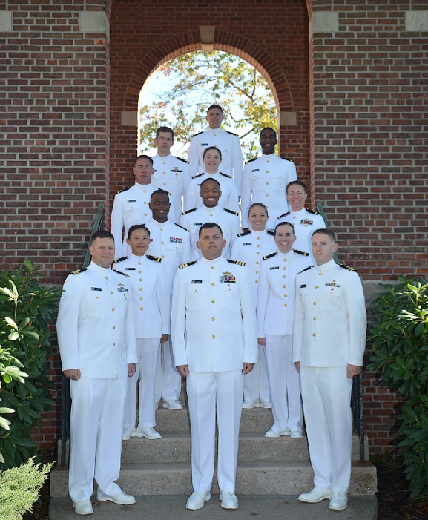
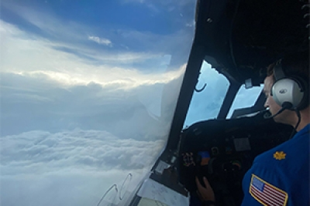
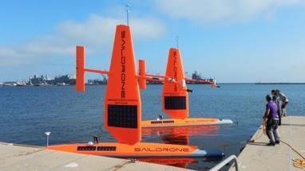
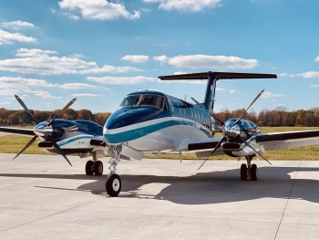
OMAO FY 2024 Priorities
The FY 2024 Budget Request provides $460.6 million for OMAO in discretionary accounts, $2.1 million decrease from the FY 2023 Enacted.
Increase NOAA Corps
Adopt New UxS Technology
Invest in Hurricane Hunters
Introduction of Oceanographer
Introduction of 3rd King Air
Notes:
NOAA products and services rely on NOAA ships, aircraft, NOAA Corps and UXS to deliver these to the nation
When/ if ships, aircraft and NOAA corps don’t show up where needed, the data Americans rely on every day for livelihood, don’t show up

Slide 9
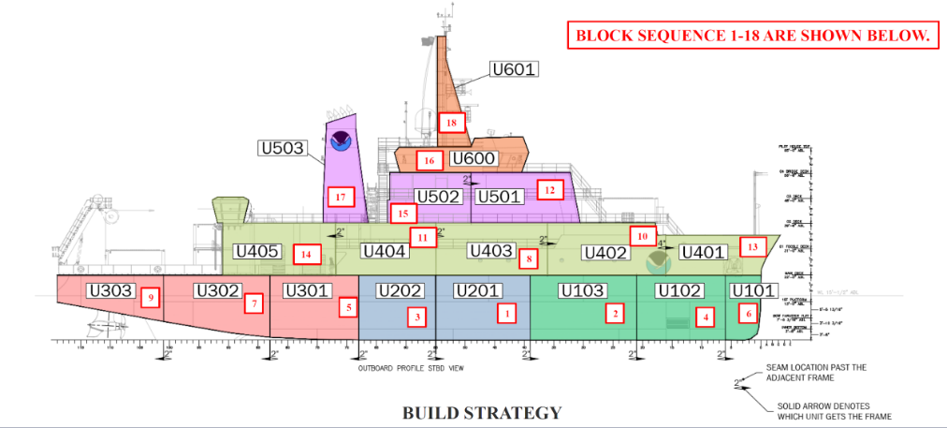
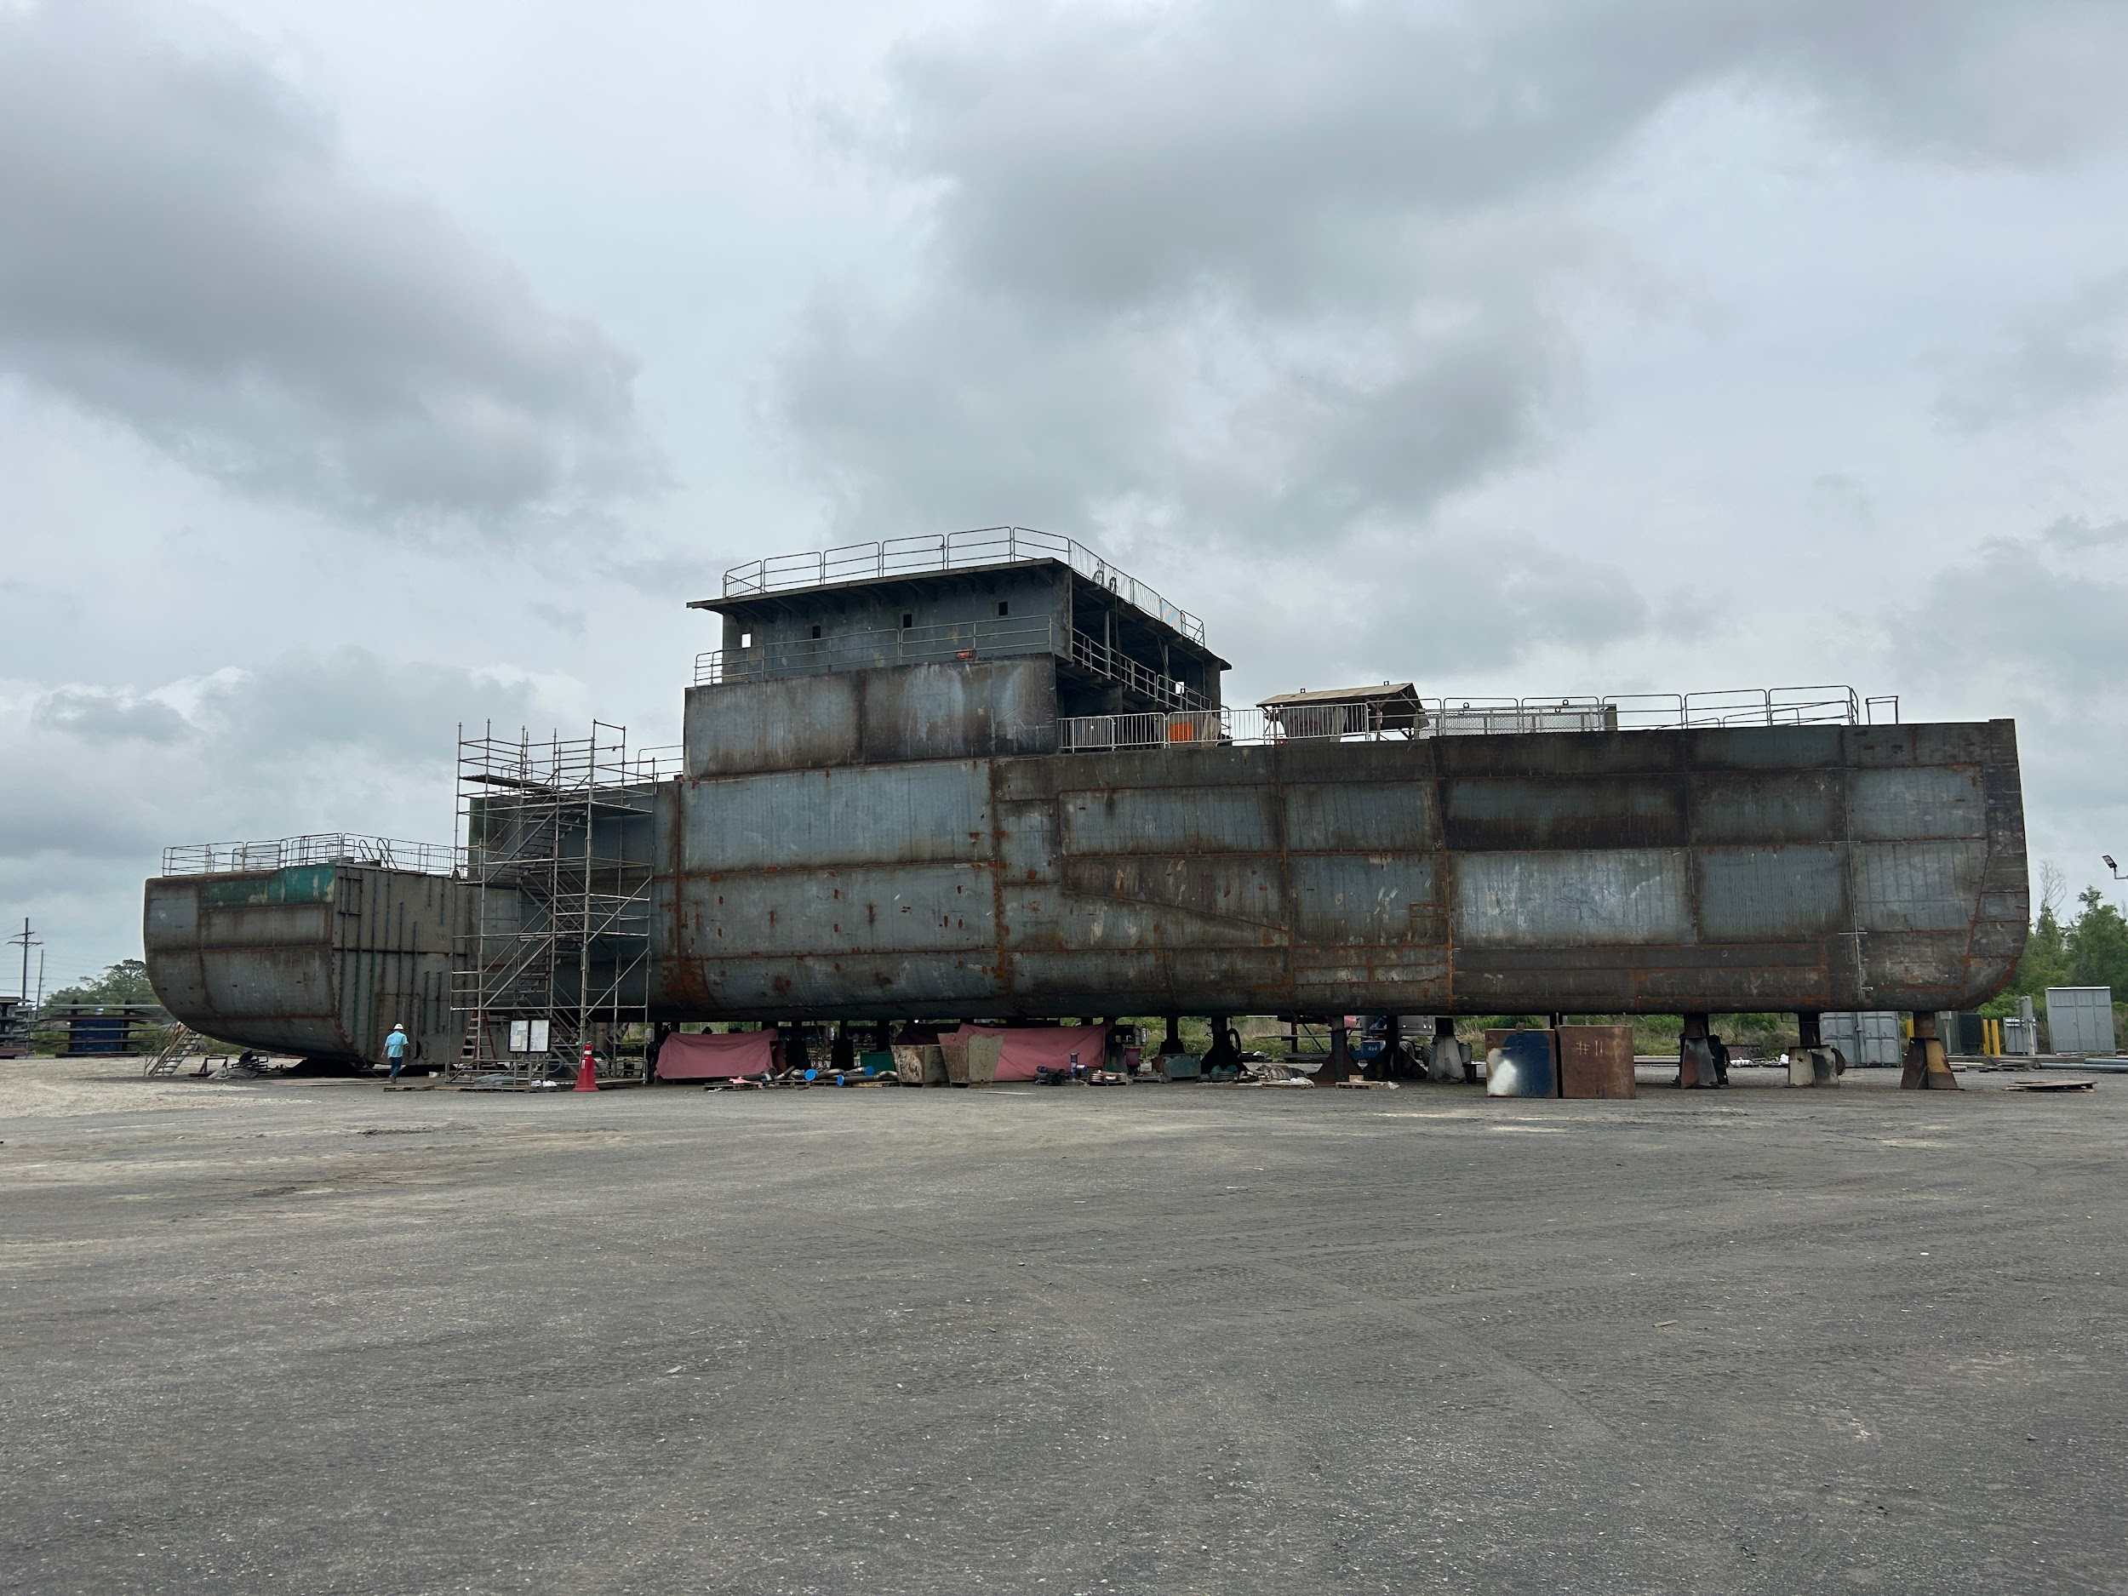
Ship Construction Updates
Ship Construction Updates:
Oceanographer
6 of 18 modules erected
15 of 18 modules in process

Slide 10
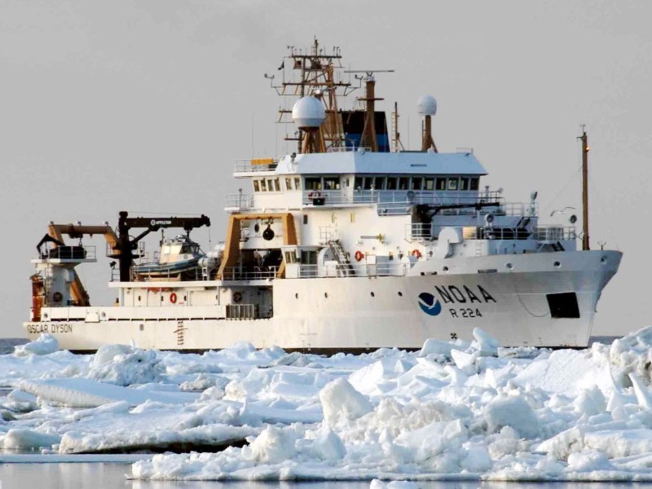
FSV Ship Life Extension Program (SLEP)
Primary Goals
Extend Service Life 20 Years
Reduce Carbon Footprint
Increase Reliability
Secondary Goals
Standardization
Serviceability
Regulatory Requirements
Notes:
Between 2025 and 2034 each of the five FSVs (Dyson, Bigelow, Pisces, Shimada and Lasker) will enter a ~18 month midlife repair (MLR) period.
DY Project Timeline
April of 2027 completion of OSCAR DYSON
Piecemealing Supporting Documentation to contracting.
General Specifications completed by 3/31/23.
85% Work items completed by 10/1/23.
100% Work Items completed by 12/31/23.
Final Review Specifications Submittal to Contracting by 4/3/24.
Drawing updates for contracting completed by Award Date of 4/3/25.
Contract Award 4/3/25
Shipyard Planning / LLTM 4/3/25 to 4/3/26
Industrial Period 4/3/26 to 4/3/27
Primary goals - Reduce carbon footprint, extend service life, increase reliability (people)
Secondary goals - Standardization (people), serviceability (people), regulatory
28 work packages -
Primary work package is to repower -
Request for Information (RFI) on SAM.gov for FSV Propulsion Repower options
Seeking market capabilities for alternative propulsion motor and drive units.
Siemens (only response)
BlueDrive 24P AC propulsion or BlueDrive PlusC DC Propulsion System.
Able to provide engines, generators, switchboards, distribution, propulsion, energy storage systems, alarm and monitoring system.
Could be standardized with new construction which would be beneficial.
Completed a study for energy efficiency and options for energy reductions -
All lighting converted to LED’s
More Power Management System (more efficient generators (tier IV with exhaust gas recirculation system), propulsion motors, integration)
Replace hydraulic winch systems with electric winch systems
Upgrades to HVAC systems
Evaluate propellor efficiencies vs. ICES goals
Crew Training
Acoustic quietness - still working this out!

Slide 11
Mid Life Repair: Ronald H. Brown
The overhaul is expected to extend the life of the vessel, first launched in 1996 (27 years old), by an additional 15 years to its originally expected 30 year service life.
Work is scheduled to be complete by summer 2024.
During the refit modification, the propulsion system will largely be replaced with new more environmentally friendly diesel generators, renewal of the bow thruster and propulsion motors, new switchboards, control systems, and alarms.
Additional ship systems that are scheduled to be upgraded include:
the potable water plants
sewage plant
uncontaminated seawater sampling system
HVAC systems
tank level indicators
navigational components
radar renewals
overhead lighting
ballast and exterior fuel tank vent renewals.
Bollinger will replace much of the ship’s piping, along with steel as identified by the American Bureau of Shipping (ABS).

Slide 12
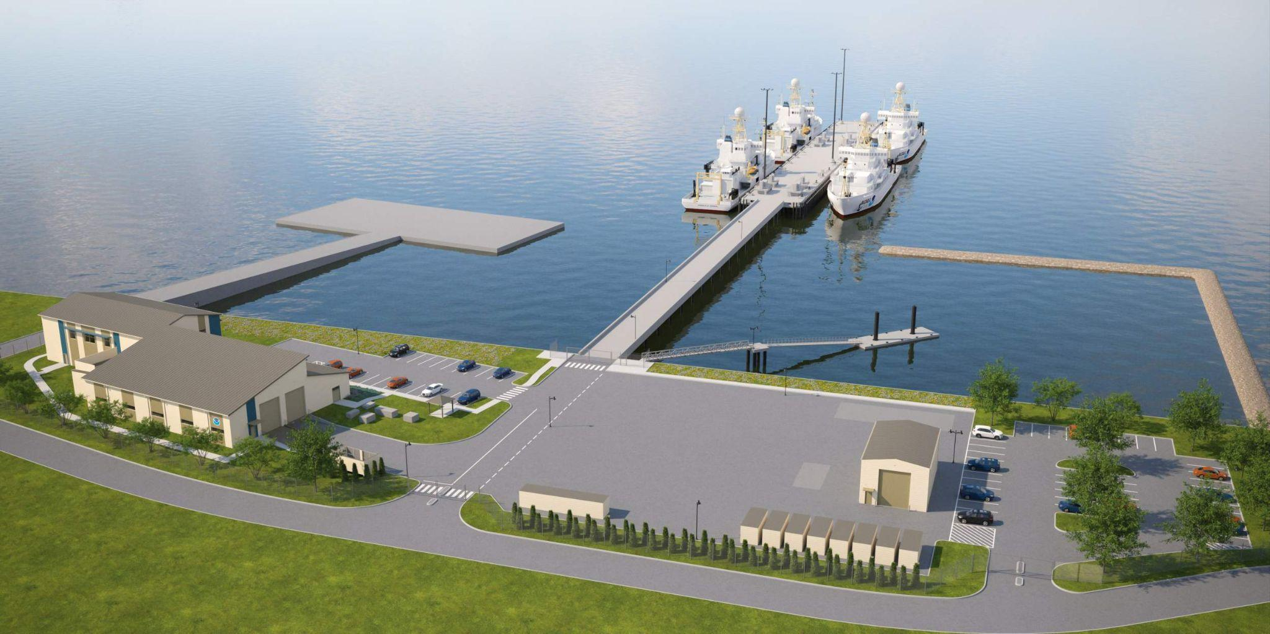
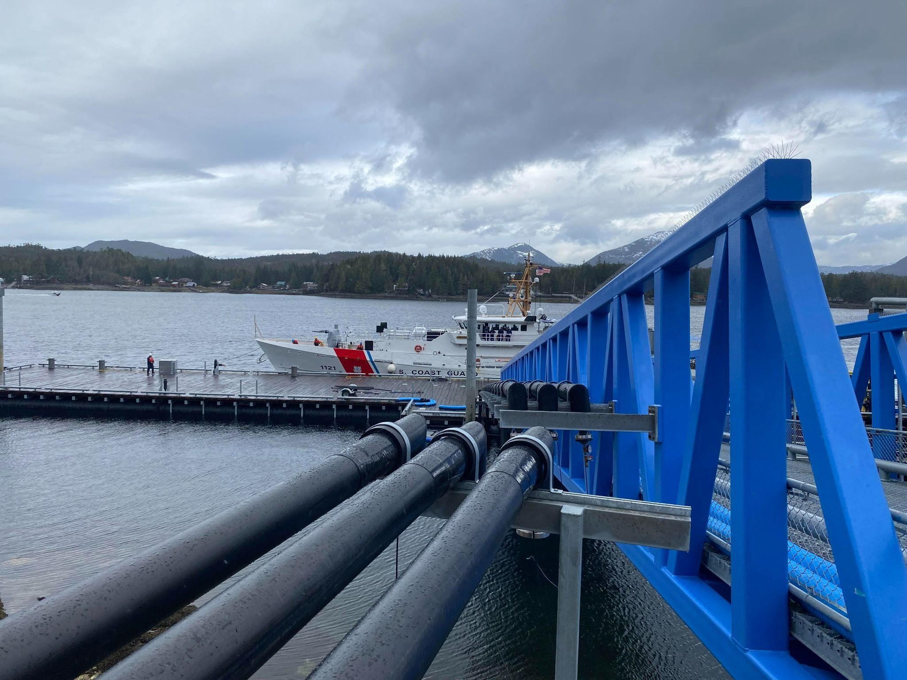
OMAO Facility Projects
Northeast and Mid Atlantic/ NAVSTA Newport
NOAA continues to support the NAVY project team in answering contractor questions.
100% Design completed. RFP for construction contract released January 2023. Contractor proposals are due on June 2023.
Southeast and Gulf Coast:
North Charleston, SC - Currently involved in the source selection process that will occur over the next few weeks.
Gulfport, MS - Short-term UMS facility established. Evaluating long-term facility lease proposal.
Northwest, Alaska, and Pacific:
Ketchikan, AK – Bull rail and bollards around the main pier are complete and ready to support vessel loading. The pier utility work is expected to continue through April and into May. Project completion at 90%. Size of waterfront ~300ft and can accommodate vessels roughly to that size.
Ford Island, Hawaii - Navy Piers used by NOAA require upgrades to support new vessels power, water, and sewer requirements. Piers are load restricted due to their condition. BCA study started in FY23 to determine best path forward.
Notes:
ADD IRA Bullet

Slide 13
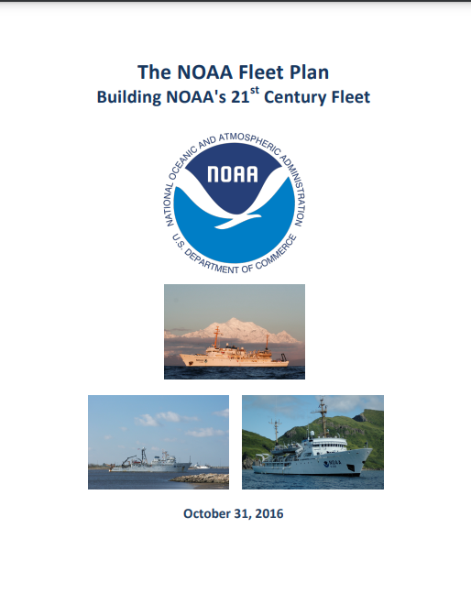
NOAA Fleet Recapitalization
NOAA Fleet Plan released to Congress October 2016
Updating the 2016 Fleet Plan
Working with the U.S. Navy to acquire 2 NOAA research vessels for the oceanographic mission
Will issue the contract for the next two charting and mapping ships in 2023
Working on requirements for the replacements of the smaller, trawl capable fisheries survey vessels
Notes:
Planning ( 10+) years vs Reality: No ships since ARRA
Plan NAV 1,2 Thomas Sea - cut steel June 15
Dynamic (B, C)- greater need
Primary mission:
Class A- Oceanographic monitoring, research, and modeling
AGOR variant- 240ft oceanographic collection in coastal and deep ocean
Class B- Charting and surveying-
Class C- Assessment and management of LMR (shallow draft, trawl capable)
Class D- Assessment and management of LMR (deep ocean/near shore, trawl capable, longer endurance)
Possibly FSV
2016 NOAA Fleet Plan Recommends:
Sustain capabilities with up to 8 new ships
Start now with AGOR design: meets requirements, known platform, leverages resources and time
Increase use of existing NOAA ships and small boats
Increase use of charters
Strengthen partnerships
Integrate emerging technologies
We do have an update that we are planning to route once the coordination across NOAA is complete.

