Slide 1
Presentation on High Seas Treaty or “BBNJ”
Also known as the international legally binding instrument under the United Nations Convention on the Law of the Sea on the conservation and sustainable use of marine biological diversity of areas beyond national jurisdiction
Allison Reed
May 17, 2023

Slide 2
Today’s Focus
History and structure of BBNJ Agreement
Key parts of the Agreement
Closer look at the Marine Genetic Resources provisions
Next steps
Q & A

Slide 3
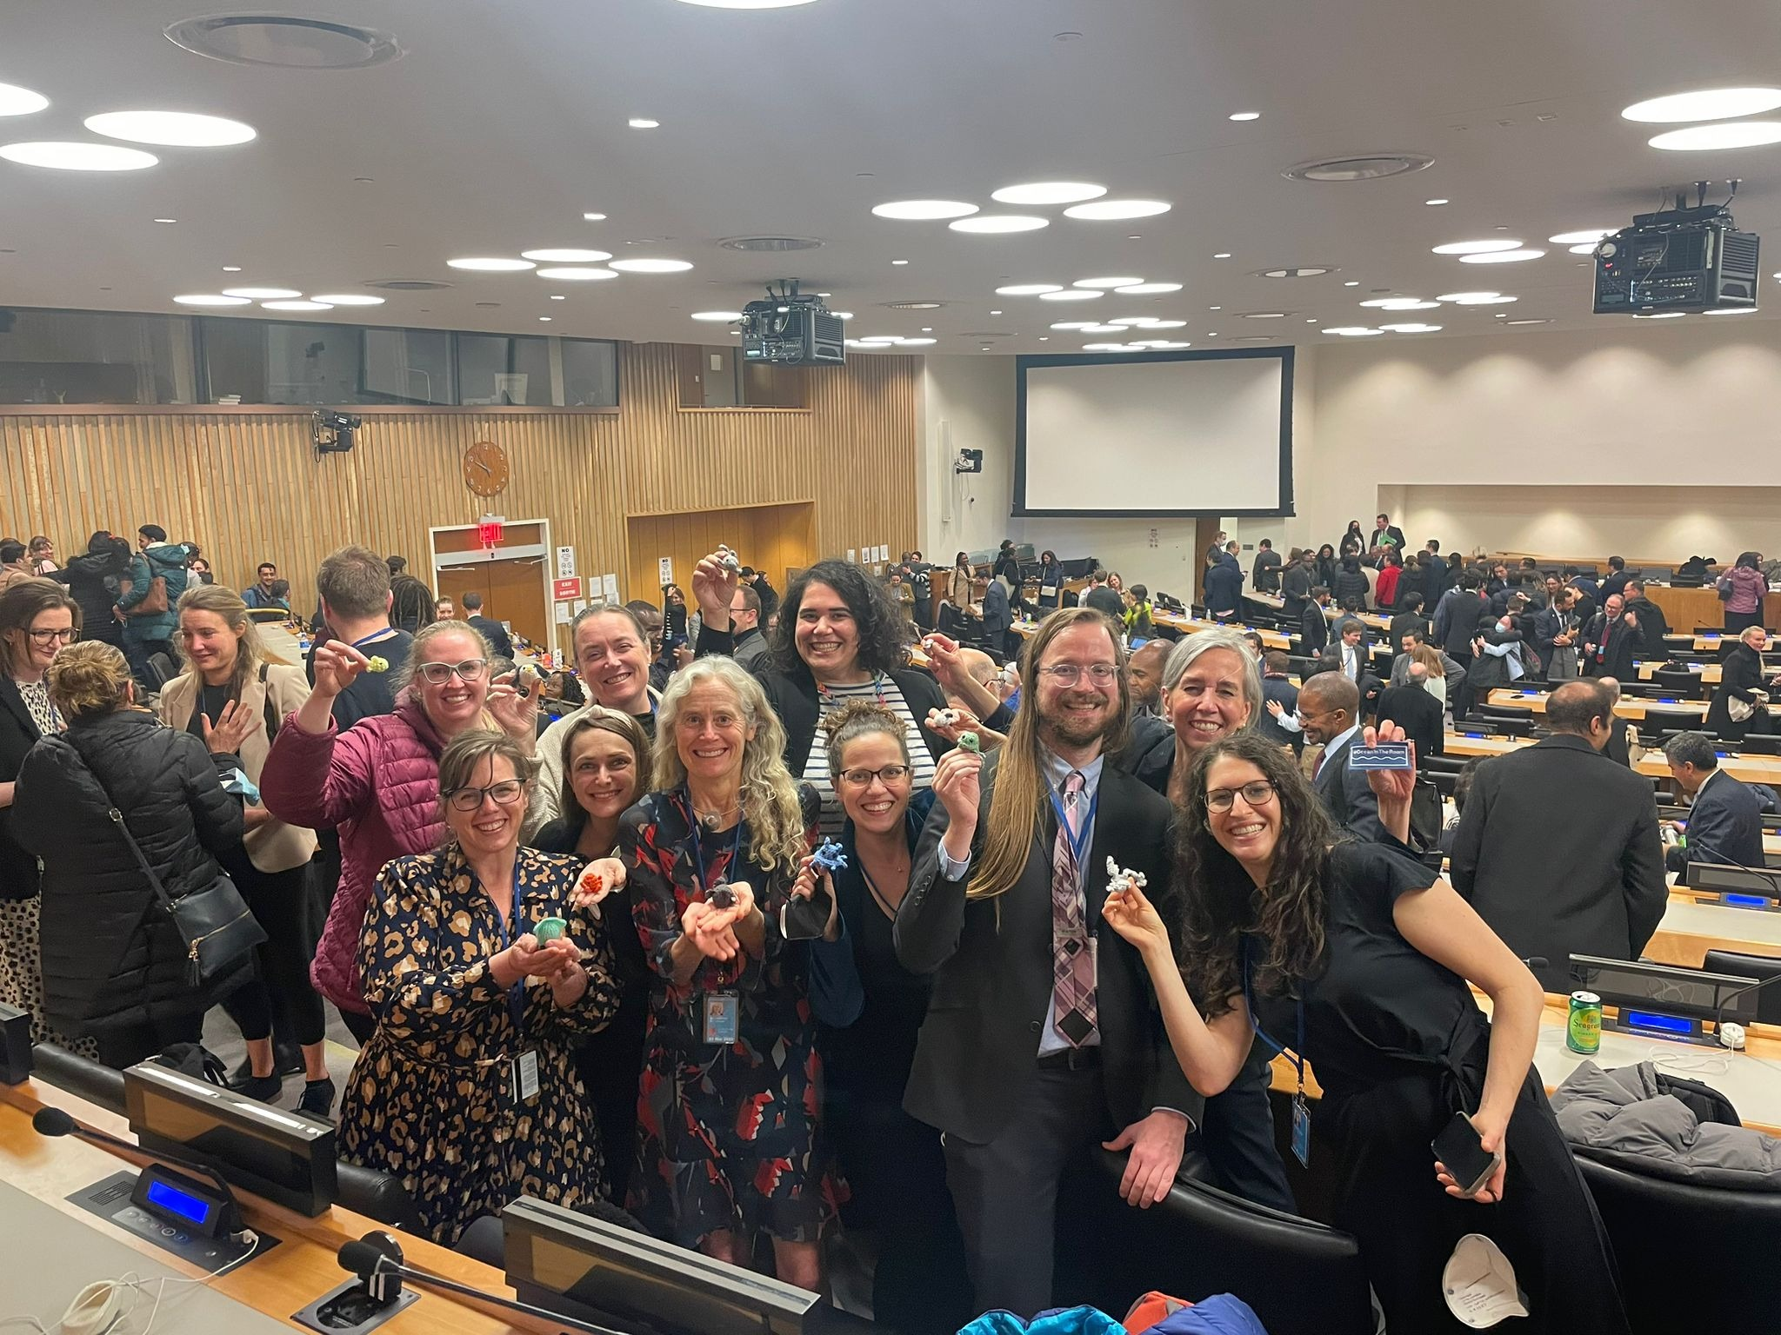
June 2015: United Nations General Assembly (UNGA) establishes a Preparatory Committee on BBNJ.
April 2018: IGC initial organizational meeting
September 2018: First session of the IGC
March - April 2019: Second session of the IGC
August 2019: Third session of the IGC
March 2022: Fourth session of the IGC (postponed due to COVID-19)
August 2022: Fifth session of the IGC
February - March 2023: Resumed fifth session of the IGC
BBNJ Agreement text finalized
(to be adopted by the IGC in June 2023)
December 2017: UNGA convenes an Intergovernmental Conference (IGC) to draft initial text

Slide 4
Structure of BBNJ: Four Agreements in One
Marine Genetic Resources, Including the Fair and Equitable Sharing of Benefits (MGR)
Environmental Impact Assessments (EIA)
General Provisions, Institutional Arrangements, Funding, Dispute Settlement, Final Provisions
Area-Based Management Tools, Including Marine Protected Areas (ABMT)
Capacity Building and Transfer of Marine Technology (CBTMT)

Slide 5
Key Provisions: Area-Based Management Tools
BBNJ establishes a collaborative, cross-sectoral approach to setting up ABMTs, including marine protected areas (MPAs) in the high seas.
An inclusive system of consultation
Provisions to establish ABMTs, including MPAs
Robust scientific assessment to inform decisions
Ability to make recommend-dations on measures where measures are within competence of existing body
Parties may opt-out of measures adopted by the COP on a limited number of bases
Ability to adopt measures where there is no existing body with competence to do so
Provisions for proposals for ABMTs/MPAs

Slide 6
Key Provisions: Environmental Impact Assessments
BBNJ establishes an EIA process for activities on the high seas that would bring other countries up to the standards of the United States.
Provisions for comprehensive and rigorous assessments of activities on the high seas
Provisions to harmonize BBNJ with EIAs conducted under other international bodies
State decision-making on activities on the high seas under their jurisdiction or control following an EIA

Slide 7
Key Provisions: Capacity Building & Transfer of Marine Technology
BBNJ outlines the process by which Parties (within their capabilities) must ensure capacity building and cooperate to achieve transfer of marine technology to developing States Parties to achieve BBNJ objectives.
A list of the types of capacity building that might be provided, ranging from research opportunities to technical training
Transfer of marine technology must be on fair and most favorable terms and on mutually agreed terms
Balance between the needs for CBTMT to implement the agreement and the need to protect the IPR of stakeholders

Slide 8
Key Provisions: Marine Genetic Resources
BBNJ creates a system for the fair and equitable sharing of benefits arising from activities related to MGR of ABNJ, such as collection, access to MGR stored in repositories, and utilization of MGR and digital sequence information (DSI).
A notification system for activities with respect to MGR and DSI
Non-monetary benefit sharing Access to samples of MGR or access DSI generated from MGR
Monetary benefit sharing Paid by developed States: 50% of, and in addition to, assessed contributions; option for the COP to determine an alternate monetary benefit provision in the future
Intellectual property rights (IPR) protections in three separate articles
NO language stating that MGR are the common heritage of mankind
NO definition of DSI; clarity that MGR and DSI are distinct from one another

Slide 9
MGR Notification System
Basic information is shared to the BBNJ Clearinghouse Mechanism before collection such as geographical areas, methods of collection, the dates of collection, opportunities for collaboration by other States, and a data management plan
Pre-collection Notification
Post-collection Notification
Post-collection information via a report that is shared to the Clearinghouse, along with information on where MGR samples and digital sequence information from such MGR will be held
Utilization Results
Information regarding where results on utilization of MGR and DSI of MGR can be found, if available

Slide 10
MGR Benefit-Sharing Provisions
Non-Monetary Benefits
Monetary Benefits
Alternative: future COP decision; take into consideration benefit sharing mechanisms in other fora (e.g. CBD)
Generally what already occurs, such as providing access to MGR samples or DSI from such MGR in accordance with current international practice
Initial: 50% of assessed contributions (not linked to an activity)

Slide 11
Next Steps
Now: Technical scrub of the final text and translations (at UN)
June 2023: Adoption of the final text by IGC
Analysis of domestic implementing authorities by the interagency
Interagency process on determine next steps
September 2023 (tentative): Agreement open for signature
Entry into force after 60 ratifications

Slide 12
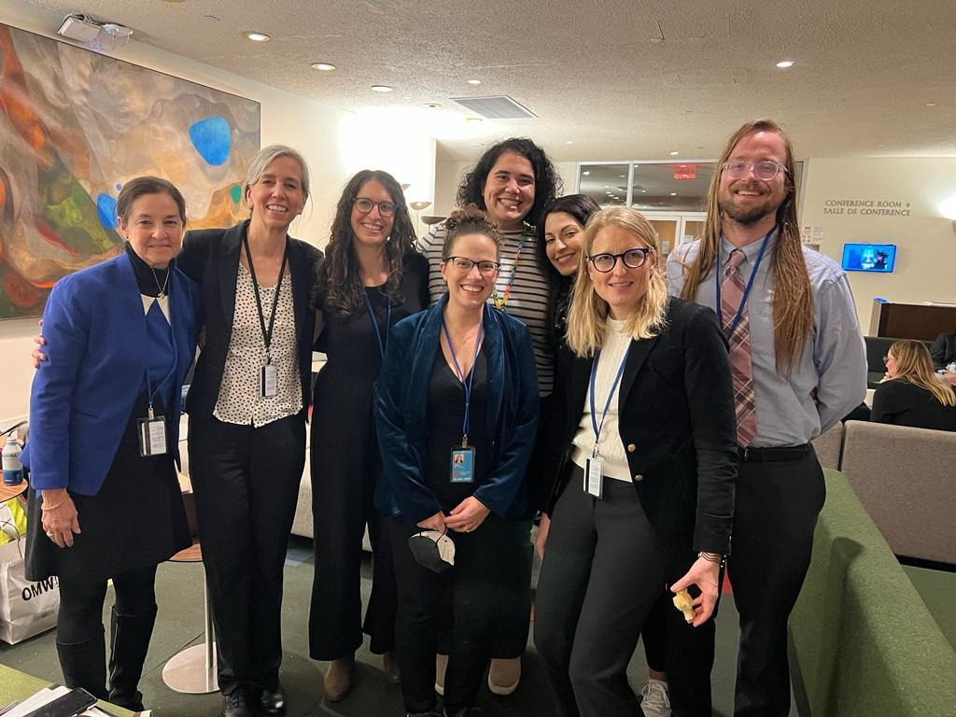
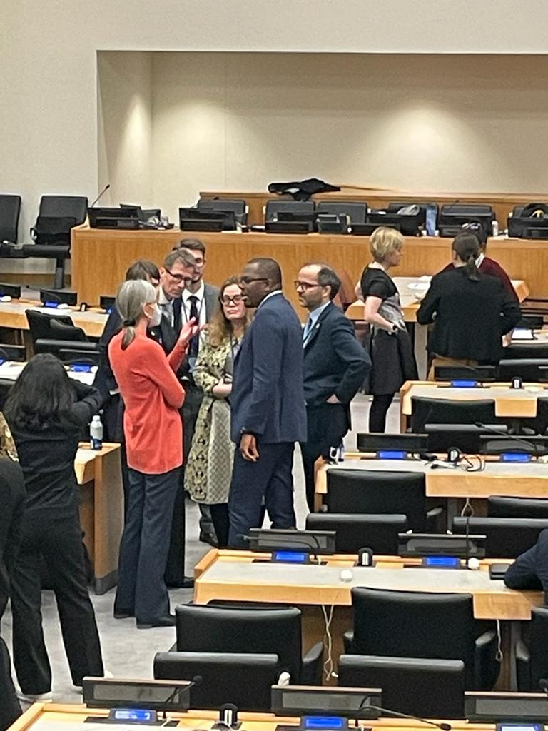
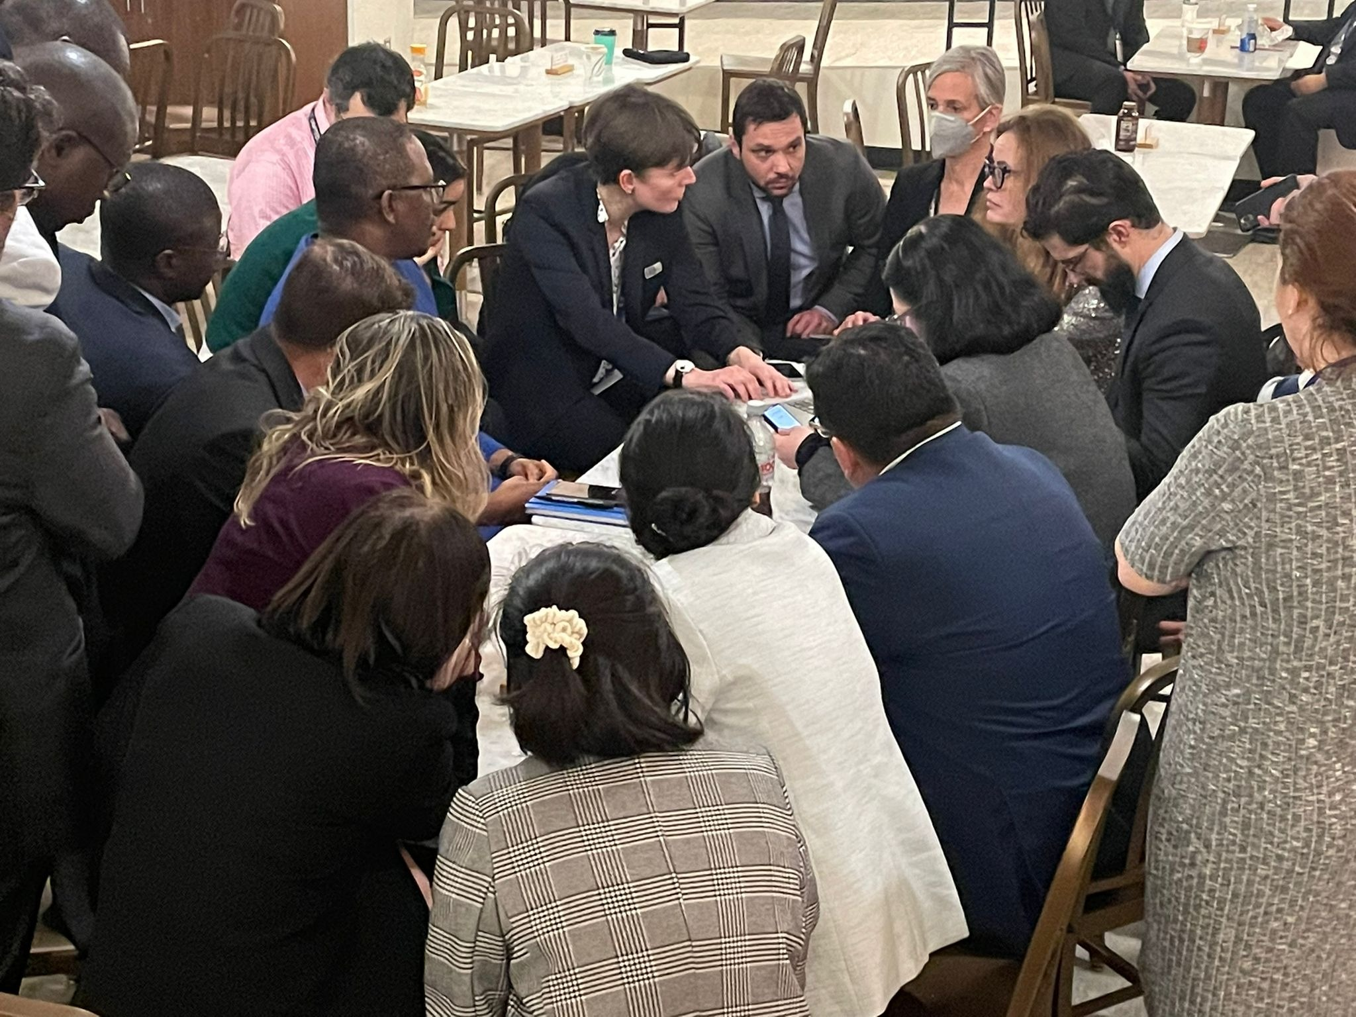
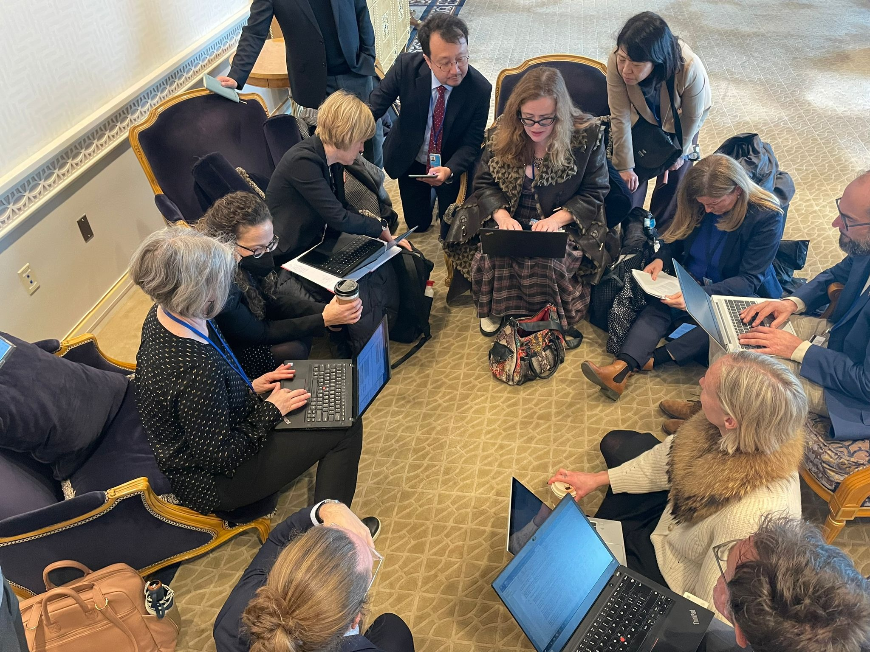

Slide 13
Questions?

