Slide 1
SHIP OPERATIONS NATIONAL OCEANOGRAPHY CENTre

Slide 2
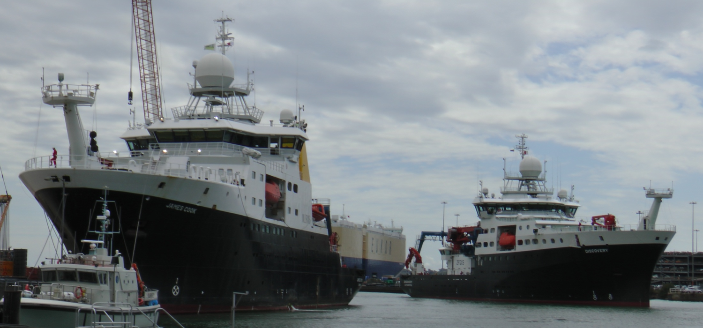

Slide 3
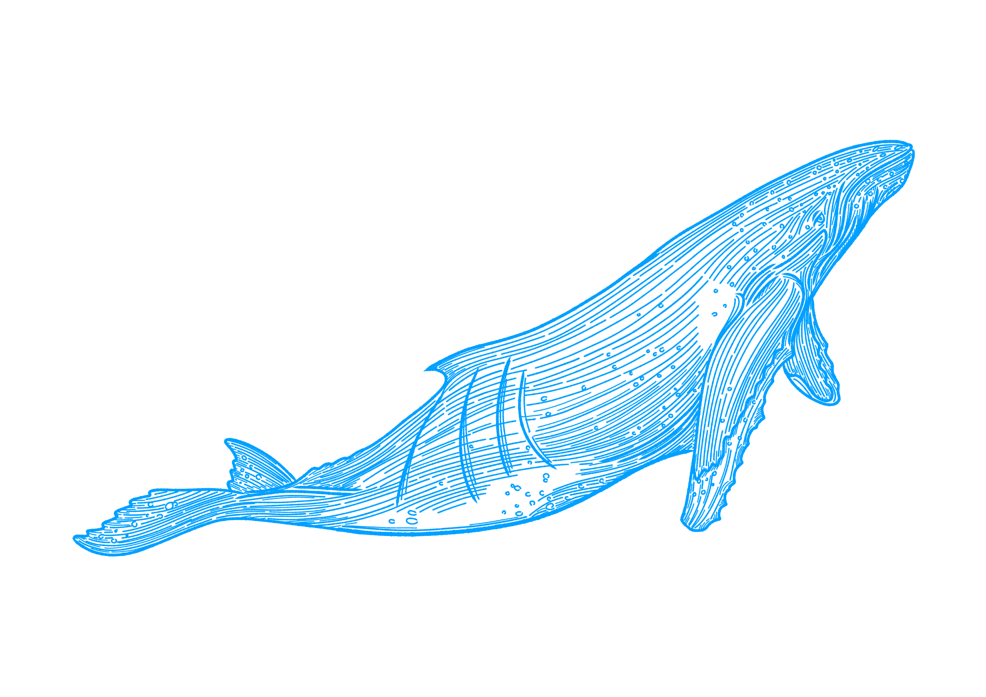
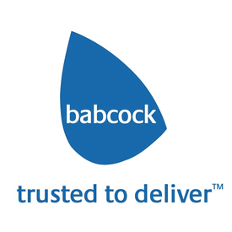
what’s new ?
New Branding and Logo. Designed to show 30% of world is land and 70% made up of seas and oceans. 'Go Deeper – Our Purpose and our Vision'
Plan to trial HVO (Hydrotreated Vegetable Oil) as a drop in fuel on board James Cook as part of NZOC (Net Zero Oceanographic Capability) process to reduce carbon emissions from our Research Vessels.
New Shiprepair contract Babcock Rosyth Scotland at least three years for RRSs Discovery, James Cook and Sir David Attenborough

Slide 4
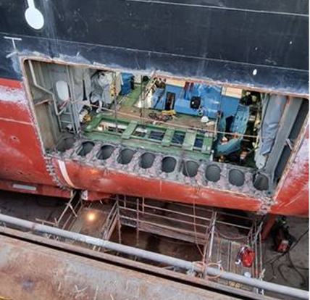
SOME HIGHLIGHTS SINCE WE LAST MET –unplanned overhaul PORT PROPULSION MOTOR RRS JAMES COOK
James Cook –insulation readings on Port Electric Drive Motor fell to 0.3 ohms
An in situ clean of the motor was carried out in planned drydocking July\August 2021 but unsuccessful so only action was removal
With such a large motor the only way out was through the side of the ship
Insulation restored 2Gohms
Maintenance and removal Stbd motor scheduled July 23

Slide 5
COVID-19
Vaccinations
Fundamental to NOC Approach
2+1 Dose (UK) or 'fully vaccinated' status (Non-UK vaccination programme)
No exceptions
Covid-19 management onboard
All to LFT test within 24hrs of joining if sailing
Positives to self-isolate in cabin until 2 x negative LFTs or disembark
We will / do sail with Covid onboard
Impact of Pandemic
A lot of re-programming (a lot!)
Focused on UK to UK expeditions in 2020-2021
2 cruises lost (Galapagos and UKOT in Atlantic)

Slide 6
SCIENCE PROGRAMME 01 Apr 22 – 31 MAr 23

Slide 7
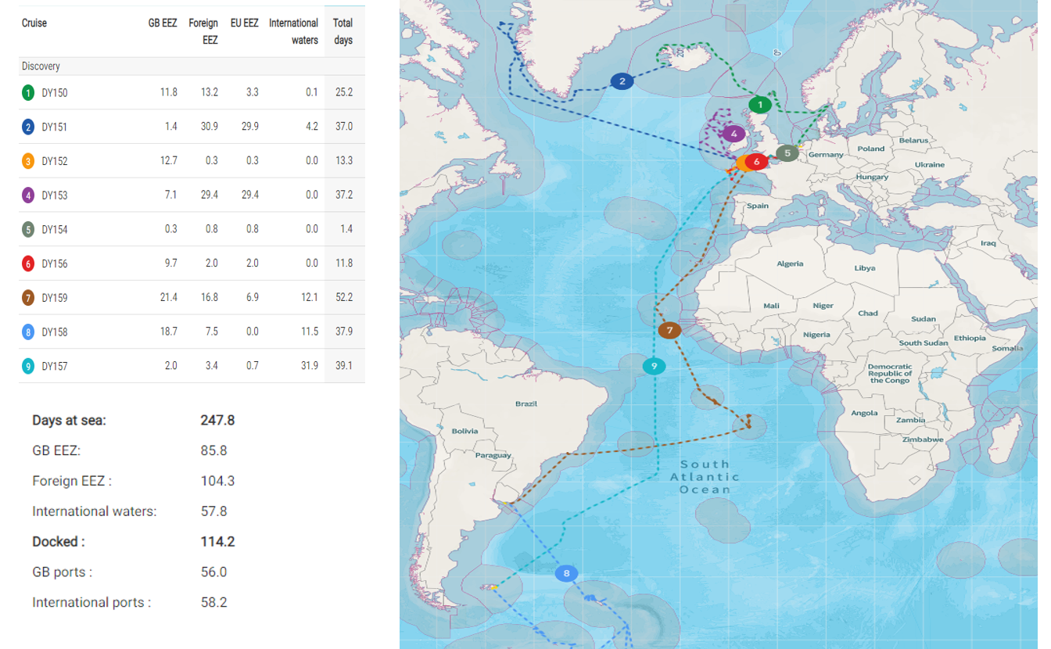
RRS DISCOVERY EXPEDITIONS –2022 / 2023

Slide 8
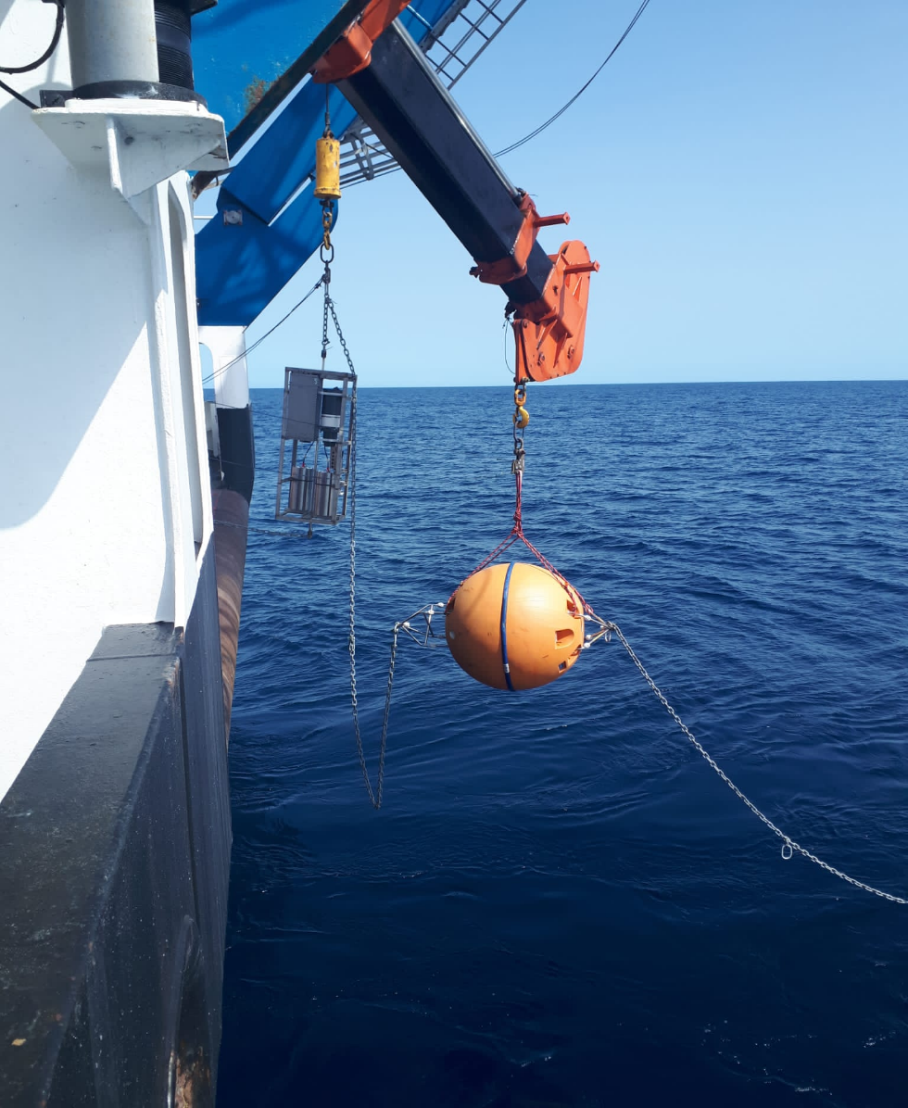
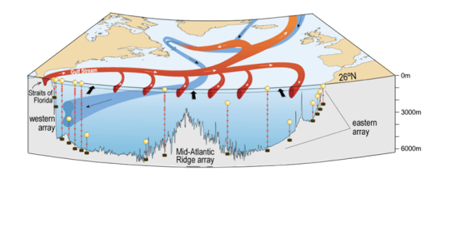
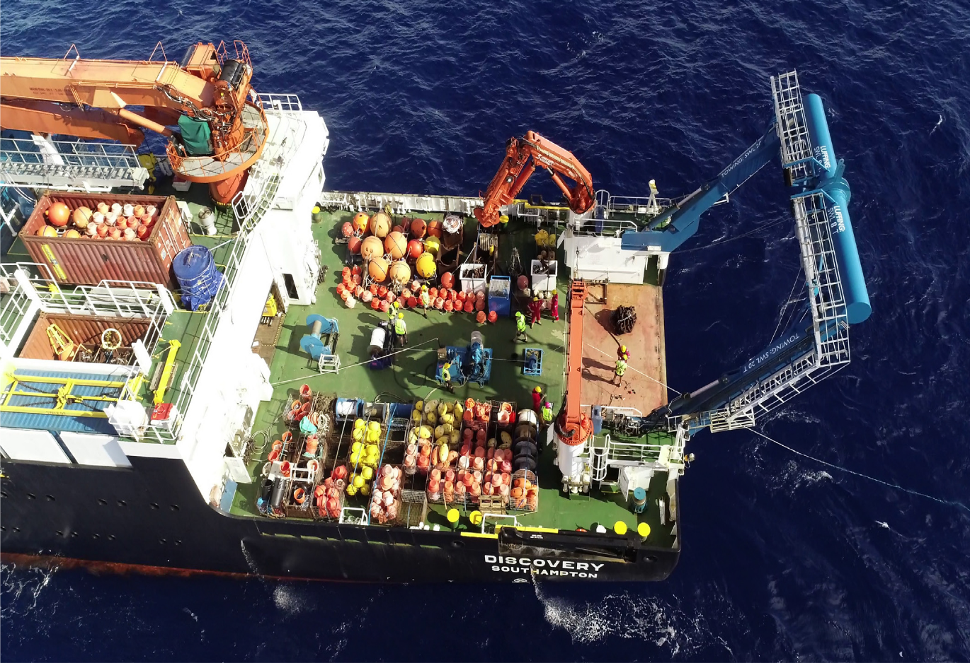
RRS DISCOVERY – The RAPID ARRAY
Started the Year by Servicing Eastern Boundary RAPID Array
A series of oceanic moorings maintained in collaboration with University Miami and NOAA
At 26N they extend from Morocco to Florida
Recover, service, replace moorings by day and up to ten CTD casts each night

Slide 9
RRS DiscoverY - study of Atmospheric Emissions from ships
Mobilised in Reykjavik for SEANA (Shipping Emissions in the Arctic and North Atlantic)
General location Baffin Bay/Labrador Sea/Eastern entrance to North-West Passage
SEANA - Shipping Emissions in the Arctic and North Atlantic Global shipping is undergoing significant changes. In January 2020 the maximum sulphur emission by ships in international waters will reduce from 3.5% to 0.5% by mass, as a result of new International Maritime Organisation (IMO) regulations. Superimposed on that, changes in Arctic sea ice are opening up new seaways enabling shorter sea passages between key markets.. There exists a short window of opportunity to define current atmospheric conditions, against which the impact of these changes must be determined.

Slide 10
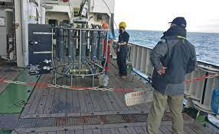
Discovery- BLT (BOTTOM BOUNDARY Turbulance SERIES)
Mobilising in Southampton with science undertaken in the Rockall Trough including a mid-expedition port call in to Killybegs, Eire. Part of a NSF / NERC Funded project that involved Scripps and WHOI.
US Moorings recovery and deployment of OTIS (Ocean Tracer Injection System) close to the ocean floor
Deploy ADCP measuring currents and up to 100 CTD

Slide 11
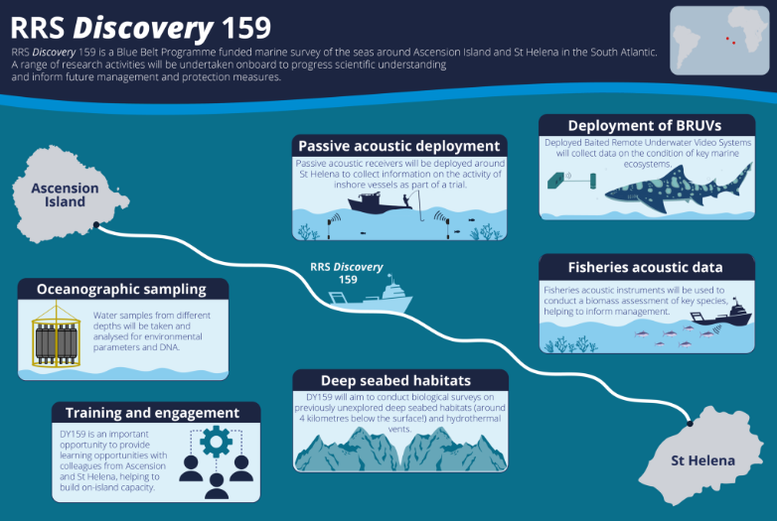
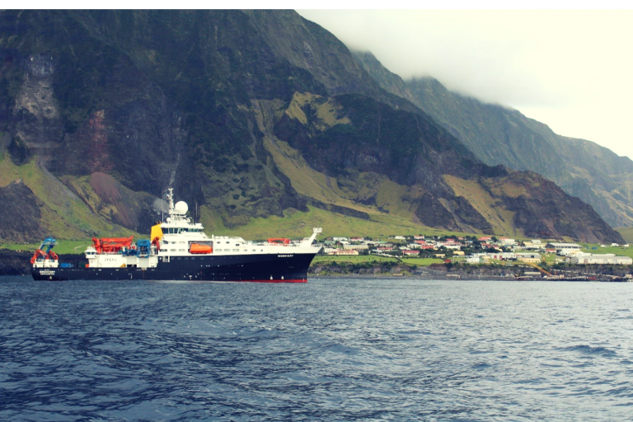
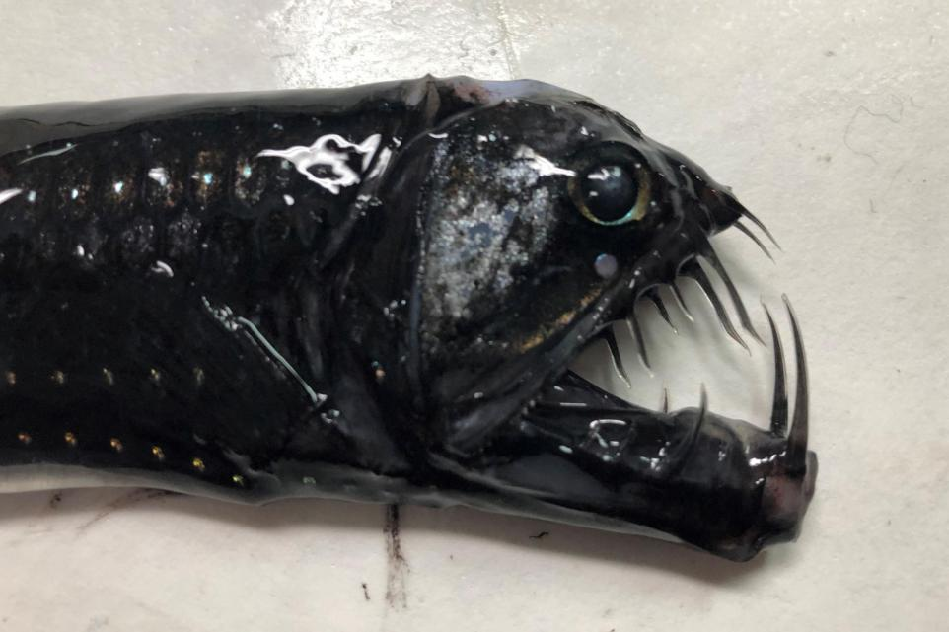
RRS discovery - Cefas blue belt big ocean survey Southampton~Ascension~Saint Helena~MONTEVIDEO

Slide 12
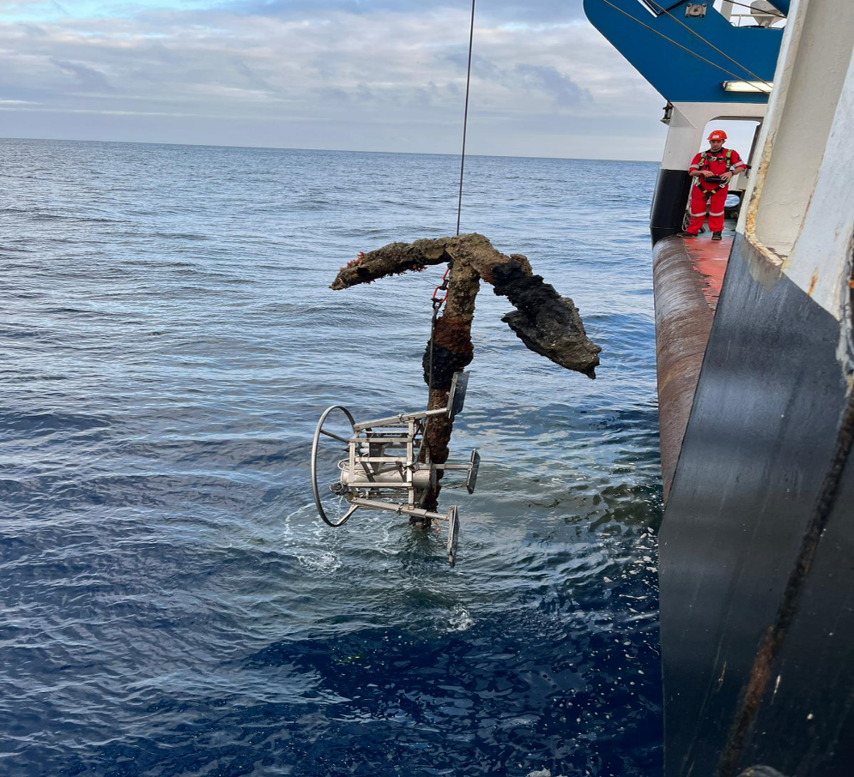
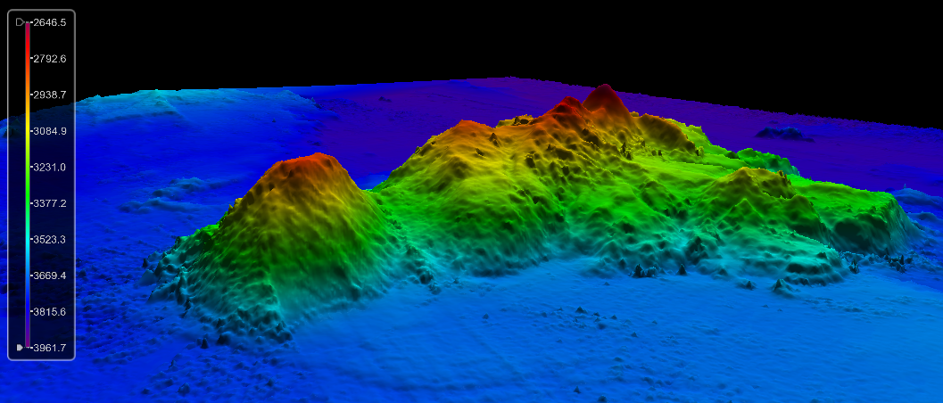
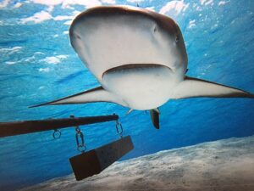
RRS DISCOVERY - CEFAS BLUE BELT BIG OCEAN SURVEY SOUTHAMPTON~ASCENSION~SAINT HELENA~MONTEVIDEO
During recovery of a lander in St Helena waters we also recovered an early 19th Century anchor at the same time
The St Helena Archaeological society estimated the anchor to be 200 years old.
On the advice of the St Helena Authorities, the anchor was returned to the sea and the UK Hydrographic Office Notified
New Seamount Discovered within Ascension MPA
BRUVS-Baited Remote Underwater Video System Deployed

Slide 13
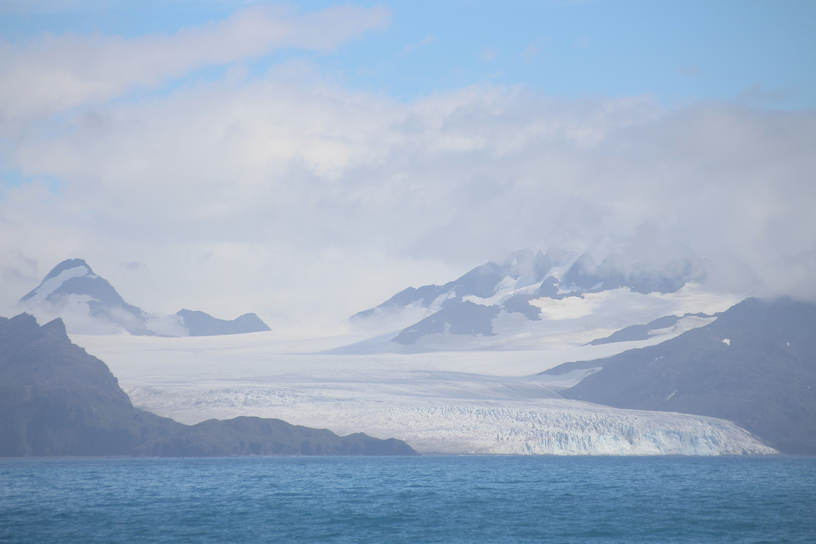
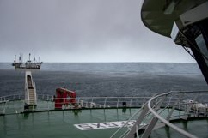
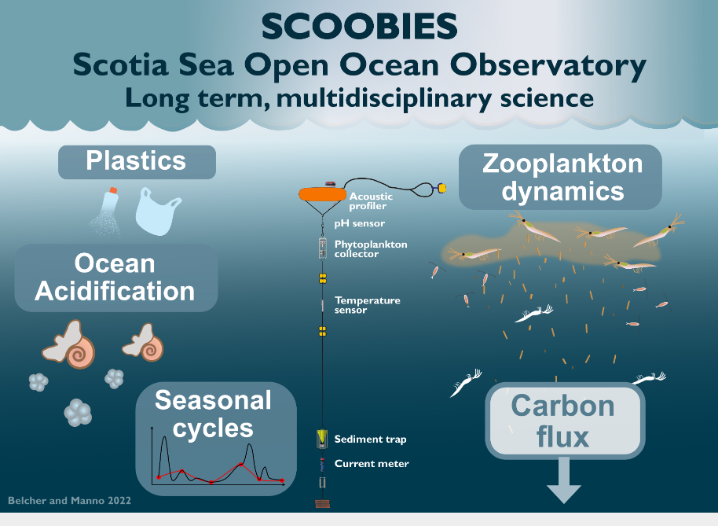
Discovery - polar ocean SOUTH GEORGIA, scotia sea, the Falkland islands
Uruguay to South Georgia and Polar Antarctic to Falklands
Plastics, Moorings and CTD and Zooplanton studies on
behalf of BAS
Opportunity Science – Iceberg A76a

Slide 14
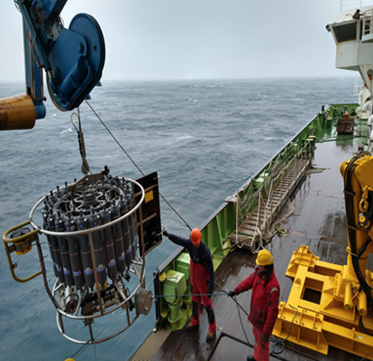
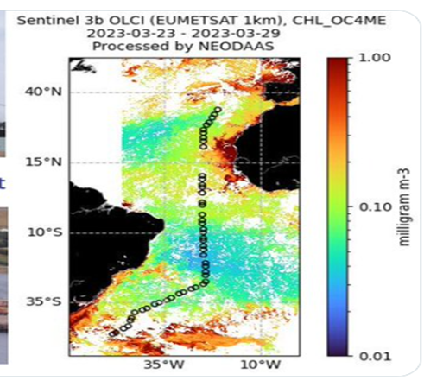
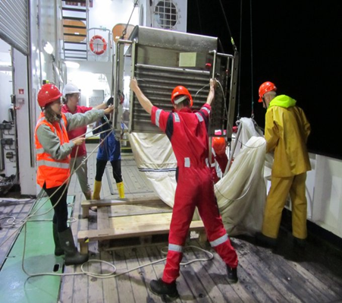
RRS DISCOVERY - amt north (mid-Atlantic TRANSECT South to North
The Atlantic Meridional Transect (AMT) multidisciplinary programme, which undertakes biological, chemical and physical oceanographic research during an annual voyage between the UK and destinations in the South Atlantic. This year it was run in reverse Falklands to Southampton, a distance of approx. 7000nm.
Deployments carried out were: CTDs Daily Launch, Zooplankton Net, Atmospherics for CO2, Moorings.

Slide 15
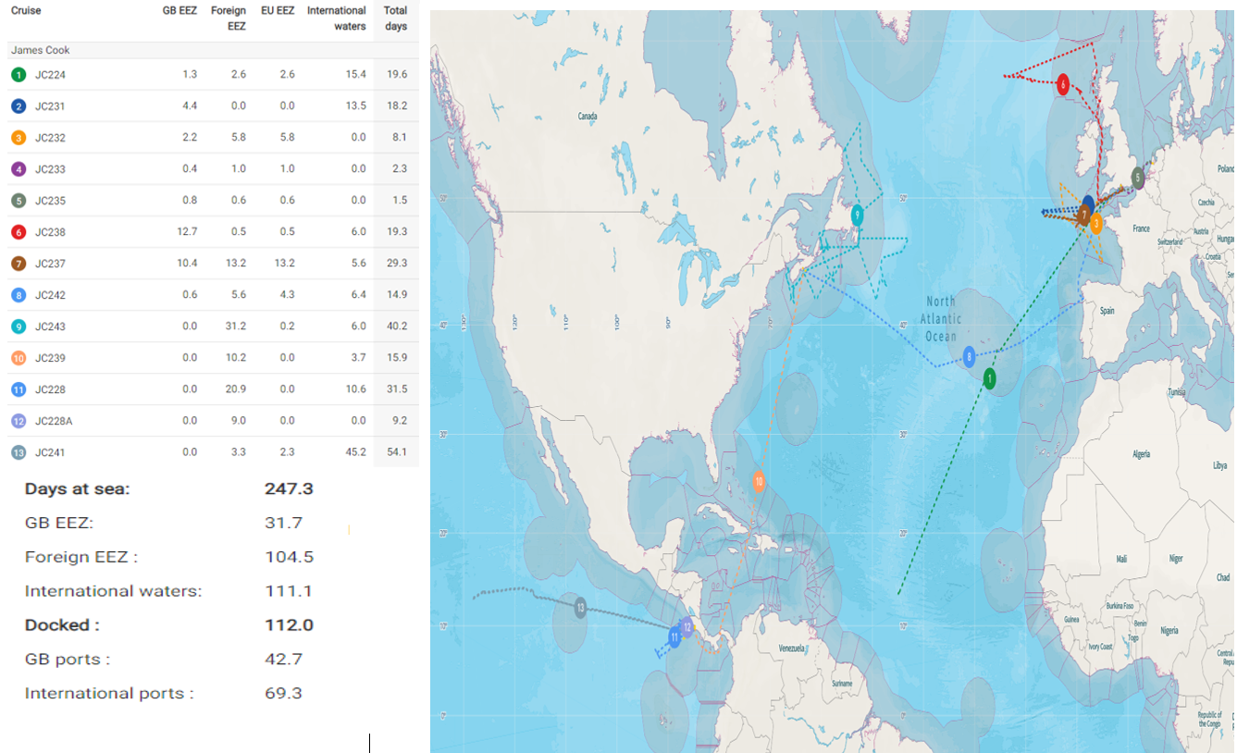
RRS JAMES COOK EXPEDITIONS –2022 / 2023

Slide 16
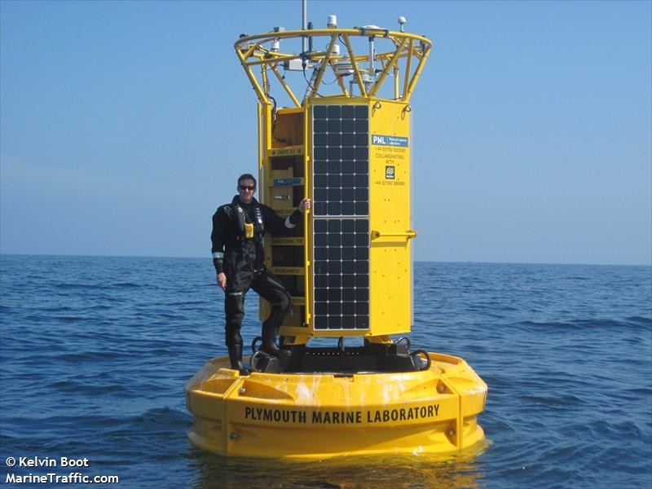
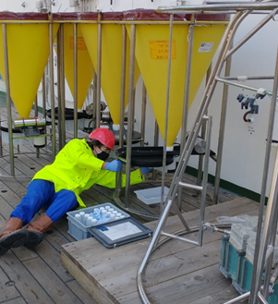
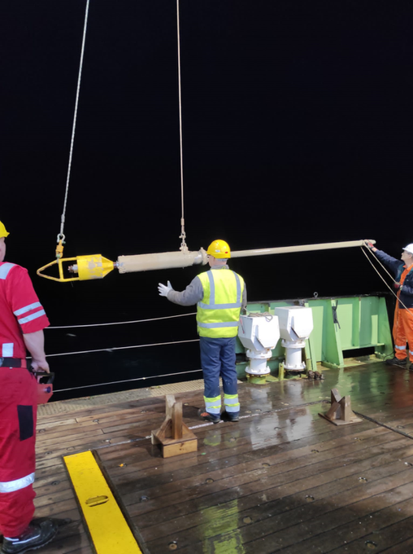
RRS James cook - Porcupine abyssal plain (PAP) and iceland basin
PAP - sustained observatory dating back to 1985 located South-West Approaches
Type of work carried out: Net sampling, Sediment traps, Box and Gravity coring
Maintenance of Met Office ODAS Buoys, including removal of Marine growth.
Iceland Basin - OSNAP (Overturning in the Sub-Polar N. Atlantic Programme)

Slide 17
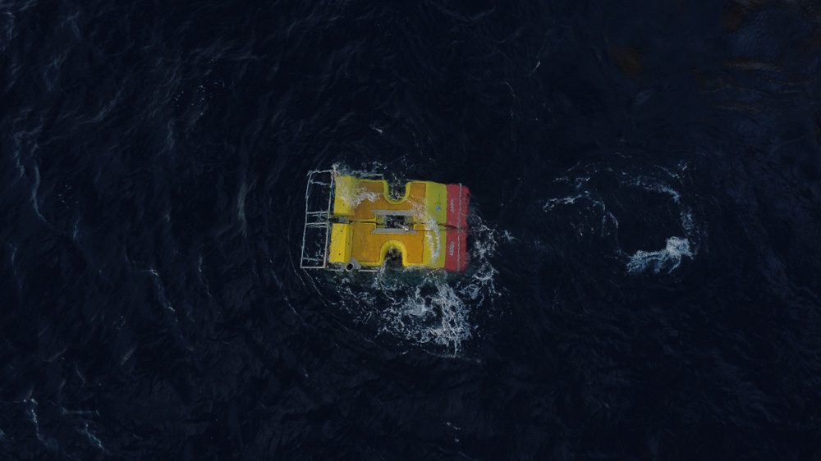
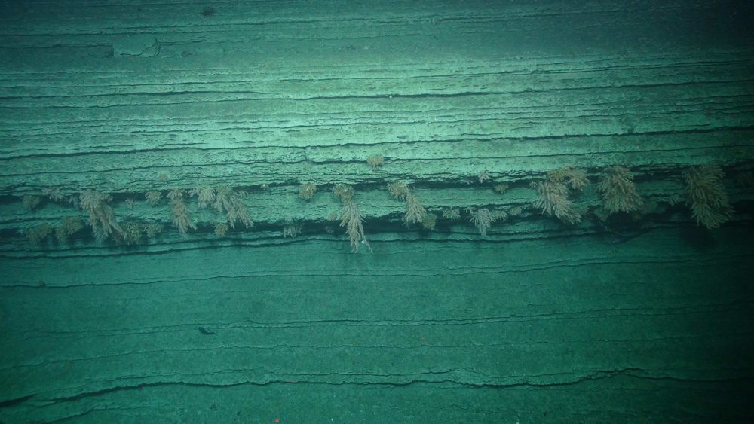
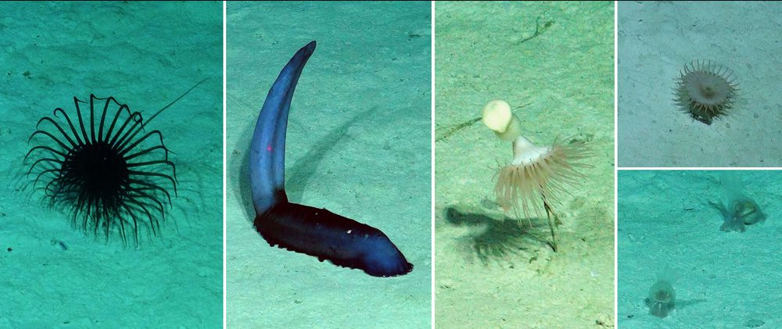
RRS James cook - whittard canyon south-west approaches uk’s only submarine canyon
Multi disciplined cruise - Biologists, Scientists, Geologists
Deployments of Auto-Sub similar to ‘’Boaty’’ and the NOC ROV for sampling and Imagery
ROV also deployed at PAP site

Slide 18
RRS James cook - Canadian DEPT. OF fisheries and oceans Atlantic zonal monitoring programme
September 2022 saw JC leave the UK for six months
After a Port call in Vigo to collect seismic equipment for future use in the Pacific the ship sailed to Halifax, NS.
From October to mid-November 2022 the ship undertook deployment and recovery of moorings, ADCP work, XBT deployments and extensive CTD work in between Port calls to Halifax, Sydney and St John's (NFL)

Slide 19
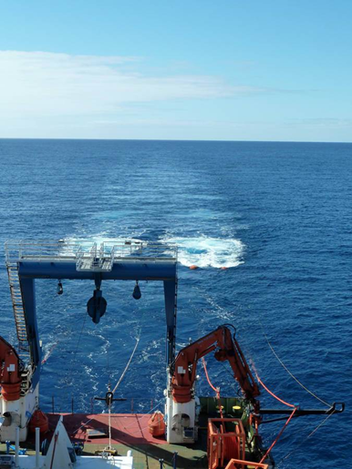
RRS JAMES COOK - Passage to pacific (via PANAMA CANAL) - MoHOLE (SEIsmics) - NERC SMARTEX
Mobilising out of Caldera, Costa Rica (Nov 22-Apr 23)
JC 228 – MoHOLE to Bending Faults
Seismics geophysical investigation in Guatemala Basin
First NOC Seismics Survey in 7 yrs
Utilised CSIC(Consejo Superior de Investigaciones Científicas) guns and winches- 6km streamer
Ended up rescuing the Guard Boat !
JC228A - MoHOLE Part 2
AUV and Coring
Central America lends itself to potential sites for a new attempt

Slide 20
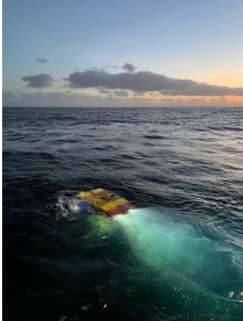
RRS JAMES COOK – NERC SMARTEX Environmental impact assessment of Deep sea mining clarion clipperton zone (UK CONCESSION AREAS)
NERC SMARTEX (Seabed Mining And Resilience To Experimental impact) project aims to provide the scientific evidence base for informed decision making by understanding the long-term environmental impacts of mining and consequences to the ecosystem.
ROV survey inc. Nodule collection
Seamount discovery by echo sounder
Reef ecological studies
Box Coring
AUV survey not delivered due to u/s AUV

Slide 21
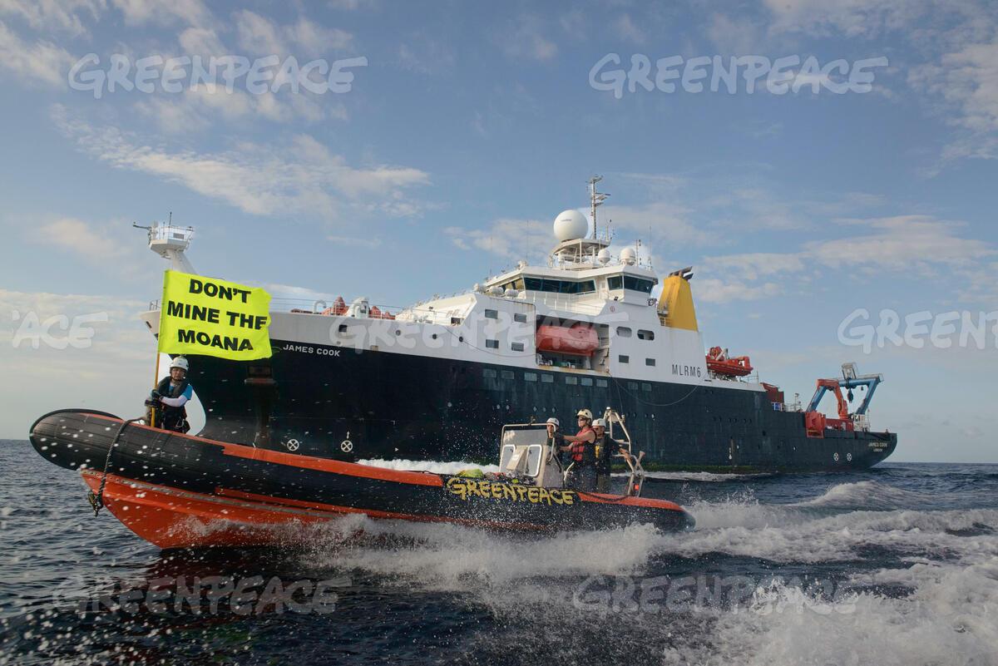
Greenpeace incident - 26 Mar 23 (Costa Rica EEZ / TW)
BE AWARE !
Intercepted by GREENPEACE M/V ARCTIC SUNRISE (Dutch registered) off Costa Rican coast after NERC SMARTEX expedition
Initial Warning of peaceful protest given to JAMES COOK over VHF but followed by reckless endangerment of protesters lives by Greenpeace
UK Maritime and Coastguard Agency (MCA) currently discussing follow up action against Master / Ship / Vessel Owners with Dutch Authorities

Slide 22
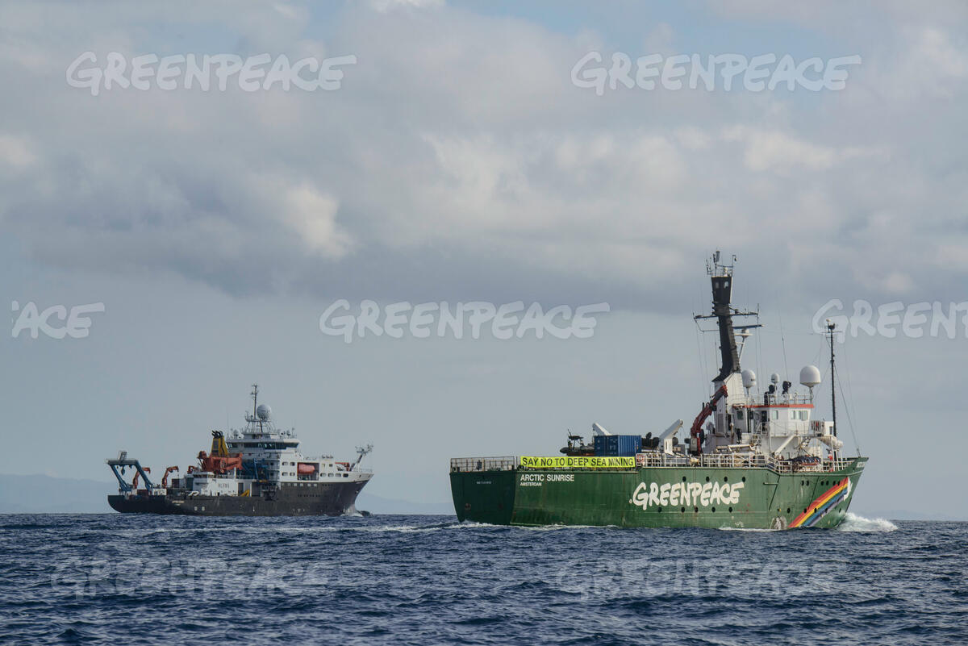
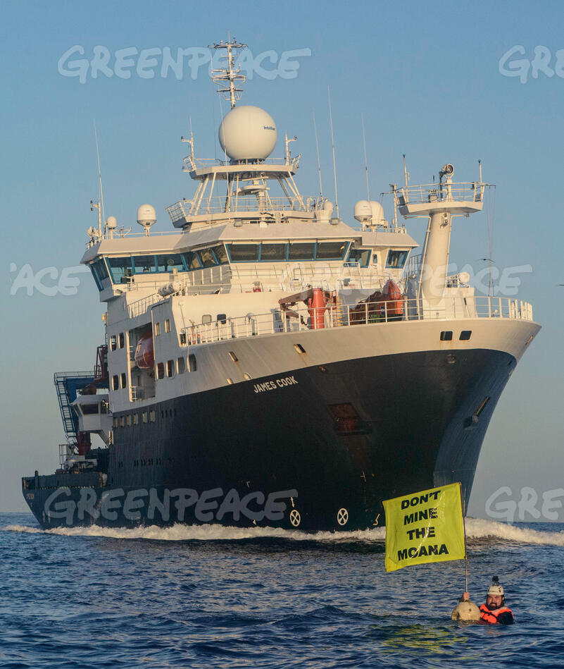
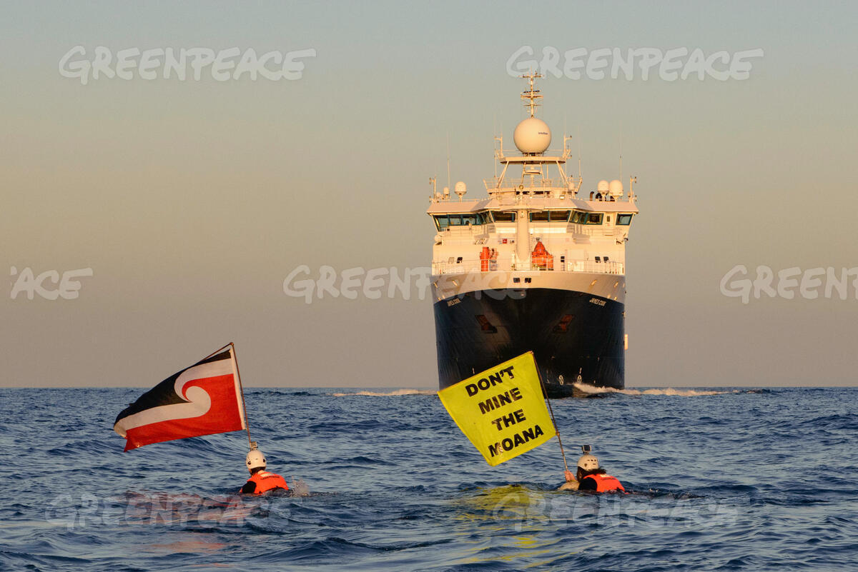
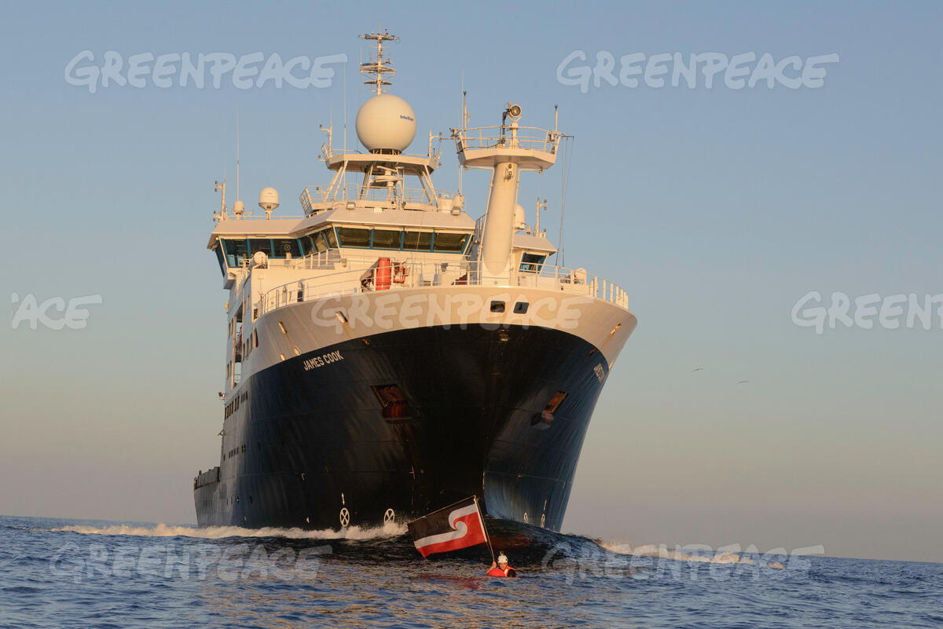
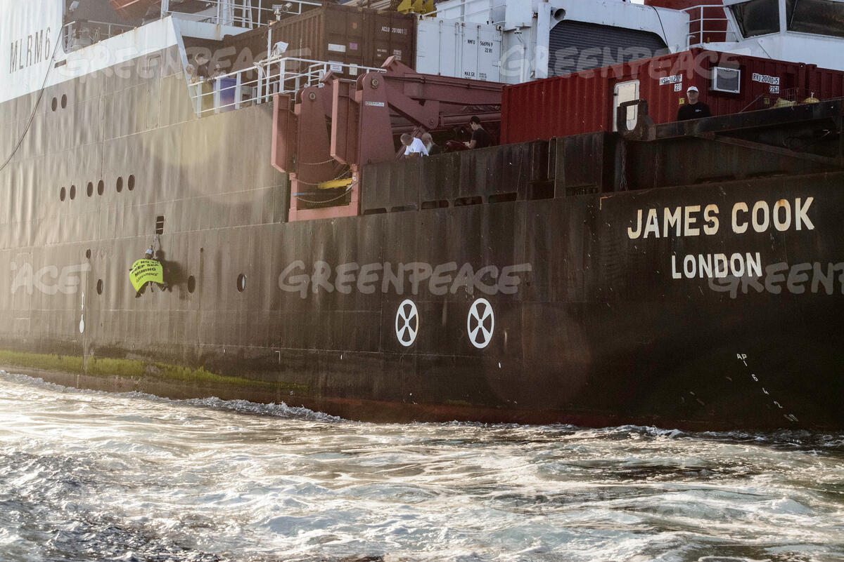
GREENPEACE INCIDENT - 26 MAR 23 (COSTA RICA EEZ / TW)
https://youtu.be/2-OsaptjXAA​
https://media.greenpeace.org/asset-management/27MZIFJLI7ESK

Slide 23
Any Questions?

