Slide 1
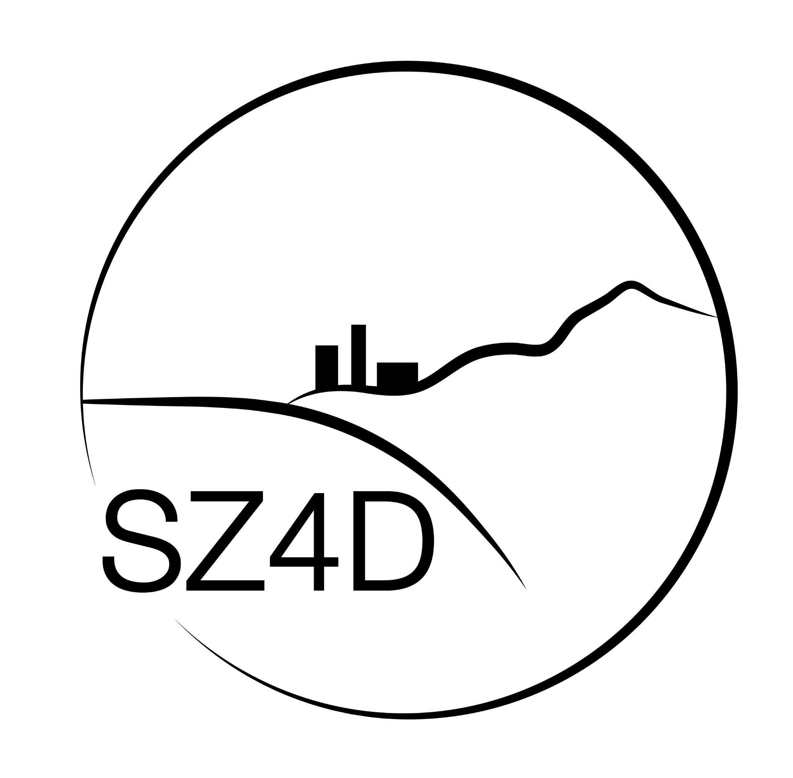
The current state of SZ4D
(December 11, 2022)
🌐
www.sz4d.org
@SZ4D1
contact @sz4d.org
Notes:
On behalf of the organizing committee and SZ4D steering committee, welcome to community meeting to everyone online and everyone here in person in Houston
So excited that we’ve reached a point where we could have this meeting (in so many ways)
As you’ll hear, a particularly important moment in SZ4D’s evolution that requires community feedback and engagement. This is a really important milestone, and thank you for being here and engaging.

Slide 2
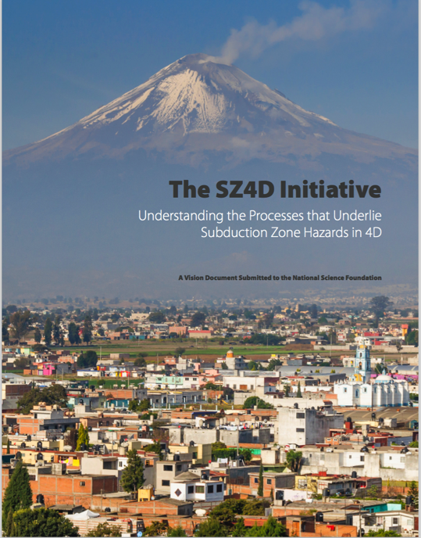
SZ4D: What is it and where did it come from?
A community initiative/plan to investigate the fundamental processes that underlie subduction zone geohazards
2016: The “Boise Workshop” and “Vision Doc”
EAR-1636548 (PIs: Detrick and Meltzer) - $150,317
Subduction Zone Observatories Workshop
2018-2022: A pair of NSF-funded Research Coordination Networks (the “SZ4D RCN” and “MCS RCN”) - now merged
McGuire et al., 2017
EAR-1828096 (PI: Tobin) - $599,979
RCN: A Research Coordination Network for the SZ4D Initiative
EAR-1824343(PI: Becker) - $400,000
RCN: Planning for a Modeling Collaboratory for Subduction Zone Science

Slide 3
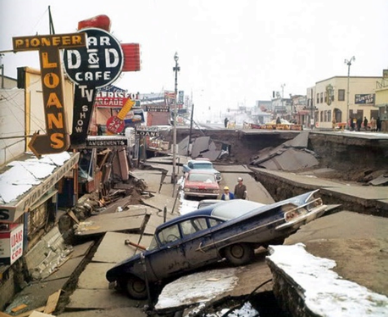
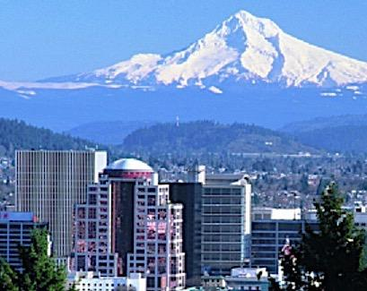
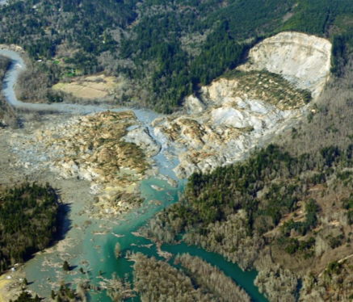
SZ4D RCN Accomplishments
Working Groups defined science goals and strategies
Faulting & Earthquake Cycles Working Group
(FEC)
Magmatic Drivers of Eruption Working Group (MDE)
Landscapes & Seascapes Working Group
(L&S)

Slide 4
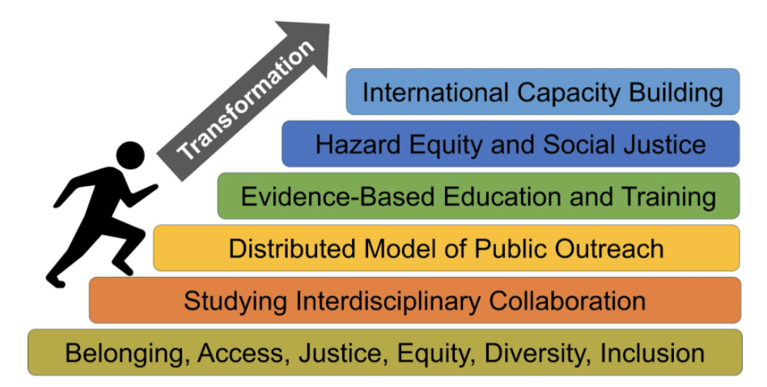
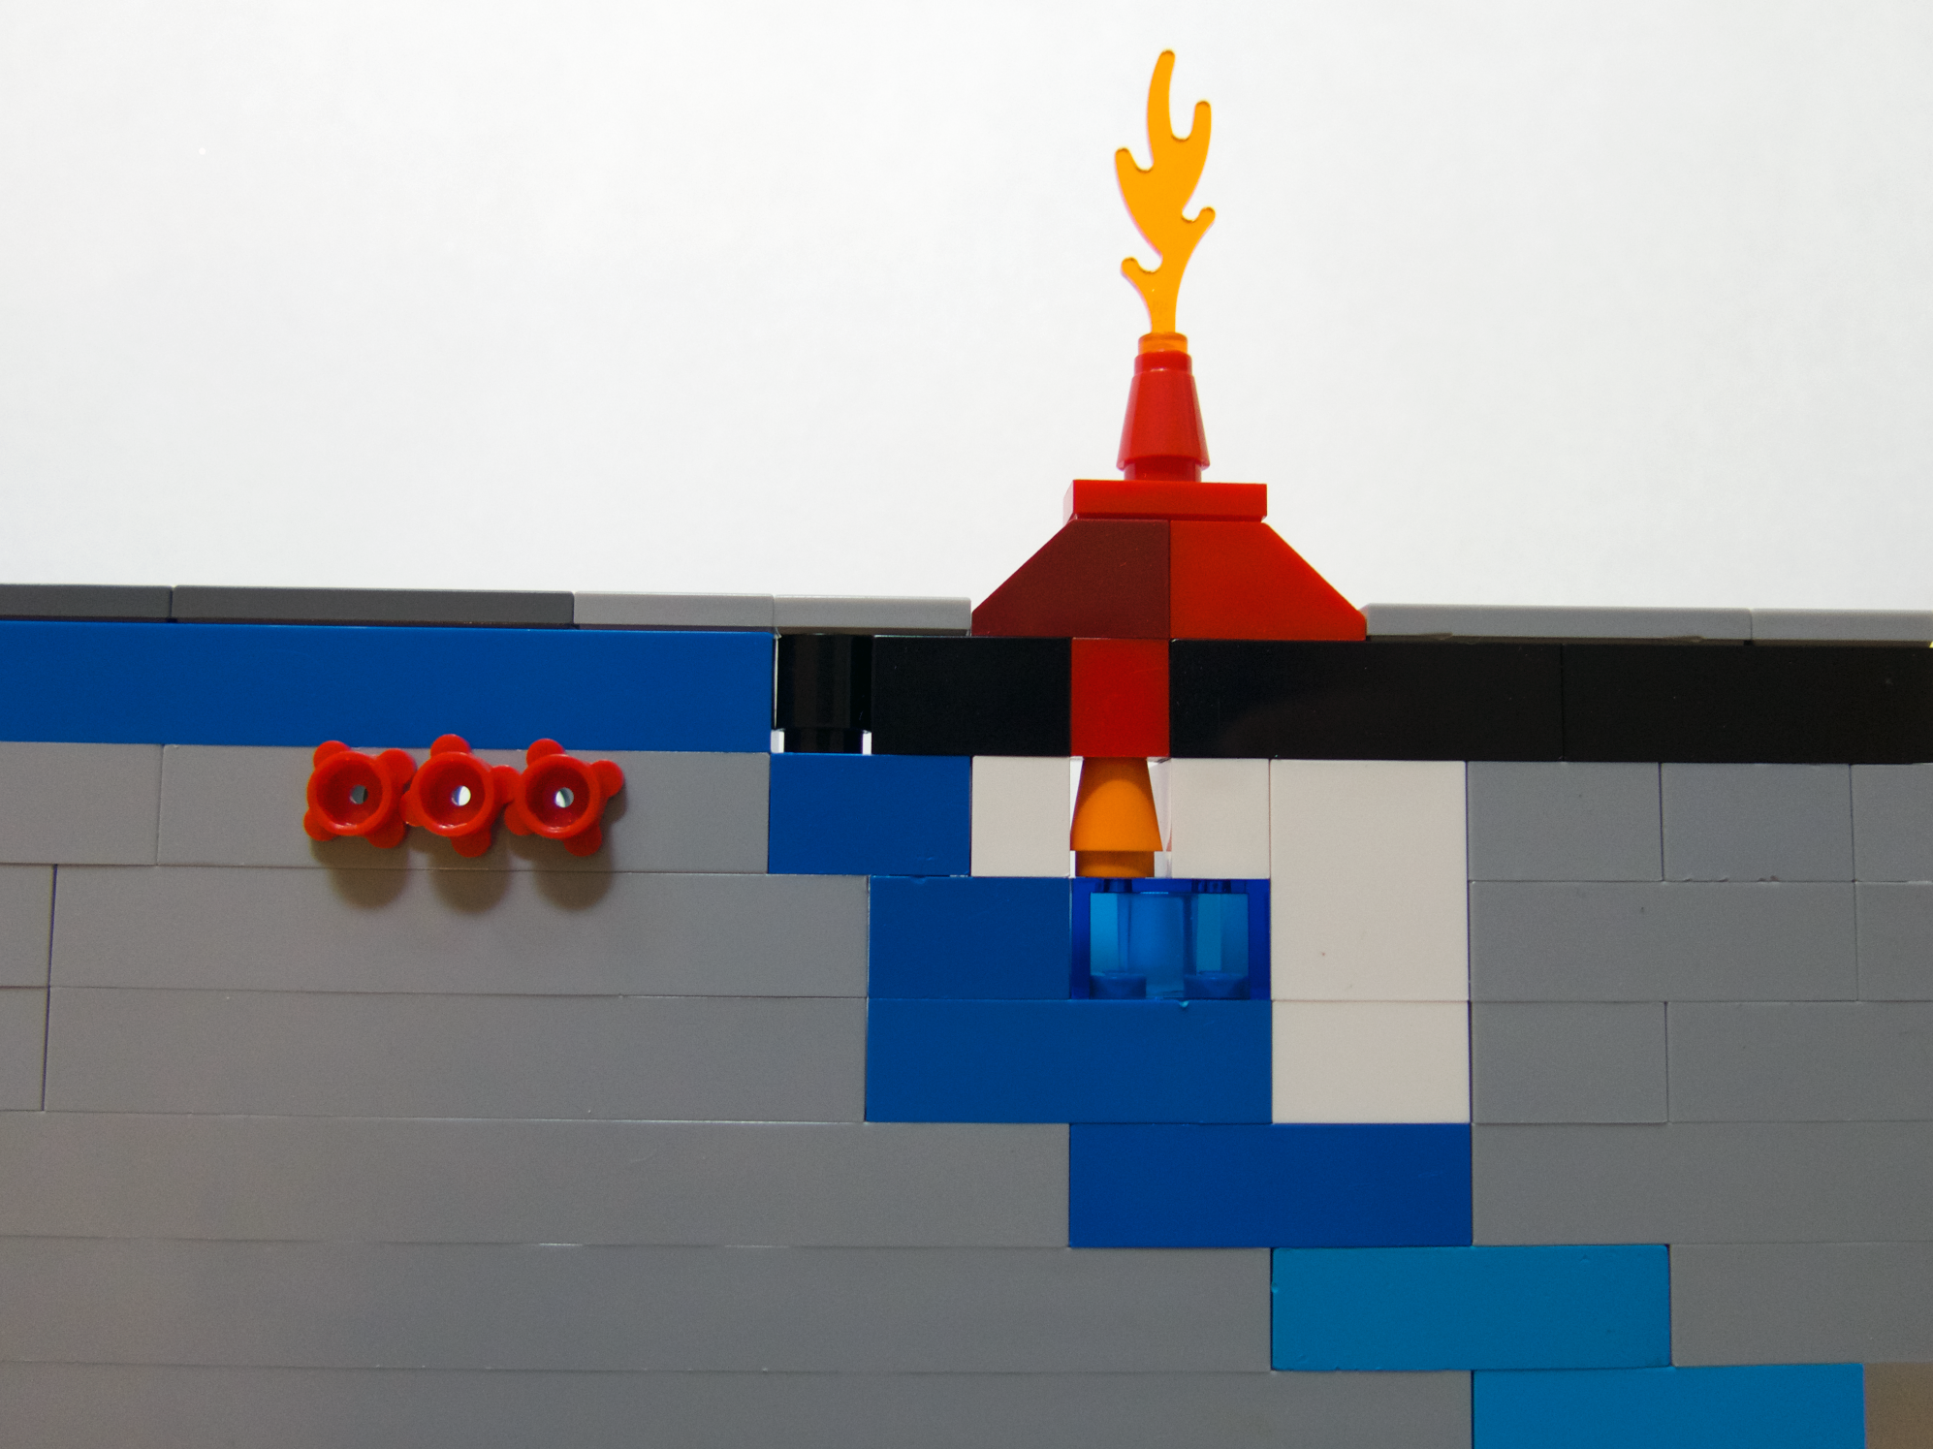
SZ4D RCN Accomplishments
Integrative Groups formed to plan infrastructure and activities that reach across the system
Building Equity and Capacity in Geoscience (BECG)
Modeling Collaboratory for Subduction
(MCS)

Slide 5
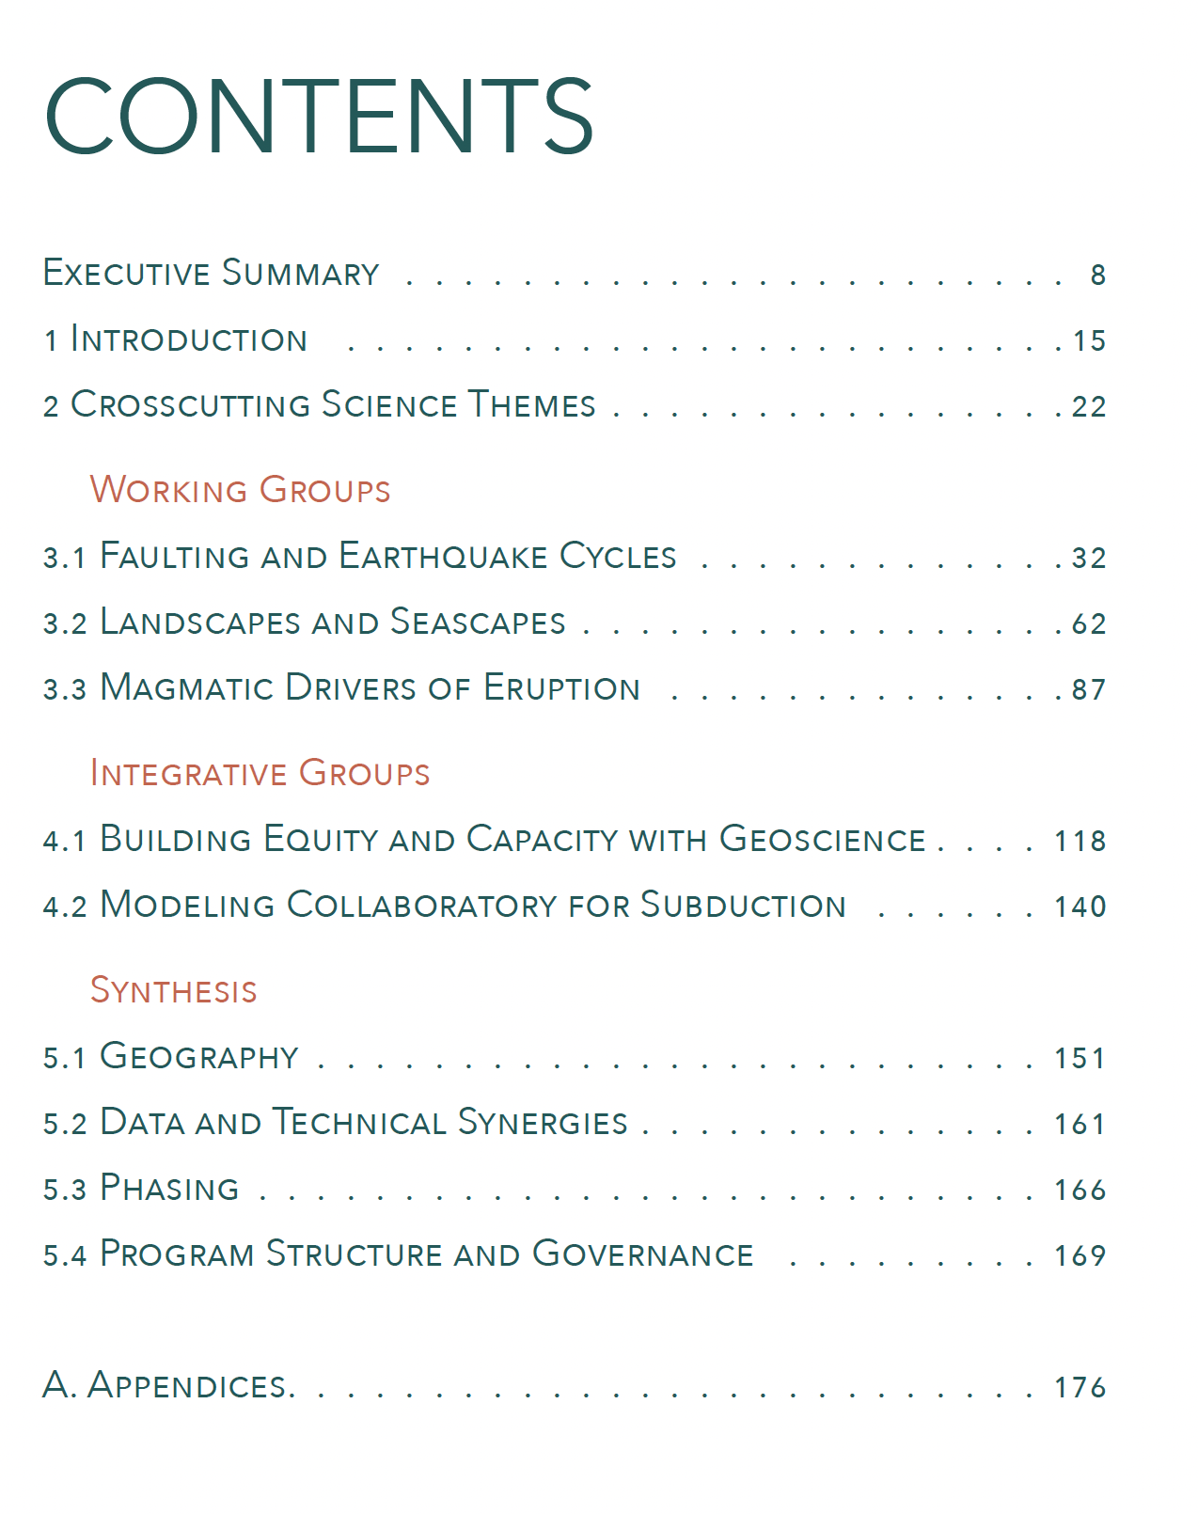
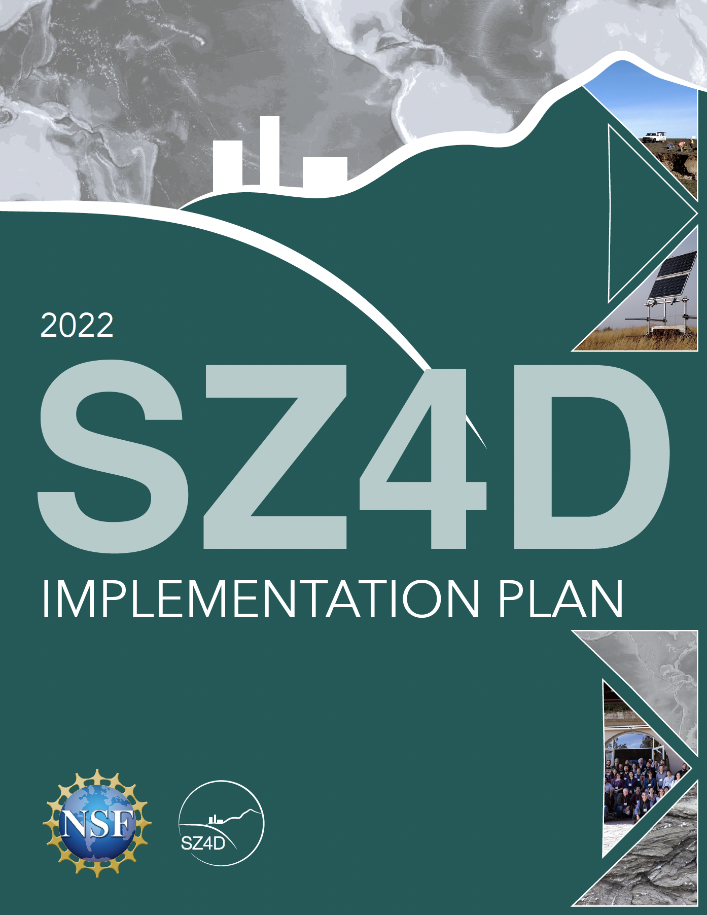
Implementation Report Released November 2022
Hilley, G. E. (ed.), Brodsky, E.E., Roman, D., Shillington, D. J., Brudzinski, M., Behn, M., Tobin, H. and the SZ4D RCN (2022). SZ4D Implementation Plan. Stanford Digital Repository. Available at https://purl.stanford.edu/hy589fc7561. https://doi.org/10.25740/hy589fc7561

Slide 6
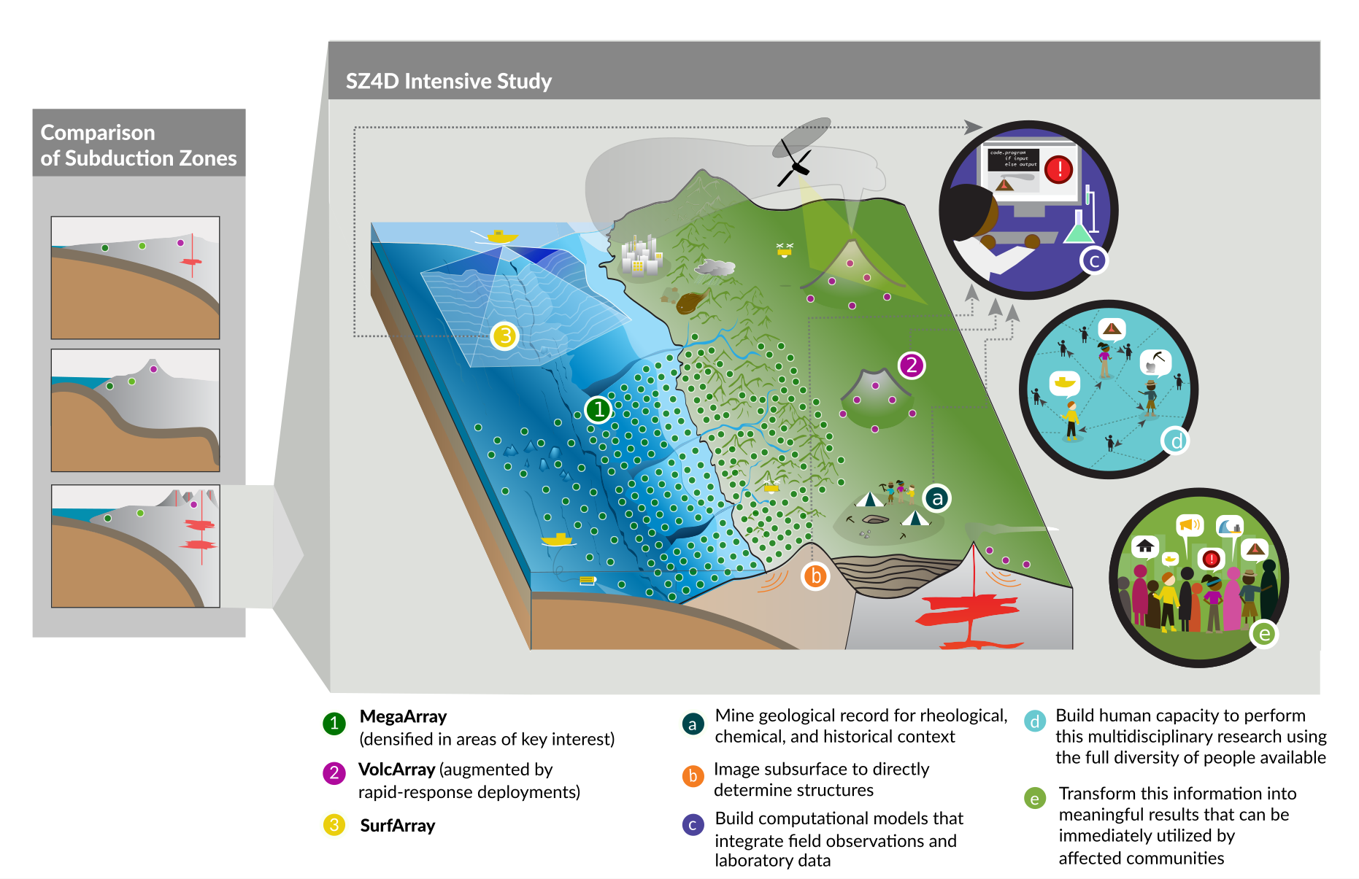
Instrumentation and Activities
Observational arrays
MegaArray
VolcArray
SurfArray
Activities
Analysis of data from arrays
Other observations:
Field geology
Geophysical imaging
Numerical modeling
Lab experiments
Training and outreach
SZ4D Implementation Report Fig. ES-1
Notes:
Geophysical imaging: active source seismic, CSEM, etc…

Slide 7
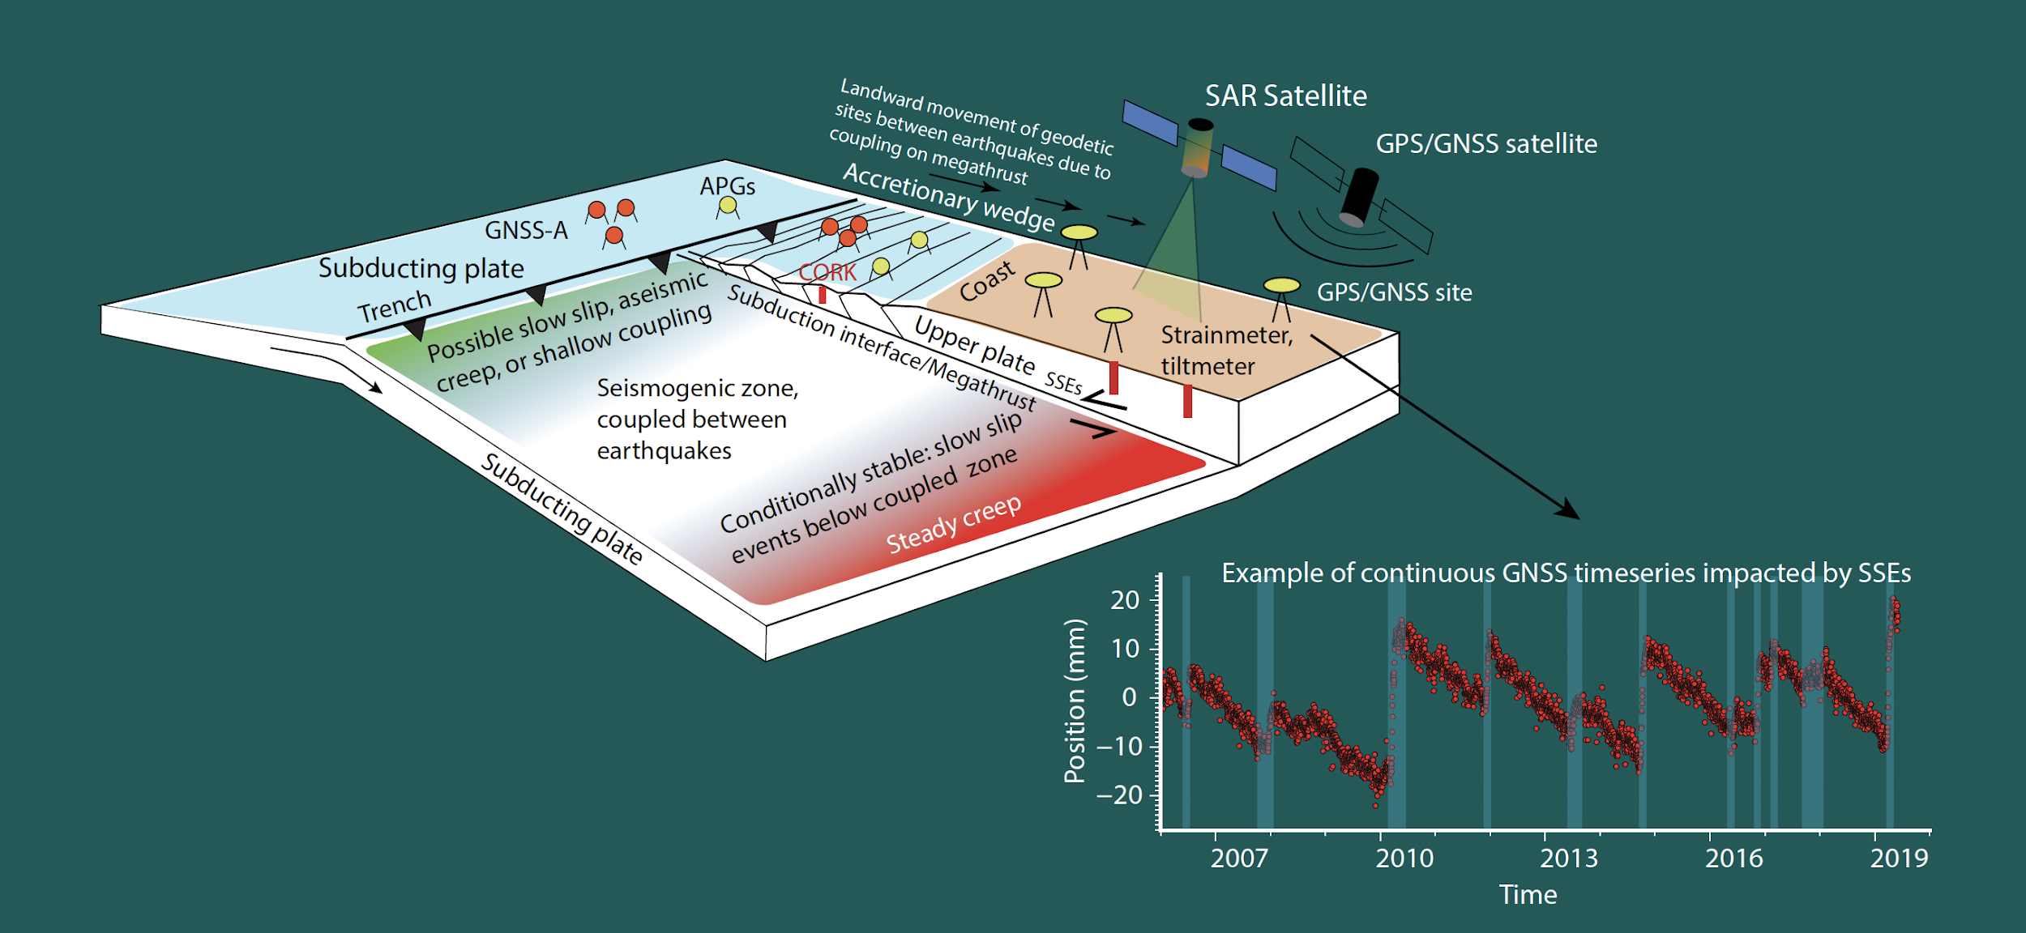
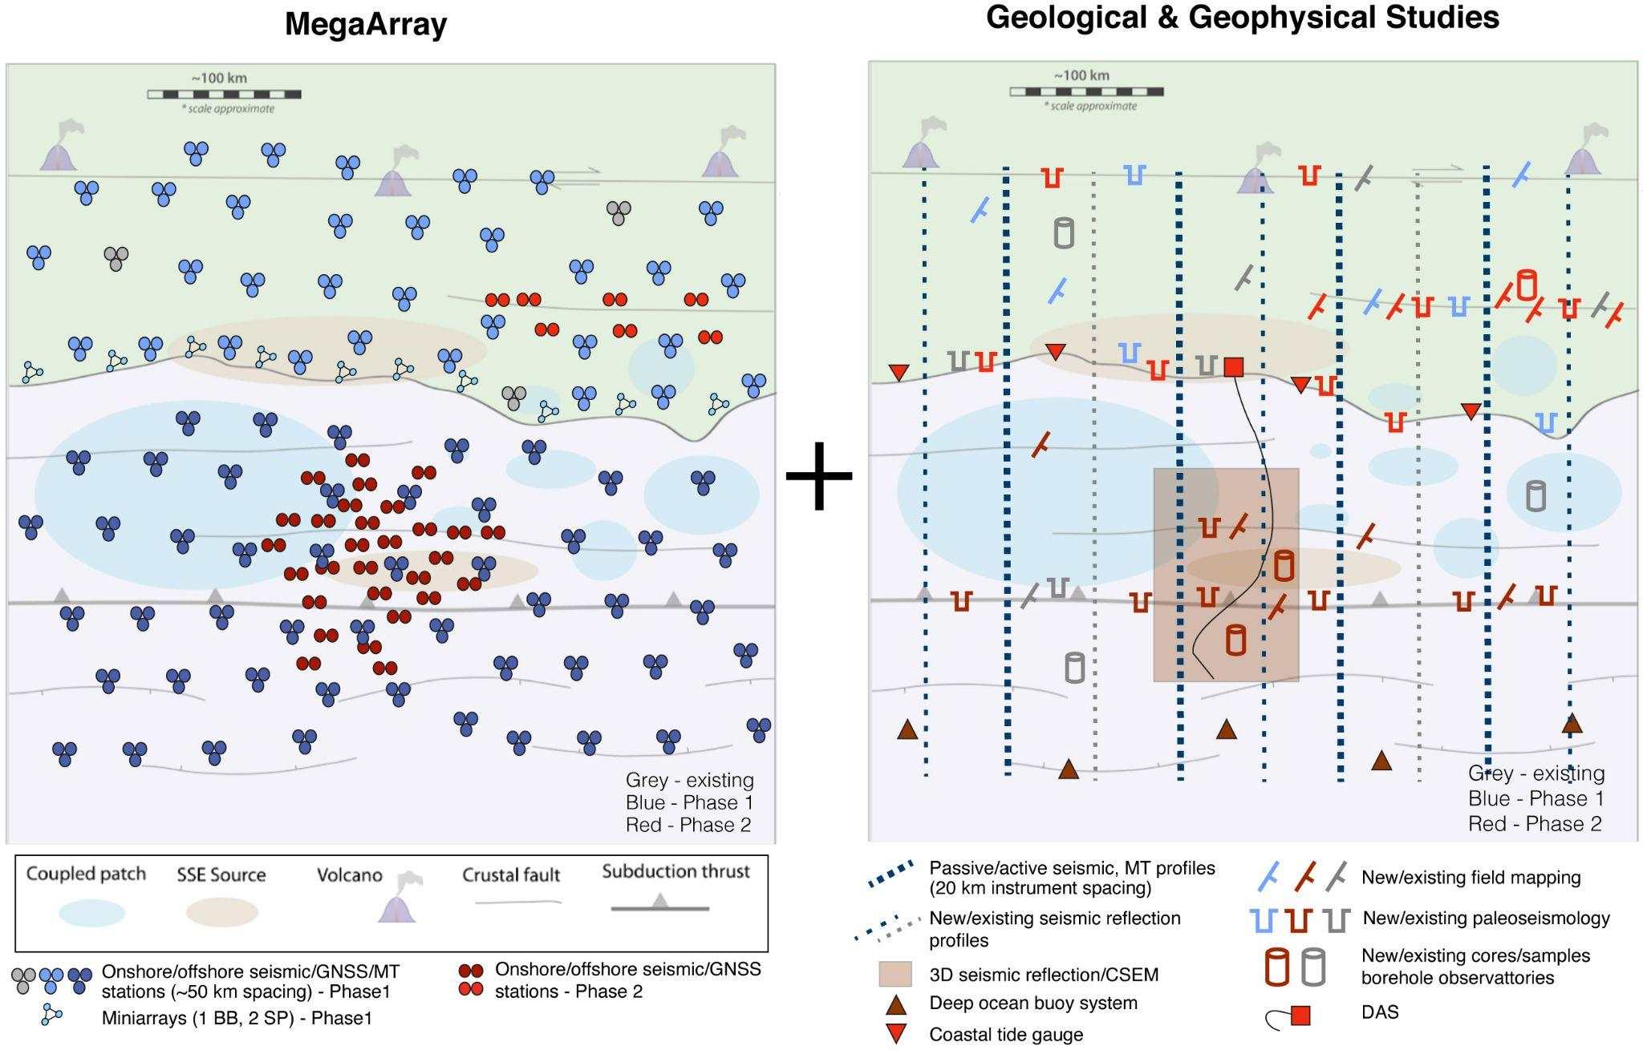
MegaArray Schematically
Backbone imaging and characterization of subduction zone behavior
Detailed, long-term characterization of areas of interest
Variations in coupling behavior
Adaptation of SZ4D Implementation Report Fig. FEC-10

Slide 8
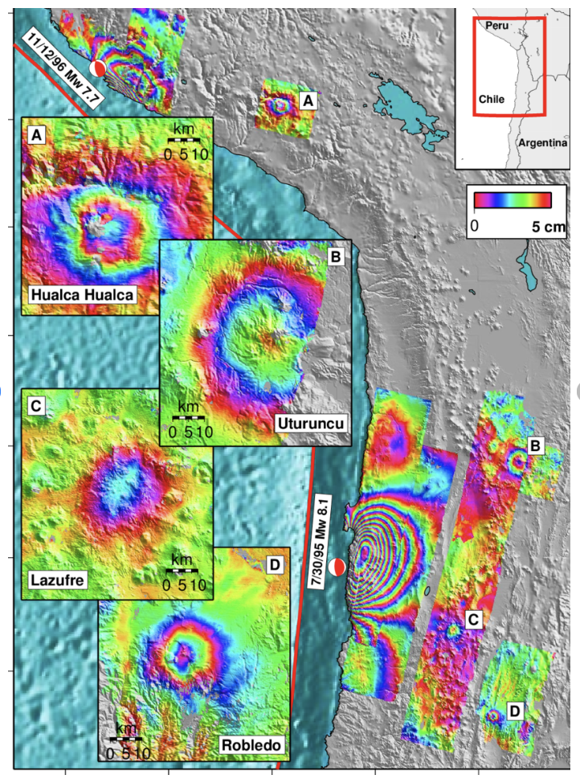
VolcArray Schematically
Pritchard & Simons, 2002
Volcano Sensor Arrays
Goal: Observe evolution of monitored parameters in near-real time from background state through eruption
Volcano Imaging Arrays
Goal: Quantify magma supply rate from the mantle, the geometry of the trans-crustal magmatic system, and eruptive histories
SZ4D Implementation Report Fig. MDE-4

Slide 9
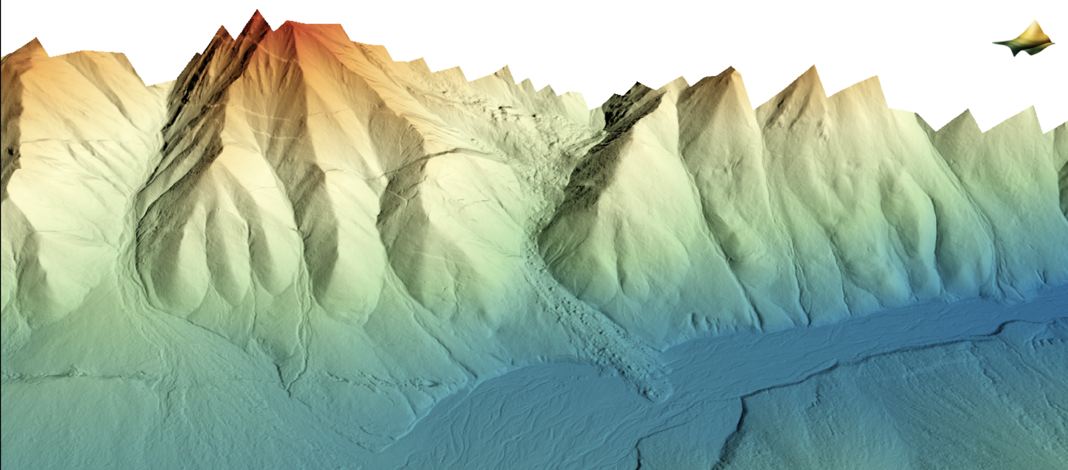
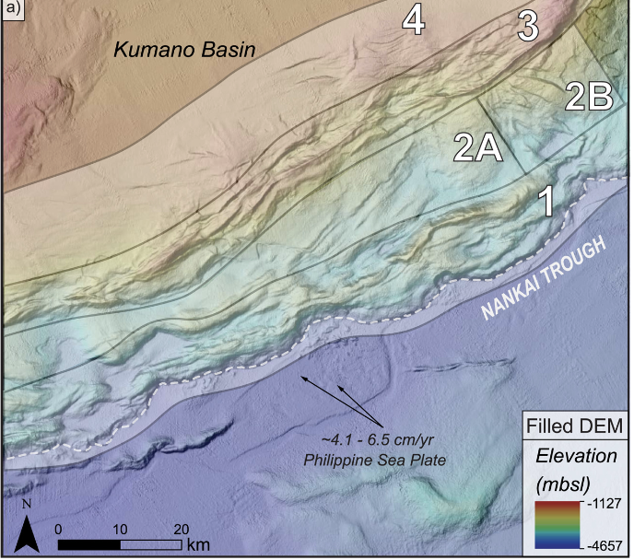
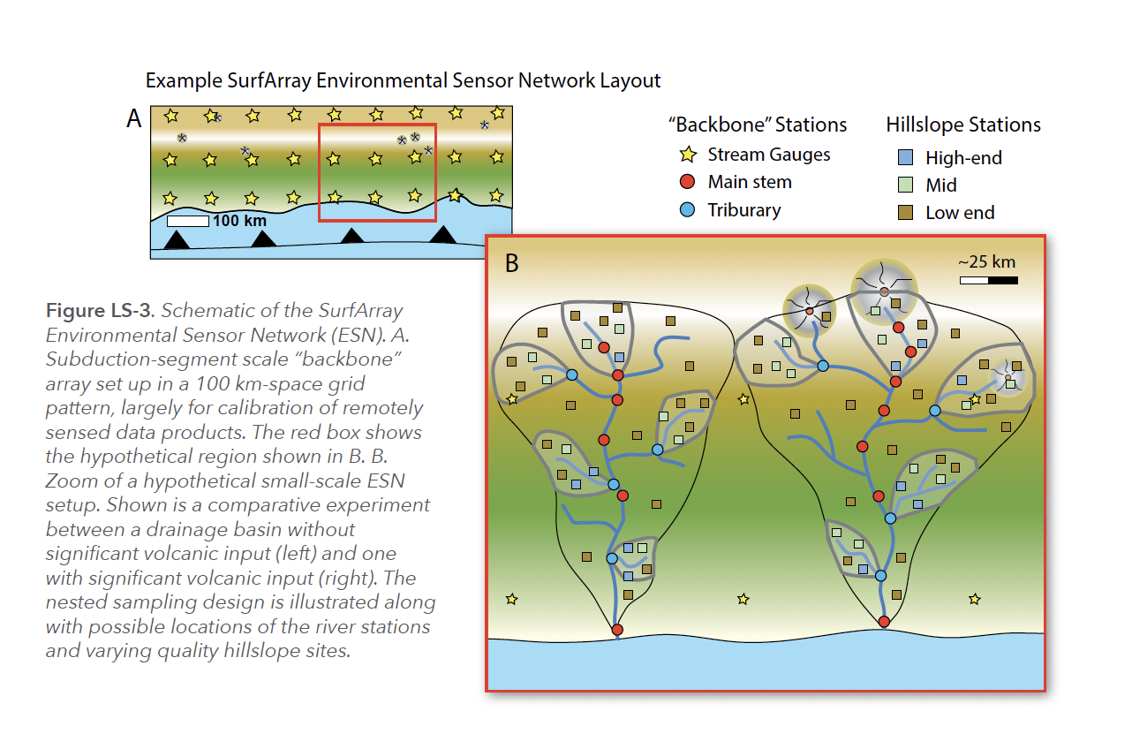
SurfArray: Topography, Bathymetry and Environmental Sensing
Remote sensing of topography
Notional Experiment
Select paired subduction-zone segments that control for (as best as possible) non-targeted factor, while letting single factor vary.
Given domestic sites (Cascadia and Alaska), most plausible comparison would be between segments in Chile with similar climates but differing tectonic rates:
EarthScope Alaska Denali Totschunda LiDAR Project
Slow Subduction
(e.g., Cascadia)
Fast Subduction
(e.g., central Chile)
SZ4D Implementation Report Fig. LS-3

Slide 10
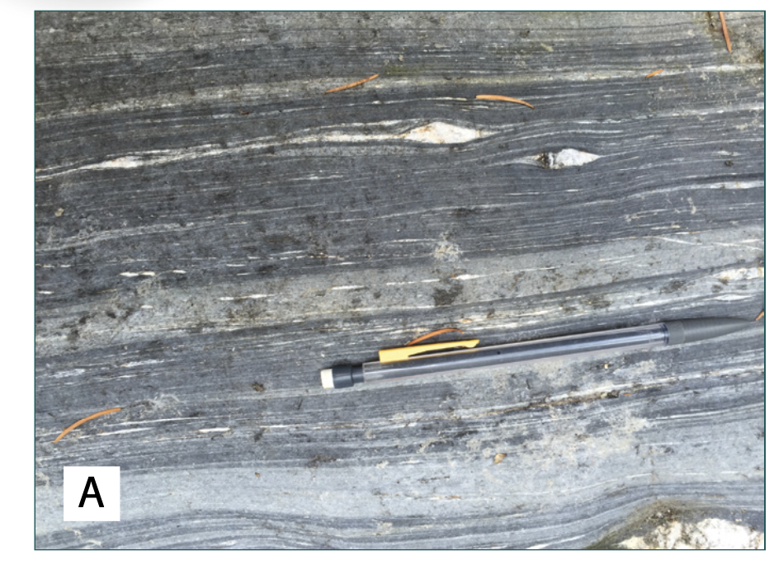
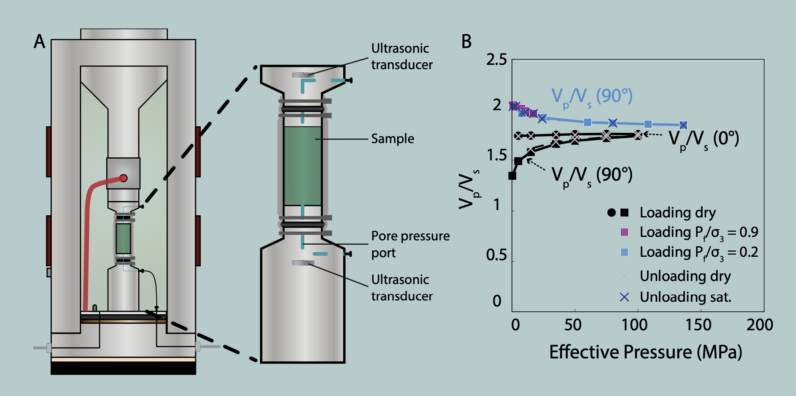
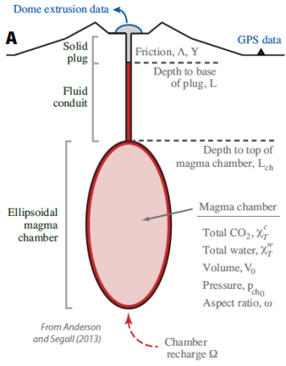
Activities: Field geology, geophysical imaging, experiments and modelling
Kirkpatrick et al., 2021
Fliedner & French, 2021
Li et al., 2015
SZ4D Implementation Report Fig. FEC-6,7,8
Anderson and
Segall, 2013

Slide 11
Components of envisaged SZ4D plans that are most relevant to MSROC
Long term OBS/geodetic deployment for subduction zone behavior
DAS???
Active and passive source marine geophysical imaging
Bathymetric mapping

Slide 12
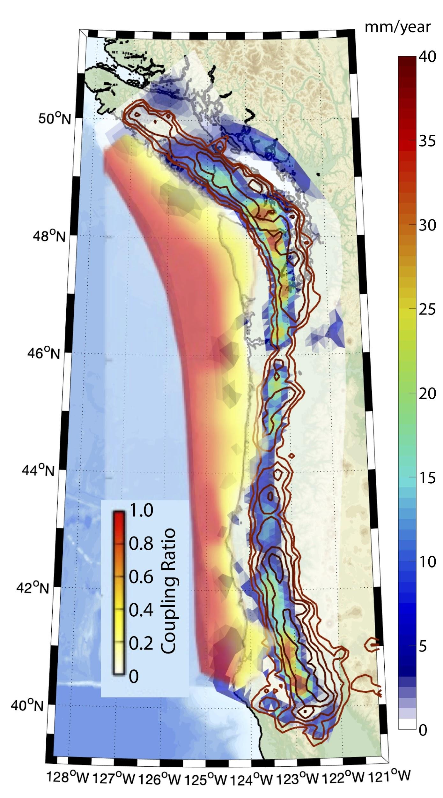
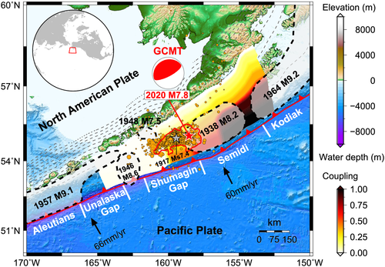
Locations for study
Bartlow
(2020)
Recommend:
Complementary domestic and international sites
Regions of Special Interest:
Chile
70% Instrumentation; 50% Activities
Cascadia
20% Instrumentation; 40% Activities
Alaska
10% Instrumentation; 10% Activities
Liu et al. (2020)

Slide 13
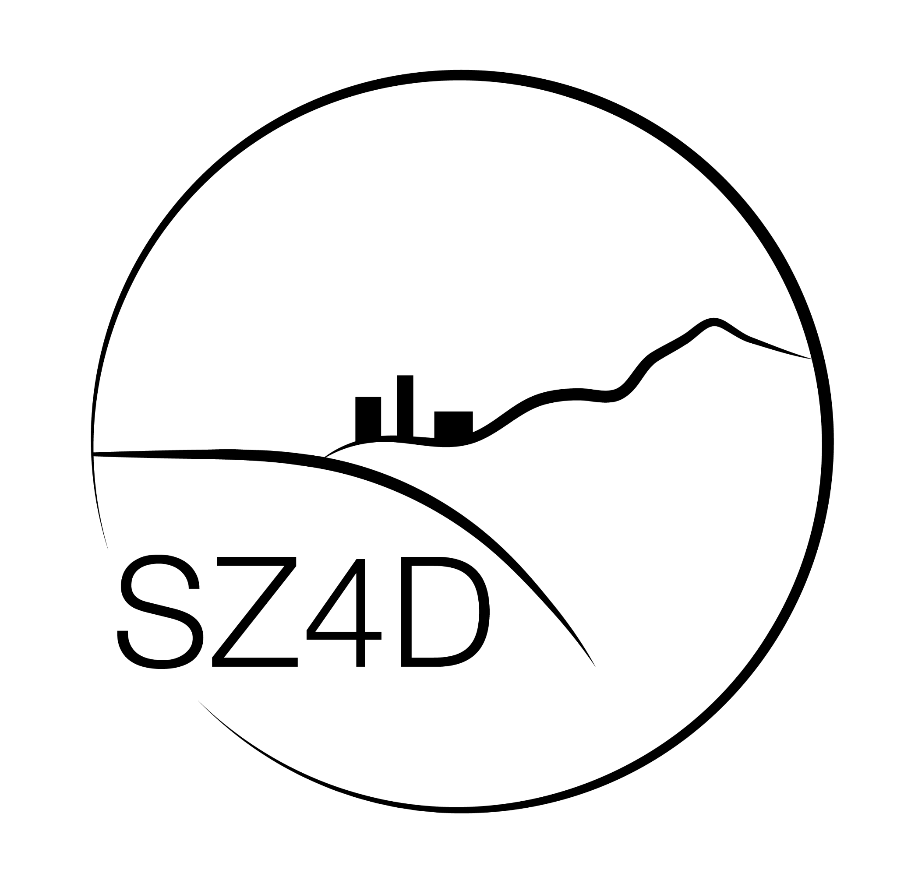
What is the purpose of the effort?
To instigate a large-scale, multi-national program
2020: SZ4D Listed as a Priority in the National Academies Earth in Time Decadal Report 2020 - 2030
NASEM, 2020
Notes:
NEED STATS

Slide 14
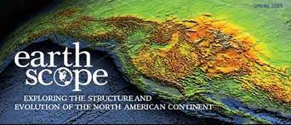
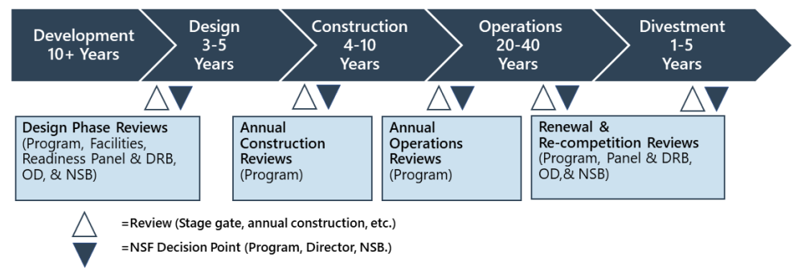
How do large-scale programs in the US happen?
Organize
Write Reports
Apply For Opportunities
Coalesce within and across agencies
We are here
We are here (~$3M to date)

Slide 15
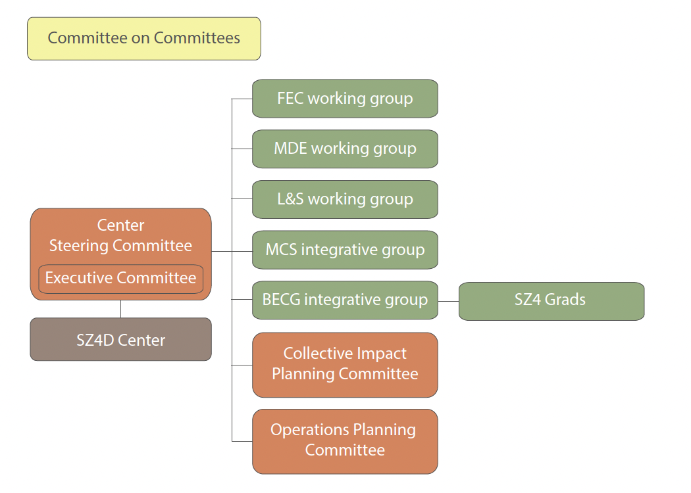
SZ4D Now: Transition Structure
Announced May 2022
>200 Volunteers
Launched new committees
Fall 2022
These committees doing further planning to prepare for future proposals
Lower commitment
High commitment
SZ4D Implementation Report Figs SG-1

Slide 16
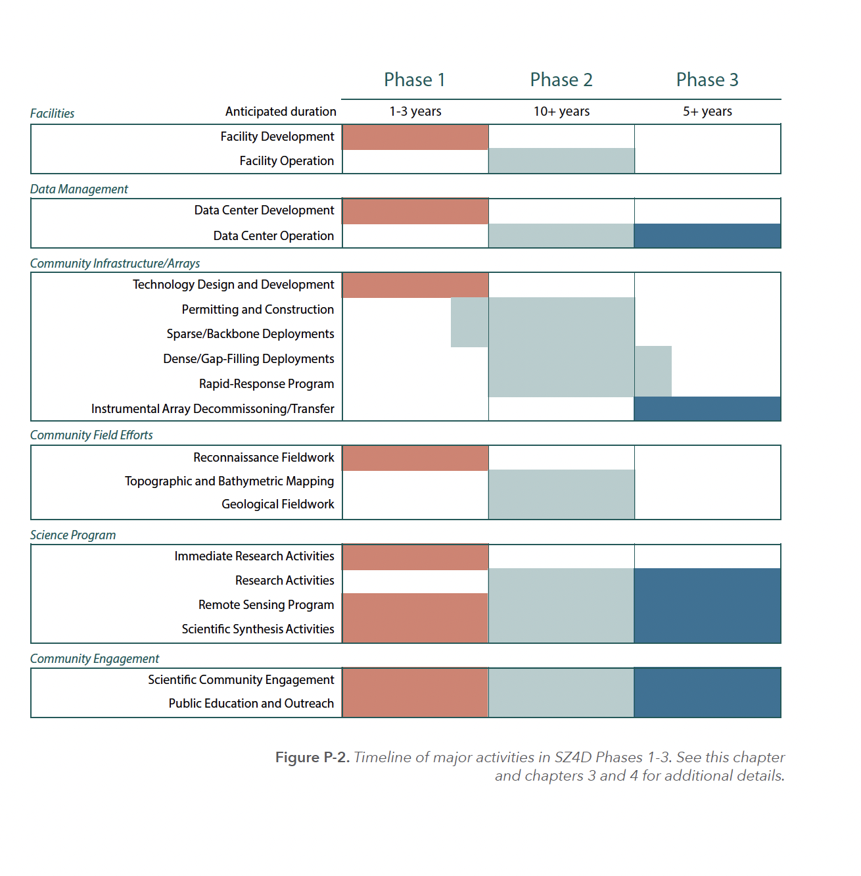
The Road Ahead
We are here
Phase 0
Done!

Slide 17
Components of envisaged SZ4D plans that are most relevant to MSROC
Long term OBS/geodetic deployment for subduction zone behavior
DAS???
Active and passive source marine geophysical imaging
Bathymetric mapping

Slide 18
extra

Slide 19
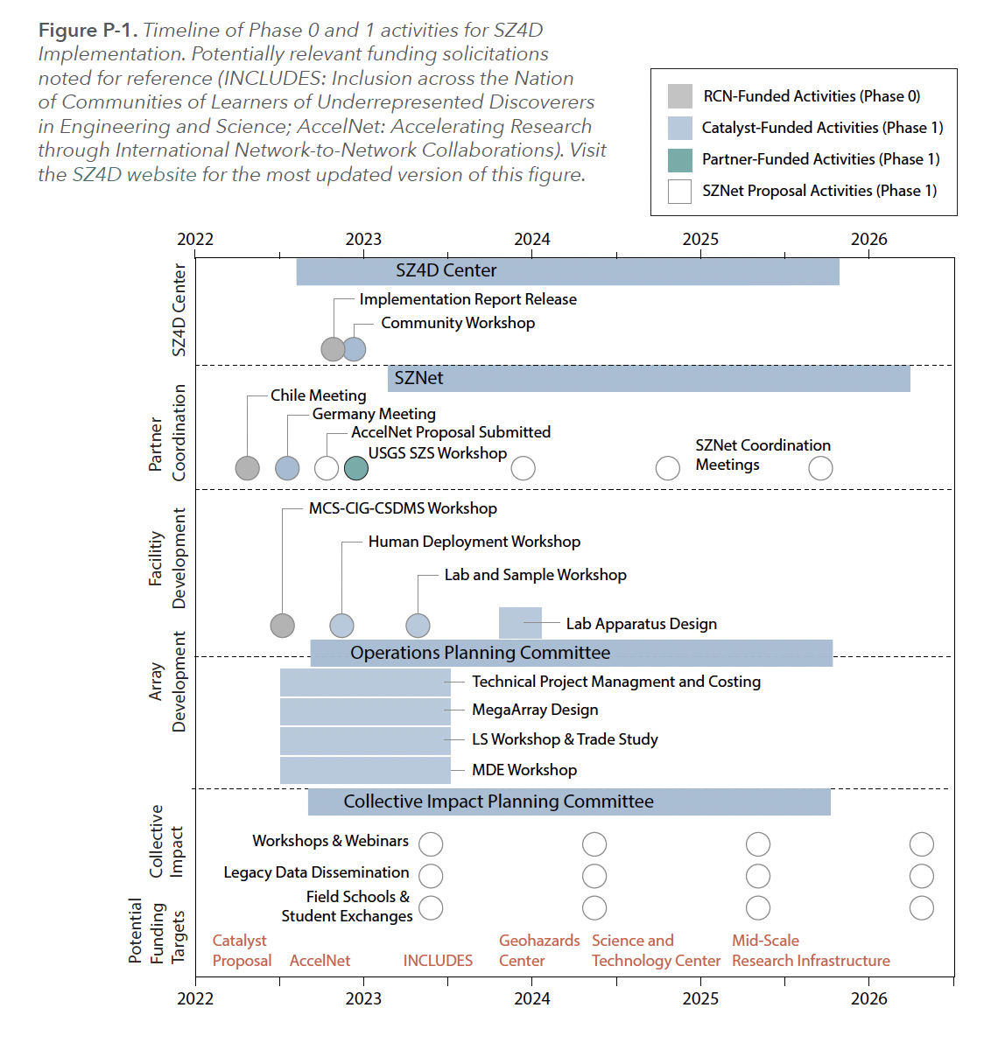
The “Catalyst Proposal”:
What SZ4D is currently funded to do
1) A staffed Center (Anais Ferot and Dana White) 2) Technical project management to realistically evaluate costs and trade-offs of the instrumentation options. 3) Preparatory work for the geological, modeling and laboratory facilities which include workshops and modest
engineering design work.
SZ4D: Where are we now?
SZ4D Implementation Report
Fig. P-1
EAR-2221947 (PIs: Brodsky, Woodward, Mattioli, Newman) - $1,685,599
Collaborative Research: SZ4D Catalyst

Slide 20
The Collective Impact Conundrum
US Mechanisms to fund collaboration
RCN ✅
Catalyst ✅
Accelnet - pending ☑
International Mechanisms to fund collaboration, infrastructure, and science
ANID programs
EU programs
NSF-ANID Partnership?
NSF-EU Partnerships?
Other programs/partnerships
US Mechanisms to fund infrastructure
MRI (Major Research Infrastructure)
MSRI (Mid-Scale Research Infrastructure)
MREFC (Major Research Equipment and Facility Construction)
US Mechanisms to fund science
Core programs
Centers
Geohazards
STC (Science & Technology Centers)
Dedicated Science Program

Slide 21
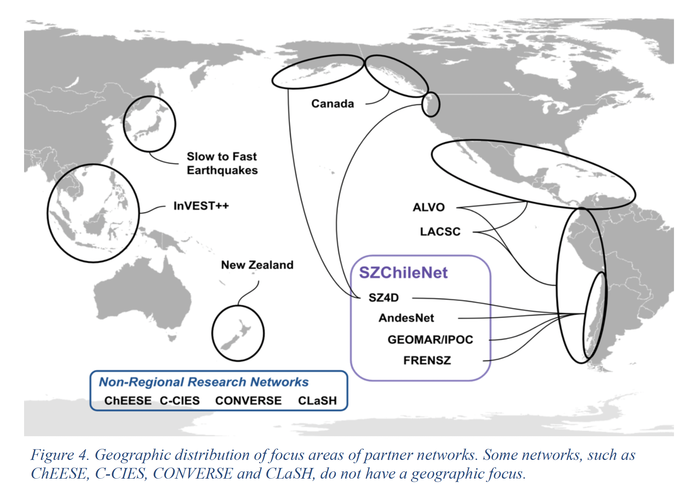
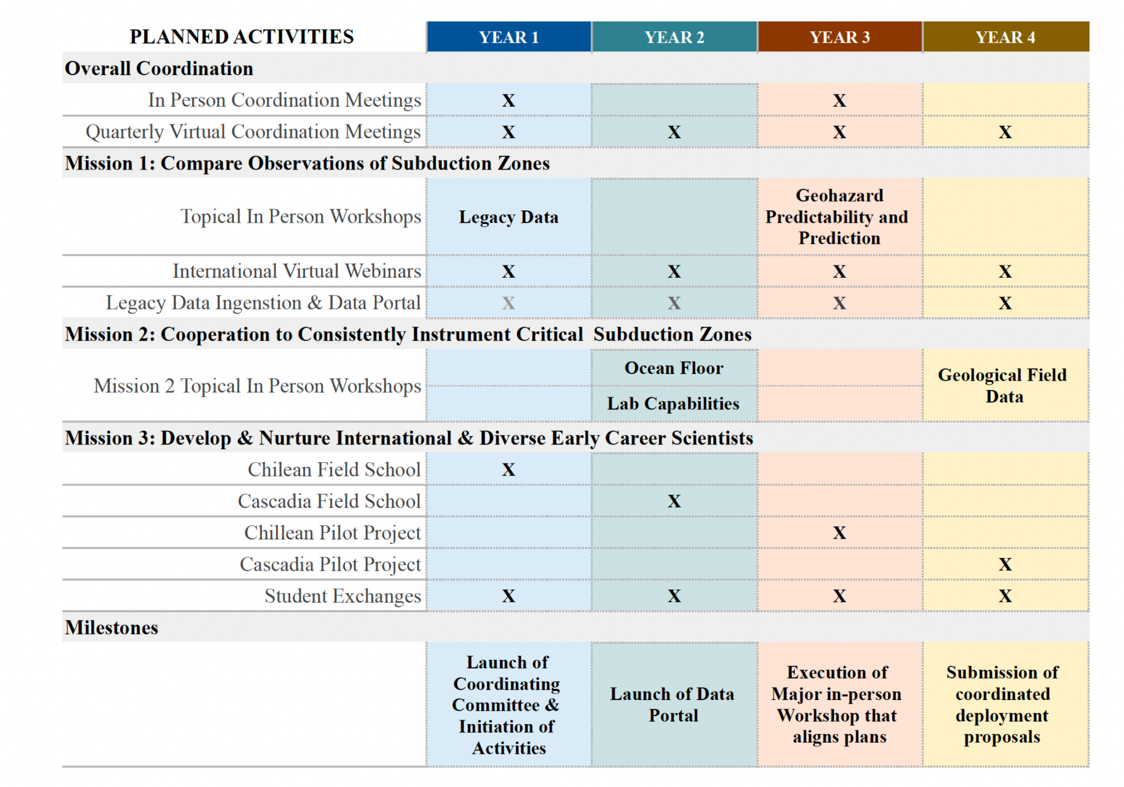
Proposal Pending: SZNet
(PIs: Brodsky, Carter) - $1,999,834
AccelNet-Implementation: SZNet - A Coordinated Global Effort to Understand Subduction Geohazards

Slide 22
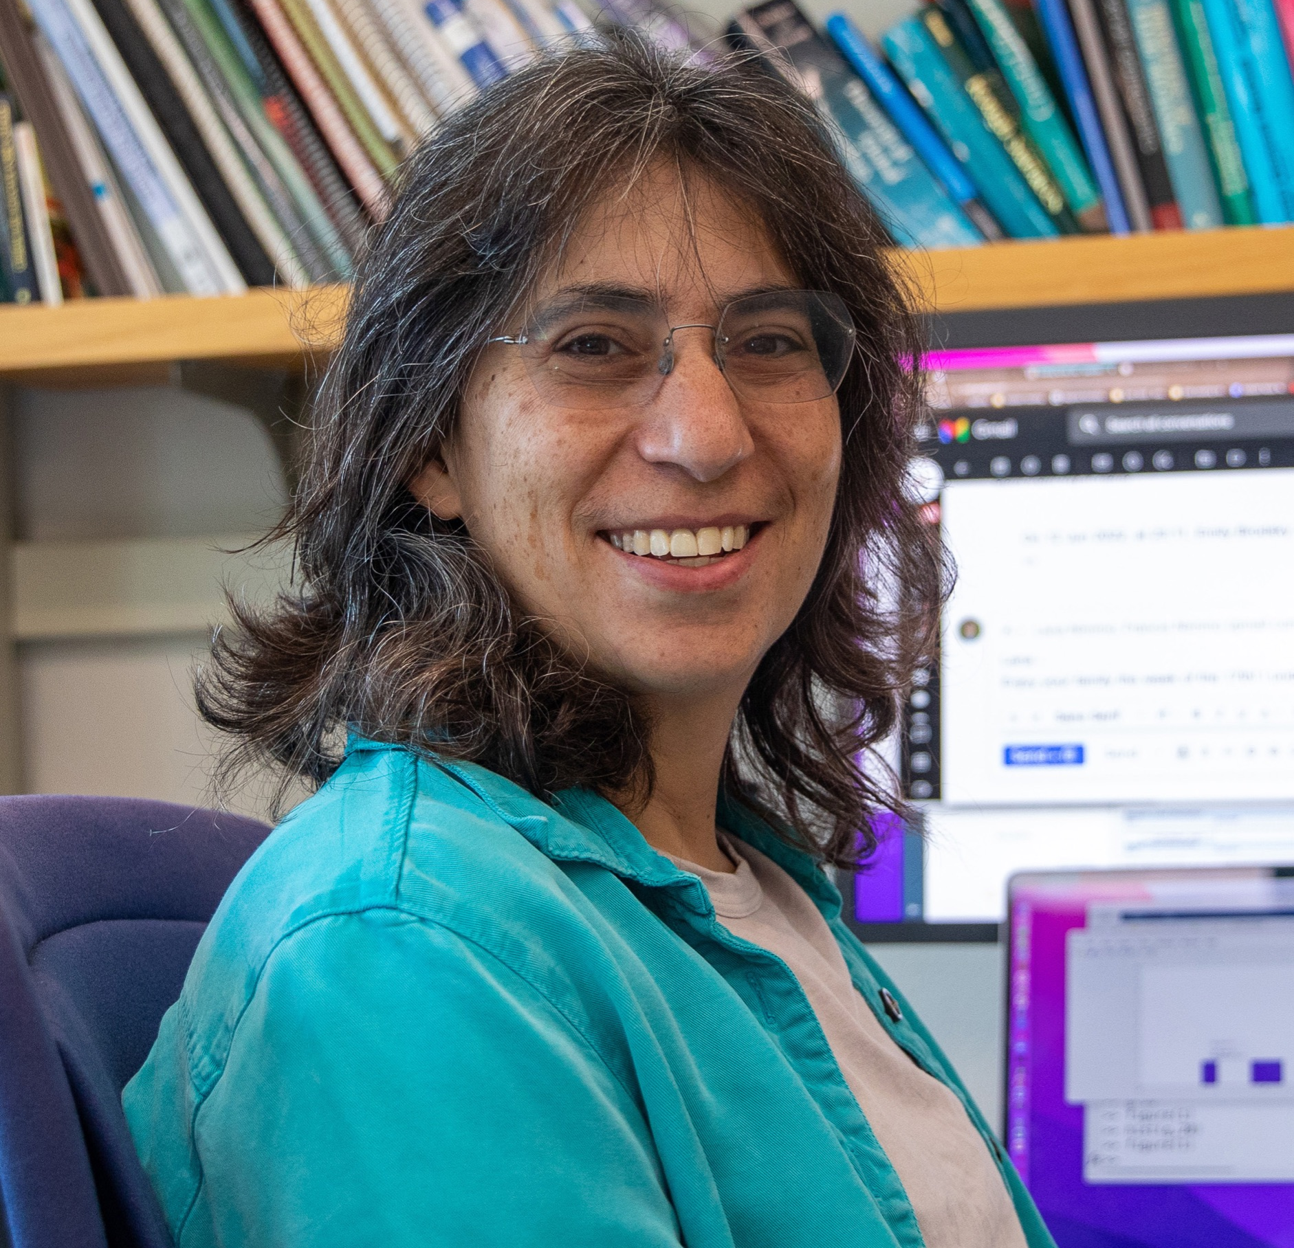
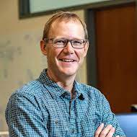
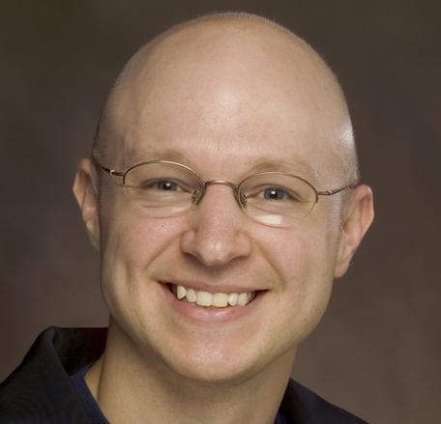
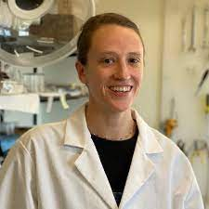
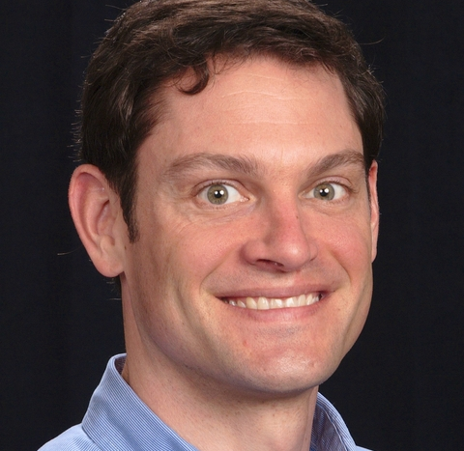
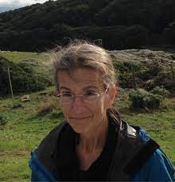
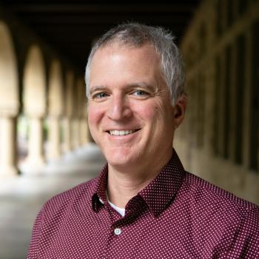
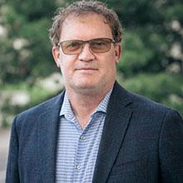
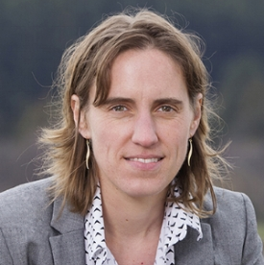
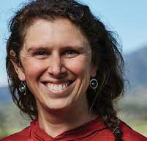
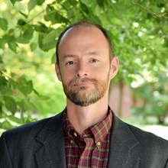
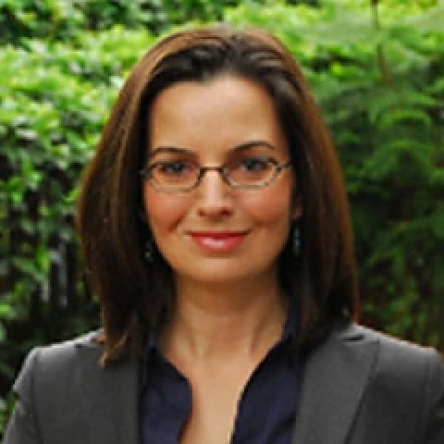
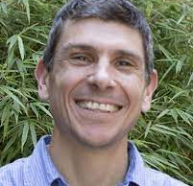
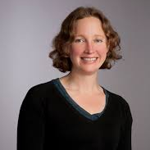
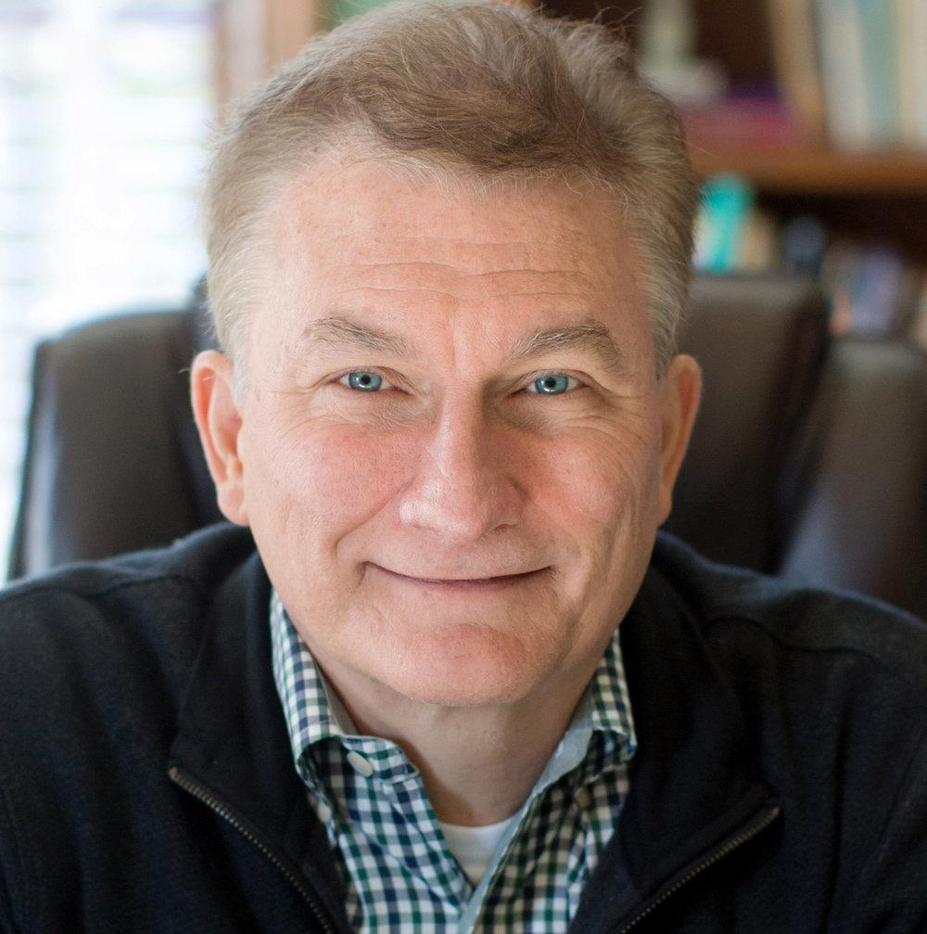
Current Steering Committee Members
Goal: 3 year staggered terms
KEEP YOUR EYES OUT FOR CALL IN THE SPRING

