Slide 1

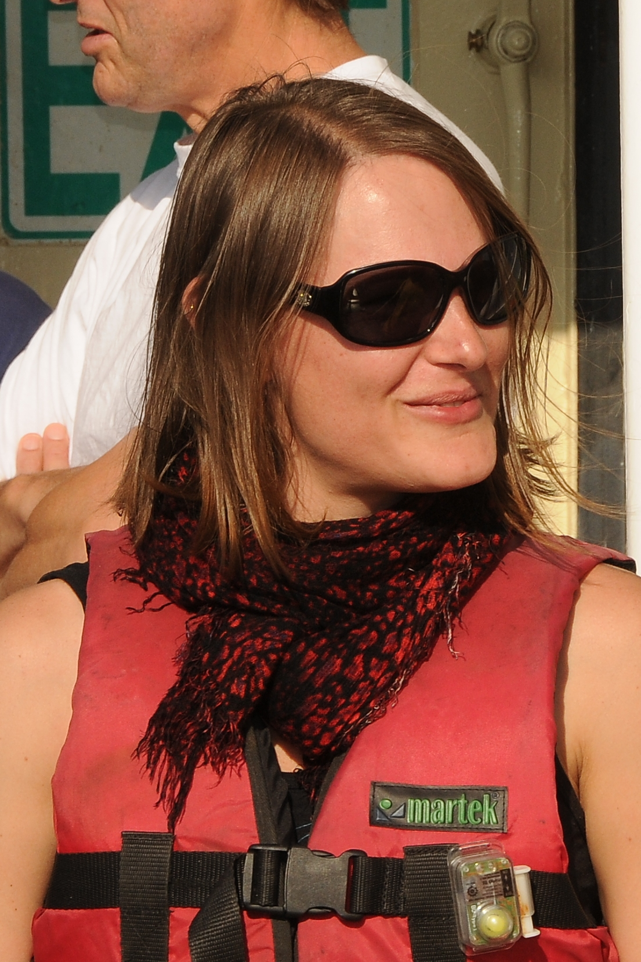


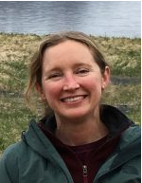


Quantifying incoming plate hydration and role of fluids on megathrust properties in and around the Guerrero Gap, offshore Mexico
Anne Bécel
Anne
Bécel
(LDEO)
Brian
Boston
(LDEO)
Adrien
Arnulf
(UTIG)
Donna
Shillington
(NAU)
Victor
Cruz-Atienza
(UNAM)
Yoshihiro
Ito
(Kyoto Univ.)

Slide 2
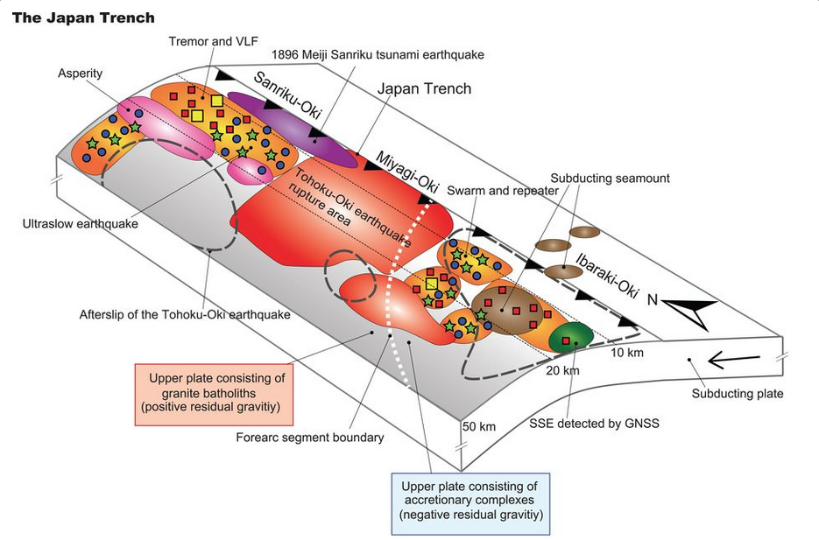
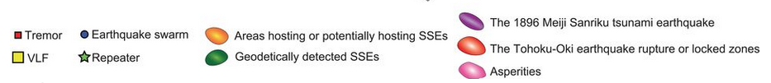
Main Science Question
What controls the down-dip and along-strike variability in fault-slip behavior in subduction zones?
Nishikawa et al., Science, 2019

Slide 3
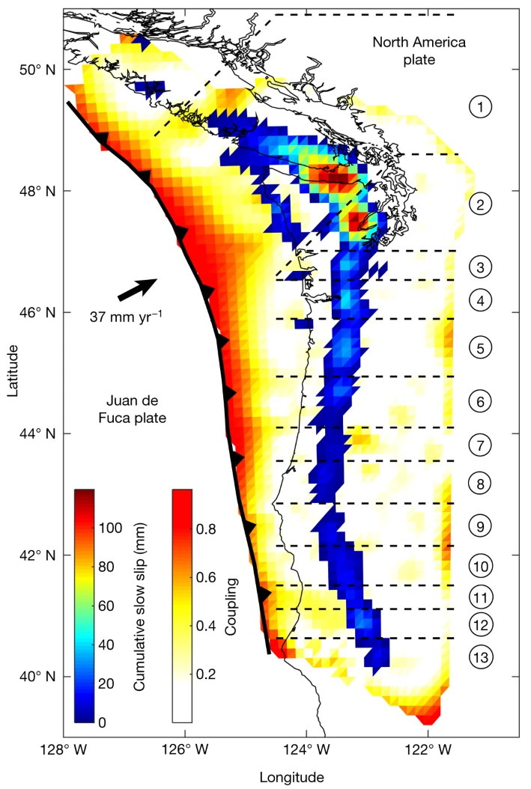
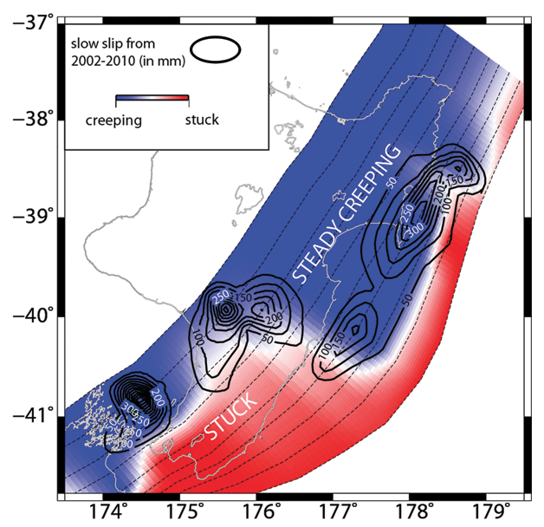
Relationship between SSE and fluids
Cascadia
Hikurangi
Wallace and Beavan, JGR, 2010
SSE most commonly attributed to elevated pore-fluid pressures at the plate interface
Michel, Nature, 2019

Slide 4
Role of fluids in subduction zone processes
Hydration of the forearc mantle wedge
Generation of island arc magmatism
Intermediate depth earthquakes
Modified from
Oleskevich et al., 1999
and Gerya et al, 2006

Slide 5
Middle America Trench offshore of Mexico
Guerrero Gap and its neighboring segments
Subduction of the young 13-14 Myr old Cocos plate at 6.5 cm/yr
No large subduction zone earthquakes (M>7) have occurred in the Guerrero Gap since at least 1911
Modified from Cruz Atienza et al., 2018

Slide 6
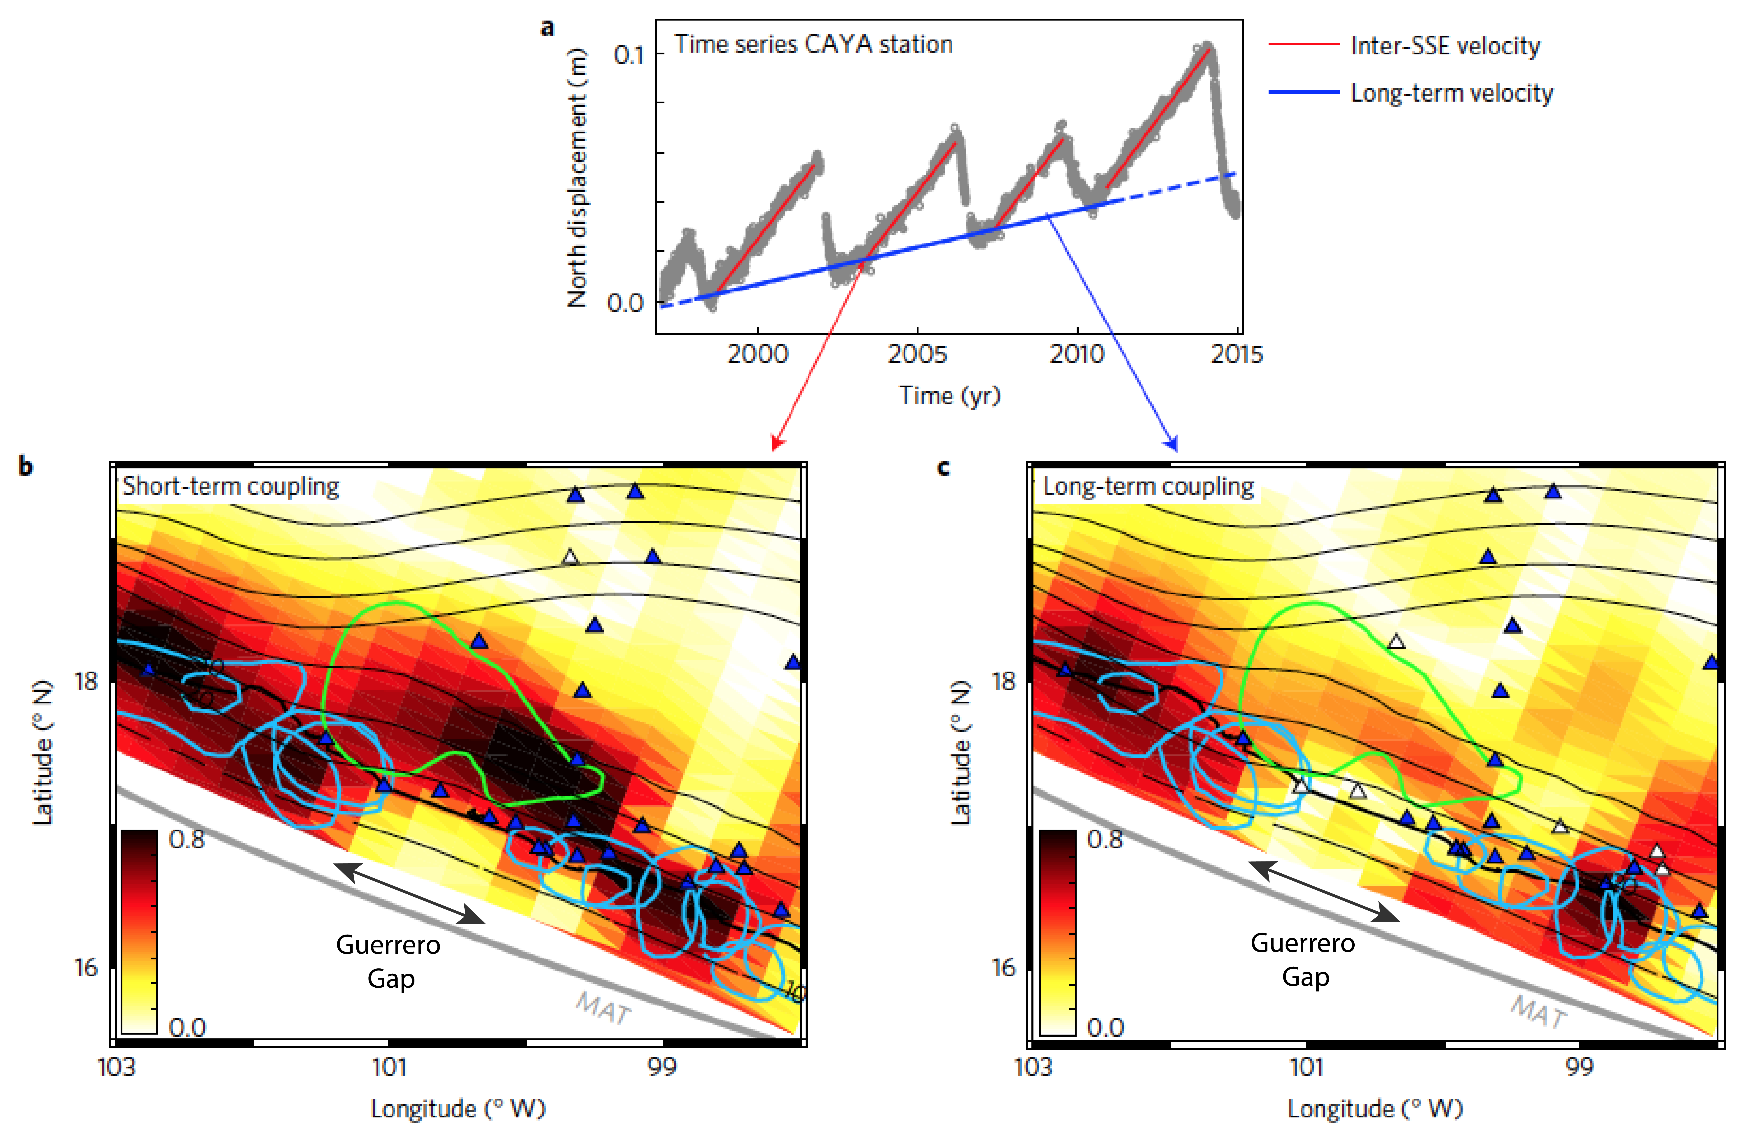
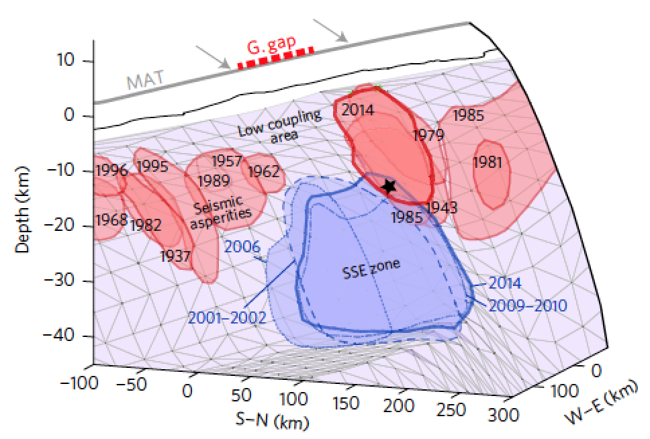
Slow-Slip Events (SSE) within the Guerrero Gap
Radiguet et al., Nat. Geosc., 2016

Slide 7
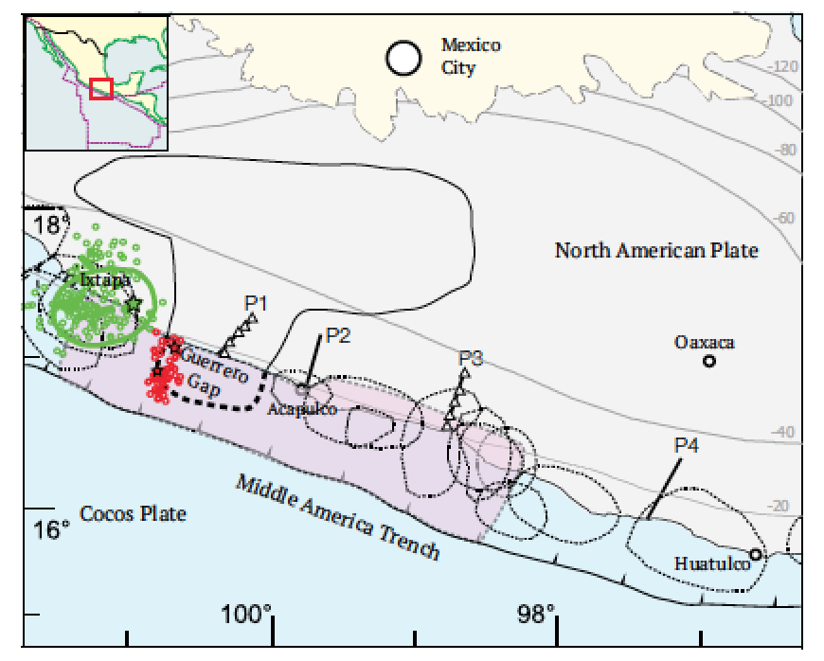
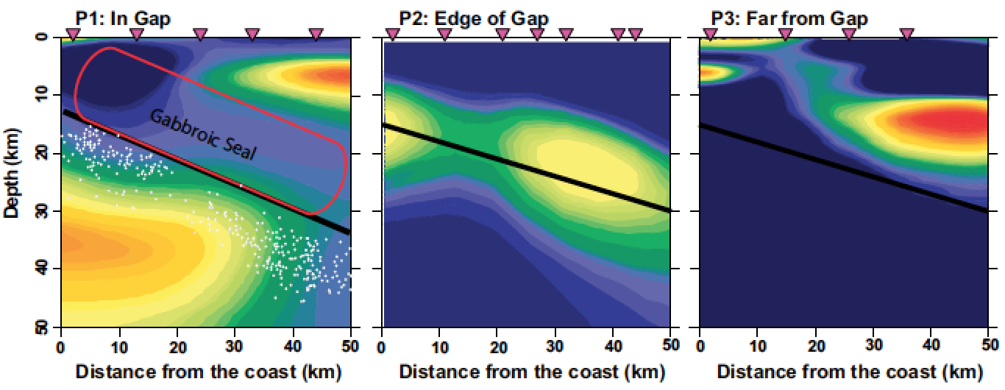
SSE: high pore fluid pressure on the plate boundary ?
Husker et al., 2018

Slide 8
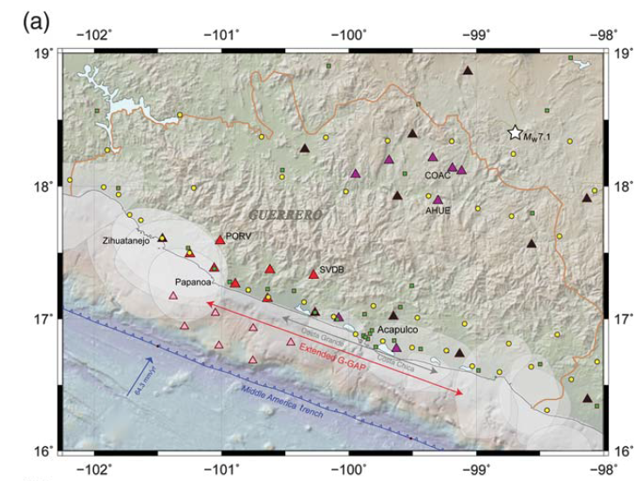
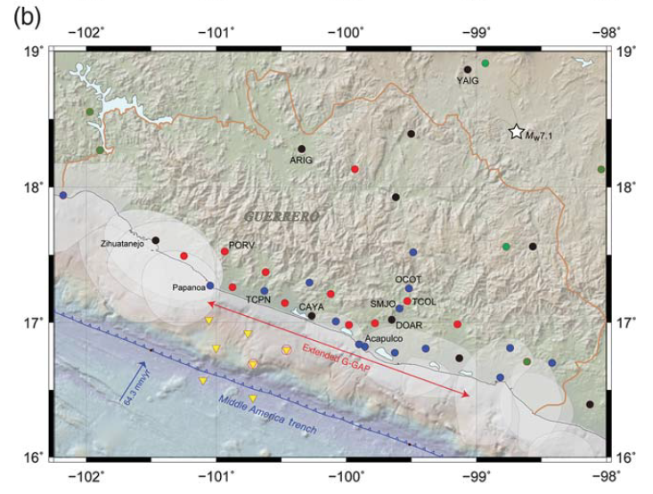
Ongoing amphibious geodetic and seismic deployment
Effort led by Victor Cruz Atienza and Yoshihiro Ito
Seismological Network
Geodetic Network
Cruz Atienza et al., 2018

Slide 9
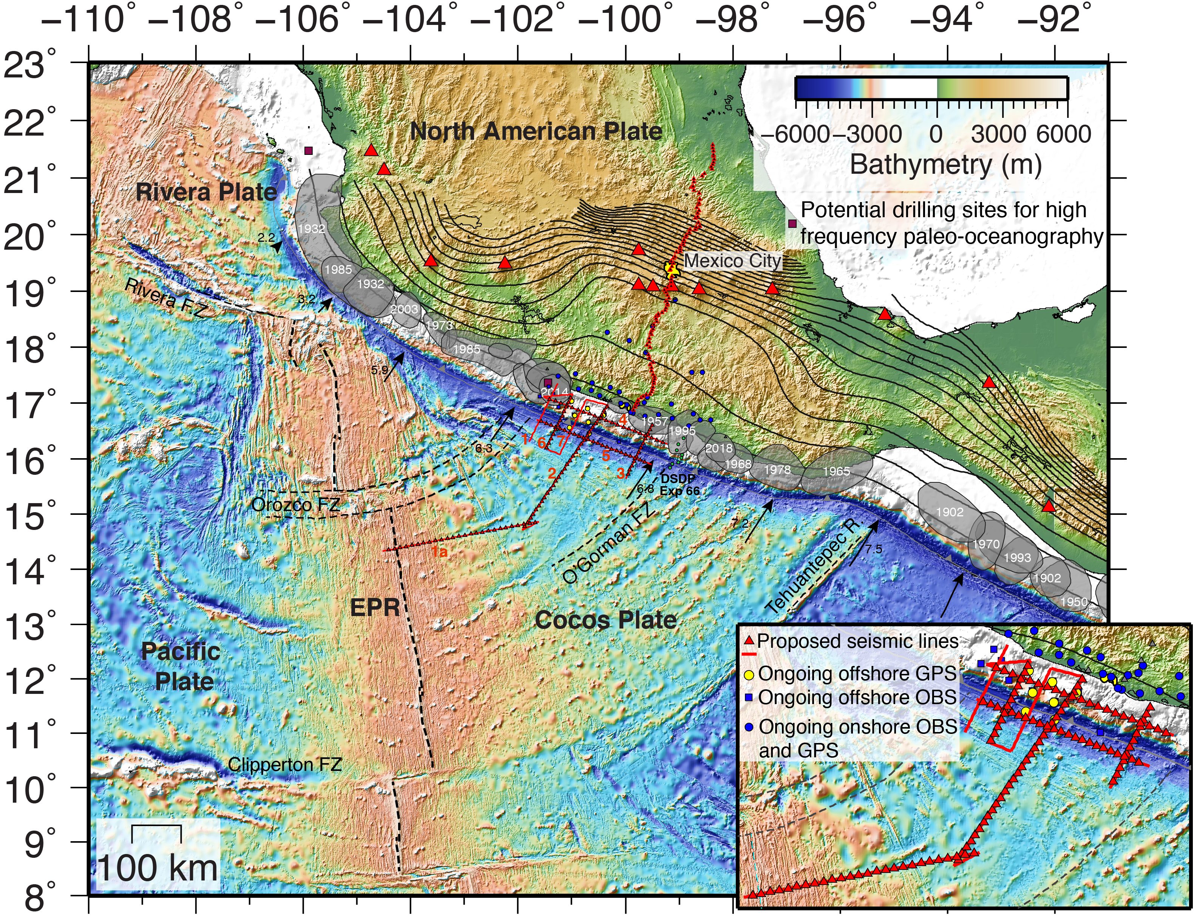
New NSF-funded seismic project
What is the hydration state of the incoming Cocos oceanic plate, and how does it vary along-strike and relate to changes in subduction zone slip behavior?
How do geometrical and material properties of the downgoing and overriding plates influence slip behavior along the megathrust fault?

Slide 10
Langeth active source seismic survey
combined 2D wide-angle seismic reflection/refraction and ultra-long offset multi-channel seismic (MCS) survey
48 day seismic program
six primary MCS/OBS transects
15 km-long streamer and 6600 cu.in airgun array of the R/V Langseth

Slide 11
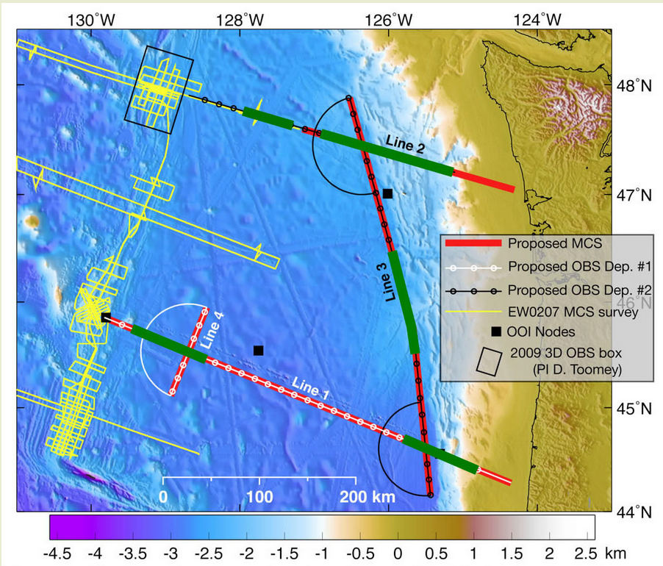
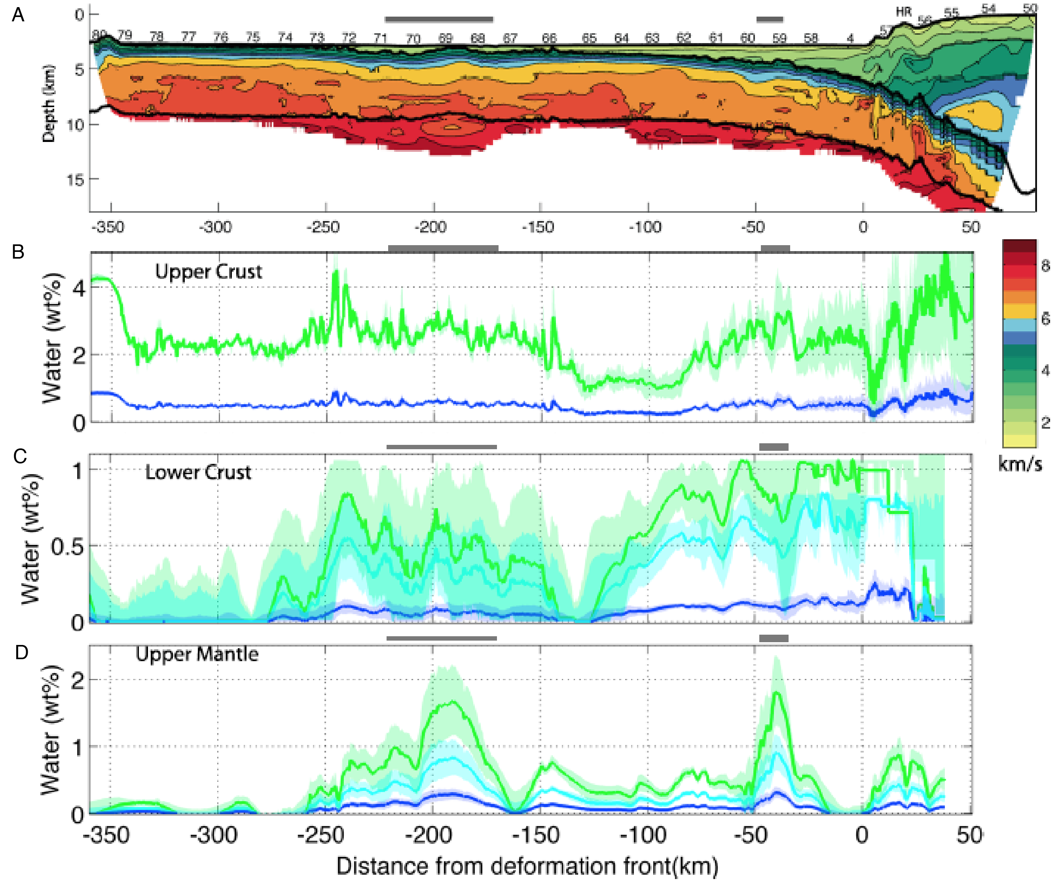
Comparison to Cascadia subduction zone
Guerrero Gap
Experiment
Ridge 2 Trench
Experiment
Young, well-sedimented
Juan de Fuca Plate
Young, sediment-starved
Cocos Plate
Direct comparisons between these two subduction zones will provide key constraints on the influence of sediment thickness on the hydration state of young incoming plates
Limited hydration
Horning et al., 2016

Slide 12
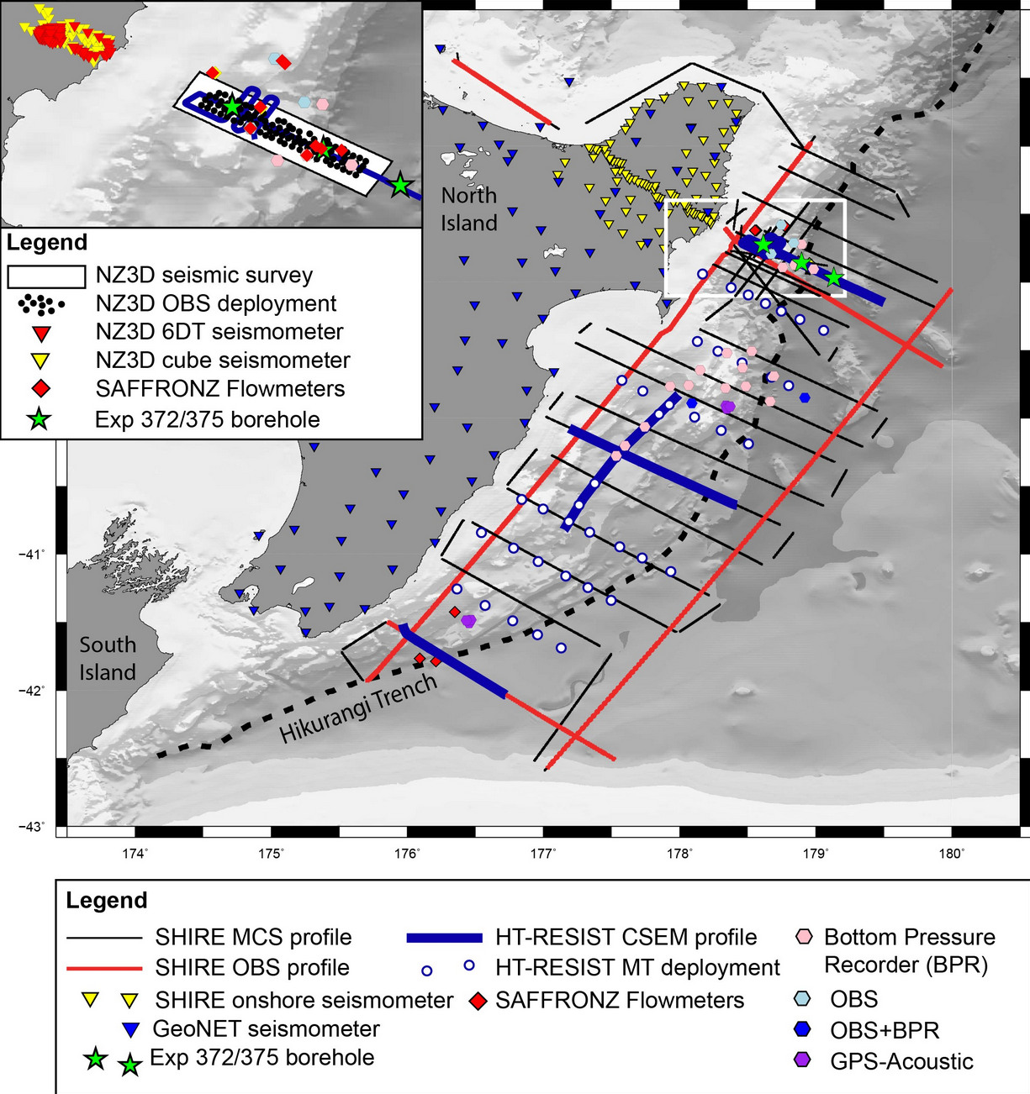
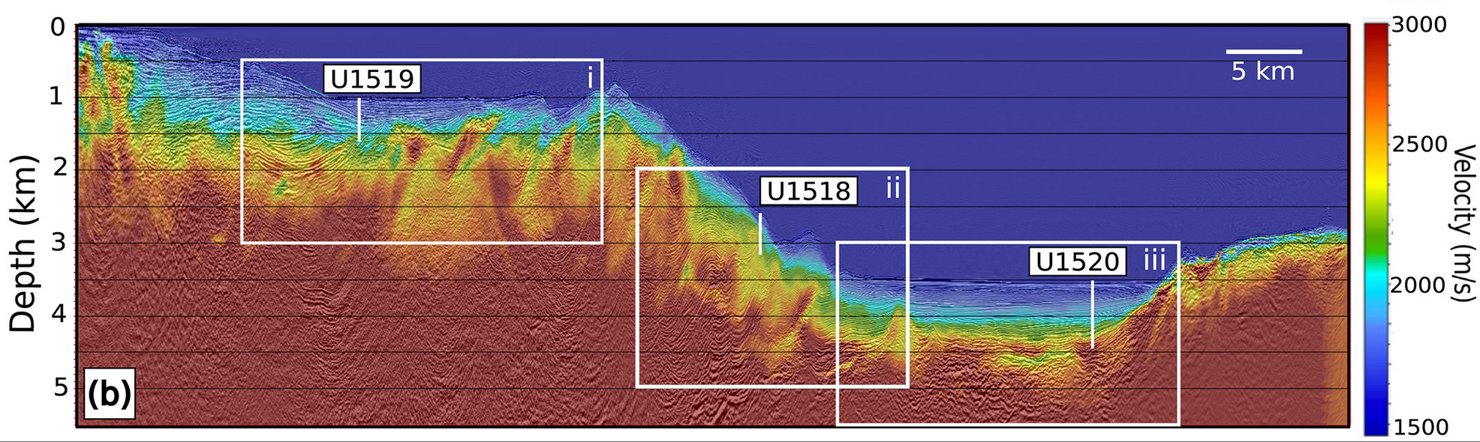
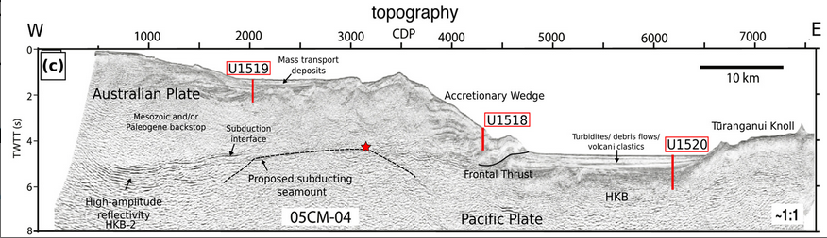
Comparison to Northern Hikurangi Margin
Hikurangi margin
Experiment
Guerrero Gap
Experiment
test whether there is a ubiquitous parameter that lead to shallow slow slip events or a combination of parameters
Gray et al., 2019

Slide 13
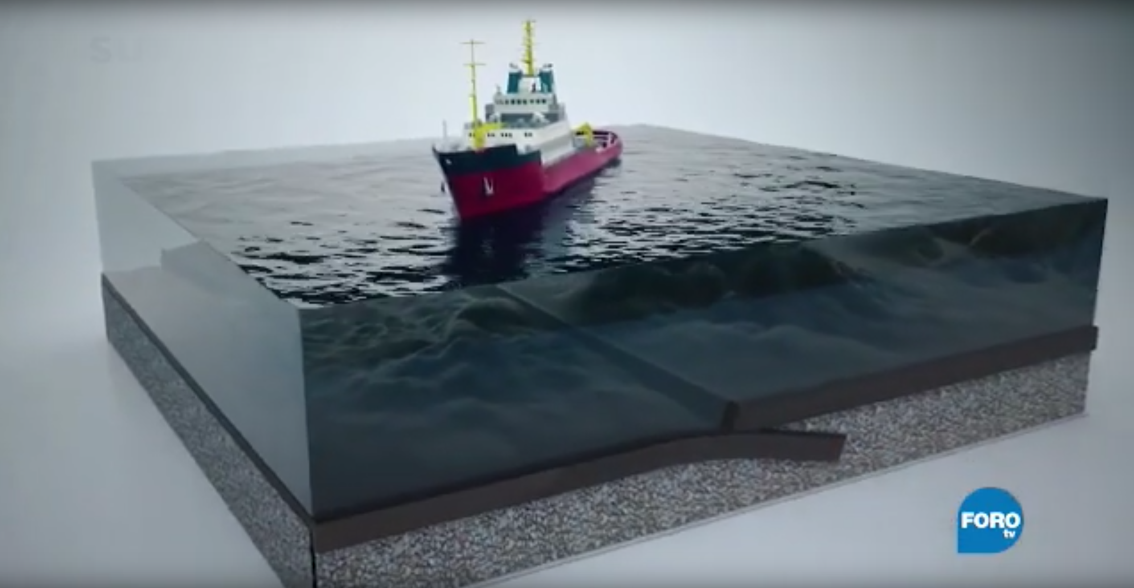
Thank you !
Cruz-Atienza, 2019
https://youtu.be/uKnaOYSt84g

