Slide 1
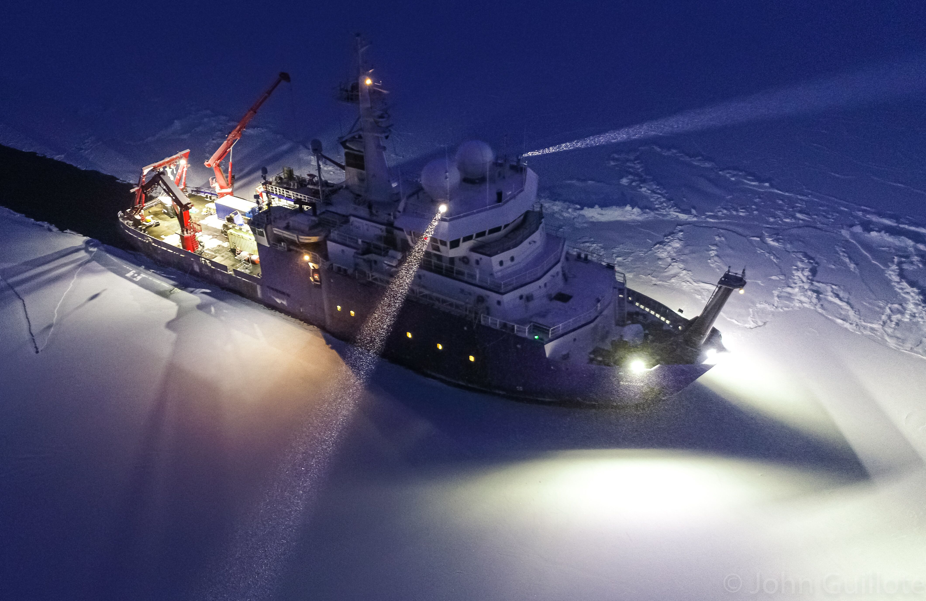
AICC January 2020 SIKULIAQ Introduction
Photo Curtsey @iceinmotion

Slide 2
SIKULIAQ Charateristics
Polar Class 5
Length 261 Feet
Beam, Max Across Reamer 52 Feet
Bear, Max Across hull amidship 48 Feet
Draft 18 Feet 9 Inches
Displacement 3,665 Long Tons
Propulsion 5,750 BHP (Z Drives)
Endurance ~40 Days
Transit Speed 10.5 Knots
Level ice at 2 knots 3 feet
Science Berths 24
Crew 20 +2 Marine Techs
(QTY 2) Drum Winch (RAPP). .322 EM Cable
Heave Comp CTD over LHS Boom
Traction Winch .681 FO and 9/16 wire rope
(QTY 2) Articulating Cranes 35K lbs at 25 feet
Under Wire Winch (Kolstrand) Starboard Crane (2019)
Aframe (Allied) 30K lbs Luffing Load

Slide 3
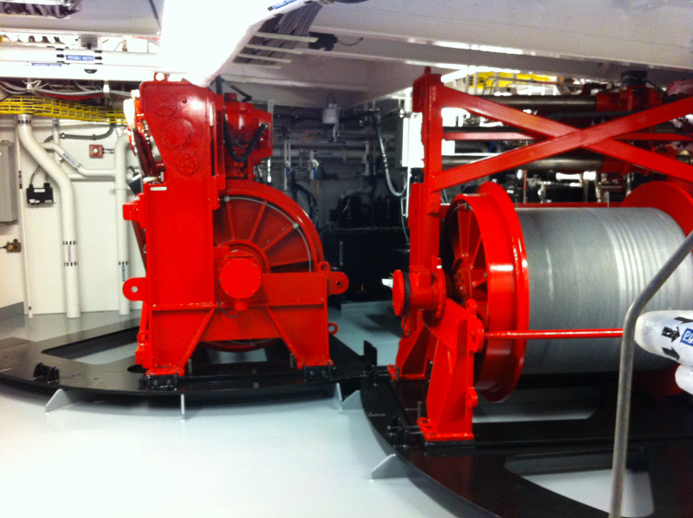
RAPP Winches for CTD and Aft Deck Operations

Slide 4
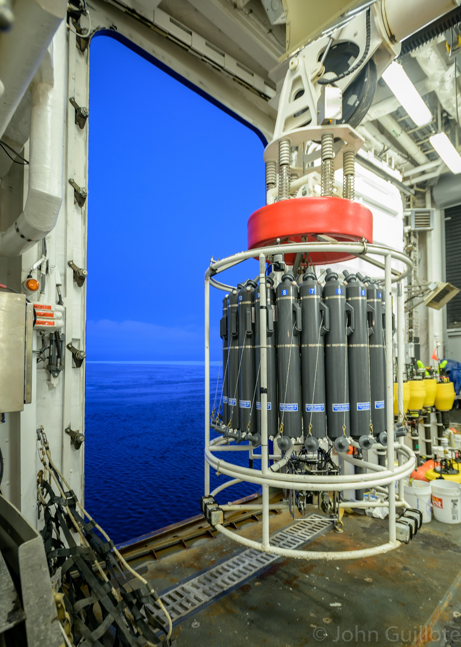
CTD Captured by Load Handling System
Photo Curtsey @iceinmotion

Slide 5
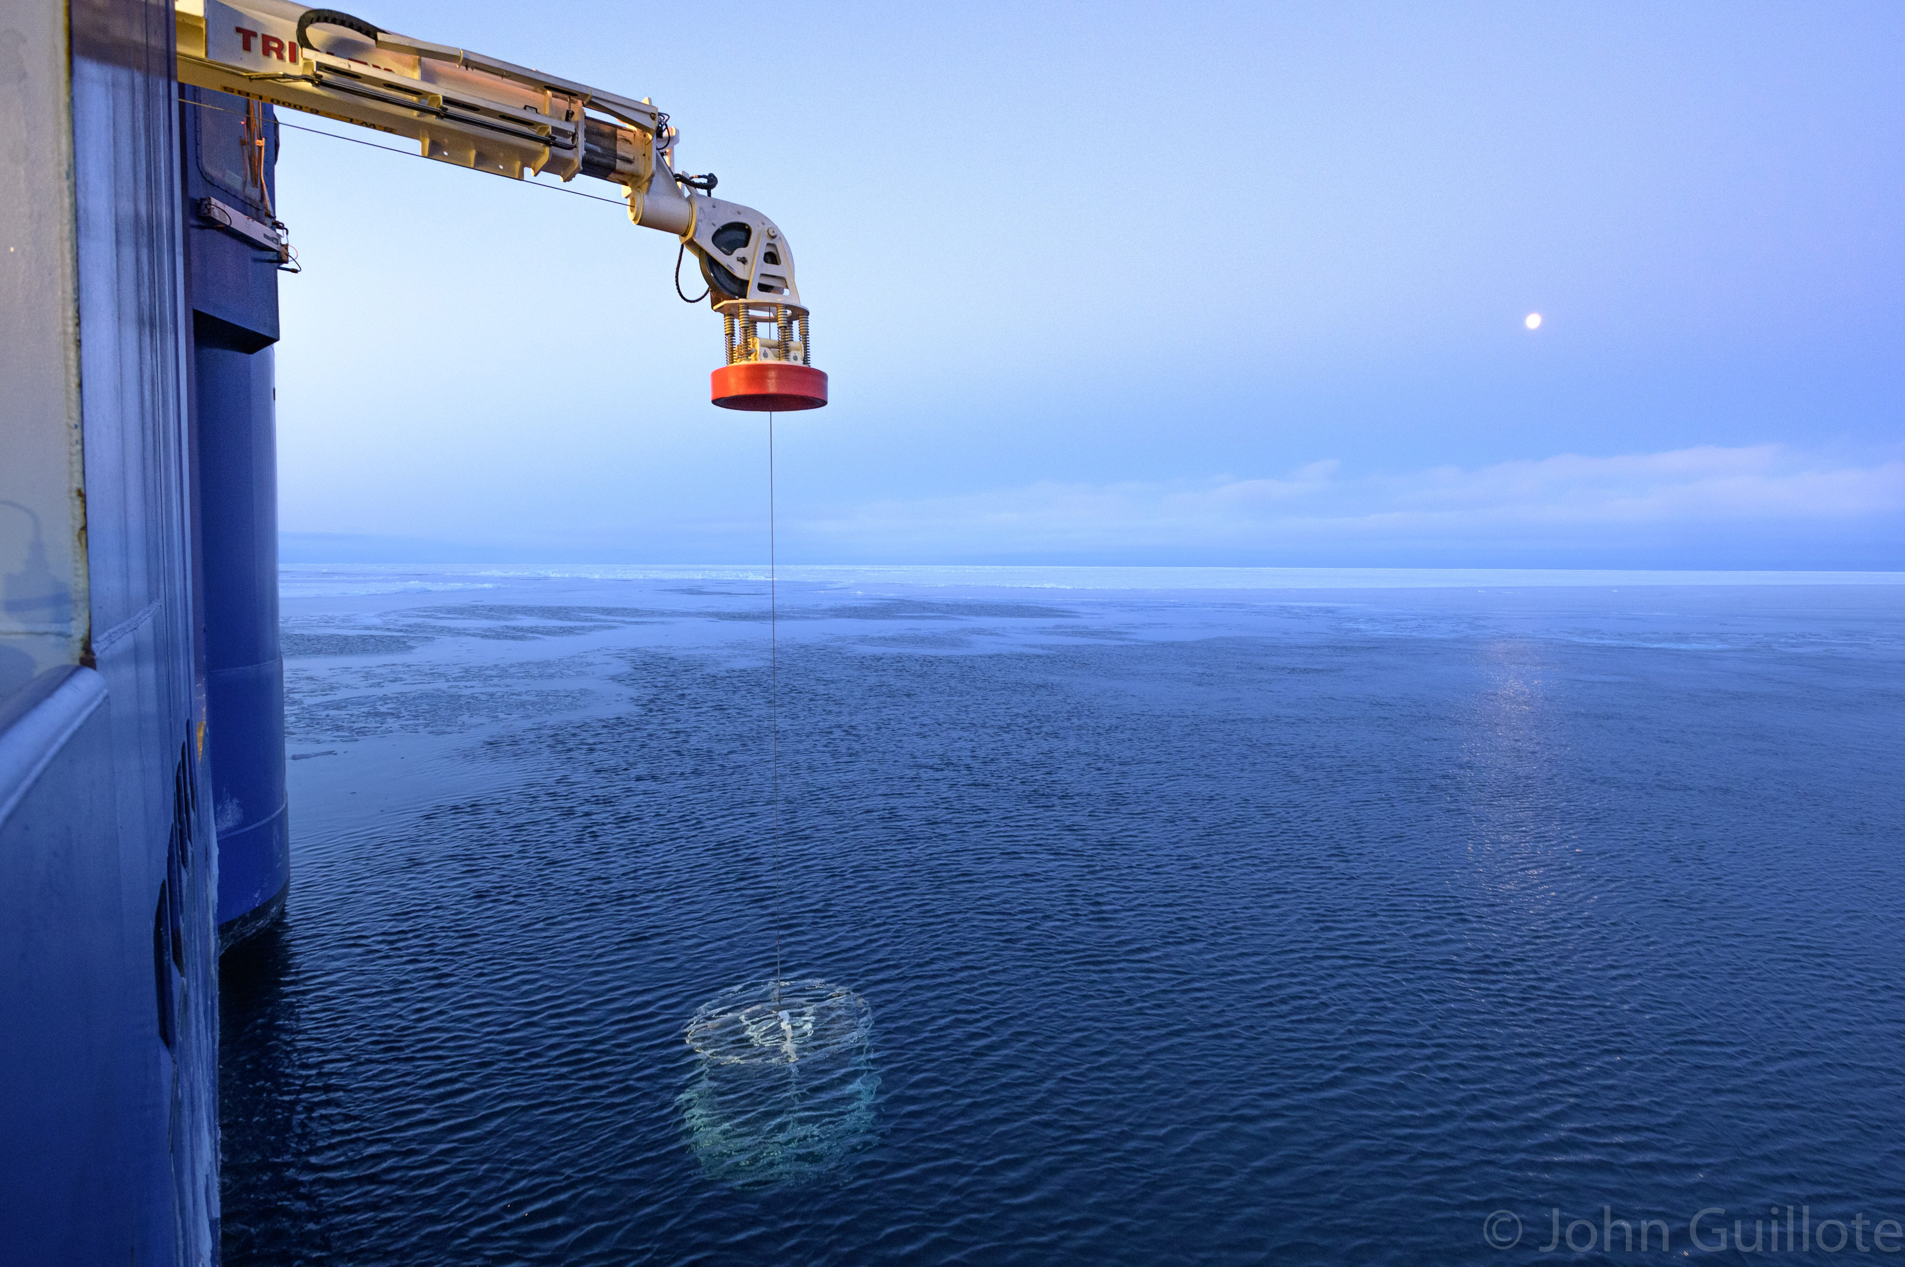
Photo Curtsey @iceinmotion
CTD Deployed

Slide 6
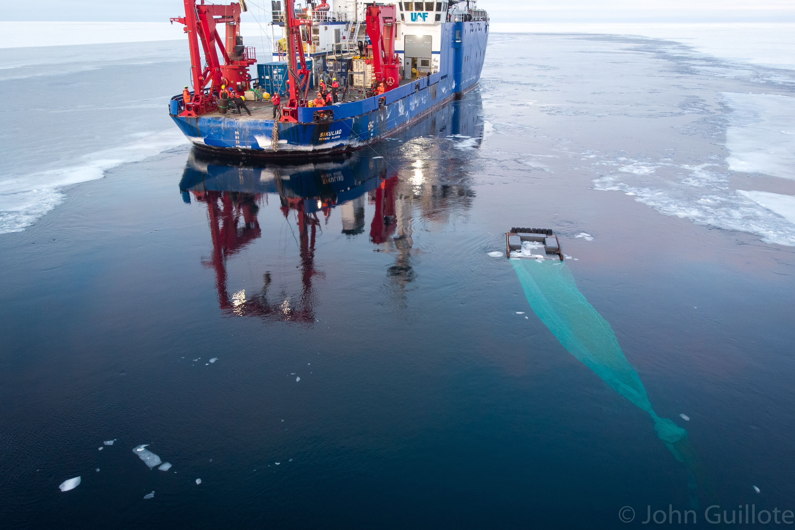
Photo Curtsey @iceinmotion
Surface and Under Ice Trawl (SUIT)

Slide 7
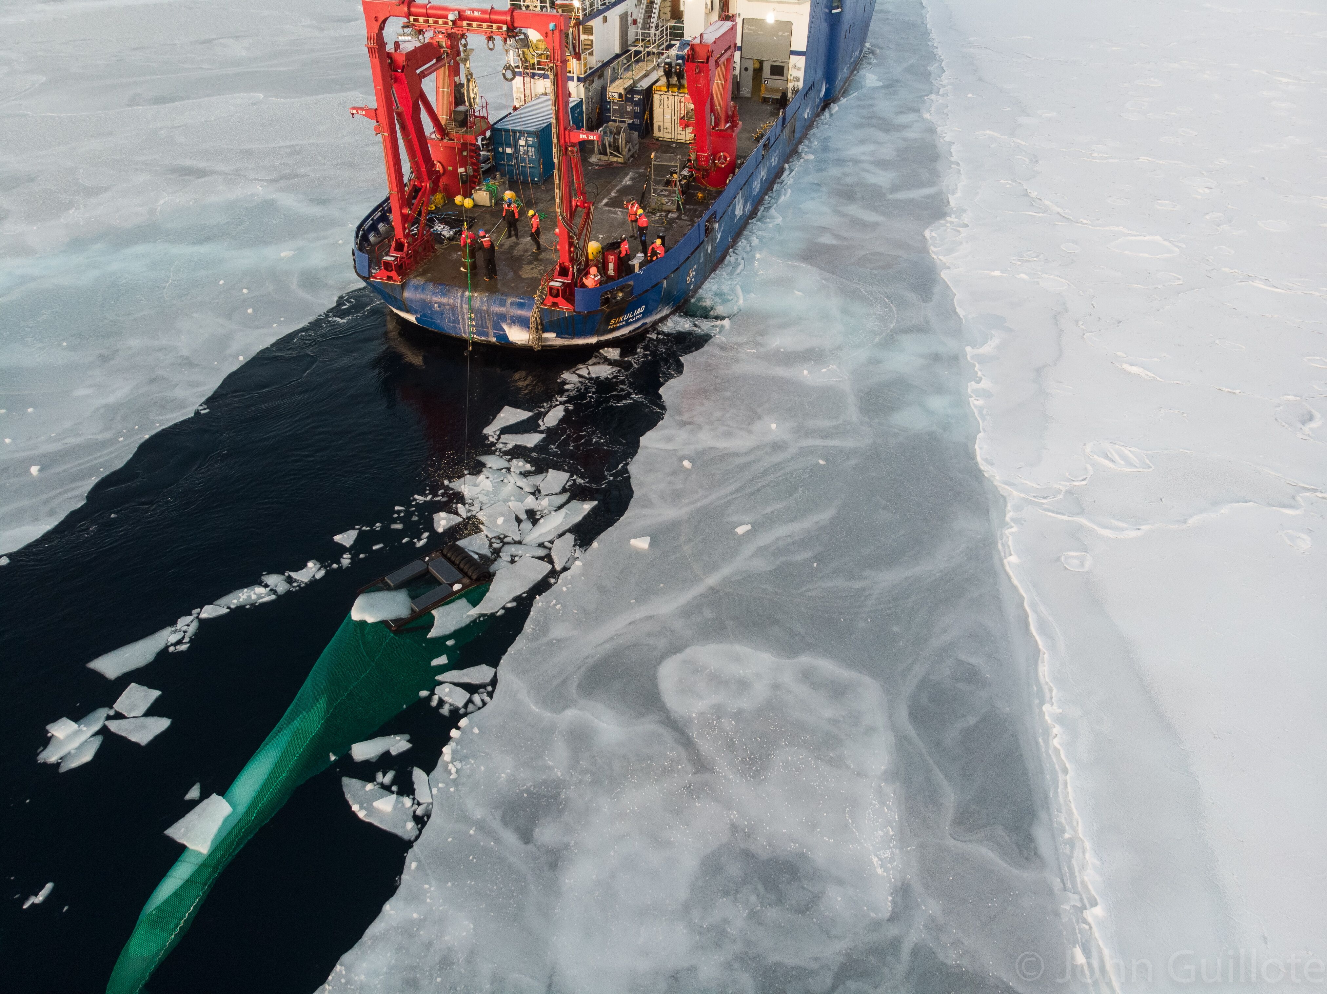
Photo Curtsey @iceinmotion
Surface and Under Ice Trawl (SUIT)

Slide 8
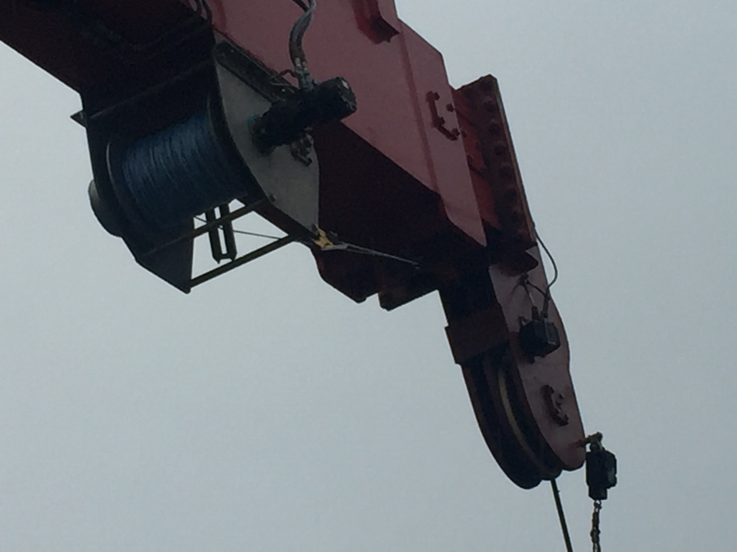
Starboard Crane Underwire Winch (New 2019)

Slide 9
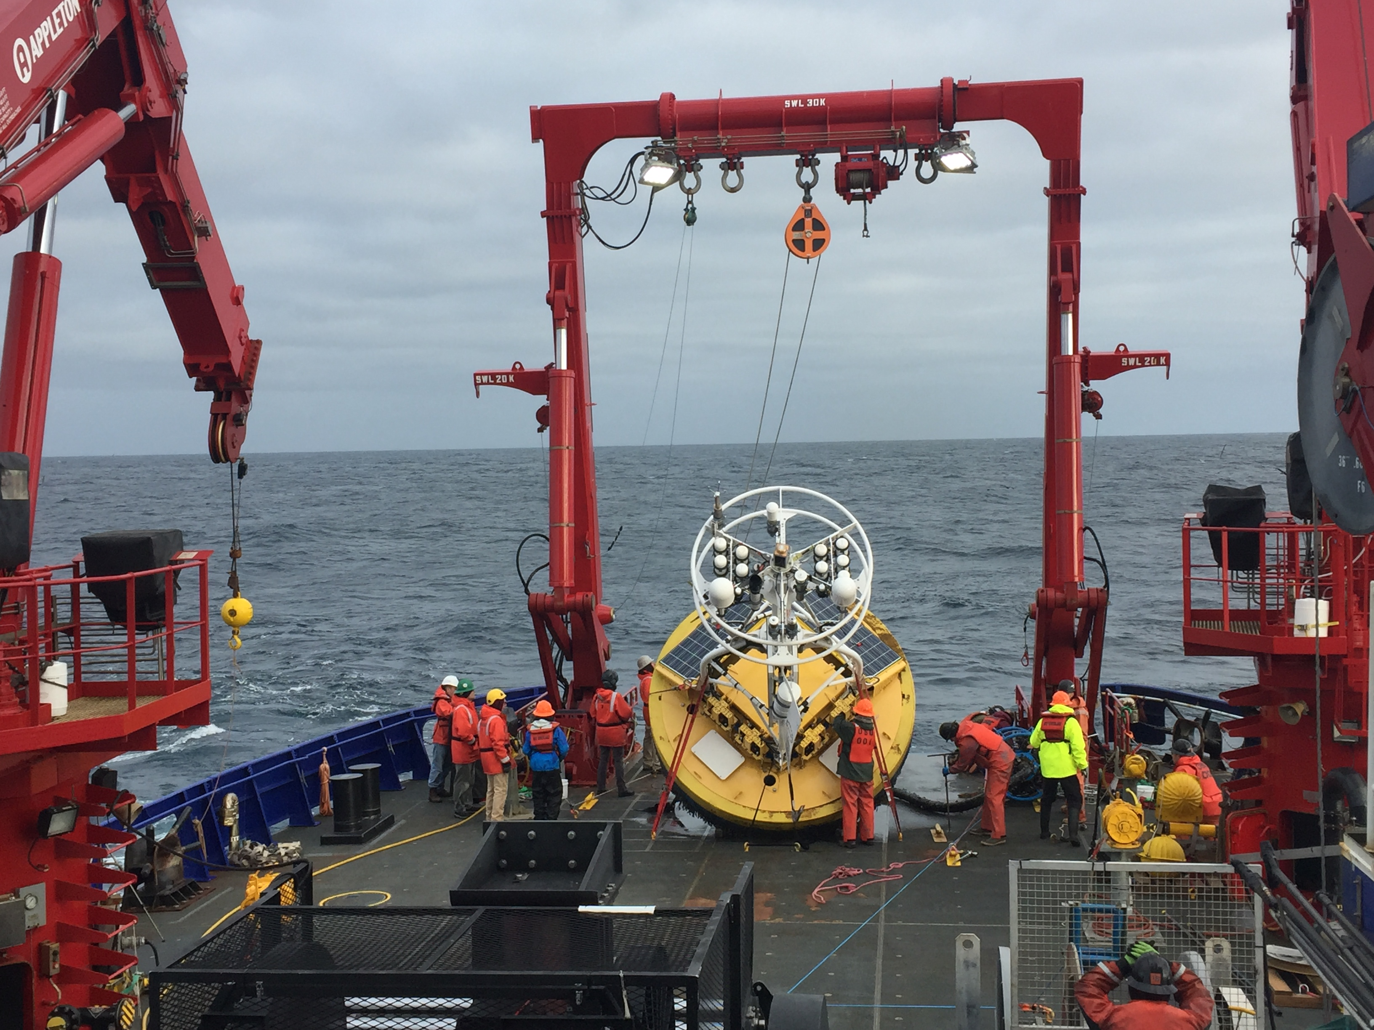
Allied A-Frame

Slide 10
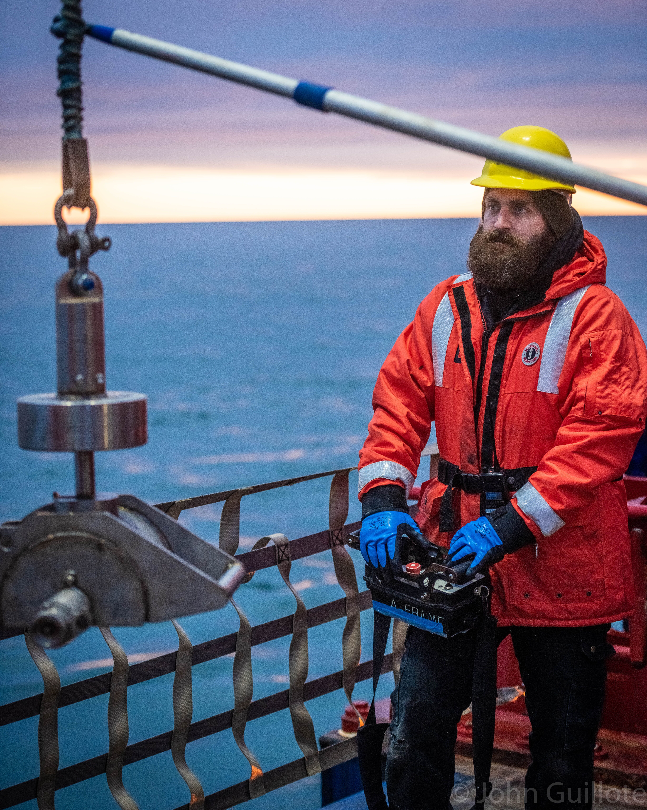
Radio Controls for Crane and A-frame Operations
Photo Curtsey @iceinmotion

Slide 11
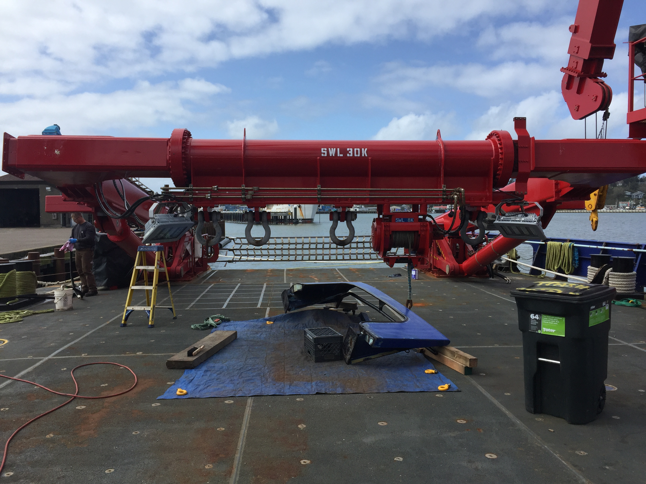
Aframe in Maintenance Position

Slide 12
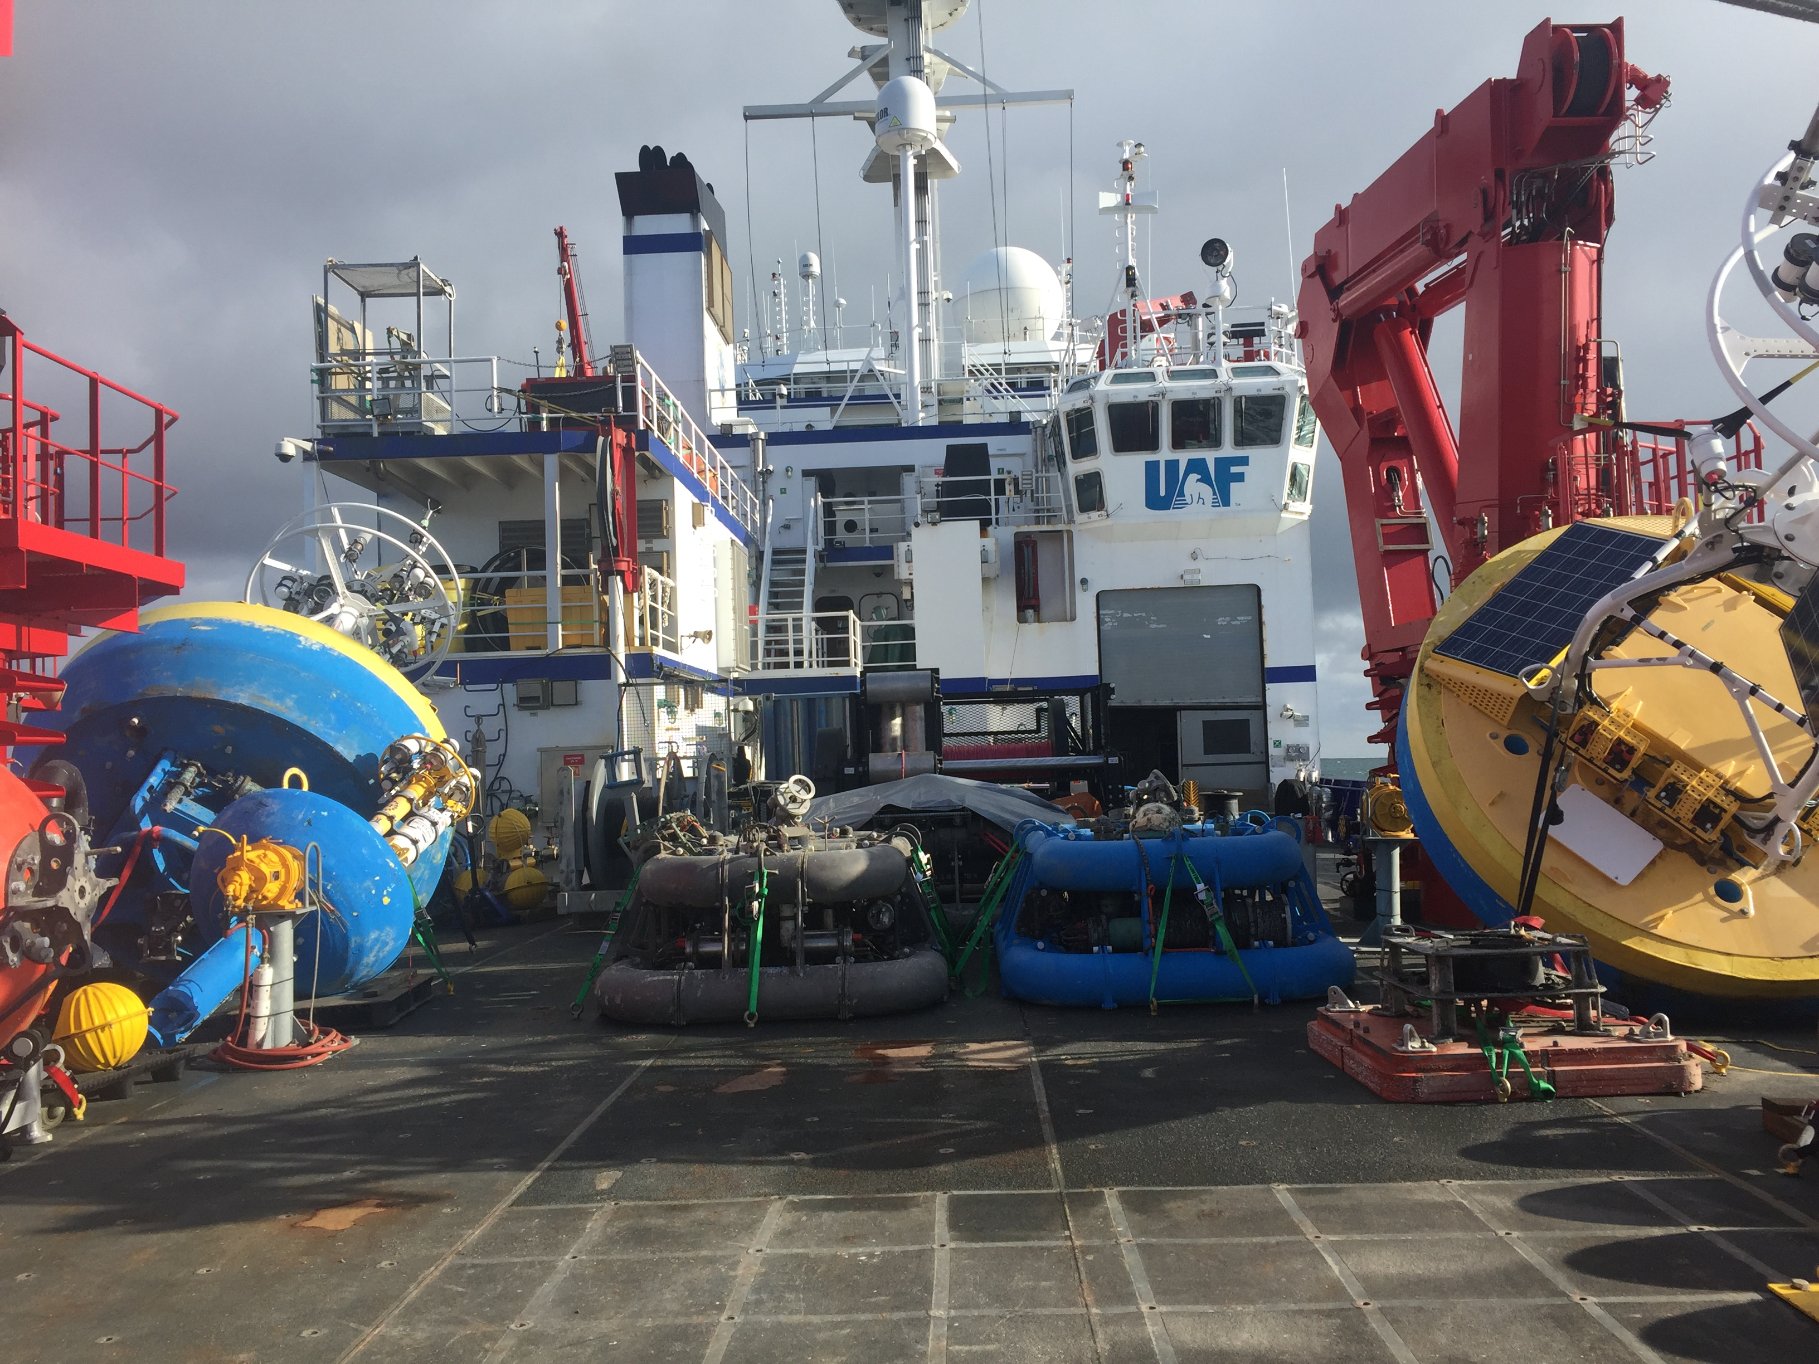
AFT Deck

Slide 13
AFT Deck

Slide 14
Photo Curtsey @iceinmotion
On Ice Operations

Slide 15
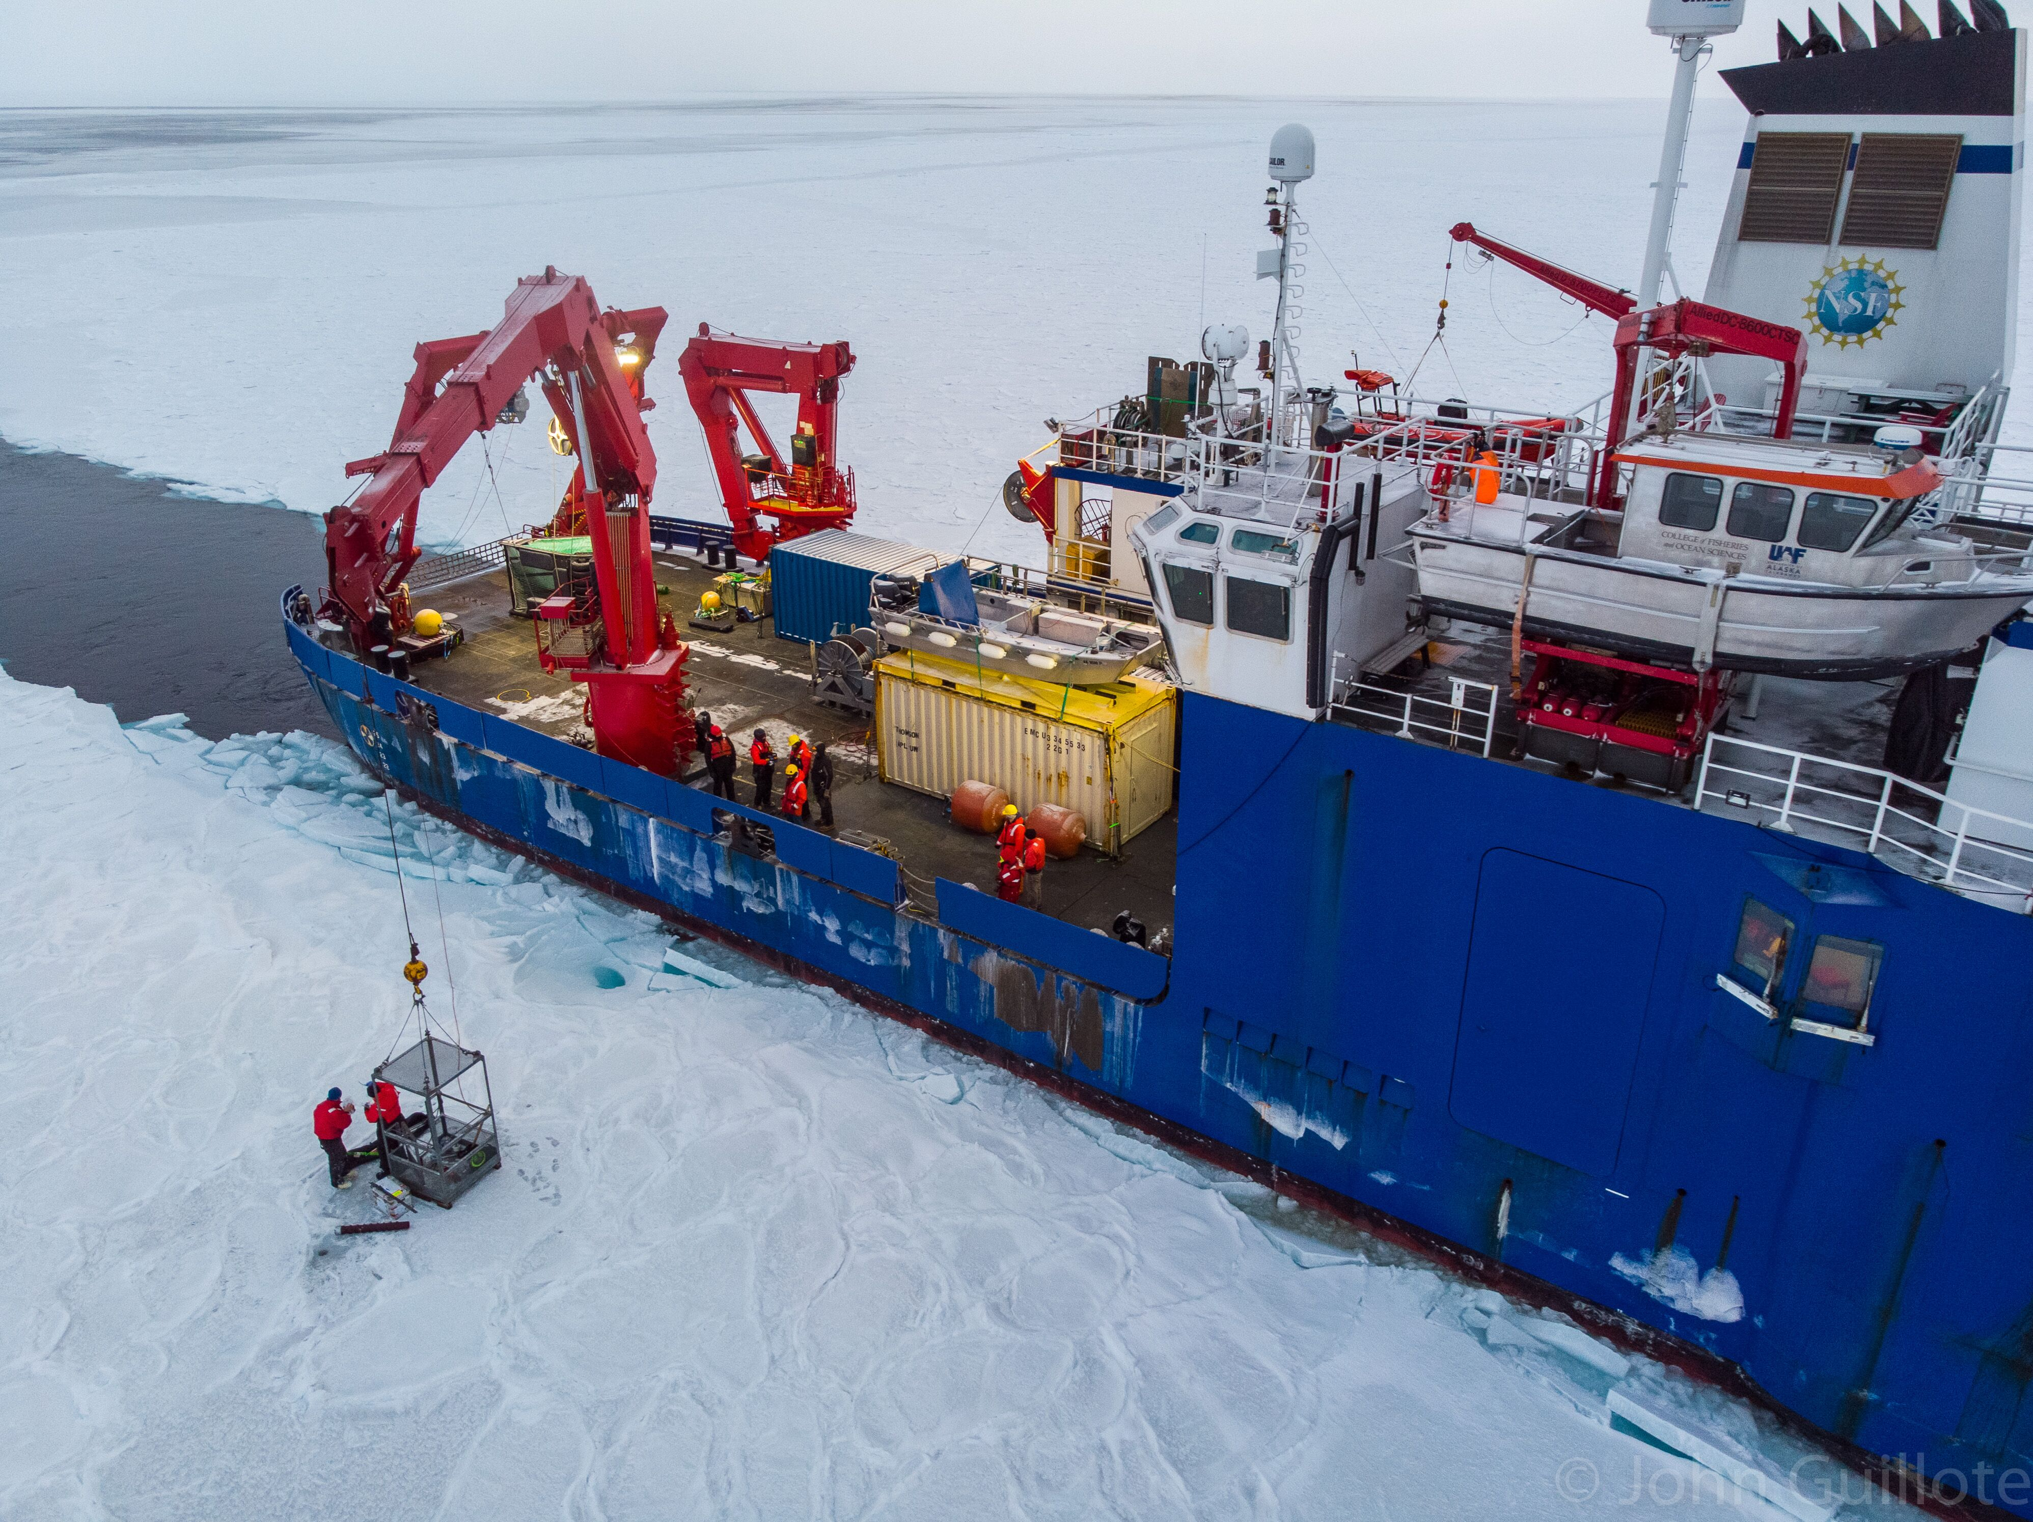
Photo Curtsey @iceinmotion
On Ice Operations

Slide 16
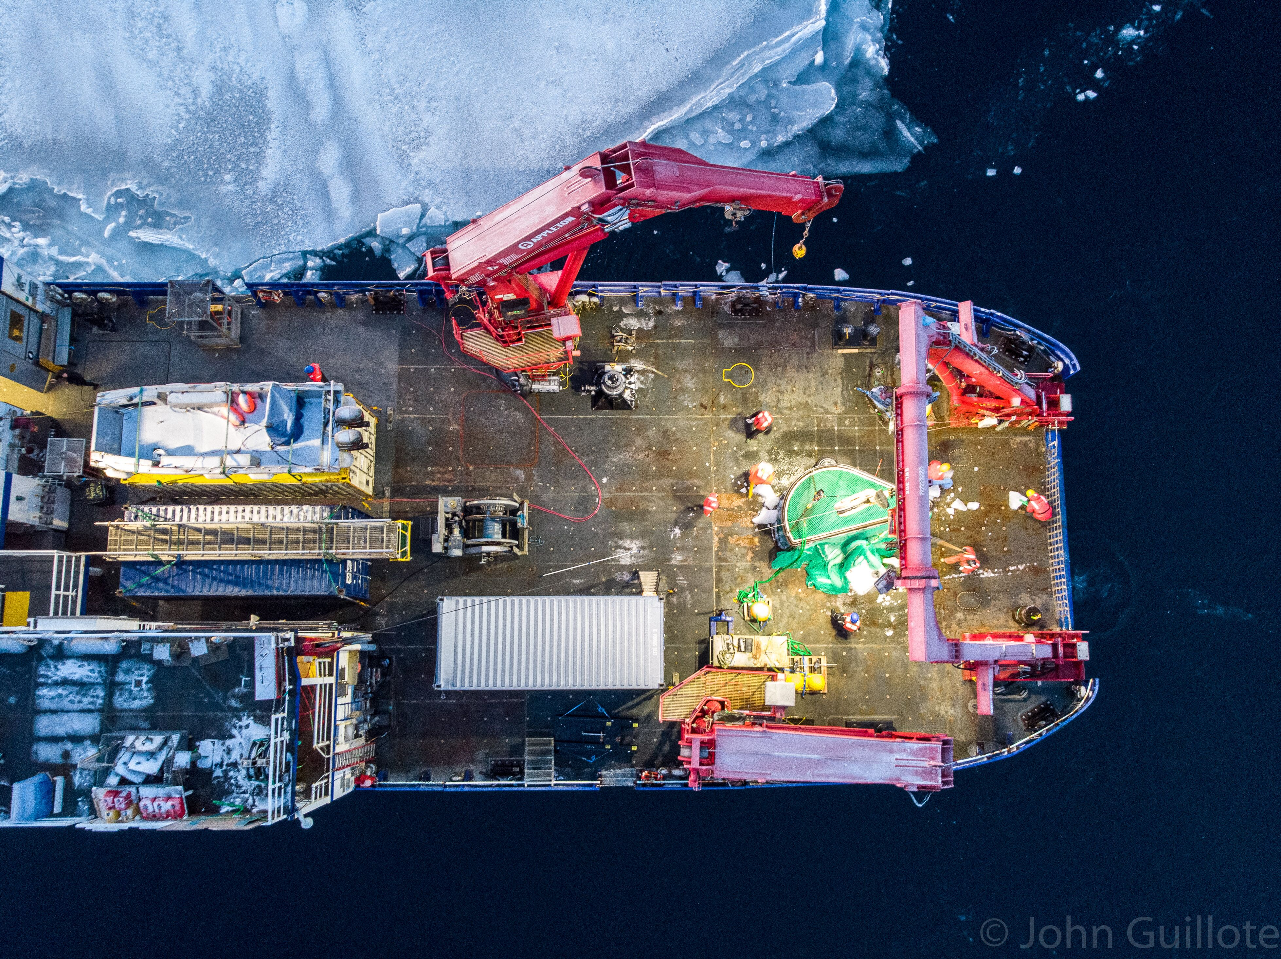
Photo Curtsey @iceinmotion
The End – Questions?

